Slide 1
Protection of Transportation Infrastructure from Cyber Attacks: project summary
Summary of Findings and Primer Overview
Final Presentation
Countermeasures Assessment and Security Experts, LLC
New Castle, Delaware
and
Western Management and Consulting, LLC
Madison, Wisconsin

Slide 2
Presentation Overview
Project Overview
Cybersecurity Survey Overview
Primer Overview
Summary of Research Findings

Slide 3
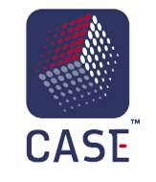
Research Team
Principal Investigators
Ernest “Ron” Frazier (CASE)
David Fletcher (WMC)
Countermeasures Assessment & Security Experts
David Ekern, Mike Smith
Western Management and Consulting
Jeff Western, Pat Bye
Subject Matter Experts
Yuko Nakanishi, Jennifer Bayuk,
Barry Horowitz

Slide 4
Project Objective
The objective of this research was to develop
a cybersecurity primer,
an executive briefing for transportation infrastructure managers,
technical webinars for highway and transit audiences
These products
explain the nature of cyber events and their operational and safety impacts, and
contain effective practices that can be used to protect transportation systems from cyber events and to mitigate damage should an attack or breach occur.
The research material was derived from a variety of non-classified sources and is intended to introduce the roles, responsibilities and capabilities associated with enterprise-wide cybersecurity programs to non-security professionals.

Slide 5
Project Scope
Sponsors: NCHRP, TCRP
Institutional Scope: Highway and public transportation organizations and infrastructure
Technical Scope: Industrial control, transportation control and enterprise data systems

Slide 6
Project Overview
Phase I Tasks
Transit Cyber Lit. Review
Highway Cyber Lit. Review
Survey of Agency Cybersecurity Practice
Executive Briefing
Phase II Work Plan
Interim Report
Phase II Tasks
Develop Case Studies, Briefing, Primer,
Pilot Briefings and Webinars
Final Report, Briefing and Primer

Slide 7
Literature Review
Cyber Security Definitions and Concepts
Cyber Security and Transportation Systems
Threats and Vulnerabilities in IT, Control Systems and Enterprise Data Systems
Transportation Cyber Security Incidents
Cyber Security and Control System Recommended Practices
Executive Decision Making in Cyber Security
Cyber Security Standards for IT and Control Systems
Cyber Security Training
Federal and Legal Cyber Security Requirements

Slide 8
Cybersecurity in Transportation Survey
Scanning survey designed to
Raise awareness of cyber issues
Baseline sector cyber security maturity
Identify “best practice” organizations
Survey focused on
How serious a problem do respondents perceive cyber security to be?
How serious of a problem has cyber security been in the transportation industry to-date?
What are the quantity and depth of resources (i.e., skills, dollars, training time. etc.) being applied to these problems?
Is this investment sufficient, given all the other things that need attention?
850 invitations sent to AASHTO and APTA members and other stakeholders
90+ responses (11% return)

Slide 9
Survey Findings
Respondents driven by desire to reduce or avoid service interruption, loss of life and property damage
Most respondents are aware of cyber-threats and vulnerabilities but rank their risk as moderate to low.
Top 3 threats believed to be natural disasters, criminal behaviors of outsiders and/or the loss of critical related services although transit agencies rank insiders as a significant threat.
Most respondents assess risk to control systems as less than risk to data systems.
Line-of-business managers see security as an IT issue.
Almost no respondent reported previous cyber security events.

Slide 10
Primer Overview
Preface
Introduction
Chapter 1
Chapter 2
Chapter 3
Chapter 4
How to Use This Guide
Top Myths of Transportation Cybersecurity
Cybersecurity Risk Management, Risk Assessment and Asset Evaluation
Cybersecurity Plans and Strategies, Establishing Priorities, Organizing Roles and Responsibilities
Transportation Operations Cyber Systems
Business Case for Cybersecurity
Chapter 5
Countermeasures: Protection of Operational Systems
Chapter 6
Training: Building a Culture of Cybersecurity
Chapter 7
Security Programs and Support Frameworks

Slide 11
Top Myths of Transportation Cybersecurity
Nobody wants to attack us
It can’t happen to us
It’s all about IT
It’s possible to eliminate all vulnerabilities in systems
Cybersecurity incidents will not impact operations
Control system cybersecurity can be handled the same as IT cybersecurity
Security is a problem that needs to be solved only once

Slide 12
Cybersecurity Risk Management, Risk Assessment and Asset Evaluation
Risk Management Program for Control System Security
Source: PowerPoint Presentation on Control Systems Security Program – Transportation DHS CSSP ICSJWG Conference – Seattle October 27, 2010 │David Sawin Volpe Program Manager, Information Assurance (Control Systems)

Slide 13
Cybersecurity Plans and Strategies, Establishing Priorities, Organizing Roles and Responsibilities

Slide 14
Transportation Operations Cyber Systems Control systems vs. IT systems
CONTROL SYSTEMS
Monitor/control PHYSICAL WORLD with emphasis on SAFETY & AVAILABILITY.
Risks loss of life or equipment destruction.
IT SYSTEMS
Collect/process DATA or INFORMATION with emphasis on INTEGRITY & CONFIDENTIALITY.
Risks loss of services or confidential information.
Notes:
Historically ICS and IT used separate and distinct architectures, hardware, software and communications components acquired and operated by different user groups with different backgrounds, training, and missions.
However, over the past generation, ICS vendors/manufacturers began to incorporate IT protocols (e.g., Ethernet, IP, NTCIP), OS (Windows), and other low cost, widely available technologies (e.g., processors, storage devices) replacing older proprietary components.
In addition, ICS systems used in transportation now routinely share enterprise IT solutions promoting network connectivity, data sharing and remote access capabilities. In extreme cases the same communication infrastructure carries voice traffic, along with enterprise data and control system signals. Other enterprise capabilities such as data archiving may also be shared between IT and ICS.

Slide 15
Persistent Cybersecurity Issues in Surface Transportation
Resilience – In this context, resilience refers to the ability of a system to operate adequately when stressed by unexpected or invalid inputs, subsystem failures or extreme environmental conditions.
Privacy - The ability of a system to protect sensitive information from unauthorized access by humans or machines.
Malicious Attacks – The ability to deter and recover from internal vulnerability exploits even in “air-gapped” systems.
Intrusion Detection – The ability of a system to monitor its internal baseline “normal” operating parameters and issue an alert when deviations are detected.

Slide 16
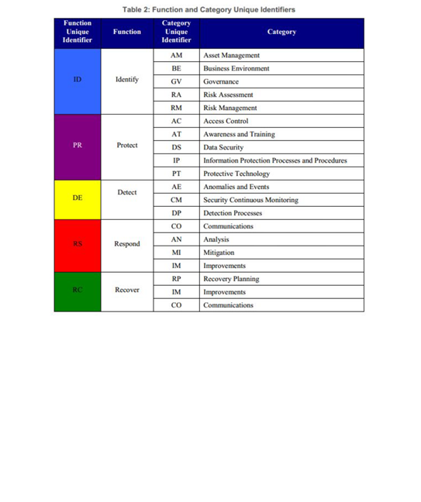
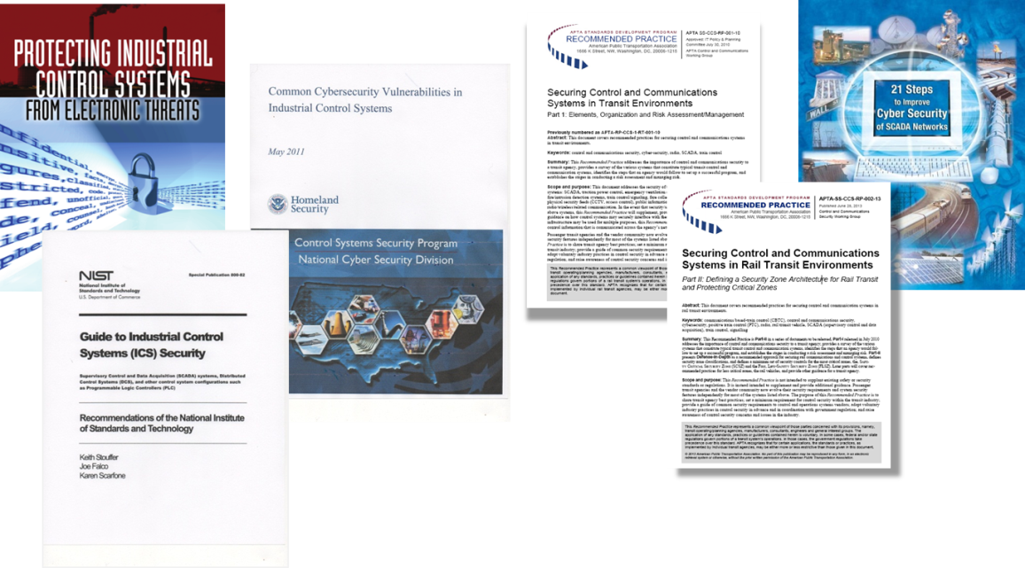
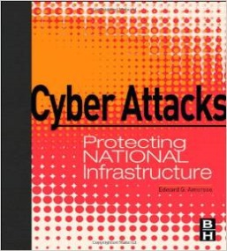
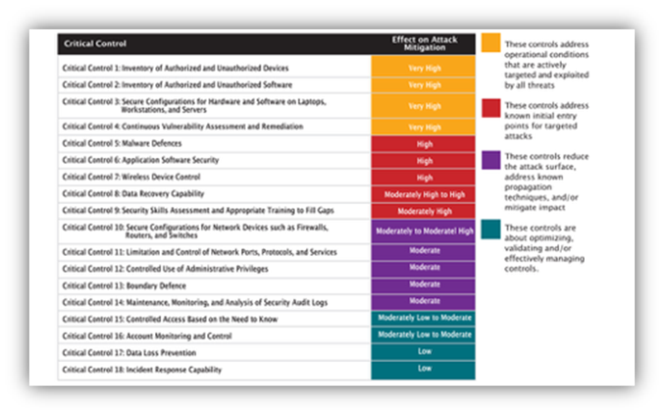
Countermeasures
There are approaches to reduce risks & mitigate impacts. Expert resources & guidance exist to help.
Industry Textbooks & Technical Papers
DHS & FHWA Resources
APTA Recommended Practices
NIST Framework
NIST ICS Guide
COBIT & SANS
https://ics-cert.us-cert.gov/Standards-and-References

Slide 17
Recommended Best Practices
Cyber Hygiene
Access Control
Data Security and Information Protection
Protective Technology
Boundary Defense and Network Separation
Configuration Management
Training
Notes:
Cybersecurity countermeasures fall into categories as listed here. Most of these are categories included in the NIST Framework.

Slide 18
Countermeasures: Findings
No “one-size-fits-all” cybersecurity program, technology or training exists or can ever be developed; each agency must determine, deploy and operate countermeasures unique to its local circumstance. These circumstances are continuously evolving forcing the continual evaluation and evolution of effective cybersecurity measures.
Although the Primer contains guidance on a variety of possible countermeasures, many recommended practices may be unavailable or not implementable due to local regulatory, governance, commercial, technical or other resource constraints.

Slide 19
Training: Building a Culture of Cybersecurity
What is a Culture of Cybersecurity?
Importance of Awareness and Training
Organizational Support
Building upon Safety and Security Cultures
Cybersecurity Awareness and Training Program
Functions and User Categories
Training Course Content
Awareness and Training Delivery
Evaluation
Performance Indicators
Continuous Improvement
Awareness and Training Resources

Slide 20
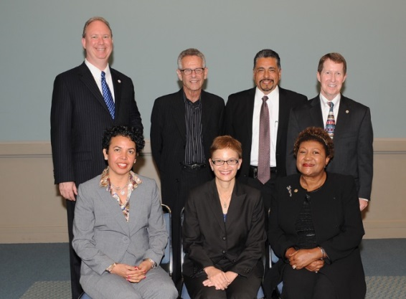
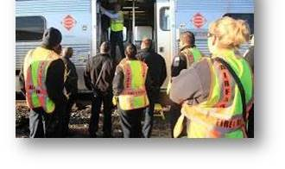
Cyber Culture
Everyone from frontline personnel…
“Cybersecurity involves
People, Technology, & Process…”
… to senior managers
“People, essential in the creation of a cybersecurity culture, are often thought to be
the most vulnerable element
and therefore require significant attention…”
“Culture is fueled by good basic practices which some describe as
Cyber Hygiene and Sustained Awareness
by all employees.”
Images: APTA.com

Slide 21
Enterprise Training
Cybersecurity Functions
IDENTIFY
PROTECT
DETECT
RESPOND
RECOVER
Roles & User Categories
All Users & Third Party Stakeholders
Privileged Users
Managers/Senior Executives
Training Personnel
IT/Cybersecurity Personnel
Physical Security Personnel
NIST Pubs
800-16 Rev 1 | Cybersecurity Framework

Slide 22
Security Programs and Support Frameworks
USA Patriot Act of 2001
The National Strategy To Secure Cyberspace (2003)
Presidential Policy Directive 8: National Preparedness (2011)
The National Infrastructure Protection Plan (NIPP) (2013)
Executive Order 13636 (EO) Improving Critical Infrastructure Cybersecurity (2013)
NIST Cybersecurity Framework (2014)

Slide 23
Control System Cybersecurity Support
“The Transportation Industrial Control Systems (ICS) Cybersecurity Standards Strategy” (2012)
“A Roadmap to Secure Control Systems in Transportation” (2012)
US-CERT and Industrial Control Systems (ICS-CERT) Cyber Information Sharing and Collaboration Program
National Institute of Standards and Technology (NIST)
Cyber Framework/Cyber-Physical Systems Framework
National Vulnerability Database
Computer Security Division's Computer Security Resource Center
Surface transportation ISAC
APTA Recommended Practices: Securing Control and Communications Systems in Rail Transit Environments
Part I (2010) Elements, Organization and Risk Assessment/Management
Part II (2013) Defining Security Zone Architecture for Rail Transit and Protecting Critical Zones
Part IIIa (2015) Attack Modeling for Rail Transit
Notes:
Goals of the transportation control systems roadmap
- to build a "culture of cybersecurity” that includes an ICS cybersecurity governance model and a cybersecurity awareness training program
- to assess and monitor risk that includes identifying risk management framework and standards, roles and responsibilities, and developing and implementing a risk management model and strategy
- to develop and implement risk reduction and mitigation measures such as securing interfaces between ICS and other systems and encouraging development of self-defending technologies built-in to the ICS infrastructure
- to manage incidents including research new effective detection and response tools. Near-term objectives focus on assessing risk, with long-term objectives focused on establishing continuous and automated risk monitoring programs and regularly measuring risk management performance.

Slide 24
Summary of Research Findings I
Cyber-incidents are not a major concern within State DOTs perhaps because due to a lack of experience with a serious attack or loss of essential function due to cyber failure.
Although transit systems have encountered cyber-attacks in the past, cyber risks are still perceived as low to medium, especially for smaller transit systems.
However, transportation systems are vulnerable to the same and/or similar cyber-attacks as any other industry that uses information systems and industrial control networks to accomplish its core business functions.
Within the transportation sector, there are significant differences between the perception of cyber risks for critical infrastructure and the current state of practice in cybersecurity.
Cyber risks are significant and growing in transportation because of the increasing dependence on connected information systems and networks with inherent vulnerabilities (e.g., ICS systems, fare/payment systems, BYOD), expanding opportunities for attack (positive train control, ITS, wireless systems), and increasing sophistication and availability of attack tools.
Within transportation agencies, there are different “cultures” (operations, IT, corporate) that may not understand each other’s systems and processes which can create a lack of awareness of cyber threats and potential weaknesses and vulnerabilities in the system.
Recent, highly publicized “hacks” in transportation have centered on vehicle security and not infrastructure breaches. Although an important topic, vehicle-based cybersecurity was not in the scope of this research
Manufacturers of digital components, particularly those used in control systems act as gatekeepers of systems security. Many of the vendors in this space do not have demonstrated security capability.

Slide 25
Summary of Research Findings II
In today’s cyber environment, 100% security is not possible, but it is possible to…
Address most common vulnerabilities that cause a majority of cyber incidents
Make it “more expensive” for the attacker in terms of types of effective approaches, required level of skills, and the extent of knowledge of systems to be attacked, etc.
Look to other industries for effective approaches and recommended practices
Find standards and guidance for transportation agencies
Effective cybersecurity should focus more on intrusion detection and system resilience
Improving security behavior and work flows are just as important as technology in improving cyber security.
Security decisions should be risk based and part of routine cost, schedule, and performance tradeoffs.
However, there are inadequate measures of “security” to calculate how much “security” is enough.
There are a range of current decision-making approaches being used in transportation today.
Cybersecurity decision-making approaches range from ad hoc and disaster driven to formal governance and policy-based approaches.
Decision-making approaches include top down decisions where CIO or functional owner makes decisions or committee decisions with representatives from multiple departments and functions.
Participants in cybersecurity decision-making include IT, engineering, operations, and sometimes other representatives, such as law enforcement.

Slide 26
Thank you
Countermeasures Assessment and Security Experts
302-322-9600
https://www.caseexperts.com

