Slide 1
Communicating the Connection:
NCHRP 20-24(137) – Assessing and Communicating the Economic and Quality of Life Benefits of Transportation Infrastructure Investments: Message Testing
DECEMBER 2022
Notes:
Quote is from Los Angeles Mayor Eric Garcetti, addressing the importance of infrastructure for quality of life in 2019

Slide 2
This study was requested by the American Association of State Highway and Transportation Officials (AASHTO) and conducted as part of National Cooperative Highway Research Program (NCHRP) Project 20-24(137). NCHRP is supported by annual voluntary contributions from state departments of transportation (DOTs). The work was guided by an NCHRP project panel, listed below, and the project was managed by Ann Hartell, NCHRP Senior Program Officer.
National Cooperative Highway Research Program Panel
Emanuel Banks, Arkansas DOT
William Cass, New Hampshire DOT
Beth Frady, Florida DOT
Beth Hallmark, Texas DOT
Shante Hastings, Delaware DOT
Marisa Maez, New Mexico DOT
Guy Tridgell, Illinois DOT
Maggie Kasperski, AASHTO Liaison
WSP Research Team
Paula Hammond, Principal Investigator
Shane Peck, Project Manager
Pam Lebeaux, Lead Researcher
Laura Lamorette, Graphic Design
Chris Sawiel, Videography
Dee Allsop, Heart + Mind Strategies
Jaclyn Crawford, Heart + Mind Strategies
Acknowledgements
Notes:
The study and Communications Guide were funded through the National Cooperative Highway Research Program, however they are not official publications of NCHRP. The work was guided by an NCHRP project panel.

Slide 3
Methodology
MODE | BrightBoardTM
LENGTH | 3 days
DATES | July & September 2022
GEOGRAPHY | Nationwide
AUDIENCE | Urban n=6 Suburban n=9 Rural n=11 n= 6-7 from each AASHTO region TOTAL N=26
DEMOGRAPHICS | Balanced mix of: Age Gender Ethnicity Income
Employment
Education
Note: General Norm comparisons are included. These are for general audiences on a range of issues (not audiences known to be supportive/sympathetic to an issue).
Notes:
The research team developed two sample communications for each of the five messages: a static image suitable for use across social media platforms and a short video. These formats are representative of communication methods in common use by state DOTs. The ten communications pieces were tested using an online bulletin board technology known as BrightBoards, which allows participants to join at their convenience to complete a series of tasks over several days.
Two rounds of BrightBoard testing were conducted, in July and September 2022, allowing the materials to be refined slightly based on participant feedback from the first round.
A total of 55 people participated in the BrightBoards, 29 in the first round and 26 in the second round.
Participants were recruited nationwide and included urban, suburban, and rural residents with a balanced mix of age, gender, ethnicity, income, employment, education, and political party affiliation.
Each round of testing included opportunities to evaluate the message wording, static images, and videos in detail. For both the images and videos, in addition to a question about overall likability, respondents were asked whether or not they agreed that “This concept really caught my attention,” “This concept shows or talks about things that are important to me personally,” and “I found this concept to be very compelling and persuasive,” as well as questions that assessed the relevance of the communications to specific themes. Respondents were also asked to describe in a sentence or two “what you specifically believe this concept is trying to communicate. What is the main message?” and to state what they found best and worst about each concept. Respondents could also indicate reactions to specific elements of each still image and video with emojis or comments. On the final day of the BrightBoard, respondents were asked to rank both the images and videos from most to least favorite.

Slide 4
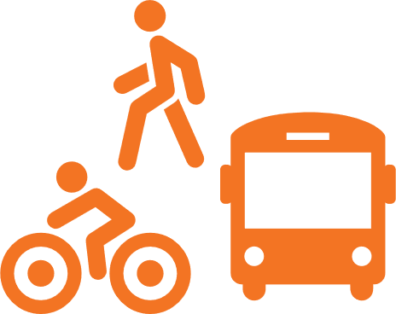
Key Messages
This study helped to validate five messages that transportation agencies can use to raise awareness of the benefits of transportation infrastructure investment:
“Transportation that works for everyone improves all our lives.” (Equity)
“Improving transportation means you can get where you need to go — quickly and easily.” (Mobility)
“More reliable transportation makes your commute less stressful.” (Easier Commutes)
“Time spent sitting in traffic is time away from the important things in life.” (Time)
“Investing in transportation creates more jobs in your community.” (Jobs)

Slide 5
Five key themes perform well as messages that resonate with the public:
Key Metric: | Format: | Equity: | Time: | Mobility: | Jobs: | Easier Commutes:
Likeable: | Image | 8.7 | 7.7 | 7.1 | 8.1 | 7.6
 | Video | 8.2 | 8.3 | 8.5 | 7.9 | 8.4
Attention-Getting: | Image | 8.3 | 6.9 | 6.6 | 7.2 | 6.0
 | Video | 7.6 | 7.9 | 7.9 | 6.5 | 7.7
Personally Relevant: | Image | 7.1 | 7.5 | 7.6 | 7.1 | 6.0
 | Video | 8.0 | 8.2 | 8.2 | 7.2 | 8.2
Persuasive: | Image | 8.0 | 7.3 | 6.9 | 7.1 | 6.1
 | Video | 7.7 | 7.7 | 8.0 | 6.8 | 7.5

Slide 6
Findings
Do…
Lead with the positive
Include details on “how” and ”what” transportation does for people
Use “investing” instead of “spending money”
Show relatable images of individuals or families enjoying the freedom to move about; include a variety of people
Use short videos to communicate the connection between transportation investment and benefits to people’s daily lives
Show direct, literal connections between investments and benefits, such as construction workers making local purchases that help create more jobs
Don’t…
Start with negative imagery, such as traffic jams, that reminds people of when transportation is bad; this sets the wrong tone when trying to rally support
Over-state what transportation can do, or suggest it’s the key to happiness.

Slide 8
Key Message Metrics: Equity Image
Transportation is for everyone
“Transportation that works for everyone improves all our lives,” is a highly resonant message.
The image of a wheelchair elicited a lot of empathy and good feelings from most respondents.
Focus group participants also indicated that they strongly agreed that:
This concept reminds me that investing in transportation infrastructure makes life better for everyone
This concept reminds me that investing in transportation plays an important part in the health and well-being of families.
This concept really caught my attention.
I found this concept to be very compelling and persuasive.
This concept reminds me that investing in transportation infrastructure saves time for what makes life worth living.
(1= Do not agree at all and 10= Strongly agree) | Total | Urban | Suburban | Rural
Overall image likeability (1= Did not like it at all and 10= Completely liked the image in every way) | 8.8 | 9.8 | 9.2 | 8.1
This concept really caught my attention. | 8.3 | 9.0 | 7.9 | 8.2
This concept shows or talks about things that are important to me personally. | 7.5 | 7.3 | 8.0 | 7.2
I found this concept to be very compelling and persuasive. | 8.4 | 9.3 | 8.3 | 8.1
This concept makes me want to go to a website so I can learn and see more. | 6.6 | 8.3 | 6.6 | 5.9
This concept reminds me that investing in transportation infrastructure saves time for what makes life worth living. | 8.1 | 9.3 | 7.8 | 7.8
This concept reminds me that investing in transportation reduces traffic jams and makes commuting easier. | 6.2 | 5.8 | 6.0 | 6.4
This concept reminds me that investing in transportation creates jobs and a more vibrant economy. | 6.1 | 7.5 | 6.2 | 5.5
This concept reminds me that investing in transportation plays an important part in the health and well-being of families. | 8.7 | 9.5 | 8.0 | 8.8
This concept reminds me that investing in transportation infrastructure makes life better for everyone. | 9.0 | 9.0 | 9.1 | 8.9
Notes:
So where did we get the themes we tested? We considered six different sources…and identified over 100 terms and themes that could be used to describe the economic and quality-of-life benefits of transportation infrastructure investment.
We aggregated these to form eight themes for testing.

Slide 9
EQUITY
LIKES
“I like that public transportation provides those with disabilities opportunities to easily get where they need to go”
“It's so important for handicapped people need transportation to feel independent and have freedom.”
“Shows inclusivity”
“The person can operate the wheelchair by himself and does not need other help.”
“I like that it included a wheelchair as you don't always think of wheelchairs in transportation.”
“Everyone should be able to get where they need to go.”
“I like the ramp for wheelchairs. It makes easy for people with special needs to move in and out .”
LOVE
“More attention needs to be paid to our disabled & challenged community”
“I take the bus to work, and we frequently stop to bring someone on board in a wheelchair. Each time, I am so grateful public trans exists to take care of this population.”
“With a wheelchair bound father, I really appreciate the diversity shown by focusing this image on how transportation betters the lives and increases independence of people with mobility limitations.”
“smooth transition from ramp to sidewalk is very important, especially in adverse weather conditions. It is also safer to the individual, so that they may enter and exit the bus without assistance.”
“It's so important for handicapped people need transportation to feel independent and have freedom.“
“I may be somewhat biased, but I truly believe that when transportation accommodates people who have specific needs, it really improve their quality of life and the overall experience when commuting and using transportation. I use A stroller, and rarely do I ever come in contact with a ramp that would help me transport me and my child more easily onto a train or a bus and I feel like small towns are good for not making those accommodations, perhaps because of a lack of resources.”
BORING
“Doesn’t stand out”
INTERESTING
“Something able bodied people wouldn't think about.”
CONFUSING
“How does this work with trains and rideshares?”
“The logo itself really is confusing and is a tongue twister. It's too much of a mouthful.”
DISLIKES
“The font looked very boring”
 | 39%​
 | 52%​
 | 2%​
 | 3%​
 | 2%​
 | 2%​
 | -​
IMAGE
“I really like the visual of the ramp. There are so many different needs ranging from those that are physically disabled to parents with children that would truly have an improved quality of life when taking transportation if they had a ramp.”
MESSAGE
“I thought the text was effective, although I'm not sure that the image backed up the "improves all our lives" part of the statement. The image tells me that transportation has to work for everyone - period!”
“I like the all-inclusiveness”

Slide 10
Equity Video:
“Everyone needs reliable safe, and affordable transportation. Whether you drive, take the bus, or use another way to get around, being able to go where you need to when you need to is vital to your daily life. Better transportation means more time for the things that count. Transportation that works for everyone improves all our lives. Better transportation is for everyone.”

Slide 11
Key Message Metrics: Equity Video
(1= Do not agree at all and 10= Strongly agree) | Total | Urban | Suburban | Rural
Overall video likeability (1= Did not like it at all and 10= Completely liked the image in every way) | 8.2 | 8.5 | 8.4 | 8.0
This concept really caught my attention. | 7.4 | 8.5 | 7.5 | 6.9
This concept shows or talks about things that are important to me personally. | 7.9 | 8.7 | 7.8 | 7.6
I found this concept to be very compelling and persuasive. | 7.4 | 8.3 | 7.6 | 6.9
This concept makes me want to go to a website so I can learn and see more. | 6.0 | 7.5 | 5.8 | 5.6
This concept reminds me that investing in transportation infrastructure saves time for what makes life worth living. | 7.9 | 9.2 | 7.4 | 7.6
This concept reminds me that investing in transportation reduces traffic jams and makes commuting easier. | 7.2 | 9.3 | 7.0 | 6.4
This concept reminds me that investing in transportation creates jobs and a more vibrant economy. | 6.8 | 9.0 | 6.4 | 6.0
This concept reminds me that investing in transportation plays an important part in the health and well-being of families. | 7.9 | 8.3 | 8.3 | 7.5
This concept reminds me that investing in transportation infrastructure makes life better for everyone. | 8.5 | 8.3 | 9.5 | 8.0
When the equity message is presented in a video allowing for greater explanation, it is well received.
Across all respondents the video scored well particularly in agreement with the statement, “This concept reminds me that investing in transportation infrastructure makes life better for everyone.”
The video was especially popular among urban residents.

Slide 12
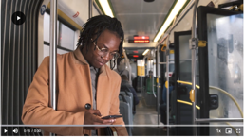
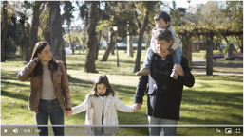
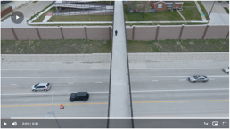
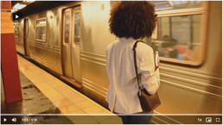
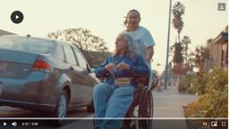
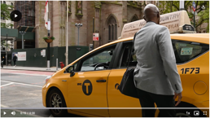
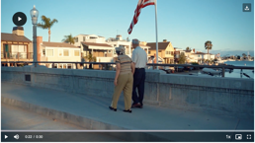
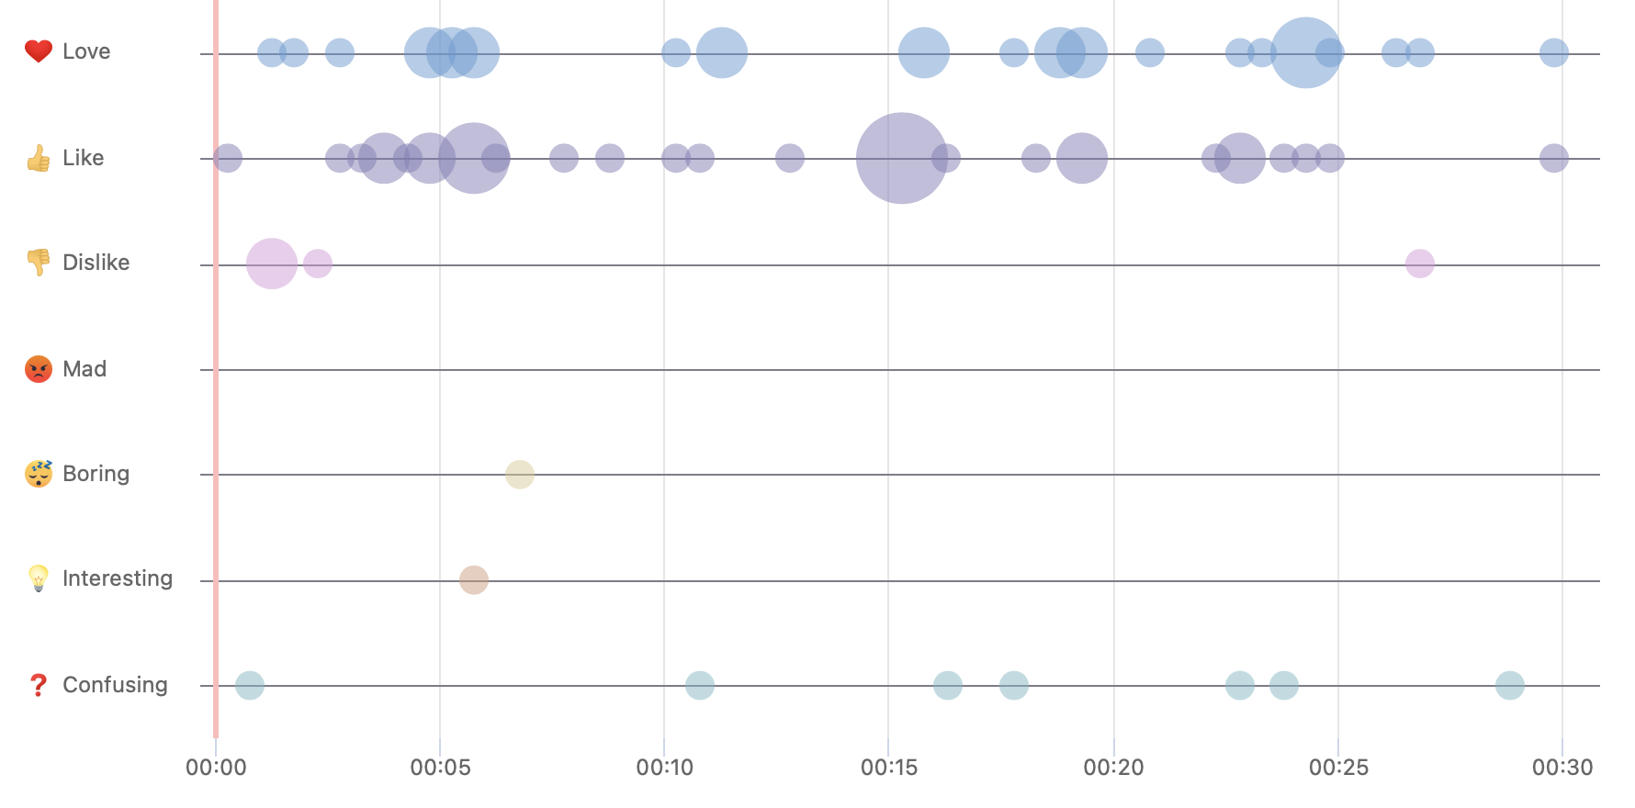
EQUITY Video Markup
Why show gridlock?
“If you're suggesting current means of transportation aren't great, why are you showing traffic. Moving at a good speed, and not gridlock?”
“There was lots of usage of people walking in this video, that detracts from the topic of transportation.”
Sweet couple
“I love that this video includes seniors as they are often left out!”
“LOVE the old couple walking. Sweet”
“I chose the heart emoji for this image. I love how an elderly couple is taking a nice evening walk together to stay active. It’s a great bonding time after a long day and having a nice bridge/walkway over the water is so beautiful and refreshing.”
Safe, reliable, affordable
“I chose the thumbs up emoji for this image. I like how there is a nice bridge over crossing a main driving area. It has railed ramps leading to the bridge making it easy and accessible for those who don’t drive. You could easily walk or jog like the person in the video. It also looks wide enough for someone who was in a wheelchair, and you could even ride a bike.”
“like adding this bridge concept for 'safety’”
“I like that this included a walkway bridge for pedestrians as that is a means of transportation.”
“Affordability is also top notch.. The lesser money I spend on good transportation the happier I become”
“I agree, everyone deserves this. They deserve to get opportunities just like everyone else."
Vital for family and daily life
“Being able to go where I need to and when I need to is vital to my life and I love how it is captured here”
I like the family that is portrayed.
“Showing a family having more time to be together is lovely”
“I chose the heart emoji for this image. I love how this family is spending time together. It’s important to spend as much time with your children while you can and while they are still little.”
Especially for people with special needs
“I liked the reasons of why everyone needs affordable transportation”
“Being able to get around when in a wheelchair is so important for the aging population”
“I love that this video includes people with mobility issues and their means of transportation.”
Different modes of transportation
“Convenience is important”
“Have to be able to get to where you need to go when you have to”
“Nice to include non-standard methods of transportation”
“like the mention of different modes of transportation”
“All kinds of travel”

Slide 13
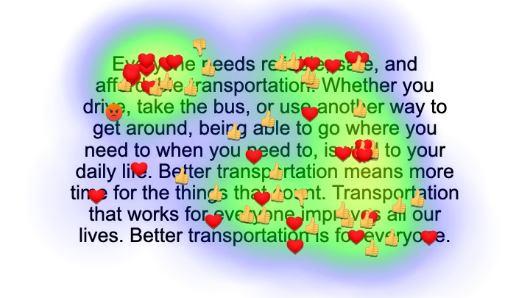
EQUITY Video Script Markup
LIKES
“Great word for those that do not have their own personal transportation”
“The fact that transportation would be reliable, safe and affordable. Which is normally the reasons people don’t have transportation”
“Because it’s true, not all transportation is reliable”
LOVE
“Everyone needs reliable, safe and affordable transportation pretty much sums it up in this one sentence.”
“We all rely on some form of transportation.”
“Everyone needs reliable, safe and affordable transportation.. I have been anticipating this for a very long time..”
“this is attractive to those who struggle to make a living”
”No matter who you are, you rely on transportation in some way or another. Everyone deserves good transportation”
LOVE
“When you think of transportation you want it to be safe and secure. These words make me feel good about the advertisement.”
“Safety is key in our community these days”
“reliable transportation is vital”
INTERESTING
“this may be too strong of a word ”
LIKES
“Must be affordable”
“Transportation has become way too expensive for the average person. Gas, insurance, maintenance, car upkeep is outrageously expensive. Everyone would like it to be more affordable.”
“Affordable is very important to me.”
“All three descriptions are so right and necessary - reliable, safe and affordable!”
LOVE
“Vital to your daily life is son on the nose. Without reliable and safe transport one can be hindered in an unsafe manner”
“Yes, it is vital for everyday life”
“Everyone needs some form of transportation as it is vital for survival.”
 | 44%
 | 48%
 | 1%
 | -
 | -
 | 4%
 | 1%
MAD
“I chose the angry emoji for drive. Gas prices have been so high in my area these past few months”
DISLIKES
“The final three sentences seem too choppy to me. I would combine a couple, like "Better transportation improves all our lives by leaving more time for the things that really matter."”

Slide 15
Key Message Metrics: Mobility Image
Getting where you need to go
It is important to remember that the word “mobility” is not what resonates with the public. It is the concept of mobility.
Regardless of the quality of the roadway, whether or not traffic is backed up, or the image shows a nice clear day, if it shows traffic, it elicits negative feelings.
Focus group participants also indicated that they strongly agreed that:
This concept reminds me that investing in transportation reduces traffic jams and makes commuting easier.
KEY MESSAGE METRICS (1= Do not agree at all and 10= Strongly agree) | Total | Urban | Suburban | Rural
Overall image likeability (1= Did not like it at all and 10= Completely liked the image in every way) | 8.0 | 8.7 | 8.1 | 7.7
This concept really caught my attention. | 7.3 | 7.8 | 7.1 | 7.3
This concept shows or talks about things that are important to me personally. | 7.6 | 7.2 | 7.9 | 7.5
I found this concept to be very compelling and persuasive. | 7.3 | 8.2 | 7.2 | 6.9
This concept makes me want to go to a website so I can learn and see more. | 5.7 | 7.2 | 5.8 | 4.9
This concept reminds me that investing in transportation infrastructure saves time for what makes life worth living. | 7.9 | 8.0 | 7.1 | 8.3
This concept reminds me that investing in transportation reduces traffic jams and makes commuting easier. | 8.7 | 8.5 | 8.4 | 8.9
This concept reminds me that investing in transportation creates jobs and a more vibrant economy. | 6.4 | 6.3 | 6.8 | 6.2
This concept reminds me that investing in transportation plays an important part in the health and well-being of families. | 6.6 | 6.0 | 6.6 | 6.9
This concept reminds me that investing in transportation infrastructure makes life better for everyone. | 7.4 | 7.8 | 6.3 | 7.9
Notes:
So where did we get the themes we tested? We considered six different sources…and identified over 100 terms and themes that could be used to describe the economic and quality-of-life benefits of transportation infrastructure investment.
We aggregated these to form eight themes for testing.

Slide 16
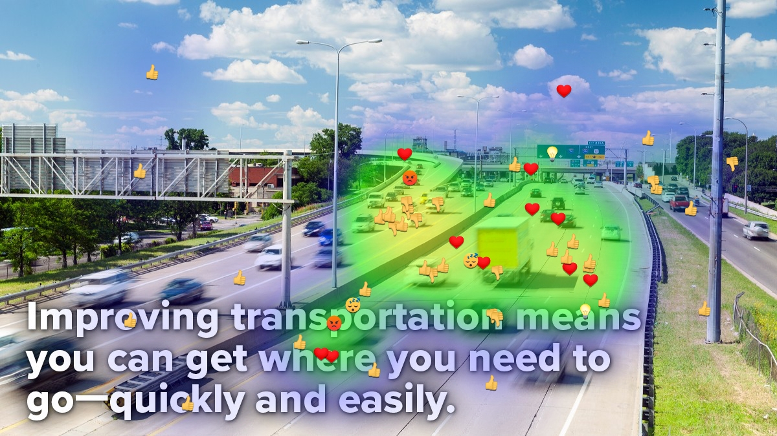
MOBILITY
DISLIKES
“There needs to be an increase in the number of lanes”
“I do not like how these lanes merge and causing a cluster of traffic.
Personally, when I’m driving on the highway this can cause a little panic for me when having to merge with so much traffic.”
“The traffic gave me an immediate sense of anxiety”
“There needs to be an increase in the number of lanes”
“Road narrows to fast”
“I dislike being stuck in traffic, behind trucks”
“Not one bus or coach in the photo. so, where’s the carbon footprint aspect of this expansion of infrastructure?”
LIKES
“This looks like a nice commute. Traffic appears to be moving, and there aren’t too many cars on the road.”
“Clear, free flowing roadways.”
“The highway is not that busy.”
“I drive may miles on my commute and would love to be able to get where I need to go, faster.”
“Traffic seems to be moving smoothly.”
“Shows easier commute time which makes more time with things we like.”
“Fast free flowing traffic with no delays”
“Does not seem to busy and the roads appear to be in good condition in this area.”
LOVE
“Sky is beautiful”
“I love the view of this landscape.. It's very beautiful”
“I love that this is a 4-lane highway making it easier for multiple cars to travel at once and not be so bunched up. traffic running smooth.”
MAD
“I do not enjoy driving on the highway”
BORING
“Blur images makes it very boring..”
“its a cliched dull image- oh look, everyone's going really quickly on this extra wide highway! except when rush hour starts.....”
INTERESTING
“The signs are up so you can see where you’re going”
 | 20%
 | 49%
 | 4%
 | -
 | 4%
 | 20%
 | 4%
MAD
“This statement makes me mad because so much more goes into transportation improvement then just allowing people to get somewhere quickly and easily. It must also be completed correctly the first time to prevent future repairs.”
IMAGE
“The scenery really captures the means and essence of transportation ”
“I like the image since it's a 4-lane expressway.”
“The images were taken while the cars were traveling at a high rate of speed, with the effect of the moving cars. Speaks to the message here.”
“Looks like a beautiful day! That always makes things better.”
MESSAGE
“This message is very direct and straight to the point”
“I agree with this. We need to make many improvements.”

Slide 17
Mobility Video:
“The ability to easily get to work, shopping, school, doctors’ appointments, and other destinations is important to your daily life. Improving transportation means you can get where you need to go more quickly and more easily. Access to reliable transportation means job security, healthier families, and more time for what really matters. Improved transportation makes life better.”

Slide 18
Key Message Metrics: Mobility Video
(1= Do not agree at all and 10= Strongly agree) | Total | Urban | Suburban | Rural
Overall video likeability (1= Did not like it at all and 10= Completely liked the image in every way) | 8.3 | 8.8 | 8.4 | 8.1
This concept really caught my attention. | 8.2 | 9.2 | 7.4 | 8.2
This concept shows or talks about things that are important to me personally. | 8.3 | 8.5 | 7.8 | 8.4
I found this concept to be very compelling and persuasive. | 8.3 | 9.2 | 7.6 | 8.2
This concept makes me want to go to a website so I can learn and see more. | 6.4 | 7.0 | 6.0 | 6.3
This concept reminds me that investing in transportation infrastructure saves time for what makes life worth living. | 8.5 | 9.2 | 7.9 | 8.6
This concept reminds me that investing in transportation reduces traffic jams and makes commuting easier. | 8.0 | 8.8 | 7.6 | 7.9
This concept reminds me that investing in transportation creates jobs and a more vibrant economy. | 7.4 | 9.0 | 7.0 | 6.9
This concept reminds me that investing in transportation plays an important part in the health and well-being of families. | 8.3 | 9.3 | 7.4 | 8.4
This concept reminds me that investing in transportation infrastructure makes life better for everyone. | 8.9 | 9.5 | 8.1 | 9.1
The video scored significantly higher than the still image. It was the highest rated video out of the five videos
The mobility video and message also scored the highest (8.0) among the five tested with members of the public strongly agreeing, “I found this concept to be very compelling and persuasive”
Focus group participants also indicated that they strongly agreed that:
This concept is very compelling and persuasive to me.
This concept shows or talks about things that are important to me personally.
This concept reminds me that investing in transportation infrastructure saves time for what makes life worth living.
This concept reminds me that investing in transportation reduces traffic jams and makes commuting easier.
This concept reminds me that investing in transportation plays an important part in the health and well-being of families.
This concept reminds me that investing in transportation infrastructure makes life better for everyone.

Slide 19
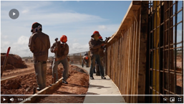
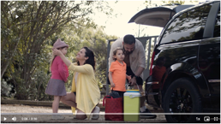
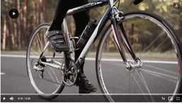
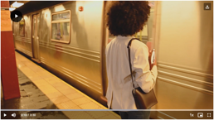
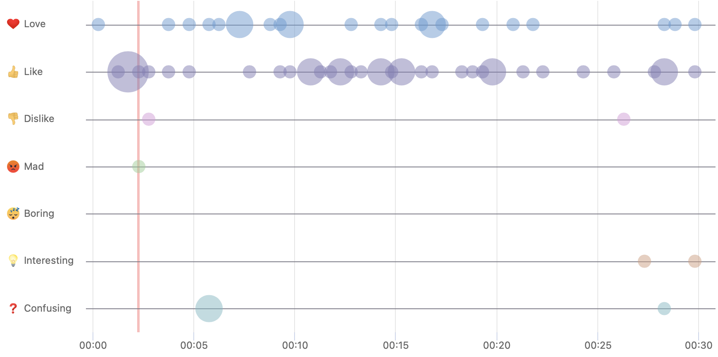
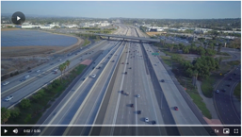
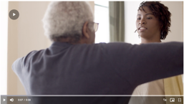
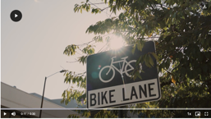
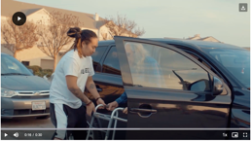
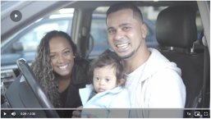
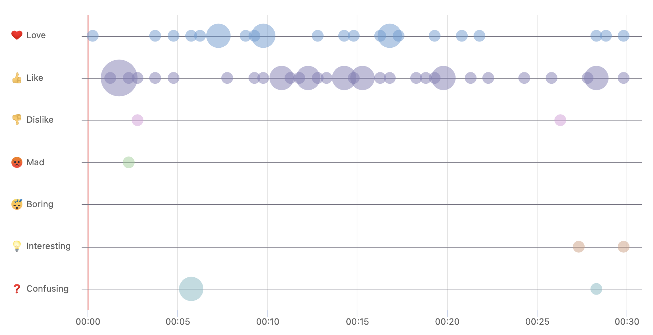
MOBILITY Video Markup
Showing good transportation
“The use again of the interstate is a good concept to use when framing a reference to your main message.”
“Nice open roadway”
“I wish our roads were this traffic free.”
“I chose the thumbs up for this image. I like how easily the cars are traveling on a busy highway with no back ups.”
“Like the idea of getting to work faster”
Accessibility, compassion
“Love this scene showing a woman providing transportation for an elderly lady who has a walker. Shows compassion.”
“Like the accessibility highlight”
“I like that the disabled are included.”
Showing the important things in life
“Improved transportation makes life better”
“Shows what’s important in life”
“Sweet family!!!”
Showing different activities
“The use of workers working outside on what looks to be infrastructure is important to message.”
“Ability to get to shopping”
“I liked the reasons for being able to get to the places you need to”
“I chose the heart emoji for this image. I love how the elderly is getting the care he needs because this is so important for our health as we get older and having the transportation to get us to and from these appointments.”
“I love the seniors and caring about their health.”
Reliable public transportation improves lives
“I don't use public transportation, but it is a big part of how our infrastructure works.”
“Improves quality of life”
“Realistic”
“Access to reliable transportation means job security”
Confusing lab scene
“All other activities are clear; this one is not ”
“This doesn't look like school to me - more like a scientist lab and its workers”
Life and family
“Love the scene of a family preparing to go somewhere in the car”
“Life”
“these things are needed and so helpful”
“The family going a picnic or just enjoying their time together ”
“Family going on an outing, love it”
“Like the portrayal of an everyday family and what they deal with.”

Slide 20
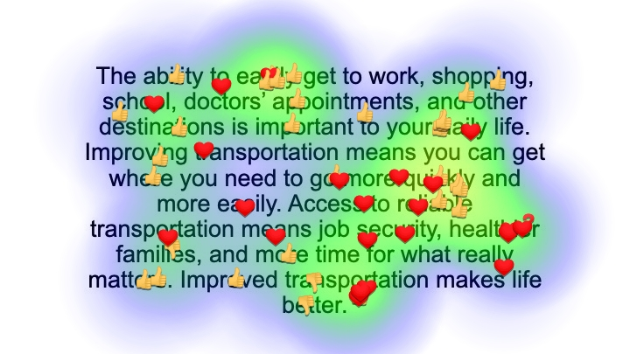
MOBILITY Video Script Markup
LIKES
“Great everyday list of places most people need to go!”
“You get right to establishing the benefits first thing.”
CONFUSING
“I’m not really sure how improving transportation makes your family healthier ”
LIKES
“Quickly means saving time ”
“Like like that this is open ended and not just about cars.”
“The most honest wording. Its about doing the commute quicker, not a better version.”
DISLIKES
“Don't get the connection between better infrastructure and someone's health? It’s far reaching.”
LOVE
“ I chose the heart emoji for healthier families because I feel like this is very important. You are only given one life and you need to be in the best mental and physical health you can be.
“If you spend less time in traffic then it will reduce your stress levels and contribute to you becoming more healthier”
DISLIKES
“I don't know that it all makes my life better - but it makes it easier. (I know easier is improving it, which means it is better, but I still think "easier" would work here.)”
“Less emphasis on transportation but more message on benefits in this script.”
 | 41%
 | 52%
 | -
 | 2%
 | -
 | 6%
 | -
LOVE
“ Improved transportations allows us to get to where we need to go more quickly and easily. I'm all for that!”
“Because getting somewhere faster saves time”
“We all use transportation in some form. Having reliable transportation means people can count on getting to and from their destinations easily.”
“Everyone wants to feel that they can depend on getting to the job that pays their bills”

Slide 22
Key Message Metrics: Easier Commutes Image
Quicker and less stressful
The lack of other passengers and the need for a more extensive explanation of how commutes would be made more reliable resulted in a somewhat lukewarm response.
There was wide variation depending on where focus group participants live.
Two categories in which urban residents scored the image and message highly were strongly agreeing that:
“This concept reminds me that investing in transportation reduces traffic jams and makes commuting easier,” and
“This concept reminds me that investing in transportation infrastructure makes life better for everyone.”
KEY MESSAGE METRICS (1= Do not agree at all and 10= Strongly agree) | Total | Urban | Suburban | Rural
Overall image likeability (1= Did not like it at all and 10= Completely liked the image in every way) | 8.4 | 9.8 | 7.9 | 8.1
This concept really caught my attention. | 7.8 | 9.3 | 7.2 | 7.6
This concept shows or talks about things that are important to me personally. | 7.9 | 8.8 | 8.3 | 7.1
I found this concept to be very compelling and persuasive. | 8.0 | 9.0 | 7.3 | 8.0
This concept makes me want to go to a website so I can learn and see more. | 6.6 | 7.5 | 6.2 | 6.4
This concept reminds me that investing in transportation infrastructure saves time for what makes life worth living. | 7.9 | 9.3 | 7.1 | 7.8
This concept reminds me that investing in transportation reduces traffic jams and makes commuting easier. | 7.9 | 8.5 | 7.3 | 8.0
This concept reminds me that investing in transportation creates jobs and a more vibrant economy. | 6.3 | 7.3 | 6.3 | 5.9
This concept reminds me that investing in transportation plays an important part in the health and well-being of families. | 7.3 | 7.3 | 6.6 | 7.7
This concept reminds me that investing in transportation infrastructure makes life better for everyone. | 8.4 | 9.2 | 7.4 | 8.6
Notes:
So where did we get the themes we tested? We considered six different sources…and identified over 100 terms and themes that could be used to describe the economic and quality-of-life benefits of transportation infrastructure investment.
We aggregated these to form eight themes for testing.

Slide 23
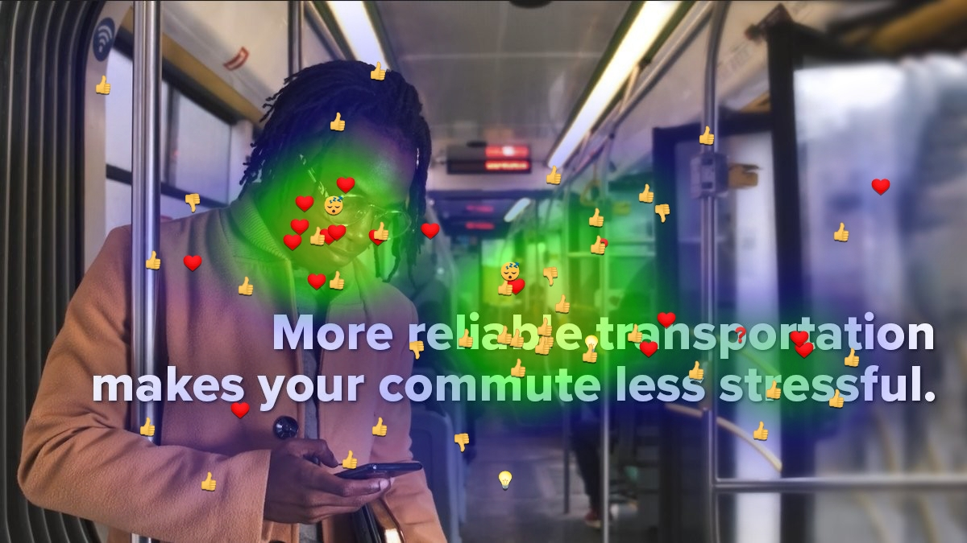
EASIER COMMUTES
LOVE
“The person in the image truly conveys a non-stressed commuter. She is absorbed on her phone, but she seems to almost ready to break out in a smile.”
“The slight, subtle smile is more realistic and believable than a bigger expression would have been. Reliable transportation isn't something most people would jump in happiness over, but it does add a level of security and comfort that allows for small moments of happiness like this one”
“Yes, I really agree with the concept that more reliable transportation makes commute less stressful”
“The man has a pleasant look on his face showing some form of pleasure from bus ride.”
“love how this young man is portrayed as happy and successful.”
“appears stress free = train may have been on time”
“I love to see POC in pics”
LIKES
“Denoting a Wi-Fi symbol for a current and capable machine to help transport individuals. The idea of current and useful equipment instead of old nearly retired buses or hardware.”
“It shows that the man has ample room to be able to hold on to the bar safely without the crowding of other passengers. He is enjoying his ride by relaxing on his phone.”
“I like the fact that when you use public transportation you have the freedom to do other things while someone else worries about getting you where you need to go.”
“The transit appears very clean”
“Reliability is good as it shows the transportation can get the job done.”
“Looks like a clean, relaxing train with no crowds”
“Clear message and very positive.”
“The train looks very modern.”
BORING
”this is true marketing...a happy commuter....?”
“Although I don’t dislike the image of the gentleman on his phone, I’m just not impressed by it and I feel like it’s not really aligning with the overall message. With the specific message, I would’ve liked to have seen him sitting down with his eyes closed and his head sort of thrown back to make it look like he is relaxing and content and has no worries.”
CONFUSING
“This picture is of a subway, is this directed toward public transportation or transportation in general?”
 | 27%​
 | 55%​
 | 3%​
 | 3%​
 | 3%​
 | 8%​
 | -​
DISLIKES
“Words and image clash
“It looks like there are a many seats open, yet this man is standing.”
“Sometimes it makes it stressful depends on the people on the transportation”
MESSAGE
“I think "safe" should be added to reliable because people have to feel safe on public transportation if they are going to have less stress.”
“Wording is in a good font that is easy to read and differentiate from the background.”
“I like the slogan as it's very relatable.”
“I like the words reliable and "less stressful””
“That choice of word actually gives reassurance”
IMAGE
“I like the images with people because it feels relatable”
“He’s on public transportation wearing nice clothes”
“The visible illustration of a commuter ensuring his safety on the train is an addition I appreciate”
“That it showed some diversity in the image.”
“Best image yet, picture tells the whole story.”

Slide 24
Easier Commutes Video:
“Easier commutes mean less time going to and from work—helping ensure job security, reducing stress, and getting you back to the important things in life. Transportation improvements that reduce traffic jams and make buses and trains more reliable mean you get where you need to be with fewer hassles. Better transportation means easier commutes.”

Slide 25
Key Message Metrics: Easier Commutes Video
Presenting the easier commutes message in a 30-second video resulted in a big improvement in how the message was received.
It scored higher among suburban residents than any of the videos
Focus group participants strongly agreed that:
This concept shows or talks about things that are important to me personally.
This concept reminds me that investing in transportation infrastructure saves time for what makes life worth living.
This concept reminds me that investing in transportation reduces traffic jams and makes commuting easier.
This concept reminds me that investing in transportation plays an important part in the health and well-being of families.
(1= Do not agree at all and 10= Strongly agree) | Total | Urban | Suburban | Rural
Overall video likeability (1= Did not like it at all and 10= Completely liked the image in every way) | 7.6 | 7.7 | 7.6 | 7.5
This concept really caught my attention. | 7.9 | 8.0 | 8.5 | 7.4
This concept shows or talks about things that are important to me personally. | 7.5 | 7.7 | 7.8 | 7.2
I found this concept to be very compelling and persuasive. | 7.9 | 8.5 | 7.6 | 7.7
This concept makes me want to go to a website so I can learn and see more. | 5.8 | 6.3 | 6.0 | 5.5
This concept reminds me that investing in transportation infrastructure saves time for what makes life worth living. | 7.5 | 7.3 | 8.1 | 7.1
This concept reminds me that investing in transportation reduces traffic jams and makes commuting easier. | 8.8 | 8.8 | 8.8 | 8.7
This concept reminds me that investing in transportation creates jobs and a more vibrant economy. | 6.9 | 8.8 | 6.8 | 6.1
This concept reminds me that investing in transportation plays an important part in the health and well-being of families. | 7.1 | 8.0 | 7.3 | 6.7
This concept reminds me that investing in transportation infrastructure makes life better for everyone. | 7.6 | 7.3 | 7.5 | 7.8

Slide 26
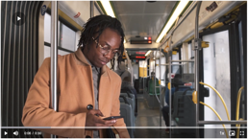
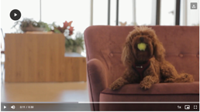
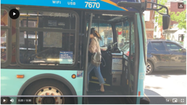
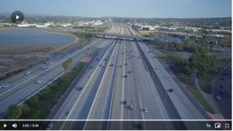
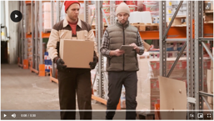
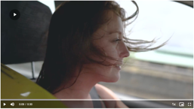
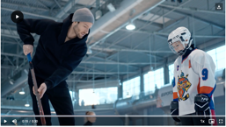
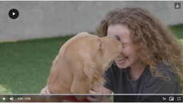
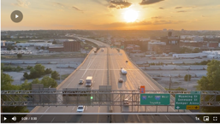
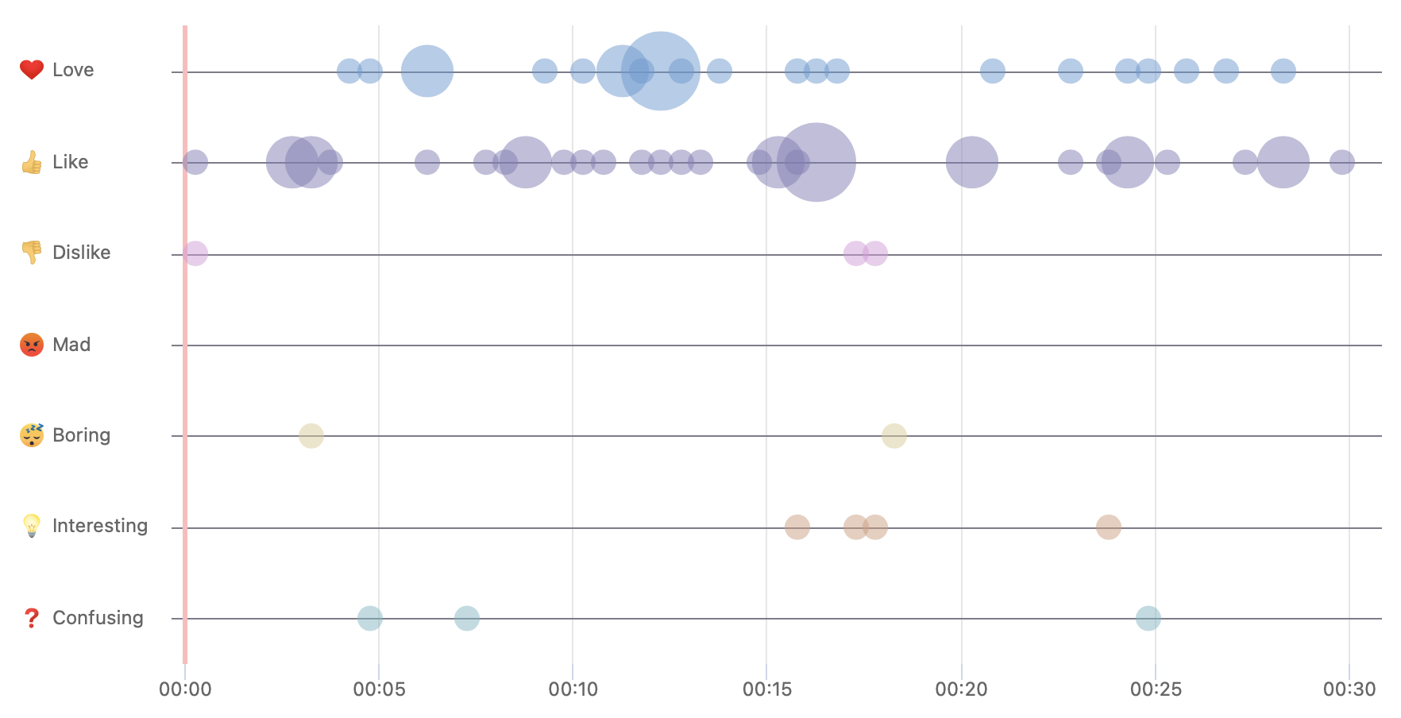
EASIER COMMUTES Video Markup
Saving time
“Truly easier commutes means less time going to and from and this could help a lot with one's daily schedule”
“saving time is precious”
Opposing reactions
“Seeing people smiling though they are on the road but doing something they enjoy”
“I like this road scene better than the one in an earlier scene because the traffic isn't heavy and stressful.”
“Easier commutes, I'm sold”
“Picture on point”
Free-flowing
“Looks like a nice and free-flowing freeway”
“Like seeing the roads not at a standstill”
“better transportation is easier commute to be with our loved ones”
Shorter commute to work
Easier commutes means less time going to work.
I would love a shorter commute to work. There is too much traffic with people who don't know how to drive.
Working people who got to work.
Positive interactions
“Fewer hassles”
“Love the dog!”
“I like the positive interactions”
Less stress
“Good transportation reduces stress...”
“Less driving, reducing stress is good”
“She looks relaxed
Family time
“I like that it show a father having time to play hockey with his son”
“I chose the heart emoji for this image. I chose this because it shows a connection between a father/coach to the child of being taught a sport. Family is really important especially when it comes to sporting events and being there for them. Not running late due to traffic or re routes.”
Reliable buses
“People love fewer traffic jams”
“More reliable buses is a must. Not everyone drives.”

Slide 27
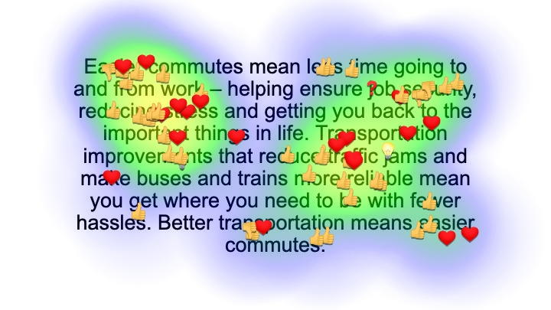
EASIER COMMUTES Video Script Markup
LIKES
“Nobody wants to sit in traffic, especially before or after work.”
“Just the easier commute does it for me”
CONFUSING
“Ensuring job security does not make sense.”
DISLIKES
“That's an over claim. All people will do is lay in bed longer before getting up- they wont actually go into work earlier. ”
“I don't feel it has to with job security”
LOVE
“Less stress by not sitting in long traffic helps us to have more productive lives ”
“Good transportation systems does reduce stress for me”
“Anything that reduces stress is beneficial”
INTERESTING
“Sometimes a better choice of route or earlier leave time is a problem solver”
LIKES
“No one need stress when traveling”
“No one likes to be stressed out on their way to work. This is a terrible way to start the day”
“I will support transportation improvements if it helps reduce stress in my commute”
“I chose the thumbs up emoji for reducing stress. I feel like this is very important because there are already so many other things in our lives that cause us stress.”
“Such an important thing! Stress is a killer!!”
LOVE
“Improvements in transportation and necessary in order to reduce traffic which helps us lead to more productive lives”
“less traffic means I can get there on time”
“Because it can reduce traffic jam”
LIKES
“I chose the thumbs up emoji for reduce traffic jams because I feel like this is important so we can get to work, doctors, or back to our families quickly and safely.”
“Great informative sentence with cause and effect clearly shown.”
”Phrases like this help you understand the message”
“I like that this includes not just cars, but also public transportation”
 | 31%
 | 58%
 | 3%
 | 2%
 | -
 | 6%
 | -

Slide 29
Key Message Metrics: Time Image
KEY MESSAGE METRICS (1= Do not agree at all and 10= Strongly agree) | Total | Urban | Suburban | Rural
Overall image likeability (1= Did not like it at all and 10= Completely liked the image in every way) | 8.7 | 9.8 | 8.0 | 8.6
This concept really caught my attention. | 8.2 | 9.7 | 7.3 | 8.1
This concept shows or talks about things that are important to me personally. | 8.5 | 9.2 | 8.3 | 8.3
I found this concept to be very compelling and persuasive. | 8.1 | 9.8 | 7.1 | 7.9
This concept makes me want to go to a website so I can learn and see more. | 6.2 | 6.7 | 5.4 | 6.6
This concept reminds me that investing in transportation infrastructure saves time for what makes life worth living. | 8.7 | 9.5 | 7.3 | 9.3
This concept reminds me that investing in transportation reduces traffic jams and makes commuting easier. | 7.9 | 9.0 | 6.4 | 8.3
This concept reminds me that investing in transportation creates jobs and a more vibrant economy. | 5.8 | 7.7 | 5.2 | 5.4
This concept reminds me that investing in transportation plays an important part in the health and well-being of families. | 8.9 | 10.0 | 8.0 | 9.0
This concept reminds me that investing in transportation infrastructure makes life better for everyone. | 8.3 | 9.0 | 7.6 | 8.6
More moments that matter
The idea of being able to get around more quickly, with fewer delays and more time to focus on family, relaxation and recreation appeals to diverse audiences.
Focus group participants also indicated that they strongly agreed that this concept:
Reminds me that investing in transportation infrastructure saves time for what makes life worth living.
Reminds me that investing in transportation plays an important part in the health and well-being of families.
Notes:
So where did we get the themes we tested? We considered six different sources…and identified over 100 terms and themes that could be used to describe the economic and quality-of-life benefits of transportation infrastructure investment.
We aggregated these to form eight themes for testing.

Slide 30
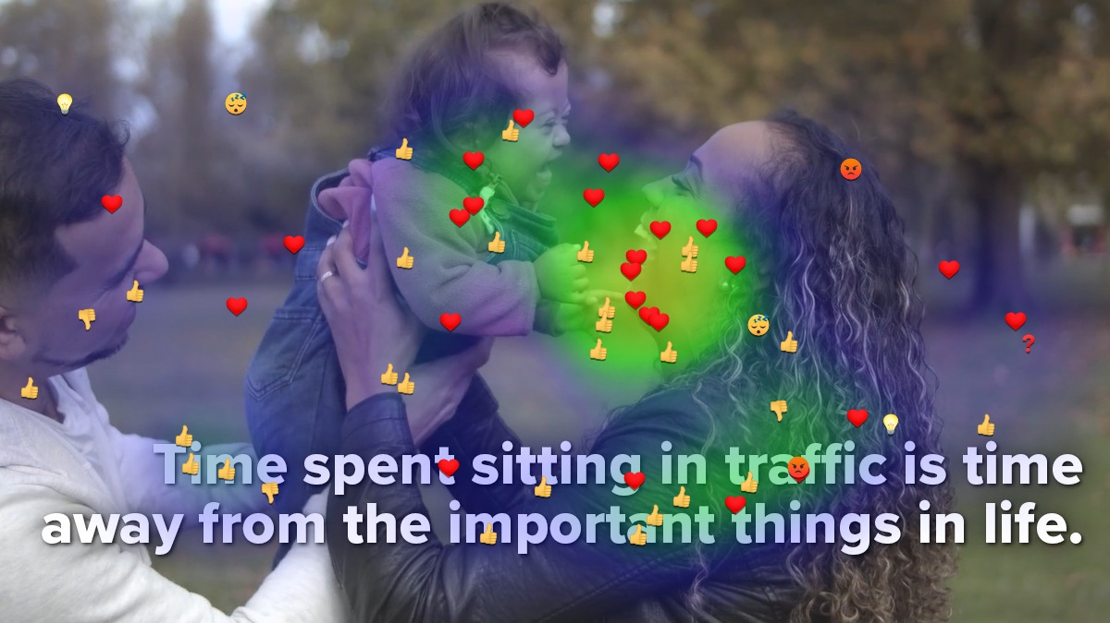
TIME
LOVE
“I absolutely adore the photo of this family as well as the general message behind it that it’s trying to convey. As someone who has their own family, I believe that every minute of the day counts and sometimes commuting is hard enough because it’s time spent away from the family just to get to and from work, but when unexpected and unnecessary events happen like traffic jams, it can be frustrating because those minutes turns into hours away from your family that you can just never get back.”
“Commitment to the idea that traffic should be reduced as much as possible to allow people to recapture precious time.
“The happy family is very relatable.”
“Joy in a family's face.”
LIKES
“It appeals to emotion by expressing how we still need time for ourselves.”
“Making time to enjoy moments.”
“Saving time from traffic is valuable.”
“The dad looks so happy to be home and not stuck in traffic.”
“Enjoying being stress free.”
MAD
“Traffic is very uncomfortable part of every trip”
“Because it’s kind of true depends on how you look at it”
DISLIKES
“I don't like the dude just hanging out.”
“It's not just sitting in traffic, it's also waiting for buses, subways and trains. It doesn't accurately represent everyone.”
CONFUSING
“Missing a highlight of how transit helped unite the group.”
BORING
“Very basic”
“The family was boring and made me yawn”
INTERESTING
“Interesting connection”
“It's interesting to see how people would spend extra time when they didn't waste it in traffic.”
 | 41%
 | 43%
 | 3%
 | 2%
 | 3%
 | 5%
 | 3%
IMAGE
“The image supports the statement as it shows that family time is important.”
“Clear message and picture is very positive.”
“The image is wholesome”
“The image tugs at the heart strings”
“Relatable image of the joy of family.”
MESSAGE
“An important message! And the image backs up the message.”
“The font really grabbed my attention”
“I agree with the statement”
“Concise font used, easy to read and right to the point.”

Slide 31
Time Video:
“Time spent sitting in traffic is time away from the important things in life. Investing in improvements that reduce traffic jams gives you more time in your day by helping you get to where you need to go more quickly with fewer hassles. Better transportation means time for what matters—time for work, time for family, and time for yourself.”

Slide 32
Key Message Metrics: Time Video
Urban participants scored this video highest out of the five presented.
Focus group participants also strongly agreed that this concept:
Shows or talks about things that are important to me personally.
Reminds me that investing in transportation infrastructure saves time for what makes life worth living.
Reminds me that investing in transportation reduces traffic jams and makes commuting easier.
Reminds me that investing in transportation plays an important part in the health and well-being of families.
Reminds me that investing in transportation infrastructure makes life better for everyone.
(1= Do not agree at all and 10= Strongly agree) | Total | Urban | Suburban | Rural
Overall video likeability (1= Did not like it at all and 10= Completely liked the image in every way) | 8.3 | 9.8 | 8.1 | 7.7
This concept really caught my attention. | 7.4 | 8.7 | 7.1 | 7.1
This concept shows or talks about things that are important to me personally. | 8.5 | 9.7 | 8.3 | 8.1
I found this concept to be very compelling and persuasive. | 7.8 | 9.0 | 7.4 | 7.4
This concept makes me want to go to a website so I can learn and see more. | 6.2 | 8.2 | 5.9 | 5.6
This concept reminds me that investing in transportation infrastructure saves time for what makes life worth living. | 8.5 | 9.2 | 8.3 | 8.4
This concept reminds me that investing in transportation reduces traffic jams and makes commuting easier. | 8.5 | 8.8 | 8.4 | 8.4
This concept reminds me that investing in transportation creates jobs and a more vibrant economy. | 7.1 | 9.5 | 6.4 | 6.6
This concept reminds me that investing in transportation plays an important part in the health and well-being of families. | 8.5 | 9.5 | 8.3 | 8.2
This concept reminds me that investing in transportation infrastructure makes life better for everyone. | 8.6 | 9.5 | 8.1 | 8.5

Slide 33
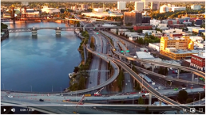
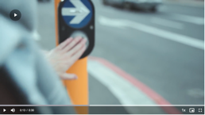
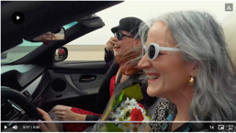
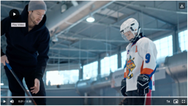
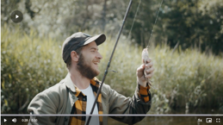
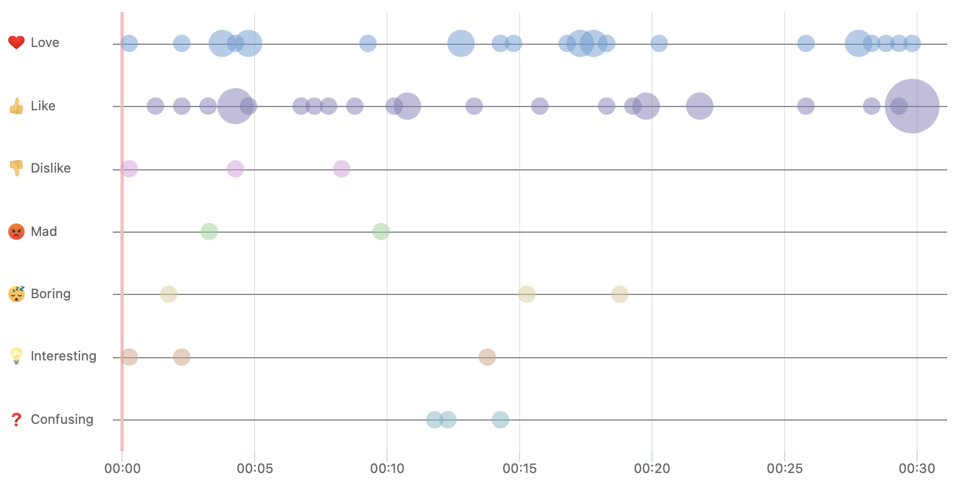
TIME Video Markup
Tugs the heartstrings
“It demonstrates that we will have more time for ourselves and our families”
“This reminds me of my own kids and touches my heart.”
“With good transportation bad and hectic traffic can be avoided”
“I chose the thumbs done for this image. This image makes me feel sad as if she is waiting on one of her parents who hasn’t made it home yet.”
“This little girl reminds me of my granddaughter and how much I LOVE spending time with her.
“cute kiddo”
“Time spent sitting in traffic is time away from the important things in life, I totally agree to this fact. Traffic jams are tedious and frustrating.”
Time for self
“I like the time for self and a simple man fishing. This is the everyday person to whom your advertising should appeal.”
“Love having my time for myself”
“Alone time is needed”
“Nice summary here”
Freedom, family and fun
“This is a good use of a scene in which a car is free flowing, and no stops and the people are laughing going wherever they are going.”
“Better transportation gives you more time to get other things done”
“hassle free”
“Like to have more time to spend with friends, having fun”
“Freedom”
“Better transportation means time for what matters”
“Time with son is important”
Horrible traffic
“Time sitting in traffic is horrible for me personally just finished sitting with stop and go this morning working slowdowns.”
Doesn’t show working women
“Rich women who do not have to be anywhere at any certain time. Once again, these are the people who do not care about the infrastructure as it does not affect their daily lives. Show us working women that rely on transportation, good roads, etc. to be on time for work, pick their kids up from school or activities.”
Showing better flowing transportation
“Showing a cityscape with many interstates is a good way to preview the need for better flowing transportation.”
Confusing scene
“What does the person with a backpack have to do with the transportation infrastructure?
“People can walk whenever. I'm not sure how this correlates to transportation.”
“they're walking! how can roads improve the commute when they walk to work?”

Slide 34
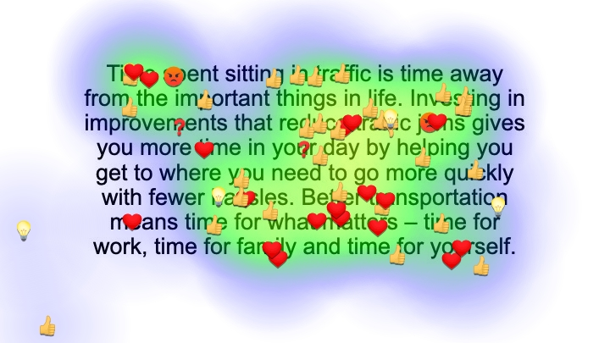
TIME Video Script Markup
INTERESTING
“I agree this is necessary, but I also think the routing systems on busy freeways could more clearly marked to make for less confusion”
“I agree this can be a problem, but sometimes it is time to realize it is what it is so just relax a little bit and accept what is happening”
MAD
“traffic jams make me anxious and mad. ”
“I don’t like spending time in traffic though it does give me time to think, and listen to music and sing along since there’s nothing else to do”
LIKES
“This is a good mention of what investing does with factual examples rather than just talking benefits.”
“I would like more time in my day”
“What everyone hopes for”
“Everyone likes less traffic jams.”
CONFUSING
“What improvements? Vague. ”
CONFUSING
"in your day" could be left off. Too wordy
LIKES
“I would like quick and easy transportation without hassles”
“Everyone wants more time in their day for things that matter.”
 | 32%
 | 50%
 | 10%
 | 3%
 | -
 | 2%
 | 3%
LOVE
“For me, spending time with family is what matters most. If I'm sitting in traffic jams on the interstate, that takes away valuable time I could be spending with them.”
“The message speaks directly to me”
“I chose the heart emoji for family. I feel like there is no better time spent then when you are with family and doing what you love.”
“Better transportation saves time that will be used for other things..”
“A very strong and good reason for improvements needed in infrastructure”
LOVE
“People often forget to take care of themselves!”
“Of course, the time for myself is most important.”

Slide 36
Key Message Metrics: Jobs Image
KEY MESSAGE METRICS (1= Do not agree at all and 10= Strongly agree) | Total | Urban | Suburban | Rural
Overall image likeability (1= Did not like it at all and 10= Completely liked the image in every way) | 7.4 | 8.2 | 7.6 | 7.0
This concept really caught my attention. | 6.6 | 7.5 | 6.9 | 5.9
This concept shows or talks about things that are important to me personally. | 6.3 | 7.5 | 6.4 | 5.8
I found this concept to be very compelling and persuasive. | 6.5 | 7.8 | 6.1 | 6.1
This concept makes me want to go to a website so I can learn and see more. | 5.1 | 6.3 | 4.8 | 4.7
This concept reminds me that investing in transportation infrastructure saves time for what makes life worth living. | 5.8 | 8.0 | 6.0 | 4.6
This concept reminds me that investing in transportation reduces traffic jams and makes commuting easier. | 5.2 | 7.0 | 5.8 | 4.1
This concept reminds me that investing in transportation creates jobs and a more vibrant economy. | 7.9 | 9.7 | 8.0 | 7.0
This concept reminds me that investing in transportation plays an important part in the health and well-being of families. | 6.5 | 8.3 | 6.3 | 5.9
This concept reminds me that investing in transportation infrastructure makes life better for everyone. | 7.2 | 9.0 | 7.4 | 6.4
Making the connection clear
Indirect jobs do not typically come to mind for average Americans. Construction workers, however, could be key to making that connection.
The words and image presented made a literal connection between the investment in infrastructure and the jobs it supports beyond those directly on improvement projects.
Focus group participants also indicated that they strongly agreed that:
This concept reminds me that investing in transportation creates jobs and a more vibrant economy.
Notes:
So where did we get the themes we tested? We considered six different sources…and identified over 100 terms and themes that could be used to describe the economic and quality-of-life benefits of transportation infrastructure investment.
We aggregated these to form eight themes for testing.

Slide 37
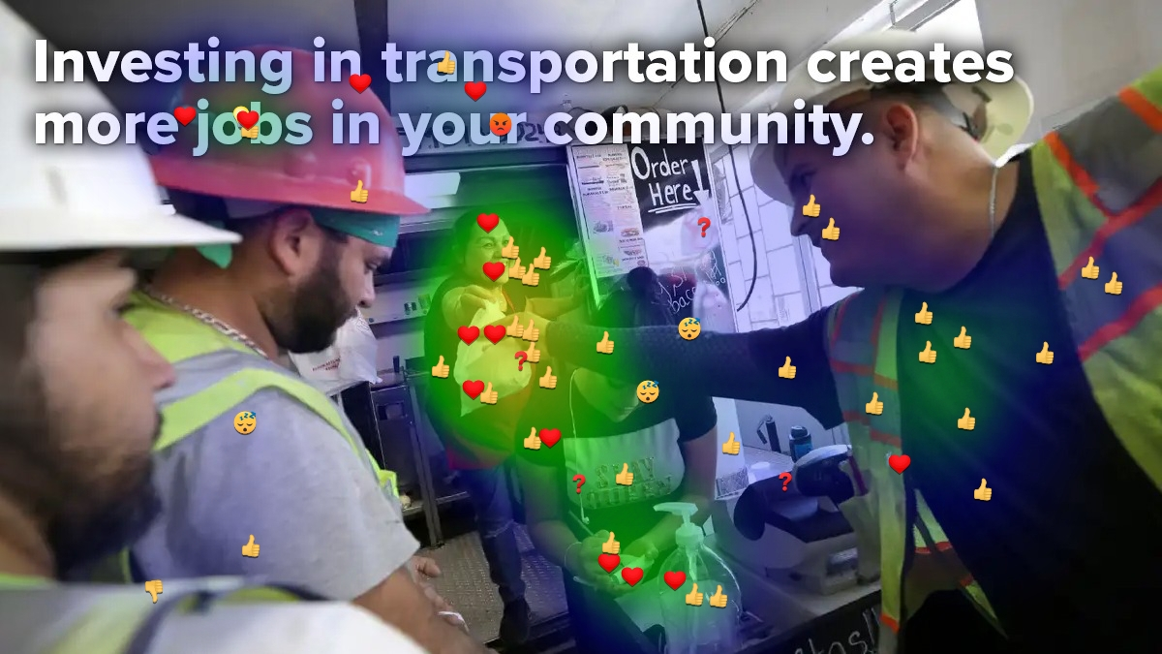
JOBS
MAD
“While I can appreciate the fact that this looks good on paper, it always angers me as a resident when I hear about a road project. It means that I, as the taxpayer, will be inconvenienced for months maybe a year or two, while people work on the road. It is always done during the busiest times of the day and causes huge backups, road rage, etc. Why can't these project be done after rush hour and during the night. Most of the time the business that would benefit from the increased traffic flow are blocked off and so hard to get to that they actually lose money rather than make it.”
LIKES
“Quickly establishes construction, infrastructure component.”
“The hand off of lunch from one worker to a transportation worker (possibly) ties into the idea that more jobs means more money for everyone.”
“I like that investing in transportation would add new jobs, helping the economy.”
“She appears to enjoy helping other people and busy business.”
“Happy people out working.”
“A nice gesture happening.”
“Shows employed people smiling and happy to be working.”
“creating more transportation jobs helps the whole community and makes them happy.”
“I gave the thumbs up emoji because they seem like they are construction workers that could be fixing our roads/highways.”
“This guys seems like a contractor with transportation in some way, ties in a little better.”
“New jobs established by improvements in Infrastructure helps everyone”
“I appreciate construction workers!”
“Everyday Americans.”
“this is kind of realistic. nobody wears masks anymore- there's a token hand sanitizer pump jug that nobody actually uses.”
BORING
“Don’t see the point here”
“Immediately I saw this picture I was bored”
“This is doing nothing for me”
LOVE
“This shows another great reason we need reliable transportation ”
“More jobs would definitely be beneficial to the community and economy”
“She’s all smiles about giving”
“She is happy that she is getting business from these workers”
“Improvements in infrastructure helps to increase the number of careers which helps to improve our economy”
“I love it when people works together”
“I gave the heart emoji because I love the fact that they are ordering food from somewhere local vs a chain restaurant.”
 | 25%
 | 58%
 | 2%
 | 7%
 | 5%
 | 2%
 | 2%
DISLIKES
“Very crowded image”
IMAGE
“Everyone looks happy in this image. workers are on break to eat and food truck owners happy to have business”
“The number of people on this picture is too much.. It made the concept not to be attractive”
MESSAGE
“The message includes the importance of good roads for the community”
CONFUSING
“While I see what looks like construction workers getting lunch, it is not super clear what jobs are being referred to. I'm assuming the construction workers. ”

Slide 38
Jobs Video:
“Good jobs are key to a thriving lifestyle, a vibrant economy, and the well-being of our families. Investing in transportation creates not only construction jobs but jobs in local restaurants, stores, offices, and all the other businesses that support a thriving community. Access to reliable transportation means more job security, healthier families, and more time for the things you really enjoy.”

Slide 39
Key Message Metrics: Jobs Video
(1= Do not agree at all and 10= Strongly agree) | Total | Urban | Suburban | Rural
Overall video likeability (1= Did not like it at all and 10= Completely liked the image in every way) | 7.9 | 8.2 | 8.3 | 7.6
This concept really caught my attention. | 8.0 | 8.3 | 7.4 | 8.3
This concept shows or talks about things that are important to me personally. | 7.9 | 7.7 | 8.1 | 7.8
I found this concept to be very compelling and persuasive. | 7.5 | 8.5 | 7.4 | 7.2
This concept makes me want to go to a website so I can learn and see more. | 6.1 | 6.8 | 6.1 | 5.8
This concept reminds me that investing in transportation infrastructure saves time for what makes life worth living. | 7.6 | 7.8 | 8.3 | 7.2
This concept reminds me that investing in transportation reduces traffic jams and makes commuting easier. | 6.9 | 8.5 | 6.6 | 6.3
This concept reminds me that investing in transportation creates jobs and a more vibrant economy. | 8.4 | 7.8 | 8.6 | 8.6
This concept reminds me that investing in transportation plays an important part in the health and well-being of families. | 8.1 | 8.7 | 7.8 | 8.1
This concept reminds me that investing in transportation infrastructure makes life better for everyone. | 8.2 | 8.5 | 7.5 | 8.5
The jobs video was well-received, but scored the lowest of the five videos reviewed by focus group participants.
The video and messaging related to jobs were very popular with urban respondents
Urban residents agreed very strongly that:
"This concept reminds me that investing in transportation infrastructure makes life better for everyone,” and
"This concept reminds me that investing in transportation creates jobs and a more vibrant economy”

Slide 40
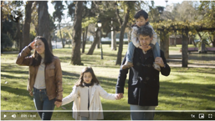
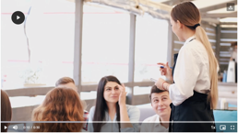
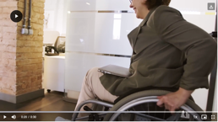
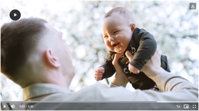
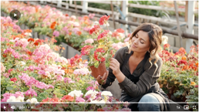
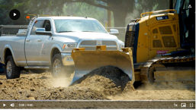
JOBS Video Markup
Love the flowers scene
“I love this. It looks so pretty and catches my attention. It's also something many people enjoy doing.”
“The farmer and agriculture are extremely important and need a good infrastructure to transport goods and services.”
“Love the flowers!
More time to enjoy
“More time for family and things you enjoy”
“Good transportation creates more time for the things you enjoy”
“Love the baby's face.”
Good jobs???
“This is not a good job”
“Good jobs? Most agriculture or farming jobs in the fields are very low paid with no benefits.”
Access for everyone
“Access to reliable transportation is important for EVERYONE resonates with me.”
“Everyone needs reliable transportation. Unfortunately, it seems like there is less and less of it these days.”
“Reliable transportation helps people in wheelchairs have access to many places”
“Accessibility = empowerment”
“I like that disabled people are represented in this commercial.”
The connection between good jobs and well-being of families
“I love the saying that good jobs are key to a thriving lifestyle and the well-being of our families”
”Family”
“Family is always important and the number one priority in everyone's life.”
“Family outings are important”
The connection between mobility and jobs
“I chose the thumbs up emoji for this image. I like how improving transportation can create more jobs.”
“Lots of sectors are affected by better movement of people”
“Good visuals of jobs but not much on transportation in this one.”
“I like to see a lot of people working in different jobs.”
The connection between mobility and jobs
“I chose the heart emoji for this image. I love the glowing and happy smiles from these ladies. How happy they are to be able to keep their business open and thriving because of a part being in investing in transportation.”
“Investing in transportation provides job opportunities in other sectors”

Slide 41
JOBS Video Script Markup
LIKES
“Getting to and from work requires reliable transportation. This means that employees can get to their places of employment, which generates revenue. ”
“Need lots of good jobs”
“This is true, but it can't just be a good job - it has to be a well-paying job as well. (Especially in this current terrible economy!)”
LIKES
“We all know we need a better economy”
“economy is a concern for most people.”
“With the current rate of inflation, we need a vibrant economy”
“Create a healthy economy”
DISLIKES
“dislike that the word "thriving" is used twice. Redundant”
LOVE
“Job creation is vital to a thriving economy and investing in transportation is on e of the key factors.”
“A good point as it helps to improve our economy.”
”Investing in transportation creates not only construction jobs but jobs in local restaurants, stalls, offices and all the other businesses that support a thriving community.. I was actually attracted to this content more”
CONFUSING
“I’m not sure how access to reliable transportation makes your family healthier”
 | 36%
 | 55%
 | -
 | 7%
 | -
 | 2%
 | -
LIKES
“Everyone needs access to some form of transportation to get to work, go to medical appointments, visit family, etc.”
“Everyone needs to have the ability to access transportation regardless of who they are or what their place in life is.”
LOVE
“I chose the love emoji for healthier families. I chose this because this is so important for my family. With just having a baby it is important that we have access to get to doctors' appointments and possibly an emergency room quickly and in a timely manner.”
“I am all for healthier and happy families”

Slide 42
Conclusions
This study helped to validate five messages that transportation agencies can use to raise awareness of the benefits of transportation infrastructure investment:
“Transportation that works for everyone improves all our lives.” (Equity)
“Improving transportation means you can get where you need to go — quickly and easily.” (Mobility)
“More reliable transportation makes your commute less stressful.” (Easier Commutes)
“Time spent sitting in traffic is time away from the important things in life.” (Time)
“Investing in transportation creates more jobs in your community.” (Jobs)

Slide 43
Conclusions
When placed in the context of communications pieces with imagery, all five messages resonated with members of the public in two rounds of detailed qualitative message testing. The most successful messages across most of the metrics tested were on Equity and Mobility, with the Time message also performing well. While the Jobs and Easier Commutes messages were somewhat weaker overall, they still rated favorably.
Respondents consistently liked seeing imagery that involved people from different walks of life engaging in typical daily activities, with a clear connection to transportation.
Through image selection, communicators have the ability to make a visual connection between transportation investment and the tangible benefits it provides.
Benefits-related messages can be adapted to the local context and used in a wide range of communications
The message format also affected participants’ perceptions:
The Equity message was somewhat more successful as a still image than as a video
The Jobs message benefited from the additional time and narration of a video to develop the connection between transportation investment and job creation.
For videos, the study revealed the importance of starting with positive images and wording.

Slide 44
Questions/Open Discussion
Thank You!

Slide 45
For more information about this project, visit:
https://apps.trb.org/cmsfeed/TRBNetProjectDisplay.asp?ProjectID=5078
The National Cooperative Highway Research Program (NCHRP) produces ready-to-implement solutions to the challenges facing transportation professionals. NCHRP is sponsored by the individual state departments of transportation of the American Association of State Highway and Transportation Officials (AASHTO), in cooperation with the Federal Highway Administration (FHWA). NCHRP is administered by the Transportation Research Board (TRB), part of the National Academies of Sciences, Engineering, and Medicine. Any opinions and conclusions expressed or implied in resulting research products are those of the individuals and organizations who performed the research and are not necessarily those of TRB; the National Academies of Sciences, Engineering, and Medicine; or NCHRP sponsors.

