Slide 1
SCENARIO PLANNING

Slide 2
IT’S EASY TO GET THE FUTURE WRONG
We have a long history of it, in fact.

Slide 3
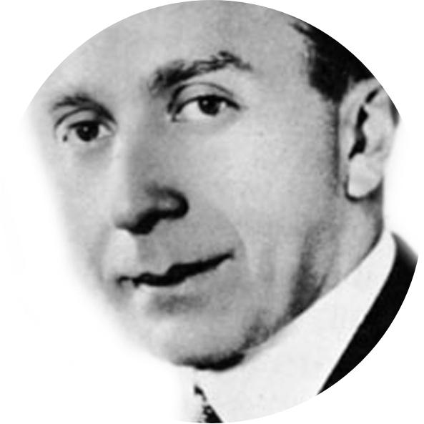
HARRY WARNER 1925
One of the Warner Brothers
“Who the hell wants
to hear actors talk?”
Notes:
Then there’s Harry Warner. In 1925 he doubted anyone would want to hear actors talk.
Two years later, in October 1927, Warner released the first “talkie” “The Jazz Singer” starring Al Jolson. It essentially saved a struggling Warner Brothers studio.

Slide 4
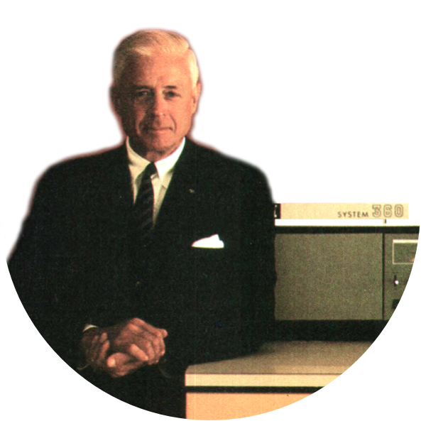
THOMAS WATSON 1943
Chairman of IBM
“I think there is a world
market for maybe
five computers.”
Notes:
And, then there was Thomas Watson.
He obviously had this one wrong. Over 300 million computers are sold each year.

Slide 5
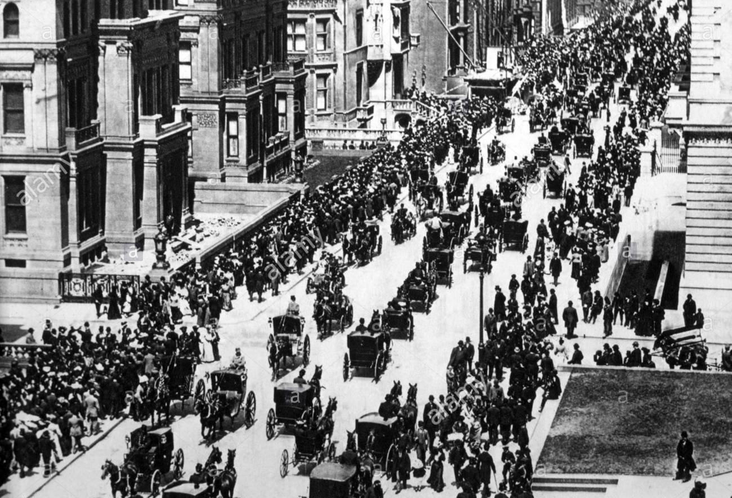
5th Avenue
New York City
1900
WHERE IS THE CAR?
2016 Tony Seba

Slide 6
5th Avenue
New York City
1900
WHERE IS THE CAR?
2016 Tony Seba

Slide 7
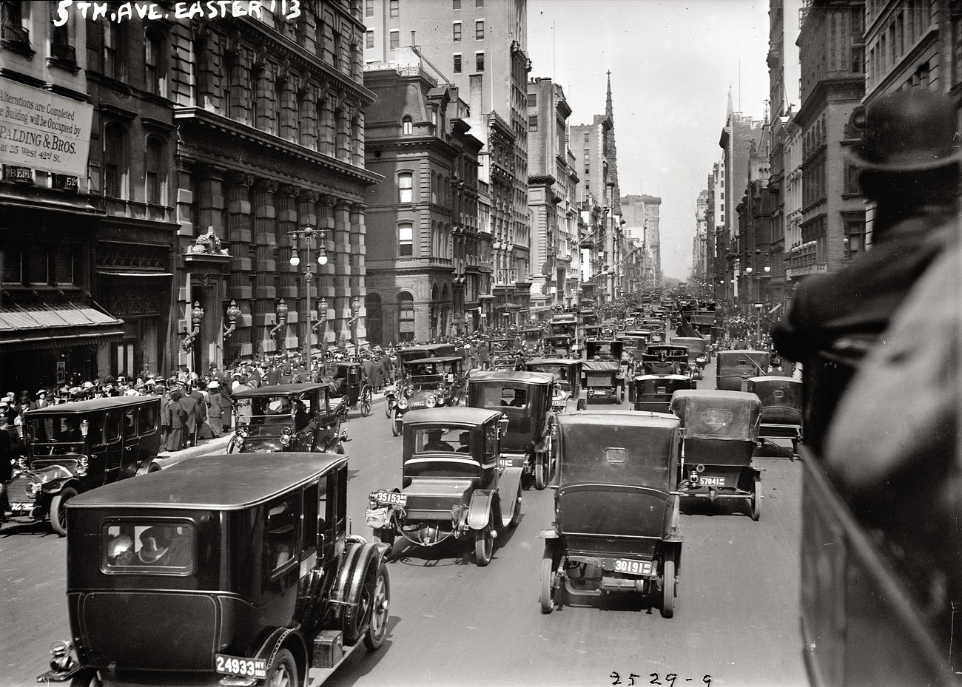
5th Avenue
New York City
1913
WHERE IS THE HORSE?
2016 Tony Seba

Slide 8
5th Avenue
New York City
1913
WHERE IS THE HORSE?
2016 Tony Seba

Slide 9
TECHNOLOGY
Years until technology was used by one-quarter of Americans
ELECTRICITY
RADIO
PC
WORLD WIDE WEB
46 years
31 years
16 years
7 years
1876
1926
1983
1873
1897
1975
1991
TELEPHONE
TELEVISION
MOBILE PHONE
WHAT’S NEXT?
35 years
26 years
13 years
faster adoption
Notes:
This is another take on the Seba adoption curve
Take a moment to look at the years to adopt different technologies.
The rate at which Americans can and are adopting technology has accelerated dramatically. It took us 35 years to adopt a landline telephone but only 13 years to adopt mobile phones. Sixteen years to adopt personal computers but the world wide web was built out in less than half that time.
So how do transportation agencies decide how and when to invest in new technology? This volume introduces STREAM – an evaluation methodology DOTs can use to select the right technology investments at the right time.
But this graphic also begs the question: what is next transportation technology will Americans adopt? Will it be autonomous vehicles? Will it be a connected network of vehicles and infrastructure, where vehicles are in constant contact with each other and the roadway features, creating a potentially “crash less” driving environment? Some argue it isn’t a matter of if but rather when. And will DOTs be ready?
Source The Atlantic

Slide 10
A shift from prediction to preparation
TODAY
PLANNING HORIZON
POINT FORECAST
Planning for a short term point in time.
Future Scenario 1
FUTURE SCENARIO PLANNING
Future Scenario 2
Looking out decades and letting the future drive the planning.
Future Scenario 3
Notes:
Many DOTs find themselves planning for the very short term. This approach of point forecast may be driven by uncertain budgets or politics, and it is what many of us are asked to do.
The other common form of planning is risk based. For example, we know when a certain asset will reach its limit of safety, and we program to meet that risk.
But what we’re going to talk about is long term planning where we identify multiple future scenarios and work backwards to identify the work that needs to happen today. So, we begin with the end in mind and let that drive our planning.
In other words, a scenario is a set of assumptions about how drivers of change interact.
Scenario planning is about thinking about implications of deficient profiles.
Scenarios are planning aids used to develop long-range plans by considering potentially different futures; they are not predictions.”

Slide 11
General Approach: Scenario Planning
Identify Focal Issue
Analysis of Key Trends and Critical Factors
Identify Driving Forces / Critical Uncertainties
Rank Driving Forces / Select Scenario Logic
Importance vs. Uncertainty
Predetermined vs. Uncertain
Flesh Out Scenarios
Apply the Scenarios and Uncover Implications
Identify Leading Indicators and Signposts
*from Strategic Issues Facing Transportation, Volumes 1 & 6
Notes:
P6, p 11-12 Freight
P 30 Demographics

Slide 12
Foresight Enhanced
Analysis of Driving Forces
MOMENTUM
GLOBAL CHAOS
TECH TRIUMPH
GENTLE FOOTPRINT
Economy
Technology
Politics
Society
Environment

Slide 13
Foresight Series
Strategic Issues Facing Transportation, Volume 1: Scenario Planning for Freight Transportation Infrastructure Investment
Global Marketplace
One World Order
Millions of Markets
Naftástique!
One World Order
Global Marketplace
Global Trade
Naftástique!
Millions of Markets
Resource Availability
Notes:
Global Marketplace (high global trade and high resource availability) is a highly competitive
and volatile world. Open, vigorous trade between virtually all nations has led to market-based
approaches to most contemporary challenges.
One World Order (high global trade and low or restricted resource availability) is a highly
regulated and managed world. Facing global scarcity of key resources, nations establish international rules to ensure their fair and sustainable use. Global trade thrives, but the very visible
hand of regulation, at times an iron fist in a velvet glove, shapes its course.
Millions of Markets (low global trade and high resource availability) is a world where advanced
technological breakthroughs have enabled the United States (and other countries) to become
highly self-reliant in terms of energy, agriculture, manufacturing, and other needs. There is increased migration toward smaller urban areas that are supported by nearby regional innovation hubs that can manufacture highly customized goods.
Naftástique! (low global trade and low resource availability) is a world where trade has moved
away from a single global market toward a number of emerging regional trading blocs. China,
Europe, and South America form their own clusters. The United States leads an effort to make
North America a self-sufficient economic community.

Slide 14
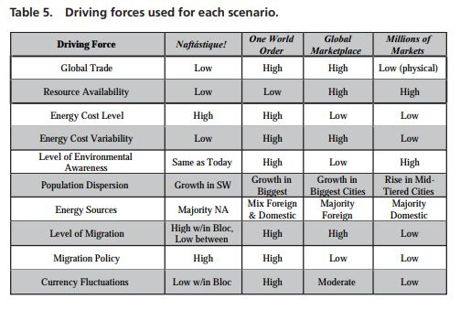
Foresight Series
Strategic Issues Facing Transportation, Volume 1: Scenario Planning for Freight Transportation Infrastructure Investment
Notes:
Global Marketplace (high global trade and high resource availability) is a highly competitive
and volatile world. Open, vigorous trade between virtually all nations has led to market-based
approaches to most contemporary challenges.
One World Order (high global trade and low or restricted resource availability) is a highly
regulated and managed world. Facing global scarcity of key resources, nations establish international rules to ensure their fair and sustainable use. Global trade thrives, but the very visible
hand of regulation, at times an iron fist in a velvet glove, shapes its course.
Millions of Markets (low global trade and high resource availability) is a world where advanced
technological breakthroughs have enabled the United States (and other countries) to become
highly self-reliant in terms of energy, agriculture, manufacturing, and other needs. There is increased migration toward smaller urban areas that are supported by nearby regional innovation hubs that can manufacture highly customized goods.
Naftástique! (low global trade and low resource availability) is a world where trade has moved
away from a single global market toward a number of emerging regional trading blocs. China,
Europe, and South America form their own clusters. The United States leads an effort to make
North America a self-sufficient economic community.

Slide 15
What makes a good scenario?
Plausible
Internally Consistent
Challenging
Differentiated
Memorable
Notes:
P4, P7 Freight

Slide 16
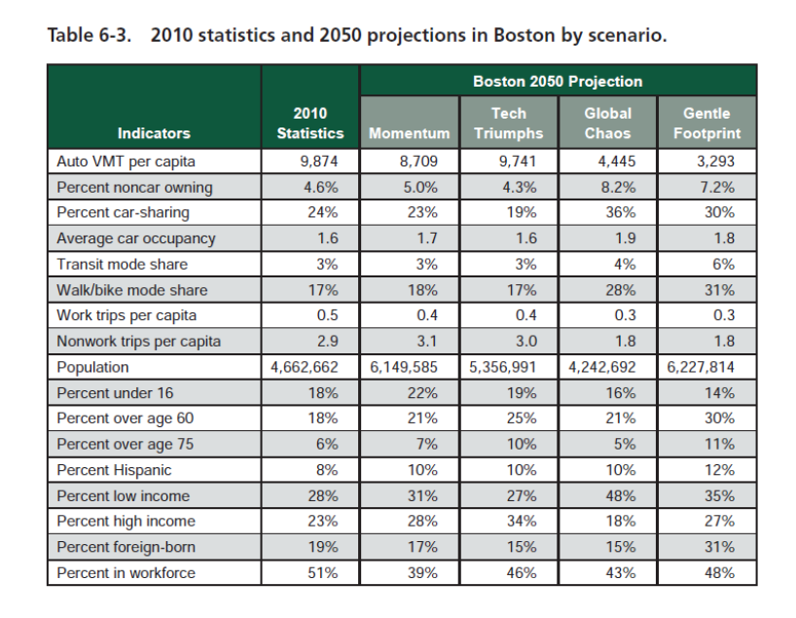
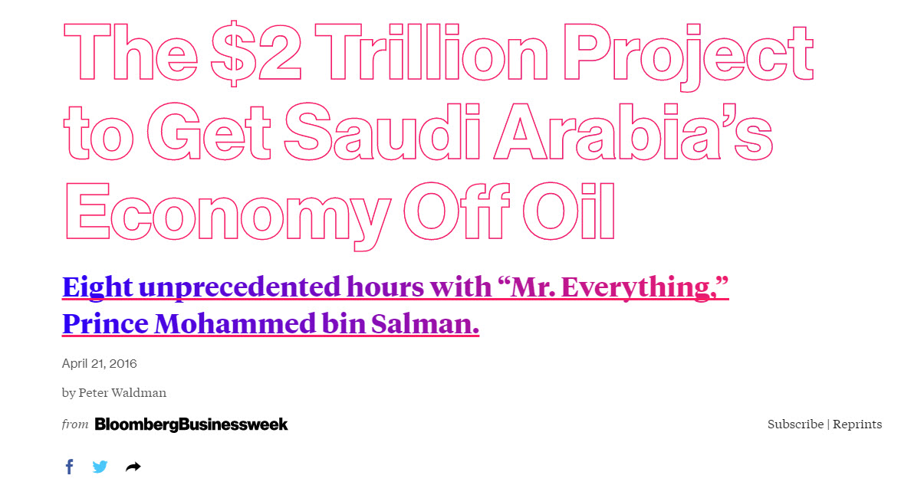
Signposts and Indicators :
2010 statistics and 2050 projections in Boston metro by scenario
Notes:
Global Marketplace (high global trade and high resource availability) is a highly competitive
and volatile world. Open, vigorous trade between virtually all nations has led to market-based
approaches to most contemporary challenges.
One World Order (high global trade and low or restricted resource availability) is a highly
regulated and managed world. Facing global scarcity of key resources, nations establish international rules to ensure their fair and sustainable use. Global trade thrives, but the very visible
hand of regulation, at times an iron fist in a velvet glove, shapes its course.
Millions of Markets (low global trade and high resource availability) is a world where advanced
technological breakthroughs have enabled the United States (and other countries) to become
highly self-reliant in terms of energy, agriculture, manufacturing, and other needs. There is increased migration toward smaller urban areas that are supported by nearby regional innovation hubs that can manufacture highly customized goods.
Naftástique! (low global trade and low resource availability) is a world where trade has moved
away from a single global market toward a number of emerging regional trading blocs. China,
Europe, and South America form their own clusters. The United States leads an effort to make
North America a self-sufficient economic community.

Slide 17
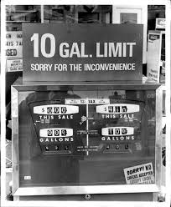
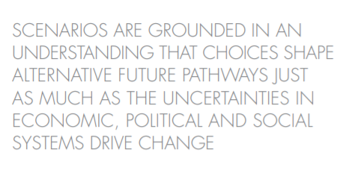
Royal Dutch/Shell
1973 –
Not proactive, but emotionally prepared
Grew from smallest of major seven oil companies to the most profitable
Notes:
https://www.shell.com/energy-and-innovation/the-energy-future/scenarios/new-lenses-on-the-future/earlier-scenarios/_jcr_content/par/expandablelist/expandablesection_842430368.stream/1447230877395/5ab112e96191fa79e1d30c31dc6e5cd2ce19ed518a4c1445ab32aa4c4b5c7ec5/shell-scenarios-explorersguide.pdf

Slide 18
IT’S YOUR TURN
What are the facts and trends that you consider most important for the Commission to be aware of and consider?
In thinking about the breadth of Massachusetts, what are the important issues or considerations for our cities, suburbs, and rural communities?
It’s 2040. Choose one (or more if you want).
Describe how you (or your children?) get to work?
How do you receive a package from California?
A recent interesting travel experience.
1
2
3

