Slide 1
NCHRP 08-112: A Guidebook for Implementing Alternative Technical Concepts into Project Delivery Methods
Doug Gransberg, PhD, PE, DBIA
Gransberg & Associates, Inc.
Norman, OK
dgransberg@gransberg.com

Slide 2
Setting the Stage - Presentation Agenda
Introduction
Key Findings
ATC Working Definition
Guide Outline
Notes:
Key Message
The shift in US infrastructure needs has largely been from building new infrastructure to replacing, expanding, or renewing existing infrastructure. The project management issues involved with infrastructure renewal are markedly different than the issues for new construction, furthering the need for a change in project management approaches to renew the nation’s infrastructure.
Background and Notes
The objective of this research program is to identify and communicate the critical factors involved in successfully managing complex transportation design and construction projects. One of the key underlying assumptions is that the ability to successfully manage complexity is directly related to the ability to integrate the project team across the entire lifecycle. In short, the project team in a rapid renewal environment must be able to meet the task objectives associated with careful planning and execution of scope, cost, schedule, quality, and technical design issues, while at the same time carefully managing the administrative and human relations tasks of contract compliance, stakeholder communication and negotiation, team member motivation, and labor recruitment and retention.

Slide 3
Research Team – Steering Group
Douglas D. Gransberg, PhD, PE Principal Investigator
Co- Principal Investigators
Michael C. Loulakis, Esq, DBIA Capital Project Strategies, LLC | Keith Molenaar, PhD University of Colorado
Debra R. Brisk, PE DRB Consulting, LLC | Ghada Gad, PhD Cal Poly Pomona
Steven D. DeWitt, PE TIS, PLLC | Jorge Rueda-Benavides, PhD Auburn University
Name | Organization | Name | Organization
Peter Davich | Minnesota DOT | Randy Hitt | Missouri DOT
Chris Youngs | Michigan DOT | Jim Hunt | Atkins-Global
John Carlson | Sundt Construction

Slide 4
Key Findings
The use of ATCs in ACM projects continues to furnish a mechanism to obtain early contractor design involvement with the goals:
Improving the project’s final technical quality,
Improving both cost and schedule certainty.
The use of ATCs is increasing. However, most of the growth remains in DB and P3 projects.

Slide 5
Key Findings
The use of DBB ATCs has not been perceived as attractive by most DOTs.
Primary technical issue is the time it takes to receive, evaluate, and approve proposed ATCs in a traditionally short procurement period.
Primary risk issue is the assignment of design liability and complications added by only modifying individual features of work.
Limited scope DBB ATCs where the allowable changes are restricted to temporary works and traffic control seem to provide the most potential for growth in this area.
Opportunities during procurement to propose alternatives to the solicitation’s scope has been expanded:
Alternative financial concepts (AFC) in P3
Alternative configuration concepts (ACC) in DB.
Pre-Approved Elements (PAE): utilities, geotechnical investigations, etc.

Slide 6
Proposed Working Definition
Synthesizing the various definitions discussed above leads to a working definition for ATCs that satisfies the following tests:
The alternative must modify a specific contract requirement in a manner that is not contemplated by the project’s solicitation.
It must be equal to or better than the baseline design as determined by the agency advertising the project in a verifiable manner.
Incorporating the above tests into a single definition results in the following:
An ATC is a proposed modification to a contract requirement in a manner that is equal to or better than the baseline articulated in the project’s solicitation.

Slide 7
Project Delivery Method Orientation
Guidebook based on comparative approach.
Assist in deciding whether to include ATCs
Assist in PDM selection
Includes actual experience where appropriate.
On 6 Texas DOT DB and P3 projects:
341 ATCs worth $2.9 Billion were proposed
142 ATCs worth $1.1 billion were accepted
35 ATCs worth $210.8 million were implemented
(Zapalac 2013)

Slide 8
Relates Actual DOT Experiences in the Field
Lessons Learned Call-out Boxes
Tables to compare alternatives

Slide 9
ATC Guidebook Outline
Chapter 1 – Introduction
A Bold Approach
Project Delivery Methods
ATC Legal Matters
Characteristics of ATC Delivery
How to Use This Guide
Chapter 2 – ATC Procurement Considerations
Conducting an Open and Transparent Procurement
Maintaining Confidentiality
Design Liability
ATC Roles and Responsibilities
Developing ATC Project Scope
Chapter 3 – Accounting for ATCs in Design
Characteristics of an ATC Project
Risk Analysis and Mitigation
Scope Development
Design Packaging
NEPA/Permitting Constraints
Chapter 4 – Agency Review and Evaluation of ATCs
ATC Review Process
ATC Evaluation Process
ATC Submittal Documentation
ATC LDs and Incentives/Disincentives
Clarifications/Modifications of Baseline Scope for Approved ATCs
Amendments triggered by ATCs

Slide 10
ATC Guidebook Outline
Chapter 5 – Project Administration
Incorporating ATCs from Unsuccessful Proposals
Project Oversight/Inspection
ATC Payment Provisions
Change Orders on ATC Projects
ATC Impact on QA
Future for ATC Implementation
Appendix A – DB ATC Information
Appendix B – P3 ATC Information
Appendix C – DBB ATC Information
Appendix D – CMGC ATC Information
Appendix E – Example ATC Solicitation and Contract Clauses
Nondisclosure agreements
Example ATC RFP Clauses
ATC and Differing Site Conditions
Pre-Accepted Elements (PAE) Clause

Slide 11
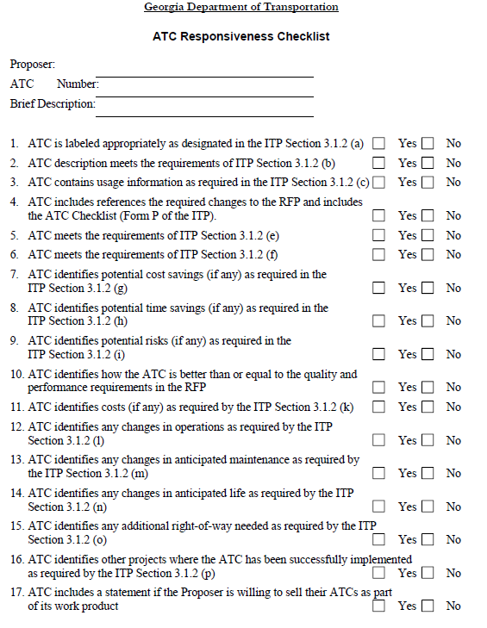
Typical Project Delivery Method Appendix
Flow chart
Example CATC/ATC submittal form
Example Evaluation Plan

Slide 12
Visual Content Maximized
Risk Assessment
Example ATC Evaluation Factors
Key messages

Slide 13
Summary
Draft Guide is in panel review.
Next step is to vet the draft of the revised guide with two DOTs.
Vetting #1 – Experienced DOT
Colorado, Ohio, Minnesota, or Washington State
Vetting #2 – DOT new to ATCs
Alabama or Nebraska
Developing an implementation toolkit to go along with the guide
ATC project early identification tool
ATC model contract clauses and risk mitigation tool
“Equal to or Better Than” decision tool.
Training material as needed.
Project is on schedule - Final completion March 31, 2019
Welcome any feedback – dgransberg@gransberg.com

