Slide 1
NCHRP Report 956: TAM Data and Information System Assessment
Assessment Kickoff Meeting

Slide 2
Kickoff Meeting Agenda
Assessment Introduction:
Assessment Context, Objectives, and Team
Subject Matter Expert Overview
Targeted Assessment Elements
Assessment Approach and Next Steps
Guidebook and Tool Overview and Resources
Framework Overview
Links to Resources (TAM Data Guide & Assistant, User Guide & Videos)
TAM Data Guide Overview Slides

Slide 3
Introduction
Project Context
Research Objectives
Work Plan Overview

Slide 4
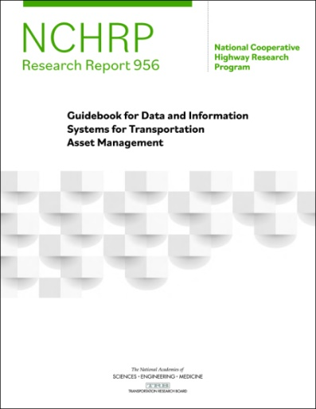
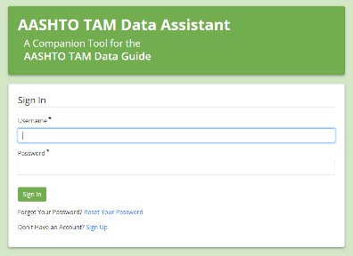
TAM Data and Information System Assessment
NCHRP Project 08-115: Report 956
Developed data self-assessment and improvement methodology and tools
Guidance provided by NCHRP Report 956
Web-based version provided by AASHTO: www.tamdataguide.com
AASHTO TAM Data Assistant
A supporting, web-based tool provided by AASHTO: www.dataassessment.tam-portal.com
4

Slide 5
<Assessment Name>
Assessment Context
<describe targeted asset program, data area, or other context>
Assessment Objective
Benchmark current and desired data collection, processing, and decision-support capabilities
Identify opportunities to improve supporting data, processes, and tools
Document assessment outcomes and high-level action plan to support implementation

Slide 6
Assessment Team
Core Team
Sponsor:
<name, position>
Business Lead(s):
<name, position>
<name, position>
Facilitator(s):
<name, position>
General Participants
Subject Matter Experts:
<name, position>
<name, position>
<name, position>
Field Representatives:
<name, position>
<name, position>
<name, position>
Consulted:
<name, position>
<name, position>
<name, position>
<name, position>

Slide 7
<Placeholder for Detailed SME Overview Slides>
Insert slides to be developed and presented by SMEs to ensure common understanding and context of the targeted area

Slide 8
High-Level Assessment Approach
Use the TAM Data Assistant to guide group discussion of the current and desired state of data, systems, and tools supporting the TAM project evaluation process.
Benchmarking and Improvement Selection
Group discussions to:
Summarize key assessment themes.
Identify notable gaps in current vs. desired state.
Develop an implementation action plan to address priorities.
Implementation Planning
Refine planned implementation actions – considering implementation leads and target completion dates.
Finalize assessment closeout materials – useful to engage other stakeholders and support future implementation actions.
Closeout

Slide 9
High-Level Assessment Approach and Timeline
1
Kickoff Meeting – <Date>
Set scope, schedule, expectations (60 min)
3
Improvement Eval. – <~Dates
Core team consolidates improvements
Improvement Evaluation Meeting (90 min)
Discuss potential improvement priorities
Evaluate potential organizational challenges
Core team drafts assessment themes/actions
2
Benchmarking – <~Dates>
Offline Individual Assessments
Completed by <DD/MM>
Group Assessment Meeting 1 (60-90 min)
<Anticipated Discussion Areas/Topics>
Group Assessment Meeting 2 (60-90 min)
<Anticipated Discussion Areas/Topics>
Group Assessment Meeting 3 (60-90 min)
<Anticipated Discussion Areas/Topics>
4
Action Planning – <~Dates>
Summary & Planning Meeting (60-90 min)
Confirm assessment themes
Explore proposed implementation actions
5
Closeout – <~Dates>
Assessment Closeout Meeting (60-90 min)
Finalize plan, set responsibilities/timelines
Assessment Summary Materials finalized

Slide 10
Next Steps
Schedule Group Assessment Meetings (90min each)
Prepare for individual assessment and group discussion:
Begin thinking about…
- What is generally working well and meeting needs?
- How could the data, tools, or process be working better?

Slide 11
Guidebook and Tool Overview
NCHRP Report 956: Guidebook for Data and Information Systems for TAM
Supporting Tools:
AASHTO TAM Data Assistant

Slide 12
NCHRP Report 956: Guidebook for Data and Information Systems for TAM
Companion Digital Tool
This Guidebook provides a structured approach to assess current practices and improve use of data and information for TAM
Detailed Practice Benchmarking
Improvement Identification and Evaluation
Executive Communication Summaries
Implementation Support
NCHRP 08-115: Guidebook Overview
12

Slide 13
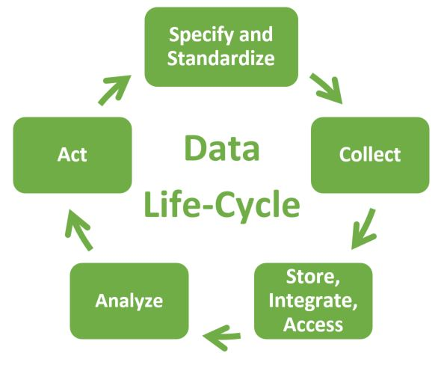
Guidebook Technical Framework
Specify and Standardize Data – Establish asset, treatment, and work data standards; prioritization factors; metadata standards; and governance programs.
Collect Data – Address coverage, automation, and collection of data for incorporation into the TAM program.
Store, Integrate, and Access Data – Structure, integrate, and provide access to data to support TAM operations, management and reporting needs.
Analyze Data – Establish decision-support tools, techniques, and practices to develop actionable information and insights.
Act Informed by Data – Apply data and information systems, processes, tools, and techniques to TAM decision-making.
NCHRP 08-115: Guidebook Overview
13

Slide 14
Specify and Standardize
Inventory, Condition, and Performance Data Standards
Standardized how these critical data are captured
Location referencing / design standards support integration
Treatment and Work Data Standards
Support modeling by better understanding costs, work history, performance of different treatments, etc.
Allow for work to readily associated with asset inventory
Resource Allocation and Prioritization
Standardize factors / parameters to support decisions, alignment with agency objectives, and transparency
Metadata
Document data elements, datasets calculations and ensure data are well understood and useful
Governance
Formal policy, procedures, processes for data
: Targeted for assessment
14

Slide 15
Collect
Inventory, Condition, and Performance Collection
Plan data collection activities to ensure that the right data are gathered – with sufficient quality – to support decisions
Project Information
Track information about capital projects from planning through construction phases
Maintain asset specific work histories to better understand asset performance
Maintenance Information
Capture standard maintenance work order / accomplishment information
Provide insight into asset performance and lifecycle planning
Priority Criteria and Values
Capture asset user and decision-maker values to enhance technical factors in decision-making
: Targeted for assessment
15

Slide 16
Store, Integrate, Access
Databases
Identify how data should be made available – from paper-based data to fully integrated databases
Asset Lifecycle Data Integration Workflows
Identify how data should be integrated between planning, design, delivery, and operations and maintenance
Other Data Integration Workflows
How should non-asset information (e.g. financial, traffic, environmental data) by integrated to support TAM decisions
Data Access
Examine field data access needs
Identify public data sharing needs
Evaluate access security requirements
: Targeted for assessment
16

Slide 17
Analyze
Data Exploration, Reporting, and Visualization
Evaluate how data is transformed into actionable information – considering data processing, analysis, and reporting environments, tools, procedures, and training
Modeling
Identify detail required in asset performance models and investment prioritization and optimization techniques
Support lifecycle planning, project prioritization and network-level resource allocation
: Targeted for assessment
17

Slide 18
Act
Resource Allocation and Prioritization
Identify needs to support resource allocation and project prioritization
Project Planning, Scoping, and Design
Evaluate how asset inventory, condition, work history, and treatment recommendations can be used to support efficient project development, project design, and maintenance and operational needs
Maintenance
Examine routine, preventive, and reactive maintenance program decisions and needs
: Targeted for assessment
18

Slide 19
Detailed Framework Areas, Sections, and Elements
: Targeted for assessment

Slide 20
Additional Resources
Helpful Links
Supplemental Material

Slide 21
Helpful Links
AASHTO TAM Data Assistant and User Guide
AASHTO TAM Data Assistant
AASHTO TAM Data Assistant Quick Reference Guide
TAM Data Assistant Tutorial Videos
New User Registration and Group Assessment Participation
Benchmarking Levels and Selecting Improvements
Evaluating Selected Improvements
Reviewing your Group Assessment Results
Detailed Framework and Guidance
AASHTO TAM Data Guide (web-based version)
NCHRP Research Report 956 (print version)

Slide 22
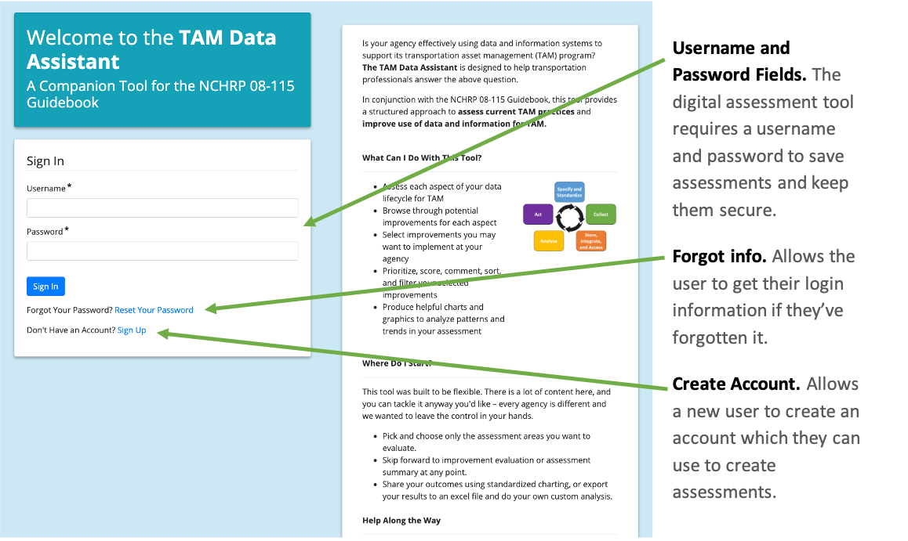
Log In Page
TAM Data Assistant Quick Reference Guide

Slide 23
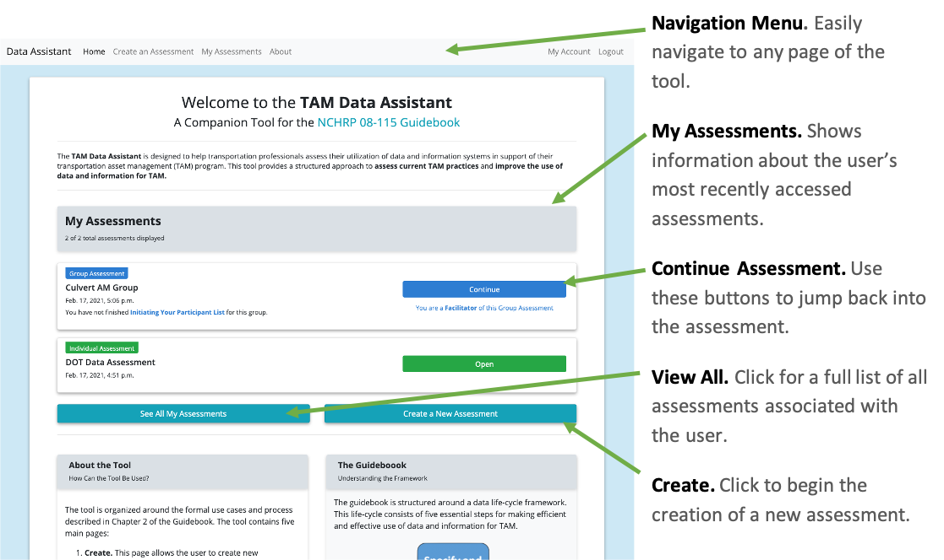
Home Page

Slide 24
Benchmarking and Improvement Selection Page
TAM Data Assistant Quick Reference Guide

Slide 25
Improvement Evaluation Page
TAM Data Assistant Quick Reference Guide

Slide 26
Results Summary Page
TAM Data Assistant Quick Reference Guide

Slide 27
Thank you
Contact information
For more info, please contact:
<insert name>
<insert email>
<insert name>
<insert email>

