Slide 1
Strategic Framework for: TAM Data and Information System Investments

Slide 2
Motivation for the Framework
Become more strategic when investing in…
TAM Data,
Systems, and
Processes.
Many DOT TAM programs are working to prioritize and tier their assets.
A systematic approach is needed to align:
New and ongoing data collection
Enhancements to systems and tools
Limited data management resources
Investments across program silos
Be confident your asset data and system capabilities
meet your intended management approaches.
Notes:
DOTs are looking to become more strategic in how they invest in TAM data, systems, and processes. This is aligned with your work to prioritize and tier your assets, and calls for a systematic approach. At the end of the day, asset management is all about making the right investments at the right time - investments in TAM data and systems should be no different.

Slide 3
The Solution
Connect two methodologies
MN DOT Framework
Asset Management Approach Concepts
Matrixed Checklist Organization
AASHTO TAM Data Guide
Detailed Practice and Capability Benchmarks for TAM Data and Information Systems
3
Notes:
The framework Minnesota DOT created to evaluate their asset management approaches and associated data needs and the AASHTO TAM Data Guide were connected to create a more detailed framework that helps evaluate potential asset management approaches with required data and information system capabilities

Slide 4
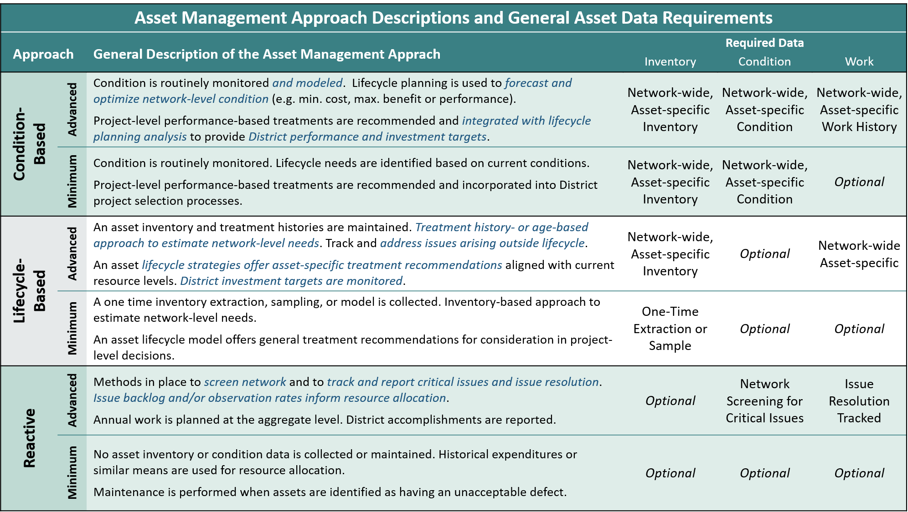
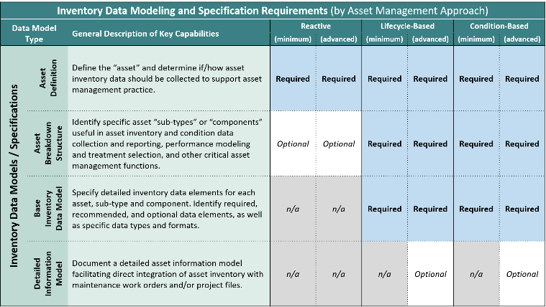
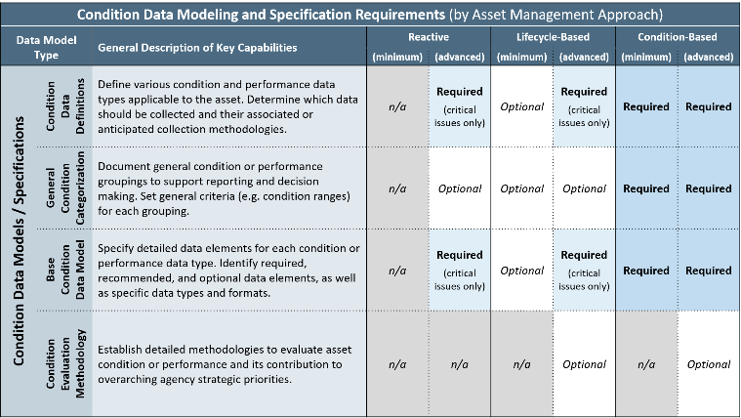
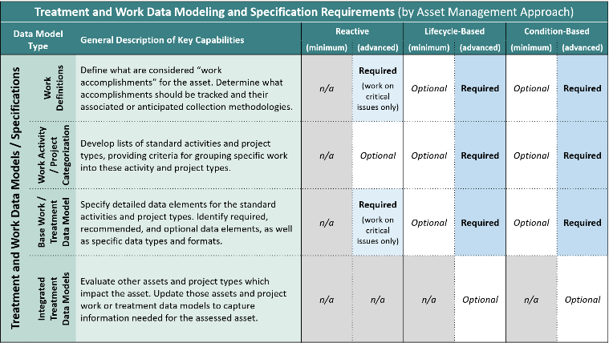
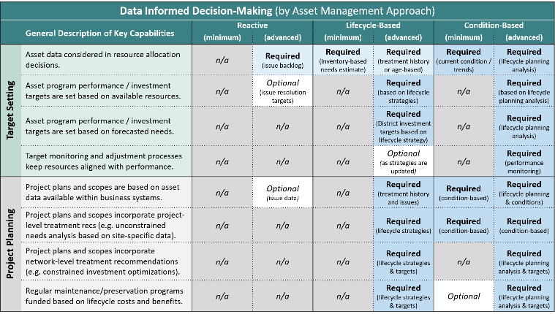
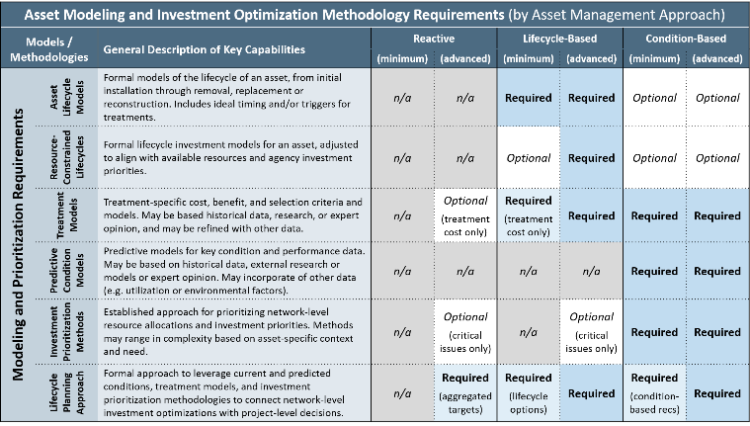
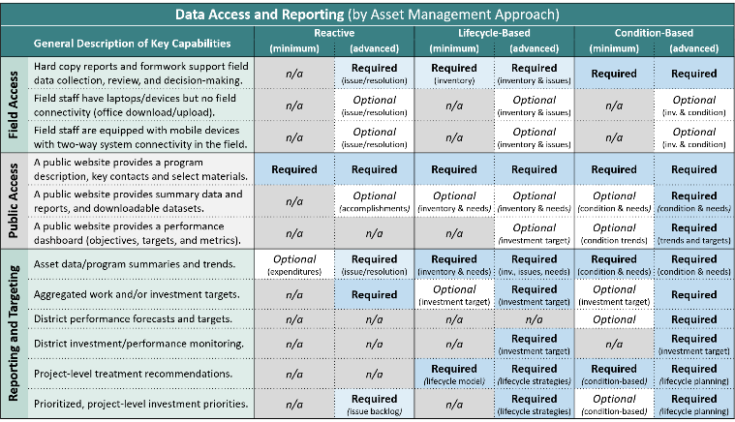
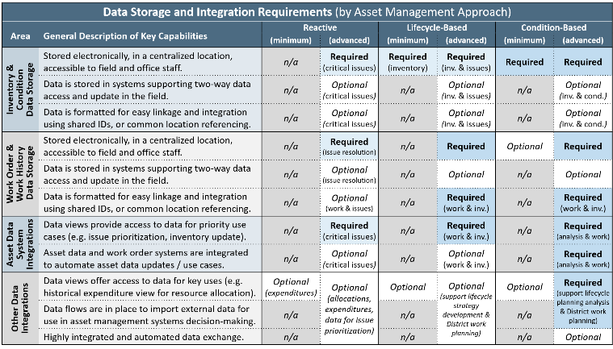
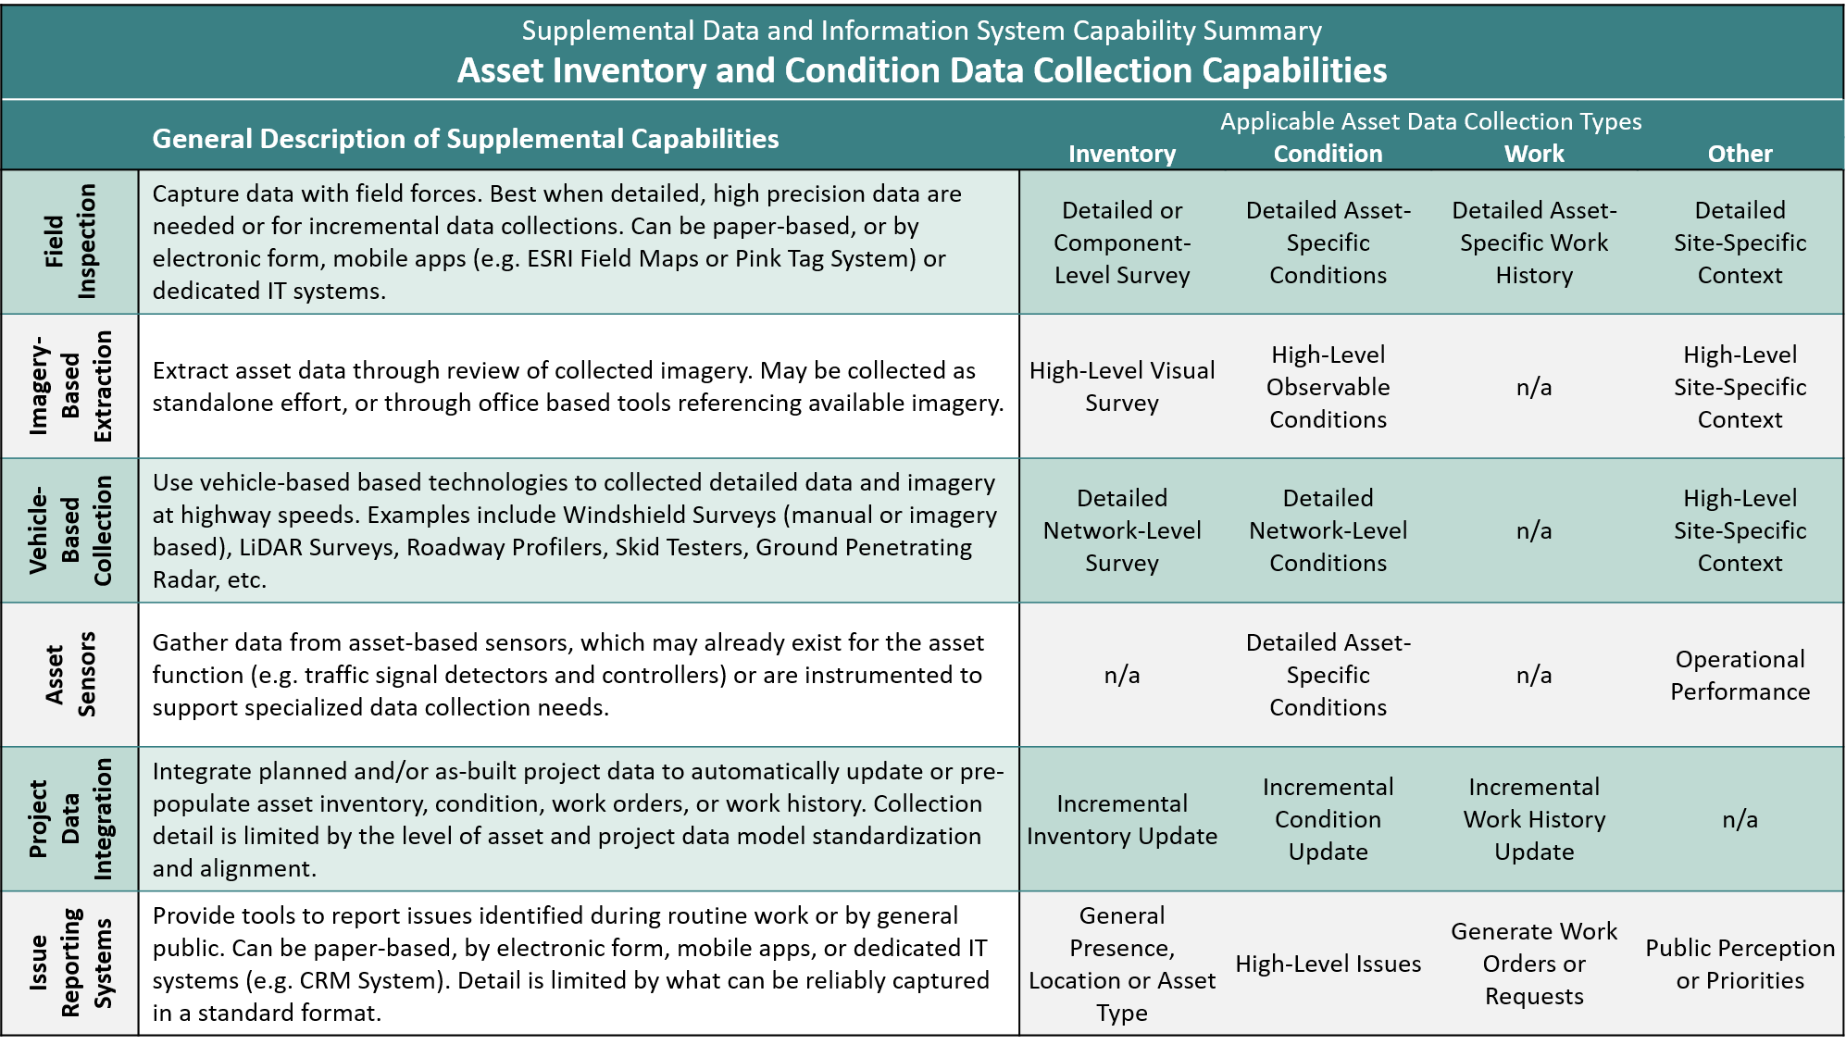
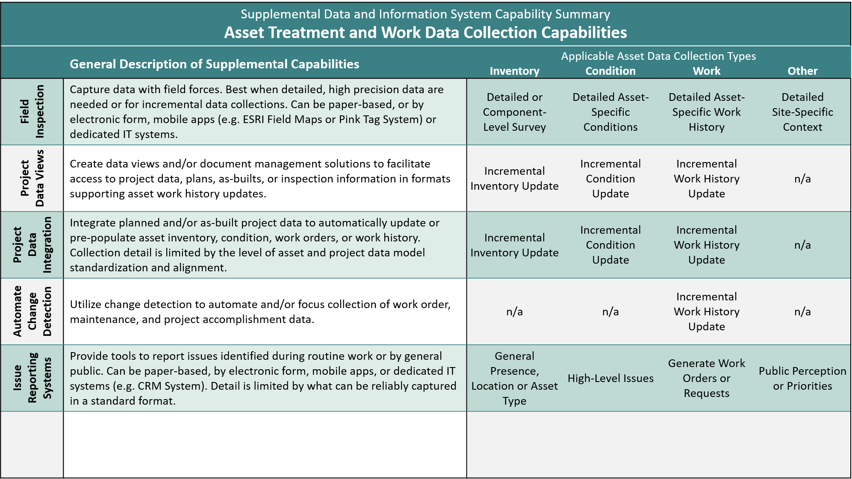
The Strategic Framework for TAM Data and Information System Investments
Approach
Data Models
Support Capabilities
Data Collection
A Series of Matrices
Organized by tiered management approaches.
Linked to potential data and information system capabilities.
Providing a structured approach to identify:
What management approach is intended for your asset?
What data is required, optional, or not needed for the approach?
What data informed decisions are intended to be supported?
What analytical methodologies should be in place?
What data access and reporting capabilities are expected?
How should data be stored and integrated?
What data collection methodologies may be appropriate?
Notes:
The framework consists of a series of matrices.
Each matrix presents a different data type (e.g. inventory data or work data) or general area of information system capabilities (e.g. Data Access or Report).
Walking through each matrix allows the user to ask and answer critical questions about specific required or optional capabilities - it also highlights were certain data or capabilities may not be necessary for a given management approach
At the end of the process, the user should have a good idea of what is necessary to execute on their envisioned management approach

Slide 5
Applying the Framework
Pre-Requisite Activities
Step 1: Identify the Targeted Asset
Step 2: Gather Stakeholders and Decision-Makers
TAM Program Leadership
Data Stewards / Systems Owners
Asset-Specific SMEs
Field Representatives
District Management
Executive Management
Step 3: General Framework Review and Discussion
Be sure everyone understands what is being decided!
Framework Application
Step 4: Select Desired Management Approach
Be sustainable – consider resources, current data and tools, culture, asset priority, etc.
Step 5 & 6: Evaluate Data and Capabilities
Address all required / optional elements for the selected approach
Assessment Outcomes
Step 7: Gap Analysis
Compare current vs. desired data / capabilities
Document gaps and identify opportunities
Recommend actions to streamline current state and expand into desired capabilities
Notes:
Applying the framework is a relatively straightforward process:
As is typical of most self-assessment methodologies - the value is in the discussion - so it is important that you gather a small group of informed stakeholders to participate in the process
Each asset program should be evaluated separately, and it is critical to identify the desired management approach early in the process - that is necessary to inform detailed data and capabilities evaluation
At the end of the process, you can perform a gap analysis on the asset data and system capabilities - however findings across multiple asset programs could be reviewed against each other to identify further synergies (e.g. in data collections, or supporting systems and tools)

Slide 6
Anticipated Implementation Steps
Ongoing Actions:
Engage stakeholders to prioritize your assets
1
2
Assessment
Pilot test and refine the framework to your needs
Complete assessments
3
Implementation
Streamline data collections
Close gaps in systems/tools
Align dedicated resources
Notes:
First prioritize and tier your assets
From there select some early applications to test and refine the framework. These will be in areas where a major investment is needed or planned, or an asset steward is really motivated to improve.
Once you have some lessons learned, complete assessments of all assets and use that to identify opportunities to streamline current investments, close gaps in necessary capabilities, and align our staff and resources.

Slide 7
An Example Application of the Framework
Entirely Hypothetical!!!
Notes:
If you have questions reach out to Will Duke (at Spy Pond Partners) who helped develop this as part of the NCHRP 08-115 Research Implementation activities.

Slide 8
Approach Definition and Data Requirements Evaluation Selecting an Approach
Entirely Hypothetical!!!
An application example for
Guardrail
Selected Approach:
Limited asset data collection – GR investments will be driven by non-lifecycle needs.
Identification, tracking and resolution of safety issues
Option for a simple inventory (i.e. track end terminal products and locations)
Reactive
(Advanced)
Notes:
Three general management approaches are defined - a reactive approach, a lifecycle based approach, and a condition based approach
Each of these are further subdivided into a minimum and advanced level of application. At the minimum level, you won't have all the bells and whistles, but you should still be able to execute at a reasonable level (for the approach). At the advanced level, you will be focused on extending the capabilities that are most meaningful to that approach.
As you can see a detailed definition, as well as some very high-level data requirements, are presented to help make an initial decision. From there, the framework gets much more detailed, allowing for a robust exploration of supporting data models and system capabilities that are aligned with the approach you select.

Slide 9
Approach Definition and Data Requirements Evaluation Evaluating the Inventory Data Model
Entirely Hypothetical!!!
An application example for
Guardrail
Define the asset.
Traffic barrier systems installed to contain and redirect vehicles from departing the road, not including concrete barrier systems.
Should inventory data be collected?
Optional: High-level run-on end terminal type, product and location should be maintained
Identify asset types / components.
W-beam / cable guardrail
Run-on and run-off terminals, rail
Any key data elements?
Run on terminal type and product
Terminal GPS location
Address Required and Optional items for the selected approach

Slide 10
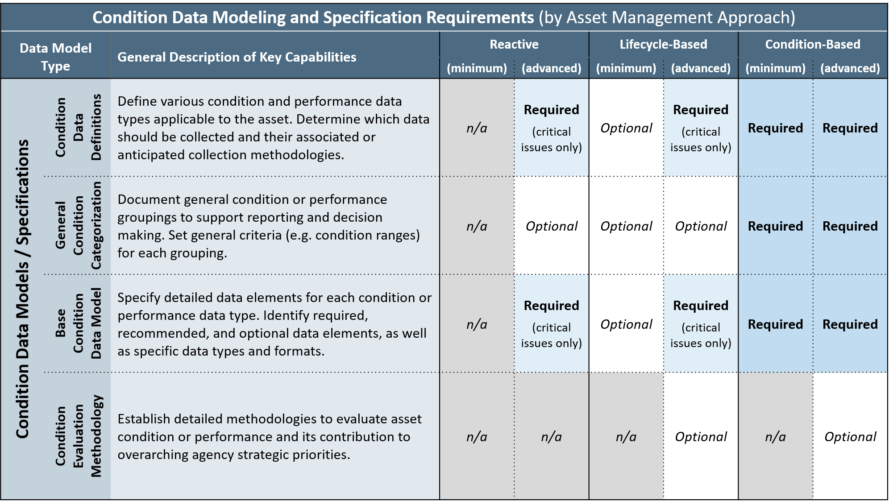
Approach Definition and Data Requirements Evaluation Evaluating the Condition Data Model
Entirely Hypothetical!!!
An application example for
Guardrail
Define condition data types.
Windshield screening assessment
Issue report
Detailed field inspection
Should condition data be collected?
Windshield screening – recurring
Reported issues – when reported
Inspections – by project
Identify condition types.
Obsolete – no longer acceptable
Severe Condition Issue – e.g. damage, steel blockouts, concrete post, major rust/rot, low height
Any key data elements?
Observation GPS, Side of Road
Issue Type (LOV)
Address Required and Optional items for the selected approach

Slide 11
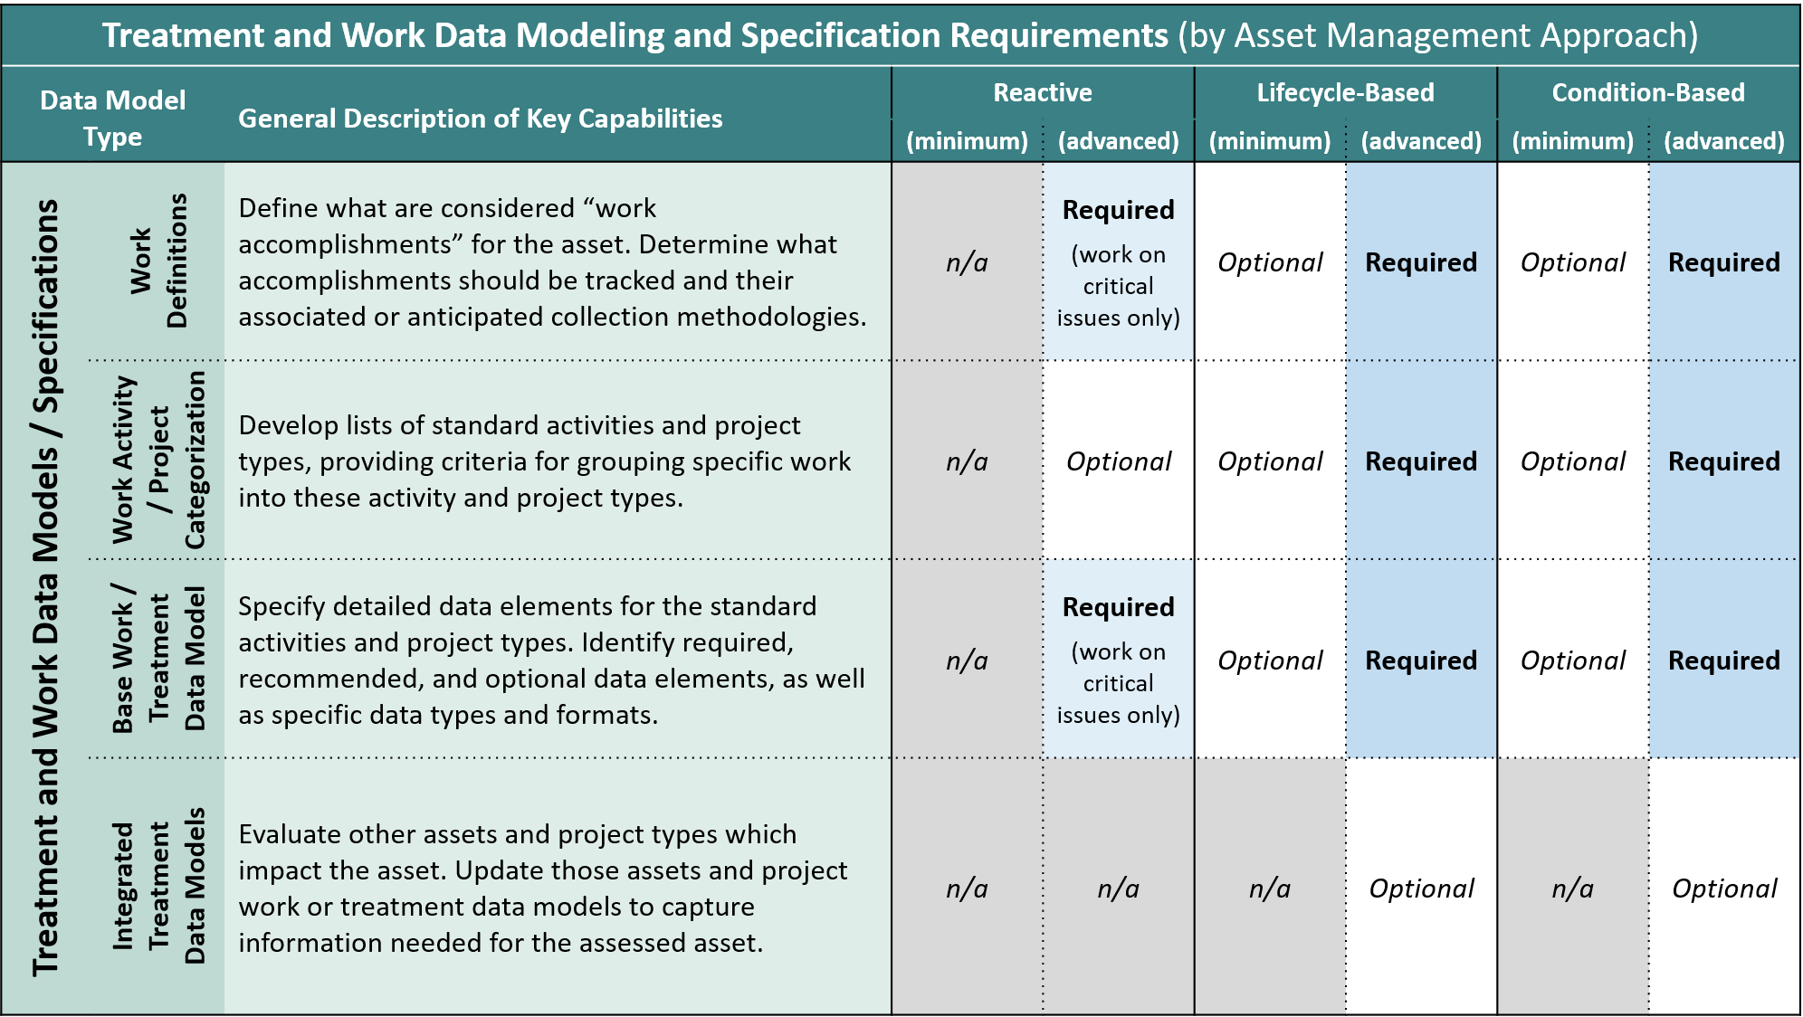
Approach Definition and Data Requirements Evaluation Evaluating the Work Data Model
Entirely Hypothetical!!!
An application example for
Guardrail
Define work accomplishments.
Full replacement of any component
Any spot repair >100’
Should work data be collected?
Work Orders completed against priority issues / observations
Option: Track aggregated quantities of other work
How is work data captured?
Priority issue resolution – AMS work order completion
Quantities – planned projects
Any key data elements?
Related Observation
Work Order Completion Date
Address Required and Optional items for the selected approach

Slide 12
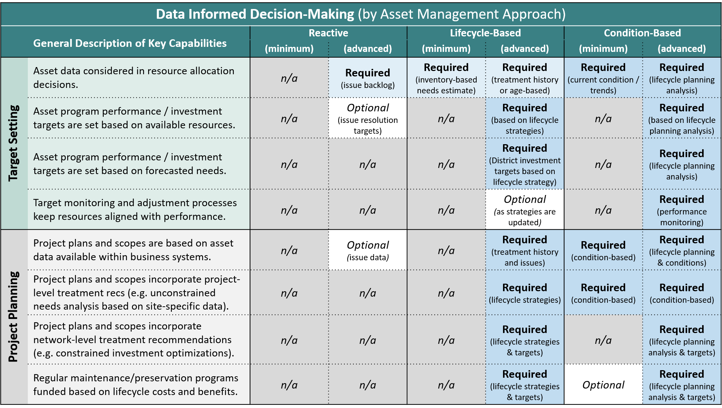
Data and Information System Capabilities Evaluation Decision-Making Capabilities
Entirely Hypothetical!!!
An application example for
Guardrail
Resource Allocation Method
Set annual budget based on issue backlog and previous investments
Investment Targets
Option: Set targets for number of priority issues address with funds
Forecasting / Monitoring
No capabilities necessary for selected management approach
Project Planning
Option: Pre-populate work orders in the AMS / MMS / WMS based on priority issues
Treatment Recommendations
No capabilities necessary for selected management approach
Address Required and Optional items for the selected approach

Slide 13
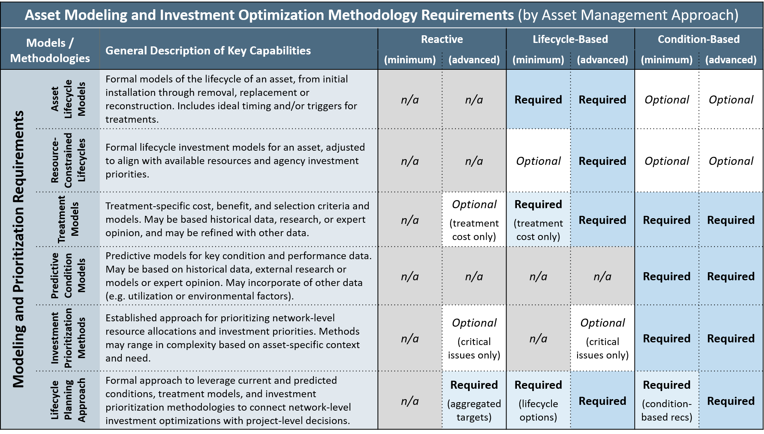
Data and Information System Capabilities Evaluation Modeling and Prioritization
Entirely Hypothetical!!!
An application example for
Guardrail
Asset Lifecycle Modeling
No capabilities necessary for selected management approach
Treatment Modeling
Option: model typical activities – use bid tabs or state force material, equipment, labor costs
Predictive Condition Models
No capabilities necessary for selected management approach
Investment Targets
Option: Prioritize known issues – severity, traffic, accident data
Lifecycle Planning Approach
District and system-specific targets– based on allocations
Address Required and Optional items for the selected approach

Slide 14
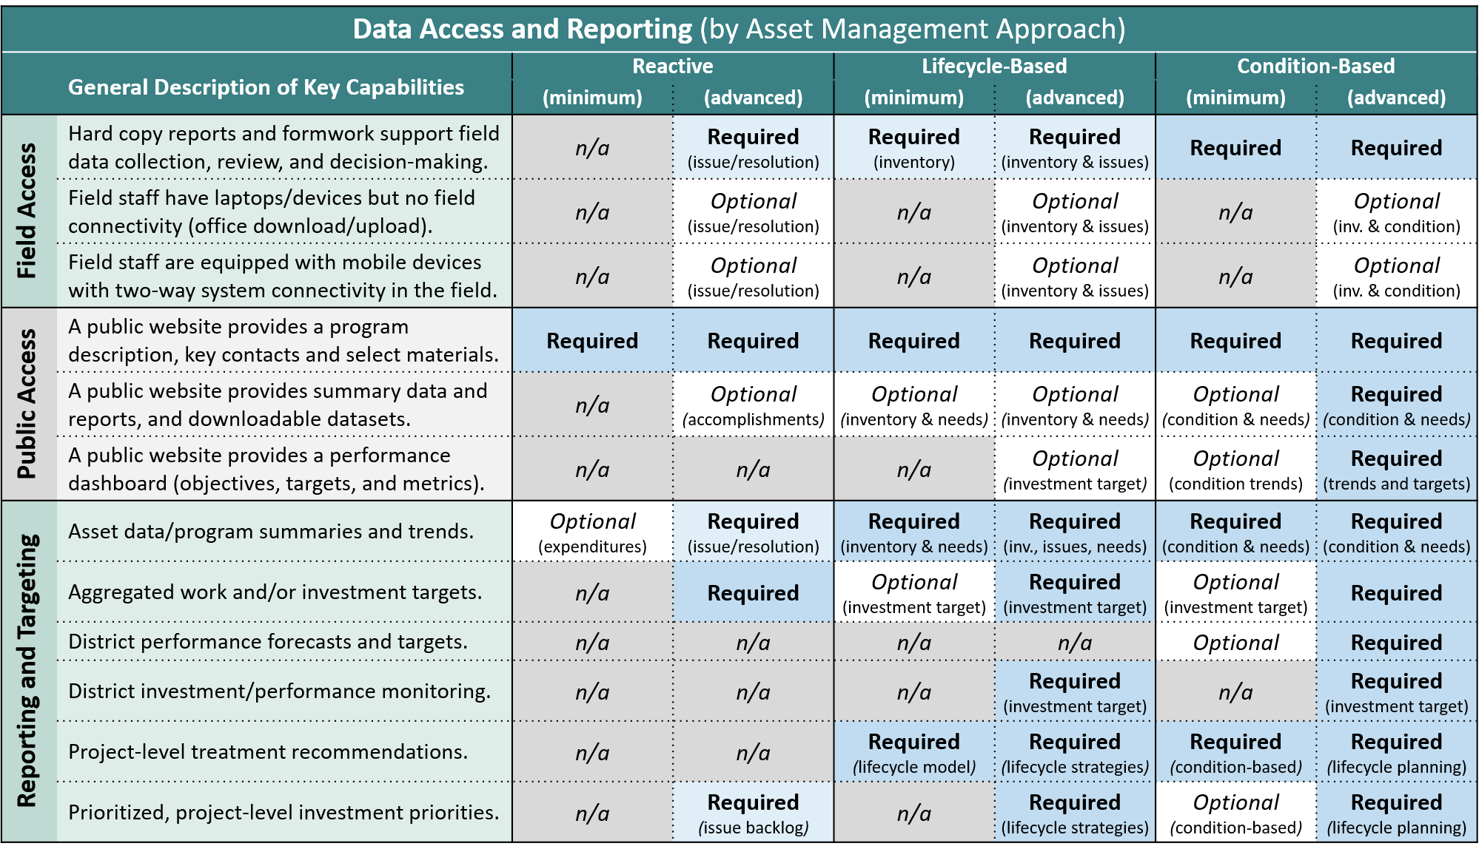
Data and Information System Capabilities Evaluation Data Access and Reporting
Entirely Hypothetical!!!
An application example for
Guardrail
Field Access
Windshield data collection form (supporting 2-person, vehicle based issue tracking)
Mobile tools to capture and review issues
Mobile tools to create, update and complete work orders
Public Access
Website with GR program description and contacts
Option: include summary data regarding past accomplishments
Reporting and Targeting
District- and system-specific reporting of issue backlog, work accomplishments and trends
Option: priority issue lists
Address Required and Optional items for the selected approach

Slide 15
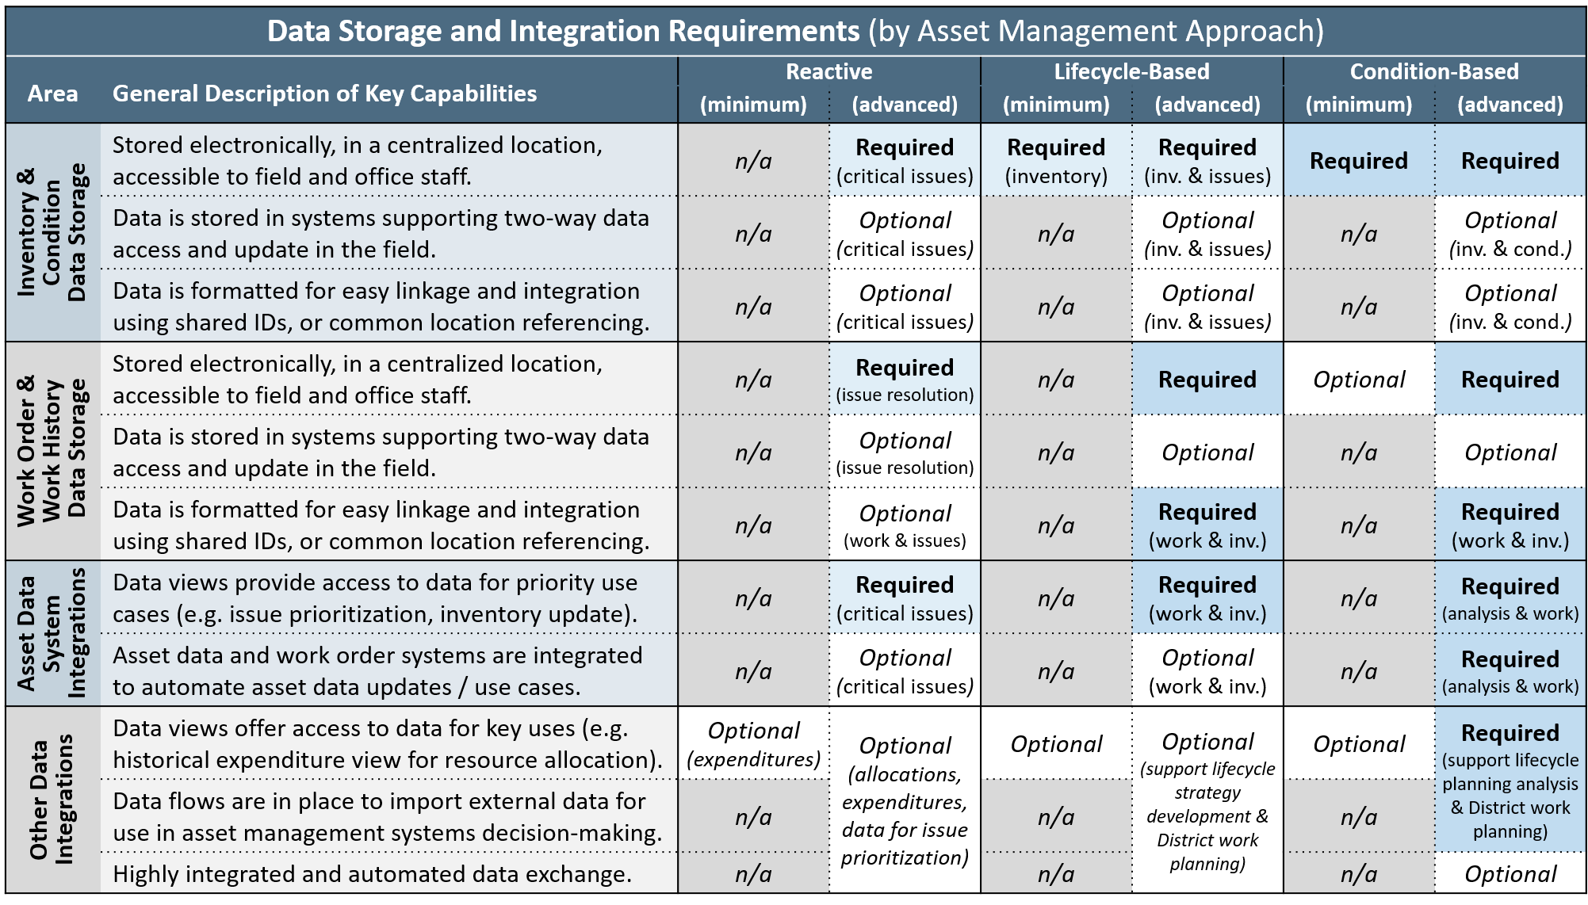
Data and Information System Capabilities Evaluation Data Storage and Integration
Entirely Hypothetical!!!
An application example for
Guardrail
Inventory & Condition Data Storage
Centralized, map-based, field accessible repository for GR issues (e.g. ArcGIS Online app)
Post process LRS to provide route and milepoint information
Work Order & History Data Storage
Track issue resolution (tool above)
Calculate and store aggregated GR work in a central repository
Asset Data System Integration
Integrate GR issues / work orders
Other Data Integration
Option: Import traffic, crash history to support prioritization
Option: Import CRM requests for issue creation / prioritization
Address Required and Optional items for the selected approach

Slide 16
Data and Information System Capabilities Evaluation Inventory & Condition Data Collection
Entirely Hypothetical!!!
An application example for
Guardrail
Field Inspection
Issue / basic inventory mobile app
Option: detailed GR inspection form (for project-specific data)
Imagery-Based Extraction
Virtual GR windshield assessment tool – use with pavement imagery
Vehicle-Based Collection
Paper-based GR windshield assessment form (w/ upload tool)
Asset Sensors
No capabilities necessary
Project Data Integration
No capabilities necessary
Issue Reporting System
Option: CRM – GR request form
Identify Collection Methods for Required Inv. and Condition Data

Slide 17
Data and Information System Capabilities Evaluation Treatment and Work Data Collection
Entirely Hypothetical!!!
An application example for
Guardrail
Field Inspection
Issue resolution mobile app
Project Data Views / Integration
Option: map-based overlay and/or integration of GR project locations & known issue locations – to support issue resolution
Automated Change Detection
No capabilities necessary
Issue Reporting System
Option: CRM – GR request form
Identify Collection Methods for Required Work Data

