Slide 1
Managing Where’s My Stuff
Why an enterprise-wide, inter-operable,
geospatially-enabled
Information Management System
for Transportation Agency Right-of-Way Offices

Slide 2
Why an Information System
Project delivery management
Real-time scheduling
Real-time cost control
Precise and rapid information access
On-time real property delivery
Fingertip access to status
Quality control

Slide 3
Why GIS
Adds the “where” to managing information
project status
acquisition and relocation status
management of real property
Enhances analysis and decision support

Slide 4
Benefits to Agency
Improved on-time delivery of project real property
Expedited project award
Reduced staffing and/or improved staff efficiency
Improved access to information
Improved customer service and public relations
Increased management flexibility
Improved oversight capabilities
Improved integration, use, and sharing of information

Slide 5
Benefits to Right-of-way Office
Improved scheduling
Improved documentation and reporting uniformity
Reduced time to perform tasks
Reduced redundancy
Reduced staffing and/or improved staff efficiency
Improved access to information
Improved customer service and public relations
Increased management flexibility
Improved oversight capabilities
Improved integration, use, and sharing of information

Slide 6
Documented Savings
Return on investment
21% return from reduced annual operating costs while providing greater convenience to users (Pennsylvania)
Through interoperability with financial system, payment processing reduced from several days to several minutes. (Pennsylvania)
Oversight and management of real estate activities
A single person manages a multi-million dollar airport project through desktop access to near real-time project information (Illinois)

Slide 7
Documented Savings
Staffing reductions and improved on-time performance
Access to all information on ROW projects by over 500 staff and contractors, providing exceptional customer service. Information entered once, eliminating duplication of effort. (Virginia)
Reduction of research staff by half. Parcel information available on-line eliminating in-person courthouse research and travel. (Maryland)
Reduction in time from several hours to several minutes by providing GIS-based summaries of excess property for sale to the public. Questions from the public reduced. (New Mexico)
Elimination of manually locating and reviewing large drawing sets. Staff clicks on desired section of road using GIS to access project drawings. (San Antonio District, Texas)

Slide 8
Potential Problems
Missed milestones when critical dates not tracked
Inaccessibility of right-of-way data for management analysis
Difficulty searching and updating information
Inconsistent formats used throughout the state
Laborious completion of correspondence and internal documentation
Duplication of effort

Slide 9
Potential Risks
Inability to strategically adjust resources to meet on-time performance measures
Unmet expectations
Poor performance on agency audits

Slide 10
Examples of GIS Use
Minnesota REALMS geospatial status reporting

Slide 11
Examples of GIS Use
Nevada’s IRWIN – Alternate alignment evaluation

Slide 12
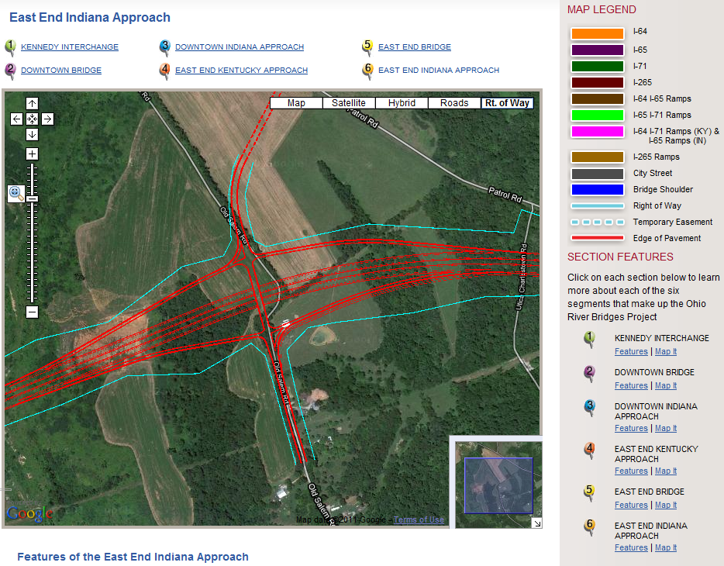
Examples of GIS Use
Kentucky and Indiana on-line Outreach– Ohio River Project: new right-of-way

Slide 13
Examples of GIS Use
Illinois ALAS Public Interface

Slide 14
Examples of GIS Use
Maryland MdProperty View visual access to statewide parcel information

Slide 15
Examples of GIS Use
New Mexico NRW Parcel & Improvement Inventory

