Slide 1
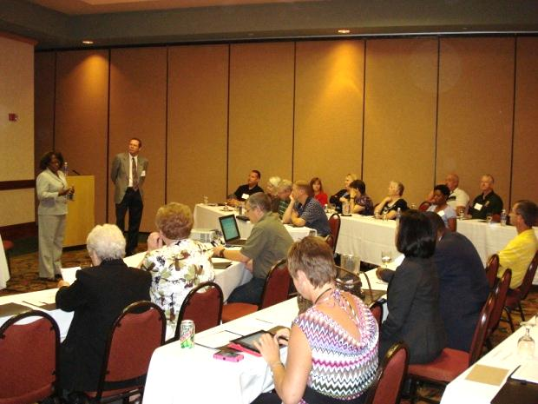
Using Peer Exchanges to Improve the Effectiveness of a State's Strategic Highway Safety Plan
NCHRP Project 17-52
Notes:
The research team has learned through a review of peer exchange experiences, best practices, and lessons learned that by sharing information related to peer exchange events safety practitioners can improve the SHSP process and continue to save lives.
The developed Guide provides States with information and tools to plan and conduct effective peer exchange events that include the following elements: focus, advanced planning, effective facilitation, and post-event follow-through.

Slide 2
NCHRP 17-52 Objective
Produce a Guidebook to support State highway safety agencies in planning and conducting State-level peer exchanges focused on evaluating and improving their SHSPs.
Key themes
Focus on the end user: State agency practitioner
Easy-to-read, user-friendly Guide
Cover multiple types and delivery methods
Types | Delivery Methods
In-State | In-person
Multi-State / Regional | Video
Peer Review | Internet-based
One-on-One | Teleconference
Notes:
The research team and project panel discussed key themes of this project:
Focus on the end user: State agency practitioner
State DOT staff are often very busy and have multiple duties, so producing a Guide to lead them through this process step by step could be beneficial
Easy-to-read, user-friendly Guide
Cover multiple types and delivery methods
One size does not fit all, so producing guidance for multiple PX types was important. Due to financial limitations and other issues, a variety of delivery methods are likely to be used. The Guide must provide full guidance for all methods.

Slide 3
NCHRP 17-52 Research Team and Project Panel
Research Team | Project Panel
Brian Chandler, SAIC (P.I.) | Leanna Depue, Missouri DOT (Chair)
Tom Welch, SAIC | John Goodknight, Marion County, Florida
Tom Bryer, SAIC | Robert Hull, Utah DOT
Vern Betkey, SAIC | Priscilla Tobias, Illinois DOT
Jennifer Atkinson, SAIC | Terecia Wilson, South Carolina DOT (Retired)
Tim Neuman, CH2M HILL | Ning Li, Virginia DOT
Kim Kolody, CH2M HILL | Tim Pieples, Pennsylvania DOT
Richard Storm, CH2M HILL | Jim Taylor, University of Notre Dame
Richard Retting, Sam Schwartz Engineering | Gary Williams, Maine DOT
Greta Cleary, Voice Associates | Jennifer Warren, FHWA
Richard Pain, TRB Liaison | Tamiko Burnell, FHWA
Lori Sundstrom, NCHRP Staff | Lorrie Lau, FHWA
Notes:
Following are the research team and project panel members, along with TRB staff.

Slide 4
NCHRP 17-52 Project Tasks
Task 1 | Conduct Project Kick-off Meeting, Refine Work Plan, and Prepare Interim Reports
Task 2 | Identify External Sources of Current SHSP Peer Exchange Practices
Task 3 | Develop and Present Annotated Outline of Draft SHSP Peer Exchange Guidebook
Task 4 | Develop Draft Guidebook
Task 5 | Conduct a Field Test of the SHSP Peer Exchange Guidebook
Task 6 | Prepare & Submit Draft Final Guidebook, Draft Final Project Report, & Draft Final Project Presentation
Task 7 | Prepare and Submit Final Guidebook, Final Project Report, and Final Presentation
Notes:
17-52 included seven tasks.
Task 1—Conduct Project Kick-off Meeting, Refine Work Plan, and Prepare Interim Reports
Task 2—Identify External Sources of Current SHSP Peer Exchange Practices
Task 3—Develop and Present Annotated Outline of Draft SHSP Peer Exchange Guidebook
Task 4—Develop Draft Guidebook
Task 5—Conduct a Field Test of the SHSP Peer Exchange Guidebook
Task 6—Prepare and Submit Draft Final Guidebook, Draft Final Project Report, and Draft Final Project Presentation
Task 7—Prepare and Submit Final Guidebook, Final Project Report, and Final Presentation

Slide 5
Task 1 - Conduct Project Kick-off Meeting, Refine Work Plan, and Prepare Interim Reports
Project Timeline: May 2011 – June 2013
Prepared monthly and quarterly reports
Project Panel meetings
Teleconference January 12, 2012
In-person Meeting June 22, 2012
Teleconference November 8, 2012
Teleconference April 30, 2013

Slide 6
Task 2 – Identify External Sources of Current SHSP Peer Exchange Practices
Literature Review
Reviewed 20 pieces of literature on peer exchanges
Key Issues
Determining Need
Peer Exchange Types and Delivery Methods
Planning
Pre-event Activities
Post-event Activities
Notes:
The research team conducted a search to identify published information regarding various types of peer exchange programs, particularly those related to transportation safety. We discovered very few references specifically on the topic of SHSP peer exchange programs. However, we identified numerous examples of transportation peer exchange programs.
Topics
Determining if a Peer Exchange Event is Needed
Peer Exchange Types and Delivery Methods
Planning for a Peer Exchange Event
Pre-even and post-event activities

Slide 7
Task 2 – Identify External Sources of Current SHSP Peer Exchange Practices
Telephone Interviews
Interviewed 5 State DOTs and 1 FHWA staff member
What makes a successful SHSP peer exchange?
Up front planning
Local needs focus
Including the right participants
Networking
Areas for improving peer exchanges
Encourage taking away implementable ideas
Consider more follow-up after the event
Target peer exchange on a specific topic
Notes:
The research team conducted 1-hour phone discussions with representatives from five departments of transportation (DOT) and the FHWA Peer-to-Peer Program to gain insight into effective SHSP peer exchanges. The State DOTs were Idaho, Illinois, Missouri, New Hampshire, and Utah. They were selected based on their depth and variety of peer exchange experience.
Two main questions were the focus of the interviews
1. What makes a successful SHSP peer exchange?
2. What are some areas for improving peer exchanges?

Slide 8
Task 2 – Identify External Sources of Current SHSP Peer Exchange Practices
Key Lessons from State of the Practice Review
Critically consider timing
Define clear objectives
Evaluate different delivery methods
Recognize that a peer exchange is the first step to improve safety
Notes:
The agency interviews and literature review revealed many useful suggestions for hosting a successful peer exchange.
Critically Consider Timing. Possible criteria to help determine if the time is right include time since last peer exchange, desire to advance the implementation of a new countermeasure, staff turnover, or the need for additional time to evaluate the impact recent changes had on the program.
Define Clear Objectives. Considerable thought should be given to focusing and clearly stating objectives and goals of the peer exchange before any plans are made. This step significantly impacts many future decisions, such as selecting appropriate peers and facilitators, identifying participants, and choosing a format that allows the peer exchange to obtain the goals.
Evaluate Different Delivery Methods. With improving technology and increasingly specific regional issues related to SHSPs, agencies are experimenting with alternative formats, including reverse scans, virtual peer exchanges, and regional events. No guidance was found to help States determine when each is the most appropriate.
Recognize that a Peer Exchange is the First Step to Improve Safety
The most important work is to implement the ideas, inspire change, and follow up on valuable action items resulting from the peer exchange. A peer exchange event does not reduce traffic fatalities or guarantee success; it is the ensuing actions and changes that make the difference

Slide 9
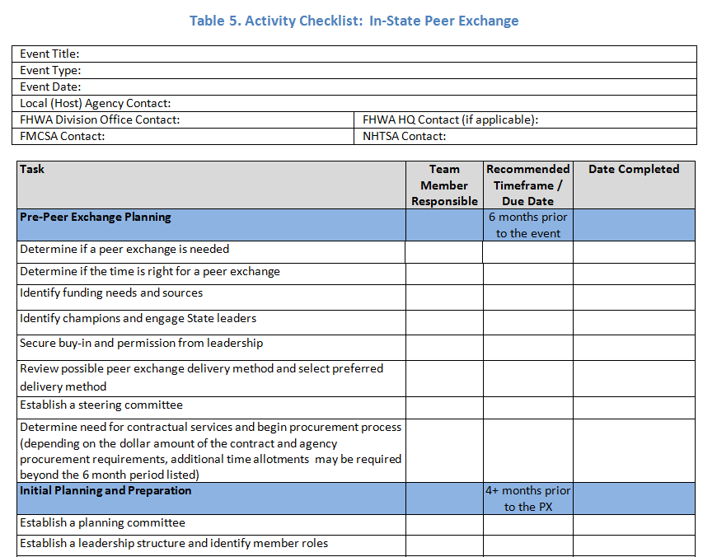
Task 2 – Identify External Sources of Current SHSP Peer Exchange Practices
Notes:
One of the most important key lessons from the state of the practice review was the development of an Activity Checklist (see a partial example here) that provides steps and timelines for peer exchange planning teams.

Slide 10
Technical Memos A - G
Potential Tasks and Timelines Necessary to Plan and Conduct a Peer Exchange
Expertise Necessary for Members of Expert SHSP Peer Exchange Panels
Characteristics and Responsibilities of Host State Planning Committee
Characteristics and Responsibilities of Peer Exchange Participants
Documenting the Peer Exchange, Implementation Recommendations, and Follow-up Suggestions
Evaluation Instrument for Participants to Evaluate their Peer Exchange Experience
Evaluation Instrument for the Host State to Evaluate Implementation
Notes:
Information from the state of the practice review (literature and interviews) was analyzed to developed the following technical memos. These tech memos served as the basis for the technical content of the Draft Guide.

Slide 11
Tasks 3 & 4 – Develop Annotated Outline and Draft SHSP Peer Exchange Guidebook
Discussions at Project Panel Meeting
Need more detail for all types and delivery methods
Guide organization ideas
One step-by-step chapter with type-specific text when needed
Multiple parallel chapters for each type
“Choose Your Own Adventure” style
In-State
Multi-State / Regional
Peer Review
One-on-One
Notes:
During review of the Draft Guide, we determined that additional information was needed for the different types of peer exchanges. The original guide was focused mainly on a multi-state, in-person event.
The alternatives each had pros and cons.
One step-by-step series of chapters would make for a shorter, more accessible-looking Guide, but there would be a lot of content readers would need to bypass to get to what they want.
Parallel chapters would require additional work, redundant content, and careful control over each chapter to ensure edits were carried over. But it would provide the reader exactly what they needed for their chosen peer exchange type.
The research team decided to go with Option #2, using a “Choose Your Own Adventure” strategy in the early chapters.

Slide 12
Tasks 3 & 4 – Develop Annotated Outline and Draft SHSP Peer Exchange Guidebook
Introduction
SHSP Basics
Peer Exchange Basics
Pre-Peer Exchange Planning
Choose Peer Exchange Type
In-State Peer Exchange
Multi-State / Regional Peer Exchange
Peer Review
One-on-one Discussion
Conclusion
Notes:
Basic Table of Contents
Chapters 5-8 are the parallel chapters based on PX type

Slide 13
Task 5 – Conduct a Field Test of the SHSP Peer Exchange Guidebook
Criteria for choosing states for 2 events
SHSP update upcoming
State interest
States chosen
Arkansas
In-state, in-person peer exchange
Alaska / North Dakota
Multi-state, virtual peer exchange
Notes:
The research team has been working to identify field test participants to pilot the SHSP Peer Exchange Guidebook materials. Criteria for choosing States included the following.
Proposed criteria used to choose participating States to test the Guidebook
The State’s current SHSP should be several years old and recognized as being in need of updating.
States should either have plans underway or forthcoming to update their current SHSP.
States should have a strong interest in participating in a peer-exchange event.
There should be geographic diversity between the two pilot field locations for testing the Guidebook under this project.
The Project Panel asked the research team to consider one field test comprised of a one-state host and multiple practitioners coming in from other states.
Potential States agreed upon by the SAIC team and the Project Panel
Arkansas has been identified as a host State for testing the Guidebook, with peer States to potentially include representatives from Florida, Kentucky, Louisiana, Missouri, and/or South Carolina.
This event will be a face-to-face peer exchange held in Little Rock.
North Dakota has been identified as a host State for testing the Guidebook, with the peer State to include representatives from Alaska.
This event will be a virtual peer exchange

Slide 14
ARKANSAS In-state, In-person Peer Exchange
Arkansas updated SHSP in 2012
Focus on new plan + implementation
New Safety leadership at Arkansas Highway & Transportation Department (AHTD)
Research Team Support
Provided Table of Activities from Guide
Provided Facilitator Guide
Helped Develop Agenda
Contacting Potential Peers
Notes:
The research team conducted regular conference calls with the Arkansas Highway and Transportation Department (AHTD) and the FHWA Division Office to finalize peer exchange objectives, potential peer State invitees, and agenda topics. AHTD built an agenda for the July 31 event, confirmed a location, and sent invitations to potential attendees.
AHTD and FHWA Arkansas Division met with the Arkansas SHSP Steering Committee to discuss the peer exchange event. The research team followed up with an additional conference call to help the state identify peer exchange objectives, potential peer State invitees, and agenda topics.

Slide 15
ARKANSAS In-state, In-person Peer Exchange
July 31, 2012
Arkansas Focus with Peer and National Support
Terecia Wilson, South Carolina DOT (Retired)
Tom Welch, Iowa DOT (Retired) / SAIC
Steve Kite, North Carolina DOT
Romell Cooks and Bill Sullivan, NHTSA
Kelly Hardy, AASHTO
Brent Willhite, PPBH

Slide 16
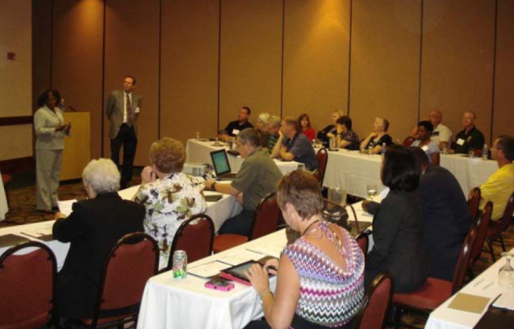
ARKANSAS: In-person SHSP Peer Exchange
Big group + breakout sessions
Lessons Learned
One day was tight
Consider immediate follow-up meeting
Easy to fall into typical presentations
True peer exchange is challenging

Slide 17
ALASKA / NORTH DAKOTA Multi-state, Virtual Peer Exchange
Alaska: Revised SHSP in 2011
Focus on Implementation
North Dakota: Revised SHSP in 2013
Seeking Lessons Learned from Alaska
Unique Needs
Research Team Support
Facilitating Conference Calls
Provided Table of Activities from Guide
Helped Develop Agenda (time zones)
Notes:
The research team held a joint teleconference with Alaska DOT&PF and North Dakota DOT to discuss the peer exchange event. Since the research team was working with two states at two different sites, it took some additional coordination
Topics included the following:
Identify objectives of Alaska / North Dakota peer exchange
Choose date
Identify funding needs and sources
Event agenda
Event logistics
Meeting location
Supplies and equipment needed
Technical support for virtual PX needs
Speakers, moderators, facilitators, recorders
Identify action items, responsible parties, and due dates
Each State confirmed their participation from DOT senior leadership and responded to the research team. The research team held a series of joint conference calls with Alaska DOT&PF and North Dakota DOT to build the event agenda; discuss peer exchange objectives, State attendees, and technical topics; and coordinate logistics.

Slide 18
ALASKA / NORTH DAKOTA Multi-state, Virtual Peer Exchange
August 15, 2012
Research Team and Peers
Alaska Site
Brian Chandler, SAIC
North Dakota Site
Richard Retting, SSE
Tom Welch, SAIC
Howard Preston, CH2M HILL
Cheri Marti, CH2M HILL

Slide 19
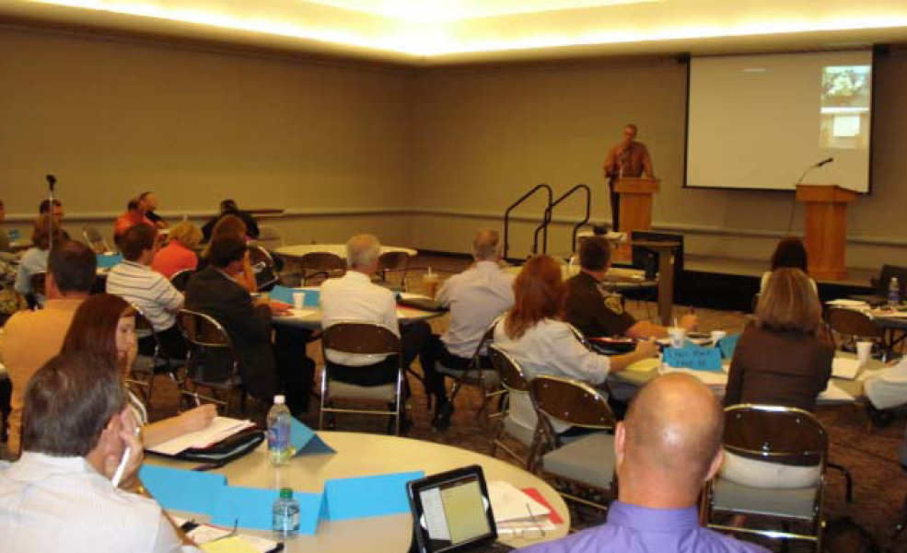
ALASKA / NORTH DAKOTA Multi-state, Virtual Peer Exchange
Notes:
North Dakota was set up in a round table / conference style, with a video feed of the Alaska group as part of the presentation screen (see circle in this photo).
The Alaska site was set up in a small conference room, with the 6 attendees around a table.

Slide 20
ALASKA / NORTH DAKOTA Multi-state, Virtual Peer Exchange
Research Team members at both locations
Lessons Learned
State pairing is important (AK & ND had similarities)
Time zones are tricky
Logistics matter: Room setup; Audio/video
Size of groups should be similar (ND:48 AK:6)
Presentation-mode (again)
Peer exchange is challenging

Slide 21
Tasks 6 & 7 – Prepare & Submit Guidebook, Project Report, & Project Presentation
Notes:
Final Guide and project reports were developed in 2013.

Slide 22
Contact Information for Key Project Leaders
Brian Chandler, Principal Investigator
SAIC
Seattle, WA
Tel: 573.356.7520 | Email: brian.e.chandler@saic.com
Lori Sundstrom, Sr. Program Officer
NCHRP
Washington, DC
Tel: 202.334.3054 | Email: lsundstrom@nas.edu
Leanna Depue, Project Panel Chair
Missouri DOT
Jefferson City, MO
Tel: 573.751.0599 | Email: leanna.depue@modot.mo.gov

