Slide 1
Guidelines for Selecting Sign Sheeting Materials for AASHTO M268
NCHRP Project No. 20-07/Task 374
PI: Gene Hawkins, Ph.D., P.E.
Texas A&M University,
Texas A&M Transportation Institute

Slide 2
Retroreflective Sign Sheeting
Redirects light from headlight back toward vehicle
Retroreflective sign sheeting makes signs more visible at night
Especially at a distance
Many factors affect sign brightness
Range of choices for sign sheeting
Challenge is selecting an appropriate sheeting for a given application

Slide 3
Project Objective
Develop guidance for agencies to select sign sheeting materials using AASHTO M268 specification
Project was a limited resource project
Not able to address all factors affecting sheeting selection

Slide 4
AASHTO Sheeting Spec
M268: Standard Specification for Retroreflective Sheeting for Traffic Control
Revised 2015 to provide 4 sheeting types
AASHTO sheeting types:
A: encapsulated bead
B: microprismatic without significant 1° observation angle performance
C: microprismatic with significant 1° observation angle performance
No products currently certified as Type C
D: microprismatic with 0.5 & 1° observation angle performance about twice that of Type C

Slide 5
Project Activities
Measure selection of sheeting materials
Create generic AASHTO sheeting types
Create selected roadway and sign scenarios (15 individual scenarios)
Calculate luminance supplied by generic sheeting types
Compare to luminance demand
Develop general guidelines

Slide 6
Sheeting Evaluation
Calculate luminance for specific conditions (supply luminance)
Roadway size and alignment, vehicle size, headlamps, sign position, sheeting
Used ERGO program
Required measuring sheeting retroreflectivity
Determine demand luminance
Used research by others
Based on sign legend size and driver accommodation level
Compare supply and demand luminance

Slide 7
Sign Luminance
Sign luminance: apparent brightness
Function of:
Headlamp performance
Sheeting retroreflectivity
Viewing geometry
To evaluate, need sheeting retroreflectivity (R_{A}) for each combination of four viewing angles:
Observation, entrance, rotation, orientation

Slide 8
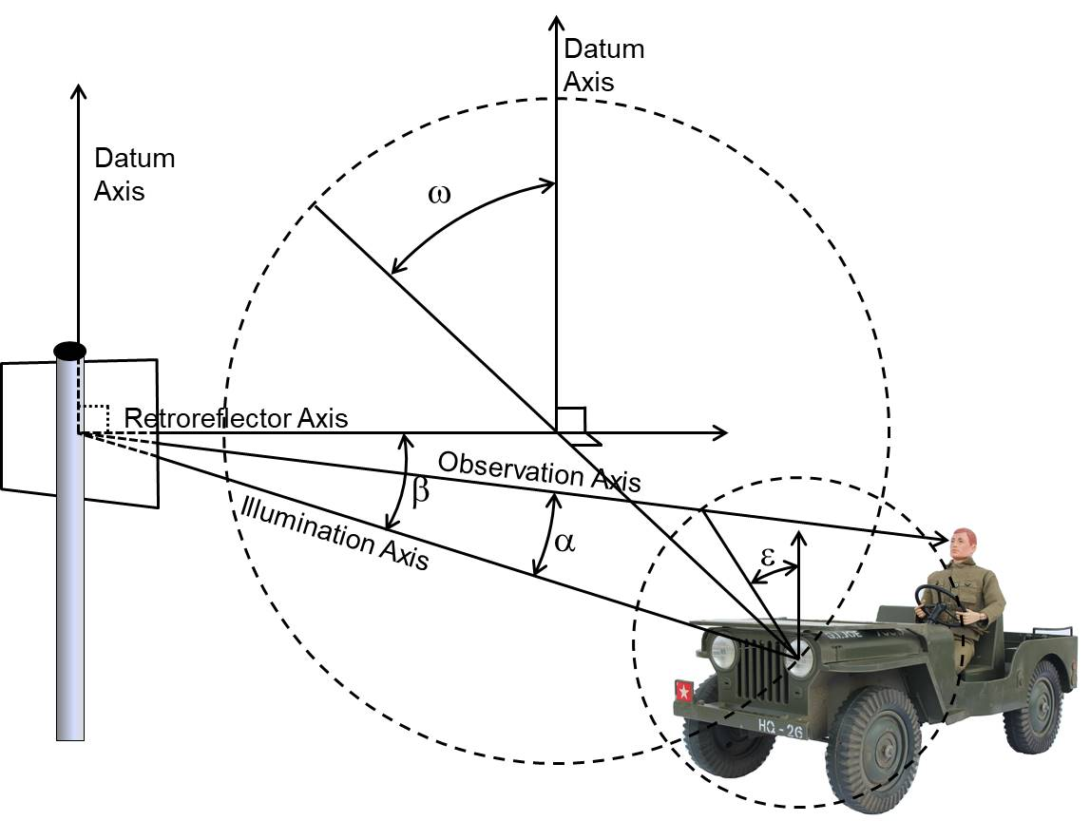
R_{A} Measurement Angles
α: observation
β: entrance
ε: rotation
ω: orientation

Slide 9
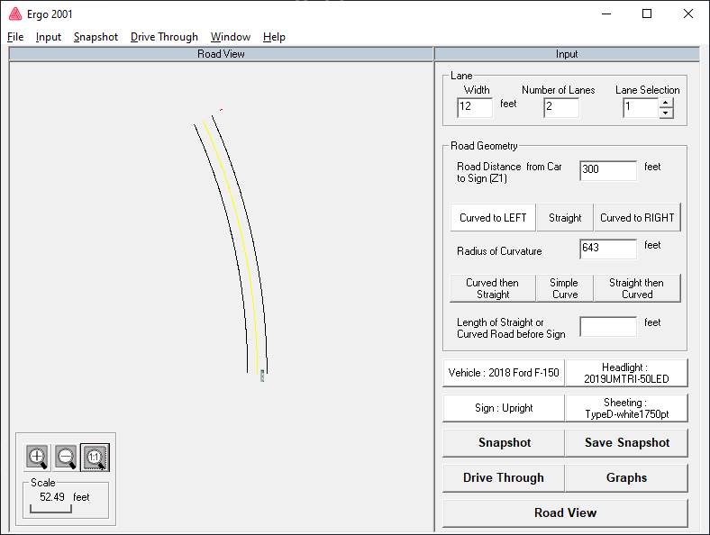
Supply Luminance Calculations
Used ERGO
Developed by Avery-Dennison
No longer available
Inputs
Roadway alignment
Vehicle size
Headlamp performance
Sign position
Sign sheeting retroreflective performance

Slide 10
Sheeting R_{A} Measurement
Measured in lab
ERGO prismatic files have > 500K points
Too many for this project
Determine min number of measurement points (1,750 used for project)
Retroreflectivity array size limited by lab equipment
Array size prevented analysis of some roadway scenarios (short radius curves, left side signs)
Measured 5 products (11 samples total)

Slide 11
Sample Measurement
All samples were white sheeting
Sample measurement:
Type A
Single product, average of 2 samples
Type B
Average of 2 products, each product is average of 2 samples
Type C
Not measured, no current product
Created “pseudo-Type C” from ERGO retroreflectivity file
Type D
Two products, each product is average of 2 or 3 samples
Average sample measurements averaged to create generic R_{A} file for each sheeting type
Yellow and orange sheeting
Created by applying M268 color correct factors to all 1750 measurements
Used standard yellow for yellow (0.75×white)
Used fluorescent orange for orange (0.30 ×white)

Slide 12
Pseudo Type C Sheeting
For supply luminance analysis, use single material included in the original release of ERGO
ERGO retroreflectivity measurements are not representative of the current version of the product on the market
Product (old or new) does not meet Type C specification
Type C material not included in guidelines

Slide 13
Roadway Alignment
Calculated supply luminance for:
Straight road
Curved road (left and right)
643 ft radius (represents 45 mph speed)
1,333 ft radius (represents 60 mph speed)
Retroreflectivity measurement limitations prevented analysis of 30 mph curve (231 ft radius)

Slide 14
Vehicle Size
Supply luminance associated with best selling light pickup truck
2018 model year
Driver height: 5 ft, 6 in
Basis for light pickup:
Best selling vehicle model in US
Larger vehicle produces lower luminance than for typical sedan

Slide 15
Headlamp Performance
Headlamp performance used UMTRI 2019 data for 2018 model year headlamps
LED and tungsten-halogen headlamps
25th, 50th, and 75th market-weighted percentile performance
Array: ±25º horz, +7º to -5º vert
Used 50th percentile LED headlamp to calculate supply luminance

Slide 16
Sign Placement
Post-mounted
Right side of 2-lane and 4-lane roads
Sign centroid: 14 ft offset, 9 ft high
Overhead
Centered over lane to left of vehicle
Centroid: 22 ft above road

Slide 17
Demand Luminance
Two conditions based on scene complexity
Low/Medium/High with Lighting
Represents rural, suburban, lit urban
High without lighting
Represents urban without street lights
Older driver accommodation
Plots for 50th, 75th, 85, and 95th percentile accommodation
Data from CIE report
Based on legibility index applied to LOOK3 model
Legibility index multiplied by sign letter height provides limits of LOOK3 range

Slide 18
LOOK3 Model

Slide 19
Roadway & Signing Scenarios
Roadway scenarios (5 total)
Tangent
Curved: left and right, 643 and 1,333 ft radii
Sign placement
2-lane: centroid 14 ft from edge line, 9 ft above edge line
4-lane: centroid 14 ft from edge line, 9 ft above edge line, vehicle in left lane
Freeway: overhead sign centered above lane to left of vehicle, centroid 22 ft above pavement
Sign scenarios
White: 16- (overhead), 10-, and 6-inch legends
Yellow: 6-inch legend
Orange: 5-inch legend

Slide 20
Comparing Supply/Demand
Many plots prepared comparing supply and demand luminance
45 plots each for two types of scene complexity
Plots provide supply luminance for:
Sheeting types
Roadway alignment
Plots provide demand luminance for:
Percent accommodation
Scene complexity
Sign letter height

Slide 21
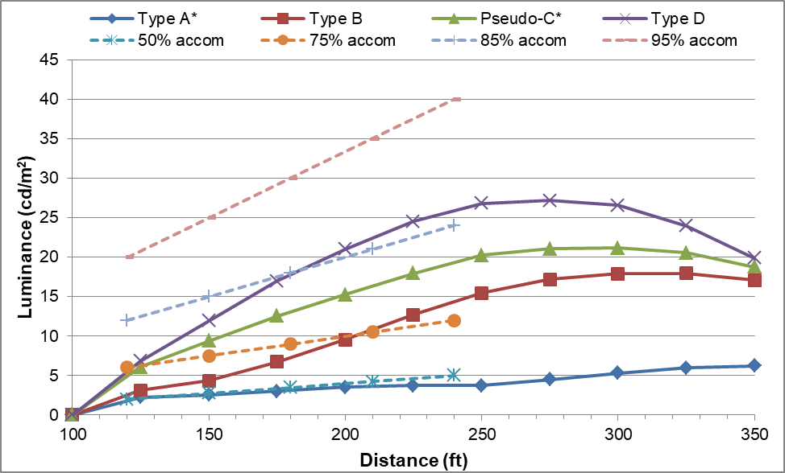
Sample Plot
4-lane, post-mounted white sign (6 in legend), curve right (643 ft R), high complexity without lighting

Slide 22
Study Limitations
Complicated topic, not feasible to simplify
Many variables affect results
R_{A} files:
Type C not included in guidelines
Size limited ability to evaluate wide range of conditions
Does not include all materials that meet AASHTO specification
May not have adequate number of samples of each product
Yellow and orange data may not be accurate
R_{A} values do not represent the manufacturers minimum performance or the minimum performance of ASTM or AASHTO sheeting types
Results represent new material
R_{A} performance of aged sheeting not known

Slide 23
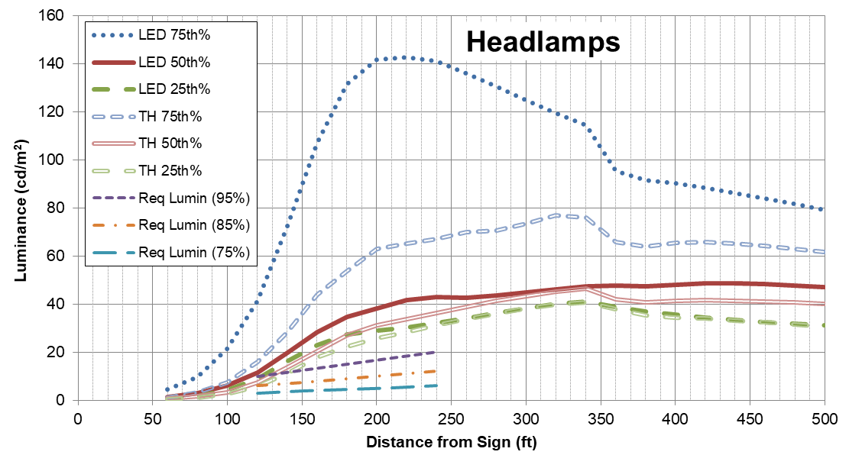
Luminance Variability
Recent TRR paper evaluated variability in luminance as function of input variables
Headlamp example (straight road, 6-in legend):
116 cd/m²
452%

Slide 24
Guideline Summary: L/M/Hw
Scene complexity: low, medium, high with lighting
Type A:
Mostly provides 75% accommodation on 2-lane roads
Multilane: use only with large legend
Not recommended with yellow/orange signs
Overhead provides 75% accommodation on tangent alignment (limit use to tangent only)
Type B:
White large legend mostly provides 95% accommodation
White (small legend) and yellow mostly provides 75% accommodation
Not recommended for orange signs
Overhead: mostly 95% accommodation on tangent, mostly 75% accommodation on curved
Type C: not addressed
Type D:
Mostly provides 85-95% accommodation for white and yellow
Mostly provides 50% accommodation for orange
Preferred type for overhead
Report provides additional details for guidelines

Slide 25
Guideline Summary: Hwo
Scene complexity: high without lighting
Type A:
Not recommended
Type B:
50-85% accommodation on 2- & 4-lane roads depending upon scenario
Not recommended for orange and overhead signs
Type C: not addressed
Type D:
Mostly provides 50-85% accommodation for white and yellow
Generally provides 50% accommodation for orange
Preferred for overhead signs
Report provides additional details for guidelines

Slide 26
Recommendations
Create pubic domain luminance calculation tool
Manufactures and agencies should work to develop fully characterized retroreflectivity files for sheeting products used by agencies
Refine research on demand luminance
Create fully characterized retroreflectivity files for sheeting near end of service life
Evaluate luminance for a wider ranges of vehicle sizes, headlamps, and roadway geometry
Revise Type C R_{A} values in M268 so that some products will meet Type C spec
Set 0.2°/-4° geometry between 350-450 cd/lux/m²

