Slide 1
“Combining Individual Scour Components to Determine Total Scour”
FINAL REPORT PRESENTATION
Project 24-37
Prepared for
National Cooperative Highway Research Program (NCHRP)
Transportation Research Board
of the
National Academies of Sciences, Engineering, and Medicine
Terry Sturm¹, Bruce Melville², Thorsten Stoesser³, Steven Abt⁴,
Seungho Hong⁵, Irfan Abid¹, Xiaozhou Xiong², Bruno Fraga Bugallo³ and Ken Vui Chua³
September 15, 2017
¹Georgia Institute of Technology, Atlanta, GA 30332; tsturm@ce.gatech.edu
²University of Auckland, Auckland New Zealand; b.melville@auckland.ac.nz
³Cardiff University, Cardiff, Wales; stoesser@cardiff.ac.uk
⁴Colorado State University, Ft. Collins, CO; sabt@engr.colostate.edu
⁵West Virginia University, Morgantown, WV; sehong@mail.wvu.edu

Slide 2
NCHRP 24-37: “Combining Individual Scour Components to Determine Total Scour”
INTRODUCTION

Slide 3


MOTIVATION
Risk
Overtopping
Bridge deck
Submerged orifice flow
Free surface flow
Abutment
Hydrodynamics
Scour
River bed
Sediment Erodibility
Extreme flood events can cause bridge foundation failure through scour of erodible sediments due to the action of complex turbulent flows induced by the bridge abutments and forced flow contraction through the bridge opening. Current practice is linear superposition of scour depth components which may over-predict maximum scour depths.
Research needs in bridge scour prediction methodology:
Predicting scour depth for combined abutment, pier and contraction scour assuming no interaction of scour components in free surface, submerged orifice, and overtopping flows
Understanding and computing flow field turbulence properties that cause scour component interactions

Slide 4
OBJECTIVE
Determine the relationships among individual scour components observed in the same flow event at a bridge, and determine how to combine them to produce realistic estimates of total scour depth based on laboratory experiments and numerical modeling.
T = A + L + V + P ??
where
  T = total scour depth
  A = abutment scour depth
  L = lateral contraction scour depth
  V = vertical contraction scour depth
  P = pier scour depth
i.e., Does linear superposition overestimate
scour depths, and if so, how can we account for
component interactions?

Slide 5
TYPES OF SCOUR

Slide 6
FLOW TYPES

Slide 7
SCOUR INTERACTIONS
HYPOTHESIS
Lateral contraction scour and abutment scour act simultaneously and are influenced
by similar variables that reflect the relative degree of turbulence-induced shear flow
due to flow separation near abutments and piers vs. pure contraction of the flow
caused by the constricted bridge opening. Pier interaction with abutment/contraction
scour depends on pier position relative to the abutment, while vertical contraction scour
can be treated similarly to lateral contraction scour in the vicinity of the abutment.
Outside the zone of influence of the abutment, interactions of pier scour and vertical
contraction scour may be weak.

Slide 8
NCHRP 24-37: “Combining Individual Scour Components to Determine Total Scour”
RESEARCH APPROACH

Slide 9
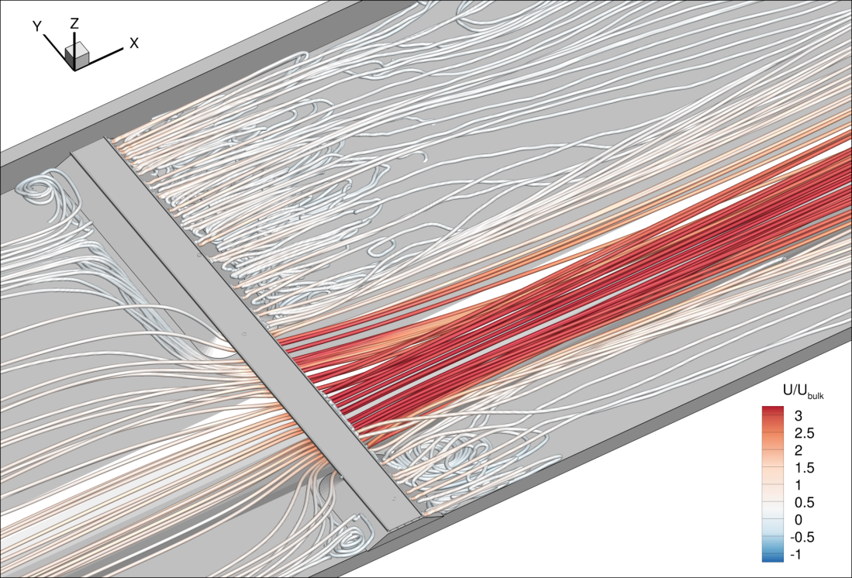
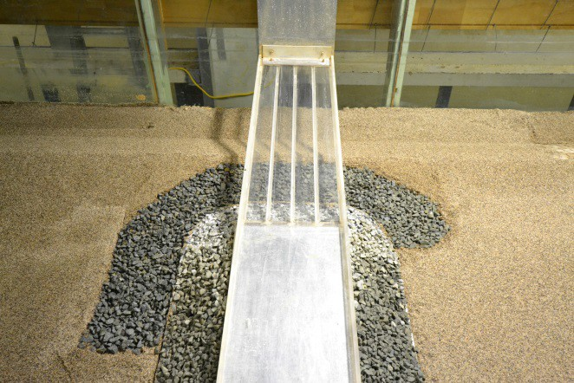
RESEARCH APPROACH
Experimental and computational:
Georgia Tech Flume
Computational Fluid Dynamics (CFD)
at Cardiff University
University of Auckland Flume

Slide 10
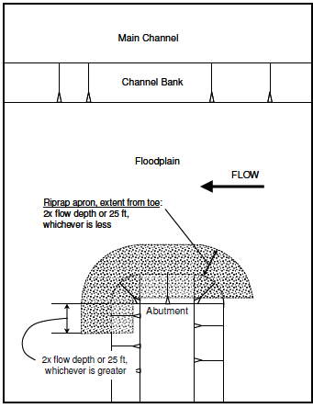
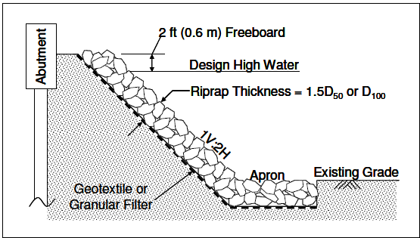
RIPRAP APRON (HEC-23)
Riprap thickness = 2 D50
No geotextile in this project
Embankment
Experiments all utilized the protection of riprap on the embankments and a riprap apron designed according to
HEC-23. The purpose was to ensure a consistent level of risk for all experiments and to prevent catastrophic
failure of the embankment.

Slide 11
DEFINITION OF VARIABLES

Slide 12
TERMINOLOGY
CWS – clear-water scour
LBS – live-bed scour
LSA – long setback abutment with maximum scour depth in floodplain
SSA – short setback abutment with maximum scour depth in channel bank or bed
BLA – abutment with toe at bank line of main channel with maximum scour depth in channel bed
F – free flow
SO – submerged orifice flow
OT – overtopping flow
GT – Georgia Tech
UoA – University of Auckland
CSU – Colorado State University pier scour equation
S&M – Sheppard & Melville pier scour equation
HEC-18 – Hydraulic Engineering Circular 18 on bridge scour (Arneson et al. 2012)
LES – large eddy simulation
RANS – Reynolds-averaged Navier Stokes equations

Slide 13
EXPERIMENTAL VARIABLES
1. Discharge, Q, with flow type changing from free (F) to submerged orifice (SO) to overtopping (OT) as Q increased;
2. Tailwater elevation which increased with Q as in the field;
3. Abutment/embankment length which resulted in long-setback abutments (LSA-scour hole in floodplain), short-setback abutments (SSA-scour hole straddling floodplain and main channel near the bank), and bankline abutments (BLA-abutment at main channel bank with scour hole in main channel);
4. Shape and location of piers (twin rectangular column and wall piers);
5. Abutment shape (spill-through and wingwall);
6. Compound channel geometry;
7. Geometric scale of bridge components and embankment;
8. Clear-water vs. live-bed scour

Slide 14
CFD SCOPE
Large eddy simulation (LES) applied to Georgia Tech model for validation and for physical insights into contribution of turbulence to scour component interactions
3D Reynolds Averaged Navier Stokes equations (3D RANS) applied to a series of abutment lengths
2D RANS (SRH-2D) used to compute flow variables needed in scour prediction equations
Application of 2D RANS and HEC-RAS at prototype scale for a field example

Slide 15
NCHRP 24-37: “Combining Individual Scour Components to Determine Total Scour”
FLOW VISUALIZATION

Slide 16
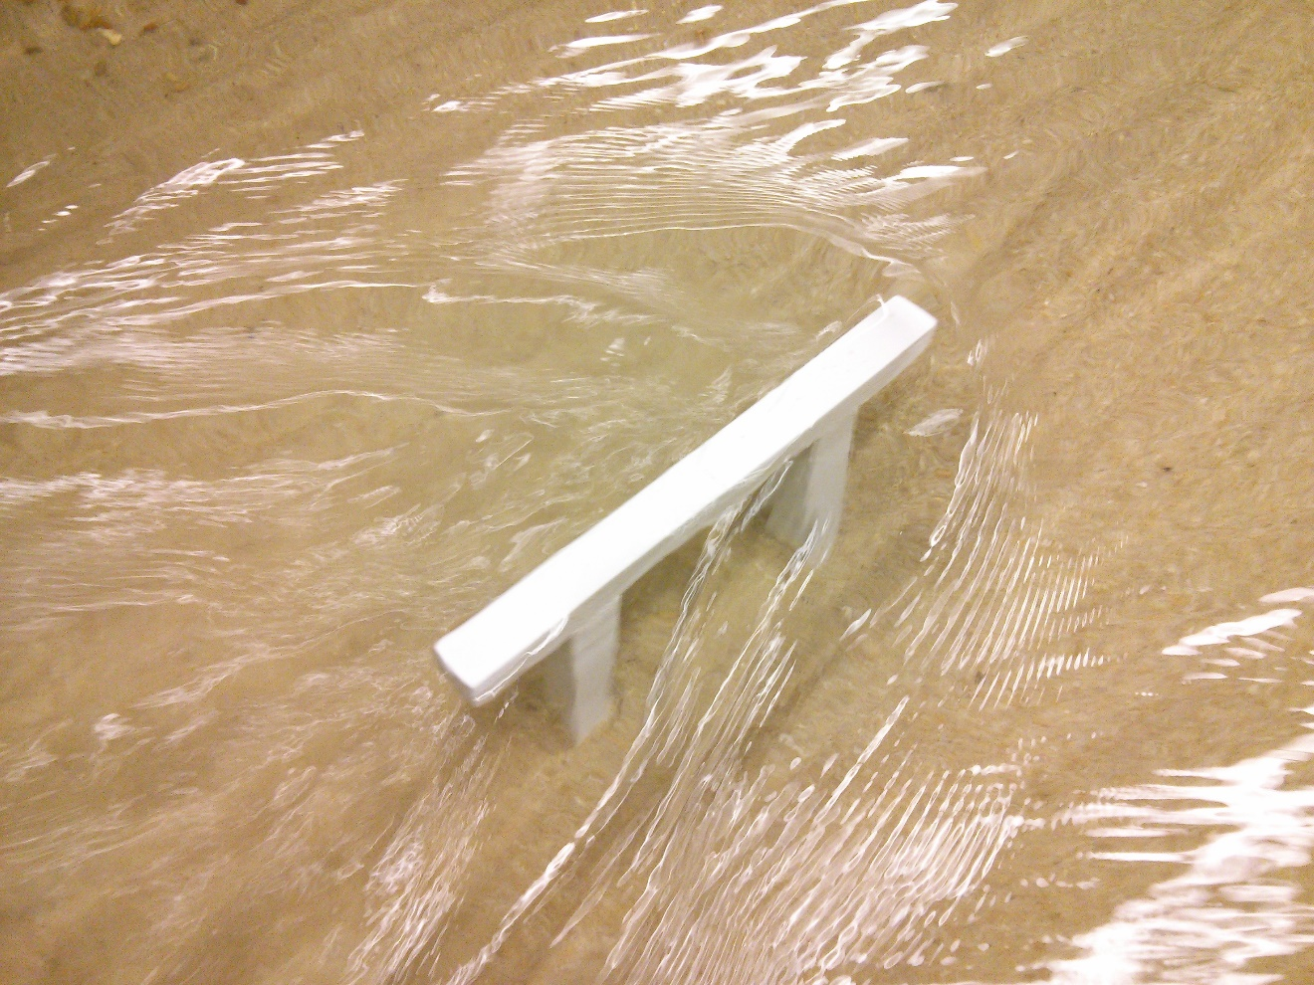
FREE FLOW AROUND A PIER (GT) OUTSIDE THE
ZONE OF INFLUENCE OF THE ABUTMENT
Note the bow wave, separation eddies on the right side
(looking downstream) of the pier, and the wake zone.

Slide 17
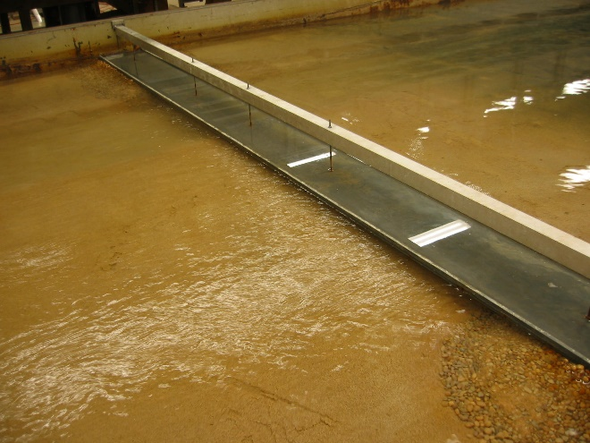
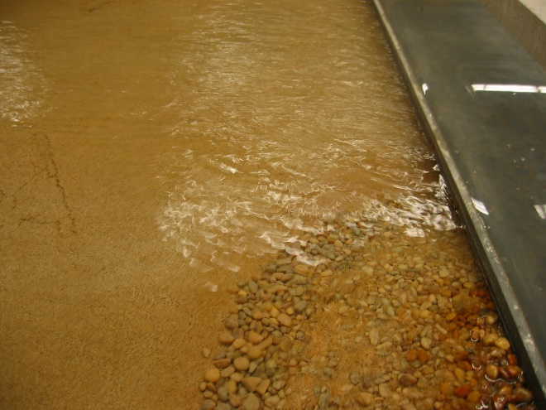
SUBMERGED ORIFICE FLOW – LSA FIXED BED (GT)
Flow from right to left
Flow from right to left

Slide 18
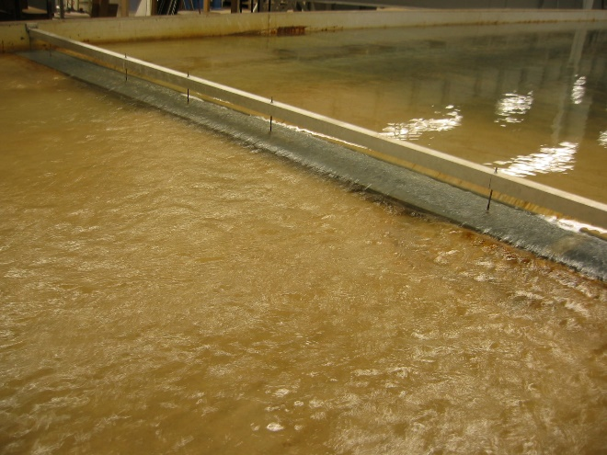
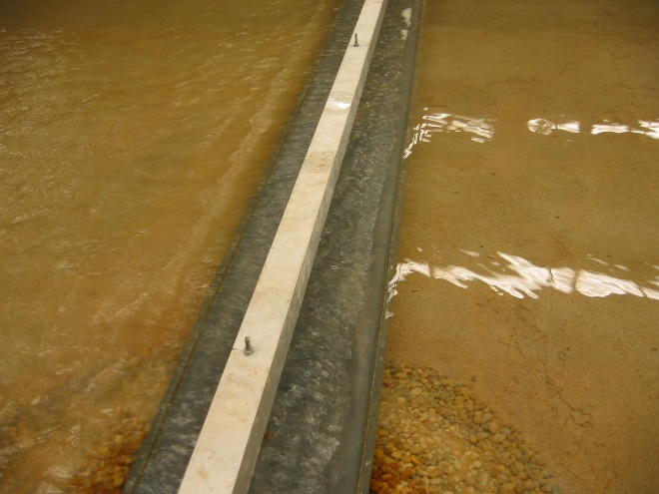
OVERTOPPING FLOW-LSA FIXED BED (GT)
Flow from right to left
Flow from right to left

Slide 19
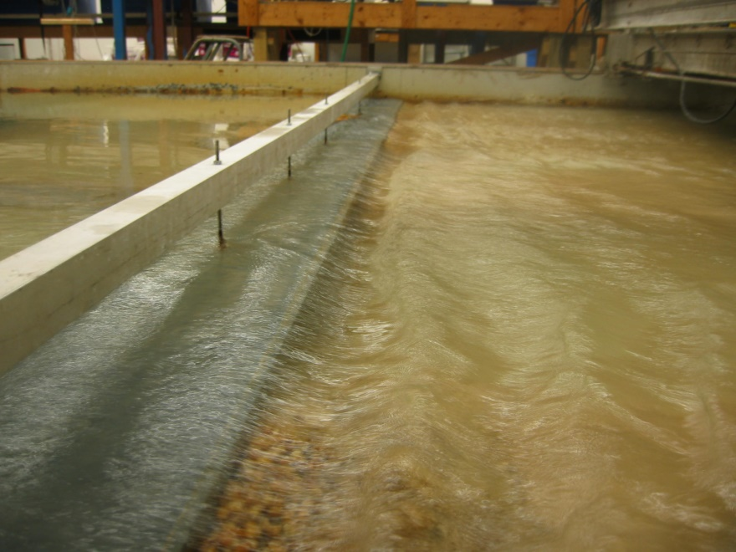
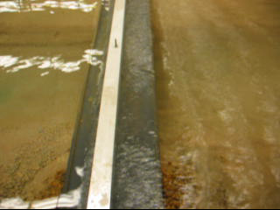
OVERTOPPING FLOW, SSA (GT)
STILL: Flow from left to right
VIDEO: Flow from left to right
(roll mouse over picture to play)

Slide 20
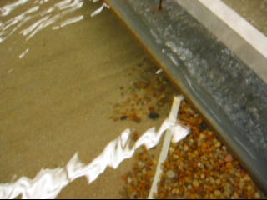
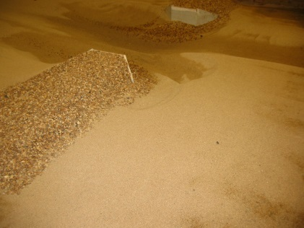
GT RUN 27, OVERTOPPING FLOW, SSA, WINGWALL
VIDEO: Flow from left to right
Bed contours at end of scour
Flow from left to right
Photo at end of scour: Flow from right to left

Slide 21
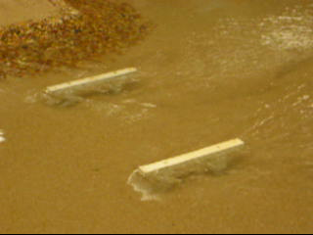
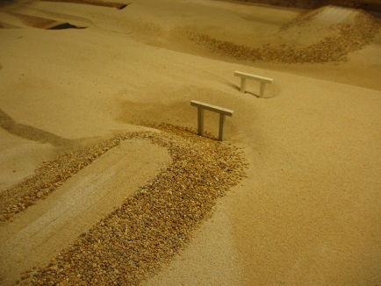
GT RUN 43, FREE FLOW, LSA, WITH PIERS
VIDEO: Flow from left to right
Bed contours at end of scour
Flow from left to right
Photo at end of scour: Flow from right to left

Slide 22
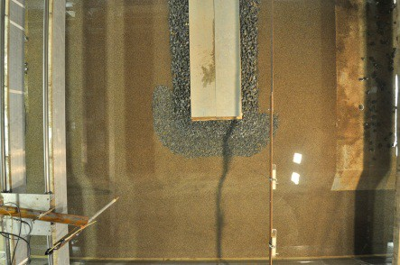
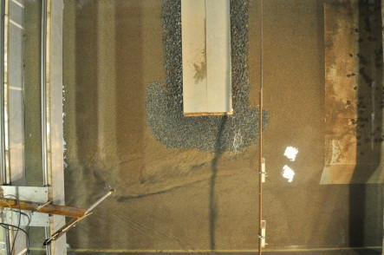

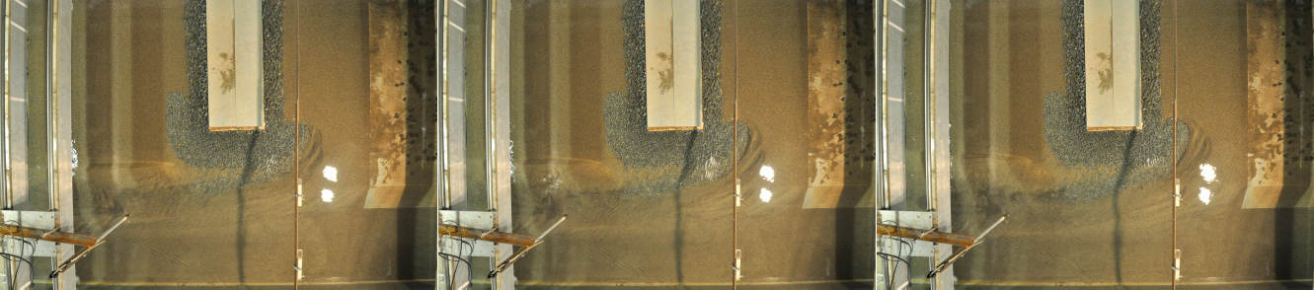
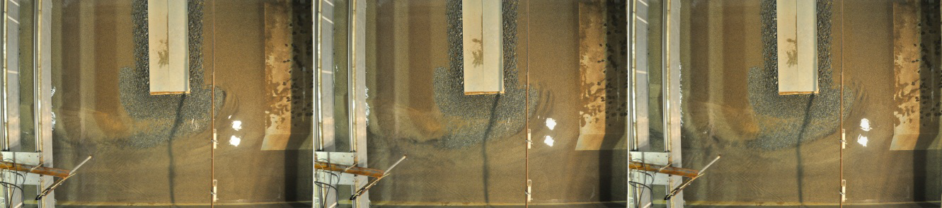
PLAN VIEW OF TIME DEVELOPMENT
OF LIVE-BED SCOUR WITH RIPRAP APRON
t = 0
t = 0.5 hours
t = 1.0 hours
t = 5 hours
t = 10 hours
t = 20 hours
t = 30 hours
t = 50 hours
t = 70 hours

Slide 23
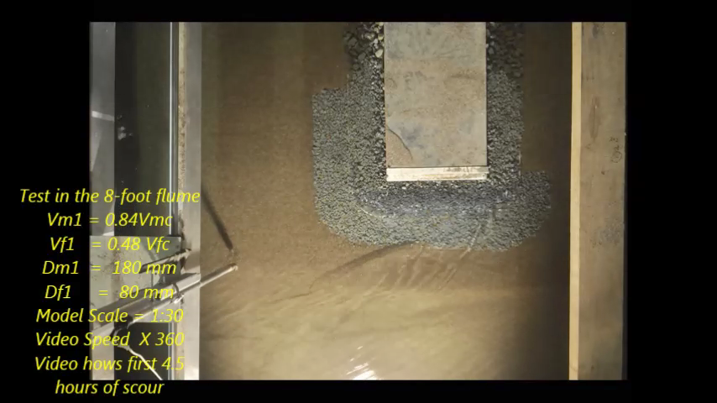
CWS VIDEO FOLLOWED BY LBS VIDEO
VIDEO: playback speed is x360; actual duration = 4.5 hours
Note dune migration in LBS segment

Slide 24
NCHRP 24-37: “Combining Individual Scour Components to Determine Total Scour”
EXPERIMENTAL RESULTS

Slide 25
RESULTS-SCOUR INTERACTION CATEGORIES
I. Abutment/Lateral Contraction Scour with or without Vertical Contraction Scour for LSA: combination of local scour around the abutment induced by the turbulent structure of the flow and acceleration of the flow resulting from the width constriction offered by the bridge opening for free flow around LSA, with or without the addition of vertical contraction scour in SO and OT flows;
II. Abutment/Lateral Contraction Scour with or without Vertical Contraction Scour for SSA/BLA: same combinations as Category I, but for SSA and BLA;
III. Abutment/Lateral Contraction Scour for LSA with pier scour in F, SO, and OT flow;
IV. Vertical Contraction Scour and Pier Scour in the floodplain outside the zone of influence of the abutment.
LSA – long setback abutment; SSA – short setback abutment; BLA – bankline abutment;
F – free flow; SO – submerged orifice flow; OT – overtopping flow

Slide 26
SCOUR INTERACTION CATEGORIES ILLUSTRATED
Category I (upper scour hole) and Category II (lower scour hole) for Free Flow,
Submerged Orifice Flow, and Overtopping Flow; from left to right, respectively

Slide 27
SCOUR INTERACTION CATEGORIES ILLUSTRATED, continued.
Run 7
Run 9
Pier Scour in Category IIIa and Category IIIb for Overtopping Flow and
Long Setback Abutments; from left to right, respectively.

Slide 28
SCOUR INTERACTION CATEGORIES ILLUSTRATED, continued.
Run 43
Run 37
Pier Scour in Category IVa (pier scour alone) and Category IVb (pier scour and vertical
contraction scour); Free Flow and Submerged Orifice Flow from left to right, respectively.

Slide 29
SPILL-THROUGH VS. WINGWALL ABUTMENTS
Run 1
Run 22
Category I scour for Spill-Through vs. Wingwall Abutments in Free Flow;
from left to right, respectively.

Slide 30
RECTANGULAR COLUMN PIER VS. WALL PIER
Run 6
Run 39
Category I scour for Rectangular Column vs. Wall Piers in Free Flow;
from left to right, respectively.

Slide 31
TIME DEVELOPMENT OF SCOUR
Time development of clear-water
scour in Georgia Tech flume
Time development of live-bed
scour in Auckland flume

Slide 32
WATER SURFACE PROILES FOR FREE, SUBMERGED ORIFICE AND OVERTOPPING FLOWS
Clear-water scour in GT flume
Live-bed scour in Auckland flume

Slide 33

MEASURED CROSS-SECTIONAL DISTRIBUTION OF VARIABLES AT DOWNSTREAM FACE OF BRIDGE AND DOWNSTREAM TOE OF EMBANKMENT (GT)
K_{b}=turbulent
kinetic energy
u_{*c} = critical
shear velocity
q₂ = unit discharge
in bridge section
q_{1avg}=ave. unit
discharge in approach
flow section
V_{2(R)} = resultant velocity
in bridge section
L_{a} = abutment length
B_{f} = floodplain width
(a) Run 1, Free flow, L_{a}/B_{f} = 0.41 (b) Run 10, Free flow, L_{a}/B_{f} = 0.77
(c) Run 2, SO flow, L_{a}/B_{f} = 0.41 (d) Run 11, SO flow, L_{a}/B_{f} = 0.77

Slide 34
ABUTMENT LENGTH: LSA VS. SSA/BLA
Circled data points were observed to have maximum scour depths on the bank or in
the main channel so they were identified as SSA.

Slide 35
SCOUR RESULTS: PIER SCOUR ALONE
The Sheppard and Melville (S&M) pier scour equation and the CSU equation produced
very similar results for pier scour alone in comparison with the GT experiments.

Slide 36
VERTICAL CONTRACTION SCOUR ALONE
Due to the scatter in data from several sources, the upper Lyn equation is recommended
For vertical contraction scour alone.

Slide 37
CATEGORY I SCOUR RESULTS (CWS)
Best fit equation for CWS Category I lab results at UOA and GT agrees well
with data from others and with two extreme field data points at either end
of the spectrum. Ratio of predicted scour to theoretical contraction scour
decreases as the driving independent variable on the horizontal axis increases.

Slide 38
CATEGORY II SCOUR RESULTS (CWS)
Similar behavior to Category I best-fit relationship but with a smaller
leading coefficient of 1.725 compared to 2.363. Good agreement again with
data from others and field data through the entire range of the relationship.

Slide 39
CATEGORY II SCOUR RESULTS (CWS & LBS)
Reasonable agreement of LBS results in Category II with CWS
Category II results. Single scour relationship suffices for both

Slide 40
CATEGORY III: ABUTMENT INFLUENCE ON PIER SCOUR
Upper curve – Eq. 4-12
Lower curve – Eq. 4-13
NOTE: Add pier scour from CSU or
S-M eq. to excess pier scour from
Eq. 4-12 or Eq. 4-13
Excess pier scour due to abutment influence dependent on same independent
variables as for abutment/ contraction scour but with additional effect of pier
distance from toe of abutment.

Slide 41
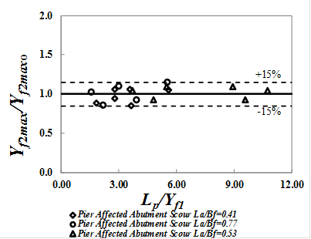
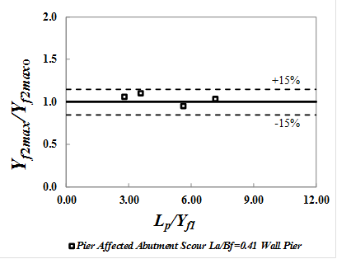
CATEGORY III - EFFECT OF PIER SCOUR ON ABUTMENT/CONTRACTION SCOUR
Rectangular column piers
Wall piers
Category III abutment/contraction scour: Ratio of maximum abutment/contraction scour depth
with pier to that without pier for rectangular column piers and wall piers (Y_{f2maxo} ) from Eq. (4-8)
for Category I scour). The piers have essentially no effect on the maximum abutment/contraction
scour which occurs downstream of the maximum pier scour at the upstream face of the pier

Slide 42
CATEGORY IV - COMBINED PIER AND VERTICAL CONTRACTION SCOUR
NOTE: Add vertical
contraction scour from
upper Lyn Eq. and pier scour
from CSU or S-M eq.

Slide 43
COMPARISON WITH HEC-18 – CATEGORY I
HEC-18
Eq. 4-8
Over-prediction by the HEC-18 additive procedure is approximately 20-30% within 95% confidence limits.
In contrast, the prediction error of Eq. 4-8 developed in this study is ±4% within the 95% confidence
Intervals. Approximately 75% of the predictions of Eq. (4-8) are within ±10% of the measured values. This level of error is consistent with the expected experimental uncertainty.

Slide 44
COMPARISON WITH HEC-18 – CATEGORY II (CWS)
HEC-18
Eq. 4-10
The prediction error of Eq. (4-10) is approximately ±3% within the 95% confidence limits. Nearly 80% of the
predictions are within the ±10% error lines, indicating that as for Category I scour, the approach suggested
in this study eliminates the large bias associated with over-predictions by the HEC-18 procedure of as much
as 40% to 50% within the 95% confidence intervals.

Slide 45
COMPARISON WITH HEC-18 – CATEGORY II (LBS)
HEC-18
Eq. 4-10
Predicted maximum Category II LBS depths are compared with observed values in the figure on the
left in which the HEC-18 additive calculation procedure has been used. Overestimates of as much as
a factor of two are shown. The figure on the right shows the comparison of observed LBS depths with
values predicted by Eq. (4-10), and the data all lie within the ±20% error limits.

Slide 46
COMPARISON WITH HEC-18 – CATEGORY III
HEC-18
Eq. 4-12 and Eq. 4-13
Effect of abutment/contraction scour on pier scour indicates HEC-18 overestimation
of approximately 30 to 50% within 95% confidence intervals.
In contrast, for the proposed method, approximately 80% of the predicted data points
lie within the ±10% error criterion.

Slide 47
SCOUR PREDICTION EQ. SUMMARY

Slide 48
NCHRP 24-37: “Combining Individual Scour Components to Determine Total Scour”
CFD RESULTS

Slide 49
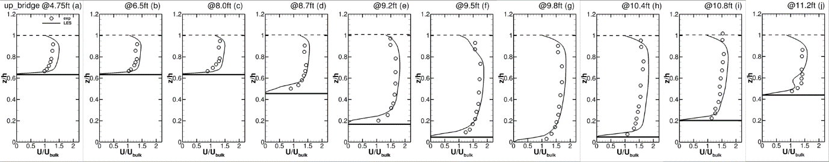
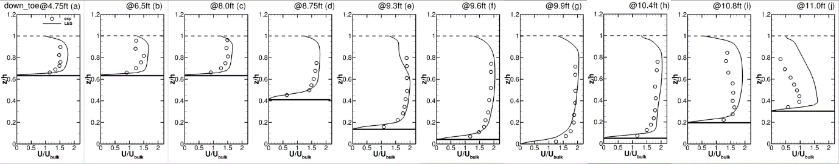
SAMPLE LES VALIDATION
Profiles of the normalized streamwise time-averaged velocity for Run 1 (free flow, long setback abutment) at two cross sections, up_bridge = upstream face of bridge; down_toe = downstream toe of embankment. Each row represents a cross-section with increasing lateral distances shown across the top of each row for each velocity profile. (U/U_{bulk} vs. z/h where U is point velocity, U_{bulk} is mean cross-sectional velocity, z is vertical distance
above bottom of main channel and h is flow depth). (CIRCLES ARE MEASURED AND LINES ARE COMPUTED)

Slide 50
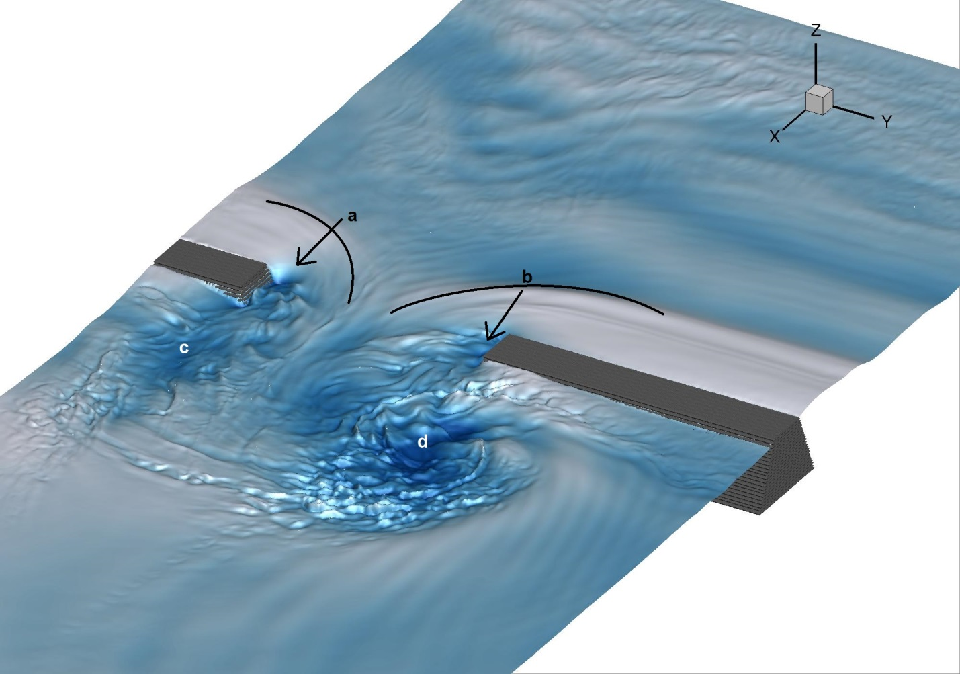
LES COMPUTED WATER SURFACE,
FREE FLOW, SSA
Free surface of the instantaneous flow of Run 10 (free flow, short setback abutment)
color-coded with the water surface elevation. Water surface deformation is exaggerated
by a factor of two to highlight the significance of the turbulence structures.

Slide 51
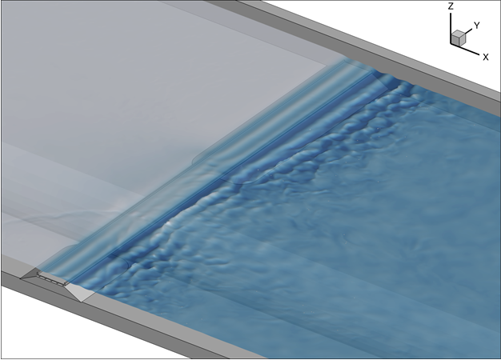
LES COMPUTED WATER SURFACE,
OVERTOPPING FLOW, SSA
Flow from left to right. Note standing waves on the downstream
side of the bridge. These can be seen in the experimental results
and the field photos.

Slide 52
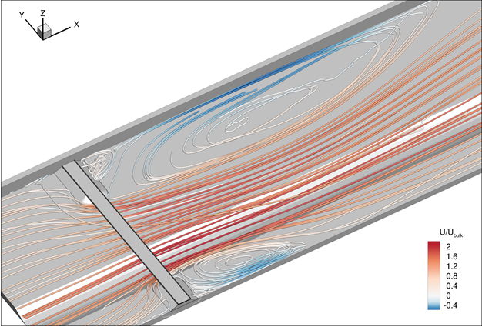
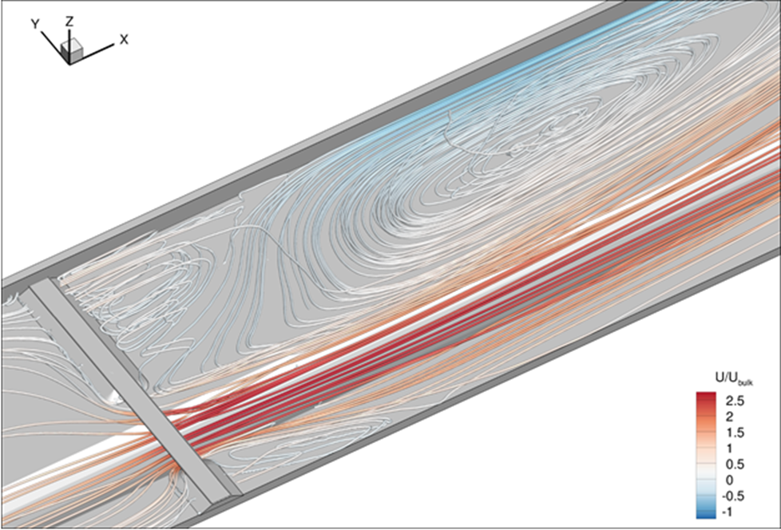
LES STREAMLINES, FREE FLOW (color code is for U/U_{BULK})
Run 1, Free Flow LSA
Run 10, Free Flow, SSA
At the leading edges of the abutments, the flow
separates, which causes the formation of
substantial recirculation zones. The length of the large recirculation zone on the left is approximately two times the width of the channel. High velocity flow occurs on the floodplain and in the main channel with a maximum U/U_{bulk} of 2.
The flow is forced through a much smaller
bridge opening between the abutments,
causing a significant velocity increase, up
to more than 2.5 times the bulk velocity. The
counter-rotating vortex downstream of the left
abutment is driven by the recirculating flow.

Slide 53
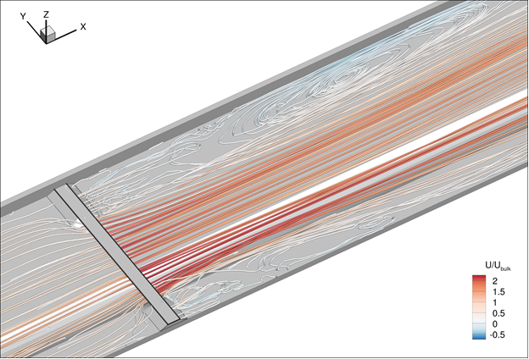
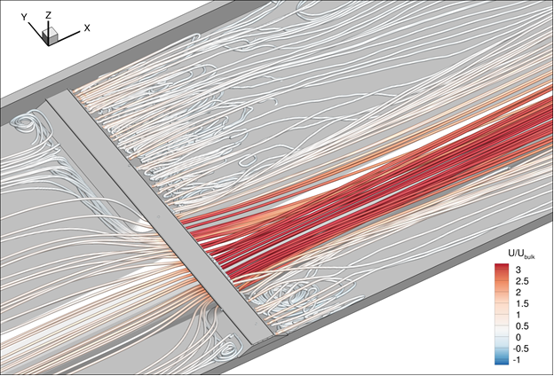
LES STREAMLINES, SUBMERGED ORIFICE FLOW
(color code is for U/U_{bulk})
Run 2, Submerged Orifice Flow, LSA
In comparison to the free flow, the streamlines
downstream of the abutment are almost parallel.
The variation of streamwise velocity across the
cross-section is not as pronounced as for the free
flow run. A large horizontal vortex is found further
downstream than for free flow.
Run 11, Submerged Orifice Flow, SSA
The recirculation zone on the left floodplain
appears to rotate about a horizontal axis rather
than a vertical axis, whereas the recirculation zone
on the right floodplain is predominantly rotating
about a vertical axis. The highest velocities are
found on the downstream side of the abutment
and primarily in the main channel.

Slide 54
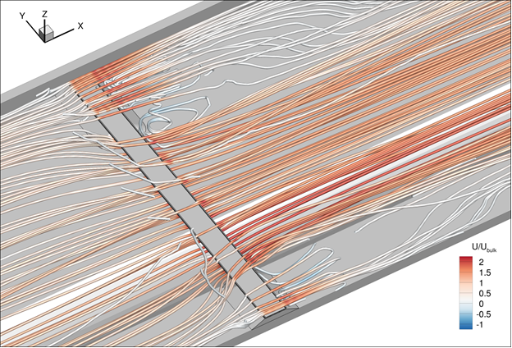
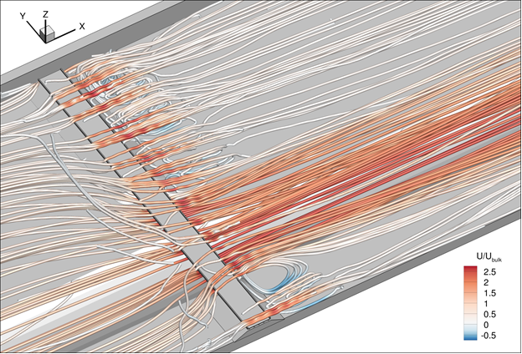
LES STREAMLINES, OVERTOPPING FLOW
(color code is for U/U_{bulk})
Run 3, Overtopping Flow, LSA
The overtopping flow accelerates at the trailing edge of the bridge deck due to the flow plunging into the downstream area of the bridge. The overtopping causes a vertical recirculation zone downstream of the abutments on both floodplains.
Run 12, Overtopping Flow, SSA
The overtopping flow plunges into the downstream
area where it accelerates and drives the vertical
recirculation zones that form on the downstream side of the abutments. Maximum streamwise velocities are found in the main channel.

Slide 55
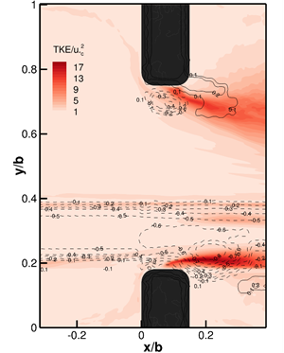
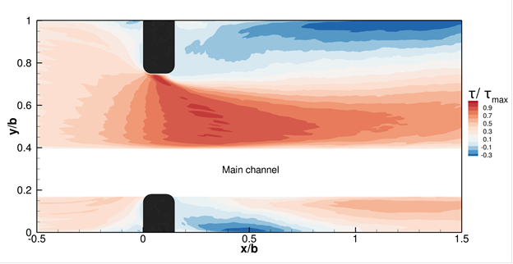
LES TURBULENT KINETIC ENERGY (TKE) & SHEAR STRESS, FREE FLOW, LSA
(a) Color coded TKE overlaid on
bed elevation contours
(b) Color coded shear stress relative to
the maximum value.
Two peaks of TKE are found near the tips of the abutments, clearly the signatures of the
shear layers. Elevated levels of the bed shear stress are fairly consistent with elevated levels
of the TKE with the location of the peaks of these two quantities nearly coinciding suggesting
that both quantities contribute to local scour.

Slide 56
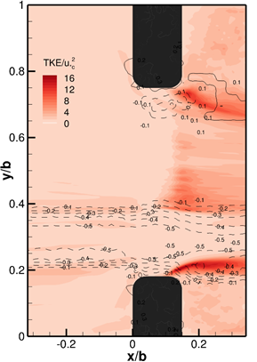
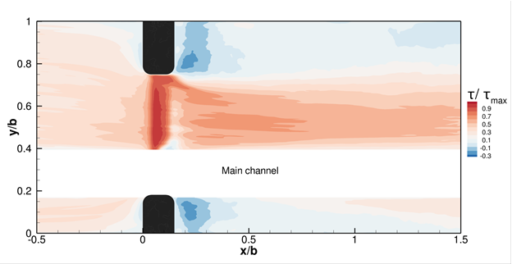
LES Turbulent Kinetic Energy (TKE) & Shear Stress, Overtopping Flow, LSA
(a) Color coded TKE overlaid on
bed elevation contours
(b) Color coded shear stress relative to
the maximum value.
Elevated areas of TKE are visible on the floodplain, due to the flow acceleration, and distinct peaks of TKE
are found near the abutment toes coinciding with the local scour. However, large values of shear stress
occur across the floodplain and are primarily responsible for the vertical contraction scour.

Slide 57
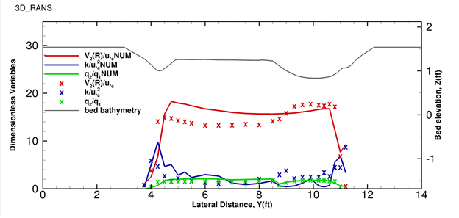
3D RANS SCOUR PREDICTORS, LSA, FREE FLOW
The 3D-RANS predicted profiles are in reasonably good agreement with
the measurements, in particular for the unit discharge ratio, q₂/q_{1 ,} but also
for the resultant velocity, V₂(R)/u_{*c}. However, the 3D RANS significantly
overestimates the TKE (K/u_{*c}²) at the left abutment and underestimates it
at the right abutment. As shown in the final report, the 3D RANS also
overestimates the size of the recirculation zone which is important to scour.

Slide 58
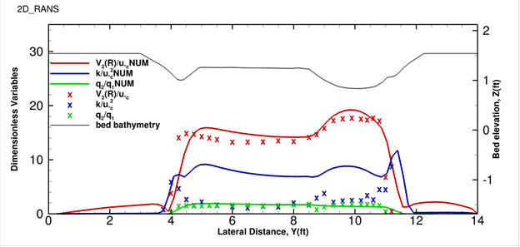
2D RANS, FREE FLOW, LSA
The 2D model is able to calculate with reasonable accuracy the measured q₂/q₁
and V₂(R)/u_{*c} profiles, but it fails completely with respect to predicting TKE as
expected because the turbulence processes are highly three-dimensional.

Slide 59
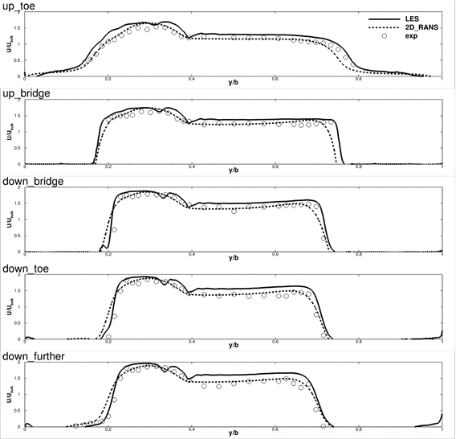
2D RANS SCOUR PREDICTORS, FF, SSA
Note good agreement of LES and 2D RANS with experimental
values of velocity distribution.

Slide 60
NCHRP 24-37: “Combining Individual Scour Components to Determine Total Scour”
NUMERICAL SIMULATION
AT PROTOTYPE SCALE

Slide 61
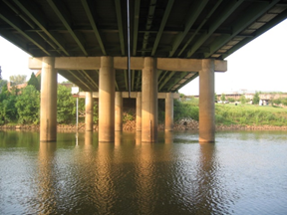
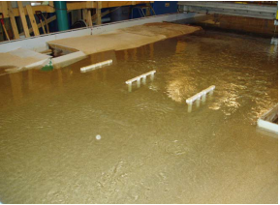
SRH-2D and HEC-RAS SIMULATION AT PROTOTYPE SCALE, OCMULGEE R. BRIDGE AT MACON, GA
Prototype Ocmulgee R. Bridge
Physical Model Study of Ocmulgee R. Bridge

Slide 62
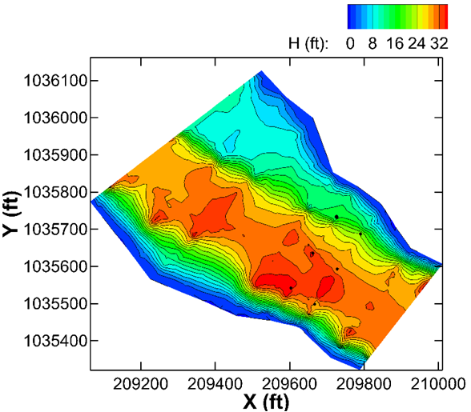
BATHYMETRY, OCMULGEE R. BRIDGE AT MACON, GA

Slide 63
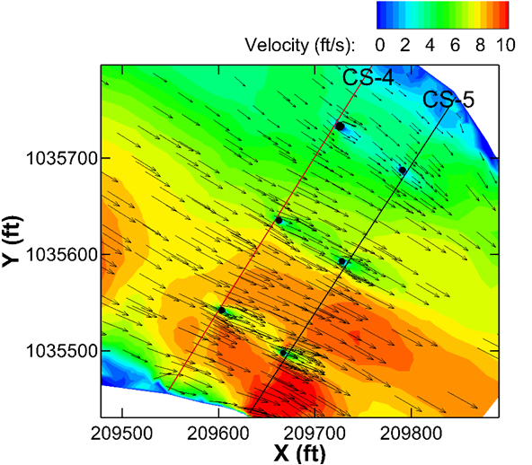
SRH-2D VELOCITY VECTORS AROUND BRIDGE PIERS

Slide 64
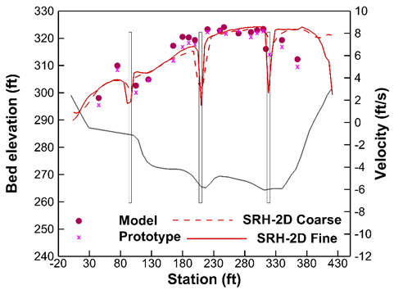
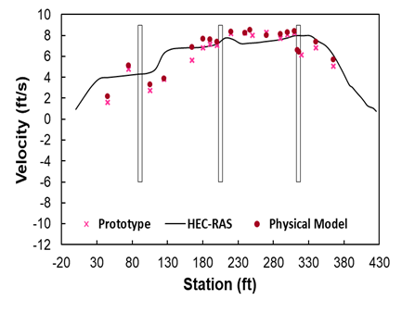
OCMULGEE R. VELOCITY DISTRIBUTION COMPARISONS AT CROSS SECTION 4
SRH-2D predictions of streamwise velocity are reasonably good, but the HEC-RAS
velocity results are as much as 12% less than the measured values in the center
of the main channel, and the decrease in velocity as the piers are approached is not
captured. The velocity near the left abutment is significantly overestimated by HEC-RAS.

Slide 65
NCHRP 24-37: “Combining Individual Scour Components to Determine Total Scour”
APPLICATION

Slide 66
Flow
Chart

Slide 67
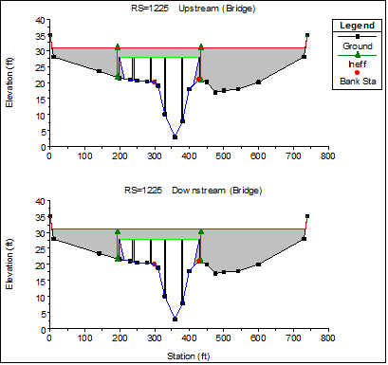
HEC-RAS EXAMPLE BRIDGE SECTION

Slide 68
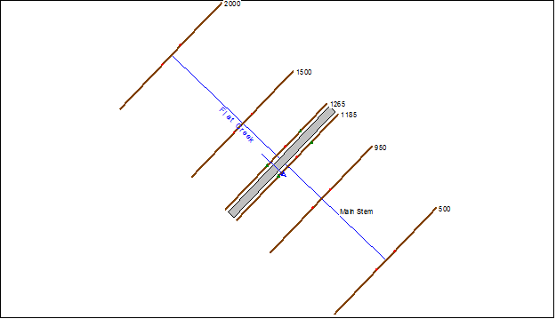
HEC-RAS EXAMPLE CROSS SECTION LAYOUT

Slide 69
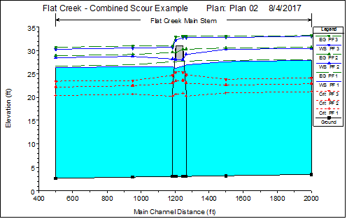
HEC-RAS EXAMPLE WATER SURFACE PROFILES
PF1: Q₁ = 16,000 cfs, Free Flow
PF2: Q₂ = 23,000 cfs, Submerged Orifice Flow
PF3: Q₃ = 30,000 cfs, Overtopping Flow

Slide 70
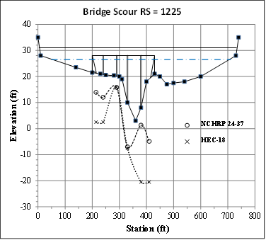
MAXIMUM SCOUR DEPTH COMPARISONS
HEC-RAS estimates of scour in this example problem are significantly
larger near the abutments than for the proposed methodology, but a
proper comparison is the statistical one relative to lab and field measurements
provided previously.

Slide 71
NCHRP 24-37: “Combining Individual Scour Components to Determine Total Scour”
CONCLUSIONS AND RECOMMENDATIONS

Slide 72
CONCLUSIONS
Scour interactions can be organized into four categories according to the relationships governing their prediction:
  Category I – combination of lateral contraction and abutment scour, including vertical contraction scour for submerged orifice and overtopping flows, for long setback abutments defined by the maximum scour depth occurring in the floodplain
  Category II – same combinations of scour components as in Category I except for short setback and bankline abutments for which maximum scour occurs in the main channel
  Category III-combination of pier scour with Category I or Category II scour in terms of the influence of abutment/contraction scour on pier scour, based on the distance of the pier from the toe of the abutment, but with negligible influence of pier scour on abutment/contraction scour
  Category IV-interaction of pier scour with vertical contraction scour

Slide 73
CONCLUSIONS, continued
Scour prediction equations for Category I and II were determined from dimensional analysis and regression of the large database obtained from realistic experiments in this study (compound channel, typical bridge geometry, live-bed and clear-water scour, and flow types of free, submerged orifice and overtopping).
Category I and II scour prediction equations were found to depend on the flow intensity (V₁/V_{c}), unit discharge ratio (q₂/q₁), and backwater ratio Y₁/Y₀)
Category III maximum scour depth was determined to be a sum of excess scour due to abutment influence as a fraction of Category I or II scour depths, depending on the pier distance from the abutment, and the estimated isolated pier scour depth
Category IV scour depth was found to be reasonably estimated by the sum of the vertical contraction scour depth of the Lyn equation and either the CSU or Sheppard-Melville pier scour equation
The proposed combined scour equations were validated by laboratory data of others and field data from the Missouri River, Towaliga River in Georgia, and two Minnesota rivers

Slide 74
CONCLUSIONS, continued
Clear-water scour was modeled at two different physical scales in the laboratory and the results were found to agree.
Live-bed scour experiments all fell into Category II and the results were found to agree with the relationship developed for Category II clear-water scour.
The LES results were validated by extensive experimental data from the GT flume and they revealed the characteristics of turbulence and their influence on scour as affected by the type of flow and abutment length. Areas of high turbulent kinetic energy due to flow separation and formation of a shear layer around the abutment coincided with regions of local scour. Vertical contraction scour was more dependent on elevated regions of shear stress on the floodplain due to the flow acceleration there.
3D RANS simulations showed good agreement with experimental distributions of unit discharge ratio and resultant velocities in the bridge sections but turbulent kinetic energy and the size of the recirculation zone downstream of the abutment, which is an important factor in the scour process, were not reproduced well.
2D RANS modeling provided very good agreement of unit discharge ratios and resultant velocities in the bridge sections with experimental data and the LES results, but turbulent kinetic energy results were unacceptable, as might be expected for a two-dimensional model

Slide 75
CONCLUSIONS, continued
The Ocmulgee River bridge in Macon, GA was modeled by 2D RANS at prototype scale and the flow field agreed very well with field measurements and results from a physical model study.
HEC-RAS modeling of the Ocmulgee River produced velocity distributions with some deficiencies in the bridge section but they were not unacceptable.
An applications guide showed that the proposed methodology can be implemented using HEC-RAS but future efforts toward widespread use of a 2D flow field model that includes submerged orifice and overtopping flows would be desirable.
Scour interactions produce less scour than predicted by current methods of adding individual scour components in Categories I, II, and III. Overestimation of maximum scour depth ranged from 20% to 45% at the 95% level of confidence for these three categories. In contrast, approximately 80% of maximum scour depth estimates using equations developed in this study fell within ±10% of the line of perfect agreement. Using current methods, zero to 15% of the data points fell within ±10% of the line of perfect agreement. For Category IV scour, 100% of the data points fell within ±20% of the line of perfect agreement using the equations suggested herein.

Slide 76
RECOMMENDATIONS
Implement the scour interaction equations proposed herein for estimating maximum depth of scour for four separate categories of interactions;
Investigate additional properties of turbulent flow features using LES, especially for overtopping flows, and their quantitative connection with scour depths;
Add a sediment transport model to the LES model to obtain direct estimates of scour depth;
Adopt the Bureau of Reclamation model SRH-2D or a similar 2D model using k-epsilon turbulence closure and including submerged orifice and overtopping flows as well as free flows for estimating scour prediction parameters;
Extend current riprap protection design procedures for embankments and riprap aprons to include more energetic submerged orifice and overtopping flows, especially in live-bed scour;
Commit to a long-term scour monitoring program at bridges to obtain a more robust set of field data for model validation at a wide variety of bridges.

