Slide 1
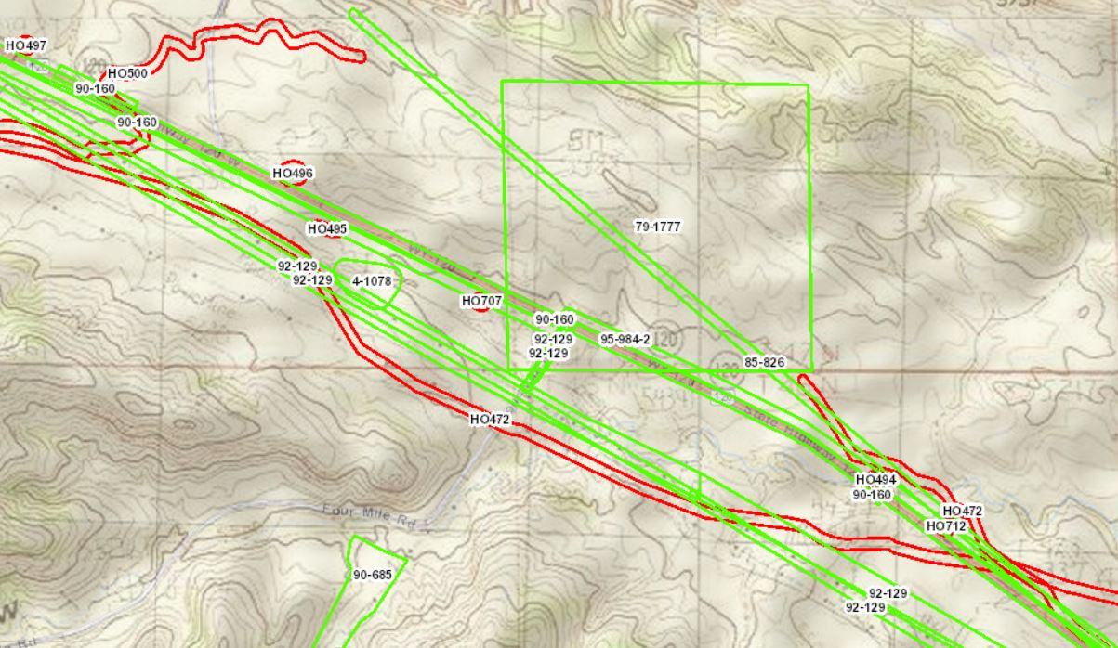
APPLICATION OF GEOGRAPHIC INFORMATION SYSTEMS (gis) FOR Historic properties
NCHRP 25-25/ Task 90
September 2015
Notes:
The National Cooperative Highway Research Program (NCHRP) has conducted a variety of studies in the past that looked at how state Departments of Transportation (DOTs) streamline and enhance compliance with Section 106, through the use of such tools as cultural resources GIS.
National Cooperative Highway Research Program (NCHRP) 25-25/ Task 90 is a logical extension of these previous studies, in that it examines the specific value and structure of GIS use among state DOTs and their historic preservation partners. In addition, a major goal of this current study is creating guidance for improving and maintaining a GIS for cultural resources.
As a note, “cultural resources” include archaeological sites, the historic built environment, and properties of religious and cultural significance to tribes and Native Hawaiians. A sub-set of these resources include properties that are listed in or are eligible for listing in the National Register of Historic Places (i.e., “historic properties”).

Slide 2
What is a GIS?
As used in this study, GIS is an information system that includes:
map (“geographic”) representations,
relational databases, and
digital files (e.g., Reports, Site Files, and other documents).
These are information systems that contain both geospatial information and non-spatial data.
Notes:
When first developed, geographic information systems denoted a fairly simple combination of map, that is, “geographic” representations. Contemporary geographic information systems still incorporate simple map data sets, but now also include relational databases; digital files such as reports, site files, and other documents; and, are essentially information systems that contain both geospatial information and non-spatial data. Thus, the term GIS, as used in this NCHRP study, signifies an information system and not just simple map representations.

Slide 3
NCHrP Study Goals and Objectives
What are the time and cost benefits of using a cultural resources GIS?
What are the costs (time and money) for maintaining and improving a cultural resources GIS?
What are the barriers to maintaining an effective GIS program? How does one overcome these barriers?
What lessons have state DOTs learned from using cultural resources GIS during transportation planning and project development?
Notes:
Here are the goals and objectives of this NCHRP study.
Paraphrase the text in the slide.

Slide 4
Study Approach
Review of previous NCHRP and FHWA studies on cultural resources GIS.
Survey of State DOTs to fill information gaps on GIS use.
Interviews of 15 State DOTs and their historic preservation partners on the use, maintenance, and improvements to their gis.
Notes:
And these are primary elements of this study.
Paraphrase text on the slide, and note that we will be discussing each of these in more detail.

Slide 5
Literature review and initial survey
Based on literature review and project team’s work with state DOTs, found most DOTs had a GIS or had access to a GIS
But, lacked information on 13 states.
Contacted these states and found all but one had a GIS or access to a GIS.
Notes:
At the start of the current study, the project team had information that most state DOTs used or had access to a cultural resources GIS; but, the project team was missing information on 13 states. To fill this information gap, the project team sent a survey questionnaire to the 13 states, asking if they had a cultural resources GIS, and if they did not, were they planning to develop a GIS. This initial survey, combined with information on the other states, showed that virtually every state had a cultural resources GIS. The state DOTs either have an in-house GIS, or share or have access to a GIS maintained by their SHPO or another state agency, such as a state university. A few states have both an in-house GIS and participate in a shared GIS.

Slide 6
Interviews of a sample of state DOTs
Interviewed 15 DOTs.
Sample represented diversity among states in terms of:
maturity of GIS,
how used,
who managed and held GIS, and
use of special applications.
Interviews focused on use, maintenance, and improvements to cultural resources GIS.
Notes:
After the initial survey, the project team interviewed a sample of state DOTs, including several that participated in the initial survey. The interviews focused on the use, maintenance, and improvement of cultural resources GIS. To determine which states were to be included in this sample, the project team, in consultation with the NCHRP panel overseeing this study, considered several factors:
Length of time the GIS has been used (i.e., the maturity of the GIS).
Ways in which the GIS is used by a state DOT (i.e., during long range planning, analysis of projects in a State Transportation Improvement Plan (STIP), and/or during project development).
Whether the state DOT’s GIS is a shared system with other agencies (e.g., the SHPO).
The use of special applications in GIS, such as archaeological predictive modeling.
If the state’s GIS is currently being improved or enhanced.
DOTs were selected based upon the above factors, attempting to maximize the variation among the sampled states. A total of 15 states were interviewed. When possible, the state DOT’s historic preservation partners were also interviewed (e.g., the SHPO, a state office of archaeology, or a university that housed and maintained the cultural resources GIS).

Slide 7
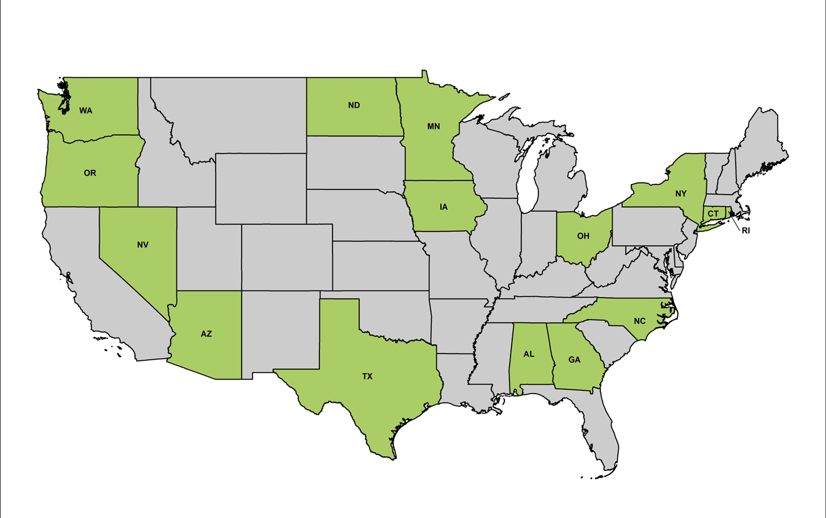
States Interviewed
Notes:
Here are the 15 states interviewed.

Slide 8
Who maintains the GIS?
SHPO
State Archaeologist Office
State University
State DOT
Other State Agency
But, each organization may have different data sets or overlapping data sets.
And, data held by each organization may not be up to date.
Notes:
Based on the state DOT interviews, along with interviews of the DOT’s historic preservation partners, the study found that different types of cultural resources data are often contained in different GIS within a state. For example, the GIS maintained by an office of the State Archaeologist will contain only archaeological site data while the GIS for the historic built environment is maintained by the SHPO. Often, a state archaeologist’s office is required to house archaeological data because of state law.
In addition, a state DOT will have the reports and supporting documentation on cultural resources associated with DOT projects, while these reports and documents are not in the SHPO GIS or with the state archaeologist’s office.
In one state, the DOT holds the state archaeologist’s and SHPO systems on DOT servers because the DOT has greater capacity in GIS than state archaeologist’s office and the SHPO. And, a few state DOTs have a separate in-house cultural resources GIS and also participate in a shared GIS with the SHPO or a state archaeologist’s office, but the types of data in these GIS may not be the same.
And in a few cases, the same type of data are contained within a state’s multiple cultural resources databases, but the data held by these different entities may not all be current and up to date.
And finally, in a few states, the GIS are not accessible online, and require going to the office holding the database in order to access the cultural resources data.

Slide 9
How states use cultural resources gis
Research and screening tool
Assess potential for cultural resources
Identify previously inventoried areas
Constraints Analysis
Notes:
As evident in previous NCHRP studies, and based on the results of the current NCHRP project interviews, the most common use of cultural resources GIS is as a research and screening tool, enabling users to identify the locations of recorded archaeological sites and historic built environment. These GIS are also used to assess the potential for as yet-to-be identified cultural resources within a proposed project area. When accessible through a GIS, DOT staff can also identify locations in a project area that have been previously surveyed. These types of analyses are in turn used to assess the need for future cultural resources surveys, the level of effort associated with these surveys, the location of potentially significant Section 106 issues, the location of potential Section 4(f) properties, and to assist in the analysis of proposed project alternatives.
These analyses are generally conducted after the initiation of the National Environmental Policy Act review process. A few state DOTs, however, use cultural resources GIS to conduct constraint analyses of proposed projects included in a STIP or early corridor studies, sometimes as part of long-range planning. The focus of these analyses is on the location of recorded National Register listed and eligible properties, as well as historic sites that may warrant protection under Section 4(f).

Slide 10
Benefits of having a cultural resources gis
Saves Time and money
Facilitates tribal consultation
Serves as a critical tool for implementing section 106 program alternatives
Streamlines archaeological investigations
Notes:
Almost all of the interviewed DOTs noted cost and time savings as a result of using a cultural resources GIS, especially for online systems. Ohio DOT, for example, noted that time and money have been saved by retrieving most (if not all) of the site records and reports online rather than retrieving them manually at the SHPO.
In terms of tribal consultation, two states noted the benefit of providing tribes access to the GIS. Georgia DOT stated that “Getting tribes access to the GIS was a big success because it streamlined tribal consultation. There are no tribes in the state, so non-resident tribes can access the GIS right at their desktops.” Minnesota DOT noted that “Using the Cultural Resources GIS to create maps for tribal consultation has been very successful. Helps the tribes consult with MnDOT and FHWA.”
Having a cultural resources GIS improves project decision making, in addition to implementation of statewide Section 106 programmatic agreements and national programmatic approaches to managing historic properties. Iowa DOT noted that the state’s GIS is a very important tool for implementing their statewide programmatic agreement. They noted that “The decision-making ability and decision-making power it gives us is phenomenal.”
In another example, Texas DOT staff noted their GIS was an integral part of their implementation of the Section 106 program comment on common post-1945 concrete and metal bridges. The use of GIS helped roll out the post-1945 historic bridge data to the public, in order to get the public’s buy-in for the treatment of these classes of historic bridges.
Minnesota DOT’s use and updating of their GIS-based Mn/Model continues to be an important tool in streamlining compliance-driven archaeological investigations. The model is used to determine, very early in project development, the scope, schedule, and cost for archaeological investigations. The model is also used in early assessments of potential impacts to archaeological resources from proposed project alternatives.
It should be noted that the states did not have information on the actual cost savings, that is, dollar figures per project or per year. This is because the states do not track these metrics. Also, it is very difficult to separate out the cost benefits of using a GIS when the GIS is part of a larger project streamlining program that includes the use of other tools, such as a statewide PA that excludes classes of actions from further Section 106 review or allows the state DOT to make Section 106 findings without consulting the SHPO.

Slide 11
So, How Much Does It Cost To Maintain and Improve?
TIME:
One to two dedicated FTEs, plus part time staff (e.g., 20%-25% of an FTE’s hours)
Money:
$20,000 to $150,000 to maintain per year
$40,000 to $2.2 million to improve (e.g., mapping property locations, digitizing and entering historic built environment data, dealing with legacy data)
Notes:
Only a few of the interviewed states provided information on the level of effort and cost of maintaining their GIS, and also costs for improving their GIS.
The level of effort, that is time required to maintain a GIS was generally consistent among the responding states. Whoever maintained the GIS had one to two full time staff dedicated to maintaining the GIS, with additional part time support from other staff.
The responding DOTs, SHPOs, and other state agencies managing the GIS had a wide range of costs for GIS maintenance, ranging from $20,000 to around $150,000 per year
Costs for improving their GIS was even more wide ranging, but this is not surprising, given that states are doing different types of improvements. A major determinant of these costs is the amount and nature of legacy data that need to be digitized and mapped into a cultural resources GIS ,and the development of special applications, such as an archaeological predictive model.

Slide 12
States moving, or would like to move toward the same goal:
A single,
statewide
cultural resources GIS
maintained by a single entity
Notes:
A key finding of this study was that the interviewed state DOTs, and their historic preservation partners, are all moving, or would like to move, toward the same goal. This goal is to have a single, statewide cultural resources GIS maintained by a single entity. The reason behind this movement is that states want to get away from the situation where there are multiple entities holding and managing different and at times overlapping cultural resources GIS, and where the data are up to date in some systems but not others. In addition, some of these systems cannot be accessed online.
Several of the DOTs noted they did not care who maintains the GIS as long as the DOT staff, their consultants, and local transportation agencies could access the system to obtain the data they needed for Section 106 compliance and project delivery, with the acknowledgement that different users would have different levels of access to the GIS, given the sensitivity of some data within the GIS.
This goal of having a single, statewide cultural resource GIS is in keeping with the findings of FHWA’s study on the use of geospatial tools for data sharing (Federal Highway Administration, September 2014). This study found that transportation agencies are using GIS and other geospatial applications to address their need to more effectively “consolidate, communicate, or share information.” As noted in the study, agencies are
…focusing on dynamic, web-based tools that aggregate large amounts of geospatial data, allow users to create customized visualizations, and are easily accessible even to those without advanced GIS expertise (page iv).

Slide 13
What would this GIS look like?
housed and maintained by a state university, the DOT, the SHPO, or other entity.
Accessible online with appropriate security measures.
Has multiple levels of access.
Contains all recorded cultural resources locations and boundaries.
Shows boundaries of all surveyed areas.
Notes:
What would this single, statewide cultural resources GIS look like and how would it function? Based on the findings of earlier NCHRP and FHWA studies, and on the interviews of the 15 state DOTs and their historic preservation partners, this GIS would:
Be housed and maintained by a state university, the DOT, the SHPO, or other entity.
Be accessible online with appropriate security measures.
Have multiple levels of access (e.g., the public; DOT cultural resources staff, environmental staff, designers, and project managers; local transportation agencies; cultural resources professionals outside the DOT; tribes; etc.).
Contain all recorded cultural resources locations and boundaries (archaeology and historic built environment, historic districts).
Show boundaries of all surveyed areas.

Slide 14
What would this GIS look like (continued)?
Contains Section 106 correspondence and associated documents.
Has all associated reports, property/site forms, and other records (including National Register status of recorded properties).
Allows multiple contributors to upload data into the GIS.
Allows users to download data and use these data for conducting agency-specific analyses, and producing agency maps and reports.
Notes:
Contain Section 106 correspondence and associated documents from the SHPO, the state DOT, and other state and federal agencies.
Have all associated reports, property/site forms, and other records, including information on National Register status of all recorded properties.
Allow multiple contributors to upload data into the GIS.
Allow users to download data and use these data for conducting agency-specific analyses, and producing agency maps and reports.

Slide 15
How do you get there?
System Vision
Organizational Recruitment and Sponsorships
Notes:
Every state DOT operates in a different situation when it comes to data stewardship, agency relationships, and technology. Yet DOTs nationwide face the same work needs and usually, the DOT cultural resources programs conduct their business similarly from one state to the next. The kinds of cultural resources they must consider and the other agencies with whom the DOTs interact are different from place to place, but the general work needs and workflow are approximately the same. For these reasons, implementing a statewide shared GIS can follow fairly similar steps in any state.
Many states have parts of a fully-shared statewide GIS, so, the steps described here may have already been completed, in whole or in part, by any given DOT.
A system vision is a conceptual description of the shared GIS. Just as an organization may have a mission statement, most information systems have a vision or prospectus. The most common way a vision is created is by a small group either sharing dissatisfaction with current conditions or desiring a new approach for achieving project or process outcomes. Alternatively, there may be a small group who would like to champion the improvement and enhancement of their existing GIS. Perhaps one of the best forms of creating a system vision is by building on the work of other states, agencies, or even other DOT or regulatory realms. Cultural resource professionals from other states can provide examples of how their information systems work. Similarly, a wildlife biologist, for example, may be able to demonstrate a system that has worked well and has analogous functions to those needed by cultural resources professionals. This gives potentially interested parties an excellent sense of why a new system (the system envisioned) will be useful and beneficial in terms of historic preservation and environmental compliance, and overall project delivery.
Organizational Recruitment and Sponsorship. Once a community of interest or core group has been created, the proposed statewide cultural resources GIS project goes from an idea to something that needs a guiding structure and sponsorship. There is no single or optimal pathway toward establishing this core group of sponsors. The important outcome of this step is the creation of a coalition of organizations that will drive the creation or evolution of a statewide system, and identify the mechanisms for funding the system. A guiding council of representatives from these sponsor organizations, for example, can take the overall development process forward. Arizona has followed this pathway through the development of AZSITE, the states’ archaeological GIS. The system is still evolving, but it does so under the guidance of a formal board and advisory committee with regular meetings.

Slide 16
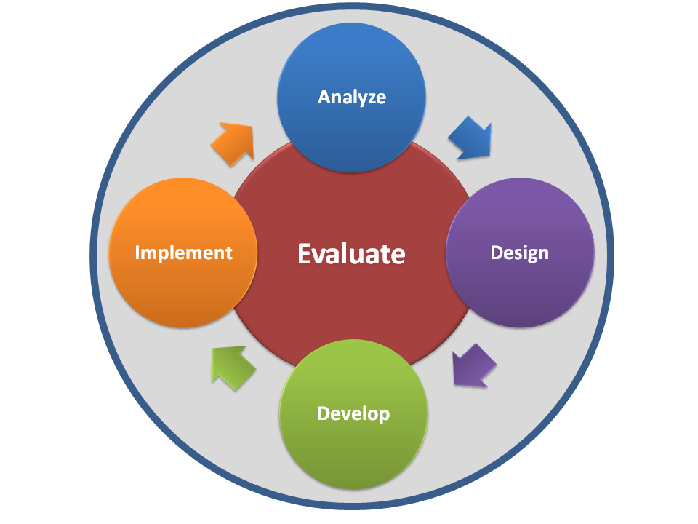
How do you get there (continued)?
Needs Assessment and Priority Setting
System Design
Notes:
Needs Assessment and Priority Setting. The statewide cultural resources GIS will contain many components: electronic archives of documents, database tables, and GIS data sets. The point of a statewide cultural resources GIS is to have a useful, functional, and maintainable information system. Therefore, the organizing coalition for the statewide cultural resources GIS must take responsibility for conducting user needs surveys. These should be as inclusive as possible, including not just cultural resources professionals but also planners and engineers, and members of the interested public. The goal of the needs-gathering process is to have a long list of functional requirements, each of which can be assigned a priority. Priorities may be altered as the planning team considers the needs of major sponsors. Also, the nature of a state’s cultural resources and the most common modes of management can, and should, drive the assignment of priorities to the different needs.
System Design. Designing the GIS (or designing an improved GIS) is the next step. The planning coalition must determine the cutoff point in the list of user needs. This decision should involve a consideration of what is feasible to implement. Feasibility means meeting the priority needs in a way that is affordable and retains the necessary functional features and maintainability. Specific technology choices usually crop up at this point because the sponsoring / hosting organizations will likely have preferences that they can support.

Slide 17
How do you get there (continued)?
Funding
System development and Data Population
Use and Maintenance
System Governance
Notes:
Funding, of course, is a big issue! We will discuss this critical issue separately in a short while.
System Development and Data Population . The GIS development and implementation step is inherently complicated. How a system is developed (as a set of software, hardware, network protocols, etc.) will vary tremendously depending on who are the system’s sponsors, and their IT resources. And one of the most important determinants of system development is funding.
Getting data into the system, that is, populating the GIS, is a substantial endeavor. Most states have between 100,000 and 300,000 cultural resources recorded in some form or another. These are often paper records consisting of a form for each site, building, structure, or district. These forms need to be scanned to become digital documents, entered into a database, and digitized as to their geospatial boundary or point location. Then, each data category needs to be integrated with the other so that from a given interface, one can get to the other modes in which information is stored. Project-related correspondence, historic preservation compliance findings, and investigation reports must also be entered and linked. The order in which the system is populated can be geographic, source-driven, time-driven so that newer or older records are entered first, or any combination of these approaches. This is determined by the system design and plan, based on needs and feasibility.
Use and Maintenance. This step is the final part of a cultural resources GIS evolution. The majority of GIS maintenance is intake of new data. Data maintenance is the single largest challenge for every system. Many cultural resources are newly recorded or updated each year. At a statewide level, hundreds or even thousands of field investigations may occur with attendant report documents. Since most investigations are conducted as a result of federal, state, or local historic preservation statutes, regulations, or ordinances, an equal or greater number of undertakings (“projects”) and their chain of correspondence and regulatory findings are generated in a year. The only effective way to cope with this flood of information is to have data entry occur within the GIS through the uploading of electronic records and documents
There are several barriers to successful GIS use and maintenance. These include, but are not limited to, training, correcting system and information errors, and IT support. We will discuss this separately in a short while.
System Governance. The creation and continued operation of a statewide cultural resources GIS clearly involves many interested parties. A system of on-going governance is important both to create policy and to ensure funding. In Arizona, for example, the AZSITE system is governed by a board, who are assisted by an advisory committee. AZSITE users participate in regular meetings (held in-person and on-line simultaneously) where the governing board presents plans for future enhancements and can field comments from the system’s users. Funding the system is always a topic at meetings, and this allows system sponsors and users to air their thoughts on the value of the AZSITE system in relation to its cost. In the AZSITE case, the system of governance creates an avenue of communication for both continued use of the system and on-going funding of the system.
When a cultural resources GIS is included in a larger portal, as in Florida’s Efficient Transportation Decision-Making program (ETDM), funding and operations may become easier. The ETDM portal is where the Florida DOT conducts its business, so there is no question on whether the cultural resources component should be supported. This is another mode in which a shared cultural resources GIS can be both governed and funded effectively.

Slide 18
RECOMMENDED Partnerships
FHWA
SHPO
Tribes
Repository organizations for historic built environment and archaeological records
land-managing agencies
Private sector cultural resources firms
DOT IT and GIS staff
DOT project managers and transportation planners
Universities
Notes:
As noted in previous slides, a state DOT needs to partner with several other agencies, organizations, and groups of system users, in order to develop and maintain a statewide cultural resources GIS, or to improve and expand an existing statewide GIS. These partnerships include:
FHWA
The SHPO
Tribes
Repository organizations for historic built environment records and archaeological records (e.g., the SHPO, a State Archaeologist Office)
Land-managing agencies, both federal and state
The consulting / contractor community of cultural resources professionals
DOT IT and GIS staff, even if the DOT will not be the hosting organization
DOT project managers and transportation planners
Universities with archaeological, historic architectural, and historic preservation programs
In addition to these required partnerships, state DOTs seeking to create, improve, or collaborate on a cultural resources GIS should also consider partnerships with Metropolitan Planning Organizations, Regional Planning Organizations, and other local governments.

Slide 19
Funding!!
DOT Operational Funds
State Planning and Research Funds
User Fees/Subscriptions
All Federal, State, and Local Agency Users Fund The GIS
Component of larger environmental or project delivery system
Notes:
The interviews of the 15 state DOTs and their historic preservation partners, demonstrate the variety of funding sources used for developing, maintaining and improving a system. These include the use of regular state DOT operational funds and State Planning and Research (SPR) funds (see https://www.fhwa.dot.gov/map21/factsheets/spr.cfm for information on SRP funds). In some cases, when these funding sources are used, GIS users may not pay a fee or subscription for accessing the GIS or downloading records and documents from the GIS. In other situations, there are various types of user fees or subscriptions. These include, for example, an annual fee or subscription per user (e.g., organization, agency, individual), or a fee each time a user accesses a record or document within the system. Some also have a “filing fee” to process documents into the system.
In most cases where a state DOT (and FHWA) has paid for the development of a cultural resources GIS, and/or supports the maintenance and/or improvements to the GIS, the DOT does not pay any fees to access and use the GIS.
One important option to consider in terms of funding the development, maintenance, and improvements to a statewide GIS is to have all federal, state, and local agency users of the system fund the GIS. How much these agency fund the system and when, would be determined during implementation of the Organizational Recruitment and Sponsorship step of creating a statewide GIS. This option might eliminate the need for a use and access fee structure since sufficient funds would come through these agencies to develop, maintain, and improve the GIS.
One approach that might reduce costs is for the cultural resources GIS be a component of a larger, comprehensive transportation project delivery system, such as Florida’s ETDM program. Another is to have the cultural resources GIS as an element within an overarching environmental GIS. The latter contains not only cultural resources data, but also natural resource data, in addition to land use, social, economic, and community data. Virginia DOT’s Comprehensive Environmental Data and Reporting System (CEDAR) is an example. Having a cultural resources GIS as a component of a larger GIS would save costs on hardware, software licensing, and IT support.

Slide 20
How to overcome the barriers?
Maintenance
Training
Notes:
As noted earlier, there are several barriers to successful use and maintenance of a statewide cultural resources GIS, beyond funding.
Data maintenance is the single largest challenge for every system. Many cultural resources are newly recorded or updated each year. At a statewide level, hundreds or even thousands of field investigations may occur with attendant report documents. Since most investigations are conducted as a result of federal, state, or local historic preservation statutes, regulations, or ordinances, an equal or greater number of undertakings (“projects”) and their chain of correspondence and regulatory findings are generated in a year. The only effective way to cope with this flood of information is to have data entry occur within the GIS through the uploading of electronic records and documents, rather than having it trail the work by months or even years.
Training. Several of the DOT cultural resources offices noted that a lack of staff training was a barrier to effective use of GIS. Cultural resource staff with GIS expertise often had this skill prior to joining the DOT, or obtained this skill on their own while on the job. The senior supervisor of one state’s DOT cultural resources office said they make sure that at least one individual within their group has the GIS expertise needed to use and maintain their in-house GIS; and, if this person leaves, GIS expertise is one of the skill sets required for replacing this individual. Another state DOT noted that even though funding for GIS training was available within their Department, staff did not have the time to take the training, as this training would take away from staff’s regular workload. North Carolina was the only interviewed state that has regular internal training in GIS use. At times, staff from the North Carolina Office of State Archaeology and the Historic Preservation Office participate in this training with North Carolina DOT staff. A regular system of training, therefore, is clearly a wise investment in a system’s usefulness.

Slide 21
How to overcome the barriers (continued)?
Correcting System and Information Errors
IT Support
Notes:
Correcting System and Information Errors. As an information system is used, flaws are found in its design and implementation. These may be design oversights, software or hardware issues, or may be induced by changes in historic preservation policy and field practices. The prevalent use of GPS in the field is a good example of this last change. Systems implemented twenty years ago are now being updated to incorporate geospatial information uploaded directly as GPS-gathered data, rather than typed in or drawn on a computer screen or digitizing tablet. Therefore, a well-regulated system must have a capability for its users and hosts (e.g., IT staff) to suggest improvements. These suggestions should be reviewed by the system’s governing body or management team.
Information errors are common in cultural resources information systems. They stem from many sources: poor maps, older records in different formats and with maps at different scales, changes in field technology so that older resources can be located more accurately, and a myriad of other factors. A GIS should have a way to report errors in information content, and include an effective work flow to make these changes. As noted in FHWA’ study on geospatial data-sharing, GIS can be structured to improve data quality, as information is more transparent within a GIS and users can see where there are quality control issues, encouraging data owners to quickly address errors (Federal Highway Administration, September 2014).
IT Support. Many of the interviewed state DOTs noted that cultural resources staff do not have the time to support and improve their state’s cultural resources GIS due to their regular project workload. To address this problem, several of the interviewed states said they wished they had a dedicated, full-time GIS expert within the cultural resources office in order to maintain their in-house GIS. Some DOTs do in fact have a dedicated IT staff person supporting their cultural resources unit, or the larger office in which the cultural resources unit is located.
Some of the interviewed state DOTs identified problems associated with IT support when the GIS was housed and managed by a DOT division other than the cultural resources office, or when managed by another state agency. Maintenance and improvement of a cultural resources GIS can be viewed by these other divisions or agencies as a low priority. A state DOT’s IT division might also not relinquish control of the data or allow data stewards outside of the IT division to facilitate updates or make improvements to the data sets and overall system. As a result, the cultural resource staff are often left to use desktop tools and are compelled to create local data sets that are not accessible to others within the DOT. These data sets are then maintained outside of the DOT’s agency-wide data management system; and, the data are not standardized, backed-up, or updated for general DOT use.
This is a difficult barrier to overcome. Addressing this barrier may require a champion within each of the organizations involved in the statewide cultural resources GIS, a champion who has the authority to break down this barrier. Another approach is to openly discuss this potential problem, creating protocols for addressing this issue as part of establishing system priorities and system design.

Slide 22
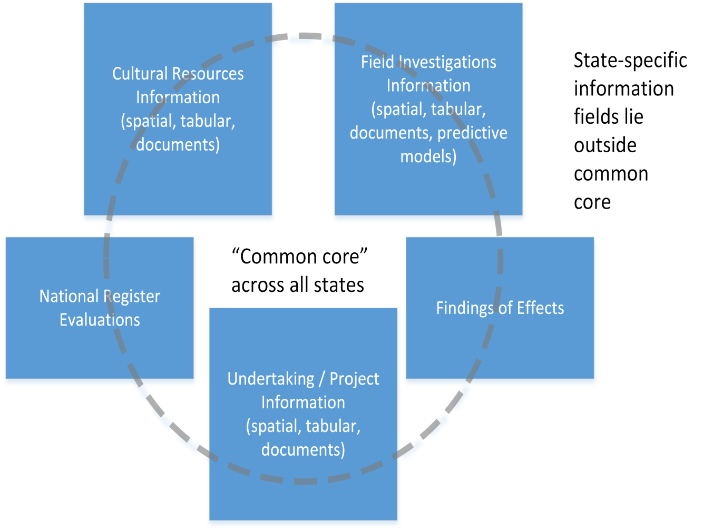
Some Final Observations and recommendations
Create a Shared Common Core Architecture
Notes:
In closing, here are some final observations and recommendations on the results of this NCHRP study.
State DOTs as a whole have similar cultural resources information needs, driven by common work processes. These information needs include, but are not limited to:
Cultural resources characteristics: age, type, and location/areal extent (spatial data).
Field investigation characteristics: type of field investigation, date performed, and location/areal extent (spatial data).
Undertaking (project) information: type of project, project year(s), project location (spatial data).
Federal historic preservation compliance decisions and findings (e.g., National Register evaluations, assessment of effects).
Linkage between these categories of information.
These common information needs could form the basis for a core, shared, statewide cultural resources GIS architecture across states. This core architecture can be used as a template, with each state adding to the core architecture to meet their particular needs and organizational relationships. The creation of this shared architecture can save each state development effort and time, allowing a state to focus on determining what information to include outside of the core architecture.
To facilitate the development of statewide cultural resources GIS, it may be useful for a coalition of state DOTs and their historic preservation partners to meet at the national level, or regionally, to create this core architecture. Individual states can then use this core architecture, as just noted, to focus on determining what information to include outside of the core for their specific state. FHWA, the American Association of State Highway and Transportation Officials, the Transportation Research Board, the National Conference of State Historic Preservation Officers, and the Advisory Council on Historic Preservation might serve as co-sponsors for these national or regional meetings or workshops.

Slide 23
More Final Observations and recommendations
Identify Champions within Agencies
Promote Development of GIS at National and Regional Venues
Notes:
Successful implementation of any new or innovative approach to streamlining and improving environmental compliance and transportation project delivery requires the presence of a champion within a state DOT, and also within a DOT’s partner agencies and organizations. This also applies to the implementation and funding of a single, statewide cultural resources GIS. An agency champion will need to promote the value of a single, statewide cultural resources GIS to agency decision makers. An important tool for promoting this value will be examples from other states and agencies, and even from non-cultural resources offices within the DOT that use GIS (e.g., state and national natural resource GIS). These examples provide decision makers an excellent sense of why the system envisioned will be useful and beneficial in terms of historic preservation and environmental compliance, and overall project delivery. The current NCHRP study can also be used as a resource for promoting, developing, and sustaining a statewide cultural resources GIS that focuses on data-sharing, agency cooperation, and streamlining project delivery.
Additional platforms for promoting the development, expansion, and improvement of a statewide cultural resources GIS include national and regional conferences. These venues can provide opportunities for a dialogue on the need for these data systems. These national and regional conferences include, but are not limited to, the meetings of appropriate committees of the Transportation Research Board, the American Association of State Highway and Transportation Officials, and the National Conference of State Historic Preservation Officers. These opportunities for dialogue among the federal, state, and local agencies and private sector practitioners who attend these meeting should not be restricted to the presentation of papers or panel discussions, but should involve working sessions that address the issues raised in this current NCHRP study. A product of these working sessions might include action plans for advancing statewide cultural resources GIS, and improving and expanding those systems which are already in place.

Slide 24
NCHRP Study Panel
Gail D’Avino, Chair, Georgia Department of Transportation
William Bachman, Westat, LP
Christopher Bell, Oregon Department of Transportation
Faisal Hameed, District of Columbia Department of transportation
Elizabeth Hobbs, Minnesota Department of Transportation
Roy Jackson, Florida Department of Transportation
Bruce Jensen, Texas Department of Transportation
Erin Littauer, Washington Department of Transportation
MaryAnn Naber, Federal Highway Administration
Crawford Jencks, NCHRP Staff Officer

Slide 25
Study Project Team
Eric Ingbar, Gnomon, Inc.
Terry Klein, SRI Foundation
Melissa Cascella, ICF International

