Slide 1
NCHRP 19-16: Executive Presentation Federal Funding Uncertainty in State, Local, and Regional Departments of Transportation: Impacts, Responses, and Adaptations
February 2022

Slide 2
Presentation Contents
Objectives and Audience
History of Federal Funding Uncertainty
Impact on Transportation Agencies and the Economy
Mitigation Strategies
Outcomes of Federal Funding Uncertainty

Slide 3
Objectives
Characterize how federal funding uncertainty has impacted state, regional, and local transportation programs
Investigate the methods agencies employ to mitigate and adapt
Assess the impacts of federal funding uncertainty on program delivery

Slide 4
Report Audience
The report is useful for a variety of audiences, including:
State Departments of Transportation
Metropolitan and Rural/Regional Transportation Planning Organizations
United States Department of Transportation staff
Legislative and elected officials
Legislative Aides and Staff

Slide 5
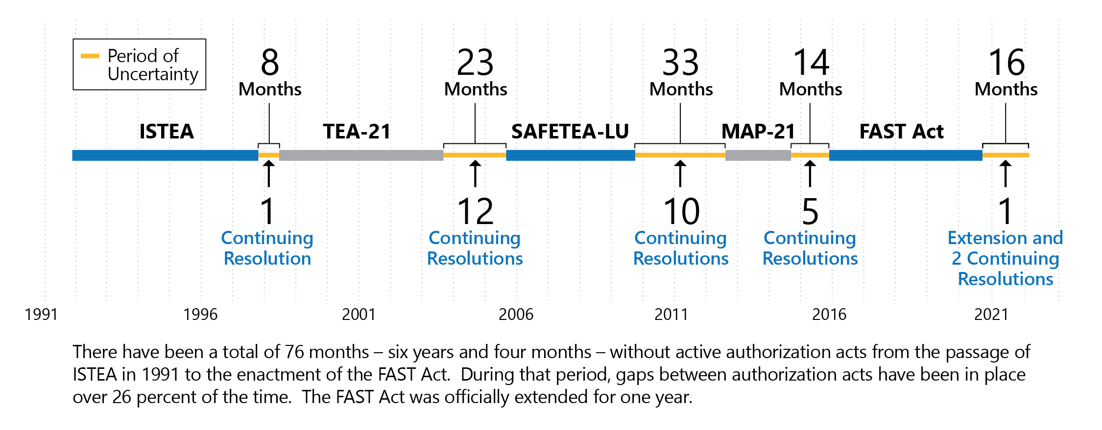
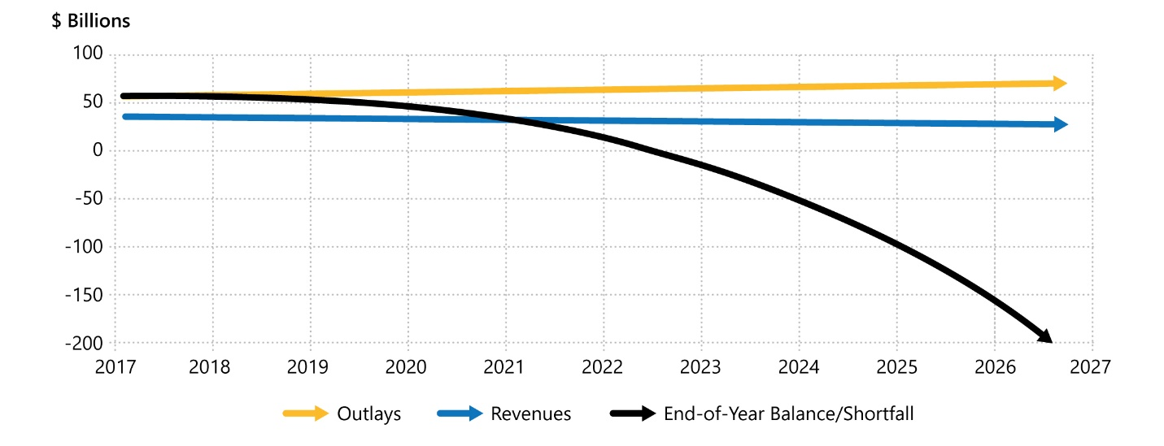
The History of Federal Transportation Funding Uncertainty
Significant gaps between authorization bills leads to numerous continuing resolutions
The Highway Trust Fund (HTF) account is facing significant shortfalls due to an unchanging federal gas tax

Slide 6
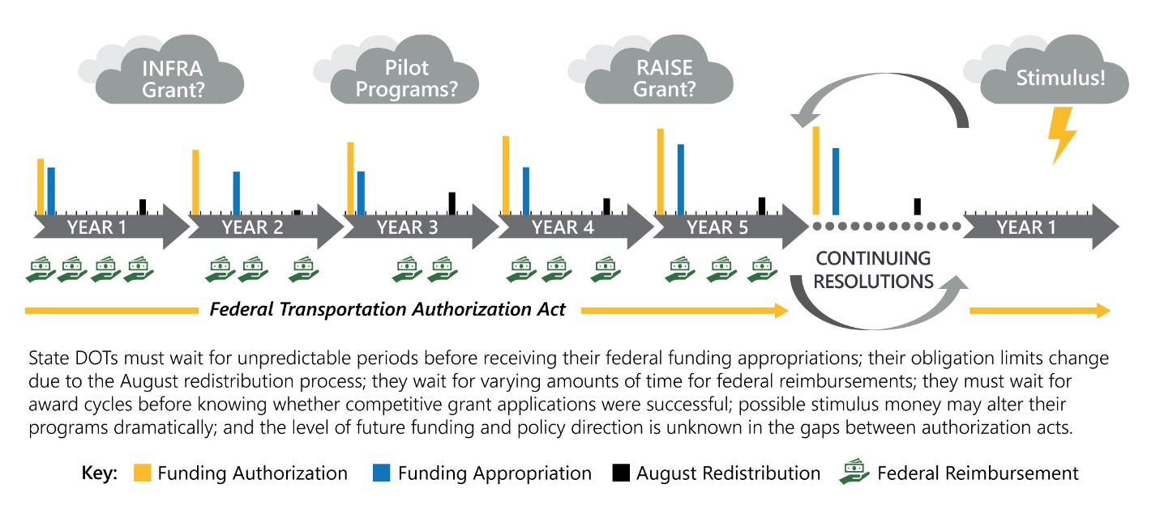
Primary Elements of Federal Transportation Funding Uncertainty
Timing:
within a single fiscal year (timing of appropriations)
over a longer period for large projects with multi-year federal funding needs.
Amount:
Changes within a fiscal year
Changes in later fiscal years
Long-term outlook

Slide 7
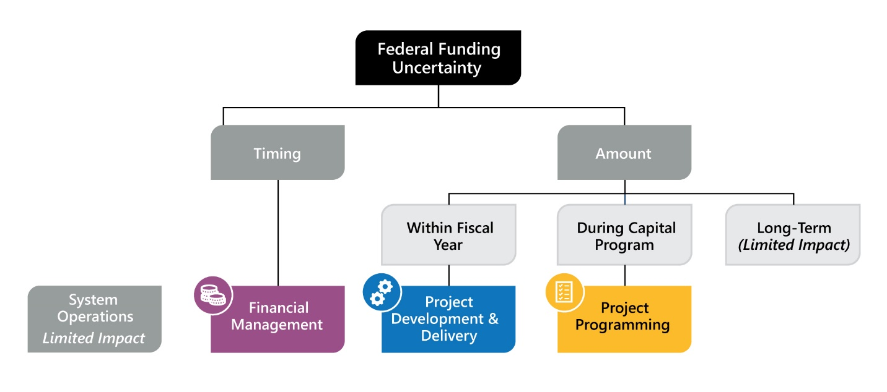
Functional Areas Affected by Federal Funding Uncertainty

Slide 8
Broader Economic Impacts
3 federal funding programs chosen to demonstrate impacts of potential federal funding shortfall or delays:
CMAQ – Cutting CMAQ funding by 50% would defund an estimated 1,200 eligible projects per year
Full social cost > $1.3 billion / year.
FTA CIG: reducing FTA CIG funding by $463 million per year would result in lower transit service leading to slower public transit ridership growth.
Increase in household transportation costs: $1.6 billion / year by 2040 due to congestion and increases in emissions
Bridges - A reduced funding scenario (50%) in the short-term would impact bridge ratings and possibly result in diversions, reduced speeds, and weight restrictions.
Net loss in travel benefits and vehicle costs: $2.52 billion / year
Increase in transportation agencies costs: $5.4 billion / year

Slide 9
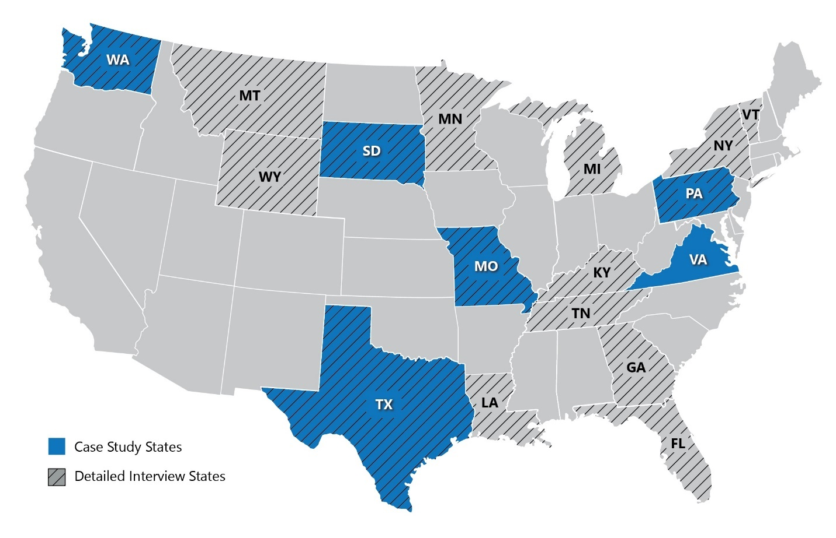
Agencies Interviewed
Various states and regional transportation agencies were involved in the project:

Slide 10
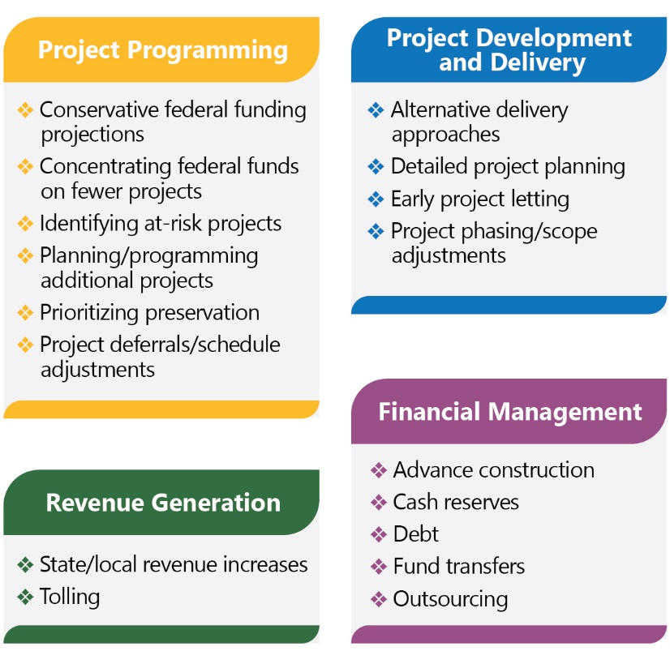
Mitigation Strategies by Functional Area
A similar toolbox is used around the country to mitigate federal funding uncertainty.

Slide 11
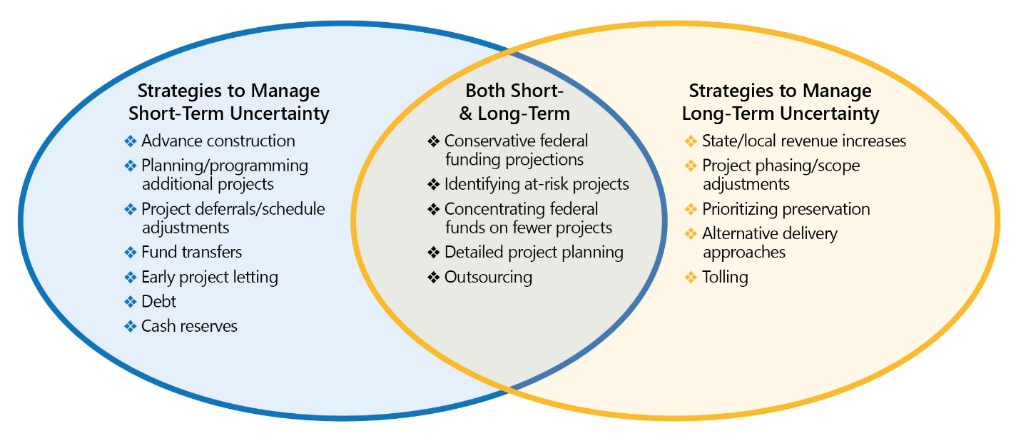
Mitigation Strategies to Manage Short- and Long-Term Uncertainty

Slide 12
Outcomes of Federal Funding Uncertainty
While there are both generally positive and negative outcomes, the effects of funding uncertainty are largely deleterious.

Slide 13
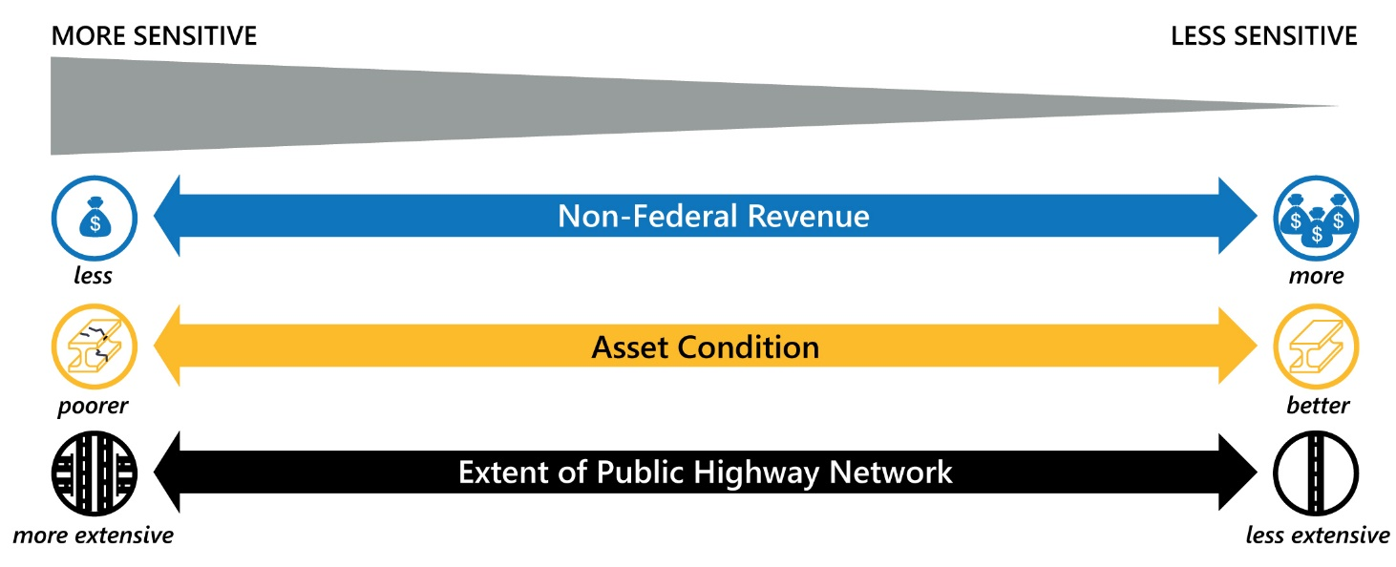
Sensitivity to Federal Funding
Some States are better
equipped than others to
manage federal funding
uncertainty.
Notes:
Sub-sections:
How to determine the need to issue debt.
How to develop guiding policies and tools that consider statutory and regulatory parameters and constraints
How the various types of surface transportation debt may be aligned with surface transportation priorities and policies to establish an approach to debt issuance
How to incorporate iterative learning and strategy enhancement, including market analysis

Slide 14
Conclusion
The research shows that:
Short-term effects of uncertainty are largely mitigated
But uncertainty generates significant inefficiencies for agencies in planning and delivering projects
Many state and local governments continue to struggle to meet their transportation investment needs
Even with increases in federal, state and local transportation funding
Federal funding uncertainty is particularly harmful to states and regions more dependent on federal funding and have comparatively poor asset condition

Slide 15
NCHRP 19-16 Research Team
Simon Mosbah Principal Investigator
Simon.Mosbah@wsp.com
Muhammed Patel Research Analyst Muhammed.Patel@wsp.com
Sarah Kline Case Study Researcher sarah@sksolutions.net
Ben Perez White Paper Lead
Benjamin.Perez@wsp.com

