Slide 1
NCHRP 22-26:
Fatal and Serious Injury
Factors in
Motorcycle Collisions with Traffic Barriers
H. Clay Gabler
Virginia Tech
Department of Biomedical Engineering and Mechanics
Center for Injury Biomechanics

Slide 2

NCHRP
The National Cooperative Highway Research Program (NCHRP) produces ready-to-implement solutions to the challenges facing transportation professionals. NCHRP is sponsored by the individual state departments of transportation of the American Association of State Highway and Transportation Officials. NCHRP is administered by the Transportation Research Board (TRB), part of the National Academies of Sciences, Engineering, and Medicine, under a cooperative agreement with the Federal Highway Administration (FHWA). Any opinions and conclusions expressed or implied in resulting research products are those of the individuals and organizations who performed the research and are not necessarily those of TRB; the National Academies of Sciences, Engineering, and Medicine; the FHWA; or NCHRP sponsors.

Slide 3
Guardrail Fatalities by Vehicle Type
Motorcycles account for more guardrail fatalities than any other vehicle type
Motorcycles surpass all vehicles in Guardrail Fatalities
[Data from FARS 2018]

Slide 4
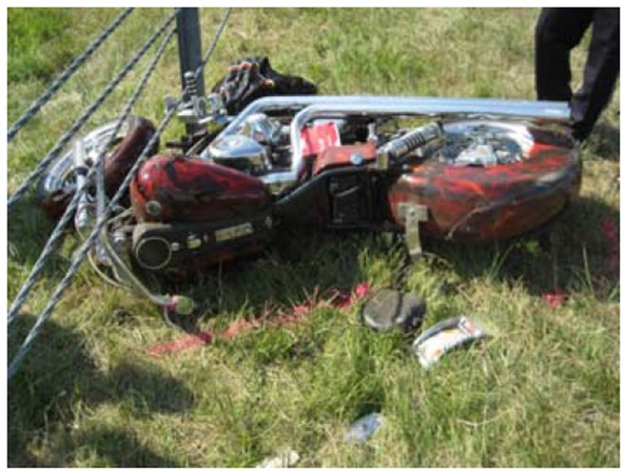
NCHRP 22-26:
Objective
What is the risk of serious-to-fatal injury in barrier crashes?
What are the causes of serious-to-fatal barrier injuries?
What are the countermeasures?

Slide 5
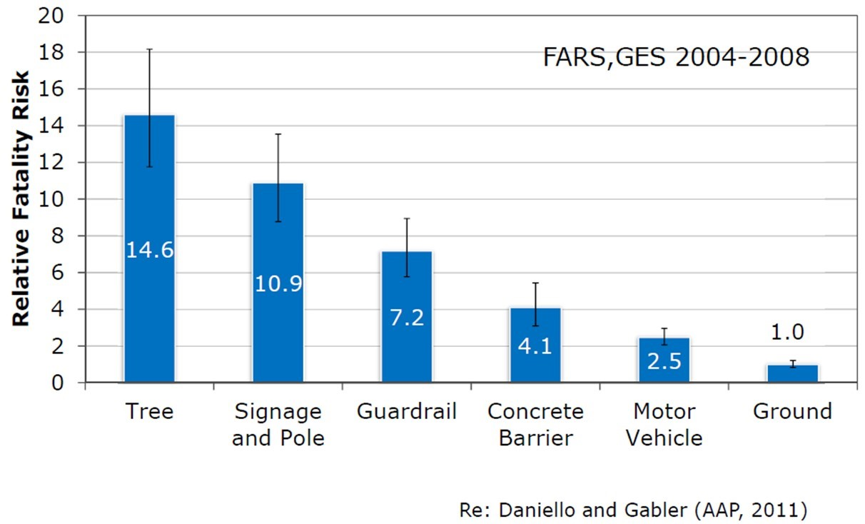
Study 1: Relative fatality risk of fixed object vs. ground collisions

Slide 6
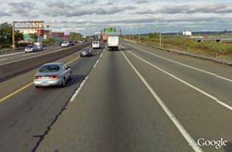
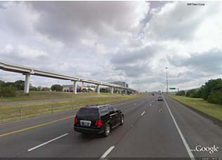
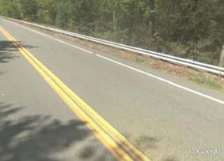
Study 2:
Does Injury Risk vary by Barrier Design?
2003 to 2008
3 States
951 Crashes
W-Beam and Concrete Barrier
(NJ)
Cable Barrier (TX)
W-Beam Guardrail (NC)
Barrier Type | New Jersey | North Carolina | Texas | Total
W-beam | 168 | 134 | 244 | 546
Concrete Barrier | 87 | 23 | 248 | 358
Cable Barrier | 0 | 15 | 32 | 47
Total | 255 | 172 | 524 | 951
Photos from Google Earth
Re: Daniello and Gabler (TRR, 2011)

Slide 7
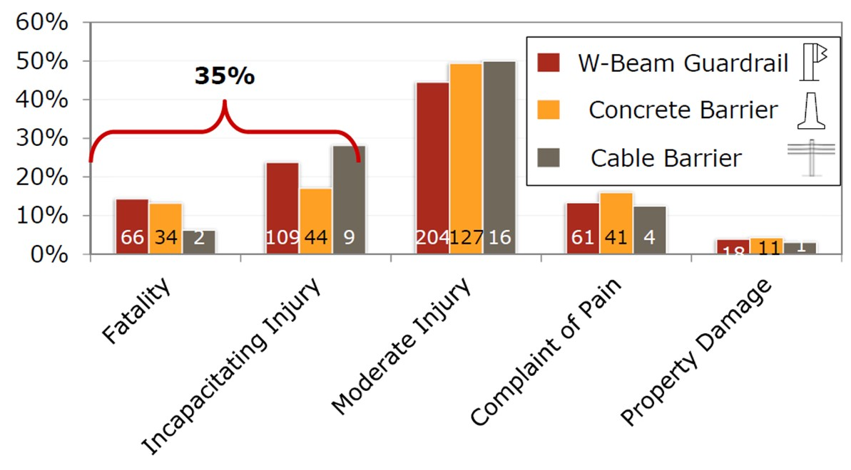
Injury Severity by Barrier Type
Helmeted Riders

Slide 8
Odds Ratio of Severe Injury (K+A)
Helmeted Riders
W-Beam
vs.
Concrete Barrier
No Statistical
Difference between
Cable and W-Beam Risk
Cable Barrier
vs.
Concrete Barrier
Cable Barrier
vs.
W-Beam

Slide 9
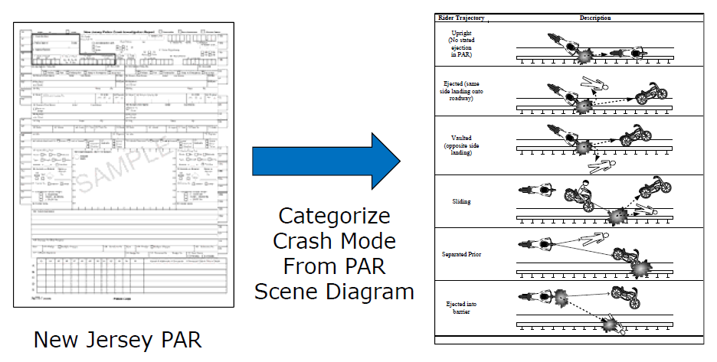
Study 3: Rider Trajectory vs. Injury
Problem:
  Riders often separate from motorcycle on impact
  Police accident reports indicate rider/motorcycle as united
  Do riders actually impact guardrail?
Research Questions
  How do riders impact barrier? Upright, sliding, other?
  How does rider trajectory influence injury risk?
Approach:
  NJ 2007 – 2011
  342 MC-Barrier crashes categorized
  Compute odds of serious injury (K+A)
Re: Daniello A, Cristino D, and Gabler HC, “Relationship Between Rider Trajectory and Injury Outcome in Motorcycle-Barrier Crashes”, Transportation Research Record (2013)

Slide 10
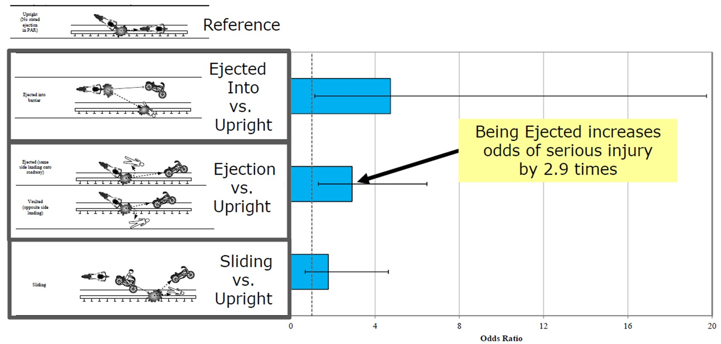
Injury Risk vs. Upright

Slide 11
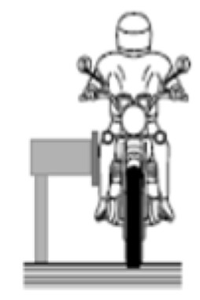
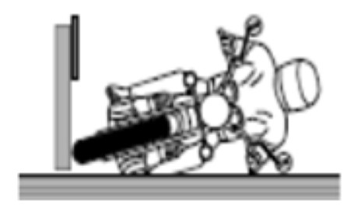
Impact Configuration
Impacts approx. split between upright & sliding
Source | Upright Impact (%) | Sliding Impact (%)
Quincy et al. (1988) | 42 | 58
Berg et al. (2005) | 51 | 45
Peldschus et al. (2007)* | 75* | 25*
Baumbach et al. (2013) | 44 | 47
Daniello et al. (2013 | 51 | 41
Source | Upright Impact (%) | Sliding Impact (%)
Quincy et al. (1988) | 42 | 58
Berg et al. (2005) | 51 | 45
Peldschus et al. (2007)* | 75* | 25*
Baumbach et al. (2013) | 44 | 47
Daniello et al. (2013 | 51 | 41
Only 8% of riders do not impact barrier
*Note: Also included non-barrier run-off-road crashes

Slide 12
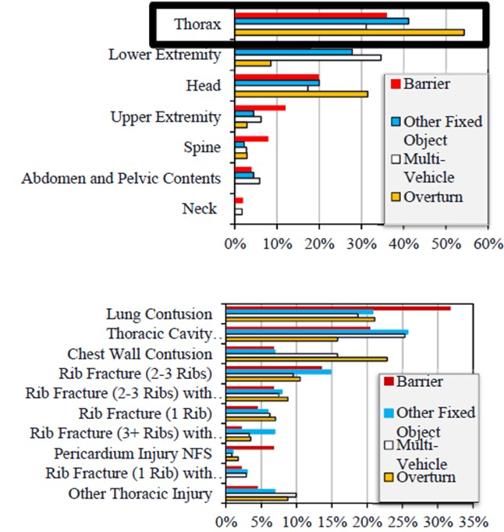
Study 4:
What Injuries Occur in Barrier Crashes?
Serious Injuries (AIS3+)
1,707 motorcyclists in crashes in Maryland
  CODES: Linked Hospital + Police Accident Reports
Odds of thoracic injury double in barrier crashes
Need to differentiate between barrier types
Re: Daniello A and Gabler HC,
“The Characteristics of Injuries in Motorcycle to Barrier
Collisions in Maryland”,
Transportation Research Record (2012)
Injuries indicate blunt impact, Not laceration

Slide 13
Study 5:
Effect of Roadway Characteristics on Injury
Research Question:
Do roadway characteristics affect risk of injury in barrier crashes?
  Radius of Curvature
  Vertical Grade
  Speed Limit
  Shoulder Width
  Traffic Volume
  Divided vs. Undivided
Data Sources:
Re: Gabauer DJ, “Characterization of roadway geometry associated with motorcycle crashes into longitudinal barriers,”
Journal of Transportation Safety and Security (2016)

Slide 14
Injury Risk (K+A)
Variable Type | Parameter | Value | Comparison Group | Odds Ratio | 95% CI
Roadway | Normalized horizontal curve radius | < 820 feet | Tangent Section | 1.31 | 0.92 – 1.9
 |  | ≥ 820 feet | Tangent Section | 0.96 | 0.63 – 1.5
 | Vertical grade | < 3% | ≥ 3% | 1.28 | 0.95 – 1.7
 | Posted speed | > 45 mph | ≤ 45 mph | 1.32 | 0.97 – 1.8
 | Roadside shoulder width | ≥ 2 and < 10 feet | < 2 feet | 1.11 | 0.72 – 1.7
 |  | 10+ ft | < 2 feet | 0.91 | 0.53 – 1.6
 | AADT | < 2,500 vpd | > 50,000 vpd | 1.09 | 0.62 – 1.9
 |  | 2,500 – 9,999 vpd | > 50,000 vpd | 1.55 | 0.89 – 2.7
 |  | 10,000 – 49,000 vpd | > 50,000 vpd | 1.00 | 0.67 – 1.5
 | Configuration | Divided | Undivided | 1.81 | 1.16 – 2.8
Crash | Surface condition | Dry | Wet | 3.78 | 2.09 – 6.8
 |  | Other | Wet | 2.86 | 0.80 – 10.2
Rider | Helmet use | No | Yes | 2.04 | 1.56 – 2.7
 |  | Unknown | Yes | 1.45 | 0.81 – 2.6
 | Age | > 25 years | ≤ 25 years | 1.43 | 1.03 – 2.0
 | Alcohol | Yes | No | 2.99 | 2.10 – 4.3
No statistically significant difference
Higher Injury
Risk
Factors

Slide 15
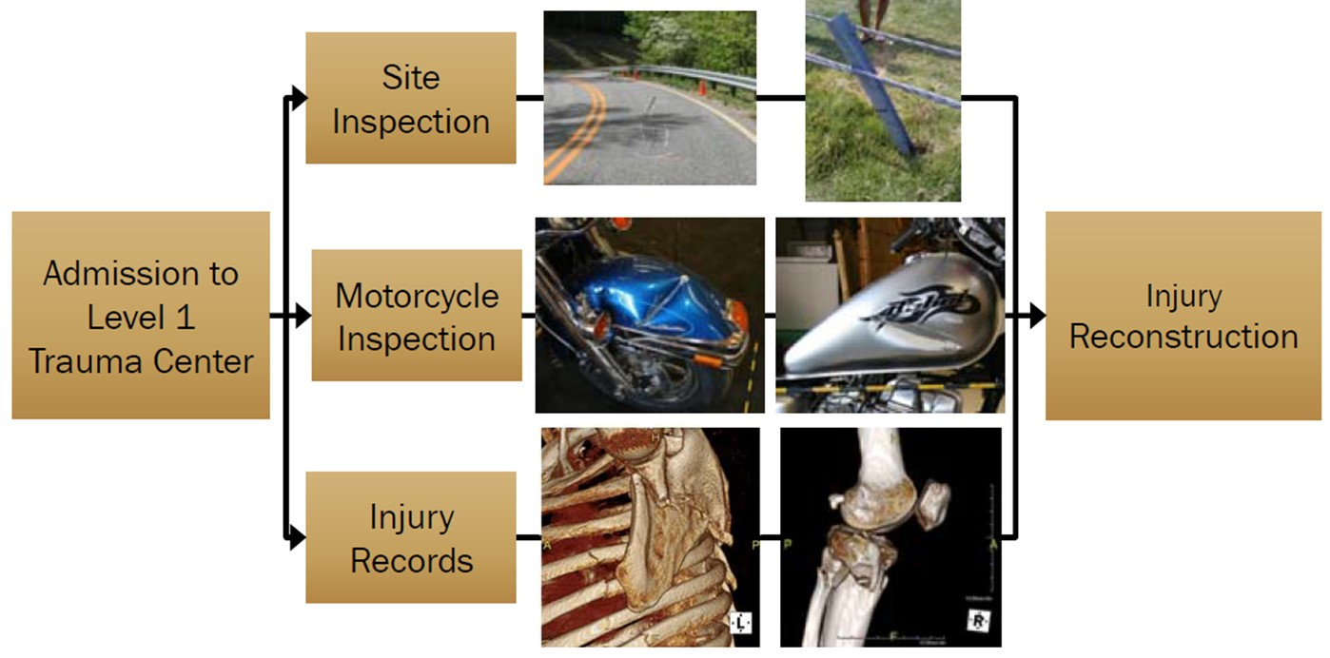
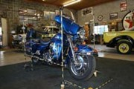
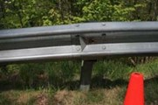
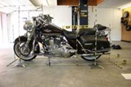
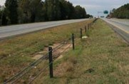
Study 6:
What are the causes of Motorcycle-Barrier Injuries
Approach:
  In-depth crash investigations
  22 cases collected
Barrier Struck Distribution:
  18 W-beam
  2 Cable
  1 Cable + W-Beam
  1 Concrete + W-Beam

Slide 16
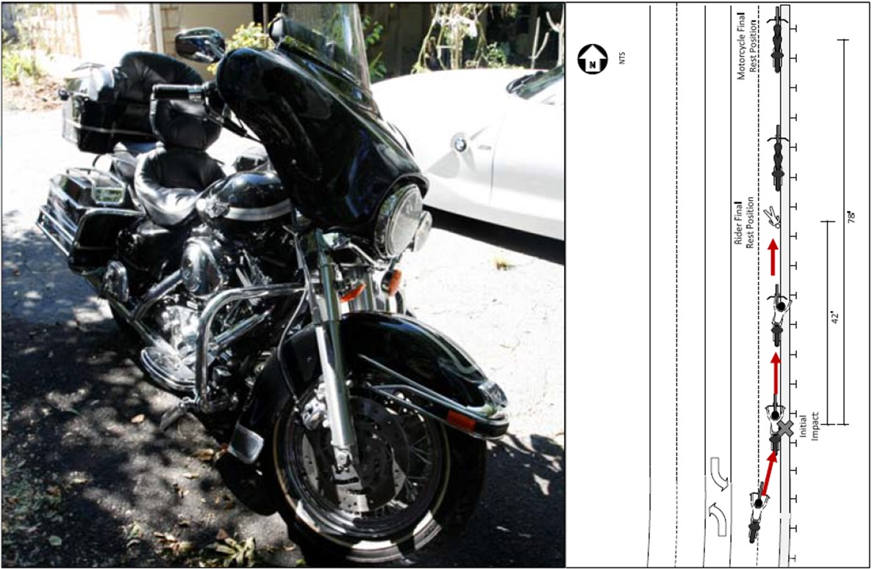
Case MC-007-D:
Motorcycle:
2003 Harley Davidson
Electra Glide Classic
Barrier Struck
W-Beam
Rider
33 y.o. male
230+ lbs.

Slide 17
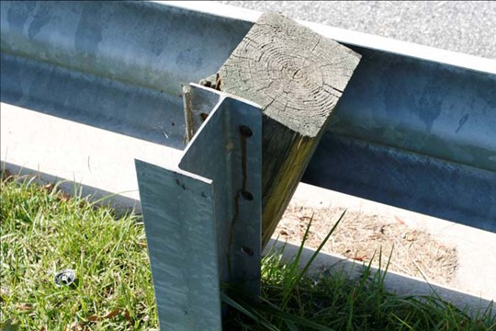
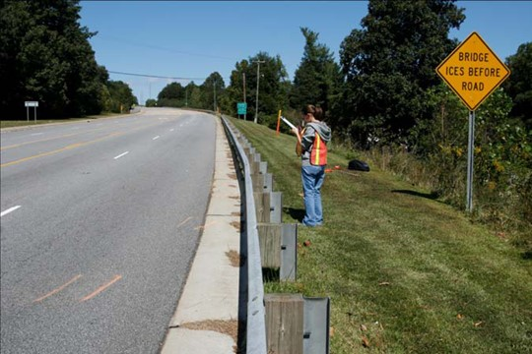
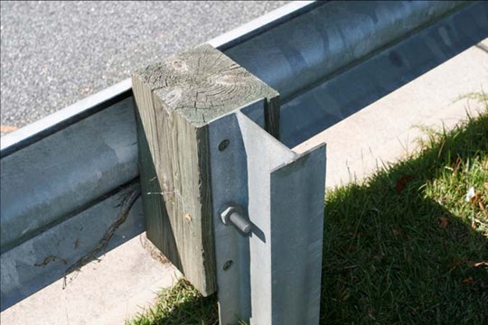
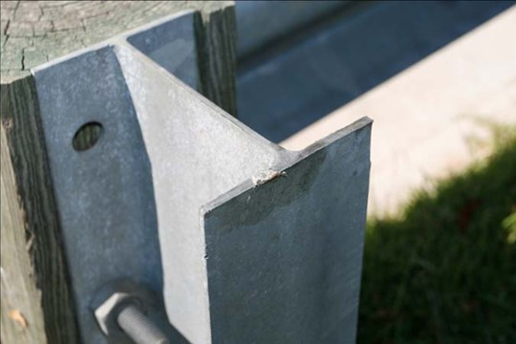
Case MC-007-D:
Displaced Post
Ebar End Cap
Fourth Post Upstream from Impact Point
Second Post Upstream from Impact Point
Tissue Transfer

Slide 18
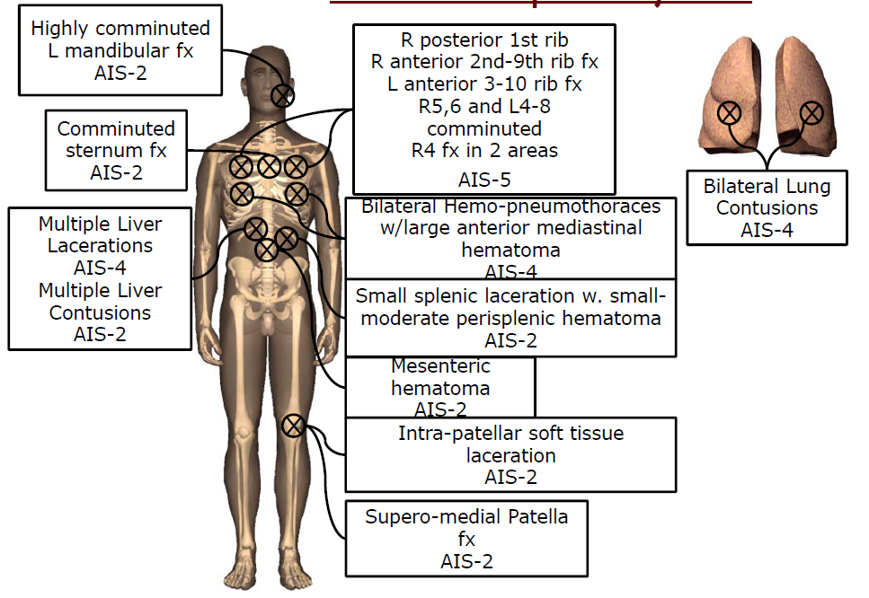
Case Occupant Injuries

Slide 19
Serious Injuries by Body Region and Source
(MAIS 3+)
Body Region
Injury Source
Thorax and Lower Extremities are nearly 2/3 of serious injuries

Slide 20
Conclusions
40% of guardrail fatalities are motorcyclists.
Fatality Risk from guardrail nearly double risk from concrete barrier.
No evidence that cable more dangerous than W-Beam.
Serious injuries are primarily to thorax and lower extremities.
Countermeasure priority – reduce post entanglement.

Slide 21

Countermeasure Priorities
Rider entanglement with posts
Lacerations from top of posts
Laceration from top of rail
No evidence of wire rope laceration
Rider MC-007-D
dragged along top of posts
causing serious abdominal
injuries

Slide 22
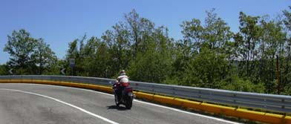
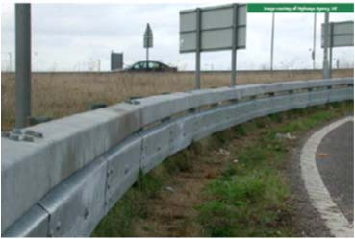
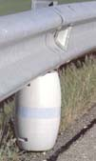
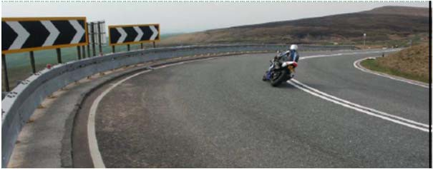
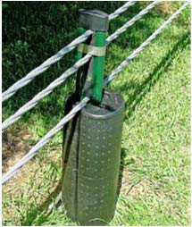
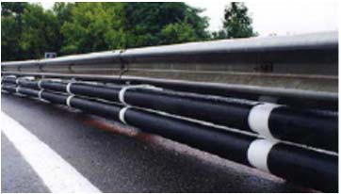
Example Countermeasures
Images – Lindsay, Sodirel,
EuroRAP, MCDonald, Ingal

Slide 23
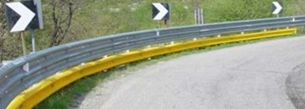
Pilot Tests of MPS in US
CALTRANS: 260 feet on canyon road near Auburn, CA. No impacts since installed.
NCDOT: 4500 feet on NC 143 installed in 2018. Will be evaluated in 2021.
Lindsay Transportation Systems
DR-46 Motorcycle Barrier Attenuator

Slide 24
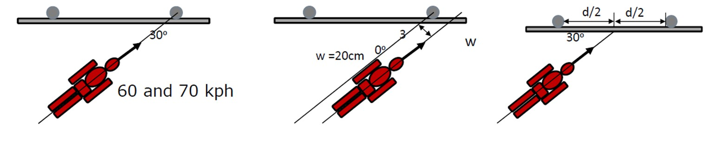
CEN TS 1317-8 Crash Testing in Europe
Configuration 1:
Post-Centered
for continuous and
discontinuous MPS
Configuration 2:
Post- Offset
only for
discontinuous MPS
Configuration 3:
Midspan
only for
continuous MPS
Currently, No Motorcycle Crash Test in MASH

Slide 25
Opportunities to improve CEN 1317-8
Grzebieta et al. (2013) noted CEN 1317-8 does not test most common crash configurations and injuries.
Only tests sliding configuration. Upright impacts are approximately 50% of crashes.
Only evaluates head and neck injury. Most serious injuries are to thorax.
Is dummy biofidelic?

Slide 26
Recommendations
Develop a MASH motorcyclist crash test
Considerations for the AASHTO Roadside Design Guide
Develop methods to determine where to locate Motorcycle Protection Systems (MPS)
Evaluate field performance of US pilot tests of Motorcyclist Protection Systems (CA and NC)
Evaluate EN 1317-8 crash test in the US
Evaluate crash performance of Motorcyclist Protection Systems for four-wheeled vehicles

