Slide 1
The following presentation is supplemental to NCHRP Research Report 1018: Zone of Intrusion Envelopes Under MASH Impact Conditions for Rigid Barrier Attachments (NCHRP Project 22-34, “Determination of Zone of Intrusion Envelopes Under MASH Impact Conditions for Barrier Attachments”). The full report can be found by searching on the report title on the National Academies Press website (www.nap.edu).
The National Cooperative Highway Research Program (NCHRP) is sponsored by the individual state departments of transportation of the American Association of State Highway and Transportation Officials. NCHRP is administered by the Transportation Research Board (TRB), part of the National Academies of Sciences, Engineering, and Medicine, under a cooperative agreement with the Federal Highway Administration (FHWA). Any opinions and conclusions expressed or implied in resulting research products are those of the individuals and organizations who performed the research and are not necessarily those of TRB; the National Academies of Sciences, Engineering, and Medicine; the FHWA; or NCHRP sponsors.

Slide 2
NCHRP Project 22-34:
Determination of Zone of Intrusion Envelopes Under MASH Impact Conditions for Rigid Barrier
Midwest Roadside Safety Facility
University of Nebraska–Lincoln
Research Team
Cody S. Stolle, Ph.D., Principal Investigator
Jennifer Rasmussen, Ph.D., P.E., Co-Principal Investigator
Robert W. Bielenberg, M.S.M.E.
Ronald K. Faller, Ph.D., P.E.
Luis Rodriguez, M.S.M.E.
Nathan Dowler, M.S.M.E.
Chen Fang, Ph.D.

Slide 3
NCHRP 22-34 Project Scope
PHASE I
Task 1: Project setup and kickoff meeting
Task 2: Literature review and agency survey
Task 3: Identify barrier height thresholds
Task 4: Rigid barrier crash data analysis
Task 5: Prepare interim summary report and meet with panel
PHASE II
Task 6: Simulation model creation and validation
Task 7: Simulation of recommended barrier configurations
Task 8: Development and validation of ZOI envelopes
Task 9: Identify future research needs
Task 10: Prepare documentation for inclusion in Roadside Design Guide
Task 11: Prepare final report, deliverables, and project closure

Slide 4
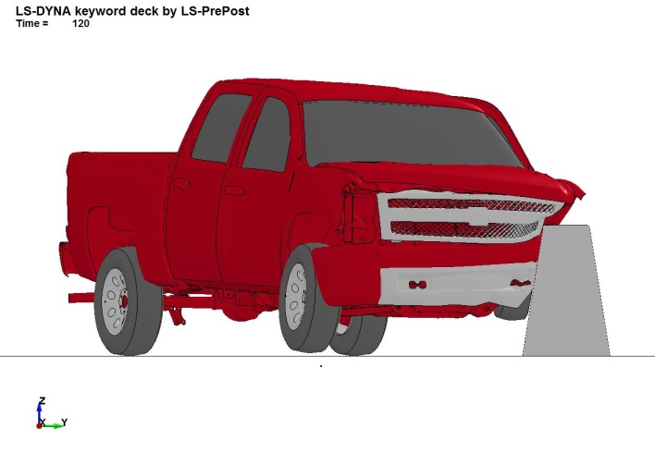
Background
Zone of Intrusion (ZOI)
  Concept: stiff components of vehicle can protrude to back side of barrier
  Lateral and vertical extents of protrusion define the “Zone of Intrusion” (ZOI)
  May result in occupant compartment penetration or increased vehicle accelerations
PHASE I TASK 1: PROJECT SETUP → TASK 2 → TASK 3 → TASK 4 → TASK 5

Slide 5
ZOI envelopes
ZOI envelopes used by designers to determine safe placement of features near back side or over top of barrier
Objects located in ZOI may require testing to confirm crashworthiness
PHASE I TASK 1: PROJECT SETUP → TASK 2 → TASK 3 → TASK 4 → TASK 5

Slide 6
Project Objectives
Main objective: develop ZOI envelopes for a variety of rigid barriers under MASH criteria
Identify rigid barrier height thresholds
  Minimum required and maximum used barrier heights
Determine ZOI for each class of rigid barriers
  Jersey, F-shape, single-slope, vertical, low-profile
Analyze ZOI under MASH TL-2, TL-3, TL-4, and TL-5
Validate ZOI envelopes using simulation and previous full-scale crash tests
Develop guidance for inclusion in Roadside Design Guide
PHASE I TASK 1: PROJECT SETUP → TASK 2 → TASK 3 → TASK 4 → TASK 5

Slide 7
Task 1
Research team met with NCHRP panel to discuss plan
  Result: Contract and AWP executed 9/20/2018

Slide 8
Task 2
Literature review performed to collect full-scale crash test data & ZOI references
  AASHTO RDG
  MASH test designations 2-11, 3-11, and 4-12
  MASH and NCHRP Report No. 350 test designation 5-12
  Real-world crash data (ISPE)
Also surveyed state DOTs on ZOI design & common barrier heights, shapes

Slide 9
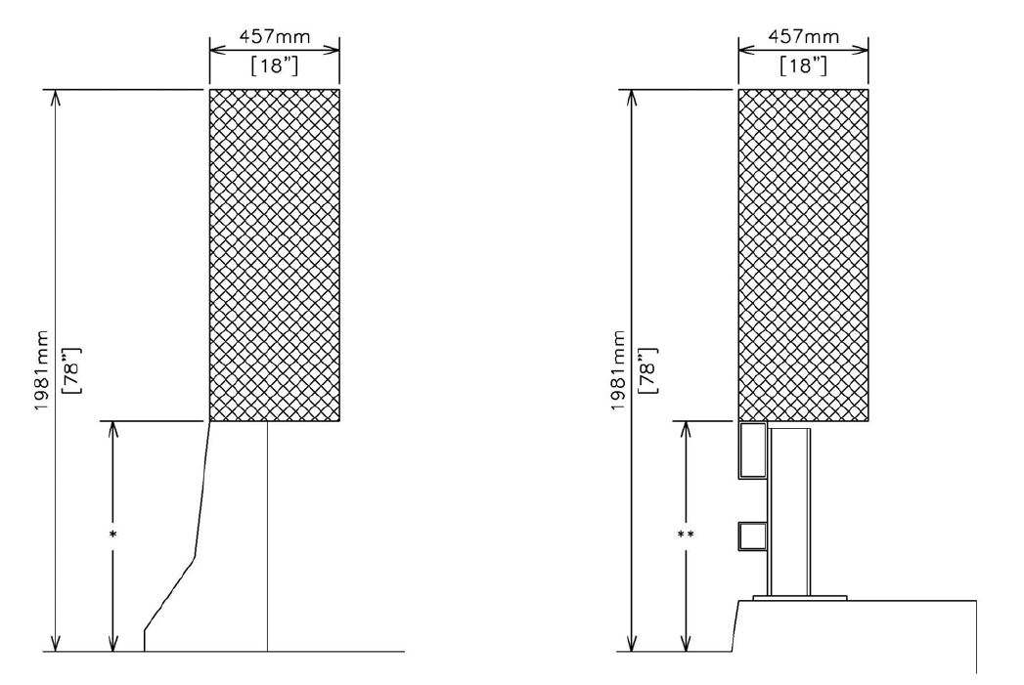
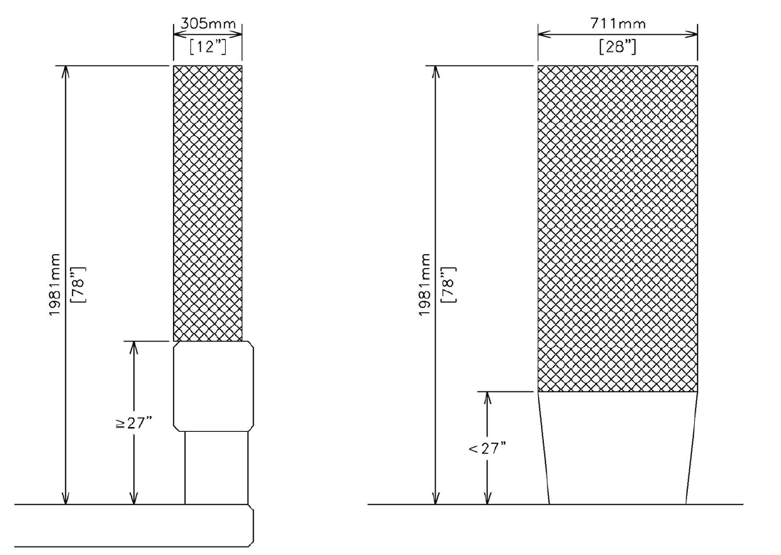
NCHRP Report 350 ZOI envelopes
TL-2 barriers
(≤ 27 in.)
TL-3 sloped-face
barriers (30-to-32 in.)
TL-3 steel tubular rails on curb (32-to-34 in.)
Roadside Design Guide (4th Ed), AASHTO, Washington, D.C., 2011.
PHASE I TASK 1: PROJECT SETUP → TASK 2 → TASK 3 → TASK 4 → TASK 5

Slide 10
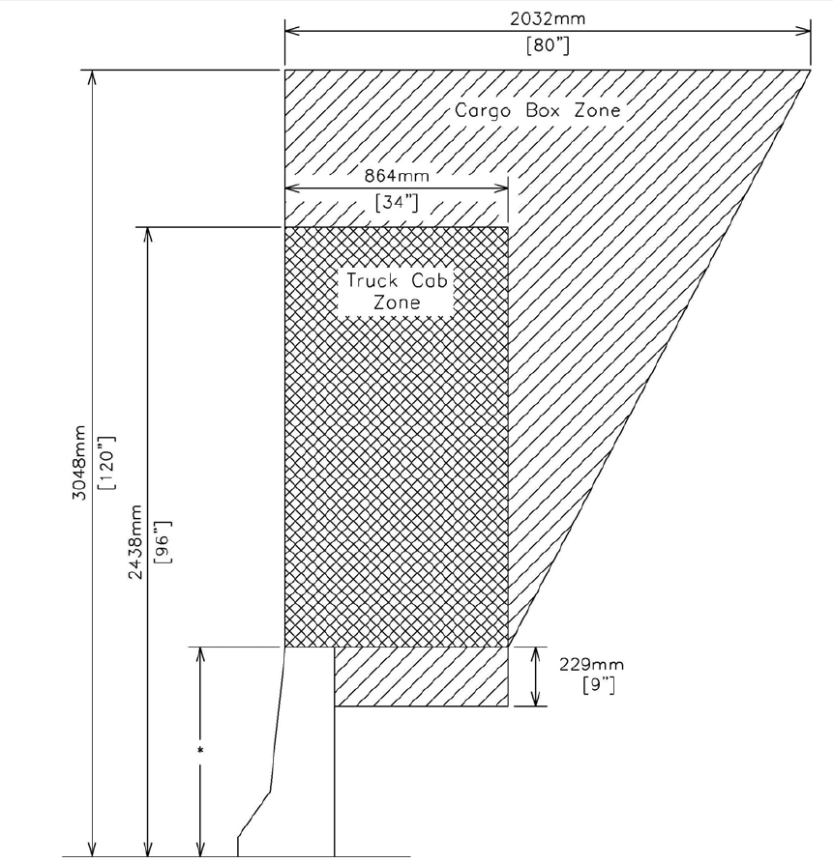
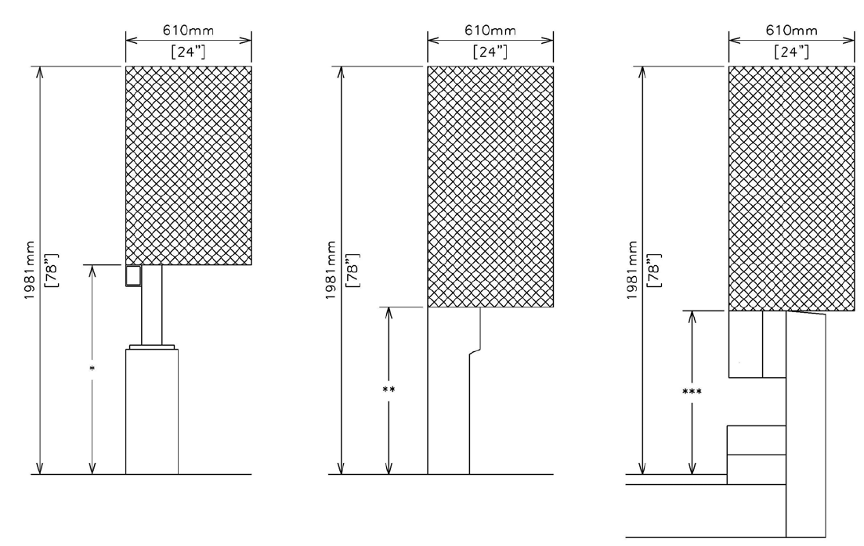
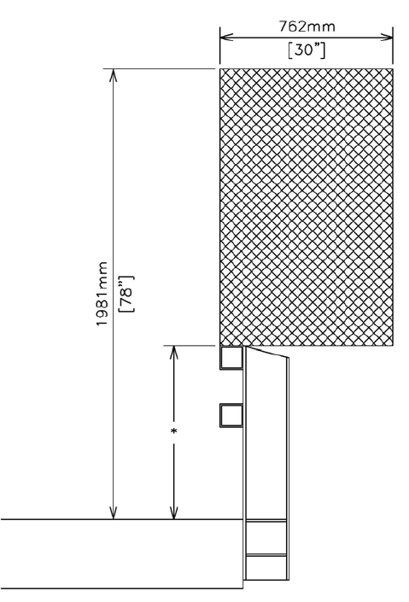
NCHRP Report 350 ZOI envelopes
TL-3 combination barriers (35-to-42 in.)
TL-3 vertical barriers (29-to-32 in.)
TL-3 timber barriers (33 in.)
TL-3 steel tubular rails (27.75-to-36 in.)
TL-4 barriers (29-to-42 in.)
*NCHRP Report 350 did not establish TL-5 ZOI envelopes
Roadside Design Guide (4th Ed), AASHTO, Washington, D.C., 2011.
PHASE I TASK 1: PROJECT SETUP → TASK 2 → TASK 3 → TASK 4 → TASK 5

Slide 11
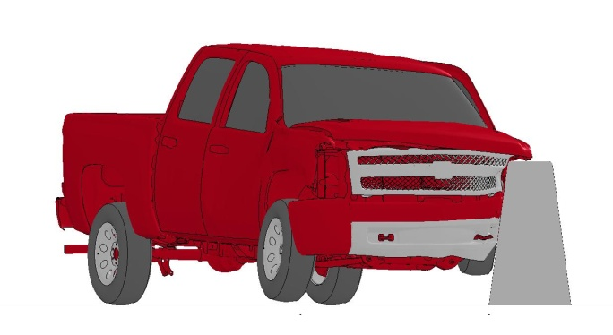
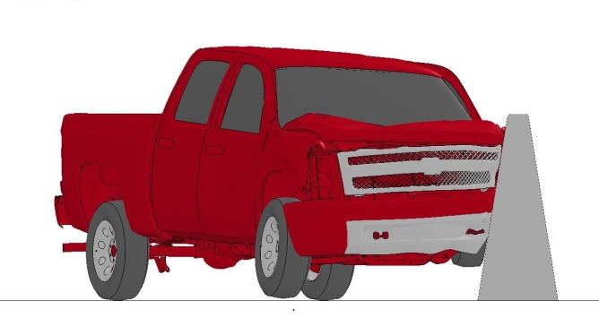
WisDOT simulated ZOI (2014)
MASH TL-3 2270P impact with 36-, 42, and 56-in. tall 9.1-deg single-slope concrete barriers
  Multiple suspension failure conditions used to maximize accuracy
  Working width: 24.0 in.
36-in. tall barrier
Barrier height (in.) | Fender ZOI (in.) | Hood ZOI (in.)
36 | 12.2 | 9.4
42 | 6.4 | 6.5
56 | 0 | 0
42-in. tall barrier
56-in. tall barrier
PHASE I TASK 1: PROJECT SETUP → TASK 2 → TASK 3 → TASK 4 → TASK 5

Slide 12
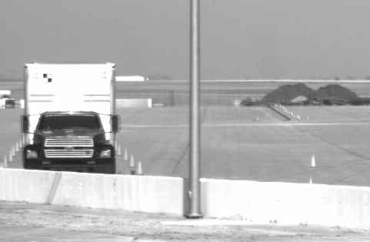
Rigid hazards in ZOI
NCHRP Report 350 TL-3 and TL-4 tests, luminaire on 10.8-degree single-slope barrier (MwRSF, 2008)
ZOI-1 ZOI-2 ZOI-3
MASH TL-4 test, luminaire on 10.8-degree single-slope barrier (TTI, 2019)
PHASE I TASK 1: PROJECT SETUP → TASK 2 → TASK 3 → TASK 4 → TASK 5

Slide 13
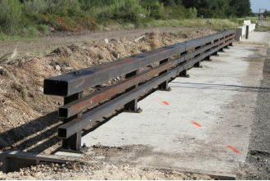
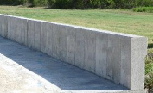
Crash test database
Data collected from 80 successful MASH crash tests on rigid barriers
Rigid: deflected 10 in. or less during impact event
NCHRP Report 350 TL-5 tests included as TL-5 criteria was very similar to MASH
F-shape
Steel combination
Barrier | No. crash tests |  |  |  | Total
 | TL-2 | TL-3 | TL-4 | TL-5
Jersey | 0 | 8 | 0 | 3 | 11
F-shape | 0 | 2 | 0 | 0 | 2
Single-slope | 0 | 4 | 6 | 2 | 12
Vertical | 2 | 6 | 4 | 5 | 17
Steel combination | 2 | 8 | 17 | 3 | 30
Low-profile | 0 | 0 | 0 | 0 | 0
Other | 2 | 5 | 1 | 0 | 8
Total | 6 | 33 | 28 | 13 | 80
Jersey
Vertical
Single-slope
PHASE I TASK 1 → TASK 2: LITERATURE REVIEW → TASK 3 → TASK 4 → TASK 5

Slide 14
Existing rigid barrier simulations
FEA is often used as a cost-effective method of evaluating vehicle-barrier interaction
25 existing NCHRP Report 350 and MASH rigid barrier simulations were identified, 15 of which had been validated against full-scale crash tests
  Most simulations used a MASH 2270P test vehicle
Friction coefficient ranges determined
Contact | Friction range
 | Low | High
Vehicle-barrier | 0.05 | 0.4
Tire-barrier | 0.1 | 0.45
Barrier-ground | 0.2 | 1.4
Tire-ground | 0.9
PHASE I TASK 1 → TASK 2: LITERATURE REVIEW → TASK 3 → TASK 4 → TASK 5

Slide 15
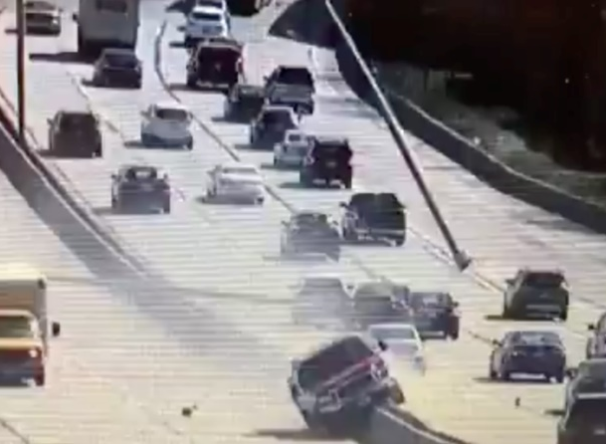
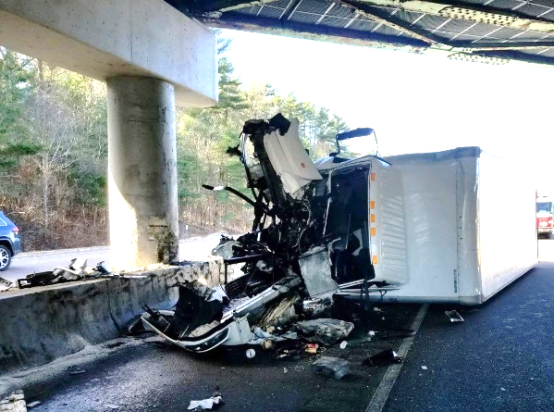
In-service performance review
Relatively little published information exists reviewing the impact performance of fixed objects in the ZOI
No time or budget to conduct a full ISPE, instead focused on crash records, research reports, and anecdotal accounts
  No supplementary analysis performed, but considered relevant to provide examples of potential real-world hazards
A 2018 study found the majority of force and damage in TL-4 or TL-5 impacts comes from the cab, not cargo box
PHASE I TASK 1 → TASK 2: LITERATURE REVIEW → TASK 3 → TASK 4 → TASK 5

Slide 16
Agency survey
An eight-question survey was conducted to obtain information on barrier shapes and heights used at each test level
  Sent to all 50 state DOTs; 32 responded
Most states use RDG when placing barrier attachments
Single-slope barriers most common, Jersey barriers least common
Most states had not conducted ISPEs on rigid barrier attachments in the ZOI nor planned to
PHASE I TASK 1 → TASK 2: LITERATURE REVIEW → TASK 3 → TASK 4 → TASK 5

Slide 17
Task 3: Barrier Height Thresholds
Preliminary MASH barrier height thresholds
  Based on the literature review and agency survey
  Engineering judgement and simulation analyses when necessary
Some states used barriers as glare screens
  Taller than required by MASH, test plans
Maximum concrete and steel barrier heights varied due to availability
MASH TL | Barrier height (in.)
 | Min. | Max. concrete | Max. steel | Most common range
2 | 14 | 54 | 54 | 32 to 42
3 | 26 | 57 | 56 | 32 to 54
4 | 32 | 90 | 56 | 32 to 54
5 | 41 | 90 | 54 | 41 to 54
PHASE I TASK 1 → TASK 2 → TASK 3: BARRIER HEIGHT THRESHOLDS → TASK 4 → TASK 5

Slide 18
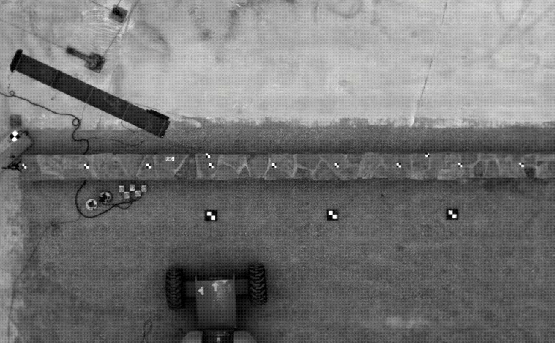
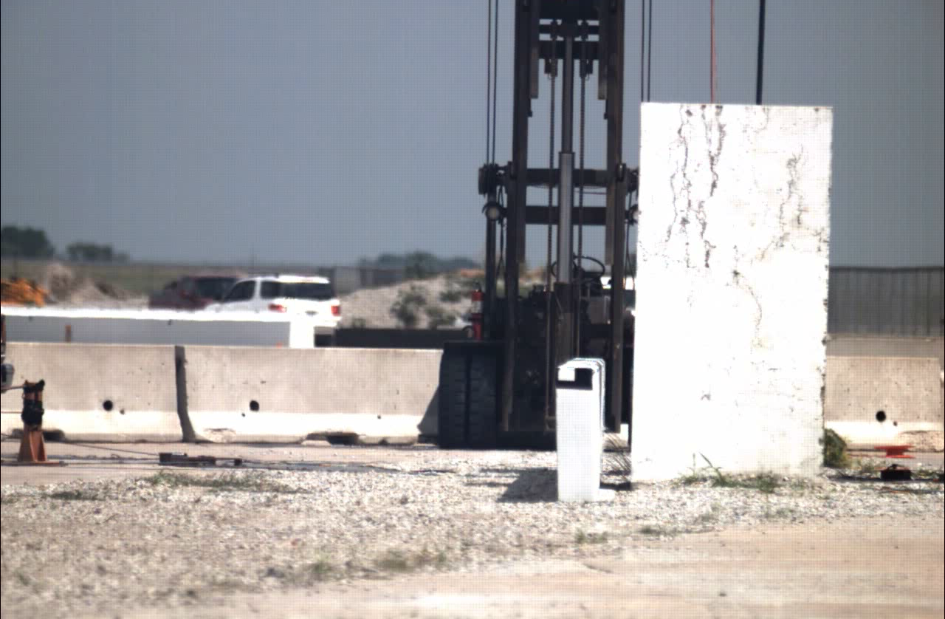
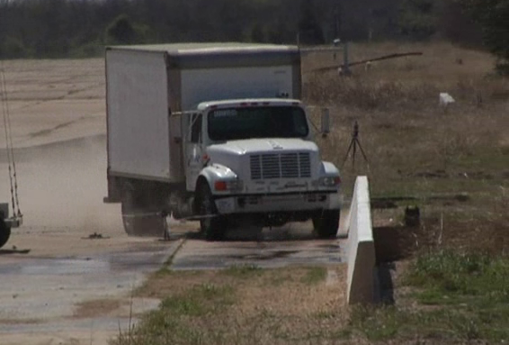
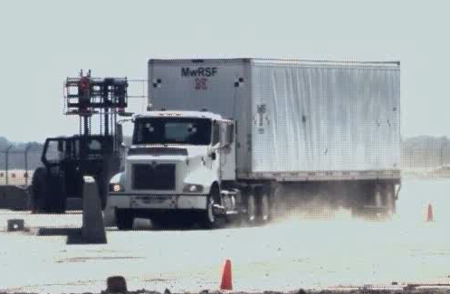
Task 4: Crash Test Video Analysis
22-in. tall stone wall (NCHRP 2-11)
32-in. tall vertical barrier (NCHRP 3-11)
36-in. tall single-slope barrier (MASH 4-12)
49¼-in. tall concrete bridge rail (MASH 5-12)
PHASE I TASK 1 → TASK 2 → TASK 3 → TASK 4: CRASH TEST REVIEW → TASK 5

Slide 19
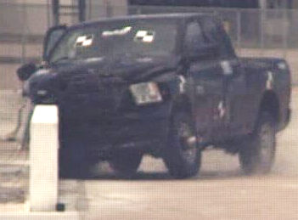
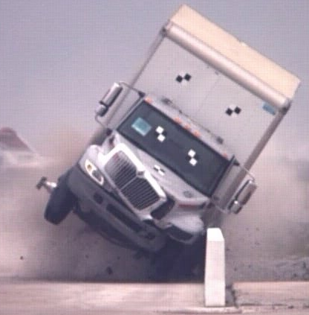
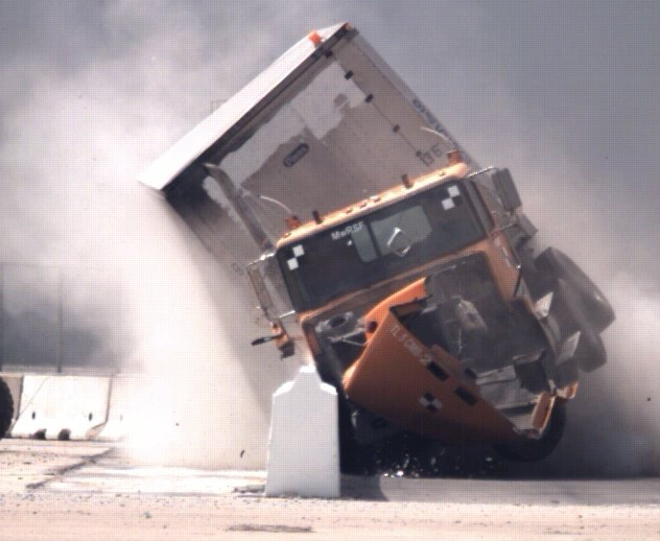
ZOI measurement from video
High-speed video was used to isolate critical vehicle components and determine range of movement during impacts
Three measurements were taken from each test:
  Maximum lateral extent
  Vertical extent at the point of maximum lateral extent
  Maximum vertical extent over the front barrier face
Used to develop preliminary, conservative ZOI envelopes
PHASE I TASK 1 → TASK 2 → TASK 3 → TASK 4: CRASH TEST REVIEW → TASK 5

Slide 20
Vehicle-barrier interaction
Factors affecting ZOI were examined
  Vehicle-barrier friction
  Vehicle suspension failure
  Tire deflation
No common parameters found, but used to develop accurate models for simulation
Test no. | Test designation | Barrier type | Peak lateral load (kips) | Peak longitudinal load (kips) | Estimated friction coefficient
4CBR-1 | 4-12 | Concrete | 152.6 | 50.2 | 0.29 - 0.59
H34BR-1 | 3-10 | Concrete | 58.7 | 16 | 0.29 - 0.68
H34BR-2 | 3-11 | Concrete | 88.6 | 21.6 | 0.29
KSFRP-1 | 3-11 | Concrete | 76.2 | 15.6 | 0.13 - 0.17
OSSB-1 | 3-11 | Concrete | 84.5 | 20.0 | 0.28
STBR-2 | 4-11 | Steel | 82.0 | 9.1 | 0.13
STBR-3 | 4-10 | Steel | 52.2 | 15.9 | 0.11 - 0.36
STBR-4 | 4-12 | Steel | 106.2 | 44.9 | 0.12
PHASE I TASK 1 → TASK 2 → TASK 3 → TASK 4: CRASH TEST REVIEW → TASK 5

Slide 21
Task 5: Phase I Summary
Interim report submitted to committee, reviewed, & Phase 1 completed September 2019
PHASE I TASK 1 → TASK 2 → TASK 3 → TASK 4 → TASK 5: PHASE I SUMMARY

Slide 22
Task 6: Simulation Validation
Validation using full-scale tests (2-3 per vehicle model)
  Different barrier shapes, heights for each test condition
Bracket ZOI behavior considering:
  Vehicle tire/suspension failure
  Vehicle-barrier friction
Test and model compared using visual inspection and kinematic behavior
MASH TL | Test no. | Test vehicle | Vehicle model | Weight (lb) |  | Velocity (mph) |  | Angle (deg.)
 |  |  |  | Test | Model | Test | Model | Test | Model
2 | IBBR-1 | 2011 RAM 1500 Quad | 2018 RAM 1500 Quad | 4,980 | 5,022 | 45.3 | 45.3 | 25.6 | 25.0
3 | H34BR-2 | 2018 RAM 1500 Crew | 2018 RAM 1500 Quad | 5,001 | 5,022 | 64.0 | 63.9 | 25.4 | 25.0
 | OSSB-1 | 2011 RAM 1500 Quad | 2018 RAM 1500 Quad | 5,001 | 5,022 | 62.8 | 62.8 | 24.9 | 25.0
4 | 4CBR-1 | 2005 International 4300 | 1996 Ford F800 | 22,198 | 21,768 | 57.6 | 57.6 | 16.0 | 16.0
 | 420020-9b | 1991 International 4700 | 1996 Ford F800 | 22,150 | 21,768 | 57.2 | 57.2 | 16.1 | 16.1
5 | MAN-1 | 2004 International 9200 | Tractor-trailer | 80,076 | 80,126 | 51.7 | 51.9 | 15.2 | 15.2
 | 510605-RYU-1 | 1995 GM Tractor | Tractor-trailer | 79,650 | 79,982 | 49.1 | 51.9 | 14.6 | 14.6
PHASE II TASK 6: MODEL VALIDATION → TASK 7 → TASK 8 → TASK 9 → TASK 10 → TASK 11

Slide 23
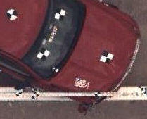
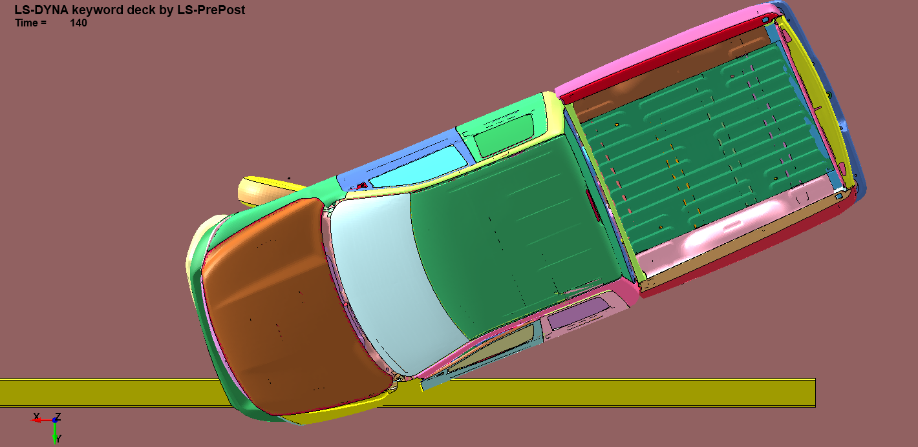
MASH TL-2 test no. IBBR-1
Barrier: 24-in. tall parapet, 24-in. tall top-mounted bicycle rail
  48-in. total barrier height
  Top bicycle rail low-strength, did not contribute to vehicle redirection
Euler angles similar, but lateral ZOI differed by 26.5 percent
  Noted: in test, impacting front fender extended laterally due to buckling after impact with weak vertical posts
Validation parameters | Max. lateral extent (in.) | ZOI time (ms) | Parallel time (ms) | Max. Euler angles (deg.)
 |  |  |  | Roll | Pitch | Yaw
Test no. IBBR-1 | 21.7 | 68 | 254 | -3.0 | 14.8 | 30.1
FEA | 16.0 | 85 | 265 | -5.5 | 11.1 | 31.2
PHASE II TASK 6: MODEL VALIDATION → TASK 7 → TASK 8 → TASK 9 → TASK 10 → TASK 11

Slide 24
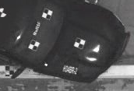
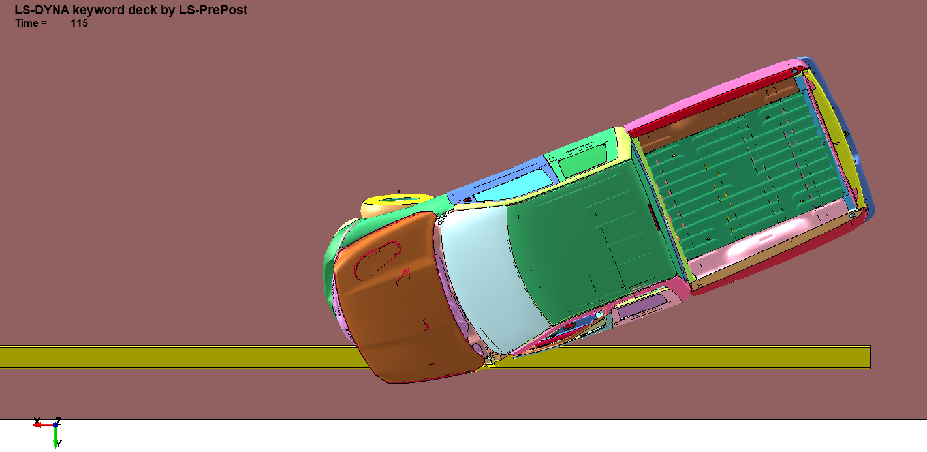
MASH TL-3 test no. H34BR-2
34-in. tall, 10-in. thick vertical barrier
Good comparison between test, simulation model
Validation parameters | Max. lateral extent (in.) | ZOI time (ms) | Parallel time (ms) | Max. Euler angles (deg.)
 |  |  |  | Roll | Pitch | Yaw
Test no. H34BR-2 | 16.7 | 68 | 192 | 13.7 | -2.8 | -37.6
FEA | 16.1 | 75 | 195 | 9.5 | -1.6 | -34.1
PHASE II TASK 6: MODEL VALIDATION → TASK 7 → TASK 8 → TASK 9 → TASK 10 → TASK 11

Slide 25
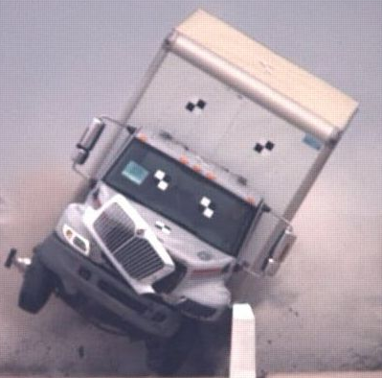
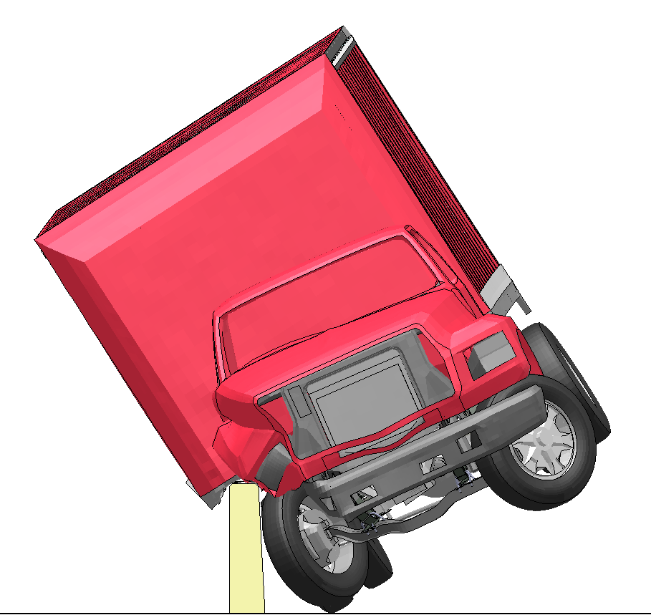
MASH TL-4 test no. 4CBR-1
Barrier: 36-in. tall single-slope barrier
Visual and quantitative analysis of simulation results was deemed comparable to the full-scale test
Validation parameters | Max. lateral extent (in.) | ZOI time (ms) | Parallel time (ms) | Max. Euler angles (deg.)
 |  |  |  | Roll | Pitch | Yaw
Test no. 4CBR-1 | 55.4 | 827 | 840 | 32.8 | -6.0 | -15.3
FEA | 62.4 | 296 | 300 | 33.7 | -4.7 | -15.3
PHASE II TASK 6: MODEL VALIDATION → TASK 7 → TASK 8 → TASK 9 → TASK 10 → TASK 11

Slide 26
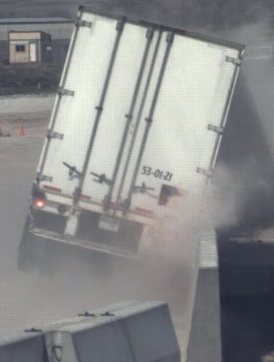
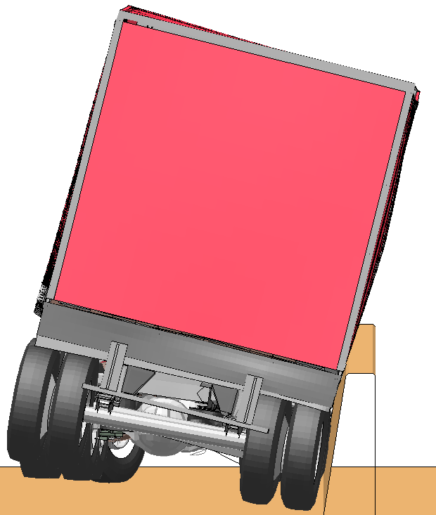
MASH TL-5 test no. MAN-1
Barrier: 49.25-in. tall, 9.85-in. thick 9.1-degree single-slope barrier
Minor vehicle behavior differences attributed to increased front axle stiffness of model
Validation parameters | Max. lateral extent (in.) | ZOI time (ms) | Parallel time (ms) | Max. Euler angles (deg.)
 |  |  |  | Roll | Pitch | Yaw
Test no. MAN-1 | 22.7 | XXX | 776 | 16.3 | 5.2 | -15.2
FEA | 25.2 | 860 | 720 | 11.7 | 4.2 | -13.6
PHASE II TASK 6: MODEL VALIDATION → TASK 7 → TASK 8 → TASK 9 → TASK 10 → TASK 11

Slide 27
Task 7: Simulation Matrix
Simulation matrix
  MASH test conditions 2-11, 3-11, 4-12, 5-12
  Barrier classes simplified
    F-shape (similar to NJ)
    Single-slope
    Vertical (similar to combination rails, hybrid rails)
  Table of heights shown below
MASH TL | Barrier height (in.)
 | 24 | 27 | 29 | 32 | 36 | 42 | 48 | 54 | 90
2 | X¹ | X¹ | X¹ | X | X | X |  | X
3 |  |  | X¹ | X | X | X |  | X
4 |  |  |  |  | X | X | X | X | X
5 |  |  |  |  |  | X | X | X | X

Slide 28
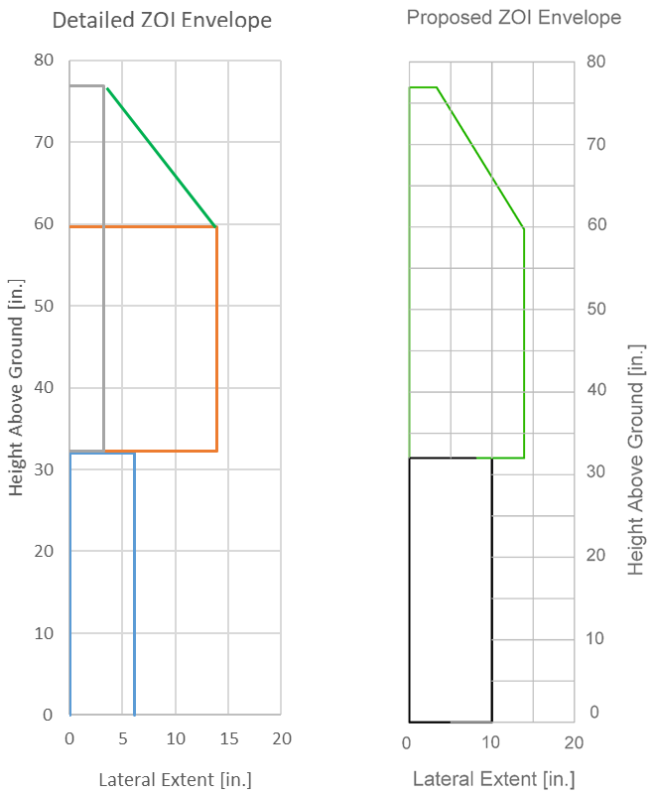
Task 8: Selection of ZOI Envelopes
Evaluated ZOI envelope shapes
  Detailed: lower box (fenders, hood, engine) & upper box (windows, roof, doors, box)
  Piecewise: connect all boundaries of ZOI envelope data
  Conservative: max lateral & vertical extents
Piecewise offered best comparison to test data but not as conservative
Recommendation: hybrid method between detailed, piecewise
PHASE II TASK 6 → TASK 7: SIMULATION → TASK 8 → TASK 9 → TASK 10 → TASK 11

Slide 29
Evaluation of Simulation Results
Compared simulation lateral & vertical points to test data from video analysis
  2D spatial plots (per barrier height)
  Overplotted lateral results (trends)
Observed that there were clear trendline relationships for lateral ZOI as a function of barrier height
  Recommended series of conservative lateral extents for each barrier height

Slide 30
Proposed TL-2 ZOI envelopes
PHASE II TASK 6 → TASK 7: SIMULATION → TASK 8 → TASK 9 → TASK 10 → TASK 11

Slide 31
Proposed TL-3 ZOI envelopes
PHASE II TASK 6 → TASK 7: SIMULATION → TASK 8 → TASK 9 → TASK 10 → TASK 11

Slide 32
Proposed TL-4 ZOI cab envelopes
PHASE II TASK 6 → TASK 7: SIMULATION → TASK 8 → TASK 9 → TASK 10 → TASK 11

Slide 33
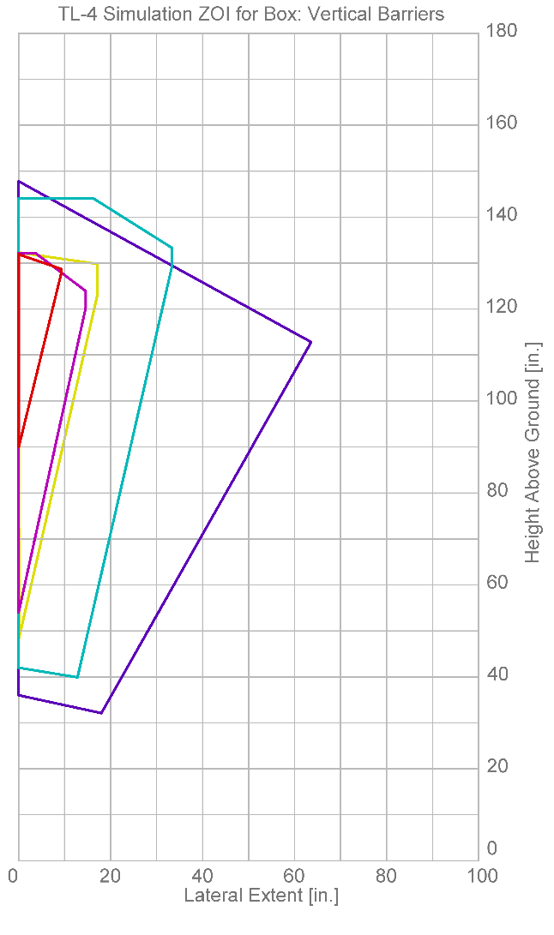
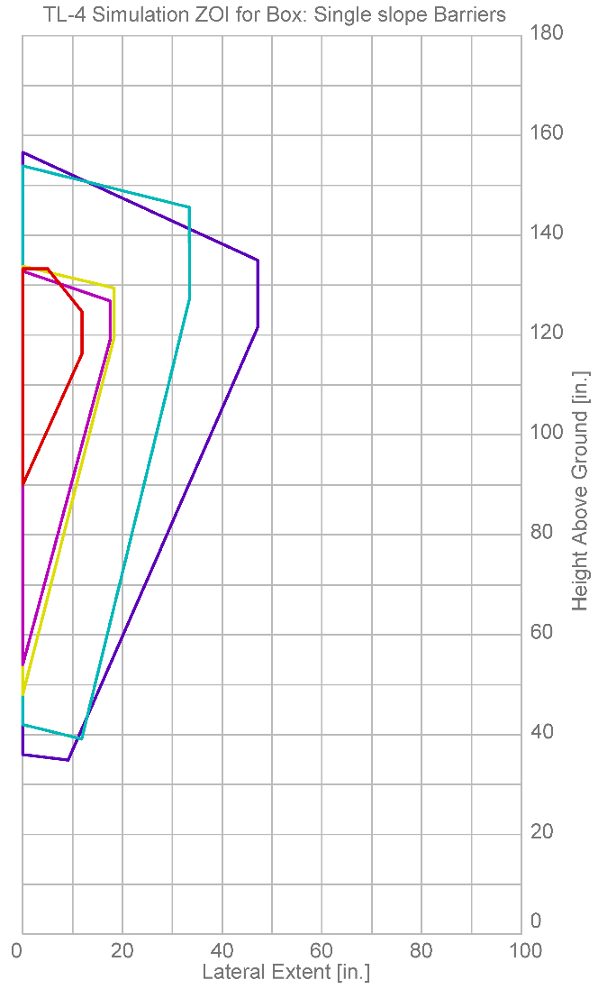
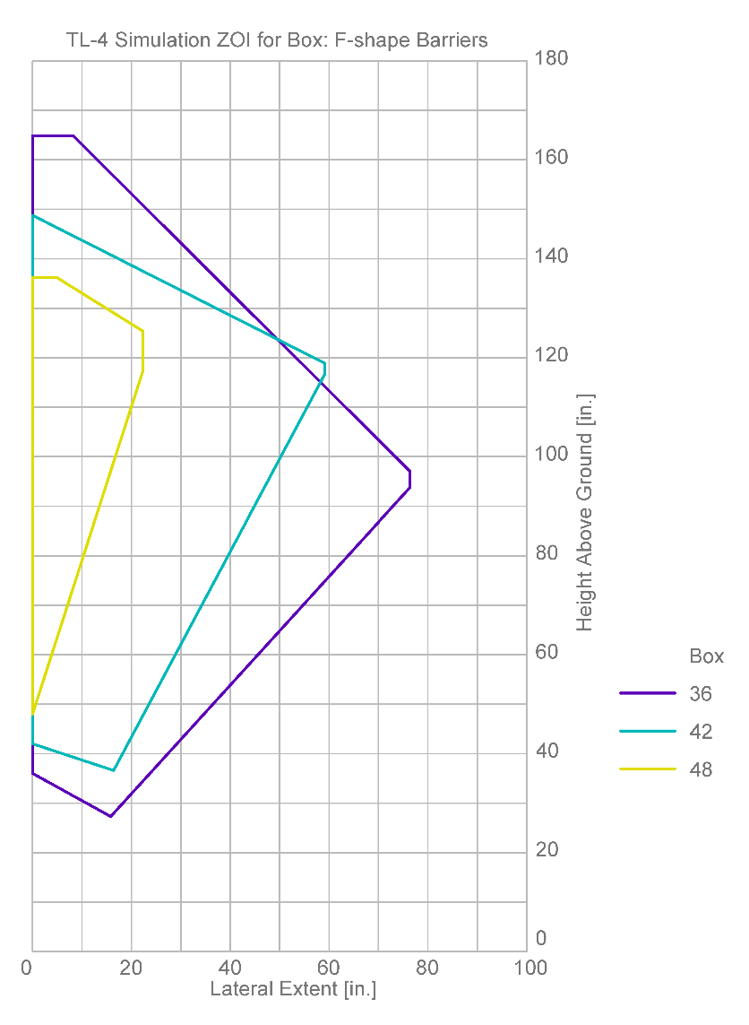
Simulated TL-4 ZOI box envelopes
PHASE II TASK 6 → TASK 7: SIMULATION → TASK 8 → TASK 9 → TASK 10 → TASK 11

Slide 34
Proposed TL-4 ZOI box envelopes
PHASE II TASK 6 → TASK 7: SIMULATION → TASK 8 → TASK 9 → TASK 10 → TASK 11

Slide 35
Proposed TL-5 ZOI cab envelopes
PHASE II TASK 6 → TASK 7: SIMULATION → TASK 8 → TASK 9 → TASK 10 → TASK 11

Slide 36
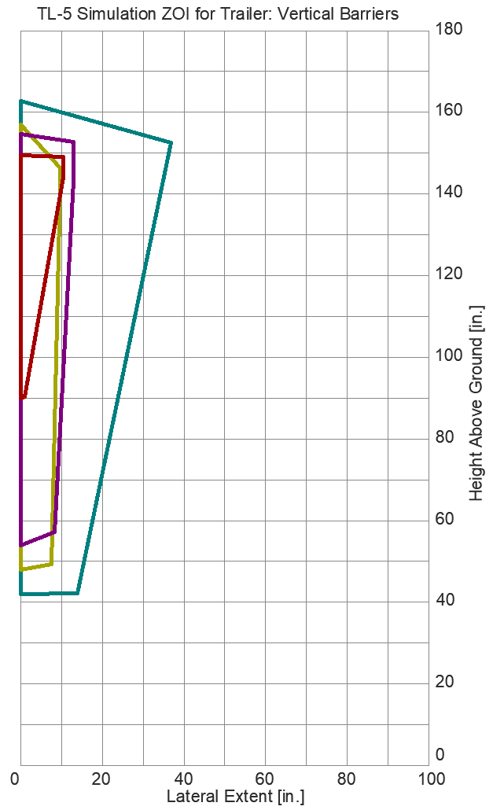
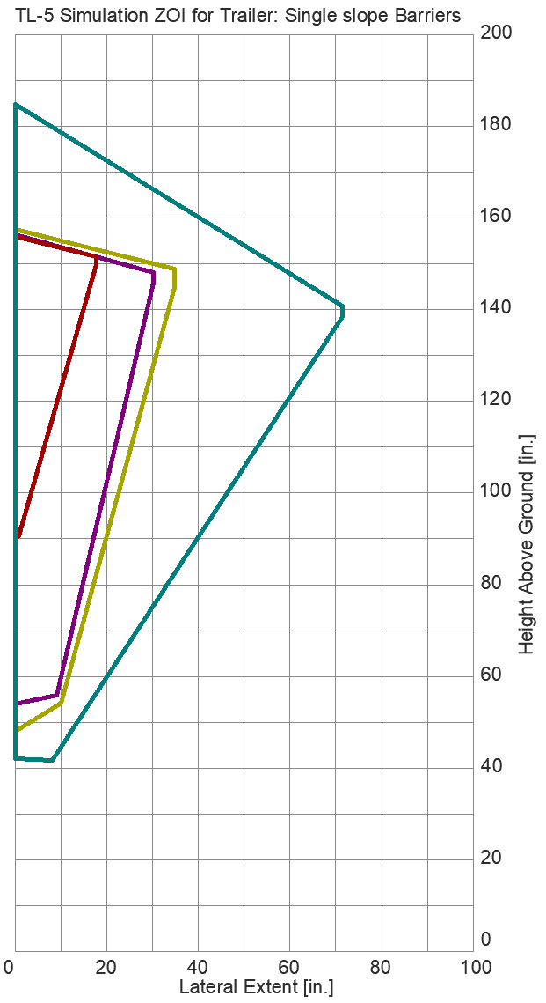
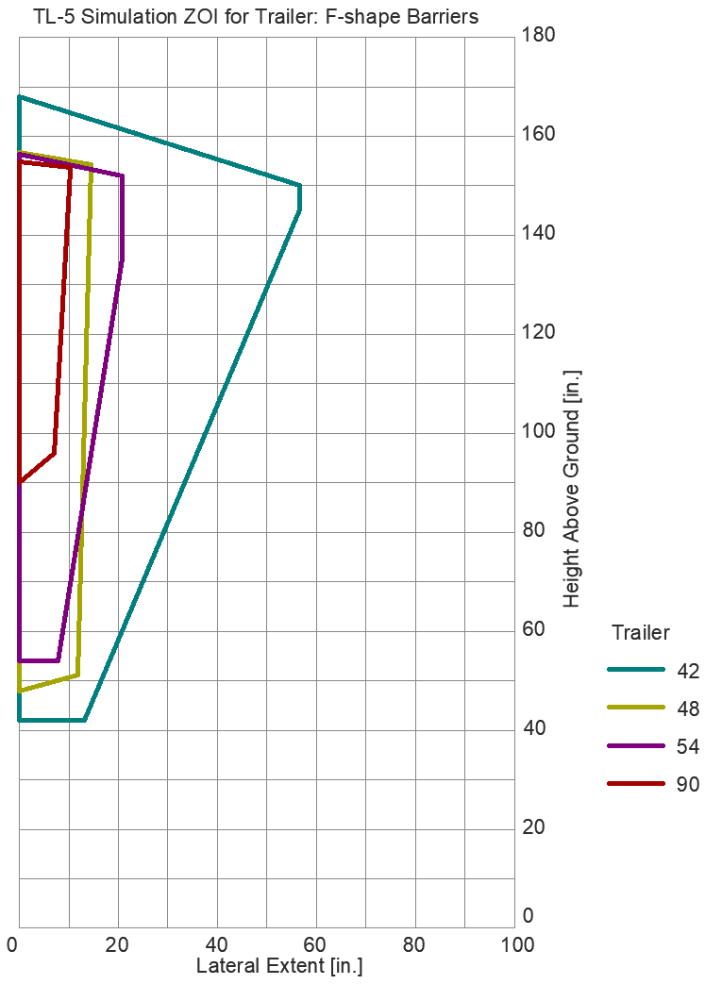
Simulated TL-5 ZOI trailer envelopes
PHASE II TASK 6 → TASK 7: SIMULATION → TASK 8 → TASK 9 → TASK 10 → TASK 11

Slide 37
Proposed TL-5 ZOI trailer envelopes
PHASE II TASK 6 → TASK 7: SIMULATION → TASK 8 → TASK 9 → TASK 10 → TASK 11

Slide 38
RDG Envelope Recommendations
Used lateral extent trends, vertical extent data from tests and simulations to develop RDG envelope update recommendations
Overplotted results to ensure data accurately represented findings
  White cells, plain text: test or simulation data collected at noted barrier height
  Gray cells, italic text: ZOI estimated using interpolation

Slide 39
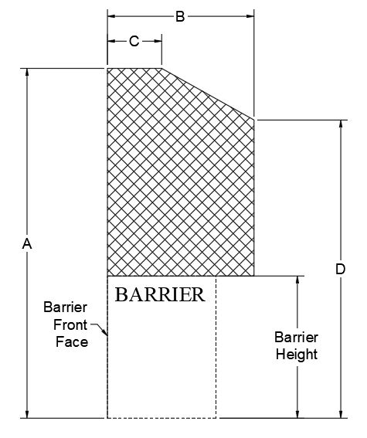
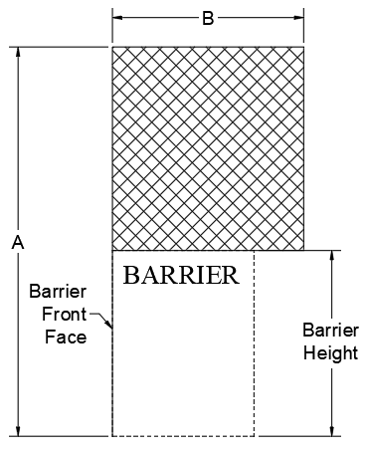
TL-2 RDG Recommendations
Barrier top height (in.) | Dimension (in.)
 | A | B | C | D
24 | 76 | 16 | 7.5 | 57
27 | 65 | 14.6 | 7.5 | 54
29 | 64 | 13.6 | 7.5 | 54
32 | 64 | 12.1 | 7.5 | 54
36 | 61 | 10.2 | 5.4 | 54
39 | 61 | 8.8 | 5.4 | 54
Barrier top height (in.) | Dimension (in.)
 | A | B
42 | 58 | 7.3
46 | 58 | 4.9
50 | 58 | 2.5
54 | 55 | 0
PHASE II TASK 6 → TASK 7 → TASK 8: RECOMMENDATIONS → TASK 9 → TASK 10 → TASK 11

Slide 40
TL-3 RDG Recommendations
Barrier top height (in.) | Dimension (in.)
 | A | B | C | D
29 | 77 | 18 | 61 | 7
32 | 77 | 18 | 61 | 5
34 | 74 | 18 | 61 | 4
36 | 71 | 18 | 61 | 3
38 | 68 | 13 | 61 | 2
40 | 65 | 13 | 61 | 1
Barrier top height (in.) | Dimension (in.)
 | A | B
42 | 61 | 12
44 | 61 | 9.4
46 | 61 | 6.8
48 | 61 | 4.3
50 | 61 | 3.2
52 | 58 | 2.5
54 | 58 | 1
PHASE II TASK 6 → TASK 7 → TASK 8: RECOMMENDATIONS → TASK 9 → TASK 10 → TASK 11

Slide 41
TL-4 ZOI Cab RDG Recommendations
Barrier top height (in.) | Dimension (in.)
 | A | B
36 | 115 | 36
42 | 111 | 24
46 | 111 | 8.5
48 | N/A | 0
PHASE II TASK 6 → TASK 7 → TASK 8: RECOMMENDATIONS → TASK 9 → TASK 10 → TASK 11

Slide 42
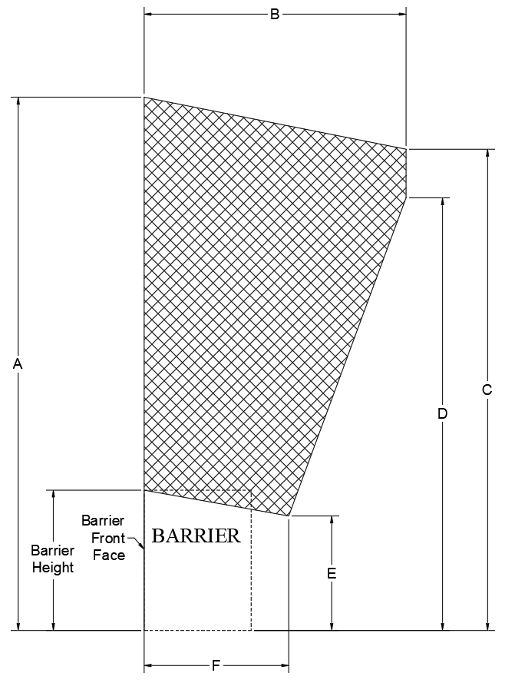
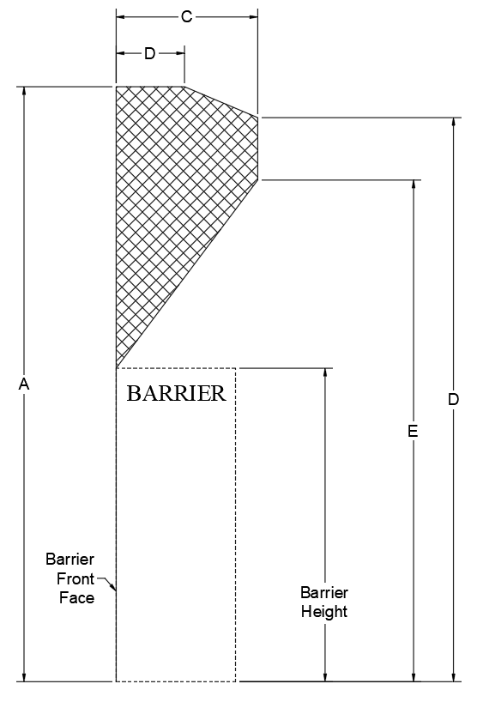
TL-4 ZOI Box RDG Recommendations
Barrier top height (in.) | Dimension (in.)
 | A | B | C | D | E
48 | 137.5 | 32 | 13.5 | 130 | 117
64 | 137.5 | 25 | 13.5 | 129 | 117
76 | 136 | 20 | 13.5 | 129 | 116
90 | 135 | 13.5 | 5 | 129 | 116
Barrier top height (in.) | Dimension (in.)
 | A | B | C | D | E | F
36 | 181 | 88 | 148 | 89 | 27 | 30
42 | 181 | 63 | 146 | 103 | 36.5 | 24
PHASE II TASK 6 → TASK 7 → TASK 8: RECOMMENDATIONS → TASK 9 → TASK 10 → TASK 11

Slide 43
TL-5 ZOI cab envelope recommendations
Barrier top height (in.) | Dimension (in.)
 | A | B
42 | 113.5 | 21.5
48 | 108.5 | 15.5
54 | 107 | 9.5
62 | N/A | 0
PHASE II TASK 6 → TASK 7 → TASK 8: RECOMMENDATIONS → TASK 9 → TASK 10 → TASK 11

Slide 44
TL-5 ZOI trailer envelope recommendations
Barrier top height (in.) | Dimension (in.)
 | A | B | C | D | E | F
42 | 185 | 85 | 153 | 98 | 33 | 70
48 | 157.5 | 35 | 153 | 128 | 48 | 12
Barrier top height (in.) | Dimension (in.)
 | A | B | C | D | E
54 | 156 | 32.5 | 21 | 153 | 128
62 | 156 | 29.5 | 153 | 21 | 128
72 | 156 | 25.5 | 153 | 18 | 132
84 | 156 | 20.5 | 152 | 13 | 140
90 | 153 | 18.0 | 152 | 10.5 | 144
PHASE II TASK 6 → TASK 7 → TASK 8: RECOMMENDATIONS → TASK 9 → TASK 10 → TASK 11

Slide 45
Task 9: Future Work
Research recommendations
  Bridge piers
  Rigid median obstructions
  Noise walls and debris fences
  Accommodation for pedestrians in close proximity to rigid barriers
Additional priority research needs
  ZOI envelopes for truck-tank trailer combination vehicles (MASH TL-6)
PHASE II TASK 6 → TASK 7 → TASK 8 → TASK 9: FUTURE RESEARCH → TASK 10 → TASK 11

Slide 46
Task 9: Future Work
Identified series of recommendations for improving ZOI envelope determination
  Test data documentation
  Technical reporting documentation
  Modeling improvements
    Inter-lab model standardization
    Vehicle component modeling improvements
    New model development for TL-4, TL-5
PHASE II TASK 6 → TASK 7 → TASK 8 → TASK 9: FUTURE RESEARCH → TASK 10 → TASK 11

Slide 47
Task 10: RDG Update
Recommendations for consideration by the Technical Committee on Roadside Safety (TCRS) and AASHTO in consideration with NCHRP panel
Meeting with TCRS, state DOTs anticipated after the acceptance and publication of project deliverables
New text added to report with suggested revision to RDG based on existing text
  NOTE: because significant part of RDG is being revised, actual text may vary from recommendation
PHASE II TASK 6 → TASK 7 → TASK 8 → TASK 9 → TASK 10: RDG UPDATES → TASK 11

