Slide 1
NCHRP 15-71
Contingency Factors to Account for Risk in Early Construction Cost Estimates for Transportation Infrastructure Projects
Notes:
This presentation highlights the key findings of the NCHRP1 15-71: Contingency Factors to Account for Risk in Early Construction Cost Estimates for Transportation Infrastructure Projects.

Slide 2
Research Goal
1. Introduction
This research project aims to identify, analyze, and understand the risk factors associated with the accuracy of early construction cost estimates and develop a standardized approach to accounting for project-related risks in early construction cost estimates, including the determination of contingency factor ranges for at least eight high-priority risks.
Notes:
The goal of this project was to Identify, analyze, and understand the risk factors associated with the accuracy of early construction cost estimates, and develop a standardized approach to accounting for project-related risks in early construction cost estimates.

Slide 3
Guidebook Structure
Introduction
Key Concepts – Construction Contingencies
Estimation Methods for Construction Contingencies
Major Risks for Construction Contingency Consideration
Guidance on Risk-Driven Approach for Estimating Construction Contingencies
Guidance on Historical Data-Driven Approach for Estimating Construction Contingencies
Guidance on Tracking and Monitoring Construction Contingencies
Notes:
As the final deliverable, the guidebook provides systematic guidance on how to estimate project risk driven construction contingency for DOT’s highway projects. It consists of seven chapters.

Slide 4
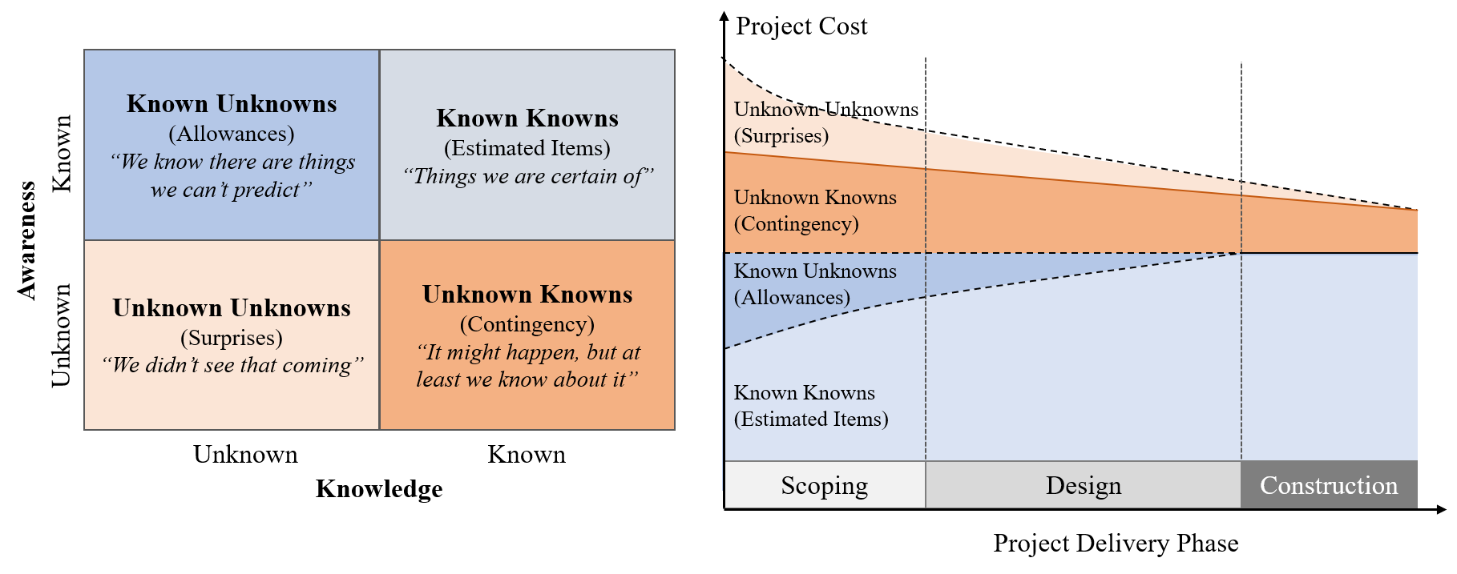
Major Elements of Construction Cost Estimate
2. Key Concepts – Construction Contingencies
Contingency for Unknown Knowns
Early Estimate = Base cost (itemized costs + allowance) + Contingency
Notes:
Chapter 2 describes key concepts related to construction cost estimating with a specific focus on major elements of construction cost estimate.
Typically, a construction cost estimate consists of (a) Known-Knowns (estimated items), (b) Known-Unknowns (allowances), and (c) Unknown-Knowns (contingency).
Unknown-Unknowns may eventually increase or decrease the final project costs but due to extremely high infrequency and unidentifiability, they are typically excluded from a cost estimate.
As an amount added to the base estimate to cover costs associated with identified uncertainties and risks, construction contingency is used to address Unknown-Knowns.

Slide 5
Construction Contingency Estimating
3. Estimation Methods for Construction Contingencies
Contingency estimating methods
Deterministic approach
Determine a single point estimate.
Appropriate when estimators are familiar with the type of the project from their experience.
Deterministic approach
Probabilistic approach
Fixed percentage
Expected value
Probabilistic approach
Sliding scale
Monte-Carlo simulation
Modeling uncertainty through statistical techniques.
Quantify risk impacts of probability with given project information.
Expert judgment
PERT
Parametric estimating
Notes:
Chapter 3 describes available methods for construction continency estimation. There are two major approaches for estimating construction contingency: Deterministic approach and probabilistic approach.
The deterministic approach allows cost estimators to determine a single point estimate for construction contingency, such as a specific percentage of base estimate. This approach is appropriate when estimators are familiar with the type of project from their experience and the perceived project risks are well-known and minimal.
The Probabilistic approach considers estimating construction contingency by quantifying the probability of occurrence and the consequence of risks with given project characteristics. This approach has the advantage of reflecting and modeling uncertainty through statistical techniques.

Slide 6
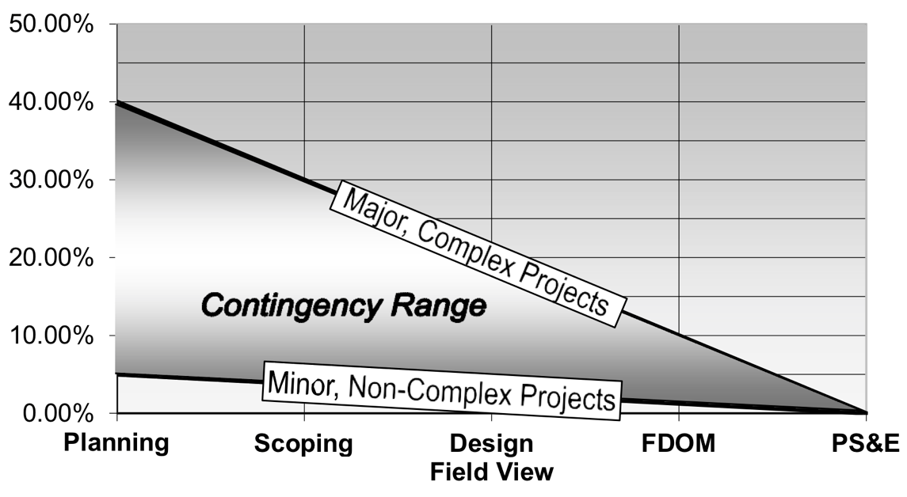
Deterministic approach
3. Estimation Methods for Construction Contingencies
Fixed percentage of base cost
Sliding Scale
Expert Judgment
The simplest method.
A pre-determined percentage of the base cost.
A range of percentages.
Different ranges for different project conditions
Use estimator’s personal experience and judgement.
Reflect project specific characteristics.
Project development stage | Contingency for roadway portion | Contingency for structure portion
Feasibility | +55% | +15%
Functional | +45% | +15%
Preliminary | +35% | +10%
At ROW | +25% | +10%
Final preliminary | +15% | +5%
Define decision problems
Recruit experts
Collect expert judgement
Analyze expert judgement
(Pros) Simple, straightforward, and available when useful project information is insufficient.
(Cons) Accuracy is dependent upon cost estimator’s experience and expertise.
Notes:
The deterministic approach includes fixed percentage, sliding scale, and expert judgement based estimating methods.
Fixed percentage: construction contingency is estimated through a predetermined percentage of the base cost and added to the construction budget.
Sliding scale: this method provides a range of percentages instead of a single percentage in estimating construction contingency.
Expert judgment: An estimator’s personal experience and judgement is the sole source for determining a project’s construction contingency.
(Pros) . Concerning estimation time, the deterministic methods can perform a swifter estimation than the probabilistic method by following their percentage determination guidelines.
(Cons) Accuracy is dependent upon cost estimator’s experience and expertise, and the available information for construction contingency estimating.

Slide 7
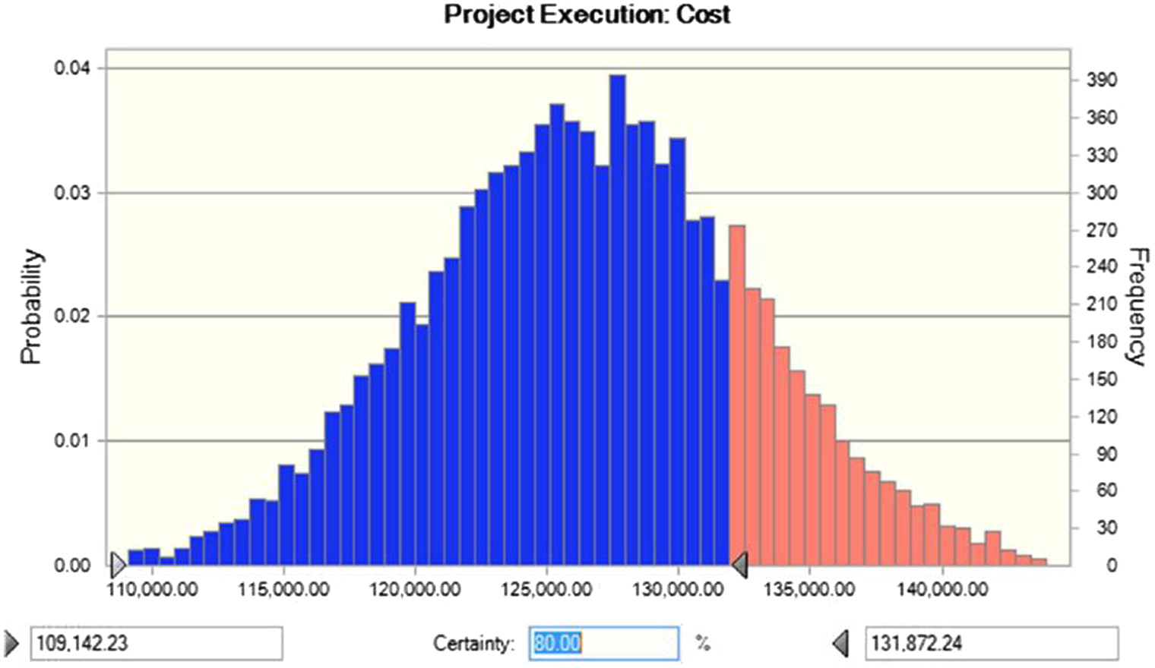
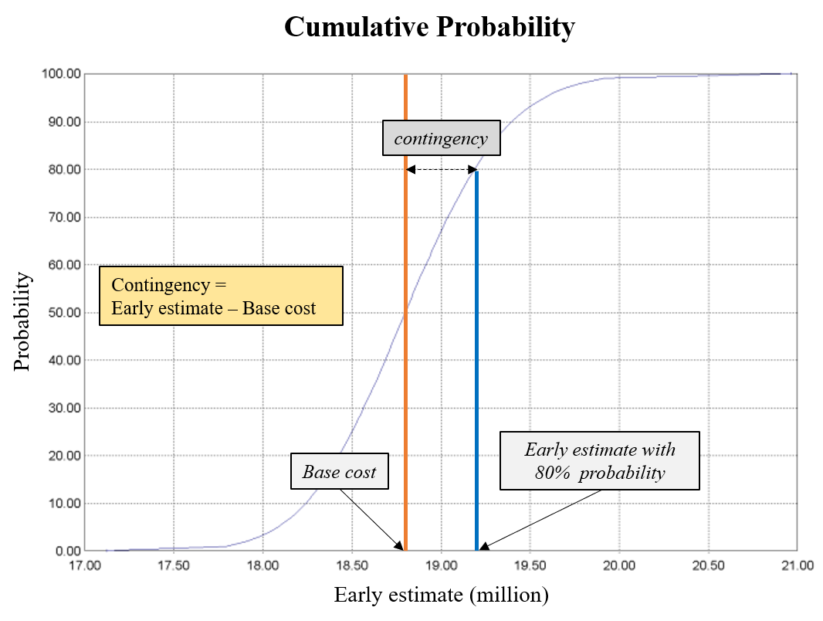
Probabilistic approach
3. Estimation Methods for Construction Contingencies
Expected value
Risks | Occurrence (%) (A) | Impacts ($) (B) | Contingency ($) (A)*(B)
Known Hazardous Substance | 10 | 125,000 | 12,500
Coordination with Railroad Agencies | 10 | 50,000 | 5,000
Treatment of Water Discharged from Site | 3 | 400,000 | 12,000
Total |  | 29,500 | 29,500
Identify project-specific risks and evaluate the probability and impact of the identified risks.
Require detail project information.
Monte Carlo simulation
A sophisticated computer-based probabilistic method.
Provide more realistic contingencies through a range of possible values.
(Pros) Can reflect project-specific characteristics and conduct more flexible contingency estimates.
(Cons) Requires more time and effort to perform it.
Notes:
The probabilistic approach includes expected value, monte-carlo simulation, pert, and parametric estimating methods.
Expected value: the estimator estimates the probability of occurrence (A) and the impact in terms of cost if the risk is realized (B). contingency for each risk is calculated by multiplying (A) by (B) and the sum of all contingencies will become the project’s total contingency.
Monte Carlo simulation: the Monte Carlo simulation provides a reliability -based estimate of contingency by iteratively sampling the probabilities of risks and the associated impact distributions.
(Pros) this approach can reflect project-specific characteristics and conduct more flexible contingency estimates.
(Cons) this approach requires more time and effort to perform it.

Slide 8
Major Risks for Construction Contingency Estimating
4. Major Risks for Construction Contingency Consideration
Top risk identification process
1. Analysis of DOT risk checklists and risk registers
2. Find risks through discussions with DOTs
3. Assess risk occurrences and impact magnitude
4. Prioritize top 12 risks
The list of 23 risks
Determined top 12 risks
Notes:
Chapter 4 of the guidebook discusses major risks to be considered in estimating construction contingency.
- The identification and prioritization of potential construction risks associated with a project is the starting point for a project risk-specific contingency estimation.
The analysis of available DOT risk checklists and risk registers of historical projects from FHWA and several DOTs and intensive discussions with DOT cost estimators have resulted in a list of 23 construction risks.
The assessment of their high likelihood of occurrence and the magnitude of impact on construction costs via questionnaire surveys with DOT cost estimators lead to prioritizing top 21 construction risks.

Slide 9
Top 12 Major Risks
4. Major Risks for Construction Contingency Consideration
23 risks for contingency estimating
Prioritized Top 12 risks
Utility issues
Unexpected geotechnical issues
Constructability issues
Railroad involvement
Late changes requested by stakeholders
Errors in cost estimating
Maintenance of traffic/work zone traffic control
Unknown or change in current asset conditions
Unexpected archeological or historic findings
Endangered/protected species encountered during construction
Issues with new materials, technologies, and methods
Coordination with other projects
Poor or incomplete project scope definition during the scoping phase
Design changes
Contractor availability and competition
Market conditions
Project duration-related issues
Funding availability
Hazardous materials encountered during construction
Coordination with government agencies
Surveys late or in error
Political risks
Unanticipated noise impacts and noise mitigation
Ranking | Risk
1 | Utility issues
2 | Poor or incomplete project scope definition during the scoping phase
3 | Unexpected geotechnical issues
4 | Design changes
5 | Constructability issues
6 | Contractor availability and competition
7 | Railroad involvement
8 | Market conditions
9 | Late changes requested by stakeholders
10 | Project duration-related issues
11 | Errors in cost estimating
12 | Funding availability
Notes:
Out of those 23 risks for construction contingency estimation, top 12 risks were prioritized.
These risks typically occur in common project types, defined by FHWA (2009), such as new construction, reconstruction, bridge new construction, and bridge replacement.
However, an individual project’s risk profile might be unique; if so, an individual project-level risk assessment must be performed.

Slide 10
Workflow of Estimating Contingency for High Priority risks
5. Guidance on Risk-Driven Approach for Estimating Construction Contingencies
1. Determine project characteristics, conditions, and environments
Is there any trigger?
No
Stop
Yes
3. Conduct qualitative assessment
2. Contact subject matter experts (SMEs)
Is this risk significant?
No
Stop
Help more thorough and comprehensive risk considerations.
Can reflect project characteristics rather than simply apply pre-defined percentages
Yes
4. Gather information & data from SMEs
5. Determine the probability and cost impact of the risk
6. (Optional) Select a response strategy & determine residual contingency
Output the contingency amount for the risk
Notes:
Chapter 5 describes a Risk-driven construction contingency estimating process
A general workflow has been proposed to address individual risks, especially the top priority ones.
This workflow is expected to help cost estimators consider risks more thoroughly and comprehensively and guide them through how to develop a contingency estimate specific to their project rather than simply applying predefined percentages without examining project conditions and issues.

Slide 11
Step 1
5. Guidance on Risk-Driven Approach for Estimating Construction Contingencies
1. Determine project characteristics, conditions, and environments
Is there any trigger?
No
Stop
Yes
3. Conduct qualitative assessment
2. Contact subject matter experts (SMEs)
Is this risk significant?
No
Stop
Step 1: Determine project characteristics, conditions, and environments
Yes
4. Gather information & data from SMEs
Gather key project information from scoping reports, including characteristics, conditions, and environments.
Identify the triggers for each of the top risks.
5. Determine the probability and cost impact of the risk
6. (Optional) Select a response strategy & determine residual contingency
Output the contingency amount for the risk
Notes:
Step 1: Determine project characteristics, conditions, and environments.
Gather key project information from scoping reports, including characteristics, conditions, and environments.
Identify the triggers for each of the top risks.

Slide 12
Step 2
5. Guidance on Risk-Driven Approach for Estimating Construction Contingencies
1. Determine project characteristics, conditions, and environments
Is there any trigger?
No
Stop
Yes
3. Conduct qualitative assessment
2. Contact subject matter experts (SMEs)
Is this risk significant?
No
Stop
Yes
Step 2: Contact subject matter experts (SMEs)
4. Gather information & data from SMEs
SMEs can provide valuable input and help validate project cost estimates.
Early cost estimators can contact relevant SMEs to get more information on the risks.
5. Determine the probability and cost impact of the risk
6. (Optional) Select a response strategy & determine residual contingency
Output the contingency amount for the risk
Notes:
Step 2: Contact subject matter experts (SMEs).
SMEs can provide valuable input and help validate project cost estimates.
Early cost estimators can contact relevant SMEs to get more information on the risks

Slide 13
Step 3
5. Guidance on Risk-Driven Approach for Estimating Construction Contingencies
1. Determine project characteristics, conditions, and environments
Is there any trigger?
No
Stop
Yes
3. Conduct qualitative assessment
2. Contact subject matter experts (SMEs)
Is this risk significant?
No
Stop
Step 3: Conduct qualitative assessment
Yes
4. Gather information & data from SMEs
Evaluate the risk’s significance on the project.
Assign scores from 1 to 5 to the risks in terms of occurrence probability and their impacts.
5. Determine the probability and cost impact of the risk
6. (Optional) Select a response strategy & determine residual contingency
Output the contingency amount for the risk
Notes:
Step 3: Conduct qualitative assessment
Evaluate the risk’s significance on the project.
Assign scores from 1 to 5 to the risks in terms of occurrence probability and their impacts.

Slide 14
Step 4
5. Guidance on Risk-Driven Approach for Estimating Construction Contingencies
1. Determine project characteristics, conditions, and environments
Is there any trigger?
No
Stop
Yes
3. Conduct qualitative assessment
2. Contact subject matter experts (SMEs)
Is this risk significant?
No
Stop
Yes
Step 4: Gather information & data from SMEs
4. Gather information & data from SMEs
Gather information and data from SMEs that can serve as a reference for early cost estimators.
5. Determine the probability and cost impact of the risk
6. (Optional) Select a response strategy & determine residual contingency
Output the contingency amount for the risk
Notes:
Step 4: Gather information and data from SMEs
- Gather information and data from SMEs that can serve as a reference for early cost estimators.

Slide 15
Step 5 and Step 6
5. Guidance on Risk-Driven Approach for Estimating Construction Contingencies
1. Determine project characteristics, conditions, and environments
Is there any trigger?
No
Stop
Yes
3. Conduct qualitative assessment
2. Contact subject matter experts (SMEs)
Is this risk significant?
No
Stop
Step 5: Determine the probability and cost impact of the risks
Yes
Estimate the risk’s impact (optimistic (O), most likely (M), and pessimistic (P)).
The average impact: I = (O+4M+P)/6.
Contingency amount = Pr x I
4. Gather information & data from SMEs
5. Determine the probability and cost impact of the risk
6. (Optional) Select a response strategy & determine residual contingency
Step 6: (Optional) Select a response strategy & determine residual contingency
Output the contingency amount for the risk
Notes:
Step 5: Determine the probability and cost impact of the risk.
Estimate the risk’s impact based on risks’ potential optimistic (O), most likely (M), and pessimistic (P)) costs.
Step 6: (Optional) Select a response strategy and determine residual contingency.
- A risk response action may be implemented to mitigate its impact. The additional cost associated with the response action is added to the base cost estimate.

Slide 16
MS Excel Tool for Risk-Driven Contingency Estimating
5. Guidance on Risk-Driven Approach for Estimating Construction Contingencies
Early Risk-Driven Estimating and Monitoring of Construction Cost Contingencies (EReC3)
"Home" sheet
“Risk list-up" sheet
Notes:
An MS Excel based Tool (EReC3) was developed to facilitate the risk-driven contingency estimating process for DOTs.
The Home“ sheet provides the short description of the estimating process and the buttons for directly moving to major time points for construction contingency tracking and monitoring.
The " Risk list" sheet lists up the top 12 risks affecting construction costs for contingency consideration and the general process of evaluating individual risks.

Slide 17
Specific sheets of EReC3
5. Guidance on Risk-Driven Approach for Estimating Construction Contingencies
Sheet 1: Risk identification
Sheet 2: Qualitative risk assessment
Sheet 3: Quantitative risk assessment
Sheet 4: Risk mitigation
Notes:
This slide provides the screenshot of each sheet in the tool
Sheet 1: Risk identification sheet
The selected risks are automatically generated in the "Risk Identification" worksheet.
Their common triggers are also provided to evaluate whether each of them occurs in a specific project.
If a trigger exists, the corresponding risk will be moved to the next stage.
Sheet 2: Qualitative risk assessment
Each risk is assigned scores for the "Likelihood" and "Impact" columns with input from the relevant SMEs.
A checkmark corresponding to the assigned scores will automatically appear in the "Risk Matrix" column.
A risk item in the yellow or red areas is typically considered significant.
Sheet 3: Quantitative risk assessment
Early cost estimators may need to gather additional data and information relevant to the risk from the earlier determined SMEs.
Historical cost data are also available for estimation.
If not, SMEs' judgments and experiences in past projects are a crucial and most probable source for early cost estimators.
Sheet 4: Risk mitigation
- This tool has an extra function to determine residual contingen.cy if an action is performed to mitigate the expected impact of a specific risk

Slide 18
Overall Process of Historical Data-Driven Approach
6. Guidance on Historical Data-Driven Approach for Estimating Construction Contingencies
1. Historical Cost Data Collection
2. Data Cleaning and Pre-processing
3. Data Analysis and Project Characterization
4. Model Development
5. Apply Model to Projects
Use historical digital data for performing a construction contingency estimation.
Allow cost estimators to have confidence in their contingency numbers for a new project.
Notes:
Chapter 6 provides descriptions of the Historical data-driven construction contingency estimating process.
Many DOTs have accumulated a significant amount of digital data across different divisions and offices.
Project cost estimates and cost performance data are some of the core digital datasets that DOTs have collected and stored.
A historical data–driven construction contingency estimation will allow cost estimators to have confidence in their contingency numbers.
This proposed approach is composed of five tasks.

Slide 19
6. Guidance on Historical Data-Driven Approach for Estimating Construction Contingencies
Work Tasks for Historical Data-Driven Approach
1. Historical Cost Data Collection
2. Data Cleaning and Pre-processing
3. Data Analysis and Project Characterization
4. Model Development
5. Apply Model to Projects
Data collection and cleaning
<Cost data for data collection>
Cost type | Ideal data attributes
Early estimate | Base estimate (major work items + allowance)
 | Construction contingency
Engineer’s estimate | The entire list of pay items with their quantities and unit prices
Final construction cost | The entire list of actual pay items with their quantities and unit prices
 | Change orders
Gather historical data over the project development phases.
Filter out projects that went through major scope changes.
Notes:
Task 1. Historical cost data collection
The quantitative approach starts with gathering historical cost data over the project development phases.
This step requires (a) early cost estimates in the scoping phase, (b) engineer’s estimates in the project design and PS&E development phase, and (c) final construction costs at project close-out.
Task 2. Data cleaning and pre-processing
Data cleaning is necessary to eliminate (a) historical projects that may have missing data points and (b) unnecessary data attributes available in the raw dataset.
The data cleaning process filters out projects that have undergone scope changes between the scoping and the final design phases since scope change typically requires a new baseline cost estimate.

Slide 20
6. Guidance on Historical Data-Driven Approach for Estimating Construction Contingencies
Work Tasks for Historical Data-Driven Approach
1. Historical Cost Data Collection
2. Data Cleaning and Pre-processing
3. Data Analysis and Project Characterization
4. Model Development
5. Apply Model to Projects
RFB: The ratio of the final construction cost to the base cost estimate
$$RFB (\%) =(\frac{Final construction cost at the end of project}{Base cost estimate at the scoping phase}−1) X 100$$
Classify project based on characteristics
Ex) Project type: New construction, Reconstruction, Resurfacing, Rehabilitation, and Relocation.
Project size: Small sized, Mid sized, and Large sized.
Notes:
Task 3. Data analysis and project characterization
- Calculate the Difference between the Base Cost Estimate and the Final Construction Cost via RFB
The RFB indicates the percentage of the base estimate that should have been used to allocate the construction contingency amount at the scoping phase to fully cover any construction cost changes
Classify project based on characteristics
Major project characteristics such as project type, location, complexity, and project size may significantly influence the construction contingency amount since they may pose different types of risks and uncertainties.
Thus, the master database of historical projects needs to be reorganized by these project characteristics.

Slide 21
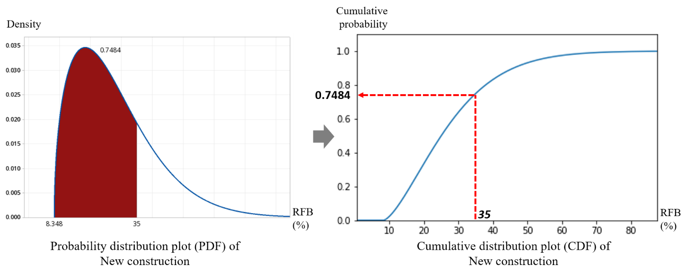
6. Guidance on Historical Data-Driven Approach for Estimating Construction Contingencies
Work Tasks for Historical Data-Driven Approach
1. Historical Cost Data Collection
2. Data Cleaning and Pre-processing
3. Data Analysis and Project Characterization
4. Model Development
5. Apply Model to Projects
Contingency range estimation
Perform statistical analysis.
Probability distribution fitting.
Develop probability density functions (PDF) and cumulative distribution functions (CDF).
<PDF>
<CDF>
Notes:
Task 4. Model development (contingency range estimating)
Perform statistical analysis for developing distribution fittings for RFBs
A distribution fitting is applied to determine the most appropriate distribution curve that can explain the distribution of RFBs of historical projects for project characteristics.
Develop probability density functions (PDF) and cumulative distribution functions (CDF) for computing certainties for available construction contingencies.
Task 5. Apply the proposed model to real projects
- An estimator can directly use them to estimate a construction cost contingency using the base estimate of the project in the scoping phase.

Slide 22
Case Study
6. Guidance on Historical Data-Driven Approach for Estimating Construction Contingencies
Demonstrate the process with real data.
Use DOT’s actual historical data for in-depth case study
Offer a practical idea on how the results can be assessed for a more defensible construction contingency estimation.
<Project types for case study>
Project types | Number of projects
Roadway - new construction | 112
Roadway - reconstruction | 76
Roadway – resurfacing | 338
Roadway - rehabilitation | 90
Roadway – replacement | 15
Bridge – new construction | 6
Bridge – replacement | 50
Bridge – rehabilitation | 52
Total | 739
Notes:
An in-depth case study for historical-data driven construction contingency estimating was conducted to show how the process can be applied to a DOT’s system.
The intent of this case study is to demonstrate the entire process with real data, show practical issues and concerns that DOTs may encounter when they want to implement a historical data-driven construction contingency estimation approach.
This case study also offers a practical idea on how the results can be assessed with the results from the project risk-driven contingency estimating approach for a more defensible and reliable construction contingency estimation.
Projects for the case study were categorized into six groups: (a) roadway–new construction, (b) roadway–reconstruction, (c) roadway–resurfacing, (d) roadway–rehabilitation, (e) bridge–replacement, and (f) bridge–rehabilitation.

Slide 23
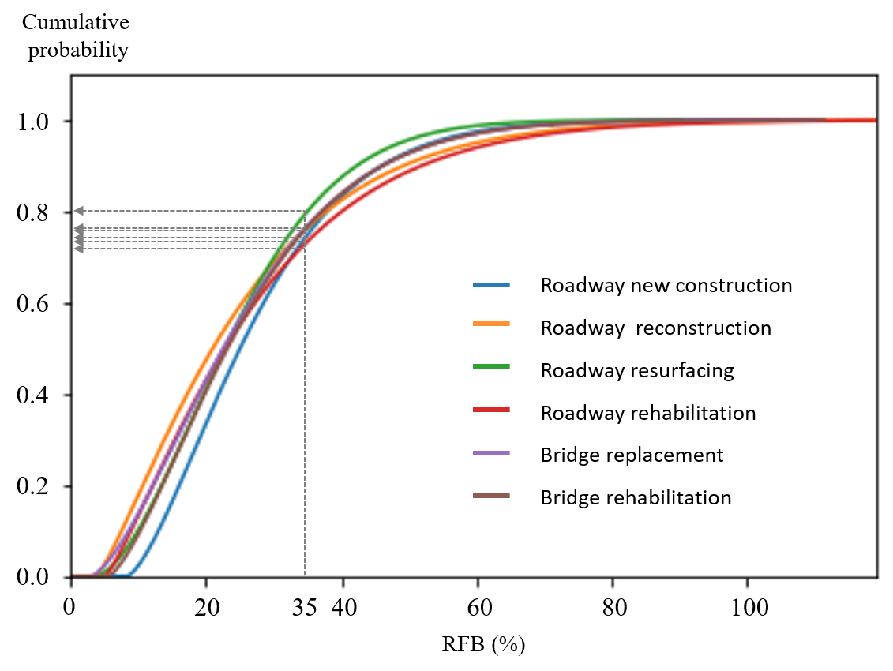
Case Study
6. Guidance on Historical Data-Driven Approach for Estimating Construction Contingencies
CDFs of six project types.
Cumulative probability refers to certainty about a given RFB.
RFB can be a percentage of base cost.
Types | RFB
 | 10% | 30% | 50%
Roadway - new construction | 0.022 | 0.638 | 0.93
Roadway – reconstruction | 0.177 | 0.688 | 0.905
Roadway – resurfacing | 0.101 | 0.697 | 0.966
Roadway – rehabilitation | 0.132 | 0.652 | 0.888
Bridge replacement | 0.136 | 0.677 | 0.928
Bridge rehabilitation | 0.091 | 0.670 | 0.927
Notes:
This slide shows the Case study results and describes how to interpret the results.
For example, a cumulative probability of 0.67 with 30 percent RFB indicates that if the contingency estimate is 30 percent of the base estimate, about 67 percent of the previous roadway resurfacing projects would have been completed within the estimated budget.
It can be rephrased that estimators can have 67 percent certainty if they set the construction contingency estimate to 30 percent of the base estimate.

Slide 24
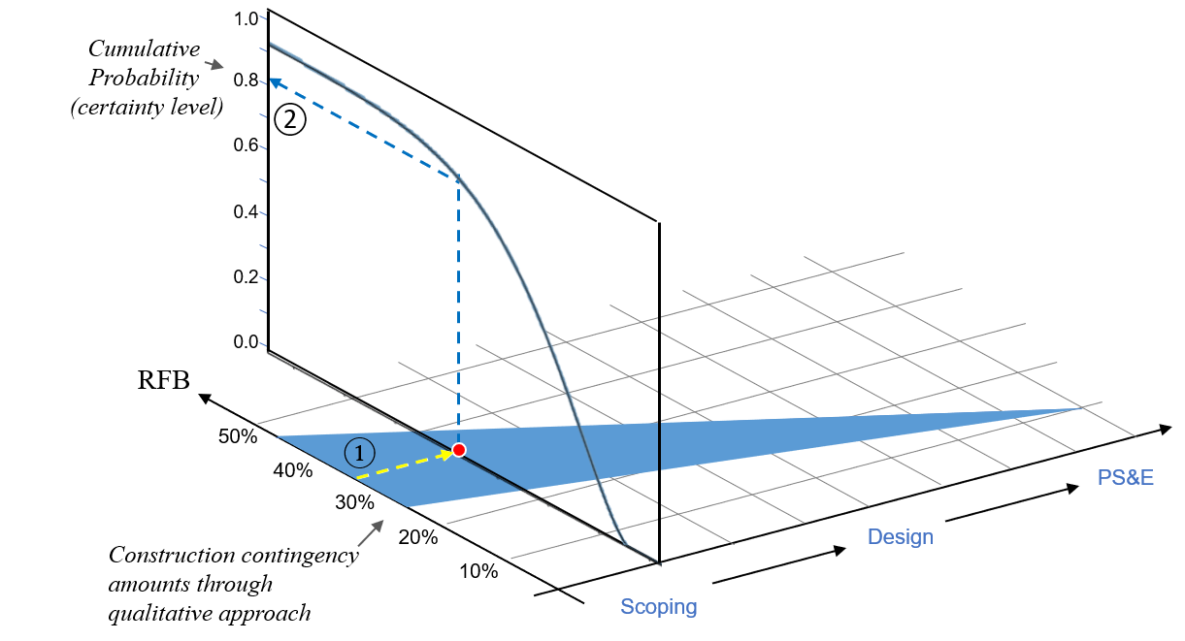
Case Study
6. Guidance on Historical Data-Driven Approach for Estimating Construction Contingencies
Applications (Incorporate CDF into sliding scales)
①: Convert a construction contingency amount to the percentage of the base estimate.
②: Check cumulative probability from CDF curves to ensure the certainty of construction contingency.
Notes:
There are two potential applications
1. : A construction contingency amount calculated from the qualitative approach is converted to the percentage of the base estimate. This percentage corresponds to the RFB developed by the quantitative approach.
2. The CDF curve provides the cumulative probability information for construction contingency. The cumulative probability indicates the certainty level of the contingency percentage so that the agency can perform a reality check to ensure that the construction contingency calculated from the risk-driven approach is within a reasonable range based upon the historical projects’ cost performance data.

Slide 25
Use of Two approaches
6. Guidance on Historical Data-Driven Approach for Estimating Construction Contingencies
Verification: Historical data-driven approach
Estimation: Risk-driven approach
Conduct risk identification and estimate their impacts on construction contingency.
Backcheck the amounts from risk-driven estimating.
Evaluate certainty for verification.
Notes:
The two methods proposed in the guidebook (risk driven construction contingency estimating method and historical data driven approach) can be strategically used for better construction contingency estimating
First, the risk-driven approach based on EReC3 is applied to conduct risk identification and estimate their impacts for computing construction contingency amounts.
Next, the historical data-driven approach is applied to backcheck and verify the certainty of contingency amounts from the risk-driven approach.

Slide 26
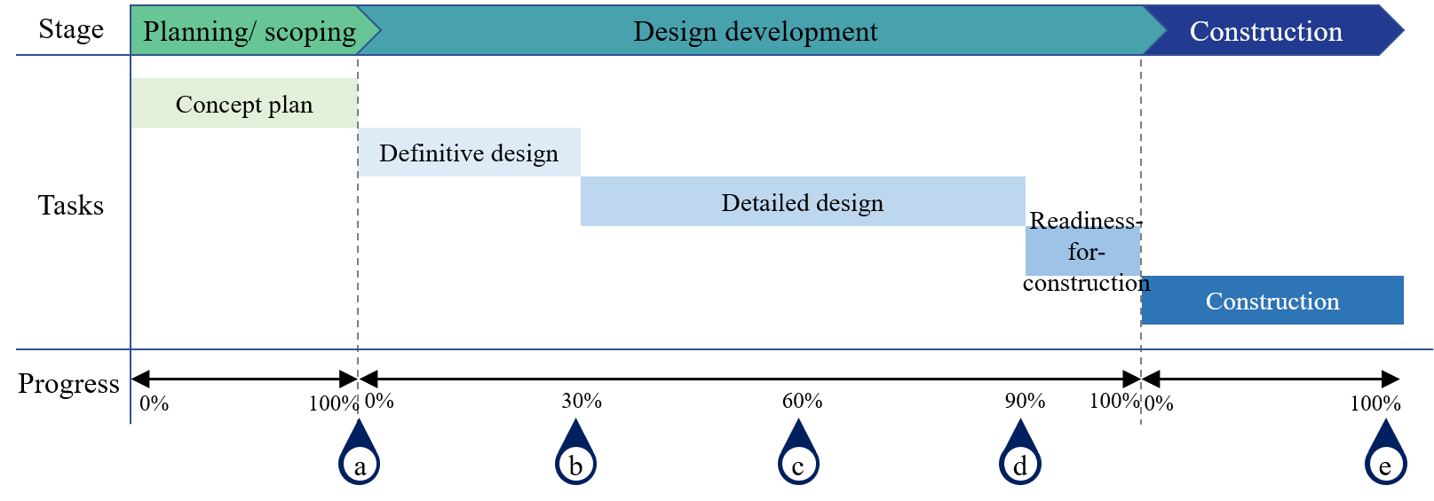
Construction Contingencies Tracking and Monitoring
7. Guidance on Tracking and Monitoring Construction Contingencies
Major milestone meetings for tracking and monitoring
(a) | (b) | (c) | (d) | (e)
End of project scoping | 30% design | 60% design | 90% design | Construction completion
Notes:
Chapter 7 offers a process for construction contingency tracking and monitoring
Tracking and monitoring construction contingencies should be performed as one of the risk management tasks during the pre-construction phase.
Construction contingency tracking is recommended as part of the iterative risk analysis at major milestone meetings during design and post-construction meeting. .
In terms of design development level, milestone workshops are held at 30 percent, 60 percent, and 90 percent design complete.
This post-construction meeting mainly deals with change orders, claims, maintenance of traffic issues, cost overruns of pay items, and other issues that participants want to discuss.

Slide 27
Iterative Process for Tracking and Monitoring Construction Contingencies
7. Guidance on Tracking and Monitoring Construction Contingencies
<MS Excel tool interface for contingency tracking and monitoring>
Notes:
The EReC3 tool has a function for contingency tracking and monitoring
This graph allows estimators and project managers to easily figure out trends in project risk-driven contingency performance as the project progresses.
DOTs are recommended to use the EReC3 at the scoping phase and continue to use during the design and construction phase for consistent contingency tracking and monitoring.

Slide 28
Construction contingency monitoring metrics
7. Guidance on Tracking and Monitoring Construction Contingencies
Metrics during design
Metrics during construction
Quantity growth
Quantity growth
Schedule growth
Quantity growth due to Change Orders
Change order cost growth
Contingency growth
Change Order schedule growth
Risk retirement rate
Risk retirement rate
Contingency consumption rate
Contingency consumption rate
Value engineering savings rate
Value engineering savings rate
Notes:
The guidebook also provides construction contingency monitoring metrics
These metrics are also recommended as part of construction contingency tracking and monitoring efforts for consistent evaluation.
a) Schedule growth and b) contingency growth during design → a) Quantity growth due to change orders, b) change order cost growth, and c) change order schedule growth.
Metrics during design
Quantity growth: Change in quantity of work for a specific cardinal pay item not due to scope additions.
Schedule growth: Change in the estimated contract time.
Contingency growth: Change in quantified amount of contingency between two sequential estimates.
Contingency consumption rate: Amount of current contingency that has been allocated to cover design changes, quantity growth, etc. over time.
Risk retirement rate: Change in the number of active risks that the contingency covers.
Value engineering saving rate: Change in the estimated construction cost due to accepted value engineering changes.
Metrics during construction
Quantity growth: Change in quantity of work for a specific cardinal pay item due to actual versus as-bid quantities.
Quantity growth due to change orders: Change in quantity of work for a specific cardinal pay item resulting from change orders.
Change order cost growth: Change in contract value as a result of approved change orders.
Change order schedule growth: Change in the award contract time as a result of approved change orders.
Contingency consumption rate: Amount of current contingency that has been allocated to cover quantity growth, changes, weather, etc. over time.
Risk retirement rate: Change in the number of active risks that the contingency covers.
Value engineering saving rate: Change in the estimated construction cost due to accepted value engineering changes.

Slide 29
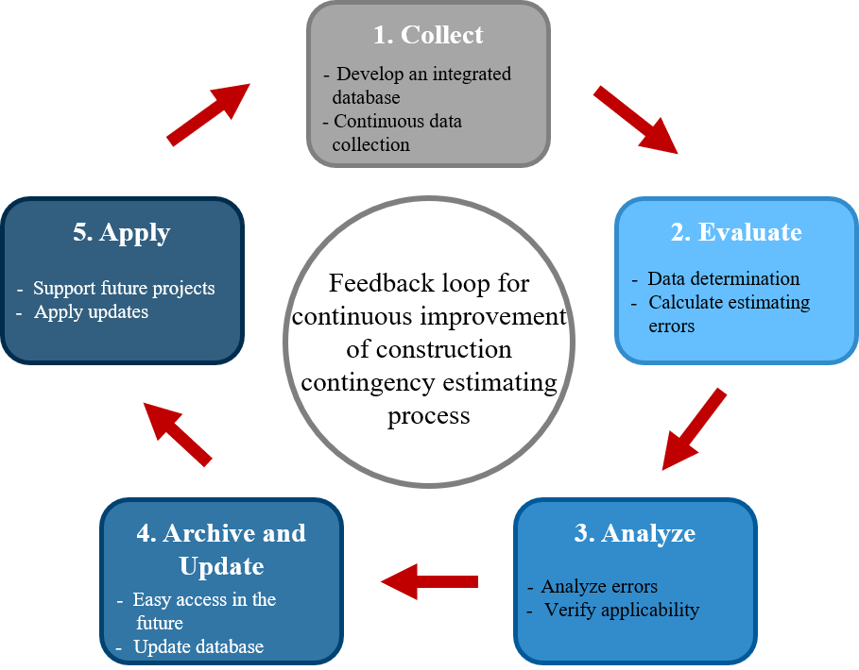
Continuous Improvement of Construction Contingency Estimating Process
7. Guidance on Tracking and Monitoring Construction Contingencies
<Process for feedback loop for construction contingency estimating>
Notes:
The guidebook offers a continuous improvement process of construction contingency estimating
The information obtained from previous projects can significantly help improve planning and designing activities for future projects.
However, in practice, DOTs are poor at sharing, disseminating, and transferring knowledge due to a) the lack of a database that facilitates learning between projects and among people and b) the heavy reliance on an individual’s capability in capturing knowledge from previous projects.
Feedback loop for construction contingency estimating
1. Collect:
This step aims to acquire the data needed to calculate construction contingency estimating performance and recognize significant causes of performance results.
Since the uniqueness and complexity of highway projects establish a huge amount of different project-specific data, highway agencies can recognize and determine data that are necessary for construction contingency estimating.
2. Evaluate:
This step is to evaluate contingency errors.
$Contingency error= \frac{Actual contingency−Estimated contingency at scoping phase }{Actual contingency}$
3. Analyze:
This step aims to conduct an in-depth analysis that focuses on why contingency errors happened.
This step requires identifying root causes resulting from estimating errors and investigating the relationship between the identified root causes and project-specific characteristics.
4. Archive
This step encourages users to quickly access and update data for easy retrieval and adequate storage and management of insights for future projects.
The data archiving can be implemented through the standardization of data or information with database structure, a logical system for classifying data, and the adoption of a user-friendly update interface.
5. Disseminate and Apply
This step aims to disseminate obtained insights for better estimating construction contingency.
The obtained insights help highway agencies make appropriate adjustments for better construction contingency estimating.

Slide 30
Thank you
This presentation highlights the key findings of NCHRP Project 15-71: Contingency Factors to Account for Risk in Early Construction Cost Estimates for Transportation Infrastructure Projects.
More information is available in NCHRP Research Report 1025:Contingency Factors to Account for Risk in Early Construction Cost Estimates for Transportation Infrastructure, which can be obtained from the National Academies press website (www.nap.edu).
The National Cooperative Highway Research Program (NCHRP) is sponsored by the individual state departments of transportation of the American Association of State Highway and Transportation Officials. NCHRP is administered by the Transportation Research Board (TRB), part of the National Academies of Sciences, Engineering, and Medicine, under a cooperative agreement with the Federal Highway Administration (FHWA). Any opinions and conclusions expressed or implied in resulting research products are those of the individuals and organizations who performed the research and are not necessarily those of TRB; the National Academies of Sciences, Engineering, and Medicine; the FHWA; or NCHRP sponsors.

