Slide 1

NCHRP Project 24-48: Develop a Formula for Determining Scour Depth around Structures in Gravel-bed Rivers
Dr. Elowyn Yager, University of Idaho
Notes:
Please find training slides at the end of this template.

Slide 2
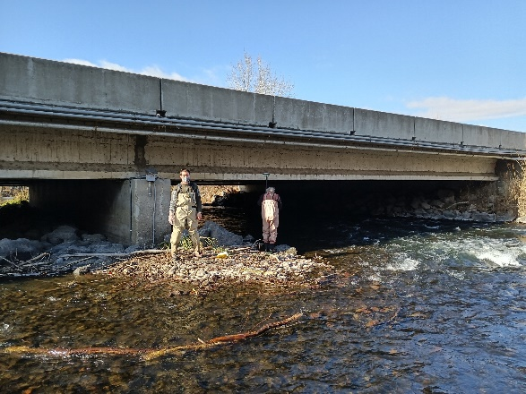
Project Overview set by NCHRP
Objective:
Develop scour equation for bridge piers that are located in coarse bedded (gravel to cobbles) rivers.
Equation should include shear stress decay in scour hole and effects of grain size distribution on scour.

Slide 3
Project Overview set by NCHRP
Why: Most equations developed for finer bedded rivers and do not correctly predict scour in coarse bedded rivers.

Slide 4
Proposed equation form
Maximum scour depth is balance of the driving fluid shear stress and resisting grain shear stress

Slide 5
Proposed equation form
Resisting shear stress (critical shear stress, τ_{c}) changes with composition of different sediment layers
Original bed surface
τ_{c} =2.2 Pa
τ_{c} =1.5 Pa
Increasing scour depth
τ_{c} =3.0 Pa

Slide 6
Proposed equation form
Driving shear stress often decreases as scour hole develops (shear stress decay curve)
Original bed surface
Increasing scour depth
Maximum applied shear stress

Slide 7
Proposed equation form
Combine equations: Maximum scour depth when driving shear stress is no longer > critical shear stress
Original bed surface
τ_{c} =2.2 Pa
τ_{c} =1.5 Pa
Increasing scour depth
τ_{c} =3.0 Pa
2 Pa
3 Pa
4 Pa
Maximum applied shear stress

Slide 8
Proposed equation form
Combine equations: Maximum scour depth when driving shear stress is no longer > critical shear stress
Original bed surface
τ_{c} =2.2 Pa
τ_{c} =1.5 Pa
Increasing scour depth
τ_{c} =3.0 Pa
2 Pa
3 Pa
4 Pa
Maximum applied shear stress

Slide 9
Proposed equation form
Combine equations: Maximum scour depth when driving shear stress is no longer > critical shear stress
Original bed surface
τ_{c} =2.2 Pa
τ_{c} =1.5 Pa
Increasing scour depth
τ_{c} =3.0 Pa
2 Pa
3 Pa
4 Pa
Maximum applied shear stress

Slide 10
Proposed equation form
Combine equations: Maximum scour depth when driving shear stress is no longer > critical shear stress
Scour stops, maximum depth
Original bed surface
τ_{c} =2.2 Pa
τ_{c} =1.5 Pa
Increasing scour depth
τ_{c} =3.0 Pa
2 Pa
3 Pa
4 Pa
Maximum applied shear stress

Slide 11
Develop equations
Need:
Critical shear stress variation with bed grain size distribution (laboratory experiments)
Scour depth variation with bed grain size distribution and flow (laboratory experiments)
Shear stress decay curve (numerical modeling based on experiments)
Field data to test and further calibrate design equations

Slide 12
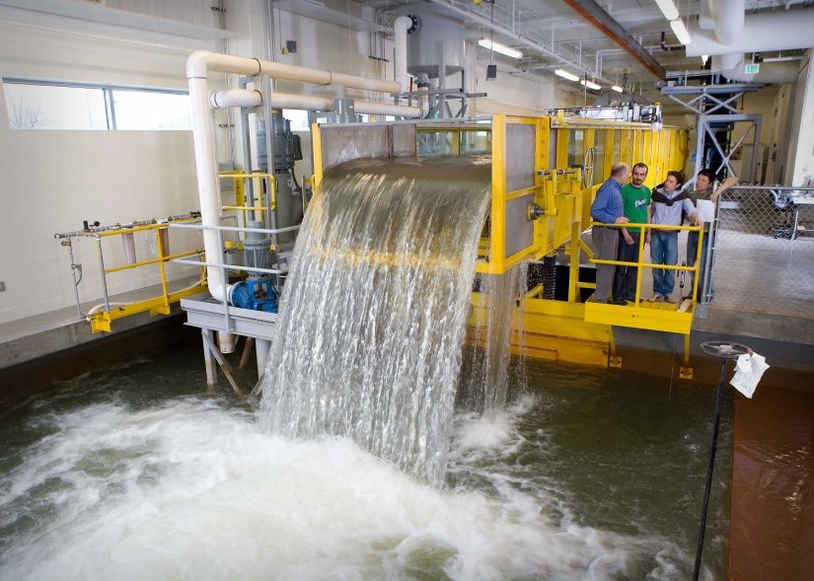
All laboratory experiments
20 meters long
2 m wide
Flow straighteners upstream
Tailgate downstream
Slope of 1.15%

Slide 13
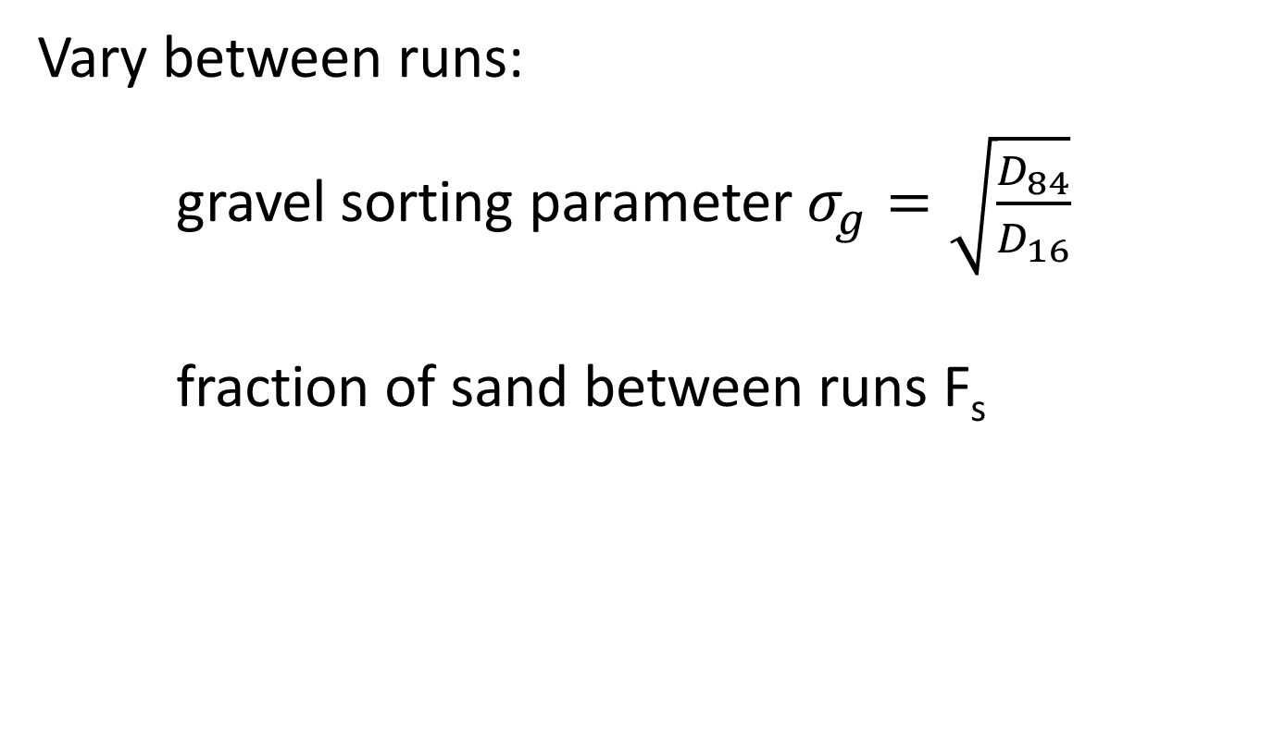
All laboratory experiments
Vary between runs:
gravel sorting parameter $σ_{g}=\sqrt{\frac{D_{84}}{D_{16}}}$
fraction of sand between runs F_{s}

Slide 14
All laboratory experiments
Armored gravel bed with finer subsurface layer by water working for 16 hours before each run.
Coarse armor layer
Finer subsurface layer

Slide 15
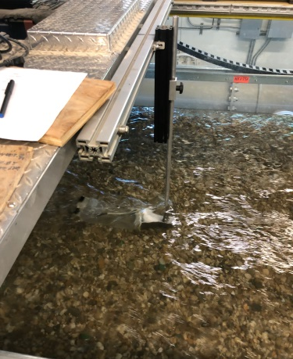
Laboratory experiments: critical shear stress
Measure sediment transport rates of armor and subsurface layers for range of shear stresses

Slide 16
Laboratory experiments: critical shear stress
Measure sediment transport rates of armor and subsurface layers for range of shear stresses
Use reference transport rate method to obtain critical shear stress for each layer and run

Slide 17
Equation for critical shear stress
Critical shear stress (τ_{c}) changes with composition of different sediment layers
Coarse armor layer τ_{c}
Finer subsurface layer τ_{c}

Slide 18
Equation for critical shear stress
$$τ_{c}=\exp\left(0.279 σ_{g}−2.38 F_{s}−3.5\right)\left(\left(ρ_{s}−ρ\right)gD_{50}\right)$$
ρ is water density
ρ_{s} is water density
g is gravitational acceleration
D₅₀ is median grain size

Slide 19
Equation for critical shear stress
$$τ_{c}=\exp\left(0.279 σ_{g}−2.38 F_{s}−3.5\right)\left(\left(ρ_{s}−ρ\right)gD_{50}\right)$$
Critical shear stress:
increases with greater gravel sorting parameter (wider grain size distribution)
decreases with greater sand content

Slide 20
Laboratory experiments: scour depths
Between experiments vary flow conditions (live bed vs. clear water) and grain size distribution of the sediment layers

Slide 21
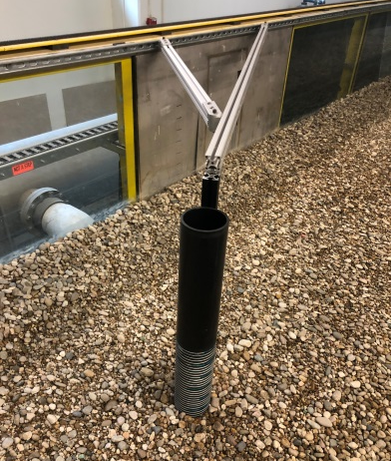
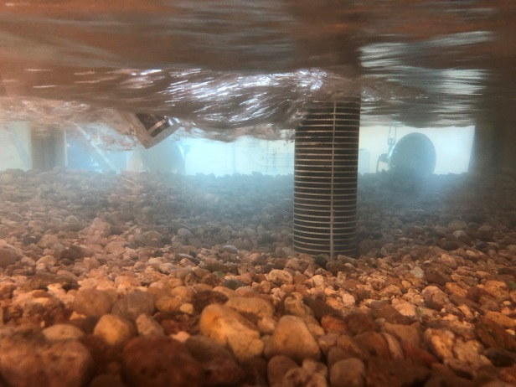
Laboratory experiments: scour depths
Simulated bridge pier installed after armoring bed:

Slide 22
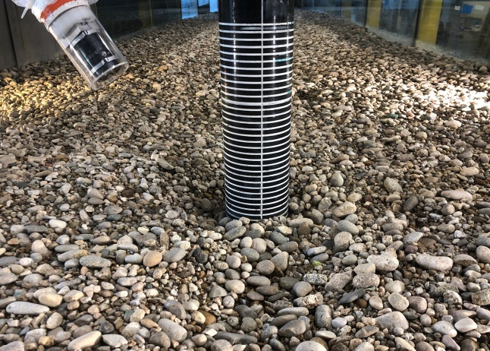
Laboratory experiments: scour depths
Measure scour every 1-2 hr using photographs and Structure from Motion (SfM software):

Slide 23
Laboratory experiments: scour depths
Measure scour every 1-2 hr using photographs and Structure from Motion (SfM software):

Slide 24
Laboratory experiments: scour depths
Determine maximum scour depth from topography:

Slide 25
Laboratory experiments: scour depths
Measured scour depths generally decreased with greater bed gravel sorting parameters (wider grain size distribution) and lower bed sand contents.
Inclusion of layers with very different grain size distributions had a large influence on the measured scour depths.

Slide 26
3D Numerical Model (Large Eddy Simulation)
Detailed topography of some experiment runs used in numerical model

Slide 27
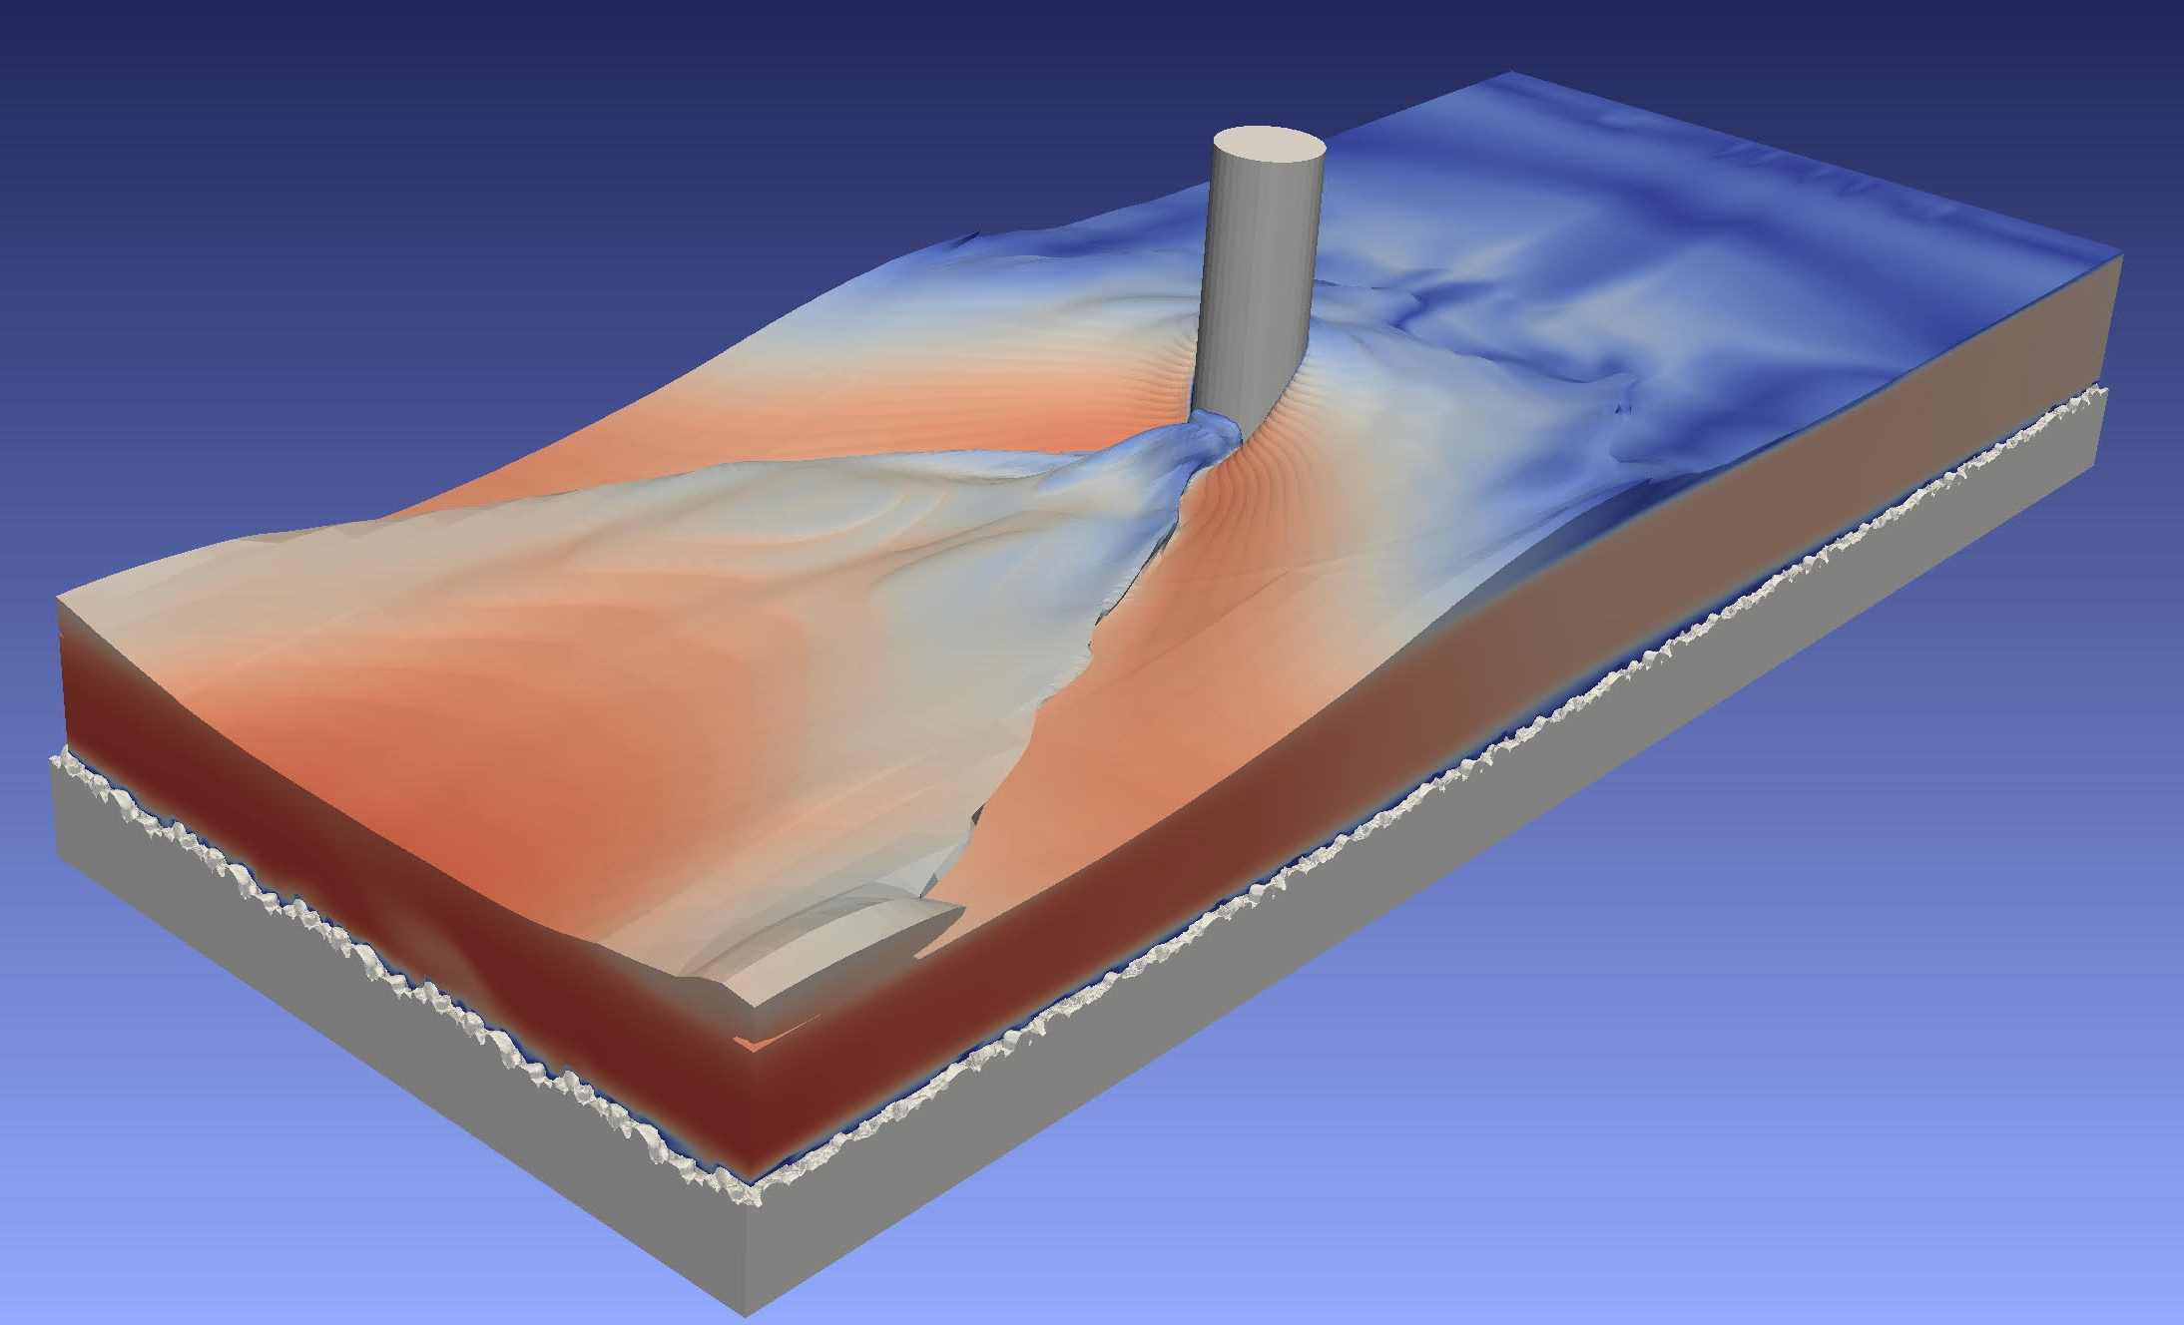
3D Numerical Model (Large Eddy Simulation)
Used subset of experiments (and timesteps) from laboratory
Input flow discharge and topography

Slide 28
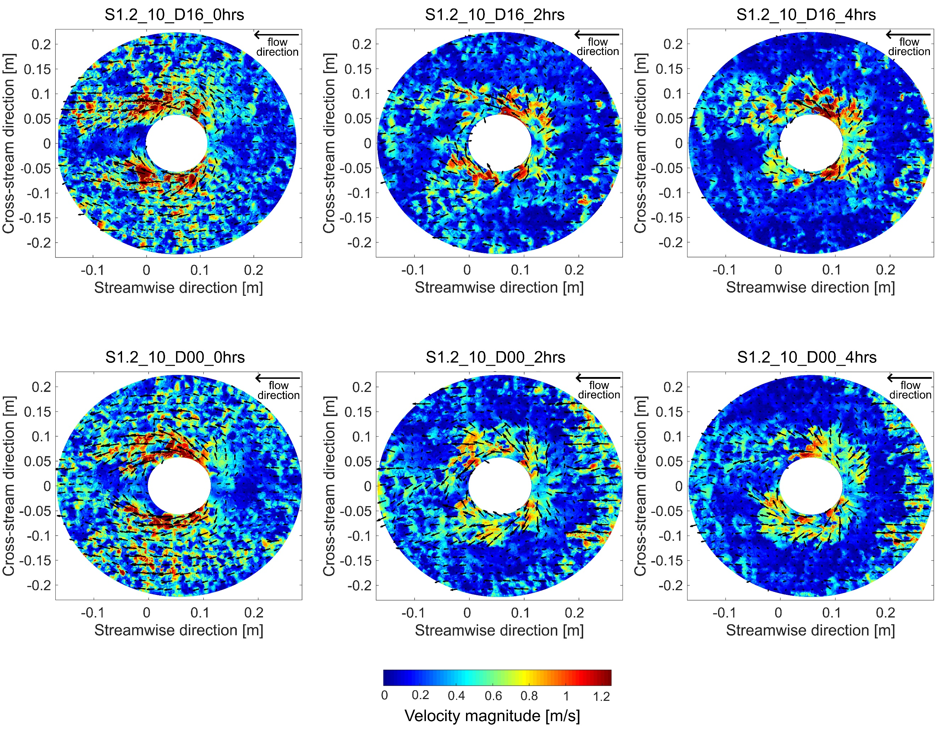

3D Numerical Model (Large Eddy Simulation)
0 hr
4 hr
Provides near-bed shear stresses (mean Reynolds stresses at 1 cm above bed) for each modeled timestep of each experiment

Slide 29
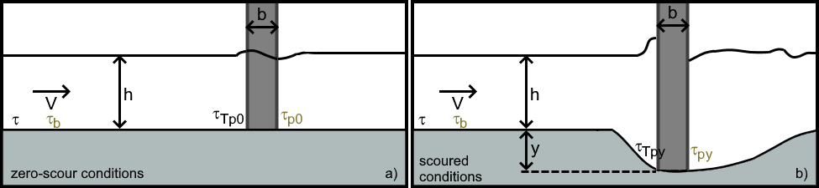

System of equations for shear stress decay
System of equations that:
1) Convert near-bed shear stresses from 3D model (τ_{po}) into total shear stresses (τ_{Tpo}) to compare with critical shear stress, where:
total shear stress far from pier
S=channel bed slope, h=flow depth
$$τ_{T_{}}=ρghS$$

Slide 30
System of equations for shear stress decay
System of equations that:
2) Calculate how the total shear stress near the pier (τ_{Tpy}) declines with greater scour depth (y) based on numerical model and experiment results

Slide 31
Combine equations
Maximum scour depth when driving shear stress is no longer > critical shear stress

Slide 32
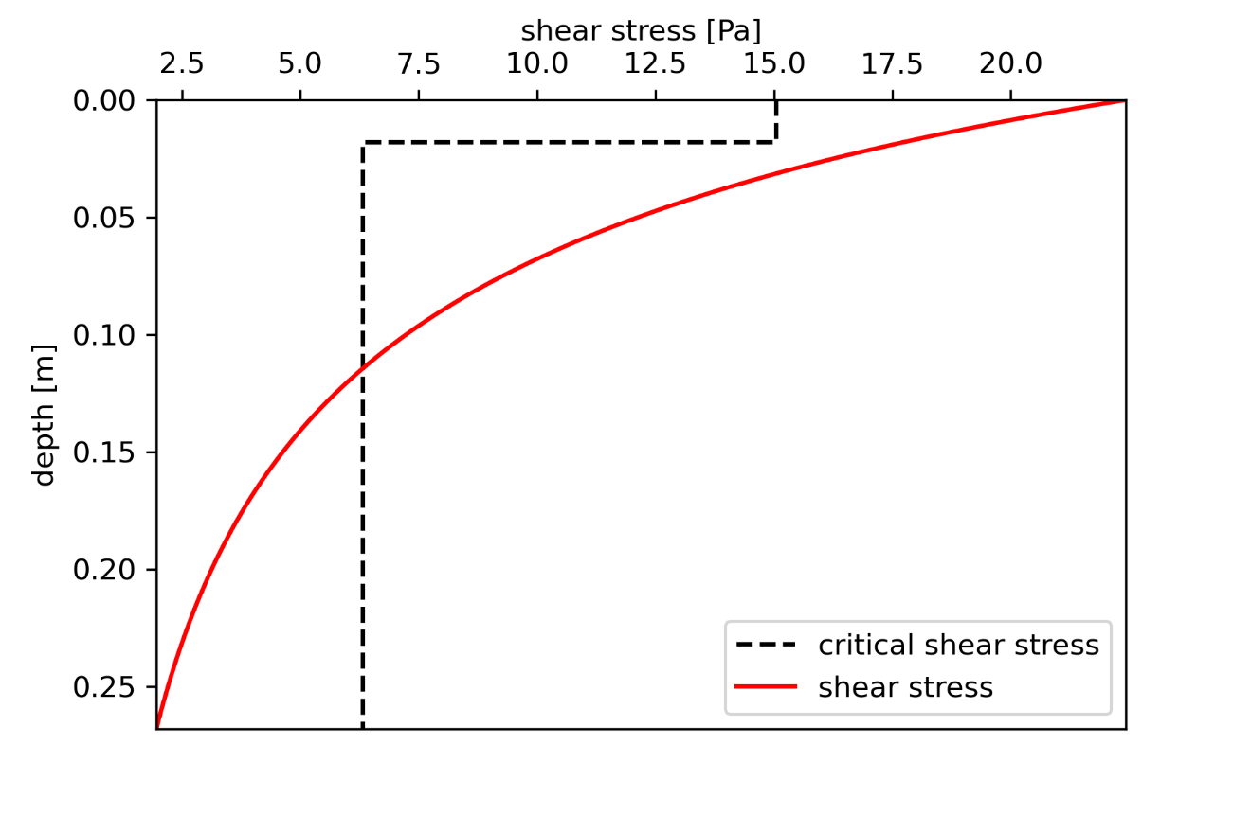
Combine equations
Maximum scour depth when driving shear stress is no longer > critical shear stress
Layer 1
Layer 2
Maximum scour depth

Slide 33
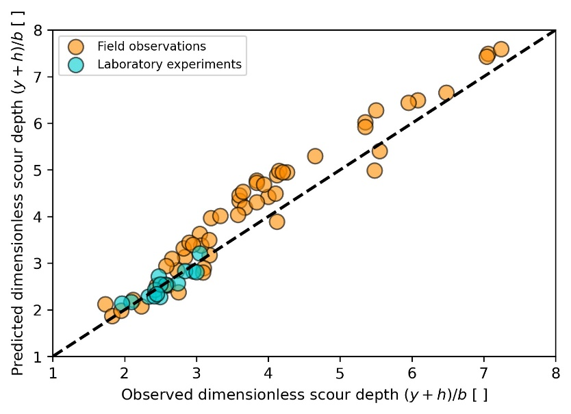
Test equations
Use field data collected in coarse bedded rivers (USGS BSDMS) and laboratory experiments to test equations

Slide 34
Calibrate design version of equations
Use field data collected in coarse bedded rivers (USGS BSDMS) to modify equations into design equations for range of pier configurations and shapes.

Slide 35
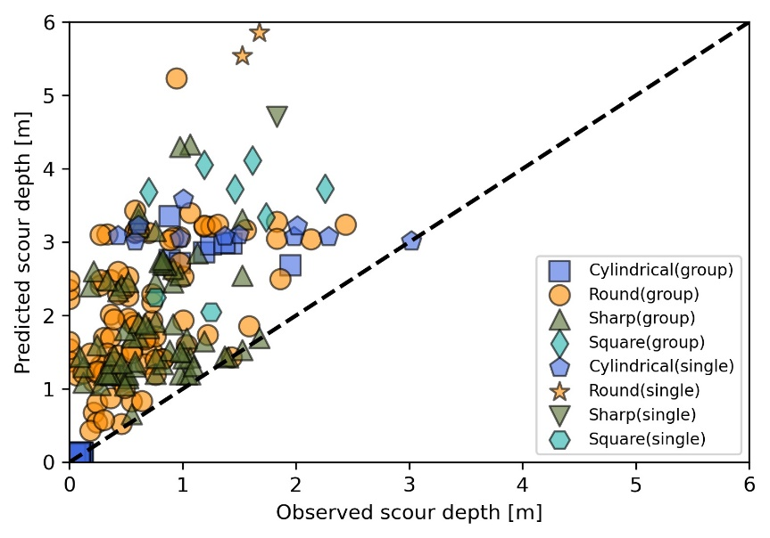
Calibrate design version of equations
Design equations never under-predict scour and improve predictions over the coarse bed version of HEC-18

Slide 36
Equation requirements
Predictions require :
Channel bed slope
Flow velocity
Flow depth
Pier width
Angle of attack
Pier configuration and shape
Bed grain size measurements for each layer or for the entire bed

Slide 37
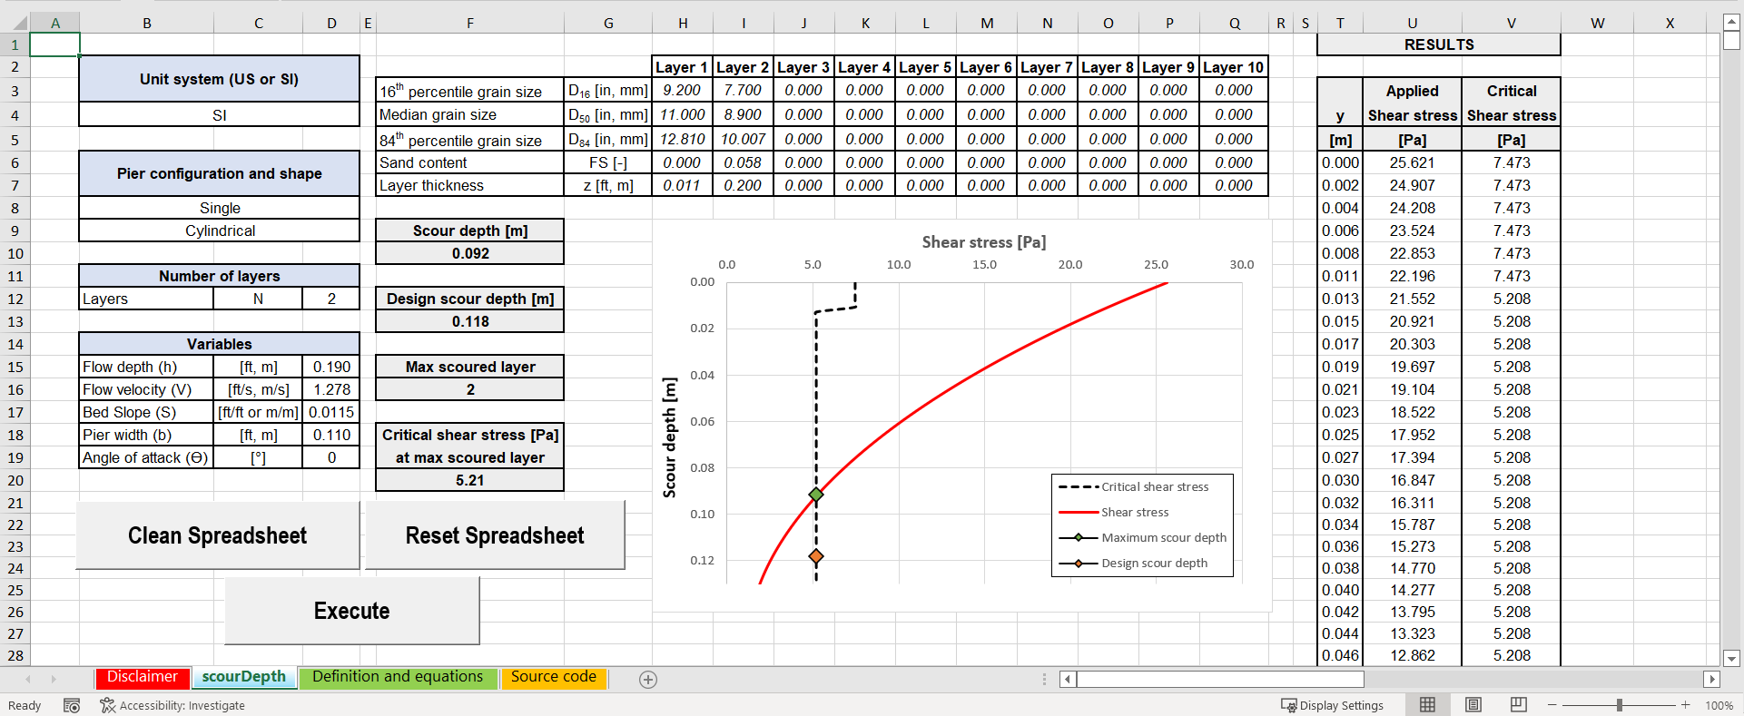
Equation requirements
Predictions can be completed in provided excel spreadsheet

Slide 38
Recommendations from this work
When possible, include layers in bridge pier scour predictions. Layers can affect scour.
Measure the entire grain size distribution of the bed including the proportion of sand. The sorting of gravel and the amount of sand impact scour.
Use estimates of near-pier shear stresses and shear stress decay curves. These local flow conditions influence scour.

Slide 39
Recommendations for future work
Measure scour for more complex pier configurations and shapes in coarse bedded rivers. Limited field data exist for these complex piers as well as for complex channel morphologies.
Use 2D models for individual piers to determine the local near-pier shear stresses.
Modify this new set of scour equations to account for flow complexity around such more complex piers.

Slide 40
More information is available in NCHRP Research Report 1031: Determining Scour Depth Around Structures in Gravel-Bed Rivers, which can be found on the National Academies Press website (nap.nationalacademies.org).
NCHRP is sponsored by the individual state departments of transportation of the American Association of State Highway and Transportation Officials. NCHRP is administered by the Transportation Research Board (TRB), part of the National Academies of Sciences, Engineering, and Medicine, under a cooperative agreement with the Federal Highway Administration (FHWA). Any opinions and conclusions expressed or implied in resulting research products are those of the individuals and organizations who performed the research and are not necessarily those of TRB; the National Academies of Sciences, Engineering, and Medicine; the FHWA; or NCHRP sponsors.

