Slide 1

NCHRP Project 25-47
How to Measure and Communicate the Value of Access Management
Research Team
PI: Kristine M. Williams, FAICP, (Center for Urban Transportation Research)
Karen Dixon, PhD, and Brianne Glover (Texas A&M Transportation Institute)
Jerry Gluck (AECOM),
Frank Broen (Teach America)
Gary Sokolow and Chris Huffman (CUTR Affiliated Faculty)
Notes:
This is Kristine Williams of CUTR at USF and I’m the Principal Investigator for NCHRP 25-47, How to Measure and Communicate the Value of Access Management. Before I tell you more about the project I’d like to acknowledge the research team, which includes Karen Dixon and economist Brianne Glover of Texas A&M Transportation Institute,
Jerry Gluck of AECOM, and Frank Broen of Metroanalytics and Teach America. And also former Florida DOT Access Management Program Administrator Gary Sokolow and engineer and appraiser Chris Huffman, of Huffman corridor consulting.

Slide 2
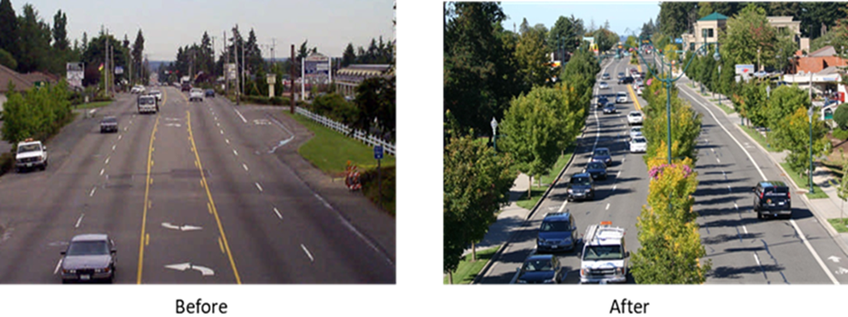
Background
Access management improves safety, reduces delay, offers better multimodal quality of service, and enhances livability.
Yet government agencies are often intense pressure to yield to access requests or forego access management projects.
Notes:
These benefits translate into economic value to the public.

Slide 3
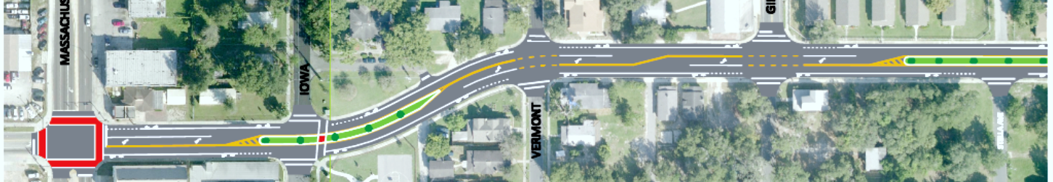
Research Objective
Guidance for transportation agencies
Simple research-based tools
Quantitative and qualitative approaches
How to measure and communicate the value of AM at a program, corridor or project level
Measure benefits and costs
To agencies and the public
Costs of failure to implement
Economic value
Notes:
As the title suggests, the objective of this project is to provide guidance to the practitioner on how to measure and communicate the value of access management.
Access to the transportation system takes a variety of forms such as driveways, intersections, medians, signals and turn lanes, as well as bicycle lanes, pedestrian crossing and transit stops. All of these have attributes that can be expressed in terms of benefits or costs (B/C). In some cases the value of managing these access feature can be quantified, whereas for others the value is more qualitative (e.g., livability) or cannot yet be effectively quantified (e.g., life cycle of an interchange or major roadway investment).
For this purpose, we developed a suite of simple, research-based tools, methods and visuals that can be customized and adapted for use by agency staff and consultants to readily “tell the Am story” at a program, corridor or project level including the economic value of AM to agencies and the public, and costs of the failure to implement AM.
I’ll begin by briefly summarizing the tools and then show how we compiled them into a user friendly Access Management Communications Toolkit.

Slide 4
Methodology
Phase 1: Foundational Research
Literature Review
State of the Practice Survey and Interviews

Slide 5
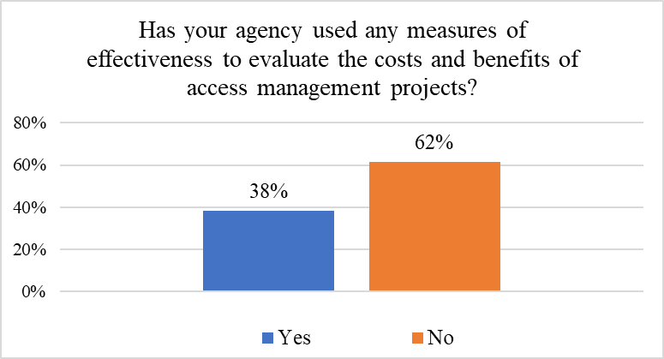
Survey Findings – Agency Practices
MOEs used by agencies for AM tend to focus on safety, then delay
Survey Responses
Safety | Operations | Economic | Other*
conflict rates | travel time | sales tax data | network connectivity
conflict points | travel speed | shopper surveys | aesthetics
crash reduction | person hours of delay | vacancies
crash severity | queueing
CMFs | LOS, V/C
FHWA CMF clearinghouse
* qualitative only
Notes:
majority of the respondents do not use any measures of effectiveness in access management decision-making. About a third (38%) of the states have used MOEs

Slide 6
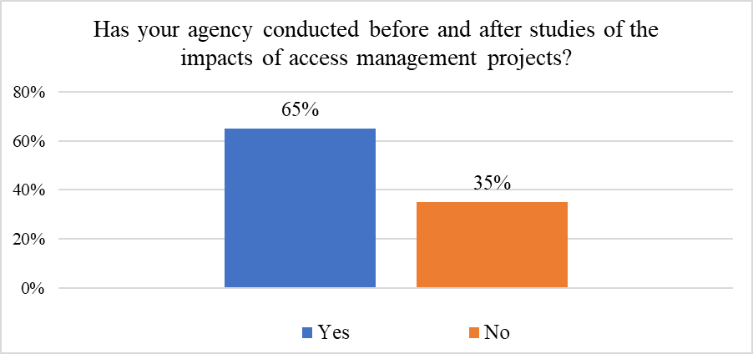
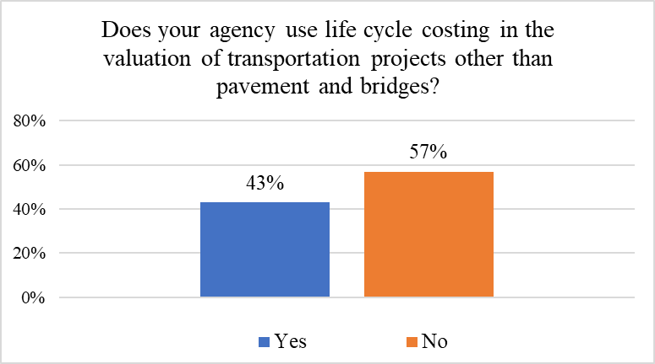
Survey Findings – Agency Practices
Notes:
Sixty-five percent of the states indicated that they have conducted this type of analysis, examples of these studies collected as part of interviews.
Use of life cycle costing in this context was identified in relation to transportation system management and operations/intelligent transportation systems (TSMO/ITS) projects, intersection control evaluation and improvement projects, ramp management, capital projects, interchange and highway bypass projects, asset management, safety improvements and countermeasures, maintenance cost and salvage value evaluation, toll roads, and transit projects

Slide 7
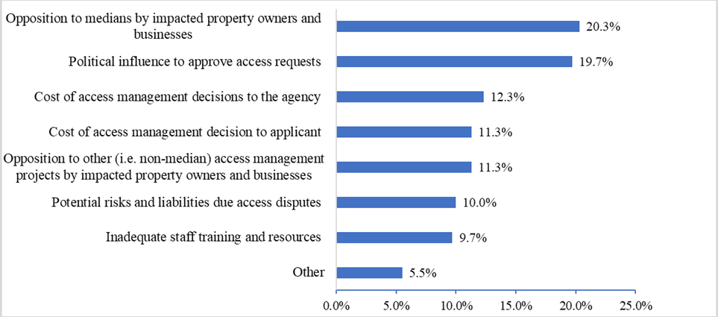
Survey Findings – Implementation Issues
Notes:
Commonly noted obstacles when attempting to implement AM opposition to medians, followed by use of political influence to obtain access approval (overarching issues, such as to get signal approvals)
Costs and liabilities:
Utah court case created a precedent now greatly increasing costs of median projects. If median includes widening and ROW must be acquired, then the loss of access is considered part of the damages associated with the value an appraiser assigns to the access point.
Oregon, Division 51 – (AM) Oregon Admin. Rule recently changed to mandate that driveways existing as of January 1, 2014, have presumed written permission for the connection - more cases where ODOT must compensate owner for removal/relocation
Wisconsin DOT opposition to driveway removals and resulting lawsuits have led state attorneys to ask staff not to take driveways when taking ROW. Staff compelled by elected officials to provide access even if alternative access is available.
Median opposition has resulted in stopping projects or large numbers of crossovers (VDOT, Washington DOT).

Slide 8
Key Findings
B/C analysis for AM
Mostly for FHWA Highway Safety Improvement Program (HSIP) projects (e.g., TWLTLs, roundabouts, medians, conflicts)
Some Intersection Control Evaluations (ICE)
Methods:
Historical Crash Method (before/after)
Predictive methods (Roadside Safety Analysis Program guidance and HSM)
Notes:
Several DOTs include AM strategies in SHSP done for HSIP, which involves b/c.

Slide 9
Key Findings
AM value also addressed in project prioritization
NCDOT SPOT program for small scale safety and mobility projects
VDOT SMART SCALE scoring via B/C analysis
CDTC provides merit scores for AM as part of Land Use Compatibility measures.
AM measures part of broader project, not individually quantified
Changes to state laws or case law due to AM disputes have increased situations where state must compensate property owners, increasing costs

Slide 10
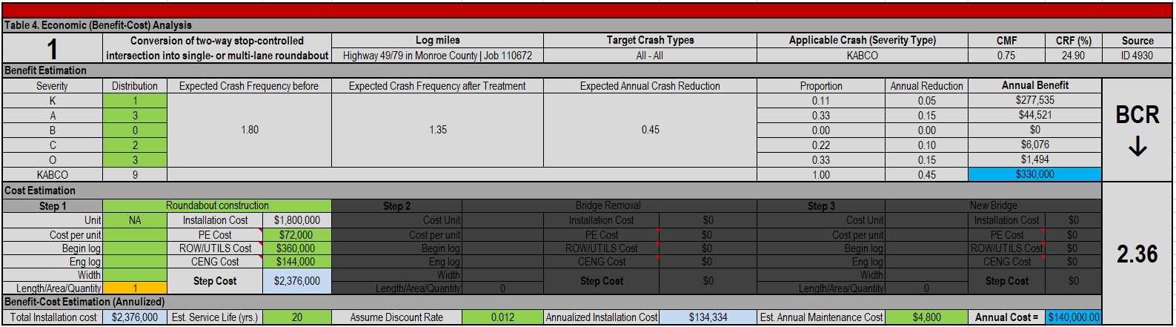
ArDOT
MEASURE
Benefit-Cost Ratio
FACTORS
KABCO Safety
Step Cost
Annual Cost
SPECIAL
Safety Benefits only
Notes:
Example of safety analysis for HSIP funds.
Expected annual crash reduction in relation to annual cost (installation is a step cost, discount rate, out 20 yrs plus maintenance)
They are working toward incorporating intersection control evaluations (ICE) into their general process.

Slide 11
Route 412 Median Project (Benton County, AR)
Before
After
4.25 KA crashes/year
.75 KA crashes/year
Notes:
Before /after study of fatal and severe injury crashes (KA) on Highway 412 showed benefits of median

Slide 12
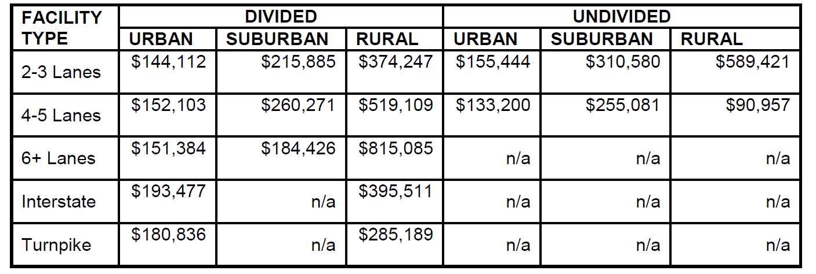
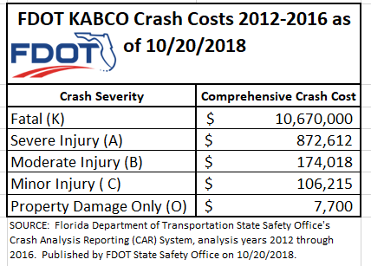
FDOT
MEASURE
Safety Costs
FACTORS
KABCO
SPECIAL
Shown across facilities
Note: this table represents 2014 data
Notes:
2014 are in report. This is more up to date. FDOT has developed cost information for crashes as part of its Crash Analysis Reporting system. This data is also broken down by type of facility.
FDOT staff note that each state differs on how societal costs are applied in the HSIP cost benefit process, which makes use of these costs inconsistent. A standard discount rate of 4% to convert future costs to present cost was proposed for use by FDOT offices to help improve internal consistency across the state

Slide 13
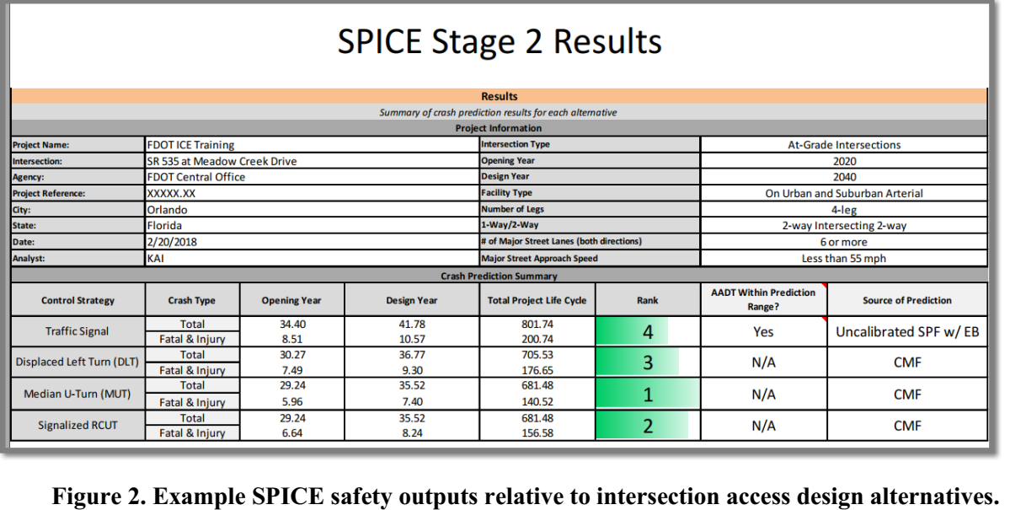
FDOT SPICE Training – Actual Case Study
Base case
Notes:
Since launching median push in the 1990s, FDOT has developed Crash Reduction Factors (CRFs) for 135 different types of highway improvements, many involving access management treatments. FDOT studies helped populate the FHWA CMG Clearinghouse.
FDOT has improved upon the SPICE tool. This example compares predicted crashes using CMFs for different alternatives. Traffic Signal is base case. Median has highest ranking.

Slide 14
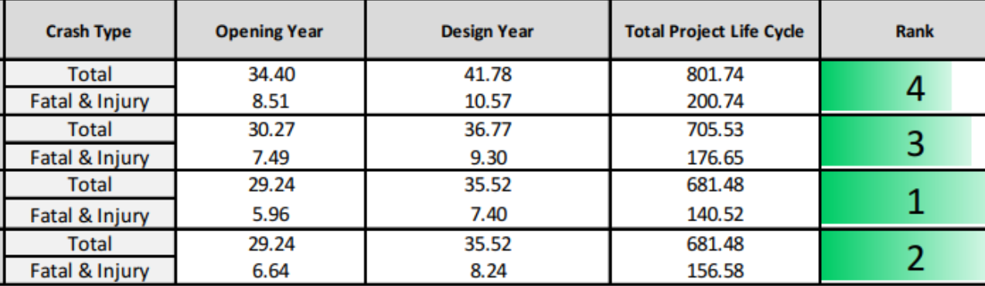
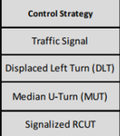
FDOT SPICE Training – Actual Case Study (cont.)
Crashes during life of the project
Notes:
The benefit cost analysis used in the FDOT-ICE model is based on the safety (and delay?) over the life of the project, not just construction and initial operations.

Slide 15
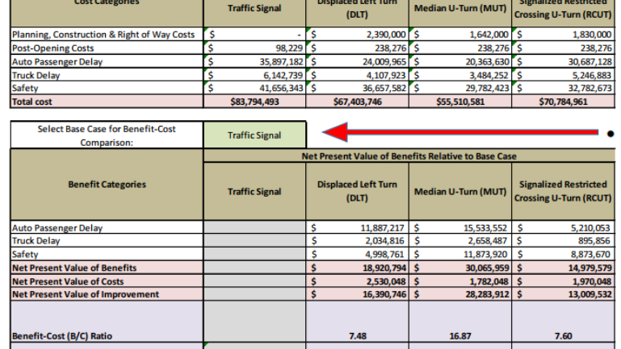
FDOT SPICE Training – Actual Case Study (cont.)
Notes:
Traffic Signal is base case and used the tools to see what NPV is for Displaced LT and Median U-Turn, and RCUT.

Slide 16
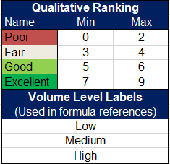
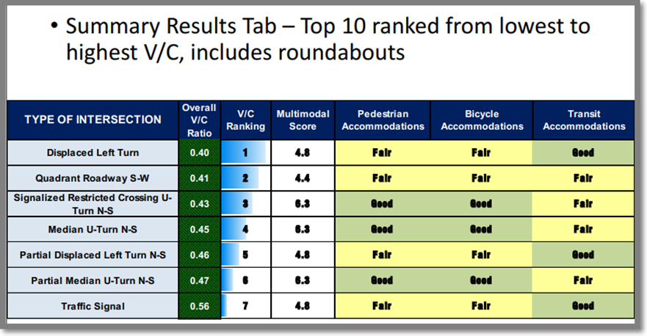
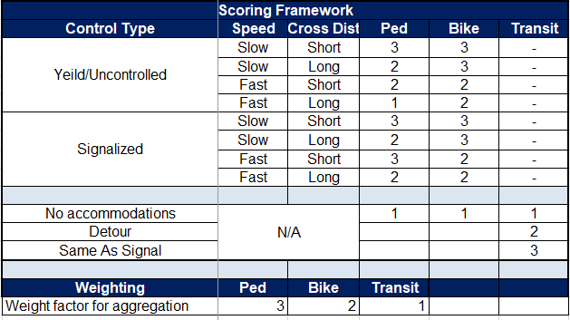
FDOT - Example Cap-X Multimodal Outputs
Scoring based on combinations
Notes:
• # of pedestrian crossings (both approaches, if app): Enter number of pedestrian crossings during typical a.m. and p.m peak hours for the intersection. If crosswalks/crossings are present on both approaches of the major or minor streets, combine the number of crossings from both approaches into a single number of crossings per street.
• # of bicycle crossings (both approaches, if app): Enter the number of bicycle crossings during the typical peak hour for the intersection. If crosswalks/crossings are present on both approaches of the major or minor streets, combine the number of crossings from both approaches into a single number of crossings per street.
• Level of pedestrians/day and bicycles/day activity: Select the appropriate level of pedestrian and bicycle activity identified in FDOT CAP-X Tool: <240 low, 240-3200 med, > 3200 High
MM capacity adjustment factors (min factor for all three modes on all four approaches) based on guidance in HCM 6 and HSM
Scoring based on combinations – such as Short exposure or long, high or low speed, signalized or not etc

Slide 17
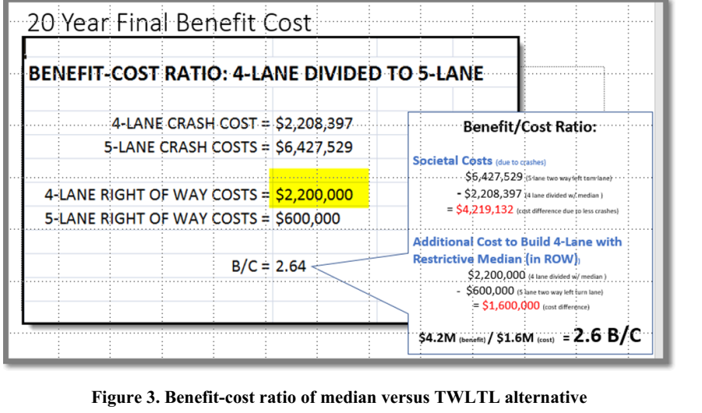
FDOT District 7 Case Study SR574 Tampa Bay
Notes:
Before SPICE tool, FDOT was using B/C to helped communicate the benefits of median project. IN this example they used the analysis to convince upper management to pay more (two million vs 600K) for ROW to include the raised median.
Based on HSM, but spreadsheets were put together by D7 staff.

Slide 18
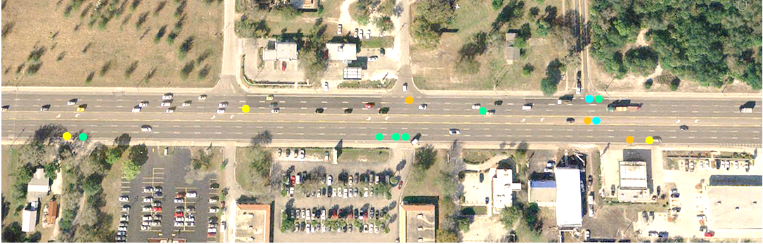


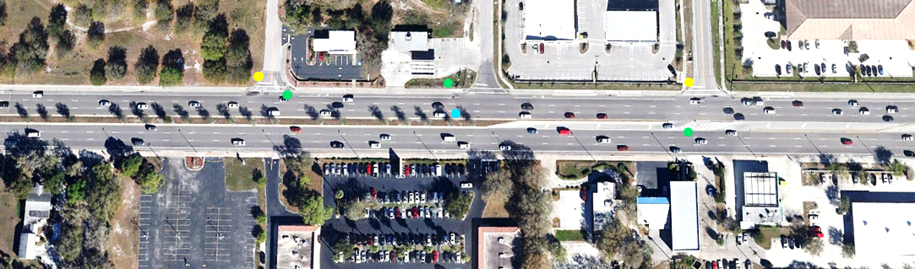


FDOT Before/After Median Studies
Before: January 2003 – December 2005 (36 months), 14 crashes
Fruitville Rd, Sarasota County
After: January 2007 – December 2009 (36 months), 6 crashes
Head-on Rear-end Left-turn Angle Bike/Ped Others
Notes:
Study done by FIU for FDOT (Gary), where 8 7-lane projects converted from TWLTL to medianin SW FL were evaluated

Slide 19
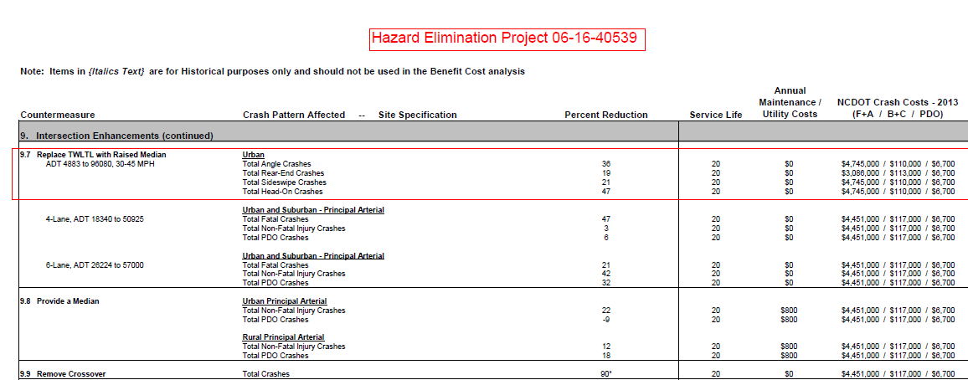
NCDOT
SPOT safety project example
Notes:
SPOT is a $20m annual program (safety funds of up to $450K per project, mobility funded up to $750 K/project) measuring the expected benefits of the project over a ten-year period against the estimated project cost to NCDOT.
Intersection safety fund for low-cost high impact AM improvements.
Example of CRF info developed by NCDOT

Slide 20
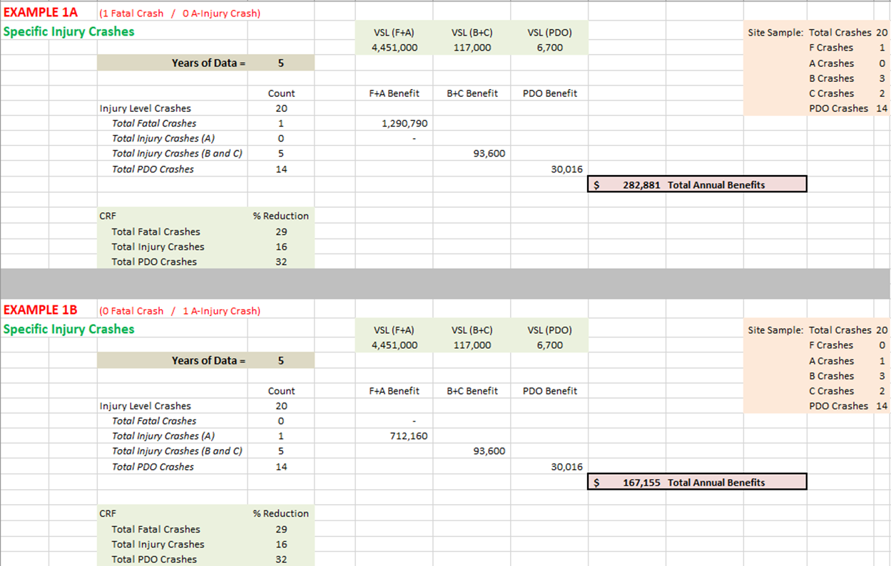
NCDOT CRF Benefits Calulation Spreadsheet
Notes:
The CRF Annual Benefits Calculation spreadsheet used by NCDOT includes a benefit-cost sheet and calculates CRF for specific injury crashes, specific type crashes, total crashes, and combination

Slide 21
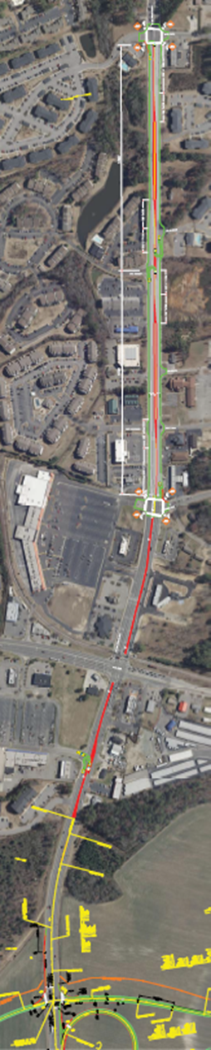
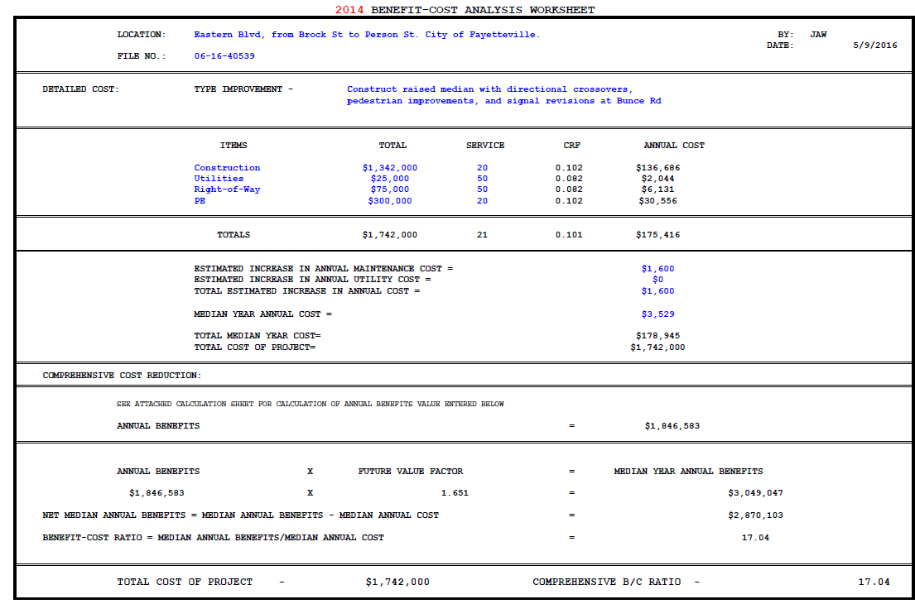
NCDOT
SPOT safety project
B/C ratio 17.04
Notes:
Construct median with directional openings, ped improvements and signal changes. $17 of benefits for each $1 of costs

Slide 22
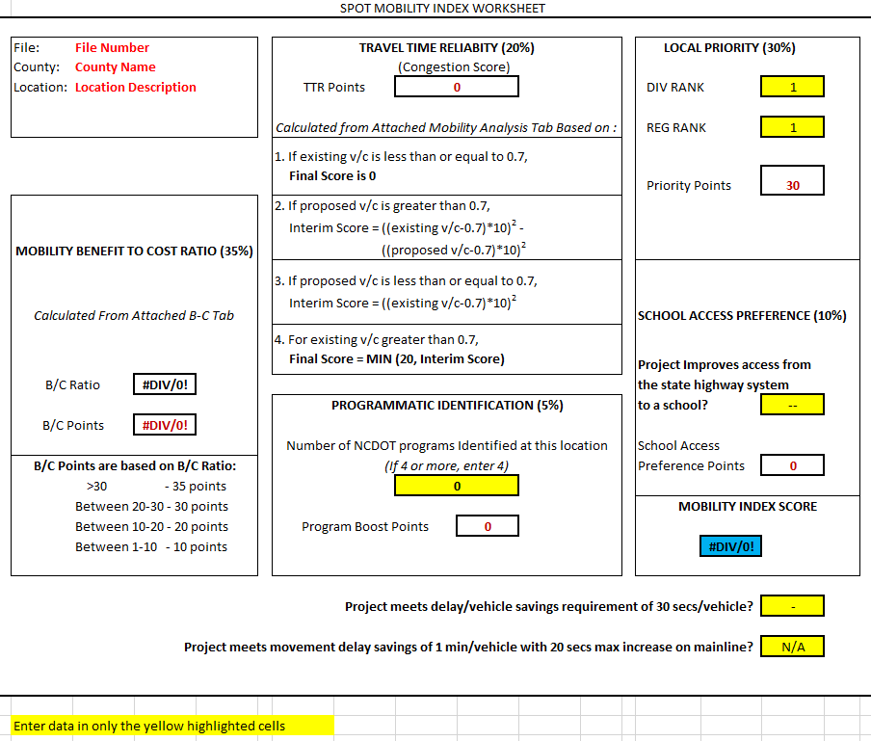
NCDOT
MEASURE
MOBILITY INDEX SCORE
FACTORS
Mobility B/C Ratio
Travel time reliability
Local priority
School access preference
SPECIAL
Point Values used to score
Notes:
New law called Strategic Transportation Investments aimed at allocating available revenues based on transparent, data-driven scoring and local input.

Slide 23
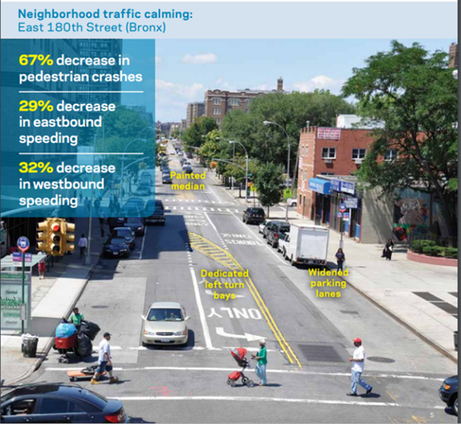
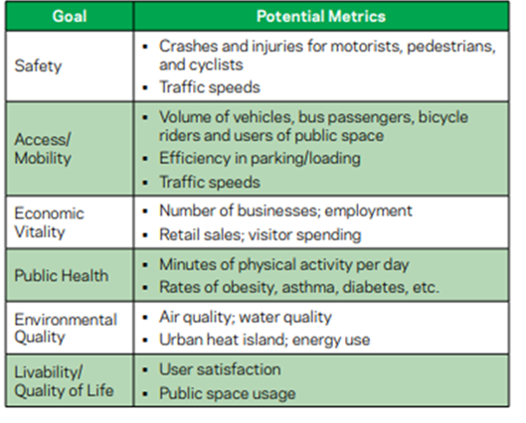
NYCDOT
NYCDOT, The Economic Benefits of Sustainable Streets, Table 1, 2013
Figure 28. Benefits of access management improvements on East 180th Street (Bronx).
Notes:
Key implementation issues in the City included controversy over changes in curbside parking or management. In addition, the City has been advised that it has no authority to require driveway removal or redesign during site redevelopment or a change in use. Access management is part of a broad toolbox for implementing safety and operation improvements.

Slide 24
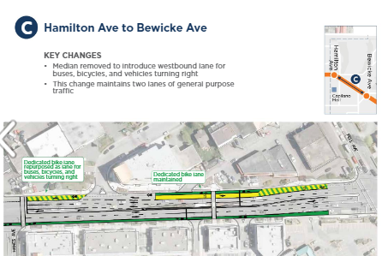
TransLink (Vancouver, BC)
Implements transit priority measures on existing roadways, usually by borrowing auto capacity for transit use
Often involves changes to access management
Benefit-cost analysis
B-Line project - shorten left turn bays into parking, restrict left turns, dedicate lanes to transit, remove medians, remove turn bays, signal priority
Notes:
quantifying impact on traffic and access (when borrowing capacity for transit) would help to support implementation of these access management decisions
Costs are measured in the transit priority evaluation process in terms of costs of construction and the benefit is deduced from person-hours of delay reduction, which is based on existing ridership data and travel time savings.

Slide 25
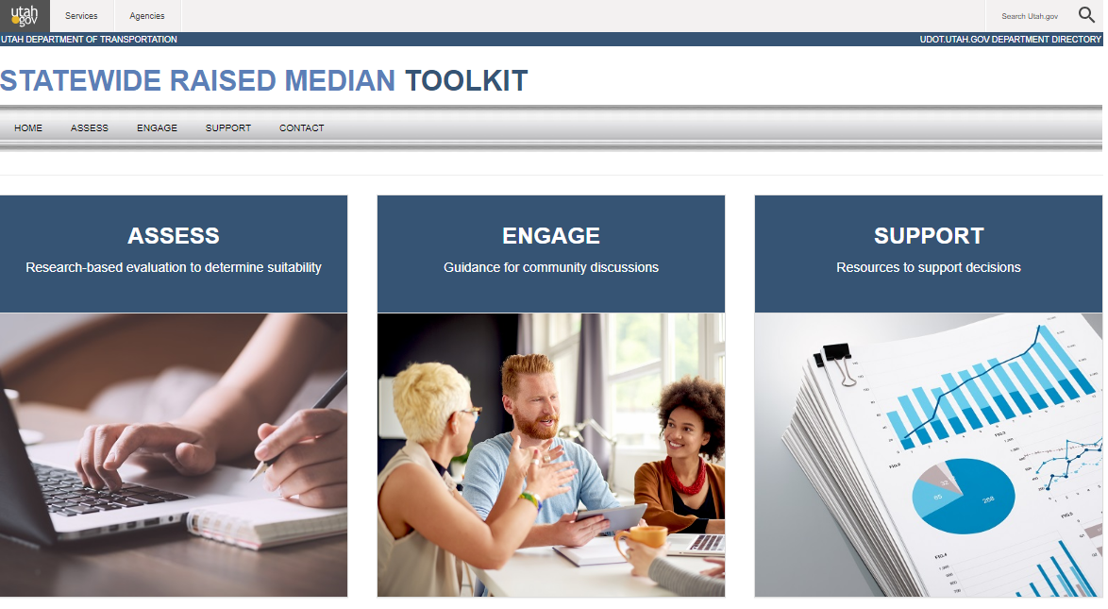
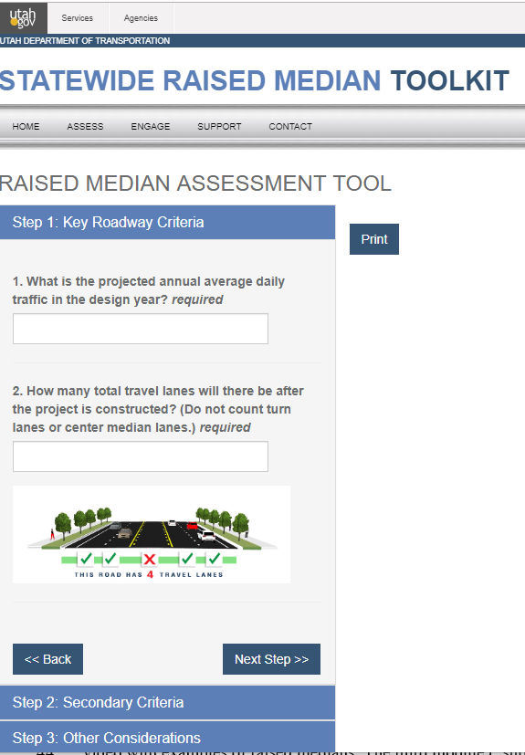
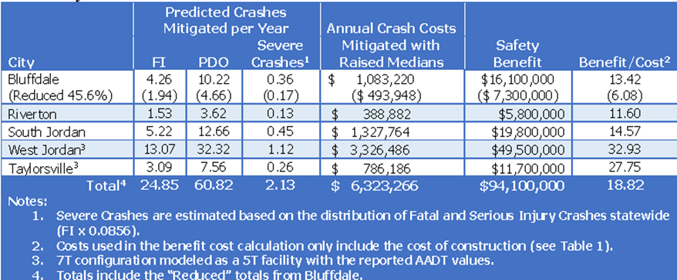
UDOT
Before/after analysis of all safety projects
For medians:
naïve method (crashes, CMF)
predictive method (HSM)
H.B. 266 (early 2018) restricts ability of UDOT to require access changes during permitting of redevelopment without compensation
Notes:
Raised median project analysis is done by either of two methods
identify crashes, apply crash modification factors (CMF), evaluate the number of crashes being reduced, and assign cost based on severity level. Results are extrapolated over twenty-year period for a twenty-year life cycle.
Or uses HSM to predict crashes and apply them to predicted crash reduction. This method applies the crash cost, and gets a present value for crash cost.
Cost and Liability issues: (Toolkit to help staff address median challenges.)
Mentioned earlier if median includes widening and ROW must be acquired, then loss of access is considered part of the damages associated with value an appraiser assigns to the access point.
HB 266: UDOT cannot close legal access point unless “the property has reasonably equivalent access to the public highway after the legal access is closed or the highway authority acquires the legal point of access by gift, agreement, purchase, or eminent domain.”
Prevents UDOT from requiring property owners with existing access to the state highway system to build a new access at the appropriate location, appropriate spacing, or consolidate access during redevelopment. If UDOT determines it is necessary, they must compensate instead of requiring as a part of the permit.

Slide 26
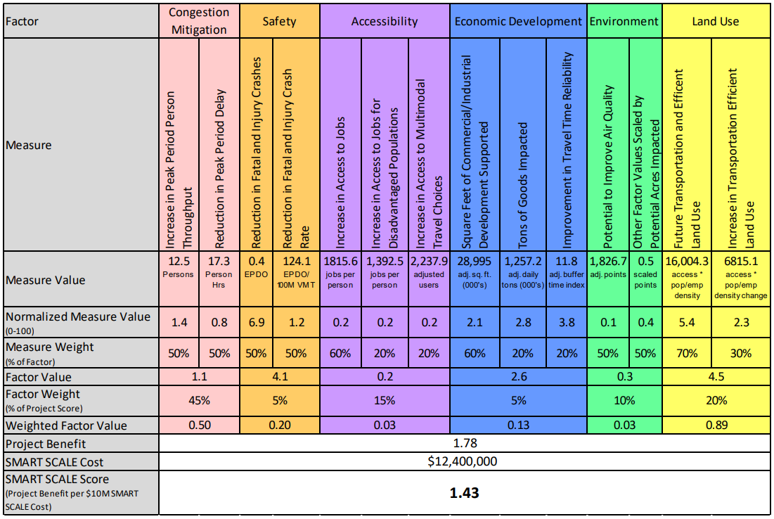
VDOT
MEASURE
SMART SCALE Score
FACTORS
Congestion
Safety
Accessibility
Economic
Environment
Land Use
SPECIAL
Weighted Factor Value
Project Benefit per $10M SMART SCALE Cost
Notes:
Funds competitively allocated to projects in the VDOT long range plan using transparent scoring method that included a B/C analysis . AM construction projects tend to score well and have been funded.
Factor weights are assigned for each of 6 factors, which are calculated, normalized, and then weighted by category. Weights vary by region per VDOT District and MPO desires. Cost = funded requested from Smart Scale only.

Slide 27
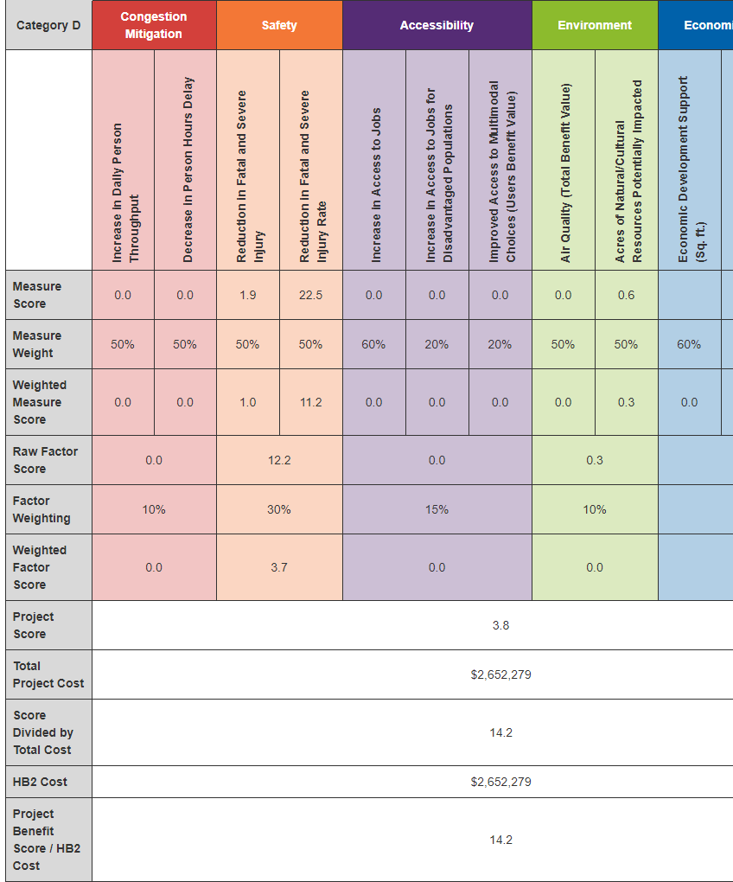
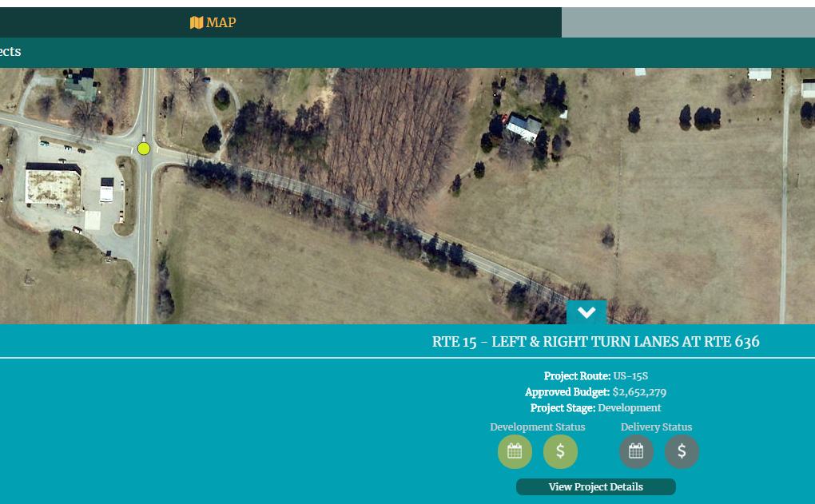
VDOT
Example Smart Scale Project
14.2
Notes:
Here is an example smart scale project identified for access management - turn lanes at an intersection. Note that the scoring came up only for safety and primarily for reduction of fatal and severe injury rate. This in relation to project cost yielded a benefit score/cost of 14.2

Slide 28
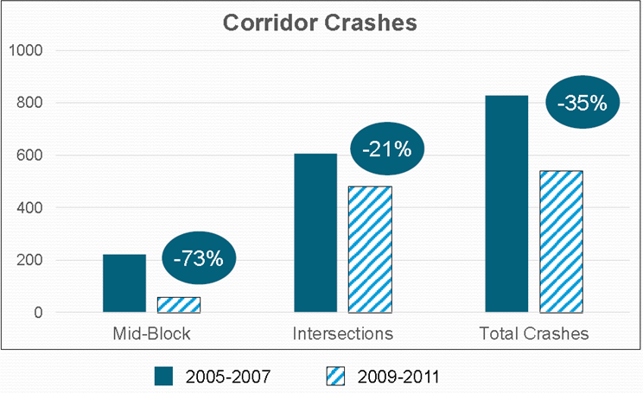
Wisconsin DOT
Expanding asset mgt and safety emphasis
Systematic use of Highway Safety Manual CMFs to prioritize highway projects (not programmed if no crash reduction)
AM impacts often “challenging to isolate”, especially operations, but also safety (e.g., functional area or sight distance issues with no crash history)
Staff working to collect data to aid in driveway removals
US 18: Bluemound Road corridor before/after crash data
Eliminated unrestricted median openings
Realigned right turn lanes
Increased traffic signal spacing
Notes:
Concerns about gaming the system and also ability to show large b/c on things like rumble strips, but hard to demonstrate b/c of poor corner clearance and sight distance issues at intersection driveways.

Slide 29
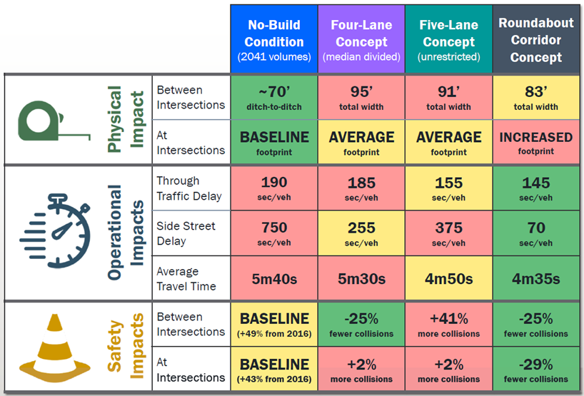
Tennessee Comparative Alternatives Analysis
Impact | Method
Physical | ROW based on footprint
Operational | HCM, Synchro (delay, incl. side streets)
Safety | Interactive Highway Safety Design Model
Notes:
Consultants evaluated AM value of a roadway redesign project in Tennessee.
The roundabout option was determined to be the most suitable for the conditions evaluated, because it demanded smaller width than the other built conditions, shorter travel time with less delay, and provided safer traffic

Slide 30
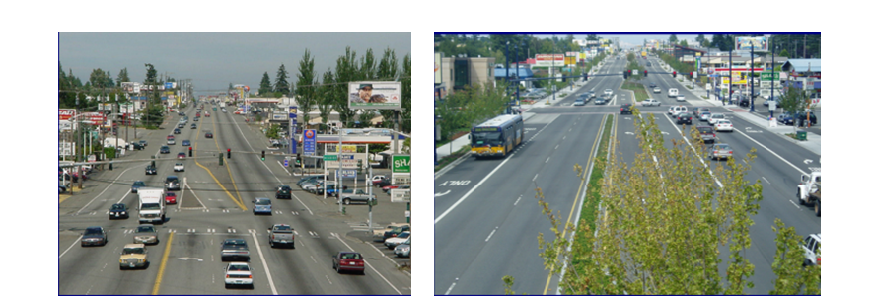
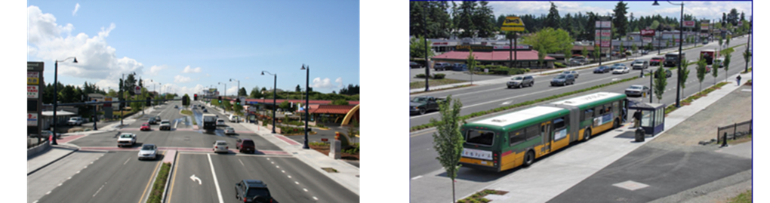
WSDOT Aurora Avenue Project
Increased redevelopment activity;
Improved safety and mobility, including
  a 60% reduction in crashes in first mile due to median, and
  Improved transit speed and reliability (BRT)
Gathering spaces, aesthetics, community identity
Before
After
Notes:
Issues that arose in the project were safety, traffic flow, increased transit use and service efficiency, economic revitalization, aesthetics, business access and parking, and concerns relative to median impacts

Slide 31
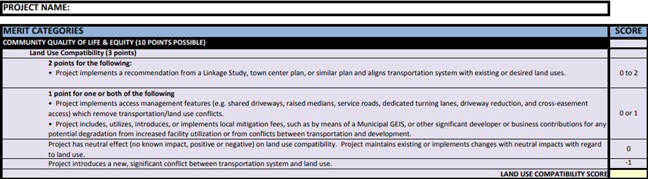
CDTC (MPO) Merit Scoresheet
Value of AM primarily addressed through qualitative merit scoring of projects, but also safety metrics for b/c
Notes:
Access management primarily arises in the merit scoring – particularly under Land Use Compatibility measures.
MPO is focusing less on access management, unless there is a safety issue associated with the project, such as pedestrian, intersection, and lane departure issues.
Staff noted that it is sometimes difficult to relate safety issues to access management due to crash reporting that may not identify access as the issue.

Slide 32
Gaps
Operational MOEs (e.g. delay, speed) use is more limited than for safety; significance of operations (secs of delay) versus safety (fatalities, injuries)
Limited scope of analysis - lack of measures for contribution to economy, livability, sustainability/service life
Service life not tracked in relation to poor AM
Political and liability costs are considerations, barriers
Network connectivity/accessibility addressed qualitatively, lack of data
Few performance measures specific to AM or non-auto interactions; studies tend to focus on auto PMs and costs
Cost effectiveness of AM is rarely evaluated
Notes:
Much more can be done to help states measure and communicate the value (benefits versus costs) of access management. (Current safety analyses focused more on individual roadway elements rather than suite of AM treatments. Most states have no PMs specific to AM or any mechanism for tracking benefits. Cost effectiveness is rarely evaluated (except ICE, median studies).
Use of quantifiable operational measures (e.g. delay and speed) in assessment of access-related projects much more limited than true for safety. Appropriate application of operational measures in benefit-cost analysis as it relates to access management? Can existing resources (e.g. the HCM) may be applied to assess operational effects. (inputs not new tools)
Significance of operations versus safety in the calculation of benefit-cost? Relative benefit of safety (where the benefit of reducing the potential for a fatal crash would reflect a crash cost severity of millions of dollars) outweighs operations (where there may only be a reduction in a few seconds of delay). Miniscule time savings per person have no economic value or utility.
Measures for other potential components of benefit-cost analysis needed (contribution to the economy, livability, and sustainability). Agencies indicate that political and liability costs are also considerations. Qualitative costs and benefits may need to be addressed through a scoring process and/or assessment matrix.

Slide 33
Methodology
Phase 2: Analysis and Tool Development
Identify and Document Methods and Data Sources
Develop Smart Spreadsheets and Visualization Tools (AMC Toolkit)
Prepare Practitioners Guide (Final Report) and Training Materials

Slide 34
Safety Assessment Tools
Median Type
Estimated crash reduction of providing a median versus undivided or TWLTL
Right-turn Lanes
Estimated crash reduction of providing right turn lanes at three-leg and four-leg intersections
Left-turn Lanes
Estimated crash reduction from providing left-turn lanes at three-leg and four-leg intersections
Unsignalized Intersection and Driveway Density
Estimated number of crashes for different access densities on: (a) urban/suburban 4-lane roadways with TWLTL or (b) by median type (two tools)
Signalized Intersection Density
Estimated number of crashes by changing density of four-leg and three-leg intersections per mile
Median Opening near Signalized Intersection
Estimated number of crashes from providing a median opening near a signalized intersection.
Notes:
The suite of safety spreadsheet tools developed for the project employs crash modification factors (CMFs) or the latest predictive methods from the Highway Safety Manual (HSM) to estimate the potential crash reduction associated with the access management treatments or techniques you see here.
Median Type: Predicted crashes (per HSM) based on median type (does not include localized calibration).
Right-turn Lanes: Estimated crash reduction while providing a right-turn lane(s) at three-leg intersections and estimated crash reduction while providing a right-turn lane(s) at four-leg intersections.
Left-turn Lanes: Estimated crash reduction while providing a left-turn lane(s) at three-leg intersections and estimated crash reduction while providing a left-turn lane(s) at four-leg intersections.
Unsignalized Intersection Density: Estimated crash reduction by changing the unsignalized intersection density on an urban/suburban four-lane roadway where a two-way left-turn lane (TWLTL) is present.
Signalized Intersection Density: Estimated number of crashes for various traffic signal spacing (presented as the density of signalized intersections per mile).

Slide 35
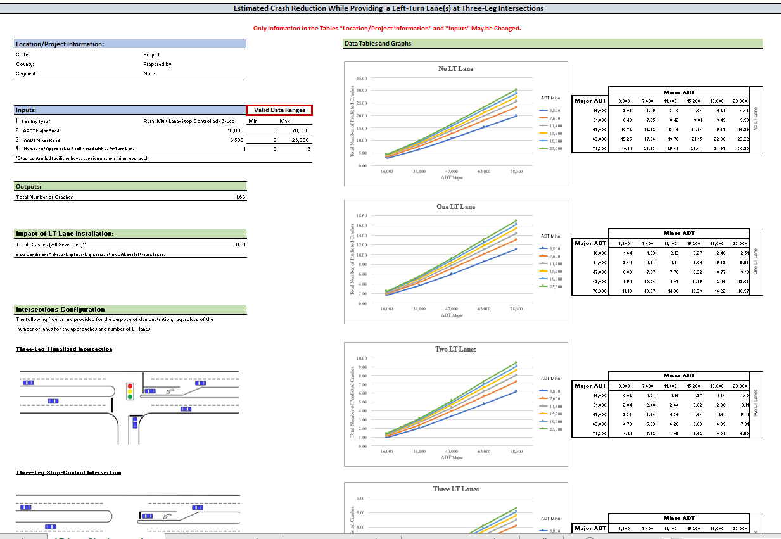
Left Turn Lanes Module - Safety
Notes:
By removing stopped or slower turning vehicles from the through lanes, turn lanes reduce the potential for high-speed rear-end collisions.
Inputs include facility type, number of approaches facilitated by turn lane, and AADT of the major and minor road. Begin by selecting facility type (urban suburban signalized, urban suburban stop controlled, rural two-lane stop controlled, or rural multi-lane stop controlled). Next input the number of approaches facilitated by the turn lane. Note that stop controlled approaches are not considered in the number of approaches with right turn lanes. Next input the AADT of the major road and the AADT of the minor road.
Outputs include total number of crashes without installation of the turn lane (Total Number of Crashes) and the total crashes for all severities with installation of the turn lane (Safety Effect of LT Lane Installation). The relative change in safety performance can be determine by comparing the estimate of total number of crashes prior to installing the turn lane with the total crashes after installation. The guidance document includes several sample applications.
facility type (rural multilane stop controlled 3 leg intersection) and varies based on AADT on major (10,000) and minor (3500) road and number of approaches (1 approach) facilitated with left turn lanes. Total number of crashes with no LT lane is 1.63. With LT Lane =.91

Slide 36
Mobility Assessment Tools
Signal Spacing
Estimated increase in travel time based on adding new signals
Signal Progression
Estimated progression speed based on signal spacing and cycle length
Right-turn Lanes and Left-turn lanes (two tools)
Estimated delay reduction from providing right-turn deceleration lane or left-turn deceleration lane at unsignalized intersection
Unsignalized Access Spacing
Estimated impact of driveway spacing on right-lane, through-vehicle mobility
Corner Clearance
Estimated % of cycles during which a driveway near a signalized intersection will be blocked
Notes:
The suite of mobility spreadsheet tools adapts findings from a variety of NCHRP research projects to enable the user to estimate the potential implications of access management techniques relative to delay. They include modules for each of the following applications:
Signal Spacing: the estimated increase in travel time based on adding new signals;
Right-turn Lanes: the reduction in delay to through traffic associated with adding a right-turn lane on four-lane and two-lane arterial roadways;
Left-turn Lanes: the reduction in delay from adding a left-turn lane at an unsignalized intersection at an existing site and at a new development site on four-lane and two-lane arterial roadways;
Signal Progression: the estimated progression speed based on signal spacing and cycle length;
Driveway Spacing: the mobility impacts of unsignalized access spacing on traffic in the curb lane (percent of vehicles impacted – brake and/or evasive maneuvers); and
Corner Clearance: the percentage of signal cycles during which a driveway near a signalized intersection will be blocked.

Slide 37
Signal Spacing Module
Estimated increase in travel time based on adding new traffic signals |  |  |  |  |  |  |  |  |  | Signal Spacing
 | Inputs: |  |  |  |  |  |  |  |  | Valid Data Ranges
 |  |  |  |  |  | Units |  |  |  |  | Min | Max
1 | Current signal density |  |  |  | 2 | Signals per Mile |  |  |  | --> | 2 | 2
2 | Potential signal density |  |  |  | 4 | Signals per Mile |  |  |  | --> | 0 | 8
 | Outputs: |  |  |  |  |  |  |  |  | Calculations/Data
 |  |  |  |  |  | Units |  |  |  |  | % Increase in Signal Density
1 | Estimated percent change in travel time |  |  |  | 16% |  |  |  |  | --> | 100.0%
Notes:
Here is an example of the signal spacing module that estimates the increase in travel time based on signal density, here going from 2 to 4 signals per mile for an estimated 16% increase in travel time.

Slide 38
Economic Value Assessment Tools
Safety Economic Value
monetized value of crash reduction in 2020 dollars
benefit-cost ratio: the monetary value of the reduction in number of crashes and expenditures to construct and maintain the facility
Mobility Economic Value
applies a value of time for a daily and annual cost of increase in travel times due to changes in signal spacing
Notes:
The spreadsheet tools work in tandem with outputs of the safety and mobility tools to calculate the economic value of the reduction in crashes or delay to society. The tools are demonstrated in the example applications, as well as the case study applications.

Slide 39
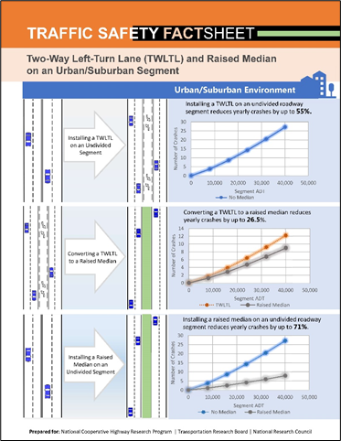
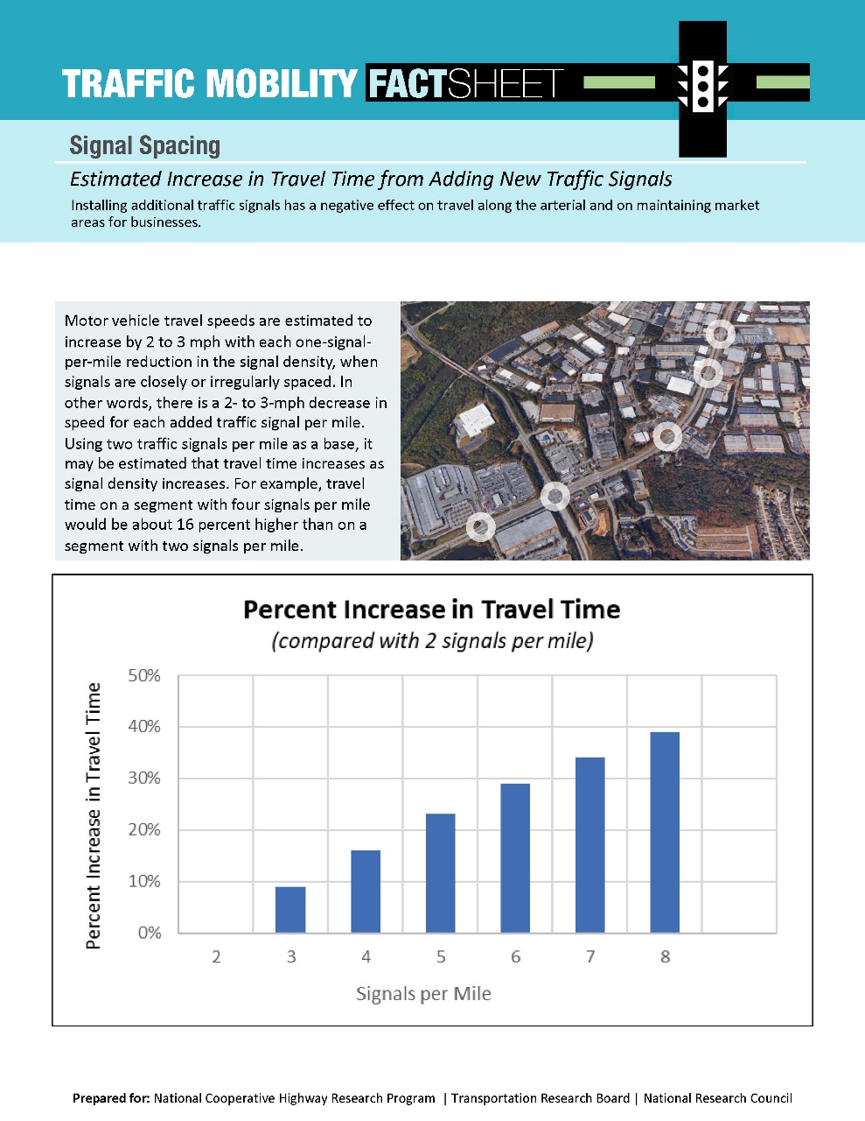
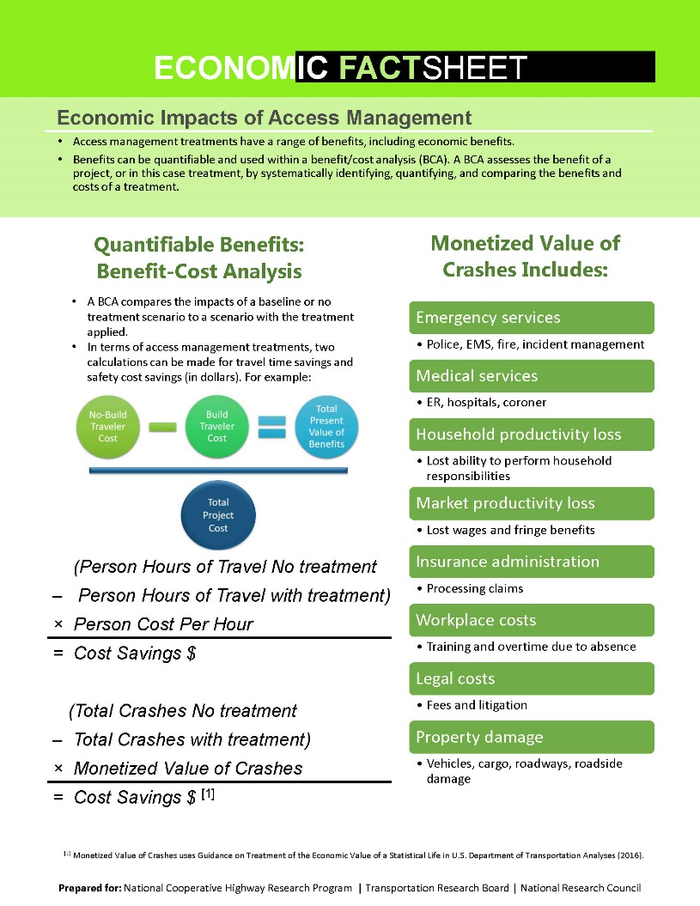
Fact Sheets Demonstrate Outputs or Methods
Notes:
Each tool is accompanied by a Fact Sheet illustrating the outputs. The Economic Fact Sheet also describes methods such as benefit/cost studies and before/after studies of sales tax receipts for estimating the economic value of access management projects.
A really nice one for livability too

Slide 40
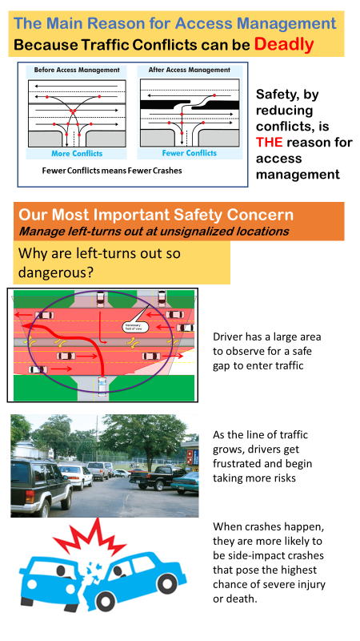
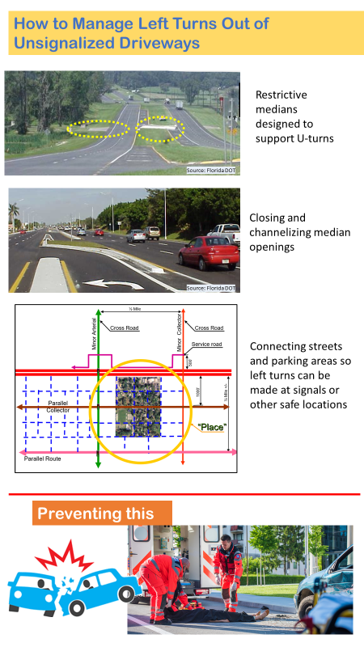
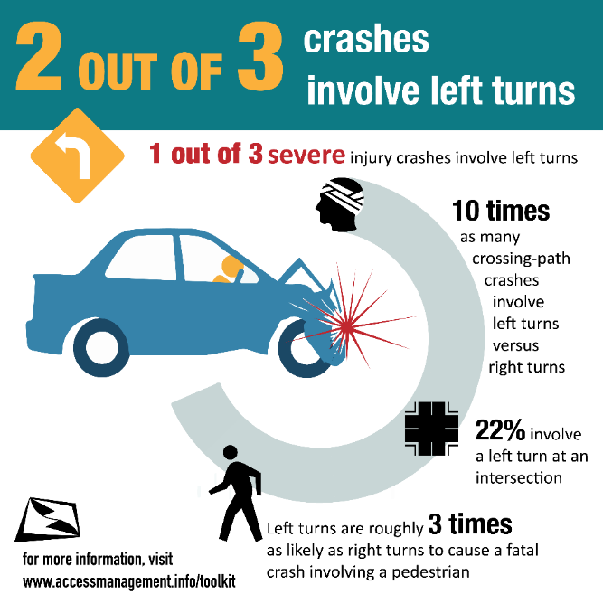



Infographics and Slide Decks
Can be edited for your project
Converting a TWLTL
to a raised median
reduces yearly
pedestrian crashes by
46%
Notes:
To increase the utility of the various tools to the practitioner, we also provide Infographics and PowerPoint slide decks on the value of each technique. They include both general infographics to convey concepts of importance to access management like the ones shown on the left and middle of the slide and infographics like the one to the bottom right where the values may be easily changed using project-specific data or tool outputs and then used in presentations or other media related to a project.

Slide 41




Access Management Communication TOOLKIT
To consolidate project tools and resources and for use in training
Notes:
A central product of the research is the AMC Toolkit which I’ll show you next.

Slide 42
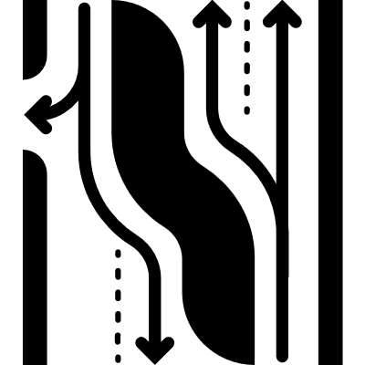

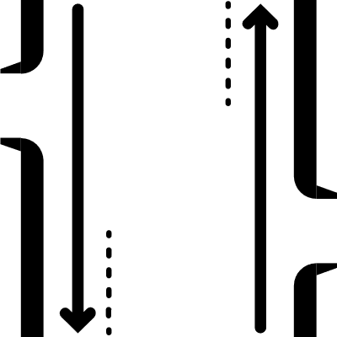

TABLE OF CONTENTS
1
2
3
4
5
6
7
8
Introduction
Program
Median Treatments
Turn Lanes
Signalized Access Spacing
Driveway & Unsignalized Access Spacing
Network Connectivity
Case Examples
  About the Toolkit
  Safety
  Economy
  Mobility
  Livability
  Safety
  Economy
  Mobility
  Livability
  Safety
  Economy
  Mobility
  Livability
  Safety
  Economy
  Mobility
  Livability
  Safety
  Economy
  Mobility
  Livability
  Safety
  Economy
  Mobility
  Livability
  Permitting
  Safety
  Mobility
  Resources
Pages 3–6
Pages 7–18
Pages 19-27
Pages 28-34
Pages 35-40
Pages 41-48
Pages 49-53
Pages 54-65
Notes:
Here you can see the contents of the toolkit. Again our overarching goal was to gather the research on access management that pertains to value of AM to society and distill it in a way that helps you, the user, clearly communicate that value in the form of benefits and costs. It includes 8 sections and the value of Am techniques to four key topic areas –safety, economy, mobility and livability.

Slide 43


About the Toolkit
      The Toolkit offers ideas on communicating the value of access management techniques. Every section focuses on a technique and its value. Each page has a message and links to communication tools that you can download and customize for your program or project.
      The next page explains how to use the toolkit. You will select techniques you want to apply. Then click through the information on their value. Use the images and ideas to create customized communication tools with PowerPoint, video, handouts, and infographics to meet the needs of your project.
      The spreadsheets provide simple planning level calculations to estimate the impact of specific techniques.
of these techniques
the value
Communicate
Turn Lanes
Signalized Access Spacing
Driveways & Unsignalized Access Spacing
Network Connectivity
Access Management Program
Median Treatments
Economy
Safety
Mobility
Livability
This Toolkit is a visual document that organizes ideas, images, and resources on the value of access management.
Notes:
We recognize that in today’ busy world practitioners don’t always have time to distill and apply the findings of detailed technical reports. So we decided to produce the Toolkit in the form of a visual document. So although it was produced in Powerpoint it is not a presentation but a reference document full of tools.

Slide 44
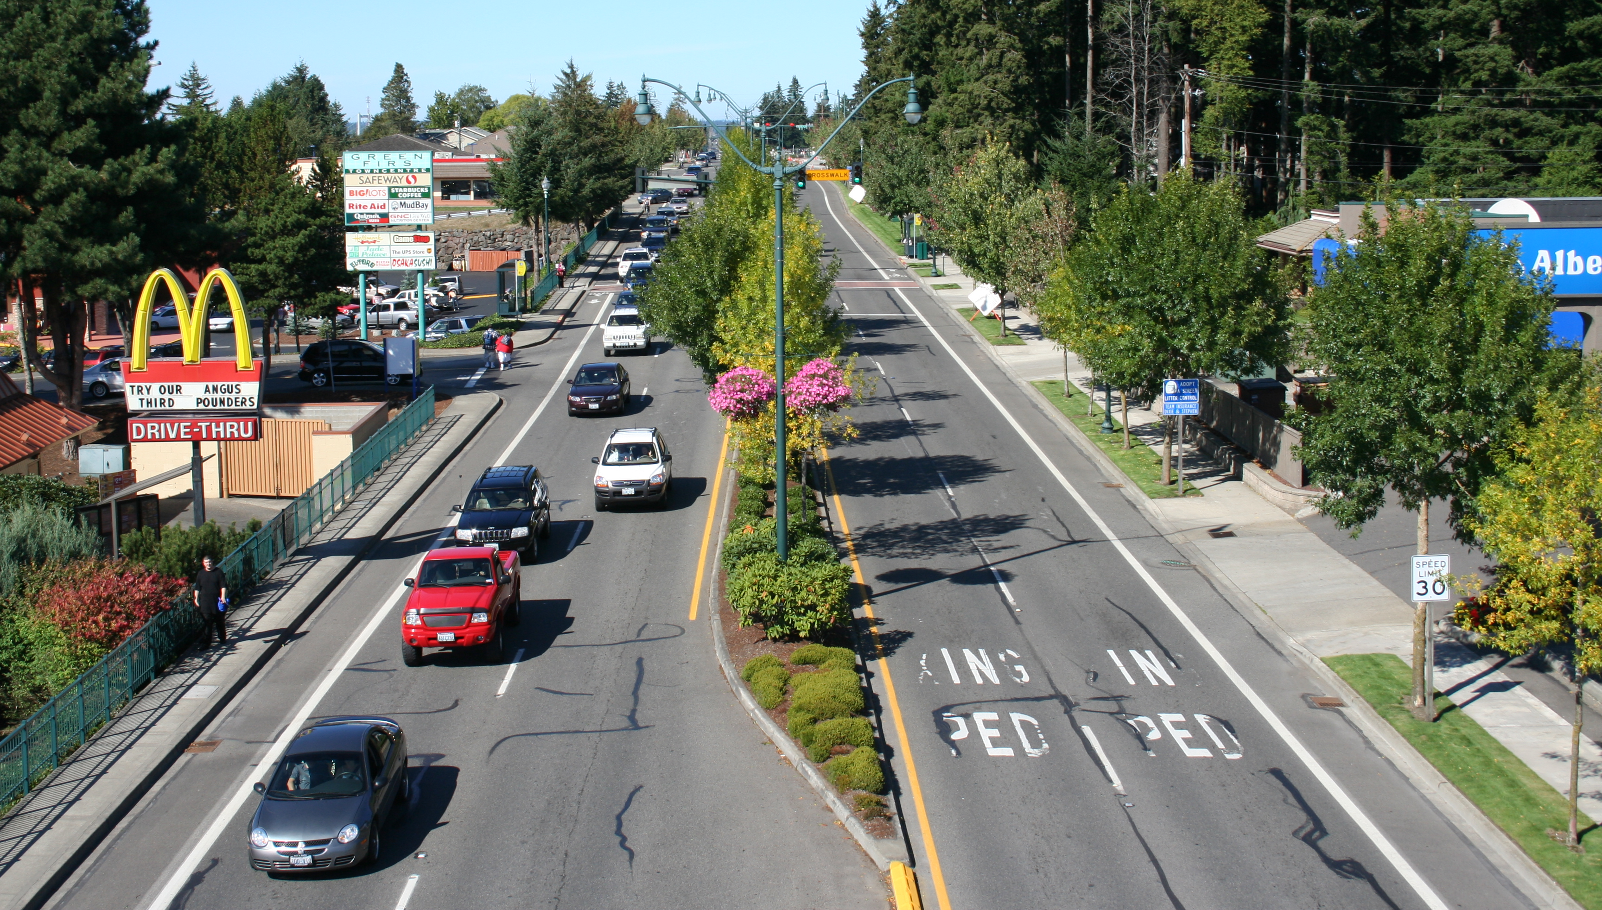






HOW TO USE THE TOOLKIT
Safety | Economy | Mobility | Livability
This area shows messages you can share with stakeholders.
This area provides technical support in the form of information, tools, and other resources.
This area above indicates the value being communicated.
      Access management preserves the safety, economy, mobility and livability of our community.
Infographics
PowerPoint
Brochures
Communication tools can be created or adapted using these resources.
Fact Sheets
Case Studies
Photo by J. Malone
A Fact Sheet is available for every spreadsheet
The photo or graphic shown in this area can be used or modified to communicate about your project. Please credit photographer or source where indicated.
Use the spreadsheets to generate project-specific data for your communication tools
Simple spreadsheet tools provide help in calculating the safety, mobility, and economic value of selected techniques.
Spreadsheets
The technique is highlighted here with an icon so you know where you are in the Toolkit.
See the final report for more information on how to use the tools.
Notes:
Purpose: The purpose of this slide is to walk through how the document pages are organized.
Key Message: There are links throughout the Toolkit that will allow you to access the platforms associated with that material.
Outcomes: Recognize that –
1) Where a technique is highlighted the value is shown in the middle.
2) A graphic is shown that supports the message you can share using the communication tools that are linked.
3) Where spreadsheets are available you can use them to customize the tools to your situation and the references are shown to supporting research.
Suggestion: It is advisable to play with the links and demonstrate the interoperability of the toolkit.

Slide 45



NCHRP Project 25-47
How to Measure and Communicate the Value of Access Management
The National Cooperative Highway Research Program (NCHRP) is sponsored by the individual state departments of transportation of the American Association of State Highway and Transportation Officials. NCHRP is administered by the Transportation Research Board (TRB), part of the National Academies of Sciences, Engineering, and Medicine, under a cooperative agreement with the Federal Highway Administration (FHWA). Any opinions and conclusions expressed or implied in resulting research products are those of the individuals and organizations who performed the research and are not necessarily those of TRB; the National Academies of Sciences, Engineering, and Medicine; the FHWA; or NCHRP sponsors.
Prepared for:
National Cooperative Highway Research Program
Transportation Research Board
Prepared by:
Center for Urban Transportation Research
Texas A&M Transportation Institute
AECOM
Teach America
Notes:
No Trainer/Speaker Notes Required

