Slide 1
NCHRP Project 17-43 Long-Term Roadside Crash Data Collection Program
Luke E. Riexinger
Hampton C. Gabler
Virginia Tech
Department of Biomedical Engineering and Mechanics
Center for Injury Biomechanics
The National Cooperative Highway Research Program (NCHRP) is sponsored by the individual state departments of transportation of the American Association of State Highway and Transportation Officials. NCHRP is administered by the Transportation Research Board (TRB), part of the National Academies of Sciences, Engineering, and Medicine, under a cooperative agreement with the Federal Highway Administration (FHWA). Any opinions and conclusions expressed or implied in resulting research products are those of the individuals and organizations who performed the research and are not necessarily those of TRB; the National Academies of Sciences, Engineering, and Medicine; the FHWA; or NCHRP sponsors.

Slide 2
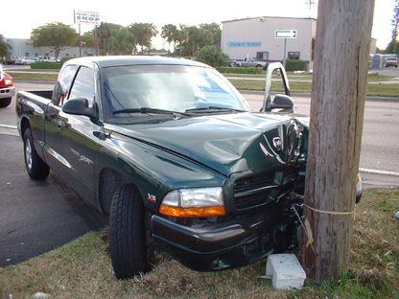
NCHRP 17-43
Motivation:
Need for Roadside Crash Data
NCHRP 17-22 data is 20 years old
Objective:
Develop sustainable, long-term data collection system for roadside crash investigations

Slide 3
Database Development
The NCHRP 17-43 database was built on NCHRP 17-22 methodology to extract roadside crash elements from the National Automotive Sampling System Crashworthiness Data System (NASS/CDS).
Additional data elements were selected based on recommendations from the NCHRP 17-22 project and the NCHRP 17-24 project.
88 data elements were collected to describe the road, roadside, trajectory, and roadside object characteristics. Each of these elements was extracted from an existing NASS/CDS variable, scene photographs, or scene diagram.
The NCHRP 17-43 database included case identifiers to join the dataset with NASS/CDS, allowing analyses to include the detailed variables present in NASS/CDS such as occupant injury severity.

Slide 4
NCHRP 17-43 = NASS/CDS + Roadside Data
Accident
NASS/CDS
Database
Vehicle
Crush
Occupant
Injury
Crash
Causation
4000 - 5000
Cases/year
Airbag + Restraints
Roadside
Data

Slide 5
Database Development
The NCHRP 17-43 database contains data from 1,581 run-off-road crashes extracted from NASS/CDS and an additional 277 crashes extracted from the Crash Investigation Sampling System (CISS).
The research team built custom quality control software to ensure that each entry in the dataset
(a) had a valid variable definition,
(b) was internally consistent with other tables in the dataset,
(c) was externally consistent with NASS/CDS or CISS.
NCHRP 17-43 Database
From NASS/CDS 2011-2015
1,581 Road Departure Crashes
821 with reconstructed speeds
NCHRP 17-22 Database
From NASS/CDS 1997-2001
889 Road Departure Crashes
869 with reconstructed speeds

Slide 6
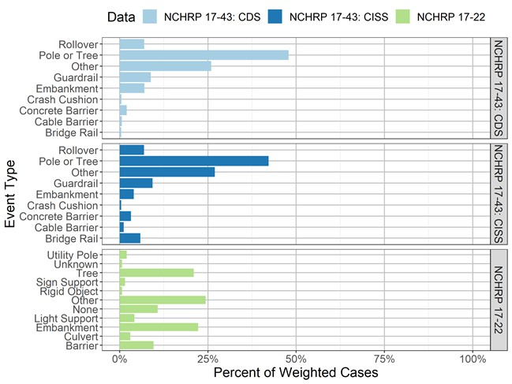
NCHRP 17-43 Type of First Impact Events
Notes:
Median model year 1993, 2004

Slide 7
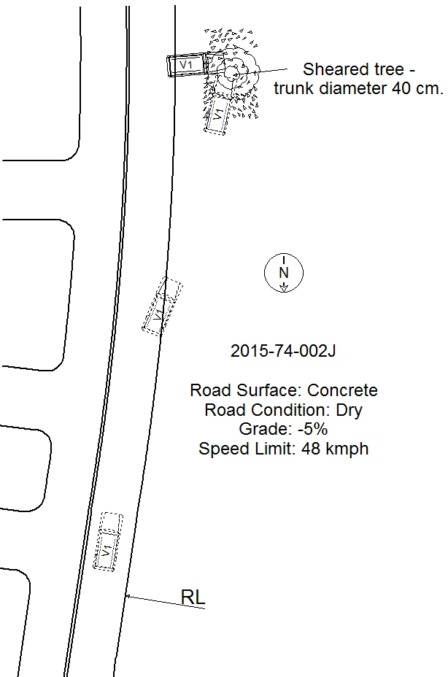
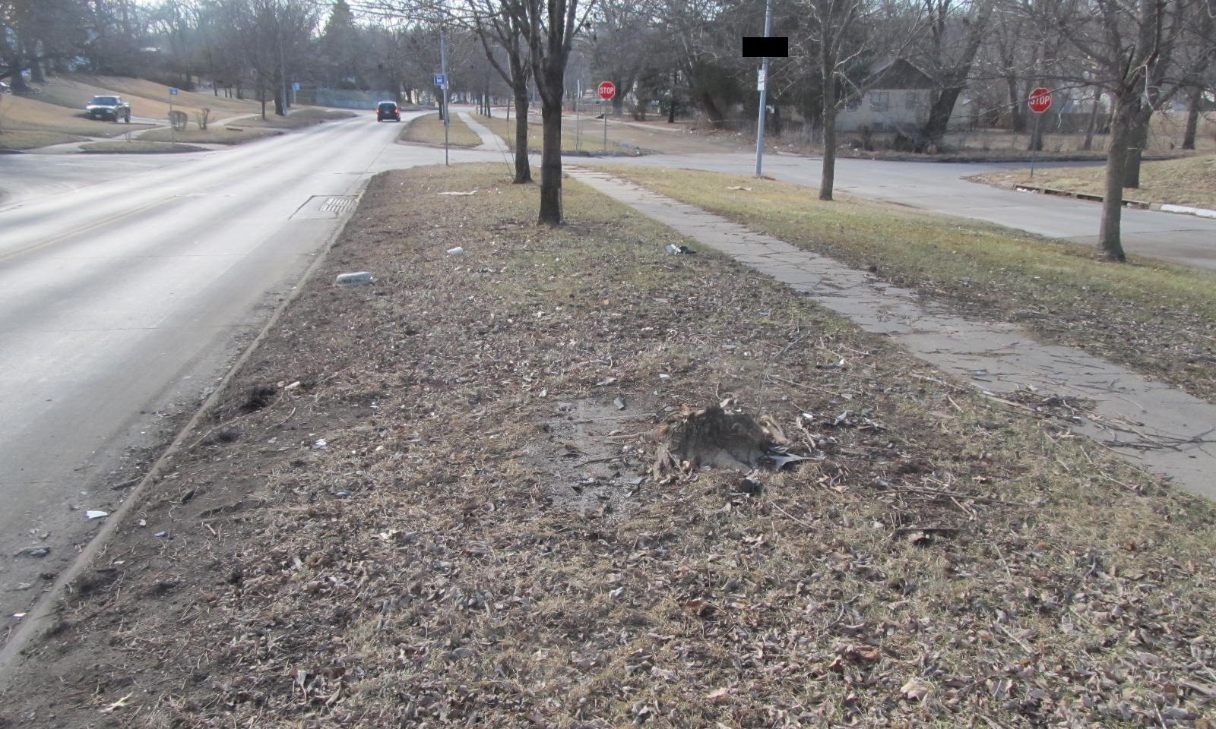
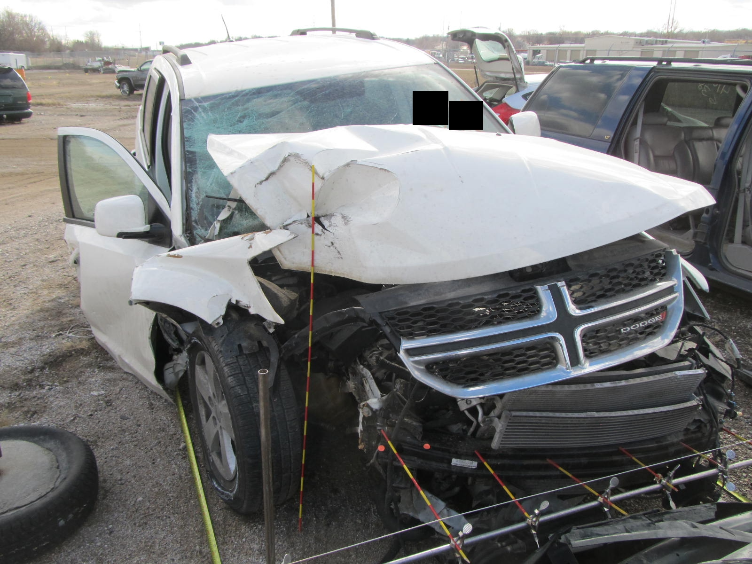
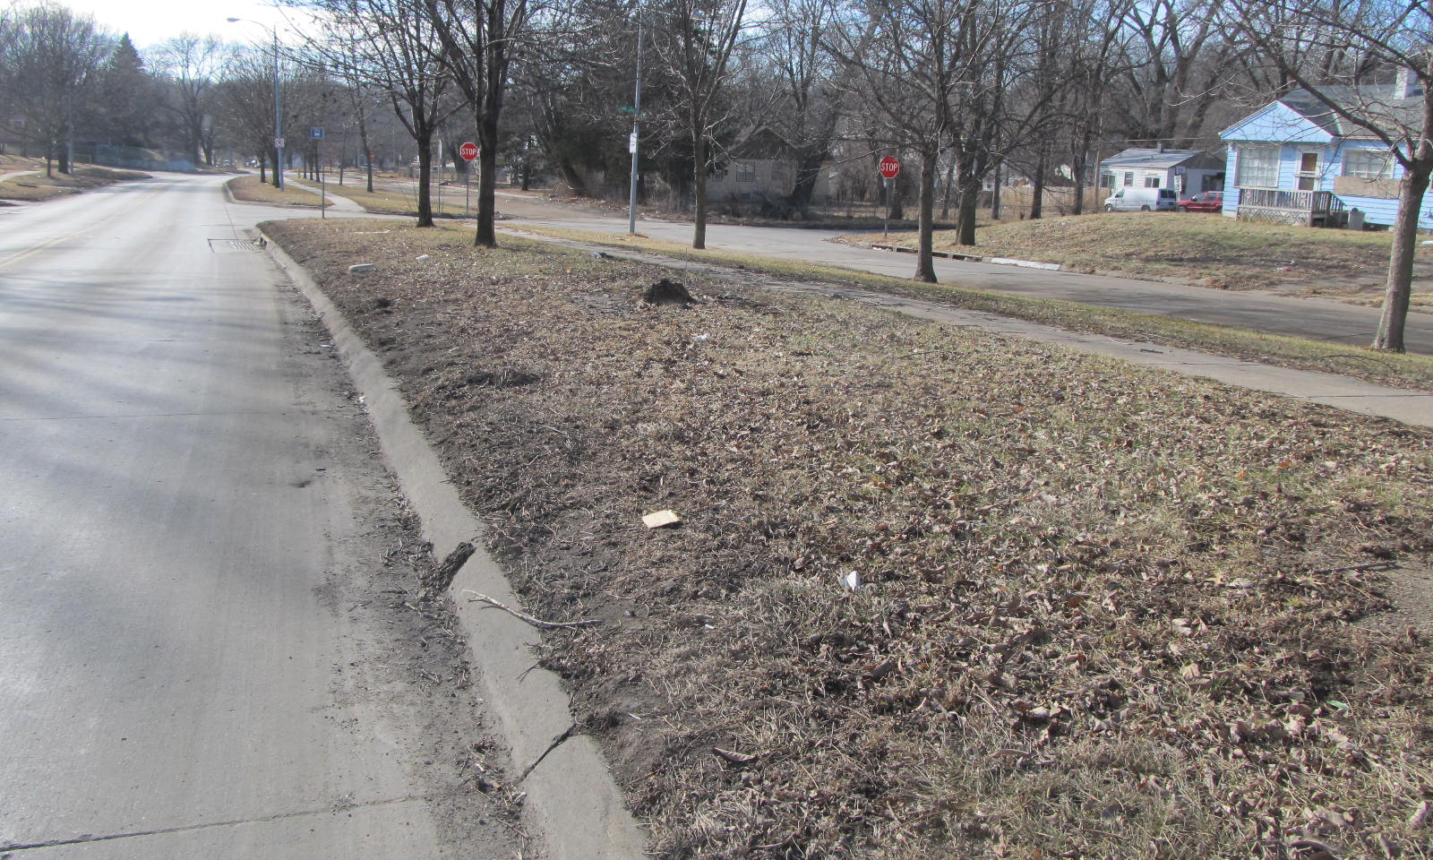
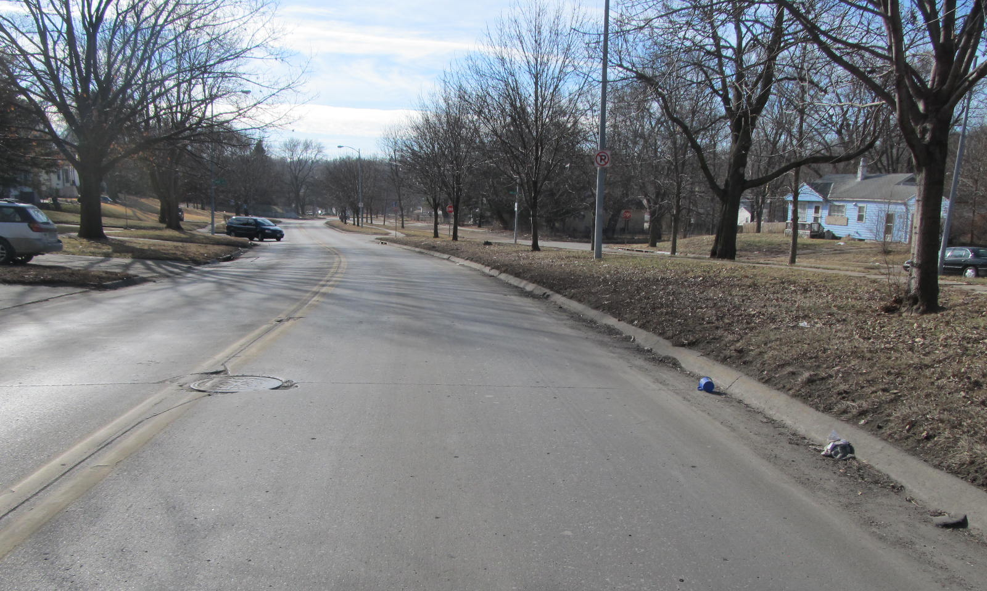
NCHRP 17-43 Example Case
2012 Dodge Journey
Tree Impact Location
Notes:
January Evening in 2015.
2012 Dodge Journey
27 yr old male driver and a 26 yr old male RF passenger
Both received MAIS2 injuries
Drunk driver
0.234 bac

Slide 8
Driver Injuries
Passenger Injuries
Cerebral Concussion AIS 2
Left Incisor Fracture AIS 1
Right Acetabulum Fracture AIS 2
Right Acetabulum Fracture AIS 2
Left Knee Abrasion AIS 1
Notes:
1-2% prob death
Medically coded injury severity score

Slide 9
NCHRP 17-43 Example: Road Data
Radius: 310 m
Right Lane Marking: None
Left Lane Marking: Double Solid Yellow
Lane Width: 3.2 m

Slide 10
NCHRP 17-43 Example: Roadside Data
Clear Zone Width: 4.78 m
Departure Angle: 8 deg
Roadside Cross Section:
Edge of
Travelled Way
No Shoulder

Slide 11
NCHRP 17-43 Example: Trajectory and Object Struck Data
(0.94, 19.7)
(3.3, 16.3)
Impacted Object: Tree
Performance: Sheared
(0,0)

Slide 12
NCHRP 17-43 Example: Reconstructions
At Rest:
Energy = 0 kJ
(0.94, 19.7)
Energy from:
Distance Travelled = mass*g*mu*4.12 = 30.4 kJ
Delta-v = 21 kJ
Sheared Tree = 356 kJ
(3.3, 16.3)
At Impact:
Total Energy = 407.4 kJ
Impact Velocity = 20.81 m/s = 74.9 kph
(0,0)
Energy from:
Distance Travelled = 0 kJ
Elevation Change = mass*g*3.3*grade= -3kJ
At Departure:
Total Energy = 404.4 kJ
Initial Velocity = 20.7 m/s = 74.5 kph
Notes:
Assumed no reaction since drunk 0.234 bac

Slide 13
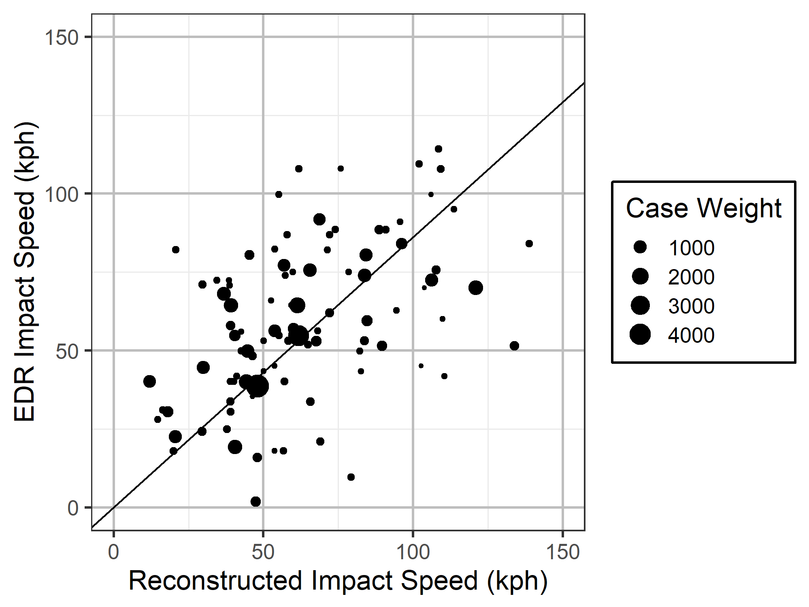
NCHRP 17-43 EDR Validation
97 cases with EDR pre-crash data and reconstructed impact speeds
Underestimates EDR impact speed on average by only 14%
Based on WinSMASH delta-v, which underestimates EDR delta-v by 13%
Notes:
R^2 = 0.88

Slide 14
Research Findings: Comparison with NCHRP 17-22
Run-off-road crash characteristics were compared between the NCHRP 17-22 database, NCHRP 17-43 database from case years 2011 to 2015, and NCHRP 17-43 database from case year 2017.
The NCHRP 17-43 database included more recent vehicles than the NCHRP 17-22 database.
The NCHRP 17-22 focused data collection on roads with a speed limit over 56 km/h (35 mph), but the NCHRP 17-43 database sampled roadway departure crashes at all speed limits.
Most case characteristics were similar between the two datasets:
The NCHRP 17-43 database contained crashes that occurred on roads with smaller radius of curvatures than in the NCHRP 17-22 database,
In the NCHRP 17-43 database, 51.9% of departures occurred on a road without a shoulder compared to only 10.1% in the NCHRP 17-22 database,
Both of these trends are likely due to the low speed roads in NCHRP 17-43, which were not sampled in the NCHRP 17-22 database.

Slide 15
Research Findings: Impact Conditions Compared to MASH
The impact speeds in both the NCHRP 17-43 database and the NCHRP 17-22 database are below the MASH TL-3 impact speed.
For left-side departures, the impact angle in both datasets is larger than the MASH TL-3 impact angle.
The impact angle in the NCHRP 17-43 database for right-side departures is lower than the MASH TL-3 impact angle.
The MASH TL-3 impact angle between the 85th percentile for both left and right departures may be intentional since the MASH tests can be conducted as either a left- or right-side departure.

Slide 16
Research Findings: Corridor Method for Barrier Length of Need
Based on real-world, run-off-road crash trajectories from the NCHRP 17-43 database, encroachment corridors were constructed with linear extrapolation to a common lateral offset.
These corridors incorporate the effects of the obstacle location, departure side, and barrier location on the recommended runout length:
Typically, left side departures required a longer runout length to intercept the same proportion of crashes,
The runout length for objects close to the road based on the corridor method was much smaller than the runout length recommended by the Roadside Design Guide,
The benefit of this corridor-based approach to barrier placement is that each agency can balance the runout length and the protected proportion of encroachments depending on their individual priorities.

Slide 17
Recommendations: Improved LON Procedure
The detailed roadside encroachments in the NCHRP 17-43 database could be used to generate encroachment corridors.
The encroachment corridor methodology quantifies the proportion of encroachments captured by a particular barrier installation while accounting for:
Object location,
Barrier installation location,
Driver steering.
It is recommended that a similar methodology be considered for:
Justifying the recommended barrier LON in the RDG,
Use by individual state Departments of Transportation to compare two potential barrier installations.

Slide 18
Recommendations: Revisit Run-Off-Road Crash Analyses
It is recommended that analyses based on the NCHRP 17-22 database be revisited using the NCHRP 17-43 database due to changes in the vehicle fleet.
It is recommended that these studies be revisited periodically in the future with continued data collection as the fleet changes.

Slide 19
Recommendations: Continued Retrospective Data Collection
It is recommended that retrospective roadside data collection be continued using CISS until it can be replaced with a prospective data collection study:
Potential future projects could use the coding manual and reconstruction techniques developed by the NCHRP 17-43 research team for CISS to continue the data collection,
NHTSA has provided a method for combining NASS/CDS cases with CISS cases for case years after 2019, which will allow the NCHRP 17-43 data to be combined with any future data collection projects.

Slide 20
Recommendations: Prospective Data Collection
Implementation of a prospective data collection procedure would allow for additional data elements to be directly measured:
Slope,
Shoulder width,
Tree diameter,
Geometric dimensions of roadside barriers:
Guardrail height,
Post spacing.

