Slide 1
NCHRP 23-02: Guidelines on Collaboration and Information Security for State DOTs
Final summary of research performed

Slide 2
Lynne Randolph
Marisa Ramon
Jesus Martinez
NCHRP 23-02
Senior Program Officer
Southwest Research Institute
David Jared
John Wolff
Joah Sapphire
Global Dynamic Group
Special thanks to the NCHRP 23-02 project panel members and public agency staff interviewees.

Slide 3
Agenda
Project purpose and goals
01
Research performed
02
Analysis and approach
03
Secure Collaboration Tool
04

Slide 4
Project Purpose
Transportation Research Board (TRB) Project 23-02 “…describe the organizational motivations for collaboration and develop guidelines for state Department of Transportation (DOT) leadership, staff, and others on effective practices for balancing concerns for collaboration and for information security in support of the state DOT’s evolving business needs. “
See project website for more details

Slide 5
Project Goals
Finding Balance
Knowledge or Data Sharing
Security and Protection
Collaboration With Others
Encourage knowledge and data sharing
Promote collaboration
Provide guidelines on security
Notes:
Agencies must find the appropriate balance between sometimes conflicting needs. Knowledge and data sharing and collaboration with others is a requirement of our globally connected society. But opening our doors also opens us up to the risk of intrusion. These needs often appear to be mutually exclusive, but they do not have to be.

Slide 6
Tasks
Task 1: Perform Literature Review
Task 2: Develop Descriptive and Analytical Framework
Task 3: Prepare Interim Report 1
Task 4: Prepare Interim Report 2
Task 5: Prepare Final Deliverables
Task 6: Finalize Project Summary Report

Slide 7
Research Performed
Reviewed existing literature, current state of practice, and NCHRP past projects
Identified practices which promoted or prevented collaboration and information sharing
Interviewed people from a cross-section of agency roles
Leadership, strategic planning, operations
Security, researchers
Other staff involved in collaboration or knowledge/data sharing
Determined example use cases for determining business requirements
Representative cross-section of activities
Differing breadth of stakeholders
Notes:
From the review of existing practices, discussions with panel members, and our interviews with various DOT staff , we picked a cross-section of use cases to be a representative sample. We also identified practices promoting or preventing knowledge and data sharing and collaboration.

Slide 8
Selected Use Cases
Use Case | Stakeholders | Activity Range | End Date
Participation on an international committee | Many Private & public Various nationalities | Wide, varied | Unknown
Federal grant project collaboration | Many Private & public | Wide, varied | Known, typically multiple years
911 data integration | Limited number Possibly only public | Limited | Intended to be continuous
Federal data sharing effort | Many Private & public | Limited | Intended to be continuous
Construction, both planning and execution | Many Private & public | Wide, repeated for subsequent of the same type | Generally known, typically multiple years
Notes:
The use cases presented as examples in this report are each based on observed research conducted in previous tasks. Although anonymized, each one exemplifies important aspects of collaboration and data and information sharing among multiple parties with respect to both challenges and benefits. The electronic tools that facilitate collaboration and data and information sharing, when available and when operated with confidence, contribute to powerful outcomes that realize the greatest benefits from collaboration and information sharing.
While some of these initiatives take a considerable degree of time, resources, and sustained effort, in our interviews we observed satisfaction in the outcomes from those states whose collaboration efforts are advanced by their willingness and ability to share data and information and support advanced multi-party collaboration activities.

Slide 9
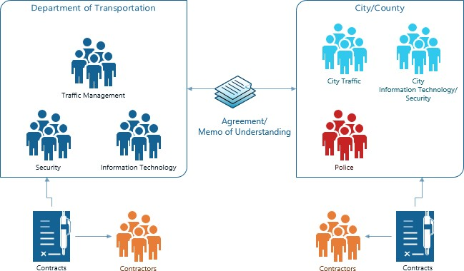
Use Case Content
Business case
Risks/impediments
Workflows
Setup
Ongoing activities
Outcomes/benefits
Scenarios
Diagram represents the initial setup of a use case.
Notes:
For each use case, we developed content ranging from why the activities should occur (the benefits) to the risk and barriers to performing the activities. The diagram on the screen shows the diagram representing the ongoing activities for the AASHTO committee. The use cases contain many ongoing collaborative efforts which in themselves contain smaller use case/activities.

Slide 10
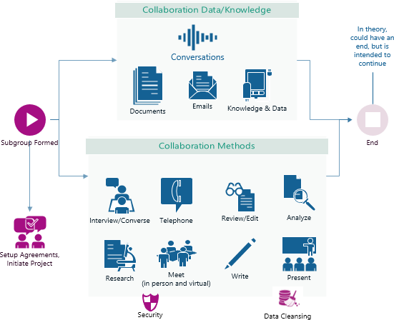
Use Case Content
Business case
Risks/impediments
Workflows
Setup
Ongoing activities
Outcomes/benefits
Scenarios
Diagram represents ongoing activities of a use case.
Notes:
For each use case, we developed content ranging from why the activities should occur (the benefits) to the risk and barriers to performing the activities. The diagram on the screen shows the diagram representing the ongoing activities for the AASHTO committee. The use cases contain many ongoing collaborative efforts which in themselves contain smaller use case/activities.

Slide 11
Derived Business Requirements
Functional
Goals
Expected outputs
Technical
Methods
Data characteristics
Content and data, information, and knowledge management
Operational
Documented guidelines
Data sharing agreements
Security
Tools
Permissions
Policies
Procedures
Notes:
From the use cases, we developed a set of requirements to be defined for collaboration and sharing of data or knowledge. The requirements were grouped into categories and refined.

Slide 12
Analysis
Analyzed use cases
Mapped requirements to generated use cases
Refined scenarios for specific activities in the use cases
Considered variations between agencies
Reviewed interview data for key takeaways

Slide 13
Research Findings
Our interview data showed DOTs with clear policies, procedures, and guidelines enabled safe and secure collaboration efforts.
What could we do to help DOTs ensure not only that they had these policies and procedures, but that agency staff knew how to find them?
Clear Policies & Procedures
Leadership Promotion of Collaboration
Improved Knowledge & Data Sharing and Collaboration
Notes:
From our research, we observed that the ability to share and collaborate is greatest in states with the strongest and clearest security practices and policies. Some states have practices and policies but do not provide a single location for someone to easily find what is required to collaborate. This suggests that both the presence and the promotion of strong and clear security practices and policies are key to enabling agency staff to engage in safe and secure collaboration and data and information sharing.
The person with the use case has the best information to decide which of the requirements are applicable so with that in mind, what goes in our secure collaboration tool?

Slide 14
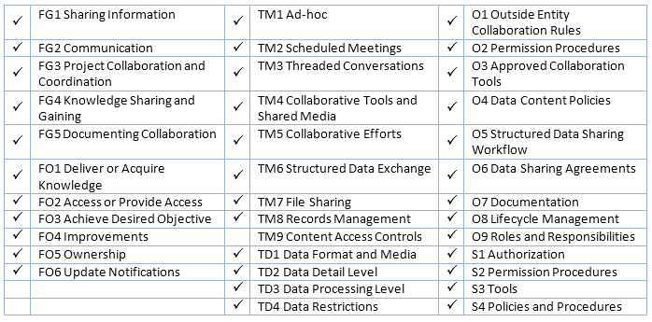
Analysis Challenges
Difficult to determine (in a generic way) which requirements are applicable to a DOT’s specific use case
In many use cases, almost every requirement was relevant
Notes:
After reviewing the requirements for each of the example use cases, we observed that a high percentage of requirements were applicable. This discovery focused our attention on determining what format of instructional guide would provide the greatest benefit to agencies wanting to collaborate in a secure manner.
Because of this, better to have something to filter your specific use case to the appropriate requirements.

Slide 15
Agency Variations
No “one-size-fits-all” answers or guidelines
Each agency has specific policies and procedures
Best practices for one agency may not fit other agencies
Anything developed by this project needed to provide flexibility
Notes:
In general, creating one document that described best practices and the “what” that every agency should implement was not going to provide value. Each agency has their own overarching requirements for security, tools, and other policies and procedures related to knowledge and data sharing and collaboration.

Slide 16
Developing A Secure Collaboration Tool
Determined what content was needed to provide best guidelines
The secure collaboration tool has two very different types of users:
Agency policy makers
Create the policies and procedures
Provide guidelines and direction on collaboration and data/knowledge sharing
Agency staff
Want to engage in collaborative efforts or sharing activities
Need to know the appropriate policies and procedures to follow
Notes:
We foresee two types of users for the guide: policy makers responsible for setting policy, procedures, and security rules, and collaborators who seek to engage in collaboration or sharing activities and must determine the appropriate practices and policies for their agency. Each have distinct benefits that will be gained by using the guide.

Slide 17
Agency Policy Makers
Ensure policies and procedures exist
Keep communication open for what works and does not work
Review the policies on a regular basis

Slide 18
Agency Collaborators
Identify requirements applicable to their use case
Review the policies, procedures, and best practices for selected requirements
Provide feedback to policy makers

Slide 19
Secure Collaboration Tool Content
Requirement Identifier
Description |  | Examples
Textual description of the requirement |  | Examples of what the requirement might entail
Tool Output
Guidance | Policies and Procedures | Best Practices | Applicable Requirements
Textual guidelines for this requirement | [link to applicable documents and agency policies & guidelines or language indicating that no formal policies or guidelines are available] | List of best practices around the requirement | Other requirements which should be considered
Agency owners will populate the policies and procedures for their agency.
Agency users will be shown the applicable policies and procedures for their use case and selected requirements.
Notes:
Cannot just make a guidelines document as agency policies are different in each agency. A simple document would not provide as useful of benefits as providing a tool where requirements are filtered to those specific to an activity which then provides more directed content to the collaborators.

Slide 20
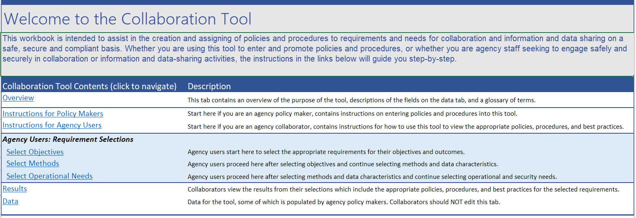
Secure Collaboration Tool: Introduction

Slide 21
Secure Collaboration Tool: intended impact
The act of using the tool provides equal benefit to the output of the tool
Requires users to think about what they are planning to do
Exposes users to needs they might not otherwise have considered
Reveals insights relevant to their specific activities or use cases
Agency policy makers populate the data in the tool
Customizable
Provides a single location for accessing the relevant polices and procedures

Slide 22
Secure Collaboration Tool: Demo
Shows an agency user using the tool to select their requirements, the tool suggesting related requirements, and the results showing the agency’s policies, procedures, best practices, and guidelines.

Slide 23
Summary Of Tasks Performed
Task 1: Performed a strategic literature review including the topics of security, knowledge management, data sharing, collaboration, and existing frameworks and practices.
Task 2: Developed Descriptive and Analytical Framework
Interviewed Subject Matter Experts (SMEs) in state transportation agencies to determine current practices and lessons learned.
Created a document outlining a framework for assessing needs and risks associated with collaboration and data and knowledge sharing.
Task 3: Prepared Interim Report 1
Created use cases representative of types of collaborative efforts including a variety of stakeholders.
Determined a set of user needs and requirements related to collaboration and data and knowledge sharing.
Task 4: Prepared Interim Report 2
Expanded the use cases by developing scenarios for specific activities.
Analyzed the data we had collected and determined a mechanism to provide this data in a user-friendly format.
Task 5: Prepared Final Deliverables
Created content for the collaboration tool including requirements, guidelines, best practices, and examples.
Created PowerPoint presentation and presented findings to date at TRB Annual Meeting 2022.
Task 6: Finalized Project Summary Report
Delivered a final report to inform readers of program., implementation of research findings
Delivered final version of customizable Secure Collaboration Tool
Provided supplemental Task information to assist in implementation and usage of Task results.

Slide 24
Project Results
Delivered a final summary report
Summarizes project activities
Provides general best practices for data and knowledge sharing and collaboration
Includes adoption plan and future research
Secure Collaboration Tool
Implemented in Excel to promote wider adoption
Customizable by the agency policy makers
Promotes the creation and usage of clear policies and procedures

Slide 25
For more information about NCHRP 23-02, visit: http://apps.trb.org/cmsfeed/TRBNetProjectDisplay.asp?ProjectID=4783
The National Cooperative Highway Research Program (NCHRP) is sponsored by the individual state departments of transportation of the American Association of State Highway and Transportation Officials. NCHRP is administered by the Transportation Research Board (TRB), part of the National Academies of Sciences, Engineering, and Medicine, under a cooperative agreement with the Federal Highway Administration (FHWA). Any opinions and conclusions expressed or implied in resulting research products are those of the individuals and organizations who performed the research and are not necessarily those of TRB; the National Academies of Sciences, Engineering, and Medicine; the FHWA; or NCHRP sponsors.

