Slide 1
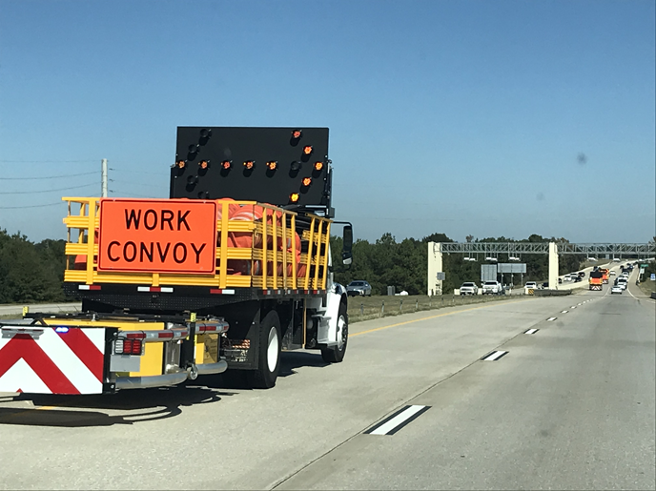
NCHRP Project 20-07/Task 358: Reducing Risks to Worker Safety in Work Zones due to Distracted Drivers
LuAnn Theiss, P.E., PTOE, PMP
Principal Investigator
Gerald Ullman, P.E., Ph.D.
Key Researcher
Texas A&M Transportation Institute
September 1, 2022

Slide 2
Background & Objective
Drivers are often distracted from their driving task for a variety of reasons, which can lead to work zone intrusions. Solutions are needed to improve safety for workers.
The objective of this research is to develop recommendations for strategies to:
Alert distracted drivers to the presence of a work zone or maintenance moving operation, and
Prevent those drivers from hitting a work vehicle or intruding into the work zone.
Notes:
Work zones are complex and often hazardous places to work. The Bureau of Labor Statistics reports several hundreds of worker fatalities in the transportation industry every calendar year. Workers in work zones report an increasing concern of distracted drivers resulting in near misses, and vehicles hitting pedestrians and/or equipment in work zones. In the past, driver distractions in the vehicle were limited to people, for example, eating, reading a map or applying makeup while operating the vehicle. However, now technology allows drivers to e-mail, text, and make extended phone calls while driving. An increasing need exists to determine what transportation agencies are doing to minimize or mitigate the intrusion of vehicles of distracted drivers into work zones and areas.
A significant amount of research has investigated how distracted driving impacts an individual’s ability to drive or the impact of technology use on driver performance. The primary focus though has been on enforcement, education, and advocacy to reduce or eliminate use of technology while driving or operating a vehicle. Little research has been performed to investigate what states are doing to alert workers or distracted drivers of approaching hazards prior to the distracted driver’s vehicle entering work areas.
This research project is intended to find solutions.

Slide 3
Countermeasures from Literature Review and Survey of 27 States
Enhanced traffic control devices (TCD)
Queue warning systems
Speed limit reductions
Temporary portable rumble strips (TPRS)
Law enforcement
Intrusion alarm systems
Real-time in-vehicle notifications
78%
74%
89%
63%
93%
22% studied
44% pursuing
Notes:
Based on the literature review and survey responses from 27 states, the research team identified 7 different strategies for addressing distracted driving in work zones.
Utilization of these countermeasures is shown in parentheses (X% of the 27 respondents use this strategy, as needed).
While no states use the intrusion alarms, 22% have participated in some type of investigatory study.

Slide 4
Summary
Despite many agencies using various countermeasures, distracted driving crashes still occur
Effectiveness of countermeasures relies on getting distracted driver’s visual attention
Tactile and auditory warnings may be beneficial tools to grab attention of drivers
Ultimately, the panel chose to evaluate TPRS and a WATCH FOR WORKERS WHEN FLASHING warning sign.
Notes:
Despite high utilization rates for many of these countermeasures, distracted driving crashes still occur. Driver detection of enhanced warning signs (with brighter sheeting, flags, and lights) is only successful if the driver sees the signs with their eyes and cognitively registers that information. The same is true for queue warnings, speed limit reductions, and law enforcement presence. While many of these countermeasures have been shown to have safety benefits, their impact on driver behavior is highly dependent upon the driver’s visual detection of the information presented.
In contrast, TPRS and work zone alarms do not rely on visual perception. Instead, TPRS provide tactile warnings, while work zone alarms provide both visual and auditory warnings. When distracted drivers are mind wandering and/or not looking at the road ahead, pursuing an alternate sensory path may have some benefit. TPRS are widely available and observational studies of driver behavior could be used to determine their effectiveness. The AWARE alarm system is currently in use as well.
After a discussion of the pros and cons of all the countermeasures, the panel chose to evaluate TPRS and a WATCH FOR WORKERS WHEN FLASHING warning sign.

Slide 5
Evaluations
Distracted driving data included observation of driver behaviors in real work zones
Talking on phone or looking anywhere except straight ahead
Data were collected in 2 locations at each work zone
upstream of the deployment location (near the ROAD WORK AHEAD sign)
at the treatment location
Data were collected with and without the treatments deployed
Notes:
The evaluation of each countermeasure used a simple comparison of distracted driving behaviors with and without each treatment deployed. The measure of effectiveness was driver visual attention (i.e., where drivers were looking immediately after they passed the countermeasure). Drivers who were looking directly forward at the roadway ahead (and not talking on their phones) were considered to have “undistracted” visual attention. When drivers were looking in the rear-view mirror, out the side window, at passenger(s), at a cellular phone, or down into the cab of the vehicle, their visual attention was considered “distracted.” While drivers’ cognitive distraction per se could not be measured within the scope and budget of this project, any drivers that were holding their cellular phone near their face (in a talking position) were included with the cellular phone distracted drivers. This type of distraction is likely underrepresented in the data because the use of Bluetooth-connected devices could not be discerned. In addition, if the data collectors could not discern driver attention from passing vehicles, these drivers were not included in the data.

Slide 6
TPRS/Alabama
Site No. | Direction | Location Description | Posted Speed Limit (mph) | Number of Minutes of Data
1 | Eastbound | West of County Road 100 | 55 | 251
2 | Westbound | West of State Highway 49 | 45 | 250
3 | Eastbound | East of County Road 17 | 55 | 264
4 | Westbound | East of Georgia State Line | 55 | 256
Notes:
All TPRS data was collected at four locations along State Route 22 in Central and Eastern Alabama. All were flagging stations set up according to ALDOT standard detail 2002-A
An example of the TPRS deployment is shown in these images.

Slide 7
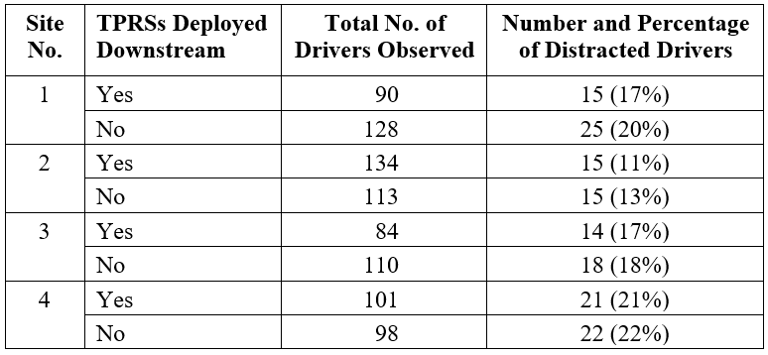
TPRS Upstream Data Summary
Researchers performed at test of proportions for each site
No differences were found in the upstream distraction percentages

Slide 8
TPRS Downstream Data Summary
Site No. | TPRSs Deployed | Total No. of Drivers Observed | Number and Percentage of Distracted Drivers | Work Operation Visible
1 | Yes | 103 | 18 (18%) | No
 | No | 125 | 26 (21%) | No
2 | Yes | 136 | 16 (12%) | No
 | No | 130 | 34 (26%) | No
3 | Yes | 85 | 9 (11%) | Yes
 | No | 102 | 25 (25%) | No
4 | Yes | 107 | 17 (16%) | No
 | No | 96 | 22 (23%) | No
Comparison of Upstream & Downstream TPRS Data
Site No. | TPRS Deployed | Upstream Percentage, $p_{1}$ | Downstream Percentage, $p_{2}$ | Change in Percentage, $∆p$
1 | Yes | 17% | 18% | +1%
 | No | 20% | 21% | +1%
2 | Yes | 11% | 12% | +1%
 | No | 13% | 26% | +13%
3 | Yes | 17% | 11% | –6%
 | No | 18% | 25% | +7%
4 | Yes | 21% | 16% | –5%
 | No | 22% | 23% | +1%
Notes:
The researchers then looked at the data collected at the downstream location of each site with and without the TPRSs deployed. The total number of drivers observed does not match the upstream data from Table 3 exactly because:
•Vehicles may have entered or exited the advance warning area of the work zone between the upstream and downstream locations.
•Some vehicles may have been missed at either location due to coordinated start and stop times for data collection.
•Driver attention may not have been discernable by one or both data collectors.
The researchers also noted whether the work operation (i.e., flagger, work vehicles, or queue traffic at the flagger station) was visible from the downstream position. This table shows the distracted driving data for the downstream TPRS sites.
Distraction rates varied from 11 to 26 percent.
Next, the researchers calculated the percent change in distraction rates for each site with and without the TPRSs deployed. Considering the sample sizes of the data used to calculate each percentage, which ranged from 84 to 141 observations, an error in researcher categorization of distraction by as few as one or two drivers could have an impact on the change in percentage (∆p). Thus, the small increases of 1 percent shown in the table are essentially negligible. But let’s take a look at each site individually.

Slide 9
Site 1 (TPRS)
Changes in percentages were insignificant
No differences in driver attention were apparent
Notes:
This table shows a breakdown of the distracted driving behaviors observed at site 1. The changes in percentages were insignificant. Both the upstream and downstream locations were in areas of similar roadside development, and the work operation was not visible from the downstream location during either data collection period. Differences in driver attention with and without the TPRSs present were not apparent at this site.

Slide 10
Site 2 (TPRS)
Less attention to nearby recreational facility when TPRS were deployed
TPRS may have had a positive effect on distraction reduction
Notes:
This table shows a breakdown of the distracted driving behaviors observed at site 2. Here, the roadside development was similar at both the upstream and downstream locations, and the work operation was not visible from the downstream location during either data collection period. While collecting data without the TPRSs present, the researchers noted that many of the distracted drivers appeared to be glancing at a recreational facility that was located near the downstream location. This behavior was not as prevalent when the TPRSs were deployed. After ALDOT removed the work zone at the end of the workday, the researchers stayed behind to gather additional data without the work zone present. Even with a very small amount of data, the researchers noted that glances at the recreational facility accounted for half of the distracted behaviors with no work zone present. Thus, the TPRSs may have had an impact on the distraction by the recreational facility at this site.

Slide 11
Site 3 (TPRS)
Changes in percentages were insignificant
No differences in driver attention were apparent
Notes:
This table shows a breakdown of the distracted driving behaviors observed at site 3. The downstream location was near the crest of a vertical curve. The site was also at the end of a long (approximately 2-mile) section with limited sight distance due to horizontal and vertical roadway curvature. As drivers came over the hill, they entered a long, straight section of roadway where they could see a significant distance ahead. During the data collection period with the TPRSs deployed, the flagger, the work vehicles, and any queued traffic at the flagger station were located near the downstream location and could easily be seen by approaching drivers. During the data collection period without the TPRSs deployed, the work operation was not visible from the downstream location. This likely impacted the distracted driving behaviors recorded at the downstream location of site 3.
The changes in percentages were insignificant. Both the upstream and downstream locations were in areas of similar roadside development, and the work operation was not visible from the downstream location during either data collection period. Differences in driver attention with and without the TPRSs present were not apparent at this site.

Slide 12
Site 4 (TPRS)
Less attention to nearby convenience store when TPRS were deployed
TPRS may have had a positive effect on distraction reduction
Notes:
This table shows a breakdown of the distracted driving behaviors observed at site 4. At site 4, drivers approaching the work zone were just crossing the Georgia state line into Alabama. For several miles upstream of the work zone, there was no commercial or retail roadside development, and the clear zone of the roadway was rather narrow. As drivers passed the rumble strips, they encountered a wider view and a busy convenience store. The work operation was not visible during either data collection period.
As with site 2, the researchers noticed that many drivers were distracted by the convenience store when the TPRSs were not present. Thus, a small amount of data was collected after ALDOT removed the work zone at the end of the workday. It does appear that the TPRSs had an impact on the distraction by the convenience store located at this site.

Slide 13
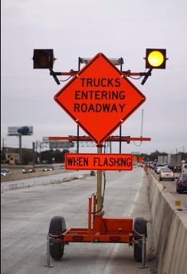
WATCH FOR WORKERS WHEN FLASHING Sign
Sign was fabricated using a warning sign system currently available for warning motorists about construction vehicles in work zones

Slide 14
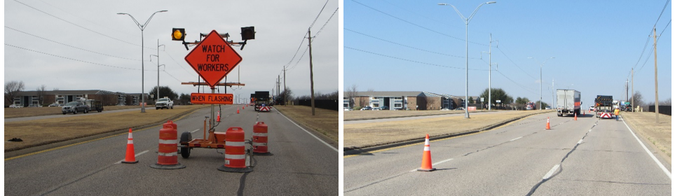
WFWWF/Texas
Site No. | Roadway | Direction | Location Description | Posted Speed Limit (mph) | Number of Minutes of Data
5 | Interstate 30 | Eastbound | East of Ridgmar Blvd. | 65 | 60
6 | State Highway 303 | Westbound | West of State Highway 161 | 45 | 74
7 | State Highway 303 | Westbound | West of State Highway 161 | 45 | 65
8 | Interstate 35 | Northbound | South of US 67 | 70 | 47
At site 8, unexpected congestion occurred while the WFWWF sign was not deployed, resulting in no data for comparison.
Notes:
All WFWWF data was collected at four different lane closures on multilane roads in the Fort Worth District of TxDOT. TxDOT TCP 1-5a was used.
An example of the WFWWF sign deployment is shown in these images.

Slide 15
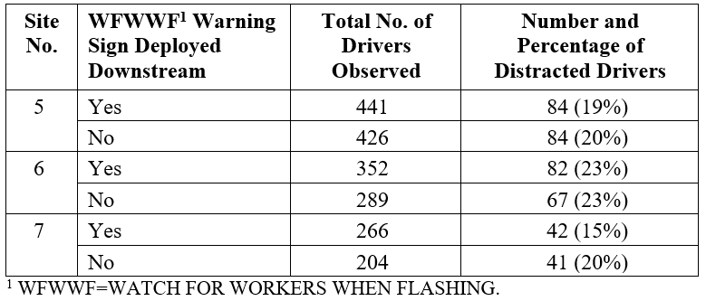
WFWWF Upstream Data Summary
Researchers performed at test of proportions for each site
No differences were found in the upstream distraction percentages
Notes:
This table summarizes the data collected at the upstream location of each of the remaining sites.
Distraction rates run between 15 and 23 percent.

Slide 16
WFWWF Downstream Data Summary
Site No. | WFWWF Warning Sign Deployed | Total No. of Drivers Observed | Number and Percentage of Distracted Drivers | Work Operation Visible
5 | Yes | 449 | 103 (23%) | No
 | No | 447 | 115 (26%) | No
6 | Yes | 344 | 82 (23%) | No
 | No | 287 | 67 (23%) | No
7 | Yes | 274 | 42 (15%) | Yes
 | No | 217 | 49 (23%) | Yes
Comparison of Upstream & Downstream TPRS Data
Site No. | WFWWF Warning Sign Deployed | Upstream Percentage, $p_{1}$ | Downstream Percentage, $p_{2}$ | Change in Percentage, $∆p$
5 | Yes | 19% | 23% | +4%
 | No | 20% | 26% | +6%
6 | Yes | 23% | 23% | 0%
 | No | 23% | 23% | 0%
7 | Yes | 15% | 15% | 0%
 | No | 20% | 23% | +3%
Site No. | WFWWF Warning Sign Deployed | Upstream Percentage, $p_{1}$ | Downstream Percentage, $p_{2}$ | Change in Percentage, $∆p$
5 | Yes | 19% | 23% | +4%
 | No | 20% | 26% | +6%
6 | Yes | 23% | 23% | 0%
 | No | 23% | 23% | 0%
7 | Yes | 15% | 15% | 0%
 | No | 20% | 23% | +3%
Notes:
The researchers then looked at the data collected at the downstream location of each site with and without the WATCH FOR WORKERS WHEN FLASHING deployed. The researchers also noted whether the work operation (i.e., workers, work activity, or work vehicles) was visible from the downstream position. This table summarizes the downstream location data.
The researchers calculated the percent change in distraction rates for each site with and without the WATCH FOR WORKERS WHEN FLASHING warning sign deployed, as shown in this table. Interestingly, at site 5, there appears to be slight increases in the percentage of distracted driving behaviors at the downstream location, although the increase was greater when the sign was not present. Site 6 shows no difference in downstream distraction rate, so let’s look at sites 5 and 7 individually.

Slide 17
Site 5 (WFWWF)
Percentages were very similar
WFWWF sign appeared to have no effect on distraction reduction at this site
Notes:
At site 5, the upstream location was near an entrance ramp on a freeway with three lanes in the direction of the single lane closure. Distracted driving data were recorded at the upstream location only for vehicles in the right lane (or third lane) since the WATCH FOR WORKERS WHEN FLASHING warning sign was located on the right side of the road at the downstream location. When the WATCH FOR WORKERS WHEN FLASHING warning sign was deployed, it was located between the first and second advance warning signs. The work operation was not visible from the downstream location during either data collection period.
This table shows the breakdown of distracted driving behaviors. The distribution of the various behaviors appears to be very similar, regardless of the presence of the WATCH FOR WORKERS WHEN FLASHING warning sign.

Slide 18
Site 7 (WFWWF)
Data likely influenced by contractor activity
WFWWF sign may have had a small positive effect on distraction reduction at this site, but data are not conclusive
Notes:
Site 7 data were collected at the same upstream and downstream locations as site 6 on the following day, except the contractor was using a double-left-lane closure to continue the milling and begin the overlay work. When the WATCH FOR WORKERS WHEN FLASHING warning sign was deployed, the milling equipment was visible from the downstream data collection location. After the sign was removed, the researchers began to collect data without the warning sign deployed. Before that effort could be completed, the contractor began unloading equipment near the downstream location. This likely impacted the distracted driving behaviors recorded at the downstream location, as shown in this table.

Slide 19
Summary of Evaluations
TPRSs
likely did reduce visual distraction at 2 of the 4 sites (2-lane flagger stations)
recommended as a reasonable countermeasure for reducing driver distraction approaching work zones
WFWWF Sign
data from 2 sites (multilane highways) suggest a small positive effect is possible
not recommended as a distracted driving countermeasure, but may have other benefits not evaluated (i.e., increased signing credibility)

Slide 20
Questions?
LuAnn Theiss
Research Engineer
Texas A&M Transportation Institute
Office: 979-317-2146
Email: l-theiss@tti.tamu.edu
The National Cooperative Highway Research Program (NCHRP) is sponsored by the individual state departments of transportation of the American Association of State Highway and Transportation Officials. NCHRP is administered by the Transportation Research Board (TRB), part of the National Academies of Sciences, Engineering, and Medicine, under a cooperative agreement with the Federal Highway Administration (FHWA). Any opinions and conclusions expressed or implied in resulting research products are those of the individuals and organizations who performed the research and are not necessarily those of TRB; the National Academies of Sciences, Engineering, and Medicine; the FHWA; or NCHRP sponsors.
20

