Slide 1
The following presentation is supplemental to NCHRP Research Report 1038 Update of Highway Capacity Manual: Merge, Diverge, and Weaving Methodologies (NCHRP Project 07-27, “Update of Highway Capacity Manual: Merge, Diverge, and Weaving Methodologies”). The full report can be found by searching on the report title on the National Academies Press website (www.nap.edu).
The National Cooperative Highway Research Program (NCHRP) is sponsored by the individual state departments of transportation of the American Association of State Highway and Transportation Officials. NCHRP is administered by the Transportation Research Board (TRB), part of the National Academies of Sciences, Engineering, and Medicine, under a cooperative agreement with the Federal Highway Administration (FHWA). Any opinions and conclusions expressed or implied in resulting research products are those of the individuals and organizations who performed the research and are not necessarily those of TRB; the National Academies of Sciences, Engineering, and Medicine; the FHWA; or NCHRP sponsors.

Slide 2
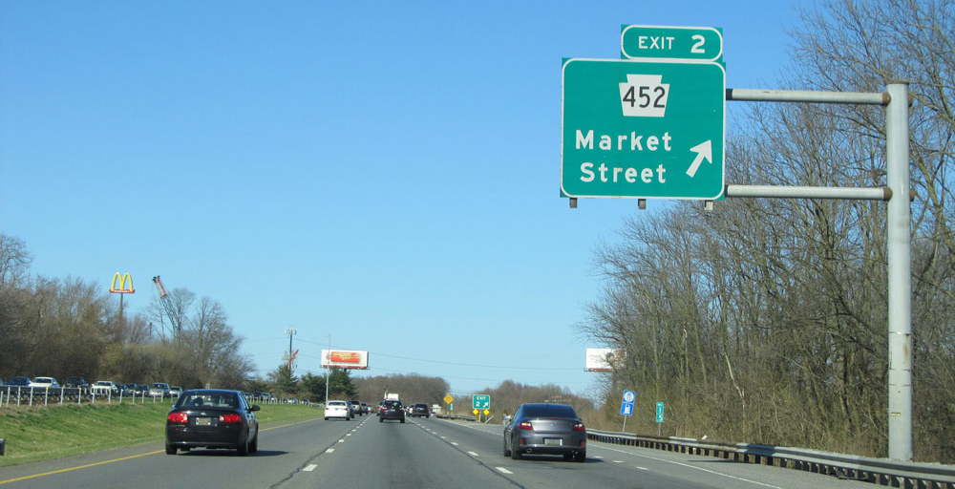
DATE 7/22/2022
http://www.crosscountryroads.com/
NCHRP 07-26:
NEW HCM
MERGE, Diverge
& WEAVING Methods
Overview Presentation

Slide 3
NCHRP Project 07-26
Research Objectives
The objectives of this research are to
  (1) develop methodologies to update the HCM related to merge, diverge, and weaving methodologies; and
  (2) pilot the developed methodologies to demonstrate the full range of applicability of the proposed updates to the HCM.
Period of Performance June 2019-Mar 2022
http://apps.trb.org/cmsfeed/TRBNetProjectDisplay.asp?ProjectID=4553

Slide 4
Acknowledgments
Research Team
  Kittelson and Associates
    Bastian Schroeder (PI)
    Burak Cesme
    Paul Ryus
    Azy Avr
    Lilian Wu
  University of Washington
    Yinhai Wang
    Wei Sun
    Shuyi Yin
  Nagui Rouphail

Slide 5
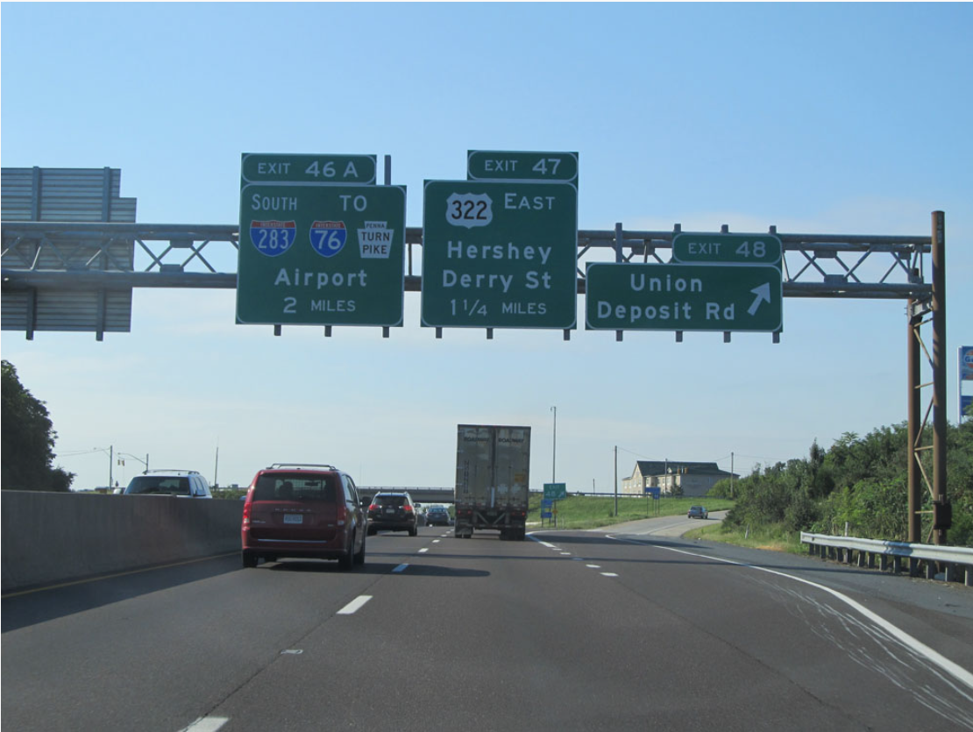
Source: http://www.crosscountryroads.com/
Freeway Analysis Basics

Slide 6
Module Purpose & Contents
Provide a refresher on basic concepts underpinning HCM freeway analysis methods
  Key definitions
  Freeway segment types
  Freeway flow types
  Measuring & estimating free-flow speed (FFS) and capacity

Slide 7
Capacity: Glossary Definition
The maximum sustainable hourly flow rate at which persons or vehicles reasonably can be expected to traverse a point or a uniform section of a lane or roadway during a given time period under prevailing roadway, environmental, traffic, and control conditions

Slide 8
Capacity: Field Measurement
Freeway segment capacity is the maximum 15-min flow rate that produces an acceptable (λ%) rate of breakdown
HCM recommends a default 15% acceptable rate of breakdown

Slide 9
Demand Volume
The number of vehicles that arrive to use the facility
Under noncongested conditions, demand volume is equal to the observed volume
HCM methods work with demand in units of pc/h/ln
Field sensors count vehicle throughput (demand served)

Slide 10
Demand Flow Rate
The number of vehicles that arrive to use the facility during a 15-minute analysis period, expressed as an hourly rate
HCM methods convert vehicle counts or forecasts to demand flow rates using
  Heavy vehicle factor (veh → pc)
  Peak hour factor (1 hr → peak 15 min)

Slide 11
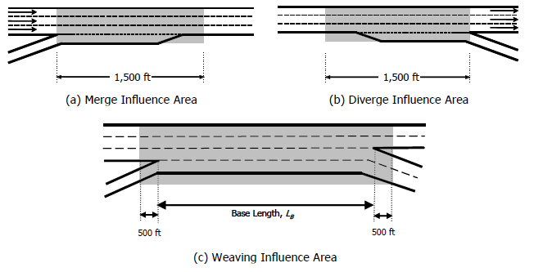
Freeway Segment Types
Basic
Merge (on-ramp)
Diverge (off-ramp)
Weaving
  Ramps connected by auxiliary lane
Overlap

Slide 12
Freeway Flow Types

Slide 13

Freeway Flow Types: Undersaturated
Traffic flow unaffected by upstream or downstream conditions
Bottleneck
Undersaturated
Oversaturated
Queue
Discharge
Under-
saturated

Slide 14
Freeway Flow Types: Oversaturated
Traffic flow influenced by downstream bottleneck
Bottleneck
Undersaturated
Oversaturated
Queue
Discharge
Under-
saturated

Slide 15
Freeway Flow Types: Queue Discharge
Traffic flow that has just passed through a bottleneck and is accelerating back to the freeway’s FFS
Bottleneck
Undersaturated
Oversaturated
Queue
Discharge
Under-
saturated

Slide 16
Determining FFS from Sensor Data
Average speed when volumes are less than 500 veh/h
Speeds sometimes can be unusually low at very low volumes
  For example, trucks dominate traffic during late-night hours
  FFS for these sites can be calculated as speed limit + 5 mph
Average speed
Possible truck
effects

Slide 17
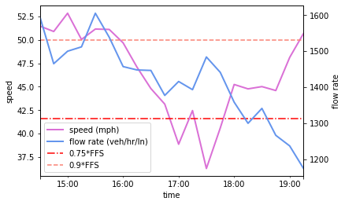
Determining Capacity from Sensor Data (1)
Observed throughput at a bottleneck varies from day to day
Identify breakdown events and recoveries
  Breakdown: speed drops
  below 75% of FFS
  Recovery: speed climbs
  above 90% of FFS
Recovery
Breakdown

Slide 18
Determining Capacity from Sensor Data (2)
Uncongested flow rates put into bins of 100 veh/h/ln
Pre-breakdown flows put into bins of 100 veh/h/ln
Average flow rate calculated for each bin
Recovery
Uncongested flow rates
Pre-breakdown flow rate
Breakdown

Slide 19
Determining Capacity from Sensor Data (3)
Calculate breakdown probability for each bin
  Count of pre-breakdown events / count of uncongested events
Weibull distribution parameters α and β estimated from average flow rates and breakdown probability, for bins with >1,000 veh/h
  λ = acceptance rate of breakdown
  (HCM recommends 15%)
$$Capacity=α∗\sqrt[β]{−\ln\left(1−λ\right)}$$

Slide 20
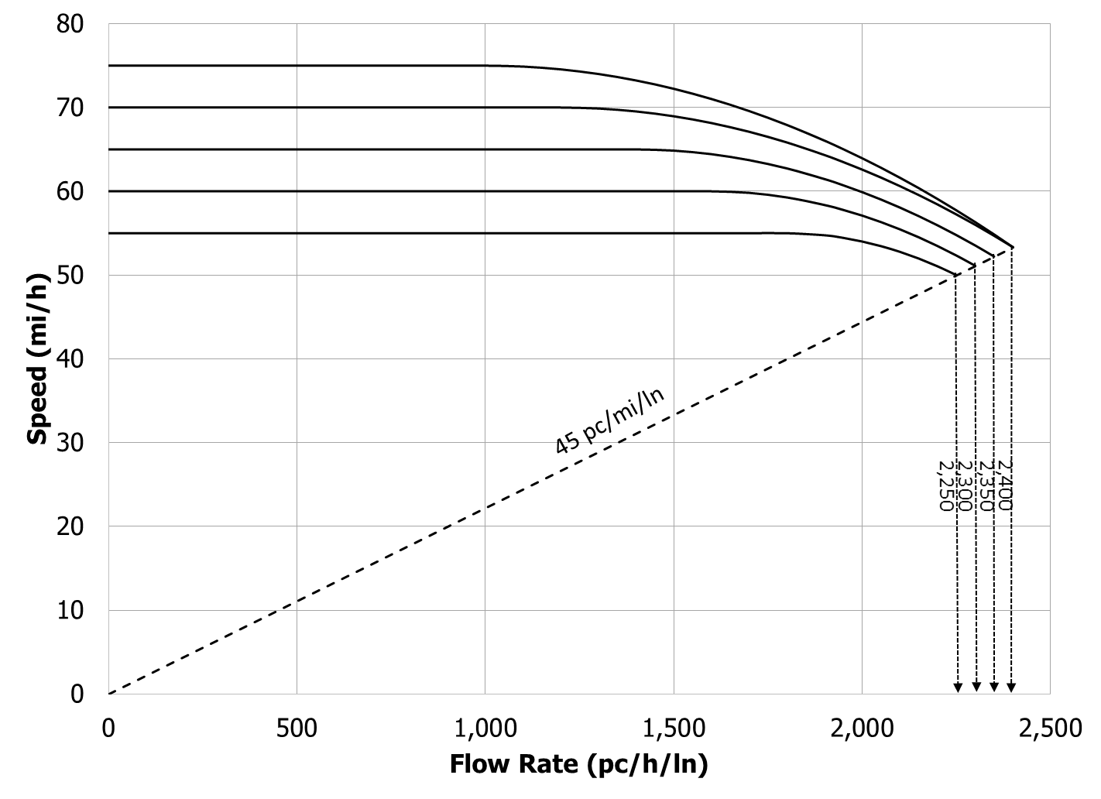
Speed–Flow Relationship
Breakpoint varies with FFS
Base capacity varies with FFS

Slide 21
Speed–Flow Curves
Represent “ideal” conditions
  Only passenger cars
  Minimum 12 ft lane width with 10+ ft right shoulder
  Regular, familiar drivers
  Interchanges spaced at 2 mi or greater
  Level terrain with grades 2% or less

Slide 22
Basic Segment FFS Estimation
TRD = total ramp density (ramps/mi) = # of on- and off-ramps within 3 mi up- and downstream, divided by 6
Total Ramp Density, TRD, ramps/mi,

Slide 23
Basic Segment FFS Estimation
Total Ramp Density, TRD, ramps/mi,

Slide 24
Basic Segment Capacity Estimation
Total Ramp Density, TRD, ramps/mi,

Slide 25
Summary:
Factors Influencing Basic Segment Capacity
Roadway geometry
Ramp spacing
Non-recurring events
(severe weather, incidents, work zones)
Driver population
(future: connected and automated vehicles)

Slide 26
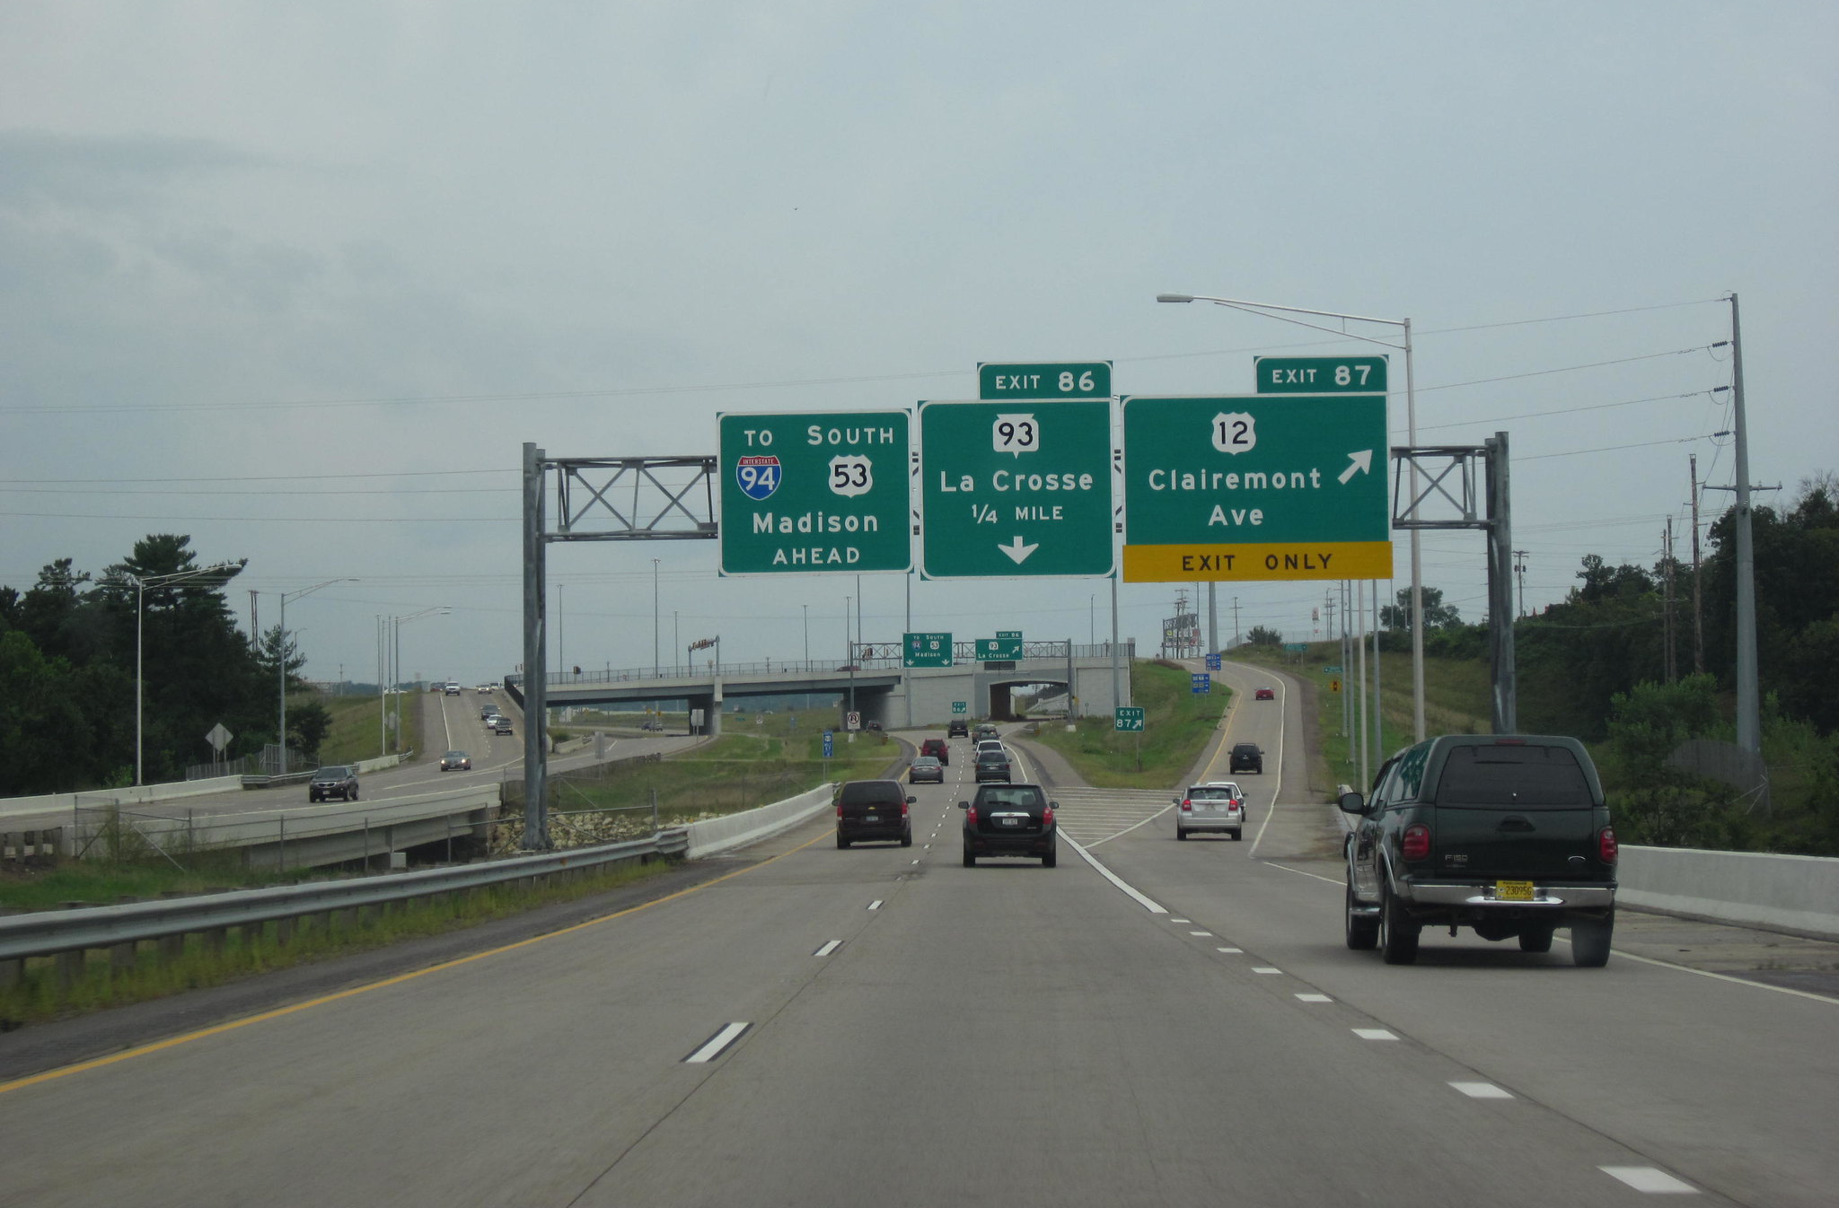
Doug Kerr / CC BY-SA 2.0
NCHRP 07-26 Approach

Slide 27
NCHRP -07-26 Desired Model Characteristics
Applicable to merge, diverge, and weave segments → Consistency!
Upholds fundamental relationship between flow, density, and capacity
Sensitive to key parameters influencing speed and capacity
Calibrated from empirical data at US bottlenecks
Flexible for future expansion (new geometries, CAVs, work zones, weather, etc.)

Slide 28
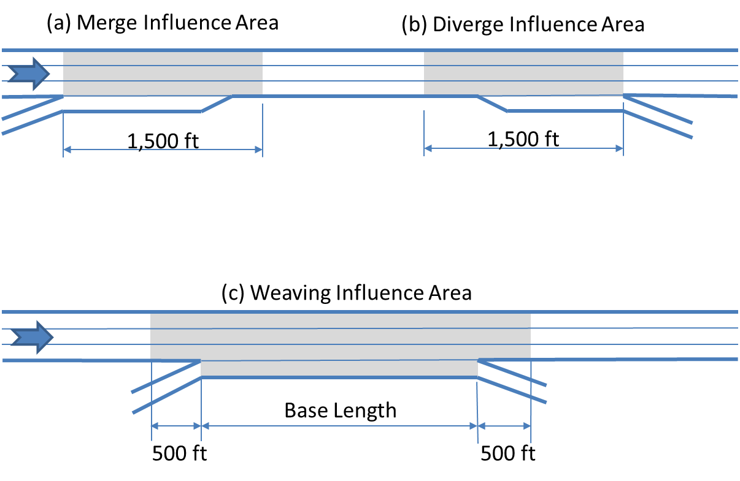
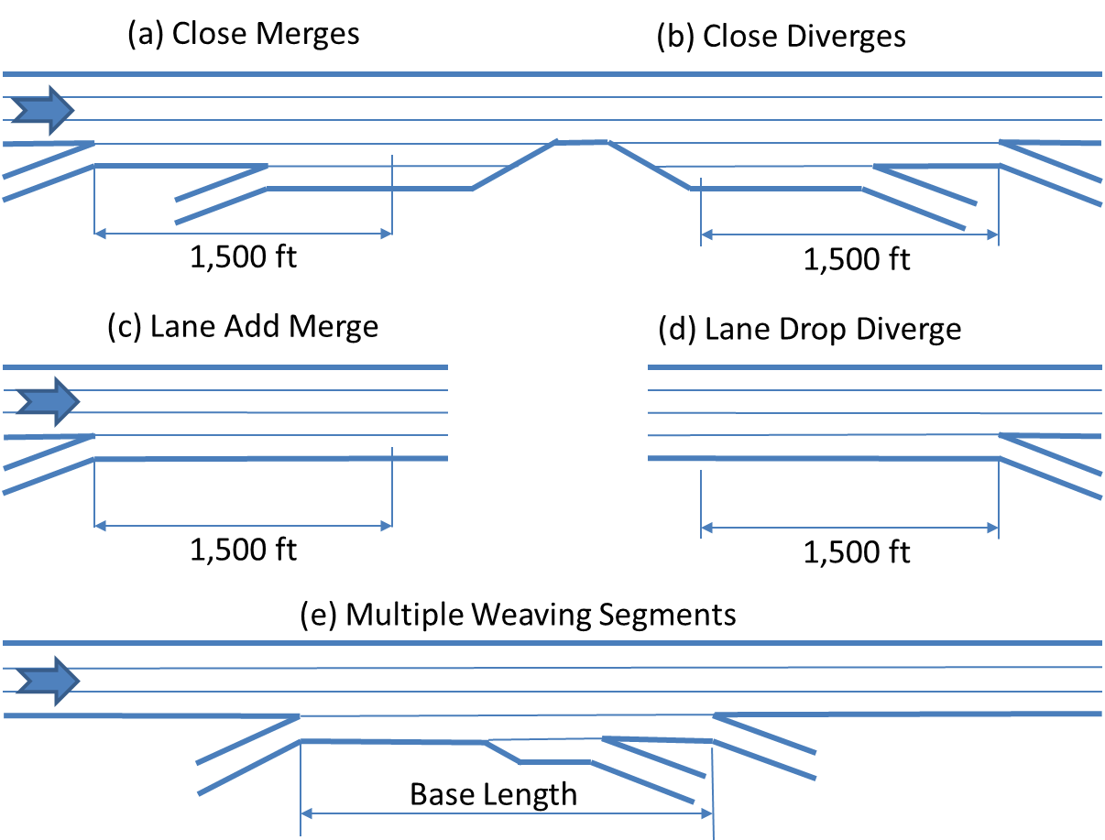
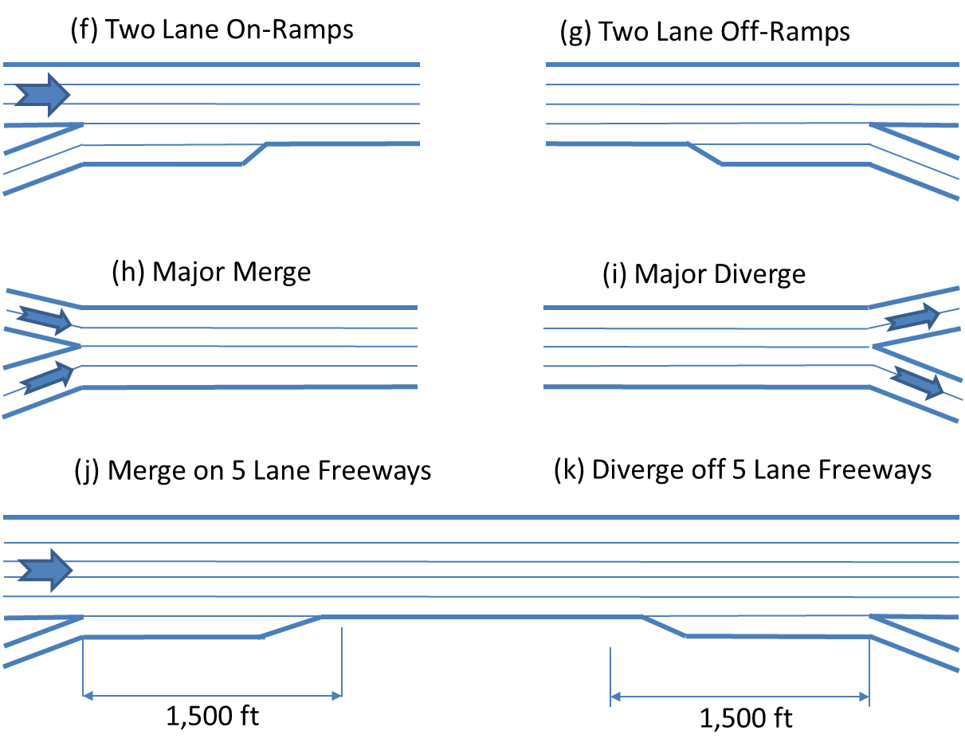
Ramp Configurations Studied
Simple Merge Simple Diverge
Close Merge Close Diverge
2-Lane Ramp Merge 2-Lane Ramp Diverge
Lane Drop Diverge Ramp Meter Merge
Geometry | Sample Size
Simple Merge | 26
Simple Diverge | 23
Close Merge | 6
Close Diverge | 7
Two-Lane On-Ramp | 5
Two-Lane Off-Ramp | 9
Lane Drop Diverge | 6
Ramp Metering | 4

Slide 29



Weave Configurations Studied
Geometry | Sample Size
Simple Ramp Weave | 15
C-D Weave | 8
Complex Weave | 12

Slide 30
Capacity Estimation Process
Aggregate 5-min sensor data to 15-min flow rates
Aggregate mainline & ramp lane-by-lane speed and flow rates
Apply HCM method for estimating capacity from field data (described in a previous module)
Evaluate realism of capacity estimate
  Unrealistic estimates could occur when a site had few breakdown events
  Capacity estimated from speed–flow curve in these cases (85th percentile of pre-breakdown event)
  Investigate possibility of spillback from downstream bottleneck

Slide 31
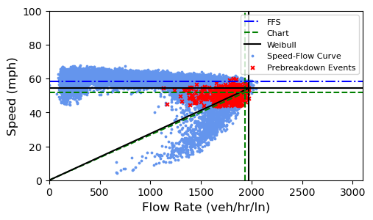
Sample Speed-Flow Data

Slide 32
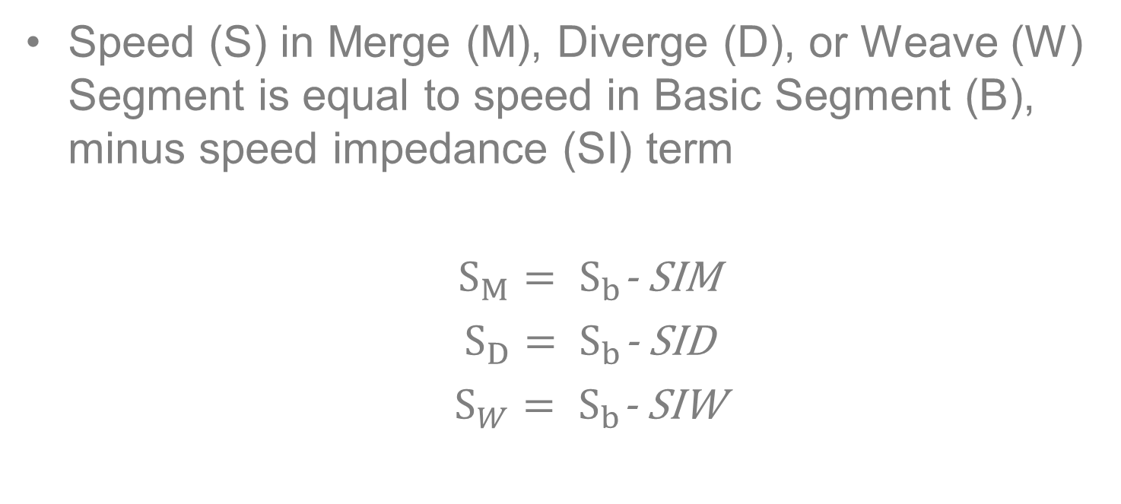
Basic Model Form
Speed (S) in Merge (M), Diverge (D), or Weave (W) Segment is equal to speed in Basic Segment (B), minus speed impedance (SI) term
  $S_{M}{= S}_{b}$- SIM
  $S_{D}{= S}_{b}$- SID
  $S_{W}{= S}_{b}$- SIW

Slide 33
Revisiting Density at Capacity
HCM 6 Density at Capacity for Weave
NCHRP 07-26 Recommended Density at Capacity

Slide 34
Proposed Segment LOS

Slide 35
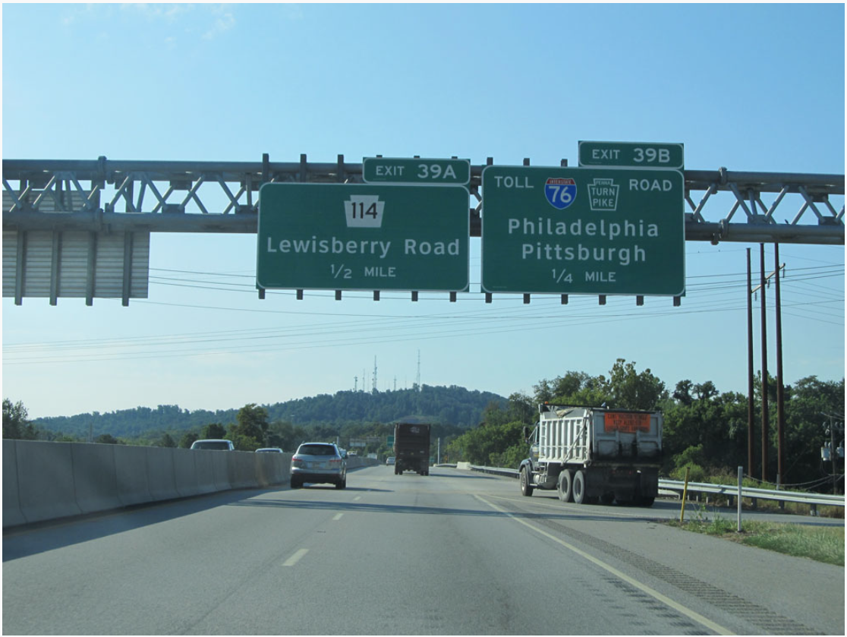
Source: http://www.crosscountryroads.com/
Current HCM Merge & Diverge Method

Slide 36
Module Purpose & Contents
Provide a high-level overview of the current HCM merge & diverge method and its issues
  Data collection & model development
  Methodological steps
  Special cases
  Issues with the method

Slide 37
Research Basis
Developed by NCHRP Project 03-37 (1993)
68 sites in 10 states with varying characteristics
  Video camera observations
  Breakdowns observed at only 16 sites
  Maximum stable flows at other sites compared to HCM basic segment capacities
  No evidence that turbulence effects reduced merge/diverge capacity below basic segment values

Slide 38
Methodological
Steps
Gather Input Data
Determine Demand Flow Adjustments
Compute Adjusted Flow Rates
On-Ramp (merge) Off-Ramp (diverge)
Compute Demand Flow Rate
in Lanes 1 and 2 Immediately Upstream of Merge Influence Area
Compute Demand Flow Rates
in Lanes 1 and 2 Immediately Upstream of Diverge Influence Area
Compute Capacity of Merge Area
and Compare with Demand Flows
Compute Capacity of Diverge Area and Compare with Demand Flows
Demand > Capacity?
Yes
LOS = F
Go to Chapter 10
No
Compute Density
Determine LOS
Estimate Speeds

Slide 39
Merge/Diverge Segment Capacity
Capacity same as basic segment capacity
Also compare flows entering the segment’s influence area
  Right two mainline lanes
  Right two mainline lanes + ramp
Exceeding HCM’s “maximum desirable flow” values for the influence area
  Does not indicate LOS F
  May indicate that operations will be worse than predicted by the method

Slide 40
Special Cases
Single-lane ramp lane additions & lane drops
Two-lane ramps
Left-hand ramps
Freeways with 5 directional lanes
Major merges & diverges
All are extensions to the method; not directly researched

Slide 41
Issues with the HCM Merge Method
More recent research consistently shows merge capacities lower than basic segments
“Maximum desirable flow” values may not be conservative enough
Possible effects of ramp volume, ramp metering, close merges
Consistency at 0 ramp volume

Slide 42
Issues with the HCM Diverge Method
Limited number of small studies indicate capacity may be less than a basic segment
Possible effect of close diverges
Consistency at 0 ramp volume

Slide 43
Issues with Previous Studies
Nearly all previous studies looked at only 1 or 2 sites
The few larger studies couldn’t evaluate close to the full range of possible conditions
Differences in international driving compared to US

Slide 44
Summary:
Current HCM Merge & Diverge Methods
Capacity set equal to that of basic segments,
but recent research indicates capacity is lower
Exceeding the “maximum desirable flow” in the right 2 lanes and/or right 2 lanes + ramp
indicates conditions may be worse than predicted
Special cases reflect extensions to the method that haven’t been well-researched

Slide 45
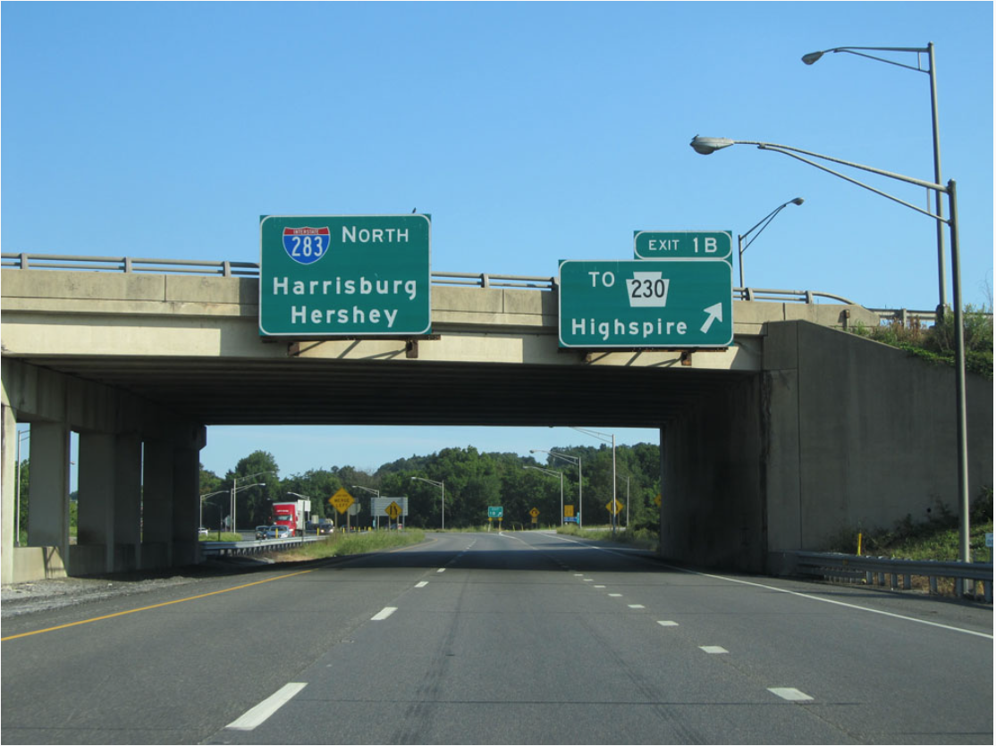
Source: http://www.crosscountryroads.com/
Proposed Merge & Diverge Method

Slide 46
Module Purpose & Contents
Provide background on the development of the proposed new HCM merge & diverge methods
  Data collection & model development
  Methodological steps

Slide 47
Data Sources
Sensor data used to allow much greater number of sites to be analyzed, compared to video-based methods
Sources
  RITIS (University of Maryland)
  PeMS (CalTrans)
  DriveNet (University of Washington)
  PORTAL (Portland State University)
  Data collected by NCHRP 15-57 & University of Kansas

Slide 48
Ramp Configurations Studied
Simple Merge Simple Diverge
Close Merge Close Diverge
2-Lane Ramp Merge 2-Lane Ramp Diverge
Lane Drop Diverge Ramp Meter Merge
Geometry | Sample Size
Simple Merge | 26
Simple Diverge | 23
Close Merge | 6
Close Diverge | 7
Two-Lane On-Ramp | 5
Two-Lane Off-Ramp | 9
Lane Drop Diverge | 6
Ramp Metering | 4

Slide 49
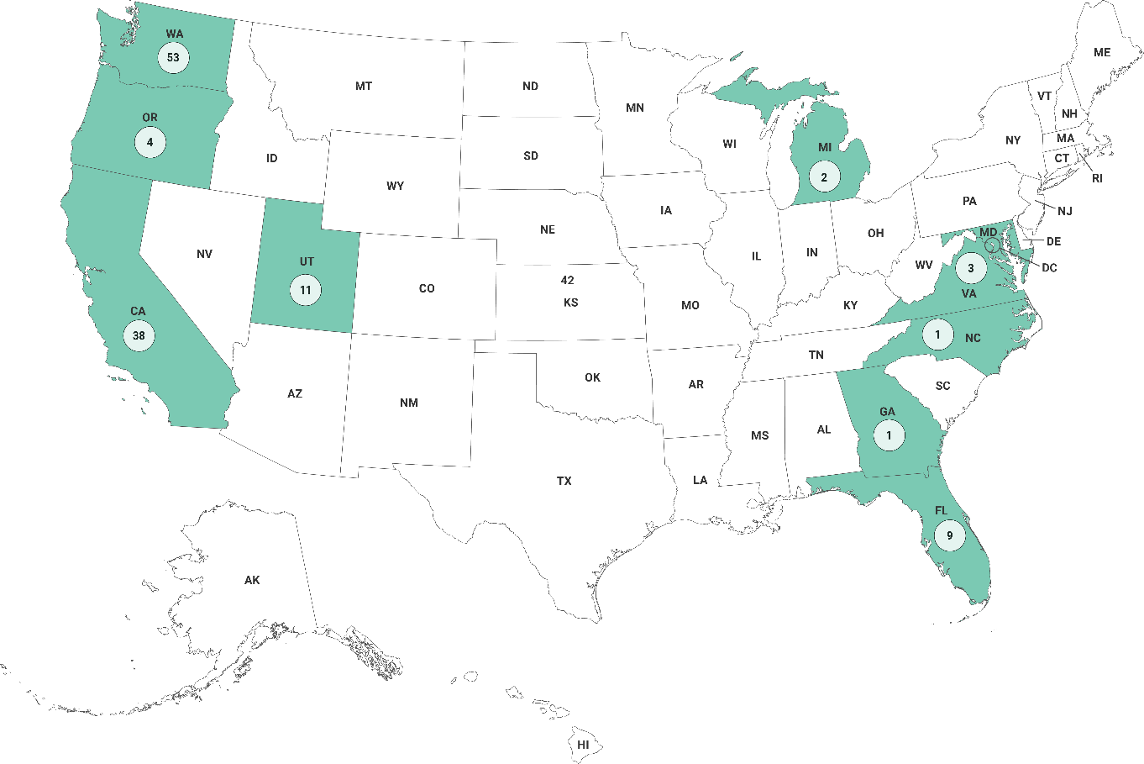
Data Collection Sites
Total of merge, diverge, and weave sites

Slide 50
Site Selection Process
Google Traffic used to identify possible bottlenecks
Check for potential geometric constraints
  Wanted to study congestion with ideal geometry
Identify sensor availability
Verify recurring congestion
Download & extract 5-minute sensor data
Perform data quality checks
Obtain heavy vehicle & grade data

Slide 51
Capacity Estimation Process
Aggregate 5-min sensor data to 15-min flow rates
Aggregate mainline & ramp lane-by-lane speed and flow rates
Apply HCM method for estimating capacity from field data (described in a previous module)
Evaluate realism of capacity estimate
  Unrealistic estimates could occur when a site had few breakdown events
  Capacity estimated from speed–flow curve in these cases (85th percentile of pre-breakdown event)
  Investigate possibility of spillback from downstream bottleneck

Slide 52
Site with Consistent Capacity Estimates

Slide 53
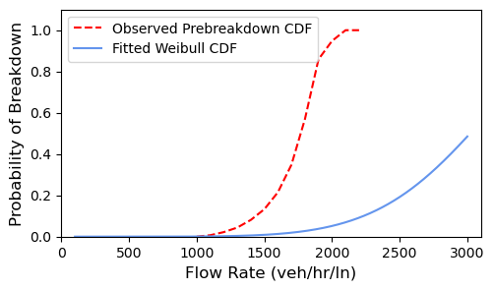
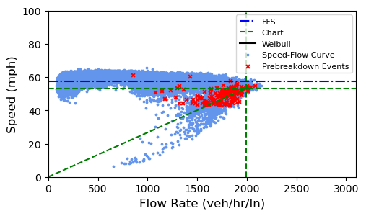
Site with Inconsistent Capacity Estimates
Weibull Capacity ≈ 2,400 veh/h/ln
Chart Capacity ≈ 2,000 veh/h/ln

Slide 54
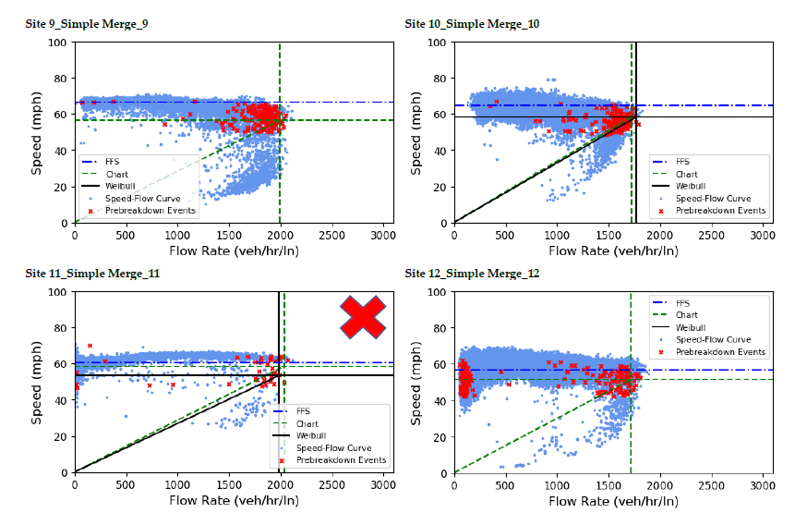
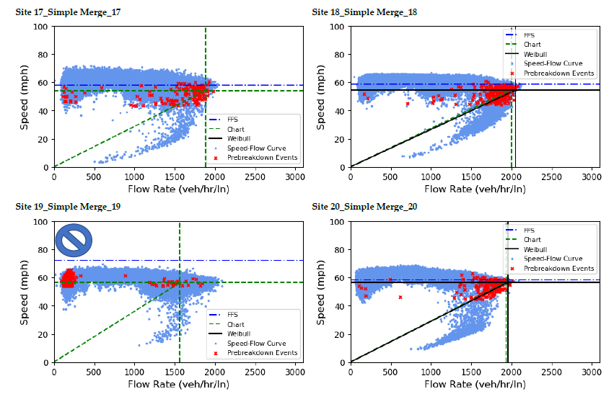
Review of Speed-Flow Curves for All the Analysis Sites
Sites not used for capacity estimation due to downstream spillback
Sites used a manual estimation of free flow speed due to insufficient or faulty data at rates below 500 veh/hr/ln

Slide 55
NCHRP -07-26 Desired Model Characteristics
Applicable to merge, diverge, and weave segments → Consistency!
Upholds fundamental relationship between flow, density, and capacity
Sensitive to key parameters influencing speed and capacity
Calibrated from empirical data at US bottlenecks
Flexible for future expansion (new geometries, CAVs, work zones, weather, etc.)

Slide 56
Model Development
Applied general model form developed by a recent STRIDE project for weaving segments
  Expanded the parameter set
  Adapted model to merge and diverge segments
  Explored relationship of capacity to density

Slide 57
Model Approach
Upper limit of segment speed is basic segment speed with identical demand, FFS & lanes
Speed reduction term applied to account for merge/diverge turbulence at higher volumes
Density at capacity = 35 pc/mi/ln
  Reduced from 45 in current method

Slide 58
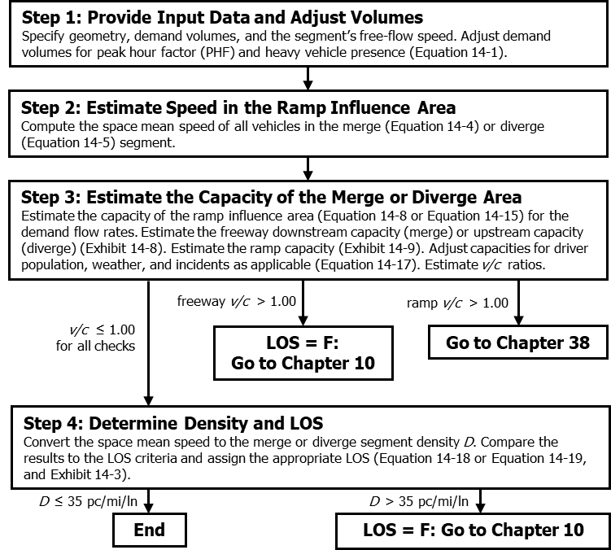
Merge Diverge Proposed
Methodological Steps

Slide 59
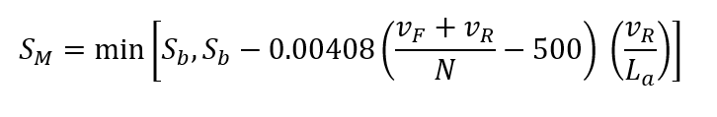
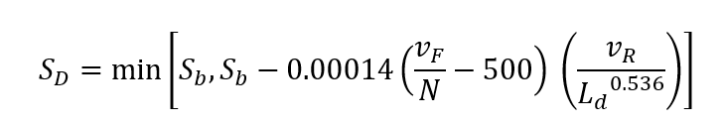
Step 2: Merge/Diverge Segment Speed
Merge
Diverge
equivalent basic
segment speed
freeway, ramp
flow rates
ramp
flow rate
number of freeway
mainline lines
acceleration
lane length
deceleration
lane length

Slide 60
Step 3: Merge/Diverge Capacity
Merge
Diverge
equivalent basic
segment capacity
basic segment
breakpoint

Slide 61
Capacity Checks (Upper Limits)
Upstream/downstream freeway segment
Ramp roadway

Slide 62
Merge/Diverge Segment Density

Slide 63
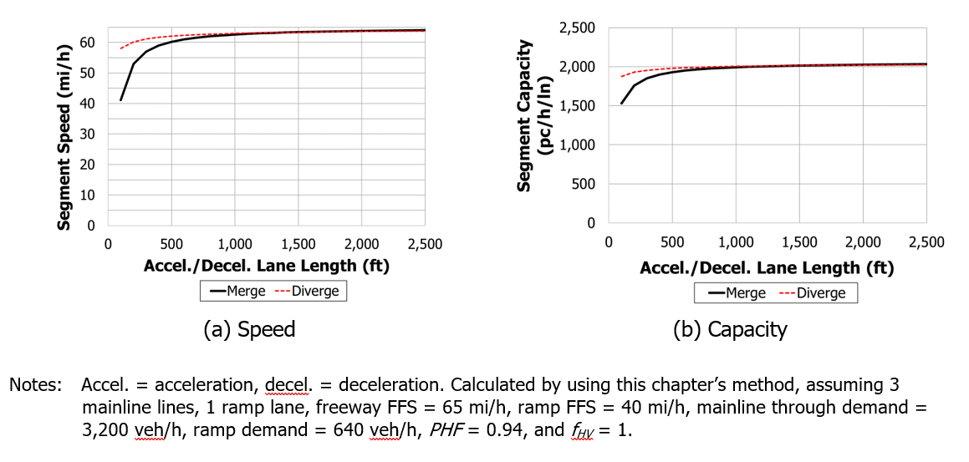
Model Sensitivity:
Acceleration Lane Length

Slide 64
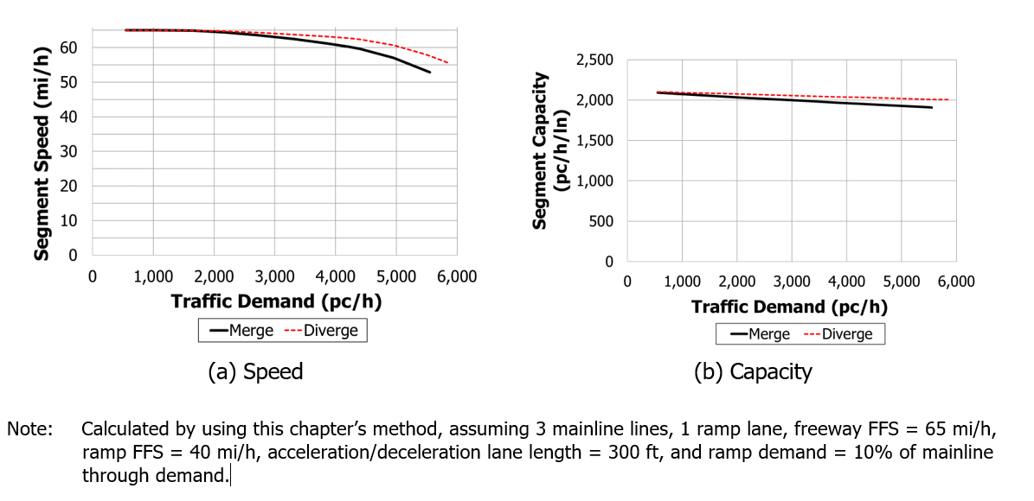
Model Sensitivity:
Traffic Demand

Slide 65
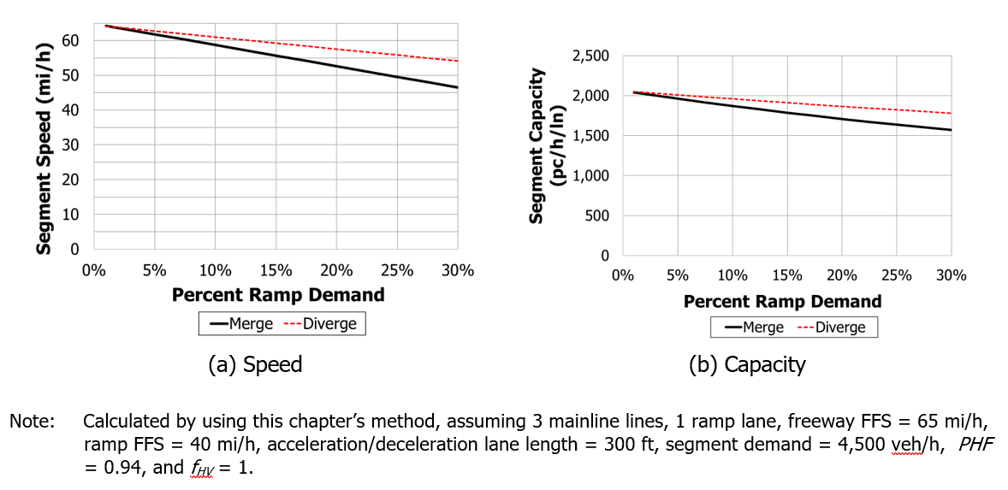
Model Sensitivity:
Proportion of Ramp Demand

Slide 66
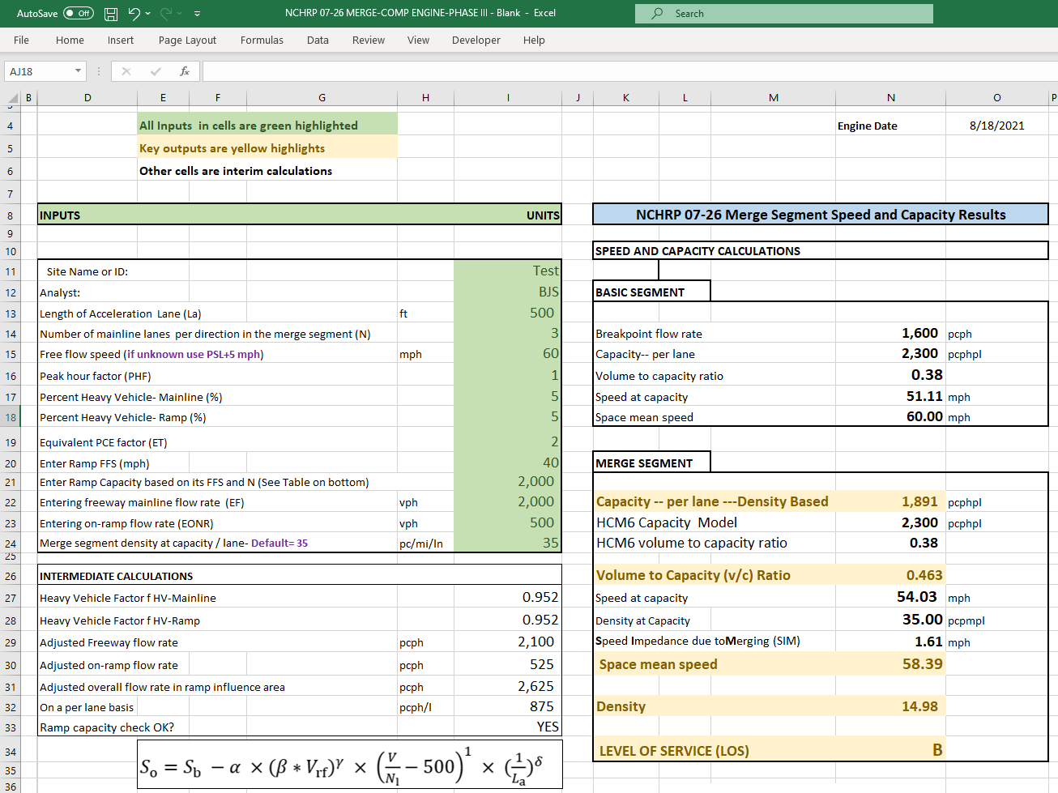
Merge/Diverge Spreadsheet Tool

Slide 67
Summary:
Proposed Merge & Diverge Methods
Better speed and capacity predictions than current HCM model
Simpler model (no look-up tables and multiple conditions)
Consistent with fundamental speed–flow relationships
Merge & diverge capacities lower than current HCM
Density at capacity reduced to 35 pc/mi/ln

Slide 68
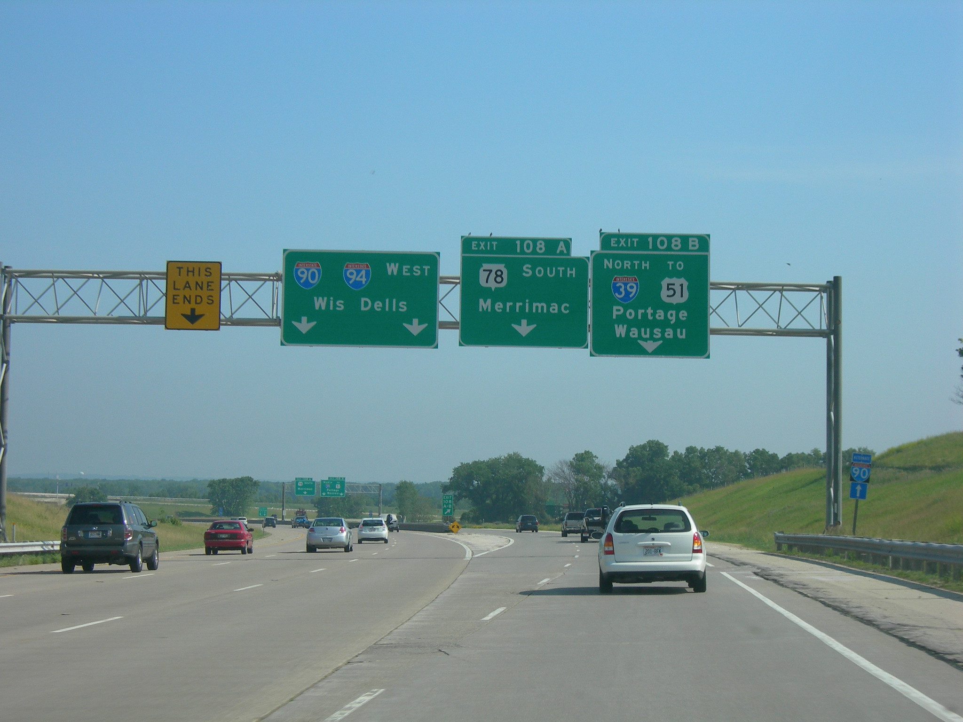
Jimmy Emerson / CC BY-NC-ND 2.0
Merge & Diverge Case Studies

Slide 69
Spreadsheet Tool Demonstration

Slide 70

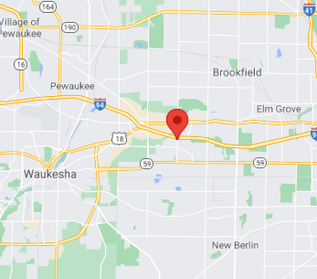
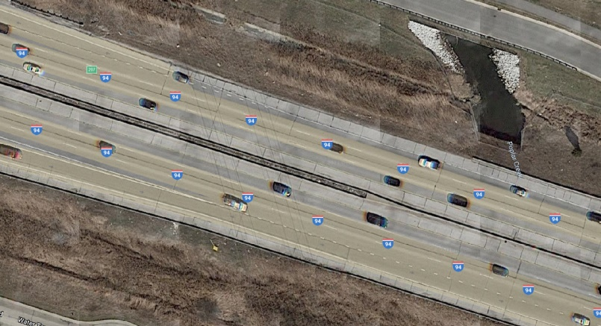
Simple Merge Site
Segment Type: Simple Merge | LC_{RR}: n/a
Coordinates: 43.028908, -88.146834 | N_{WL}: n/a
State: WI | L_{s}: n/a, L_{b}: n/a
City: Brookfield | AADT (mainline): 132,500
Area Type: Non-rural | Posted Speed Limit: 70 mph
Route Name: I-94 | Truck Percentage: 10.00%
Data Source: WIDOT | Grade/Terrain Type: -0.56%/ Level
Detector #: | Interchange Type: Simple
Direction: Eastbound | Date: 01/01/2019 - 12/31/2019
Number of Mainline Lanes: 3 | Sample Size: 33,574 observations
Number of On-Ramp/ Off-Ramp Lanes: 1/ n/a | Breakdowns: 224
Acceleration/ Deceleration Lane Length: 1065 feet/ n/a | Weibull Distribution Alpha: 2,422
LC_{RF}: n/a | Weibull Distribution Beta: 6.5
LC_{FR}: n/a | Free flow speed: 70 mph
Map Data ©2020 Google
Map Data ©2020 Google

Slide 71
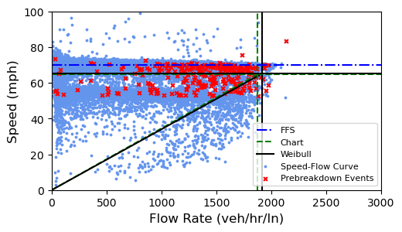
Simple Merge : Sensor Data

Slide 72
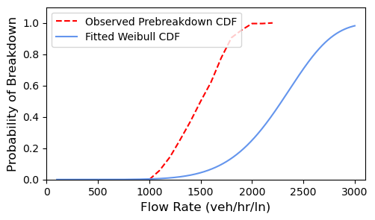
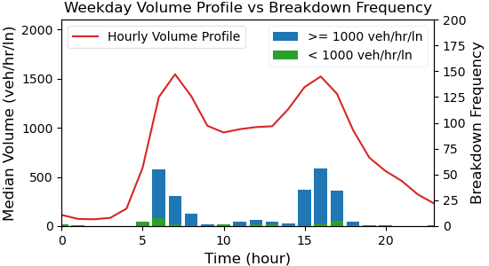
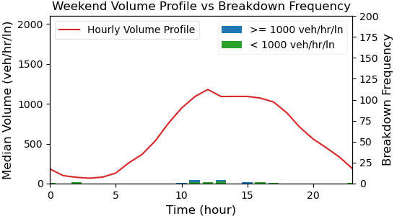
Simple Merge : Analysis

Slide 73
On your own – Merge Example
Mainline Flow = 3,275 vph
On-Ramp Flow = 1,227 vph
Free-Flow Speed = 70 mi/h
Ramp FFS = 35 mi/h
10% Heavy Vehicles (PCE=2)
Geometry as shown below

Slide 74
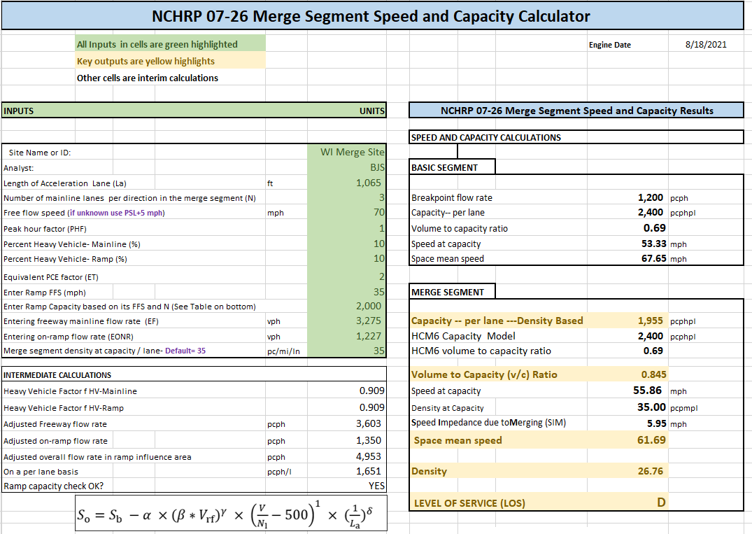
Simple Merge - Results

Slide 75
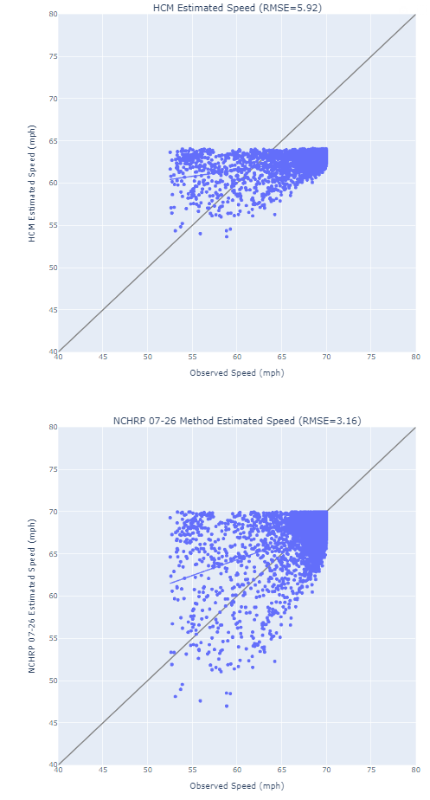
Simple Merge: Results
 | Observed |  |  |  | HCM6 Capacity (pcphpl) | NCHRP 07-26 Results
Analysis Hour | PB Avg. Speed (mph) | PB Avg. Vol (pcphpl) | FFS (mph) | Capacity (pcphpl) |  | Capacity (pcphpl) | v/c | Space Mean Speed (mph) | Density (pc/mi/ln)
6:00-7:00 | 59.8 | 1,501 | 70 | 1,831 | 2,400 | 1,955 | 0.845 | 61.7 | 26.8
PB = pre-breakdown

Slide 76
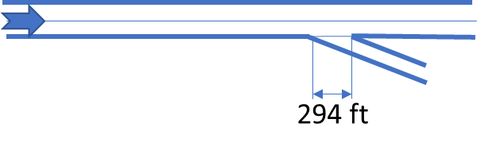
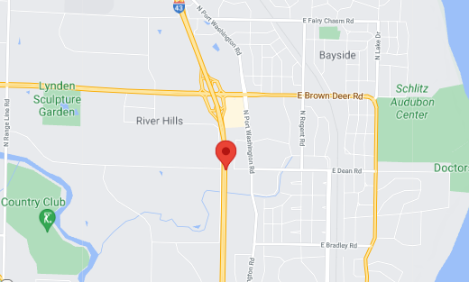
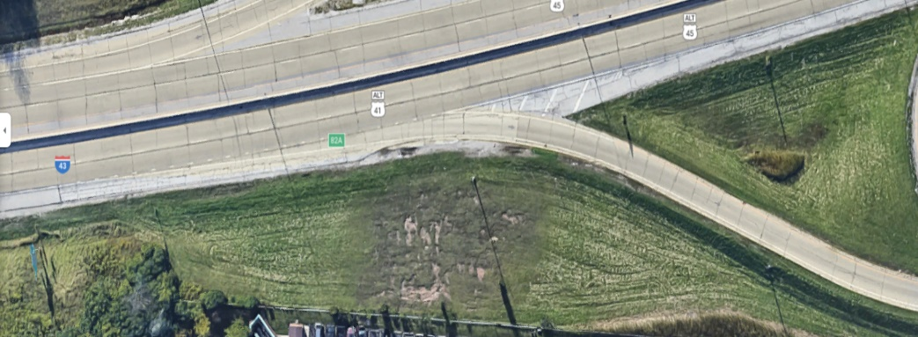
Simple Diverge Site
Segment Type: Simple Diverge | LC_{RR}: n/a
Coordinates: 43.169556, -87.915500 | N_{WL}: n/a
State: WI | L_{s}: n/a, L_{b}: n/a
City: Fox Point | AADT (mainline): 97,395
Area Type: Non-rural | Posted Speed Limit: 55 mph
Route Name: I-43 | Truck Percentage: 7.68%
Data Source: WIDOT | Grade/Terrain Type: -0.34%/ Level
Detector #: | Interchange Type: Full-Clover Leaf
Direction: Northbound | Date: 06/01/2019 - 10/31/2019
Number of Mainline Lanes: 2 | Sample Size: 14,376 observations
Number of On-Ramp/ Off-Ramp Lanes: n/a / 1 | Breakdowns: 55
Acceleration/ Deceleration Lane Length: n/a / 294 feet | Weibull Distribution Alpha: 8,672
LC_{RF}: n/a | Weibull Distribution Beta: 2.8
LC_{FR}: n/a | Free flow speed: 52.95 mph
Map Data ©2020 Google
Map Data ©2020 Google

Slide 77
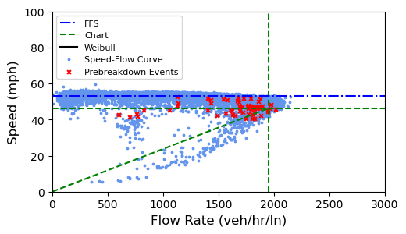
Simple Diverge: Sensor Data

Slide 78
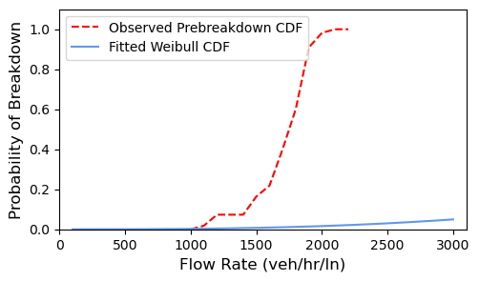
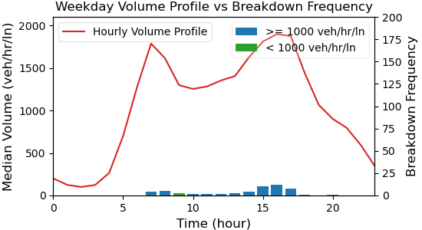
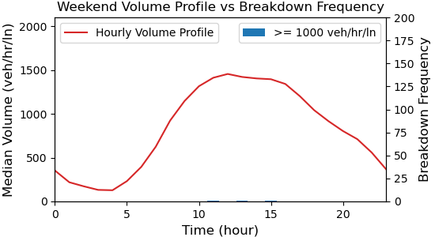
Simple Diverge: Analysis

Slide 79
On your own – Diverge Example
Mainline Flow = 3,347 vph
Off-Ramp Flow = 743 vph
Free-Flow Speed = 52.95 mi/h
Ramp FFS = 35 mi/h
7.68% Heavy Vehicles (PCE=2)
Geometry as shown below

Slide 80
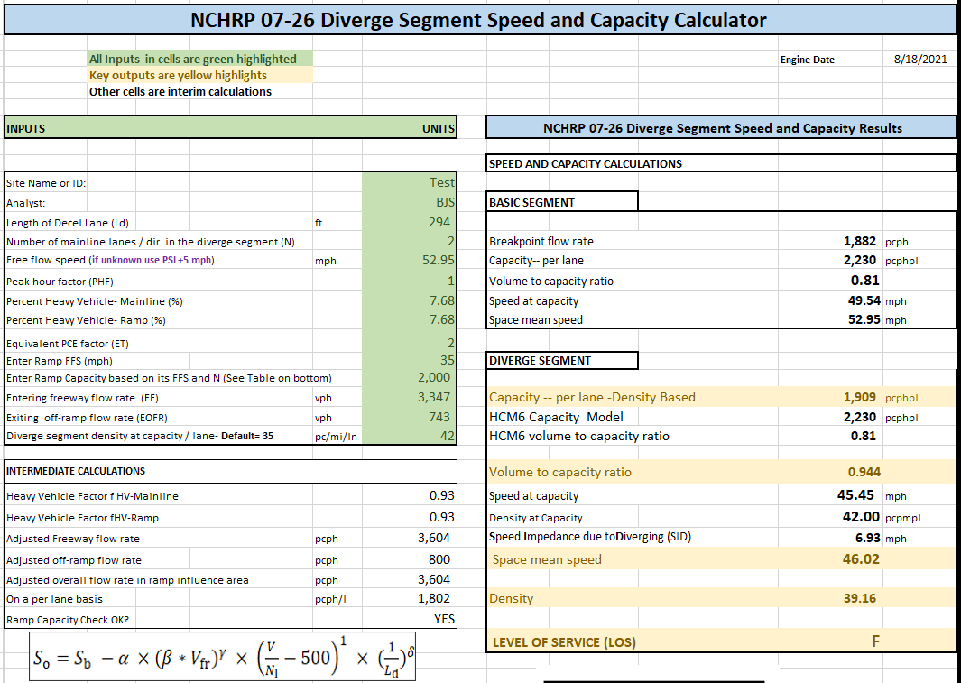
Simple Diverge - Results

Slide 81
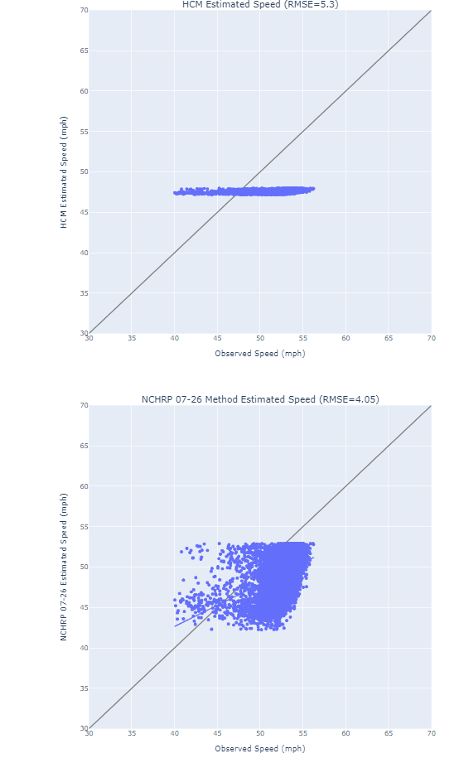
Simple Diverge: Results
 | Observed |  |  |  | HCM6 Capacity (pcphpl) | NCHRP 07-26 Results
Analysis Hour | PB Avg. Speed (mph) | PB Avg. Vol (pcphpl) | FFS (mph) | Capacity (pcphpl) |  | Capacity (pcphpl) | v/c | Space Mean Speed (mph) | Density (pc/mi/ln)
15:00-16:00 | 44.6 | 1,674 | 53 | 1,953 | 2,230 | 1,909 | 0.944 | 46.0 | 39.2
PB = pre-breakdown

Slide 82
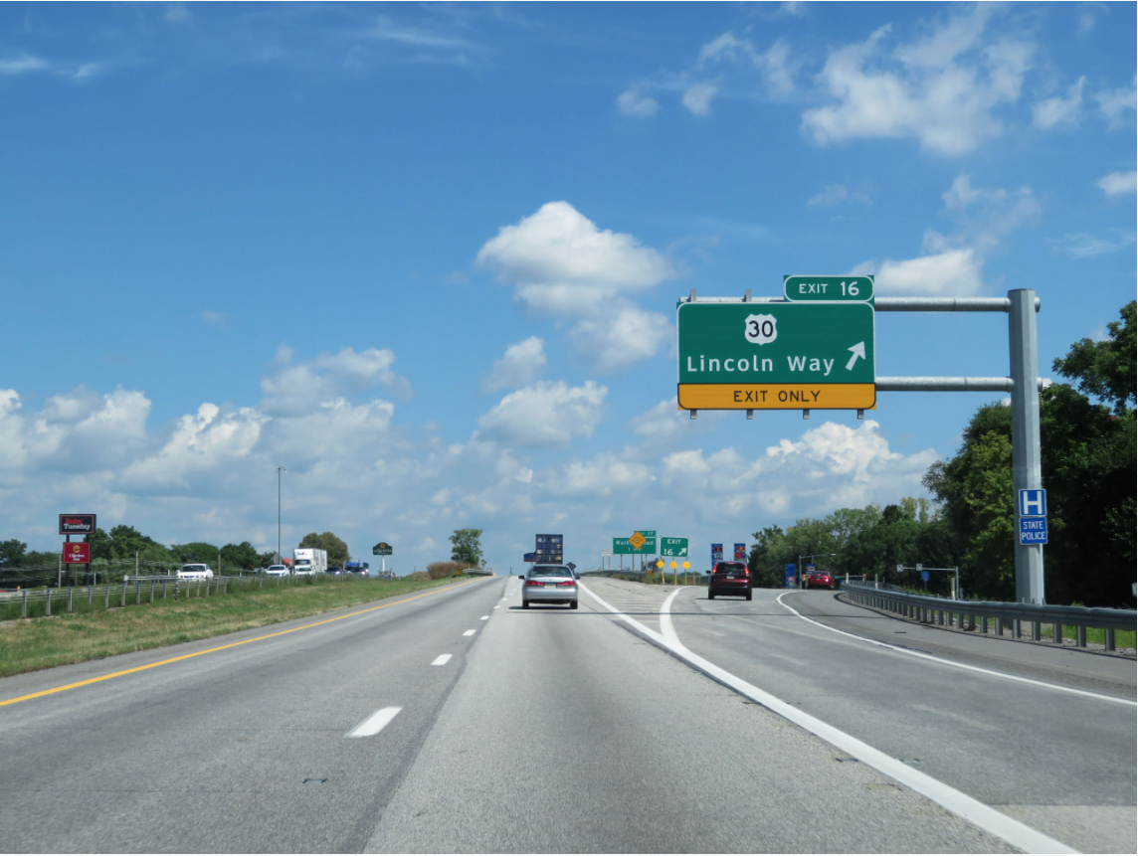
Source: http://www.crosscountryroads.com/
Current HCM Weaving Method

Slide 83
Module Purpose & Contents
Provide a high-level overview of the current HCM weaving method and its issues
  Data collection & model development
  Methodological steps
  Special cases
  Issues with the method

Slide 84
Research Basis
Developed by NCHRP Project 03-75 (2008)
14 sites in 6 states
  3 ramp weaves, 11 major weaves
  Primarily video observations from fixed-wing aircraft
  52 data points (15-min observations)

Slide 85
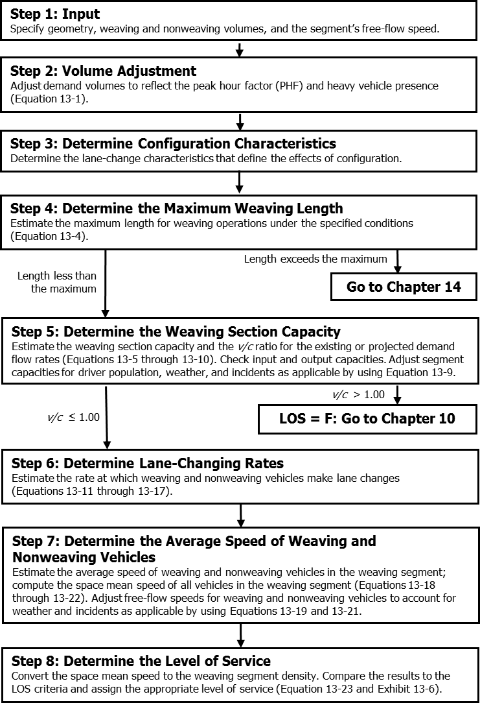
Methodological
Steps

Slide 86
HCM 6 Weaving Segment Capacity (1)
Capacity controlled by density (>43 pc/mi/ln)
Per-lane capacity of weaving segment
Volume ratio
(weaving flow rate / total flow rate)
Number of weaving lanes
$$c_{IWL}=c_{IFL}−\left[438.2{\left(1+VR\right)}^{1.6}\right]+\left(0.0765L_{S}\right)+\left(119.8N_{WL}\right)$$
Per-lane capacity of equivalent basic segment
Short length of
weaving segment
Total capacity of weaving segment
Total
number
of lanes
Heavy
vehicle
factor
$$c_{W}=c_{IWL}×N×f_{HV}$$

Slide 87
HCM 6 Weaving Segment Capacity (2)
Short length, L_{S}
Number of
weaving lanes, N_{WL}
  Number of lanes from
  which a weaving
  maneuver can be made
  with 0 or 1 lane changes
2
2
3

Slide 88
Weaving Segment Capacity (3)
Capacity controlled by total weaving demand flow rate
$$c_{W}=c_{IW}×f_{HV}$$

Slide 89
Lane-Changing Rates
Weaving vehicles
Nonweaving vehicles
  Three models depending on combination of
  weaving length, nonweaving flow, and interchange density
Minimum number of lane changes in one hour to complete weaving maneuvers
Interchange
density
$${LC}_{W}={LC}_{MIN}+0.39\left[{\left(L_{S}−300\right)}^{0.5}N^{2}{\left(1+ID\right)}^{0.8}\right]$$

Slide 90
Speed Estimation (1)
Weaving vehicles
Nonweaving vehicles
Speed adjustment factor
(work zone, weather, etc.)
Total lane-changing rate
$$S_{W}=15+\left(\frac{FFS×SAF−15}{1+W}\right)$$
$$W=0.226{\left(\frac{{LC}_{ALL}}{L_{S}}\right)}^{0.789}$$
Segment flow rate
$$S_{NW}=FFS×SAF−\left(0.0072{LC}_{MIN}\right)−\left(0.0048\frac{v}{N}\right)$$

Slide 91
Density
Average speed of all vehicles
Density
$$S=\frac{v_{W}+v_{NW}}{\left(\frac{v_{W}}{S_{W}}\right)+\left(\frac{v_{NW}}{S_{NW}}\right)}$$
$$D=\frac{\left(v/N\right)}{S}$$

Slide 92
Special Cases
Basic
Multiple weaving segments
  Segregate into separate merge, diverge, and simple weaving segments
C-D roads, multilane highways
  Apply method directly to obtain approximate result
All are extensions to the method; not directly researched
Merge with
lane add
1,500 ft
Basic
1,500 ft
Diverge
Basic
Diverge
(2-lane ramp)
1,500 ft
Basic

Slide 93
Issues with the HCM6 Weaving Method
Underestimates speeds in 50–65 mph range
Underestimates capacity at high weaving ratios
Overestimates density by an average of 22%
Outputs insensitive to weaving length, although weaving length is a model parameter
Method can predict
  v < c, but D > density at capacity
  Weaving speeds > nonweaving speeds
Inconsistencies with merge/diverge method
Max weaving segment length can vary during day

Slide 94
Issues with Previous Studies
Few large-scale studies
  28 sites combining NCHRP 03-75 dataset and data from various studies in California
  Five sites in NC plus one 03-75 site
  Seven sites in Nanjing, China with special pavement markings controlling lane changes

Slide 95
Summary:
Current HCM Weaving Method
Data collection challenges for all weaving studies
HCM method generally overestimates density
HCM method can underestimate speed, capacity
Special cases reflect extensions to the method that haven’t been well-researched

Slide 96
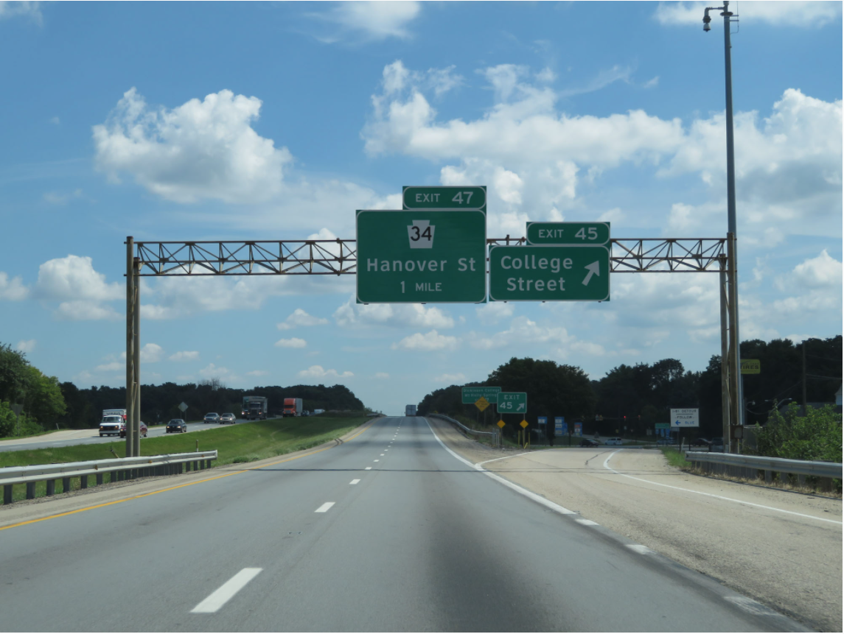
Source: http://www.crosscountryroads.com/
Proposed Weaving Method

Slide 97
Module Purpose & Contents
Provide background on the development of the proposed new HCM weaving method
  Data collection & model development
  Methodological steps

Slide 98
Data Sources
Sensor data used to allow much greater number of sites to be analyzed, compared to video-based methods
Sensor data sources same as merge/diverge
Where ramp sensors were not available, StreetLight data used to determine proportion of traffic staying on the mainline vs. entering/exiting
  Anonymized location records from smartphones and navigation devices

Slide 99
Weave Configurations Studied
Geometry | Sample Size
Simple Ramp Weave | 15
C-D Weave | 8
Complex Weave | 12

Slide 100
Data Collection Methodology
Same as merge/diverge processes
  Site selection
  Capacity estimation
  Data quality checks
  Desired model characteristics

Slide 101
Model Development
Explored various model forms
Applied general model form developed by a recent STRIDE project
  Expanded the parameter set
  Expanded model calibration to complex weaving segments
  Explored relationship of capacity to density

Slide 102
Model Approach
Upper limit of segment speed is basic segment speed with identical demand, FFS & lanes
Speed reduction term applied to account for weaving turbulence at higher volumes
Density at capacity = 35 pc/mi/ln
  Reduced from 43 in current method

Slide 103
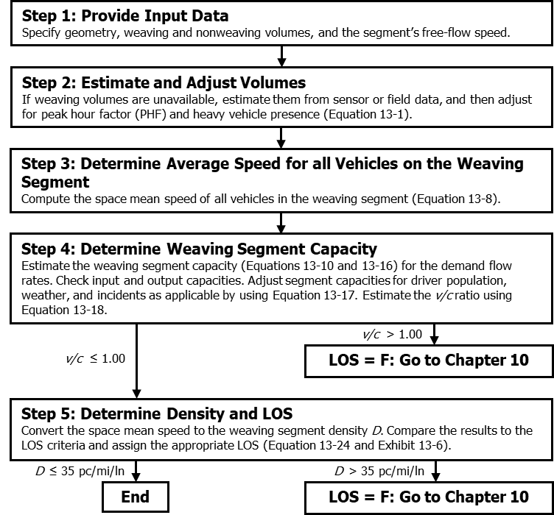
Methodological
Steps

Slide 104
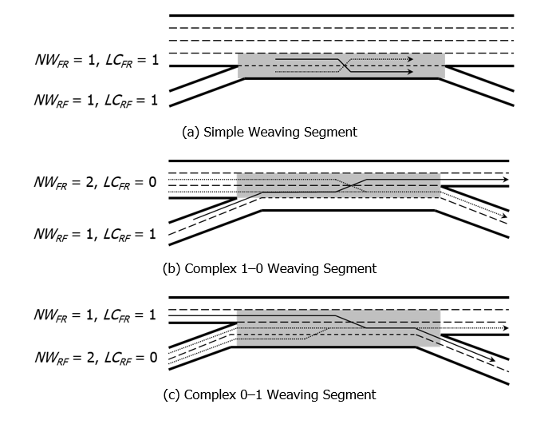
Defining NW by Movement (one-sided)

Slide 105
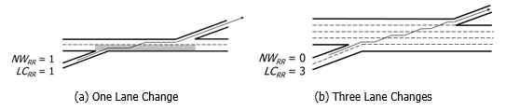
Defining NW by Movement (two-sided)

Slide 106
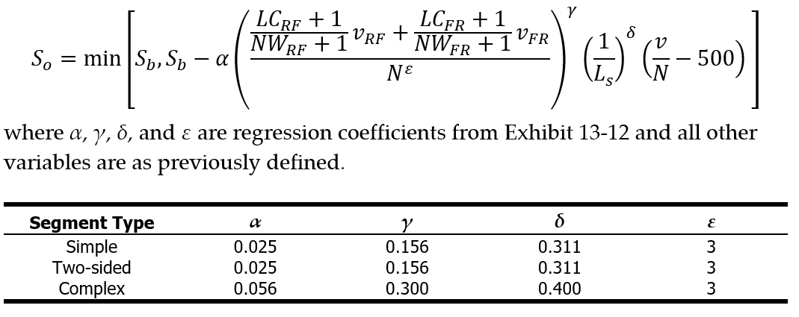
Weaving Segment Speed
equivalent basic
segment speed
weaving
flow rates
total
flow rate
number of freeway
mainline lines
weaving
short length

Slide 107

Weaving Segment Capacity (Density)
$$\frac{C_{W}}{35}=S_{b}\left(C_{W}\right)−SIW$$
C_{W} = weaving segment capacity (pc/h/ln);
S_{b}(C_{W}) = basic segment speed evaluated at the weaving segment capacity (mi/h);
SIW = speed impedance term due to weaving and segment configuration (mi/h).

Slide 108

Weaving Segment Density
$$D=\frac{\left(v/N\right)}{S_{o}}$$

Slide 109

Model Sensitivity:
Volume Ratio

Slide 110

Model Sensitivity:
Segment Short Length

Slide 111

Model Sensitivity:
Weaving Segment Demand

Slide 112

Weaving Spreadsheet Tool

Slide 113
Summary:
Proposed Weaving Method
Better speed and capacity predictions for complex weaves than current HCM model
Refinements needed to simple weave model
No maximum weaving segment length
Simpler model
Consistent with fundamental speed–flow relationships
Density at capacity reduced to 35 pc/mi/ln

Slide 114

Jimmy Emerson / CC BY-NC-ND 2.0
Weaving Method Case Studies

Slide 115
Spreadsheet Tool Demonstration

Slide 116



Simple Weave Site
Segment Type: Simple Weave | LC_{RR}: n/a
Coordinates: 44.2981854, -88.3651368 | N_{WL}: 2
State: WI | L_{s}: 1,920 feet, L_{b}: 2055
City: Appleton | AADT (mainline): 67,119
Area Type: Non-rural | Posted Speed Limit: 70 mph
Route Name: I-41 | Truck Percentage: 8.7%
Data Source: WIDOT | Grade/Terrain Type: 0.31%/ Level
Detector #: | Interchange Type: Single-Clover Leaf/Diamond
Direction: Westbound | Date: 07/01/2018 - 12/31/2019
Number of Mainline Lanes: 2 | Sample Size: 50,621 observations
Number of On-Ramp/ Off-Ramp Lanes: 1 / 1 | Breakdowns: 68
Upstream / Downstream Ramp : 2,183 / 1995 feet | Weibull Distribution Alpha: 1697
LC_{RF}: 1 | Weibull Distribution Beta: 10.4
LC_{FR}: 1 | Free flow speed: 70 mph
Map Data ©2020 Google
Map Data ©2020 Google

Slide 117

Simple Weave: Sensor Data

Slide 118



Simple Weave: Analysis

Slide 119
On your own – Weaving Example
Mainline Flow = 2,295 vph
On-Ramp Flow = 1,325 vph
Off-Ramp Flow = 854 vph
Ramp-to-Ramp Flow = 27 vph
Free-Flow Speed = 70 mi/h
Ramp FFS = 35 mi/h
8.7% Heavy Vehicles (PCE=2)
Geometry as shown below

Slide 120

Weaving Example - Results

Slide 121

Simple Weave: Results
 | Observed |  |  |  | HCM6 Capacity (pcphpl) | NCHRP 07-26 Results
Analysis Hour | PB Avg. Speed (mph) | PB Avg. Vol (pcphpl) | FFS (mph) | Capacity (pcphpl) |  | Capacity (pcphpl) | v/c | Space Mean Speed (mph) | Density (pc/mi/ln)
7:00 - 8:00 | 63.3 | 1,235 | 70 | 1,425 | 1,989 | 1,363 | 0.963 | 66.6 | 19.7
PB = pre-breakdown

Slide 122

Summary

Slide 123
Summary:
Proposed Merge & Diverge Methods
Better speed and capacity predictions than current HCM model
Simpler model (no look-up tables and multiple conditions)
Consistent with fundamental speed–flow relationships
Merge & diverge capacities lower than current HCM
Density at capacity reduced to 35 pc/mi/ln

Slide 124
Summary:
Proposed Weaving Method
Better speed and capacity predictions for complex weaves than current HCM model
No maximum weaving segment length
Simpler model
Consistent with fundamental speed–flow relationships
Density at capacity reduced to 35 pc/mi/ln

Slide 125
NCHRP 07-26 Deliverables
Final Project Report
Draft HCM Chapters
  Chapter 13: Freeway Weaving Segments
  Chapter 14: Freeway Merge and Diverge Segments
  Chapter 27: Weaving Segments Supplemental
  Chapter 28: Merge and Diverge Segments Supplemental
Implementation Workshop Slides (1-day course)

Slide 126

General Discussion
Doug Kerr / CC BY-SA 2.0

