Slide 1
NCHRP Project 17-85 Development and Application of Crash Severity Models for the Highway Safety Manual
Summary of Research Findings
September 30, 2022

Slide 2
Presentation Outline
Recap of New Methodologies Considered
Data Sources Used for Estimation and Validation
Recommended Methodologies by Facility Type
Implementation Guidance and Software
QIE Estimation of Input Variables
Project Objectives

Slide 3
Project Objectives (From RFP)
Assess the current HSM approaches for estimating and predicting crash count by severity
Identify gaps and opportunities in the current prediction/estimation procedures
Develop and validate new severity models to address the gaps and opportunities
Develop a guidance document to apply the new models in a format suitable for possible adoption in the HSM

Slide 4
Distinctive Feature of New Methodologies
Inclusion of driver and vehicle variables as predictors
Most important variables in most severity prediction models
Usually only available in crash data – not segment data
Quasi-induced Exposure translates crash involvement to segment-level population proportions
Not at fault drivers assumed to appear randomly in crashes
Necessary to aggregate groups of segments and intersections to get sufficient observations by involvement group

Slide 5
Method 1 Negative Binomial - Ordered Probit Fractional Split Modeling Framework
Dataset Overview
ID
Total Crash
PDO
Injury
Fatal
PDO
Injury
Fatal
1
10
6
4
0
0.6
0.4
0
2
12
6
5
1
0.5
0.42
0.08
3
8
5
2
1
0.63
0.25
0.12
4
4
0
3
1
0
0.75
0.25
Crash counts by severity level
Crash proportions by severity level
Total Fatal Crash =1
Total Crash =4
Fatal Proportion = ¼

Slide 6
Method 1 Negative Binomial - Ordered Probit Fractional Split Modeling Framework
Model Prediction
ID
Total Crash
PDO
Injury
Fatal
PDO
Injury
Fatal
1
10
6
4
0
0.6
0.4
0
2
12
6
5
1
0.5
0.42
0.08
3
8
5
2
1
0.63
0.25
0.12
4
4
0
3
1
0
0.75
0.25
Ordered Fractional
Split Model
NB Model
Predicted
Total Crash Counts
X
Predicted
Severity Proportions
Predicted
Severity Counts

Slide 7
Method 2 Univariate Count Modeling Framework
Univariate count models to be estimated
(Negative Binomial)
$μ_{i}=Years∗Length∗{AADT}_{i}^{β_{1}}∗$
$e^{β_{2}∗x_{site_features,i}+β_{3}∗P_{older,i}+β_{4}∗P_{male,i}+β_{5}∗P_{truck,i}+…+β_{k}x_{k,i}}$
Average crash frequency at this site $i$
(each crash severity level has its own model)
Proportions of certain drivers and vehicles at this site $i$
(obtained from quasi-induced exposure analysis)

Slide 8
Method 3 Multilevel Discrete Outcome Modeling Framework
Models to be estimated
Total Crash Count Model (at segment and intersection level, using Negative Binomial)
Crash Severity Discrete Outcome Model (at crash level, using PPO & ML)
Driver Group Estimation (at segment and intersection level, using Quasi-Induced Exposure)
Model Prediction
Crash count by severity = (Predicted total crash count)
× (Predicted driver group proportion)
× (Predicted crash severity probability by driver group)

Slide 9
Recommendation Criteria
Models with lower Mean Absolute Deviation or Mean Square Prediction Error across different severity levels and for both estimation and validation datasets were preferred.
Consistency within the same facility group was preferred. For example, we preferred to recommend the same best model for Rural two-lane highway segments and Rural two-lane highway 3ST, 4ST, and 4SG intersections.
We preferred to recommend models from the three new approaches, unless the HSM or NCHRP 17-62 models strongly outperformed them.
We verified our final recommendations using an overall model performance metric that aggregates the performance measures over all severity levels for both the estimation and validation datasets.

Slide 10
Recommended Approach by Facility Type
Facility Type Group | Approach
Two-lane Rural Highways (all types) | Univariate severity count modeling
Multilane Rural Highways: All except 4SG intersections 4SG intersections | Multilevel discrete outcome modeling Current (1st edition) HSM approach
Urban/Suburban Arterial Segments and Intersections | Negative Binomial Ordered Probit Fractional Split
Urban and Rural Freeway Segments | Current (1st edition) HSM approach

Slide 11
Quasi-Induced Exposure Algorithm for Creating Aggregate-Level Data
Challenge in getting statistically stable estimates of driving population distributions by characteristics at site-level.
Overall idea is aggregating adjacent sites that are similar.
$p_{d,j,i}=\frac{c_{d,j,i } }{n_{i}}$
Meeting condition $\sum{n_{i}{ p}_{d,j,i}}≥5$, equivalently $\sum{c_{d,j,i }}≥5$,
$p_{d,j,I}=\frac{\sum_{i=1}^{I}{c_{d,j,i }} }{\sum_{i=1}^{I}{n_{i}}}$
$d$ denotes the demographic variable $(d=1, …, D)$ with j levels $\left(j=1, …, J\right). i \text{be} \text{a} \text{site}\text{ (}\text{segment} \text{or} \text{intersection}\text{)}$.

Slide 12
Implementation Guidance
The guidance provides instructions for implementing the crash severity models as recommended in NCHRP Project 17-85
Facility types covered in this guidance are the same as shown in “Recommended Methodologies by Facility Type”, including
rural two-lane two-way roadways
rural multilane highways
urban and suburban arterials

Slide 13
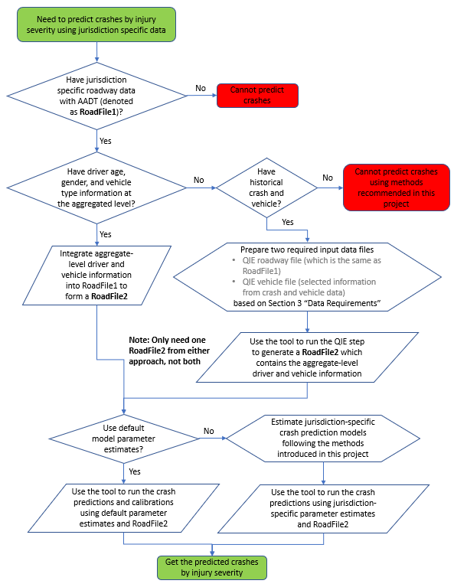
Decision Flow to Use the Tool

Slide 14
Data Requirements Discussed in the Guidance
Applicable AADT ranges for segments and intersections
Data requirements for generating the demographic and vehicle composition variables using the QIE method
QIE roadway file
QIE driver file
Data requirements for predicting the crash counts by severity
Lists of variables required for different facility types if default parameter estimates are to be used

Slide 15
Introduction of the Web-Based Application
The team developed an R Shiny web-based application for generating the QIE variables and predicting crashes by severity using one of the three new modeling approaches.
Shiny is an open-source R package that provides a web framework for building web applications using R.
The application is available on the National Academies Press website (nap.nationalacademies.org) by searching for NCHRP Research Report 1047: Development and Application of Crash Severity Models for Highway Safety.

Slide 16
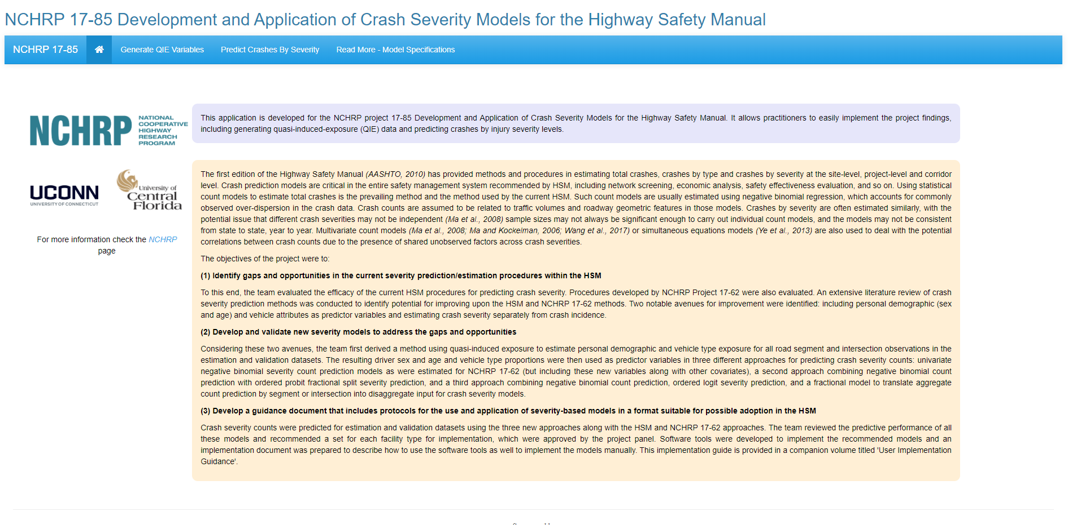
Home Page

Slide 17
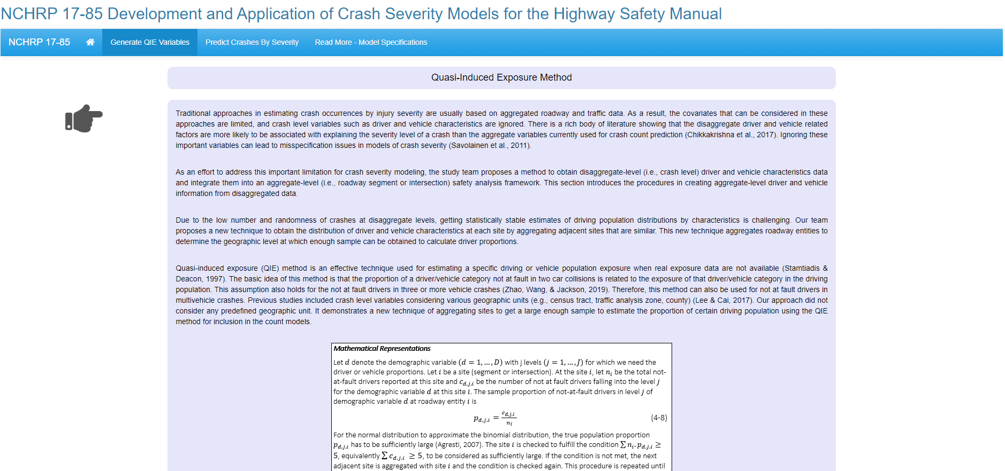
Generate QIE Variables Page

Slide 18
Predict Crash Page

Slide 19
NCHRP is sponsored by the individual state departments of transportation of the American Association of State Highway and Transportation Officials. NCHRP is administered by the Transportation Research Board (TRB), part of the National Academies of Sciences, Engineering, and Medicine, under a cooperative agreement with the Federal Highway Administration (FHWA). Any opinions and conclusions expressed or implied in resulting research products are those of the individuals and organizations who performed the research and are not necessarily those of TRB; the National Academies of Sciences, Engineering, and Medicine; the FHWA; or NCHRP sponsors.
More information is available in NCHRP Research Report 1047: Development and Application of Crash Severity Models for Highway Safety: User Guidelines, which can be obtained at the National Academies Press website (www.nap.edu).

