Slide 1
The following presentation is supplemental to NCHRP Research Report 1048: Corrosion Protection of Steel Bridges Using Duplex Coating Systems (NCHRP Project 12-117, “Guidelines for Corrosion Protection of Steel Bridges Using Duplex Coating Systems”). The full report can be found by searching on the report title on the National Academies Press website (www.nap.edu).
The National Cooperative Highway Research Program (NCHRP) is sponsored by the individual state departments of transportation of the American Association of State Highway and Transportation Officials. NCHRP is administered by the Transportation Research Board (TRB), part of the National Academies of Sciences, Engineering, and Medicine, under a cooperative agreement with the Federal Highway Administration (FHWA). Any opinions and conclusions expressed or implied in resulting research products are those of the individuals and organizations who performed the research and are not necessarily those of TRB; the National Academies of Sciences, Engineering, and Medicine; the FHWA; or NCHRP sponsors.

Slide 2
Guidelines for Corrosion Protection of Steel Bridges Using Duplex Coating Systems
NCHRP Project 12-117
Workshop Kickoff Meeting

Slide 3
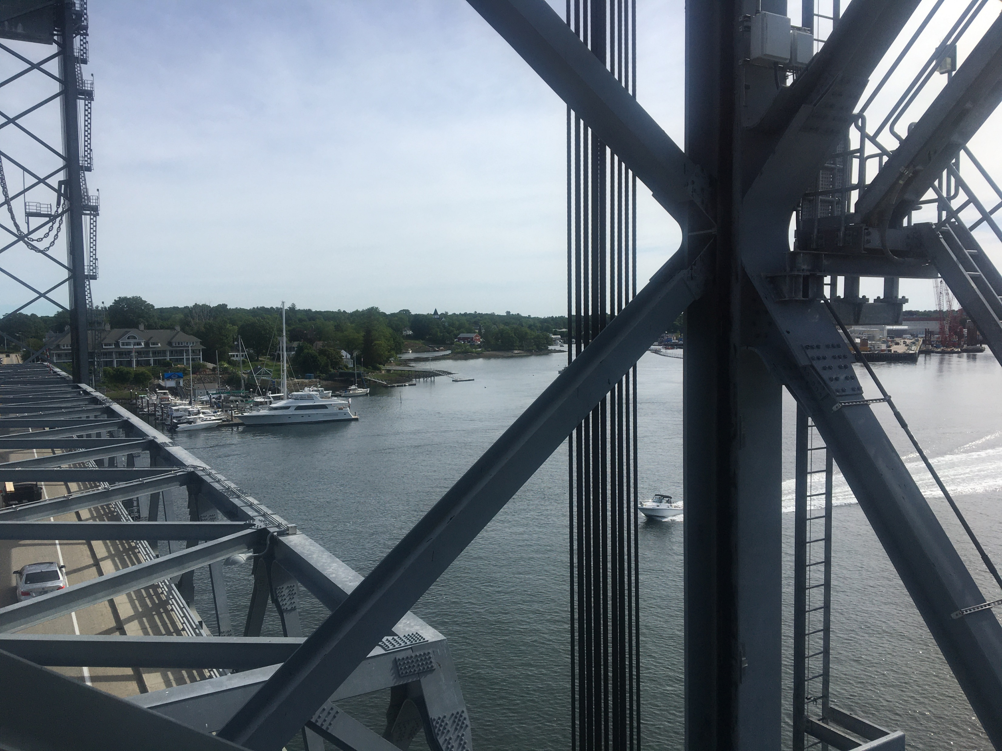
Agenda
Introductions/Roll Call
Project Background
  Literature Review
Summary of Project Research
  Testing
  Case Studies
Overview of the Guidelines
  Objective
  Design Guidance
  Life-Cycle Considerations
  Model Specification
Questions and Discussion
Path Forward
  Review and provide written feedback on the proposed guidelines
  Participate in a discussion regarding revisions to the proposed guidelines
Note that this meeting is being recorded

Slide 4
Introductions

Slide 5
Project Team
NCHRP Program Representatives
  Waseem Dekalbab, NCHRP Program Officer
  Tyler Smith, Program Assistant
Panel Chair
  Ivan Lasa, Lasa and Associates Corrosion Services Inc.
Project Panel
  Joshua Charnosky, PennDOT
  David Dobson, Oregon DOT
  Mike Hewins, MassHighway
  Quidan Huang, Univ of Akron
  Steve Kahl, Michigan DOT
  Ping Lu, FHWA Liaison
  Johnnie Miller, Texas DOT
  Jared Rigo, HRV Conformance Verification
  Jerry Zoeler, New Hampshire DOT
Research Team (Elzly/KTA)
  Pete Ault, Principal Investigator
  Ken Trimber
  Jay Helsel
  Rich Burgess
  Greg Richards

Slide 6
Stakeholders
Paul Blake, Tri State Painting LLC
Michael Brown, WSP
Jeff Carlson, AASHTO/NSBA
Rich Collins, V&S Galvanizing
Matt Cote, Casco Bay Steel
Sam Fallaha, FDOT
Alana Fossa, American Galvanizers Association
Ryan Foster, Vtrans
Martin Gagne, International Zinc Association
Mark Hudson, Sherwin Williams
Chase Knight, FDOT
Øle Knudsen, SINTEF
Pete Kohler, V&S Galvanizing
Tom Langill, American Galvanizers Association
Michael Leggett, PPG
Pete McDonagh, MTA B&T
Ron Medlock, High Steel
Dwayne Meyer, Carboline
Paul Tsourous, Jupiter Paining Contracting
Sarah Wilson, IDOT
Dave Wixson, TMS Metallizing Systems
Ryan Wixson, TMS Metallizing Systems

Slide 7
Disclaimer
This investigation was sponsored by TRB under the NCHRP Program. Data reported are work in progress. The contents of this presentation have not been reviewed by the project panel or NCHRP, nor do they constitute a standard, specification, or regulation.
The National Cooperative Highway Research Program (NCHRP) is sponsored by the individual state departments of transportation of the American Association of State Highway and Transportation Officials. NCHRP is administered by the Transportation Research Board (TRB), part of the National Academies of Sciences, Engineering, and Medicine, under a cooperative agreement with the Federal Highway Administration (FHWA). Any opinions and conclusions expressed or implied in resulting research products are those of the individuals and organizations who performed the research and are not necessarily those of TRB; the National Academies of Sciences, Engineering, and Medicine; the FHWA; or NCHRP sponsors.

Slide 8
Project Background & Literature Review

Slide 9
NCHRP 12-117 Objective
The objectives of this research are to:
  (1) develop AASHTO guidelines for corrosion protection using duplex coating systems for extending the service life of steel bridges that can be adopted by AASHTO and
  (2) plan and conduct a workshop to demonstrate the use of proposed guidelines to an audience of DOT staff and other stakeholders.
The guidelines shall cover the selection and application of duplex coating systems during the new design, and maintenance and rehabilitation of existing steel bridges.

Slide 10
NCHRP 12-117 Project Phases
Phase I – Planning
Phase II – Laboratory Testing and Case Studies
Phase III – Proposed AASHTO Guidelines
Phase IV – Final Products
  (a) a final report that documents the entire research effort and
  (b) the proposed AASHTO guidelines and ballot, workshop materials, and implementation plan.
Completion Date – March, 2022

Slide 11

No Common Definition of a “Duplex” Coating
Organic coating system, details may vary
“Sealer” is generally considered to be a thin (~1 mil) coat which is capable of penetrating into pores of TSC
The primer of a coating system may be a “sealer,” a thinned version of a primer, or a direct to metal coating
The coating system may consist of 1 to 3 coats applied at total thickness of 5-10 mils
Powder coating
Metallic Coating Alternatives:
Galvanizing
Zinc Metallizing
85Zn/15Al Metallizing
Aluminum Metallizing
Note: “metallizing” is also referred to as thermal sprayed coating (TSC), thermal sprayed zinc (aluminum, or 85/15), wire arc spray, metallization, metalizing
Steel Substrate

Slide 12
The Duplex Coating Guidelines Scope Includes
Organic Coating System
(sealer, one or multiple coats)
Metallic Coating
Steel Substrate

Slide 13
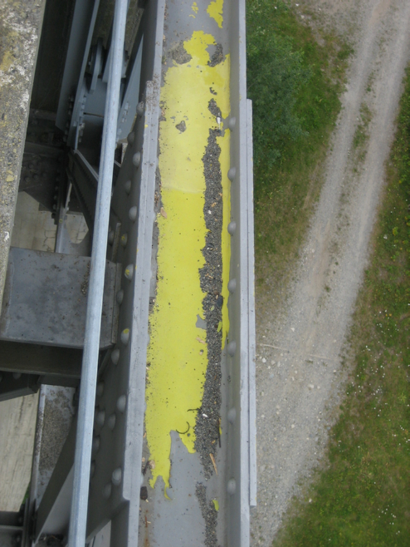
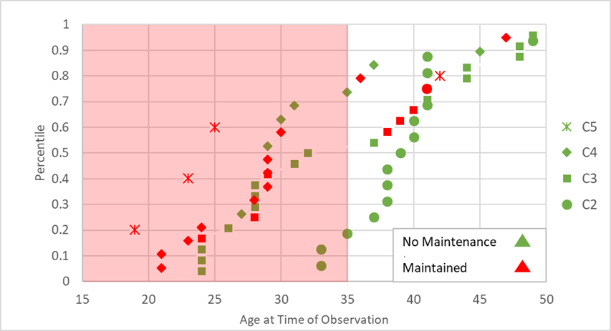
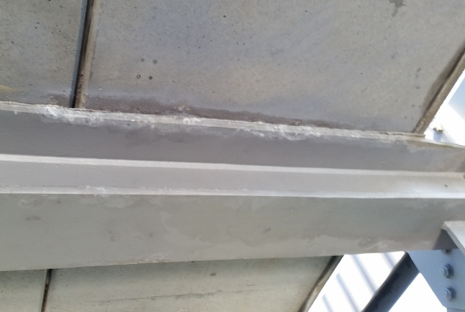
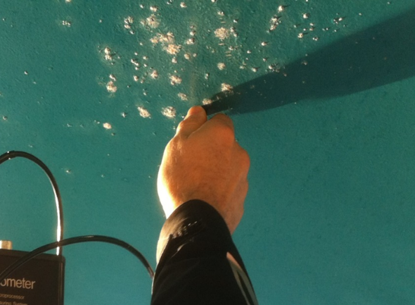
Why Use Duplex Coating?
Graph based on data from: O. Knudsen, H. Matre. (2019). Experiences with Thermal Spray Zinc Duplex Coatings on Road Bridges. MDPI Coatings, 371, pp.1-15 and presentation by O. Knudsen at 2019 Transportation Research Board, Washington DC
Synergy: 1+1=2.3+
Notes:
Images contain several concepts
Graph details:
Percentile is cumulative probability of observation. Age is in years.
The coating system is 4 mils of Zn with 8 mils of Alkyd in 4 coats. The Alkyd primer changed from a zinc chromate to zinc phosphate in 1977.
The legend refers to ISO environmental corrosivity (5 is worst)
Red is bad in the sense that maintenance was required, however said maintenance was generally maintenance of the alkyd to protect the TSZ.

Slide 14
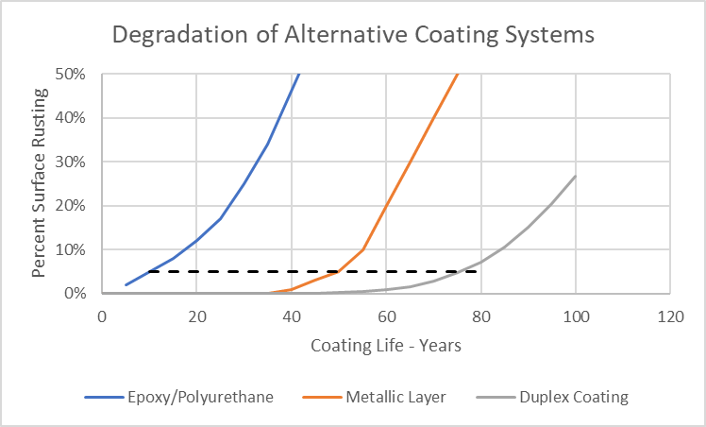
Duplex Coating Service Life
Synergy: 10+50=77 (28% Improvement)
Notes:
Images contain several concepts
Graph details:
Percentile is cumulative probability of observation. Age is in years.
The coating system is 4 mils of Zn with 8 mils of Alkyd in 4 coats. The Alkyd primer changed from a zinc chromate to zinc phosphate in 1977.
The legend refers to ISO environmental corrosivity (5 is worst)
Red is bad in the sense that maintenance was required, however said maintenance was generally maintenance of the alkyd to protect the TSZ.

Slide 15
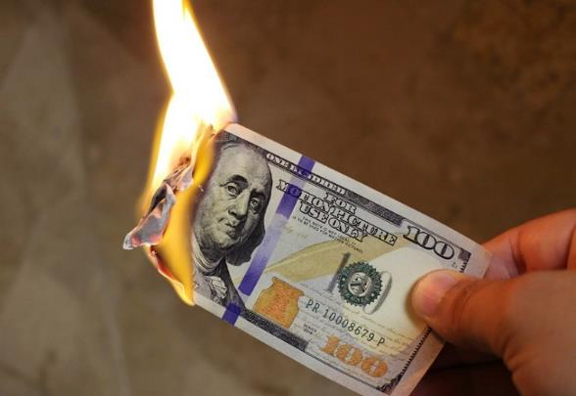
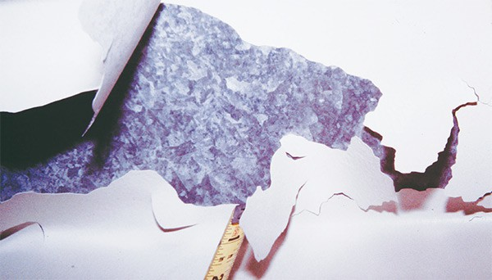
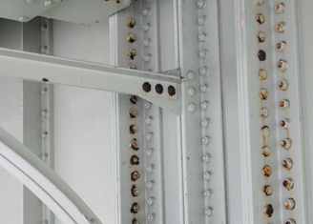
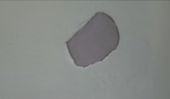
What Can Go Wrong?

Slide 16
Summary of Project Research

Slide 17
Study 1 – Quantitative Detection of Zinc Hydroxide (HDG) and Oxides (TSC)
Key Questions
Approach
How do the metallic coatings change (oxidize) in the timeframe of concern before painting?
Can we do better than visual assessment of oxides that may impact coating adhesion?
  Is there any impact before visual changes are evident?
Expose panels in 100% humidity conditions for various durations
Use analytical and field methods to characterize the surfaces over time
  Raman Spectroscopy, tape tests, SEM, surface pH, paint adhesion, ....
Neglect external contamination to the extent possible (e.g., dust, soluble salts)
  Eventually added Prohesion exposure

Slide 18
Study 1 – Quantitative Detection of Zinc Hydroxide (HDG) and Oxides (TSC)
Key Questions
Findings
How do the metallic coatings change (oxidize) in the timeframe of concern before painting?
Can we do better than visual assessment of oxides that may impact coating adhesion?
  Is there any impact before visual changes are evident?
Corrosion in the span of weeks is less significant than stringent “time to paint” requirements suggest
  Galvanizing visually corrodes more than thermal spray coatings
  Soluble salts and other contaminants are more significant
Added Prohesion conditioning to the Study 3 conditions

Slide 19
Study 2 – Comparison of Epoxy Coatings from Three Manufacturers to Select a Product for Further Testing Under Study 3
Key Questions
Approach
What are the performance expectations for typical coatings?
What coatings system should be used for Study 3?
12 unique conditions
Triplicate panels
Uncontaminated metallic coating
Similar coating alternatives from three manufacturers
  Sweep blast/epoxy on galvanized coating
  Penetrating sealer and epoxy on TSC
Freeze Thaw & Cyclic Corrosion Testing
Thermal Spray Coating | Galvanized
Rustbond/ Carboguard 893 | Carboguard 893
Interbond 600/ Intergard 475HS | Intergard 475HS
Pre-prime 920/ Macropoxy 646 | Macropoxy 646

Slide 20
Study 2 – Comparison of Epoxy Coatings from Three Manufacturers to Select a Product for Further Testing Under Study 3
Key Questions
Findings
What are the performance expectations for typical coatings?
What coatings system should be used for Study 3?
Three epoxy coatings commonly used on bridges performed comparably given the degree of replication
  Added the cyclic corrosion test based on the limited differences observed after Freeze-Thaw testing
“System C” was selected as representative of the epoxy materials

Slide 21
Study 3 – Adhesion of Epoxy Coating over Various Concentrations Oxides (HDG and TSC) After Cleaning using Different Methods of Preparation
Key Questions
Approach
51 unique conditions
  Combinations of metallic coating, oxidation, and surface preparation
  Triplicate panels
One topcoat for metallizing and one for galvanizing based on Study 2
Oxidized surface were selected based on Study 1
  None
  14 days Humidity exposure
  14 days Prohesion exposure
How much oxide impacts coating adhesion?
What is the best way to remove deleterious oxides?
Metallic Coating | No Prep-aration | SSPC-SP 1 | Pressure Wash/ Blow Dry | Wash Primer | Pressure Wash + Power Sand | Pressure Wash + SP16
HDG | 9 | 9 | -- | 9 | 9 | 9
Zn TSC | 9 | 9 | 9 | -- | 9 | --
85/15 Zn/Al TSC | 9 | 9 | 9 | -- | 9 | --
Al TSC | 9 | 9 | 9 | -- | 9 | --

Slide 22
Study 3 – Adhesion of Epoxy Coating over Various Concentrations Oxides (HDG and TSC) After Cleaning using Different Methods of Preparation
Key Questions
Findings
How much oxide impacts coating adhesion?
What is the best way to remove deleterious oxides?
Prohesion conditioning (contamination) had a greater impact than Humidity conditioning
Adhesion over HDG without surface preparation was poor regardless of conditioning (oxide level)
  Nuanced differences observed
Conditioning of TSC impact the TSC adhesion/cohesion
  No observations differentiated adhesion of organic coating as a function of TSC surface preparation
Extended exposure testing being performed

Slide 23
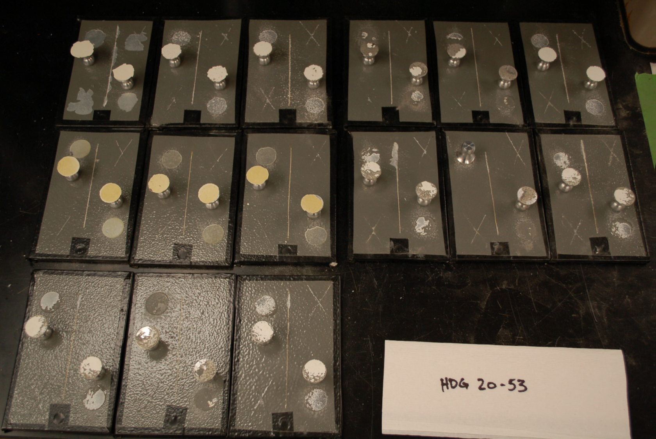

Slide 25
Study 4 – Slip Resistance Testing
Key Question
Approach
What is the impact of mixed alloys on slip resistance?
Test six material combinations in accordance with Appendix A of the Specification for Structural Joints Using High-Strength Bolts
 | Surfaces A & D | Surfaces B & C
Test 1 | Zinc Metallized (w/o sealer) | Zinc Metallized (w/o sealer)
Test 2 | 85Al-15Zn Metallized (w/o sealer) | Zinc Metallized (w/o sealer)
Test 3 | Galvanized | Zinc Metallized (w/o sealer)
Test 4 | Organic Zinc Coating | Zinc Metallized (w/o sealer)
Test 5 | 85Al-15Zn Metallized (w/o sealer) | Galvanized
Test 6 | Organic Zinc Coating | Galvanized

Slide 26
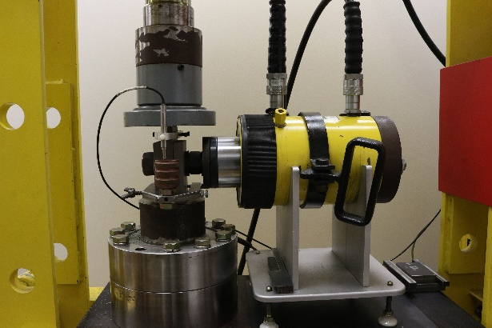
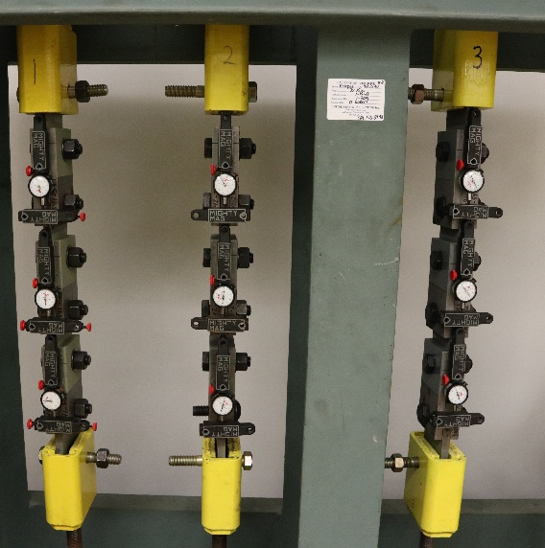
Study 4 – Slip Resistance Testing
Test | Mating Surfaces | Average Slip Coefficient | Tension Creep Deformation Prior to Post-Loading | Tension Creep Deformation Following Post-Loading
Passing Criteria: |  | Class B: 0.50 min. Class A: 0.30 min. | All replicates must exhibit ≤ 0.005″ | Average of 3 replicates must be <0.015″
1 | Zn TSC/Zn TSC | 0.704 | 0.0052″ 0.0038″ 0.0010″ | 0.0042″
2 | 85/15 Zn/Al TSC/Zn TSC | 0.707 | 0.0010″ 0.0031″ 0.0020″ | 0.0020″
3 | HDG/Zn TSC | 0.683 | 0.0029″ 0.0036″ 0.0058″* | 0.0051″
4 | SW Zinc Clad 4100/ Zn TSC | 0.610 | 0.0034″ 0.0046″ 0.0036″ | 0.0047″
5 | 85/15 Zn/Al TSC/HDG | 0.690 | 0.0021″ 0.0011″ 0.0019″ | 0.0023″
6 | SW Zinc Clad 4100/HDG | 0.44 | 0.0002″ 0.0006″ 0.0000″ | 0.0004″
Key Question
Findings
What is the impact of mixed alloys on slip resistance?

Slide 27
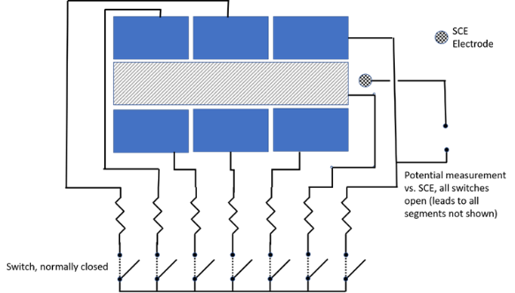
Study 5 – Segmented Cell Testing of Metallic Duplex Systems
Key Questions
Approach
What are the degradation mechanisms/rates for an organic coating over zinc coatings?
How might we rapidly evaluate the suitability of an organic coating for a duplex system?
Use segmented cell to compare
  HDG with and without some degree of wet storage stain before epoxy coating
  TSC (Al and Zn) with and without a sealer before epoxy topcoat

Slide 28
Study 5 – Segmented Cell Testing of Metallic Duplex Systems

Slide 29
Study 5 – Segmented Cell Testing of Metallic Duplex Systems
Key Questions
Findings
What are the degradation mechanisms/rates for an organic coating over zinc coatings?
How might we rapidly evaluate the suitability of an organic coating for a duplex system?
Sealer does not appear to change the tendency for underfilm creep for TSA or TSZ, though it does seem to promote more localized blistering and corrosion at a coating scribe
The surface oxide created appeared to reduce the magnitude of the anodic undermining current and the local variability of these currents

Slide 30
Case Studies

Slide 31
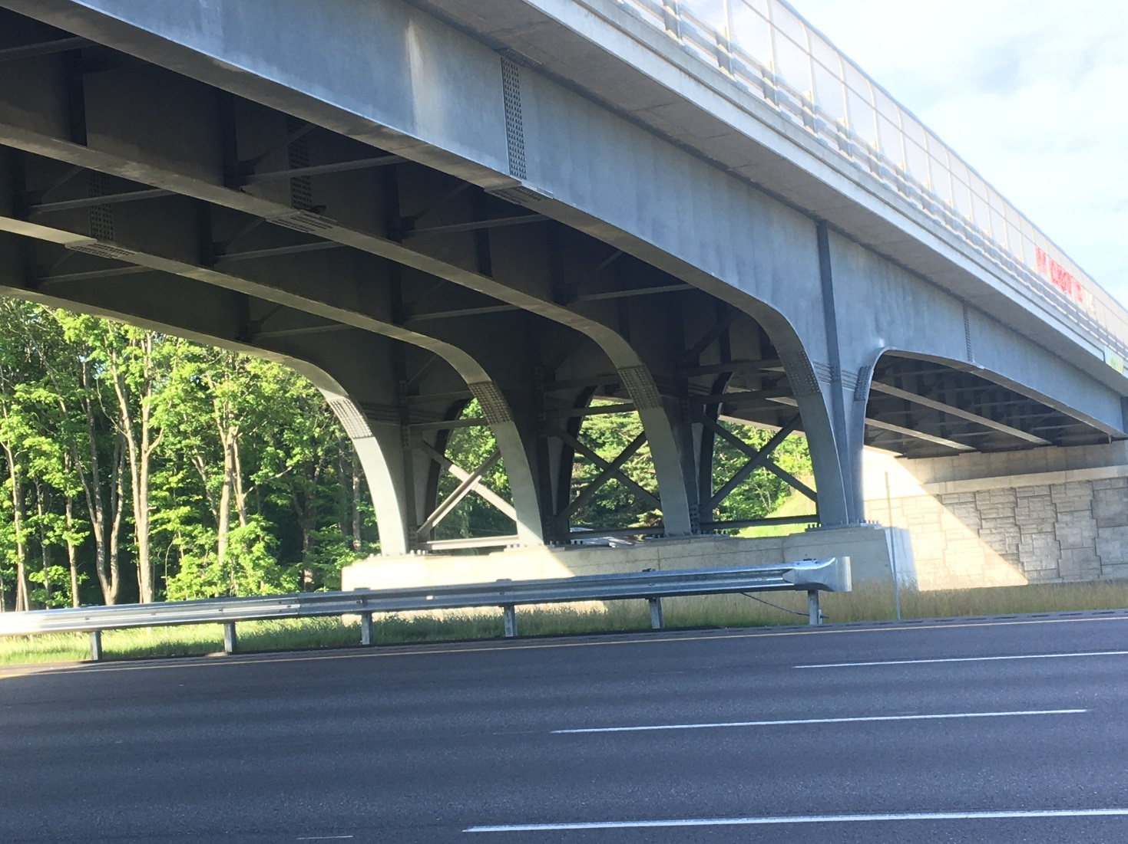
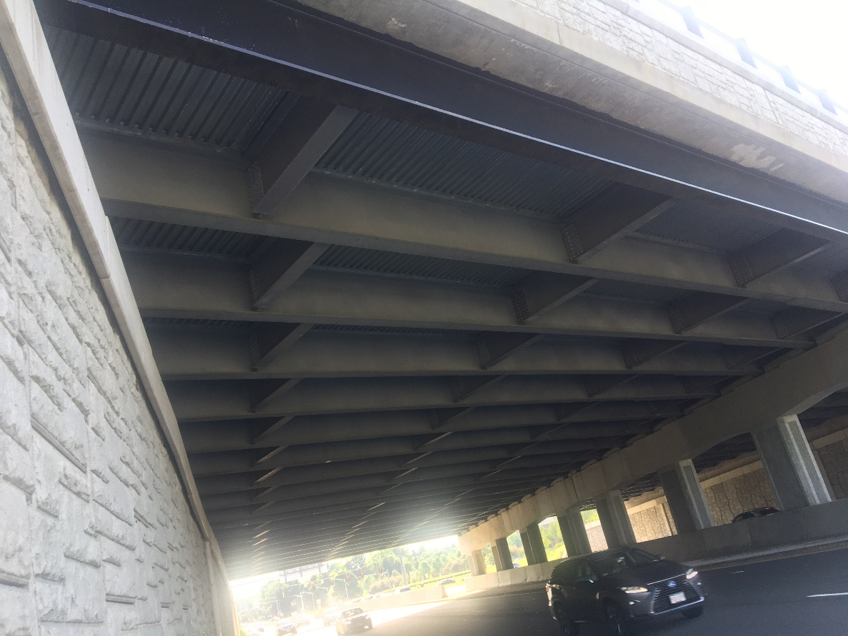
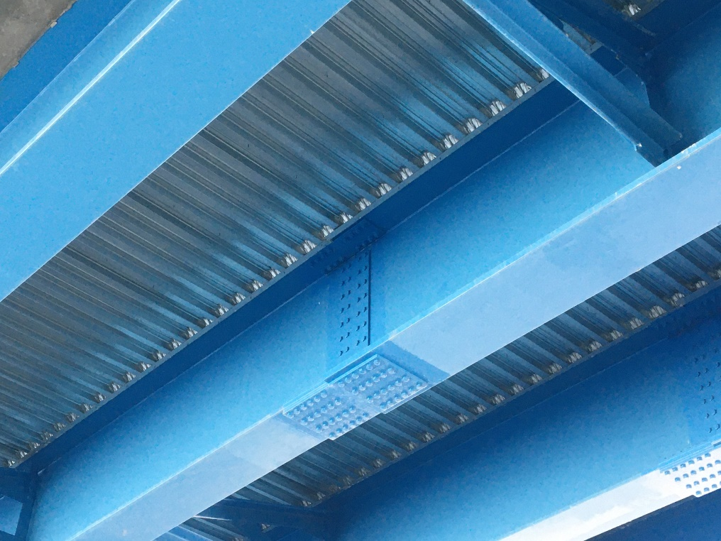
New Structures

Slide 32
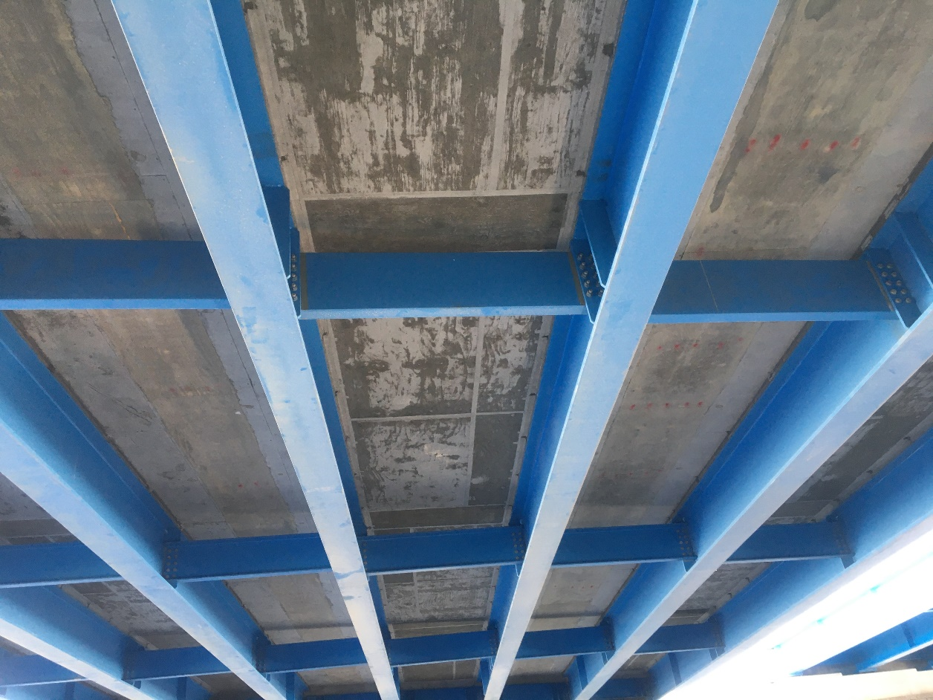
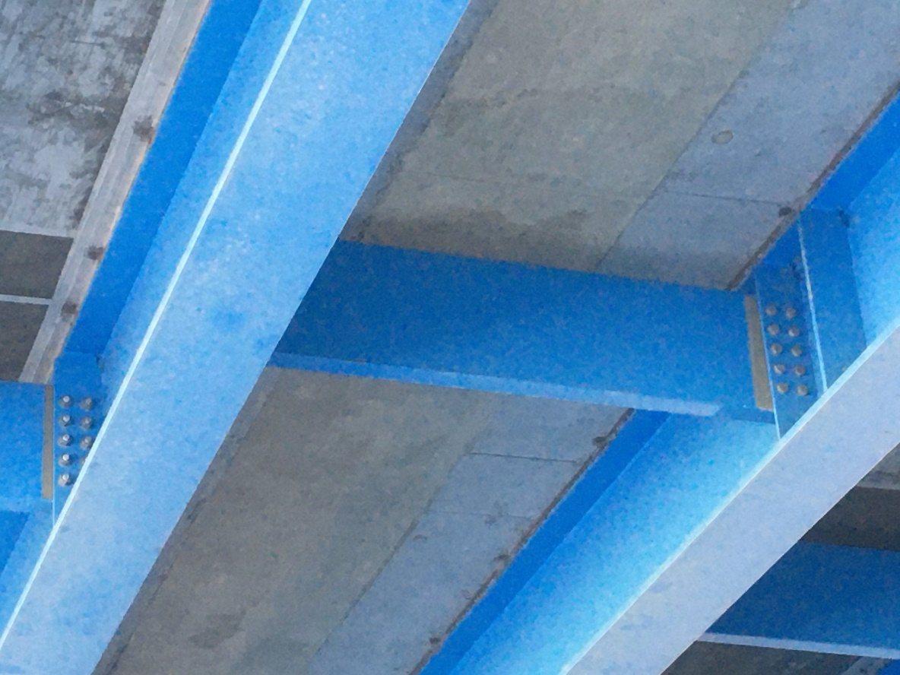
Accelerated Bridge Construction

Slide 33
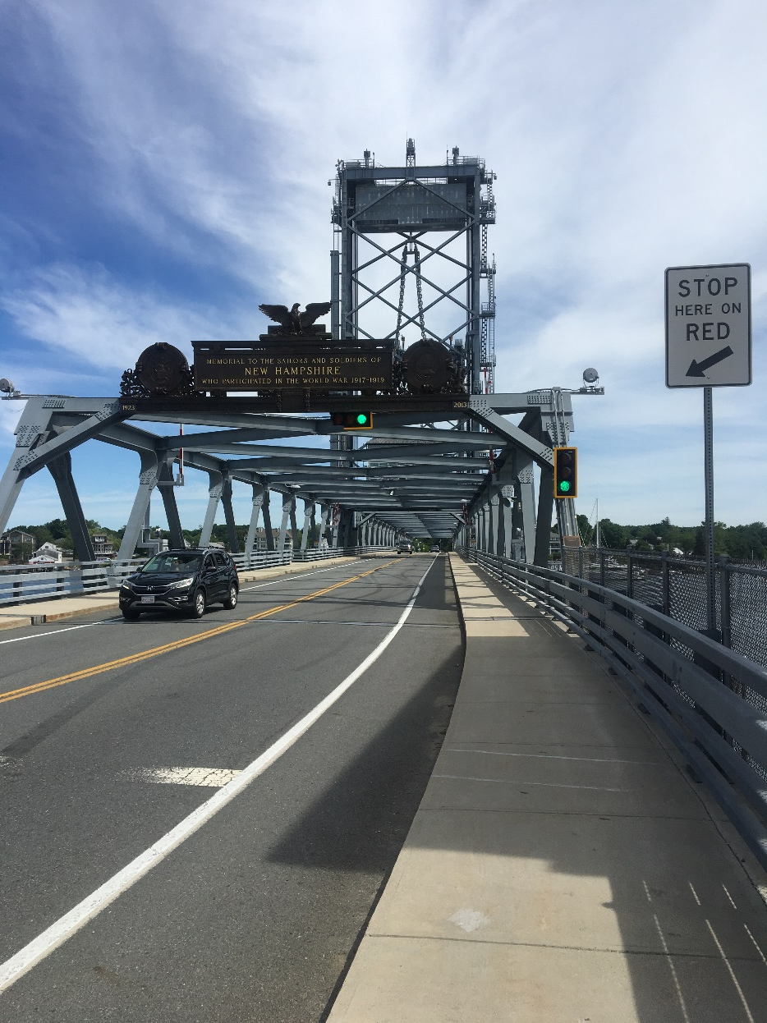
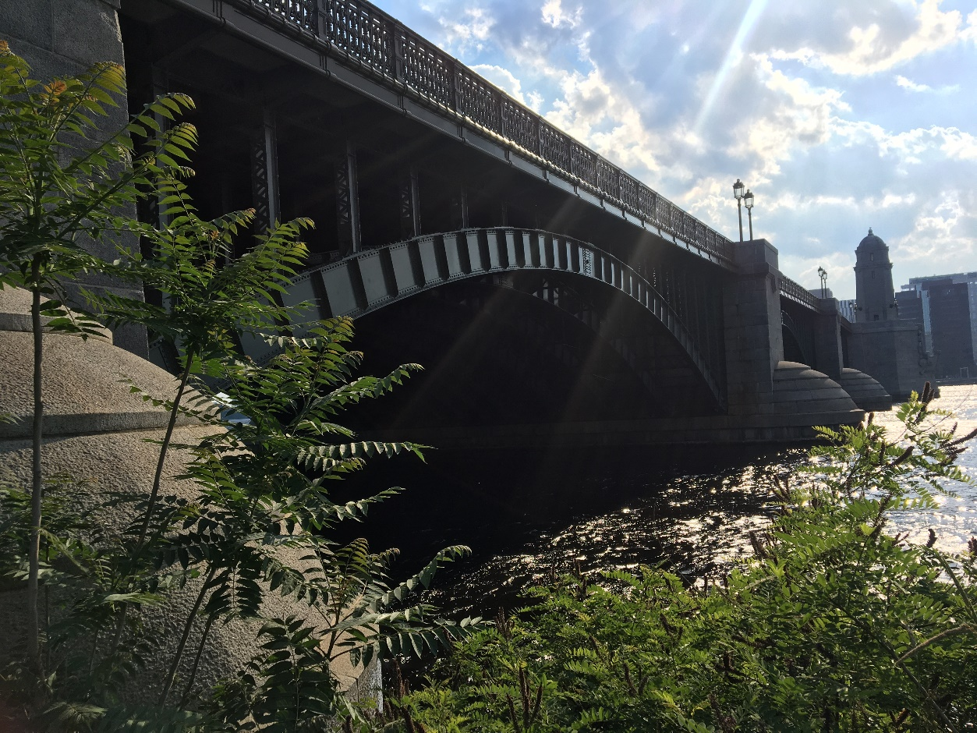
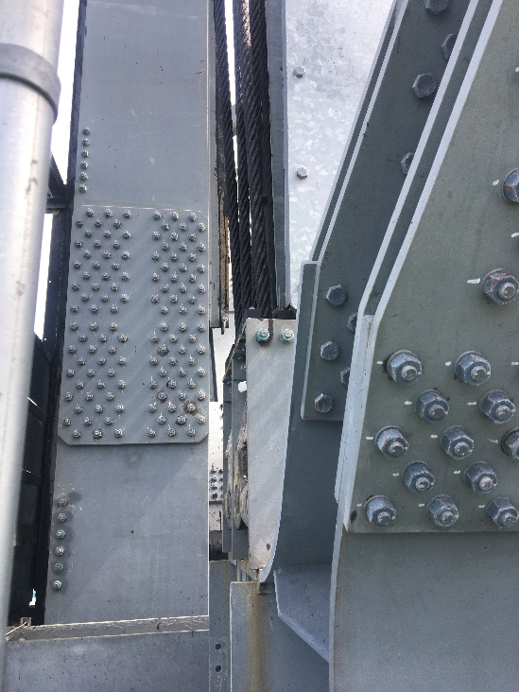
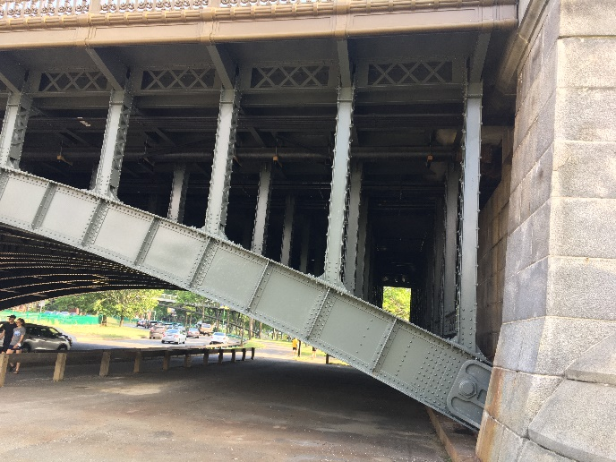
Signature Bridges

Slide 34
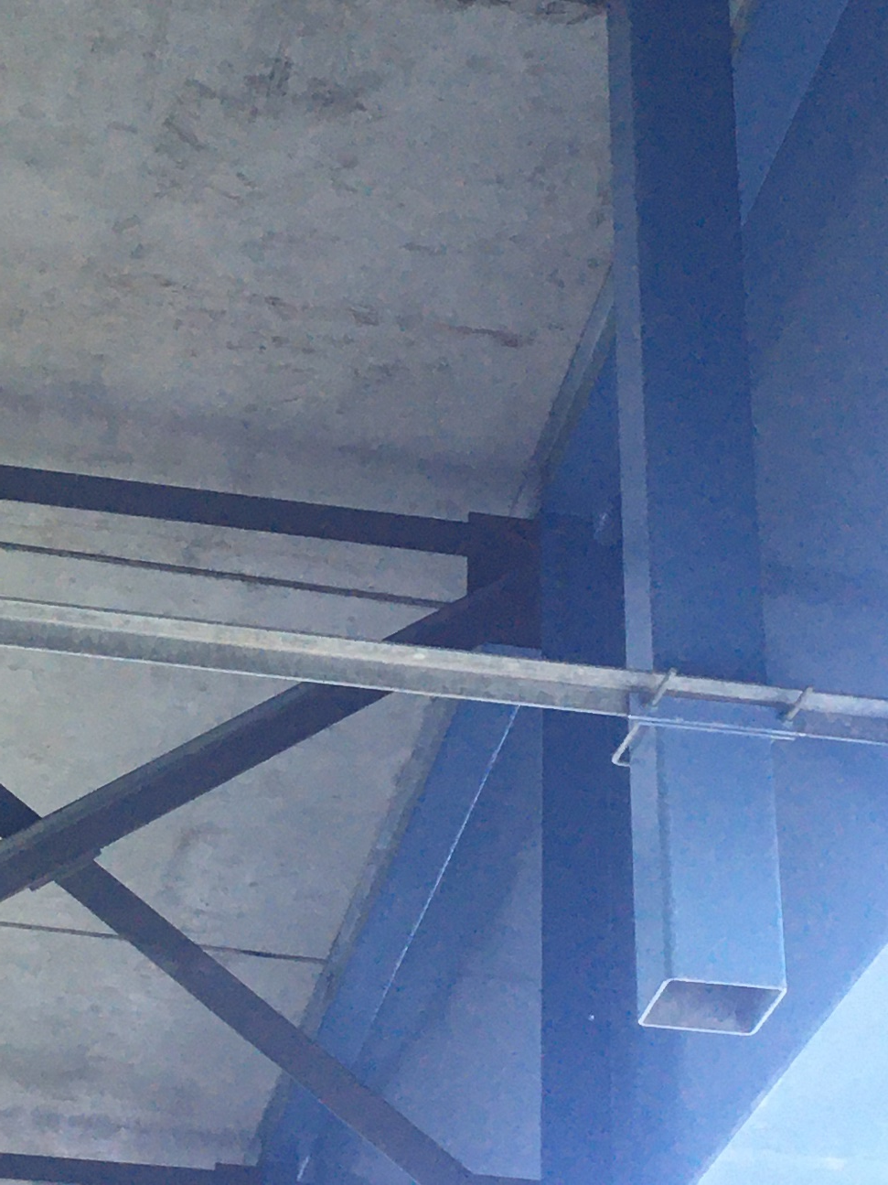
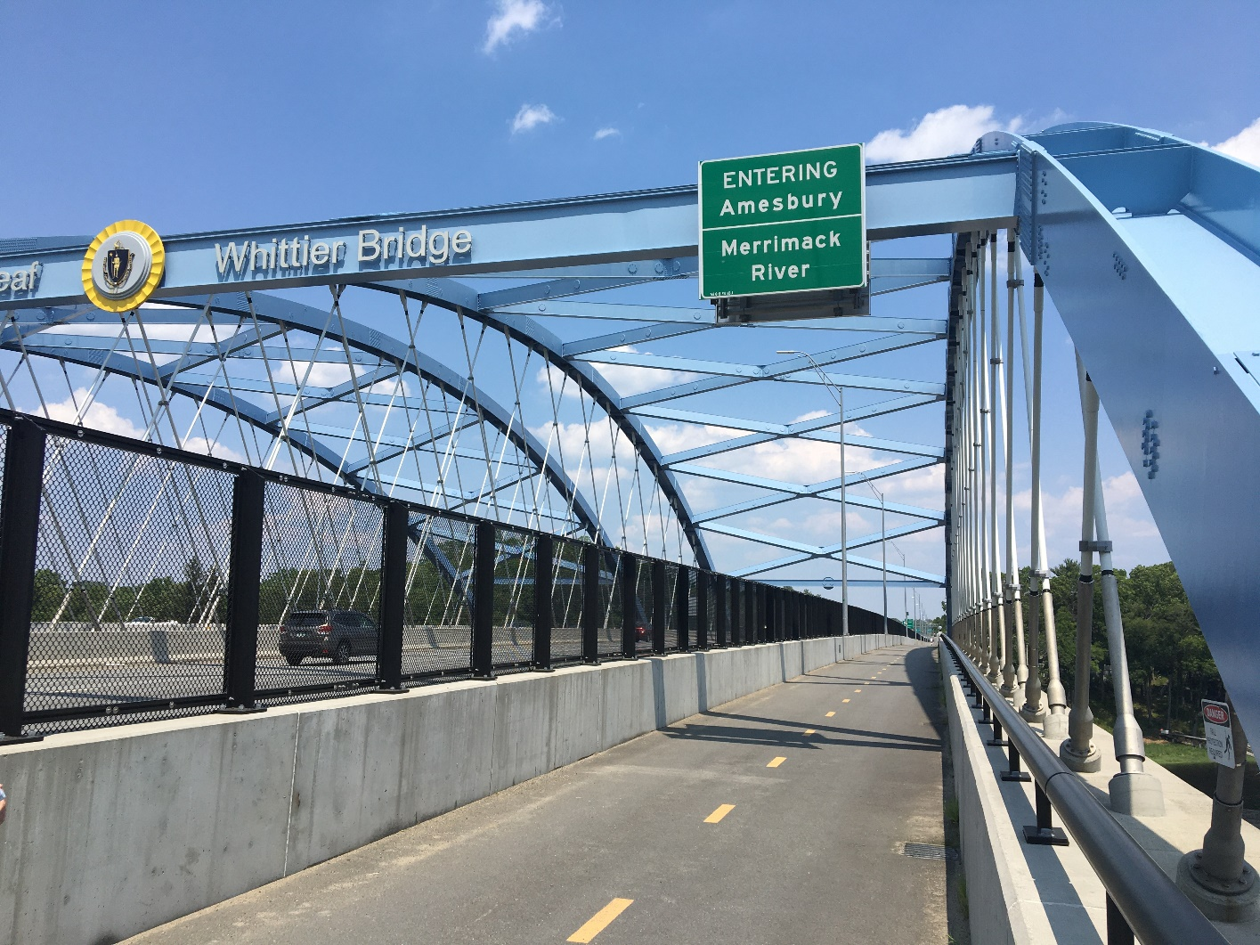
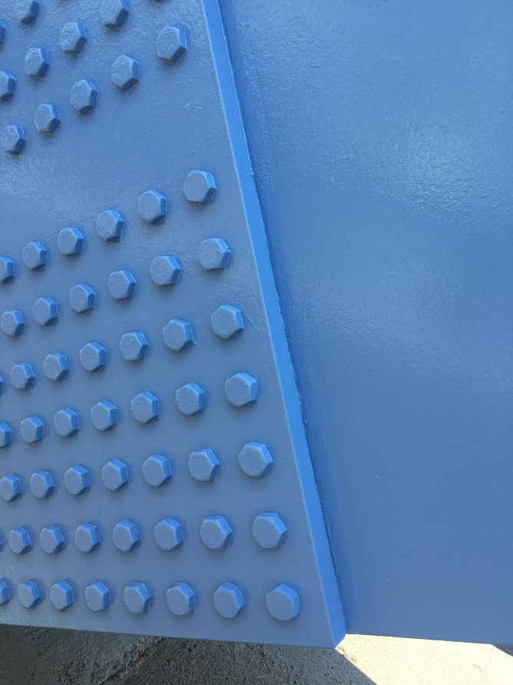
Signature Bridges

Slide 35
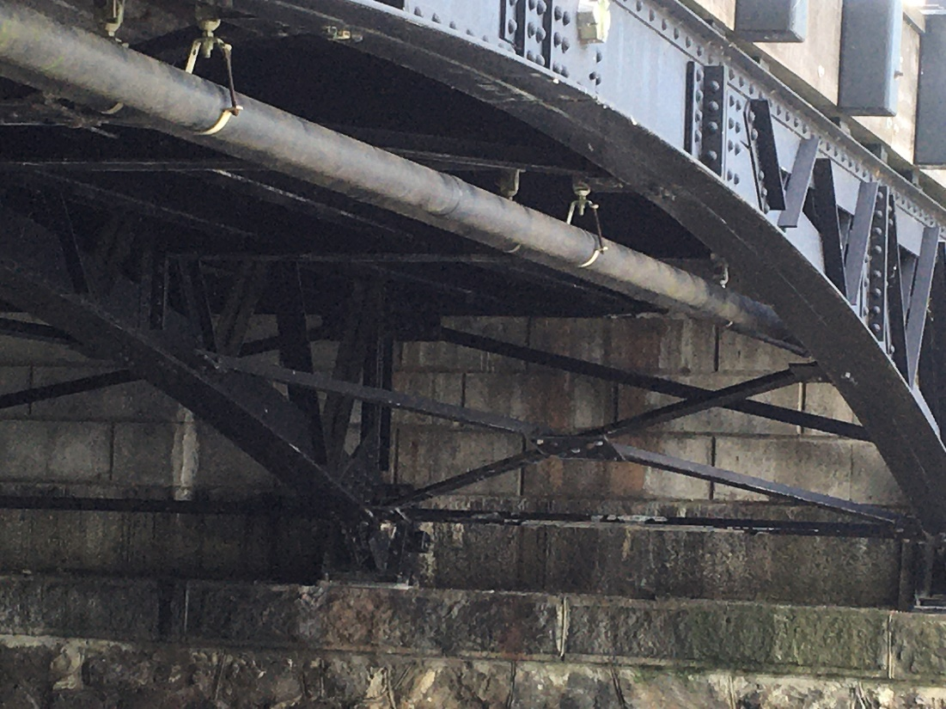
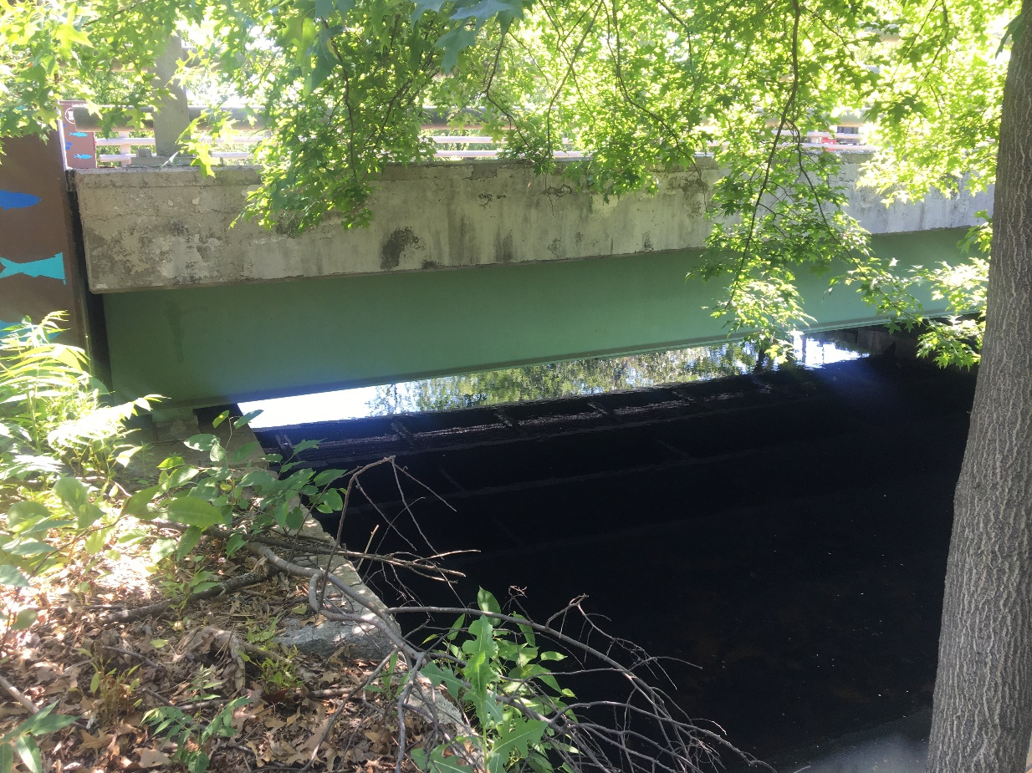
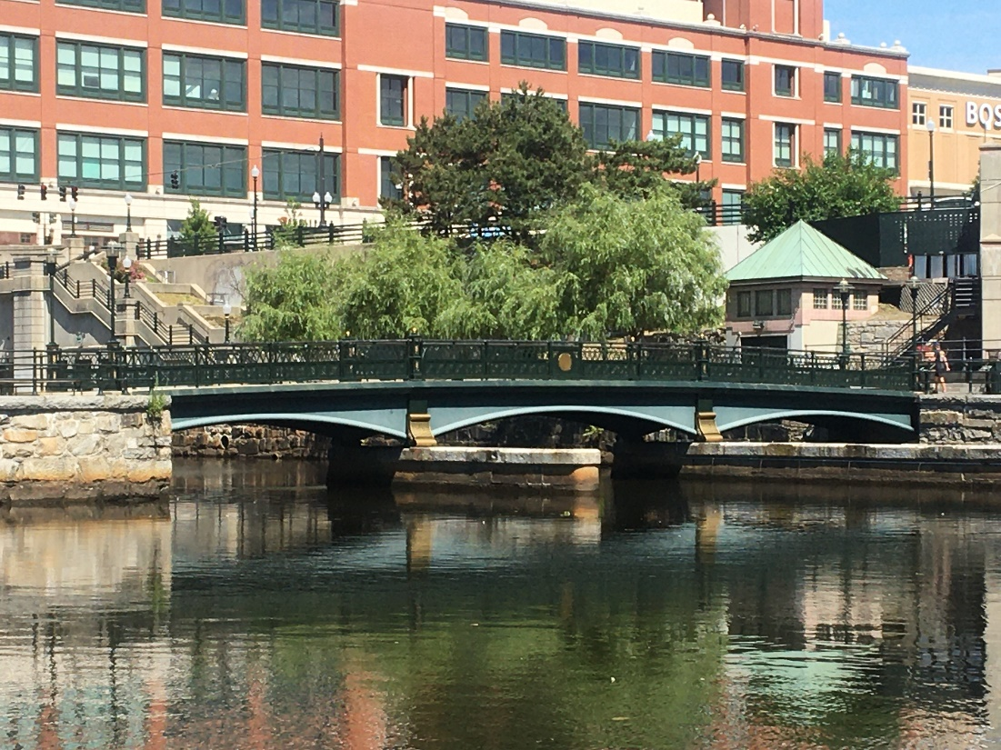
Older Structures

Slide 36
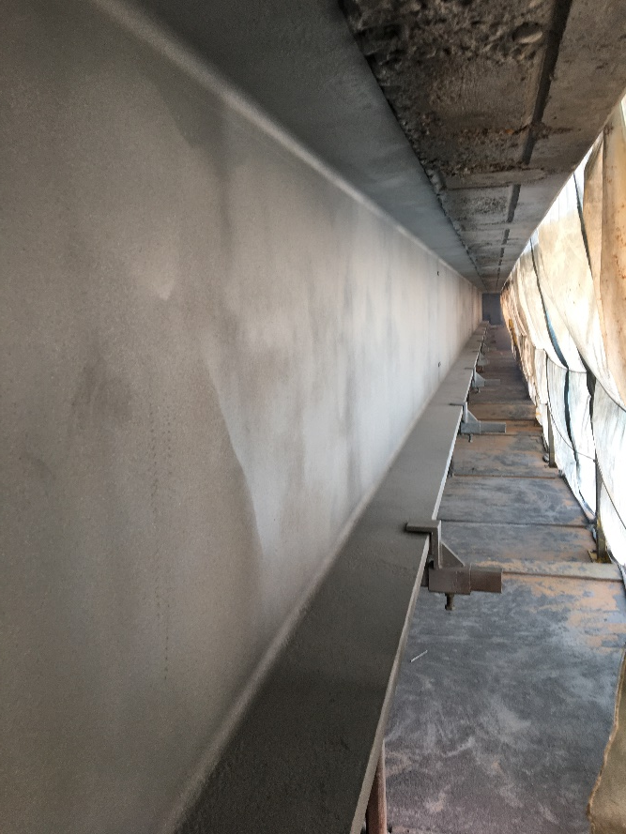
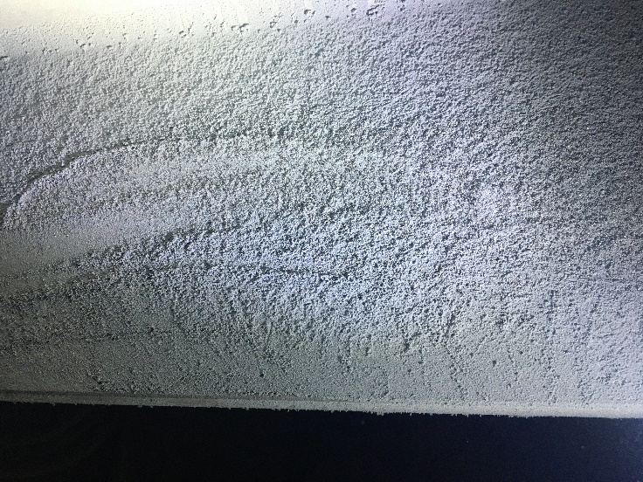
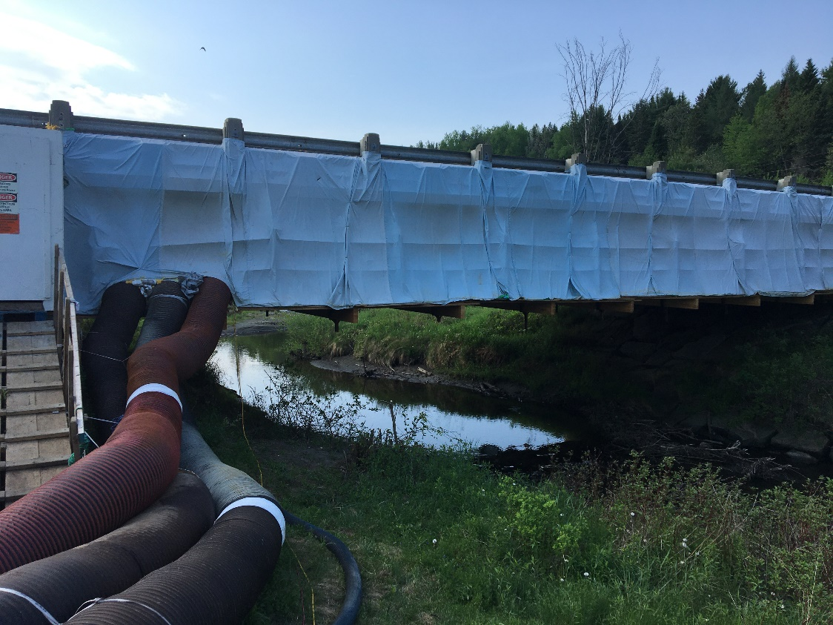
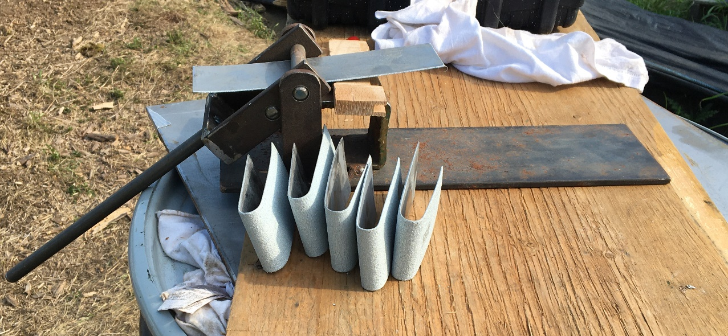
Field Metallizing

Slide 37
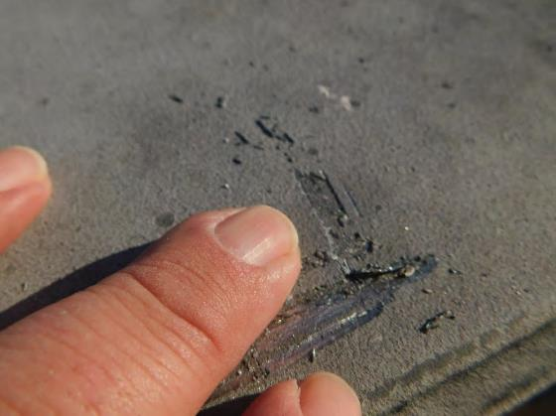
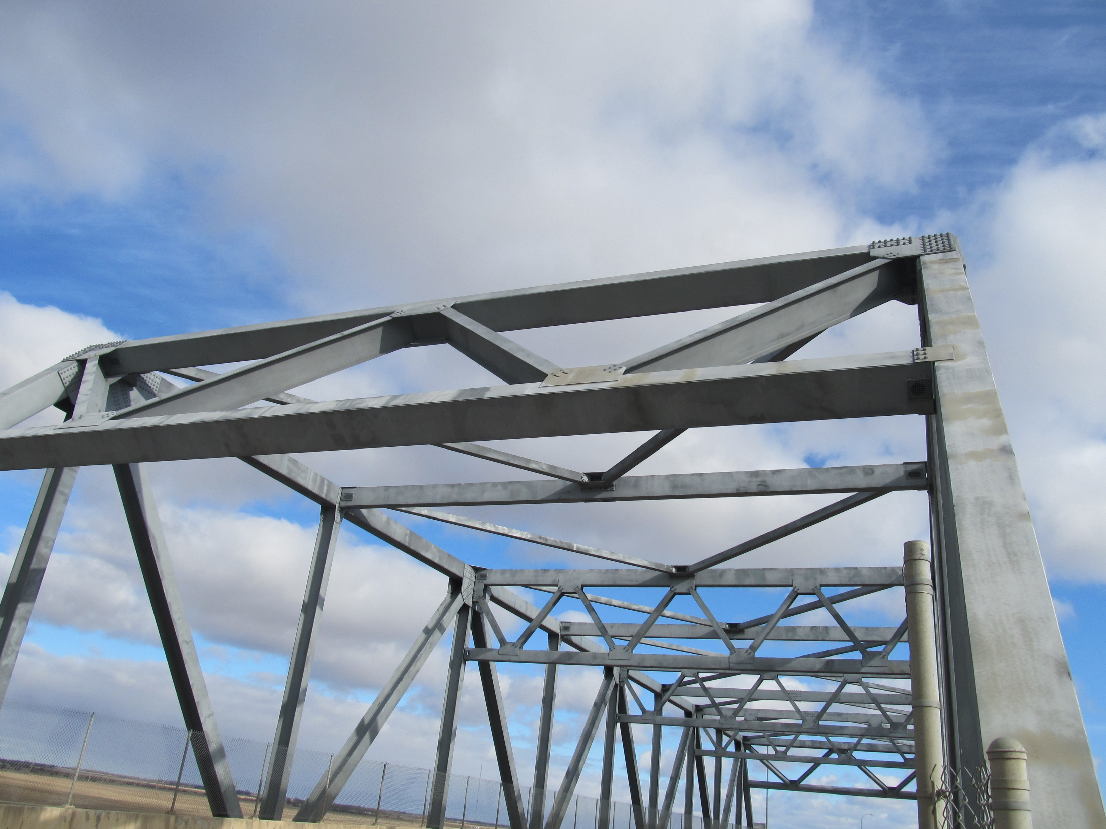
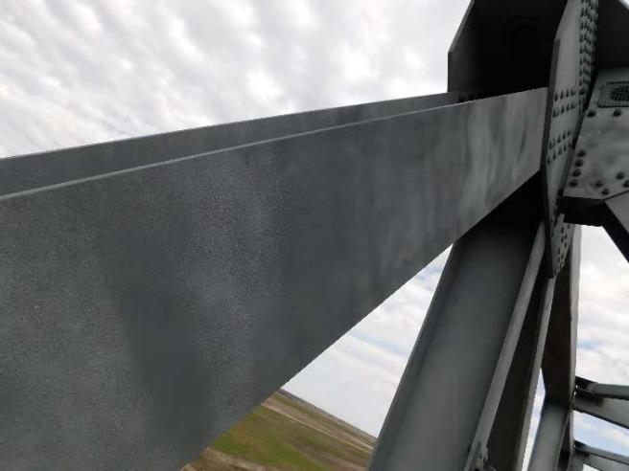
Repair of Aged Structure

Slide 38
Overview of Guidelines

Slide 39
Vision - Integrated AASHTO Guidelines for Steel Structure Coatings
Duplex Coating Selection and Use Guideline (Life-Cycle)
S8.x-20xx Specification for Duplex Coating Steel Bridges
S8.x-20xx Specification for Galvanizing Steel Bridges
S8.1-2014 Guide Specification for Application of Coating Systems with Zinc-Rich Primers to Steel Bridges
S8.2-2017 Specification for Application of Thermal Spray Coatings for Steel Bridges
Gray – Existing Documents
Yellow – To be addressed by this project

Slide 40
Duplex Coating Selection and Use Guideline
Section 1 – Introduction to Duplex Coatings – Definitions Limitations, and Case Histories
Section 2 – Qualification of Duplex Coating Systems
Section 3 – Duplex Coating System Selection Criteria and Cost Analysis
Section 4 – Structural Design and Fabrication Considerations
Section 5 – Application of Metallic Coating, Surface Preparation, and Application of Liquid Organic Coatings
Section 6 – Repair and Maintenance of Duplex Coatings
Section 7 – Quality Control and Inspection
Section 8 – Qualifications (applicator and inspector)

Slide 41
Duplex Coating System Selection Criteria and Cost Analysis Tools

Slide 42
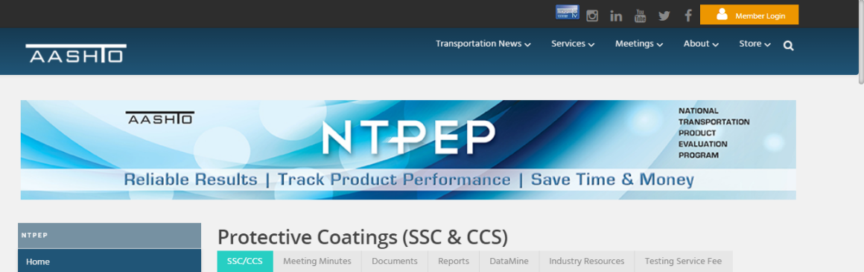
Qualification of Duplex Coating Systems
Test | AASHTO NTPEP Tests for Liquid- Applied Coatings | Modifications for Tests for Duplex Coatings
1 | Slip Coefficient/Tension Creep (primer only) | Test may not be needed – testing of bare galvanizing and bare metallizing exists
2 | ASTM B117 Salt Fog Resistance (5,000 hours) – panels are scribed to the bare steel prior to exposure to address rust creepage | Test cycle is appropriate, but two scribes should be made for evaluation – one to the steel, and one to the metal layer to assess both undercutting of the metal coating, and separation of the liquid coating from the metal coating
3 | ASTM D5894 Cyclic Weathering Resistance (5,040 hours [15 – 336-hour cycles]). Same scribing as salt fog. | Test cycle is appropriate with same modifications to scribe as for salt fog.
4 | ASTM D4541 Tensile Adhesion | No change needed.
5 | Freeze Thaw Stability (30-days) | No change needed.
6 | Coating Identification tests – a battery of tests is included to fully characterize each of the liquid-applied coatings | The battery of tests is appropriate for the coatings applied to the metal coating, but in addition, the metal coatings should be characterized as follows: [consider referencing galvanizing and metallizing specifications]

Slide 43
Duplex Coating Service Life
Synergy: 10+50=77 (28% Improvement)
Notes:
Images contain several concepts
Graph details:
Percentile is cumulative probability of observation. Age is in years.
The coating system is 4 mils of Zn with 8 mils of Alkyd in 4 coats. The Alkyd primer changed from a zinc chromate to zinc phosphate in 1977.
The legend refers to ISO environmental corrosivity (5 is worst)
Red is bad in the sense that maintenance was required, however said maintenance was generally maintenance of the alkyd to protect the TSZ.

Slide 44
Specification for Duplex Coating Steel Bridges
1. Introduction
2. Applicable Specifications and Documents
3. Definitions
4. Submittals
5. Certifications and Qualifications
6. Paint Materials
7. Metallic Coating Materials and Installation
8. Compressed Air Cleanliness
9. Lighting
10. Test Sections (Hold Point)
11. Surface Preparation of Galvanizing (Hold Point)
12. Surface Preparation of TSC (Hold Point)
13. Mixing of Coatings (Hold Point)
14. Ambient Conditions for Painting
15. Painting of Galvanizing (Hold Point)
16. Painting of TSC (Hold Point)
17. Film Continuity (Hold Point)
18. Slip-Critical Connections and Fasteners (Hold Point)
19. Repair of Damage and Unacceptable Coatings (Hold Point)
20. Environmental Protection and Waste Handling
21. Quality Control and Quality Assurance
22. Testing of Coating Materials

Slide 45
Questions and Discussion

Slide 46
Path Forward

Slide 47
Review and Feedback
Proposed Guidelines and Model Specification
  “...shall cover the selection and application of duplex coating systems during the new design, and maintenance and rehabilitation of existing steel bridges.”
  Project Deliverable
  This is not a consensus process
  Prepared in a manner that they are suitable for AASHTO adoption
The adoption process could involve another round of modifications that would be more consensus-driven
Please provide feedback by August 30, 2021 via e-mail (pault@elzly.com) either as an annotated .pdf or a list of written comments.
  We will compile and address them in preparation for the discussion

Slide 48
Final Discussion
Brief overview of the feedback
Discussion of the key issues raised by the stakeholders
  Intended to be more interactive than this meeting
Schedule via Poll
  2-hour meeting during the September 8-23 timeframe

Slide 49
Next Steps
August 10 you will receive via e-mail
  Draft Guidelines and Model Specification in pdf format
  A copy of this presentation
  Link to a Poll for final meeting in September
The requested actions are
  Please respond to the Poll at your earliest convenience
  Please provide feedback by August 30, 2021 via e-mail (pault@elzly.com) either as an annotated .pdf or a list of written comments
    Earlier responses are appreciated!

Slide 51
Guidelines for Corrosion Protection of Steel Bridges Using Duplex Coating Systems
NCHRP Project 12-117
Stakeholder Discussion Meeting

Slide 52
Agenda
Introductions
Brief overview of the feedback
Interactive discussion of the key issues raised by the stakeholders
Wrap-up
Note that this meeting is being recorded

Slide 53
Introduction and Background

Slide 54
Project Team
NCHRP Program Representatives
  Waseem Dekalbab, NCHRP Program Officer
  Tyler Smith, Program Assistant
Panel Chair
  Ivan Lasa, Lasa and Associates Corrosion Services Inc.
Project Panel
  Joshua Charnosky, PennDOT
  David Dobson, Oregon DOT
  Mike Hewins, MassHighway
  Quidan Huang, Univ of Akron
  Steve Kahl, Michigan DOT
  Ping Lu, FHWA Liaison
  Johnnie Miller, Texas DOT
  Jared Rigo, HRV Conformance Verification
  Jerry Zoeler, New Hampshire DOT
Research Team (Elzly/KTA)
  Pete Ault, Principal Investigator
  Ken Trimber
  Jay Helsel
  Rich Burgess
  Greg Richards

Slide 55
Stakeholders
Paul Blake, Tri State Painting LLC
Michael Brown, WSP
Jeff Carlson, AASHTO/NSBA
Rich Collins, V&S Galvanizing
Matt Cote, Casco Bay Steel
Sam Fallaha, FDOT
Alana Fossa, American Galvanizers Association
Ryan Foster, Vtrans
Martin Gagne, International Zinc Association
Mark Hudson, Sherwin Williams
Chase Knight, FDOT
Øle Knudsen, SINTEF
Pete Kohler, V&S Galvanizing
Tom Langill, American Galvanizers Association
Michael Leggett, PPG
Tim McCullough, FDOT
Pete McDonagh, MTA B&T
Ron Medlock, High Steel
Dwayne Meyer, Carboline
Paul Tsourous, Jupiter Paining Contracting
Sarah Wilson, IDOT
Dave Wixson, TMS Metallizing Systems
Ryan Wixson, TMS Metallizing Systems
Vicki Young, FDOT

Slide 56
Disclaimer
This investigation was sponsored by TRB under the NCHRP Program. Data reported are work in progress. The contents of this presentation have not been reviewed by the project panel or NCHRP, nor do they constitute a standard, specification, or regulation.
The National Cooperative Highway Research Program (NCHRP) is sponsored by the individual state departments of transportation of the American Association of State Highway and Transportation Officials. NCHRP is administered by the Transportation Research Board (TRB), part of the National Academies of Sciences, Engineering, and Medicine, under a cooperative agreement with the Federal Highway Administration (FHWA). Any opinions and conclusions expressed or implied in resulting research products are those of the individuals and organizations who performed the research and are not necessarily those of TRB; the National Academies of Sciences, Engineering, and Medicine; the FHWA; or NCHRP sponsors.

Slide 57
NCHRP 12-117 Objective
The objectives of this research are to:
  (1) develop AASHTO guidelines for corrosion protection using duplex coating systems for extending the service life of steel bridges that can be adopted by AASHTO and
  (2) plan and conduct a workshop to demonstrate the use of proposed guidelines to an audience of DOT staff and other stakeholders.
The guidelines shall cover the selection and application of duplex coating systems during the new design, and maintenance and rehabilitation of existing steel bridges.

Slide 58
Stakeholder Review and Feedback
Obtain Feedback from a Group of Industry Representatives
Proposed Guidelines and Model Specification – Project Constraints
  “...shall cover the selection and application of duplex coating systems during the new design, and maintenance and rehabilitation of existing steel bridges.”
  Prepared in a manner that they are suitable for AASHTO adoption
The adoption process could involve another round of modifications that would be more consensus-driven

Slide 59
Overview of Feedback

Slide 60
Discussion Topics

Slide 61
New Section to Be Added?
Should the guideline have some sort of Executive Summary up front?
If so, what key points should be covered?

Slide 62
Section 1 – Introduction to Duplex Coatings – Definition, Limitations, and Case Histories

Slide 63
Section 1, Figure 3

Slide 64
Various Locations – Organic (viz metallic) coating and related issues
Better define “organic coating” (and consider a better name)
  May consist of sealer, intermediate and/or topcoat
  Liquid applied for purposes of this spec
  Eliminated liquid inorganic coatings, is that ok?
Should the guideline contain more detail regarding the function of the paint coating
  Sealers penetrate, eliminate outgassing
  All organic coatings are barrier coatings
  Mention zinc primers or does that muddy the discussion?

Slide 65
Figures 4 & 5 need to be clearer
Observational Data
Predictive Result
90% chance of 80-yr to first maintenance in C2; 38-yr in C3; and 20-yr in C4 or C5

Slide 66
Section 3 – Duplex Coating System Selection Criteria and Cost Analysis

Slide 67
Table 1
Delete red box - illogical

Slide 68
Table 1
Break into 2 rows:
60-70ft = “Maybe, see considerations for progressive dipping”
>70ft = “No”

Slide 69
Table 1
Add option to paint galvanized surface or qualify as a Class C joint
Add clarifying language to state “Class B or D Joints Needed”

Slide 70
Tables 3 through 5
Should the guide contain more detailed discussion of the assumptions? Are sensitivity analyses helpful?

Slide 71
Section 4 – Structural Design and Fabrication Considerations

Slide 72
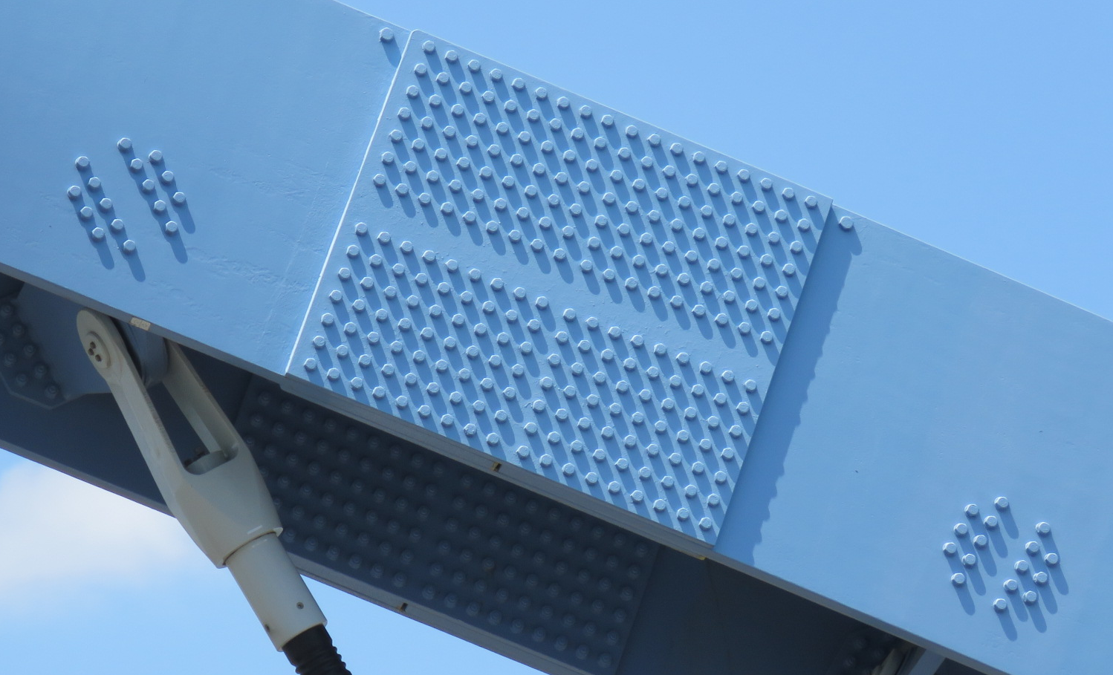
Clarification of Terms
WRT coating surfaces of joints
  “mating surfaces” - “faying surfaces” – “backside of bolt patterns”
WRT use of caulking
  “crevices” – “joints”
Others?

Slide 73
Page 20
Address the benefits of caulking crevices in the guidelines?
Fasteners
  How do we want to paint galvanized?
  Do we specifically require HDG fasteners (exclude mechanically galvanized)?

Slide 74
Page 23
Metallic coating repair
  Zinc primer associated with full system?
  Why bother with touchup at the plant?
HDG Surface Preparation
  Wet stain removal
Coating application
  Sealer vs Primer

Slide 75
New Sub-section – Zone Painting Strategies
Provide a duplex coating only for certain areas
  highly visible (fascia)
  highly exposed areas (i.e. beam ends under leaking joints)
  Other??

Slide 76
Section 5 – Application of Metallic Coating, Surface Preparation, and Application of Liquid Organic Coatings

Slide 77
Additional Text
Currently Section 5 directs the reader to other documents for metallic coating application
  Intended to keep focus on “duplex” elements
  Should subsections be added to discuss elements of the metallic coating application that are relevant to duplex
    E.g., HDG – do not use chromates; metallizing – impact of “spitting”

Slide 78
Section 6 – Repair and Maintenance of Duplex Coatings

Slide 79
Section 6 – Repair and Maintenance of Duplex Coatings
What types of maintenance are we concerned about?
  Punch list or disturbed coating repairs
  “Warranty” or early-breakdown repairs
  Mid-life maintenance
  Major recoat

Slide 80
Section 6 – Repair and Maintenance of Duplex Coatings
  Is a visual guide helpful?

Slide 81
Section 9 – Guide Specification for the Application of Liquid Coating Systems to Steel Bridges Coated with Thermal Spray Metal or Hot-Dip Galvanizing

Slide 82
5. Certifications and Qualifications
5.2. Qualifications and Certifications of companies and/or individuals that will perform TSC application shall be submitted for review and approval by the Engineer. Acceptable qualifications shall include AISC-420-10/SSPC-QP3 and AWS C2.16/C2.16M.
Note that the AISC Sophisticated Paint Endorsement and SSPC-QP3 are now a single standard. The proper terminology is:
  SSPC QP3/AISC 420.10 Certification Standard for Shop Application of Complex Protective Coatings Systems

Slide 83
11. Surface Preparation of Galvanizing
Address if repairs using ZRP shall be performed by the galvanizer; possible issues/concerns include:
  SP 16 may remove most/all ZRP repairs
  ZRP repairs may need to be removed if a chemical surface treatment is required
  ZRP repairs may have a counter-productive overcoat window
  Coating system may require a specific primer
  If the coating applicator to be responsible for galvanizing repairs, the galvanizer cannot "certify" the part meets A123 unless
  Solder/metallizing repair methods may not present any issues

Slide 84
11. Surface Preparation of Galvanizing
11.2.2 – In addition to referencing ASTM D 6386, should the document include a list of surface conditions to be smoothed?
  E.g., general roughness, high spots, drips, spikes, zinc splatter, dross inclusions, galvanizing skimmings, and rough surfaces resulting from thermally cut edges (especially flame cut edges) which are not prevented before HDG by grinding
11.8.1 "The thickness of HDG shall not be reduced to less than specified in A123"
  Can this requirement result in unnecessary burden with minor impact to corrosion protection?

Slide 85
19. Repair of Damage and Unacceptable Coatings
Types of repair are confusing - need to address better
HDG & Metallizing repairs are addressed in “7. Metallic Coating Materials and Installation”
  References AASHTO/NSBA S8.2 and S8.3
  Intended for the galvanizer or metallizer
  Clarify that those methods would apply for repairs down to bare steel resulting from damage during handling, erection or field modifications – this may replace 19.3?

Slide 86
19.3 (Repair of Damage and Unacceptable Coatings)
Current version of the specification uses 1% (of a project-agreed to area) as a criteria
Consider what was used on the Memorial Bridge
  Less than four square inches may be repaired with liquid paint
  More with than four square inches must be repaired with TSC

Slide 87
20. Environmental Protection and Waste Handling – ELIMINATE?
20.1. Containment shall be used to contain surface preparation debris and paint drips, spills, and overspray for disposal according to all applicable regulations. Fire-retardant materials shall be used. Details on the method of containment shall be provided with the submittals.
20.2. Operations shall cease immediately in the event of visible emissions or escapes of debris from the contained area. Operations shall not resume until remedial action and cleanup has been completed.
20.3. Spent materials from a containment enclosure or the work area shall be collected daily. All spent material paint waste and other project debris shall be handled, stored, transported, and disposed of according to all applicable federal, state, and local regulations.
20.4. WHAT IS THE POTENTIAL FOR HAZARDOUS WASTE- SHOULD THERE BE AN ACCOUNTING OF THE AMOUNT OF MATERIAL COLLECTED AND DISPOSED OF?

Slide 88
21.3. Quality Assurance
The Quality Assurance inspectors shall have a minimum certification of NACE Coating Inspector Level 2 or SSPC BCI Level 2 and have a minimum of 3 years’ experience in the industrial painting industry including at least two projects applying duplex coatings
  Do we need Level 3 Inspectors?
  Should 5.4 (QC Inspectors) have the same level of experience?
    5.4. Quality Control Inspectors - Inspectors shall have a minimum of 24 hours formal inspection training from NACE, SSPC, and a minimum two years’ experience in the industrial painting industry including at least one project applying a duplex coating.

Slide 89
Misc. Specification Issues
Paint application
  indicate that sealer and intermediate needs to fully cover the peaks of the TSC
  expanding on types of intermediate and topcoats
HDG condition
  addressing the surface prep for the HDG
  including language to address the age and condition of the HDG prior to paint
Pull Testing
  Impact of the selection of instrument for pull-off testing of TSC,
  that is not necessary to pull a work piece to failure when applying TSC, etc. May not be able to be specific, but at least we can include a commentary.
Caulking of crevices & joints
  Required? Commentary? Silent?

Slide 90
Open Discussion

Slide 91
What’s Next?

Slide 92
NCHRP 12-117, Guidelines for Corrosion Protection of Steel Bridges Using Duplex Coating Systems
Phase IV – Final Products
  (a) a final report that documents the entire research effort and
  (b) the proposed AASHTO guidelines and ballot, workshop materials, and implementation plan.
Completion Date – March, 2022 (Likely to be Delayed)
Anticipated Outreach
  Transportation Research Board - January 9–13, 2022 in Washington, D.C.
  AASHTO COBS Meeting – July 19-23, 2022 in Pittsburgh, PA
  Others TBD

Slide 93
Thank You!
If you have something more:
pault@elzly.com
609-374-7355

Slide 95

Guidelines for Corrosion Protection of Steel Bridges Using Duplex Coating Systems
NCHRP Project 12-117
2022 Outreach Briefing
November 3, 2021

Slide 96
Disclaimer
This investigation was sponsored by TRB under the NCHRP Program. Data reported are work in progress. The contents of this presentation have not been reviewed by the project panel or NCHRP, nor do they constitute a standard, specification, or regulation.
The National Cooperative Highway Research Program (NCHRP) is sponsored by the individual state departments of transportation of the American Association of State Highway and Transportation Officials. NCHRP is administered by the Transportation Research Board (TRB), part of the National Academies of Sciences, Engineering, and Medicine, under a cooperative agreement with the Federal Highway Administration (FHWA). Any opinions and conclusions expressed or implied in resulting research products are those of the individuals and organizations who performed the research and are not necessarily those of TRB; the National Academies of Sciences, Engineering, and Medicine; the FHWA; or NCHRP sponsors.

Slide 97
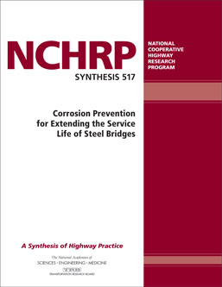
NCHRP Synthesis 517
Corrosion Protection For Extending Steel Bridge Service Life

Slide 98
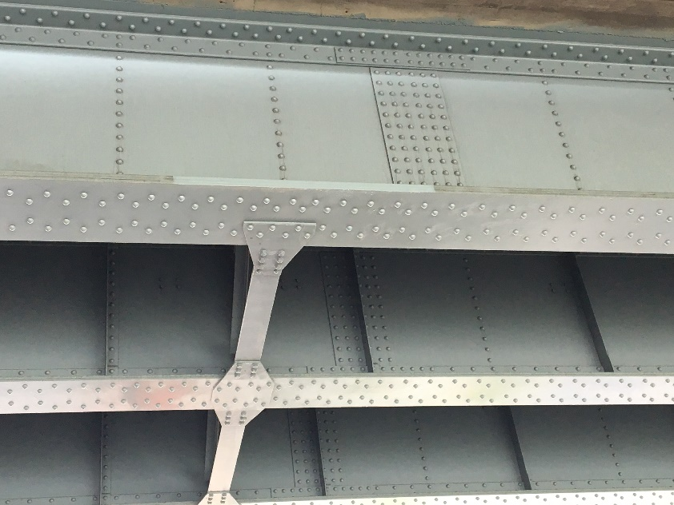
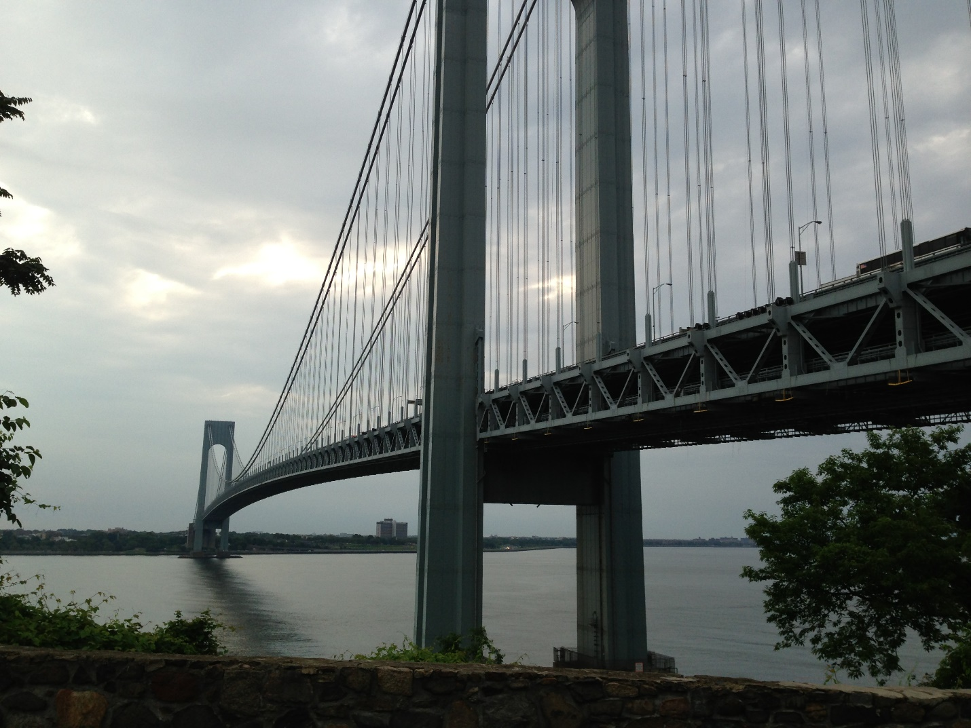
State of the Practice for Design of Coated Steel Structure
Design Coated Steel
Design Uncoated Steel
Maintain Coated Steel
Maintain Uncoated Steel
Predominately 3-coat liquid coating system with zinc primer applied over blasted steel
  Primer applied in shop
  Remainder shop or field
15-50 year service life
Susceptible to damage during erection and in service
Perhaps not always the most cost-effective coating option

Slide 99
State of the Practice for Design of Coated Steel Structure
Design Coated Steel
Design Uncoated Steel
Maintain Coated Steel
Maintain Uncoated Steel
Predominately 3-coat liquid coating system with zinc primer applied over blasted steel
  Primer applied in shop
  Remainder shop or field
15-50 year service life
Susceptible to damage during erection and in service
Perhaps not always the most cost-effective coating option

Slide 100

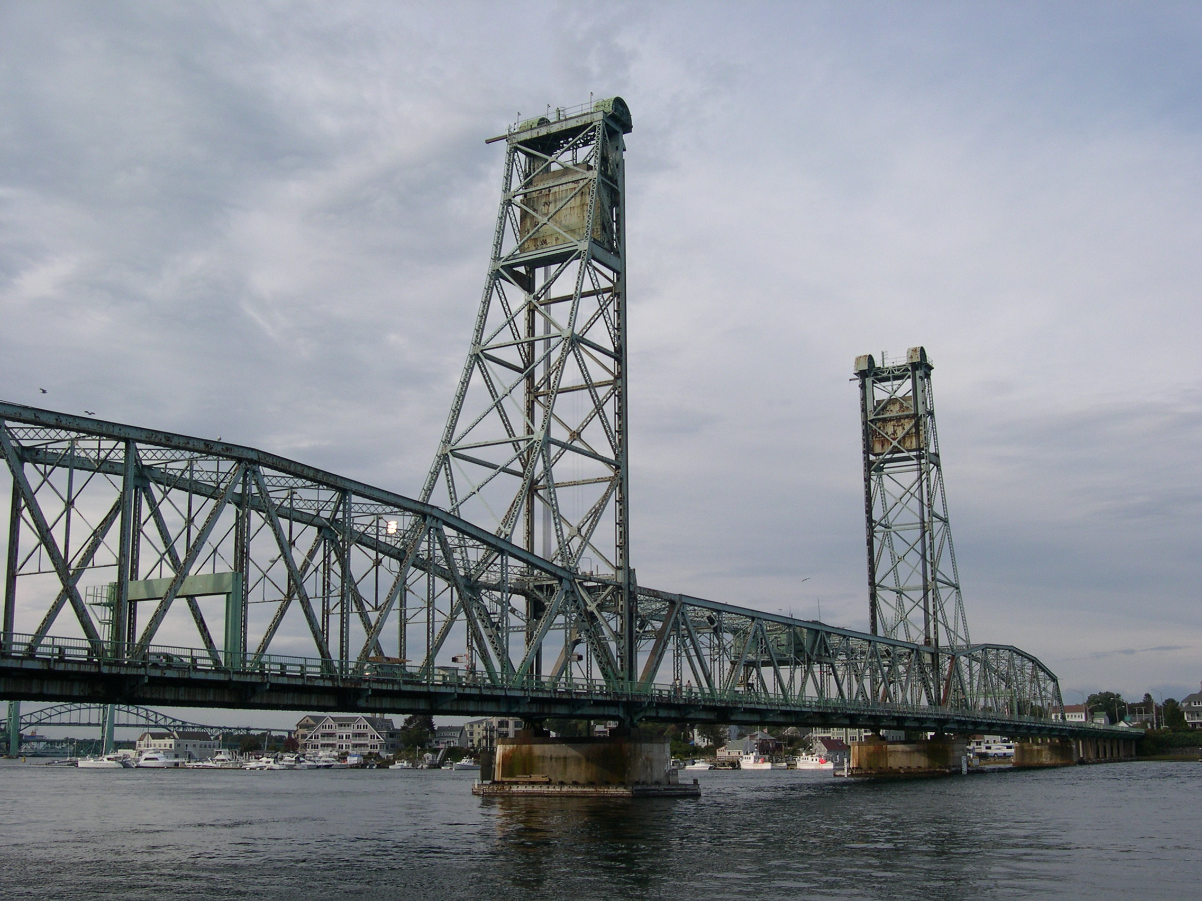
Future Direction for Design of Coated Steel Structure
Design Coated Steel
Design Uncoated Steel
Maintain Coated Steel
Maintain Uncoated Steel
Metallized or galvanized steel with protective organic coating
  35-75 year service life
  More robust protection against mechanical damage
Other coating options for specific circumstances
  Zone Painting
  Single coat IOZ
  Gloss & color retentive finish coats
  Rapid cure
  High build
Optimizing Coating Options

Slide 101
NCHRP 12-117
The objectives of this research are to:
  (1) develop AASHTO guidelines for corrosion protection using duplex coating systems for extending the service life of steel bridges that can be adopted by AASHTO and
  (2) plan and conduct a workshop to demonstrate the use of proposed guidelines to an audience of DOT staff and other stakeholders.
The guidelines shall cover the selection and application of duplex coating systems during the new design, and maintenance and rehabilitation of existing steel bridges.
  A research report will also be available online
Expected Report Date – Late 2022

Slide 102
Background

Slide 103
No Common Definition of a “Duplex” Coating
Organic Coating System
(sealer, one or multiple coats)
Metallic Coating
(TSC or Galvanizing)
Steel Substrate

Slide 104
Why Use Duplex Coating?
Paint protects the Metallic Coating
Only the exposed Metallic Coating Corrodes
Metallic coating “life” begins later”
Notes:
Images contain several concepts
Graph details:
Percentile is cumulative probability of observation. Age is in years.
The coating system is 4 mils of Zn with 8 mils of Alkyd in 4 coats. The Alkyd primer changed from a zinc chromate to zinc phosphate in 1977.
The legend refers to ISO environmental corrosivity (5 is worst)
Red is bad in the sense that maintenance was required, however said maintenance was generally maintenance of the alkyd to protect the TSZ.

Slide 105
What Can Go Wrong?

Slide 106
Summary of Project Testing
Study 1 – Quantitative Detection of Zinc Hydroxide (HDG) and Oxides (TSC)
Study 2 – Comparison of Epoxy Coatings from Three Manufacturers to Select a Product for Further Testing Under Study 3
Study 3 – Adhesion of Epoxy Coating over Various Concentrations Oxides (HDG and TSC) After Cleaning using Different Methods of Preparation
Study 4 – Slip Resistance Testing
Study 5 – Segmented Cell Testing of Metallic Duplex Systems

Slide 107
Summary of Project Testing
Study 1 – Quantitative Detection of Zinc Hydroxide (HDG) and Oxides (TSC)
Study 2 – Comparison of Epoxy Coatings from Three Manufacturers to Select a Product for Further Testing Under Study 3
Study 3 – Adhesion of Epoxy Coating over Various Concentrations Oxides (HDG and TSC) After Cleaning using Different Methods of Preparation
Study 4 – Slip Resistance Testing
Study 5 – Segmented Cell Testing of Metallic Duplex Systems
Corrosion in the span of weeks is less significant than stringent “time to paint” requirements suggest
Contamination appears more significant than “oxide formation”
Coatings applied over galvanizing perform better with some sort of surface preparation
TSC needs to be “clean”

Slide 109
Summary of Project Testing
Study 1 – Quantitative Detection of Zinc Hydroxide (HDG) and Oxides (TSC)
Study 2 – Comparison of Epoxy Coatings from Three Manufacturers to Select a Product for Further Testing Under Study 3
Study 3 – Adhesion of Epoxy Coating over Various Concentrations Oxides (HDG and TSC) After Cleaning using Different Methods of Preparation
Study 4 – Slip Resistance Testing
Study 5 – Segmented Cell Testing of Metallic Duplex Systems
Data generally supports combinations of metallic coatings
Electrochemical data may be able to reduce approval test periods

Slide 110
Selected Project Case Studies

Slide 111
New Structures

Slide 112
Accelerated Bridge Construction

Slide 113
Signature Bridges

Slide 114
Signature Bridges

Slide 115
Older Structures

Slide 116
Field Metallizing

Slide 117
Overview of Guidelines

Slide 118
Duplex Coating Selection and Use Guideline
Section 1 – Introduction to Duplex Coatings – Definitions Limitations, and Case Histories
Section 2 – Qualification of Duplex Coating Systems
Section 3 – Duplex Coating System Selection Criteria and Cost Analysis
Section 4 – Structural Design and Fabrication Considerations
Section 5 – Application of Metallic Coating, Surface Preparation, and Application of Liquid Organic Coatings
Section 6 – Repair and Maintenance of Duplex Coatings
Section 7 – Quality Control and Inspection
Section 8 – Qualifications (applicator and inspector)
Section 9 – Specification for Duplex Coating Steel Bridges

Slide 119
Section 2 – Qualification of Duplex Coating Systems
Qualification testing could leverage existing NTPEP protocol with modifications or supplemental data:
Test | AASHTO NTPEP Tests for Liquid- Applied Coatings | Modifications for Tests to be performed on Duplex Coating Systems
1 | Slip Coefficient/Tension Creep (primer only) | Test may not be needed if existing testing of bare galvanizing and/or bare metallizing is available
2 | ASTM B117 Salt Fog Resistance (5,000 hours) – panels are scribed to the bare steel prior to exposure to address rust creepage | Test cycle is appropriate, but two scribes should be made for evaluation – one to the steel, and one to the metal layer to assess both undercutting of the metal coating, and separation of the liquid coating from the metal coating
3 | ASTM D5894 Cyclic Weathering Resistance (5,040 hours [15 – 336-hour cycles]). Same scribing as salt fog. | Test cycle is appropriate with same modifications to scribe as for salt fog.
4 | ASTM D4541 Tensile Adhesion | No change needed.
5 | Freeze Thaw Stability (30-days) | No change needed.
6 | Coating Identification tests – a battery of tests is included to fully characterize each of the liquid-applied coatings | The battery of tests is appropriate for the coatings applied to the metal coating, but in addition, the metal coatings should be characterized as described in galvanizing and metallizing specifications

Slide 120
Section 3 – Duplex Coating System Selection Criteria and Cost Analysis
Step 1 – Can Duplex Coatings be used on a given structure?
Step 2 – Compare the installed and life-cycle costs of candidate duplex and liquid-applied coating systems
Step 3 – Confirm the constructability and acceptability of the maintenance requirements
Step 4 – Make the final selection
Appendices – Discuss Life Cycle Cost Analysis and Provide Examples

Slide 121
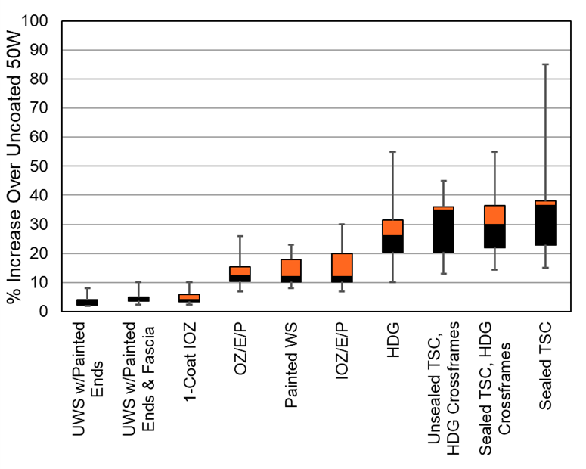
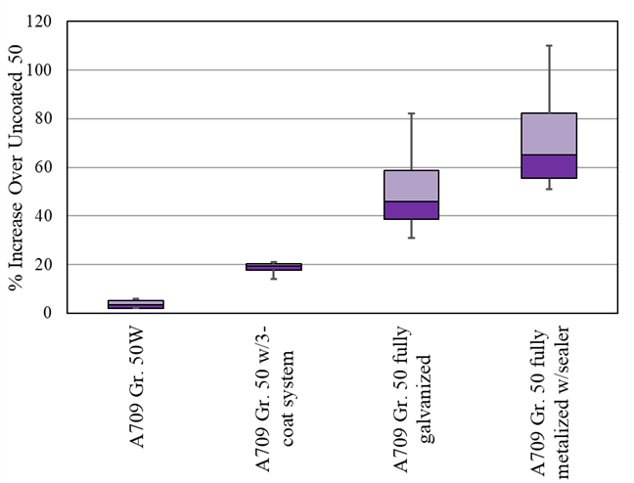
Section 3 – Duplex Coating System Selection Criteria and Cost Analysis
Decreasing Cost of Sealed TSC

Slide 122
Section 3 – Duplex Coating System Selection Criteria and Cost Analysis
Installed Cost Factors
Life Cycle Maintenance Cost Factors
Availability of certified personnel and companies
HDG Considerations
Facility/Contractor Capabilities
Field vs Shop
Zone Painting
Coating Cost
Surface Preparation
User Cost
Economic Factors
Maintenance Frequency and Cost
Macro Environment
Use of De-icing Salts
Desired Maintenance Condition

Slide 123
Section 4 – Structural Design and Fabrication Considerations
Design Detailing
Progressive Dipping (HDG)
Slip Coefficient
Galvanized vs Black Bolts
Caulking Crevices
Weld Sequencing
Environment Corrosivity
Zone Painting
Allowing coating options & material combinations

Slide 124
Section 5 – Application of Metallic Coating, Surface Preparation, and Application of Liquid Organic Coatings
Metallic Coating Application
  ASTM A123/A123M, Standard Specification for Zinc (Hot-Dip Galvanized) Coatings on Iron and Steel Products
  ASTM A780/A780M, Standard Practice for Repair of Damaged and Uncoated Areas of Hot-Dip Galvanized Coatings
  AASHTO/NSBA Steel Bridge Collaboration (AASHTO/NSBA) specification “Hot Dip Galvanizing Specification for Bridge and Highway Structure Elements
  SSPC-CS 23.00/AWS C.2.23/NACE No. 12, “Specification for the Application of Thermal Spray Coatings (Metallizing) of Aluminum, Zinc, and Their Alloys and Composites for the Corrosion Protection of Steel”
  AASHTO/NSBA and SSPC Specification S8.2-2017/SSPC PA18, Specification for Application of Thermal Spray Coating System to Steel Bridges
Surface Preparation of Metallic Coating
  Recommend SSPC-SP 16, Brush off Blast Cleaning preparation of HDG
  Recommend SSPC-SP 1 surface preparation if the organic coating is applied within 48 hours of TSC application
Liquid Coating Application
  Note the need to seal the porosity of TSC to prevent outgassing

Slide 125
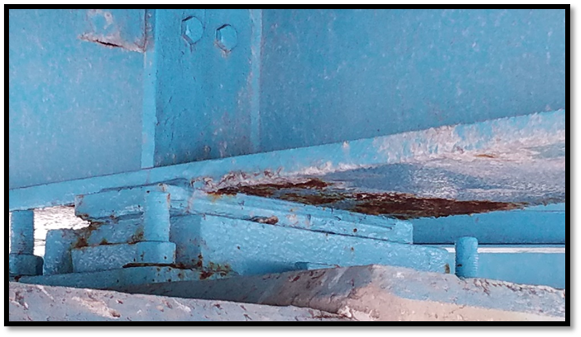
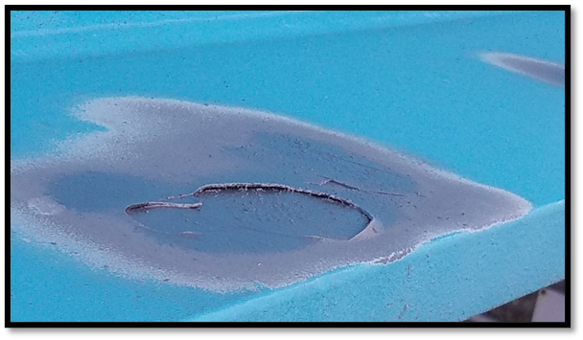
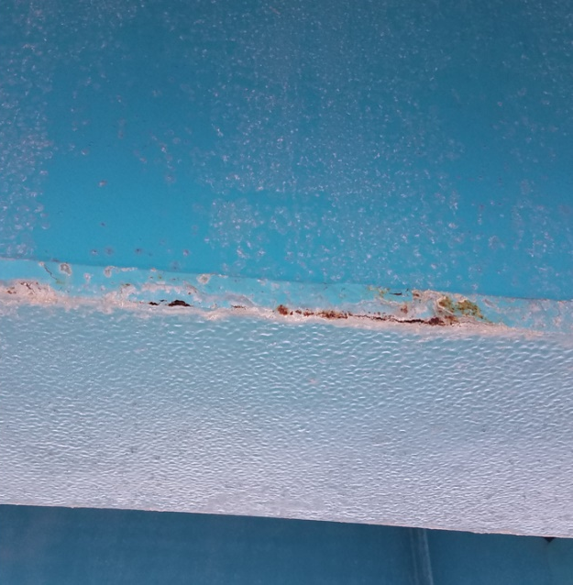
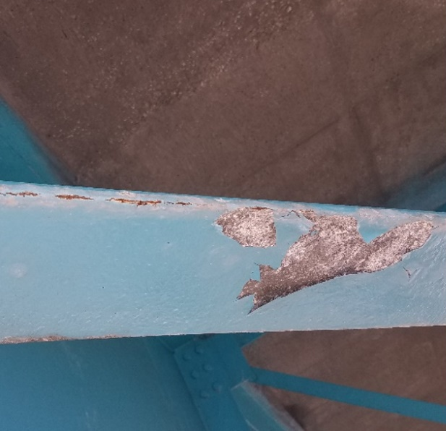
Section 6 – Repair and Maintenance of Duplex Coatings

Slide 126
Section 6 – Repair and Maintenance of Duplex Coatings

Slide 127
Section 7 – Quality Control and Inspection
Discusses unique ways to assess “white oxides” and their impact
  Tape adhesion, pH, Conductivity
  Subsequent paint adhesion
Refer to industry standard quality checks for galvanizing, metallizing and liquid coating application
Recommend anniversary inspection

Slide 128
Section 8 – Qualifications (applicator and inspector)
SSPC-QP6, “Standard Procedure for Evaluating the Qualifications of Contractors Who Apply Thermal Spray (Metallizing) for Corrosion Protection for Steel and Concrete Structures,”
SSPC-QP1, “Standard Procedure for Evaluating the Qualifications of Industrial/Marine Painting Contractors” (Field Application to Complex Industrial Steel Structures and Other Metal Components),
AISC-420-10/SSPC-QP3, “Certification Standard for Shop Application of Complex Protective Coating Systems.” Ideally QP6 should be required if metallizing is part of the duplex system, along with QP1 if field application of coatings is specified or QP3 if shop application will be performed.
AWS C2.16/C2.16M, “Guide for Thermal Spray Operator Qualification Programs”

Slide 129
Section 9 – Specification for Duplex Coating Steel Bridges
1. Introduction
2. Applicable Specifications and Documents
3. Definitions
4. Submittals
5. Certifications and Qualifications
6. Paint Materials
7. Metallic Coating Materials and Installation
8. Compressed Air Cleanliness
9. Lighting
10. Test Sections (Hold Point)
11. Surface Preparation of Galvanizing (Hold Point)
12. Surface Preparation of TSC (Hold Point)
13. Mixing of Coatings (Hold Point)
14. Ambient Conditions for Painting
15. Painting of Galvanizing (Hold Point)
16. Painting of TSC (Hold Point)
17. Film Continuity (Hold Point)
18. Slip-Critical Connections and Fasteners (Hold Point)
19. Repair of Damage and Unacceptable Coatings (Hold Point)
20. Environmental Protection and Waste Handling
21. Quality Control and Quality Assurance
22. Testing of Coating Materials

Slide 130
Vision - Integrated AASHTO Guidelines& Specification for Steel Structure Coatings
Duplex Coating Selection and Use Guideline
Working through COBS for approval as AASHTO document
S8.x-20xx Specification for Duplex Coating Steel Bridges
S8.x-20xx Specification for Galvanizing Steel Bridges
S8.1-2014 Guide Specification for Application of Coating Systems with Zinc-Rich Primers to Steel Bridges
S8.2-2017 Specification for Application of Thermal Spray Coatings for Steel Bridges
Gray – Existing Documents
Yellow – To be addressed by this project

Slide 131
Thank You!
Pete Ault
KTA-Tator/Elzly Technology
pault@elzly.com
609-374-7355

