Slide 1
NCHRP Project 20-102(28),
“Preparing Transportation Agencies for Connected and Automated Vehicles in Work Zones”
Assessing Benefits and Challenges

Slide 2
Available Resources
Understanding the Technologies PowerPoint
Provides an overview of CAV- and infrastructure-based technologies and how these may improve work zone safety
Provides infrastructure-based solutions that can be either technology- or non-technology-based that an agency can implement to facilitate CAV technologies
Supporting CAVs in Work Zones Handout
Stakeholder support
Sources of technical and financial resources
Relevant specifications and standards
A Framework for Assessing Benefits and Costs PowerPoint (this document)
Provides a framework for conducting benefit/cost assessments
Provides a tool for use in the assessment of benefits, costs, and challenges for selected work zone CAV applications
Helps practitioners better understand the challenges, limitations, and data availability for CAV benefit-cost analyses (BCAs)

Slide 3

Background
Objective
  Develop a framework for conducting benefit/cost assessments
  Assess benefits, costs, and challenges for selected work zone CAV applications
  Understand challenges, limitations, and data availability for CAV benefit-cost analyses (BCAs)
Learning Outcomes
  Understanding factors affecting benefits and costs of work zones CAV applications
  Knowledge about the potential benefits and costs of CAV applications
  Awareness of the challenges for CAV deployment at work zones and/or CAV benefit-cost assessment
  Prepares state DOTs for taking/weighing actions to facilitate the deployment of work zone CAV applications
  Helps state DOTs conduct benefit/cost assessments using the framework

Slide 4

Outline of this Module
The BCA framework for CAV work zone applications
  Steps involved in a BCA for work zone CAV applications
  Factors/considerations for each step in the BCA
  Challenges
Benefit-cost analysis methodological notes
  Identifying and quantifying benefits and costs
  Example BCA approach – computing benefit-cost ratios (BCRs)
  Resources for conducting BCAs for CAV work zone applications
Benefit-cost assessments for sample CAV work zone applications
  Lane keeping
  Queue warning system for work zones with CV support
  Automated truck-mounted attenuators (ATMAs)
  Work zone traveler information system (WZTIS) with CV support

Slide 5
Framework for Benefit-Cost Analysis of CAV Work Zone Application
Notes:
This figure is an overview of the proposed framework for the benefit, cost, and challenge analysis of CAV work zone applications to be performed under this project. This framework is formulated around three types of components: (1) activities or steps forming a general analysis procedure, (2) potential challenges, and (3) considerations or options involved in each step. The following slides will talk about each step in more detail.

Slide 6
BCA: Identify Audience and Scope, Determine Timeline
Identify audience and scope
  What type of CAV application is analyzed (e.g., roadway/crew based versus vehicle based)?
  What is the purpose of the BCA (e.g., public information/education, prioritizing CAV apps at an IOO, or supporting app deployment at an IOO)?
  What benefit/cost aspects are of interest to the audience?
Determine timeline for the BCA
  CAV applications are technologies, and technologies advance/evolve quickly
    Is the technology mature?
    Where is the technology going in the foreseeable future?
    Can we reliably predict the deployment perspective/cost trend?
  Choose a reasonable timeline, acknowledge the limitations
Notes:
Identify audience, priorities and scope. The identification of the intended audience needs to take into consideration the type of applications (e.g., applications based on roadway or construction crew/equipment and applications based on personal vehicles) and the purpose of the BCA. Depending on the type of audience (e.g., technology developers, technology users, and transportation agencies) and the priorities of the analysis, some cost and benefit items may not necessarily be considered. For this reason, it is important, yet in many cases challenging, to identify the target audience and the priorities that need to be addressed during the analysis. During this project, however, the benefit assessment effort will be primarily focused on transportation agencies as the target audience. To the extent needed, the benefit assessment for the selected CAV applications will discuss other types of audiences as well.
Determine timeline. CAV applications are technological developments that are time sensitive. During their service lives, such applications can change rapidly in costs, configuration/components, and market penetration. Due to this, analyses with a focus of different timeframes need to make different assumptions and consider different scenarios in terms of adoption rate, technology efficacy, and, in turn, costs and benefits.

Slide 7
BCA: Identify and Assess Benefits and Costs
Understand the technology
  How it works, major hardware/software components, purpose and functioning mechanisms
Potential costs to consider
  Materials and initial installation/acquisition
  Operations and maintenance
  Supporting/required services
  Cost occurrence timeline
Potential benefits to consider
  Safety benefits
  Operations benefits
  Environmental benefits
  Infrastructure benefits
  Other benefits (accessibility, equity, land use, etc.)
BCA scope
  All costs/benefits versus specific costs/benefits
Data availability and limitations
Notes:
There are potentially a large number of benefit and cost items that need to be considered in a comprehensive BCA. Data availability, such as costs, benefits, and exposure data, are critical for the overall assessment of both benefits and costs. During this process, it is critical to make reasonable assumptions in consideration of data availability, data collection efforts, and acceptable analysis accuracy. Any assumptions, however, should be provided with sufficient support and justifications based on available data, literature, and stakeholder input.

Slide 8
BCA: Select Metrics and Conduct Analysis
Select metrics for BCA
  Benefits or costs or both?
  Qualitative or quantitative metrics?
  BCR, return on investment, cost effectiveness, etc.
Conduct analysis
  Select base year
  Converting past costs
  Discounting future dollars
Assess challenges
  Data availability and implications to BCA results
  Challenges affecting technology deployment
    Market readiness of technology
    Policy/legal
    Leadership/willingness
    Public acceptance/perception
    Funding/resources
Notes:
Select benefit-cost metrics. A potentially large variety of benefit and/or cost metrics are available depending on the required end results of the analysis. Based on the audience and priorities, studies may focus on only benefits or costs or both. In general, both benefit and cost items can be classified as qualitative or quantitative. Quantitative measures can be further monetarized if so desired in order to develop overall benefit-cost measure such as benefit-cost ratio (BCR), return on investment, and cost effectiveness. Note that challenges, in many cases, are difficult to quantify and therefore are most likely be addressed qualitatively.
Conduct analysis and assess challenges. This is the step that compiles the benefit-cost data into the needed measures and outputs required for the benefit-cost measurements. This process involves a number of economic considerations and computations. Additionally, the comprehensive assessment of challenges requires a deep understanding of the concept, functions, and system design for the subject CAV work zone applications. The challenge assessment should particularly consider those relevant to the development, deployment, and optimization of the applications.

Slide 9
BCA: Outreach/Results Dissemination and Accelerate Deployment
Outreach/results dissemination
  Reach out to targeted audience
  Improve understanding with data-driven/quantitative benefits
Accelerate deployment
  Gain support from stakeholders
  Secure/allocate needed resources
Notes:
Outreach for stakeholder/public support. The purpose of a BCA is ultimately for the audience (transportation agencies in the case of this project) to understand the potential benefits and associated costs and challenges of the subject CAV applications. With this information, the public and/or stakeholders may make better decisions either for the selection and prioritization among different technological options or to provide support for the accelerated deployment of the technologies. The outreach effort can be conducted in a number of venues based on the target audience, and may include publications, fliers/digests posted online or distributed via emails, outreach meetings, and public campaigns.
Accelerate deployment/maximize benefit. The BCA results help stakeholders to understand the potential return on investment if such applications are deployed, which in turn helps accelerate large scale deployment and maximizing potential benefits.

Slide 10
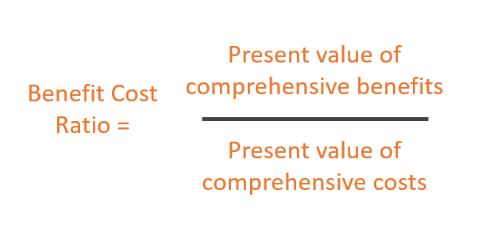
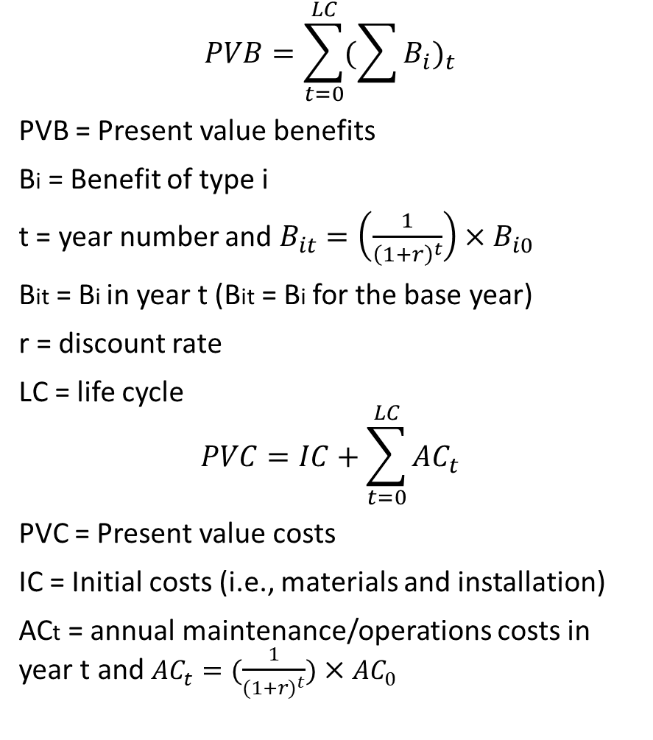
Example BCA Approach: Calculate Lifecycle BCRs
$$PVB=\sum_{t=0}^{LC}{{(\sum{B_{i}})}_{t}}$$
PVB = Present value benefits
Bi = Benefit of type i
t = year number and $B_{it}=\left(\frac{1}{{\left(1+r\right)}^{t}}\right)×B_{i0}$
Bit = Bi in year t (Bit = Bi for the base year)
r = discount rate
LC = life cycle
$$PVC=IC+\sum_{t=0}^{LC}{{AC}_{t}}$$
PVC = Present value costs
IC = Initial costs (i.e., materials and installation)
ACt = annual maintenance/operations costs in year t and ${AC}_{t}=(\frac{1}{{(1+r)}^{t}}){×AC}_{0}$
Source: American Association of State Highway and Transportation Officials, 2010

Slide 11

Work Zone CAV BCA Resources (among Others)
BCA general guidance
  Highway Safety Manual
  FHWA guidelines, references, and tools
  USDOT Office of the Secretary of Transportation publications
Benefits/costs assessment
  Crash costs (NHTSA injury unit costs for crashes, FHWA crash unit costs)
  National crash data: NHTSA Fatality Analysis Reporting System (FARS)
  Crash Modification Clearinghouse
  ITS Deployment Evaluation – USDOT ITS joint Program Office
Economic data/resources
  Consumer Price Index – U.S. Bureau of Labor Statistics
  Employment Cost Index – U.S. Bureau of Labor Statistics
  National Highway Construction Cost Index - FHWA
Work zone and travel related statistics
  FHWA highway and related statistics
  BTS freight and travel statistics
  National Work Zone Safety Information Clearinghouse
Other resources
  Census American Community Survey data
  State data sources (roadway, safety, vehicle, driver, project, bid/contract databases)

Slide 12
Work Zone CAV BCA Case Studies
Lane keeping systems in work zones
Work zone queue warning system with CV support
Automated truck-mounted attenuator (ATMA) systems
Work zone traveler information system with CV support

Slide 13
BCA Case Study 1: Lane Keeping Systems in Work Zones
Function description
  Use machine vision systems to detect vehicle lane position
  Focus on lane keeping assist and lane centering assist (both provide steering assist)
  Levels of automation: Level 1 - Driver Assistance
Potential audience for BCA
  Federal, state, and local transportation agencies (i.e., IOOs)
  Public and private sectors including vehicle owners for comprehensive benefits/costs
  Vehicle owners for the return on investments of such systems from a user perspective
BCA considerations
  Which audience? (has implications for the costs and benefits to be considered)
  What is the projected market penetration?
  What is the safety effectiveness of such systems in work zones?
  How to enhance work zones to enable such systems?
  How many work zones are there that can/should benefit from such systems?

Slide 14

BCA Case Study 1: Lane Keeping Systems in Work Zones
Key decisions and assumptions
Select audience of this BCA
  IOOs due to the project scope and target users of the products
Major benefits
  Potential benefits: safety, operations, reduced work zone delay due to reduced crashes (hard to quantify), reduced vehicle operational costs for owners
  Considered only safety benefits due to reduced crashes (includes operational and environmental costs associated with the reduced crashes)
Major costs
  Potential costs: work zone enhancement costs for IOOs, added price for vehicle owners
  Considered only work zone enhancement costs due to selected audience
Scope and timeline of BCA
  Potential scope and timeline scenarios: nationwide versus
  individual work zone, service life of systems versus individual
  work zone duration, etc.
  Challenges: different individual work zone durations and
  conditions
  Final analysis scope and timeline: (A) nationwide for 1 year,
  and (B) an individual hypothetical work zone for 1 year

Slide 15
BCA Case Study 1: Lane Keeping Systems in Work Zones
Forecast market penetration rate
Data sources
  NHTSA’s Annual Technology Adoption Survey (2013-2018) as part of the New Car Assessment Program
  Total vehicle registrations by year at FHWA
  Annual new light weight vehicle sales data at Federal Reserve Bank
Methods used for predictions
  Projection of total U.S. vehicles: linear regression
  Projection of annual vehicle sales: last 10-year average (highly affected by economic conditions, e.g., the COVID pandemic)
  Market penetration rate of lane keeping systems: linear regression

Slide 16
BCA Case Study 1: Lane Keeping Systems in Work Zones
Projected market penetration rate for lane keeping systems

Slide 17
BCA Case Study 1: Lane Keeping Systems in Work Zones
Safety benefits of lane keeping systems in work zones
Limited literature showing safety effects of lane keeping systems in work zones
Effectiveness estimation method:
  Identify work zone crashes by type (fixed-object involving roadside objects, head-on opposite direction, sideswipe same or opposite direction, roadway departure, and cross centerline/ median)
  Assume different effectiveness levels for preventing relevant crash types
  Work zone crash percentages by type and severity based on seven states and 2019
Estimated Total Annual Work Zone Crashes Relevant to Lane Keeping Nationwide
Notes:
K: fatal crashes
A: serious injury crashes
B: minor injury crashes
C: possible injury crashes
O: property-damage-only crashes

Slide 18
BCA Case Study 1: Lane Keeping Systems in Work Zones
Estimated work zone crashes prevented and total benefits annually nationwide
Effectiveness = 0.5
Effectiveness = 0.75

Slide 19
BCA Case Study 1: Lane Keeping Systems in Work Zones
Estimated work zone annual nationwide work zone enhancement costs
Potential work zone enhancement costs to enable lane keeping systems
  Complete removal of existing lane markings and reconditioning the scratched/masked pavement surface
  Temporary pavement markings with performance and visual characteristics comparable to permanent lane markings
  Improved transition between permanent lane markings and temporary markings
  Improved pavement surface for work zones due to new construction, repaving, and/or resurfacing work that requires removal of existing pavement surface and/or use of temporary roadway surface layers
Cost assumption: enhancement cost is the difference between permanent markings and temporary markings due to limited data
Pavement marking costs estimated based on 2019-2021 VDOT statewide average bid prices and literature review

Slide 20
BCA Case Study 1: Lane Keeping Systems in Work Zones
Estimated work zone annual nationwide work zone enhancement costs
Estimated lane marking enhancement unit cost: $0.74/LF in 2020 dollars
Estimate total annual nationwide work zone lane marking enhancement costs
  Work zone on interstates: total lane markings = 8,994,483 miles (assuming an average of 2.5 lanes for each work zone)
  Work zone on non-interstates: total lane markings = 7,922,614 miles (assuming an average of 3 lanes for each work zone)
  Total annual nationwide lane marking enhancement costs: $66 billion
Notes:
For the sake of this BCA, the team used the unit cost difference between 6” Type B Class II markings (i.e., $2.24/LF) and 4” Type D Class II temporary markings (i.e., $1.50/LF), which was calculated as $0.74/LF in 2020 dollars.

Slide 21
BCA Case Study 1: Lane Keeping Systems in Work Zones
Final BCA findings for lane keeping systems in work zones
BCRs for enhancing lane markings to enable
lane keeping functions in work zones –
effectiveness = 0.75
National policy not justified by BCRs
BCRs for enhancing lane markings based on individual work zones
  Work zone duration: 1 year
  Work zone length: 5-mile
  freeway segment (single
  direction)
  Work zone settings: three
  lanes and an ADT of 100,000
Notes:
The previous slides discussed the estimated total annual costs for enhancing the lane markings for all work zones across the country and the benefits associated with the potentially prevented work zone crashes. Based on these results, it was straightforward to use benefit-cost ratios as a measure for the return on investment for IOOs when considering enhancing the work zone lane markings. The first table lists the benefit-cost ratios for years 2023–2030 assuming an effectiveness of 0.75. The BCR estimates for lower effectiveness scenarios were not presented due to their lower values. For these estimates, note that benefits were estimated based on 2019 crash data and 2020 lane enhancement costs. Based on the BCA results, the BCRs for enhancing lane markings in all work zones were estimated to be significantly lower than one. This indicates that it would not make sense before 2030 to make blanket policies on the enhancement of work zone lane markings towards reliable performance of lane keeping functions assuming lane enhancement costs would not significantly decrease. Please note that the work zones considered in this analysis scope included all types of work zones, including short-term and/or mobile work zones for which lane marking enhancement would be unnecessary and/or impractical.
To illustrate the benefits of lane keeping systems in large, major work zones, the project team also conducted a benefit cost analysis for a typical freeway work zone. For this purpose, the research team first estimated the number of work zone crashes that could be prevented by lane keeping systems per VMT based on the total nationwide VMT and the total crashes of types relevant to lane keeping systems. Assuming a one-year work zone on a five-mile freeway segment (single direction) with three lanes and an ADT of 100,000, the BCRs were estimated in the second table above. As the results show, the BCRs for enhancing work zone lane markings to utilize the safety benefits of lane keeping systems considerably exceed one, indicating the importance for lane marking enhancement at long-term work zones on major facilities carrying significant ADT.

Slide 22
BCA Case Study 1: Lane Keeping Systems in Work Zones
Challenge assessment
Lack of data for state and national work zone statistics
  Very difficult to find detailed work zone statistics by work type, facility type, etc.
  Challenging for work zone related analyses to facilitate policy making
Lack of effectiveness assessment for lane keeping systems
  Few studies conducted reliable assessment of the safety effect for lane keeping systems
Public acceptance of the lane keeping systems
  Some users turn off lane keeping systems believing they offer no tangible safety benefits or thinking they are annoying
Lack of work zone related cost data
  States do not track detailed cost data by cost items in work zones
Work zone crash data needs
  A reliable way to predict work zone crash risks
  Safety performance functions or crash modification factors for work zones are needed

Slide 23
BCA Case Study 2: Queue Warning System for Work Zones
Function description
  Targets traditional vehicles with ITS devices, with a CV component to better target CVs
  Has an enhanced traffic management controller (including software to generate safety messages and communicate with CVs)
  Communication support via DSRC or cellular connectivity
Potential audience for BCA
  Federal, state, and local transportation agencies (i.e., IOOs)
  Public and private sectors including vehicle owners for comprehensive benefits/costs
  Vehicle owners for the return on investments of such systems from a user perspective
BCA considerations
  Which audience? (has implications for the costs and benefits to be considered)
  What is the projected market penetration (little information found in the literature)?
  What is the safety effectiveness of such systems in work zones?
  What are the hardware/software components?
  How many work zones are there that can/should benefit from such systems?

Slide 24
BCA Case Study 2: Queue Warning System for Work Zones
Key decisions and assumptions
Select audience of this BCA
  IOOs due to the project scope and target users of the products
Scope and timeline of BCA
  BCA conducted only for the CV portion of the system
  Queue warning systems are mostly used for longer term work zones on major arterials
  Assumed a 5-year service life for software and hardware
  BCA conducted over service life and for a hypothetical work zone on a typical freeway section
  Used hypothetical market penetration rates: could not be reliably projected (lack of data and studies)
Major benefits
  Potential benefits: safety, operations, reduced work zone delay due to reduced crashes (hard to quantify), reduced vehicle operational costs for owners, etc.
  Safety benefits are the dominant
Major costs
  Potential costs: system hardware and software for IOOs, added price for vehicle owners
  Considered only costs to IOOs

Slide 25
BCA Case Study 2: Queue Warning System for Work Zones
Safety benefits estimation
Safety benefits of work zone queue warning systems
  44% reduction of rear-end collisions for the non-CV portion of the system
  The effect of the CV portion only applies to the remaining rear-end crashes
Average percent of rear-end collisions in work zones by severity estimated based on 2019 crash data for eight states
Estimated Per-Million-VMT Rear-End Work Zone Crash Rates by Severity

Slide 26

BCA Case Study 2: Queue Warning System for Work Zones
System costs estimation (CV portion)
Information collected based on literature review
Assumed the costs for the traditional portion of the queue warning system would not change due to the added CV functions
Cost estimates
  Communications support
    Roadside units (RDUs): $5,000 per unit (2020 $) one-time charge with a $1,000 annual maintenance cost
    Cellular services: no added costs beyond existing cellular services required by the non-CV functionality
  Software upgrade to enable V2I communications
    $100,000 per system one-time charge with a 10% (i.e., $10,000) yearly maintenance fee

Slide 27
BCA Case Study 2: Queue Warning System for Work Zones
BCA results
Used a typical freeway work zone for demonstration
Used multiple market penetration and system effectiveness scenarios
Basic Information and Assumptions for the Queue Warning BCA

Slide 28
BCA Case Study 2: Queue Warning System for Work Zones
BCA results
Total Lifetime Benefit of CV Queue Warning Component Due to Crash Reduction
Lifetime BCRs for the CV Portion of a Work Zone Queue Warning System
= Effectiveness of the CV portion of the queue warning system
= CV market penetration rate
Notes:
The first table lists the annual average work zone crashes prevented attributable to the added CV component of the work zone queue warning system for the hypothetical work zone type at a usage rate of 50%. It also lists the corresponding benefits in 2020 dollars. The values were calculated for two effectiveness scenarios (i.e., $e_{CVQW}$ = 0.75 or 1) and three hypothetical market penetration rates (i.e., $r_{CV}$ = 5%, 10%, or 25%).
Using the estimated costs and benefits, the second table shows the calculated lifetime BCRs for different effectiveness, market penetration rates, and communication mechanisms. The results showed that, assuming that the CV queue warning system is 100% effective for CVs in preventing rear-end crashes and when using DSRC, a market penetration rate of just 10% would yield a BCR of 1.14. At 25% market penetration rate, the BCR would be 2.86, indicating benefits almost triple the costs. If a cellular communication method is used and assuming no additional communications costs required for the CV component, the lifetime BCRs would increase considerably.

Slide 29
BCA Case Study 2: Queue Warning System for Work Zones
Challenge assessment
Direction of CV deployment
  Lack of national policy and regulations
  Communication methods (cellular versus DSRC)
  Market penetration rates in the foreseeable future
  User privacy concerns
Competing AV and CV functions
  Adaptive cruise control and emergency brakes will reduce rear-end collision risks as well
  V2V communications would help detect queues and therefore reduce the need for queue warning systems

Slide 30
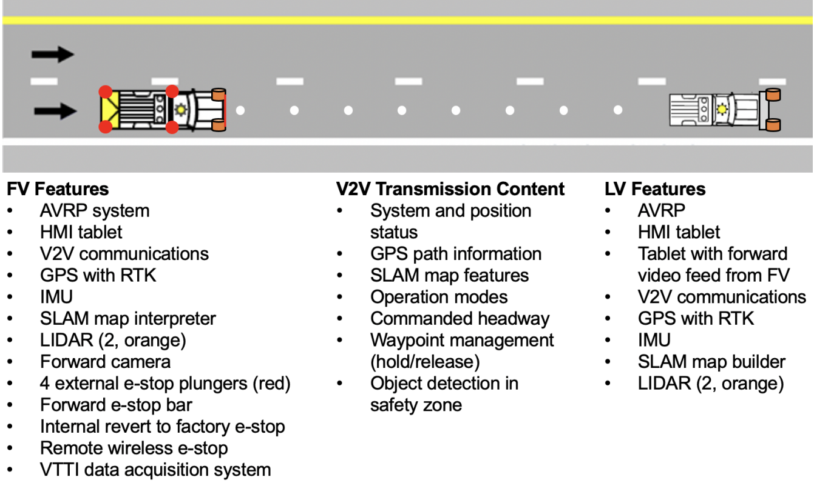
BCA Case Study 3: Automated Truck-Mounted Attenuators
Function description
  Typically consists of a lead vehicle (with human operator) and a following vehicle (automated)
  Both vehicles communicate throughout the entire operation
  When a collision risk is detected, the ATMA sends out a warning and prepares for the impact
  Used mostly for mobile or short-term work zones on roadways with higher speeds
Target audience for BCA
  Federal, state, and local transportation agencies (i.e., IOOs)
BCA considerations
  What is the safety effectiveness of ATMA
  systems (few studies available)?
  Lack of TMA crash data (particularly injury
  crashes involving TMA operators)
BCA approach: focus on understanding the
costs and consider qualitative benefits
Source: VTTI

Slide 31
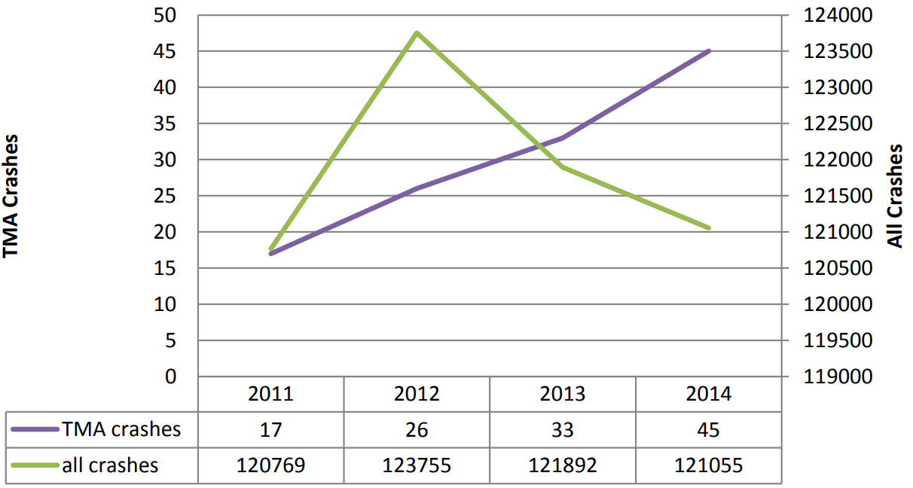
BCA Case Study 3: Automated Truck-Mounted Attenuators
Identify benefits
Purpose of ATMA in replacement of traditional TMA: take human operators out of the equation
  Reduce potential injuries to human TMA operators
  May reduce TMA crashes with more advanced design
  and safety features
Potential benefits
  Reduced TMA operator injuries
  Reduced work stress for TMA operators
  Reduced labor costs
Data limitation for estimating potential injuries prevented
  TMA crashes injuring TMA operators are rare
  Crash data generally does not include information to identify TMA operator injuries
Estimated Person-Injury (KABC Scale) Unit Cost in 2020 Dollars
Notes:
K: fatal crashes
A: serious injury crashes
B: minor injury crashes
C: possible injury crashes

Slide 32
BCA Case Study 3: Automated Truck-Mounted Attenuators
Estimated costs
Cost information sources
  VTTI in-house experience based on the development of the VTTI ATMA system for VDOT
  Interview with Kratos® Defense & Security Solutions
Cost estimates
  Purchasing: $150,000 - $200,000 per system
  Developing: ~$180,000 per system including materials, equipment, and labor
  Leasing: $15,000 - $20,000 per month
  One-time training cost: $15,000 - $20,000
  Adding additional ATMAs to existing ATMA fleet generally costs less due to less hardware/software customization
  Costs would likely decrease in future as technology becomes more mature and more ATMAs are deployed

Slide 33
BCA Case Study 3: Automated Truck-Mounted Attenuators
Benefit-cost analysis and challenge assessment
Within the service life of an ATMA system, if one serious injury can be prevented, the benefits (A-level injury = $555,157 or MAIS 2 injury = $493,004) would significantly outweigh the cost (<$250,000)
Most recommended for work zones on high-speed roadways, with known speeding problems, with large volume of heavy vehicles, and/or roadway work during severe weather conditions
Challenges
  Lack of TMA-related crash information
  ATMA systems are still in their early stage of development
  Replacement of human TMA operators at work zones may be considered a loss of jobs
Notes:
The MAIS is the most severe AIS (Abbreviated Injury Scale) code in a crash involving multiple injuries used by the Association for the Advancement of Automotive Medicine (AAAM). It is a more detailed injury scale describing person-level injuries. A MAIS of 0 indicates no injury and 6 indicates fatal injury. MAIS 2 injury is roughly equivalent to an A-level injury.

Slide 34
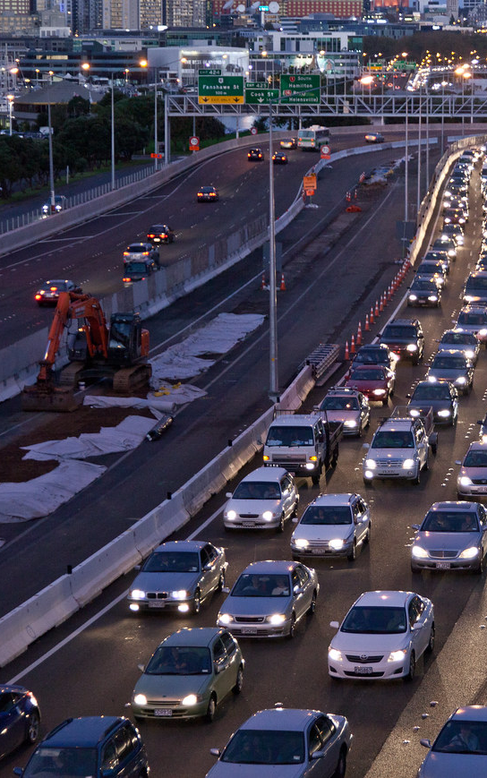
BCA Case Study 4: Work Zone Traveler Information Systems
Function description
  Purpose: divert traffic, reduce delays, and improve safety
  Communicates real-time work zone traffic and roadway information to travelers
  with varying
    Information communicated
    Communication mechanisms
    Range covered
    Supports to CAVs
  This BCA assumes a comprehensive WZTIS with CV support (i.e., V2I connectivity)
Potential audience for BCA
  Federal, state, and local transportation agencies (i.e., IOOs)
  Public and private sectors including vehicle owners for comprehensive benefits/costs
  Vehicle owners for the return on investments of such systems from a user perspective
BCA considerations
  Which audience? (has implications for the costs and benefits to be considered)
  What is the projected market penetration? (little information found in the literature)
  What is the safety effectiveness of such systems in work zones?
  What are the hardware/software components?
  What work zones would use such systems?

Slide 35
BCA Case Study 4: Work Zone Traveler Information Systems for CAVs
Key decisions and assumptions
Select audience of this BCA
  IOOs due to the project scope and target users of the products
Scope and timeline of BCA
  BCA conducted only for the CV portion of the system
  Traveler information systems are mostly used for work zones on major arterials/freeways
  Assumed a 5-year service life for software and hardware
  BCA conducted over service life and for a typical work zone on a major freeway section
  Used different market penetration rates: could not be reliably projected (lack of data and studies)
Major benefits
  Potential benefits: reduced crashes, reduced delay, improved travel time reliability, reduced emissions, reduced work zone delay, reduced vehicle operational costs, etc.
  Only considered safety benefits due to reduced crashes and operations benefits due to reduced delays
Major costs
  Costs for the CV portion comparable to those for queue warning systems

Slide 36
BCA Case Study 4: Work Zone Traveler Information Systems for CAVs
Estimate benefits due to reduced delays (CV portion)
Information sources:
  Literature review
  Office of the Secretary of Transportation guidance
  FHWA National Household Travel Survey
Average travel time cost used: $27.43/hr in 2020 $
Major assumptions:
  The use of the WZTIS diverted CVs away from the work zone and resulted in reduced delays for both the work zone traffic and the CVs
  The alternate route taken by CVs had an increased travel time 50% of the work zone delay
  Congestion and delay only occur at the work zone approach. Within the work zone, the roadway reaches its capacity (estimated using Highway Capacity Manual)
  The system results in a 20% diversion rate for traditional vehicles and 100% diversion rate for CVs
  Delays only assessed for peak hours (i.e., 6:00-9:00AM and 4:30-7:30PM)

Slide 37
BCA Case Study 4: Work Zone Traveler Information Systems for CAVs
Estimate benefits due to reduced crashes (CV portion)
Safety benefits during non-peak hours
  The traveler information system functions similarly to a queue warning system
  CVs using the work zones have 0% rear-end crash risks approaching and in the work zone
  The CV portion of the system only applies to the CVs beyond the traditional portion of the system
Safety benefits during peak hours
  CVs diverted from the work zone have 0% rear-end crash risks
    Conditions of the detours used are unknown due to the BCA being non-case specific
    Detours are most likely surface streets with lower speed limits

Slide 38
BCA Case Study 4: Work Zone Traveler Information Systems for CAVs
BCA results and challenge assessment
Work Zone Condition and Other Assumptions Used in this BCA

Slide 39
BCA Case Study 4: Work Zone Traveler Information Systems for CAVs
BCA results and challenge assessment
Estimated Lifetime Benefit Due to Reduced Travel Delay for CVs
Estimated Lifetime Benefit Due to Reduced Crashes for CVs
Estimated Lifetime BCAs for CV Component of Work Zone Information System
Notes:
The first table lists the lifetime benefits due to reduced travel delays for attributed to the CV component based on the hypothetical work zone condition. The second table lists the lifetime safety benefits. Based on these estimates, the lifetime BCA for the hardware and software invested by IOOs to support CVs with a work zone traveler information system would lead to a lifetime BCR of 23 at a 5% CV market penetration rate or greater than 100 if the CV market penetration rate is 25% or more (see the third table). If cellular communications are used, the cost of the CV component would be further reduced. For this scenario, a lifetime BCA of 42 was estimated for just a 5% market penetration rate. Note that the BCRs estimated for the traveler information system appear to be relatively high. This is due to the assumption that such a system is only used for congested work zones on major freeways. For the purpose of this BCA, the team assumed a major freeway segment with three nominal lanes, one of which is closed. A traveler information system would understandably yield considerable benefit in such traffic conditions.

Slide 40

Summary
Developed a framework for work zone CAV benefit and cost analysis
Conducted BCAs for four work zone CAV applications
Illustrated the multitude of considerations involved in a BCA for CAV applications
Discussed challenges for conducting such BCAs as well as for accelerating CAV deployment
Major takeaways of this benefit-cost effort
  CAV BCAs require knowledge and decision making in multiple subject areas
  Selecting costs/benefits but acknowledging the limitations
  Work zone CAV applications in general have tangible benefits (particularly on major highways)
  The lack of data hinders reliable BCAs of CAV apps
  Lack of policies, public perception, need for better understanding of their effectiveness, among others

Slide 41
Summary
Summary of BCA results
Lane keeping systems in work zones
  Major costs are for enhancing lane markings and temporary pavement conditions in work zones
  Safety benefits for major work zones significantly outweigh costs
  Suitable for long-term, long-length, high-speed, and/or work zones with large traffic
Work zone queue warning systems with a CV component
  For freeway work zones, CV support in the queue warning system has a BCR >1 with just 10% CV market penetration rate
  When V2I is widely available, IOOs should consider CV support with work zone queue warning systems
Automated truck-mounted attenuator systems
  With just one severe injury to TMA operators avoided, the ATMAs would yield a BCR significantly >1
  Suitable for deployment at work zones that have higher TMA crash risks
Work zone traveler information systems with a CV component
  The CV component results in significant operations and safety benefits for CVs on major facilities
  When V2I is widely available, IOOs should consider CV support for such systems

Slide 42
Summary
Review of challenges and gaps
Data gap
  Detailed work zone statistics
  AV and CV market penetration rates
  CAV function effectiveness
Technological gap
  Functions by different OEMs have different performance
Public perception gap
  Perception of effectiveness, concern of privacy, inconvenience/intrusiveness, etc.
Infrastructure support gap
  Requires changes to practices, related policies, and modifications to existing infrastructure
Policy gap
  Expected performance, performance standards, market/technological development directions, etc.

Slide 43

This presentation was developed by Virginia Tech Transportation Institute under NCHRP Project 20-102(28). More information about this topic can be found in NCHRP Research Report 1051: Preparing Transportation Agencies for Connected and Automated Vehicles in Work Zones available on the National Academies Press website (www.nationalacademies.org).
NCHRP is sponsored by the individual state departments of transportation of the American Association of State Highway and Transportation Officials. NCHRP is administered by the Transportation Research Board (TRB), part of the National Academies of Sciences, Engineering, and Medicine, under a cooperative agreement with the Federal Highway Administration (FHWA). Any opinions and conclusions expressed or implied in resulting research products are those of the individuals and organizations who performed the research and are not necessarily those of TRB; the National Academies of Sciences, Engineering, and Medicine; FHWA; or NCHRP sponsors.

