Slide 1
NCHRP Project 20-102(28),
“Preparing Transportation Agencies for Connected and Automated Vehicles in Work Zones”
Understanding the Technologies
Notes:
To understand the issues surrounding the implementation of connected and automated vehicles in work zones, it is key to have a strong understanding of the technologies, both vehicle- and infrastructure-based, that are currently available, upcoming, or proposed, as well as their relative impacts and deployments in process. This information is covered in this presentation.

Slide 2
Available Resources
Understanding the Technologies PowerPoint (this document)
Provides an overview of CAV- and infrastructure-based technologies and how these technologies may improve work zone safety
Provides infrastructure-based solutions that can be either technology- or non-technology-based that an agency can implement to facilitate CAV technologies
Supporting CAVs in Work Zones Handout
Stakeholder support
Sources of technical and financial resources
Relevant specifications and standards
A Framework for Assessing Benefits and Costs PowerPoint
Provides a framework for conducting benefit/cost assessments
Provides a tool for use in the assessment of benefits, costs, and challenges for selected work zone CAV applications
Helps practitioners better understand the challenges, limitations, and data availability for CAV benefit-cost analyses (BCAs)
Notes:
Additional supporting materials may be found as companions to this presentation.

Slide 3
Overview
Objective
To provide an overview of Connected and Automated Vehicles (CAVs) and related infrastructure-based technologies and how these technologies may improve work zone safety
To provide a better understanding of technology- and non-technology-based infrastructure solutions that an agency can implement to support and/or facilitate CAV technologies
Learning Outcomes
The ability to describe Automated Vehicles (AVs), Connected Vehicles (CVs), and Connected and Automated Vehicles (CAVs)
The ability to name technologies that may be used to enable CAV and related infrastructure-based technologies and to recall some of the pros and cons of each
The ability to name non-technology-based infrastructure solutions that an agency can take to facilitate the safe performance of CAVs through work zones
The ability to describe how these technologies may be implemented to improve work zone safety
Notes:
The objective of this module is to provide an overview of CAV- and infrastructure-based technologies and potential considerations regarding their applications in work zones. Upon completing this module, you should be able to: describe AVs, CVs, and CAVs, name the technologies that may be used to enable CAV- and infrastructure-based technologies and recall some of the pros and cons of each, describe how these technologies may be implemented to improve work zone safety, and list the challenges and benefits of implementing these technologies in work zones.

Slide 4
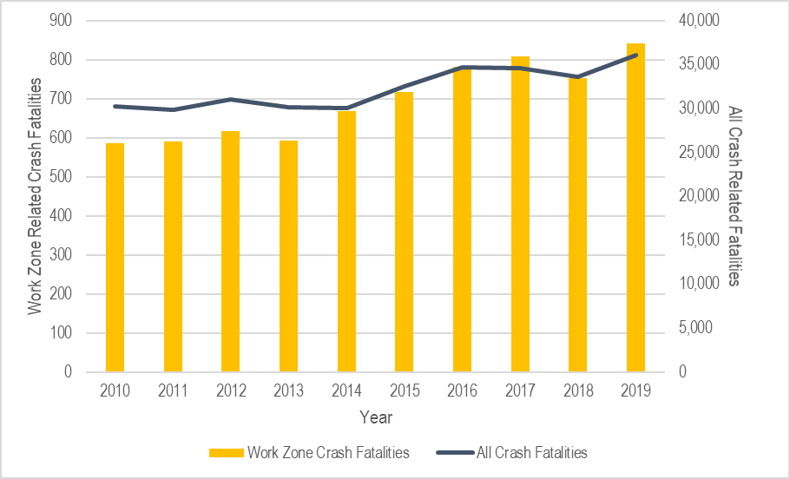
Background
Work zone related crash fatalities have increased 29% since 2010
755 work zone related crash fatalities in 2018¹
64% in construction zones (n = 482)
Work zones were responsible for 25% of all nonrecurring traffic delays²
Among 842 fatalities in work zone crashes in 2019, 16% were workers²
CAV-related applications may improve work zone safety
Figure 1. National fatal crashes (NHTSA, 2020) and work zone related fatal crashes (National Safety Council, 2020) 2010 through 2019.
Notes:
Figure 1 shows the upward trend of fatal crashes from 2010 through 2018 as reported by NHTSA as well as work zone related fatal crashes made available by the National Safety Council in 2020. In the figure, the yellow bars represent work zone related fatalities and corresponds to the left axis, and the dark line represents all crash related fatalities and corresponds to the right axis. As all crash related fatalities have steadily risen, work zone related crash fatalities have trended similarly, increasing 29% since 2010.
Of the 755 work zone related crash fatalities recorded in 2018, 482 were in construction zones, 131 were in unknown work zone types, 54 were in maintenance zones, and 1 was in a utility zone (National Safety Council, 2020). Additionally, work zones are estimated to be responsible for nearly a quarter of all nonrecurring traffic delays (National Work Zone Safety Information Clearinghouse, n.d.). In 2019, there were 842 fatalities in 762 work-zone crashes; 135 of these fatalities were workers.
References:
National Highway Traffic Safety Administration [NHTSA]. (2020). Traffic Safety Facts Annual Report Tables. https://cdan.nhtsa.gov/tsftables/tsfar.htm
National Safety Council. (2020). Motor Vehicle Safety Issues: Work Zones. Injury Facts. https://injuryfacts.nsc.org/motor-vehicle/motor-vehicle-safety-issues/work-zones/
National Work Zone Safety Information Clearinghouse. (n.d.). Work Zone Fatal Crashes and Fatalities. https://www.workzonesafety.org/crash-information/work-zone-fatal-crashes-fatalities/#national

Slide 5
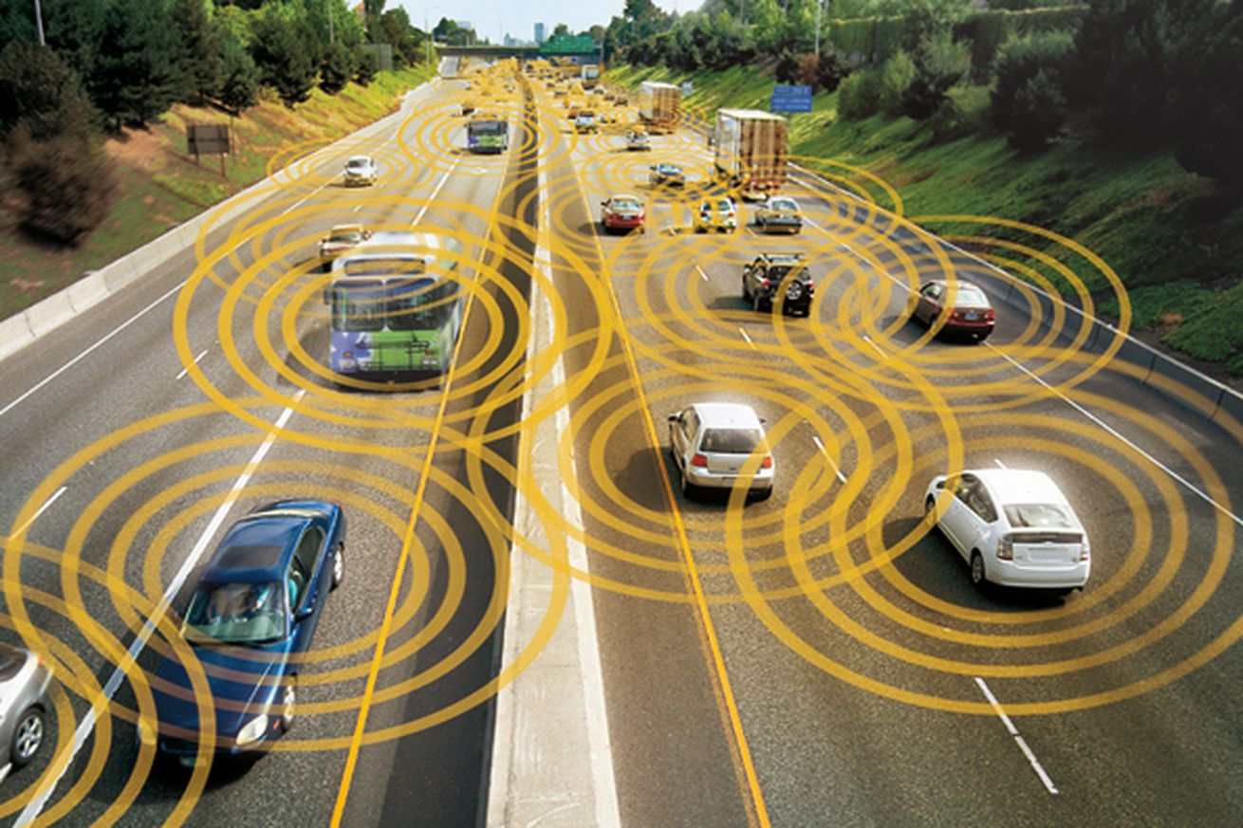
Potential Benefits Associated with CAVs
May reduce gaps between vehicles in a queue
Increase capacity and efficiency
May reduce human error during travel due to blind spots or reaction times
May reduce traffic accidents by an estimated 70% in 25 years
Notes:
One of the potential benefits of CAVs, for example, is the reduction in the gaps between vehicles in a queue to increase capacity and efficiency on roadways. CAVs also have the potential to increase traveler safety without risk of human error due to blind spots or reaction times. It has been estimated that traffic accidents could be reduced by 70% in 25 years thanks to CAV deployment. According to current fatality estimates reported above, a 70% reduction from 2018’s statistics would mean that by the year 2045, fatalities could be reduced to 10,000 per year with 225 fatalities attributed to work zones. There may be opportunities beyond the 70% predicted reduction to further reduce fatalities through advanced technologies given their capabilities and cooperation with infrastructure.
Reference:
MRCagney (2017). Autonomous Vehicles: Research Report. https://www.mrcagney.com/case-studies/research/autonomous-vehicles-research-report/

Slide 6
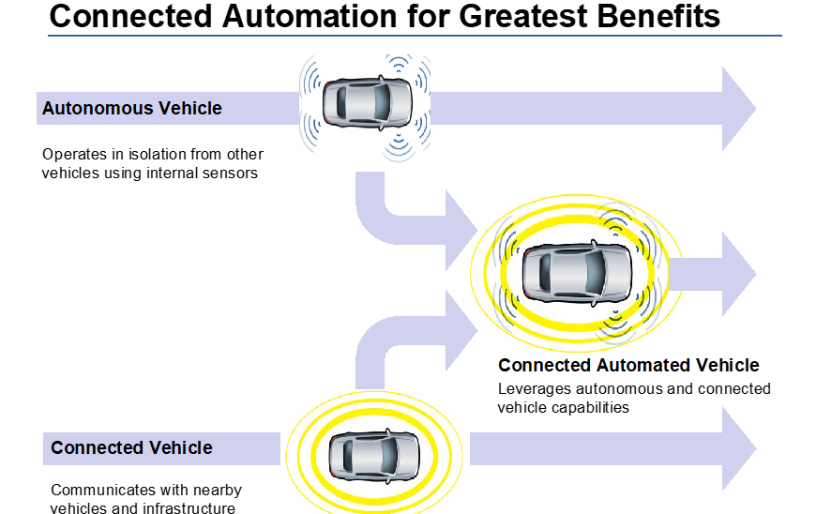
Connected and Automated Vehicles – Definitions and Uses
Connected vehicles (CVs) can wirelessly communicate with other vehicles or the environment
Includes vehicle-to-vehicle, vehicle-to-infrastructure, vehicle-to-cloud, and vehicle-to-person applications
Uses: active safety warnings, caution alerts (road work, conditions, congestion, detours, etc.)
Automated vehicles (AVs) are capable of automating some or all driving tasks depending on automation level
SAE J3016 standard
Connected and automated vehicles (CAVs) are the interconnection of AVs with other vehicles or infrastructure
Figure 2. Connected automation for greatest benefits (U.S. Department of Transportation [USDOT], 2020).
Notes:
CVs are vehicles that can communicate with other vehicles or their environments wirelessly. CAVs are the interconnection of AVs with other vehicles or surrounding infrastructure. A CV can interact with other vehicles, infrastructure, the cloud, or even people by way of radio communication or other wireless technologies. Uses include active safety warnings issued to drivers when potential conflicts are detected between two or more appropriately-equipped vehicles, as well as roadway-specific cautions for drivers, such as advanced warnings on road and surface conditions, congestion, detours, or road work. Connectivity to the vehicle’s controller bus or to a signal controller’s local network does not imply automation, as it assumes no control over the vehicle’s actions. Whereas an AV, referred to as an ADS-equipped vehicle by SAE International’s J3016 standard (2018), has the capability to automate some or all driving tasks depending on the automation levels.
Figure 2 illustrates the relationship between CVs, AVs, and CAVs.
References:
SAE International. (2018). J3016_202104: Surface Vehicle Recommended Practice: Taxonomy and Definitions for Terms Related to Driving Automation Systems for On-Road Motor Vehicles.
U.S. Department of Transportation [USDOT]. (2020). Intelligent Transportation Systems Joint Program Office: Strategic Plan 2020-2025. (Report No. FHWA-JPO-18-746). https://www.its.dot.gov/stratplan2020/

Slide 7
Wireless Communications Enable CV Applications
DSRC wireless technology
PRO: Low latency
CON: Future use for CV purposes uncertain due to FCC regulations
Ideal for safety-critical applications
Currently used in pilot projects
Cellular technology
PRO: Mature and newer generations of technology are ubiquitous (4G, 5G, LTE).
CON: Privately owned networks and inconsistent network access
Satellite technology
PRO: Can provide coverage where cellular is unavailable
CON: Lower-bandwidth and higher-latency than DSRC
Wi-Fi
PRO: Ubiquitous, cost effective, high bandwidth capabilities
CON: Security considerations
Bluetooth
PRO: Mature and secure
CON: Range concern, lower-power option
Notes:
CAV technologies are enabled by various technologies. This slide and the next discuss these technologies in greater detail.
Several different wireless communications alternatives may be used to enable CV applications.
DSRC is one wireless technology with potential for CV use. Different manufacturers prefer their own technology, and each has its own maturity forecast. DSRC has been tested in a variety of settings, and standards for it are being developed. DSRC has low latency, and because it is protected (licensed), it is ideal for safety-critical applications. The technology is expected to progress through more certification programs as it matures. Currently, DSRC is being used in CV pilot projects sponsored by the USDOT. It is important to note that per recent Federal Communications Commission (FCC) regulations, the spectrum allocated for licensed use has been reallocated, thus putting in question the future use of DSRC for CV purposes, which has led some agencies to hesitate to commit to any specific communication technology.
Cellular technology is mature, and newer generations of technology are ubiquitous (4G, 5G, and LTE). The major drawbacks of cellular are that networks are privately owned and network access is not consistent. 4G LTE technology is the most prevalent method for currently transmitting roadway information, such as roadway closures and estimated arrival times, to travelers. Future generations of cellular technology for C-V2X applications are being developed and deployed; however, due to the FCC regulations, the technology type that will be widely accepted going forward is a matter of debate.
Satellite technology is also mature and can provide coverage where cellular is not available. The communication is lower-bandwidth and higher-latency than DSRC and has challenges in providing local or “regional” information.
Wi-Fi is ubiquitous, cost effective, and has high-bandwidth capabilities but also comes with some security considerations. Wi-Fi access is expected to improve, and some states have made commitments for improving their Wi-Fi infrastructure in the near term. Some drawbacks of Wi-Fi include increased power consumption when using direct-connect modes and increased latency and lower packet delivery rates.
Bluetooth is considered a mature technology and is relatively secure due to the authorization and authentication process it necessitates prior to data exchange. Range is the critical component concerning Bluetooth technology but is a lower-power option.

Slide 8
LiDAR, Radar, and Cameras Enable AV Applications
3 types of technology for sensing, detecting, and generating maps of the environment
LiDAR
Highly accurate, builds a 3D view quickly
Loses performance in weather; costly; difficulty detecting differences between roadway hazards and general debris
Radar
High performance in adverse weather and lighting
Limited resolution
Cameras
Provide color contrast, high resolution, less cost
Limited by lights and weather
Currently no standard that identifies all data elements and performance characteristics
Notes:
The methods AVs currently use and that are forecasted for use over time to replicate human actions rely on their sensor suites. The eyes of the human driver are being replaced with radar, LiDAR, and cameras capable of detecting many of the same elements of the roadway that human drivers use for guidance, such as lane markings, signage, crosswalks, and other features. If these key attributes of the highway system are made consistent and are well maintained, then it is assumed that AVs could successfully replicate many human driving behaviors. Further, AVs may be able to improve upon several areas where humans fail, such as full 360-degree awareness, maintaining constant and full attention, and improved logic for anticipating speed and distance. It is then also expected that in areas where lane marking qualities are inconsistent, such as within or around work zones, AVs will need another method for effectively navigating without human input.
LiDAR is considered highly accurate but drops in performance (up to 33%) during adverse weather. Using invisible laser light to measure the distance to objects in the environment, LiDAR can build an accurate 3D view very quickly. However, a single LiDAR device can cost up to $10,000 to implement. LiDAR also has limited abilities to distinguish differences between significant roadway hazards or general debris.
Like LiDAR, radar’s benefits over cameras are its ability to overcome weather and its consistent performance despite lighting conditions (day, night, or twilight). The drawback of radar is limited resolution, as current 24 GHz radars are considered limited for high-speed needs. There are, however, newer and more robust radar systems becoming more readily available. These are smaller and operate in the 77 GHz range, which eliminates most blur and increases the resolution for more accurate pinpointing of position and speed.
Cameras provide color contrast, can have higher resolution, and are less costly to implement. Many ADSs and ADAS currently utilize cameras to build out their features, such as surround view systems (SVS) and driver monitoring systems (DVS). However, cameras have issues that are equal to those of the human eye in that they are limited by light and the effects of weather. Cameras must also rely on an in-vehicle computing system for understanding the context of objects in view.
Presently, there is no standard or specification from a standards body that clearly identifies all the data elements and performance characteristics necessary to produce an HD map. Manufacturers may adhere to one or two specific technologies while ignoring others or use a combination of all three.

Slide 9
Operational Design Domains
Operational design domain (ODD): conditions in which vehicle features can operate optimally and safely
ODD of vehicles produced by different manufacturers will vary
Varied ODDs could result in OEMs supporting specific design standards that fit their ODD
Notes:
An ODD is the operating environment defined by the vehicle’s manufacturer that prescribes the conditions in which the vehicle’s features can operate optimally and safely. ODDs of vehicles produced by different manufacturers will vary. OEMs use their own strategies and patented technologies for achieving automation and, as with conventional vehicles, there will be differences in performance, which will lead to a varied ODD-capable market. These varied ODDs could potentially result in one manufacturer supporting the 4-inch-wide pavement markings and another supporting 6-inch-wide pavement markings, leading to a costly investment decision from transportation agencies on whether to adhere to or change markings as a result of minimum design standards in a manufacturer’s ODD.

Slide 10
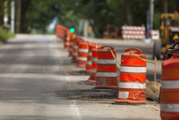
Non-technology-based Infrastructure Solutions Facilitating the Safe Operation of CAVs
To operate effectively, it is reported that CAVs will benefit from:
Sign standardization
Clearly marked travel lanes
Standardized retroreflective devices, reliable in all weather
Visible pavement markings that delineate vehicle path through work zones
Minimum device spacing
However, questions surrounding the specifics associated with the above remain:
For example, what do clearly marked travel lanes look like? What is the maximum recommended device spacing?
Notes:
Several non-technology-based infrastructure solutions may be implemented to facilitate the safe performance of CAVs through work zones. These infrastructure-based solutions include sign standardization, clearly marked travel lanes through work zones, standardized retroreflective devices that are reliable in all weather conditions, visible pavement markings that delineate the vehicle path through a work zone, and a need for minimum device spacing. However, questions surrounding the specifics associated with the above remain. For example, what do clearly marked travel lanes look like? What is the minimum recommended device spacing?

Slide 11
Work Zone Applications that May Be Expanded with CAV Applications
Automated Assistance in Roadwork and Congestion
Enables automated driving through a work zone (WZ) to support driver overload situations and considers the possibility that lane lines are not accurate. Uses objects (e.g., trucks, beacons, guide walls) for guidance
Queue Warning
Provides vehicle operator with sufficient warning of impending queue for safe braking, lane changing, or route modification
Reduced Speed/Work Zone Warning
Broadcasts alerts to drivers to reduce speed, change lanes, or stop in a WZ
Warnings about Work Zone Intrusions
Provides warnings to maintenance personnel within a WZ about potential hazards (e.g., high-speed vehicle entering WZ)
Warnings about Upcoming Work Zones
Provides approaching vehicles with information about WZ activities (e.g., travel lane obstructions, lane closures, lane shifts, speed reductions, vehicles entering/exiting WZ)
Work Zone Traveler Information
Aggregates WZ traffic data
Notes:
This section details applications for work zones. All current CV applications, on their own, fall into the SAE Level 0 category, as they generate warnings to the driver and exert no control over the vehicle. There are six applications that tie-in with work zones: (1) Automated Assistance in Roadwork and Congestion, (2) Queue Warning, (3) Reduced Speed/Work Zone Warning (RSWZ), (4) Warnings about Hazards in Work Zones, (5) Warnings about Upcoming Work Zones, and (6) Work Zone Traveler Information. There are others that may have work zone applications, depending on the features and traffic control devices (TCDs) used in any given work zone, such as signal controlled lighting, stop signs, narrow pathways, etc.
Include the CV/AV aspect on these applications.

Slide 12
CAV Applications
iCone
Suite of connected technologies that interface with existing traffic control devices (TCDs) to report real-time WZ data to navigation and in-dash systems
Example application: devices on barricade equipment that broadcast locations to public using Waze from inside WZ
Waycare
Detects traffic crashes and uses predictive analytics to identify risks of collisions, facilitating faster validation and reducing emergency response times
Example application: replace human for contacting emergency services by analyzing data from multiple sources (vehicle navigation devices, roadside traffic detectors, third-party apps, and telematics providers)
HAAS
HAAS Alert Safety Cloud directly warns road users of nearby emergency vehicles using existing vehicle systems (i.e., navigation systems)
Example application: report to Waze the location of vehicles, equipment, and workers within active construction zones
Nexar
ITS platform uses dashcams to identify TCDs and road obstructions from the driver’s perspective and collect data about the effect on traffic
Example application: CityStream, an ITS that uses CV network to update the movement and location of traffic cones and their effect on traffic
Notes:
In the Las Vegas Valley, the Regional Transportation Commission of Southern Nevada has launched an artificial intelligence (AI) project on a busy section of Interstate-15. Multiple tech companies have converged to display innovative technologies for improving work zone safety. We will discuss several notable companies:
iCone uses a suite of connected technologies that interface with existing TCDs to report real-time work zone data to navigation systems and vehicle in-dash systems. An example application includes devices located on barricade equipment that broadcast locations to the traveling public using the Waze traffic app from inside a mock work zone.
HAAS is a technology company specializing in mobility applications. The “HAAS Alert Safety Cloud” is a system developed to directly warn road users of emergency vehicles in their vicinity using existing applications built into modern vehicles, such as on-board navigation systems. The HAAS Alert system is being tested in Nevada to report to Waze the location of construction vehicles, equipment, and workers within active construction zones.
Waycare’s AI and real-time data analysis detects traffic crashes and uses predictive analytics to identify risks of collisions, facilitating faster validation and reducing emergency response times. Waycare eliminates the need for a human to contact emergency services by analyzing data from multiple sources, including in-vehicle navigation devices, roadside traffic detectors, the Waze app, and other telematics providers. The real-time data collected by the various technologies in use, such as Nexar, iCone, and HAAS Alert, is fed through Waycare’s platform to inform first responders of incidents.
Nexar CityStream is an ITS that uses a CV network to update the movement and location of hundreds of traffic cones and their effect on traffic in a 3-square-mile pilot area. Leveraging circulating vehicles, like those driven by Uber and Lyft drivers, the Nexar platform uses dashcams to identify TCDs and road obstructions from a driver’s perspective. Data is collected about the effect on traffic, including the location, time of day, affected travel lanes, and an image of the detected activity. The technology automates the flow of data into local traffic databases, helps determine the validity of lane closure compliance, and streamlines permit management.

Slide 13
Example Projects Exploring CAV Applications for Work Zones
Safe Integration of Automated Vehicles into Work Zones
Current USDOT study that is identifying the impact of connectivity between AVs and WZs
Urban, rural, suburban scenarios and configurations
Closed-course and live on-road testing
Public safety benefits and overall evaluation
CARMA Project
Open-source software platform
Provides a base of features and facilitates development of new strategies to allow for testing and evaluation of CVs
Three research tracks:
Traffic
Reliability
Freight
Notes:
A current USDOT study in cooperation with the Pennsylvania DOT, Pennsylvania Turnpike Commission, Penn State University, and Carnegie-Mellon University, is focused on identifying the impact of connectivity between AVs and work zones. The effort includes at least 17 common work zone scenarios and configurations (urban, rural, and suburban) for demonstrating AVs in work zones. For each scenario, there will be closed course testing, and at least three scenarios will be demonstrated in a live on-road test to demonstrate an urban environment. This effort will also focus on public safety benefits in concert with an evaluation of market failure, economic vitality, and the complexity of the technologies.
In addition to the various independent forms of technology and message relay mechanisms currently at the forefront of connected work zone research, FHWA has led the development of CARMA, an open-source software platform. CARMA allows for the testing and evaluation of CVs, or cooperative automation, by providing a base set of features and facilitating development of new strategies. CARMA allows for collaboration, and FHWA encourages collaboration for innovation. There are three CARMA research tracks: Traffic, Reliability, and Freight. The Reliability track focuses on TIM strategies, road weather management, and work zones.
References:
Federal Highway Administration [FHWA]. (n.d.). CARMA. U.S. Department of Transportation. https://highways.dot.gov/research/operations/CARMA
Pennsylvania Department of Transportation (n.d.). Safe Integration of Automated Vehicles into Work Zones. https://www.transportation.gov/sites/dot.gov/files/docs/policy-initiatives/automated-vehicles/351461/36-penndot.pdf

Slide 14
Example Projects Exploring CAV Applications for Work Zones (continued)
Alabama Work Zone Incident Notification System
ALGO smart phone app that provides users information about downstream work zones
Lanes of travel
Description of work at work zone
Anticipated action within work zone (i.e., lane shifts)
Duration of work zone
Estimated distance to work zone (for alternative route planning)
Arizona and Kentucky Commercial Vehicle (CV) Operator Alerts
Similar system for CV operators to provide in-vehicle information on downstream work zones
Weather alerts
Work zone locations
511 alerts
Works to improves drivers’ situational awareness
Notes:
The Alabama Work Zone Incident Notification System is an application available on most smart phone devices (Android and iOS) that can provide users with information about downstream work zones. The information provided includes affected lanes of travel, specific information about the work zone, including a description of work, and anticipated actions such as lane shifts. The duration of the work zone is also broadcast, and drivers are provided with estimated distances to the work zones so alternative routes can be considered (Alabama DOT, 2020).
In Arizona and Kentucky, a system has been created that can provide in-vehicle information on downstream work zones to CV operators. The information includes weather alerts, the location of the work zones, and 511 alerts inside the vehicle’s cab to improve drivers’ situational awareness (TTI, 2020).
References:
Alabama Department of Transportation. (2020). ALGO Traffic App. www.algotraffic.com
Texas A&M Transportation Institute [TTI]. (2020). Syntheses of Research Related to the Use and Implementation of Advanced Technology to Improve Work Zone Management (U.S. Department of Transportation Cooperative Agreement No. 693JJ31750001). Federal Highway Administration.

Slide 15
Example Projects Exploring CAV Applications for Work Zones (continued)
Michigan Department of Transportation
Conducted a Smart Work Zone demonstration in cooperation with General Motors
Video provides an overview of technologies tested
Website provides link to additional work zone safety videos
Source: Michigan Department of Transportation
Notes:
References:
Michigan Department of Transportation (2022). Work Zone Safety Media. https://www.michigan.gov/mdot/travel/safety/road-users/work-zone-safety/media
Video may also be accessed on YouTube at https://www.youtube.com/watch?v=w4miISHq0ks&t=157s

Slide 16
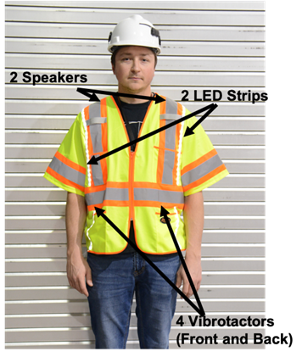
Example Projects Exploring CAV Applications for Work Zones (continued)
Worker Safety Systems in Intelligent Transportation System (ITS) Work Zones
Haptic and auditory alarms worn on body are beneficial for safety
Haptic warning indicated direction and level of threat
Provided advanced alert to worker
Commercial Vehicle Applications
Provide advance audible and visual alerts before time to collision (TTC) zones requiring speed reduction
Autonomous Truck Mounted Attenuators (ATMAs)
Can be used to provide an upstream buffer from oncoming traffic
Programmed to follow a predetermined path at set speed and shadow a WZ
Figure 3. Smart Vest communication device during testing at VTTI (Mollenhauer, 2019).
Notes:
A recent study conducted by VTTI sought to determine the best use of new technologies in ITS work zones. The study concluded that haptic and auditory alarms worn on the bodies of workers would be beneficial for safety. A haptic warning indicated the direction and level of the threat to provide workers an advanced alert. Another ITS connected system is being developed by Purdue University and Trimble® software company. This service would use connected systems in commercial trucks to provide audible and visual alerts in advance of time to collision zones requiring a reduction in speed.
In addition to body worn devices, other worker safety benefits of CAVs include unmanned systems such as Autonomous Truck Mounted Attenuators (ATMAs), which are vehicles that provide an upstream buffer from oncoming traffic. A conventional TMA is a large vehicle specifically designed to attenuate or absorb the impact of a crash. ATMAs are programmed to follow a predetermined path at a set speed and shadow a work zone without a driver onboard. A study currently underway by VTTI is further evaluating the efficiency and safety of ATMAs, including the usability of control systems, various following distances, and controlling the ATMAs under variable GPS conditions.
References:
McLoud, D. (2020). Trimble work zone alerts designed to reduce rear-end crashes involving heavy trucks. Equipment World. https://www.equipmentworld.com/trimble-alert-reduce-rear-end-crashes-work-zones/
Mollenhauer, M., White, E., Roofigari-Esfahan, N. (2019). Design and Evaluation of a Connected Work Zone Hazard Detection and Communication System for Connected and Automated Vehicles (CAVs). Safe-D National UTC, Virginia Tech Transportation Institute.
North Dakota Department of Transportation [NDDOT]. (2020). NDDOT demonstrates its first autonomous impact protection vehicle. https://royaltruckandequipment.com/autonomous/
Virginia Tech Transportation Institute [VTTI]. (2020b). Automated Truck Mounted Attenuator. https://safed.vtti.vt.edu/projects/automated-truck-mounted-attenuator/

Slide 17
Work Zone Data Exchange
Effort of FHWA and ITS Joint Program Office (JPO) to develop a recommended practice for managing work zone event data
Will create consistent language for communicating events across jurisdictions and organizations
Can be leveraged to increase public road safety and assist AVs and human drivers through work zones
WZDx v3 data feed publicly available
https://ops.fhwa.dot.gov/wz/wzdx
In 2021, 13 WZDx demonstration grants were funded
Notes:
The Work Zone Data Exchange (WZDx) project is an effort to motivate the adoption of a basic work zone data specification through collaboration with data producers and users in order to support AVs. FHWA and the ITS Joint Program Office (JPO) are developing a recommended practice for managing work zone event data to create a consistent language for communicating information on events across jurisdictions and organizations. Infrastructure owners and operators can leverage this data dictionary for easier sharing with third parties to increase public road safety and assist ADSs and human drivers through work zone scenarios. To date, a version of the specification is available for use and is continually being updated.
Data producers are using or will use the specification to make their data available for participating non-government entities’ use. Those entities include infrastructure owner operators, OEMs, and application developers who will benefit from a consistent data standard and a convening mechanism that allows for efficient transfer and access to work zone related data sets. Data producers include state DOTs, and data users include infrastructure owner operators, OEMs, and app developers.
Data feeds are publicly available for view and can be accessed via the FHWA website.
In January 2021, FHWA awarded WZDx demonstration grants to fund projects in 13 states, including Arizona, California, Colorado, Georgia, Iowa, Maryland, Massachusetts, Minnesota, Missouri, Utah, Virginia, Washington, and Wisconsin. Projects included updates to infrastructure to accommodate new or expand existing WZDx data feeds or demonstrate the use of smart technologies in work zones.
Reference:
Federal Highway Administration [FHWA]. (2021). WZDx Demonstration Grants. Work Zone Management Program, U.S. Department of Transportation. https://ops.fhwa.dot.gov/wz/wzdx/demonstration_grants.htm

Slide 18
Intelligent Transportation Systems Joint Program Office
ITS Professional Capacity Building Program
Program of the ITS JPO with the goal of providing CAV education to assist in the development of an intelligent transportation workforce
Provides CAV Education (CAVe)-in-a-box hands-on learning
Topics covered in the training video series includes:
Road Side Units
Onboard Unit
V2X Hub
CAVe-in-a-box
Signal Phasing and Timing (SPaT) and MAP (Intersection Map)
Traffic Management Center
Maintenance
How to build CAVe-in-a-box
Notes:
The Intelligent Transportation Systems Joint Program office has developed the ITS Professional Capacity Building program which has the goal of providing educational stakeholders with the tools and resources needed for the development of an intelligent transportation workforce. The CAVe-in-a-box is meant to aid in curriculum and support instruction. Included in the resources are training videos covering a range of topics.

Slide 19
Challenges Associated with the Implementation of CAV Applications in Work Zones
Challenge of integrating CAVs is cost of implementing newer technologies into existing systems
Existing infrastructure
Redesigning highway systems
Funding technical maintenance to support new technologies
Agencies are responsible for maintenance and upgrades; budget limitations often lead to delays and drastic consequences
Market penetration will affect the BCA associated with these technologies
Additional guidance on BCA may be found in the companion Framework for Assessing Benefits and Costs PowerPoint
Notes:
The challenge to integrating CAVs is the estimated cost of implementing newer technologies into existing infrastructure, redesigning highway systems, and funding technical maintenance to support the technologies. Agencies are responsible for ensuring the current maintenance and upgrades of pavement markings and signage; however, budget limitations and extraneous circumstances often lead to delays in addressing those needs. A delay or lapse in maintenance for infrastructure designed to support CAV functions would likely lead to more drastic consequences than it would for conventional vehicles.
Market penetration of CAVs will affect the benefit-cost analyses (BCAs) associated with CAV applications in work zones. Additional guidance on conducting BCAs may be found in the companion Framework for Assessing Benefits and Costs PowerPoint completed as part of this project.

Slide 20
Summary
CAV technologies have the potential to reduce work zone related crashes
The most common CAV applications related to work zones include:
Automated assistance in roadwork and congestion
Queue warning
Reduced speed/work zone warnings
Warnings about hazards in work zones
Warnings about upcoming work zones
Work zone traveler information
The benefits of these applications may be enhanced by CAV applications
Non-technical infrastructure improvements may facilitate the safe operations of CAVs
Resources like the WZDx may be accessed to facilitate the sharing of data related to work zones
Notes:
In summary, this module provided an overview of CAV- and infrastructure-based technologies and potential considerations regarding their applications in work zones. The module began with a description of AVs, CVs, and CAVs. It then reviewed technologies that may be used to enable CAV- and infrastructure-based technologies and discussed some of the pros and cons of each. Finally, work zone specific applications were described. Subsequent modules will further explore technical resources to aid in the deployment of CAV applications in work zones and will review a framework for evaluating benefits and costs of these technologies.

Slide 21
This presentation was developed by Virginia Tech Transportation Institute under NCHRP Project 20-102(28). More information about this topic can be found in NCHRP Research Report 1051: Preparing Transportation Agencies for Connected and Automated Vehicles in Work Zones available on the National Academies Press website (www.nationalacademies.org).
NCHRP is sponsored by the individual state departments of transportation of the American Association of State Highway and Transportation Officials. NCHRP is administered by the Transportation Research Board (TRB), part of the National Academies of Sciences, Engineering, and Medicine, under a cooperative agreement with the Federal Highway Administration (FHWA). Any opinions and conclusions expressed or implied in resulting research products are those of the individuals and organizations who performed the research and are not necessarily those of TRB; the National Academies of Sciences, Engineering, and Medicine; FHWA; or NCHRP sponsors.

