Slide 1
The following presentation is supplemental to NCHRP Research Report 1052: Integrating Resilience Concepts and Strategies into Transportation Planning: A Guide (NCHRP Project 08-129, “Incorporating Resilience Concepts and Strategies in Transportation Planning”). The full report can be found by searching on the report title on the National Academies Press website (nap.nationalacademies.org).
The National Cooperative Highway Research Program (NCHRP) is sponsored by the individual state departments of transportation of the American Association of State Highway and Transportation Officials. NCHRP is administered by the Transportation Research Board (TRB), part of the National Academies of Sciences, Engineering, and Medicine, under a cooperative agreement with the Federal Highway Administration (FHWA). Any opinions and conclusions expressed or implied in resulting research products are those of the individuals and organizations who performed the research and are not necessarily those of TRB; the National Academies of Sciences, Engineering, and Medicine; the FHWA; or NCHRP sponsors.

Slide 2
INCORPORATING RESILIENCE CONCEPTS AND STRATEGIES INTO TRANSPORTATION PLANNING
RESEARCH SUMMARY PRESENTATION
Prepared for
National Cooperative Highway Research Program
Transportation Research Board
of
The National Academies of Sciences, Engineering, and Medicine
Maria Pena
Charles Moser
AEM Corporation
Mara K. Campbell
Marra Sirianni
Jacobs
Alan O’Connor
AJOC Consulting Engineers
July 2022

Slide 3
Overview
Phase 1
Research
State of practice review
Gap assessment
Industry engagements (2)
Quick-scans (11) deep dive case studies (4)
Phase 2
Framework
Capability maturity framework
Roadmap
Phase 3
Final Guidance
Actions/strategies
Implementation plan

Slide 4
Project Objective
Develop a guidebook on how state departments of transportation (DOTs) and other transportation agencies can integrate resilience concepts into transportation planning efforts at all scales of application.
Strategic planning (enterprise)
Program/project level planning (long-range, mid-range, Statewide Transportation Improvement Program)
Business planning
Operation/maintenance planning

Slide 5
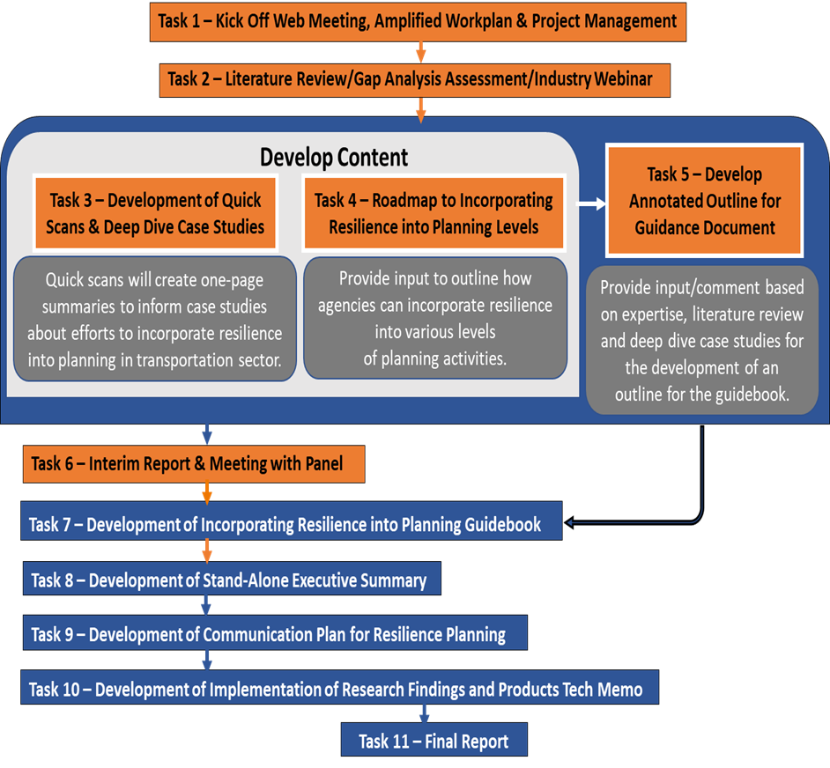
Overview of Tasks
Phase I (Task 1 – 6)
  Information gathering and planning
Phase II (Tasks 7-11)
  Develop products

Slide 6

Literature Review
Reviewed over 200 sources – focus on publications from the Transportation Research Board (TRB) and the American Association of State Highway and Transportation Officials (AASHTO)
Key findings:
Misconception between risk and resilience
Few agencies incorporate resilience beyond TAMPs
Most agencies use qualitative assessments (e.g., risk registers)
Few agencies do quantitative economic analysis
Majority of risk assessments focus on natural hazards

Slide 7

Gap Assessment
The gap analysis further investigated the challenges and barriers uncovered in the literature review.
Gaps were organized into five categories:
Policies, definitions, leadership, and communication
Data, metrics, methodologies, and tools
Multi-discipline and cross-sector system approach
Agency resources and funding
Resilience incorporation in transportation plans

Slide 8
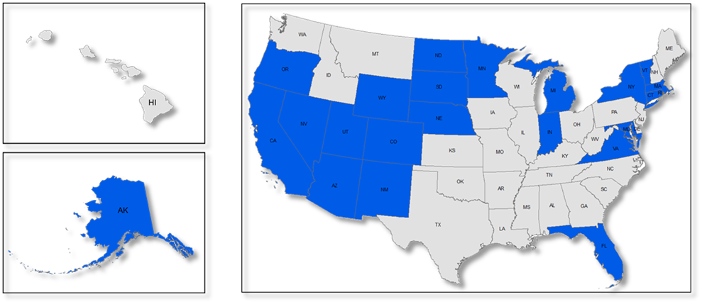
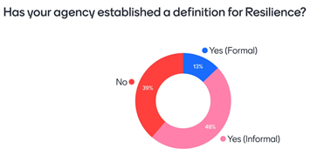
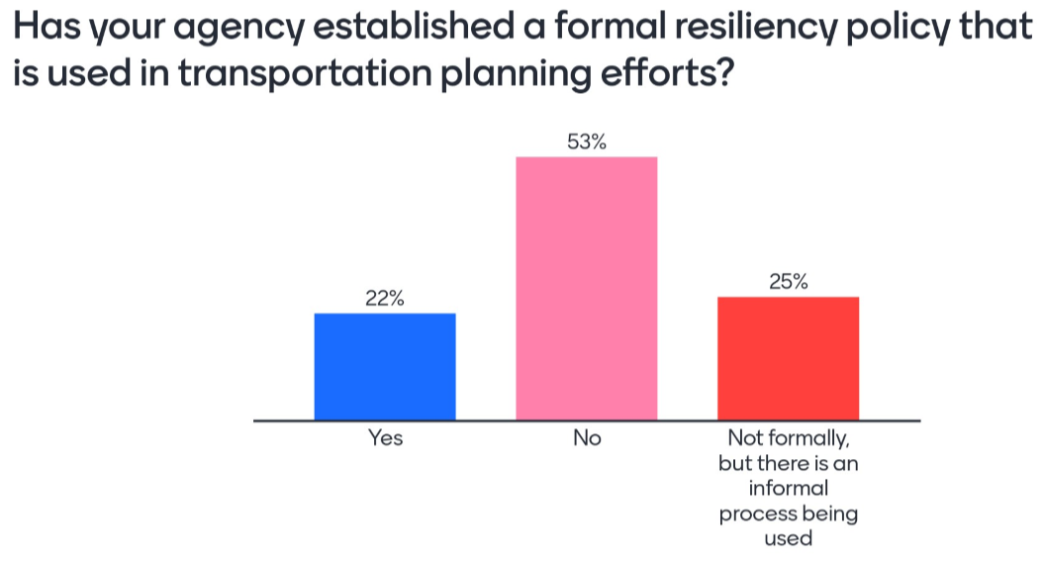
Stakeholder Engagement I (“2-Minute Drill”)
Workshop I – December 2020
  90 participants representing state DOTs, AASHTO, Federal Highway Administration (FHWA), metropolitan planning organizations (MPO), transit agencies, private sector, and academia.
Objectives
  Identify and define what transportation agencies need to successfully implement resilience into transportation planning.
  Validate gaps in the state of practice.
  Identify participants for quick-scan and deep-dive case studies.

Slide 9
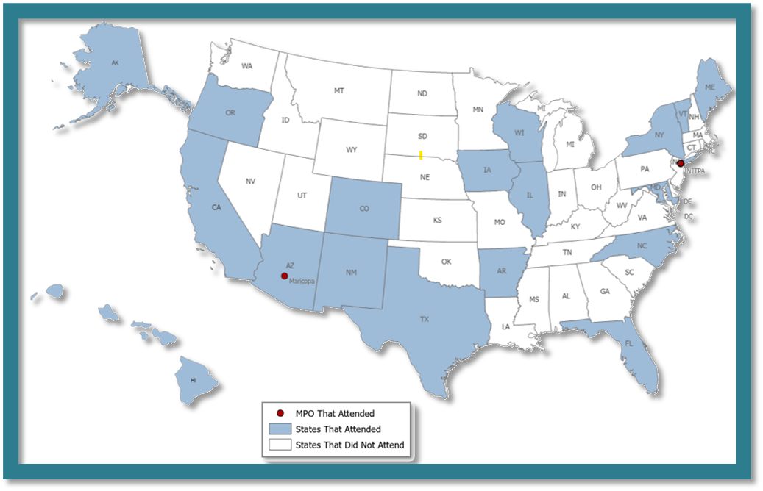
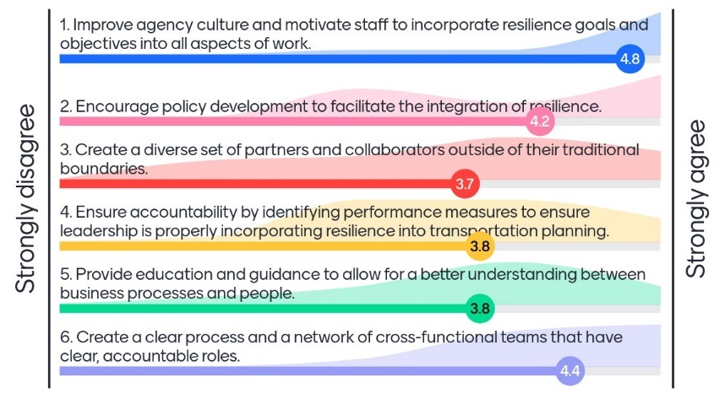
Stakeholder Engagement II
Workshop 2 – December 2021
  34 participants representing state DOTs, MPOs, FHWA, and academia.
  18 states plus the District of Columbia; Maricopa County, Arizona; and New Jersey Planning Authority
Discussion validated six “key building blocks” / strategies with online polling

Slide 10

Quick-Scan Case Studies
Conducted 11 quick-scan case studies with 11 transportation agencies:
  Maryland DOT
  Colorado DOT
  Minnesota DOT
  Oregon DOT
  Vermont DOT
  Georgia DOT
  Bay Area Transit (BART)
  Texas Capital Area Metropolitan Organization (CAMPO)
  The Danish Roads Directorate (DRD)
Developed criteria for identification of agencies for in-depth case studies.

Slide 11
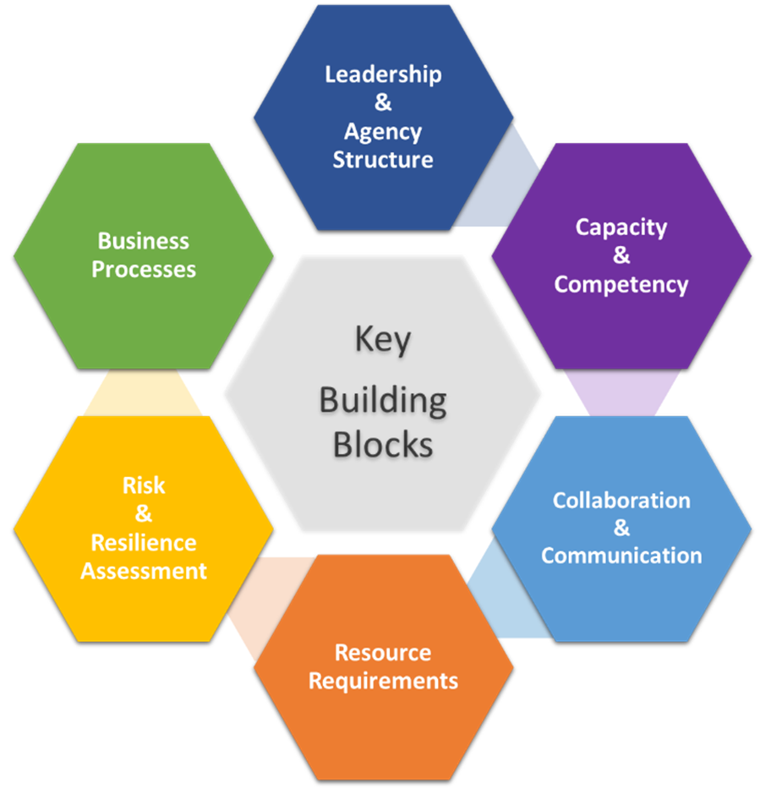
Key Building Blocks
Identified six key building blocks for successful incorporation of resilience into transportation planning based on:
  Literature review
  Gap assessments
  Stakeholder engagements
  Quick scan case studies

Slide 12
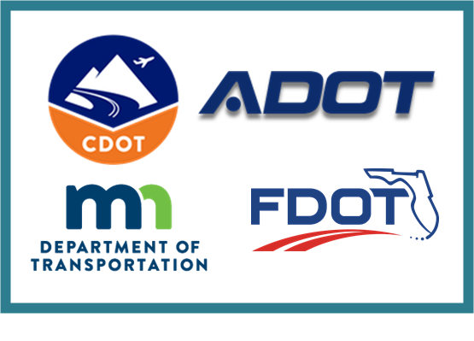
Deep-Dive Case Studies
Developed 4 deep-dive case studies from the 11 quick-scan case studies:
  Arizona
  Colorado
  Florida
  Minnesota
Deep-dive questions relate to 6 identified fundamental areas (Key Building Blocks) to incorporate resilience:
  Leadership & agency structure
  Capacity & competency
  Collaboration
  Resource requirements
  Risk & resilience assessment
  Business processes

Slide 13
NCHRP Research Report 1052:
Integrating Resilience Concepts and Strategies into Transportation Planning: A Guide
Logical outcome of the research and industry engagement.
Reflects stakeholder and panel feedback.
Provides transportation agencies with practical recommendations and resources for incorporating resilience into planning.

Slide 14
Chapter 1: Introduction
Purpose and scope
Overview of the document
Key terms: discussion of risk versus resilience
Overview of transportation planning

Slide 15
Chapter 2: Lessons Learned from Case Studies
How transportation agencies define resilience
Role of regulator drivers in transportation agency resilience programs
How transportation agencies address the key building blocks, as well as challenges and barriers

Slide 16
Chapter 3: Key Building Blocks to Incorporate Resilience into Transportation Planning Lessons
    Detailed discussion of each building block, the basis for the capability maturity framework, and actions (strategies to advance maturity):
    Leadership and institutional capacity
    Capacity & competency
    Collaboration & communication
    Resource requirements
    Risk & resilience assessment
    Business processes

Slide 17
Chapter 4: Roadmap for Incorporating Resilience into Transportation Planning
The roadmap is a structured process for
creating effective strategies to build an organizational resilience capability:
Create a working group
Develop an understanding for resilience
Access current practice
Develop strategy and action plan
Adopt and implement
Evaluate and optimize

Slide 18
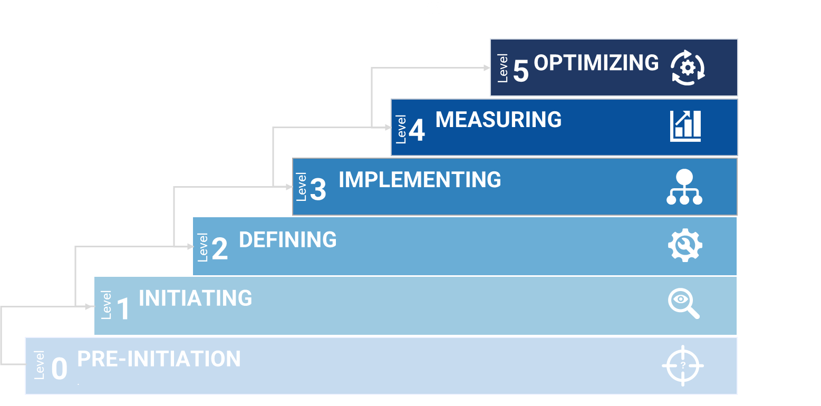
Chapter 4: Roadmap and Capability Maturity Framework
The CMF is a self-assessment checklist to evaluate an agency’s capacity.
Separate evaluation tables for each key building block.

Slide 19
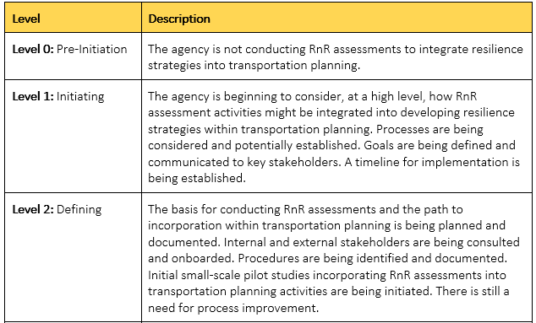
Chapter 4: Roadmap and Capability Maturity Framework
Example assessment table…

Slide 20
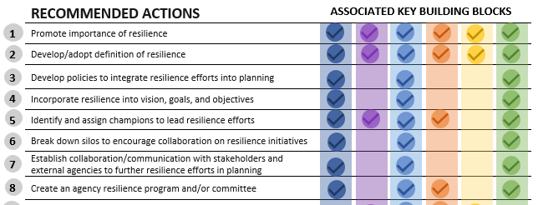
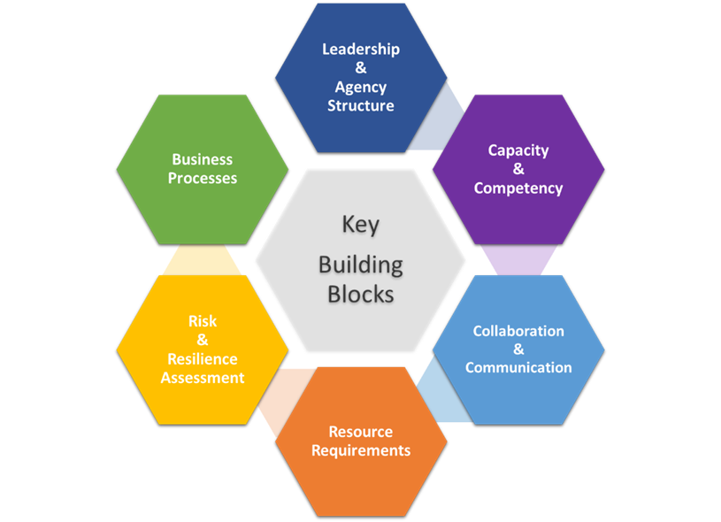
Chapter 5: Actions for Incorporating Resilience into Transportation Planning
(Strategies to Improve Resilience Programs)
Actions provide practical strategies for helping transportation agencies advance their resilience program. Each action is associated with one or more relevant building blocks.

Slide 21
Chapter 5: Actions for Incorporating Resilience into Transportation Planning
27 Actions in all with detailed explanations
Tables with useful information
    Definitions
    Data sources
    Risk and resilience assessment tools
    Resilience metrics
    Funding sources
Guidance on risk and resilience assessment, organizing for resilience, knowledge management, communications and collaboration, resources for building capacity, and more

Slide 22
Appendices
Appendix A – 11 Quick-Scan Case Studies
Appendix B – 4 Deep-Dive Case Studies
Appendix C – Relevant Sources

Slide 23
Implementation Plan
Intended audiences: State DOTS and metropolitan planning organizations
Channels of communication: webinars, TRB committee meetings, conferences (TRB, AASHTO, online publication of the Guidance)
Impediments to implementation: lack of understanding of risk and resilience concepts and lack of metrics
  Measuring implementation success: online analytics (etc., download counts), DOT performance metrics
Potential leaders in guide implementation: transportation organizations (including TRB, AASHTO); federal, state, and local agencies
Next steps: create a team to launch the communication plan for this project and Pilot test the Guidebook with multiple State DOT

Slide 24
Key Benefits to State DOTs
Provides transportation agencies with a self-assessment tool for evaluating their capacity to integrate resilience into planning.
Provides a convenient compendium of risk and resilience-related information.
Provides practical guidance and strategies to enhance a transportation agency’s resilience program.

