Slide 1
The following presentation is supplemental to NCHRP Research Report 1053: Valuation and Compensation Approaches in Utility Accommodation: A Guide (NCHRP Project 15-70, “Valuation and Compensation for Accommodating Utility and Communications Installations in Public Rights-of-Way”). The full report can be found by searching on the report title on the National Academies Press website (nap.nationalacademies.org).
The National Cooperative Highway Research Program (NCHRP) is sponsored by the individual state departments of transportation of the American Association of State Highway and Transportation Officials. NCHRP is administered by the Transportation Research Board (TRB), part of the National Academies of Sciences, Engineering, and Medicine, under a cooperative agreement with the Federal Highway Administration (FHWA). Any opinions and conclusions expressed or implied in resulting research products are those of the individuals and organizations who performed the research and are not necessarily those of TRB; the National Academies of Sciences, Engineering, and Medicine; the FHWA; or NCHRP sponsors.

Slide 2
Guidelines for Valuation and Compensation Approaches in Utility Accommodation
AN EXECUTIVE BRIEFING FOR THE NCHRP Project 15-70 GUIDE
Prepared by
NCHRP Project 15-70 Research Team
Notes:
`

Slide 3

NCHRP 15-70 Team Members
Iowa State University
  Roy Sturgill – Principal Investigator
  Tarig Omer – Graduate Student
  Jim Anspach
Parsons Corporation
  Kenny Franklin
T2 Utility Engineers, Inc.
  John Campbell
R.P. Manser, LLC
  Richard Manser

Slide 4
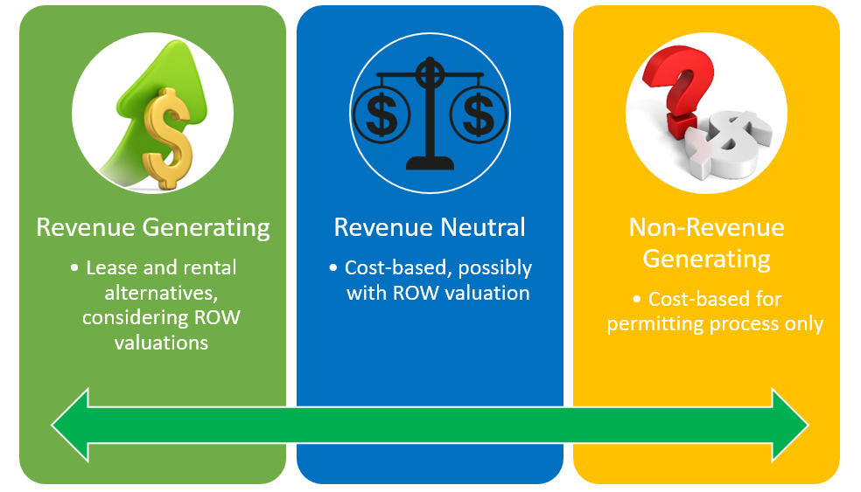
Outline
Project Overview
Research Objectives
Categorization of State Approaches
Guide Overview
Decision Support Tool

Slide 5
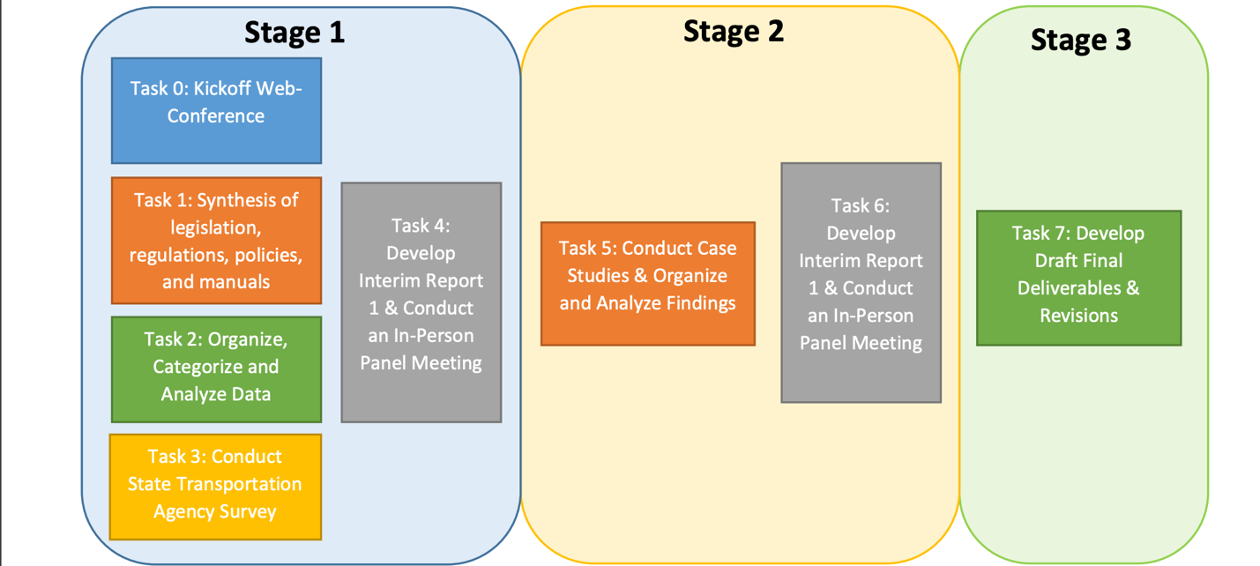
Project Overview

Slide 6
Project Overview
Information Workflow

Slide 7
Research Objectives

Slide 8
Objectives
Identify best practices and prepare guidelines for state departments of transportation (DOTs) on how to evaluate and charge for the accommodation of utility and communication installations on public right-of-way (ROW), and
Prepare guide for:
  Fee approaches in comparing fees, leasing, and in-kind trading used by other DOTs;
  Setting fees through analyzing fee structures used by other DOTs and standardizing and normalizing these fees with explanation for the variation among the fees, valuation methods, and other factors;
  Providing DOTs a decision support framework inclusive of the means and approaches necessary to execute a fee or leasing schedule for occupancy both for general utilities and for telecommunications facilities and;
  Identifying and supporting policy or legislation needs stemming from the DOT’s decision to execute a fee or leasing structure.

Slide 9
Categorization of State Approaches

Slide 10
Revenue Generation Categories

Slide 11
Compensation and Valuation Schema
Accommodation Mechanism
  Easement
  Lease
  Franchise, etc.
Compensation Methods
  Cash
  Bartering, etc.
Compensation Structure
  One-time fee
  Annual fee
  Lease,
  Resource Sharing, etc.
Valuation Approach
  Direct DOT costs
  Value of adjacent land, etc.
Variation and mixtures of the above…

Slide 12
State DOT Categorization Mechanism
Revenue Generation Category | Accommodation Mechanism | Compensation Method | Compensation Structure | Valuation Approach | Scheme Variation
A. Revenue Generating | 1. Easement | i. Cash | a. One Time Fee | 1. DOT costs | A. Singular approach
B. Revenue Neutral | 2. Lease | ii. Bartering | b. Annual Fee | 2. Bidding / competitive auction | B. Variation by roadway functional class/access control
C. Non-revenue Generating | 3. Franchise | iii. Cash and Bartering | c. Lease | 3. Valuation of adjacent land | C. Variation by utility type
 | 4. License /Permit | iv. None | d. Revenue Sharing | 4. Cost of next best alternative | D. Variation ownership
 | 5. Statutory Authority |  | e. Resource Sharing | 5. Needs-based compensation | E. Variation by attachment
 |  |  | f. None | 6. Historical experience | F. Variation by geographic location
 |  |  |  | 7. Market research | G. Variation by ROW/surplus property type (including aerial or underground rights)
 |  |  |  | 8. None | H. Variation by population served by the utility

Slide 13
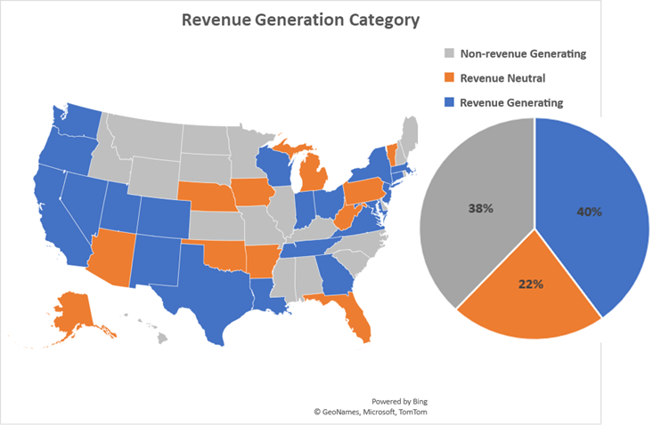
State DOT Categorization Summary

Slide 14
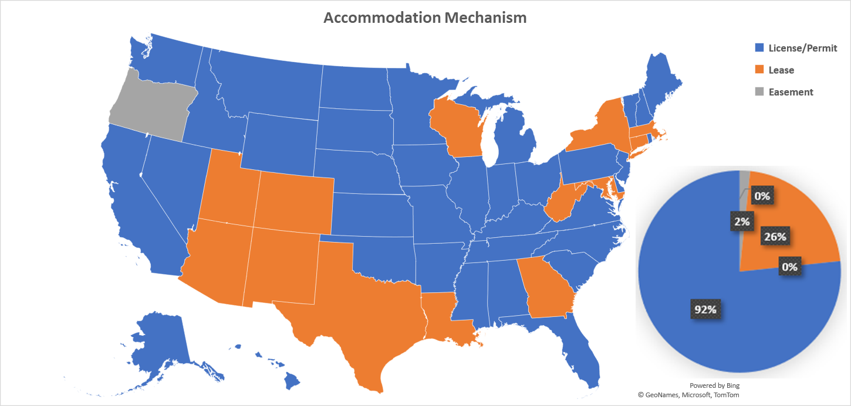
State DOT Categorization Summary

Slide 15
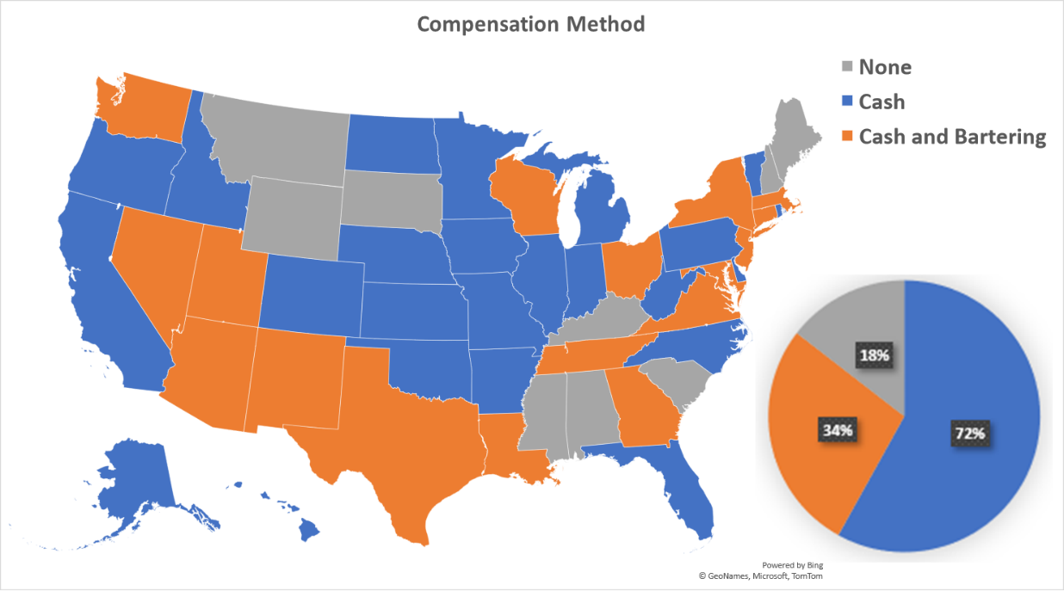
State DOT Categorization Summary

Slide 16
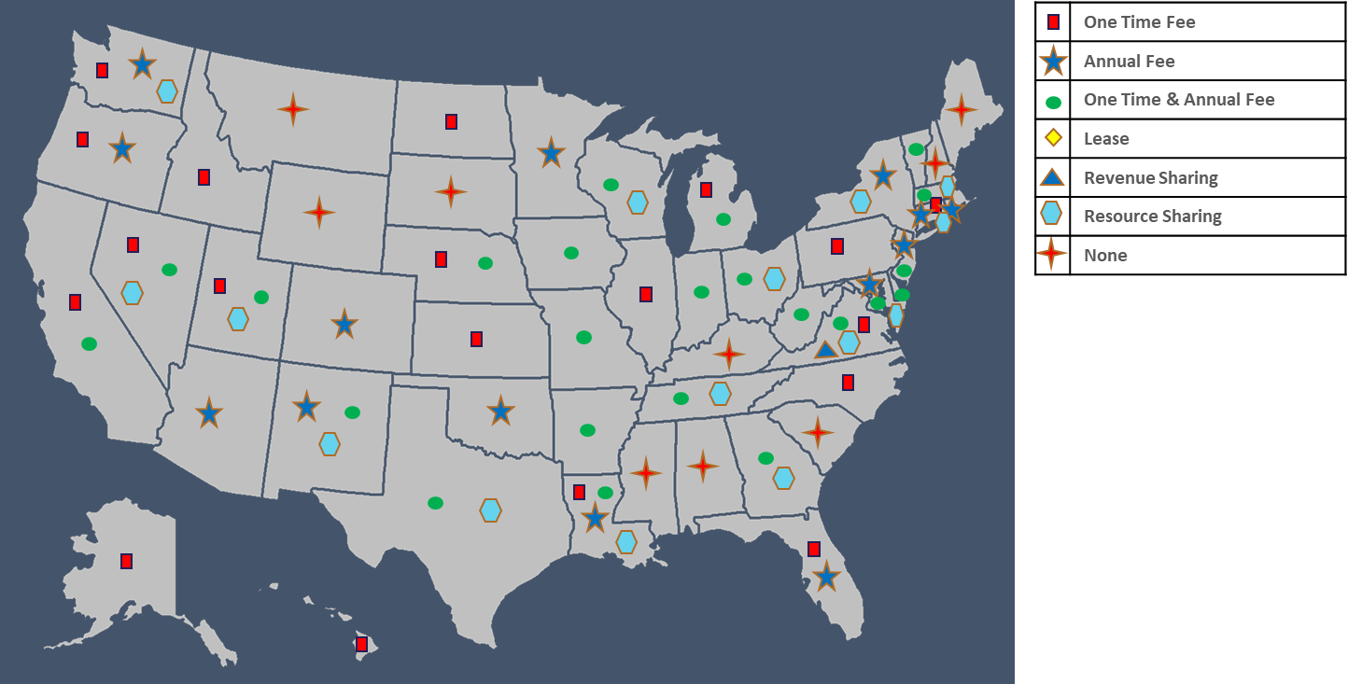
State DOT Categorization Summary
Compensation Structure

Slide 17

State DOT Categorization Summary
Valuation Approach

Slide 18
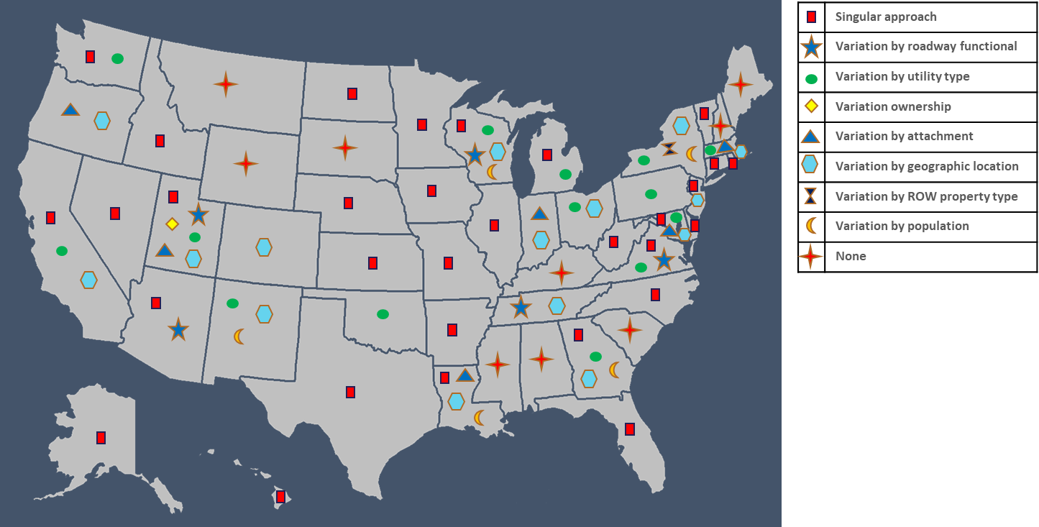
State DOT Categorization Summary
Schema Variation

Slide 19
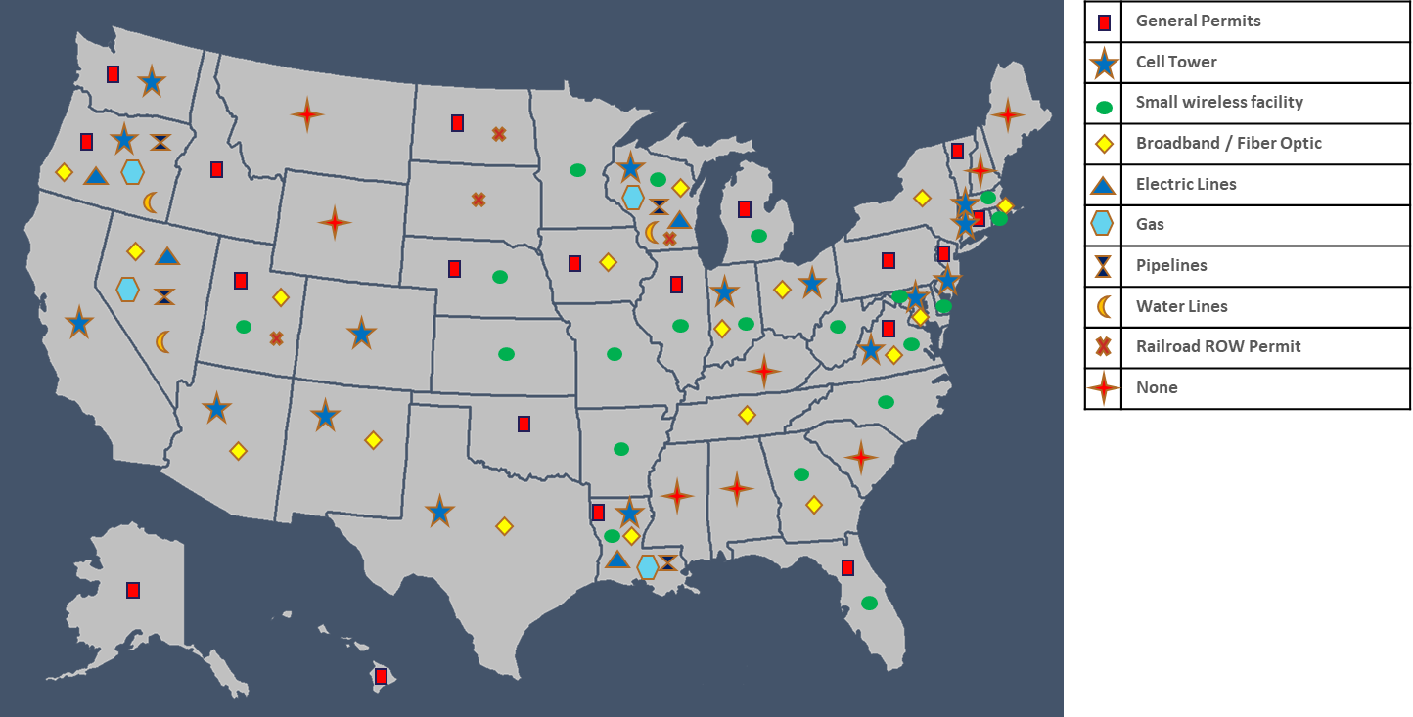
State DOT Categorization Summary
Type of Utilities Charged by State

Slide 20
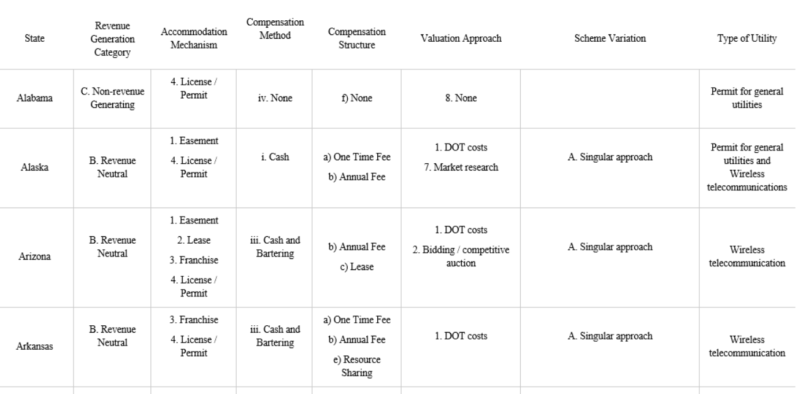
State DOT Categorization Summary ~ Example

Slide 21
Guidelines Overview

Slide 22
Guidelines Overview
Categorizing a massive collection of:
  Legislation & Regulations
  Policies
  Fee Structures, etc.
Guidelines for Valuation and Compensation Approaches in Utility Accommodation
  Background
  Objectives
  Decision Support Tool and usage

Slide 23
Decision Support TOol

Slide 24
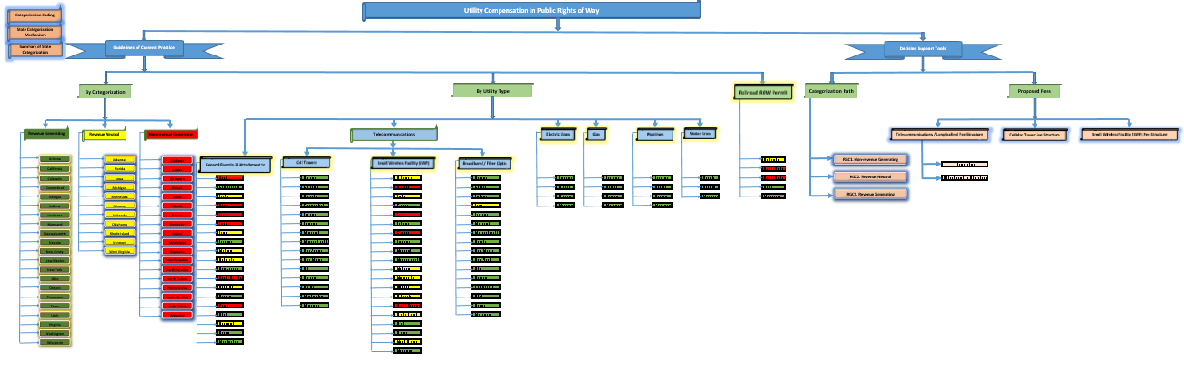
Decision Support Tool
Concisely compiled tool
Three Interest Areas
  States by Revenue Category
  Categorization by Utility Type
  Decision Support Tool Fee Templates
3
1
2

Slide 25
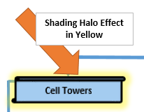
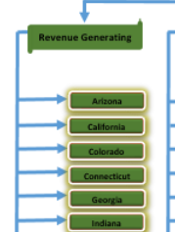

Decision Support Tool
Easy Navigation
  By spreadsheet tab
  Or hyperlinks indicated by shading halo effect

Slide 26
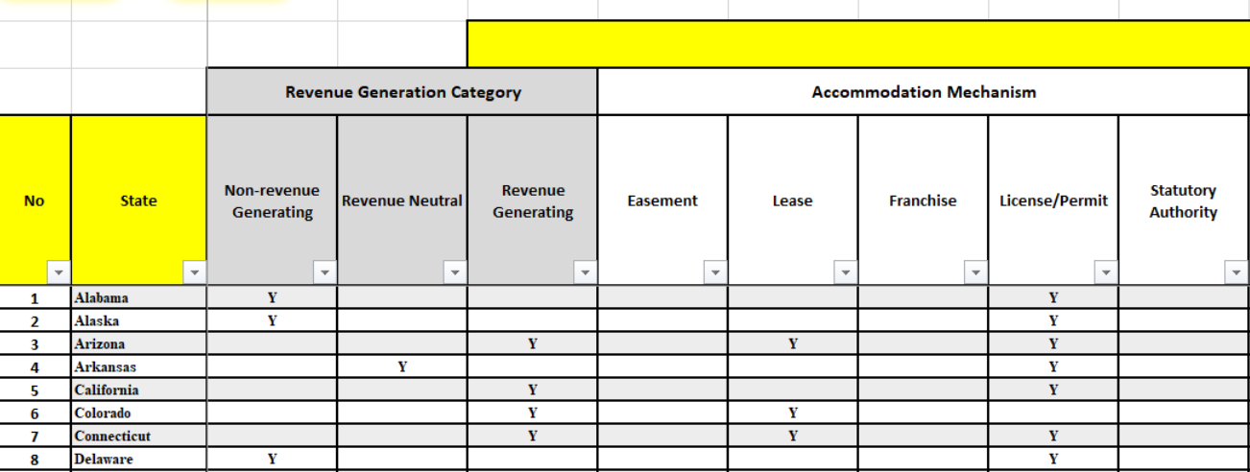
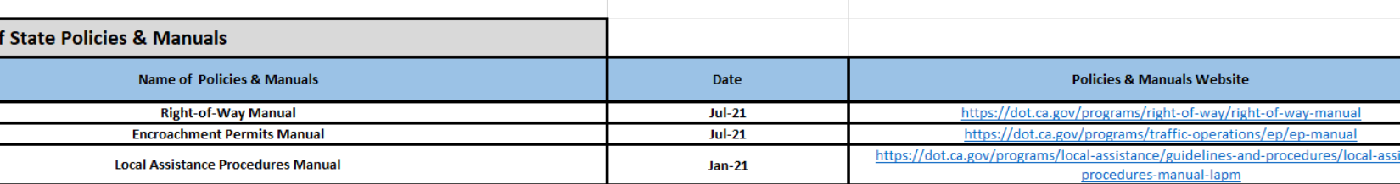
Decision Support Tool
An Assortment of Summaries
Access directly to web-based resources

Slide 27
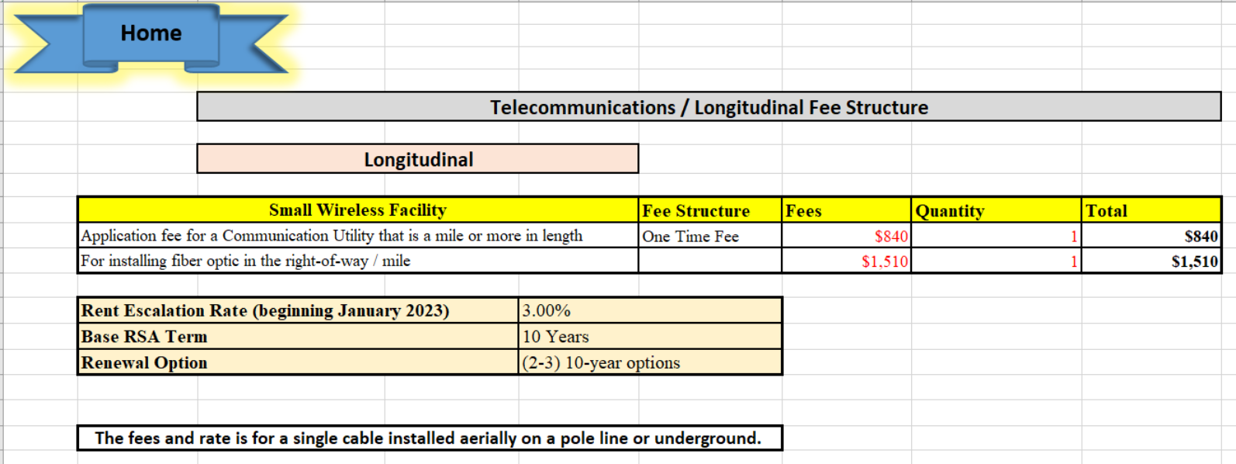
Decision Support Tool
Fee Templates

Slide 28
Decision Support Tool
Categorization and tool arrangement allow state DOTs to answer the following by investigating approaches used by other state DOTs:
What fee approaches maximize the value of utility accommodations to the taxpayer?
How should population density affect a fee structure?
What revenue projections can be expected from annual leasing of ROW?
What example legislation provides for bartering or resource sharing?
How might planned facility occupation relate to spatial needs for future new utility and highway facility accommodation?
How should future highway needs be accounted for in allowing utility occupations and setting fee structure?

Slide 29
Resources and Support
NCHRP Project 15-70, “Valuation and Compensation for Accommodating Utility and Communications Installations in Public Rights-of-Way.”
Resources and Support provided through
  Research Final Report
  Guide
  Decision Support Tool

