Slide 1
NCHRP Project 03-134
Determination of Work Zone Encroachments
The National Cooperative Highway Research Program (NCHRP) is sponsored by the individual state departments of transportation of the American Association of State Highway and Transportation Officials. NCHRP is administered by the Transportation Research Board (TRB), part of the National Academies of Sciences, Engineering, and Medicine, under a cooperative agreement with the Federal Highway Administration (FHWA). Any opinions and conclusions expressed or implied in resulting research products are those of the individuals and organizations who performed the research and are not necessarily those of TRB; the National Academies of Sciences, Engineering, and Medicine; the FHWA; or NCHRP sponsors.
Notes:
[Greeting]
- Welcome Everyone.
- This is the NCHRP project 03-134 final presentation.
- The project's title is 'Determination of Work Zone Encroachments'

Slide 2
Synopsis
United States road work zone fatalities increased by 7 percent from 2015 to 2016
Work zone equipment, traffic control devices, and workers are located in close proximity of travel lanes
Work zones require that drivers temporarily change their travel path and travel lanes → distraction
Likelihood of driver being injured is 10 percent higher when a driver involved in the crash committed an intentional improper action such as speeding or following too closely
2014 Fatal Accident Reporting System (FARS) → 71.4 percent of fatal work zone crashes are speeding related (driver behavior)
Notes:
[Synopsis]
- WZ fatalities in the US increased by 7% from 2015 to 2016.
- WZ equipment, traffic control devices, and workers are located quite close to the travel lanes.
- WZ is necessary for drivers to have enough space for changing their travel paths and lanes from distraction temporarily
- Likelihood of driver being injured is 10% higher when he/she has an intentional improper action like speeding or tailgating
- According to 2014 FARS, 71.4% of fatal WZ crashes are related to speeding

Slide 3
Synopsis
Work Zone definition
“A work zone is an area of roadway with construction, maintenance, or utility work activities. A work zone is typically marked by signs, channelizing devices, barriers, pavement markings, and/or work vehicles. It extends from the first warning sign (...) to the “End Road Work Sign” or the last temporary traffic control device” (Turner, 1999).
Work Zone Encroachment = “vehicle travel condition when a vehicle inadvertently traverses across the boundaries of a work zone”
Notes:
[Synopsis]
- Definition of WZ
An area of roadway with construction, maintenance, or utility work activities. A WZ is typically marked by signs, channelizing devices, barriers, pavement markings, and/or work vehicles. It extends from the first warning sign to the END ROAD WORK SIGN or the last temporary traffic control device
- Definition of WZ encroachment
vehicle travel condition when a vehicle inadvertently traverses across the boundaries of a work zone

Slide 4
Implications
AASHTO MASH (roadside safety hardware testing and evaluation criteria)
  Impact conditions based on NCHRP 17-22 data & 85% speed and angle
  No consideration for work zones
AASHTO RDG recognizes that barrier need within a work zone can be influenced by traffic volume, operating speed, offset, and duration of the work zone
  Work zone encroachment data needed in support of engineering risk or benefit-cost analysis for use of barriers within work zones
MUTCD refers to MASH and RDG as governing publications regarding design and use of temporary traffic control devices
  Encroachment data needed for benefit-cost analysis for use of barriers within WZ
  MUTCD relatively silent on when & where positive protection in WZ should be used
  Code of federal regulations (23 CFR 630 Subpart K) requires agencies to establish criteria regarding positive protection use in WZ.
Notes:
Potential Implications that are being investigated through this projects are related to the following AASHTO guidelines /books:
- AASHTO MASH
Roadside safety hardware testing and evaluation criteria
Impact conditions based on NCHRP 17-22 data & 85% speed and angle
No consideration for work zones
- AASHTO RDG
Recognizes that barrier need within a work zone can be influenced by traffic volume, operating speed, offset, and duration of the work zone
Work zone encroachment data needed in support of engineering risk or benefit-cost analysis for use of barriers within work zones
- MUTCD
Governing publications regarding design and use of temporary traffic control devices
Encroachment data needed for benefit-cost analysis for use of barriers within WZ
MUTCD relatively silent on when & where positive protection in WZ should be used
Code of federal regulations (23 CFR 630 Subpart K) requires agencies to establish criteria regarding positive protection use in WZ.

Slide 5
Objectives
Investigate vehicle encroachment conditions associated with work zone locations
Develop Guidance addressed to DOTs and research practitioners to improve safety for workers and traveling public in roadway work zones
Develop a work zone encroachment crash database
Notes:
[Objectives]
- Investigate the vehicle encroachment conditions associated with WZ
- Develop Guidance for DOTs and research practitioners to improve safety for workers and traveling public The Guidance is intended to address all aspects of work zones from planning (including when to use positive protection) through implementation, and be useable by any entity involved in the life cycle of the work zone
- Develop a WZ encroachment crash database

Slide 6
Approach
Review the existing literature and state of the practice
Use readily available databases to develop a work zone encroachment database for
  Evaluating the encroachment conditions in work zones
  Analyzing driver behavior in work zone encroachments
Develop guidance to:
  Enhance practitioners’ understanding of the importance of encroachment conditions in work zones
  To update the MASH, RDG, and MUTCD guidelines for improving safety in work zones
Conduct a peer-exchange workshop with state agency representatives
Notes:
[Approach]
- Review the existing literature and state of the practice
- Collect the available WZ encroachment database to evaluate the encroachment conditions in WZ and analyze driver's behavior in WZ encroachment
- Develop guidance to enhance the practitioner's understanding of the importance of encroachment conditions in WZ and update the MASH, RDG, and MUTCD guidelines for improving safety in WZ
- Conduct a peer-exchange workshop with state agency representatives

Slide 7
Work Plan
Notes:
[Work Plan]
- Phase I
Task 1: Develop Amplified Work Plan and Attend Kick-off Meeting
Task 2: Review Literature and State of the Practice
Task 3: Develop Data Collection and Analysis Plan
(Panel Approval)
Task 4: Perform Data Collection and Analysis
Task 5: Develop Draft Guidance
Task 6: Develop Preliminary Peer Exchange Workshop Plan
Task 7: Develop Interim Report
(Panel Approval)
- Phase II
Task 8: Conduct Peer Exchange Workshop
Task 9: Develop Final Guidance
Task 10: Presentation
Task 11: Develop Draft Final Report and Future Recommendation

Slide 8
Literature Review and State of Practice
Identify noteworthy state of the practice on work zone management and positive protection
Provide preliminary practitioner guidance on effective work zone strategies
  Identify the methods for collecting the encroachment data in work zones
  Identify the key data elements for developing the work zone encroachment dataset
Notes:
The following were the main objectives anticipated through the literature review and investigation of the state of practice
Identify noteworthy state of the practice on work zone management and positive protection
Provide preliminary practitioner guidance on effective work zone strategies
Identify the methods for collecting the encroachment data in work zones
Identify the key data elements for developing the work zone encroachment dataset

Slide 9
Survey for State of the Practices
Purpose was to gather agency policies, procedures, practices, and data that pertain to roadside encroachments and intrusions occurring in work zones
15 states responded
Notes:
A survey was distributed among those States that expressed initial interest and potential for contributing to the project
- Objectives: gather agency policies, procedures, practices, and data that pertain to roadside encroachments and intrusions occurring in work zones
- 15 states responded

Slide 10
Survey Result – State of the Practice
Work Zone Criteria
Roadway Characteristics
Operational Characteristics
Clear zone, Drop-off, Escape path, Duration, Project characteristics, Time of day, Work zone characteristics, Worker exposure, and Others
Cross-section, Geometry, Intersection, Location, Roadway type, Visibility, and Others
Crash, Speed, Vehicle mix, Volume, and Others
Notes:
The project team used the state DOT publications and results of a survey to review the state of the practice in states.
Data elements used in work zone positive protection practices were identified. These data elements can be divided into three key data element groups:
• Work zone characteristics and positive protection.
• Roadway and roadside characteristics.
• Operational characteristics.
A list of criteria that states use to assess whether or not to use positive protection in work zones was summarized as a result of this investigation.
A number of states indicated they consider whether vehicles have escape paths within the work zone. Most of the guidance, noted states consider escape path when considering whether to use positive protection in work zones. However, no specific criteria were provided.
The majority of the states consider presence of drop-off, presence of escape paths, duration, proximity of workers to moving traffic lanes, and work zone characteristics.
The most common roadway characteristics noted were shoulder type/width, lane type/characteristics, roadway geometry (presence/type of horizontal or vertical curves), sight distance, and type and class of roadway.
The most common consideration among operational characteristics is speed which may include speed limit, operating speed, or design speed of the facility scheduled for construction. Volume and vehicle mix were also commonly listed as criteria for consideration.

Slide 11
Develop Data Collection and Analysis Plan
State DOTs use encroachment data indirectly through AASHTO guidelines (MUTCD, RDG, and MASH): potential changes to work zone encroachment data might affect the state of practice.
A plan was conducted to:
Identify Data Needs -- Develop a comprehensive data catalog
Identify Potential Data Sources – Identify data source studies /databases for data collection and investigation
Conduct Data Collection and Analysis – Develop a comprehensive data catalog
Notes:
State DOTs use the encroachment data indirectly through AASHTO guidelines such as the MUTCD, RDG, and MASH. Any potential changes to the work zone encroachment data will affect these guidelines and thus the state practices.
A plan was conducted to:
Identify Data Needs -- Current practices used in AASHTO guidelines and related relevant information was used to develop a comprehensive data catalog (for data collection)
Identify Potential Data Sources -- data source studies /databases were initially identified as potentially applicable to the scope of this data collection and investigation study
Develop Data Analysis Plan -- Based on the list of data needs and relevant data sources, the research team developed a comprehensive data catalog

Slide 12
Develop Data Collection and Analysis Plan
Identify Data Needs
Literature review, states survey, current practices reviewed for data needs identification
  Existing encroachment databases
  Existing guidelines
    MASH
    MUTCD
    RDG
  State survey
Notes:
As mentioned earlier, State DOTs use the encroachment data indirectly through AASHTO guidelines such as the MUTCD, RDG, and MASH. Any potential changes to the work zone encroachment data will affect these guidelines and thus the state practices. Therefore, current practices used in AASHTO documents were reviewed, as well as exiting encroachment databases and the results of the state survey.
Al this information was reviewed and utilized to develop a comprehensive data catalog (for data collection)

Slide 13
Develop Data Collection and Analysis Plan
Identified Data Needs
1
Case
Information
2
Event
Description
3
Encroachment Description
4
Roadway
Description
5
Roadside
Description
6
Work Zone
Description
7
Access
Management
8
Driver Characteristics
and Behavior
Notes:
This is the list of the identified Data Needs: 1) Case Information, 2) Event Description, 3) Encroachment Description, 4) Roadway Description, 5) Roadside Description, 6) WZ Description, 7) Access Management, and 8) Driver Characteristics and Behavior

Slide 14
Develop Data Collection and Analysis Plan
Identify Potential Data Sources – Potential data source studies /databases for data collection and investigation
Naturalistic Driving Studies
  The Second Strategic Highway Research Program (SHRP 2)
Encroachment Databases
  NCHRP 17-43
  NCHRP 17-88
Crash and Crash Reconstruction Databases
  FARS
  State Crash databases
  NASS Database
Notes:
Next step was for the researchers to identify potential data sources to consider for the data collection and investigation. The following are identified potential sources:
Naturalistic Driving Studies
The Second Strategic Highway Research Program (SHRP 2)
Encroachment Databases
NCHRP 17-43
NCHRP 17-88
Crash and Crash Reconstruction Databases
FARS
State Crash databases
NASS Database

Slide 15
Perform Data Collection and Analysis
Conduct Data Collection and Analysis
SHRP2-NDS Data from Readily-available Studies
1
Case
Information
2
Event
Description
3
Encroachment Description
4
Roadway
Description
5
Roadside
Description
6
Work Zone
Description
7
Access
Management
8
Driver Characteristics
and Behavior
Notes:
From the SHRP2-NDS data source, 5 available data needs were able to be extracted: 1) Case information, 2) Encroachment description, 3) Roadway description, 4) Roadside description, and 5) Access management

Slide 16
Perform Data Collection and Analysis
SHRP2-NDS Data from Readily-available Studies
Author and Year | Study Title | Study Code
Zhou et al. (2019) | Evaluation of Work Zone Mobility by Utilizing Naturalistic Driving Study Data | NDS-1
Hallmark et al. (2015) | Evaluation of Work Zone Safety Using the SHRP2 Naturalistic Driving Study Data | NDS-2
Flannagan et al. (2019) | Analysis of SHRP2 Data to Understand Normal and Abnormal Driving Behavior in Work Zones | NDS-3
Li et al. (2016) | Evaluation of the interaction between horizontal and vertical alignment on rural two-lane roads | NDS-4
Perez et al. (2019) | Naturalistic Investigation of Contributing Factors by Crash Type | NDS-5
Rufina et al. (2019) | Inferring cognitive workload and crash risk from naturalistic driving data | NDS-6
Layman et al. (2016) | Use of SHRP2 NDS Data to Evaluate Roadway Departure Characteristics | NDS-7
Sear et al. (2018) | Use of SHRP 2 NDS Data to Evaluate Roadway Departure Crash Characteristics - Phase II | NDS-8
Perez (2017) | Explore Surrogate Measures of Safety Using SHRP2 Naturalistic Driving Data | NDS-9
Perez et al. (2016) | Iowa State University CTRE S08: Analysis of the SHRP2 Naturalistic Driving Study Data S08-D; Assessing Lane Departures on Rural Two-Lane Curves | NDS-10
Notes:
- For the purposes of this project, the research team identified and collected work zone encroachment data from 10 NDS studies.
- Table summarizes the selected studies and the number of potential events that were evaluated in the NCHRP 03-134.

Slide 17
Perform Data Collection and Analysis
SHRP2-NDS Data from Readily-available Studies
Study | Event Type | Work Zone |  | Non-work Zone |  | Total
 |  | Encroachment | No Encroachment | Encroachment | No Encroachment
NDS-3 | Crash | 7 | 7 | 1 | 0 | 15
 | Near-Crash | 20 | 20 | 0 | 1 | 41
NDS-2 | Crash | 44 | 44 | 6 | 0 | 94
 | Near-Crash | 123 | 123 | 0 | 6 | 252
NDS-7 | Crash | 5 | 5 | 1,002 | 31 | 1,043
 | Near-Crash | 39 | 39 | 441 | 78 | 597
Total |  | 183 | 1,450 | 238 | 116 | 1,987
Notes:
- Table shows the number of crash and near-crash events extracted from the NDS studies.
- A total number of 1,987 of events were investigated.
- Encroachment in work zones was identified in 183 of the events, and road departure in non-work zone locations were found in 1,450 of the events.

Slide 18
Perform Data Collection and Analysis
State Crash Database
Merging crash, unit and person datasets
Selecting work zone related crashes
Removing intersection and junction related crashes
Single Vehicle Crash (SVC)
Selecting head-on, opposite swipe, overturn
No
Yes
Selecting encroachment crashes from harmful event
Determining departure side
Removing outliers, reducing features
Data analysis
Notes:
- A total number of 27 state DOTs who previously agreed to share their work zone crash data were contacted.
- This is a general guideline for filtering and identifying the WZ-related encroachment events from the collected state crash database.
- The crash, vehicle, and driver information were merged through a unique crash identification number to create one single file.
- Work zone and work zone-related crashes were selected from the dataset.
- Due to the complexity and extension of the contributing factors to intersection and junction-related crashes, these types of crashes were removed from the dataset.
- Encroachment is mainly considered as one of the significant crash types in Single-Vehicle Crashes (SVC).
- From multiple vehicle crashes, head-on, opposite sideswipe, and overturn result from or will result in a vehicle encroachment.
- The left-side or right-side encroachment is a vital feature in the encroachment analysis.
- After determining encroachment crashes in the dataset, each variable was investigated, and events with outlier values were removed

Slide 19
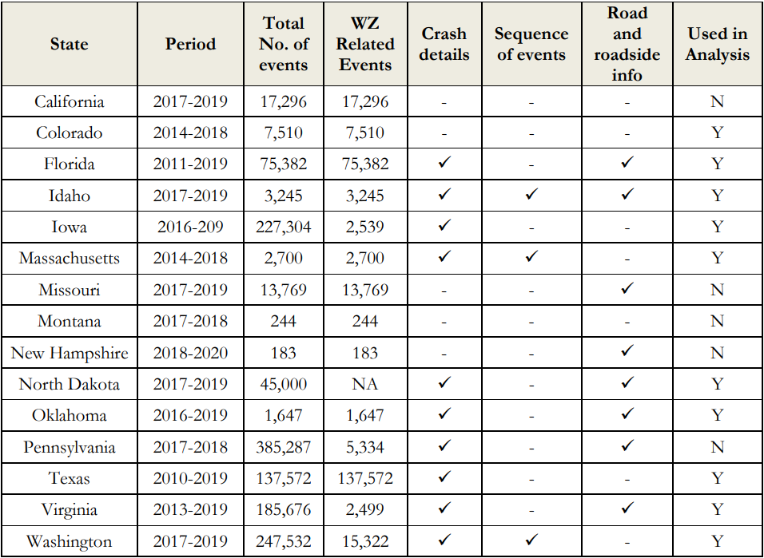
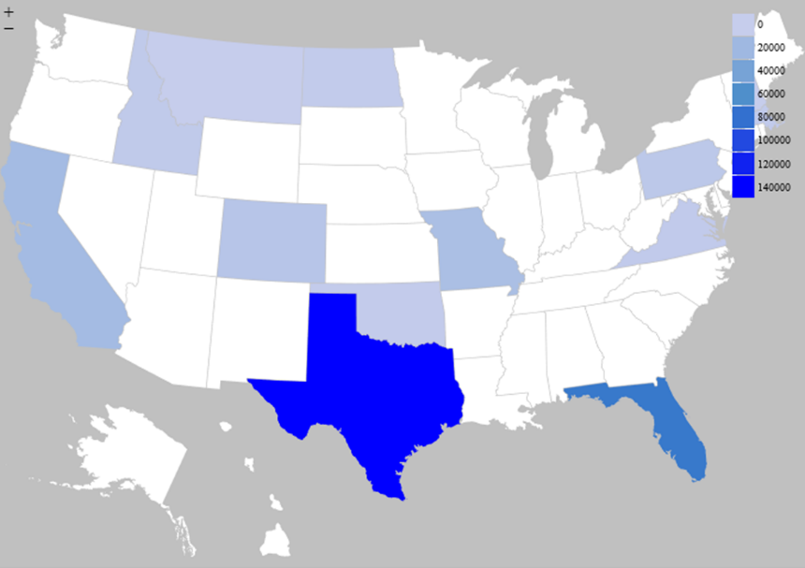
Perform Data Collection and Analysis
Notes:
- Table presents the DOTs which responded to the data request and shared their crash data.
- Each state has a specific data structure and dictionary for crash data collection.
- Thus, the collected data were investigated, and the availability of the required information in each dataset was determined.

Slide 20
Perform Data Collection and Analysis
NCHRP 17-43
NMVCC
A collection of 1,581 road departure crashes extracted from the National Automotive Sampling System Crashworthiness Sampling System
Information included in the database – encroachment trajectory of the vehicle and detailed information about the roadside environment
8 crashes were occurred in work zone out of 1,581 crashes
National Motor Vehicle Crash Causation Study
NHTSA sponsored nationwide survey of crashes involving light passenger vehicles, with a focus on the factors related to pre-crash events
A total of 6,949 crashes
  January 1st, 2005 to December 31st, 2007
31 crashes were identified in the criteria of the dataset
Notes:
1) NCHRP 17-43
- The NCHRP 17-43 database is a collection of 1,581 road departure crashes extracted from the National Automotive Sampling System Crashworthiness Sampling System (NASS/CDS).
- The database includes the encroachment trajectory of the vehicle as well as detailed information about the roadside environment such as the clear zone width, object performance, and the presence of a work zone.
- Of the 1,581 crashes in the NCHRP 17-43 dataset, 8 were related to a work zone based on the NASS/CDS scene photographs.
2) NMVCC
- One of the goals of the project is characterize the nature of work zone encroachments by examining national databases of in-depth crash investigations in work zones.
- One promising source for these in-depth crash investigations is the National Motor Vehicle Crash Causation Study (NMCCS).
- NMVCCS is a NHTSA sponsored nationwide survey of crashes involving light passenger vehicles, with a focus on the factors related to pre-crash events.
- A total of 6,949 crashes were investigated between January 1, 2005, and December 31, 2007
- The resulting dataset after applying these inclusion criteria was a dataset of 31 crashes.

Slide 21
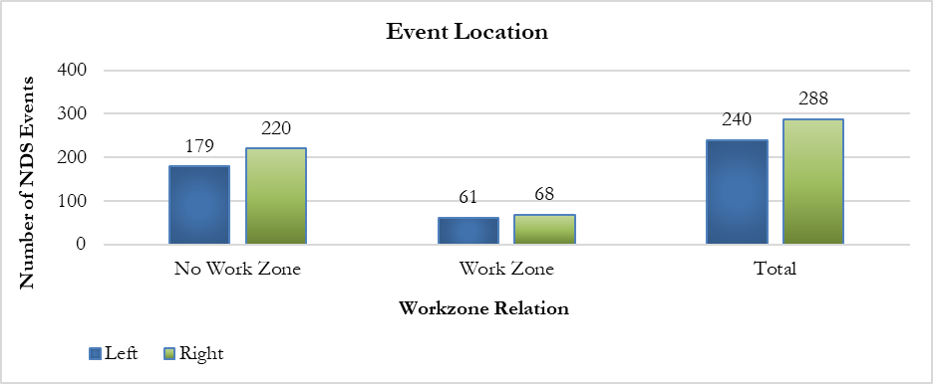
Perform Data Collection and Analysis
Exploratory Analysis of NDS Database
Event location, NDS
Notes:
- Figure shows the number of NDS events per relevance to WZ and encroachment direction.
- In non-work zone locations, there were 220 right-side and 179 left-side encroachments. Normally, the right side of the road has various fixed objects such as guardrails, trees, etc., while the left side of the road will have median barriers.
- For the work zone crashes on the other hand the number of left and right-side encroachments are almost the same, indicating that the type of the roadside barrier may not play a significant role in work zone encroachments.

Slide 22
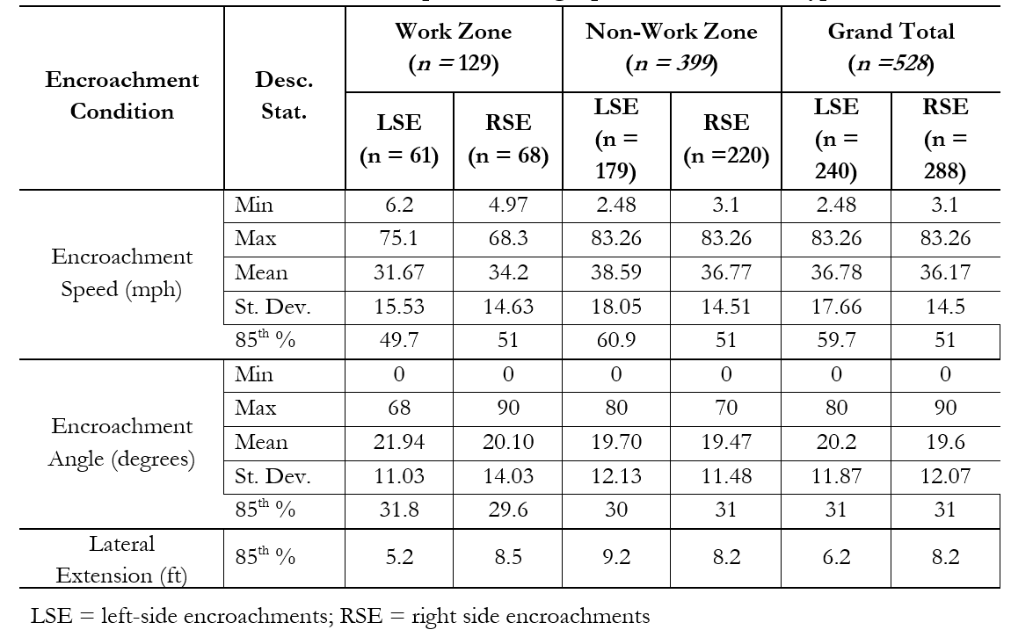
Exploratory Analysis of NDS Database
Notes:
- Table depicts the descriptive statistics of encroachment angles and speeds per 1) relation to the WZ, and 2) per direction of encroachment.
- The encroachment speed extracted from the NDS data indicates the speed at the time of encroachment or near-miss. Also, note that the posted speed limit value for the roadways of the investigated crashes was not available.

Slide 23
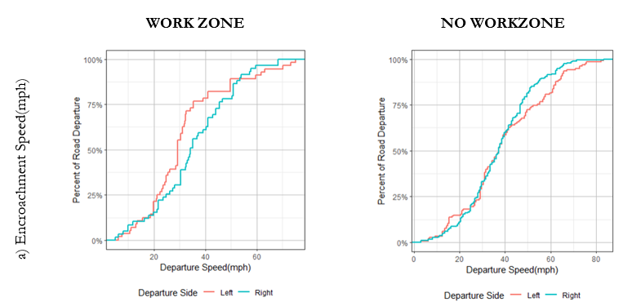
Exploratory Analysis of NDS Database
Notes:
- These figures depict the distribution of encroachment (departure) speeds and angles observed in encroachment events (WZ and non-WZ).
The analysis indicates that the 85th percentile for work-zone related encroachment speed is 49.7 mph and 51 mph for left and right-side encroachments, respectively. This compares to the recorded 85th percentile for no work-zone related encroachment speed of 60.9 mph and 51 mph for left and right-side encroachments, respectively. When considering the 85th percentile for all recorded encroachments, the values are 59.7 mph and 51 mph for left and right-side encroachments, respectively.
There is no difference in the 85th percentile value encroachment speed when comparing work-zone and no work-zone related encroachments happening on the right side (51 mph in both cases). Also, when combining the values for the left and right encroachment sides, the 85th percentile results in 50.4 mph and 55.4 mph for work zone and no work zone related encroachments, respectively.

Slide 24
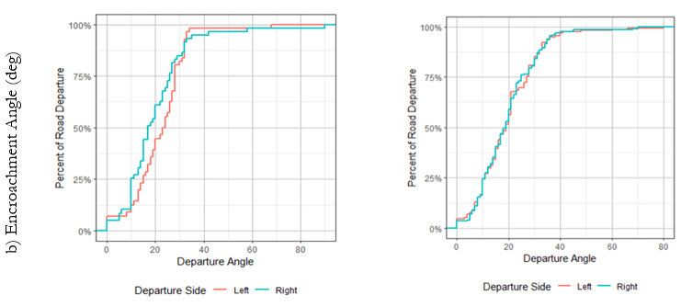
Exploratory Analysis of NDS Database
Notes:
The analysis indicates that the 85th percentile for work-zone related encroachment angle is 31.8 degrees and 29.6 degrees for left and right-side encroachments, respectively. This compares to the recorded 85th percentile for no work-zone related encroachment angle of 30 degrees and 31 degrees for left and right-side encroachments, respectively. When considering the 85th percentile for all recorded encroachments, the values are 31 degrees for both left and right-side encroachments.
There is not a significant difference in encroachment angle for a testing /design perspective, when comparing work-zone and no work-zone related encroachments happening on the right side (29.6 degrees vs. 31 degrees, respectively).
The difference between the two value is less than the current MASH tolerance value of 1.5 degrees from the nominal value, considered for testing. Also, when combining the values for the left and right encroachment sides, the 85th percentile results in 30.6 deg for both work zone and no work zone related encroachments.

Slide 25
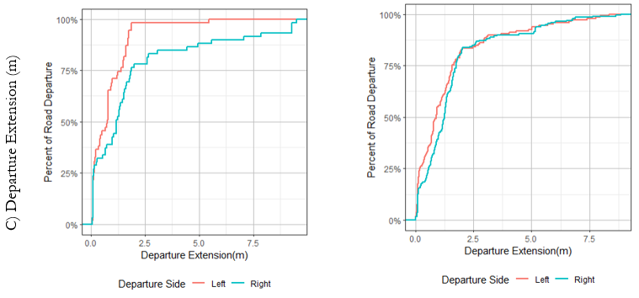
Exploratory Analysis of NDS Database
Notes:
The analysis indicates that the 85th percentile for work-zone related encroachment lateral extension is 1.6 m (5.2 ft) and 2.6 m (8.5 ft) for left and right-side encroachments, respectively. This compares to the recorded 85th percentile for no work-zone related encroachment lateral extension of 2.8 m (9.2 ft) and 2.5 m (8.2 ft) for left and right-side encroachments, respectively. When considering the 85th percentile for all recorded encroachments, the values are 1.9 m (6.2 ft) and 2.5 m (8.2 ft) for left and right-side encroachments, respectively.
There is not a considerable difference in encroachment lateral extension when comparing work-zone and no work-zone related encroachments happening on the right side (8.5 ft vs. 8.2 ft, respectively).
Also, when combining the values for the left and right encroachment sides, the 85th percentile results in 7.1 ft and 8.7 ft for work zone and no work zone related encroachments, respectively.

Slide 26
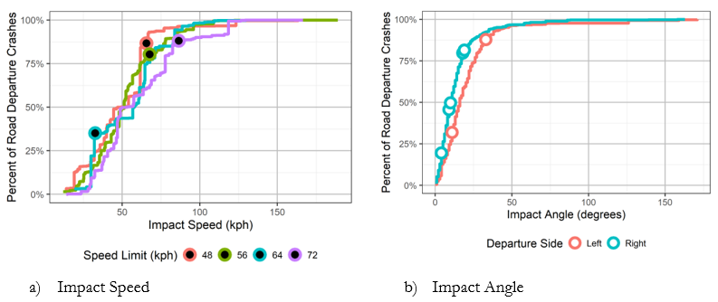
NCHRP 17-43 Database
<Distribution of impact speeds and angles, NCHRP 17-43>
* Open circles represent cases in work zones
Notes:
NCHRP 17-43 was investigated to conduct analysis on impact speed, angle, and lateral offset
Five of crashes included information on the impact speed. All of these five crashes, except for one case, had impact speeds below the 85th percentile. However, this did not account for the speed limit of the road.
When accounting for the speed limit of the road, three crashes were above the 80th percentile for impact speed
The impact angles for the crashes in work zones were compared to all road departure crashes and did not appear to be different.

Slide 27
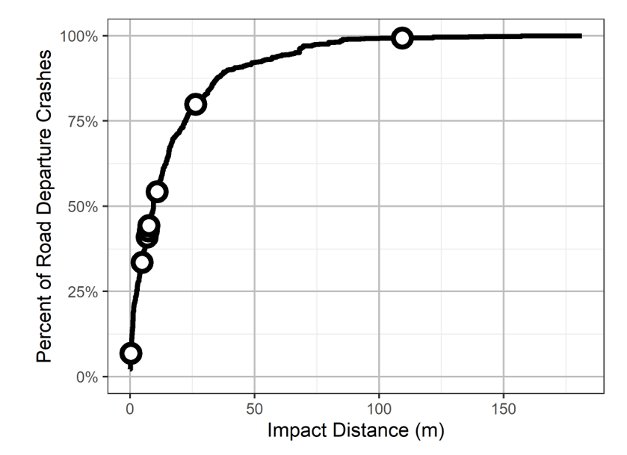
NCHRP 17-43 Database
<Distribution of Impact Distances, NCHRP 17-43>
* Open circles represent cases in work zones
Notes:
The distance to the first impact in work zones was compared to all crashes in the NCHRP 17-43 database.
The distance to the first impact in a work zone was not smaller than in the rest of the NCHRP 17-43 database.
(Surprisingly, one of the longest impact distances in the dataset occurred in a work zone.
In that case, the vehicle departs when the road turns left to pass under an overpass. The vehicle climbed a hill and struck the bridge.)

Slide 28
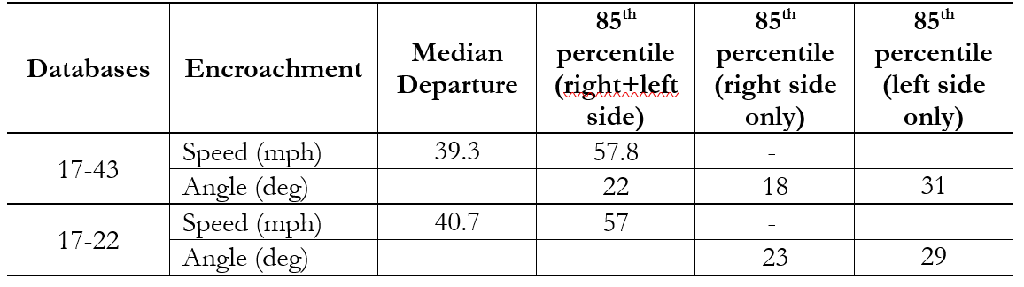
Data Results from 17-43 and 17-22 Databases
Notes:
As part of the on-going NCHRP 17-43 project, encroachment speed and angle conditions were investigated using the available data from the developed 17-43 database. As part of the investigation, these values were also compared to those derived from the NCHRP 17-22 dataset. The consideration of these encroachment conditions could be valid for potential impact conditions for work zone safety barriers implementation, given their restricted nature and closer proximity of barriers to travel lanes.
The reconstructed speed at the first departure is similar between the NCHRP 17-43 and NCHRP 17-22 database. The median departure speeds were 39.3 mph in the NCHRP 17-43 dataset and 40.7 mph in the NCHRP 17-22 dataset. The 85th percentile departure speeds were also similar at 57.8 mph in the NCHRP 17-43 dataset and 57.0 mph in the NCHRP 17-22 dataset. The departure angle distribution is similar between the datasets. In general, right-side departures tend to have a smaller departure angle than left departures.
For left side departures, the 85th percentile angle was 31 degrees in the NCHRP 17-43 database and 29 degrees in the NCHRP 17-22 database. For right side departures, the 85th percentile angle was 18 degrees in the NCHRP 17-43 database and 23 degrees in the NCHRP 17-22 database.
Additional analysis was performed under this project to investigate the 85th percentile for encroachments at both right- and left sides. The analysis indicates that the 85th percentile of the departure speed and angle are 55 mph and 22 degrees, respectively, when considering collectively right and left sides encroachments.

Slide 29
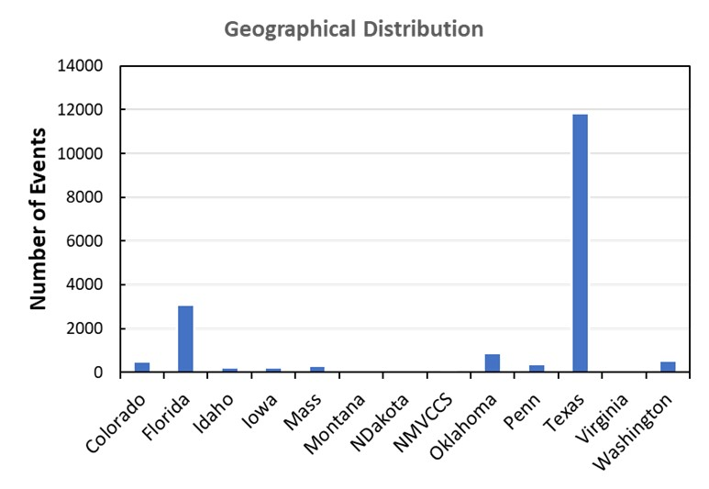
Geographical Distribution of Encroachment-Related Crash Events
Notes:
The figure shows the geographical distribution of the extracted encroachments identified in the crash databases. Texas has most of the crashes in the merged database with almost 12,000 work zone encroachment.
However, the crash database did not provide information about the impact speed, angle, and extensions. Therefore, the research team has used this data for exploring the roadway, roadside, work zone and driver behavior characteristics in encroachment events.

Slide 30
Roadway Facility Type in Encroachment Events
Travel lanes and median characteristics
Roadway functional class
Notes:
The research team has explored the roadway characteristics of locations where the work zone encroachments occur using both NDS and crash databases. This slide shows the association of the roadway facility with encroachment direction.
Left Figure:
About 60% of the encroachments on the one-way and two-way with left lane roads were toward the right side of the road. Almost 70% of the encroachments on the undivided two-way roads were toward the right side. On the other hand, most of the encroachments on two-way roads with medians were toward the left side of the road.
Right Figure:
Interstate and principal arterials (high-speed roadways) were associated with left-side encroachments, while lower classes such as collector and local roads are associated with right-side encroachments. This indicates that in high-speed roadways most of the work zone encroachments happen towards the median barriers while in low-speed roadways work zone encroachments happen towards the shoulder.

Slide 31
Roadside and Work Zone Conditions in Encroachment Events
Roadside Object
Work Zone Location
Notes:
This slide depicts the roadside object and work zone location where the encroachment occurred.
Figure Left:
The majority of encroachments involved fixed objects on the right side of the road, except for the concrete barriers. The research team assumes that these are the encroachments to the median barriers.
Figure Right:
The figure depicts the percentage of encroachments per work zone location. As observed in work zone areas, majority of encroachments are to the right side of the road.

Slide 32
Driver Behavior during Encroachment Events
Driver Distraction Factors
Driver Contributing Actions
Driver Distraction vs. Departure Direction
Notes:
1) Top Left Figure
- Among the driver contributing actions, improper speed was observed in 15% of encroachments.
- This contributing factor had more weight than road-related factors. Other contributing factors found in the crash data included failure to dim lights, careless manner, disregard for traffic and improper brake.
2) Top Right Figure
- Depicts driver distraction factors observed in work zone encroachment events.
- As observed majority of driver distraction were related to improper activity (e.g., improper speed, improper lane change, etc.), external distraction (likely due to the built environment), cell phone and other electronic device use, and passenger.
3) Bottom Figure
- Depicts the driver distraction associated with the encroachment direction.
- Both right and left side encroachments involved distraction due to the passenger and internal distractions.
- Inattention and external distraction were mainly observed in right encroachment events.
- Interestingly, among the distraction factors the cellphone use was found to be significantly associated with right-side encroachments, indicating that the drivers using the cell phone while driving will most probably encroach to the right side of the road which could result in potential fixed object crashes.

Slide 33
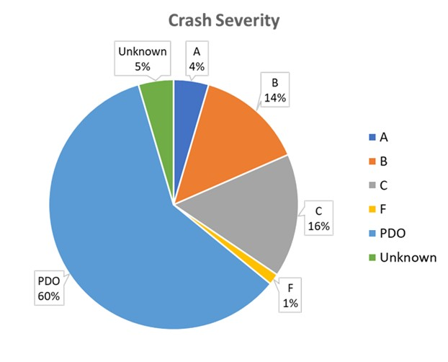
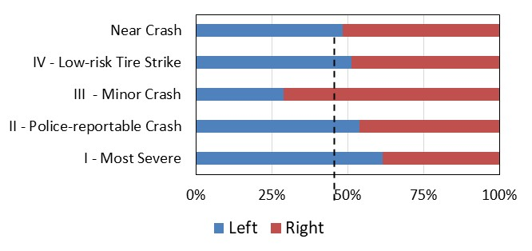
Exploratory Analysis
Crash Severity Distribution
Crash Severity vs Encroachment Direction
Notes:
This is the exploratory analysis of the work zone crash data based on some of the key factors
1) Left Figure
- Approximately 60% of the encroachment crashes in work zones that were obtained from state DOT database did not result in any injury, one percent crashes resulted in fatality (K), four percent in incapacitating injuries (A), 14% resulted in non-incapacitating injuries (B) and 16% resulted in possible injuries (C)
2) Right Figure
- Depicts the work zone crash severity per encroachment directions based on the NDS database. As observed right encroachments resulted in near crash and minor crashes (i.e., encroachment to the shoulder). On the other hand, left-encroachments mostly resulted in police-reportable and severe crashes. Such encroachments include median barriers.

Slide 34
Cluster Correspondence-Analysis
Data mining was performed to identify the patterns in work zone vs non-work zone crashes (using Texas Data).
Dimension reduction method was performed due to the complex nature of crash attributes.
Conventional regression analysis cannot determine sub-group effects in data. Cluster correspondence analysis, an advanced data mining method, can effectively determine the sub-group effects in dataset.
Notes:
- Data mining was performed to identify the patterns in work zone vs non-work zone crashes (using Texas Data).
- Dimension reduction method was performed due to the complex nature of crash attributes.
- Conventional regression analysis cannot determine sub-group effects in data. Cluster correspondence analysis, an advanced data mining method, can effectively determine the sub-group effects in dataset.

Slide 35
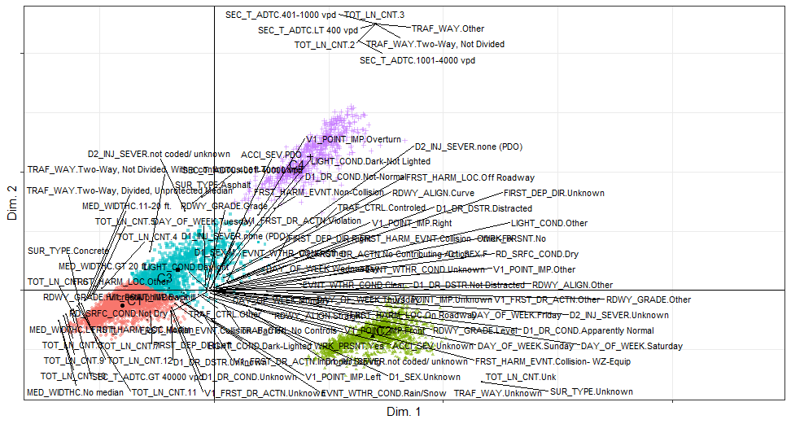
Clusters Developed from No Injury Crash Data
Notes:
- Two-dimensional biplot for no injury crash data.
- Different clusters were represented in different colors.
- As the biplot shows the locations of all attributes, it is difficult to explore individual attributes.
- This plot is provided to show the nature of attribute presence and their locations in a two-dimensional space.

Slide 36
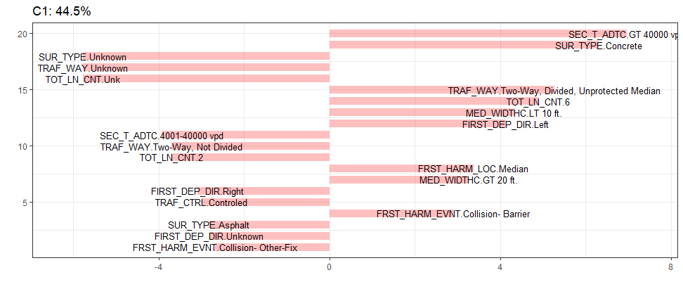
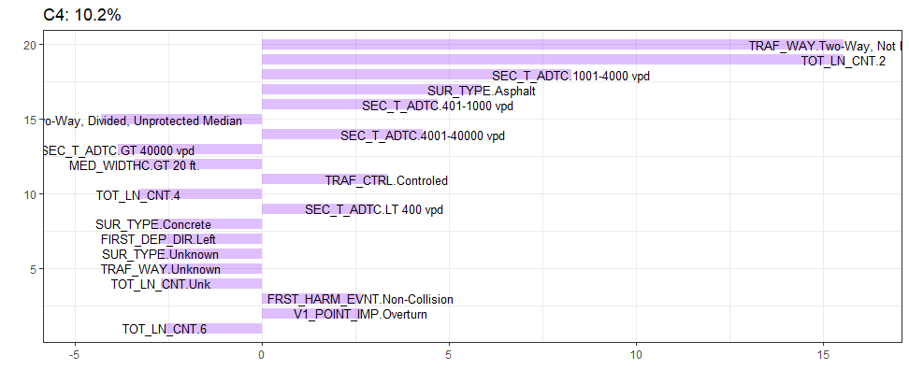
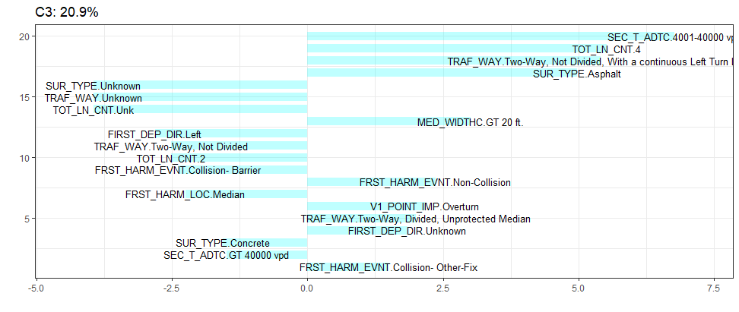
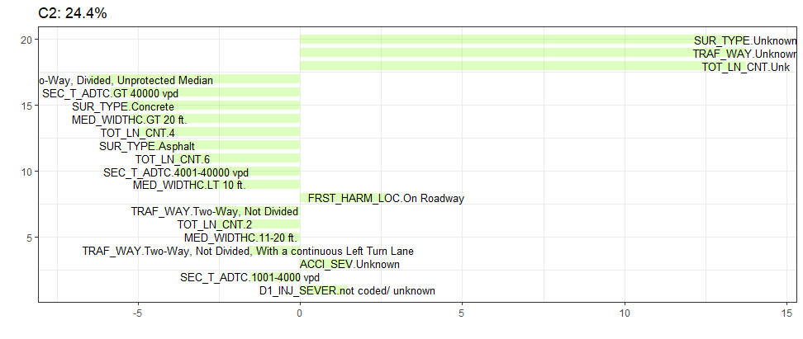
No Injury Crash Data
Notes:
- Additional cluster level bar plots
1) Top Left Figure
- Cluster 1, which explains 44.5% of data, primarily includes annual average daily traffic (AADT) greater than 4,000 vpd, concrete surface type, two-way divided, unprotected median as the traffic way, 6 lanes, a median width of less than 10 feet or greater than 20 feet, a left departure direction, the median being the location of the first harmful event, and the first harmful event being a collision with a barrier as the crash-contributing factors.
- This cluster is located mostly in quadrant three and partially in quadrant two.
- The positive long bar indicates that it has the strongest association with the other categories in this cluster.
2) Bottom Right Figure
- Cluster 2 (24.4% of data) primarily includes the first harmful location being on a roadway, along with several other positively associated but
unknown categories such as surface type, traffic way, total lane count, crash severity, and injury severity.
- This cluster is mostly located in quadrant four.
3) Bottom Left Figure
- Cluster 3 (20.9%), which primarily relates to an AADT of 4,001-40,000 vpd, four lanes, a two-way undivided, with continuous left turn lane traffic way or a two-way divided, with unprotected median traffic way, asphalt surface type, median width of greater than 20 feet, non-collision or collision with another fixed object as the first harmful event, and overturning, is located mostly in quadrants one and two, and partially in quadrant three.
4) Top Right Figure
- Cluster 4 (10.2%), which primarily relates to two-way, not divided roads as the traffic type, total lane count of two, surface type of asphalt, AADT less than 40,000 vehicles per day (vpd), controlled traffic, non-collision being the first harmful event, and an important point of vehicle 1 being overturn, is located mostly in the first quadrant. Cluster 3 is the closest to the center of the biplot.

Slide 37
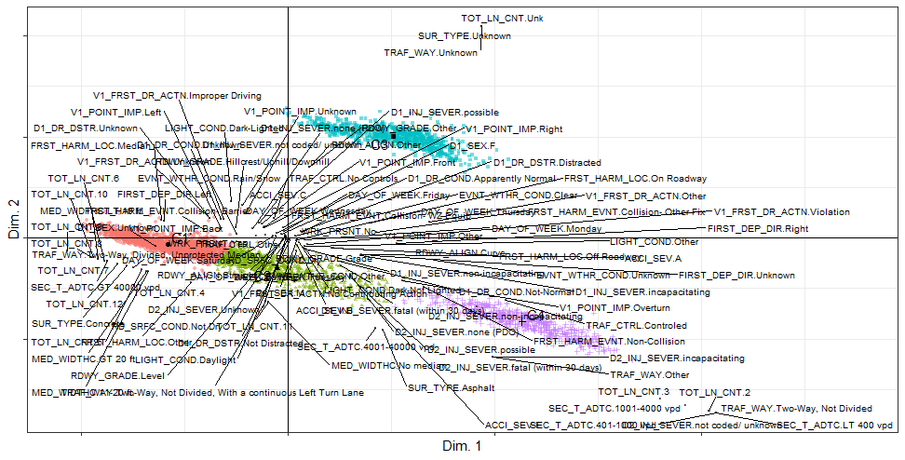
Clusters Developed from Fatal and Injury Crash Data
Notes:
The fatal and injury crash data from encroachment related work zone crashes was used to develop clusters
- The biplot is a difficult visual representation for exploring individual attributes. This plot is provided to show the nature of attribute presence and their locations in a two-dimensional space.

Slide 38
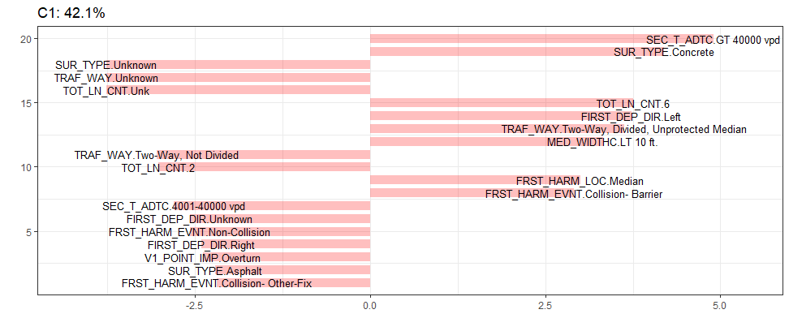
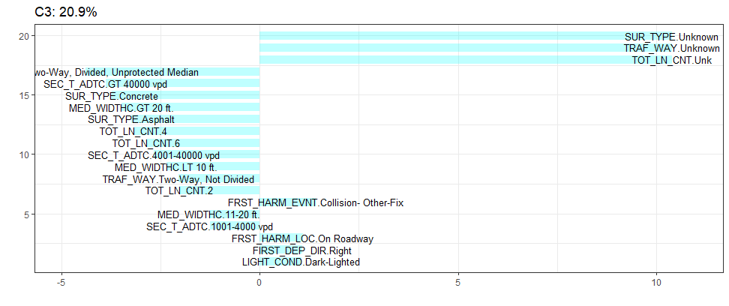
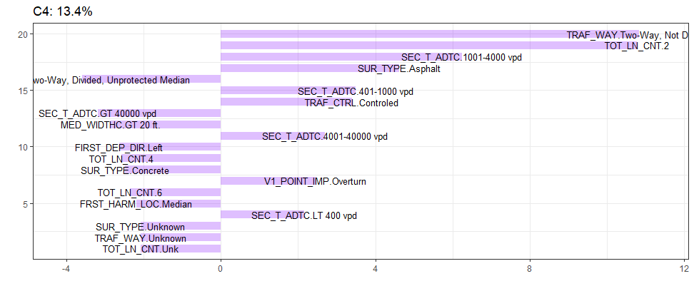
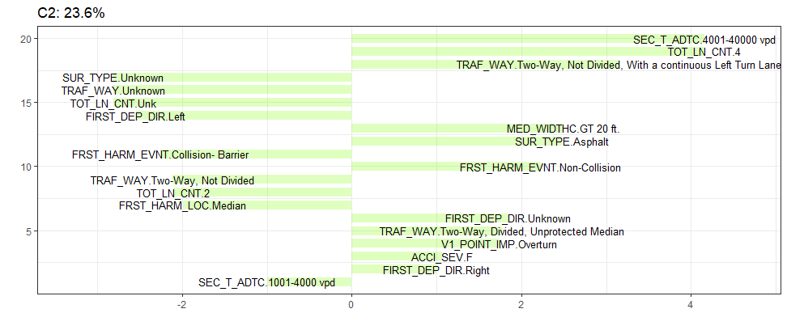
Fatal and Injury Crashes
Notes:
1) Top Left Figure
- Cluster 1 (42.1%) primarily relates to roadways with AADT greater than 40,000 vpd, concrete surface type, six lanes, the first departure direction being left, the traffic way being a two-way divided with unprotected median, a median width of less than 10 feet, the first harmful location being the median, and the first harmful event being collision into a barrier. It is located mostly in quadrants two and three.
2) Bottom Right Figure
- Cluster 2 (23.6%), which primarily relates to an AADT of 4,001-40,000 vpd, four lanes, the traffic way either being two-way undivided with a continuous left turn lane or two-way divided with an unprotected median, a median width of greater than 20 feet, an asphalt surface type, the first harmful event being non-collision with other vehicles, overturning, fatality, and the first departure direction being right or unknown, is mostly located in quadrants three
and four.
3) Top Right Figure
- Cluster 3 (20.9%), which has several unknowns, but includes positive associations with a collision with other fixed objects as the first harmful event, the first harmful location being on the roadway, the first departure direction being right, and the lighting conditions being dark but lighted, and the unknown categories including surface type, traffic way, and total lane count, is mostly located in quadrant one.
4) Bottom Left Figure
- Cluster 4 (13.4%), which primarily relates to a traffic way of two-way undivided, two-lane, AADT of less than 40,000 vpd, an asphalt surface type, controlled traffic, and an important point of vehicle one being overturned, is located mostly in quadrant four.

Slide 39
Cluster Analysis Key Findings
Fatal and Injury Crash Data
  Cluster 1 (C1)- Median related crashes on high volume two lane divided roadways
  Cluster 2 (C2)- Single vehicle overturning collisions on two-way divided roadways with unprotected median
  Cluster 3 (C3)- Crashes on roadways with dark-lighted condition
  Cluster 4 (C4)- Overturning crashes on two-lane undivided roadways with controlled traffic
No Injury Crash Data
  Cluster 1 (C1)- Median related crashes on high volume two lane divided roadways
  Cluster 2 (C2)- Encroachment on roadway
  Cluster 3 (C3)- Single vehicle overturning collisions on two-way divided roadways with unprotected median
  Cluster 4 (C4)- Overturning crashes on two-lane undivided roadways in controlled traffic
Notes:
- Key findings from the conducted Cluster Correspondence Analysis (CA) can be summarized as
follows:
1) The clusters and attributes in each cluster do not widely vary in the two datasets based on crash injury type.
2) Encroachment-related work zone no injury data has a cluster that presents 25% of data, and some critical variable categories of this cluster are unknown. For fatal and injury data, a similar cluster covers around 21% of the data. This indicates that police reports often contain less information if the crash involves no injury.
3) The three major clusters of both datasets are: median related crashes on two-lane divided high volume roadways, single vehicle overturning collisions on two-way divided roadways with unprotected median, and overturning crashes on two-lane undivided roadways in controlled traffic. The coverages by clusters vary in the two datasets. The results indicate that there is a need for median protection to reduce encroachment-related work zone crashes. Overturning crashes need to be examined in depth to see the roadway geometry, posted speed limit, and curvature information. While installation of median safety barriers could potentially increase the probability of errant vehicle crashes, implementation of such crashworthy systems will help with
limiting the severity of such crashes.
4) As the datasets are analyzed based on injury types, individual injury type attributes are only seen in one cluster (cluster 2 of fatal and injury crash data).
5) Although median related crashes dominate in both datasets, overturning and right encroachment crashes also need careful attention from safety engineers.

Slide 40
Peer Exchange Workshop
Format – Virtual
Platform – WebEx
Two half days
Breakout sessions for effective discussions
Participants – 15 state DOTs, project panel members, and program officers
Notes:
- The Peer Exchange Workshop was carried out with the objectives to provide an overview of the project draft products, engage the Agencies participants in discussions, and solicit feedback for potential inclusion in the final Guidance document as well as identify future research needs.
- The Workshop was via virtual format and through WebEx platform.
- Held in 2 half days: July 20th and 26th, 2022
- Had breakout sessions for the purpose of effective discussions
- 15 state DOTs, project panel members and program officers participated

Slide 41
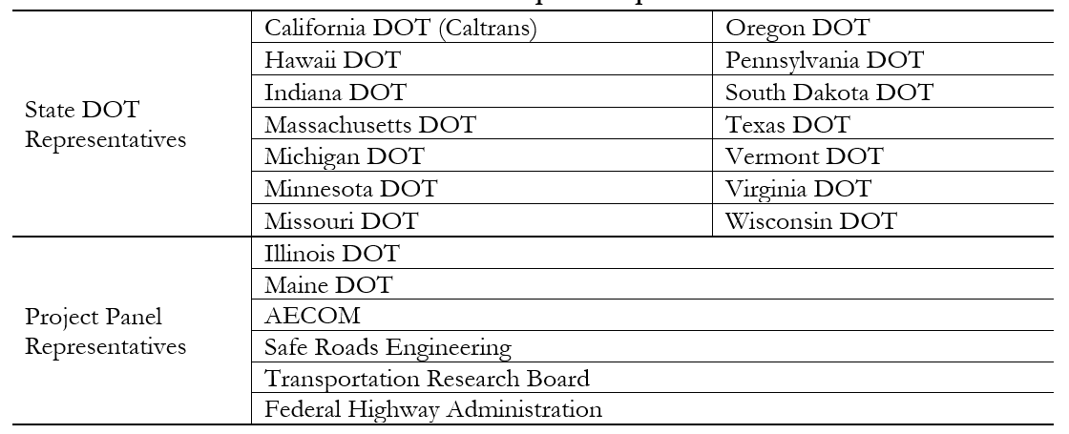
Workshop Participants
Notes:
- The detailed participants list is provided in this table

Slide 42
Peer Exchange Workshop Agenda
Day 1 (11:00 a.m. CT – 3:45 p.m. CT)​
11:00am​ | Welcome and Introductions​
11:15am​ | Revision of Workshop Agenda and Workshop Expectations​
11:20am​ | NCHRP 03-134 General Project Overview (Objectives, Tasks, Products)​
11:30am​ | Overview of Database Analysis Results​
12:00pm​ | Discussion of Database Analysis Results​
1:00pm​ | Break​
1:45pm​ | Overview Project Draft Products (Guidance – MASH)​
2:00pm​ | *Breakout Session* –Results Discussion on “Guidance -- MASH”​
3:00pm​ | 15 Minutes Break​
3:15pm​ | Reconvene Meeting from Breakout Session – Discussion of MASH Breakout Session Outcomes​
3:45pm​ | Adjourn​
Notes:
[Peer Exchange Workshop Agenda]
- In the 1st day, the workshop opened with an introduction to the project team and panel members associated with the project, followed by a revision of the proposed Agenda and clarification on the Workshop expectations.
- Next, a session was conducted with the objective to describe the purpose of the conducted project and the different tasks involved, including a general
overview of the anticipated project products.
- The following general session was to provide detailed overview of the database that was developed as one of the project products, leading to a group discussion where comments were solicited by the participants.
- During the second part of the 1st day of the Workshop, the researchers presented details of potential guidance modification suggestions with respect to MASH standards.
- The workshop attendees were then separated into two groups of smaller size to allow for deeper discussions on what was presented

Slide 43
Peer Exchange Workshop Agenda
Day 2 (11:00 a.m. CT – 3:30 p.m. CT)​
11:00am​ | Welcome and Introductions​
11:10am​ | Day-1 Workshop Meeting Recap & Comments​
11:40am​ | Minnesota “WZ Intrusion” App (Michelle Moser)​
12:00pm​ | WZ Intrusion App Discussion​
12:15pm​ | BREAK​
1:00pm​ | Overview Project Draft Products (Guidance -- RDG)​
1:15pm​ | Overview Project Draft Products (Guidance – MUTCD)​
1:30pm​ | *Breakout Session* –Results Discussion on “Guidance – RDG and MUTCD”​
2:30pm​ | BREAK​
2:45pm​ | Reconvene Meeting from Breakout Session – Discussion of RDG and MUTCD Breakout Session Results​
3:15pm​ | General Comments​
3:30pm ​ | Adjourn​
Notes:
[Peer Exchange Workshop Agenda]
- In the 2nd day, the workshop began with a general summary of the main activities /conclusions from Day-1, followed by a requested invited presentation on the development of a “Work Zone Intrusion” app, developed by Minnesota DOT, and a group discussion on the potential application of the app.
- During the second part of the 2nd day of the Workshop, the researchers presented details of potential guidance modification suggestions with respect to RDG and MUTCD criteria.
- Following the same methodology from Day-1, the workshop attendees were then separated into two groups of smaller size to allow for deeper discussions on what was presented

Slide 44
Results of Workshops
A Peer Exchange Workshop was conducted in virtual format via WebEx platform
The objectives were to provide an overview of the project draft products, engage the Agencies participants in discussions, and solicit feedback for potential inclusion in the final Guidance document as well as identify future research needs.
Based on participants’ common feedback, several common themes have emerged and there appear to be several research project ideas that can be explored, based on the identified needs.
Notes:
[Workshop Results]
- A Peer Exchange Workshop was conducted in virtual format via WebEx platform
- The objectives are to provide an overview of the project draft products, engage the Agencies participants in discussions, and solicit feedback for potential inclusion in the final Guidance document as well as identify future research needs.
- Based on participants’ common feedback, several common themes have emerged and there appear to be several research project ideas that can be explored, based on the identified needs. The following slide identifies recommendations for additional research.

Slide 45
Identified and Proposed Guidance Revisions
One of the project objectives was to support potential updates to:
Manual for Assessing Safety Hardware (MASH)
Roadside Design Guide (RDG), and
Manual for Uniform Traffic Control Devices (MUTCD)
Such investigation developed a guidance addressed to state departments of transportation (DOTs) and research practitioners to improve safety for workers and the traveling public in roadway work zones.
Notes:
As efforts were performed to investigate vehicle encroachment conditions associated with work zone locations, one of the project objectives was to support potential updates to the Manual for Assessing Safety Hardware (MASH), the Roadside Design Guide (RDG), and the Manual for Uniform Traffic Control Devices (MUTCD).
Such investigation developed a guidance addressed to state departments of transportation (DOTs) and research practitioners to improve safety for workers and the traveling public in roadway work zones.

Slide 46
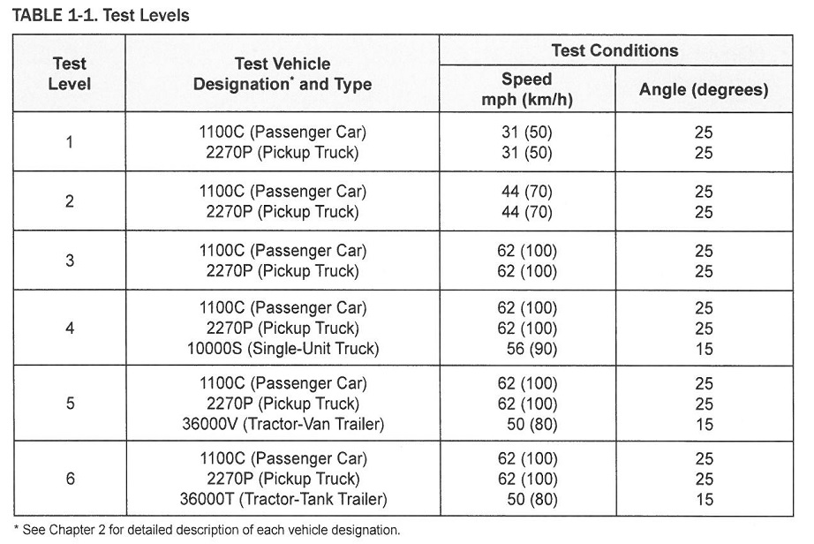

Manual for Assessing Safety Hardware
Provides specifications that govern the full-scale crash testing and evaluation of roadside safety features, including work zone barrier systems
6 test levels with different vehicle types and weights, impact speeds, and impact angles
MASH Test Level (left) and Cover Page (right)
Notes:
[Manual for Assessing Safety Hardware]
- MASH Provides specifications that govern the full-scale crash testing and evaluation of roadside safety features, including work zone barrier systems
- 6 test levels with different vehicle types and weights, impact speeds, and impact angles

Slide 47
Database Analysis Results, NCHRP 17-43
Only 8 work-zone crashes out of 1,581 crashes in the database
  5 of these included a value for the impact speed
The comparison of the reconstructed impact angles from the eight work zone crashes to the 85th percentile of the 17-43 impact angle data (from all crashes) is inconclusive, due to the limited available data
Although MASH is based on impact conditions rather than encroachment conditions, encroachment conditions will have more correlation to impact conditions for work-zone barriers and traffic control devices than other types of roadside safety devices
Notes:
[Database Analysis Results, NCHRP 17-43]
- NCHRP 17-43 database includes only 8 work-zone crashes out of 1,581 crashes in the database. 5 of these included a value for the impact speed
- The comparison of the reconstructed impact angles from the eight work zone crashes to the 85th percentile of the 17-43 impact angle data (from all crashes) is inconclusive, due to the limited available data
- Although MASH is based on impact conditions rather than encroachment conditions, encroachment conditions will have more correlation to impact conditions for work-zone barriers and traffic control devices than other types of roadside safety devices

Slide 48
Databases Analysis Results
The reconstructed speed at the first departure (i.e., encroachment speed) is similar between the NCHRP 17-43 database and older NCHRP 17-22 database
 | NCHRP 17-43 | NCHRP 17-22
Median departure speed for all roadway departure | 39.3 mph | 40.7 mph
85th percentile departure speed for all roadway departure | 57.8 mph | 57.0 mph
Notes:
[Database Analysis Results, NCHRP 17-43]
- The reconstructed speed at the first departure (i.e., encroachment speed) is similar between the NCHRP 17-43 database and older NCHRP 17-22 database

Slide 49
Databases Analysis Results
The departure angle distribution is also similar between the NCHRP 17-43 database and older NCHRP 17-22 database
 | NCHRP 17-43 | NCHRP 17-22
For left-side departure 85th percentile angle | 31 degree | 29 degree
For right-side departure 85th percentile angle | 18 degree | 23 degree
For combination of left and right-side departure 85th percentile angle | 22 degree
Notes:
[Database Analysis Results, NCHRP 17-43]
- The departure angle distribution is also similar between the NCHRP 17-43 database and older NCHRP 17-22 database

Slide 50
Databases Analysis Results, NDS
No difference in the 85th percentile encroachment speed when comparing work-zone and non-work-zone related encroachments happening on the right side
  51 mph in both cases
When left and right-side encroachments are combined, the 85th percentile speeds are 50.4 mph and 55.4 mph for work-zone and non-work-zone related encroachments, respectively
Notes:
[Database Analysis Results, NDS]
- NDS database analysis indicates that no difference in the 85th percentile encroachment speed when comparing work-zone and non-work-zone related encroachments happening on the right side. The speed was 51 mph in both cases
- When left and right-side encroachments are combined, the 85th percentile speeds are 50.4 mph and 55.4 mph for work-zone and non-work-zone related encroachments, respectively

Slide 51
Databases Analysis Results, NDS
85th encroachment angles for right-side encroachments
The difference between these values is less than the 1.5-degree tolerance for impact angle in MASH
 | Work-zone | Non-work-zone
For right-side encroachment | 29.6 degree | 31 degree
For the combination of left and right-side encroachment | 30.6 degree
Notes:
[Database Analysis Results, NDS]
- Table is 85th encroachment angles for right-side encroachments
- The difference between these values is less than the 1.5-degree tolerance for impact angle in MASH

Slide 52
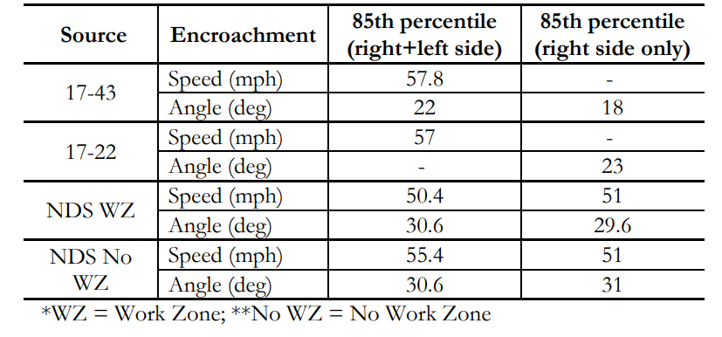
Databases Analysis Results Summary
These values are not significantly different from a barrier testing perspective when one considers the MASH tolerance for impact speed is 2.5 mph
Notes:
[Database Analysis Results Summary]
- These values are not significantly different from a barrier testing perspective when one considers the MASH tolerance for impact speed is 2.5 mph

Slide 53
Database Analysis Results Summary
The encroachment speeds obtained from 17-43, 17-22, and NDS data are comparable, with differences in the range of 3-4%
The differences in encroachment angle are considerably greater, with the NDS data having larger encroachment angles than both the 17-43 and 17-22 databases
The differences that exist among these datasets may be due to several factors
  The NDS data is encroachment based whereas the 17-43 and 17-22 databases are crash based
The posted speed limits for roadways on which the encroachments occurred in the NDS data are not available
There may also be differences associated with the different data collection periods of these datasets and the relative contribution of advancing vehicle safety technologies in each
Notes:
[Database Analysis Results Summary]
- The encroachment speeds obtained from 17-43, 17-22, and NDS data are comparable, with differences in the range of 3-4%
- The differences in encroachment angle are considerably greater, with the NDS data having larger encroachment angles than both the 17-43 and 17-22 databases
- The differences that exist among these datasets may be due to several factors. The NDS data is encroachment based whereas the 17-43 and 17-22 databases are crash based
- The posted speed limits for roadways on which the encroachments occurred in the NDS data are not available
- There may also be differences associated with the different data collection periods of these datasets and the relative contribution of advancing vehicle safety technologies in each

Slide 54
Proposed Guidance Revision
From the perspective of impact / encroachment speed
  Impact speed in work zones: Not enough data to support the need for a change in MASH
  Encroachments speed in work zones: Because of the lack of information, functional classification and posted speed limits, for the roadways on which encroachment occurred, difficult to indicate a reduction in MASH test speed
From the perspective of impact / encroachment angle
  Impact angle in work zones: Not enough data to support the need for a change in MASH
  Encroachments angle in work zones: Not a strong basis for change of the MASH impact angle as this time.
  Encroachment angle is not correlated with encroachment speed
Notes:
[Proposed Guidance Revision for MASH]
- From the perspective of impact / encroachment speed:
- Impact speed in work zones: Not enough data to support the need for a change in MASH
- Encroachments speed in work zones: Because of the lack of information, functional classification and posted speed limits, for the roadways on which encroachment occurred, difficult to indicate a reduction in MASH test speed
- From the perspective of impact / encroachment angle:
- Impact angle in work zones: Not enough data to support the need for a change in MASH
- Encroachments angle in work zones: Not a strong basis for change of the MASH impact angle as this time.
- Encroachment angle is not correlated with encroachment speed

Slide 55
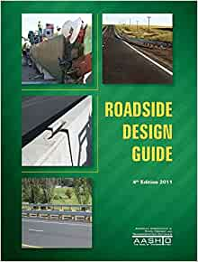
Roadside Design Guide
Provides state-of-the-practice and guidance regarding roadside safety
  Includes need, selection, and placement of roadside safety devices
The objective is to maximize roadside safety on a system-wide basis
  Implementation of forgiving roadside concept
  Reduce frequency and severity of roadway departure crashes
RDG guidance utilizes concepts such as encroachment rate, clear zone, and barrier offset
  Can vary based on factors such as traffic volume, roadway alignment, lane width, and other factors
RDG Cover Page (4th Edition, 2011)
Notes:
[Roadside Design Guide]
- RDG Provides state-of-the-practice and guidance regarding roadside safety, including need, selection, and placement of roadside safety devices
- The objective is to maximize roadside safety on a system-wide basis including 1) Implementation of forgiving roadside concept, and 2) Reduce frequency and severity of roadway departure crashes
- RDG guidance utilizes concepts such as encroachment rate, clear zone, and barrier offset, which can vary based on factors such as traffic volume, roadway alignment, lane width, and other factors

Slide 56
Roadside Design Guide
Chapter 9 of the AASHTO RDG specifically addresses Traffic Barriers, Traffic Control Devices, and Other Safety Features for Work Zones
  Provides safety, functional, and structural aspect of these devices/features and guidance on their application
Barrier need within a work zone can be influenced by various factors
  Traffic volume, operating speed, offset, and duration of the work zone
Work zone encroachment data are used in support of benefit-cost or risk analyses related to need for positive protection or other safety features used within a work zone
  Such analyses could result in updated guidance on barrier need, placement, and test level expressed in terms of key work zone design variables.
Notes:
[Roadside Design Guide]
- Chapter 9 of the RDG specifically addresses Traffic Barriers, Traffic Control Devices, and Other Safety Features for Work Zones, which provides safety, functional, and structural aspect of these devices/features and guidance on their application
- Barrier need within a work zone can be influenced by various factors which are traffic volume, operating speed, offset, and duration of the work zone
- Work zone encroachment data are used in support of benefit-cost or risk analyses related to need for positive protection or other safety features used within a WZ. Such analyses could result in updated guidance on barrier need, placement, and test level expressed in terms of key work zone design variables.

Slide 57
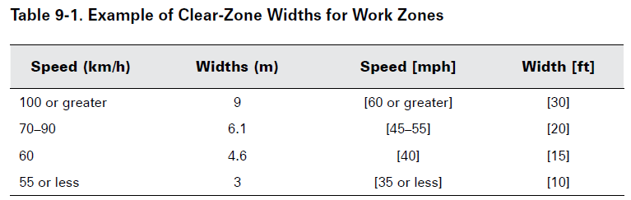
Encroachment Distance
Encroachment distance is a key encroachment variable that can inform various aspects of work zone design
Direct influence on clear zone (recovery area) guidance and barrier need based on available lateral offset
  Available clear zone affects decision to delineate or shield
Notes:
[Encroachment Distance]
- Encroachment distance is a key encroachment variable that can inform various aspects of work zone design
- Direct influence on clear zone (recovery area) guidance and barrier need based on available lateral offset. Available clear zone affects decision to delineate or shield
- The RDG indicates that “Because of the limited horizontal clearance available and the heightened awareness of motorists through work zones, the clear-zone requirements are less than those for non-construction conditions.”

Slide 58
Database Analysis Results: NCHRP 17-43
NCHRP 17-43 database includes both encroachment and impact conditions (speed and angle) derived from clinical reconstruction of roadway departure crashes
Crash data provides a right-truncated encroachment distance distribution
  Lateral travel distance interrupted by rollover or object struck
Distance to first impact in work zones was compared to all crashes
Only eight work zone encroachments in NCHRP 17-43 database
  Six crashes had maximum lateral distance under 11.5 ft (3.5 m) before impact
Encroachment corridor constructed for the work zone encroachments
  The maximum lateral encroachment increased by approximately half a meter for every additional meter traveled longitudinally
Notes:
[Database Analysis Results: NCHRP 17-43]
- NCHRP 17-43 database includes both encroachment and impact conditions (speed and angle) derived from clinical reconstruction of roadway departure crashes
- Crash data provides a right-truncated encroachment distance distribution. Lateral travel distance interrupted by rollover or object struck
- Distance to first impact in work zones was compared to all crashes
- Only eight work zone encroachments in NCHRP 17-43 database. Six crashes had maximum lateral distance under 11.5 ft (3.5 m) before impact
- Encroachment corridor constructed for the work zone encroachments. The maximum lateral encroachment increased by approximately half a meter for every additional meter traveled longitudinally

Slide 59
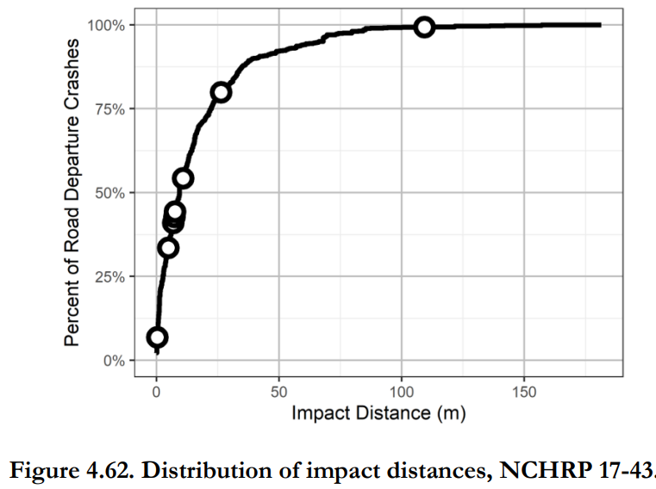
Database Analysis Results: NCHRP 17-43
Distance to first impact in work zones was not smaller than other impacts in 17-43 database.
Surprisingly, one of the longest impact distances occurred in a work zone (case #554017111)
  Vehicle departed when the road turns left to pass under an overpass. The vehicle climbed a hill and struck the bridge.
Notes:
[Database Analysis Results: NCHRP 17-43]
- Distance to first impact in work zones was not smaller than other impacts in 17-43 database.
- Surprisingly, one of the longest impact distances occurred in a work zone (case #554017111). Vehicle departed when the road turns left to pass under an overpass. The vehicle climbed a hill and struck the bridge.

Slide 60
Data Analysis: NDS
NDS data was analyzed to determine encroachment distance for both work zone and non-work zone encroachments
85th %tile lateral encroachment distance:
  Work Zones → 1.6 m (5.2 ft) left side & 2.6 m (8.5 ft) right-side departures
  Non-Work Zone → 2.8 m (9.2 ft) left side & 2.5 m (8.2 ft) right-side departures
85th %tile lateral distance for combined data (both left and right-side encroachments)
  Work Zones → 7.1 ft
  Non-Work Zone → 8.7 ft
Difference not significant
Notes:
[Database Analysis: NDS]
- NDS data was analyzed to determine encroachment distance for both work zone and non-work zone encroachments
- 85th %tile lateral encroachment distance: 1)Work Zones → 1.6 m (5.2 ft) left side & 2.6 m (8.5 ft) right-side departures, and 2) Non-Work Zone → 2.8 m (9.2 ft) left side & 2.5 m (8.2 ft) right-side departures
- 85th %tile lateral distance for combined data (both left and right-side encroachments): 1) Work Zones → 7.1 ft , and 2) Non-Work Zone → 8.7 ft
- Difference not significant

Slide 61
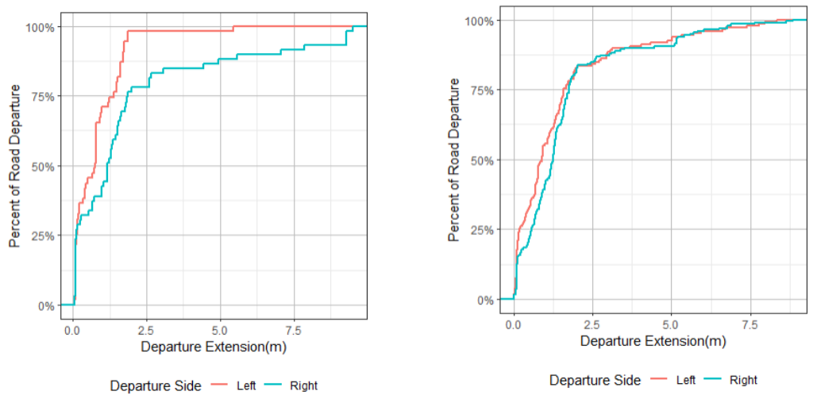
Data Analysis: NDS
Work Zone
Non-Work Zone
Notes:
[Database Analysis: NDS]
- An in-depth analysis of encroachment lateral extensions was also conducted using the available NDS data.
- There is not a considerable difference in encroachment lateral extension when comparing work-zone and no work-zone related encroachments happening on the right side (8.5 ft vs. 8.2 ft, respectively).
- Also, when combining the values for the left and right encroachment sides, the 85th percentile results in 7.1 ft and 8.7 ft for work zone and no work zone related encroachments, respectively

Slide 62
Data Analysis Results: NDS
Grand total of encroachments: 528 (L=240; R=288)
WZ encroachment: 129 (L=61; R=68)
Non-WZ encroachment: 399 (L=179; R=220)
 |  | Work zone encroachment | Non work zone encroachment
Encroachment speed – right-side departure | Mean | 36.8 mph | 34.2 mph
 | 85th percentile | 51.0 mph
 | Max |  | 83.3 mph
Encroachment speed – left-side departure | Mean | 38.6 mph | 31.7 mph
 | 85th percentile | 49.7 mph
 | Max |  | 83.3 mph
Encroachment speed can potentially inform appropriate test level for barriers
Work Zones - Speed for right-side encroachments slightly lower than for left-side encroachments
Non-Work Zone – Speed for right-side encroachments slightly higher than for left-side encroachments
Mean encroachment speed higher in work zones than non-work zones (not controlled for posted speed)
Notes:
[Database Analysis Results: NDS]
- Encroachment speed can potentially inform appropriate test level for barriers
- WZs - Speed for right-side encroachments slightly lower than for left-side encroachments
- Non-WZ – Speed for right-side encroachments slightly higher than for left-side encroachments
- Mean encroachment speed higher in work zones than non-work zones (not controlled for posted speed)
- This data provides a better understanding of the speed of vehicles at the moment of their encroachment, showing that left/right side encroachments are reasonably similar

Slide 63
Proposed Guidance Revisions
Current Roadside Design Guide guidance on Clear Zone requirements seems to be appropriate considering the recorded lateral extensions of encroachments in work zone locations
Mean encroachment speed work zones higher than non-work zones. No indication that a lower test level or impact severity for work zones is needed.
Notes:
[Proposed Guidance Revisions for RDG]
- Current Roadside Design Guide guidance on Clear Zone requirements seems to be appropriate considering the recorded lateral extensions of encroachments in work zone locations
- The collected and analyzed data show that left/right side encroachments are reasonably similar. The speed difference between left and right-side encroachments is fairly minimal, and not statistically significantly different to support different barrier recommendations based on the lane side implementation (left vs. right).

Slide 64

Manual on Uniform Traffic Control Devices
The MUTCD refers to both MASH and the RDG as governing publications regarding the design and use of temporary traffic control devices (including barrier use in work zones)
Image source: FHWA
Notes:
[Manual on Uniform Traffic Control Devices]
- The MUTCD refers to both MASH and the RDG as governing publications regarding the design and use of temporary traffic control devices (including barrier use in work zones)

Slide 65
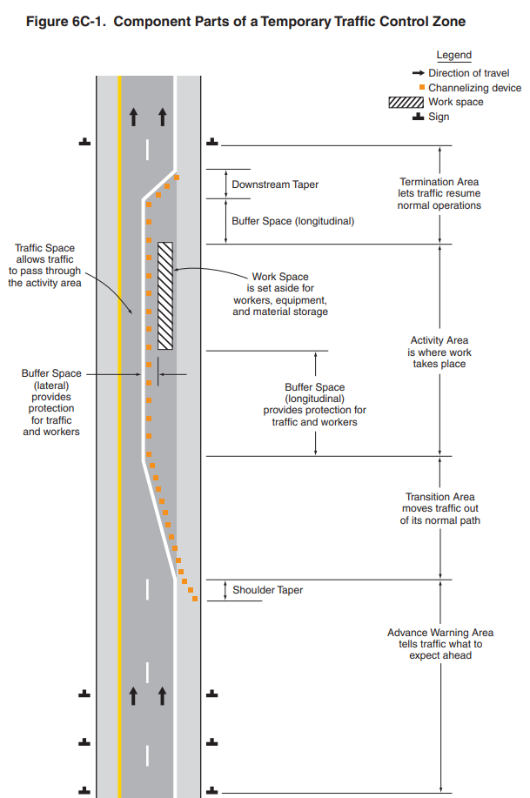
Guidance in MUTCD to Improve Worker Safety
Training for workers
General guidance for temporary barriers
Speed reduction
Activity area
Worker safety planning
Traffic control devices
MUTCD Cover Page
Notes:
[Guidance in MUTCD to Improve Worker Safety]
- The MUTCD improve worker safety by providing information including: Training for workers, General guidance for temporary barriers, Speed reduction, Activity area, Worker safety planning, and Traffic control devices

Slide 66
Manual on Uniform Traffic Control Devices
Changes to MASH and RDG will, by reference, indirectly impact the MUTCD
In addition, the MUTCD is relatively silent on when and where positive protection in work zones should be used
However, the code of federal regulations (23 CFR 630 Subpart K) requires agencies to establish criteria and guidelines regarding positive protection use in work zones
The project team anticipates that the work zone encroachment database developed in NCHRP 03-134 will have implications on TTC practices
Focus is use and placement of TCD
Notes:
[Manual on Uniform Traffic Control Devices]
- Changes to MASH and RDG will, by reference, indirectly impact the MUTCD
- In addition, the MUTCD is relatively silent on when and where positive protection in work zones should be used
- However, the code of federal regulations (23 CFR 630 Subpart K) requires agencies to establish criteria and guidelines regarding positive protection use in work zones
- The project team anticipates that the work zone encroachment database developed in NCHRP 03-134 will have implications on TTC practices
- Focus is use and placement of TCD

Slide 67
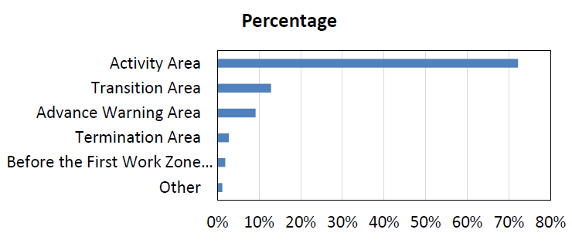
Proposed Guidance Revisions
Section 6C.04 Advance Warning Area
  Discusses TCD for advance warning area
  9% of work zone encroachment related crashes occur in the advance warning area
  12% in transition area
  Implications for signing
Notes:
[Proposed Guidance Revisions]
- Section 6C.04 Advance Warning Area: This section discusses traffic control devices for the advance warning area. The findings suggest around 9% of work zone encroachment related crashes occur in the advance warning area. However, no other information was available to suggest additional guidance needs to be provided.

Slide 68
Proposed Guidance Revisions
Section 6D.03 Worker Safety Considerations
  Encroachment speeds are 49.7 mph for left side encroachment and 51.0 mph for right-side.
  8% of encroachment crashes in work zones strike work zone equipment
  Encroachment distance was 8.5 ft to the right and 5.2 feet to the left
  Implications for placement of worker protection
Notes:
[Proposed Guidance Revisions]
- Section 6D.03 Worker Safety Considerations: This section discusses use of temporary traffic barriers which is based on factors such a lateral clearance of workers from adjacent traffic, and speed reduction. The findings suggest encroachment speeds are 49.7 mph for left side encroachment and 51.0 mph for right-side. Additionally, 8% of encroachment crashes in work zones strike work zone equipment. The suggested recommendations in this section may be examined to determine whether they is sufficient given likely lateral clearance when a vehicle encroaches into the work zone environment.

Slide 69
Proposed Guidance Revisions
Section 6F. Temporary Traffic Control Devices
  Right side encroachments are higher than left side in work zones (8.5 versus 5.2 feet)
  Impacts lateral clearance
  Implications for placement of traffic control devices and barriers
  Encroachment speeds are 49.7 mph for left side encroachment and 51.0 mph for right-side.
  Implications for design of barriers to withstand
Notes:
[Proposed Guidance Revisions]
- Section 6F. Temporary Traffic Control Devices: This section outlines considerations for traffic devices in work zones. The findings suggest right side encroachments are higher than left side in work zones (8.5 versus 5.2 feet). Section 6F could provide guidance on the amount of lateral clearance that should be provided with use of traffic control devices placed on the left or right shoulder.

Slide 70
Study Conclusions
Collected and investigated available data from vehicle encroachment conditions associated with work zone locations (mainly from available and applicable NDS studies, shared state crash databases, NMVCC and NCHRP 17-43 project databases)
Exploratory data analysis and cluster correspondence analysis conducted to investigate encroachment, roadway, roadside, work zone and driver behavior conditions.
Peer Exchange Workshop conducted to provide an overview of the project draft products, engage the Agencies participants in discussions, and solicit feedback for potential inclusion in the final Guidance document as well as identify future research needs.
During Workshop, several common themes emerged.
Data investigation developed guidance for DOTs and research practitioners to improve safety for workers and the traveling public in roadway work zones.
Notes:
The research team collected and investigated available data from vehicle encroachment conditions associated with work zone locations. Data was mainly collected from available and applicable NDS studies, shared state crash databases, NMVCC and NCHRP 17-43 project databases. Exploratory data analysis and cluster correspondence analysis were conducted to investigate encroachment, roadway, roadside, work zone and driver behavior conditions.
A Peer Exchange Workshop (PEW) was conducted with the objectives to provide an overview of the project draft products, engage the Agencies participants in discussions, and solicit feedback for potential inclusion in the final Guidance document as well as identify future research needs. Based on participants’ common feedback, several common themes have emerged and there appear to be several research project ideas that can be explored, based on the identified needs.
As efforts were performed to investigate vehicle encroachment conditions associated with work zone locations, one of the project objectives was to support potential updates to the Manual for Assessing Safety Hardware (MASH), the Roadside Design Guide (RDG), and the Manual for Uniform Traffic Control Devices (MUTCD). Such investigation developed a guidance addressed to state departments of transportation and research practitioners to improve safety for workers and the traveling public in roadway work zones.

Slide 71
Study Conclusions
Project efforts concluded:
  There is not sufficient result to support the need to revise current guidance pertaining to impact conditions in MASH;
  Current guidance in RDG on Clear Zone requirements seems to be appropriate considering the recorded lateral extensions of encroachments in work zone locations;
  Identified potential guidance implications for the MUTCD:
    Section 6C.04 Advance Warning Area
    Section 6D.03 Worker Safety Considerations
    Section 6F. Temporary Traffic Control Devices
Notes:
This project efforts concluded that there is not sufficient result to support the need to revise current guidance pertaining to impact conditions in MASH. Also, the provided current guidance from the Roadside Design Guide on Clear Zone requirements seems to be appropriate considering the recorded lateral extensions of encroachments in work zone locations.
The project findings and potential guidance implications for the MUTCD, however, include the following:
• Section 6C.04 Advance Warning Area: This section discusses traffic control devices for the advance warning area. The findings suggest around 9% of work zone encroachment related crashes occur in the advance warning area. However, no other information was available to suggest additional guidance needs to be provided.
• Section 6D.03 Worker Safety Considerations: This section discusses use of temporary traffic barriers which is based on factors such a lateral clearance of workers from adjacent traffic, and speed reduction. The findings suggest encroachment speeds are 49.7 mph for left side encroachment and 51.0 mph for right-side, which are reasonably similar. Additionally, 8% of encroachment crashes in work zones strike work zone equipment. The suggested recommendations in this section may be examined to determine whether they are sufficient given likely lateral clearance when a vehicle encroaches into the work zone environment.
• Section 6F. Temporary Traffic Control Devices: This section outlines considerations for traffic devices in work zones. The findings suggest right side encroachments are higher than left side in work zones (8.5 versus 5.2 feet). Section 6F could provide guidance on the amount of lateral clearance that should be provided with use of traffic control devices placed on the left or right shoulder.

Slide 72
Study Conclusions
Study Considerations and Limitations:
  Not enough data to support the need for a change in MASH speed and angle impact conditions for testing and evaluating roadside safety hardware implemented in WZ locations
  The encroachment conditions extracted from the 17-43 and 17-22 databases are based on run-off-road crashes, while the NDS data is based on encroachments, most of them have not resulted in a crash
Notes:
One of the conclusions reached by the research team was that there was not sufficient result to support the need to revise current guidance pertaining to impact conditions in MASH. As largely explained above in previous sections, such statement was supported by a variety of explanations, some of them related to lack of data and /or differences in data collections, in some instances:
• There is not enough data to support the need for a change in MASH speed impact conditions for testing and evaluating roadside safety hardware implemented in work zone locations
o Source is only five work-zone related crashes with reconstructed impact speed from 17-43 database
o The posted speed limits and the functional classification for the roadways on which these encroachments occurred is not available in NDS data
o There may be differences associated with the different data collection periods of the utilized datasets and the relative contribution of advancing vehicle safety technologies in each
• There is not enough data to support the need for a change in MASH angle impact conditions for testing and evaluating roadside safety hardware implemented in work zone locations
o Source is only eight work-zone related crashes with reconstructed impact angle
o The encroachment angle obtained from 17-43, 17-22, and NDS data are fairly different, potentially due to the manually technique utilized to extract the encroachment angle values directly from videos as part of the NDS data effort.
• The encroachment conditions extracted from the 17-43 and 17-22 databases are based on run-off-road crashes, while the NDS data is based on encroachments, most of them have not resulted in a crash.

Slide 73
Identified Future Research Topics
Investigate the use of video for collecting encroachment data in WZ
Collection and analysis of TMA hits to complement encroachment data in WZ
Crashworthiness investigation and implementation guidance of barrier walls (temporary and permanent)
Synthesis study of existing best practices and expected future DOTs plans to address WZ encroachments /impacts
Notes:
Based on participants’ common feedback, several common themes have emerged and there appear to be several research project ideas that can be explored, based on the identified needs

Slide 74
Identified Future Research Topics
Development of a formal process to collect and analyze vehicles impacts /encroachments in both WZ and non-WZ locations for direct comparison of impacts modes and severity
Investigation of encroachments in WZ to determine predominant causes: are they driver-behavior related or are they tied to the need for safer DOTs implementation procedures development and application?
Investigation of longevity of roadside safety devices while implemented in WZ: does their limited exposure when implemented in work zones has an effect on the overall risk of being impacted by encroaching vehicles?
Data collection and analysis to support the safe deployment of roadside safety barrier systems in WZ based on their offset implementation
Notes:
Based on participants’ common feedback, several common themes have emerged and there appear to be several research project ideas that can be explored, based on the identified needs

Slide 75
Identified Future Research Topics
In-service performance evaluation of NCHRP 350-approved Categories 2 and 3 devices
Development of MASH crashworthy WZ Category 4 safety devices
Data collection and analysis to support the identification of hit device types when implemented in proximity to WZ travel lanes
Best practices and challenges of implementing shy distances for barrier placement in WZ: what are the observed drivers’ effects?
Notes:
Based on participants’ common feedback, several common themes have emerged and there appear to be several research project ideas that can be explored, based on the identified needs

Slide 76
Project Panel Members / Acknowledgement
Name | Role | Organization | Title
Anna Ghidina | Chair | Illinois Department of Transportation | Traffic Operations Engineer
Dajaih Bias-Johnson | CRP Staff | Transportation Research Board | Senior Program Assistant
Richard Retting | CRP Staff | Transportation Research Board | Senior Program Officer
John Bilderback | Member | No Organization
Clarence Dickerson | Member | District Department of Transportation | Supervisor Civil Engineer
George Dore | Member | AECOM | Senior Traffic Engineer
Jennifer Rasmussen | Member | Safe Roads Engineering | Senior Research Engineer
Shawn Smith | Member | Maine Department of Transportation | Senior Project Manager
Daniel Sprengeler | Member | Iowa Department of Transportation | Work Zone Traffic Control Engineer
Keith Cota | AASHTO Monitor |  | Consultant
Menna Yassin | FHWA Liaison | Federal Highway Administration (FHWA) | Highway Engineer
Kelly Hardy | AASHTO Liaison | American Association of State Highway and Transportation Officials (AASHTO) | Senior Engineering Program Manager for Safety
Notes:
[Introducing Project Panel Members]
Richard Retting -- CRP Staff
Anna Ghidina -- Chair
Dajaih Bias-Johnson -- CRP Staff
John Bilderback -- Member
Clarence Dickerson -- Member
George Dore -- Member
Jennifer Rasmussen -- Member
Shawn Smith -- Member
Daniel Sprengeler -- Member
Keith Cota -- AASHTO Monitor
Menna Yassin -- FHWA Liaison
Kelly Hardy -- AASHTO of Liaison

Slide 77
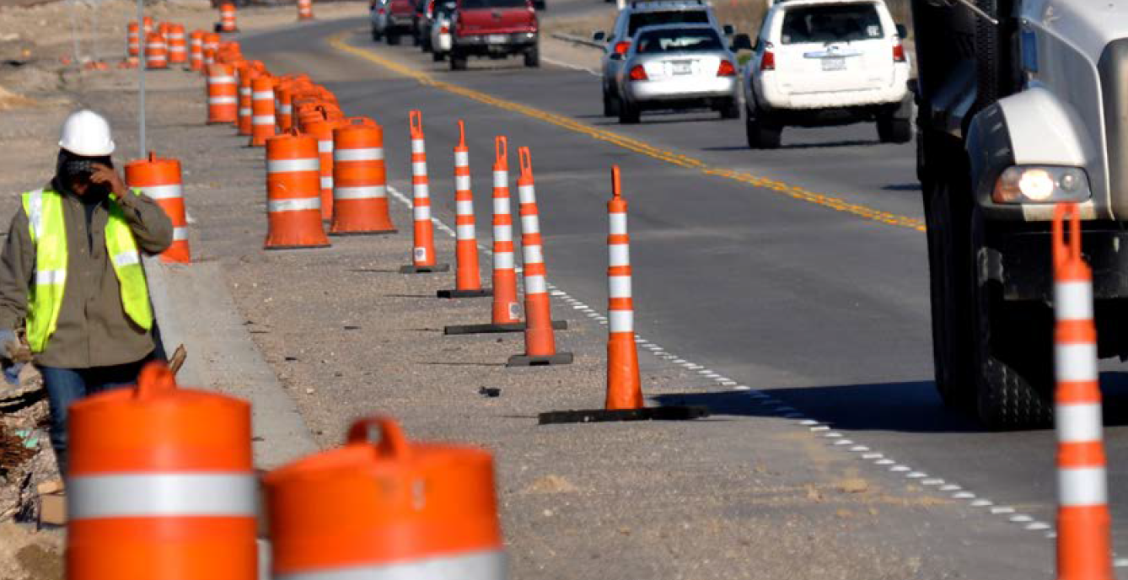
Project Team Members / Acknowledgement
Chiara S. Dobrovolny, Ph.D. (PI)
Bahar Dadashova, Ph.D. (co-PI)
Subasish Das, Ph.D.
Roger Bligh, P.E., Ph.D.
Hungjoo Kwon, Ph.D.
Mahmoud Tabesh, Ph.D.
Texas A&M Transportation Institute
Luke E. Riexinger, Ph.D.
Colin P. Smith
Clay H. Gabler, Ph.D.
Virginia Tech Transportation Institute
Shauna Hallmark, P.E., Ph.D.
Streetwise Transportation Consultants
Notes:
[Introducing Project Team Members]
- TTI (Texas A&M Transportation Institute)
Chiara Dobrovolny of PI
Bahar Dadashova of Co-PI
Subasish Das, Roger Bligh, Hungjoo Kwon, Mahmoud Tabesh
- Virginia Tech Transportation Institute
Luke Riexinger, Colin Smith, and Clay Gabler
- Streetwise Transportation Consultants
Shauna Hallmark

