Slide 1
Presentation of Research Results
NCHRP Project 25-55
Edward Carr, Seth Hartley, Chris Holder, Sam Pournazeri, Mike Brady
ICF
San Francisco, CA
John Zamurs
Zamurs and Associates, LLC
Albany, NY
Chelsea Preble, Thomas Kirchstetter, Michael Sohn
LBNL
Berkeley, CA

Slide 2
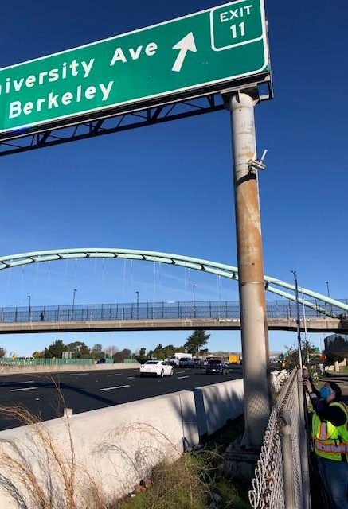
Summary of the Project
This two general objectives for this research study are:
Design and execute an experiment and conduct model evaluation with this dataset to identify the best performing air quality model for near-roadway (project-level) regulatory applications.
Research and develop recommendations for an enhanced Model Evaluation Process (MEP) for transportation projects.
Specifically, the objective of this research is to enable decision makers to identify an approach for identifying the best air quality dispersion model(s) for regulatory applications in the transportation sector. Our research was guided by the model evaluation principles of the National Research Council’s (NRC, 2007) report, which examined the use of air quality models in regulatory settings. Our research focused on four key aspects:
Specifying the procedures to test air quality dispersion models for regulatory applications in transportation settings
Applying the procedures to evaluate models against air quality data including both quantitative and qualitative aspects.
Presenting comparative analyses between models and providing insights into the best performing models
Contributing a new, mobile-source tracer experiment for a priority transportation setting.

Slide 3
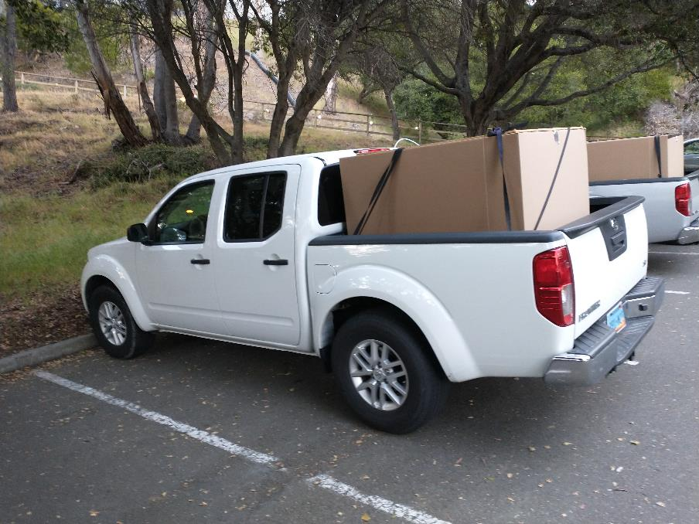
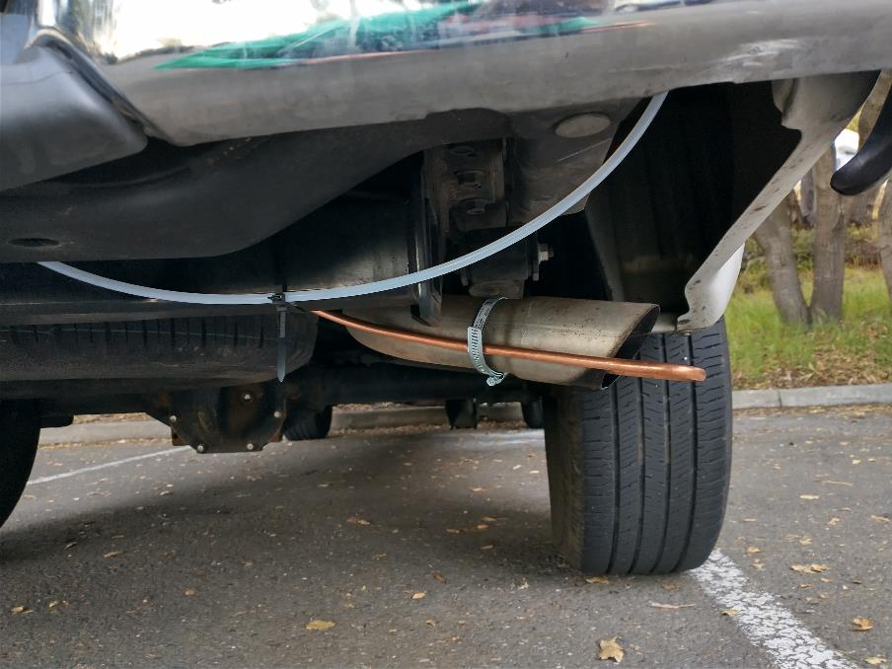
Specific Objectives of the Research
These goals were met through 4 specific research areas. We:
Conducted a comprehensive review and identification of air quality models and historic tracer in-field studies suitable for model intercomparison studies for transportation facilities.
Developed a comprehensive MEP for air quality models and the modeling process used for transportation projects. The enhanced air quality MEP evaluates impacts across the entire regulatory modeling chain (traffic, emissions, dispersion, and background concentrations).
Designed and conducted a field experiment in a high-traffic freeway setting that simultaneously released and measured inert tracer concentrations from a mobile platform, mobile source air pollutant concentrations from the facility, traffic, meteorology, and adjacent air quality data.
Used the observations from this high-quality field experiment in an air quality model intercomparison study to assess model performance in this setting.

Slide 4
Specific Scope of Work Conducted for NCHRP 25-55
The research project was completed in two phases: (I) Research Design and (II) Research Implementation, conducted as discrete tasks.
In the Research Design phase, we:
Developed an amplified research plan and coordinated research scope with the Panel (Task 1),
Developed a draft methodology and protocol for evaluating datasets and models (Task 3),
Reviewed air quality models for use in transportation settings (Task 2),
Reviewed and acquired historical tracer datasets suitable for model evaluation (Task 2),
Developed a tracer field study experiment protocol (Task 4), and
Developed an updated research plan for implementation in Phase II and coordinated scope with the Panel (Task 5).
In Research Implementation phase, we:
Rescoped, redesigned, and executed the field revised field experiment (Task 6),
Performed a detailed model inter-comparison study using data from the field program (Task 7),
Revised the methodology and protocol for an enhanced model evaluation process (MEP) for transportation projects in regulatory applications (Task 9), and
Prepared a Final Report and all supplementary materials (Task 11).
Notably this project evolved under direction of the NCHRP research panel, specifically by modifying the tracer experiment to include a mobile release platform with co-located and upwind air quality monitoring, a traffic study, and an increased number of tracer vehicles. To accomplish this, some portions of the original scope were removed:
Task 8
  Identification of the strength and weakness for each model (model performance statistics and graphical results were included).
  Characterization of models across settings (only the Berkeley Freeway Experiment is used for model evaluation).
  The uncertainty/sensitivity analysis.
Task 10
  Identifying most needed improvements in model application (we do provide indications for areas of future model improvements).
Future research should utilize the present study to further address these questions.

Slide 5
Summary and Use of this Presentation
These presentation materials highlight the research results achieved in NCHRP 25-55.
  The remainder of the presentation is organized around the 4 specific objectives.
There are 4 primary products delivered from this study, delivered as appendices to the main report:
  Datasets and documentation from previous tracer studies and review of suitable air quality models for transportation settings.
  A database of results from and documentation of (including lessons learned) a near-freeway field study. This includes simultaneous inert tracer and air quality monitoring, suitable for evaluating air quality models for evaluating the regulatory modeling chain.
  A near road air quality model evaluation assessment using the monitoring field study database, with a complete, electronic modeling dataset.
  A comprehensive enhanced model evaluation process (MEP) for evaluating air quality models for transportation projects.
Results in this presentation are tailored for 2 specific audiences.
  DOT air quality specialist - The full set of material included here is appropriate for technical air quality specialists.
  Other audiences – Certain sections present technical material that may be removed for simpler presentation. These slides are marked “Specialist”.

Slide 6
First General Objective:
Identify the best performing air quality model in a near-highway, regulatory application

Slide 7
Objective 1:
Conduct a comprehensive review and identification of air quality models and historic tracer in-field studies suitable for model intercomparison studies for transportation facilities.

Slide 8
Air Quality Models for Analyzing Transportation Projects
Rating of Air Quality Models for Quantifying the Impacts of
Transportation Emissions (from a refined perspective)
We reviewed eight air quality models. Many of these were explicitly developed for transportation project analysis.
CALINE3,
AERMOD,
CAL3QHC,
CALINE4,
HYROAD,
ROADWAY-2,
ADMS-ROADS, and
AERMOD-RLINE
We developed and applied a relative scoring table for the models technical and functional capabilities
We selected three models for use in the refined model inter-comparison study:
ADMS-ROADS
AERMOD-RLINE
AERMOD
and two for screening analysis:
CAL3QHC
AERSCREEN (AERMOD in screening mode)
Specialist

Slide 9
Historic Tracer Studies
We researched the availability of historic tracer studies suitable for this work.
Objective: Identify historical tracer studies suitable for transportation studies, identify if suitable datasets are available for model evaluation, identify gaps that would potentially benefit from new tracer studies.
We looked for studies addressing the transportation facilities of primary interest :
Intersections (skewed and un-skewed)
Interchanges, Freeway-Freeway and Freeway-Arterial Street (including adjacent congested intersections)
Freeways (with and without near-road barriers/noise walls)
Arterials
Street Canyons
Truck and Bus terminals
Port (Drayage) Operations
Park and Ride Lots

Slide 10
Historic Tracer Studies
We first identified air quality datasets that were suitable for a model comparison and evaluation study
Here we summarize those tracer studies relevant to project facility types of interest to this study. We show information related to the tracer release and the status of the data acquisition for each tracer experiment.
We have acquired the best available information from each of these tracer experiments.
More information on the tracer studies, facility types, and number of tracer experiments conducted by transportation facility type are in the report.
Reference¹ |  |  |  |  |  | Number of Facility Types
Article Title | Author(s) | Year | Journal or Sponsoring Organization(s) | Journal Volume: Issue No. | Page No. | DOI or Report Number | Intersections | Arterials | Freeways | Interchanges | Skewed Intersections | Truck and Bus Terminals
The Mammoth Lake Route 203 Transportation Project: A Case Study in Air Quality Modeling and Mitigation | Benson, Nokes, Cramer | 1985 | FHWA, Caltrans | N/A | N/A | FHWA/CA/TL-85/11 | 1 | 1 | 1
General Motors Sulfate Dispersion Experiment: Experimental Procedures and Results | Cadle et al. | 1977 | Journal of the Air Pollution Control Association | 27:1 | 33-38 | 10.1080/ 00022470. 1977. 10470389 |  |  | 1
Analyses, Experimental Studies, and Evaluations of Control Measures for Air Flow and Air Quality on and Near Highways | Dabberdt et al. | 1981 | FHWA | N/A | N/A | FHWA/RD-81/051 |  |  | 3 | 1
CALINE4 - A Dispersion Model for Predicting Air Pollutant Concentrations Near Roadways5 | Benson | 1984 | FHWA, Caltrans | N/A | N/A | FHWA/CA/TL-84/15 |  |  | 1
Near-road Multipollutant Profiles: Associations Between Volatile Organic Compounds and a Tracer Gas Surrogate Near a Busy Highway | Barzyk et al. | 2012 | Journal of the Air & Waste Management Association | 62:5 | 594-603 | 10.1080/ 10473289.2012. 656819 |  |  | 1
Total |  |  |  |  |  |  | 1 | 1 | 7 | 1 | 0 | 0
Caltrans = California Department of Transportation, DOT = Department of Transportation, FHWA = Federal Highway Administration, NCHRP = National Cooperative Highway Research Program ¹ In some instances, the same article is cited for multiple tracer experiment datasets. This is because some articles discuss multiple experiments that occurred on different dates and/or locations.
Specialist

Slide 11
Field Study for Use in the Model Intercomparison
The Panel decided none of the historical datasets were sufficient for our purposes, and that the Berkeley Freeway Tracer Experiment would provide greater benefit due to the additional data collection it included
→ Only the Berkeley Freeway Tracer Experiment dataset was used in the model intercomparison.
10 hourly experiments over 3 days.
Measurements included
  Inert tracer released from moving vehicles (tracer-based observations)
  Vehicle exhaust, brake, tire wear and entrained road dust emissions from all vehicles (pollutants-based observations)
  Yearlong air quality analysis following regulatory procedures (design values) (regulatory application)
Study Name and Location | Facility Type | Comment
Berkeley Freeway Tracer Experiment | High volume Freeway | Mobile platform release, use of multiple tracers, high volume freeway (10-lane 280,400 AADT). Co-located measurements of CO, PM_{2.5}, NO_{x} and BC made during the tracer experiment.
Aquatic Park Berkeley air quality monitoring data | High volume Freeway | Long-term, near-road air monitoring of CO, PM_{2.5}, NO_{x}, and BC collected and maintained by Bay Area Air Quality Management District (BAAQMD ).

Slide 12
Objective 3.
Design and conduct a field experiment in a high-traffic freeway setting that simultaneously released and measured inert tracer concentrations from a mobile platform, mobile source air pollutant concentrations from the facility, traffic, meteorology, and adjacent air quality data.
The Berkeley Freeway Tracer Experiment

Slide 13
Overview of the Tracer Experiment
This study conducted a perfluorocarbon tracer (PFT) field experiment
  The study successfully completed the experiment using a mobile-source tracer-release platform from multiple vehicles with fixed receptors
  Target is a high volume freeway (10-lane, 280,400 AADT) in Berkeley, California.
Data Collected during the Tracer Experiment
  Mobile platform released tracer gases
    Three types of tracer gas released from three different moving platforms
  In-field tracer concentration measurements at multiple downwind locations
  Concurrent measurements of meteorology and traffic
    Continuous Caltrans traffic data and one full day traffic study (vehicle classification and volumes)
    Simultaneous, co-located upwind and downwind measurements of concentrations from traffic-released pollutants (CO, NOx, PM_{2.5}, and black carbon (BC))

Slide 14
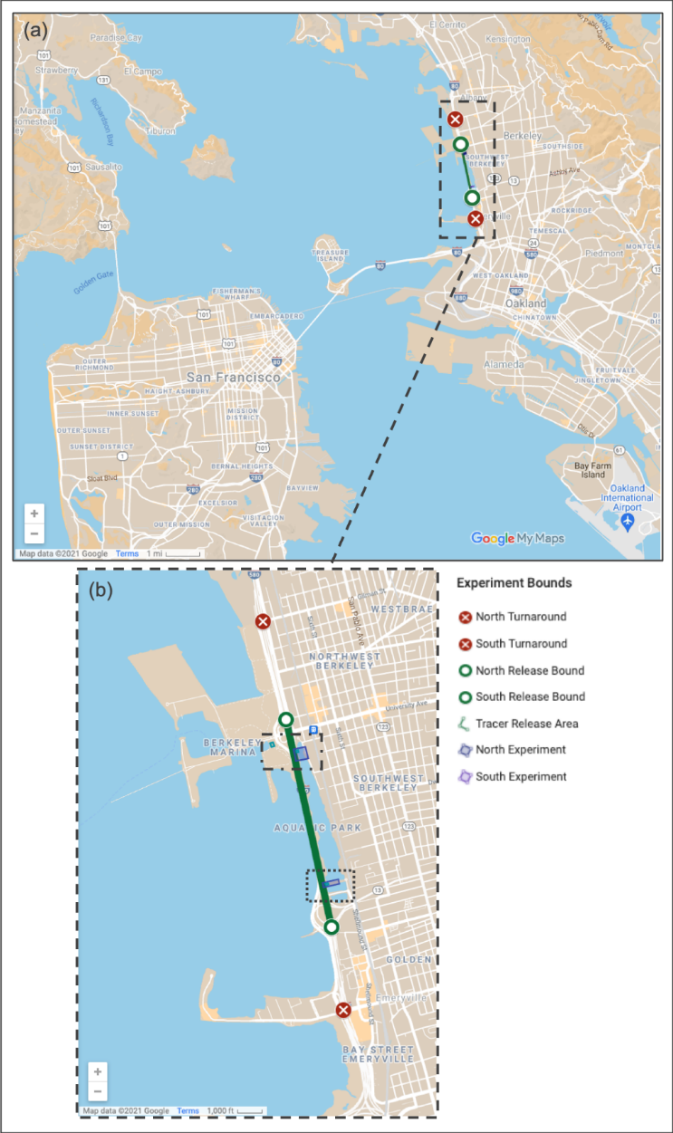
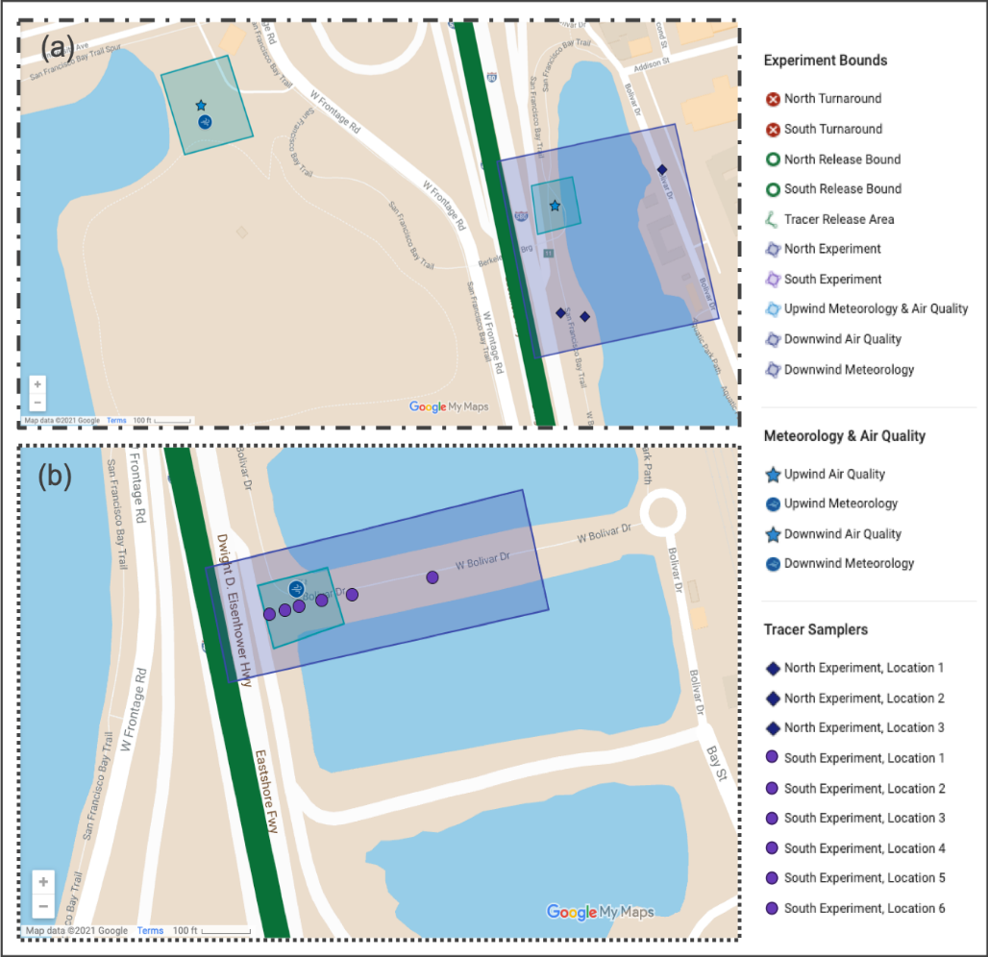
Sources and Receptor Locations Used in the Berkeley Freeway Experiment
The two experimental (receptor) areas
(a) The North Experiment Area. 60-min integrated samples were collected at three sites (navy diamonds) within the dark purple box to the right of I-80. Downwind air quality (blue star) was measured at the BAAQMD monitoring station shown within that dark purple box. Upwind meteorological (blue circle) and air quality (blue star) sampling was also conducted, as shown in the light blue box to the left of I-80.
(b) The South Experiment Area, where 10-min integrated samples were collected at six sites (purple circles) and downwind meteorology (blue circle) was measured within the lighter purple box. (Sampler placement was slightly different in Experiment 2 than depicted here.)
The study area along I-80 in Berkeley, CA (a), with greater detail shown in (b).

Slide 15
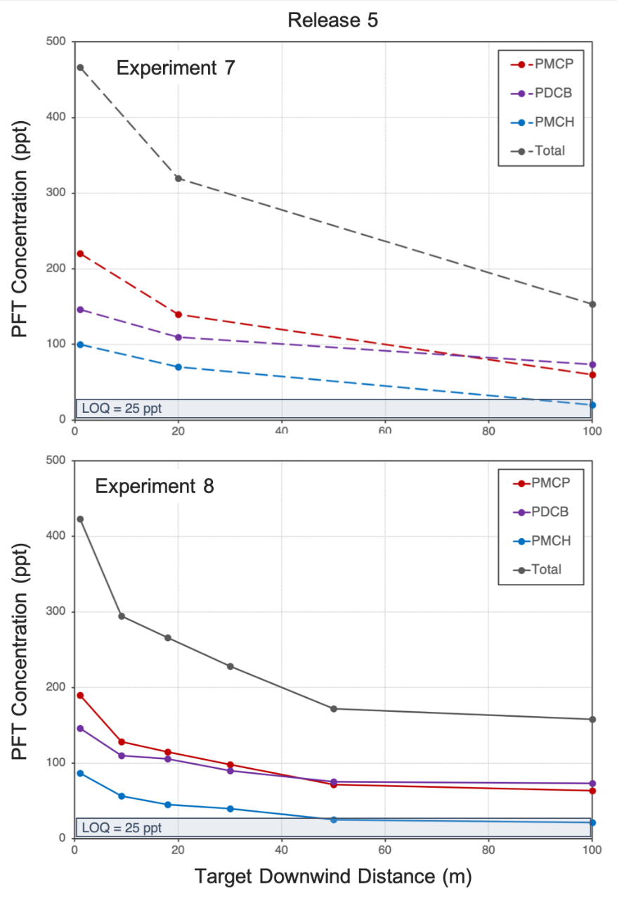
Typical hourly-average tracer concentration gradients
Examples of the typical hourly-average concentration gradient measured at the North (top plot) and South (bottom plot) Experimental Areas.
Each tracer gas has a unique release rate
Well above the Limit of quantification (LOQ) when all three tracers are combined or individually within 50 m

Slide 16
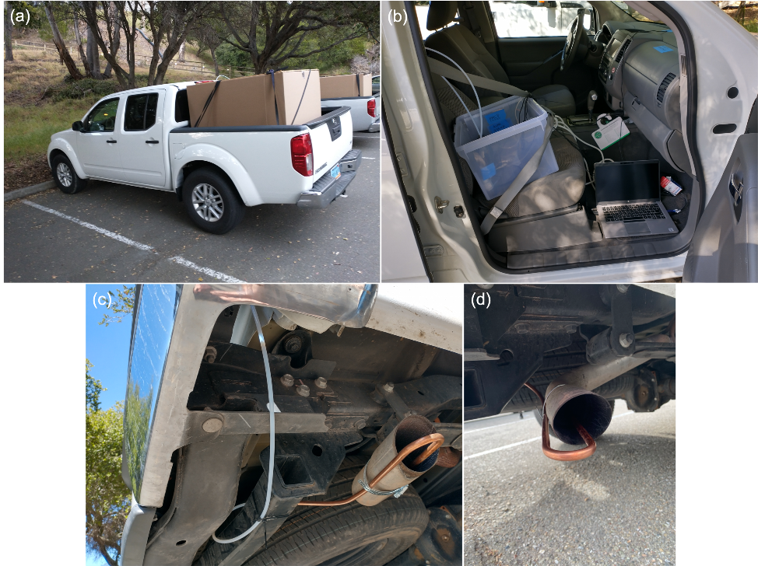
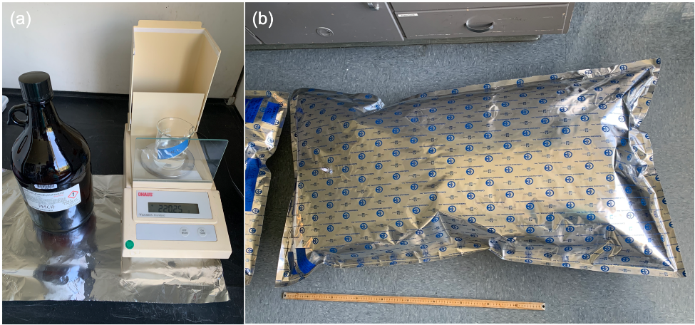
Tracers and Tracer Preparation
Perfluorocarbon tracers (PFTs) used in this study and their chemical properties.
PFT, i | CAS Registry # | Purity by Mass, X_{i} | Molecular Weight, MW_{i} (g mol⁻¹) | Density, ρ_{i} (g mL⁻¹) | Vapor Pressure, P_{i}º (atm)
Perfluoro-1,2-dimethylcyclobutane (PDCB) | 2994-71-0 | 0.99 | 300 | 1.62 | 1.13
Perfluoromethylcyclopentane (PMCP) | 1805-22-7 | 0.95 | 300 | 1.70 | 0.70
Perfluoromethylcyclohexane (PMCH) | 355-02-2 | 0.94 | 350 | 1.79 | 0.15
Figure 3. Laboratory preparation of tracer source bags, including (a) weighing the tracer material to be injected into the bag and (b) the final bag size after being filled with ultrahigh purity N₂ and the liquid tracer had evaporated.
Tracer release system installed on the vehicles that served as a mobile platform during the experiment. (a) The source bag was secured within a large cardboard box in the bed of the pickup truck. (b) The PFT + N₂ mixture was pumped out of the source bag through 1/4" Teflon tubing, through the automated system that was housed in the bin on the passenger seat, including the pump, flow meter, and Raspberry Pi controller. The GPS was secured on the vehicle’s dash and the laptop that logged pump flow rate and GPS data was placed on the floor. (c) The PFT gas flowed through a second stretch of 1/4" Teflon tubing along the side of the truck bed and down to the tailpipe, where 3/8” copper tubing was installed. (d) This copper tubing was bent into a U-shape into the truck’s tailpipe so that tracer gas was co-emitted with the truck’s exhaust at temperature.
Specialist

Slide 17
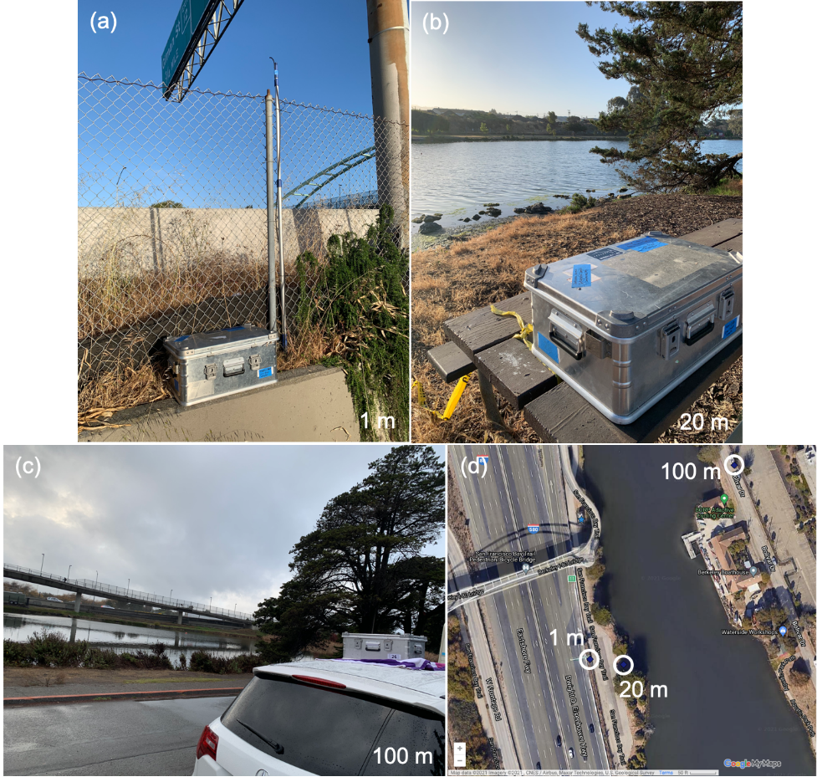
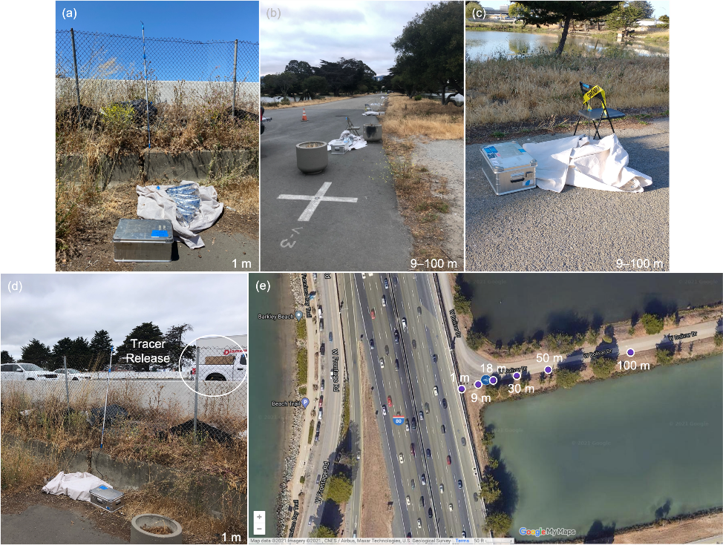
Tracer Sampling
North End
South End
In the South Experimental Area, samplers were placed at downwind target distances of 1, 9, 18, 30, 50, and 100 m. The inlet height at the 1 m distance (a) was extended to a height about 3 m above the sampling area ground level, while the inlets of all other samplers were elevated to about 0.7 m on the backs of folding chairs (b, c). Note the passing mobile tracer release platform in (d) relative to the elevated inlet for the nearest highway sampler also shown in (a).
In the North Experimental Area, samplers were placed at downwind target distances of (a) 1, (b) 20, and (c) 100 m. All inlet heights were at least >1 m above ground and were placed away from potential obstacles that would bias sampled air flow.
Specialist

Slide 18
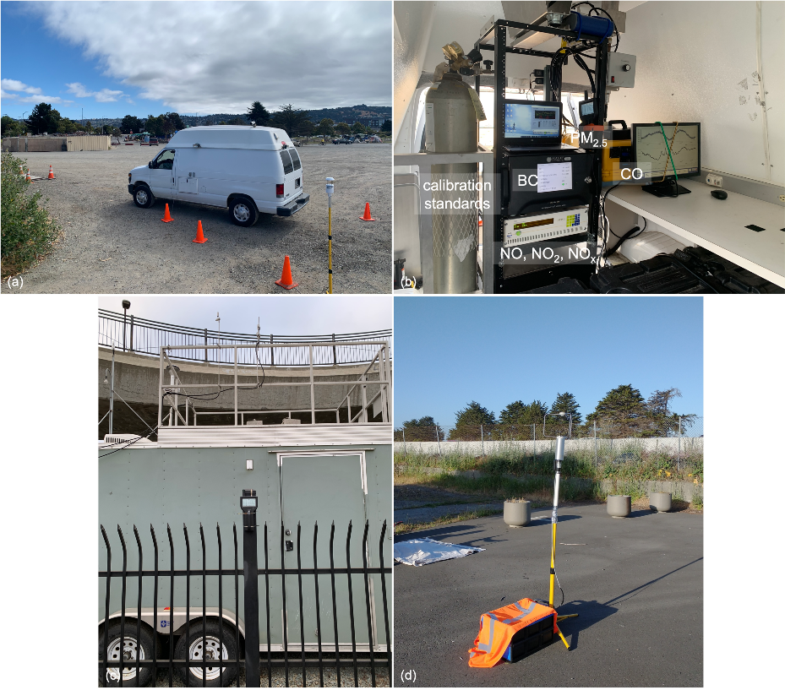
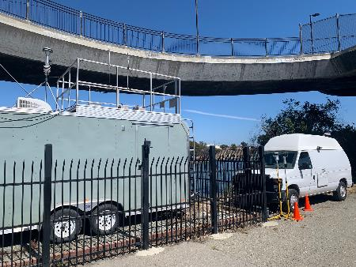
Simultaneous Meteorology & Air Quality Measurements
Analyzers used to measure traffic-related air pollutants upwind and downwind of the tracer release experiments. For most pollutants, the upwind measurements were made with the Berkeley instrumentation and the downwind concentrations were measured by the BAAQMD. The exception is PM_{2.5}, in which the Berkeley team collocated one of their instruments at the BAAQMD site to directly compare to the upwind measurement, since the operating principles of Berkeley’s and BAAQMD’s analyzers were not equivalent.
Pollutant | Berkeley Analyzers & Operating Principles | BAAQMD Analyzers & Operating Principles
NO, NO₂, NO_{x} | EcoPhysics CLD64, chemiluminescence (Ann Arbor, MI) | TECO 42i, chemiluminescence (Waltham, MA)
CO | LGR 915-0039, cavity ringdown absorption spectroscopy (San Jose, CA) | TECO 48i, non-dispersive infrared absorption spectroscopy (Waltham, MA)
PM_{2.5} | Particles Plus 8306, light scattering (Stoughton, MA) | Met One BAM 1020, beta attenuation (Grants Pass, OR)
BC | Magee Scientific AE33, aethalometers (Berkeley, CA) | Teledyne API 633, aethalometer (San Diego, CA)
The instrumented research van collocated with the BAAQMD monitoring station to compare the upwind and downwind measurements.
Concentrations of key air pollutants and wind speed/direction were measured upwind and downwind of the tracer release experiments. (a) At the upwind site, measurements were made with a 2D sonic weather sensor and an instrumented research van with a sample inlet on the roof oriented towards the San Francisco Bay. (b) Concentrations of NO, NO₂, NO_{x}, CO, PM_{2.5}, and BC were measured with analyzers housed in the van, and instrument response was verified daily with gas calibration standards and particle filters. (c) Downwind concentrations of the same pollutant species were measured at the BAAQMD’s Berkeley Aquatic Park monitoring station in the North Experimental Area, including a PM_{2.5} analyzer that the Berkeley team temporarily installed on the station’s perimeter fence. (d) Downwind measurements of wind speed were made with a 3D sonic anemometer in the South Experimental Area.
Specialist

Slide 19
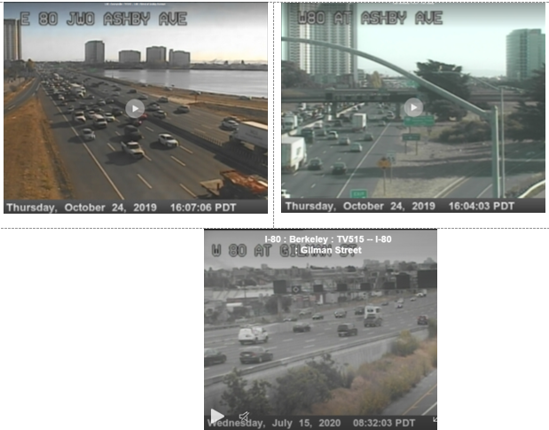
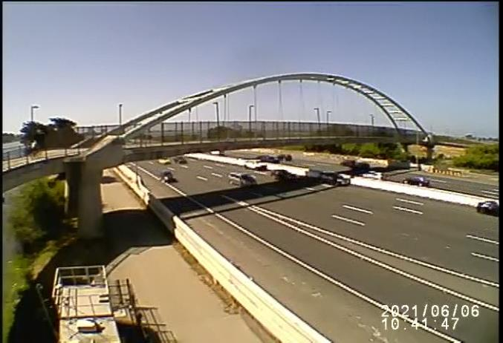
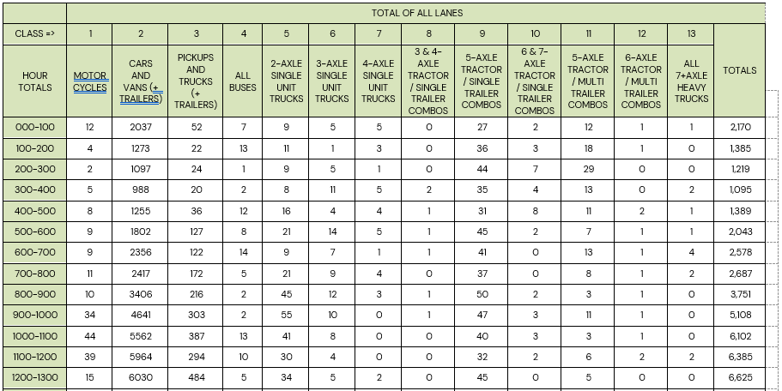
Traffic Data
On June 6, 2021, we also included a manual traffic survey of traffic flow and classification in both directions of the I-80 freeway. Below is the view from one camera’s location and a portion of the results.
We collected:
Total vehicle flow
Total vehicle speed
Truck flow
Truck proportion (percent)
Total and Truck VMT
Total and Truck VHT
from Caltrans’ online PeMS system at the study site in 5-minute increments over the full day of each experiment for the aggregate traffic across all lanes.
We used VMT and VHT to determine traffic speed, and the corresponding truck metrics to determine truck speed.
https://pems.dot.ca.gov/
We recorded streams from existing Caltrans traffic cameras in the area.
Specialist

Slide 20
Summary of Findings from the Berkeley Field Experiment
We successfully designed, tested, and completed a field experiment that employed a mobile source released inert tracer from multiple vehicles driving a set route in traffic with fixed receptors and simultaneous monitoring of traffic, meteorology, background concentration and roadway air pollutants.
The research identified that tracer datasets for use in transportation applications should only be performed using a moving release platform. Such datasets better represent emissions from moving vehicles and should be designed to mimic the release parameters of traffic on the facility.
A relatively small number of vehicles can reach steady-state hourly concentrations reducing project cost and complexity provided sampling can accurately capture the released tracer. Under steady-state meteorological and traffic conditions we found a single tracer release vehicle can provide a sufficient concentration dataset for evaluating air quality models if the experiment contains a sufficient number of vehicles passes by the receptor location. We found that at least once every 7-minutes was sufficient for one-hour average concentrations and statistical evaluations of model performance were consistent between use of one and three tracer vehicles.
As tracer data are best used to evaluate air dispersion models and evaluations using ambient air quality data are used to evaluate the complete modeling chain (including emissions, traffic, and background concentration), this study successfully used simultaneous tracer and air quality evaluations to support comprehensive modeling chain evaluations.

Slide 21
Objective 4.
Use the observations from this high-quality field experiment in an air quality model intercomparison study to assess model performance in this setting.

Slide 22
Air Quality Models Used in the Evaluation
We evaluated the models selected under Objective 1. These are:
Two models for screening model evaluation
  AERSCREEN (AERMOD in screening mode) (version 21112)
  CAL3QHC (version 2.0-95221)
  The model evaluation results are designed such that comparing screening outputs to measured outputs ensures confidence in the models to conservatively model concentrations.
Three models for refined model evaluation
  AERMOD (both area and volume source configurations) (version 21112)
  AERMOD-RLINE (version 21112)
  ADMS-ROADS (v5.0)
All were run following regulatory guidance to the extent possible and with consistent inputs across models.

Slide 23
Types of Model Evaluations Included
We used the Berkeley Freeway Experiment data in 3 distinct approaches for model performance evaluation:
Inert tracers, released from moving vehicles (tracer-based observations during the Berkeley Field Experiment)
  10 individual experiments from controlled, mobile-source platform.
  No other sources contribute to observed concentrations.
  Each approximately hour experiment is evaluated seperately.
  Evaluates the dispersion model.
2. Pollutants-Based Model Intercomparison Summary (Berkeley Field Experiment observations)
  Uses the co-located measurements of upwind and downwind black carbon (BC), CO, and PM_{2.5} made during the same days as the tracer experiments*.
  Pollutants are released (uncontrolled) from all vehicles traveling on the roadway. Used the difference in the 1-hour averaged downwind and upwind on-site concentration measurements to isolate the contribution from freeway vehicles.
  Meteorology and other location specific data are for the same days as the tracer experiment, however slightly different hours were captured for the air pollutants on the experimental days.
  Evaluates the full modeling chain - including emission modeling, traffic monitoring, and background corrected observed concentrations.
3. Regulatory Application Model Intercomparison
  Uses pollutant measurements from the permanent, Bay Area Air Quality Management District (BAAQMD)-operated, near-road, SLAMS air quality monitoring trailer at this site for a 1-year period of observations.
  Includes measurements of CO and PM_{2.5} with one year of meteorological data from the nearby Oakland Sewage Treatment Plant. All data are for year 2019.
  Does not include on-site, upwind observations. Instead, relies on nearby, upwind monitoring sites for background.
  Traffic data is based on local traffic data collection sites available from Caltrans PeMS historical records.
  Mimics how a regulatory evaluation would be performed.
Specialist
Notes:
* While measurements of NO, NO2 and NOx were also made the uncertainty with those emissions was considered high, so no model comparison was made.

Slide 24
Detailed Summary of Model Evaluations
 | (1) Tracer-based | (2) Pollutant-based | (3) Regulatory application
Pollutants | 3 tracers (PMCP, PDCB, PMCH), plus the sum of the 3 | CO, PM_{2.5}, BC | CO, PM_{2.5}
Time Period | 5 separate hours: 5/3/2021 at 8–9am, 6/6 and 6/24 at 8–9am and 1040–1140am | 9 separate hours: 5/3/2021 at 8am, 6/6 and 6/24 at 8-11am | 1 year (hourly) (2019)
Receptors and Sampling Locations | All time periods have 3 receptors at north end (same coordinates each day). 6/6/2021 and 6/24 have 6 at south end. 5/3 has 12 at south end. These receptors are at increasing distances from road. | Single receptor located at BAAQMD monitoring site | Single receptor located at BAAQMD monitoring site
Number of Receptor*Time Outputs (per pollutant) | 51 per tracer, 3 tracers plus sum, so 204 total outputs | 9 | 8760
Background | Upwind on-site monitor | Upwind on-site monitor | San Pablo (AIRS 06-013-1004), Rumrill Blvd.
On-site Meteorology | Met One AIO sonic anemometer (logged 1-min average winds - calculated sigma theta (standard deviation of horizontal wind direction). | Met One AIO sonic anemometer (logged 1-min average winds - calculated sigma theta (standard deviation of horizontal wind direction). | None, nearest representative site based on consultation with BAAQMD – Oakland Sewage Treatment Plant (STP) and Oakland NOAA National Data Buoy (OKXC1) Oakland Berth 34 for missing data
Other Met Needs | OAK airport for other surface parameters (cloud cover); OAK twice-daily radiosonde for upper -air. | OAK airport for other surface parameters (cloud cover); OAK twice-daily radiosonde for upper -air. | OAK airport for cloud cover, OAK twice-daily radiosonde for upper -air.
Terrain | AERMOD, ADMS-Roads, CAL3QHC: utilize terrain. AERSCREEN: area source cannot utilize terrain | AERMOD, ADMS-Roads, CAL3QHC: utilize terrain. AERSCREEN: area source cannot utilize terrain | AERMOD, ADMS-Roads, CAL3QHC: utilize terrain. AERSCREEN: area source cannot utilize terrain
Emissions | Tracer release rates | EMFAC emission factors with corresponding traffic data. Stratify PM_{2.5} exhaust, brake/tire, and road dust, and stratify BC exhaust, brake/tire. | EMFAC emission factors with corresponding traffic data (2019). Stratify PM_{2.5} exhaust, brake/tire, and road dust.
Traffic | Not needed except for certain ADMS-Roads and CAL3QHC inputs. PeMS and Wiltec counts. Default county age and fuel distributions. PeMS truck traffic counts and all-vehicle speed. | PeMS and Wiltec counts. Default county age and fuel distributions PeMS truck counts and all-vehicle speed. | Annual data from on-site PeMS (2019)
Models | AERMOD (volume, area, RLINE); ADMS-Roads (line); AERSCREEN (area); CAL3QHC (free-flow link) | AERMOD (volume, area, RLINE); ADMS-Roads (line); AERSCREEN (area); CAL3QHC (free-flow link; only for CO) | AERMOD (volume, area, RLINE); ADMS-Roads (line); AERSCREEN (area); CAL3QHC (free-flow link; only for CO)
Sources | Cover both freeway directions as one source (area and line sources) or many sources (volume). Incorporate some ramp areas near the monitors. | Model the two freeway directions as separate sources where the model allows (some models allow only a single source; many sources for modeling with volume sources); same for ramps that may have substantive impacts on the monitor | Model the two freeway directions as separate sources where the model allows (some screening models allow only a single source; many sources for modeling with volume sources); same for ramps that may have substantive impacts on the monitor
Specialist

Slide 25
Notes on Refined Models used in the Analysis
Selected Model | Guidance Status | Technical Notes | Other Notes
AERMOD | EPA’s preferred model for near-field (including mobile sources) for 50 km.ª Includes PM and CO hotspot analyses, NO2 near-monitor siting, PM SIP attainment determinations, and PSD.^{b} Model updated regularly (last updated in 2022). | Accounts for low-wind plume meander Gaussian plume diffusion (vertical diffusion follows bi-Gaussian PDF during convective conditions). terrain interactions, building downwash, and urban. Can produce hourly concentrations. Also other time averages (including some customized to the NAAQS). | Customizable for receptor locations, hourly meteorology, time-varying emissions, and source type (point/area/volume), along with initial plume characterization. Lagrangian models (e.g., CALPUFF^{c}) may perform better in unique scenarios with complex terrain and winds, but with reduced spatial resolution. Area and volume sources can be valid representations of roadways, but parameterizations for roadway barriers and depressed roadways are not available.
AERMOD-RLINE (AERMOD with line source as integrated point sources) | RLINE source type is a beta (pre-promulgation) option, with barriers and depressed roadways as alpha (incompletely-evaluated) options.^{d} | Accounts for low-wind plume meander (already available for AERMOD volume sources but not for area and line sources).^{d} Approved for flat terrain only.^{d} | Accounts for effects of roadway barriers and depressed roadways (alpha options, not rigorously tested), which AERMOD currently cannot do with area- and volume-source parameterizations.^{d}
ADMS-Roads (Cambridge Environmental Research Consultants, UK) | ADMS overall is used widely in the UK. EPA lists ADMS (an industrial-source model) as an alternative model (currently available version is ADMS 5). Model updated regularly (last updated in 2020). | Dispersion formulations similar to those of AERMOD. Can produce hourly concentration if needed, or other time averages and statistics (including some customized to NAAQS forms). | Roadways decomposed into elements that are parameterized according to where receptors are located. Accounts for effects of roadway barriers and street canyons. Offers several options for meteorological data depending on the parameters measured.
Notes: EPA = U.S. Environmental Protection Agency, disp. = dispersion, km = kilometers, PM = particulate matter, CO = carbon monoxide, NO2 = nitrogen dioxide, SIP = State Implementation Plan, PSD = Prevention of Significant Deterioration, PDF = probability density function, NAAQS = National Ambient Air Quality Standards, NA = not available, . ª From Appendix W – EPA Guideline on Air Quality Models – FR 82, No. 10, pp 5182–5235 (January 17, 2017). ^{b} From “Technical Support Document (TSD) for Replacement of CALINE3 with AERMOD for Transportation Related Air Quality Analyses”. EPA-454/B-16-006 (December, 2016). ^{c} See https://www.epa.gov/scram/air-quality-dispersion-modeling-alternative-models#calpuff. ^{d} From “User's Guide for the AMS/EPA Regulatory Model (AERMOD)”. EPA-454/B-22-007 (June 2022).
Specialist

Slide 26
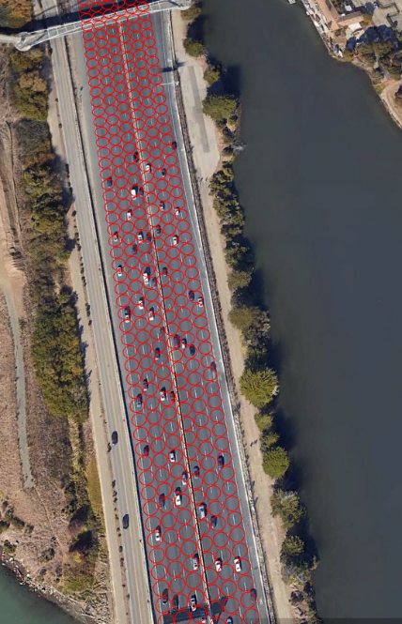
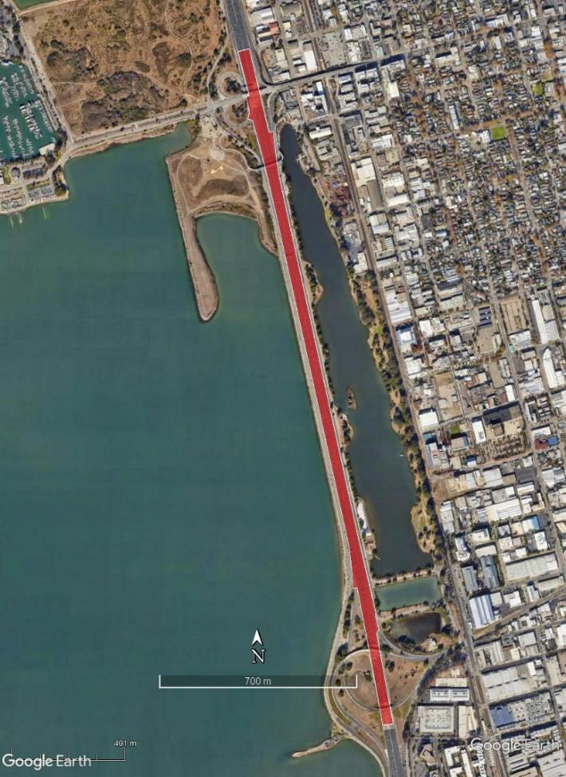
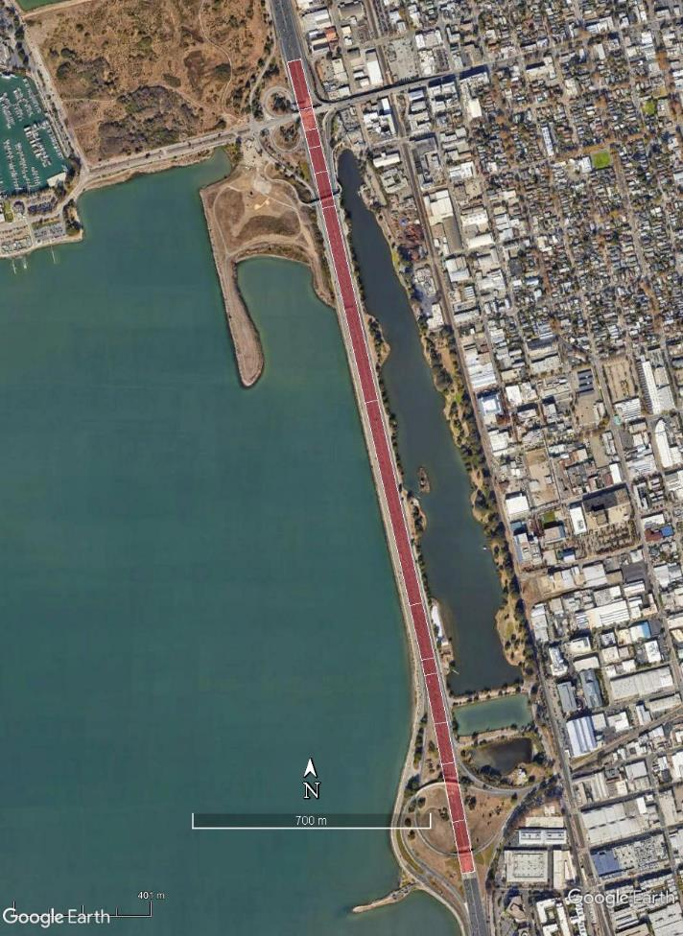

Source Configuration Geometry for Tracer Evaluations
AERMOD Volume source geometries (with zoom to show resolution)
Line source geometries (AERMOD, ADMS-Roads)
AERMOD “AREAPOLY”
Specialist

Slide 27
EMFAC Modeling for Pollutants Evaluation
We used CARB’s mobile source emission factor (EMFAC) model to model roadway pollutants, given the known traffic
Model Variable | Options | Input | Needs Traffic Data? | If Used, Source of Traffic Data
Region type | Statewide, air basin, air district, MPO, county, sub-area | County | No
Region | - | Alameda County | No
Calendar year | 2000 to 2050 | 2021 | No
Vehicle category scheme | EMFAC202x EMFAC2011 EMFAC2007 | EMFAC2007* | No | WilteC Survey Virginia PeMS
Model year | Aggregate, select, range | Aggregate | No
Speed | 5 to 90 mph in 5-mph increments | Select all | Yes | PeMS
Fuel | Aggregate, by fuel | Aggregate | No
Season | Summer/Winter/Annual | Summer for pollutant evaluation Annual for regulatory evaluation | No
We also used CARB’s speciation factors to determine BC emissions
We used CARB’s methodology, based on EPA’s AP-42 for Road Dust emissions:
E=[k(SL)^{0.91} x (W)^{1.02}] x (1-P/4N)
CARB’s silt loading for freeways = 0.015 (g/m²)
Average vehicle weight = 2.4 tons
Profile Description | EC Fraction
2021 Heavy-Duty Diesel Truck-Cruise (2016 Update) | 19.9%
2021 School Bus-Transient (2016 Update) | 7.8%
2021 Transit Bus-Transient (2016 Update) | 14.4%
Diesel Vehicle Exhaust | 26.4%
Gasoline Vehicle Equipped with Catalytic Converter | 25.2%
Brake Wear | 2.6%
Tire Wear | 22.0%
Running Exhaust from CNG -TWC on UDDS Cycle | 20.3%
Specialist

Slide 28
EMFAC Modeling for Pollutants Evaluation
Example: Emissions rate results, 6/6/2021
Ramps
  Used to capture additional emissions for pollutants evaluation that could be picked up by monitors
  Taken as 8% (by volume) of the main freeway, based on traffic counts
Specialist
Notes:
Does not include re-entrained road dust emissions; note exhaust emission are comparable to brake and tire wear emissions

Slide 29

Types of Comparisons Made
3. Qualitative
Subjective consideration of items including:
User interface
Ease of use
Model transparency (source code in public domain)
Runtime
Output resolution
Transportation Conformity and Hot-Spot Analysis (output is easy to use with these post model analysis)
Boundary-layer parameterization (state of the science)
Initial plume characterization
Maintenance (Is model regularly update and revised)
Cost
1. Quantitative
Average residual (bias), absolute average residual $Average Residual (\overline{r)}= \frac{\sum{C_{observed}−C_{modeled}}}{n}$
Absolute average residual $Absolute Average Residual= \frac{\sum{\overline{C_{observed}−C_{modeled}}}}{n}$
Root Mean Squared Error $RMSE= \sqrt{\frac{\sum{{\left(r_{i}−\overline{r}\right)}^{2}}}{n}}$
The Pearson Correlation Coefficient $r=\frac{\sum{\left(C_{Obs}−\overline{C_{Obs}}\right)\left(C_{Modeled}−\overline{C_{Modeled}}\right)}}{\sqrt{\sum{{\left(C_{Obs}−\overline{C_{Obs}}\right)}^{2}\sum{{\left(C_{Modeled}−\overline{C_{Modeled}}\right)}^{2}}}}}$
The Robust Highest Concentration $RHC=x_{n}+\left(\overline{x_{n−1}}−x_{n}\right)\ln\left(\frac{3n−1}{2}\right)$
Fractional bias of means $Fractional Bias= \frac{\sum{C_{observed}−C_{modeled}}}{\frac{1}{2}\sum{C_{observed}+C_{modeled}}}$
2. Graphical
Q-Q plots
Time-series plots
Paired scatter plots
Specialist

Slide 30
Findings: Scatter Plots of Observed vs. Modeled Concentrations for the Tracer Study

Slide 31
Findings: Q-Q Plots of Observed vs. Modeled Concentrations for the Tracer Study

Slide 32
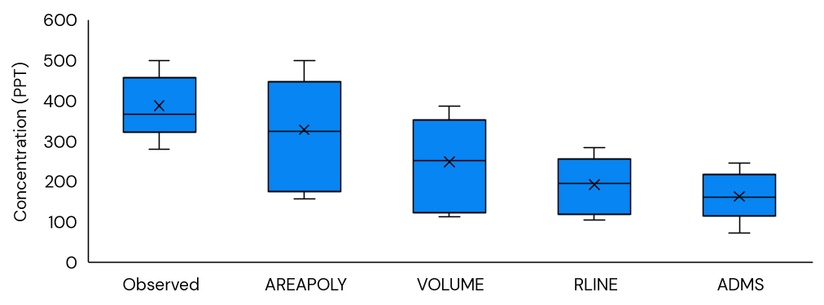

Findings: Tracer Evaluation Metrics Across All Refined Models/Source Configurations
Metric | AERMOD |  |  | ADMS Roads
 | AREAPOLY | Volume | RLINE
Average Residual | 45.0 | 81.4 | 112.7 | 116.7
Absolute Average Residual | 62.8 | 82.5 | 112.7 | 116.7
Standard Dev. of Residual | 59.1 | 49.9 | 47.7 | 58.2
Root Mean Square Error | 74.3 | 95.4 | 122.4 | 130.4
R-squared (unitless) | 0.82 | 0.79 | 0.82 | 0.8
Fractional Bias (unitless) | 0.236 | 0.472 | 0.720 | 0.756
Robust Highest Concentration – Observed | 563.8 | 563.8 | 563.8 | 563.8
Robust Highest Concentration – Modeled | 585.3 | 425.9 | 311.6 | 261.7
The table shows statistics from all experiments for the sum of all 3 tracers (ppt unless otherwise stated)
AERMOD (AREAPOLY) demonstrated the best performance.
  AERMOD-AREAPOLY had relatively lower absolute average residual, fractional bias, RMSE and importantly the best pairing of the RHC observed to modeled.
  ADMS-Roads model showed relatively poor performance. The ADMS-Roads model had the highest average residual, RMSE, and fractional bias.
  All four model/source configurations showed similar R-squared values.
The figure shows the performance of models for the receptor nearest the road in all experiments,
  This is where the highest concentrations are expected to occur.
  It is also most important for many regulatory applications
Of the four models, AERMOD-AREAPOLY has the closest mean and maximum concentrations at 1-m to observed data.
  ADMS-ROADS, by contrast, shows maxima below the minimum observed values at this important location.
Max
Q3
Mean
Median
Q1
Min
ADMS-
ROADS
AERMOD

Slide 33
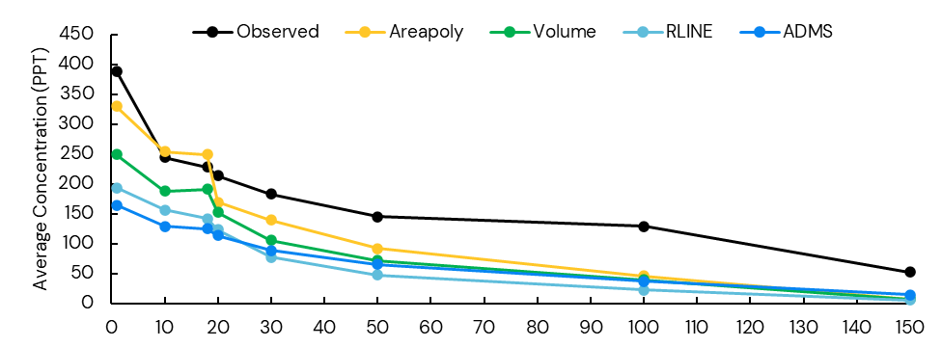
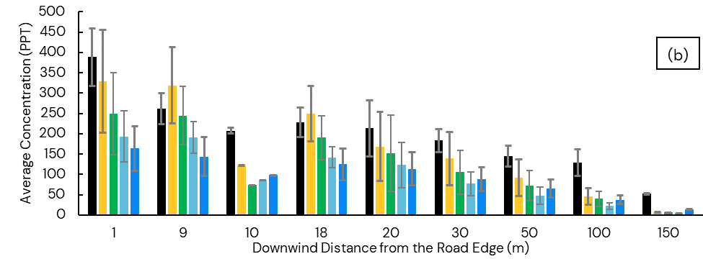
Findings: Tracer-Based Intercomparison of the Refined Models
All four models showed a tendency for underpredictions, as demonstrated by the positive fractional bias.
This underprediction tends to occur most at the lower concentrations – at further distances downwind of the roadway
These figures combine all hours and locations over all experiments
  Top Figure shows the average concentrations as a function of distance, without any measure of the variance. All of the models capture the general decrease with distance from the source.
  Bottom Figure shows the average and one standard deviation of the concentration at each measurement location. This emphasizes how well the models perform at each distance when considering the variation across experiments.
  AERMOD-AREAPOLY shows a slight tendency to overpredict at 9 and 18 meters but not at the 1-meter receptor.
    Note that receptor locations were not the same in all experiments.
    The kink observed between 10 and 20 m is due to this difference and differences in the North and South experimental areas.
(a)

Slide 34
Findings: Screening Model Evaluation with Tracer
Maximum Concentration Estimated by AERSCREEN and CAL3QHC vs. Observed for Tracer, Pollutant, and Regulatory Evaluations.
There are no values available for colored and empty cells due to application guidance.
AERSCREEN
CAL3QHC
Maximum Concentration Value | Pollutant-based |  |  | Regulatory |  |  | Tracer
 | AERS-CREEN | Obser-ved | Ratio | AERS-CREEN | Obser-ved | Ratio | AERS-CREEN | Obser-ved | Ratio
Hourly CO (ppm) | 3.2 | 0.45 | 7.1 | 4.6 | 1.1 | 4.2
Hourly PM_{2.5} (µg/m³) | 51.9 | 5.9 | 8.8
Hourly BC (µg/m³) | 4.2 | 1.1 | 3.8
8-hour CO (ppm) |  |  |  | 4.2 | 1.03 | 4.1
24-hr PM_{2.5} (µg/m³) |  |  |  | 99.7 | 28.8 | 3.5
Annual PM_{2.5} (µg/m³)
Hourly PDCB (ppt) |  |  |  |  |  |  | 949 | 171 | 5.5
Hourly PMCP (ppt) |  |  |  |  |  |  | 869 | 220 | 4.0
Hourly PMCH (ppt) |  |  |  |  |  |  | 971 | 110 | 8.8
Hourly Total Tracer (ppt) |  |  |  |  |  |  | 2,788 | 501 | 5.6
Maximum Concentration Value | Pollutant-based |  |  | Regulatory |  |  | Tracer
 | CAL3-QHC | Obser-ved | Ratio | CAL3-QHC | Obser-ved | Ratio | CAL3-QHC | Obser-ved | Ratio
Hourly CO (ppm) | 0.6 | 0.45 | 1.3 | 1.9 | 1.1 | 1.7
Hourly PM_{2.5} (µg/m³)
Hourly BC (µg/m³)
8-hour CO (ppm) |  |  |  | 1.31 | 1.03 | 1.3
24-hr PM_{2.5} (µg/m³)
Annual PM_{2.5} (µg/m³)
Hourly PDCB (ppt) |  |  |  |  |  |  | 438.2 | 171 | 2.6
Hourly PMCP (ppt) |  |  |  |  |  |  | 478.8 | 220 | 2.2
Hourly PMCH (ppt) |  |  |  |  |  |  | 283.9 | 110 | 2.6
Hourly Total Tracer (ppt) |  |  |  |  |  |  | 1146 | 501 | 2.3

Slide 35
Findings: Pollutant-based Evaluation Metrics Across All Refined Models/Source Configurations
CO (ppm, unless otherwise stated)
PM_{2.5} (μg/m³, unless otherwise stated)
Metric | AERMOD |  |  | ADMS Roads
 | AREAPOLY | Volume | RLINE
Average Residual | 0.18 | 0.191 | 0.23 | 0.22
Absolute Average Residual | 0.18 | 0.191 | 0.23 | 0.22
Standard Dev. of Residual | 0.09 | 0.083 | 0.09 | 0.09
Root Mean Square Error | 0.20 | 0.21 | 0.24 | 0.23
R-squared (unitless) | 0.22 | 0.39 | 0.14 | 0.10
Fractional Bias (unitless) | 0.894 | 0.963 | 1.250 | 1.158
Robust Highest Concentration – Observed | 0.55 | 0.55 | 0.55 | 0.55
Robust Highest Concentration – Modeled | 0.19 | 0.169 | 0.12 | 0.14
Metric | AERMOD |  |  | ADMS Roads
 | AREAPOLY | Volume | RLINE
Average Residual | -0.45 | -0.28 | 0.32 | 0.28
Absolute Average Residual | 1.9 | 1.9 | 1.8 | 1.9
Standard Dev. of Residual | 2.9 | 2.8 | 2.9 | 3.0
Root Mean Square Error | 3.0 | 2.8 | 2.9 | 3.0
R-squared (unitless) | 0.08 | 0.003 | 0.17 | 0.34
Fractional Bias (unitless) | -0.236 | -0.152 | 0.216 | 0.186
Robust Highest Concentration – Observed | 4.9 | 4.9 | 4.9 | 4.9
Robust Highest Concentration – Modeled | 3.6 | 3.1 | 2.2 | 2.4

Slide 36
Scatter Plots of Observed vs. Modeled Concentrations
For CO
For PM_{2.5}

Slide 37
Findings: Regulatory Evaluation - Design Values
Averaging Period and Pollutant | AERMOD |  |  | ADMS-Roads | Observed
 | AREAPOLY | Volume | RLINE
1-hour CO (ppm) | 1.2 | 1.1 | 1.2 | 1.6 | 1.1
8-hour CO (ppm) | 1.0 | 0.94 | 0.90 | 1.07 | 0.98
24-hour PM_{2.5} (µg/m³) | 17.9 | 19.0 | 20.1 | 19.5 | 18.6
Annual PM_{2.5} (µg/m³) | 8.8 | 9.5 | 9.7 | 10.2 | 9.3
AERMOD-AREAPOLY showed modeled DVs that were closest to the observed values. ADMS-Roads had the highest deviation from the observed values. Only ADMS-ROADS overpredicted for 8-hour CO. All models except AERMOD in the area source configuration overpredicted the annual average PM_{2.5} DV.
All four models/configurations showed DVs that were close to observed values, but a high fraction (more than 80 percent) of modeled DVs was contributed by the background concentrations, emphasizing the contribution of other components to regulatory evaluations.
Results are for all refined models/source configurations (Without outliers. See the appendices to the final report for details.)

Slide 38
Findings: Qualitative Evaluation of Dispersion Models
Evaluation Criteria | AERMOD |  |  | ADMS-Roads
 | AREAPOLY | Volume | RLINE
User Interface | 0 |  |  | 10
Ease of Use | 3 |  |  | 8
Model Transparency | 7 |  |  | 4
Runtime | 10 | 10 | 9 | 10
Output Resolution | 8 |  |  | 6
Transportation Conformity and Hot-Spot Analysis | 5 | 4 | 5 | 0
Suitability of boundary-layer parameterization | 8 |  |  | 8
Initial Plume Dispersion | 7 | 7 | 7 | 6
Model Maintenance | 10 |  |  | 10
Cost | 10 |  |  | 0
For each evaluation criteria, each model was scored as 0 through 10. A score of 10 indicates highest strength in that area.
Scoring was based on professional judgement and experience by the ICF team.
AERMOD-AREAPOLY received the highest scores overall.
We also note that commercial GUIs are available for AERMOD but were not included in this evaluation.
Notes:
For each evaluation criteria, each model was scored as 0 through 10. A score of 10 indicates it is relatively strong in that area and a score of 0 indicates that the model has significant, relative weakness. Scoring was based on professional judgement and experience by the ICF team that carried out the modeling for the study.

Slide 39
Summary of Model Evaluation Results
Comparative analysis identified that AERMOD-AREAPOLY performed best
  However, findings may indicate that current EPA guidance overstates initial vertical mixing and initial dispersion, particularly for heavy-duty trucks.
Comparative analysis for pollutant-based assessment that the models greatly underpredicted CO (> factor of 2) and to a lesser extent PM2.5.
  Given the good performance for the models evaluated with the tracer dataset, it appears that the emissions portion of the modeling chain should undergo further evaluation and study.
Both screening models AERSCREEN and CAL3QHC provided conservative estimates of CO concentration, but CAL3QHC provided significantly less overestimation.
  CAL3QHC should remain available as a regulatory CO screening model.

Slide 40
Summary of Model Evaluation Results
A summary of the qualitative assessment of the models showed that
  ADMS was preferred for its ease of use. Commercial user interfaces can equalize the ease of use between ADMS and AERMOD.
  For the physical parameterization metrics, ADMS and the AERMOD versions scored similarly, including the parameterization for boundary layer (similarity theory) and initial plume dispersion.
  ADMS is less transparent than AERMOD as the model is proprietary and requires a licensing fee

Slide 41
Summary of Model Evaluation Results (continued)
The tracer-based evaluation isolates the dispersion component of the full analysis chain and thus is the most reliable method for assessing the performance of dispersion component of the models.
  Of the four refined models, AERMOD-AREAPOLY showed the best performance
    Lowest residual values,
    Lowest absolute fractional bias, and
    Closest robust highest concentration (RHC) to the observed values.
AERMOD-AREAPOLY also showed better performance with the pollutant and regulatory evaluations (except for PM2.5).
  Based on the metrics included and for the setting and conditions evaluated in this study, these results indicate that AERMOD-AREAPOLY is the best-performing dispersion model of those evaluated here.

Slide 42
Notes and Next Steps
The ten field experiments were designed to occur in relatively similar meteorological conditions
  All were measured during the daylight from early to late morning, with winds perpendicular to 45 degrees across the roadway. This maximized the likelihood of measuring detectible tracer concentrations.
  With the relatively small number of experiments possible within budget constraints no attempt was made to stratify results by atmospheric conditions.
    Future work could potentially explore how model performance varies with wind direction and speed.
  Lessons learned can help frame future experiments that could probe a wider range of transportation facilities and meteorological conditions.

Slide 43
Notes and Next Steps (continued)
Findings are applicable to conditions observed during the Berkeley Freeway Experiment – a high volume, 10-lane freeway setting in an urban area near a large waterbody.
  This location was extensively studied, including employing a mobile-platform tracer release, monitoring of roadway air pollutants, and co-located regulatory air monitoring
  Similar modeling results are anticipated for similar high-volume freeway or heavily traffic arterials
  Results from this study may not be applicable to other transportation settings.
We also note that the findings from this study agree with some other datasets.
  Heist et al (2013) included a tracer comparison for four of the same models using the Caltrans Highway 99 Tracer Study. They found the dispersion models generally underpredict observations, although they found ADMS and RLINE* under stable conditions to be an exception
  Eisinger et al. (2019) found AERMOD-modeled, near-road PM_{2.5} increments for the average concentration overpredicted by a factors of four (Indianapolis) and six (Providence). However, for the design value (98th percentile for regulatory comparison) they found that Indianapolis modeled concentrations underpredict the observations by 30%, while for Providence AERMOD overpredicted by more than a factor of two, similar to the Regulatory Analysis evaluation here.
  * RLINE – This was for the standalone version of RLINE before being incorporated into AERMOD.

Slide 44
Second General Objective:
Research and develop recommendations for an enhanced Model Evaluation Process (MEP) for transportation projects

Slide 45
Objective 2.
Develop a comprehensive MEP for air quality models and the modeling process used for transportation projects, which evaluates impacts across the entire regulatory modeling chain (traffic, emissions, dispersion, and background concentrations).

Slide 46
Project Objective 2 – Model Evaluation Process
This study developed an enhanced model evaluation process (MEP) for transportation projects
  To identify a process for the review and approval of future air quality dispersion models and applications for transportation settings.
  The model evaluation includes factors such as usefulness and usability of the model for regulatory purposes
  The MEP describes the suggested process for the review and approval for air quality dispersion models.
  We discuss the needs for, elements of, provide recommendations for, and developed a sample MEP for transportation projects.
Key objectives for the recommended enhanced MEP for project-level air quality analyses are:
  To validate (or determine the adequacy of) both the dispersion model and the regulatory modeling chain for their intended regulatory purposes.
  To compare the results of the dispersion model and the regulatory modeling chain to draw reasonable inferences about sources of error and uncertainty.

Slide 47
Project Objective 2 – Model Evaluation Process (Continued)
This provides general principles for evaluation of transportation air quality models, and a model evaluation process consistent with these principles.
We developed an outline for a generic model evaluation and applied that outline to evaluate models against tracer data and the regulatory modeling chain against data from the Berkeley Freeway Experiment.
  A comparison of the results for the dispersion model (which showed good agreement with the tracer data) and the regulatory modeling chain (which showed less agreement with the data) indicates that the dispersion model is not the primary source of error in the modeling chain.

Slide 48
Principles of an Enhanced MEP
An enhanced MEP should
Be comprehensive, rigorous, and systematic.
Include validating not only the dispersion model, but the entire modeling chain.
Include model evaluation conducted throughout the model’s lifecycle.
Include facility-specific evaluations.
Use multiple technical criteria. We determined the following to be essential:
  Accuracy, for which there are several statistical measures. For regulatory modeling, the focus is typically on accuracy for maximum concentrations that are used to determine DV for comparison with the applicable NAAQS.
  Parsimony or Proportionality such that models not be more complex or resource-intensive to apply than needed for the specific regulatory need. This is important for all regulatory models and particularly for screening models.
  Ease-of-use, to ensure that tools are adopted, as tools which are difficult to use are frequently shunned by users and find limited utility.
  Include a measure of the model’s quality assurance and control to help users specify and check input and output data.
  A comparative analysis with other models to identify the best performing algorithms and models for specific applications.
  Stakeholder involvement, to ensure robust and ongoing peer review. We recommend key stakeholders to include. Stakeholder engagement and involvement should occur throughout the entire process.

Slide 49
Project Summary

Slide 50
Project Summary
This project:
Conducted a comprehensive review and identification of air quality models and historic tracer in-field studies suitable for model intercomparison studies for transportation facilities.
Developed a comprehensive MEP for air quality models and the modeling process used for transportation projects. The enhanced air quality MEP evaluates impacts across the entire regulatory modeling chain (traffic, emissions, dispersion, and background). We applied the procedures to evaluate models against air quality data including both quantitative and qualitative aspects and specify the procedures to test air quality dispersion models for regulatory applications in transportation settings in future analyses.
Designed and conducted a field experiment in a high-traffic freeway setting that simultaneously released and measured inert tracer concentrations from a mobile platform, mobile source air pollutant concentrations from the facility, traffic, meteorology, and adjacent air quality data. We developed a novel dataset to support project-level air quality model evaluation.
Used the observations from this high-quality field experiment in an air quality model intercomparison study to assess model performance in this setting. We presented comparative analyses between models and provide insights into the best performing models.

Slide 51
Principal Conclusions from the Project
AERMOD – using the AREAPOLY source configuration – was the best performing model for the setting and conditions explored in the Berkeley Freeway Experiment.
For regulatory CO screening applications, the CAL3QHC model is preferred.
For future model updates and changes in regulatory applications, a comprehensive model evaluation process should be conducted that includes multiple and specific evaluation criteria, along with a performance evaluation that includes simultaneous comparison against both tracer data and the assessment of the regulatory modeling chain with near-road pollutant monitoring data.
The MEP developed here can serve as this process.

Slide 52
Selected Recommendations for Future Research
Conduct co-located tracer and pollutant testing following the MEP for other high-priority transportation settings and use the resulting data to further evaluate the air dispersion models performance. Settings include:
  Intersections (skewed and un-skewed)
  Interchanges, Freeway-Freeway and Freeway-Arterial Street (including adjacent congested intersections)
  Freeways (with and without near-road barriers/noise walls)
  Arterials
  Street Canyons
  Truck and Bus terminals
  Port (Drayage) Operations
  Park and Ride Lots
Further testing supporting initial vertical dispersion parameter as used as input to AERMOD.
Conducting additional sensitivity tests for tracer experiments to identify elements most influencing performance. This could include sensitivity to vehicle wake.
Sensitivity testing for AERMOD with the recent ZOEFF approach for surface roughness length calculation.
Further evaluation of results from this experiment, such as stratification of results by specific parameters and comparison to other, similar studies to help determine those parameters most influencing model performance.
Further testing of the full regulatory modeling chain both with tracer and air pollutant measurements are needed. PM is a priority. Emission rates are a priority.
Improved recommendations and guidance for background selection, including sensitivity of results to this selection.
Conduct a full strengths and weaknesses evaluation of transportation dispersion models.

Slide 53
Further Information Available from this Study
This study resulted in multiple deliverables, all of which are available for future research. Each of these items is included in the list of final deliverables for this project:
This presentation.
Final report that documents and summarizes the entire research effort. This final report includes all deliverable products of the research. Appendices include:
  Identification of Air Quality Models and Field Studies with Suitable Datasets for Model Intercomparison for Transportation Projects
  Report on the Berkeley Freeway Tracer Experiment
  Dispersion Model Intercomparison Methodology and Results
  Recommendations for an Enhanced Model Evaluation Process for the Transportation Sector
Technical report for decision makers to identify appropriate air dispersion models for regulatory applications (aka MEP). See and Appendix D of the Final Report .
Electronic versions of historical tracer databases obtained during this study. See Appendix G.
Electronic dataset of the new Berkeley Field Experiment field tracer experiment completed under this project. See Appendix F.
Electronic version of all modeling files used in this model evaluation. See Appendix E.
Standalone memorandum – Implementation of Research Findings

Slide 54
Acknowledgments
This study was conducted for the AASHTO Committee on Environment and Sustainability, with funding provided through the National Cooperative Highway Research Program (NCHRP). NCHRP is supported by annual voluntary contributions from state departments of transportation.
We thank the technical working group for their useful contributions:
Jackie Ploch, Texas DOT, Panel Chair
Christopher Voigt, VDOT
Noel Alcala, Ohio DOT
Austina Casey, District of Columbia DOT
Dr. Yoojoong Choi, California DOT
Dr. Kevork Hacatoglu, Ontario Ministry of Transportation
Ms. Sharon Natalie Liljenwall, Oregon DOT
Dr. Jane Jie Lin, University of Illinois- Chicago
Dennis Randolph, Director of Public Works, City of Grandview, Missouri
Dr. Abhilash Vijayan, California Air Resources Board
Cecilia Ho, FHWA
Chris Owens, EPA
Trey Joseph Wadsworth, NCHRP Senior Program Officer
Disclaimer
The National Cooperative Highway Research Program (NCHRP) is sponsored by the individual state departments of transportation of the American Association of State Highway and Transportation Officials. NCHRP is administered by the Transportation Research Board (TRB), part of the National Academies of Sciences, Engineering, and Medicine, under a cooperative agreement with the Federal Highway Administration (FHWA). Any opinions and conclusions expressed or implied in resulting research products are those of the individuals and organizations who performed the research and are not necessarily those of TRB; the National Academies of Sciences, Engineering, and Medicine; the FHWA; or NCHRP sponsors.

