Slide 1
NCHRP 02-26 Implementation of Life-Cycle Planning Analysis in a Transportation Asset Management Framework
DRAFT FINAL PRESENTATION
PREPARED FOR NCHRP TRANSPORTATION RESEARCH BOARD OF THE NATIONAL ACADEMIES
WSP USA Inc September 2022
ACKNOWLEDGEMENT OF SPONSORSHIP
This work was sponsored by the American Association of State Highway and Transportation Officials, in cooperation with the Federal Highway Administration, and was conducted in the National Cooperative Highway Research Program, which is administered by the Transportation Research Board of the National Academies.
DISCLAIMER: This is an uncorrected draft as submitted by the Contractor. The opinions and conclusions expressed or implied herein are those of the Contractor. They are not necessarily those of the Transportation Research Board, the National Academies, or the program sponsors.

Slide 2
Life-Cycle Planning Definitions
Life-Cycle planning means a process to estimate the cost of managing an asset class, or asset sub-group over its whole life with consideration for minimizing cost while preserving or improving the condition
Title 23 CFR 515.5 Definitions
Life-cycle planning lays out the processes and procedures for the life cycle management of every asset class
Lifecycle planning is about optimization of costs, service goals, and risks (including extreme weather & resilience) over the life-cycle of an asset.

Slide 3
LCP Objectives
Asset Level | Identify an optimum preservation strategy to minimize life cycle costs under a given investment scenario | With or without performance constraints
Network Level | Determine the level of investments required to achieve performance objectives | Unconstrained optimization
 | Identify long term investment needs (beyond financial planning period) | Unconstrained optimization
 | Determine the level of performance that can be achieved under a given investment scenario | Budget-constrained and performance-constrained optimization.

Slide 4
Life-Cycle Planning in the Transportation Asset Management (TAM) context
System Level
Maximize the value of investments (cross-asset or cross-modal) made in achieving system objectives
Program
Level
Asset
Level
Selecting the Right Treatment at the Right Time to minimize life-cycle costs
Selecting the Right Project for the Program (of same asset classes) to maximize network performance

Slide 5
Practice of Life Cycle Planning
Role of LCP in TAM and its benefits are well understood
Variance in TAM practices among STAs and across asset classes
Effectiveness of LCP influenced by risks and uncertainties
Need a framework that builds on existing practice, adaptable to DOT practices, and serves all asset classes
Need a framework to incorporate risks and uncertainties
LCP is being practiced in some form by most state transportation agencies (STAs)
Effectiveness of LCP influenced by maturity of LCP “enablers”
Computational power needed for optimization in LCP analysis is a challenge
Need a benchmark for DOTs to advance maturity through continual improvement
Need solutions to reduce computational bottlenecks

Slide 6
Life-cycle Planning High-Level Steps
Set up LCP for both asset and network level analyses
1
Establish intervention thresholds at the asset level
2
Plan and select treatments at the asset level
3
Develop work program, determine performance gaps & provide input to financial plan
4

Slide 7
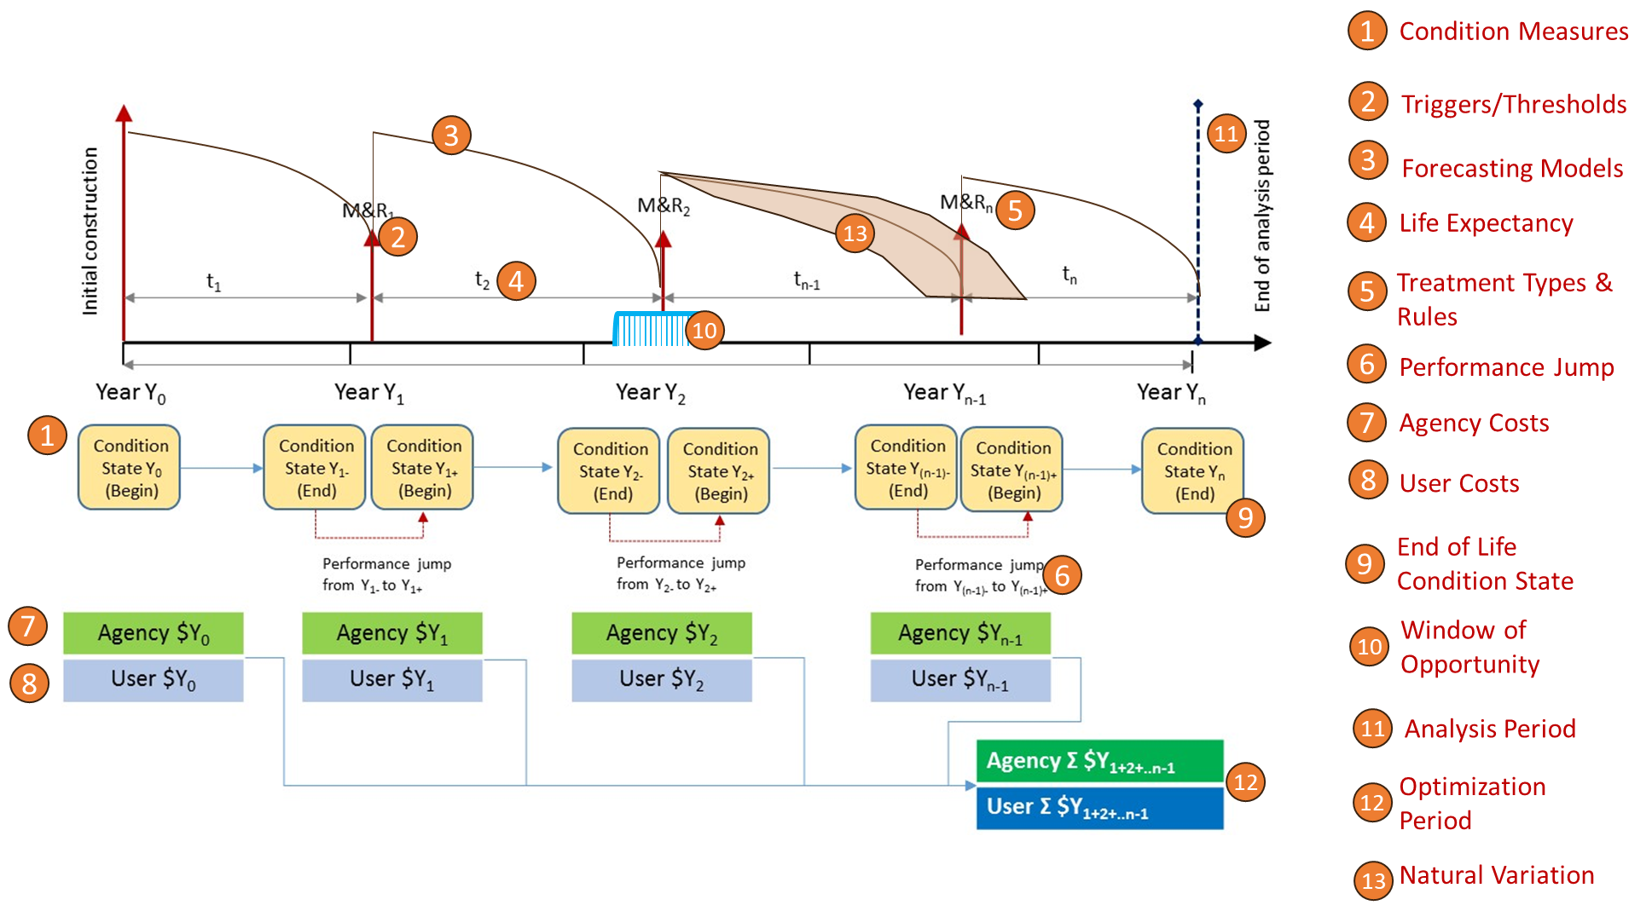
Generalized Life-Cycle Activity Plan
For a combination of treatment type, timing & service life estimates

Slide 8
Life Cycle Planning Enablers
Asset Identifiers
Performance Measures
Deterioration Models
Policies
Treatment Strategies and Effectiveness
Economic Analysis
Work Programming
Technology and Information Systems
Supplementary Data
Will be covered in more detail in this presentation

Slide 9
Performance Measures
System Preservation, Mobility, Safety, Reliability, and Economics
Asset Functional Condition | Ability to serve the user: ride, safety, operations, and other functional purposes
Asset Structural Integrity | Ability to withstand loads (environmental, traffic or electrical)
Economic | Life cycle Costs
Obsolescence | Functional Obsolescence – Requires expansion (e.g., bridge widening) Technological Obsolescence - Requires modernization Economic Obsolescence – Requires replacement Legal Obsolescence – Requires upgrade to new standards
Risk of Asset Failure | Structural Reliability – Indicates the ability of the asset not to fail or malfunction under normal operating conditions Frequency-based e.g., survival analysis Condition-based e.g., time to reach a specific threshold (RSI) Design-based e.g., bridge reliability index (β) Vulnerability
Risk of Service Disruption | Mobility, Safety, Freight Movement and Economic Vitality Measures and/or User costs
Notes:
So, to forecast future intervention needs, LCP should make sure that what we capture should align with the intervention principles. As we know, a plethora of performance measures are being used to indicate various facets of performance for asset classes. In this slide, we have indicated those that align with the intervention principles for incorporating into the LCP process. We can extend this table to a comprehensive list for various asset classes, from IRI of pavement surfaces to mean time between failure of electronic components.

Slide 10
Performance Measures – End of Life Considerations
Rockfall Scenario - Typical End of Life
Rock falls are stochastic. High intensity events exceeding the capacity of protection systems cause failure
Engineering (Condition-based)
Gradual loss in function
Sudden or physical failure
Modernization
Safety
Operational
Obsolescence (raised standards)
Reliability
Economic/Life cycle cost-based
When Net Present Value (replacement) is the most cost-effective option
Bridges - Typical End of Life
Gradual loss in function, as indicated by NBI/NBE condition states, and risk of sudden failure
Pavements - Typical End of Life
Gradual loss in function as structural cracking exceeds the acceptable limits
Excellent
High Energy Rockfall Event (stochastic) Exceeding Capacity
Low Energy Rockfall Event (stochastic)
Temporary Repairs
Poor
Threshold
Service Disruption
Failed
Notes:
Lemer, 1996:
Technological changes
Regulatory changes
Economic or social changes
Changes in user preferences
NCHRP Report 713: Some possibilities:
Sudden failure, e.g. lamps and motors
Obsolescence (e.g. discontinued support or obsolete standard)
Age-based worn out
Utilization-based worn out
Definite failure state - catastrophic or cost of failure
No definite failure state but unacceptable performance levels
Component replacement for replaceable parts
Optimal replacement time

Slide 11
Performance Measures – Establishing Condition Thresholds
Generally set by engineering, policy and regulatory requirements
Cost-effectiveness approach
Intervention Timing & Thresholds: Hastened vs Deferred
Assessment of agency costs, user costs, and effectiveness
Monetized approach (e.g. EAC)
Performance Area approach
Window of Opportunity
Hastened
Deferred

Slide 12
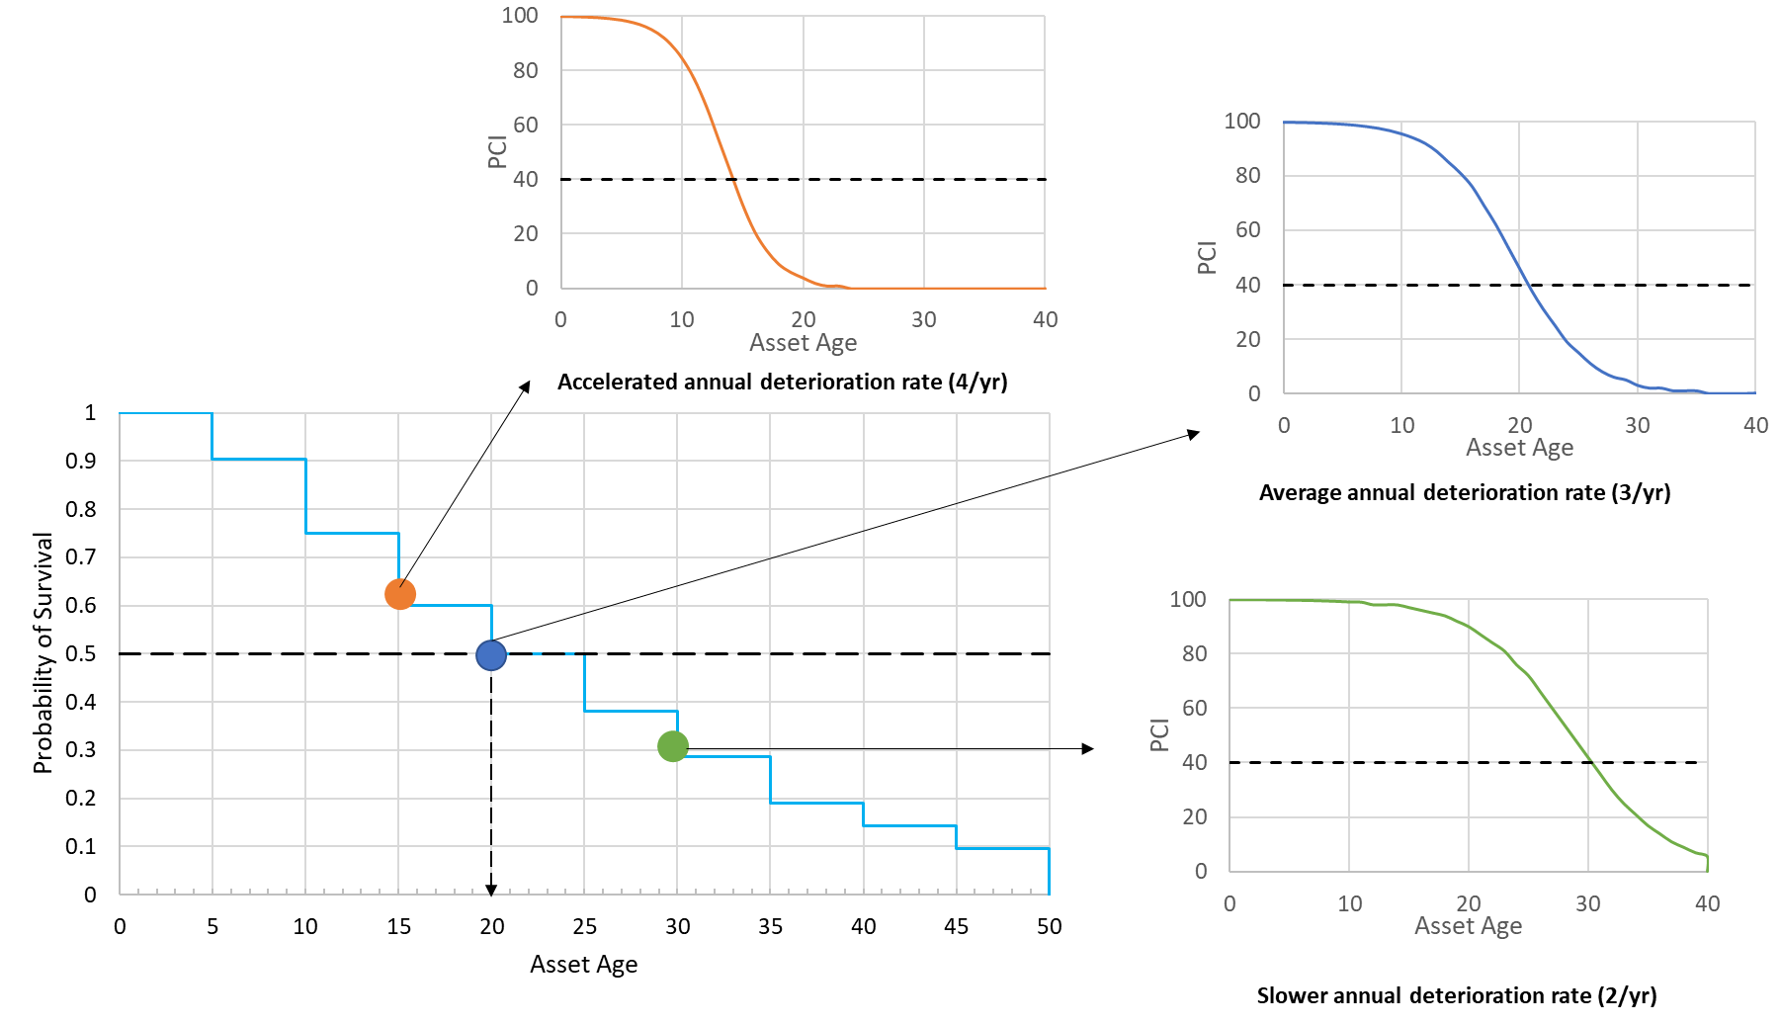
Deterioration & Survival Models
Pessimistic (Hazard) Scenario
Deterioration Rates
Deterioration Models
Age-based regression models
Markov transition matrices
Survival Models
Non-parametric (Kaplan Meier)
Semi-parametric (Cox proportional hazards)
Parametric (Weibull, log normal)
Typical Scenario
Survival Curve
Optimistic Scenario

Slide 13
Asset Deterioration Models
Pavement Deterioration Models
Composite Index of Individual Distresses
Forecast time to or time at which an asset reaches a condition state ✓
Indicate deterioration & failure modes ✓
Model probabilities in forecasting ✗
Incorporate causality ✗

Slide 14
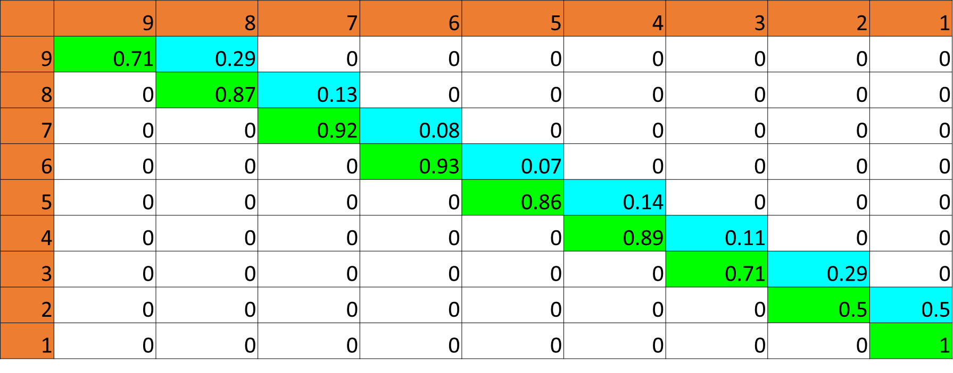
Asset Deterioration Models
Bridge Models
Transition Matrix of Condition States
Forecast time to or time at which an asset reaches a condition state ✓
Indicate deterioration & failure modes ✗
Model probabilities in forecasting ✓
Incorporate causality ✗

Slide 15
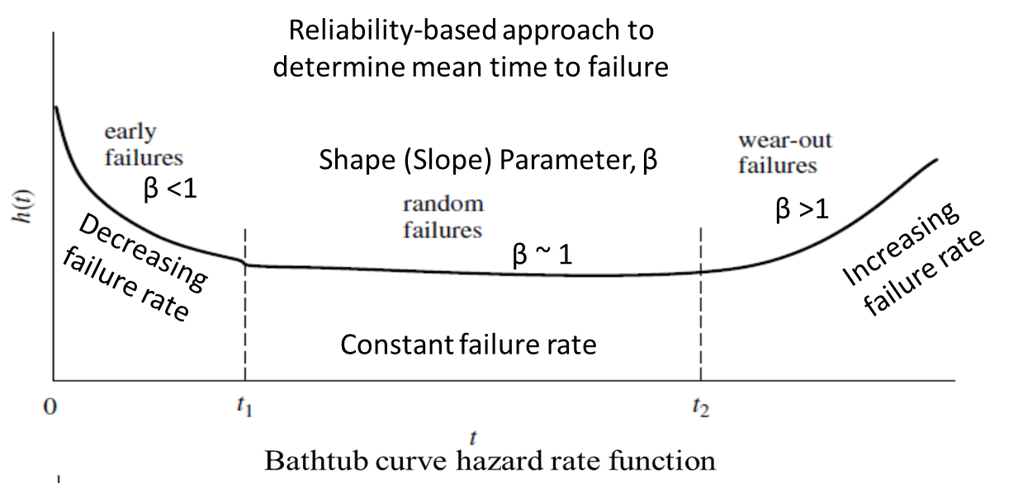
Asset Deterioration Models
TSMO “Bath-Tub” Conceptual Model
Forecast time to or time at which an asset reaches a condition state ✓
Indicate deterioration & failure modes ✗
Model probabilities in forecasting ✓
Incorporate causality ✗

Slide 16
Treatment Planning and Selection
Treatment planning and selection at the asset level
3

Slide 17
Treatment Planning
Selection of Feasible Treatment Categories
Developing Life Cycle Activity Plans
Incorporate Risks in Treatment Planning
Selection of Preferred Treatment Category
Do Nothing
Preservation
Rehabilitation
Reconstruction
Optimal treatment sequence
Possible combinations
Reduction techniques
Reliability considerations
Treatment costs
LCCA – NPV
Annualized Costs
Benefits
Area Under the Curve
Monetized
Ranking by IBC
Pareto’s Efficiency Frontier

Slide 18
Time to Intervention
Bridge Example
Rating | Condition | Indicator | Preservation | Rehabilitation | Reconstruction
9 | Excellent | Good
8 | Very good | Good | X
7 | Good | Good | X
6 | Satisfactory | Fair | X
5 | Fair | Fair | X | X
4 | Poor | Poor |  | X | X
3 | Serious | Poor |  |  | X
2 | Critical | Poor |  |  | X
1 | Imminent failure | Poor |  |  | X
0 | Failed | Poor |  |  | X
Age (t) | CR | Remaining Life to CR
Age (t) | CR | 6.5 (P) | 5.5 (P, RH) | 4 (RH, RC) | 3 (RC)
15 | 7.0 | 4.4 | 13.6 | 29.1 | 40.9
16 | 6.9 | 3.7 | 12.9 | 28.4 | 40.2
17 | 6.8 | 3.0 | 12.2 | 27.7 | 39.5
18 | 6.8 | 2.3 | 11.5 | 27.0 | 38.8
19 | 6.7 | 1.6 | 10.9 | 26.3 | 38.1
20 | 6.6 | 0.9 | 10.2 | 25.6 | 37.4
21 | 6.5 | 0.2 | 9.5 | 24.9 | 36.7
22 | 6.4 | 0.0 | 8.7 | 24.2 | 36.0
Treatment Recommendations by General Condition Ratings
Time to Intervention Calculations

Slide 19
General Asset Management Problem
Start
DN
DN
DN
DN
Interval 1 | Interval 2 | Interval 3 | Interval 4 | Interval 5 | Interval 6 | Interval 7 | Interval 8 | Interval 9 | Interval 10
DN | DN | DN | DN | DN | DN | DN | DN | DN | DN
DN | DN | DN | DN | DN | DN | DN | DN | DN | P
DN | DN | DN | DN | DN | DN | DN | DN | DN | RH
DN | DN | DN | DN | DN | DN | DN | DN | DN | RC
……
P | DN | DN | DN | DN | DN | DN | DN | DN | DN
P | DN | DN | DN | DN | DN | DN | DN | P | DN
P | DN | DN | DN | DN | DN | DN | DN | RH | DN
P | DN | DN | DN | DN | DN | DN | DN | RC | DN
……
RC | DN | DN | DN | DN | DN | DN | DN | DN | DN
……
RC | RC | RC | RC | RC | RC | RC | RC | RC | RC
……
RC | DN | DN | DN | DN | DN | DN | DN | DN | DN
RC | RC | RC | RC | RC | RC | RC | RC | RC | RC
. . . ..
P
P
P
P
High computational resources
. . . ..
RH
RH
RH
RH
. . . ..
RC
RC
RC
RC
. . . ..
Interval 1
(4)
Interval 2
(16)
Interval3 (64)
Interval 10
(1048576)
Generalized Asset Management Problem
# of Variables = (# of Assets)*(#Treatments)^{YEARS}
DN = Do Nothing P = Preservation
RH = Rehabilitation RC = Reconstruction

Slide 20
Scenario 3: Analysis of In-Service Structure Over 10 Years 25-year old Bridge with a GCR of 6.0
Y26 | Y27 | Y28 | Y29 | Y30 | Y31 | Y32 | Y33 | Y34 | Y35 | 10-Year NPV ($K) | AUC | Rank
DN | P | DN | DN | DN | DN | DN | DN | DN | DN | $120 | 52.4 | 1
P | DN | DN | DN | DN | DN | DN | DN | DN | DN | $123 | 52.4 | 2
DN | DN | P | DN | DN | DN | DN | DN | DN | DN | $118 | 52.3 | 3
DN | P | P | DN | DN | DN | DN | DN | DN | DN | $238 | 53.8 | 4
DN | DN | DN | P | DN | DN | DN | DN | DN | DN | $115 | 52.2 | 5
DN | P | DN | P | DN | DN | DN | DN | DN | DN | $236 | 53.7 | 6
DN | DN | P | P | DN | DN | DN | DN | DN | DN | $233 | 53.6 | 7
DN | RH | DN | DN | DN | DN | DN | DN | DN | DN | $1,201 | 65.6 | 8
DN | P | P | P | DN | DN | DN | DN | DN | DN | $353 | 55 | 9
DN | P | DN | DN | P | DN | DN | DN | DN | DN | $233 | 53.5 | 10
Potential for unreasonable solutions
Need for rules

Slide 21
Scenario 3: Analysis of In-Service Structure Over 10 Years 25-year Old Bridge with a GCR of 6.0
Y26 | Y27 | Y28 | Y29 | Y30 | Y31 | Y32 | Y33 | Y34 | Y35 | NPV ($K) | AUC | IBC-Rank
DN | DN | DN | DN | DN | DN | DN | DN | DN | DN | $0 | 50.7 | Baseline
P | DN | DN | DN | DN | DN | DN | DN | DN | DN | $123 | 52.4 | 2
DN | P | DN | DN | DN | DN | DN | DN | DN | DN | $120 | 52.4 | 1
DN | DN | P | DN | DN | DN | DN | DN | DN | DN | $118 | 52.3 | 3
DN | DN | DN | P | DN | DN | DN | DN | DN | DN | $115 | 52.2 | 5
DN | DN | DN | DN | P | DN | DN | DN | DN | DN | $113 | 52 | 22
DN | DN | DN | DN | DN | P | DN | DN | DN | DN | $111 | 51.8 | 166
DN | DN | DN | DN | DN | DN | P | DN | DN | DN | $109 | 51.6 | 787
DN | DN | DN | DN | DN | DN | DN | P | DN | DN | $107 | 51.4 | 2775
DN | DN | DN | DN | DN | DN | DN | DN | P | DN | $105 | 51.1 | 33581
DN | DN | DN | DN | DN | DN | DN | DN | DN | P | $103 | 50.9 | 231646
Confirms the Window of Opportunity concept
Captures the consequences of delayed or early maintenance

Slide 22
Simplified LCP Spreadsheet with Bridge Example
Age (t) |  | Recommended Actions |  |  |  | Remaining Life to CR
Age (t) | CR | SELECT | DO NOTHING | ACTION 1 | ACTION 2 | 6 | 5 | 4 | 3
15 | 7.0 | DN | DN | DN | DN | 8.9 | 18.5 | 29.1 | 40.9
16 | 6.9 | DN | DN | DN | DN | 8.2 | 17.8 | 28.4 | 40.2
17 | 6.8 | DN | DN | DN | DN | 7.5 | 17.1 | 27.7 | 39.5
18 | 6.8 | DN | DN | DN | DN | 6.8 | 16.5 | 27.0 | 38.8
19 | 6.7 | DN | DN | DN | DN | 6.1 | 15.8 | 26.3 | 38.1
20 | 6.6 | DN | DN | DN | DN | 5.4 | 15.1 | 25.6 | 37.4
21 | 6.5 | DN | DN | P | DN | 4.7 | 14.4 | 24.9 | 36.7
22 | 6.4 | DN | DN | P | DN | 4.0 | 13.6 | 24.2 | 36.0
23 | 6.4 | DN | DN | P | DN | 3.3 | 12.9 | 23.5 | 35.3
24 | 6.3 | DN | DN | P | DN | 2.5 | 12.2 | 22.7 | 34.5
25 | 6.2 | DN | DN | P | DN | 1.8 | 11.4 | 21.9 | 33.8
26 | 6.1 | DN | DN | P | DN | 1.0 | 10.6 | 21.2 | 33.0
27 | 6.0 | DN | DN | P | DN | 0.2 | 9.8 | 20.3 | 32.2
Local optimization around this notional timing using the window of opportunity analysis

Slide 23
Treatment Planning and Selection
Treatment planning and selection at the asset level
3
Incorporating Risks and Resilience in LCP Analysis

Slide 24
Incorporating Risk Management in LCP
Infrastructure Investment and Jobs Act (IIJA) emphasize on considering climate change, extreme weather and resilience in life cycle analyses
Risks and uncertainties impede the ability to achieve LCP objectives
Asset Level
Deviations from baseline standards/ assumptions/ plan
Program Level
DOT’s ability to deliver the work program as planned

Slide 25
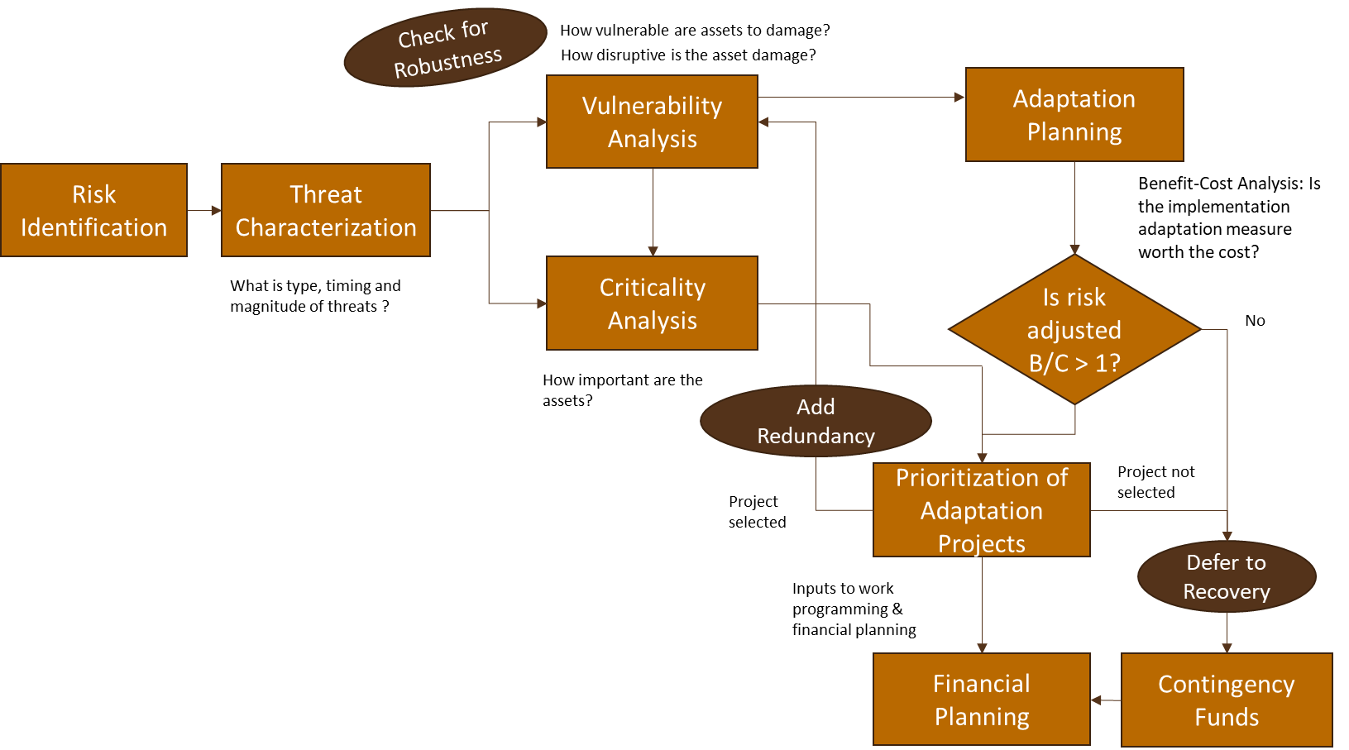
Incorporating Risks into LCP Analysis

Slide 26
Risk Identification
Risk Categories from TAM Plan Analysis
Risk Categories of Interest
Accelerated deterioration
Catastrophic or unexpected asset failure
Uncertain and insufficient funding
Reliability of technology (system), data and analytical capabilities
Future cost increase and/or uncertainty
Regulatory changes
Transportation technology changes
Asset/Service Failure Risks
e.g., accelerated deterioration, catastrophic failure
Decision Quality Risks
e.g., Reliability of data and analytical models
Funding risks
e.g., Uncertain and insufficient funding

Slide 27
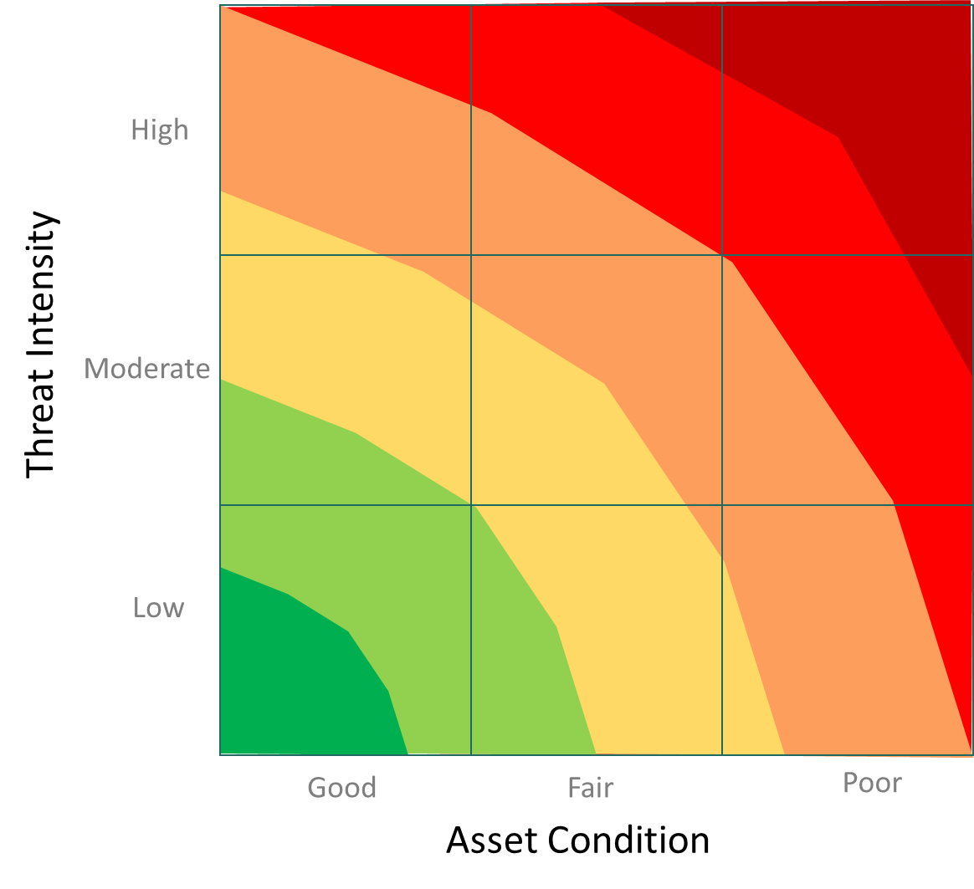
Asset Vulnerability
Intrinsic link between threat intensity and asset condition/risk factors
Increasing vulnerability
Survival Approach
Engineering Approach
Hybrid Approach
Evaluate the impacts of threats using survival analysis
Threat intensity are correlated with asset damage using historical records
Evaluate the impacts of threats using mechanistic or mechanical-empirical models
Threat intensity are converted into design parameters to study causative factors
Evaluate the impacts of threats using a combination of historical observations engineering, and often with GIS, models
Threat intensity are correlated with causative factors and observed asset damage

Slide 28
Asset Criticality & Recovery
Relative importance of an asset or facility
AADT and Functional Class of a facility do not tell the “whole story”
Other considerations
Accessibility and connectivity for lifeline/essential services and other dependency-related issues
Availability of alternative routes
Local preference
Social Vulnerability index
Economic impacts (e.g., freight, tourism)
Recovery after failure
Emergency repairs
Accelerated construction & repair techniques
Disruption Function for User Cost Calculations
Hazard Event
Full Recovery
LOS
Loss in Service
Gradual Recovery
Time in days
Examples of Scoring Approaches
VTrans Asset Criticality
CDOT Asset Criticality
WSDOT Asset Criticality

Slide 29
Incorporating Risks into LCP Treatment Selection
Threat mitigation (aka adaptation) is an objective of treatment selection
Utilization of engineered capacity
Deterioration under “normal” service
Accelerated deterioration due to hazards
Catastrophic failure
Economic principles remain the same
NPV (costs and user benefits) of adaptation (threat mitigation) > NPV of control scenario (no threat mitigation)
Asset condition
No Threat Event
Threat Event
Restoration after repairs
Residual Damage
Repair
Reduction in service life
Time
Cost
Treatment
Post-Event Repairs

Slide 30
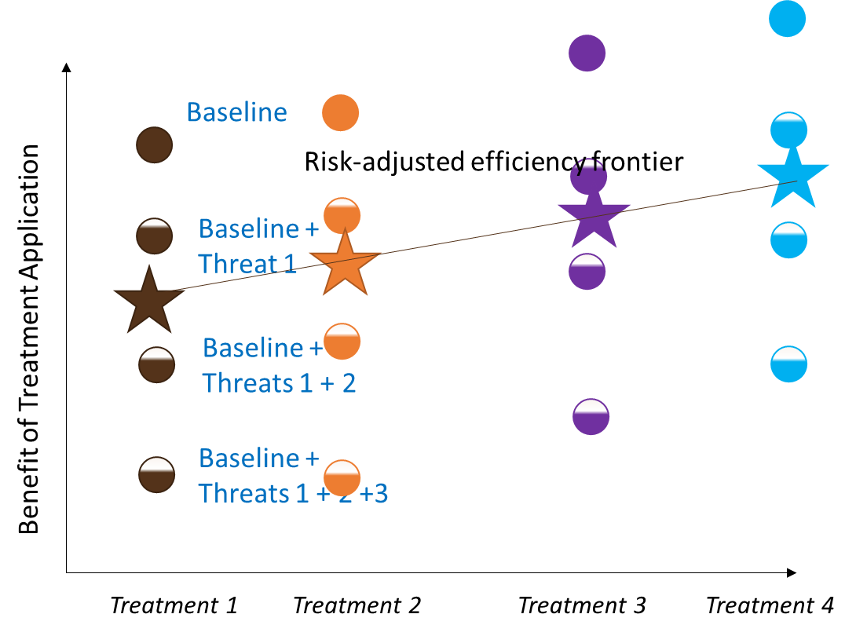
LCP Treatment Selection
Costs over the analysis period
Benefits are event-dependent
Threats are stochastic
Probabilistic approach
Risk adjustments to benefits
Treatment Selection for Prioritization
Treatment with the highest benefit
Efficiency Frontier of Treatments for Optimization
Risk adjusted benefits for all treatments
Cost of Treatment Application

Slide 31
Risk Scoring Approach for Project Prioritization
Risk Score = Risk of Asset Damage + Risk of Service Disruption
Probability of Event
Risk of Asset Damage
Risk of Service Disruption
Asset/Facility Exposure (R_{E})
Asset Vulnerability (R_{V})
Service Disruption & Recovery (R_{SD})
Occurrence (P_{E})
Asset Criticality (R_{C})
Damage Potential (DP)
Intensity (P_{I})
Recovery Time/Effort (R_{T})
R_{E} = P_{E} * P _{I}
R_{V} = P_{E} * DP
DP = (C_{PRE}-C_{POST})/ (C_{NEW}-C_{FAIL})
R_{SD} = R_{E} * R_{C} * R_{T}
Risk Score = f{P_{E,} C_{PRE}, C_{POST}, C_{NEW}, C_{FAIL}} + f{P_{E}, P_{I}, R_{C}, R_{T}}

Slide 32
Work Program Development
Work Program Development, Performance Gap Analysis and Report to Financial Planning
4

Slide 33
Project Selection
MnDOT Scoring of Bridge Projects
Prioritization vs Optimization
Differences among States
Common Prioritization Factors
Pavements (Weighted Index or $/VMT): Condition, Traffic/Truck Volume, Importance, Cost Effectiveness
Bridges (Weighted Index): Condition, Structural, Importance, Cost Effectiveness, and Risk
Optimization (Knapsack problems)
Single constraint (typically budget): incremental utility ratio
Multiple constraints (budget, performance, risk and others): multi-choice knapsack
Use of risk rating as a constraint
Criteria | Points
Condition | 50
Remaining Service Life | 20
Risk of Service Disruption | 20
Bridge Size | 10
MnDOT Scoring of Pavement Projects
Criteria | Points
Timing of Improvement | 60
Network Designation | 5
Traffic Volume | 10
Truck Volume | 10
Length | 5
Other Needs | 10

Slide 34
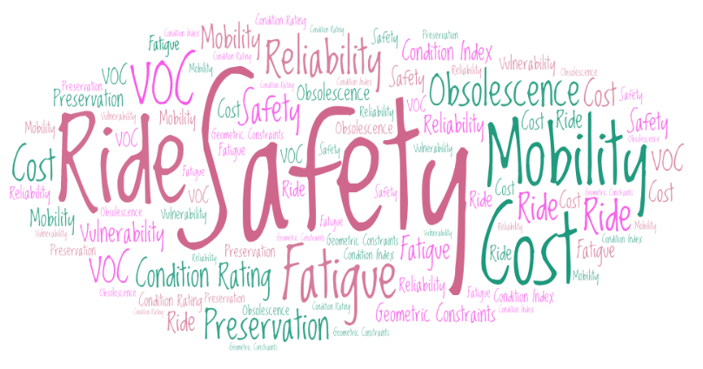
Combining & Ranking Performance Measures
Multi-Attribute Utility Functions
Direct weighting
Analytic hierarchy process
Multi-Criteria Decision Methods
Goal | Relative Weights
Preservation | 0.33
Safety | 0.33
Mobility | 0.05
Hazards | 0.12
Agency Cost | 0.10
User Cost | 0.07
Composite | 1.00
Varying Importance of Different Attributes
Synthesizing “Preferences” into a Single Criterion using weighting and scaling
NCHRP Reports 590 & 806
Adapted from NCHRP Report 590
Notes:
Multiple performance measures also indicate multiple, sometimes competing, preferences. Agencies have often used some form of a composite index to combine preferences when ranking and prioritizing projects. Pavement condition and bridge health indices are examples. However, it is observed that these indices are heavily biased to one set of factors, typically asset condition, but not sensitive enough to other factors.
We also observed issues with the sole reliance on benefit-cost ratio metrics. BCRs work well with alternative selection but BCRs have issues with prioritization of projects as BCRs do not reflect the need of a project. Amidst these challenges, the multi-attribute utility function is gaining attention as a preferred way of combining performance measures using direct weighting or pairwise comparison.
Sam Labi’s work on NCHRP Report 590 Multi-Objective Optimization for BMS illustrates how multi-attribute utility theory can be used to create a single utility function from various competing criteria. The table on the right shows an example, which was adopted and modified from an illustration in NCHRP Report 590. Besides, the cross-asset tool that NCHRP 806 developed is another example. The cross asset tool heavily relied on this approach where various performance measures from a disparate set of assets, like bridge condition, pavement IRI, crashes, jobs created, were weighted pairwise using an AHP method, scaled between its minimum and maximum values to create utility functions for each performance measure, and the resulting utility values were added. This approach will be very well handy and simple to use as we seek to combine various performance measures for LCP.

Slide 35
Enhancing the Maturity of Overall LCP Practice at each asset class level
Emerging
Strengthening
Advancing
Started to improve the overall maturity of LCP enablers
Still applying prescriptive program-level policies and practices
No decisions at an individual asset level
Making key improvements to LCP enablers
Using predictive modeling (with the aid of historical data) to make decisions at an individual asset level
Made key improvements to LCP enablers
Using predictive modeling that can incorporate the impacts of risks and uncertainties on decision-making at an individual asset level

Slide 36
Enhancing the Maturity of LCP Enablers at each asset class level
Data Requirements
Asset inventory and condition data for other assets
Maintenance costs
Hazard and asset damage history
Decision-Support /Analytical Tools
Improved asset deterioration models
Forecasting of future climate, traffic demand, and revenue
More sophisticated optimization algorithms
Technology and
Information Systems
Exchange of data with other systems, including safety, mobility, construction management, financial, and maintenance management
Design and
Construction Data
As-designed and as-built models
Construction quality
Maintenance histories

Slide 37
Implementation Requirements
Establishing a Steering Committee
Conduct Benchmark Analysis
Developing and Executing a Work Plan
Managing the Change
Establish multi-disciplinary steering committee
Develop scope and schedule
Review and approve work plans
Conduct technical reviews
Select asset class of interest
Review current capabilities
Assess gaps and improvement needs
Prioritize improvements for work plan
Fine-tune and execute work plans
Assess impacts in a testing environment
Develop a roll out plan
Update TAM plan
Internal buy-in
Communications plan
Practice Guidance
Training

