Slide 1
Risk Assessment Techniques for Transportation Asset Management
NCHRP Project 08-118
The National Cooperative Highway Research Program (NCHRP) is sponsored by the individual state departments of transportation of the American Association of State Highway and Transportation Officials. NCHRP is administered by the Transportation Research Board (TRB), part of the National Academies of Sciences, Engineering, and Medicine, under a cooperative agreement with the Federal Highway Administration (FHWA). Any opinions and conclusions expressed or implied in resulting research products are those of the individuals and organizations who performed the research and are not necessarily those of TRB; the National Academies of Sciences, Engineering, and Medicine; the FHWA; or NCHRP sponsors.
Notes:
I discuss today the National Cooperative Highway Research Program project 08-118, entitled Risk Assessment Techniques for Transportation Asset Management. This report advances the risk management state of practice by demonstrating several tools and techniques for assessing risks to the condition and performance of transportation assets.

Slide 2
Advancing the State of Practice
Prior to this report, most asset management risk publications focused on “qualitative” risk management involving input from subject matter experts (SMEs) to identify and assess risks.
This report demonstrates the use of several quantitative tools to manage risks.
Twelve studies in priority areas were tested with state agencies and are detailed, along with the methodology followed and detailed steps for implementation that an interested agency can follow.
The techniques described will help an agency quantify risks and will support trade-offs and informed decision making.
Notes:
Prior to this report, most asset management risk publications focused on what could be called “qualitative” risk management. That refers to identifying and assessing risks largely by eliciting opinions from subject matter experts (SMEs).
This NCHRP 08-118 project focusses on techniques/tools that agencies can use to augment their decision-making processes related to managing asset risks. This project reviewed US and international research on asset risk management practices, and surveyed state transportation agencies to identify the enterprise, network, and program level risk state-of-the practice. The information from these efforts served as input to identifying gaps and constraints faced by transportation agencies to implementing strategies and tools that address uncertainties at the national, state, and local level. These gaps and constraints impact the achievement of asset performance goals for bridges, pavements, and other infrastructure assets. Priority areas were identified based on the gaps and constraints and 12 studies were selected for further testing.
The figure on this page demonstrates the use of a forecasting technique called Triple Exponential Smoothing to generate a high, most probable, and low forecast for an agency’s gasoline-tax revenue. This example demonstrates how a credible, but easy-to-use, forecasting technique can quantify the uncertainty surrounding an important revenue forecast.

Slide 3
Project Objectives
1. Develop enhanced techniques to consider and evaluate asset management-related risks
2. Review effective processes to determine how existing and potential approaches can be used
3. Develop strategies and procedures for risk mitigation and response with applicable tools and tracking mechanisms
4. Develop implementation guidance, including practical tools and techniques for incorporating risk and uncertainty
Notes:
These are the project objectives.
1. Develop enhanced techniques to consider and evaluate asset management-related risks as part of investment decision-making practices, including qualitative, quantitative, and analytical methods—building on and aligning with previous and continuing research efforts in the areas of TAM and risk management;
2. Review effective processes to determine how existing and potential approaches can be used when integrating enterprise, network, and program level risk analysis. Alternative approaches should address how state departments of transportation make multi-objective, cross-asset investment decisions under uncertainty to best support national, state, and local asset performance goals for pavements, bridges, and other assets;
3. Develop strategies and procedures for risk mitigation and response with applicable tools and tracking mechanisms for transportation agencies to improve risk assessment in existing and evolving asset management business processes; and
4. Develop implementation guidance, including practical tools and techniques for incorporating risk and uncertainty, as well as possible measures of asset resilience that can be integrated into risk assessment procedures in support of national, state, and local asset performance goals.

Slide 4
Project Phases
Phase I
Incorporate results from literature review, ongoing research and legislative requirements into a set of possible approaches
Identify and assess potential risk techniques
Identify barriers and strategies to overcome
Phase II
Select priority areas to cover and develop improved strategies and tools with implementation guidance
Conduct test scenarios with the tools
Summarize lessons learned
Provide supporting materials
Notes:
The project proceeded in two phases. In Phase I we:
Conducted a literature review
Reviewed other on-going research
Examined legislative requirements
And examined the state of the practice among U.S. and international transportation agencies
Then, we identified potential risk-assessment techniques to be applied at the enterprise, network, and program level
We specifically examined how tools (techniques and guidances) could be used, including
Off-the-shelf, low-cost tools such as Excel add-ins
Bridge and pavement management systems
and, resilience-related tools that could be applicable to asset management programs
After producing an Interim Report, we moved to Phase II that consisted of:
Selecting priority areas based on constraints identified in Phase I
Developing tools and strategies for risk-based asset management decision making to address those priority areas
Documenting implementation guidance to use the new tools and strategies
Testing the new tools and strategies by using data available from State DOTs, including management systems at use in DOTs

Slide 5
Research Approach
1. Produced a literature review
2. Developed a Primer
3. Conducted interviews and surveys to summarize the current state of the practice
4. Identified risk management tools and methodologies
5. Identified constraints to implementing asset risk management
6. Prioritized tools and methodologies by their importance to asset management
7. Developed a selection process for choosing 12 studies to further develop tools and methodologies
8. Developed a testing protocol to test the tools and methodologies
9. Tested the tools and methodologies.
Notes:
More than 500 research abstracts, report summaries, books, and guidance documents were reviewed to develop a 55-page literature review. Only those relevant were summarized because most of the literature did not relate specifically to tools and techniques for risk assessment in transportation asset management. The lack of literature sources for tools and techniques for transportation asset management risk assessment reflects the observation that transportation agencies routinely consider risk, but less frequently formalize their considerations. The literature review completed for this project is included in Appendix 1 and is not further described in this report.
A Primer was developed to explain in simple terms the primary concepts underlying risk management, particularly risk management based upon modeling or statistical methods. It provides a quick refresher of risk terminology and concepts for the practitioner. It also provides for the non-practitioner a basic understanding of the concepts used in this report.
In order to understand the current state of the practice in transportation risk assessment and management, several activities were conducted following the literature review. These included:
1. A survey of state DOTs
2. Review of all 2019 transportation asset management plans (TAMPs)
3. Interviews with state DOT officials and management system vendors.
A state of the practice document was produced based upon the findings of the above activities.
Dozens of potential tools and methodologies were identified through the literature review and research into the State of the Practice. The identified tools fell into four categories:
• Inexpensive, off-the-shelf tools such as Monte Carlo simulation, or Excel-based forecasting
• The most commonly available bridge and pavement management systems
• Linking or “cross walking” climate-related risk assessment techniques to commonly used risk management techniques
• Demonstrating how risk management can influence more areas of asset management using the framework of asset management plans.
The identification of promising tools and methodologies was strongly influenced by documenting the constraints to the wider application of asset risk management that were being faced by transportation agencies. Tools were selected in part by their ability to overcome the constraints. An interim project deliverable summarized the constraints into three categories:
a. General constraints to implementing asset risk management
b. Constraints to managing climate change risks to assets
c. Wider use of management systems to address asset risks
Step 6 was to narrow down the many potential tools and techniques and to select pilot studies that best met four criteria. One criterion was whether a proposed tool or technique met or advanced the research project’s objective. The second criterion was whether the tool or technique overcame one of the constraints to implementation that was identified in the research. The third criterion was whether the tool or technique helped to assess risks to a core asset management process, such as identifying high-risk bridge and pavement assets, or integrating risk into TAMPs. The fourth was whether the tool or technique would be widely available to State DOTs. The tools and techniques selected for piloting included off-the-shelf tools, the most widely used bridge and pavement management systems, and tools available from FHWA.
Meeting those four criteria were pilot studies for 12 tools or techniques that were advanced in Phase II.
Step 7 was to develop a study protocol for all 12 selected pilots. The following protocols were identified to be followed for the 12 tools or techniques piloted in Phase II. Most of the studies identified and followed the format below:
a. Objectives of the study
b. Description of the strategy/tool that was tested
c. Methodology used in conducting the pilot
d. DOT organizational unit engaged in the pilot
e. How and who in the DOT could use the pilot
f. What is the benefit of the pilot for a DOT?
g. How difficult is it to set up the pilot and to use it?
Step 8 was to develop test protocols to test the 12 tools or techniques, usually with State DOT data.
Step 9 was to test the tools and methodologies with State DOTs or with real-world data and then to document the findings. Pilot State DOTs were selected for testing based upon agency practices identified in the literature review, the state of the practice, or through the project team’s experience. Key to this project is the step-by-step instructions on how to use the tools so that other State DOTs can avail of them.

Slide 6
The Primer
The primer provides a quick refresher of risk terminology and concepts.
It also provides for the non-practitioner, a basic understanding of the concepts deployed later in this report.
The primer explains the fundamental principles behind quantified risk management that are commonly used by risk and asset managers.
Notes:
We produced for this project a primer that focuses primarily on the mathematical and statistical concepts underlying quantitative risk assessment. The primer provides a quick refresher of risk terminology and concepts for the practitioner who may not have studied these concepts for many years. It also provides for the non-practitioner a basic understanding of the concepts deployed later in this report. Key concepts contained in the primer are summarized in this section.
The primer explains the fundamental principles behind quantified risk management that are commonly used by risk and asset managers in the private sector, and which are applicable to transportation agencies. Most of the concepts in the primer will be familiar to anyone who has taken courses in microeconomics, modeling, optimization, asset management, and some aspects of engineering. The primer is intended to refresh readers with these concepts and relate those commonly understood concepts to risk assessment.
The graphic on this slide is of a probabilistic decision tree that is one of the examples from the primer. In this case, the simple decision tree illustrates the costs and probability of impacts from a build/no build decision for a culvert. It uses the concept of the Expected Value, which is the value of a cost or benefit discounted by the probability of the cost or benefit actually occurring. In this case, it illustrates the cost of annualized culvert maintenance versus a no-maintenance alternative and the potential cost of the culvert failing because of a lack of maintenance. In this example, the cost of annual maintenance is greater than the annualized cost of having a culvert washout. So, in this example, annualized maintenance would not be justified. The primer illustrates the basic concepts that allow for these kinds of risk-based tradeoffs.

Slide 7
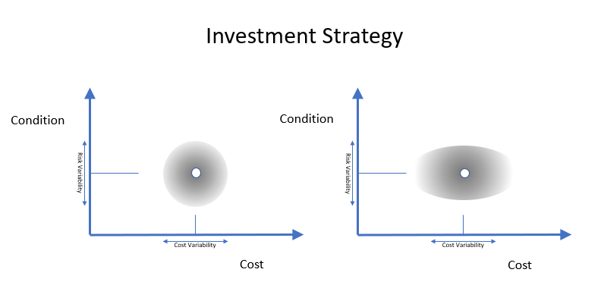
State of the Practice
The State of the Practice reviewed effective processes to determine existing and potential approaches to risk management.
It involved a review of all 2019 TAMPs, a survey of state agencies and interviews with selected state agencies.
The State of the Practice summarized legislative requirements and prevalent risk management practices.
It also summarized the current state of bridge and pavement modeling that supports risk-based tradeoffs and risk prioritization.
Notes:
The State of the Practice reviewed effective processes to determine how existing and potential approaches can be used when integrating enterprise, network, and program level risk analysis. The State of the Practice reviewed effective processes by summarizing the legislative requirements, the risk management practices as documented in the states’ transportation asset management plans and interviewing selected state agency officials who indicated they had notable risk management practices. It also summarized the current state of bridge and pavement modeling that supports multi-objective, cross-asset investment decision making under conditions of uncertainty.
The State of the Practice assessment resulted in several conclusions that directly led to the tools and approaches developed in later stages of the project. The conclusions included:
• The FHWA asset management plan requirement in 23 CFR Part 515 led all states to assess risks to their assets which gave the states at least a basic level of risk management understanding.
• However, risk management often was limited to one section of TAMPs and did not appear to be ingrained into states’ overall asset management practices.
• Interest in managing risks from climate change is growing as many states are developing tools.
• However, risk management and climate risk assessment were developing on separate paths.
• States were not using the latent ability of bridge and pavement management systems to assess risk.
• Management systems were used to assess conditions, not risks.
The graphic on this slide illustrated how risk techniques could document that most forecasts are actually “fuzzy” and not certain. This graphic illustrates that estimates of how much needs to be spent to achieve a given condition target is often presented as a specific amount. However, there are so many variables around such forecasts that it may be more accurate to show needed investment levels as a “fuzzy” range. Also, the conditions achieved by the expenditure also is uncertain, or “fuzzy.” The State of the Practice Section described how bridge and pavement management systems could be used to illustrate the amount of uncertainty that surrounds such investment forecasts.

Slide 8
Constraints to Implementation
General constraints to wider use of asset risk management include:
A lack of resources, guidance, training, or formal processes at the state or national levels
Lack of history on tools and techniques or widespread use of quantitative tools
No consequences for failure to implement risk management
Constraints to managing climate risks
Lack of understanding of how to use climate data
A sense that climate threats are not immediate
Terminology differs between climate threat analyses and traditional risk management
Difficulty in quantifying risks and consequences
Future risks not accounted for in Standard designs
Lack of funding
Constraints to wider use of management systems to assess risks
Lack of framework, examples of such applications, and a lack of training on how to perform those analyses
Notes:
General constraints to wider use of asset risk management include a lack of training and definitive guides. Expanded use of climate risk assessment is constrained by a lack of understanding of how to use climate data, a sense that climate threats are not immediate, and that terminology differs be-tween climate threat analyses and traditional risk management. Constraints to wider use of management systems to assess risks include a lack of examples of such applications, and a lack of training on how to perform those analyses. The 12 studies pursued in the later stages of this project respond directly to those constraints.
The nine general constraints to implement asset risk management included:
• Risk management is in the early stages of maturity in State DOTs. At the time of this research, there were no guides and manuals on enterprise, network, and program-level risk management of assets that can help agencies systematically implement asset risk management. (The NCHRP 08-93 project produced an enterprise risk management guide that uses some asset risk management examples, but it is not a guide dedicated to asset risk management.)
• The history of risk-based asset management in the U.S. is limited and states do not have many examples to emulate.
• A major constraint is a lack of a concerted, national implementation effort, like the NCHRP Active Implementation Framework.
• No widespread use of existing tools for asset risk management.
• Lack of widespread use of quantitative, probabilistic, or stochastic risk-assessment tools.
• Lack of training on effectively using existing tools for asset risk management.
• Lack of formal risk management process for managing assets.
• Currently few examples exist of states that have legal imperatives to implement asset risk management.
• There are few consequences for failing to manage risks.

Slide 9
Selecting, Testing Tools, Strategies
Based on the Literature Review, Primer, State of the Practice and Constraints, the project selected 12 studies
1. Deterministic Tools to Forecast Revenues at a DOT.
2. Using Probabilistic Tools to Forecast Revenues and Costs at a DOT.
3. Developing a Bridge Utility Index: Demonstrating how a risk index can be constructed and calculated.
4. Demonstrating an Asset Level Risk Index for Pavement Flooding.
5. Demonstrating an Asset Level Risk for non-NBIS Culverts.
6. Asset Level Risk Index – Landslide Hazard Management.
7. Program Level Risk – Pavement Network Analysis.
8. Program Risk – Bridge Network Analysis.
9. Crosswalk between Climate Vulnerability and Risk Terminology.
10. Providing a Decision Tree for Selecting Climate Risk Strategies.
11. Institutionalizing Risk Management.
12. Probabilistic Decision Tree for Risk Assessment.
Notes:
Twelve studies were adopted as best meeting the research project’s objectives based on the:
Primer
Literature review
State of the practice
Identification of tools, and
Identification of constraints to adoption
Those 12 are listed here.
Next, I will briefly go through each one.

Slide 10
Deterministic, Probabilistic Forecasting
Studies and 1 and 2 were complementary
Study 1 produced a deterministic revenue forecast
Study 2 used probabilistic tools to forecast revenue
State revenue data from the Vermont Agency of Transportation was used
The studies demonstrate the use of these techniques to create forecasts along with uncertainty in the forecasted values
Notes:
State transportation agencies are required to prepare financial plans for their 10-year Transportation Asset Management Plans. These plans need to include forecasts of investments needed, the corresponding bridge and pavement conditions, and the revenues the agency expects to receive during the forecast period. Federal regulations also require TAMPs to be risk based and to include mitigation strategies for the high-priority risks.
While agencies and legislatures may have control over taxes, allocations, stimuli, etc. that can influence revenues, they have no control over numerous other factors, such as, inflation, construction costs, prices of essential inputs such as steel, cement and fuel, other economic factors such as recessions, and as recently evidenced – a pandemic.
While preparing forecasts, agencies need to account for the associated uncertainties and communicate such uncertainties and the resulting implications to their stakeholders.
Study 1 and Study 2 focused on testing general approaches to using deterministic and probabilistic forecasts, respectively, for key asset management variables to manage asset risks. For testing, forecasting revenues from State sources at the Vermont Agency of Transportation (VTrans) was selected. The same data was used to forecast using the two (deterministic and probabilistic) methodologies, and the discussion and findings for both approaches are presented so that the differences between the two can be conveniently compared and assessed.
The objective of this study was two-fold. First, to illustrate deterministic and stochastic methods that can be used to forecast State Revenues. A selection of tools, from a simple deterministic model to more complex autoregressive models such as Triple Exponential Smoothing (ETS - available in Excel) and probabilistic analyses using Monte Carlo simulation were utilized for the pilot effort.
Secondly, to demonstrate how the uncertainty surrounding forecasts of various components of State Revenues can be illustrated using confidence intervals. An informed understanding of the band of likely values for the different components of State Transportation Revenues can help agencies plan for the investments they need to make to achieve bridge and pavement conditions commensurate with expected costs and available funding. It can also help them to communicate these uncertainties and the associated implications to stakeholders, help them manage their assets optimally, and set expectations of likely outcomes that are consistent with the funding available to them.
This pilot study was conducted in conjunction with SMEs and leadership from VTrans who have knowledge about the financial data, and analysts from the Vermont Legislative Joint Fiscal office who monitor the annual state revenues. In general, for revenue projections, it is important to have representation from the agency finance experts, and information and input from the state level financial analyst or an agency representative with knowledge about state level revenues and assumptions.
The methodology detailed in this pilot can be used to incorporate uncertainties associated with financial forecasting in many areas of a DOT. Depending on the area of application, subject matter experts with the appropriate understanding of the financial data should be engaged.

Slide 11
Deterministic, Probabilistic Forecasting
Forecasts were prepared using a simple deterministic technique and probabilistic techniques using off-the-shelf, Excel-based tools (triple exponential smoothing and Monte Carlo simulations).
Uncertainty in forecasts were illustrated through confidence intervals.
Projections using the different tools were compared, benefits and limitations discussed.
Notes:
Forecasts were prepared using a simple deterministic technique and probabilistic techniques using off-the-shelf, Excel-based tools (triple exponential smoothing and Monte Carlo simulations).
Uncertainty in forecasts were illustrated through confidence intervals.
Projections using the different tools were compared, benefits and limitations discussed
The chart shows that the forecasted values are generally consistent across the three methods. The deterministic method does not provide any estimate of uncertainty, whereas the projected 95 percent confidence interval is computed in the case of the ETS and Monte Carlo methods. Although an illustrative example of computation of a confidence interval for deterministic forecasts was provided in the discussion above, state agencies will need to establish an applicable means to forecast uncertainty through internal discussions and feedback from SMEs. Impacts from potential legislative actions will need to be separately accounted for. The graphic shown on this slide shows the forecasted Total Revenue to Vtrans from State sources using a deterministic method and the ETS and Monte Carlo methods. Confidence intervals computed by the ETS and Monte Carlo methods are also shown. The deterministic method computes single values for each year of the forecasted period without a confidence interval. Though this graphic does not show a confidence interval for the deterministic forecast, an approach for estimating confidence intervals for such forecasts is also discussed in the report, although it is advisable for agencies to obtain SME input when estimating confidence intervals.

Slide 12
Study 3: Bridge Risk Utility Index
This pilot illustrates the example strategy for analyzing risk in an existing BMS.
It shows how a risk index can be constructed and calculated, and then forecasted over time under scenarios with different funding levels for all applicable structures using an existing BMS.
It was tested in Kansas DOT, which uses an off-the-shelf, commercially available bridge management software.
Notes:
This pilot illustrates a strategy for analyzing bridge risk using an existing BMS. This pilot was completed in the Kansas Department of Transportation (KDOT) bridge management system (BMS.) It shows how a risk index can be constructed and calculated, and then forecasted over time under scenarios with different funding levels using an existing BMS. KDOT uses an off-the-shelf, commercially available bridge management software.
The strategy discussed in the KDOT pilot is applicable to any configurable BMS that can accommodate formulae for the construction, and further use of complex indices. The risks analyzed and the expected implementation effort for the pilot are:
• Threats from structural failure due to fracture critical design, failure due to scour criticality or waterway adequacy during flood events and issues related to posting and rail safety.
• Consequences from bridge closures due to events or incidents and possible safety issues.
The objective of this pilot was to use an agency’s existing BMS to test the incorporation of bridge risk into a utility function, calculate and forecast the bridge risk for each structure in the network, and hence forecast the overall risk carried by the network bridge population under different funding levels. Once incorporated, the risk utility function can be an integral part of the bridge management process. Notably, the risk utility function can be used to analyze and inform specific risk mitigation decisions using the BMS. For example, by being able to evaluate and project the risk for bridges within the agency, high risk bridges or groups of bridges can be identified for mitigation actions.
Depending on the maturity of the BMS within the agency, personnel within the agency’s bridge management group should be able to define risk mitigation actions that decrease the risk to individual structures. If these mitigation actions were incorporated into the BMS, the system would be able to use these actions in its overall benefit cost optimization to include risk mitigation projects in the overall bridge work plan. This will ultimately help agencies to better manage risk of bridge closure due to scour and other event related closures .
The figure on this slide shows the forecasted risk utility index components of the overall bridge utility under two funding level scenarios. The X axis shows the years of the analysis period and Y axis shows the Average Risk Utility for the bridge network. As the risk due to the factors considered in the pilot decreases the Risk Utility increases. Thus, over the analysis period, the forecasted risk improves (utility trends higher) more for the $250 M scenario than for the $125 M scenario as expected.

Slide 13
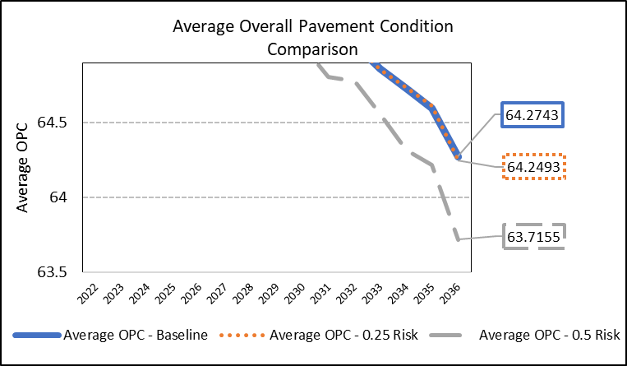
Study 4: Flooding Risk
The study performed with Delaware DOT’s existing PMS illustrates defining a risk index for a pavement section for risk from Floods, sea level rise, tides, short surge.
It calculates and compares overall pavement conditions (OPC) and risk estimates in dollars under different scenarios of minimizing risk and maximizing pavement condition with different risk mitigation treatments
Notes:
The objective of this pilot was to demonstrate the use of a pavement section level risk index that incorporates a pavement section’s risk of being flooded due to storm events, sea level rise, high tides, or storm surge using an existing PMS. This study was piloted using the existing PMS in place at DelDOT which may vary from PMSs implemented in other states. Using the methodology presented here, pavement managers can evaluate flood risk for pavements, incorporate these risks into decision making, and target high risk pavements for mitigation actions. Depending on the maturity of the PMS in an agency, risk mitigation actions can be identified and incorporated into a benefit cost optimization. This study piloted the methodology in DelDOT’s PMS to include flood related pavement risks in the overall pavement work plan to better manage risks to pavements.
The pilot was conducted with the Delaware Department of Transportation (DelDOT) pavement management system. The risk and consequence addressed in this pilot and implementation effort are:
• Threats form flood events, sea level rise, high tides, storm surge and hurricanes.
• Consequences are the roadway becomes impassable due to the flooding
This pilot incorporated risk into the objective function (i.e., the overall ‘benefit’ being maximized) in the optimization performed by the PMS. This pilot used existing national flood risk data to demonstrate the impact of flooding. This data was used to exhibit the incorporation of national risk assessments that have a bearing on roadway closures.

Slide 14
Study 5: Small Culvert Risk
This proof-of-concept study demonstrated a risk index for small culverts using data from North Carolina DOT
The risk to culverts could be included as a programming or project-selection factor
The analysis was conducted with a pavement management system
The Total Risk (in $) was computed and compared for “do nothing” and “mitigation” scenarios
Notes:
This study, though not piloted with a DOT, used the data from the North Carolina DOT (NCDOT). It illustrates an example of the development of a culvert risk index for small (non-NBI) culverts. The methodology was developed for implementation in a configurable PMS . The scenario and guidance developed for testing include the following:
• Threats from flood events and hurricanes impacts on culverts
• Consequences of the roadway becoming impassable due to non-NBIS culvert failures from washouts or flooding
The objective of this proof-of-concept study was to demonstrate a risk management methodology for managing the vulnerability of non-NBIS culverts and risks to associated portions of roadway due to washouts and/or flooding during storm and hurricane events. This proof-of-concept was developed for application in an existing pavement or general asset management systems. Similar to the pilot study for pavement section flooding, this study was conducted at the asset level and illustrates the methodology for defining an asset level risk index for use in a DOT’s PMS. Non-NBIS culverts for the purposes of this study generally include pipes and culverts greater than 48” in diameter and below the threshold of a bridge (20’ measured along the centerline of the roadway. The assumption in this case was that roadway washouts or flooding would most often take place along streams, creeks, or drainage ways where small culverts are placed.
This study used existing inventory and condition data collected for non-NBIS culverts to assess vulnerability of these structures to flood events. This vulnerability rating could then be combined with identified threat probabilities and consequences to create a risk index for each structure. Like the Pavement Section Risk study, the implementation of the process outlined in this study takes advantage of any existing vulnerability assessments that the agency has already conducted or is conducting.
Once the index is developed, the study exhibits a proposed method for incorporating risk into an existing PMS by aggregating the risk index values into a section culvert risk index for all culvert locations on a pavement management section. Alternatively, the index could be incorporated into a general asset management system where each culvert location would represent an individual asset.
The output from this study was a risk index, both at the asset level (road section) and summarized at the network level, indicating risk due to non-NBIS culvert failure during storm events. The ideal outcome of implementation would be a set of optimized strategies for the culvert locations (or road sections) that show if and when mitigation actions should be taken to minimize the risk and/or consequence of washouts or flooding. These output strategies would be accompanied by long term forecasts of risk level over time.
Agencies could use this methodology to incorporate culvert washout and flooding risk management into project and funding decisions. Additionally, the study could be useful to those involved in developing and implementing the TAMP and in integrating risk into asset management decisions. With extreme weather becoming a national challenge, this methodology could be helpful to agencies in conducting, planning for, and budgeting for projects to improve network resiliency.

Slide 15
Study 6: Landslide Hazard Index
This proof-of-concept study demonstrated a rockfall landslide hazard index.
The study capitalized on existing West Virginia DOH slope failure hazard data
The hazard data was integrated into PMS and used to develop risk hazards for pavement sections
The risk index was computed and compared for the “do nothing” and “mitigation” scenarios
Notes:
This study developed a risk index based on a vulnerability study project performed for West Virginia Department of Highways (WVDOH) on landslide hazard management. In this example approach, a risk index was calculated using a set of surveyed data provided by WVDOH pertaining to both likelihood and consequence of a slope failure that may result in closure of the road while emergency repairs are carried out.
Like other asset level studies discussed earlier in this report, the methodology in this study takes advantage of any existing vulnerability assessments on landslide hazards that the agency has already conducted or is in the process of conducting. The landslide hazard index previously developed by Marshall University was used in this proof-of-concept. This study took the assessment and exhibits how it could be incorporated into an existing PMS by aggregating the risk index values into a section landslide hazard risk index for all landslide hazard locations on a pavement section.
Alternatively, the study exhibits how the risk index values could be integrated into a general asset management system where each landslide hazard location would represent an individual asset. Once incorporated into the management system, the landslide risk index for each location could be used to select projects that address the mitigation based on benefit cost analysis.
The results of this analysis could be used by the group and decision makers responsible for landslide hazards management within the agency. With the reduction of highway fatalities being a high priority in every transportation agency, the areas in the agency involved in program and project prioritization could use the analysis results to augment decisions on safety projects. For states where such hazards are a high priority (example, Vermont) the results could help an agency plan the short and long-term management of rockfall and landslide hazards.

Slide 16
Study 7: Network-level Pavement Risk
Demonstrated program-level pavement risks based on variations in inflation rates and funding levels
PMS used to forecast pavement conditions under 3 scenarios of risks using data from ITD
An optimistic inflation rate and funding level
An expected inflation rate and funding level
A worst-case inflation rate and pessimistic funding level
Notes:
The objective of this pilot study was to demonstrate a real-world example of the analysis of pavement program level risk by forecasting condition based on high, expected, and low extents of program level variables using existing tools. Creating an expected “envelope” of predicted average network condition can better inform decision makers about the risks to the network. The study looked at variation in inflation rates and unplanned changes to funding levels.
The results of this study would provide additional resources for decision-making at a high level within the agency. It was important to consider fluctuation in high-level parameters that cannot be accurately predicted so that tradeoff decisions could be made. This study technique could be implemented for a variety of potential impacts to the network including the following examples:
• Unexpected weather could increase the need for funds to repair or mitigate impacts. The strategy exhibited in this study could be used to determine the impacts of moving funding from the pavement management program. Examples include flood events or tornados, and longer than expected snow and ice season, etc.
• Increased construction costs could reduce the number of projects that can be contracted and reduce the spending power of the originally projected funding level. The approach used in this study helps account for this scenario by projecting the future funding levels required to maintain the current level of service with potential increases in construction costs.
In this study, the Idaho Transportation Departments (ITD) PMS was used to forecast network level pavement condition for three scenarios. Scenarios were defined by different levels of variables at the program level including inflation rates and available funding levels. The variables were selected due to their associated uncertainty. An agency could define additional variables that are at risk of varying significantly or are at risk of significantly impacting the network condition. A typical PMS should be configurable to account for change in defined variables.
ITD based its pavement conditions on an Overall Condition Index. This analysis showed the overall network condition in 2030 to be an 82 out of 100 in the best-case scenario and only 75 in the worst-case scenario. The results allow decision makers to frame, or put an envelope around, the amount of risk that surrounds expected inflation and funding levels.

Slide 17
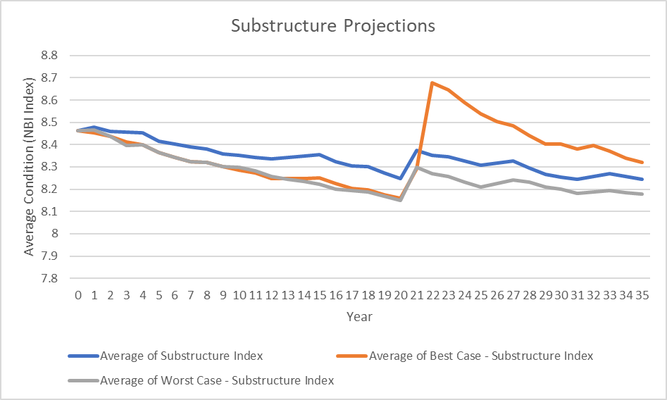
Study 8: Network-level Bridge Risk
Demonstrated program-level bridge risks using data from the City of Durham, NC
BMS used to forecast bridge conditions under three scenarios of funding
Illustrates how much risk surrounds those assumptions.
The analysis showed that the condition worsened in all three scenarios.
Notes:
The objective of this study is to demonstrate an example analysis of program level funding risk by projecting bridge condition over time based on different funding.
The results of this study would provide high level information on bridge resources needed for decision-making within an agency. In conjunction with other program level data for other asset groups, these results could inform cross-asset tradeoff decisions.
This study could be implemented in an existing management system. The approach explored forecasting network level bridge condition over time for several scenarios involving the threat of variability in program level input factors. These threats are the input variables that are selected for the study. This study proposed the use of existing BMSs or any asset management systems as a tool for assessing these threats. Examples of variables that can be used as input to the study include inflation rate, available funding levels, and adjusted deterioration models.
This study is based on data from a smaller agency, the City of Durham, NC. The City of Durham does not necessarily have a fixed structures budget per year and needs to run analyses that look at how best to spend the overall available funds across multiple years. The base data available consisted of a population of 40 NBIS bridges and culverts that are inspected regularly. Thus, inventory and condition data were available for the 40 bridges and used in this study. The scenario level input data to the analysis in this case consists of identifying best, expected, and worst-case average funding levels per year. The funding levels selected for this study were:
• Expected funding level: $317,000 per year average.
• Best case funding level: $360,000 per year average.
• Worst case funding level: $265,000 per year average.
This indicates that even under the optimistic funding level considered in this study, the substructure condition was trending downwards. If these were actual funding values used by the agency, they would show that the funding allocated may not be sufficient to maintain condition over time. As part of the study, specific projections are shown of the deck, superstructure, substructure, and culvert NBI ratings for three specific scenarios including expected, best-case, and worst-case average funding levels. The figure shows the example results for the average substructure condition for three scenario for substructure conditions. IT shows that the substructures had worsened in condition by the end of the 35-year analysis period in all three funding scenarios.

Slide 18
Study 9: Crosswalk between Climate Vulnerability and Risk Terminology
Guidance on translating climate vulnerability terms to risk terms
Risk guides focus on likelihood and impact
Vulnerability focuses on exposure and sensitivity
This provides a common rubric for both
Notes:
The objective of this pilot was to develop guidance for agencies interested in assessing the climate risks, but not sure how to apply the FHWA (2017) Vulnerability Assessment and Adaptation Framework to create outputs that tie into other risk assessment and risk management processes at the agency.
Draft guidance was prepared including summary text, tables, and graphics that explained how the terminology often used in climate change vulnerability assessments (e.g., exposure, sensitivity, and adaptive capacity) compares to terminology used in other risk assessments (such as likelihood, consequences). It also explains how to translate the information collected in a typical climate change vulnerability assessment output into risk information that would be comparable to other risks. In addition, the guidance included an approach to evaluate the likelihood of climate changes so that they can be evaluated relative to other risks.
With the rubric, agencies could scale up or down or modify the timeframe of analysis as needed. This guidance included in this study is applicable to any climate change and extreme weather threats. This includes rising temperatures, changing precipitation, sea level rise, severe storms, flooding, and wildfires.

Slide 19
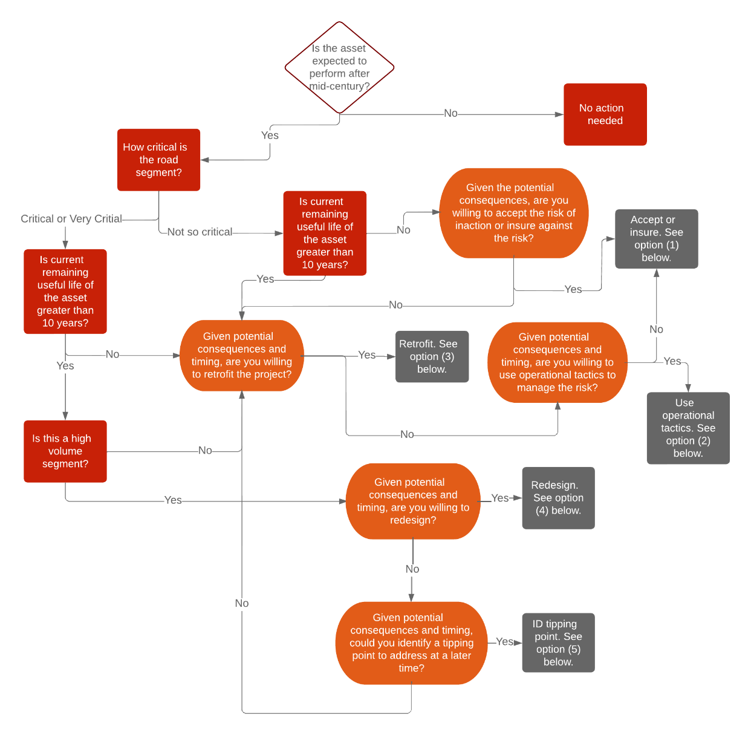
Study 10: A Climate-Risk Decision Tree
Demonstrated a decision tree for pavements at risk due to higher temperatures
Variables to be considered could be:
Pavement age
Condition
Route importance
Available funding
Expected timing of the risks
The tree aids in risk-based decision making
Notes:
This study developed a decision tree for pavements that are subjected to higher temperatures to provide a process for DOTs to decide on the best approach to manage climate risks impacts in upcoming projects as it enters the planning and design pipeline. For example, if the structure has a long remaining service life but is highly critical and already vulnerable, a replacement may be logical, whereas a structure with a short remaining service life but is at high risk from sea level rise in the coming decades could be a candidate for redesign upon natural replacement.
The guidance walks DOTs through considerations including asset lifetime, expected timing and severity of impacts, planning horizons, and available staff or funding resources to choose from available risk management options. The types of risk management options include developing and applying adaptive management techniques, accepting the risk, insuring against the risk, operational tactics to manage disruptions, or engineering solutions to protect against the threat.

Slide 20
Study 11: Institutionalizing Risk into TAMPS
Summary of 10X Structures
 | Number | Area
10X Structures | 121 | 1,443,789
10X as % of All Structures | 0.9% | 20.3%
10X Poor | 7 | 109,212
% 10X Poor Compared to all Poor Structures | 1.06% | 38.3%
10X Structures Rated Condition State 5 | 27 | 358,932
All Structures Rated 5 | 1,719 | 1,453,739
10% Structures as % of All Structures Rated 5 | 1.6% | 24.7%
Demonstrated how the results of risk analysis can be used to highlight importance of managing risks to high-priority assets.
In this case, large bridges that are 10 times the average size from Minnesota DOT were analyzed
These constitute 1% of all bridge area but 38.3 percent of all Poor bridge area at MnDOT
They present disproportionate risks
The study provided recommendations for incorporating risks to 10X structures in every section of the TAMP.
Notes:
This study illustrates an approach that can be used by transportation agencies to analyze risks to high priority critical assets and highlight the importance of managing them by incorporating risk management strategies into every section of its asset management plan. For risk management to be used consistently to improve the management of assets, its use must be institutionalized within transportation agencies. If it is not, the use of risk management could wane as individual advocates and subject matter experts retire or move into other positions. The study builds from NCHRP’s Active Implementation framework which states that innovations must be ingrained or institutionalized into the policies and processes of an agency for the innovation to be sustained. Otherwise, use of the innovation could be short-lived and confined to a few advocates within the agency without achieving enterprise-wide application. This study used large bridges as an example to illustrate how to ingrain risk management into every section of a TAMP.
This study focused on Minnesota Department of Transportation (MnDOT) bridges that are 10 times the size of the average Minnesota NBI structures. This study illustrates how large structures that are in Poor condition represent a risk to sustaining condition targets, supporting freight mobility, and financing bridge investment strategies. In past TAMPs, DOTs have addressed risk in only one section that focuses on risk management. This study shows how an agency can bring additional focus by addressing risk in all eight sections of the TAMP. The strategy detailed in this study can be applied to other assets and asset classes. Instead of large bridges, an agency may face risks from assets at risk of sea-level rise, or from slope failures, or failing to meet performance targets. By focusing on assets that create risks to performance, the study expands how risk to assets is addressed beyond the risk management section of the TAMP.
For this study, a subset of structures that have a deck area of more than 10 times (10X) the average size of all structures was selected. The table includes a summary of the 121 10X structures. It shows how they disproportionately contribute to the total percentage of Poor and to structures that have a condition rating of 5. Although the 121 10X bridges are less than 1 percent of all structures, they are 20.3 percent of all structures by deck area. They comprise 38.3 percent of all Poor structures by deck area. They are 24.7 percent of all structures that are in condition rated 5, that are of longer-term concern. Bridges in condition rated 5 may deteriorate to Poor condition within one or two decades if not treated. Bridges are rated on a 0-9 scale as defined in the NBI guide with 9 being a new bridge and 4 and below being rated Poor.
The study demonstrate how such at-risk structures could influence all TAMP sections from the setting of targets, to analysis of gaps, identification or risks, adoption of life-cycle strategies, and the selection of investment strategies. The study demonstrates that risk can be an influence on all areas of asset management.

Slide 21
Study 12: A Probabilistic Decision Tree
Demonstrated an off-the-shelf tool to assess risks to adopting a chip seal program
The study used Puerto Rico data to demonstrate the risks and potential benefits of considering a new treatment process
Notes:
The objective of this study was to utilize an off-the-shelf tool available for risk-based decision-making using data available from DOTs. When faced with the prospect of deciding on a pavement treatment option to be selected from multiple options, each with different costs and uncertainty in results, the utilization of an easy-to-use analytical tool to evaluate the options, expected costs/benefits, and probabilities of success to arrive at the most cost-effective option can be very helpful to DOTs.
The tool utilized for this study was the decision tree tool. It was applied to the problem of deciding whether to utilize a chip-seal treatment plan for a pavement during a 10-year TAMP period versus a more expensive, albeit a longer life option treatment of resurfacing with thin asphalt overlays. Cost and pavement condition data from the Puerto Rico Highway and Transportation Authority (PRHTA) was used for the decision tree analysis along with pertinent data from other State DOTs. The data from PRHTA was chosen because PRHTA currently does not perform chip-seal treatment. An evaluation of available pavement performance data showed that nearly 29% of the non-NHS lane miles managed by PRHTA are eligible candidates for chip-seal treatment. At an estimated savings of approximately $36,000 per lane mile over a 10-year period, performing chip-seal treatment could translate to approximately $86 million in savings during this period. This is a substantial amount for the cash-strapped DOT, making the current analysis a relevant one for PRHTA. Since the analysis incorporates probabilities for success of uncertain chance events, the output represents a risk-based analysis.
However, Puerto Rico and its construction industry have no experience with chip seals. If applied improperly or to the wrong pavements, the chip seals could perform poorly. Poor performance could waste money, lead to lower pavement conditions, and perhaps discourage the use of these treatments that could save money. Poor performance of early treatments could lead to a lost opportunity for the island.
The figure shows the cost and probability data entered into the decision tree in color-coded boxes. The green boxes contain the costs of the different alternatives per lane mile. The blue colored boxes at the right side of the figure show the total cost of each branch per lane mile. These are computed by summing the costs in the green boxes to the left following that branch all the way to the left-most decision node.
This study demonstrated how the various scenarios of success and failure of a chip seal program could be demonstrated in a decision tree. Each node of the treat demonstrates the potential costs, savings, or losses if different options succeed or fail. The decision tree also can highlight the sensitivity of potential options. In this case, the tree also highlighted the importance of training to reduce the likelihood of chip seals failing.
A tool such as this can help illustrate the potential savings, costs, and risks facing a new undertaking.

Slide 22
Conclusion and Benefits of NCHRP 08-118
Illustrates the use of deterministic and probabilistic forecasting techniques to incorporate and communicate risk into forecasts
Quantifies the probability of threats
Prioritizes at-risk assets, such as culverts or roadway sections threatened by storm events
Assigns values, or “utilities,” to risk so that investment tradeoffs can be made
Integrates risk into more asset management processes, such as those described in asset management plans
Links climate change and resilience assessments to risk management practice so that resilience risks can be considered along with other risks to asset performance.
Notes:
The tools and techniques developed in this project build on earlier NCHRP products such as the NCHRP 08-93 project Managing Risk Across the Enterprise, A Guide for State Departments of Transportation. That guide emphasized “qualitative” risk management, or the assessment of risks based largely upon expert judgment. The NCHRP 08-36/Task 126, Development of a Risk Register Spread-sheet Tool provided an Excel-based common risk register for State DOTs. The NCHRP 20-24 (105) project developed a workshop and a “how-to” guide for agency executives interested in launching risk management programs. The tools and techniques developed in this project also elaborate and demonstrate the recommendations in NCHRP 20-07 Task 378 Final Report that demonstrated development of bridge utility indices.
The studies included in this report demonstrate additional techniques to advance the state of practice in managing risks to assets. They:
• Illustrate the use of deterministic and probabilistic forecasting techniques to incorporate and communicate risk into forecasts
• Quantify the probability of threats
• Prioritize at-risk assets, such as culverts or roadway sections threatened by storm events
• Assign values, or “utilities,” to risk so that investment tradeoffs can be made
• Integrate risk into more asset management processes, such as those described in asset management plans
• Link climate change and resilience assessments to risk management practice so that resilience risks can be considered along with other risks to asset performance.

