Slide 1
This presentation is supplemental to NCHRP Research Report 1071: Application of Big Data Approaches for Traffic Incident Management (NCHRP Project 03-138). The full report can be found by searching for NCHRP Research Report 1071 on the National Academies Press website (nap.nationalacademies.org).
The National Cooperative Highway Research Program (NCHRP) is sponsored by the individual state departments of transportation of the American Association of State Highway and Transportation Officials. NCHRP is administered by the Transportation Research Board (TRB), part of the National Academies of Sciences, Engineering, and Medicine, under a cooperative agreement with the Federal Highway Administration (FHWA). Any opinions and conclusions expressed or implied in resulting research products are those of the individuals and organizations who performed the research and are not necessarily those of TRB; the National Academies of Sciences, Engineering, and Medicine; the FHWA; or NCHRP sponsors.

Slide 2
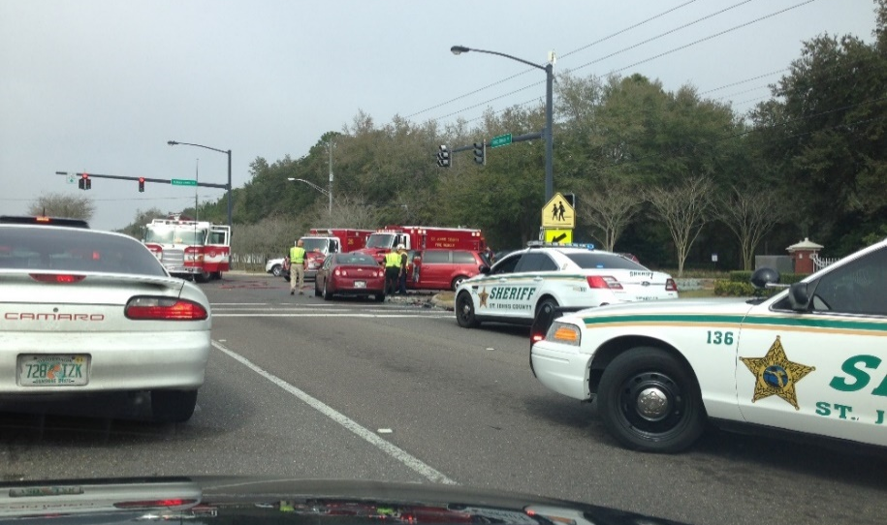
NCHRP Research Report 1071: Application of Big Data Approaches for Traffic Incident Management (NCHRP Project 03-138)
March 2023

Slide 3
NCHRP Project 03-138
Objectives
Demonstrate the feasibility and value of big data approaches to improve TIM.
Enhance and refine big data guidelines presented in NCHRP Research Report 904.
Background
NCHRP Research Report 904: Leveraging Big Data to Improve Traffic Incident Management (published 2019):
  Researched and described the state of practice of big data.
  Assessed a wide range of existing and emerging data sources relevant to TIM.
  Identified potential big data opportunities to advance the TIM state of practice.
  Explored potential challenges for transportation agencies and TIM programs to leverage a big data approach.
  Developed big data guidelines for agencies and TIM programs.

Slide 4
Overview of Approach and Final Report
Organization of Final Report
Chapter 1: Introduction
Chapter 2: Gather Information and Data and Define Use Cases
Chapter 3: Datasets and Data Quality
Chapter 4: TIM Big Data Use Cases
Chapter 5: Estimated Costs of Cloud Environments and Data Pipelines
Chapter 6: TIM Big Data Guidelines
Chapter 7: Conclusions and Recommendations
Research Approach
Conducted interviews and identified potential TIM big data use cases.
Gathered and assessed data to support use cases.
Created pilot TIM big data pipelines and data outputs/ products.
Developed TIM big data guidelines.

Slide 5
Conduct Interviews and Identify Potential TIM Big Data Use Cases
Potential Use Cases Identified
Improving data management (data organization, sharing, and integration)
Improving incident detection (identifying unexpected slowdowns)
Expanding TIM timeline/performance measures (tracking arrivals/departures of responders)
Developing a better understanding of secondary crash occurrence
Predicting likelihood of responder struck-by crashes
Selecting/recommending alternate routes
Third-party data validation (identifying supplemental relevant data)
Machine learning applications (queue prediction)
Organizations Interviewed
  Arizona DOT
  Colorado DOT
  Federal Highway Administration
  Georgia DOT
  Iowa DOT
  Kentucky Transportation Cabinet
  Maryland DOT
  Minnesota DOT
  Oregon DOT
  Pennsylvania Turnpike Commission
  Tennessee DOT
  Tennessee Highway Patrol
  TRANSCOM
  Utah DOT
  Washington State DOT
  Third-party navigation app provider
  Third-party safety/mobility solution provider
  Third-party CV data provider

Slide 6
Gather and Assess Data to Support Use Cases
Assessed Each Data Source on Six Dimensions of Data Quality
Completeness is defined as expected comprehensiveness.
Timeliness refers to whether information is available when it is expected and needed.
Consistency means that data are published the same way across their entire history and geographical coverage.
Conformity means the data follow the same set of standard data definitions – like data type, size, and format – across their history and geographical coverage.
Accuracy is the degree to which data correctly reflect the real-world events being described.
Integrability is the ability of the data to be easily integrated with other datasets in a data.
Data quality is handled differently in big data systems. Rather than removing “bad” data upon storage in the system, a dedicated data enrichment process considers multiple aspects of the data and tags each data element with quality labels and scores.

Slide 7

Gather and Assess Data to Support Use Cases (Continued)
Datasets Assessed
Traffic Incident Data
  Crash data
  Advanced Traffic Management Systems (ATMS) data
  Computer-aided Dispatch Systems (CAD) data
  Safety Service Patrol (SSP) data
  Navigation app data
Traffic Data
  DOT ITS fixed sensor data
  Probe vehicle data
Location Reference Data
  Roadway inventory data
  Linear Referencing System (LRS) data
  Google Roads API data
  SharedStreets Referencing System data
  All Roads Network of Linear Referenced Data (ARNOLD)
Weather Data
  Meteorological Assimilation Data Ingest System (MADIS)
  Road weather data/Weather Data Environment (WxDE) data
  Third-party weather API data
Third-Party Connected Vehicle Data
Major Takeaways from Data Collection and Assessment
Findings in line with NCHRP Research Report 904 – much of the relevant data is not in a ready state for big data.
Level of effort required to prepare data for pipelines was extensive.
Data sharing/accessibility is limited (lack of openness, not in readily available format, data viewed as too sensitive).
Examples of findings specific to assessed datasets:
  LRS challenges – IDs and roads are not consistent.
  TMC network – very coarse; difficult to match to incident locations.
  Probe vehicle data – imputed values, third-party data not delivered in ways that support big data analyses (data must be downloaded in batches).

Slide 8
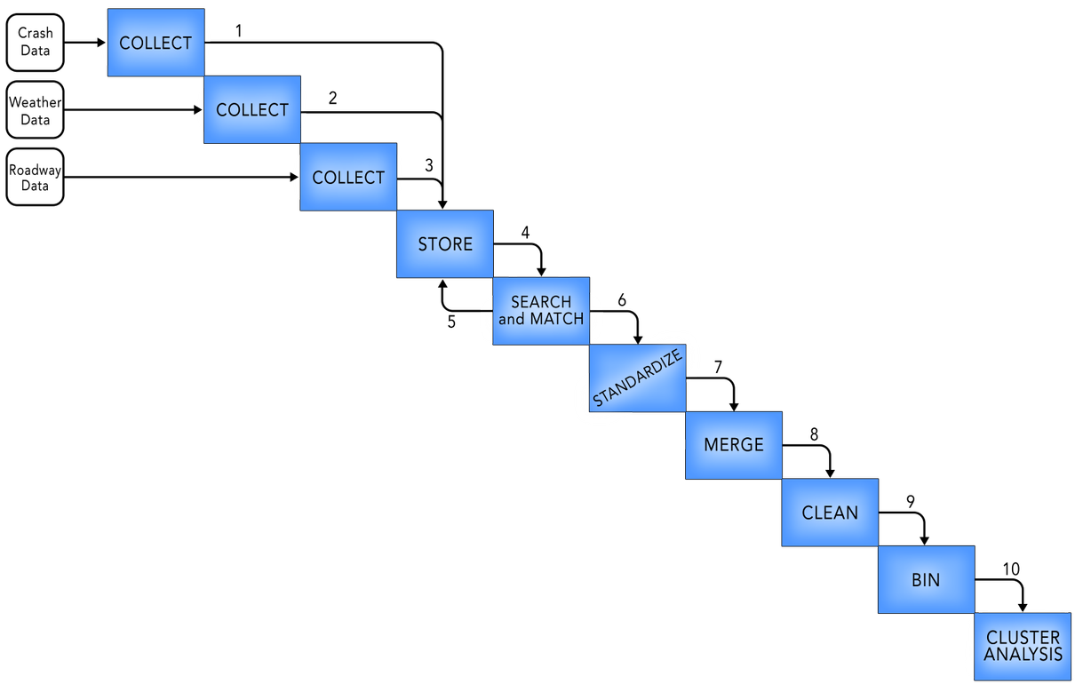
Create TIM Big Data Pipelines and Data Outputs/Products
Example N² Diagram – Pipeline Technical Blueprint
Selected TIM Big Data Use Cases
  Use Case #1 – Improving Incident Detection and Verification to Expedite Response
  Use Case #2 – Real-Time TIM Timeline and Performance Measures
  Use Case #3 – Understanding Secondary Crashes
  Use Case #4 – Exploratory Analysis of Third-Party CV Data for Crash Detection
Example Pipeline Workflow Diagram
Cloud Scheduler
(frequency)

Slide 9
Create TIM Big Data Pipelines and Data Outputs/Products (Continued)
Platforms and Tools Used
Google Cloud Platform (GCP)
  BigQuery
  Cloud console (buckets)
  Firestore
Microsoft Azure
  Databricks
  Hive
  Spark & SparkR
ESRI
  ArcGIS Online
  Spatial tools (routing, geofence, JavaScript API)
  ArcPro
Cloud Environment
Stored raw (unmodified) data in Google Cloud Platform (GCP) and MS Azure.
Files were provided in various formats (SQL, DBF, XLSX, JSON, CSV, shapefiles, geodatabase).
Spatially standardized data to compressed Parquet format; geospatially referenced using WKT.
Temporally standardized data for various time zones (local, UTC) using Unix timestamp format.
Big data in terms of velocity and variety, but not volume in every use case.
Big data in terms of the way the data were processed (using modern data techniques that originated in big data processing).

Slide 10
Develop TIM Big Data Guidelines
    NCHRP Research Report 904 (NCHRP Project 17-75) Guidelines
        Adopt a deeper and broader perspective on data use.
        Collect more data.
        Open and share data.
        Use a common data storage environment.
        Adopt cloud technologies for the storage and retrieval of data.
        Manage the data differently.
        Process the data differently.
        Open and share outcomes and products to foster data user communities.
Build from previous related efforts (e.g., NCHRP Research Report 904) and provided lessons learned specific to the data assessment and TIM data pipelines created in this research.
Guideline categories:
  Data acquisition and quality
  Data environment, platform, and architecture
  Data management
  Data processing, tools, and mining techniques
  Deployment and operations costs
  Data sharing

Slide 11







TIM Big Data Use Cases/Case Studies
Use Case #1 – Improving Incident Detection and Verification to Expedite Response
Use Case #2 – Real-Time TIM Timeline and Performance Measures
Use Case #4 – Exploratory Analysis of Third-Party CV Data for Crash Detection
Use Case #3 – Understanding Secondary Crashes

Slide 12

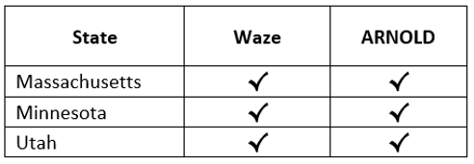
Use Case #1– Improving Incident Detection and Verification to Expedite Response
Question: By leveraging big data, can incidents be detected more quickly and more reliably to improve incident awareness and response statewide?
Problem/limitation: Current incident detection lacks timeliness, detail, and spatial coverage.
Big data opportunity: Leverage navigation app provider crowdsourced data and integrate data with a state’s roadway network data to more quickly and accurately identify when and where incidents occur statewide.
Data Pipeline

Slide 13
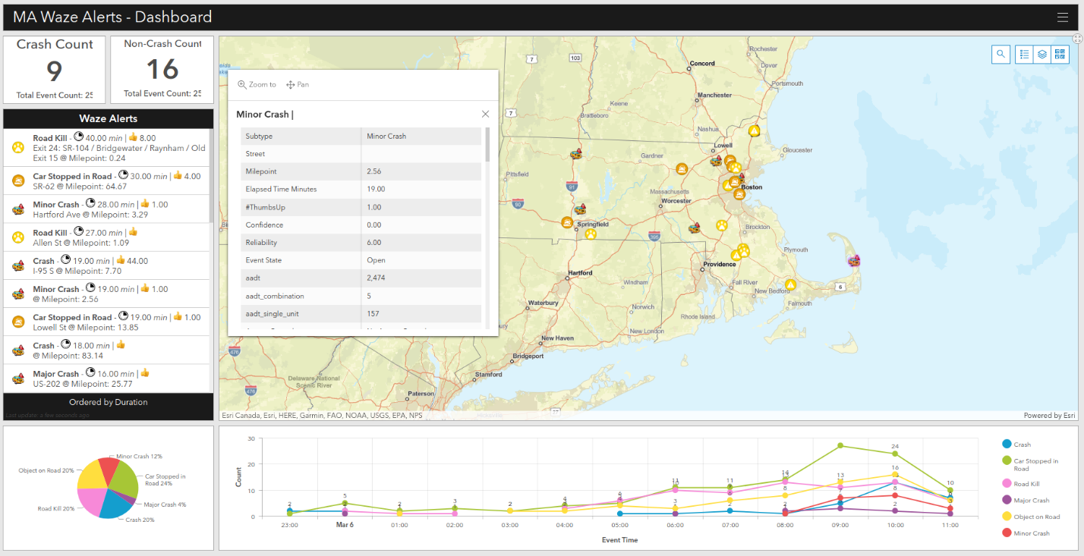
Use Case #1– Improving Incident Detection and Verification to Expedite Response (Continued)
Key Features of Dashboard
Constantly refreshes navigation app provider alerts.
Distinguishes between crash and non-crash events (top left).
Real-time calculation of elapsed time (lists in order of incident duration – left).
Visualization of active alerts over time (bottom).
Displays meta-data associated with location of alert (roadway and weather (pop-up).
Click and zoom capability for new incidents.
Key Aspects of Pipeline/Dashboard
Simple
Inexpensive
Easily/quickly expandable to include other states (Massachusetts data were added in a matter of hours)
Screenshot of Dashboard

Slide 14
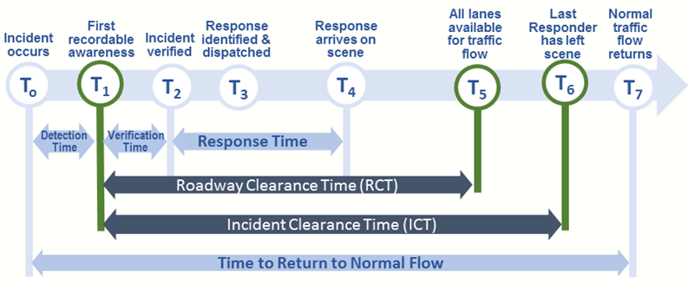
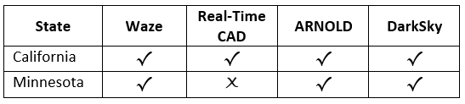
Use Case #2 – Real-Time TIM Timeline and Performance Measures
Question: Can the TIM timeline be populated automatically and in near real-time by leveraging a big data approach? How could this benefit incident response and performance?
Problem/limitation: TIM programs often struggle to populate many of the “Ts” on the TIM timeline. Challenges include a lack of internal data across all incidents, data residing with other responder agencies, and insufficient tools.
Big data opportunity: Leverage crowdsourced data from navigation app provider, integrated ATMS/CAD data, and near real-time probe speed data to populate various points on the TIM timeline and subsequently analyze performance.
Real-Time/Streaming Data Fusion
Nav App Alerts/ATMS/CAD
ATMS/CAD
Nav App Jams
TIM Timeline

Slide 15
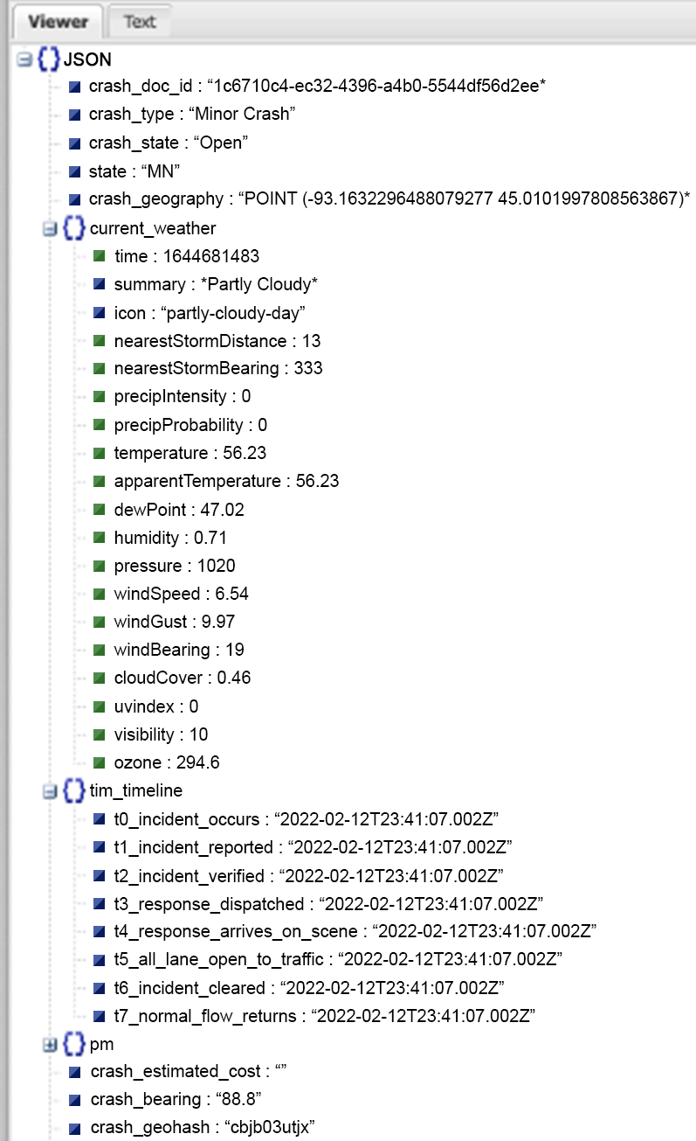
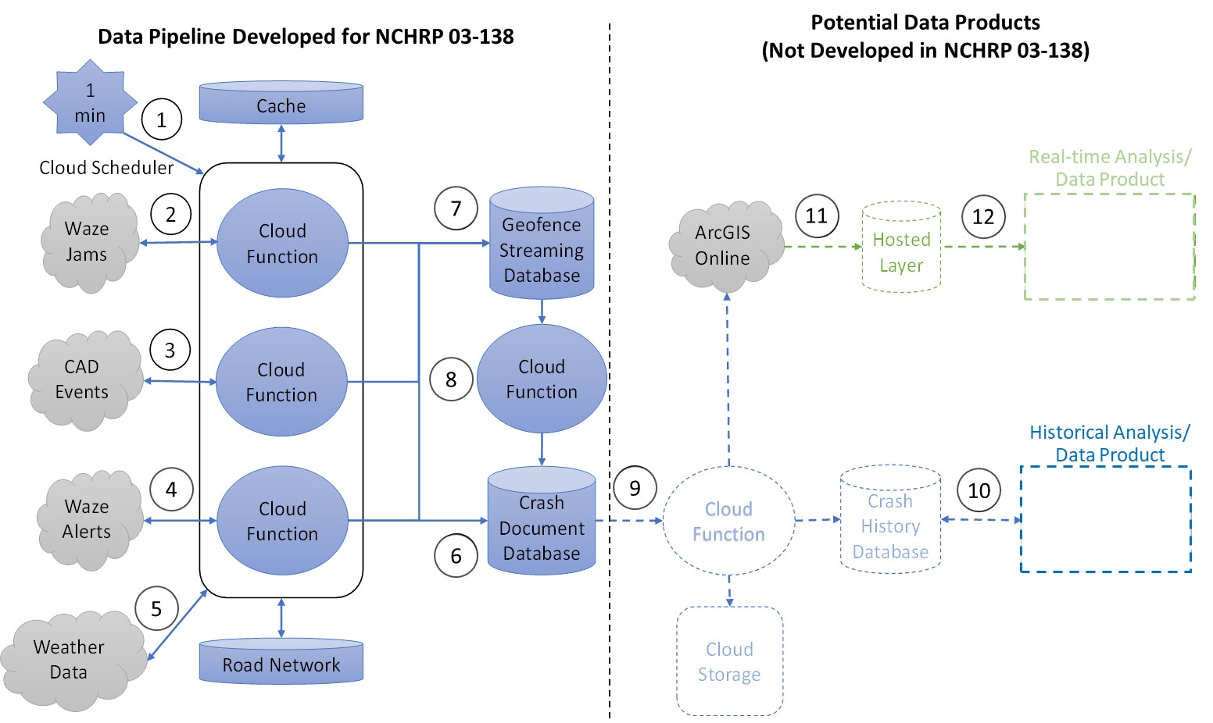
Use Case #2 – Real-Time TIM Timeline and Performance Measures (Continued)
Crash Document Created
Key Aspects/Challenges of Pipeline
Real-time (assess and affect) and historical
Data variances = cost variances
Asynchronous data (data matched spatially)
Resource intensive
Data Pipeline

Slide 16
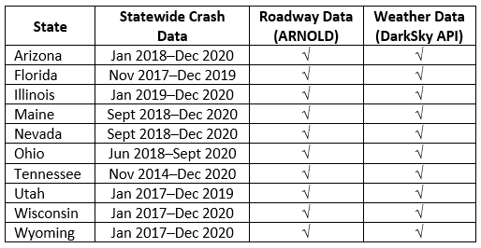
Use Case #3 – Understanding Secondary Crashes
Question: Can a big data approach help to better understand when, where, and under what conditions secondary crashes occur?
Problem/limitation: Lack of data to support analyses of secondary crashes. Where data exist, there is a lack of data analysis.
Big data opportunity: Combine crash data across multiple states. Enrich data with traffic, road, and weather data. Use big data techniques to uncover contributing factors and trends, identify typical secondary crash types, and develop a model for identifying secondary crashes.
Data Pipeline

Slide 17
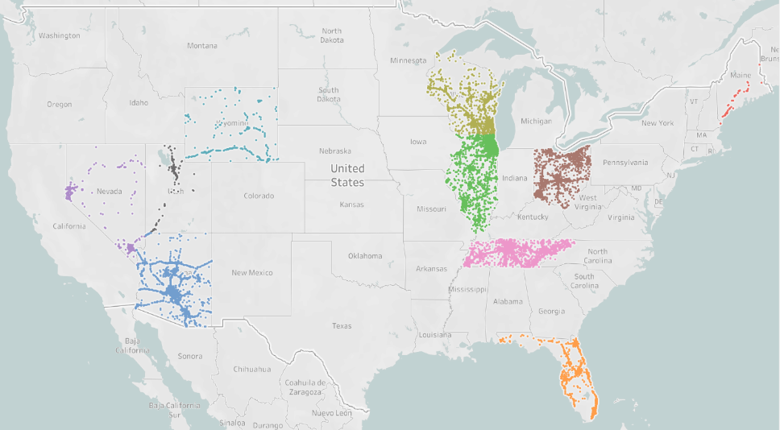
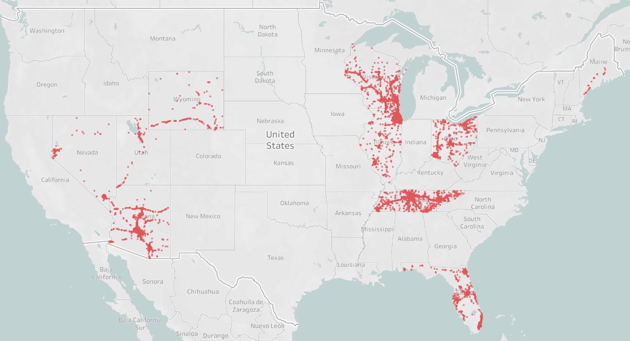
Use Case #3 – Understanding Secondary Crashes
Reported Secondary Crashes (52K)
Analysis
Spatial-temporal analysis to verify secondary crashes
Classification of secondary crashes by common characteristics (cluster analysis)
Key Aspects of Use Case
Unification of data very time consuming
Data quality limitations
Verified Secondary Crashes (15K)

Slide 18
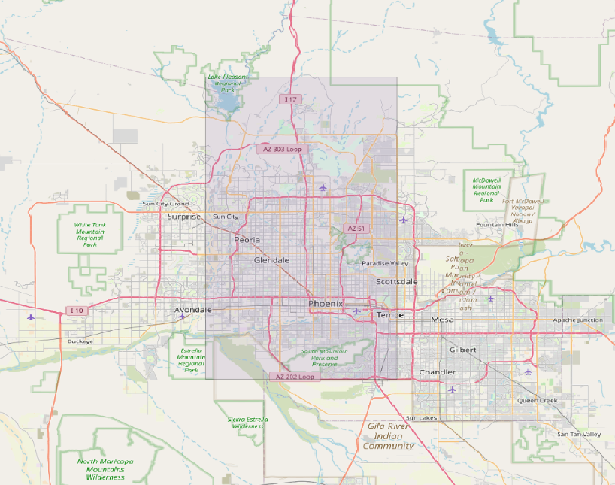
Use Case #4 – Exploratory Analysis of Third-Party CV Data for Crash Detection
Question: Can CV data provide information that would lead to a more proactive approach to TIM by providing near real-time information on system performance and traffic incidents as they unfold?
Big data opportunity: Third-party connected vehicle data is an emerging source of data that is not yet well understood by transportation agencies. The granularity of the data offers potential for new insights for operations. A data sample was assessed and explored for the potential to improve on existing use cases or to provide new use cases for improving TIM.
1 Month (Nov 2019) CV Data Sample
Phoenix, Arizona Proper
Vehicle movement data (speed and heading)
  1,837,538,420 total records
  7,121,391 total journeys
Driver event data
  18 million total records

Slide 19
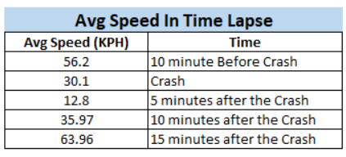
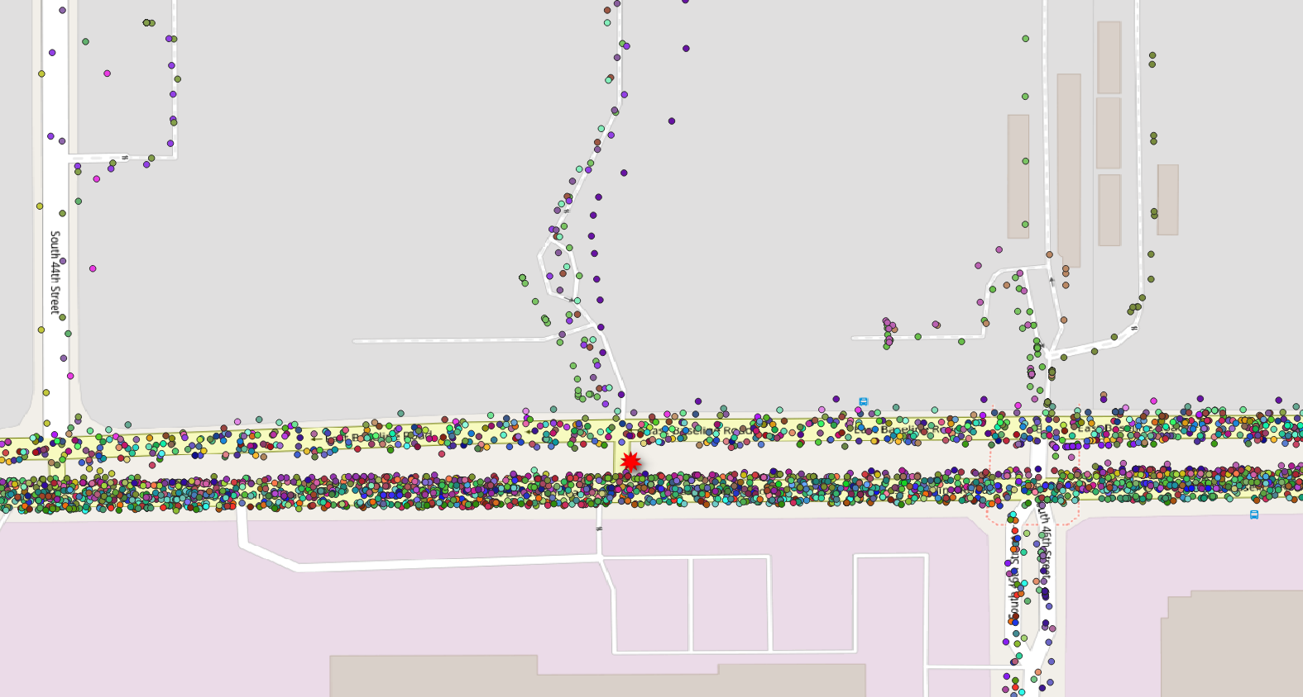
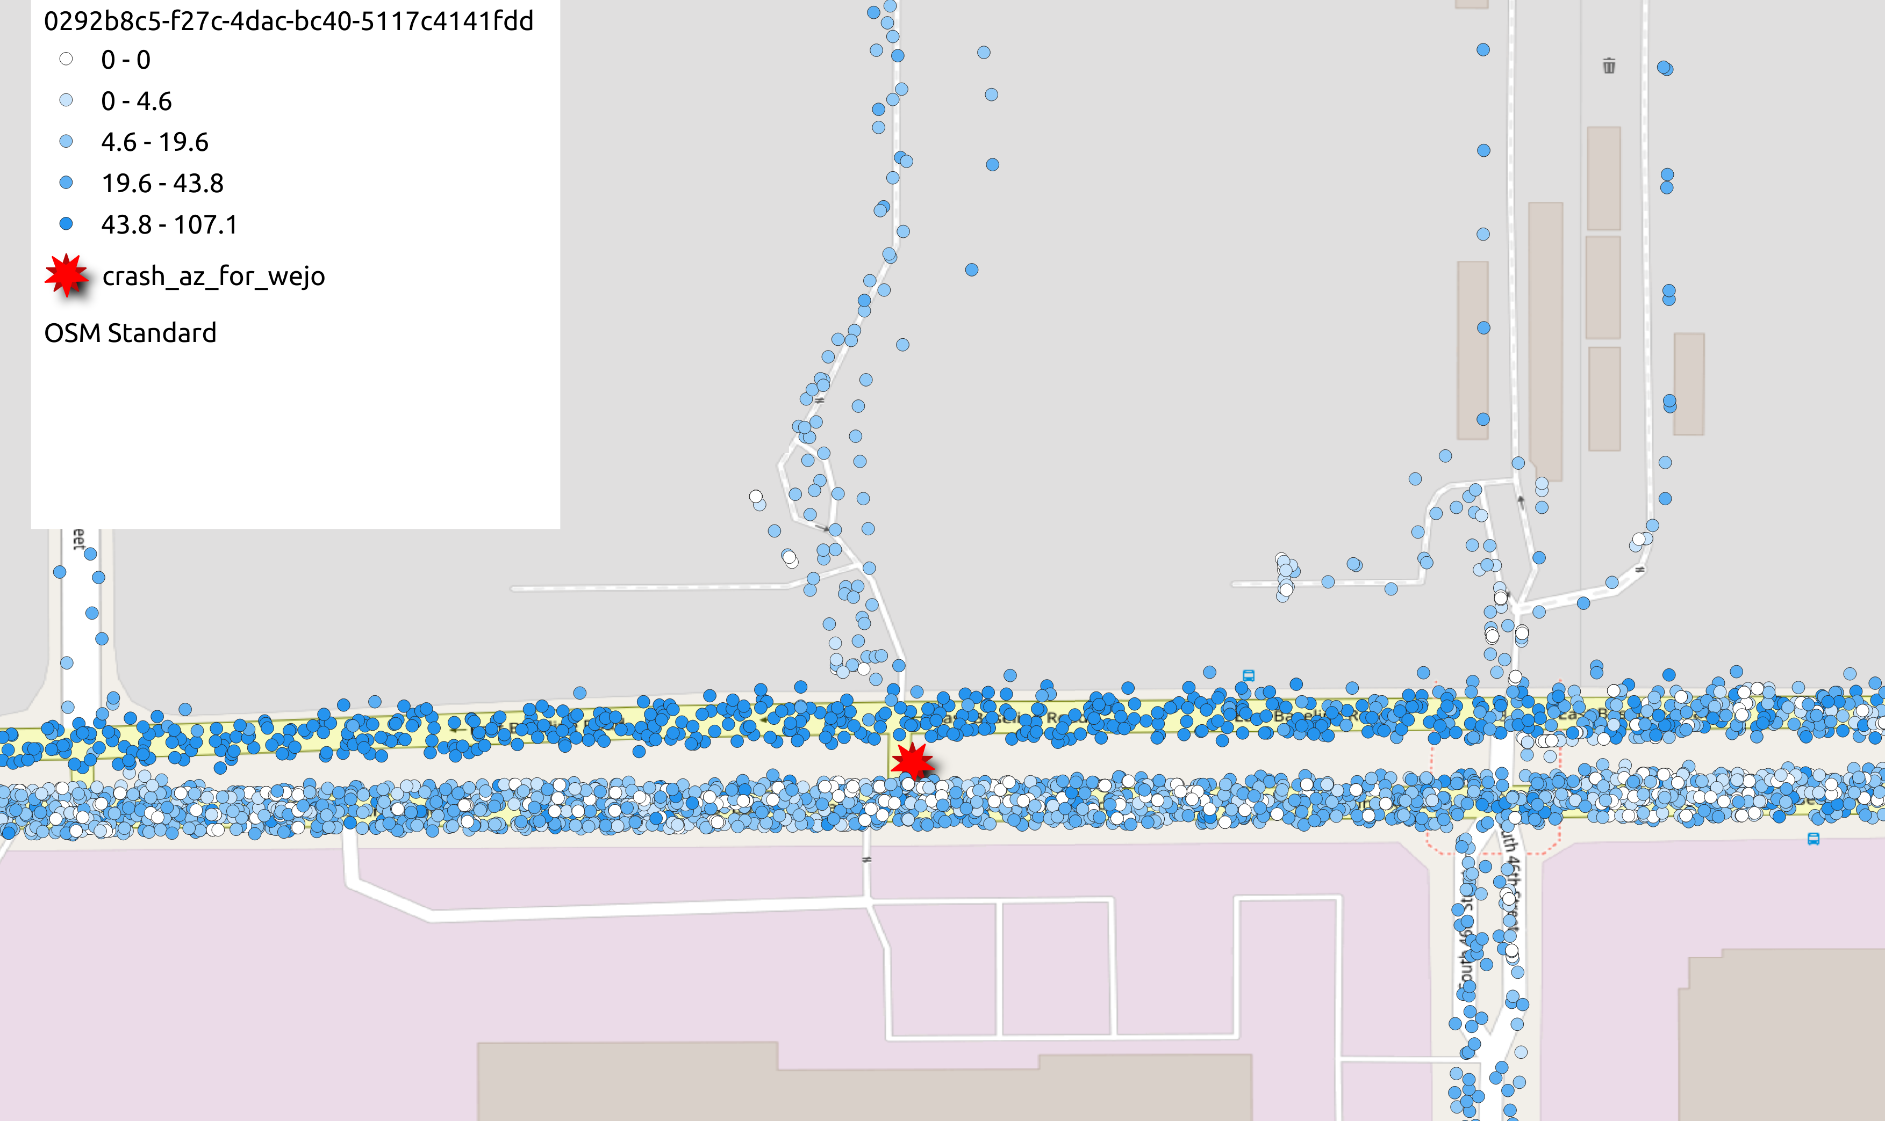
Use Case #4 – Exploratory Analysis of Third-Party CV Data for Crash Detection (Continued)
CV Data Speeds 10 Minutes Before through 10 Minutes After Crash
Individual Vehicle Trajectories
Speed of Vehicle

Slide 20
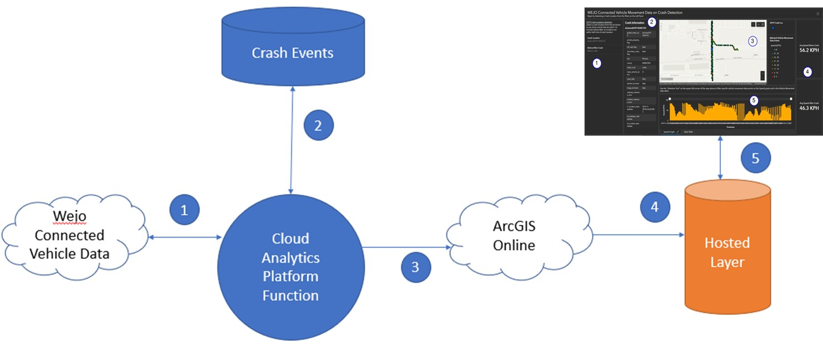
Use Case #4 – Exploratory Analysis of Third-Party CV Data for Crash Detection (Continued)
CV Vehicle Movement Data on Crash Detection Dashboard
CV Driver Event Data on Crash Detection Dashboard
Connected Vehicle Data
ArcGIS Online
Data Pipeline

Slide 21
Estimated Costs of Cloud Environments and Data Pipelines
  Cost Categories/Ranges
  $ – < $500/month
  $$ – $500-$1,500/month
  $$$ – >$1,500/month
  Cost ranges meant for planning level support.
  Cost is highly dynamic based on “on-demand” resource allocation in the cloud.
  Costs Estimated for Each Pipeline
  Data Storage
    Real-time hosted layer
    Curated storage
    Archival long-term storage
  Data Processing and Analysis
    Ingestion and processing
    Real-time query
  Data Products

Slide 22
TIM Big Data Guidelines
Data Acquisition and Quality
Collect more data.
Ready the data for big data analysis.
Data Environment, Platform, and Architecture
Leverage cloud infrastructure.
Centralize the data.
Develop flexible and distributed data.
Data Management
Store, organize, and prepare data for big data analyses.
Maintain data accessibility.
Process data where they reside (in the common, cloud-based storage solution).
Structure/optimize data for analysis and distributed computing.
Support/use many different analysis tools and software.
Understand the ephemeral nature and limitations of big data analytics.
Delegate analytics control to individual analysts/groups.
Data Processing, Tools, and Mining Techniques
Deployment and Operations Costs
Use pay-as-you-go (or pay-for-what-you-use) cloud computing.
Use inexpensive cloud-storage solutions for inactive data.
Conduct a focused spatial/temporal search to minimize computing resources.
Data Sharing
Leverage cloud storage and computing scalability to share data, analyses (code), and products.
Openly share data between TIM partners.
Open and share results of big data analyses through common data storage.

Slide 23
Recommended Next Steps
  Additional Resources
  NCHRP Research Report 904: Leveraging Big Data to Improve Traffic Incident Management
  https://doi.org/10.17226/25604
  NCHRP Research Report 952: Guidebook for Managing Data from Emerging Technologies for Transportation
  https://doi.org/10.17226/25844
  These reports offer guidelines, examples, recommendations, tools, and a roadmap to help agencies advance their capability maturity in modern data management practices, which will support the development of TIM big data use cases and pipelines.
  Further ready transportation agency and TIM partner data for big data analytics.
    Improve data quality, completeness, accessibility, format, standardization, and consistency.
    Consider more modern and automated ways to collect TIM-relevant data to improve the timeliness and quality of the data.
    Share data more openly.
  Advance the capability maturity of transportation agencies to store, integrate, and analyze big data from emerging technologies, such as connected vehicles and the Internet of Things (IoT).
    Adopt modern data management practices, both technical (e.g., cloud architecture) and institutional/cultural (e.g., procurement, IT, data sharing).

