Slide 1
NCHRP 23-13(01) Telecommuting, Remote Work, and Hybrid Schedules: Managing the Shift to a Flexible Work Future

Slide 2
Project Goal
To help state DOT leadership, management, and employees consider long-term and wide adoption of flexible working environments by developing user-friendly resources to help assess the suitability of employees and positions for a flexible work environment. The deliverables also support the aggregation of assessments for reporting to agency leadership.

Slide 3
Work Performed
Conducted Literature Review
Reviewed literature to sharpen our existing knowledge of flexible work arrangements (FWAs), understand recent state DOT experience with FWAs, and identify successful practices and key considerations.
Facilitated Interviews
Identified state DOT contacts with telework experience or expertise; conducted interviews to understand the benefits, challenges, and risks associated with telework within state DOTs; and identified best practices for evaluating success and potential criteria to determine suitability.
Developed Final Deliverables
Developed Telework Suitability Tool for assessing employee suitability for telework, Tracking Tool, and Guide with associated guidance and tools for managers related to telework and other FWAs, including implementation best practices, measuring employee performance and productivity, and determining program success.

Slide 4
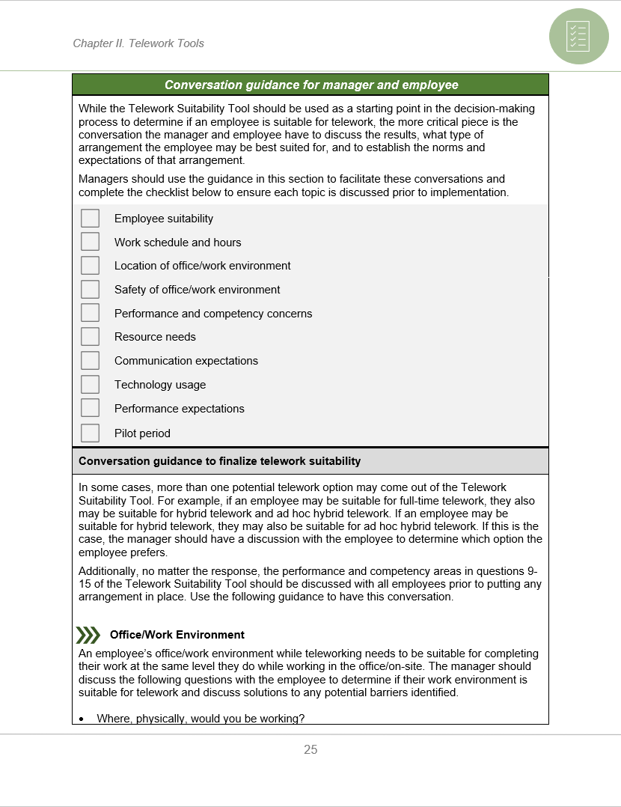
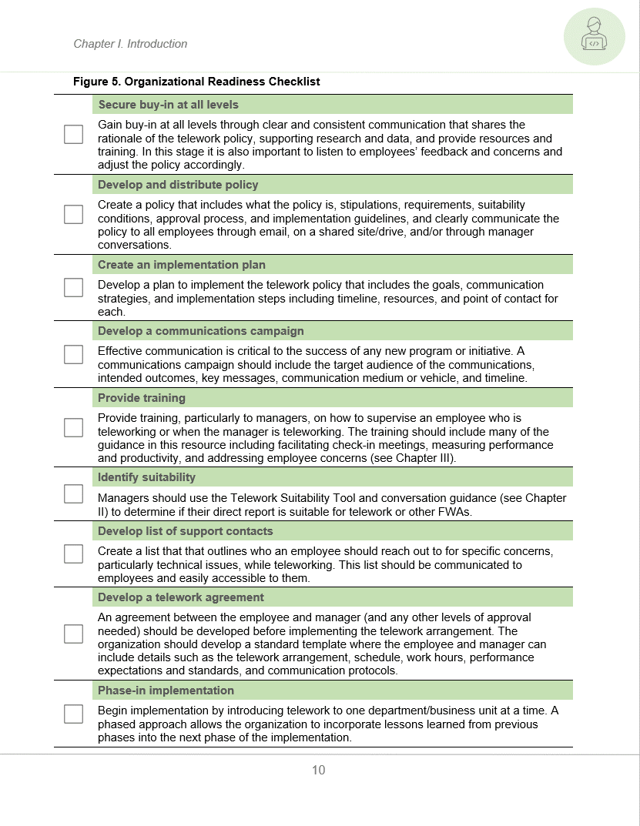
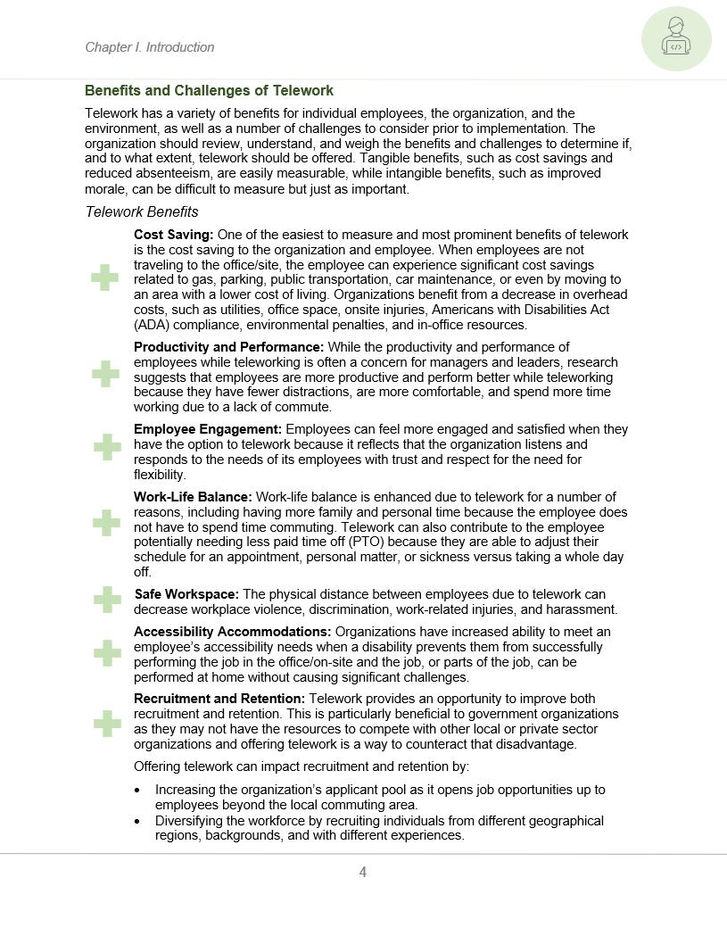
Guide Overview
Designed to provide state DOTs with a resource to:
Understand different telework and FWA options
Understand benefits and challenges of telework
Determine if the agency is ready to implement a telework program
Measure performance and productivity of an employee who is teleworking
Measure telework program effectiveness
Use tools to determine employee suitability for telework and tracking established arrangements

Slide 5
Guide Overview
The Guide is made up of three sections:
Chapter I. Introduction
Telework Options
Benefits and Challenges of Telework
Chapter II. Telework Tools
Telework Suitability Tool
Tracking Tool
Chapter III. Measuring Performance and Productivity
Best Practices for Monitoring and Measuring Productivity and Performance
Metrics for Measuring Telework Program Effectiveness
Organizational Readiness
Alternatives to Telework
Instructions
Best Practices

Slide 6
Chapter I. Introduction - Telework Options and Alternatives to Telework
Telework Options
Alternatives to Telework
Flexible Time
Part Time
Part-time work involves the employee working less than 40 hours per work week. This allows them to maintain employment while balancing personal time or demands (e.g., school, family, non-paid work). The organizations can use this option to hire or retain valued staff as well as provide support to other employees with high or fluctuating demands.
Job Sharing
More than one employee shares or divides the duties of one full-time position. This can allow the organization to meet the demands of a full-time position while hiring employees who might not otherwise be able to commit to a full-time job.
Compressed Work Week
Often referred to as 4-10s or 9-9s, this practice allows the employee to work more hours in a workday in order to work a lower number of workdays (e.g., four 10-hour workdays with one day off every week, nine 9-hour workdays with one day off every other week). This allows the employee to have more consecutive days off, which can be valuable to the employee, but this does not offer as much flexibility for unexpected events/emergencies.
The employee has the flexibility to decide when they start and end their workdays, typically around a set of core hours. This allows them to work during their preferred working hours (e.g., early in the morning), and avoid long commutes.
Full-Time Telework
Often called remote work, telework includes employees working exclusively away from the office/site every day.
Hybrid Telework
Hybrid telework involves an established schedule where an employee works some days in the office/on site and works remotely on other days.
Ad Hoc Hybrid Telework
Ad hoc hybrid telework is when an employee works primarily in the office/on site but can potentially telework with approval on an as-needed basis.

Slide 7
Chapter I. Introduction
One-pagers for each telework option and alternatives to telework that provide a high-level overview, potential benefits, challenges, and implementation best practices for each.
Benefits of telework including in-depth information and research related to the recruitment and retention benefits for state DOTs.
Challenges and mitigation strategies including working with a union, gaining buy-in, measuring performance and productivity, and addressing the lack of social interaction.
Determining organizational readiness for telework, implementation actions, and an organizational readiness checklist.
Common practices of telework implementation and best practices to strive for.

Slide 8
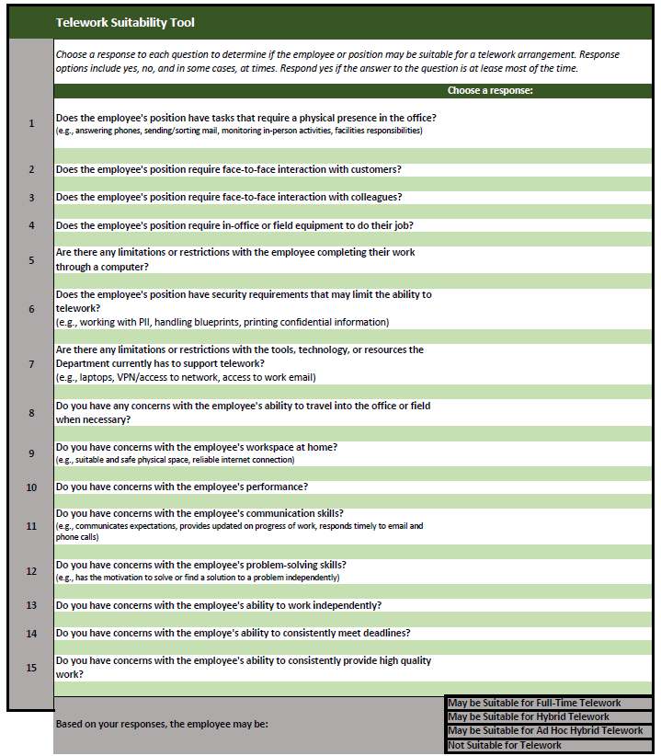
Chapter II. Telework Tools – Telework Suitability Tool
To be used by managers to determine if their employee is suitable for a telework arrangement
Manager responds to a series of questions with “yes (most of the time)” or “no,” and in some cases, “at times”
Once all questions are answered, the tool will populate one or more potential telework options, including:
Not Suitable for Full-Time Telework
May be Suitable for Ad Hoc Hybrid Telework
May be Suitable for Hybrid Telework
May be Suitable for Telework
Instructions provided include:
Completing the Telework Suitability Tool
Telework Suitability Tool Criteria
Editing a question in the Telework Suitability Tool
Adding a new question to the Telework Suitability Tool
Conversation guidance for manager and employee

Slide 9
Chapter II. Telework Tools – Tracking Tool
To track approved arrangements that employees have in place
Data can be aggregated and used to report about telework and FWAs to agency leadership
Instructions provided include:
Inputting data into the Tracking Tool
Changing data variables in the Tracking Tool

Slide 10
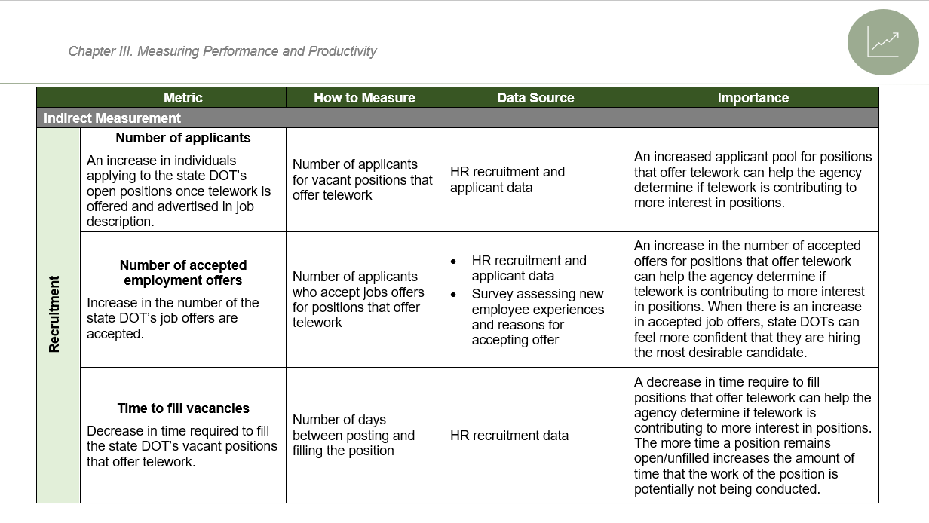
Chapter III. Measuring Performance and Productivity
Includes best practices for performance management
Establish a performance baseline
Set concrete goals
Establish outcome-based measures
Employee development roadmap
Gather performance feedback
Use a task tracker
Implement a pilot period
Conduct regular check-in meetings
Provides recommended metrics for measuring the success of the telework program. Metrics are associated with:
Recruitment
Turnover
Meeting program delivery
Employee engagement

Slide 11
Implementation Memorandum
Goal: Provide implementation guidance including recommendations on how to put the findings into practice, identifying institutions for applying findings, identifying issues affecting implementation and associated solutions, and recommend methods of identifying and measuring impacts.
Recommendations for Putting the Research Findings/Products Into Practice Sharing and promotion of the deliverables (TRID, newsletters, meetings, webinars, publications, blogs, conferences) | Institutions to Lead Application of Research Findings and Products Research participants American Association of State Highway and Transportation Officials (Committee of Human Resources)
Issues Affecting Implementation and Recommended Actions Unions Buy-in Consistent application across employees | Recommended Methods of Identifying and Measuring Impacts of Implementation Measuring impacts of telework program Measuring impacts of deliverable implementation

Slide 12
For more information, visit: https://apps.trb.org/cmsfeed/TRBNetProjectDisplay.asp?ProjectID=5089
The National Cooperative Highway Research Program (NCHRP) produces ready-to-implement solutions to the challenges facing transportation professionals. NCHRP is sponsored by the individual state departments of transportation of the American Association of State Highway and Transportation Officials. NCHRP is administered by the Transportation Research Board (TRB), part of the National Academies of Sciences, Engineering, and Medicine, under a cooperative agreement with the Federal Highway Administration (FHWA). Any opinions and conclusions expressed or implied in resulting research products are those of the individuals and organizations who performed the research and are not necessarily those of TRB; the National Academies of Sciences, Engineering, and Medicine; the FHWA; or NCHRP sponsors.

