Slide 1
Maximizing Proceeds from the Fleet Asset Disposal Sales Process
NCHRP Project 13-09

Slide 2
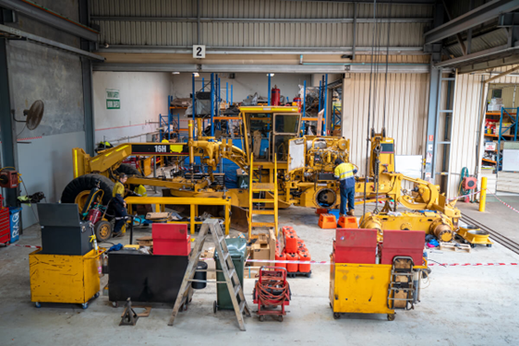
Project Team
Henry Canipe, The Mott MacDonald Group
Dennis Halachoff, Consultant
Dr. Lew Brown, Consultant
Lisa Kunzman, Consultant
John Hildreth, Western Carolina University
Dr. Geoff Morrison, Cadmus
Rex Hazelton, Cadmus

Slide 3
Agenda
Project Overview
Research Findings
Asset Sales Support Tool Overview
- Asset Disposal Matrix Module
- Disposal Method Calculator
Asset Sales Support Tool Examples

Slide 4
Project Overview

Slide 5
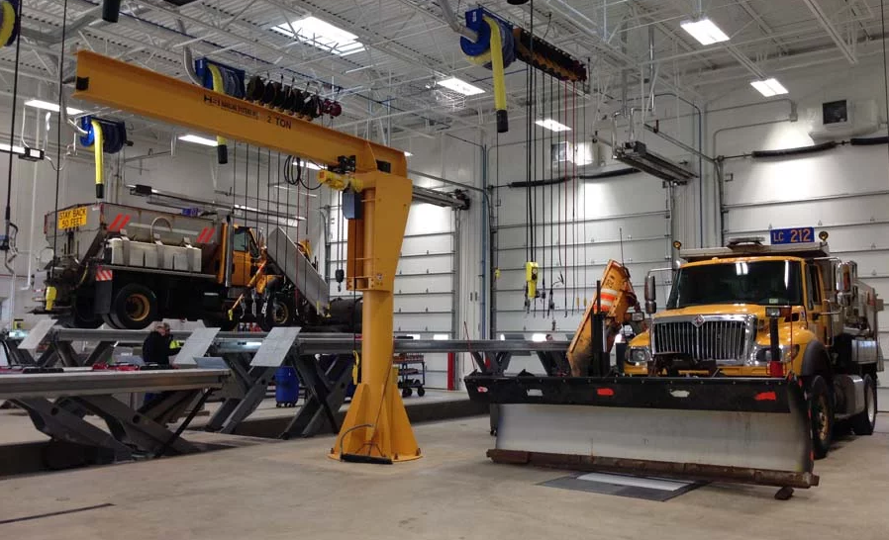
Project Objective
Develop a guidebook and a related Excel tool that assists state DOT fleet managers in selecting effective strategies for preparing, marketing, and selling surplus equipment items and to optimize net sales proceeds.
Notes:
Although the project title includes the term “maximize proceeds” in the name; the project’s major focus is to optimize net proceeds realized within situational, environmental, and policy constraints typically found within a DOT Agency environment.

Slide 6
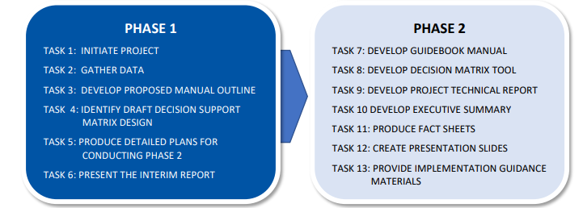
Project Timeline
2021
2022
2023

Slide 7
Target Audience for Guide and Tool
State DOT fleet and equipment managers
Agency budget personnel
State DOT maintenance personnel
Elected officials and public

Slide 8
Motivation for Study
How can fleet managers optimize net proceeds from disposal of fleet assets?
DOTs are sometimes unsuccessful in disposing of equipment at market prices.
Utilizing new/alternative sales channels can potentially generate higher net proceeds and increase sales convenience.
DOTs require guidance to understand available sales channels and best practices for disposal of different asset types based on condition and remaining life.

Slide 9
Research Findings

Slide 10
Stakeholder Survey and Interviews: Key Findings
Resulted in sales at non-market rate
Decision-Making
Varied control of asset disposal options
Public Agency Equipment Sales
May not receive disposal proceeds
Competitive sales process avoids cross-subsidies
Trade-in Programs
Can allow DOTs and Non-DOTs to reduce purchase cost
Guaranteed Buy-Back Programs
Beneficial but limited availability
Customer Research
Private sector focused on customer behavior and motivation to drive sales
Lack of similar resources for public sector to base sales decisions
Purchased-based strategies can optimize residual values
Requires knowledge of local market operators and customer relationships
Notes:
Decision-making
When equipment disposal is handled by another agency, there tends to be a reduced (but non-zero) economic incentive to the fleet to improve equipment disposal practices because of the diminished financial return.
Public Agency Equipment Sales
When DOTs have requirements to offer equipment to other public agencies at prices that are not reflective of market values (whether too low or too high), these sales represent a form of subsidy (regardless of which side is favored).
Trade-in Programs
For the state DOTs that report paying sales tax on new equipment sales, using trade-in programs does not avoid that tax cost.
Guaranteed Buy-Back Options
Guaranteed buy-back is noted as being a particularly successful program (where available). Building customer relationships is critical to long- term history with customer base
Customer Research
DOT fleets’ general lack of systematic customer outreach effort is significant; it points to a broader need for better information on which to base disposal sales channel decisions.

Slide 11
Delphi Panel: Key Findings
Self-marketing commonly used to announce and advertise assets for resale.
Methods to increase net proceeds:
Sales Channels
Marketing
Commercial auction at company-owned facility preferred to auction at vendor facility.
Asset Preparation
Minor repairs
Demonstrating functionality/condition
Commercial advertising, email distributions, or as part of the brokered sales method
May minimize transportation costs and offer control over assets offered for sale
Notes:
Sales Channels
Hosting a commercial auction at a company- owned facility is ranked higher than sending assets to an auction vendor facility. (NOTE: Panel had multiple members from equipment rental firms.)
Sales from a company facility can minimize transportation and associated labor costs. Likewise, being on site may provide increased control and oversight of the sales process and the assets offered for sale and thereby potentially increasing the sale prices.
Marketing
Self-marketing is commonly used to announce and advertise privately-owned assets for resale. The sale- event marketing by an auction vendor is the highest ranked marketing method, but self-marketing is most often employed.
The announcement medias used may include, but not limited to commercial advertising, email distributions, or as part of the contracted brokered sales method.
Asset Preparation
When preparing assets for resale, the methods most likely to increase net proceeds are focused on preparing the asset for the next owner and on demonstrating the functionality and condition.
Demonstrating equipment condition, functionality, and providing a detailed maintenance records typically will increase buyer confidence. Performing minor repairs, cleaning and detailing the asset, and performing required State or DOT inspections minimize buyer acquisition and deployment costs.

Slide 12
Delphi Panel: Private Sector Observations
Encourages investment in both assets and marketing
Additional disposal options
Opportunity-based sales
Greater risk tolerance
Stronger returns/ rewards
Notes:
Private firms have additional equipment disposal options that are not available to most public agencies. This includes (but is not limited to) conducting private, opportunity-based sales that generally are precluded under public procurement laws.
Private firms tend to have greater risk tolerance and stronger rewards for taking risks to achieve better equipment disposal returns. This can include providing managers/employees bonuses or other performance rewards that the public sector seldom uses.
These practices serve to encourage private firms to consider making additional investments in both the assets and in the marketing/sales process to attract higher margin, one-on-one (retail-focused) sales strategies. However, consistent with basic risk/return principles, there is no guarantee of a greater net return in these situations.

Slide 13
Key Research Themes
Basic ‘supply and demand’ principles apply to fleet asset disposal.
Increasing the pool of interested buyers increases demand.
State DOTs require a basic understanding of their customers, behaviors, and practices that motivate them to buy.
The ‘Convenience Concept’ provides a structured way to understand the factors that increase buyer interest and motivation.
Notes:
Basic ‘supply and demand’ principles apply to fleet asset disposal. When demand exceeds supply, prices rise; when supply exceeds demand, prices fall
Increasing the pool of interested buyers (increasing demand) is a basic strategy for improving the price received from any sale.
Any seller (including state DOTs) needs a basic understanding of current and potential customers, their behavior, and practices that motivate them to buy.
The ‘Convenience Concept’ provides a structured way to understand the factors that increase buyer interest, motivation to buy, increase satisfaction and which will optimize resale returns.

Slide 14
Key Research Findings
DOTs have invested few resources to understand their buyers. This lack of knowledge thwarts efforts attempting to attract more buyer interest.
The highest potential returns from fleet disposal sales tends to be when the equipment offered is in operating condition and has adequate amount of remaining life.
Inadequate and inconsistent replacement funding force many DOT fleets to dispose of assets past the optimal lifecycle replacement points.
Maximizing potential disposal returns involves making informed decisions between sales channels, asset condition investments, and marketing efforts.
Notes:
Lack of adequate and consistent replacement funding force many DOT fleets to dispose of assets well-past the optimal lifecycle replacement point, often near or beyond the end of the asset’s design life.
Historically, DOT have invested little effort in understanding the buyers who purchase their surplus property assets. This lack of research information and knowledge complicates any efforts which attempt to attract more buyer interest.
The widest range of potential returns from fleet asset disposal sales tends to be when the equipment offered is in operating condition and has an adequate remaining amount of asset life. As equipment ages towards end of life, the opportunity to increase net returns through different and alternative sales channel and marketing practices narrows.
Maximizing potential disposal returns involves making informed decisions between sales channels, asset condition investments, and marketing efforts.

Slide 15
Sales Channels
Direct to public agency
Direct to public consumer
Brokered sale
Auction at DOT facility
Internet auction
Auction at vendor facility
Trade-in
Guaranteed buy back
Potential Alternative Sales Channels
Notes:
Direct to public agency
Sales to other public agencies. In some cases, state regulations/legislation may mandate that equipment be offered to these entities before other disposal methods are used.
Direct to public consumer
Sales to a private entity. Assumes that proceeds would move closer to "Fair Market Value".
Brokered sale
Sales where a third party (a broker) is contracted to market equipment privately to firms/users needing equipment.
Auction at DOT facility
This a traditional auction performed at a DOT facility. The auction itself can be self-performed by DOT personnel or have a vendor/auctioneer conduct the auction.
Internet auction
Internet auctions can be used as a 'stand alone' disposal channel but often are conducted in combination with other auction types.
Auction at vendor facility
In this approach, vehicles/equipment are transported to a vendor facility for auction. This option involves additional cost/effort in exchange for a larger pool of potential buyers.
Trade-in
This approach involves disposing equipment as part of the buying transaction. Typically, this is an allowance for the value of the equipment being disposed of against the purchase price.
Guaranteed buy back
In this approach, the vendor sells the DOT equipment under terms that allow the DOT to sell the same equipment back to the vendor at a pre-agreed price at some agreed upon date, usage and condition.

Slide 16
Buyer Types, Characteristics and Motivators
Retail Buyer
Dealer/Reseller
Public Agency
General Contractor/Business
DOT Contractor (local / state)
DOT Contractor (multi-state / national)
International Buyer
Notes:
Retail Buyer
Typically, a home/farm owner; Seeking low volume, occasional use equipment; Likely to buy and hold the unit for long-term use
Dealer/Reseller
Looking to “flip” (resale) vehicle; Often looking for a specific type of equipment /
Informed and knowledgeable of prevailing market prices
May anticipate some nominal investment in the unit but not interested on making major rebuilding efforts
Public Agency;
Looking to fit a mission specific need; Often unable to fund new equipment and looking for a stopgap solution; May be willing to invest in some level of refurbishing
General Contractor/Business
Driven by near-term economic opportunity; Has ongoing need but of uncertain duration; May need a spare/back up unit
DOT Contractor (local/state)
Similar to “General Contractor/Business” but may be looking for equipment; Used DOT equipment typically has low hours/mile compared to commercial users
International Buyer
Serving export markets; Generally seeking off-road construction equipment of heavy vehicles; Attractiveness of DOT equipment varies significantly by DOT location and end customer logistics

Slide 17
Best Practices in Assets Sales
Asset Preparation
Asset Information
Auction Process
Purchasing
Market Development
Notes:
Asset Preparation
Clean and detail the equipment unit prior to offering for sale.
Perform simple repairs that otherwise detract from the asset’s overall attractiveness: fix flat tires, replace a cracked windshield/broken window, etc.
Asset Information
Provide video or demonstrate that the equipment can move/operate on its own power (if its condition supports).
Provide available maintenance records.
Auction Process
Use of internet auctions (primary/supplemental sales) can increase prices received by expanding the pool of potential buyers.
Setting a ‘reserve’ (minimum) bid may increase surplus sales return (situation dependent).
Purchasing
Guaranteed buy-back’ programs (when available) tend to be financially attractive for many DOTs.
Trade-in programs can streamline disposal process and provide comparable returns to traditional auctions.
Market Development
Develop relationships and communication to ensure good public, contractor, and dealer participation.
Communicate that DOT equipment is generally maintained to a higher level of service readiness than private sector.
The fleet manager is the ambassador; create working relationships, promote organization and equipment offered.

Slide 18
Marketing Fundamentals
Staff time or information may not be available to do market analysis
Concept of Convenience
Knowing Your Customers
The time and energy required to acquire, use and dispose of a product/service
Getting Help
Consider using local university assistance or a consultant
Measured in terms of competing alternatives
Perform outreach/research to learn about your customers
Use previous sales to group customers based on common characteristics
Notes:
Concept of Convenience: There is no such thing as convenience by itself. It can only be measured by comparing different offerings for the same product or service relative to their respective time and energy requirements.
Importance of Knowing Your Customers: It is important to analyze your records from previous sales. How did you promote the sale? What did you sell? How did you conduct the sale? How successful was the sale? What were the “costs” of preparing and conducting the sale? How did you promote the sale? What kind of positive or negative feedback did you get from customers? Did you specifically ask for customer feedback?
Can you group your customers into smaller groups: Large equipment resellers? Large paving companies? Smaller paving companies? Water and sewer companies? Building construction companies? Bridge construction companies? Commercial farmers? Individual farmers?
Gather all the information you have on each group. What can you learn from this information?
How to Get Help: If you need help gathering information, we suggest that you contact a local university that has a business program. A marketing or marketing research professor might be interested in using your project for a class project. The students can analyze previous records, determine customer groups, interview past customers, and recommend improvements to your sales and marketing processes.

Slide 19
Asset Disposal Decision Support Tool

Slide 20
Asset Sales Decision Support Tool
Asset Disposal Matrix Module
Purpose: Qualitative assessment of available sales channels and merits of each
Input: Asset type, condition and remaining life
Result: Sales options, minimum asset condition and remaining life, advantages disadvantages of sales options.
Disposal Method Calculator Module
Purpose: Quantitative assessment of potential net return of one sales channel to another
Input: Current disposal method, asset value, disposal cost, total assets, alternative sales method and estimated cost.
Result: Estimated benefit (or cost) of alternate disposal method

Slide 21
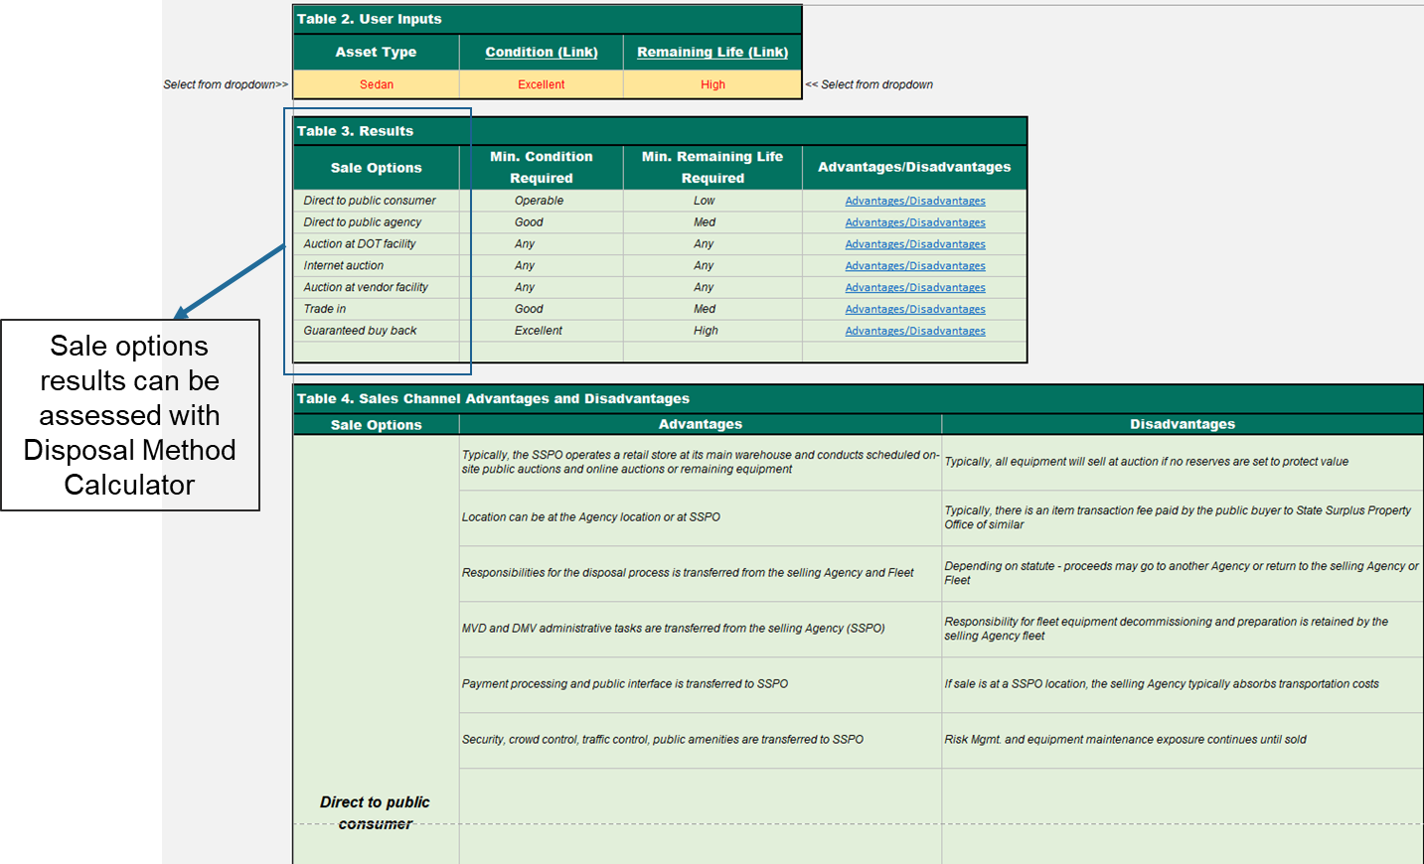
Asset Decision Matrix – Inputs & Results

Slide 22
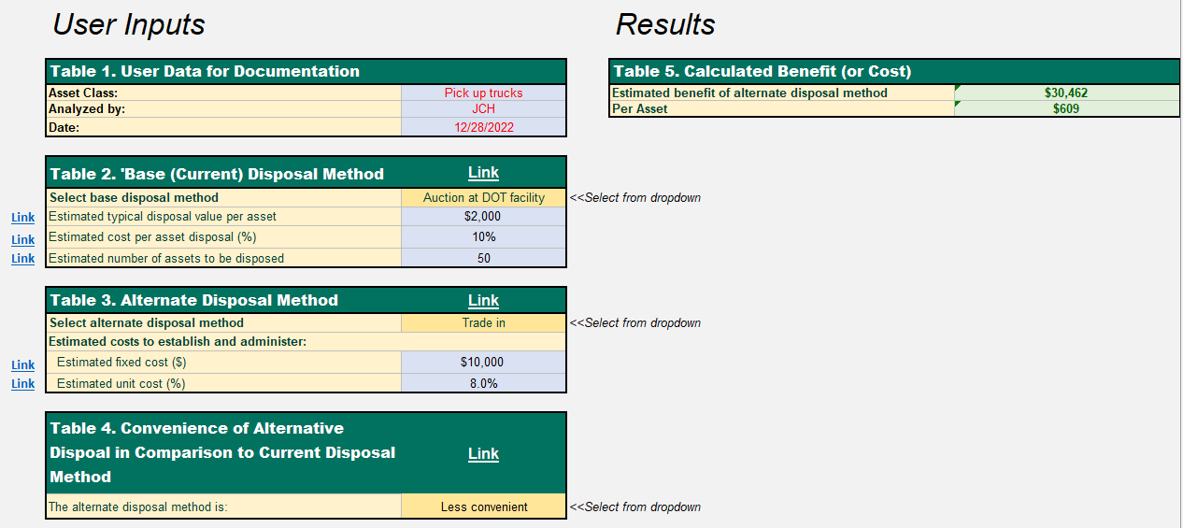
Disposal Method Calculator: Inputs & Results

Slide 23
For more information about this project, visit:
https://apps.trb.org/cmsfeed/TRBNetProjectDisplay.asp?ProjectID=4968
Henry Canipe
Principal Project Manager - Management Consulting
Mott MacDonald
(336) 210-7015
henry.canipe@mottmac.com
The National Cooperative Highway Research Program (NCHRP) produces ready-to-implement solutions to the challenges facing transportation professionals. NCHRP is sponsored by the individual state departments of transportation of the American Association of State Highway and Transportation Officials (AASHTO), in cooperation with the Federal Highway Administration (FHWA). NCHRP is administered by the Transportation Research Board (TRB), part of the National Academies of Sciences, Engineering, and Medicine. Any opinions and conclusions expressed or implied in resulting research products are those of the individuals and organizations who performed the research and are not necessarily those of TRB; the National Academies of Sciences, Engineering, and Medicine; or NCHRP sponsors.

Slide 24
The National Cooperative Highway Research Program (NCHRP) is sponsored by the individual state departments of transportation of the American Association of State Highway and Transportation Officials. NCHRP is administered by the Transportation Research Board (TRB), part of the National Academies of Sciences, Engineering, and Medicine, under a cooperative agreement with the Federal Highway Administration (FHWA). Any opinions and conclusions expressed or implied in resulting research products are those of the individuals and organizations who performed the research and are not necessarily those of TRB; the National Academies of Sciences, Engineering, and Medicine; the FHWA; or NCHRP sponsors.

