Slide 1

GUIDELINES FOR VEHICLE AND EQUIPMENT COLOR, MARKING AND LIGHTING
NCHRP Project 05-24
The National Cooperative Highway Research Program (NCHRP) is sponsored by the individual state departments of transportation of the American Association of State Highway and Transportation Officials. NCHRP is administered by the Transportation Research Board (TRB), part of the National Academies of Sciences, Engineering, and Medicine, under a cooperative agreement with the Federal Highway Administration (FHWA). Any opinions and conclusions expressed or implied in resulting research products are those of the individuals and organizations who performed the research and are not necessarily those of TRB; the National Academies of Sciences, Engineering, and Medicine; the FHWA; or NCHRP sponsors.

Slide 2
Need for Study
Some practitioners/field personnel view more markings, lights, light activity as being safer
A risk exists that over-marking and/or over-lighting decreases safety
Manufacturers continue to provide more visually-stimulating products, difficult for practitioners to know if those products provide meaningful safety benefits

Slide 3
Project Objective
Develop guidelines for the selection and application of color, retroreflective markings, and lighting to vehicles and equipment that will effectively identify vehicles and equipment, communicate their activities to the motoring public, and thus enhance safety.

Slide 4
Project Tasks
Collect and Review Information Pertinent to Vehicle Color, Retroreflective Markings, and Vehicle Warning Light Design, Selection, and Application
  Literature review
  Agency practices
  Vendor interviews
Identify and discuss factors related to vehicle color, retroreflective markings, and warning light design and selection
Assess relevance, importance, and priority of factors for study

Slide 5
Project Tasks (cont’d)
Prepare an updated work plan and interim report
Meet with panel
Execute phase II studies
  Static closed-course studies
  Dynamic closed-course studies
  Field evaluations
Prepare final report and implementation guidelines

Slide 6
Past Research – Retroreflective Vehicle Markings
Greater visual contrast = more conspicuous and detectable
Wide range of colors in use
Inverted V and checkerboard marking patterns are most common
Some concern exists about effect of highly retroreflective materials upon worker or pedestrian visibility

Slide 7
Past Research – Vehicle and Equipment Warning Lights
Amber and amber-white most common, use of other colors (red, blue, green, etc.) dependent upon state laws and codes
Multi-colored lights perceived as more urgent or hazardous, increases driver response
Detection of lights depends on peak luminous intensity and effective intensity of the warning light array
Faster flash frequencies may be perceived as implying more urgent or hazardous conditions

Slide 8
Past Research – External Factors
Vehicle and equipment detection depends upon size and extent to which color and shape differ from other vehicles in the traffic stream and from the background of the visual scene
Factors other than visibility (such as initial purchase price and salvage value) are often considered when specifying vehicle and equipment color in procurements
Optimum marking and warning light systems may differ significantly between daytime and nighttime viewing conditions

Slide 9
Fundamental Objectives of a Marking and Warning Light System
Objective 1 – Attract attention and provide adequate warning of vehicle/equipment presence
Objective 2 – Assist in determining appropriate driving action approaching work activity
Objective 3 – Not be confused with authorized emergency vehicles
Objective 4 – Not adversely affect driver abilities to detect and recognize the vehicles or equipment, other traffic control devices in use, workers on foot, or nearby pedestrians

Slide 10
Factors Examined
Retroreflective vehicle markings
Color combinations
Marking patterns
Amount of material
Flashing warning lights
Number of lights (i.e., peak luminous intensity)
Flash patterns
Colors
Ambient lighting
Daytime
Nighttime

Slide 11
Task 6 Phase II Studies
Static Closed-Course Studies - determine how vehicle marking and warning light factors affect driver recognition of workers on foot and of flashing arrow board displays
Dynamic Closed-Course Studies – determine whether different warning light factors affect driver abilities to correctly recognize work vehicle movement and perceptions of hazard risks present
Field Evaluations – determine effect of best-performing marking and warning light configurations upon driver speed and lane choice

Slide 12
Daytime Closed-Course Static Studies
Focused exclusively on vehicle markings (no warning lights included)
Treatments evaluated
  Colors: yellow and black versus red and white
  Patterns: inverted V versus checkboard (Battenburg)
  Amount of material: 3’ x 6’ panel versus 1’ x 6’ strip
Used a glance recognition study to evaluate performance
Marking treatments viewed from 400’ away

Slide 13
Study participants viewed each treatment for a brief (200 millisecond) period and determined if a worker was present or not
Notes:
Each participant viewed each treatment 6 times (treatments were presented in random order) for a total of 48 responses per participant. For each observation, the worker may or may not have been present. When present, the participant indicated whether the worker was located to the left or the right side of the vehicle, or standing in the middle of the marking panel.

Slide 14
Electronic Occlusion Shutter System
Screen is opaque until current applied
Allows for very accurate short display times
Notes:
In human factors research testing, this instrument would be referred to as a tachistiscope.

Slide 15
Effect of Marking Colors and Patterns on Worker Recognition Accuracy
Notes:
Marking colors and patterns had no effect on participants 40 years and younger. For participants 55 years and older, worker recognition accuracy was better for the yellow and black marking treatments than for the red and white treatments, and for the inverted V pattern than for the checkerboard pattern. Amount of marking material did not affect recognition accuracy. However, participants rated the 3’ x 6’ marking panels as more helpful for worker recognition than the 1’ x 6’ strips.
Results were counter to expectations that the yellow and black markings would make worker recognition more difficult. It was hypothesized that the uniqueness of the red and white markings attracted more attention to them, which resulted in poorer worker recognition accuracy.

Slide 16
Nighttime Closed-Course Static Studies
Focused on effects of warning light factors on worker recognition and arrow board display (with and without vehicle markings present)
Treatments evaluated
  Number of warning lights used in array: 2 versus 4 versus 8
  Warning light colors: amber versus amber and green
  Warning light flash speed: 1.25 hz versus 2.5 hz
  Warning light flash pattern: lights flash in an alternating left-right pattern versus asynchronous flashing of the individual lights
Vehicle markings (when used) was the 3’ x 6’ yellow and black checkerboard pattern
Notes:
Used SAE class 1 directional flashing lights. Since many states restrict use of blue lights to authorized emergency vehicles, a multi-colored light option was created using amber and green lights. Overall, 24 different warning light treatments were evaluated.

Slide 17
Study Methodology
Participant vehicle positioned either 100’ or 400’ from work vehicle with marking and warning light treatments
At one distance, participants identified worker presence; at the other distance, participants identified arrow board display
Measured time to identify worker or arrow board display, accuracy of identification, and ratings of worker or arrow board visibility, work vehicle visibility, treatment distraction, and discomfort glare created

Slide 18
Results – Worker Detection/ Recognition
Participants ≥ 55 years had longer detection/recognition times
Worker detection/recognition accuracy worse at 400 ft viewing distance
Presence of vehicle markings improved worker detection/recognition accuracy for participants ≤ 40 years

Slide 19
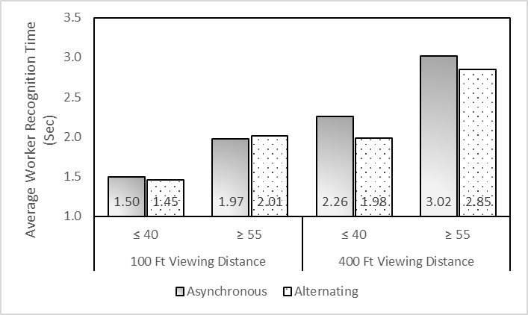
Asynchronous flashing increased worker recognition time at farther viewing distances

Slide 20
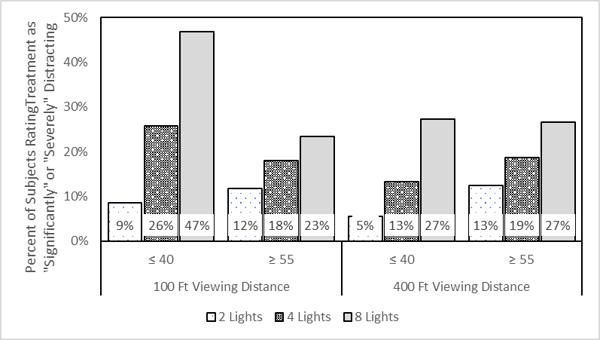
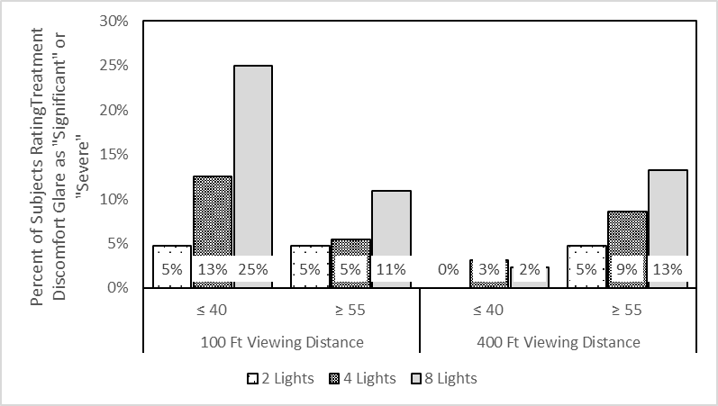
Many participants rated the 8-light display distracting and causing discomfort glare

Slide 21
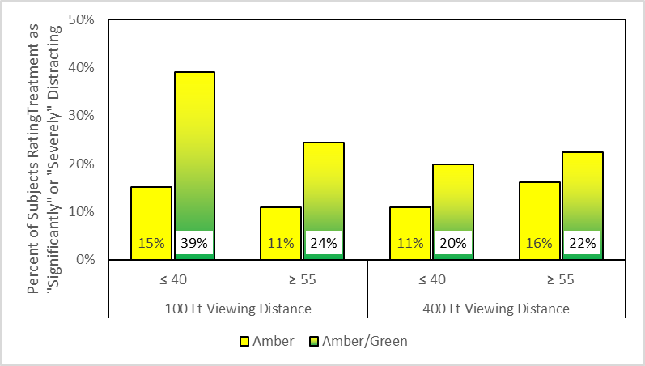
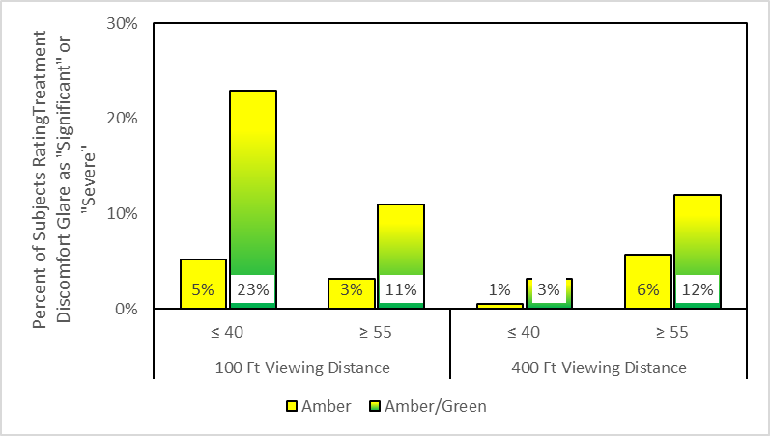
Many participants also rated multi-colored light arrays as more distracting and causing discomfort glare

Slide 22
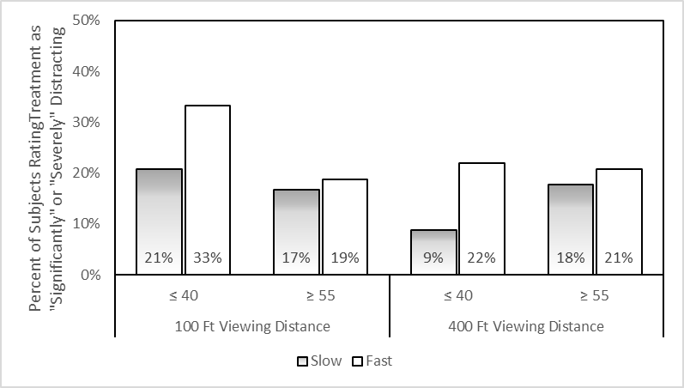
Participants ≤ 40 years rated the fast flash speed as distracting

Slide 23
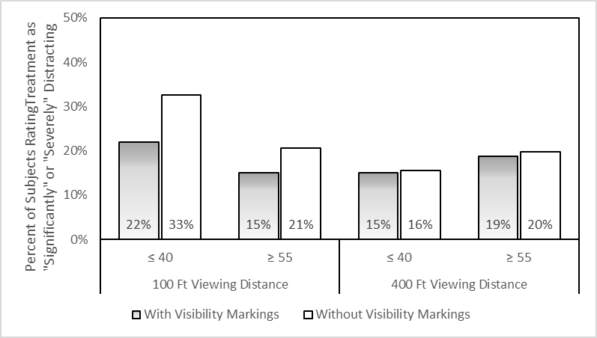
Presence of markings on the rear of the treatment vehicle reduced distraction ratings when viewed at the 100’ distance

Slide 24
Results – Arrow Board Detection/ Recognition
Participants ≥ 55 years old had longer arrow board detection/recognition times
Arrow board detection/ recognition times were worse at 100 ft viewing distance

Slide 25
Other Arrow Board Trends
None of the warning light attributes affected recognition times of the arrow board displays or accuracy of recognition.
Warning light attributes also did not significantly affect ratings of arrow board visibility.
Presence of vehicle markings on the rear of the work vehicle increased ratings of work vehicle visibility.
The fast flash speed resulted in lower ratings of work vehicle visibility.

Slide 26
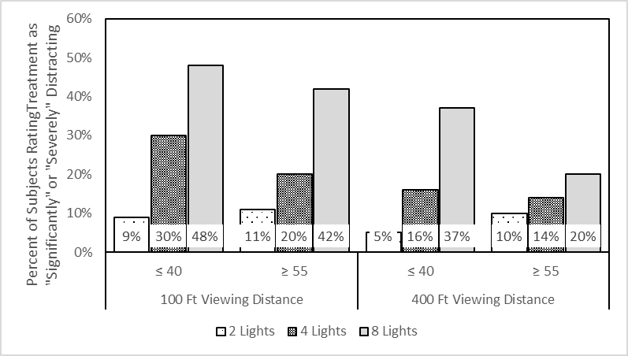
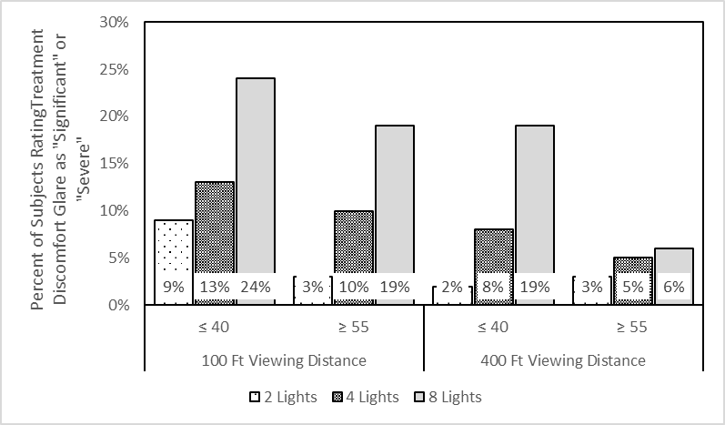
Participants again rated 8-light arrays as more distracting and causing more discomfort glare.

Slide 27
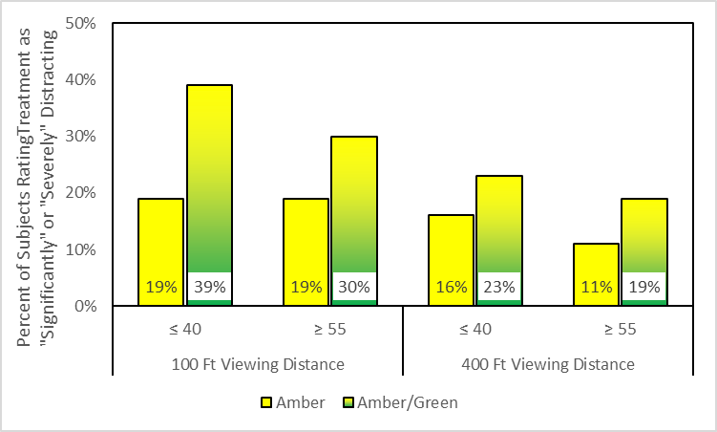
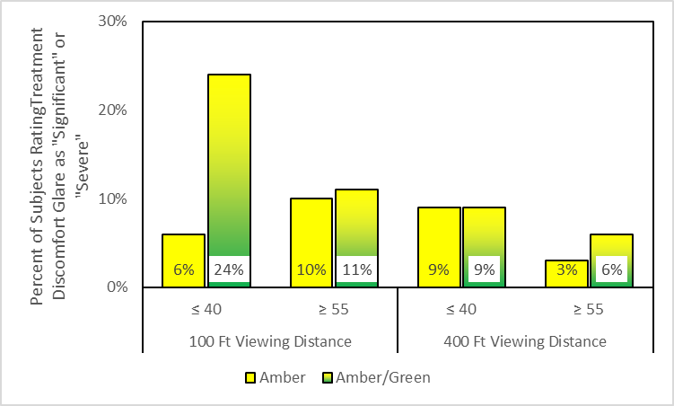
Amber and green warning light arrays resulted in higher ratings of distraction and discomfort glare for participants ≤ 40 years when viewed at 100’ viewing distance

Slide 28
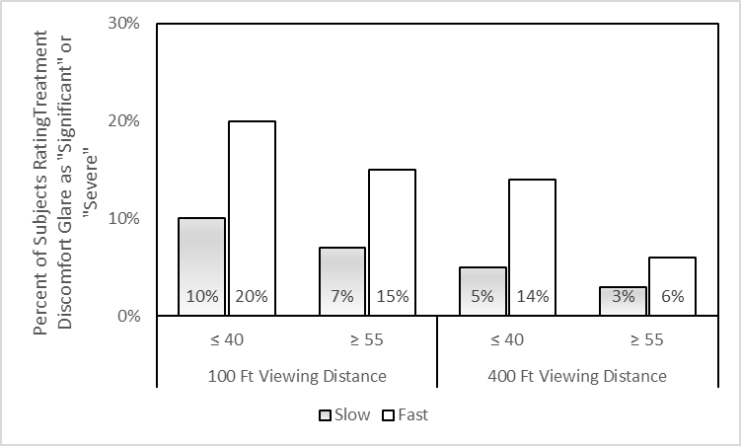
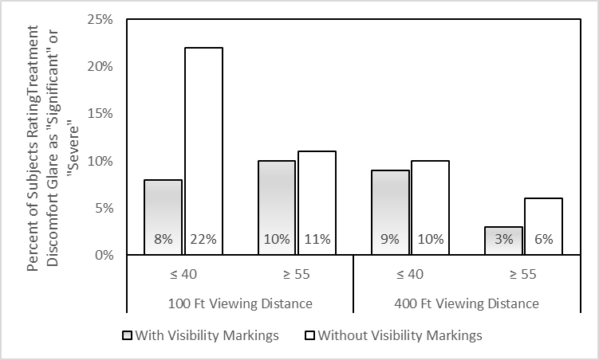
The fast flash speed resulted in higher ratings of discomfort glare, while use of vehicle markings on the rear of the treatment vehicle reduced ratings of discomfort glare.

Slide 29
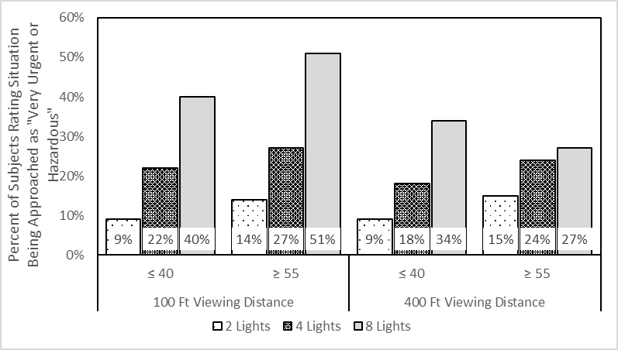
More lights in the warning light array increased participant rating of urgency or hazard risk implied by the lights.

Slide 30
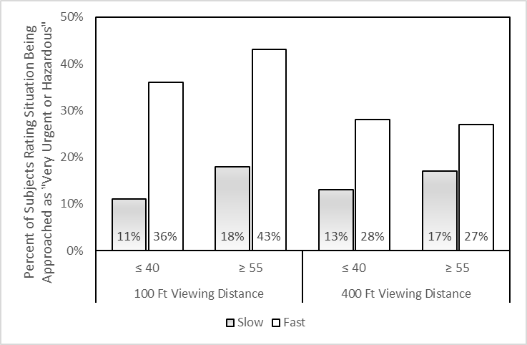
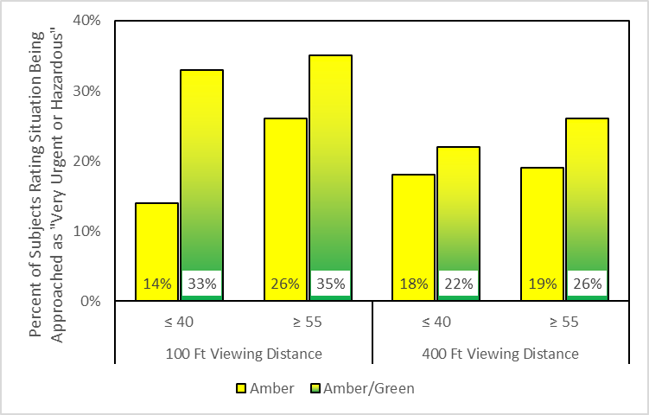
The fast flash speed and the amber and green warning light arrays also increased participant rating of urgency or hazard risk implied by the lights

Slide 31
Daytime and Nighttime Closed-Course Dynamic Studies
Focused on effects of different flash speeds or flash patterns upon driver ability to judge speed of work vehicles they are approaching while driving.
  Slow speed (1.25 hz)
  Fast speed (2.5 hz)
  An alternating slow and fast speed (1.25 hz, then 2.5 hz, then 1.25 hz, etc.)
  Alternating flash pattern
  Asynchronous flash pattern
Determine whether flash speeds and patterns have different effects of specular glare that may occur when the pavement is wet at night

Slide 32
Study Methodology
Study participants seated in driver seat of data collection vehicle traveled towards work vehicle with warning light treatment at ~ 30 mph.
Work vehicle either faced the data collection vehicle or away and either remained stationary, moved slowly (3 mph), or moved slightly faster (10 mph)
Participant identified when they could tell whether the work vehicle was stationary, moving slowly, or moving slightly faster

Slide 33
Results of Closed-Course Dynamic Studies
Participants less likely to accurately identify target vehicle speed when traveling toward the subject than when it was traveling away from (in same direction as) data collection vehicle.
None of the warning light treatments significantly affected target vehicle speed identification accuracy.

Slide 34
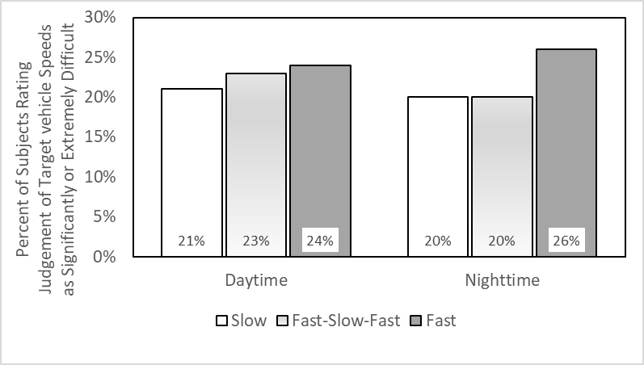
Judgement of work vehicle speed traveling toward the participant was more difficult when the fast flash speed was displayed

Slide 35
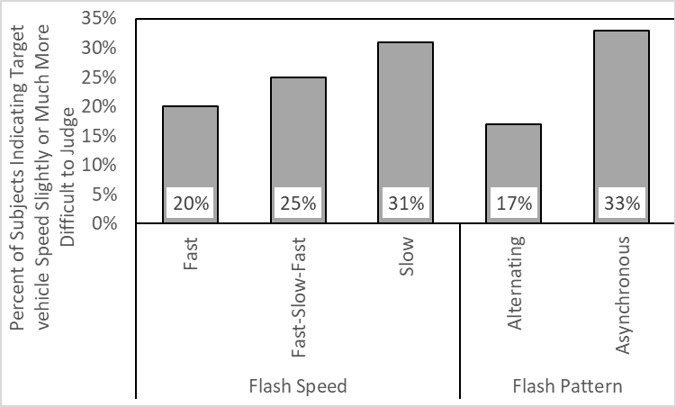
Warning light treatments using a slow flash speed was more difficult when pavement was wet

Slide 36
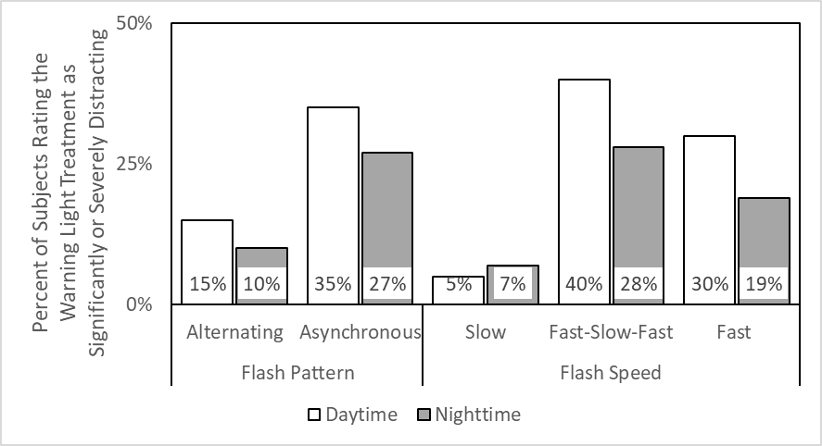
Alternating flash pattern and slow flash speed were rated as less distracting than other treatments

Slide 37
Field Evaluations of Best Warning Light Treatments
Focused on driver behaviors (speeds, lane choice) approaching and passing by a work vehicle with warning light treatments that
Warning light treatments evaluated
  Amber versus amber and green
  Slow flash speed, fast flash speed, alternating fast-slow-fast flash speed
  Alternating flash pattern
  8-light array evaluated daytime, 4-light array evaluated at night

Slide 38
Study Methodology
Stationary shoulder closures were evaluated
Same locations evaluated during daytime and nighttime viewing conditions
Four study sites selected
  Two in Texas, two in Connecticut
  Two on two-lane highways, two on multi-lane highways or interstates
Used lidar to measure speeds of vehicles passing by the work vehicle
At multi-lane highway sites, lane distribution adjacent to the work vehicle were also recorded

Slide 39
Speeds past the work vehicle tended to be lower when amber and green lights were displayed
Site | Average Speed, mph
 | Daytime |  | Nighttime
 | Amber | Amber/ Green | Amber | Amber/ Green
Site 1: Four-lane divided | 71.9 | 71.6 | 69.9 | 69.3
Site 2: Two-lane highway | 67.3 | 68.0 | 66.1 | 64.7
Site 3: Two-lane highway | 48.4 | 46.4 | 45.7 | 43.3
Site 4: four-lane divided | 70.2 | 67.9 | 67.5 | 66.5
Notes:
Warning light flash speed had no effect on average speeds

Slide 40
Amber and green lights also resulted in greater percentages of drivers using lane away from work vehicle
Site | Percent of Traffic in Lane Away from Work Vehicle
 | Daytime |  | Nighttime
 | Amber | Amber/ Green | Amber | Amber/ Green
Site 1: Four-lane divided | 74 | 80 | 86 | 93
Site 4: four-lane divided | 51 | 53 | 53 | 52
Notes:
Again, differences in warning light flash speed did not affect percentage of drivers using the lane away from the work vehicle

Slide 41
Conclusions
Vehicle markings assist driver abilities to detect workers on foot at night, so long as they are not overly unique. Unique markings may increase their attention-attracting abilities, but possibly at the expense of decreased worker detection and recognition.
Use of more Class 1 warning lights in an array increases ratings of urgency or level of hazard being approached, but also increases distraction and discomfort glare.

Slide 42
Conclusions (Cont’d)
Use of multi-color (amber and green) lights increases driver perceptions of urgency or level of hazard being approached, but also distraction and discomfort glare. Amber and green lights yielded the greatest response by drivers during the field evaluations
Fast flash speeds increases driver perceptions of urgency or level of hazard being approached, but also distraction and discomfort glare.
The alternating fast-slow-fast flash speed did not affect driver abilities to judge work vehicle speeds or influence driver behavior in the field evaluations.

Slide 43
Conclusions (cont’d)
An asynchronous flash pattern reduces driver abilities to detect and recognize worker presence and causes higher ratings of discomfort glare.
The asynchronous flash pattern was also rated as indicating a less urgent or hazardous situation than does an alternating flash pattern.

Slide 44
Implementation Considerations
Different marking and warning light needs exist depending on type of roadway operations vehicle or equipment of interest
  Service patrols/incident response
  Temporary traffic control vehicles
  Winter weather treatment and response vehicles
  Project inspector or manager vehicles
  Construction, maintenance and utility work vehicles
  Construction, maintenance, and utility work equipmen
Notes:
Each of these different vehicle and equipment types have very different operating characteristics, conditions under which they are viewed, etc.

Slide 45
Proposed Vehicle Marking and Warning Light Guidelines
Service Patrol/Incident Response | Marking Colors: red and white (or colors other than yellow and black) Marking Pattern: inverted V or checkerboard Peak Light Intensity: 1200 cd minimum daytime, 1200 cd maximum nighttime Light Color(s): multi-color (amber and green, amber and blue or amber and red if allowed by law) Light Flash Speed(s): fast (2.5-3 Hz) or alternating fast-slow (1-1.25 Hz)-fast

Slide 46
Proposed Vehicle Marking and Warning Light Guidelines (cont’d)
TTC Vehicles (Truck- or Trailer-Mounted Attenuators, Shadow Vehicles, etc.) | Marking Colors: yellow and black (if using checkerboard pattern) or red and white (if using an inverted V pattern) Marking Pattern: see marking colors Peak Light Intensity: 1200 cd minimum daytime, 1200 cd maximum nighttime Light Color(s): multi-color (amber and green, amber and blue or amber and red if allowed by law) Light Flash Speed(s): slow or alternating fast -slow -fast

Slide 47
Proposed Vehicle Marking and Warning Light Guidelines (cont’d)
Winter Pre-Treatment Vehicles/ Snowplowing Operations | Marking Colors: yellow and black (or other colors that contrast with a white background) Marking Pattern: checkerboard Peak Light Intensity: 1200 cd minimum daytime, 1200 cd maximum nighttime Light Color(s): multi-color (green and amber, blue and amber or red and amber if allowed by law) Light Flash Speed(s): slow or alternating fast-slow-fast

Slide 48
Proposed Vehicle Marking and Warning Light Guidelines (cont’d)
Project Inspector/Project Manager Vehicles | Marking Colors: yellow and black Marking Pattern: inverted V Peak Light Intensity: 1200 cd minimum daytime, 1200 maximum nighttime Light Color(s): multi-color (green and amber, blue and amber or red and amber if allowed by law) Light Flash Speed(s): slow or alternating fast-slow-fast

Slide 49
Proposed Vehicle Marking and Warning Light Guidelines (cont’d)
Construction/ Maintenance/ Utility Work Vehicles | Marking Colors: yellow and black Marking Pattern: inverted V Peak Light Intensity: 1200 cd minimum daytime, 1200 maximum nighttime Light Color(s): amber or amber and white Light Flash Speed(s): slow

Slide 50
Proposed Vehicle Marking and Warning Light Guidelines (cont’d)
Construction Equipment | Marking Colors: none required (yellow and black if agencies choose to use them) Marking Pattern: none require (inverted V if used) Peak Light Intensity: minimum 300 cd (single Class 2 warning light) Light Color(s): amber or amber and white Light Flash Speed(s): slow

Slide 51
Vehicle Marking and Warning Light Recommendations (cont’d)
Construction Equipment | Marking Colors: none required (yellow and black if agencies choose to use them) Marking Pattern: none require (inverted V if used) Peak Light Intensity: minimum 300 cd (single Class 2 warning light) Light Color(s): amber or amber and white Light Flash Speed(s): slow

