Slide 1
The following presentation is supplemental to NCHRP Research Report 1088: State DOT Models for Organizing and Operating Emergency Response: A Guide (NCHRP Project 20-128). The full report can be found by searching on the report title on the National Academies Press website (nap.nationalacademies.org).
The National Cooperative Highway Research Program (NCHRP) is sponsored by the individual state departments of transportation of the American Association of State Highway and Transportation Officials. NCHRP is administered by the Transportation Research Board (TRB), part of the National Academies of Sciences, Engineering, and Medicine, under a cooperative agreement with the Federal Highway Administration (FHWA). Any opinions and conclusions expressed or implied in resulting research products are those of the individuals and organizations who performed the research and are not necessarily those of TRB; the National Academies of Sciences, Engineering, and Medicine; the FHWA; or NCHRP sponsors.

Slide 2
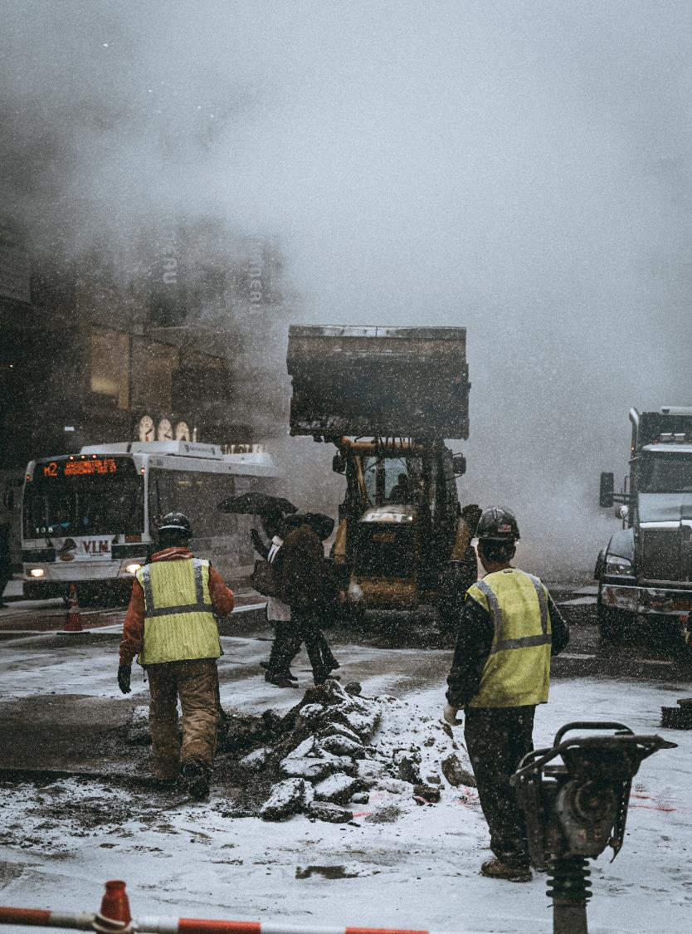
NCHRP 20-128: Organizational & Operational Models Used by State DOTs
January, 2023
Deb Matherly, MIRTA LLC | Pat Bye, Consultant Eryca Dinsdale, WSP | Trevor Clifford, WSP
NCHRP Project 20-128: Organizational & Operational Models Used by State DOTs
March 2022
Deborah Matherly, MIRTA LLC | Patricia Bye, Consultant | Eryca Dinsdale, WSP

Slide 3
Project Overview
Introduction
Project Purpose
Literature Review and Glossary Update
Survey Overview and Highlights
Conceptual Model
Case Studies
Implementation Plan
Future Research Needs

Slide 4
Core Team
Introduction
Deb Matherly
Principal Investigator
Pat Bye
Co-Principal Investigator
Eryca Dinsdale Organizational and Operational Model
Trevor Clifford WSP Project Manager

Slide 5
Task Summary Status
Introduction
Task | Description | Completed
1 | Start-up & Kick-Off | 4/6/2021
2A | Draft Literature Review | 8/10/2021
2B | Draft Glossary | 12/22/2021
3 | DOT EM Survey/Census 2ND Push Completed | 12/22/2021 7/15/2022
4 | Preliminary Model Development | 12/22/2021
5 | Interim Report | 12/22/2021
6 | Final Model | 12/9/2022
7 | Final Deliverables | 1/16/2023

Slide 6
Literature Review

Slide 7
Literature Review
Literature Review & Glossary
Objective: Overview of Information Related to DOT Organization and Operation for Response
Introduction
Federal Government Guidance
Literature Peer-Reviewed Articles
State DOT Emergency Management and Organization
Literature Review Conclusion
Notes:
1 Introduction
2 Purpose, Whole Community Approach, Federal Mandates
3 NIMS, ICS; Collaboration; Non-Standard employees in disaster mgt; whole community approach in practice
4.4 1. At State DOTs- org. structures- national scan of “gray” sources; 2. DOT EM Plans 3. DOT EM Guidance; 4. EM Capabilities: 4.4.1 Communication 4.4.2 Supporting Tools 4.4.3 Evacuation Planning 4.4.4 Training and exercises 4.4.5 After Action Reports
5 Literature Review Conclusion

Slide 8
Glossary
Literature Review & Glossary
Objective: Develop a Glossary Related to DOT Organization and Operation EM Response
Aggregated and extracted pertinent items from glossaries developed for and by other projects
Organized alphabetically
Focus on emergency management
Notes:
Related items- P. 23
P. 50-51
P. 61-62
P. 67
Welcome feedback to improve utility

Slide 9
Census Highlights

Slide 10
Overview of Census Process
Census
Objective: Understand DOT Emergency Response Organization
Step 1
Step 2
Step 3
Step 4
Step 5
Step 6
Review & Pre-Test
Pre-test with Expert Panel and Review Panel
Distribution
Distributed to AASHTO CTSSR & DOTs that responded to NCHRP 20-116 survey
Follow-up/ Reminders
Sent by AASHTO on November 22, 2021
Non-respondent reminders on December 1-2, 2021
Interim Report Census Close
December 15, 2021
2nd Push
Emails & phone calls to DOTs
Contacts with regional FHWA representatives
Census Closed
July 15, 2022
Notes:
Administered through a web-based survey administration tool, SurveyMonkey
Response period was from November 5 to December 15, 2021.
Distributed by the AASHTO representative, Robert White to the AASHTO CTSSR Emergency Management Task Force and to State DOT emergency management representatives that responded to the NCHRP 20-116 survey or were interviewed as part of that project.

Slide 11
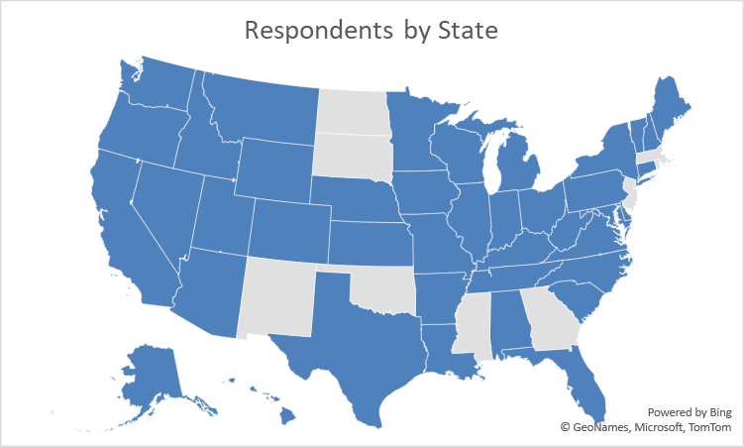
Results: Total State DOT Respondents
Census
43 DOTs in Total

Slide 12
Emergency Management in Organizational Structure
Census
DOT Executive Office
Operations and Maintenance
TSMO Division
Emergency Management
Emergency Management
Security
2%
70%
9%
15%
4%
Recent Changes
Re-organized sections
Added dedicated EM group

Slide 13
Emergency Management Employees
Census
Primary EM Responsibilities
50% have 5 or less employees
30% have 2 or less
30% have 6-15 employees
20% have 15+ employees
Recent Changes
Added dedicated EM personnel
Switched roles/responsibilities

Slide 14
Centralized vs. Distributed Emergency Management
Census
Headquarters
42%
HQ/Local 19%
Regions 12%
Op Units 16%
Local 12%
Districts, Parishes, etc.
Recent Changes
More centralized HQ structure
Added regional EM positions

Slide 15
Dedicated Strike Teams – 45%
Census
Mobile Emergency Teams
Damage Assessment Teams
Winter Weather Strike Teams

Slide 16
Ability to Flex: Cross-Training
Census
Every job description
35%
Most job descriptions
65%
Advanced training
56%
Regular Training
44%
Method for Cross-Training
Part of job description
Part of regular training
Part of advanced training
Job Description (44%)
Training (42%)

Slide 17
Pool of Surge Personnel
Census
Contractors
Both for emergency response and everyday operations.
01
CONTRACTOR
DOT STAFF
02
Other Region/District Staff
Cross departments, districts or regions or selected by managers based on experience and position.
RETIREE
Volunteers
From every part of organization statewide.
03
04
Retirees
Former state DOT employees.

Slide 18
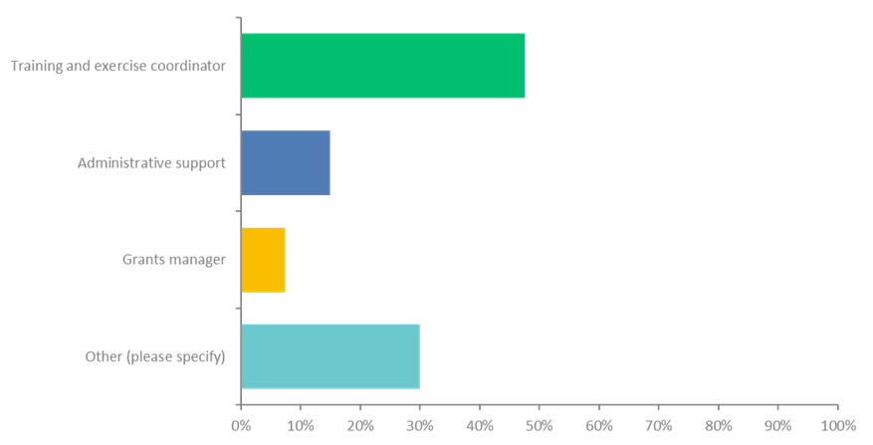
Personnel Needs
One More Person
If you could add one more person to your emergency management program, what would that person do?
Other responses included:
Recovery
Planning, preparedness, logistics, grants
Full time emergency management coordinator
Emergency event planning, response and recovery process and procedural enhancements/improvements
Someone to assist with backup during an active incident
Financial recovery depth
Grants Specialist (Field Support)
Local agency liaison

Slide 19
Organizational Models

Slide 20
Use of the flexible model
Organizational Models
Provides a framework for DOT’s when making organizational decisions such as
Staff organizational reporting
Connection to statewide EOCs
Programmatic decision-making
Field response
Surge response
There is no one ‘right’ or ‘preferred’ solution for organizing around emergency management.

Slide 21
Factors driving organizational models
Continuum of options
Organizational Model
Governance
Reporting Placement
Programmatic Planning and Support
Planning / Training / Institutionalizing
Response
Setting Strategic Direction
Staffing
Partnerships
Lead DOT Response
Response Staffing and Equipment Structure
Collaboration
Surge Capacity
Functions
Elements

Slide 22
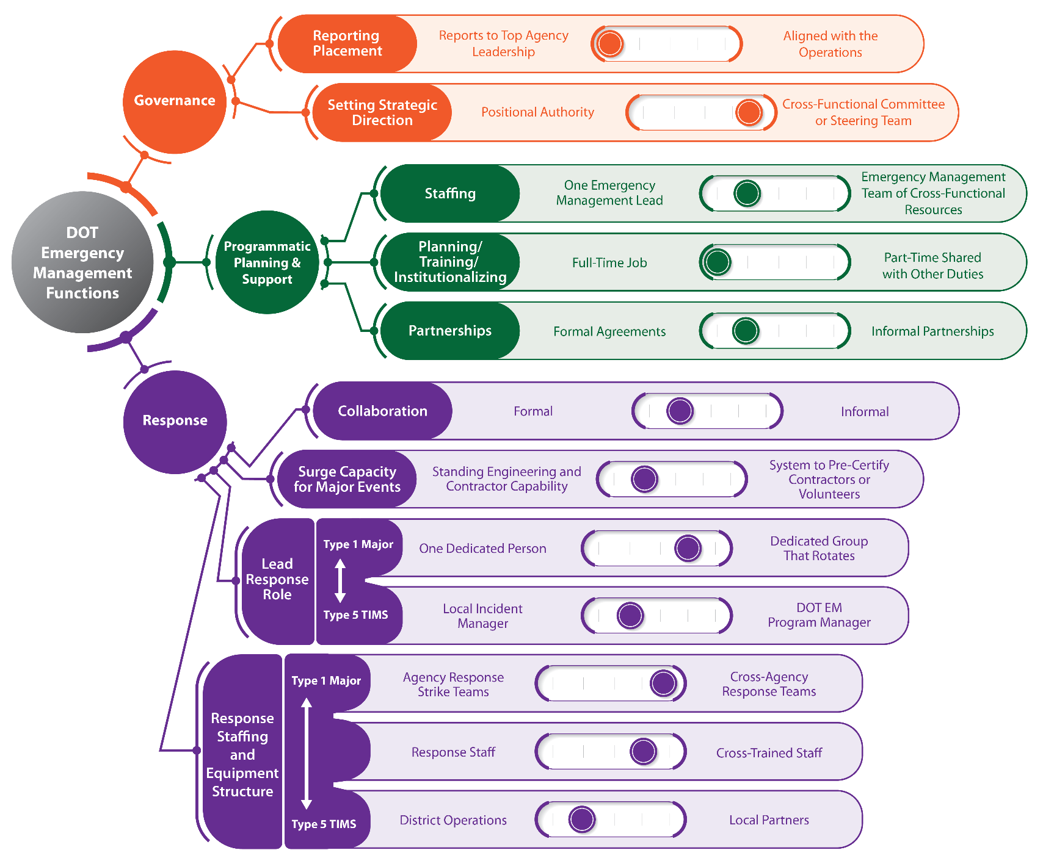
Overall
Organizational Model

Slide 23
Governance
Governance
Organizational Model
Provides the strategic direction for the EM program;
Establishes the mission, goals, objectives, and priorities in advance of events; and
Ensures that adequate funding is in place.
Addresses the relationship of “lead” EM role with top agency leadership and how roles and responsibilities of those parties are assigned.
Ensures that adequate funding is in place.
Considers questions such as:
How are the policies and procedures agreed to and disseminated?
Who ensures compliance with the requirements, manages the program risk, sets the strategic direction, and ensures that adequate funding is in place?

Slide 24
Governance: Reporting Placement
Organizational Model
WHAT IS IT: Where the reporting relationship in the agency resides in DOT
Agency Leadership
Aligned with Operations
Idaho EM program manager reports directly to Deputy Director of DOT. In Virginia Office of Safety Security and Emergency is direct report of Commissioner of Highways.
70% of DOTs have EM function aligned with the Operations. Examples include Alabama, Alaska, Connecticut and Georgia.
Ensure that agency divisions that need to support EM understand the importance of EM and what the EM program manager does.
Ensure that senior management are aware of EM and are willing to support the EM program.

Slide 25
Governance: Setting Strategic Direction
Organizational Model
WHAT IS IT: How decisions are made by an agency EM program
Positional Authority
Cross-Functional Committee/Team
Florida DOT formally delegates positional authority to Emergency Coordination Officer.
Iowa created a formal Program Advisory Group that provides support to EM program manager with program structure, job descriptions, and training program.
Ensure that agency recognizes authority of EM program manager, either formally or informally, and that senior management support that authority.
Ensure that members of steering committee stay engaged in EM and that positions are filled when committee personnel move on.

Slide 26
Planning and Programmatic Support
Organizational Model
Activities that help institutionalize EM practices but are not directly related to a specific emergency response.
Staffing and Resource Allocation – ensuring that programmatic elements of EM can be carried out and sustained, especially during larger-scale events with a longer recovery duration
Planning – implementing the strategic direction, policies, and procedures and ensuring alignment with the state emergency operations plan (EOP)
Training – identifying training plans related to EM for agency staff, ensuring that the training happens, managing continuous learning such as making sure that after-action reviews and lessons get integrated into future practices, and ensuring that the DOT incorporates National Incident Management System (NIMS)/ICS standards and protocols
Institutionalizing – establishing and maintaining processes and habits that will provide for continuity as personnel changes.
Partnerships – ensuring that relationships are being built and maintained (external and internal) and that communications and engagement activities such as spreading the word about EM (internal and external) are carried out

Slide 27
Planning and Programmatic Support: Staffing
Organizational Model
WHAT IS IT: Allocation of personnel, organization and structure of programmatic EM
EM Lead
Cross-Functional Team
Most DOTs have dedicated EM program manager located at agency HQ.
Florida DOT has dedicated personnel for plans and finance along with logistics and intelligence that report to EM lead.
Ensure back-up and assistance are available when necessary.
Establish relationships and ongoing communications with agency divisions that provide support.

Slide 28
Planning and Programmatic Support: Planning/Training
Organizational Model
WHAT IS IT: Establishing/maintaining processes that provide for program continuity
Full-Time
Part-Time
70+% agencies have dedicated full-time resource as EM program manager.
Examples include Alabama, Colorado, Indiana, Kansas, Tennessee, Pennsylvania and Vermont. Other duties include field maintenance, fleet tracking, TIM training, and safety.
Identify the available expertise and resources to support the EM program manager.
Ensure that EM is the primary responsibility. Ensure that supporting staff is dedicated to programmatic planning and support.

Slide 29
Planning and Programmatic Support: Partnerships
Organizational Model
WHAT IS IT: Building/maintaining relationships (external & internal) to support EM
Formal Agreement
Informal Partnerships
DOTs tending toward more formal agreements include Arkansas, California, Colorado, Florida, Georgia, Hawaii, and Michigan.
DOTs that rely on informal partnerships include Massachusetts, Minnesota, Montana, New Hampshire, and Wyoming.
Ensure clarity around who will do what in which situations. Build in flexibility to address unique situations.
Document contacts and relationships so they can be maintained over longer term. Communicate on a regular basis to maintain relationships.

Slide 30
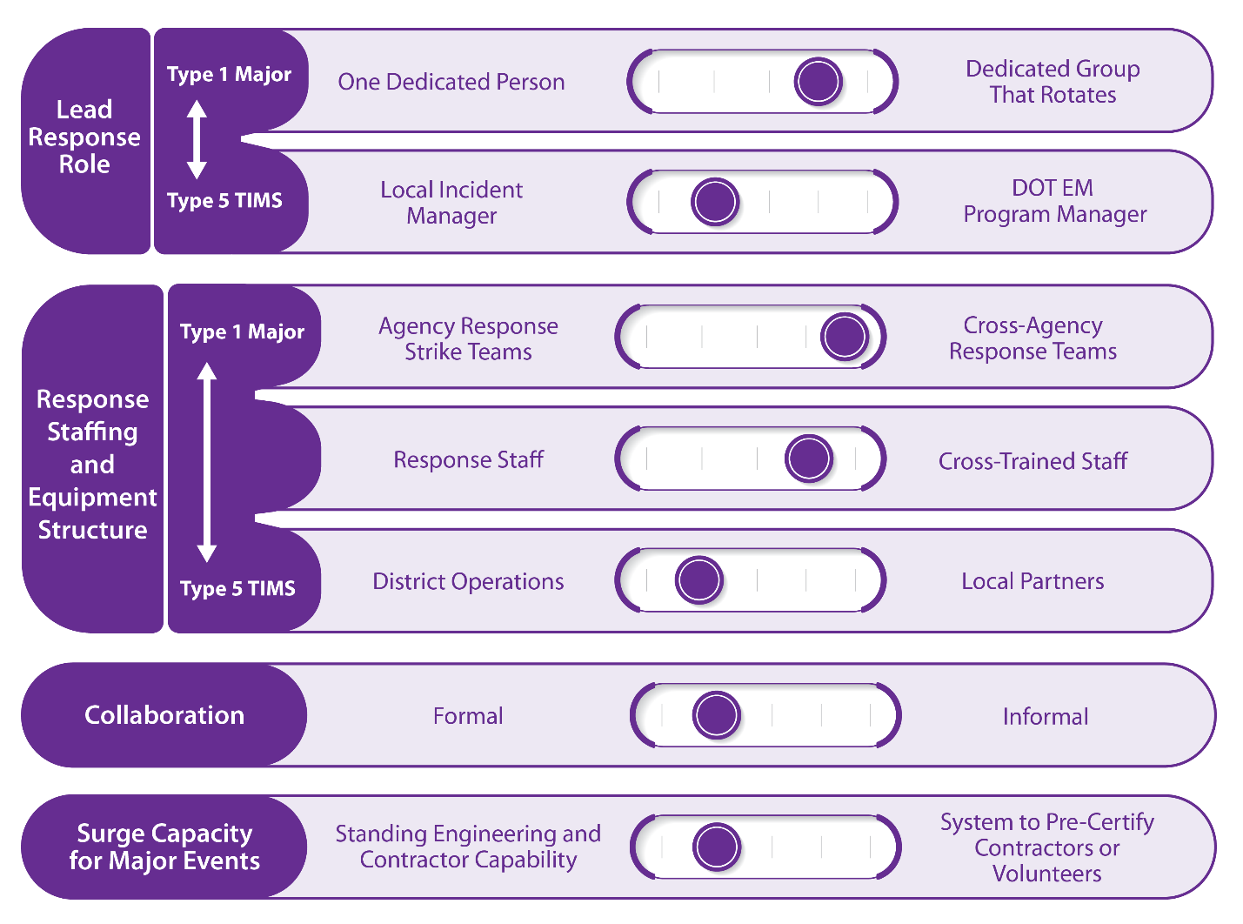
Response
Organizational Model
Deploying personnel & field equipment to address different types/levels of events and support recovery operations post- event

Slide 31
Response: Lead Response Role
Organizational Model
WHAT IS IT: Considers who incident/event manager(s) is and does this change as the incident escalates or cascading events occur.
One Dedicated Person
Designated Group
Many agencies start out with one designated person, often the DOT EM program manager, with an identified backup for rest periods.
Alabama, Delaware, Indiana and Iowa are examples of DOTs that rotate as the DOT emergency manager in significant events.
Consider backup positions for rest periods, and triggers to reevaluate the DOT’s staffing OC during the event.
During the event, will need to remain in close coordination, advice, and counsel.

Slide 32
Response: Staffing and Equipment Structure
Organizational Model
One Dedicated Person
Designated Group
WHAT IS IT: Determines how DOT responds to incident/event and how additional response personnel & equipment are mobilized as event develops
Agencies utilize O&M staff to respond to events, since typically event requires types of activities that O&M perform.
Agencies cross-train staff based on experience & position so additional resources are available when necessary.
Establish and document response procedures and ensure that O&M staff are aware of procedures.
Establish a forum or mechanism to discuss lessons learned and improvements.

Slide 33
Response: Collaboration
Organizational Model
WHAT IS IT: Process of engaging and mobilizing agency resources outside of EM and/or O&M organization
Formal
Informal
North Carolina DOT has established MOAs with local counties that proved helpful to mobilize debris removal for events.
Michigan DOT maintains close relationships with transportation officials in Ontario, Canada, in addition to relationships with states that share its borders: Ohio, Indiana, and Wisconsin.
Document agreements to ensure institutionalization. Include what is expected of each party and when, to avoid conflicts during an event.
Bolster informal relationships with other practices to remain resilient during leadership changes.

Slide 34
Response: Surge Capacity
Organizational Model
WHAT IS IT: Longer-term or major events agency staff may not be sufficient and there is need for additional response, or surge, personnel and resources
Standing Capability
Pre-Certified Capability
Tennessee DOT has established “on call” contracts so that work is ready to be done whenever needed with contract already in place.
Ohio, Massachusetts, and Vermont require contractors to be on list of pre-qualified vendors to be awarded emergency contracts.
Depending on identified technical capacity, pre-planning for the specifications and processes under the contacting mechanism will be important.
Ensure that emergency expedited processes are in place so that emergency contracts can be rapidly implemented.

Slide 35
Case Studies

Slide 36
Case Studies
Case Studies
ER Specialized “Strike Teams”
Evolution of DOT EM Program
Financial Aspects of EM
Security and EM
Training and Cross-Training for EM
TSMO and EM
Notes:
helped identify potential model characteristics:
2 Purpose, Whole Community Approach, Federal Mandates
3 NIMS, ICS; Collaboration; Non-Standard employees in disaster mgt; whole community approach in practice
4.4 1. At State DOTs- org. structures- national scan of “gray” sources; 2. DOT EM Plans 3. DOT EM Guidance; 4. EM Capabilities: 4.4.1 Communication 4.4.2 Supporting Tools 4.4.3 Evacuation Planning 4.4.4 Training and exercises 4.4.5 After Action Reports
5 Literature Review Conclusion

Slide 37
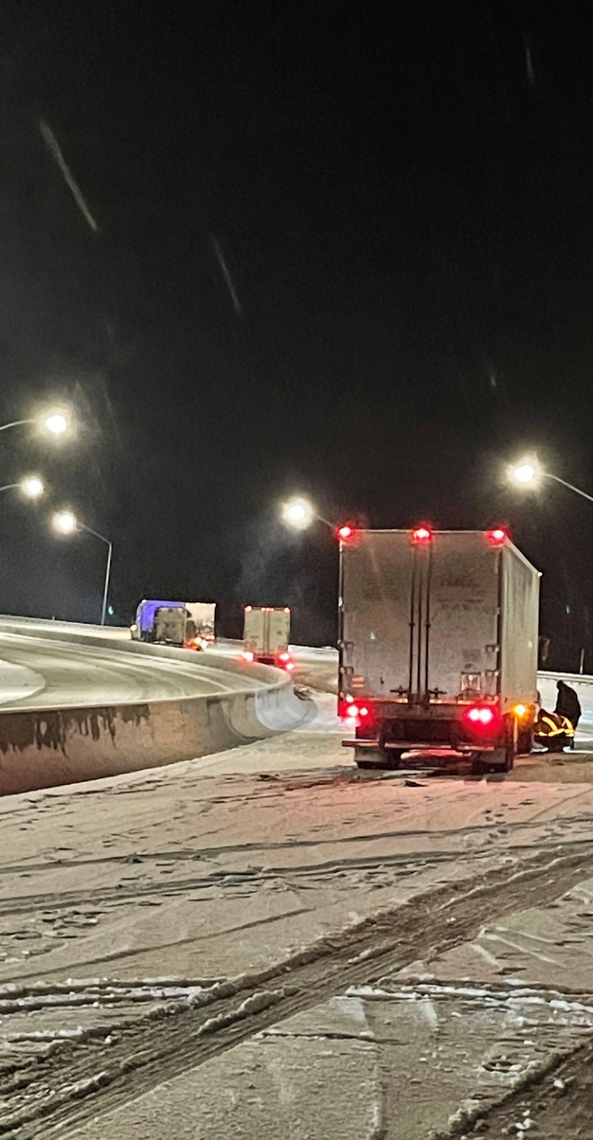
Emergency Response Specialized Strike Teams
Case Studies
Teams trained to respond to event as agency’s 1st line of response
Types:
Damage assessment teams (post-event) such as for bridge, road and facility.
Event-specific response teams such as winter storm or wildfires.
General response teams that address all-hazards.
Tennessee DOT has 8 25-member teams that are fully equipped, mobile, and self-sufficient. Notable success was Gatlinburg wildfires.
Pennsylvania DOT Mobile Equipment Teams (MET) are defined as part of all-hazards Incident Management Manual.
Florida DOT has Specialized Mission Teams including Severe Incident Response Vehicle Team (SIRV).
 | Consider potential value beyond initial vision. Consider what specialized / cross-trained teams are in place, Consider pros and cons of expanding geographic flexibility of local or limited geographic regional teams.

Slide 38
Evolution of a DOT Emergency Management Program
Case Studies
All DOT EM programs evolve, often radically after a major event or shake-up.
Georgia DOT: Major 2013 snow storm led to total EM overhaul, facilitating exceptional response and recovery from the 2017 Interstate fire and bridge collapse.
Idaho DOT: Major emergency and FEMA earthquake exercise identified shortcomings & EM reorganization.
Idaho DOT Challenge | 2013 EM Reorg | Idaho EM Today
EM 6 levels from CEO | EM direct report to Deputy Director | EM direct report to Deputy Director
Limited EM staffing | Emergency Duty Officers established | Functional Emergency Duty Officers
Limited ability to identify & organize expertise | Cross-functional Emergency Response Council established | Regular attendance at Operational & Engineering Meetings
 | Talk to senior management every day to keep activities and importance of EM top of mind. Recognize the importance of experience to reinforce EM training. Identify ways to exercise and practice EM response and support. Document procedures and lessons learned from AARs. A resilient DOT needs to learn from experience.

Slide 39
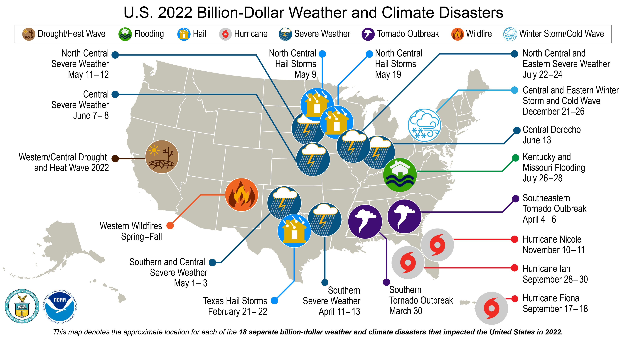
Financial Aspects of Emergency Management
Case Studies
Disaster funds need to flow quickly with states often 1st funders through varying legislative spending authorities.
Effective cost management & cost recovery require:
Plan for managing recovery funds;
Systems in place for drawdown of relief funds;
Systems in place for accurately tracking and reporting labor, supplies, and other resources (including contractors).
Federal programs/grants provide proactive and reactive additional funding:
FHWA Emergency Relief and FEMA Public Assistance programs supplement state and local resources
Federal grant program such as FEMA Hazard Mitigation Grant Program; HUD Community Development Building Grants; Economic Development Authority (EDA) Grants
Special legislation post-event, e.g., post-hurricanes Katrina and Rita, post-Superstorm Sandy
 | Designate headquarters and district reimbursement coordinators now (pre-event). Establish & publicize charge codes for labor, supplies and contracts effective w/governor declaration. Ensure financial recovery (refresher) training prior to events. Coordinate with FHWA & FEMA reps prior to, during, and after event for reimbursement process.

Slide 40
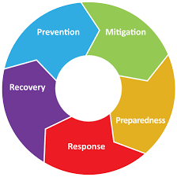
Security and Emergency Management
Case Studies
All-hazards EM approach addresses pandemics, terrorism and cybersecurity along with natural hazards. Security & EM are tied together – each one impacts the other.
Security is typically considered in realm of prevention and protection related to man-made incidents.
Emergency management includes preparedness (protect and mitigate) for all events along response and recovery.
Partnerships and coordination required for security are similar to those for Emergency Management.
Security
EM CYCLE
 | Virginia DOT combined Office of Safety, Security and Emergency Management has 6-15 employees. Includes the Emergency Operations Section (monitoring incidents and events and supporting statewide emergency response and recovery operations) and Emergency Planning Section. Idaho DOT combined Security/Safety/EM program office has 1 full-time employee. Texas DOT is a member of the Texas Homeland Security Council where the agency provides input and analysis to the Texas Homeland Security Strategic Plan and response efforts.
Emergency Management
 | Be prepared for all hazards, natural and man-made; anticipate characteristics of disruptions. Consider security as part of EM. Bake security into all agency activities.

Slide 41
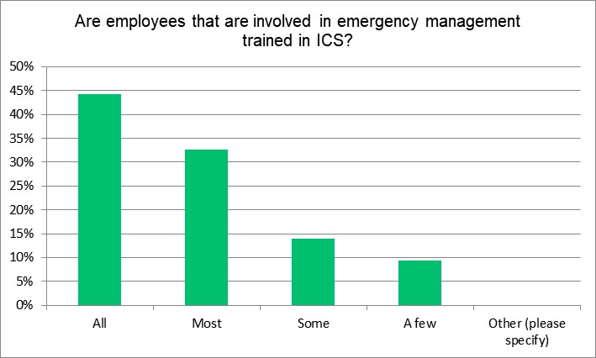
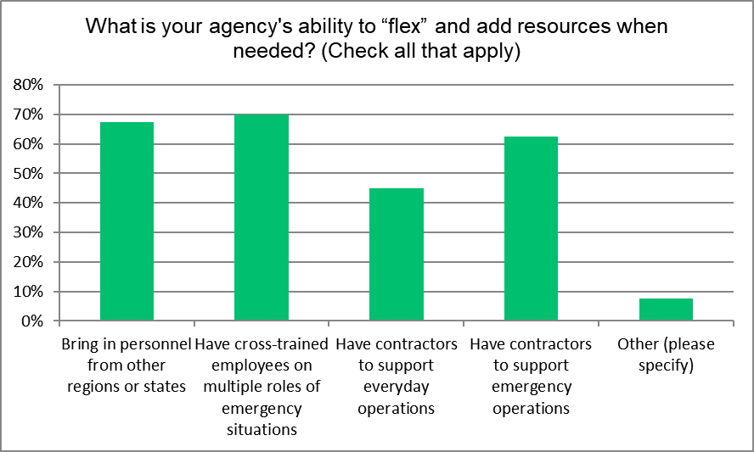
Training and Cross-Training for Emergency Management
Case Studies
Part of every agency’s O&M and administrative functions. EM training includes ICS, NIMS, and mission-specific training.
Vast majority report that all or most employees involved in EM are trained in ICS.
70% report that emergency response ability to “flex” and add resources when needed relies on employees cross-trained for multiple roles.
Many DOTs view more training resources as a priority - about 50% would add “Training and exercise coordinator” if could “Add one more person.”
 | Schedule and budget required, Include advanced individual and group training in ICS and other. Establish regular training with agency partners from tabletops through full-scale exercises. Ensure DOT is a partner in planning & executing State EM and regional emergency exercises.

Slide 42
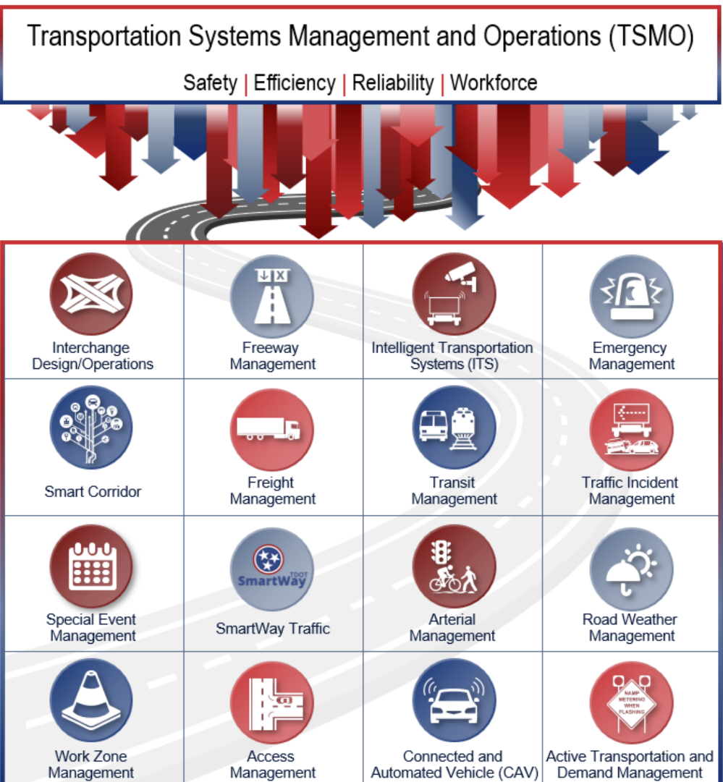
Transportation Systems Management and Operations (TSMO) with Emergency Management
Case Studies
TSMO strategies, technology, staff and relationships improve system operations and safety.
Arizona DOT locates EM in TSMO Division. Regional operations collaboration among transportation and public safety agencies are part of ADOT TSMO approach.
Iowa DOT Systems Operations Division includes Traffic Operations Bureau that includes Traffic Incident Management and Emergency Management Service Layers, including detailed Service Layer Plans.
TxDOT 2021 SOP includes TSMO strategies that address EM, incident management & special event management.
 | Consider organizational structure that integrates TSMO and EM. Leverage TSMO strategies, staff, training, technologies & relationships to foster internal and external relationships, communication and collaboration to address emergency events.
Source: TDOT Transportation Systems Management and Operations (TSMO) Program Plan, Feb 2022

Slide 43
Future Research Needs
Future Research
Model Interactive Tool Development
An interactive worksheet of model elements for DOT to perform and document a self-assessment of its EM program and identify action steps for proposed spectrum placement.
Expansion of Model Question Guide
A question guide to assist DOT in exploring EM organizational options.
Emergency Management Performance Measures
Identification of performance measures to access outcomes of the EM program and evaluate the effectiveness of DOT EM program to support decisions related to staffing, planning, resource allocation, and technology.

Slide 44
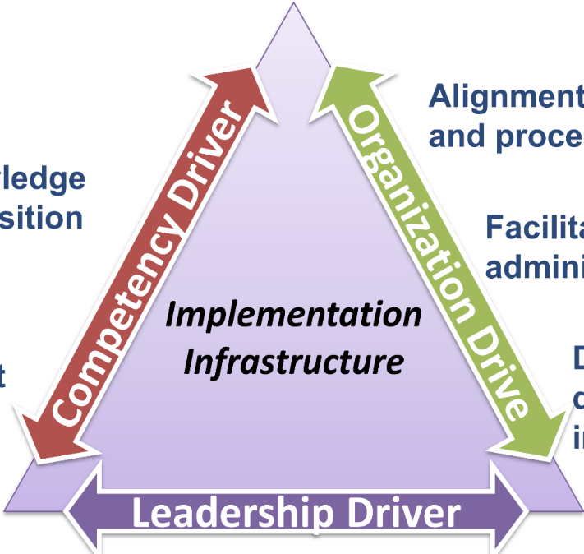
Implementation Plan
Implmentation
DOT Leadership buy-in is critical
address challenges to implementation
provide guidance on implementation approaches
be facilitators including ensuring alignment with agency policies
Implementation Action: AASHTO Regional Executive forums working with AASHTO regions
EM Managers are key implementers
provide essential assessment/feedback
identify existing and potential barriers to adoption
ensure alignment with agency procedures and policies.
Implementation Action: Work with core EM manager group on opportunities & approaches
Training is useful for developing competency
Implementation Action: Series of virtual and/or in-person multi-state training events in coordination with DOTs

Slide 45
Implementation Team
Implmentation
AASHTO Committee on Transportation System Security and Resilience and Emergency Management Task Forc can:
increase DOT buy-in
establish implementation infrastructure
promote sustainability
Proposed Implementation Action: National workshop/event at a CTSSR conference or annual meeting
Implementation Beyond DOTs
Relationships with national and international EM organizations can support implementation
Proposed Implementation Action: Workshops with established multi-state organizations by working with IAEM EM committee and US organizational leadership along with Identifying sponsors at state Emergency Management Agencies in partnership with state DOTs

Slide 46
Questions?
Deb Matherly, MIRTA LLC, Debmatherly@mirtallc.com
Patricia Bye, Consultant, patriciabye@gmail.com
Eryca Dinsdale, Eryca.dinsdale@wsp.com
Trevor Clifford, trevor.clifford@wsp.com

