Slide 1
The following presentation is supplemental to NCHRP Research Report 1103: The Effect of Vehicle Mix on Crash Frequency and Crash Severity (NCHRP Project 22-49). The full report can be found by searching on the report title on the National Academies Press website (nap.nationalacademies.org).
The National Cooperative Highway Research Program (NCHRP) is sponsored by the individual state departments of transportation of the American Association of State Highway and Transportation Officials. NCHRP is administered by the Transportation Research Board (TRB), part of the National Academies of Sciences, Engineering, and Medicine, under a cooperative agreement with the Federal Highway Administration (FHWA). Any opinions and conclusions expressed or implied in resulting research products are those of the individuals and organizations who performed the research and are not necessarily those of TRB; the National Academies of Sciences, Engineering, and Medicine; the FHWA; or NCHRP sponsors.

Slide 2
NCHRP Project 22-49 The Effect of Vehicle Mix on Crash Frequency and Crash Severity
Project Final Presentation
November 2023

Slide 3
Project Team
Project Team | Team Members
 | Naveen Eluru (Principal Investigator) Mohamed Abdel-Aty Tanmoy Bhowmik Shahrior Pervaz Dewan Ashraful Parvez Lauren Hoover
 | Kai Wang (Co-Principal Investigator) Shanshan Zhao Manmohan Joshi John N. Ivan

Slide 4
Outline
Future HSM Considerations
Project Background and Objectives
Project Tasks Completed
Key Project Deliverables
Project Implementation

Slide 5
Project Background
Highway Safety Manual (HSM) provides methods and procedures in estimating crashes at different levels.
However, these methods currently do not account for the influence of vehicle mix information while model estimation.
Recent research efforts show a substantial impact of vehicle mix on crashes.
The incorporation of vehicle mix would improve crash predictive methods and assist in better use of the limited funds and resources.

Slide 6
Project Background
The current project has
explored the impact of vehicle mix on crash analysis.
developed crash frequency and severity models for jurisdictions with vehicle mix data available by facility type.
incorporated vehicle mix information in newer approaches.
The newer approaches proposed have the advantage of being developed for recently completed NCHRP research (17-85) and would naturally lend themselves to modifying the HSM model structure for future versions.

Slide 7
Project Objectives (from RFP)
Develop methods to quantify the effect of vehicle mix on crash frequency and severity for various facility types
Develop a spreadsheet tool for practitioners to quantify the effect of vehicle mix on safety performance
Objective 1
Objective 2

Slide 8
Project Tasks Completed
Phase I
Task 1: Prepare a technical report that summarizes literature review, data availability, analytical approaches and develops a framework for incorporating vehicle mix in frequency and severity models
Task 2: Develop a detailed work plan with data sources, selected facility types, data processing and analysis approaches, validation metrics and spreadsheet development
Task 3: Prepare and submit an interim report

Slide 9
Project Tasks Completed
Phase II
Task 4: Apply the proposed framework by processing the data, estimating and validating models by facility type and examining model performance
Task 5: Develop a spreadsheet tool clearly outlining the methodology and application guidance
Task 6: Use practical examples, to test and illustrate the spreadsheet tool
Task 7: Prepare an instruction guide and a quick start guide for facilitating adoption of the developed models

Slide 10
Project Tasks Completed
Phase II
Task 8: Provide a virtual demonstration for the NCHRP Panel as well as a final presentation to sponsoring committees including coordination with NCHRP and AASHTO Committee on Highway Traffic Safety
Task 9: Prepare an accessible report with guidelines for future HSM adoption
Task 10: Prepare draft final deliverables
Task 11: Prepare documentation and guidance summarizing the research effort, future research recommendations, spreadsheet tools to enhance state DOTs’ procedures for updating crash frequency and severity models and a TR News article

Slide 11
Data Source
HSIS
California
Illinois
North Carolina
Ohio
Washington
Minnesota
Non-HSIS
Connecticut
Florida
Texas
South Dakota
Variables missing
Variables missing

Slide 12
Facility Selection
First, the team focused on the facilities that are covered in the first edition of the HSM
rural two-lane two-way roadways, rural multilane highways, urban/suburban arterials, freeway segments and intersections
Each facility is further categorized into multiple categories based on different variables (number of lanes, presence of median).
Estimating models for all the facilities will require substantial amount of time and effort
Vehicle mix might not vary across locations
The research team focused on major facilities based on total and heavy vehicle crashes.

Slide 13
Facility Selection (Coarser Level)
Segment Facilities
Urban
Limited Access Facilities
Arterials
Rural
Urban
Rural
Intersection
Facilities
Urban
Rural

Slide 14
Facility Selection (Finer Level)
Segment Facilities
Urban
Limited Access Facilities
Arterials
Rural
Urban
Rural
Intersection
Facilities
Urban
Rural
4-lane divided
6-lane divided
8-lane divided
10-lane divided
3-leg STOP controlled
4-leg STOP controlled
3-leg signalized
4-leg signalized
2-lane undivided
3-lane
4-lane undivided
4-lane divided
5-lane
4-lane divided
6-lane divided
8-lane divided
3-leg STOP controlled
4-leg STOP controlled
4-leg signalized

Slide 15
Facility Selection: Detailed Classification
Limited Access Facilities:
Urban 4-LD
Urban 6-LD
Urban 8-LD
Urban 10-LD
Rural 4-LD
Rural 6-LD
Rural 8-LD
Arterials:
Urban 2-LUD
Urban 3-L
Urban 4-LUD
Urban 4-LD
Urban 5-L
Rural 2-LUD
Rural 3-L
Rural 4-LUD
Rural 4-LD
Rural 5-L
CA
CT
FL
IL
MN
TX
WA
Segment Facility
Facility Type
CA
CT
FL
MN
STOP Controlled:
Urban 3-leg
Urban 4-leg
Rural 3-leg
Rural 4-leg
Intersection Facility
Signalized:
Urban 3-leg
Urban 4-leg
Rural 4-leg
24 Facilities

Slide 16
Pooled Datasets
Pooled Data
California
Illinois
Washington
Florida
Connecticut
Minnesota
Texas
Facility Type
Repeat process by
facility type
Estimation Sample
Validation Sample

Slide 17
Variable Assessment
Dependent Variables
KABCO severity scale
K (fatal crashes),
A (incapacitating crashes),
B (non-incapacitating crashes),
C (possible injury crashes), and
O (no injury crashes).
For intersection crashes - crashes that occurred within a 250ft intersection buffer are assigned.

Slide 18
Variable Assessment
Independent Variables
HSM aligned variables
Roadway Characteristics
Lane width, median width, shoulder width
Traffic Characteristics
AADT, major AADT, minor AADT
New vehicle mix variables
Coarser Level: %truck, %major road truck, %minor road truck
Finer Level: %truck types (single unit, double unit etc.)

Slide 19
Vehicle Mix Data Availability
State | Vehicle Mix Data Availability | Vehicle Classification |  | Data Used for Models | Source
 |  | Coarse | Fine
HSIS States
California | Available | Car | -- | Observed | CDOT
 |  | Truck | Two axle, three axle, four axle, five axle
Illinois | Available | Car | -- | Observed | IDOT
 |  | Truck | Single unit, multi-unit
Minnesota | Available | Car | -- | Observed | MNDOT
 |  | Truck | Single unit, combination unit truck
Washington | Available | Car | -- | Observed | WSDOT
 |  | Truck | Single unit, double unit and triple unit
Non-HSIS States
Connecticut | Not Available | Car | -- | Generated | QIE technique
 |  | Truck | --
Florida | Available | Car | -- | Observed | FDOT
 |  | Truck | --
Texas | Available | Car | -- | Observed | TXDOT
 |  | Truck | Single unit, combination truck

Slide 20
Approach and Assumptions of Vehicle Mix Data
We employed state specific GIS data
Developed approaches to match the nearest sections in GIS using proximity tools
When data for the exact crash year was not available, AADT data for the crash year was employed along with the truck percentage from the nearest years (with an upper limit of 2years) to get truck AADT
For jurisdictions without any Truck data, we employed Quasi-induced Exposure method to generate data (for Connecticut)

Slide 21
Generating Vehicle Mix Data
For Connecticut, we do not have information on vehicle mix
We adopted the QIE approach to generate vehicle mix data
Basic Idea: Proportion of a driver/vehicle category not at fault in two- or more-vehicle collisions is related to the exposure of that driver/vehicle category in the entire driving population at the location
We aggregated nearby sites to get a large sample to estimate the proportions
It allows us to accommodate vehicle information purely relying on crash data
Further, the relative appropriateness of the approach can be easily evaluated

Slide 22
Model Estimation with Truck Data
Based on the data availability, we used following variables as vehicle mix data
%truck: Truck AADT*100/AADT
%SUT: Single unit truck AADT*100/AADT
%major road truck: Truck AADT in major road*100/major road AADT
%major road truck: Truck AADT in minor road*100/minor road AADT
To consider additional forms of truck traffic affecting crash counts
We tested for the impact of trucks in locations with high truck volume
These are locations with truck proportion >= 85th Percentile of truck traffic proportion for the facility type
For Rural Arterial 2 Lane Undivided (RA2LUD) segments, the high truck 85th percentile value was 20%.

Slide 23
Model Frameworks
HSM Model
Multivariate Poisson-lognormal Model
Negative Binomial- Ordered Probit Fractional Split Model
Test and finalize
SPF and SDF with
vehicle mix variables

Slide 24
HSM Model
HSM models were estimated and used as benchmark for comparison of the newly developed model systems in terms of data fit and predictive ability.

Slide 25
Multivariate Count Method
ID
Total Crash
PDO
Injury
Fatal
1
10
6
4
0
2
12
6
5
1
3
8
5
2
1
4
4
0
3
1
Crash counts
Develop Multivariate Poisson Log-normal (MVPLN) model
for crash severity levels
at each facility type
by severity level

Slide 26
Count Fractional Split Method
ID
Total Crash
PDO
Injury
Fatal
PDO
Injury
Fatal
1
10
6
4
0
0.6
0.4
0
2
12
6
5
1
0.5
0.42
0.08
3
8
5
2
1
0.63
0.25
0.12
4
4
0
3
1
0
0.75
0.25
NB
Model
Ordered Fractional Split Model
Predicted
Total Crash Counts
X
Predicted
Severity Proportions
Predicted
Severity Counts

Slide 27
Calibration of NB-OPFS Model
Models were developed considering 7 States for segment facilities (CA, CT, FL, IL, MN, TX, WA), and 4 States for intersection facilities (CA, CT, FL, MN)
Calibration is recommended for other states
Calibration factor for severity S,
$$C_{NB−OPFS, S}= \frac{Σ_{allsites}\left(observed crashes for the severity level S \right)}{Σ_{allsites}\left(predicted crashes for the severity level S \right)}$$
Calibrated predicted crashes for severity S,
$C_{crash, S}= P_{crash_{, S} }∗C_{NB−OPFS}$
where $P_{cras{h,}_{S} }$ = predicted number of crashes for severity level S

Slide 28
Calibration of MVPLN Model
Models were developed considering 7 States for segment facilities (CA, CT, FL, IL, MN, TX, WA), and 4 States for intersection facilities (CA, CT, FL, MN)
Calibration is recommended for other states
Calibration factor for severity S,
$$C_{MVPLN, S}= \frac{Σ_{allsites}\left(observed crashes for the severity level S \right)}{Σ_{allsites}\left(predicted crashes for the severity level S \right)}$$
Calibrated predicted crashes for severity S,
$C_{crash, S}= P_{crash_{, S} }∗C_{MVPLN}$
where $P_{cras{h,}_{S} }$ = predicted number of crashes for severity level S

Slide 29
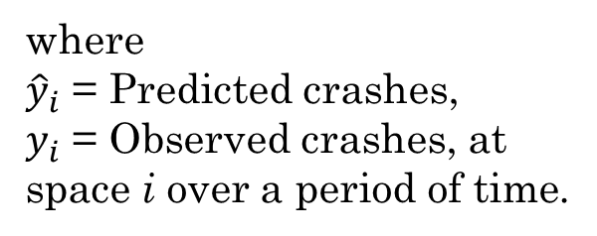
Model Selection
Use of mean square error and predictive error
We employed two different measures of fit:
Mean Absolute Deviation (MAD)
Mean Squared Prediction Error (MSPE)
$$MAD= mean |{\hat{y}}_{i}−y_{i}|$$
where
${\hat{y}}_{i}$ = Predicted crashes,
$y_{i}$ = Observed crashes, at space i over a period of time.
$$MSPE= mean {\left({\hat{y}}_{i}−y_{i}\right)}^{2}$$
The smaller the value, the better the model predicts observed crashes.

Slide 30
Model Selection Process
For each facility type: 3 Models
HSM
Multivariate Poisson Lognormal
Negative Binomial Fractional Split
For each model: 2 Performance measures
MAD
MSPE
MAD and MSPE
2 samples: estimation and validation
For all 5 severity (KABCO) categories
Identifying the “best” model is challenging
20 dimensions are compared (2*2*5)
It is unlikely: single model outperforms across all 20 measures

Slide 31
Model Selection Process
Hence, we considered 2 approaches
The first approach employs total crash frequency – model that performs better in predicting total crash counts for both samples (estimation and validation)
The second approach employs a scoring process where the models that perform well for the severity levels are awarded a point and the score for each model across the severity levels is aggregated.
The final selection is considered based on 2 approaches

Slide 32
Model Selection Process
Facility Group | Facility | Selected by MAD | Selected by MSPE | Selected for Facility | Recommended for Facility Group
Urban Limited Access | ULA4LD | NB-OPFS | NB-OPFS | NB-OPFS | HSM
 | ULA6LD | HSM | HSM | HSM
 | ULA8LD | HSM | HSM | HSM
 | ULA10LD | HSM | NB-OPFS/HSM | HSM
Rural Limited Access | RLA4LD | HSM | NB-OPFS/HSM | HSM | HSM
 | RLA6LD | HSM | HSM | HSM
 | RLA8LD | HSM | HSM | HSM
Urban Arterials | UA2LUD | NB-OPFS/HSM | NB-OPFS/MVPLN | NB-OPFS | NB-OPFS
 | UA3L | NB-OPFS/HSM | NB-OPFS/HSM | NB-OPFS/HSM
 | UA5L | NB-OPFS/HSM | NB-OPFS/HSM | HSM
 | UA4LUD | NB-OPFS/HSM | NB-OPFS | NB-OPFS
 | UA4LD | NB-OPFS/HSM | NB-OPFS | NB-OPFS
Rural Arterials | RA2LUD | NB-OPFS/MVPLN | NB-OPFS | NB-OPFS | NB-OPFS
 | RA3L | NB-OPFS | NB-OPFS | NB-OPFS
 | RA5L | MVPLN | NB-OPFS/MVPLN | MVPLN
 | RA4LUD | NB-OPFS/HSM | NB-OPFS | NB-OPFS
 | RA4LD | NB-OPFS/HSM | NB-OPFS | NB-OPFS
Scenario 1
Scenario 2
Scenario 3
If 2 different models are selected based on the 2 approaches, both models are considered.

Slide 33
Model Selection for Facility Group
Facility Group | Facility | Selected by MAD | Selected by MSPE | Selected for Facility | Recommended for Facility Group
Urban Limited Access | ULA4LD | NB-OPFS | NB-OPFS | NB-OPFS | NB-OPFS
 | ULA6LD | HSM | HSM | HSM | HSM
 | ULA8LD | HSM | HSM | HSM
 | ULA10LD | HSM | NB-OPFS/HSM | HSM
Rural Limited Access | RLA4LD | HSM | NB-OPFS/HSM | HSM | HSM
 | RLA6LD | HSM | HSM | HSM
 | RLA8LD | HSM | HSM | HSM
Urban Arterials | UA2LUD | NB-OPFS/HSM | NB-OPFS/MVPLN | NB-OPFS | NB-OPFS
 | UA3L | NB-OPFS/HSM | NB-OPFS/HSM | NB-OPFS/HSM
 | UA5L | NB-OPFS/HSM | NB-OPFS/HSM | HSM
 | UA4LUD | NB-OPFS/HSM | NB-OPFS | NB-OPFS
 | UA4LD | NB-OPFS/HSM | NB-OPFS | NB-OPFS
Rural Arterials | RA2LUD | NB-OPFS/MVPLN | NB-OPFS | NB-OPFS | NB-OPFS
 | RA3L | NB-OPFS | NB-OPFS | NB-OPFS
 | RA5L | MVPLN | NB-OPFS/MVPLN | MVPLN
 | RA4LUD | NB-OPFS/HSM | NB-OPFS | NB-OPFS
 | RA4LD | NB-OPFS/HSM | NB-OPFS | NB-OPFS

Slide 34
Model Selection for Facility Group
Facility Group | Facility | Selected by MAD | Selected by MSPE | Selected for Facility | Recommended for Facility Group
Urban Intersections | U3ST | NB-OPFS/MVPLN | NB-OPFS/MVPLN | NB-OPFS/MVPLN | MVPLN
 | U4ST | MVPLN | NB-OPFS/MVPLN | MVPLN
 | U3SG | MVPLN | MVPLN | MVPLN
 | U4SG | MVPLN | NB-OPFS/MVPLN | MVPLN
Rural Intersections | R3ST | NB-OPFS | NB-OPFS | NB-OPFS | NB-OPFS
 | R4ST | MVPLN | NB-OPFS/MVPLN | MVPLN
 | R4SG | NB-OPFS/MVPLN | NB-OPFS | NB-OPFS

Slide 35
Model Recommendations for Segment Facilities
Facility Group | Facility | Recommended for Facility Group
Urban Limited Access | Urban 4-lane divided (ULA4LD) | NB-OPFS
 | Urban 6-lane divided (ULA6LD) | HSM
 | Urban 8-lane divided (ULA8LD) | HSM
 | Urban 10-lane divided (ULA10LD)
Rural Limited Access | Rural 4-lane divided (RLA4LD) | HSM
 | Rural 6-lane divided (RLA6LD)
 | Rural 8-lane divided (RLA8LD)
Urban Arterials | Urban 2-lane undivided (UA2LUD) | NB-OPFS
 | Urban 3-lane (UA3L)
 | Urban 5-lane (UA5L)
 | Urban 4-lane undivided (UA4LUD)
 | Urban 4-lane divided (UA4LD)
Rural Arterials | Rural 2-lane undivided (RA2LUD) | NB-OPFS
 | Rural 3-lane (RA3L)
 | Rural 5-lane (RA5L)
 | Rural 4-lane undivided (RA4LUD)
 | Rural 4-lane divided (RA4LD)

Slide 36
Model Recommendations for Intersection Facilities
Facility Group | Facility | Recommended for Facility Group
Urban Intersections | Urban 3-leg STOP controlled (U3ST) | MVPLN
 | Urban 4-leg STOP controlled (U4ST)
 | Urban 3-leg signalized (U3SG)
 | Urban 4-leg signalized (U4SG)
Rural Intersections | Rural 3-leg STOP controlled (R3ST) | NB-OPFS
 | Rural 4-leg STOP controlled (R4ST)
 | Rural 4-leg signalized (R4SG)

Slide 37
Final Report
Chapter 6: Model Parameters
Descriptive statistics/variable ranges of the facility
Model equations
Model estimation results
Model performance measures (Appendix)
Model estimation results with t-statistics (Appendix)
Elasticity (Appendix)

Slide 38
Excel Spreadsheet Tools
To aid the practitioners in implementing the new models the research team developed three excel spreadsheet tools including:
22-49 Spreadsheet Tool without Calibration,
22-49 Spreadsheet Tool with Calibration, and
22-49 Data Input and Prediction Tool

Slide 39
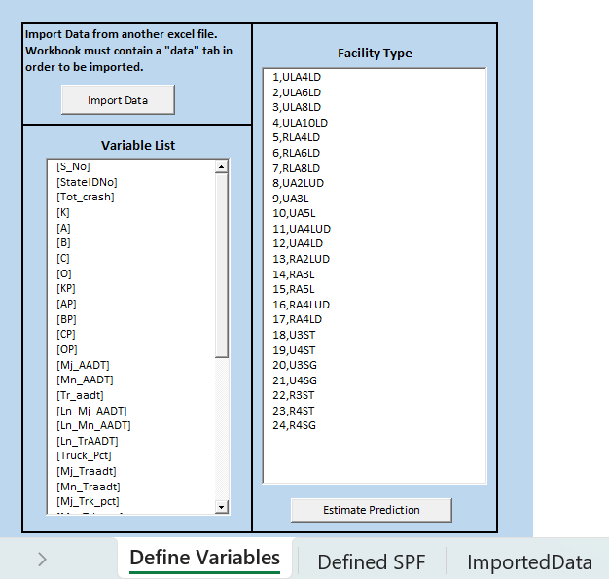
Excel Spreadsheet Tools
22-49 Spreadsheet Tool without Calibration:
Provides predictions for the user provided data directly without considering calibration.

Slide 40
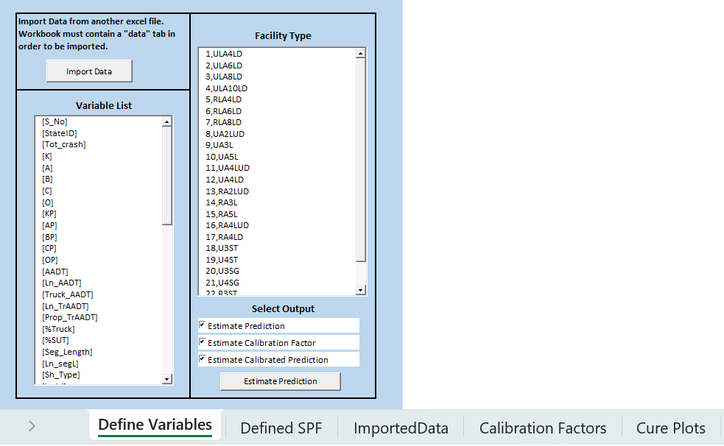
Excel Spreadsheet Tools
22-49 Spreadsheet Tool with Calibration:
Provides predictions for the user provided data while modifying the predictions considering calibration.

Slide 41
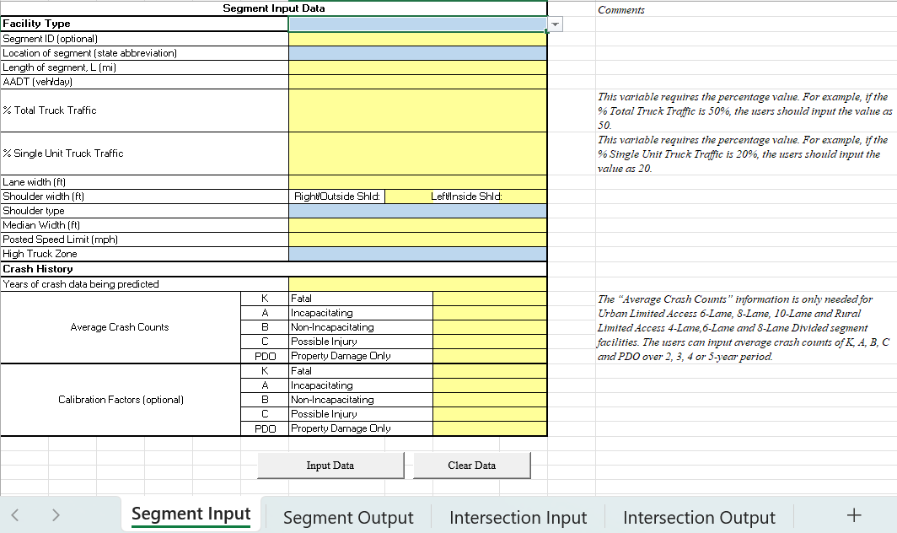
Excel Spreadsheet Tools
22-49 Data Input and Prediction Tool:
Provides practitioners a tool to undertake crash frequency and severity analysis at a facility resolution (segment and intersection).

Slide 42
Spreadsheet Tool User Guide
The step-by-step guidelines to use spreadsheet tools has been submitted.
Guidelines contains detailed instructions for three developed tools.

Slide 43
Thank you

