Slide 1
National Cooperative Highway Research Program
Impacts 2050
NCHRP Report 750 Volume 6:
Strategic Issues Facing Transportation—
The Effects of Socio-demographics
on Future Travel Demand

Slide 2
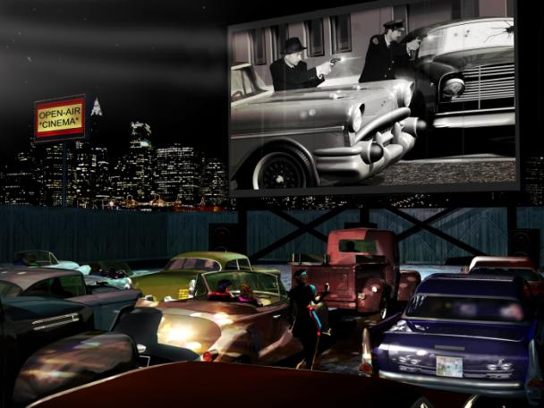
End of the Car Culture?
The total number of miles driven in the US peaked in 2006 at 2.647 trillion.
In 2011, the total number of miles driven was 5% lower. Miles driven per person and per vehicle peaked in 2004, and by 2011 had dropped by nearly 9% and 5%, respectively. (UMTRI-2013-20 July 2013)
Notes:
America has long been one of the world’s prime car cultures But might that be changing? The total number of miles driven in the US peaked in 2006 and the miles driven per person and per vehicle peaked in 2004. Then, Americans started driving less. The question is why? Certainly the economic recession played a role But because VMT rates peaked prior to the onset of the recession; it is highly likely that other societal changes have influenced the need for vehicles. Whether these changes are long-term trends depends on the extent to which they turn out to be permanent.

Slide 3
Long-Range Planning
As models are run further into future,
precision becomes challenging
Uncertainty in exogenous inputs
Uncertainty in
model relationships
Time
Variety of relationships that could be important
Notes:
In long-range planning, transportation planners are asked to predict socio-demographic trends that will affect future demand, such as what auto VMT will be in year 2030. Long-range plans are one way that decision makers evaluate the strengths and weaknesses of various future transportation alternatives. But long-range transportation planning necessarily depends on uncertain forecasts. As the travel demand models on which these forecasts are based are run further into the future, precision becomes more challenging. Uncertainty exists in the inputs, in the model relationships, and the variety of relationships that could be important.

Slide 4
Socio-Demographic Trends
Driving Uncertainty
1. The next 100 million
2. The graying of America
3. The browning of America
4. The changing American workforce
5. The blurring of city and suburb
6. Slow growth in households
7. The Generation C
8. The salience of environmental concerns
Notes:
There are numerous changes occurring in the population, demographics, and travel patterns that make the future difficult to predict. In our study we examined some of the key trends that we believe are driving future uncertainty. I’ll discuss four of these in my presentation today.

Slide 5
Next 100 Million
Trends, Impacts, Uncertainties
Projections of the Total Population for the U.S.: 2010-2050 (millions)
US population growing at higher rate than rest of world’s developed nations
Growth rate is slowing, but to what degree
Increase in total vehicle miles traveled (VMT)
Source: U.S. Census Bureau, “The Next Four Decades, The Older Population in the U.S. 2010-2050.” Population Estimates and projections, P25-1138,
May 2010, pg.1. A http///www.census.gov/prod/2010publs/p2501138.pdf
Notes:
The U.S. Census bureau projects that the U.S. population will grow over the next for decades (2010-2050) from 310 million to 439 million—an increase of 42 percent. And, while some postulate that by 2040, America will overtake Europe in population, the rate of growth is actually slowing relative to the second half of the 20th century. Based on the trends of the past four decades (through 2010), it is likely this growth was due to immigrants and their decendents. Moving forward, however, the recent recession stalled immigration and, overall, lower levels of fertility (a result of the recession). The results of a full economic recovery into 2020 could increase the rate of population grown more than shown on this slide’s table.

Slide 6
Graying of America
Trends, Impacts, Uncertainties
Percent of U.S. Population by Age Group, 1990-2010
Significant increase in population age 65+ due to Baby Boomers
How will Baby Boomers travel patterns change
Decrease in VMT per capita
  Decrease in work trips
  Decrease in transit use
  Decrease in vehicle ownership
Source: Brownell, Peter, Thomas Light, Paul Sorensen, Constantine Samaras, Nidhi Kalra, and Jan Osburg. 2013. The Future of Mobility: Scenarios for the United States in 2030, Appendixes C–G. RAND Corporation, Santa Monica, CA. http://www.rand.org/pubs/research_reports/RR246
Notes:
Population ageing is evident as shown in the upper most lightest and light blue segments on this table. The large Baby Boom cohort is just now reaching 65. As they age, the percentage of Americans who are age 65+ is estimated to nearly double form 12% of the total population in 2010 to 21% in 2050. In recent years, Baby Boomers (mostly non-Hispanic white) have dominated the US. Population. But, as they reach the older age, they are being replaced by a younger cohort, Millenials (whom are more likely to be Hispanic, Asian, or Multiracial. Traditionally, VMT levels change with age with less work travel as they enter retirement. The share of Americans in their peak driving years (age 35-54) is shown in dark blue. Between 1980 and 2000, the share of Americans in the peak driving demographic ballooned from 21.4 percent of the population to 29.5 percent, as the Baby Boomers reached peak driving age. With the Baby Boom generation now headed toward retirement, the share of Americans in the peak driving age group is projected to decline to 24.8 percent by 2020.

Slide 7
Browning of America
Trends, Impacts, Uncertainties
Population by Race and Ethnicity
(% of Total)
White, non-Hispanic share of
US population declining
Majority of America’s children
are of color
  Increase in VMT per capita
  Increase carpooling, walking,
  public transit use
  Increase in vehicle age
  Travel behavior as people acculturate or are new mainstream
  Future foreign-born percent
Projected
Note: All races are non-Hispanic; American Indian/Alaska Native not shown.
Source: Passel, J., and D’V. Cohn. February 2008. U.S. Population Projections: 2005–2050. Pew Research Center, Washington, DC. http://pewhispanic.org/files/reports/85/pdf; Census Bureau 2011 population estimates.
Notes:
White non-Hispanics account for majority of the US population, but as indicated by forest green in the pie charts their share of our country’s population has declined over time. People of color now account for most of the country's population growth. In fact, Hispanics alone accounted for 56% of our country’s population growth between 2000 and 2010. But even more important is the fact the majority of America’s children are of-color. What could be the impact of a browning America on travel demand? According to current patterns, we should see an increase in VMT per capita because Hispanics have more workers per household, larger households, and longer trip distances. At the same time, we know that foreign born Hispanics carpool, walk and take transit more. Lower incomes among people of color generally have translated into ownership of used or older vehicles. But as Hispanics, and others of color, acculturate and become the New Mainstream, these patterns may change. We also don’t know how much future growth in the Hispanic or Asian populations will be due to births vs. immigration. Immigration slowed during the last decade. While births accounted for much of the growth during the last decade

Slide 8
Changing American Workforce
Trends, Impacts, Uncertainties
Civilian Labor Force by Age
(Millions)
Workforce is growing older and
more diverse
Labor-force participation rate declining
  Decrease in VMT per capita
  Increase in work-related VMT
  Long-term effects of recession, technology on productivity,
  Hispanics on labor participation rate
Source: BLS, Monthly Labor Review, December 2013;
Toossi, M. December 2013. “Labor Force Projections to 2022:
The Labor Force Participation Rate Continues to Fall.” Monthly Labor Review. U.S. Department of Labor, Bureau of Labor Statistics. http://www.bls.gov/opub/mlr/2013/article/pdf/labor-force-projections-
to-2022-the-labor-force-participation-rate-continues-to-fall.pdf
Notes:
America’s workforce is growing older and more diverse as a result of boom and bust birthrate patterns. The number of older persons is increasing and younger persons are decreasing. The share of women in the labor force is increasing, particularly among the 55+ age group. In addition, labor force participation rates have declined over the past decade. The primary driver of this is the aging workforce. As the Baby Boom generation (mostly White) moves from middle-age, with high participation rates, to the older age groups, with significantly lower ones, the overall labor force participation rate will decline. The trend accelerated during the recession. But even as the economy improves, the workforce is still going to age, so the effect will still be felt. All things being equal, the U.S. would experience slower economic growth and the impact will be a decrease in VMT per capita. A wild card in what happens in terms of the labor force participation rates of Hispanics. Hispanics in the aggregate and Hispanic men had the highest labor force participation rates in 2010. Also Hispanics have a younger population and a greater proportion in the prime working age groups, perhaps leading to increases not decreases in work-related VMT

Slide 9
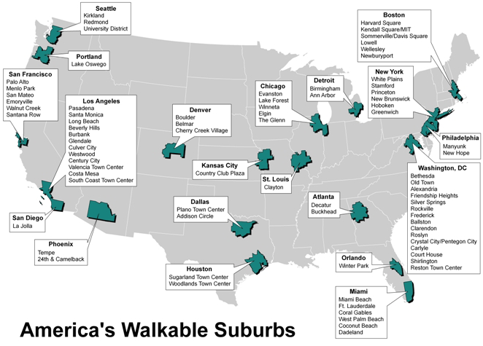
Blurring City and Suburb
Trends, Impacts, Uncertainties
Both cities and suburbs home to employers and residences
Inner-ring suburbs having
density changes similar
to center city
  Decrease in VMT per capita
  Increase in non-motorized trips
  Increase in transit trips
  Long-term demand for
  suburban urbanity
Map by Zara Matheson, Martin Prosperity Institute
Data Source: http://www.brookings.edu/papers/2007/1128_walkableurbanisim_leinberger.aspx
Notes:
Cycle your mind back to the late 1950s or early 1960s, the days of Mad Men and Leave It to Beaver. Cities were losing people and jobs. Suburbs and the Sunbelt were booming. Things are very different today. Some people talk about the Great Reset. One trend is the resurrection of cities. Another is that the division between city and suburb is blurring. No longer a clear line between an economic center where people work and a suburb where people live. Both can be home to employers and residences. It is also misleading to think about all suburbs in the same way; in the past decade inner ring suburbs have experienced population and built environment changes more similar to cities than to outer ring suburbs. Re-energized cities and more compact suburbs may lead to a less car-dependent way of life with more walking and biking and use of public transit. But such changes are generational events that will take decades to fully shake out. It’s hard to know exactly what form it will ultimately take.

Slide 10

Slow Growth in Households
Trends, Impacts, Uncertainties
Marriage rates are declining, depressing household formation and households with children
Increasing numbers of Americans are living in someone else’s home
Influence of economic recession and Millennial lifestage
Decrease in VMT per capita
  Decrease in auto ownership
  Increase in car pooling
  Increase in transit use

Slide 11

Generation C
Trends, Impacts, Uncertainties
Demand for connected devices
Gen C = hyperlinked
Super-Cs spent entire lives
with digital devices
  Decrease in VMT per capita
  Decrease in auto ownership
  What will be transportation
  needs and expectations of Super-Cs?
Notes:
Apple sold the first iPhone a little over six year ago. Today Apple has shipped about 250 M iPhones worldwide. Demand for connected devices will continue to be a major trend into the long-term future. This has spawned a new generation – the hyperlinked. Now called, Generation C – where C represents connectedness. Gen C is is a lifestyle choice not a structural imperative. But those born after 1990 are the Super-connected or super Cs. They have used digital devices their entire lives; computers, Internet, mobile phones, texting, social networking are second nature to them. They are online 24/7. They are now beginning to attend college and enter the workforce. Extrapolating from current trends we would expect them to be less car dependent and to substitute some mobile communication for actual travel. But how they will connect, communicate, and travel over the next 50 years is highly uncertain.

Slide 12
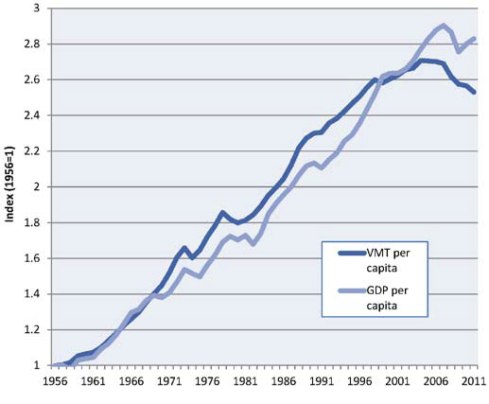
Salience of Environment
Trends, Impacts, Uncertainties
Trends in Per-Capita Vehicle-Miles Traveled and Real Gross Domestic Product
Stronger sense of concern for environment among Millennials than other generations
Influence of Millennial’s lifestage
Decrease in VMT per capita
  Decrease in auto ownership
  Increase non-motorized mode use
  Increase in transit use
Vehicle-miles traveled: see note 2; population statistics: U.S. Census Bureau, Historical Population Estimates, downloaded from www.census.gov/ popest/data/historical/index.html (for 1970-2011), and U.S. Census Bureau, Statistical Abstract of the United States,2003, Table HS-1 (1936-1969);
gross domestic product (chained 2005 dollars): U.S. Bureau of Economic Analysis,Current-Dollar and “Real” Gross Domestic Product (Excel spreadsheet), 29 November 2012.
Notes:
Recent trends indicate that economic growth and vehicle travel are no longer as closely related as they used to be. While economic factors do impact whether and how much Americans drive they are not the only ones that matter. Growing Internet-connected technologies and their related impact on how people interact and connect with one another, greater willingness to pursue less auto-dependent lifestyles, and stronger concern for the environment are other driving factors. According to the National Household Travel Survey, from 2001 and 2009, the annual number of vehicle-miles traveled by 16 to 34 year-olds (a group that included a mix of Millennials and younger members of Generation X) decreased from 10,300 miles to 7,900 miles per capita—a drop of 23 percent.

Slide 13
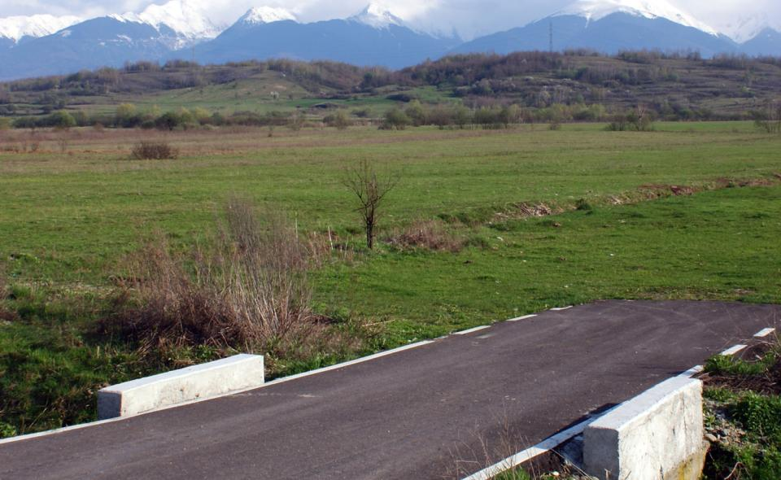
What is the Impact…
…of these Trends on Future Travel Demand?
Conflicting
Evolving
Incomplete
Notes:
As transportation planners and decision makers, you face strategic decisions in terms of how to cope with or adapt to these trend. What is their impact on future travel demand. As evident in my review of four trends, the impact is conflicting, evolving, incomplete. This situation illustrates the fact that the future is unpredictable and shaped by many interacting factors. This is where scenario planning comes into play.

Slide 14
Our Approach: Impacts 2050
Tool for applying scenario approach for handling uncertainty
  4 Scenarios for visioning the future
  System dynamics model that represents links between population, land use, employment, and travel behavior
Enables users to:
  Examine socio-demographic trends and impact on travel demand
  Be in position to account for these trends in forecasts and plans
  Examine policy or other interventions that might offset trends
Notes:
A goal of our study was to provide transportation planners and decision makers with an increased awareness of how socio-demographic trends might impact long-range transportation conditions or needs. With knowledge of the limitations of traditional models, we focused on developing a tool, impacts 2050 that would facilitate applying a scenario approach for handling uncertainty. The tool incorporates two elements: scenarios representing visions of possible futures and a system dynamics model. The tool was designed to enable users to examine the relationship between socio-demographics and travel demand in yearly increments through 2050. With the resulting information, users would be in a position to account for these trends in plans and forecasts, and examine policies or other interventions that might offset these trends.

Slide 15
Impacts 2050: 4 Scenarios
Momentum
State of the country in 2050 is recognizable to any planner who had worked in 2010.
Tech Triumphs
By 2050, technological innovations have changed how we travel, connect our world, and reduce our carbon footprint.
Global Chaos
The world is a more difficult place to live in 2050 with growing financial instability, and insecurity over food, jobs, oil.
Gentle Footprint
Recovering from droughts and superstorms , the US has taken significant and serious action to mitigate global climate change.
Notes:
As part of the study, we developed 4 scenarios that represent a range of future possibilities. They are multi-layered, complex, and fundamentally distinct from each other. Their names give you a good idea of the scenario narratives and assumptions: Momentum, Tech Triumphs, Global Chaos, Gentle Footprint.

Slide 16
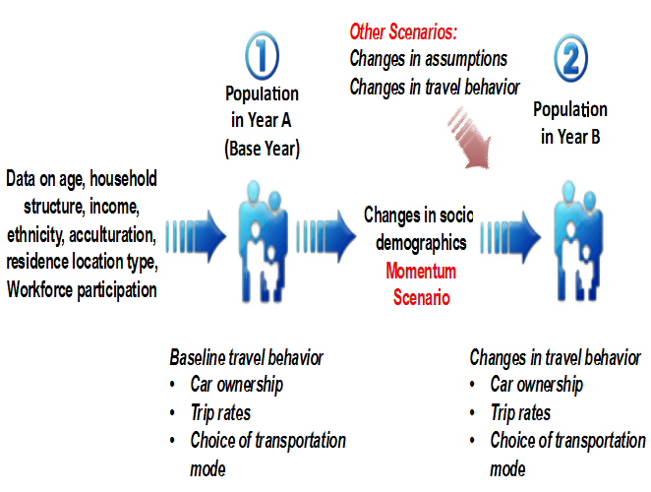
Impacts 2050: System Dynamics Model
Notes:
The statistical engine of our tool is a system dynamics model. Its purpose is not so much to predict travel behavior but to realistically illustrate different scenarios. The model segments a region’s population by age, household structure, income, race, etc. The model then evolves this population over time. The evolution of the population over time impacts travel behavior. The impacts are indicated in terms of car ownership, trip rates and distance, and mode choice. Land use, employment and transport supply sectors are present in the model in minimal detail. Their presence enables the incorporation of feedback lops that represent the dynamics of the transportation system.

Slide 17
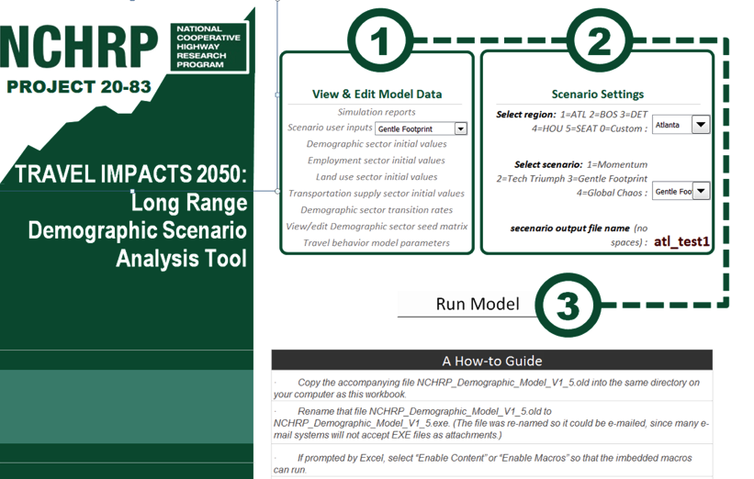
User-Friendly Spreadsheet Model
Notes:
The tool is designed to run easily and quickly so that many different future scenarios can be played out.

Slide 18
Impacts 2050: Scenario Worksheets
Notes:
The four scenarios are pre-defined in the tool. But a user can create new scenarios by altering the scenario parameters in the yellow highlight. Color coding helps the user to know if they are increasing (green) or decreasing (red) the impact. Also the assumptions for each scenario are evident.
Data has already been entered into the tool for Atlanta, Boston, Detroit, Houston or Seattle regions. A users’ guide instructs a region other than our five in setting up the model for itself. Next, I’m presenting some slides using the Atlanta data to illustrate the outputs of the tool.

Slide 19
Momentum Scenario: Atlanta
Population by Age Group
Year | 2000 | 2010 | 2020 | 2030 | 2040 | 2050
Population | 4,247,982 | 5,615,248 | 6,865,803 | 8,097723 | 9,319,548 | 10,562,745
Notes:
In the interest of time, I’m presenting age distribution and daily work trips by mode for the Momentum and Gentle Footprint scenarios for Atlanta. In this slide for the the momentum scenario, you’ll see that population more than doubles from about 4 million in 2000 to 10 million in 2050. Reflecting the boom and bust birth patterns that I mentioned previously – you’ll also see the steep rise in the numbers of people over age 60. Millennials, those age 16-29, also have a fairly steep increase. While the numbers of Gen X and kids grow more slowly

Slide 20
Momentum Scenario: Atlanta
Daily Work Trips by Mode
Notes:
In terms of daily work trips by mode – 2050 looks a lot like today. People in Atlanta are still traveling by and large as single auto drivers. And with population growth, daily work trips have increased. Without concomitant increases in capacity, congestion would increase as well.

Slide 21
Gentle Footprint Scenario: Atlanta
Population by Age Group
Year | 2000 | 2010 | 2020 | 2030 | 2040 | 2050
Population | 4,247,982 | 5,615,248 | 6,667,274 | 7,517,999 | 8,222.798 | 8,711,951
Notes:
Under gentle footprint, the population increases more slowly from out 4 million to a little under 9 million. The assumption here is that families are having fewer children because of a concern about the footprint of humans on the planet. You also see this assumption reflected in the downward slope of the line representing children. The numbers of older persons grows more than in Momentum because people are living healthier lifestyles and living longer.

Slide 22
Gentle Footprint Scenario: Atlanta
Daily Work Trips by Mode
Notes:
As might be expected, under a growing concern for environmental impacts, work trips by SOV decline and travel by walk and bike increases – trips by transit stay about the same. This scenario also assumes more people telecommute.
These are only a few slides but I hope this conveys the flavor of how the tool enables the exploration of multiple scenarios. If I were a planner using this tool, I could alter assumptions, change parameters, and run multiple scenarios. What if one-car policies were implemented under this scenario? What if large segments of the population moved to exurban areas of the region to grow their own food?

Slide 23
Enhanced Planning Approach
Socio-Demographic Trends
Will surely impact travel demand over the next 50 years.
4 Scenarios
Applied in a systems approach to test out socio-demographic shifts and explore what if situations
Better Insights
New and Quick insights on future reality
Future Socio-Demographic Uncertainties
Impacts 2050
Tool
Better Decisions
Notes:
What this study delivers is an enhanced approach for long-range transportation planning. The traditional planning approach relies on point prediction to address future uncertainties. The predictions are updated at certain intervals in order to course correct. Through our study we addressed future uncertainty by developing an interactive simulation tool that facilitates analytical reasoning rather the computation of a precise number. Our scenarios were designed to encourage transportation agencies to consider what they would do if the future took a decidedly different direction over the next 50 years compared to its historical trajectory. The goal is to enable better decisions.

Slide 24
Doing Better Long-Range Planning
Study products prompt change in thinking
Output is less important than process of interacting with model
Future reality is better understood by exploring multiple plausible future scenarios
Shift to thinking strategically which is more aligned with 21st century types of problems and environments
Notes:
Using the tool requires a change in thinking in which the output of the forecast is a less important ingredient to a long-range plan than is the process of interacting with the model to produce many different scenarios. What becomes important in this environment is asking the right questions. The premise is that transportation decision-makers shift from planning strategically to thinking strategically, which is more aligned with 21st century types of problems and environments.

Slide 25
How to Obtain Research Products
Full Report
(NCHRP Report 750 Volume 6: Strategic Issues Facing Transportation—
The Effects of Socio-demographics on Future Travel Demand)
Research Brief
Impacts 2050 Tool
Impacts 2050 User Guide

