Slide 1
Development and Management of Sustainable Enterprise Information Portals Guidance for Transportation Agencies

Slide 2
Purpose of Briefing
The purpose of this briefing
is to provide content for communicating
enterprise information portal concepts & considerations
with executives and stakeholders
to support a conversation that shifts DOT practices
to a sustainable, customer-centric service.
The organization of this briefing mirrors the guidance document loosely, offering definitions and examples.

Slide 3
Briefing Organization
What is an Enterprise Information Portal (EIP)?
Achieving Sustainable EIPs using the Microservice Architecture Pattern
Designing for Sustainable EIPs
Technology Recommendations for EIPs
Microservice Creation & Organization – Asset Management Example
Migration Strategy from Monolith to Microservice Architecture
Overcoming Non-Technical EIP Implementation Challenges

Slide 4
Enterprise Information Portals for Departments of Transportation

Slide 5
What is an Enterprise Information Portal (EIP)?
An EIP, also known as a business portal, is a “web site” that serves as a single gateway to a company's information and knowledge base for employees, customers, business partners, and the general public.
EIPs integrate management information systems, decision support systems, enterprise information systems, and other technologies.
EIPs are tailored or personalized to the intended user or groups of users.
EIPs provide access to a broad range of resources and services through a variety of interfaces.

Slide 6
Common Services Offered by DOT EIPs, part 1 of 2
DOT EIP Services | Description
1. Asset Management, Engineering and Maintenance Services | Services pertaining to the development, deployment, maintenance, and retirement of DOT assets.
2. GIS and Mapping Services | Services such as GIS file downloads, GIS web services, mapping of traffic conditions, construction, assets, and chain stations.
3. Operations & Performance Management Services | Services pertaining to the operation of DOT systems and measures of their performance/efficiency using indicators such as traffic speed, volume, occupancy.
4. Documents and Library Services | Services pertaining to documentation publishing, record keeping, video and image archival, and publication and journal subscriptions.
5. Bid and Contract Services | Services pertaining to contracting process information, bid, acquisition, and project tracking.

Slide 7
Common Services Offered by DOT EIPs, part 2 of 2
DOT EIP Services | Description
6. IT Services | Services and topics relevant to portal hardware, software, on premise infrastructure, cloud services, and networking.
7. Environmental Services | Services pertaining to environment monitoring and alerts such as extreme weather, flood, earthquake, and air quality.
8. Public Outreach Services | Services pertaining to public information sharing, such as 511, projects, performance and weather, and lane closure and construction.
9. Photo and Video Services | Services pertaining to the collection, storage, search, and archiving of DOT photo and video of infrastructure from drone, satellite, or ground, as well as operation and asset pictures or video, such as inspection images or incident videos.
10. Financial Services | Services pertaining to payroll, budgeting, project funding, and accounting.

Slide 8
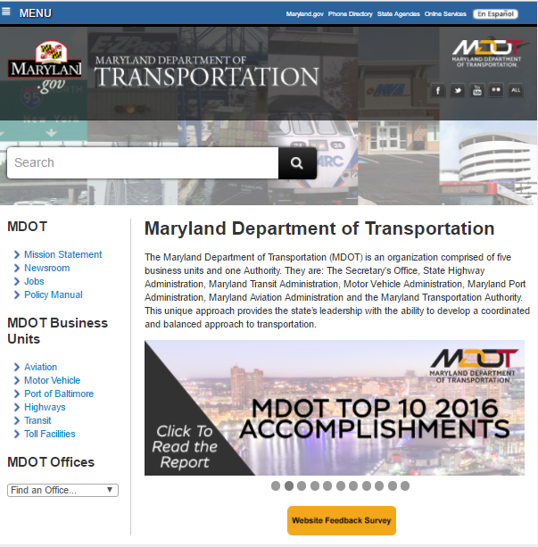
How are Departments of Transportation Implementing EIPs?
DOTs typically have multiple portal platforms with multiple services, some of which are integrated, while others are stand-alone
Internal DOT portals are typically more integrated than externally facing portals
The technology and architecture of portals varies by organization size, budget, and expertise as well as state requirements pertaining to the management of data

Slide 9
What is Sustainability in the Context of EIPs?
Sustainability is the ability of the enterprise to meet its present needs without compromising its ability to meet future needs
It’s not just about continuity of funding, making EIPs sustainable requires focus on:
Technologies,
Policies,
Procedures, and
Governance.
The cornerstones for sustainability are replaceability and resiliency of services and systems within the EIP

Slide 10
Trends in Moving toward Sustainable EIPs
A service-oriented architecture (SOA) is not just an architecture of services from a technology perspective; it includes the policies, practices, and frameworks by which we ensure the right services are provided and consumed. The basic principles of SOA include independence of vendors, products, and technologies.
Moving away from a monolithic and heavily integrated portal applications to a modular, service-oriented architecture
Less in-house hardware and data storage, and more distributed hardware and data storage leveraging cloud services
More distributed software portal applications
Less integrated management of individual portal application, more autonomy for applications

Slide 11
Why a Mix of On Premise & Cloud IT Infrastructure?
Why On Premise
To meet government regulations for storing sensitive data
Need for unique/advanced security beyond cloud offerings
Visibility of data “residency”
Bandwidth constraining accessibility at the last mile
More direct control over latency
Why Cloud
Shifts the risk of IT infrastructure obsolescence to the cloud provider
Enables a scalable, flexible, and on demand set of IT capabilities
Reduces IT infrastructure operation and maintenance time
Lower cost profile

Slide 12
What is a Distributed Software Architecture?
A distributed system is one in which the computing power and software is distributed across several servers, connected through a network, communicating and coordinating their actions by passing messages to each other.

Slide 13
Achieving Sustainable EIPs Brief Introduction to the Microservice Architecture Pattern

Slide 14
What is a Microservices Architecture?
An SOA variation, microservice architecture is an approach to developing a single application as a suite of small services. Each service:
Runs its own processes
Can be written in any programming language and is platform agnostic
Is independently deployable and replaceable
May use different storage technologies
Requires a minimum of centralized management
Large companies, such as Amazon, eBay, and Netflix, have already adopted microservice architecture as their main architecture.
Modular Space System Analogy
Rather than using a large, complex, single satellite, agencies are migrating to a suite of connected, independent, low-cost, and replaceable small satellites, each with its own function (e.g., communication, imagery, sensors).
This decomposition and migration to autonomous modules offers these agencies ease of functionality,
ease of replaceability, and ease of modernization with newer modules.

Slide 15
Visual Interpretation of Architecture Patterns
Traditional Monolithic Architecture Pattern
Microservice Architecture Pattern
“Monoliths and microservices are not a simple binary choice.
Both are fuzzy definitions that mean many systems would lie in a
blurred boundary area among the two”
-Martin Fowler
Martinfowler.com
Notes:
An approach to developing a single application as a suite of small services, each running in its own process and communicating with lightweight mechanisms. Each service is independent and can be written in different programming languages and use different data storage technologies. Services are built around business capabilities and are independently deployable using fully automated deployment and require a bare minimum of centralized management. https://martinfowler.com/articles/microservices.html
In a monolithic architecture, software components are tightly integrated as part of an application that is replicated across a server cluster to allow application scalability. In a microservices architecture, each software component is standalone and is loosely integrated with the other components. Each component is deployed independently across a server cluster and each component can be scaled independently across the cluster. This allows applications based on a microservice architecture to be reactive and adaptive to the user demand changes rapidly and without redesign.
Microservices architecture rely heavily on containerization, which allows microservices to be developed completely independently from each other using different languages and libraries. Only the external interfaces need to be standardized across all microservices.

Slide 16
Microservice Architecture Advantages
Auto-scaling - A cloud computing service feature that automatically adds or removes computing resources based on actual demand
Load balancing -The process of distributing workload evenly across computing resources in a cloud computing environment
Greater efficiencies as they are typically paired with auto-scalers and load balancers
Easily scalable in three ways:
by decomposition into simple functions (microservices)
by cloning microservices on demand
by partitioning data across a cluster
Services can be cloned or decommissioned based on user requests in real-time
Auto-scaling definition
A cloud computing service feature that automatically adds or removes compute resources depending upon actual usage
Notes:
Autoscaling definition source: http://searchcloudapplications.techtarget.com/definition/autoscaling
Load balancer definition source: http://searchcloudcomputing.techtarget.com/definition/cloud-load-balancing

Slide 17
Microservice Implementation Example of a DOT EIP on Cloud Infrastructure
IT teams shift from actively managing hardware and software to managing service layers in the microservice environment

Slide 18
Tradeoffs in Adopting a Microservice Architecture
Shifting to microservices architecture means
Reducing code complexity while increasing operational complexity
Distributing data across multiple processes while ensuring data consistency across processes
Simplifying individual services while raising the complexity of coordinating many services
Microservice Premium
Microservices impose a cost on productivity that can only be made up for in more complex systems.

Slide 19
Change in EIP Practices, part 1 of 3
Services Development
- You build it AND
you run it.
Development is Platform and Language Agnostic
When Adopting a Microservice Architecture
Design for failure – applications must be designed and developed to tolerate the failures of other services or applications.
Single lifecycle ownership of the product – “You build it, you run it,” is the motto rather than the traditional practice of a software development team handing off a service to an IT operations team.
Exercise choice in platforms, language, & libraries that best suits the microservice functionality and team expertise rather than a single language or platform for the enterprise.
Notes:
Most microservices architecture pattern implementations rely on automated services to monitor, deploy, and manage their clusters. Scripting approaches have been developed to programmatically control the configuration and behavior of microservices clusters and allow them to be rapidly be modified or corrected.
The considerations noted on this slide all present challenges to agencies and IT staff, however the Guide provides information on the advantages of each of these approaches and why the benefits outweigh the challenges.

Slide 20
Change in EIP Practices, part 2 of 3
When Adopting a Microservice Architecture
Decentralized business and messaging rules – complex centralized message handling such as Enterprise Service Bus must give way to simple communications protocols. This is referred to as “smart endpoints, dumb pipes.”
Decentralized governance – minimize top down standards or technology sets and allow in-house open source model for sharing useful, tested code
Decentralized data management to service-level data management, often called polyglot persistence.
Microservices Distributed Database
Monolithic
Database
Notes:
Most microservices architecture pattern implementations rely on automated services to monitor, deploy, and manage their clusters. Scripting approaches have been developed to programmatically control the configuration and behavior of microservices clusters and allow them to be rapidly be modified or corrected.
The considerations noted on this slide all present challenges to agencies and IT staff, however the Guide provides information on the advantages of each of these approaches and why the benefits outweigh the challenges.

Slide 21
Change in EIP Practices, part 3 of 3
When Adopting a Microservice Architecture
Organize teams around business capabilities not technology layer
cross functional teams by business capability are requisite
traditional technology layer based teams (e.g., a database applications team or a user interface team) means extensive cross-team collaboration and costly delays
Move beyond Continuous Integration to Continuous Delivery
Maintain tight integration requirements within the microservice while easing external integration requirements
Continuous Delivery means development teams build software so that the software can be released to production at any time and by anyone on the team
Example of a Basic Automated Build Pipeline that Supports Continuous Integration

Slide 22
Decomposition of Services for Fast, Frequent, and Well Controlled Continuous Delivery
Software changes should be monitored to identify and refine how an application should be decomposed into services
Parts of the system that rarely change should be in a different service, or module, than those that often change
If two services need to be changed together repeatedly, they should be merged into a single module
The decomposition of applications into services needs to be based on the notion that services can be independently replaced and upgraded without affecting the other application services with which they interact

Slide 23
Designing for Sustainable EIPs Requirements Operating Environment Technology Recommendations

Slide 24
Requirements in Designing Sustainable EIPs
A requirement
is a capability
or function
that must be delivered
by a system or system component
Functional requirements – Define the functions, or business needs, of a system or components as seen by a system user.
Performance requirements – Specifies speed or operational effectiveness of the capability that must be delivered.
Design requirements – Detail the plans for the software solution and specify architecture design, methodologies, models, or frameworks by which software is to be developed.
External interface requirements – Specify the hardware, software, communications, user, or database elements to ensure proper communications with external components.
Resource requirements – These include the hardware, software, expertise, and organizational components.
Notes:
A requirement is a capability or function that must be delivered by a system component or components. The list organizes requirements into the following categories:
Functional requirements – These define the functions, or business needs, of a system or of system components as seen by a system user. These requirements may be calculations, technical details, data manipulations, and other functionality that defines what a system is supposed to accomplish.
Performance requirements – These specify the speed or operational effectiveness of a capability that must be delivered by the system.
Design requirements – These detail the plans for the software solution and specify architecture design as well as the methodologies, models, or frameworks by which software is to be developed.
External Interface requirements – These specify the hardware, software, communications, user, or database elements to ensure that the system will communicate properly with external components.
Resource requirements – These include the hardware, software, expertise, and organizational components.

Slide 25
EIP Functional Requirement Examples
Examples of High-Level DOT EIP functional requirements include *:
Shall contain a data ingestion service
Shall contain a data visualization service
Shall contain a search service
Shall contain a librarian user interface
Shall contain a vendor procurement user interface
Shall contain a DOT map user interface
* actual requirement will have greater context and feature specificity.
Functional requirements
specify what
a system or
service must do,
but not how
it will be done

Slide 26
EIP Performance Requirement Examples
Examples of High-Level DOT EIP performance requirements include *:
Services shall be able to be started rapidly
Services shall be able to be stopped rapidly
Services shall be able to be duplicated rapidly
Components shall be able to be decommissioned rapidly
Components shall be able to be deployed rapidly
* actual requirement will have numerical and context specificity.
Performance Requirements
define how well
the system performs certain functions
under varied conditions using factors such as
speed of response, throughput, execution time, and storage capacity

Slide 27
EIP Design Requirement Examples
Examples of High-Level DOT EIP design requirements include *:
Shall use a distributed tracking and logging service
Shall use a centralized logging
Services shall adjust to demand spikes automatically
Shall follow a microservice architecture pattern
Shall use API standards to design and operate its API gateway
* actual requirement will have greater context and feature specificity.
Design requirements direct the design (internals of the system) by inclusion (build it this way) or exclusion (don't build it this way).

Slide 28
EIP External Interface Requirement Examples
Examples of High-Level DOT EIP external interface requirements include * :
Shall be able to connect to live sensor feed services
Shall be able to connect to live video feed services
Components shall rely mostly on HTTP and REST for communication with external services
* actual requirement will have greater specificity
External interface requirements state the required characteristics at a point or region of connection of the system to the outside world (e.g., location, geometry, inputs and outputs by name and specification, allocation of signals to pins, etc.)

Slide 29
EIP Resource Requirement Examples
Examples* of High-Level DOT EIP resource requirements include:
Shall be implemented on a commodity cluster infrastructure (cloud like)
Shall be developed using personnel familiar with cloud technology
Shall leverage cross-functional teams over the complete product cycle
* actual requirement will have greater context specificity.
Resource requirements
limit the usage or consumption by the system of an externally provided resource (e.g., equipment, personnel, facilities, etc.)

Slide 30
Operating Environment Recommendations for Designing for a Sustainable EIP
Mixed infrastructure (cloud and on premise) allows increased scalability and reliability of the EIP applications while allowing sensitive data to be kept in house.
Application deployment and server configuration can be cloud based or use open-source configuration management service with a containerized architecture.
Implementation of the EIP is recommended using
Open Source continuous integration (CI) tools
Hosted CI service (software as a service), or
Proprietary continuous integration (CI) tools

Slide 31
Technology Recommendations for EIPs

Slide 32
Technology Recommendations for Services
The table lists recommended approaches for the components needed to develop sustainable DOT EIPs based on a microservice architecture.
EIP Component | Recommended Approach
API Gateway | Adoption of a cloud API framework.
Searching | Adopt a cloud enterprise search platform.
GIS Data Processing and Rendering | Adopt an Open Source scale out GIS server framework in combination with the use of cloud storage.
Data Stream Processing | Adopt a cloud stream processing framework
Messaging | Adopt a cloud messaging framework.
Content Delivery | Adopt either a cloud content delivery network solution or a commercial distributed content delivery solution.
*Based on a survey of industry practitioners

Slide 33
Technology Recommendations for User Interfaces
The table lists recommended approaches for user interfaces to develop sustainable DOT EIPs based on a microservice architecture.
EIP Component | Recommended Approach
Web Applications | Adopt a cloud based web framework with an advanced client-side web development framework to support web design capabilities. Similarly, adopt a cloud monitoring service for web monitoring.
Mobile Applications | For design and monitoring capabilities, adopt a cloud mobile application deployment service.
Desktop Applications | No desktop application should be developed as part of a sustainable DOT EIP. Rather, use a Content Management Service based web application to provide desktop application like capabilities.
*Based on a survey of industry practitioners

Slide 34
Technology Recommendations for Storage
The table lists recommended approaches for storage to develop sustainable DOT EIPs based on a microservice architecture.
EIP Component | Recommended Approach
Content Archiving | Adopt a mixed storage capability using cloud and on premise storage.
Content Caching | Either adopt a cloud or commercial caching and load balancing solution.
Content Tagging | Use either a commercial metadata repository, a custom user generated metadata repository, or a semantic web solution.
*Based on a survey of industry practitioners

Slide 35
Technology Recommendations for Database
The table lists recommended database approaches to develop sustainable DOT EIPs based on a microservice architecture.
EIP Component | Recommended Approach
GIS Database Services | Adopt a cloud or on premise NoSQL geo capable database.
Document Database Services | Adopt an Open Source distributed document analysis engine.
Image, Video, and Binary Files Database Services | Adopt a basic cloud storage solution.
Financial Data Database Services | Adopt a commercial cloud enterprise solution.
Sensor Data Database Services | Adopt a cloud streaming framework based solution.
GIS Database Services | Adopt a cloud or on premise NoSQL geo capable database.
*Based on a survey of industry practitioners

Slide 36
Technology Recommendations for Management Tools
The table lists recommended management tool approaches to develop sustainable DOT EIPs based on a microservice architecture.
EIP Component | Recommended Approach
Resources and Application Monitoring | Adopt a cloud monitoring solution.
Resources Provisioning and Scaling | Adopt either a cloud based serverless architecture or a cloud or on premise container based solution.
Content Auditing | Adopt cloud based commercial or Open Source content auditing and inventory software.
*Based on a survey of industry practitioners

Slide 37
Technology Recommendations for Security and Identity
The table lists recommended security & identity approaches to develop sustainable DOT EIPs based on a microservice architecture.
EIP Component | Recommended Approach
Identity and Access Management | Adopt a cloud AIM solution (e.g., software as a service).
Security Audit | There is no single approach. Approaches are tool or human based. Propose Open Source or commercial security evaluation and monitoring tools for network and software layer, internal security audits and assessments, and external party assessments and penetration testing should be used together to provide security audits to sustainable DOT EIP.
*Based on a survey of industry practitioners

Slide 38
Microservice Creation and Organization Asset Management Implementation Example

Slide 39
Unified Modeling Language (UML) Diagrams
Types of Diagrams*:
Class (Block Definition)
Component and Data Flow
Deployment
Object
Package
Profile
Composite Structure (Internal Block)
Use Case
Activity
State Machine
Sequence
Communication
Interaction Overview
Timing
(Parametric)
UML is a way to visualize user interactions, processes, and system structure for software engineering using a collection of diagrams
Systems modeling language (SysML) is tailored from UML for systems.
Five key diagram types are presented for the asset management DOT EIP service:
Use Case Activity
Block Definition Sequence
Component and Data Flow
*Those in parentheses are modified from UML to SysML or are unique to SysML.
Note: diagrams have been modified from strict UML/SysML to accommodate the microservices architecture specificities

Slide 40
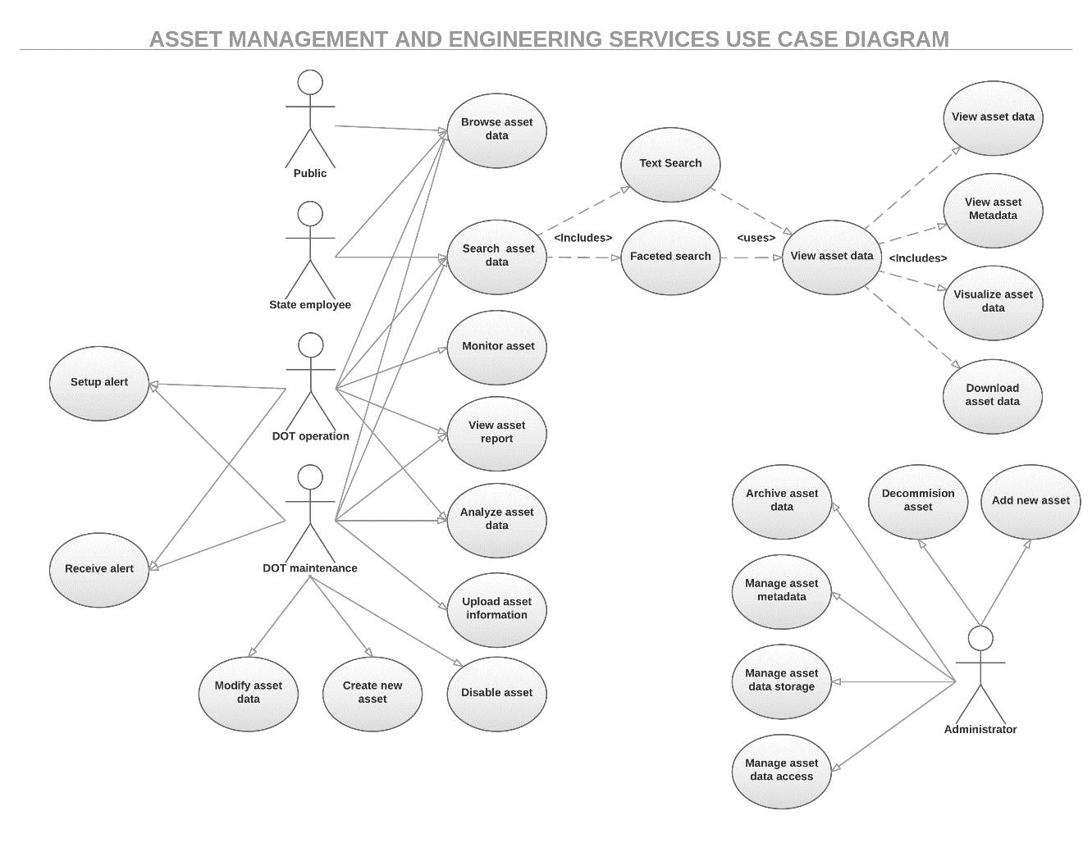
Use Case Diagram for Asset Management Service
The Use Case diagrams give a graphic overview of
the actors involved in a system
different functions needed by the actors
how these different functions interact
The Use Case diagram for asset management depicts
5 actors – public entity, state employee, DOT operations personnel, DOT maintenance personnel, and service administrator
23 actions are enumerated ranging from “add new asset” to “set up alert.”

Slide 41
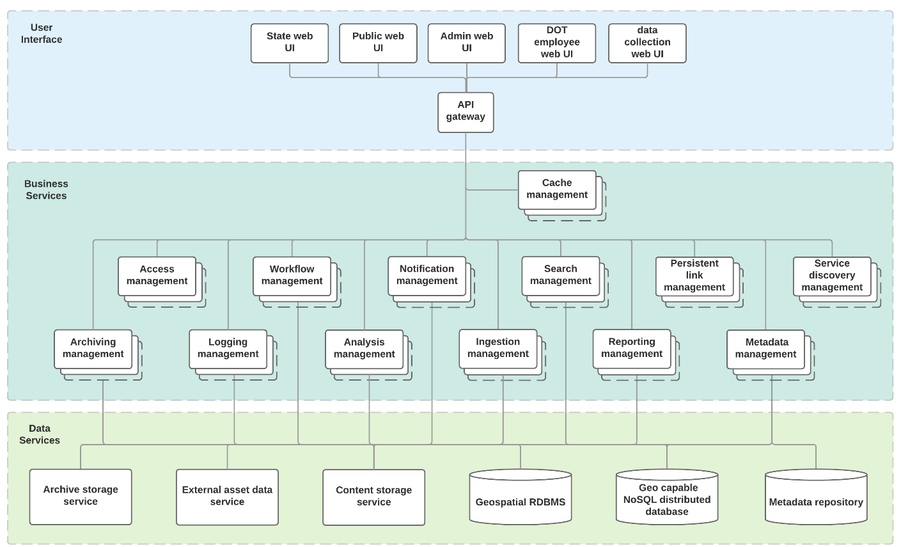
Block Definition Diagram (BDD) for Asset Mgmt. Service
The BDD communicates structural information about the system
Blocks can represent anything, components, services, etc.
The blocks for asset management include interface components, business services, and data services
Note the stacked blocks indicate the ability to scale and duplicate
Notes:
Block definition diagrams (BDDs) are created to communicate structural information about a system. This design technique creates extensibility in your system design by decoupling the clients of services from any specific implementation of a provider of those services. BDDs are not tied to any specific stage of the system life cycle or level of design. They are created and referenced to support stakeholder needs analysis, requirements definition, architectural design, performance analysis, test case development, and integration. BDDs provide a complementary view of an aspect of your system of interest.

Slide 42
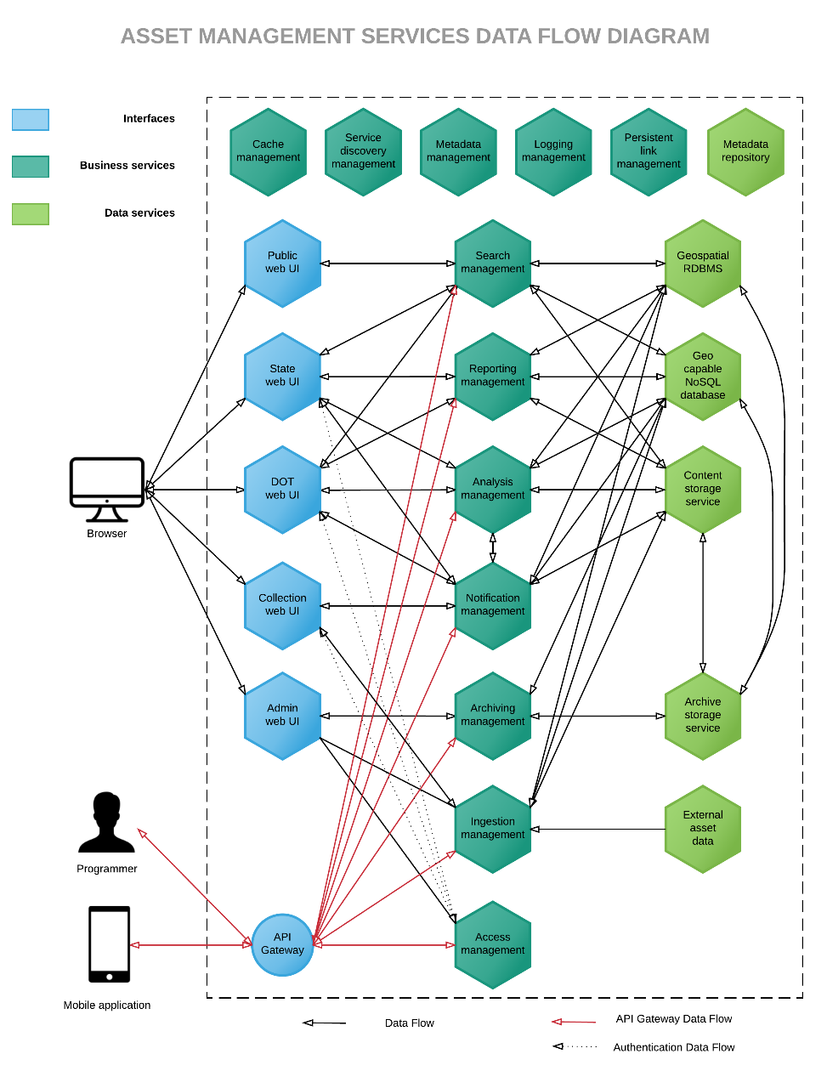
Component & Data Flow (CDF) Diagram for Asset Management
CDF diagrams define the data going through a system and any processing required
Microservices architecture greatly increases the amount of data flowing within an application and the complexity of the data exchanged between components, which makes data flow diagramming challenging
Showing every possible component or data exchange would render the diagram unreadable, therefore only the main data exchanges between the service components involved in the high-level use cases are presented.
Notes:
Data flow diagrams are designed to illustrate how data is processed by a system in terms of inputs and outputs. As its name indicates, its focus is on the flow of information – where data comes from, where it goes, and how it gets stored. Microservices architecture pattern greatly increases the amount data flowing within an application and the complexity of the data exchanged between components, which makes data flow diagramming challenging. Component and data flow diagrams may not show every single possible component or data exchange between each component for clarity purposes.

Slide 43
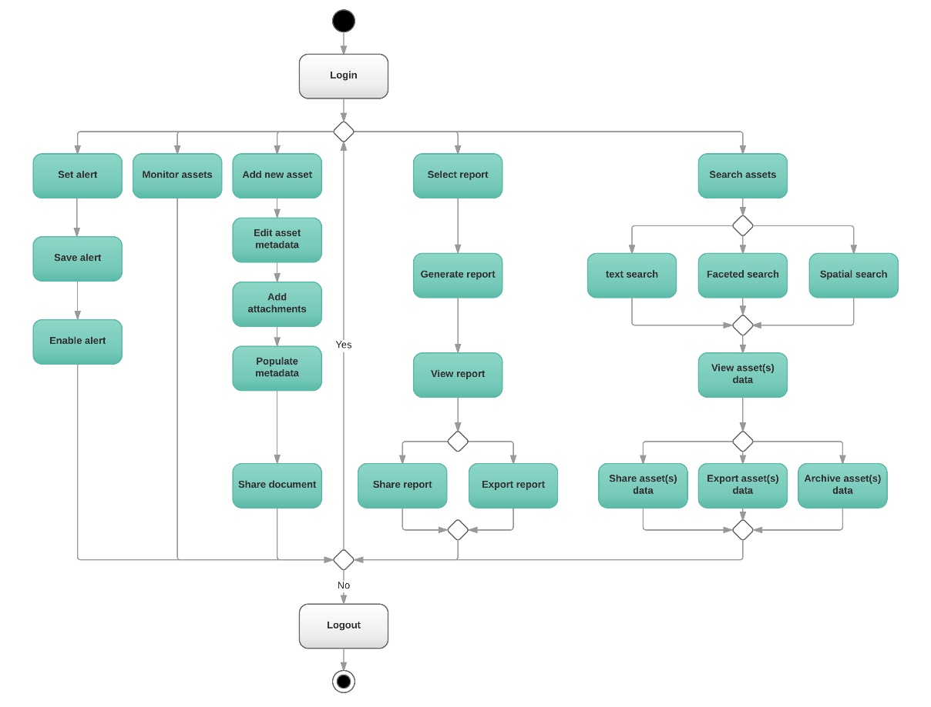
Asset Management Services Activity Diagram
Activity diagrams are designed to represent workflows of stepwise activities and actions that support choice, iteration, and concurrency.
They are intended to model both computational and organizational processes and show the overall flow of control.
This diagram representation focuses on the high-level workflow that would need to be followed to perform the tasks occurring in a session.
The activity diagram design is not intended to be exhaustive.

Slide 44
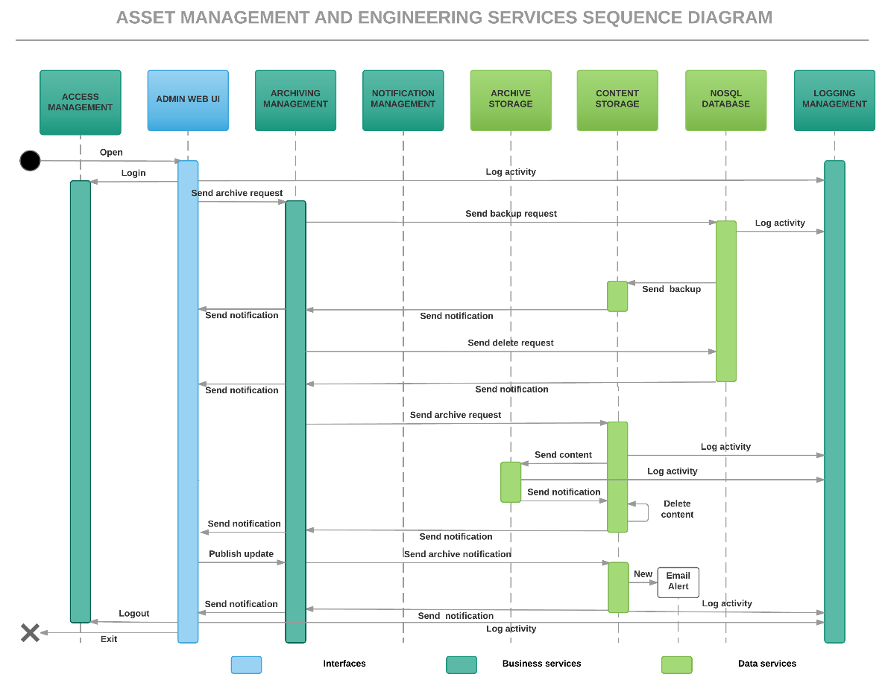
Asset Management Services Sequence Diagram
Sequence diagrams show how objects operate with one another and in what order during a specific scenario.
An important characteristic of a sequence diagram is that time passes from top to bottom
The illustrated scenario is specifically for “DOT maintenance employee archives older asset data”
Notes:
Sequence diagrams are interaction diagrams intended to show how objects operate with one another during a specific scenario and in what order. Sequence diagrams use a Message Sequence Chart construct to represent the system components and their interactions arranged in time sequence. They depict the objects involved in the scenario and the sequence of messages exchanged between the objects that are needed to carry out the functionality of the scenario.

Slide 45
Focus on Migration Strategies From a Monolithic to a Microservices Architecture
Notes:
The following slides present some common challenges to implementing DOT EIPs and recommend solutions for overcoming the challenges

Slide 46
Migration Strategy: Use Incremental Refactoring
The process of transforming a monolithic EIP into a series of microservices is a modernization effort for both the application and its governance.
This migration is a perfect fit for incremental refactoring. It should not be approached as a complete application rewrite, often called “big bang.”
Incremental refactoring enables the development team to build experience with microservices
Incremental refactoring allows teams to build experience with the service extraction process
“Refactoring is the process of changing a software system in such a way that it does not alter the external behavior of the code, yet improves its internal structure."
Martin Fowler
Notes:
Migration to microservices does not have to follow a complete application rewrite approach. Microservices based systems are modular and as such are a perfect fit for an incremental refactoring of the monolithic application. Monolithic application services can be gradually migrated out of the monolithic application and replaced by a new application consisting of microservices. The newly created service will replace the legacy of service and keep interacting with the remaining services operating on monolithic application. Over time, the amount of functionality implemented by the monolithic application shrinks until either it disappears entirely or it becomes just another microservice. This strategy is akin to servicing your car while driving down the highway at 70 mph which can be challenging, but it is far less risky than attempting a complete microservices rewrite.

Slide 47
Migration – Choose a Few Services to Extract from the Monolithic Application
Monolithic applications often consist of hundreds of modules
Determine which modules to extract first. Choose modules that are
Easy to extract
change frequently
have significantly different resource requirements compared to other modules
Do not share resource requirements
implement computationally expensive algorithms.
When migrating from monolithic to microservices, using incremental refactoring is akin to safely servicing your car when driving 70mph on the highway, and stopping the car is not an option.
Notes:
Migration to microservices does not have to follow a complete application rewrite approach. Microservices based systems are modular and as such are a perfect fit for an incremental refactoring of the monolithic application. Monolithic application services can be gradually migrated out of the monolithic application and replaced by a new application consisting of microservices. The newly created service will replace the legacy of service and keep interacting with the remaining services operating on monolithic application. Over time, the amount of functionality implemented by the monolithic application shrinks until either it disappears entirely or it becomes just another microservice. This strategy is akin to servicing your car while driving down the highway at 70 mph which can be challenging, but it is far less risky than attempting a complete microservices rewrite.

Slide 48
Migration – How to Extract a Module
Step 1 – define a coarse-grained interface between the module and the monolith
Consider creating a bidirectional API
Pay close attention to the complexities of business logic refactoring. Significant code changes may be needed to break dependencies
Step 2 – Turn the module into a free-standing service
Write code for the monolith and service to communicate through an API mechanism
Combine module with a microservice framework that handles cross‑cutting concerns such as service discovery
Over time, as modules continue to be extracted into services, the amount of functionality implemented by the monolithic application shrinks until either it disappears entirely or it becomes just another microservice
Notes:
Migration to microservices does not have to follow a complete application rewrite approach. Microservices based systems are modular and as such are a perfect fit for an incremental refactoring of the monolithic application. Monolithic application services can be gradually migrated out of the monolithic application and replaced by a new application consisting of microservices. The newly created service will replace the legacy of service and keep interacting with the remaining services operating on monolithic application. Over time, the amount of functionality implemented by the monolithic application shrinks until either it disappears entirely or it becomes just another microservice. This strategy is akin to servicing your car while driving down the highway at 70 mph which can be challenging, but it is far less risky than attempting a complete microservices rewrite.

Slide 49
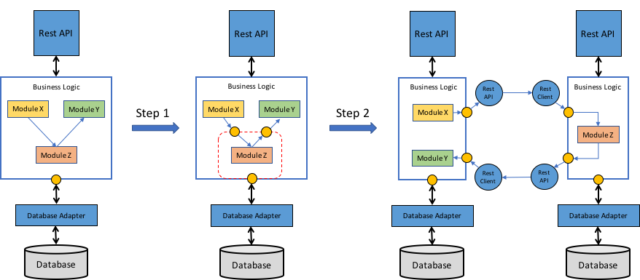
Illustration of Monolithic Module Refactoring
Notes:
The first step of extracting a module is to define a coarse‑grained interface between the module and the monolith. It is mostly likely a bidirectional API, since the monolith will need data owned by the service and vice versa. It is often challenging to implement such an API because of the tangled dependencies and fine‑grained interaction patterns between the module and the rest of the application. Business logic is often especially challenging to refactor because of numerous associations between domain model classes. The development team will often need to make significant code changes to break these dependencies. Figure 5‑6 shows the depiction of the refactoring process.
Once the development team implement the coarse‑grained interface, the team then turns the module into a free‑standing service. To do that, the team must write code to enable the monolith and the service to communicate through an API mechanism. Figure 5‑6 shows the architecture before, during, and after the refactoring.
In Figure 5‑6, Module Z is the candidate module to extract. Its components are used by Module X and it uses Module Y. The first refactoring step is to define a pair of coarse-grained APIs. The first interface is an inbound interface that is used by Module X to invoke Module Z. The second is an outbound interface used by Module Z to invoke Module Y.
The second refactoring step is to turn the module into a standalone service. The inbound and outbound interfaces are implemented by code that uses an API mechanism. The development team now need to build the service by combining Module Z with a microservice framework that handles cross‑cutting concerns such as service discovery.
Once a module has been extracted, the development team has yet another service that can be developed, deployed, and scaled independently of the monolith and any other services. The team can even rewrite the service from scratch; in this case, the API code that integrates the service with the monolith becomes an anti‑corruption layer that translates between the two domain models. Each time the team extract a service, it takes another step in the direction of microservices. Over time, the monolith will shrink and you will have an increasing number of microservices.

Slide 50
Microservice Success Strategies to overcome the non-technical hurdles

Slide 51
Migration to Microservices is Transformational
DOT Agencies vary considerably in their program area priorities, organizational structure, and culture with respect to IT and innovation.
The following sections address strategies to overcome the non-technical hurdles including
Stakeholder buy-in
Changing governance
Developing the workforce
Simplifying procurement
Addressing legal challenges
Making DOT EIPs sustainable will require transformations in equipment, facilities, staff, processes, procedures, organization, and culture.

Slide 52
Strategy: Focus on Stakeholder Buy-in
A fundamental element to adopting new EIP practices is obtaining buy-in from various levels of the DOT organization.
Cultivate a passionate executive-level sponsor, the champion for this change
Elevate IT presence to the executive level
Plan for continuing outreach cultivating champions within key business units
Formulate the Business Case that tells a compelling story, conveys value and addresses risks, scope, cost, schedule, timeline, and benefits.
Develop concise talking points for each stakeholder group that highlights value that best resonates with their needs

Slide 53
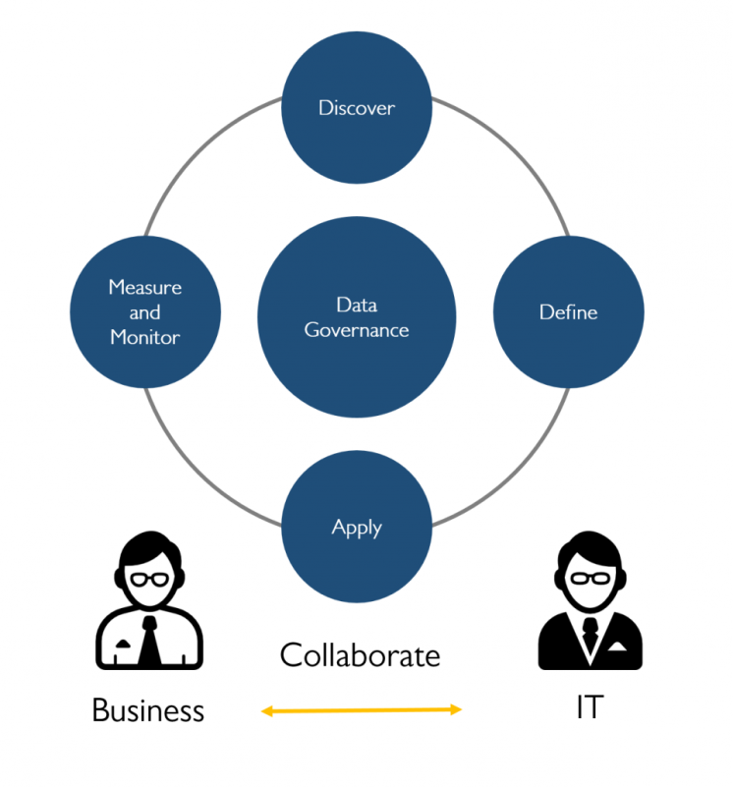
Strategy: Establish Consistent but Flexible Governance Principles
There is frustration when governing principles are not consistently implemented and enforced throughout the organization
With sustainable EIPs, governance focus shifts away from managing hardware and software resources to managing user access to data and protecting data from unauthorized access.
The key is to establish and practice consistent but flexible governance principles.

Slide 54
Strategy: Continually Develop the Workforce
People are the backbone of any industry
Adopt a proactive approach to recruit, develop, and retain staff.
Recognize the importance of recurring IT training to ensure expertise with emerging solutions and practices
Understand the effects of outsourcing. While outsourcing has perceived cost savings, the nimbleness of experienced staff who have both IT and program area knowledge will be lost.
The quality of developers and transportation experts and their effective collaboration and communication is more important to the success of an EIP than the choice of whether to use monolithic, microservice, or blended architecture.

Slide 55
Strategy: Focus on Stakeholder Buy-in
Establish ongoing dialogue and collaboration among IT, HR, Legal, and Financial stakeholders in evolving procurement processes prior to any specific procurement.
Establish a common understanding of IT procurement needs
Identify procurement and purchasing issues that may require new ways of doing business
Some DOT agencies have a separate procurement group for IT/cloud services procurement or a state-level IT cloud procurement entity.
Others will have to champion changes to procurement law to address this need for IT flexibility.

Slide 56
Strategy: Recognize Complex Legal Concerns Early
As each state has their own data retention, public record, and intellectual property laws; there is no one blanket approach to mitigating legal issues.
Legal considerations are likely to include data sharing, data storage/location, intellectual property, and backup format requirements
DOTs must begin to recognize that data sharing is becoming a key part of their business
Collaborate at the state level to address these concerns
The addition of “Rider Clauses” in contracts has often been used to help state organizations allow other states to access and use their data

Slide 57
Top 10 Strategies for Implementing Successful EIPs
Continually educate DOT staff on emerging IT capabilities.
Identify & routinely connect with stakeholders and champions.
Always lead with the business need for IT change.
Recognize and respond to institutional factors that need to be overcome.
Design a persuasive message and tailor it for the stakeholder
Define and implement changes to IT practices.
Establish, maintain, and adhere to policies and processes
Governance
Hiring and Training
Procurement
Evaluate performance and identify lessons learned
Share successes and lessons learned with peers
Evolve based on lessons learned and look forward to offering new, high value DOT EIP services.

