Slide 1
Introduction to Soluble SALTs

Slide 2
Key Learning Objectives
This Training Addresses the Following Questions
What are Soluble Salts?
What makes Salts Soluble?
How Do Salts Affect Solution Conductivity?
Why do Soluble Salts Matter for Bridges?

Slide 3
What is a Salt?
Definition:
A salt is an ionic compound that can be formed by the neutralization reaction of an acid and a base.
Skoog, D.A; West, D.M.; Holler, J.F.; Crouch, S.R. (2004). Fundamentals of Analytical Chemistry; Chapters 14, 15 and 16 (8th ed.). Thomson Brooks/Cole. ISBN 0-03-035523-0.
This compound is often formed by negatively charged non-metal ions (acids in solution) and positively charged metal ions (bases in solution)
Notes:
In chemistry, a salt is an ionic compound which is made up of two groups of oppositely charged ions. The ion with a positive charge is called a cation, and the one with a negative charge is called an anion. Salts are usually a combination of positive metal ions and negative non-metal ions that when combined have no overall electrical charge

Slide 4
Everyday Salts
Table Salt – NaCl
Rock Salt – NaCl
De-Icing Salt – NaCl, CaCl₂, MgCl₂
Sea Salt – evaporated ocean water
Epsom salt – MgSO₄
Notes:
Key point is that “salt” is a very broad term.

Slide 5
Bridge Salts
Airborne salts from salt water source
De-Icing salts deposited during winter weather
Industrial sources
Chlorides, Sulfates, Nitrates
Notes:
Salts of concern for bridges are typically from deicing salts, marine environment, or industrial sources. Common ions of concern are chlorides, sulfates, and nitrates

Slide 6
How are Salts Formed?
Neutralization Reaction
HA + BOH → BA + H₂O
Two oppositely charged ions lead to one neutrally charge salt and water
Cation -> positively charged -> HA
Anion -> Negatively charged -> BOH
To form NaCl:
$HCl+NaOH ⟶NaCl+H_{2}O$
Hydrolysis Reaction
BA + H₂O → HA + BOH
Salt + water = cation and anion in solution
Salt is solubilized onto the surface
To dissolve NaCl:
$NaCl+H_{2}O⟶HCl+NaOH$
Notes:
Formation and solubility of salts

Slide 7
Solubility Rules Relating to Salts
Soluble
Insoluble
Salts containing:
Lithium (Li)
Sodium (Na)
Potassium (K)
Caesium (Cs)
Nitrate (N0₃)
Chloride (Cl)
Bromide (Br)
Sulfate (SO₄⁻²)
Salts containing:
Silver (Ag)
Transition metals (Fe, Zn, Mg, etc)
Carbonates (CO₃)
Chromates (CrO₄₎
Phosphates (PO₄)
Fluorides (F)
Notes:
General solubility rules, there are some exceptions
Bolded common salt contributors
Sodium, Nitrate, Sulfate
Iron
Insoluble salts include most silver except silver nitrate, AgNO3
Aside from this, usually insoluble cations will take precedence over soluble ions, i.e., AgCl is insoluble.
Some of these insolubilities are used to measure the level of salts in a solution, like the above mentioned AgCl
http://www5.csudh.edu/oliver/chemdata/solrules.htm – Organized list
https://chem.libretexts.org/Core/Physical_and_Theoretical_Chemistry/Equilibria/Solubilty/Solubility_Rules – List with References

Slide 8
Precipitation of Salts
Salts will precipitate under the following conditions:
An increase of salt concentration past the solubility limit
A decrease in water present causing the concentration to exceed the solubility limit
The formation of new salts from ions in solution that are insoluble
Notes:
Precipitated salts may draw moisture from the air, keeping the surface wet which can either create a corrosion cell or stress the protective coating.

Slide 9
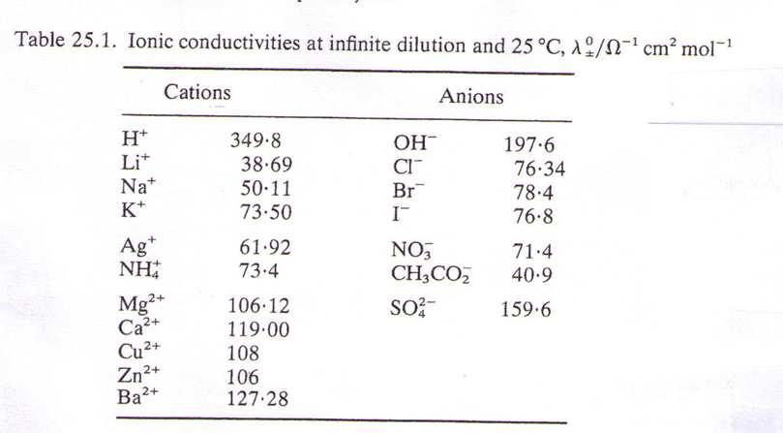
How Salts Affect Conductivity
All dissolved ions (cations and anions) contribute to solution conductivity based on their ionic conductivity as shown in the table from Physical Chemistry, P.W. Perkins, W.H. Freeman and Company, San Francisco, CA, 1978
Notes:
Key point is that both the cation and anion (e.g., Na and Cl) contribute to solution conductivity when they are dissolved. Also, different ions contribute differently to the conductivity.

Slide 10
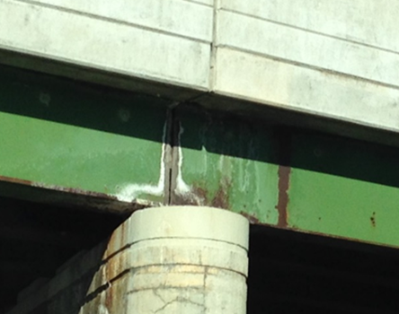
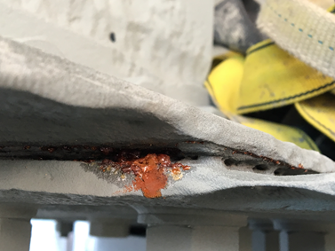
Where do Salts Occur on Bridges
Notes:
Salts may precipitate on surfaces, be contained in debris, or collect in crevices formed between steel members

Slide 11
Consequences of Soluble Salt Contamination
Why Soluble Salt Measurements are important
Higher levels of soluble salts lead to:
Increased rates of corrosion from defect sites
Increased metal loss due to corrosion
Poor adhesion of coating systems
Blistering of coatings
Pre-mature coating breakdown
Increased discoloration due to rust staining
Notes:
When moist, salts disassociate into ions in solution
Dissolved ions will increases conductivity of the solution and may de-passivate steel surfaces, both of which will increase the rate of corrosion reactions
Under a painted surface, salts will draw water through coatings through osmosis
May cause a coating to blister

Slide 12
Situations Where Salt Testing may be Useful
The following situations may benefit from soluble salt testing:
Determining if a prepared surface is sufficiently free of soluble salts to be painted.
Determine whether a bridge washing provides a thorough salt remediation
Evaluate the severity of the environment around the structure being tested, and how this environment may be changing over time
Document how different winter salt brines compositions adhere to the surface, and whether seasonal washing removes them from surfaces
Notes:
The most common use of soluble salt detection techniques on bridges is to determine if a surface is sufficiently clean prior to painting.
Detection techniques may also be used to document and/or understand what salts are on a bridge to inform future maintenance decision-making.

