Slide 1
REMEDIATION OF Soluble SALT CONTAMINATION
Notes:
This presentation covers issues related to remediation of soluble salt contamination on steel highway structures. It includes several inter-related sections. The reader should be familiar with the introduction to soluble salts training before viewing this material.

Slide 2
Key Learning Objectives
This Training Addresses the Following Questions
When Should Soluble Salts be Remediated on Steel Bridges?
How Effective are Different Methods of Soluble Salt Remediation?
What Issues are Important to Consider During Remediation?
What are the Economic Benefits of Soluble Salt Remediation?
What are the Recommended Best Practices for Soluble Salt Remediation?

Slide 3
When to remediate?
Situations calling for Salt Detection and Remediation
Notes:
Good spot to ask people when they have remediated surfaces, for what reasons

Slide 4
During Surface Preparation for Coating
Before any surface preparation process
Pressure wash salts and other debris prior to mechanical surface preparation
Ensure salt on prepared surface doesn’t exceed acceptable levels for coating
This may require reworking areas before painting
During full coating removal projects
Able to use more effective remediation methods such as:
Dry abrasive blasting to an SSPC-SP 10/NACE No 2 condition
Wet abrasive blasting SSPC-SP 10 (WAB)/NACE WAB-2 condition
Ultra-high pressure water-jetting to an SSPC-SP WJ-2/NACE WJ-2 condition
Rework may involve pressure washing in conjunction with the specified surface preparation method
Soluble salt levels in the range of 5 to 10 µg (Cl or salt per ISO 8502-9)/cm² are reasonable expectations
During spot coating removal projects
Higher levels of power tool cleaning are more effective (e.g., SSPC-SP 11 is more effective than SSPC-SP 3)
Light pressure wash after power tool cleaning is effective
Allow surface to fully dry prior to painting
May be difficult to achieve the same cleanliness as with full removal methods

Slide 5
During Subsequent Coats of Paint
Remediate primer and intermediate coats of paint when soluble salt contamination of coating is observed
Pressure wash, low pressure water, or washing with a wet cloth are effective methods
Consider soluble salt testing between coats, especially in marine environments, or where primer/intermediate coats are exposed for extended periods of time
Rusted areas may require mechanical preparation

Slide 6
Seasonal Remediation of Salts from Bridge Surfaces
Areas subject to winter snow conditions may require seasonal salting for safety
Springtime washing of these salts can prolong steel life
Remediation is typically performed with low pressure water methods
May be subject to local environmental restrictions
Visual surface inspections may be appropriate for determining reduction in salt levels
Quantitative testing may periodically be used in conjunction with visual inspection to address specific issues
In conjunction with washing, areas requiring further remediation and repainting should be identified

Slide 7
Methods to remediate soluble salts
Ways to Efficiently Remove Rust and Salts from Steel Surfaces

Slide 8
Mechanical Methods
Power Tool Cleaning
SSPC-SP 3
SSPC-SP 11
Media Blasting
SSPC-SP 10
SSPC-SP 10 (WAB)

Slide 9
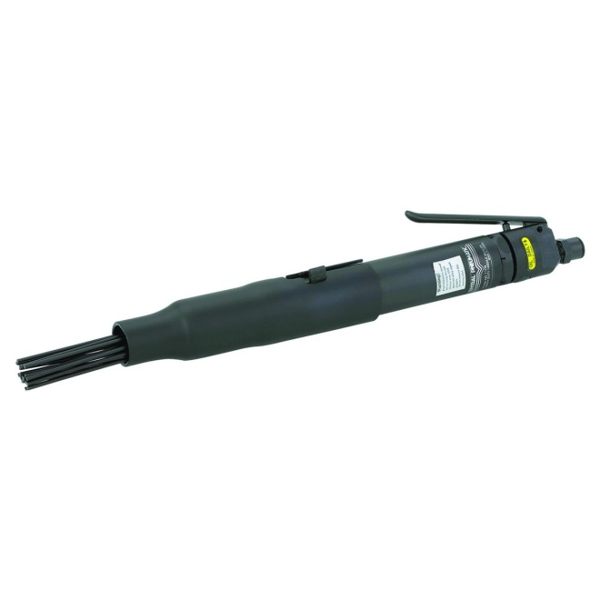
Power Tool Cleaning with Needle Gun
SSPC-SP 3 ”Power Tool Cleaning”
Quickly remediates heavy scaling on surfaces
Pneumatic tool operated at 90psi forces metal pins (needles) back and forth against the surface to remove rust and salts
May require additional dust or vacuum shroud
Achieves new surface profile
Tightly bonded rust and staining remains on the surface after use
Notes:
Not recommended as only step in remediation of soluble salts due to leaving the surface contaminated
Can be useful in tight, complex areas as first step

Slide 10
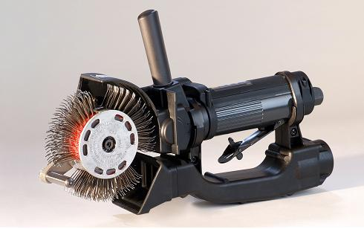
Power Tool Cleaning With Rotary Bristle Tool
SSPC-SP 11 “Power Tool Cleaning to Bare Metal”
Cuts through scale and surface rust
Pneumatic tool operated at 90psi spins brush head with needles 3500rpm against surface
Difficult to use in tight areas or complex geometries
Achieves new surface profile
Surface appears visibly cleaned of rust

Slide 11
Power Tool Cleaning Comparison
SSPC-SP 3 Needle Gun
SSPC-SP 11 Rotary Bristle Tool
Remediates well around bolts, crevices, complex and small areas
Only remediates loosely adherent rust or chlorides
Surface may be visibly dirty after completion
Good on flat surfaces but difficult to use around bolts and in tight crevice areas
Little to no visible surface rust or chlorides after
Notes:
Both used for spot surface preparation during maintenance and touch up work

Slide 12
Media Blast to an SSPC-SP 10/NACE No.2 - Near White Metal Blast
Commonly used media used: Aluminum Oxide, Steel Shot, Garnet
Abrasive media is propelled against the surface, removing scale and surface rust and re-finishing the surface
Substrate and material used will affect remediation time and final surface profile
Final surface shall be 95% free of all visible oil, grease, dust, dirt, mill scale, rust, coating, oxides, corrosion products and other foreign matter.
Surface may contain light shadows in 5% of each 3-inch by 3-inch surface area
Notes:
When viewed without magnification shall be free of all visible oil, grease, dust, dirt, mill scale, rust, coating, oxides, corrosion products and other foreign matter of at least 95% of each unit area. Staining shall be limited to no more than 5 percent of each unit area, and may consist of light shadows, slight streaks, or minor discolorations caused by stains of rust, stains of mill scale, or stains of previously applied coatings. Unit area shall be approximately 3 in. x 3 in. (9 sq. in.).

Slide 13
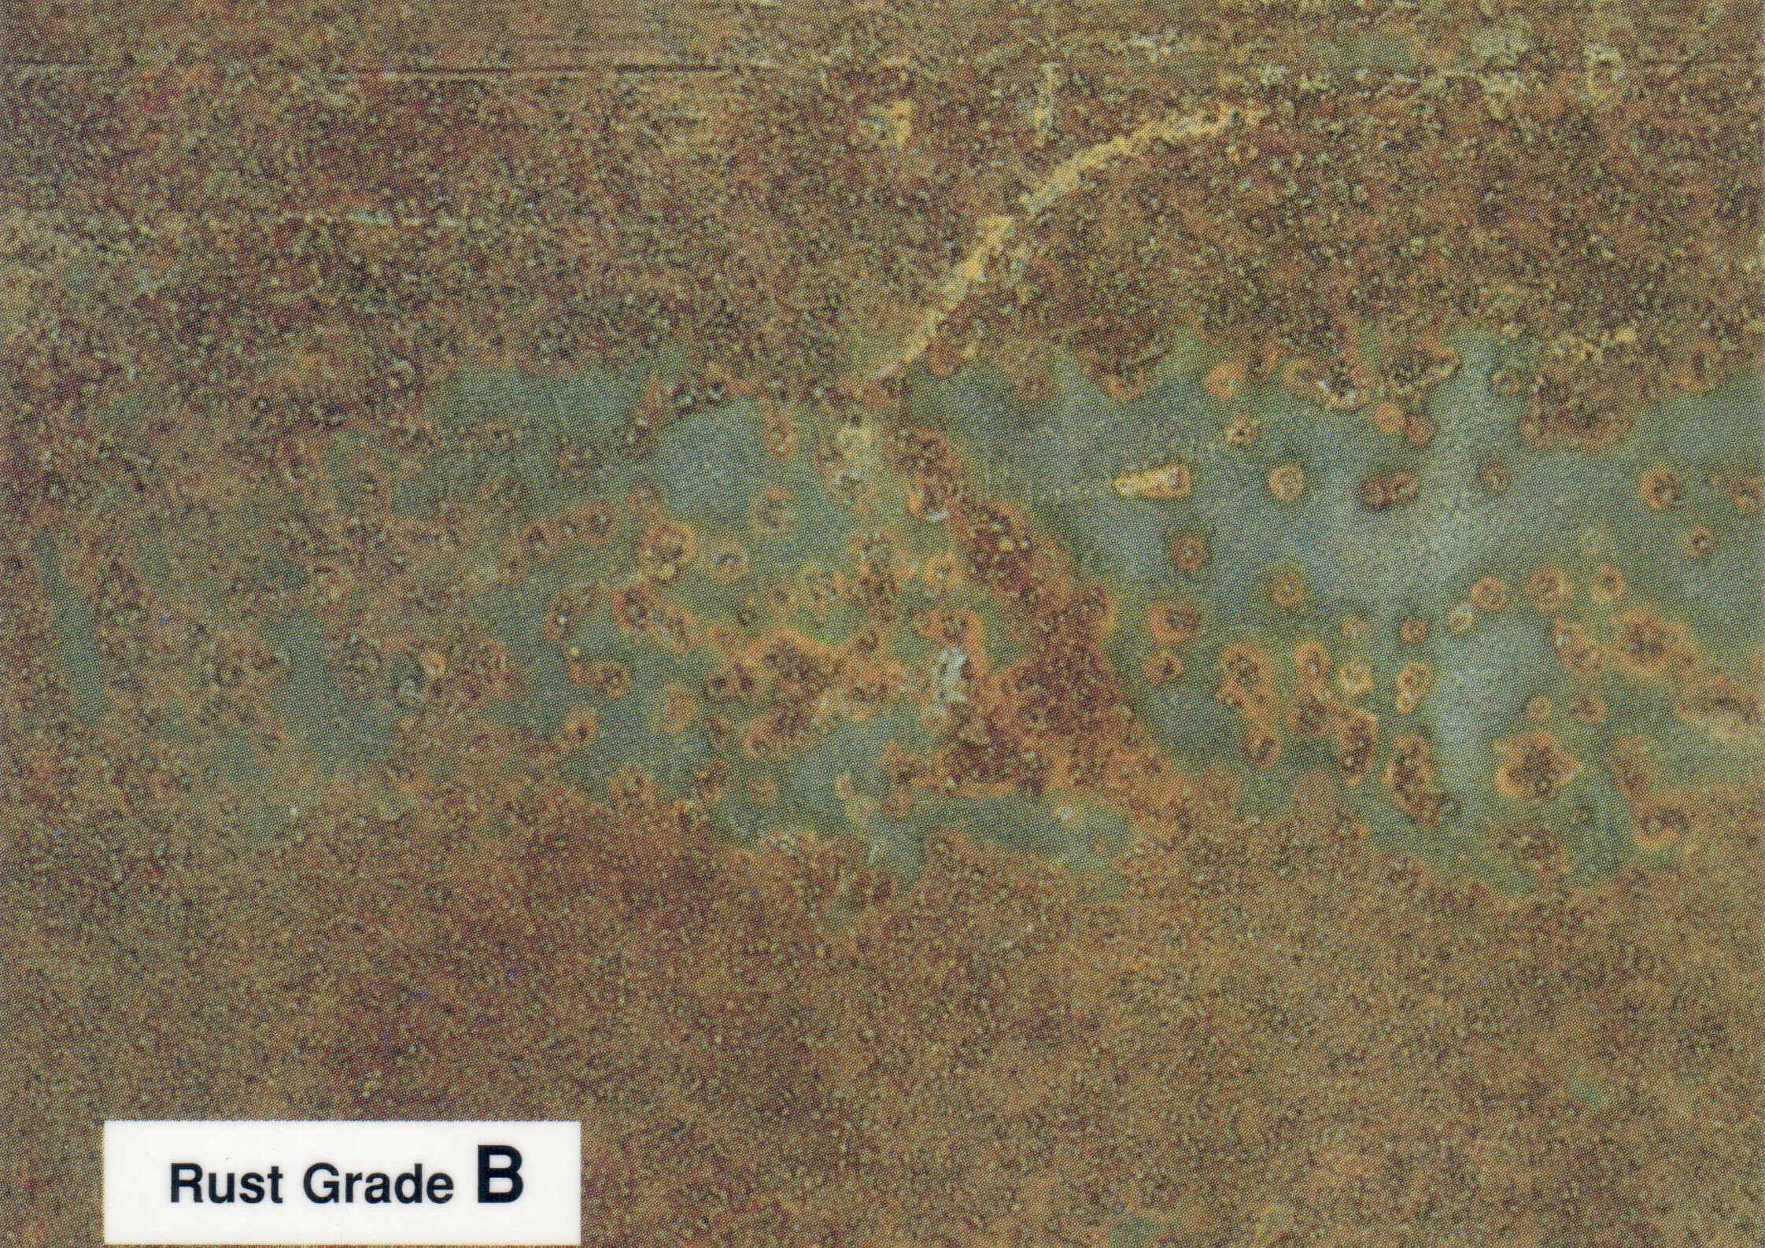
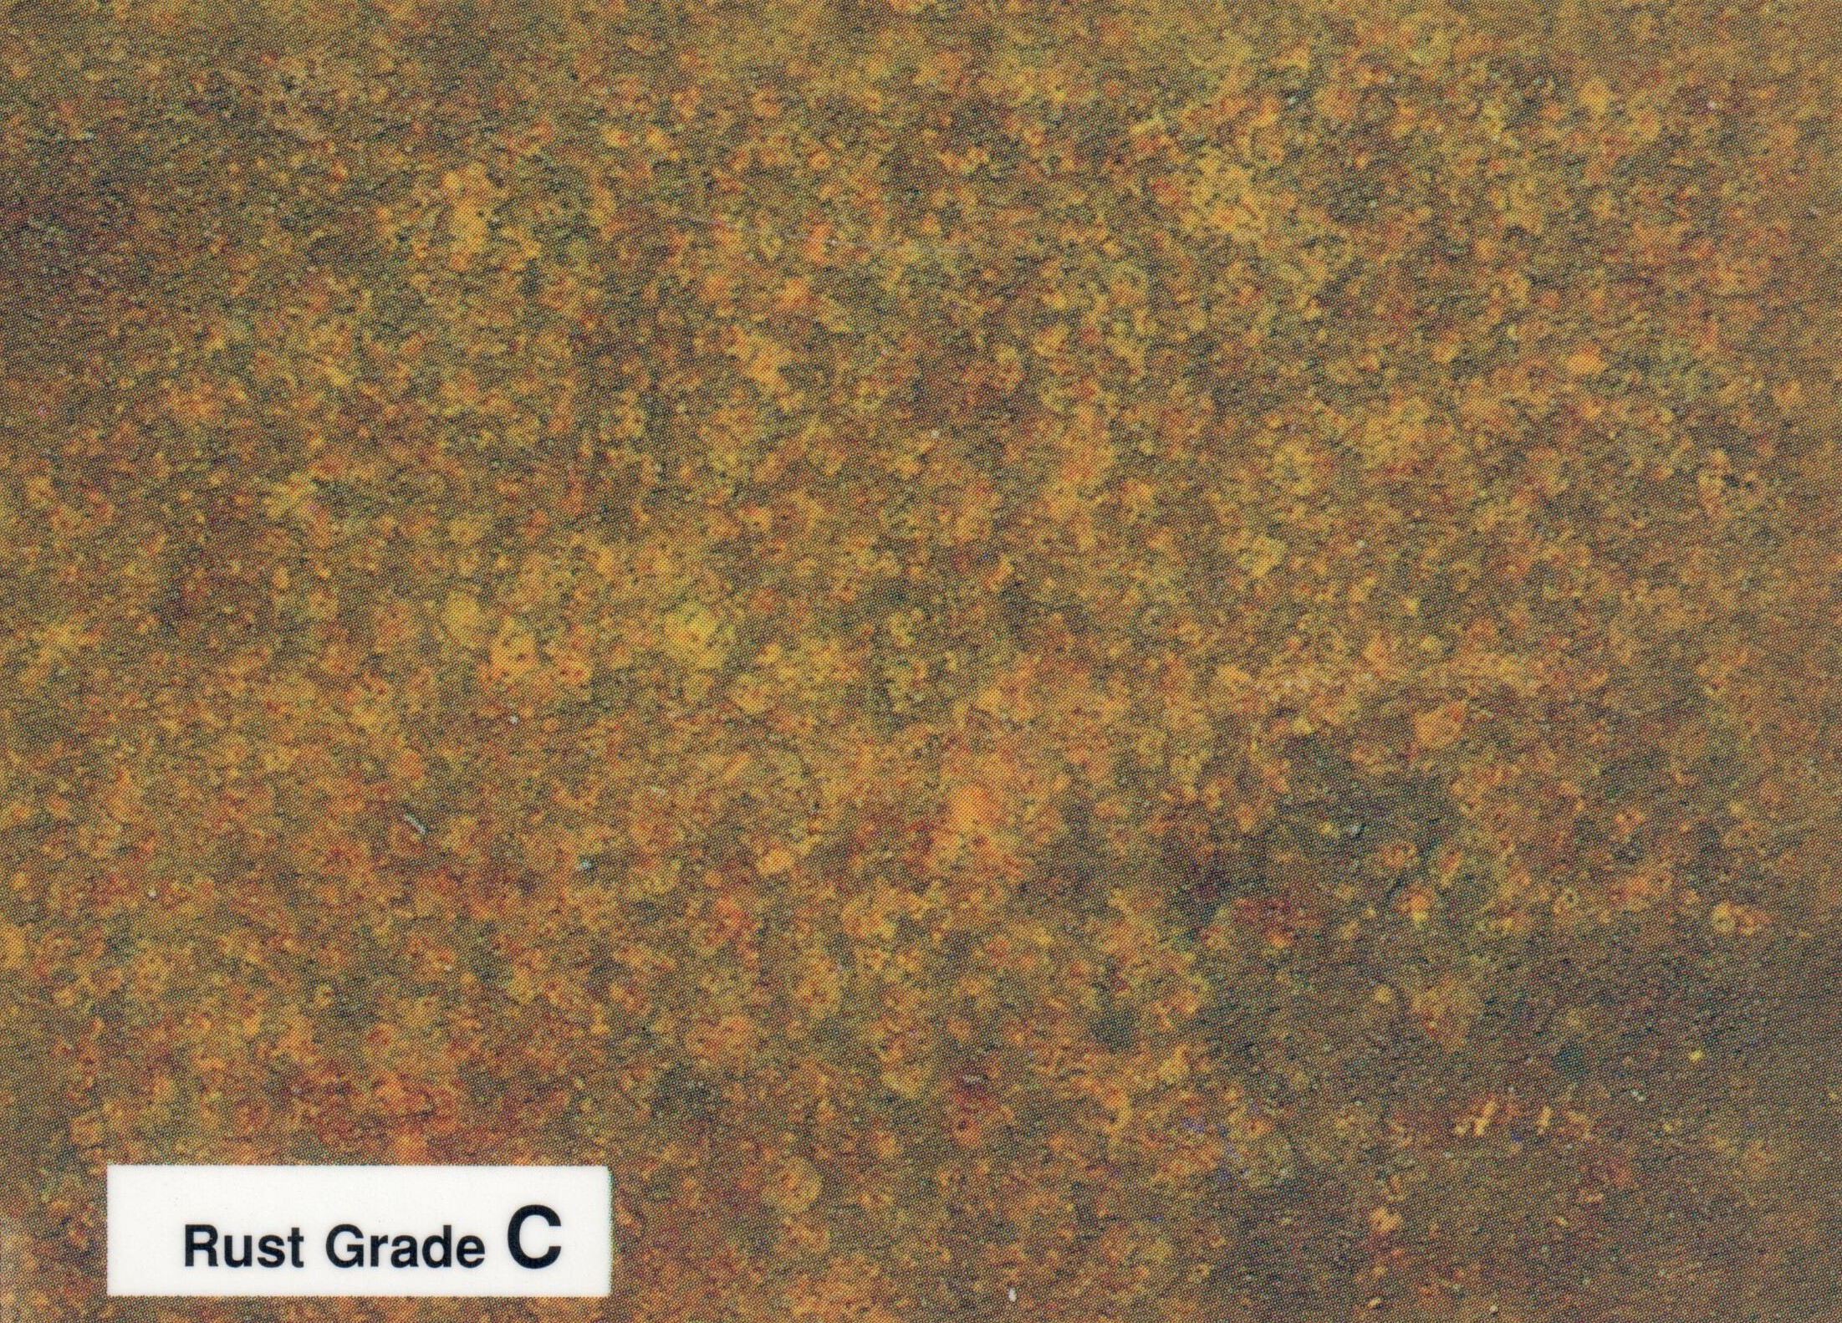
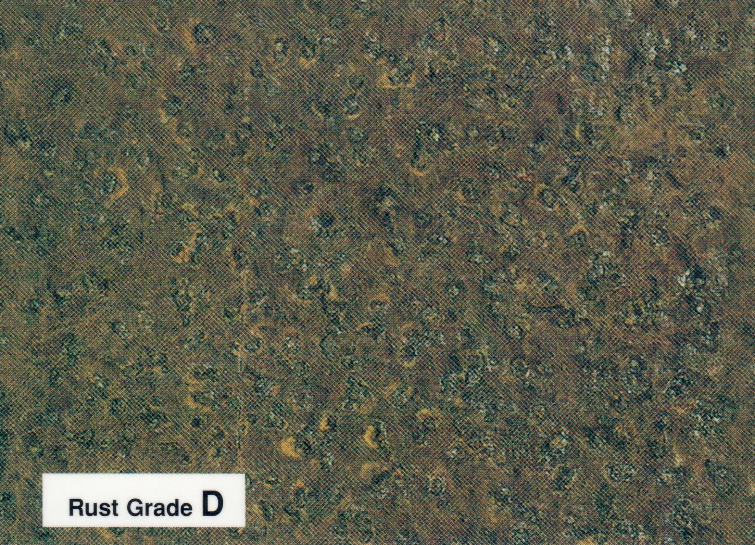
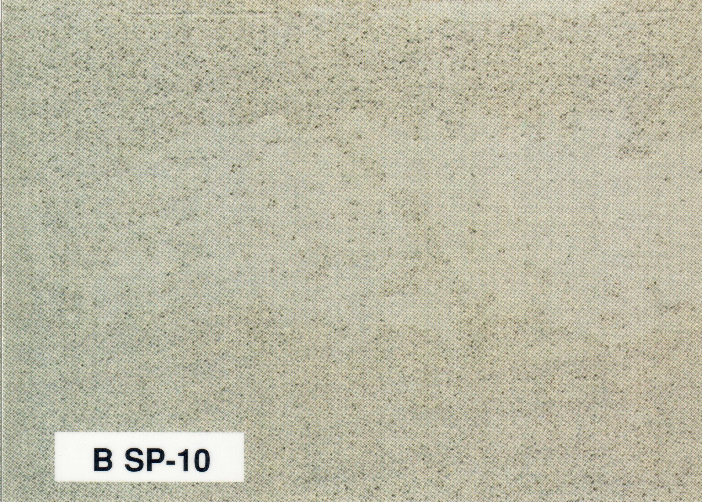
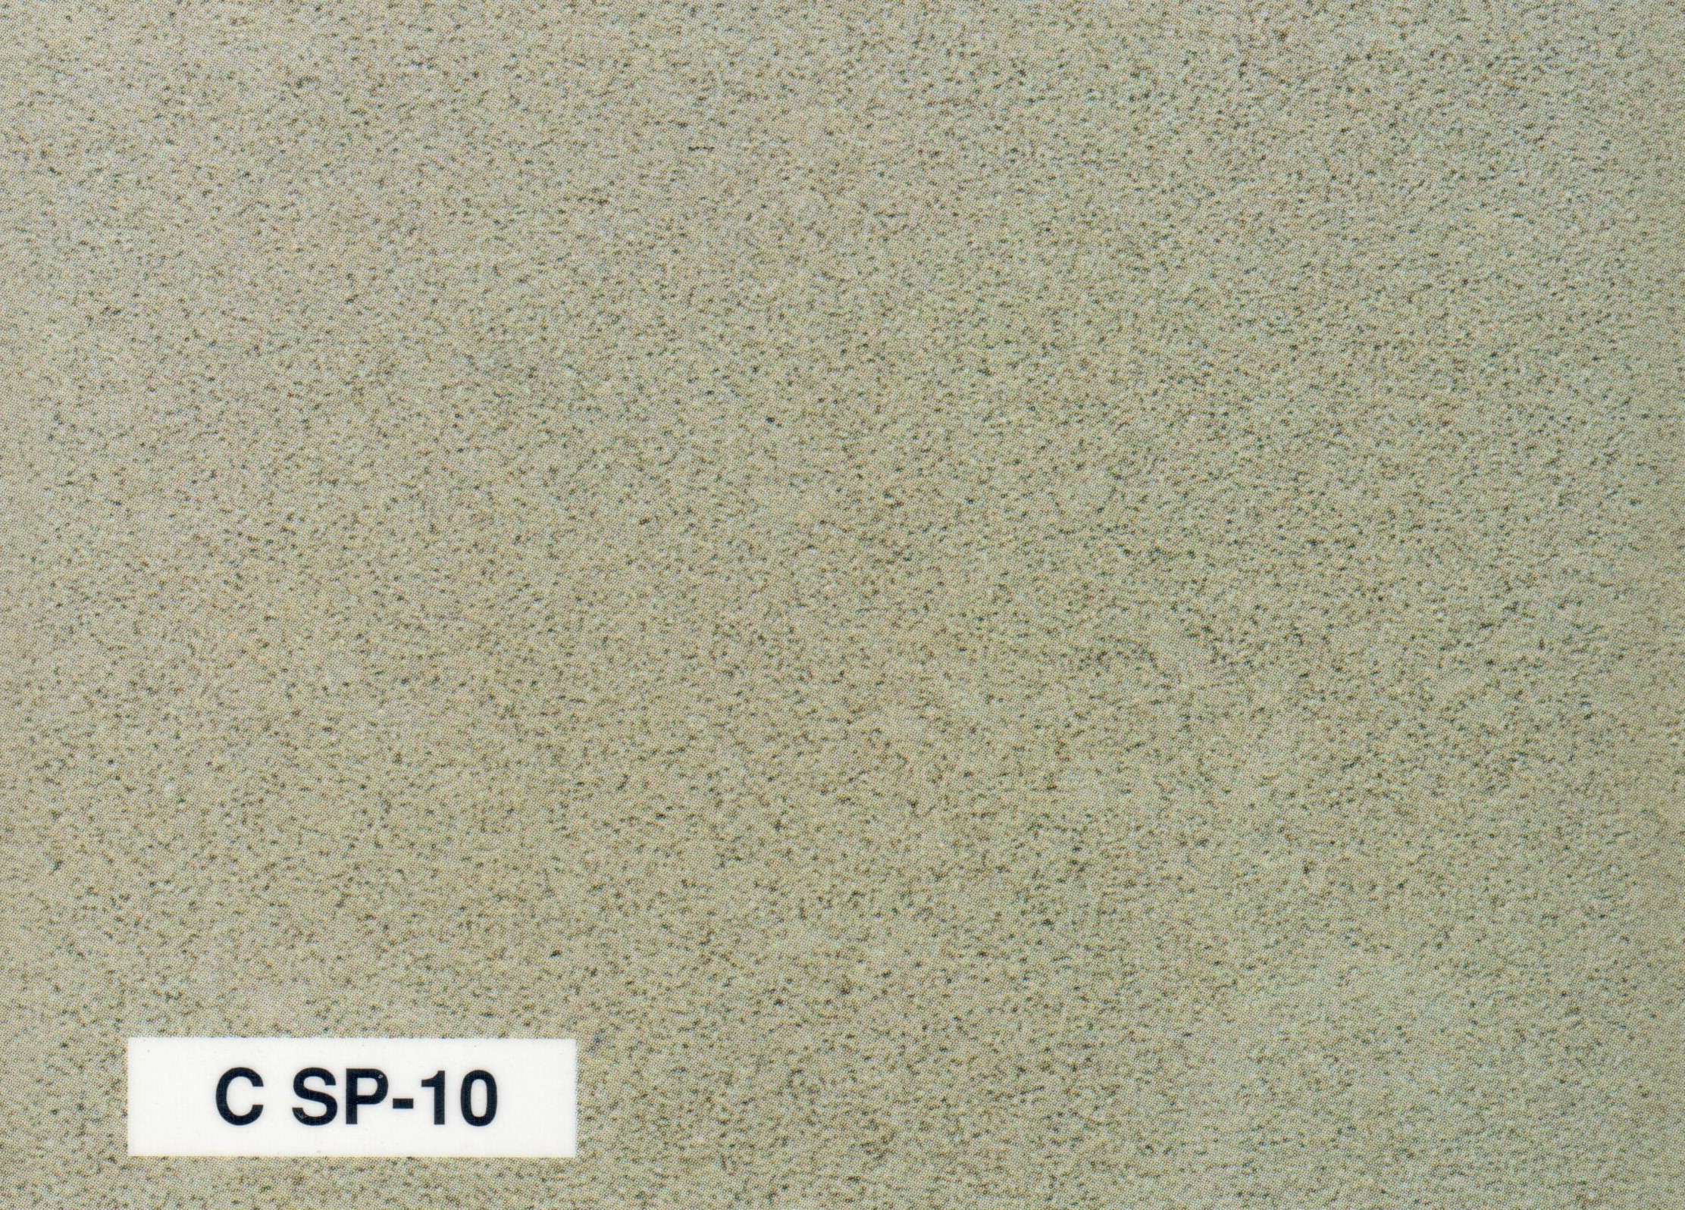
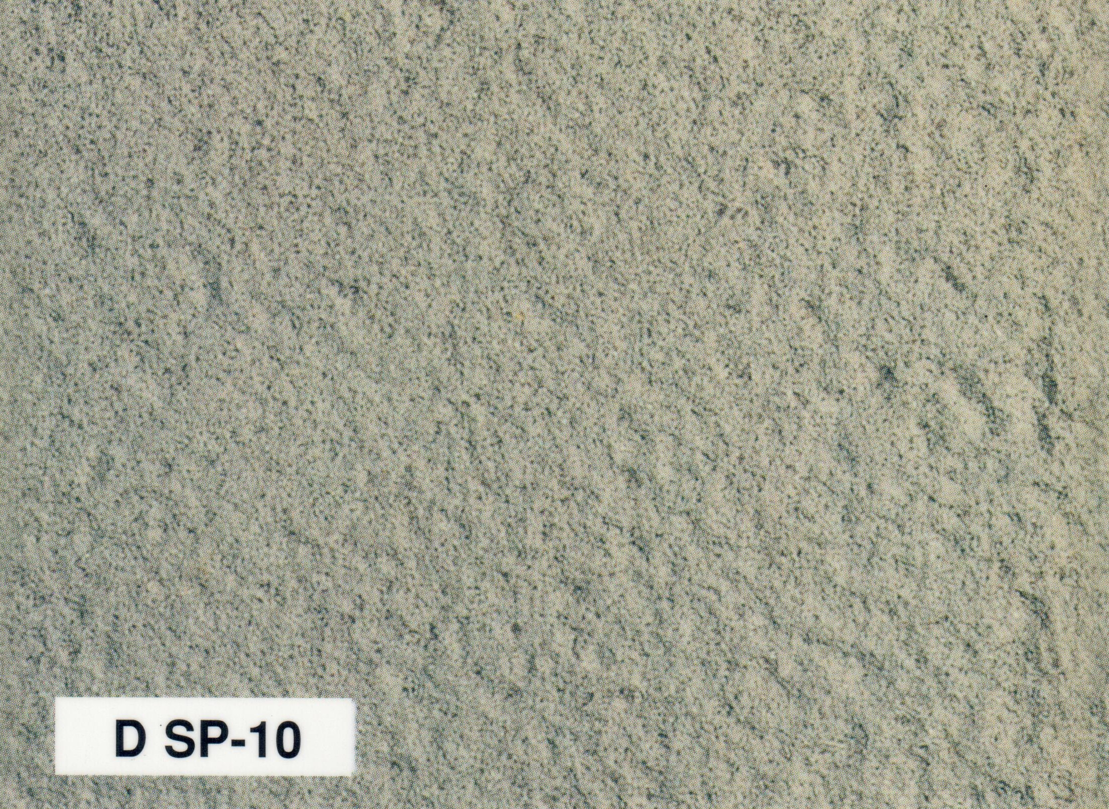
Visual Near White Metal Blast Cleaned Examples
Examples of varying initial surface conditions being remediated to an SP-10 surface, curtesy of SSPC-VIS 1 Dry Abrasive Blast Cleaning

Slide 14
Water Remediation Methods
Four SSPC/NACE standards address water remediations:
SSPC-SP WJ-1/NACE WJ-1 “Waterjet Cleaning of Metals — Clean to Bare Substrate”
SSPC-SP WJ-2/NACE WJ-2 “Waterjet Cleaning of Metals — Very Thorough Cleaning”
SSPC-SP WJ-3/NACE WJ-3 “Waterjet Cleaning of Metals — Thorough Cleaning”
SSPC-SP WJ-4/NACE WJ-4 “Waterjet Cleaning of Metals — Light Cleaning”
Does not produce a new profile, but instead exposes previous abrasive blasted profile on the steel
If pitting has occurred following corrosion of the original substrate, the exposed surface will be pitted
All wet methods of bare steel remediation are susceptible to flash rust
Specified by visual and non-visual standards of surface cleanliness

Slide 15
Water Remediation Specifications Descriptions
WJ-1
Surface shall be free of all previously existing visible rust, coatings, mill scale, and foreign matter and have a matte metal finish
WJ-2
95% of surface shall adhere to WJ 1
5% may contain only rust staining, coatings, and foreign matter
WJ-3
66% of surface shall adhere to WJ 1, with the exception of mill scale
33% may contain only rust staining, coatings, and foreign matter
WJ-4
Surface shall have all loose rust, loose mill scale, and loose coatings uniformly removed
Notes:
Not to be confused with differences in water pressures

Slide 16
Water Pressures used in Remediation
LP WC – Low Pressure Water Cleaning
3,000 to 5,000 psi
Can be used without damaging adherent coating
Recommended for seasonal & partial salt remediation
HP WC – High Pressure Water Cleaning
5,000 to 10,000 psi
Will remove all but tightly adherent rust and coating from the surface
HP WJ – High Pressure Water Jetting
10,000 to 25,000 psi
Will remove most coatings, rust, and staining from the surface
UHP WJ – UltraHigh Pressure Water Jetting
>25,000 psi
Highest level of remediation achieved through water methods
Notes:
Not to be confused with WJ-1 through WJ-4 classifications

Slide 17
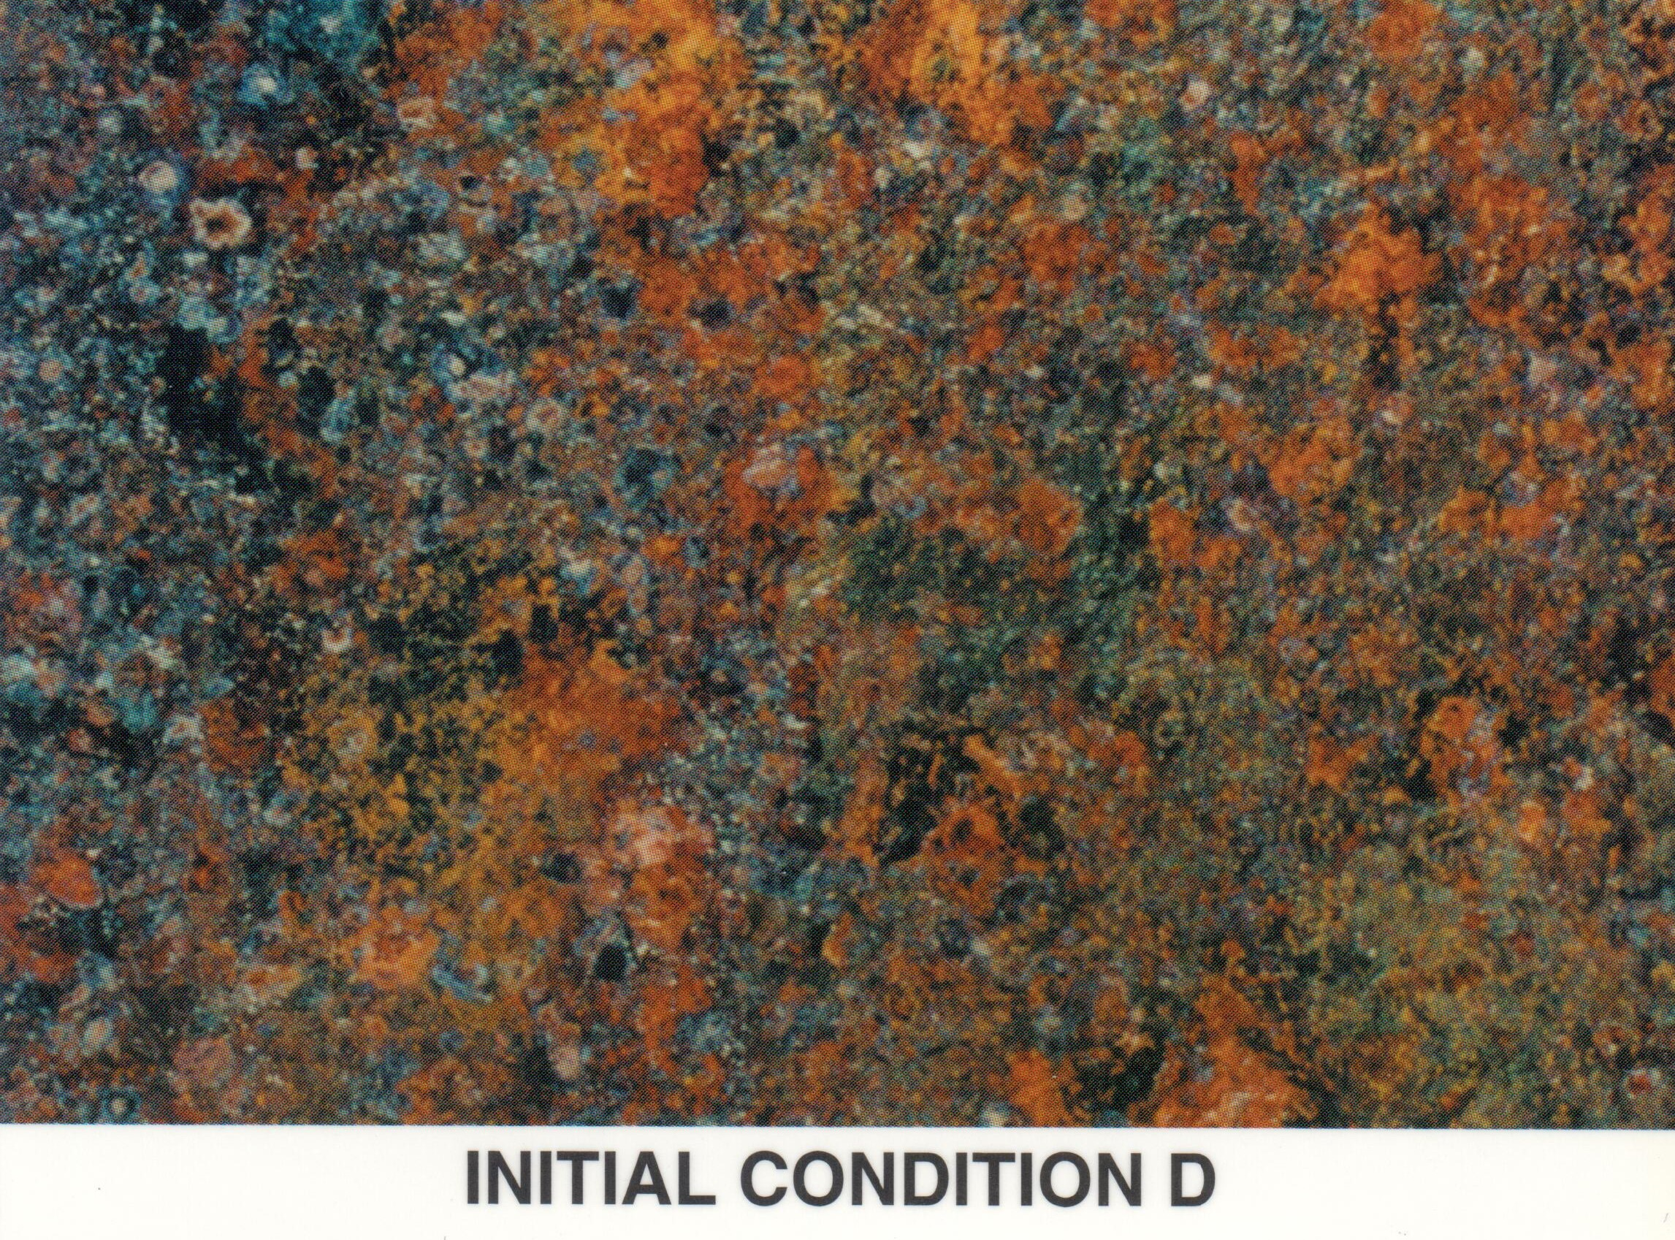
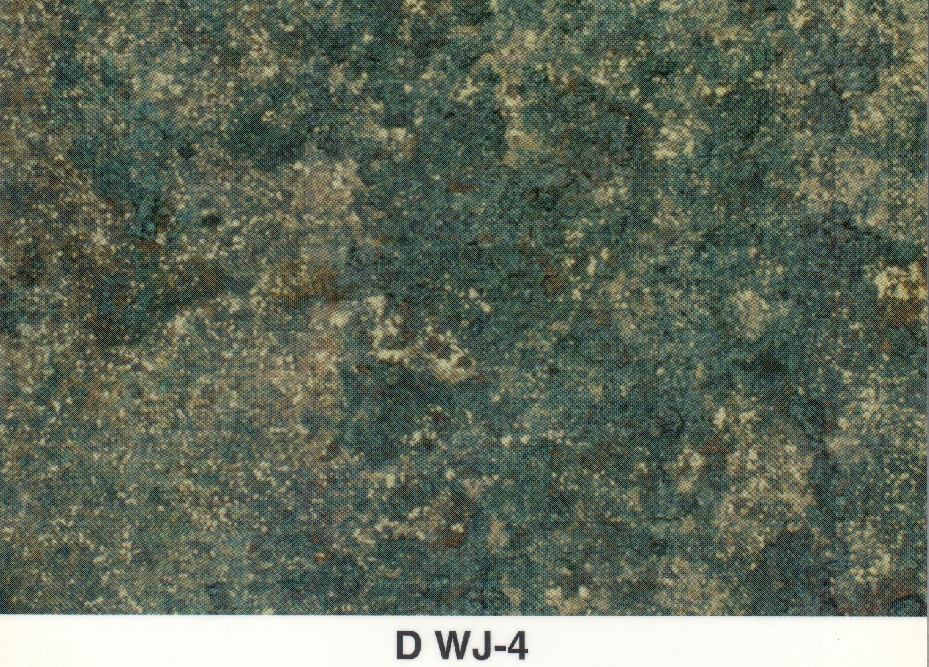
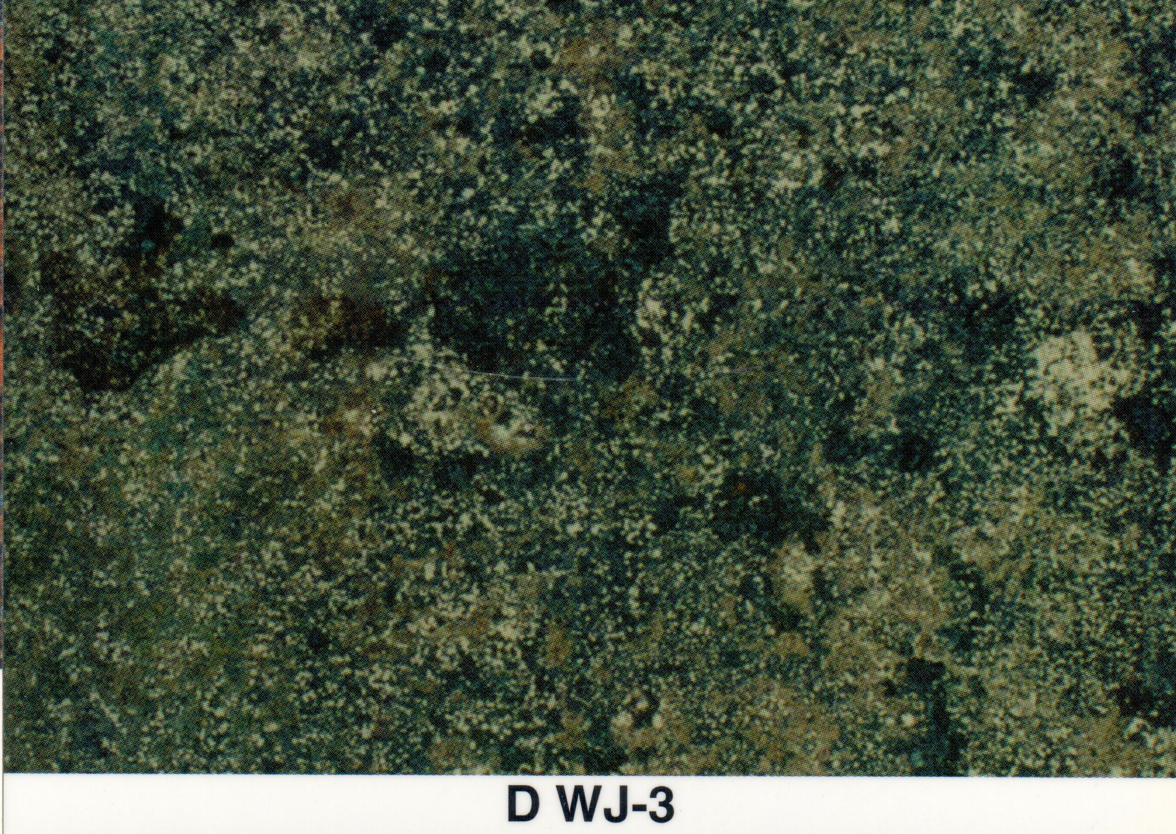
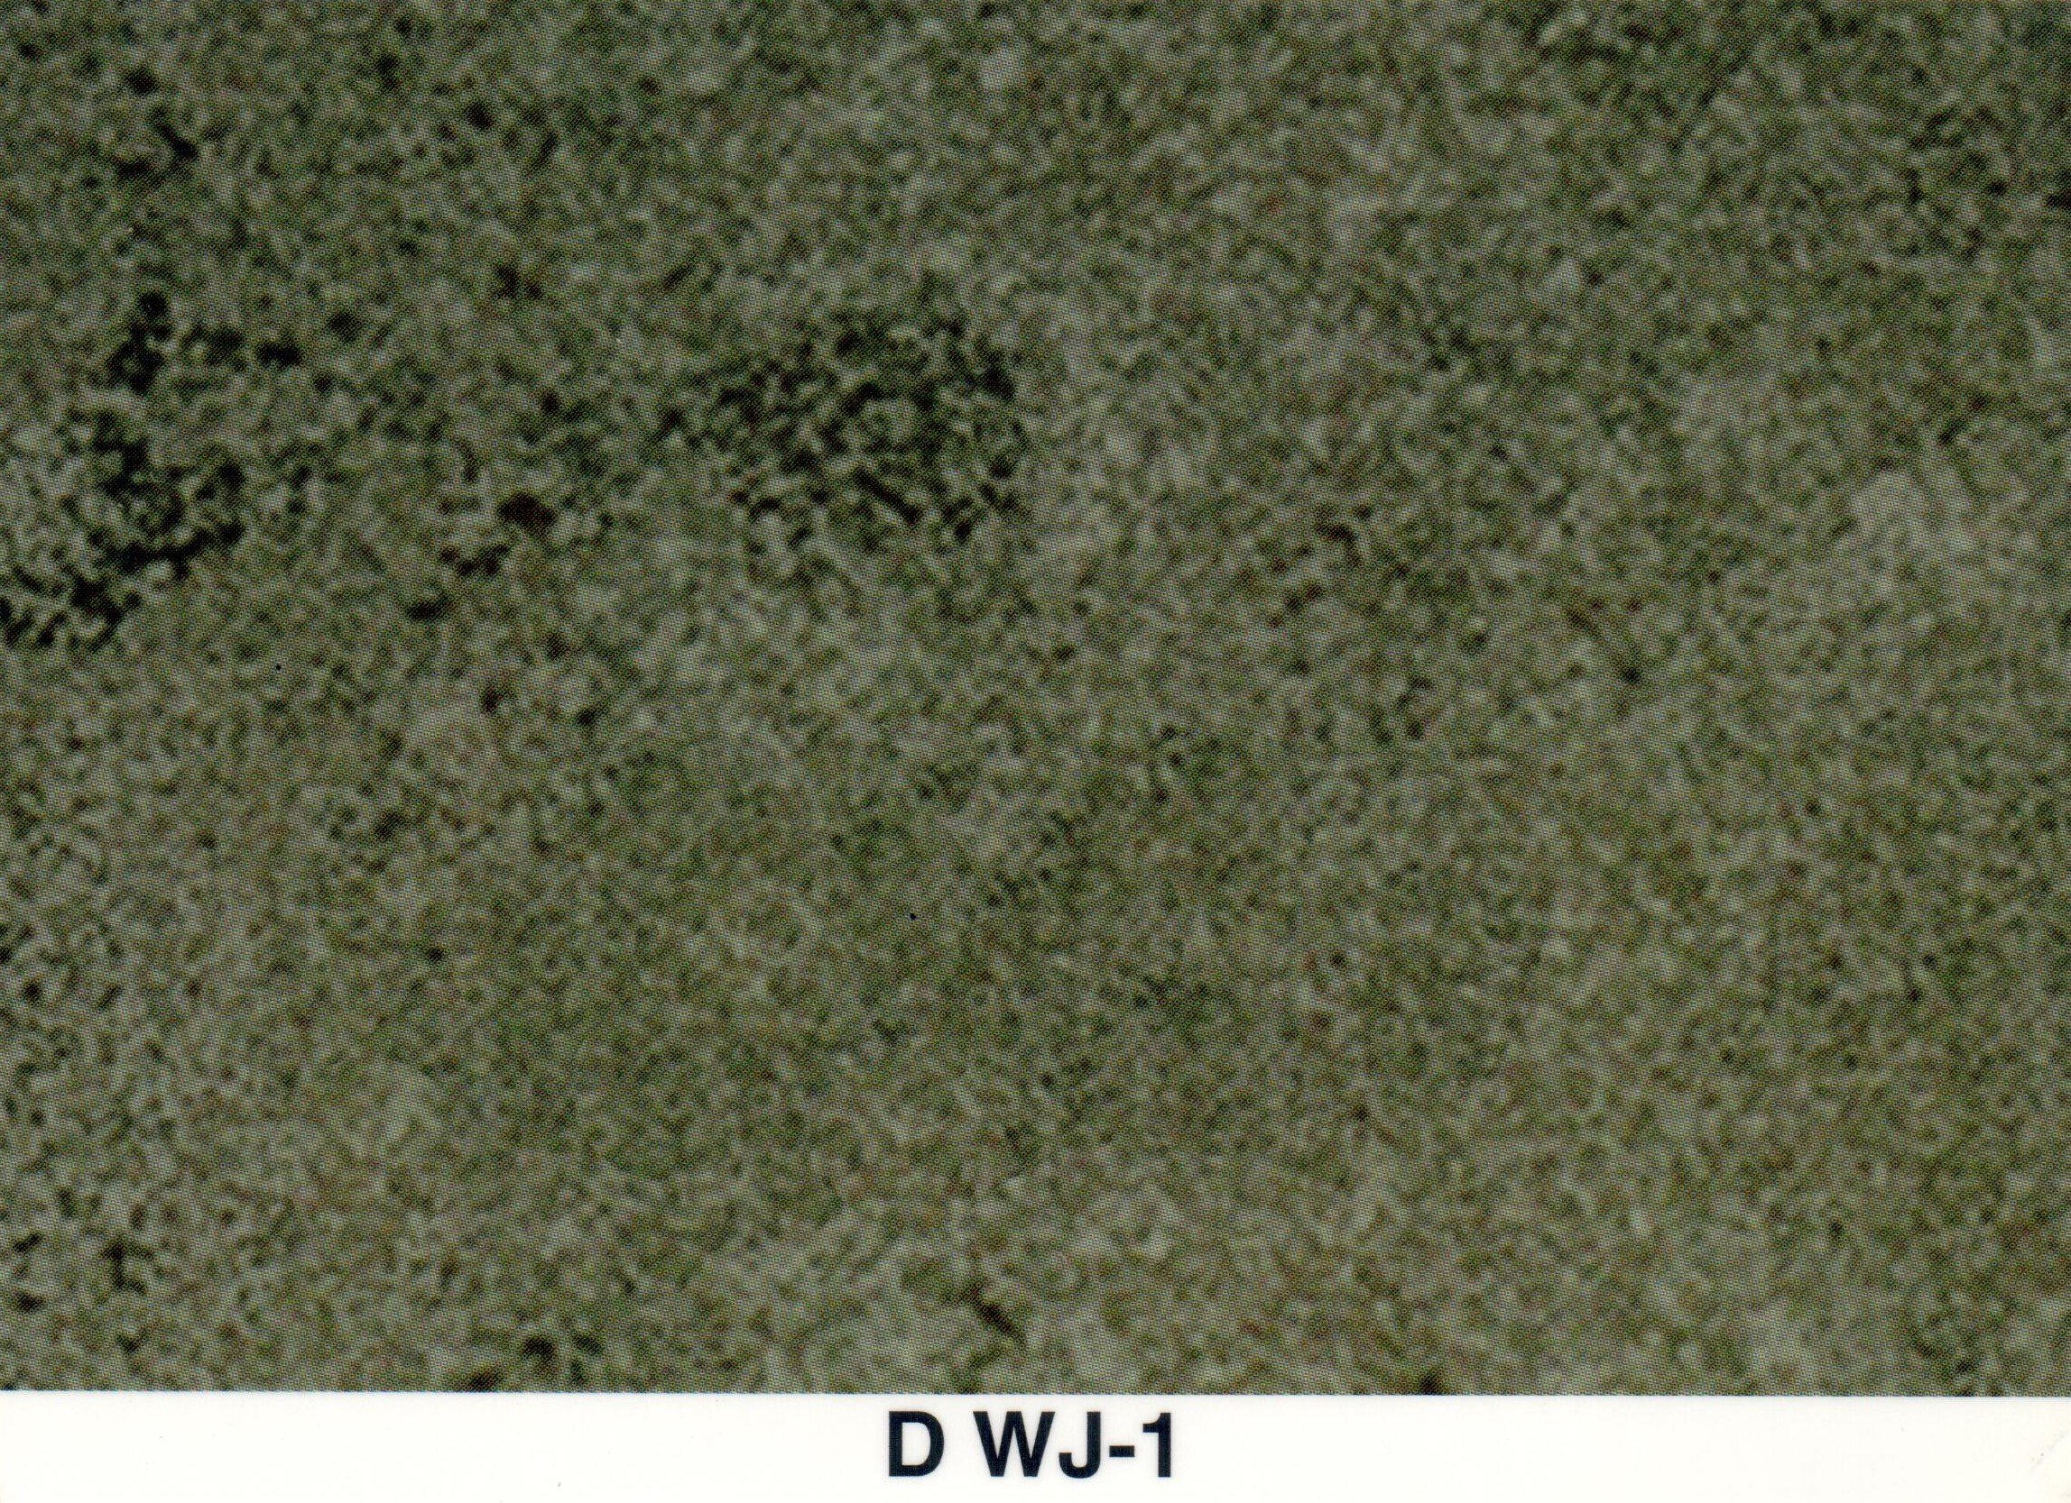
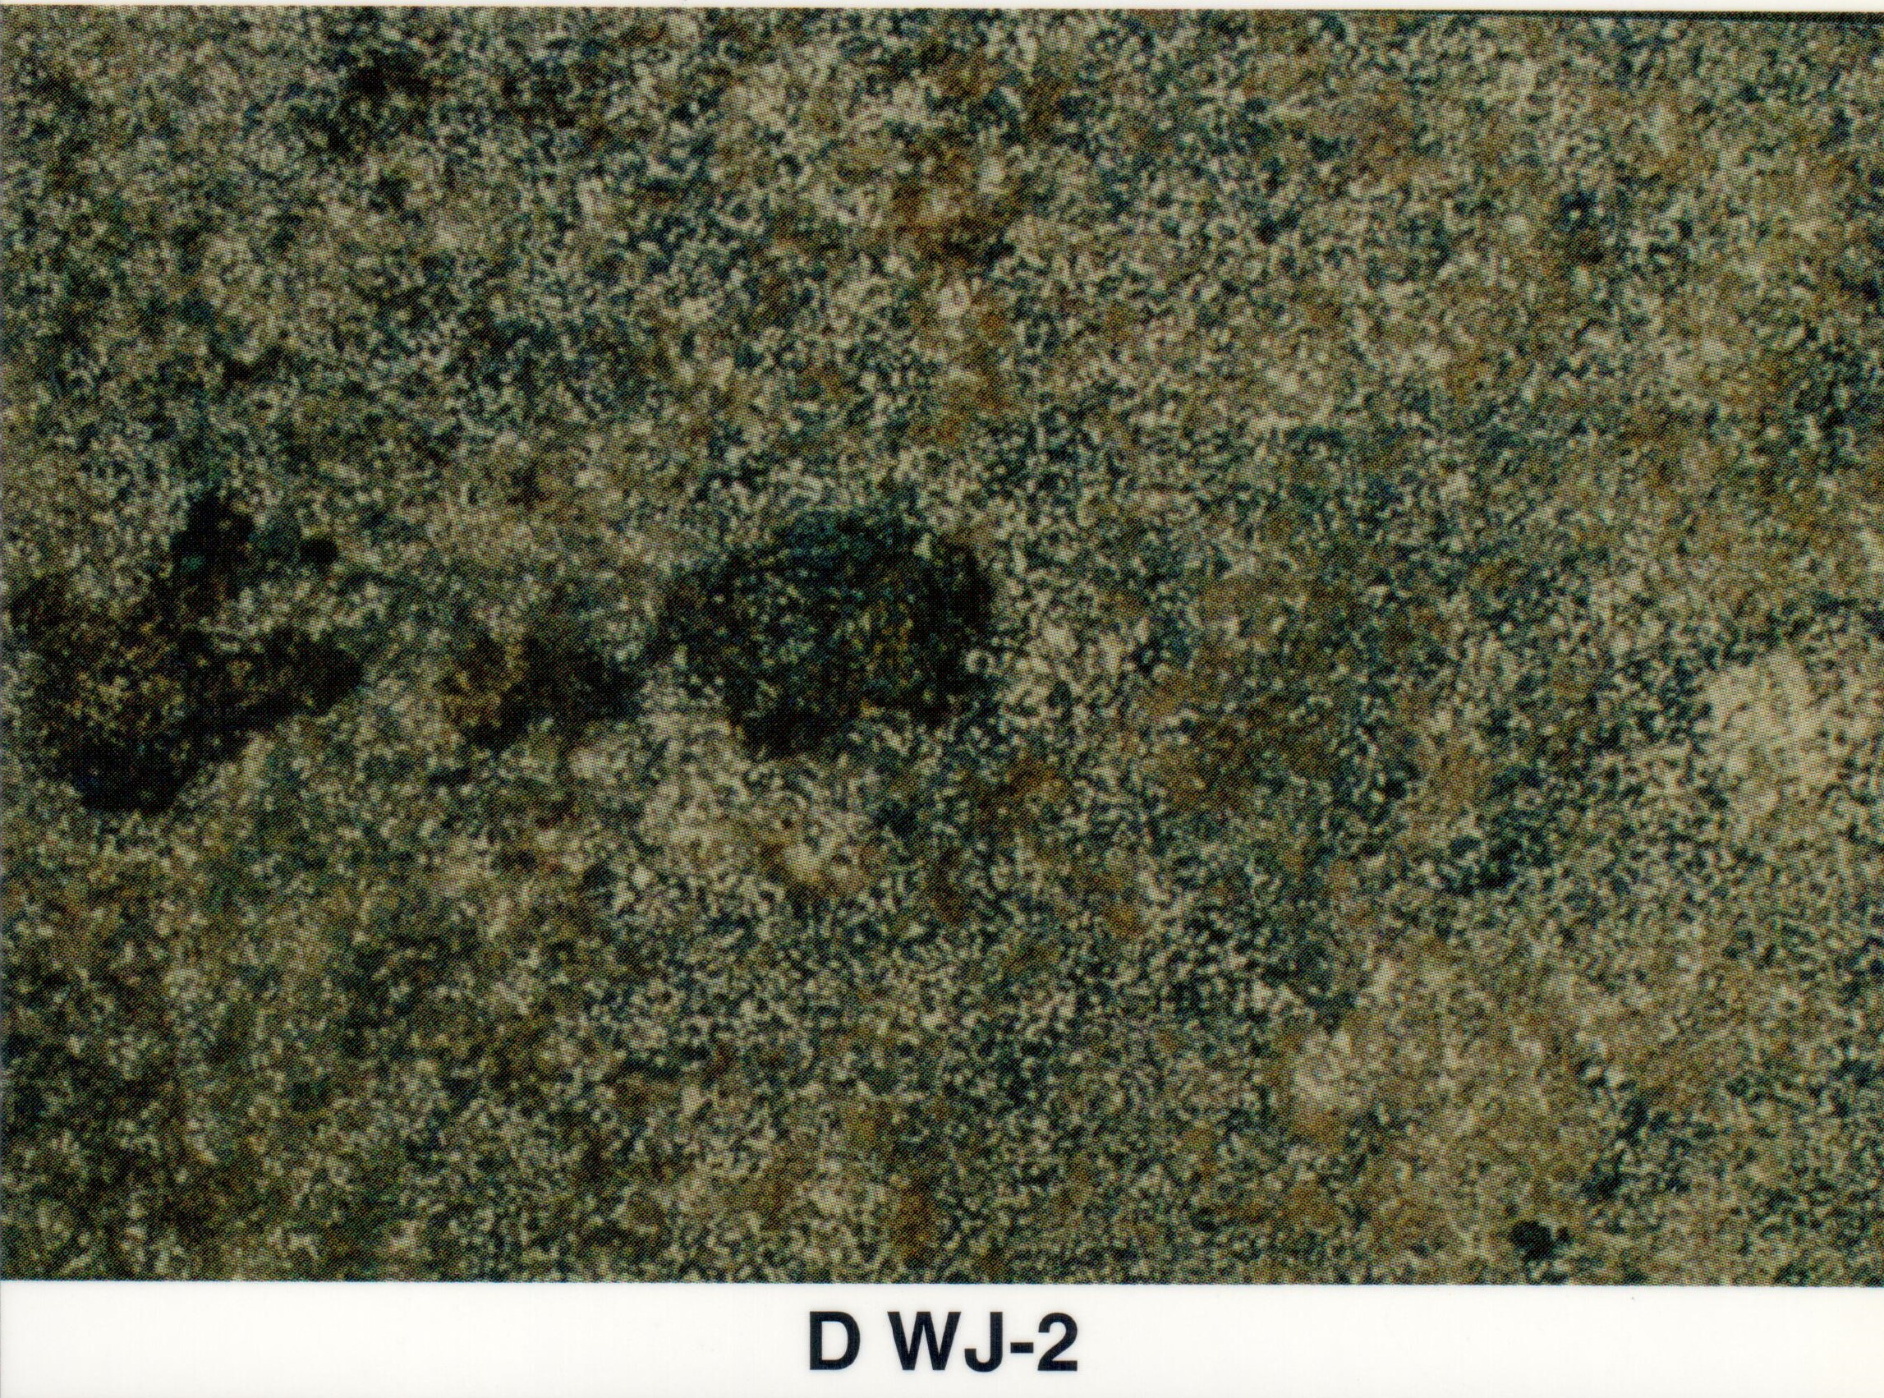
Visual Cleanliness Examples
Visual examples of a panel cleaned from WJ-4 through WJ-1 from SSPC-VIS 4 Water Jetting
Notes:
Visual examples of original panel cleaned from WJ-4 through WJ-1

Slide 18
Non- Visual Specifications of Water Remediated Surfaces
SSPC SC-1 – Surface Cleanliness 1
Surface shall be free of all detectable levels water-soluble chlorides, iron-soluble salts, and sulfates measureable at the field level
SSPC SC-2 – Surface Cleanliness 2
<7𝝁g/cm² chloride contaminants
<10 𝝁g/cm² soluble ferrous ion salts
< 17 𝝁g/cm² sulfate contaminants
SSPC SC-3 – Surface Cleanliness 3
< 50 𝝁g/cm² chloride or sulfate contaminants
Notes:
SSPC Non Visual Standards

Slide 19
Solvent Cleaning Methods
SSPC-SP 1 Solvent Cleaning
Removal of all oil, grease, soil, drawing and cutting compounds, and other soluble contaminants from the surface
Often termed as a ”Solvent Wipe” with acetone or another paint thinner
Solvents remove non-salt contaminants on surfaces as well
Addition of Chemicals to low pressure wash water
Acidic and alkaline solutions when added in low concentrations to low pressure wash water can help to dissolve salt ions from the surface

Slide 20
Natural Methods
Surface salt concentrations can be reduced through natural methods
Soluble salt measurements are necessary to determine whether natural methods are reducing salts enough to merit no further remediation
Examples include:
Entering into a wet season in certain climates
Spring snow melt

Slide 21
Issues and concerns
Troubles with Salt Remediation

Slide 22
Geometry Effects on Remediation
Surface geometry can make it difficult to remediate soluble salts with power tool methods
Corners, crevices, and tight spacing are examples of areas that are difficult to clean with most methods
HEPA vacuum shrouds are often required that limit the ability of tools to clean around obstructions
Crevices may retain water used during remediation with wet methods
The location of the contaminated surface may inhibit remediation
Working with power tools may be unsafe
Full containment of the area (e.g., for abrasive blasting) may not be possible
Chemical and/or water run off (e.g., during waterjetting) may be an environmental concern

Slide 23
Solubility of Salts
Some salts are not soluble in water, thus they are more difficult to remediate with wet methods
These salts will not be detected in methods which require the dissolution of salts on the surface being tested
Insoluble salts may or may not affect coating performance
If they are visible (e.g., ferric salts) they should be remediated as required to meet the visual requirements of the surface preparation specification

Slide 24
Remediation Within Pits or Tight Crevices
High levels of pitting will complicate the remediation process
Pits tend to trap both corrosion product and salts
Narrower and deeper pits will be more difficult to remediate than wide and shallower pitting
Pitting creates a non-uniform surface which may cause pre-mature coating failure if not remediated
Due to this, pits and tight crevices will require extra attention when remediating, similar to the extra attention needed when making salt measurements

Slide 25
Economic Benefits of soluble salt remediation

Slide 26
Economic Benefits
Remediation of Salts Before and during Coating Application
Ensuring a clean and salt free surface will decrease the chance of failures in the coating adhesion, blistering, or through film corrosion in the coating
Increases in the lifetime of the coating and reduces maintenance costs
Seasonal Remediation of Salts
Remediation allows visual inspection to parts of the bridge which would otherwise not be available for inspection
Can prolong coating lifetime by reducing salt buildup

Slide 27
Recommended Remediation practices

Slide 28
Full Remediation to Bare Steel
Remove corrosion product from heavily corroded areas using mechanical methods such as shipping tools
Pressure wash salts and other debris prior to mechanical surface preparation
Able to use more effective remediation methods such as:
Dry abrasive blasting to an SSPC-SP 10/NACE No 2 condition
Wet abrasive blasting SSPC-SP 10 (WAB)/NACE WAB-2 condition
Ultra-high pressure water-jetting to an SSPC-SP WJ-2/NACE WJ-2 condition
Ensure salt on prepared surface doesn’t exceed acceptable levels for coating
Soluble salt levels in the range of 5 to 10 µg (Cl or salt per ISO 8502-9)/cm² are reasonable expectations
Rework may involve pressure washing in conjunction with the specified surface preparation method

Slide 29
Partial Remediation to Bare Steel
Remove corrosion product from heavily corroded areas using mechanical methods such as shipping tools
Pressure wash salts and other debris prior to mechanical surface preparation
Perform Power tool cleaning to the specified requirement
Higher levels of power tool cleaning are more effective (e.g., SSPC-SP 11 is more effective than SSPC-SP 3)
Washing surface after power tool cleaning is effective at reducing soluble salt levels
Allow surface to fully dry prior to painting
Ensure salt on prepared surface doesn’t exceed acceptable levels for coating
This may require reworking areas before painting
May be difficult to achieve the same cleanliness as with full removal methods; soluble salt levels in the range of 10 to 50 µg (Cl or salt per ISO 8502-9)/cm² are reasonable expectations
Rework may involve pressure washing in conjunction with the specified surface preparation method

Slide 30
Remediation Without Coating Removal
Low pressure (e.g., 100 psi) wash with water is recommended for salt remediation without coating removal
Pressure washing (e.g., 2000 psi) may remove coating, offsetting the advantages of removing the salts
In smaller areas where low pressure washing is not economical, a water or chemical rinse and wipe with a clean cloth will remove salts from the surface
If pressure washing removes coating, consider spot maintenance painting to slow corrosion

