Slide 1
NCHRP 20-59 (51)B A Guide to Emergency Management at State Transportation Agencies, Second Edition
Overview, Key Findings, Updates from 2010 Guide, Contents

Slide 2
Outline
Project Overview
Objective, Scope
Research Approach
Key Findings and Updates
Guide Contents
Approach
Findings
Guide

Slide 3
Project Objective
Develop Second Edition “Guide to Emergency Management at State Transportation Agencies, Second Edition”
For use by transportation agencies in planning and developing their organizational functions, roles, and responsibilities for emergency management within the all-hazards context of the National Incident Management System (NIMS).
Deliverables suitable for adoption by the AASHTO Special Committee on Transportation Security and Emergency Management (SCOTSEM)
These products:
Reference the latest state of the practice and guidance in emergency management.
Focus on DOTs but will also consider local/state/regional users and differing resource levels of small vs. large states.
Include guidance of USDOT, FHWA, AASHTO, FEMA, TSA, DHS, and TRB from a state-level perspective.
Focus on threats and hazards.

Slide 4
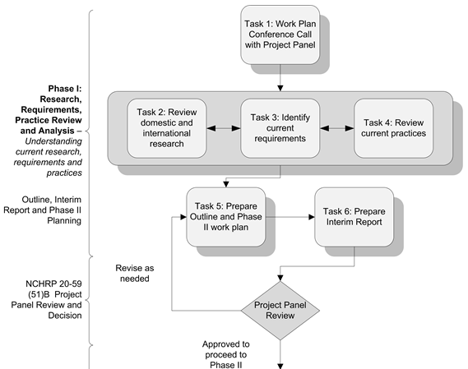
Research Approach – Phase 1

Slide 5
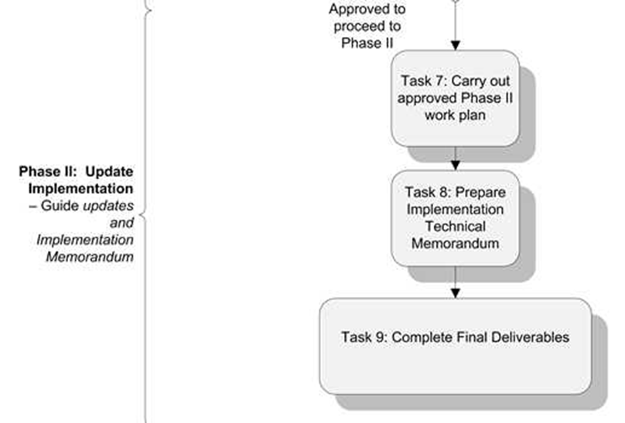
Research Approach – Phase 2

Slide 6
Task 1 - Work Plan Call/Panel Meeting
Meet with the project panel to discuss and
finalize the working plan.
Research team conducted National Operations Center of Excellence (NOCoE) Webinar on May 9, 2016.

Slide 7
Task 2 – Domestic and International Research Review
Review pertinent domestic & international research on the basis of applicability, conclusiveness of findings, and usefulness for the analytical needs of emergency management and emergency response planning at state transportation agencies.
Include relevant completed and in-progress research and information on new technologies.
Focus on highway and transit, within all-hazards context. Address expanded list of hazards to be considered, e.g.,
Extreme Weather, Space Weather, Cybersecurity, Pandemic, Intermodal Issues

Slide 8
Literature Review Focus
Updates and changes to the 1st edition of Emergency Response Planning Guide.
Catalog current transportation emergency management guidance, strategies and approaches.
Identify current emergency management training resources and requirements.

Slide 9
Literature Review Topics
Federal and State Emergency Management Requirements
Intermodal Transportation Emergency Management Planning and Coordination
Current Hazards including Space Weather
Coordination role of Metropolitan Planning Organizations (MPOs) along with the role of other local, state, and federal agencies
Short- and Long-Term Recovery Planning and Activities
Emergency Management Training and Exercises

Slide 10
New Topic: Resilience
Resilience is an increasingly important aspect of emergency preparedness and response, and essential in mitigation and recovery efforts.
Resilience principles relevant for emergency management:
Improve ability to improvise during an event.
Add redundancies to system to reroute traffic through one or more parallel components.
Have backup components available to quickly replace disrupted function.
Plan for potential disruption of interdependent systems – power, water, communications, and more.

Slide 11
Selected Highlights of Review
Transportation agencies have a broad range of capabilities and responsibilities including a large and distributed workforce, and access to heavy equipment and a robust communications infrastructure.
To address these responsibilities, agencies must have a comprehensive emergency management program with all‐hazards plans that align with their state and regional operations and authorities.
Today there are even higher expectations for system performance and reliability and lower tolerance for delays. There is an emerging focus on infrastructure protection and system resiliency as part of security and emergency management.
Notes:
Transportation’s unique role stems from the broad range of capabilities and responsibilities a transportation agency has: large and distributed workforces, easy access to heavy equipment and a robust communications infrastructure. To be ready for the agency’s role, a comprehensive emergency management program must be in place within the agency

Slide 12
Selected Highlights of Review
Threats and hazards to the system have also continued to evolve. More recently with more and more devastating events due to natural causes, or unintentional or intentional human intervention, there is a greater need for regional collaboration and coordination. Also, with the increased integration of physical and cyber systems, transportation agencies are increasing their focus on cyber risks to prevent cyber attacks on their physical infrastructure and systems.
There has been, and continues to be, significant deployment of new resources and rapidly developing technologies to support DOT activities. For example, post-event assessment and recovery have been enhanced by rapidly developing technologies providing digitized data acquisition, storage and transmission.
New guidance documents have been issued since the 2010 Guide was released, for example, FHWA primer series Routes to Effective Evacuations and TCRP Report 150: Communication With Vulnerable Populations ,which support evacuation planning and implementation.
A considerable amount of research and practice has been documented on recovery strategies.
Notes:
Transportation’s unique role stems from the broad range of capabilities and responsibilities a transportation agency has: large and distributed workforces, easy access to heavy equipment and a robust communications infrastructure. To be ready for the agency’s role, a comprehensive emergency management program must be in place within the agency

Slide 13
Selected Highlights of Review
National Incident Management System (NIMS) and Homeland Security Exercise and Evaluation Program (HSEEP) updates published since the release of the 2010 Guide provided important new definitions, policy direction and guidance.
Emergency management training and exercise tools and resources created since the release of the original Guide included:
NCHRP Incident Command System (ICS) Training for Field‐Level Supervisors and Staff
Formalization and implementation of Traffic Incident Management (TIM) training through the SHRP2 program.
Development of Transportation Emergency Response Application (TERA), a virtual exercise tool for the training of transportation emergency managers.
The establishment of the National Operations Center of Excellence as a resource for the Transportation System Management & Operations workforce.

Slide 14
Task 3 – Identify Current Requirements
Identify and analyze requirements for state transportation agency planning and response functions, roles, and responsibilities.
Examine these requirements over the continuum of emergencies, i.e.,
Planned activities, minor incident, major incident, hazmat incident, natural disaster, and terrorist incident
Specify responsibilities required under NIMS/NRF/NDRF.
Encompass all transportation modes under state control or influence.

Slide 15
Selected Highlights of Requirements
State DOTs are responsible for creating all-hazards plans and ensuring that employees have the ability to implement them. These plans must conform with and complement the planning activities of other state agencies as well as those of regional authorities.
FEMA Comprehensive Preparedness Guide (CPG) provides for development of local, state, tribal, territorial, and insular area emergency operations plans.
2016 NIMS refresh clarifies that NIMS is more than just the Incident Command System (ICS) and that it applies to all stakeholders with roles in incident management across all five mission areas (Prevention, Protection, Mitigation, Response, and Recovery).
Fixing America’s Surface Transportation (FAST) Act expands MAP-21 to focus on the resiliency of the transportation system and adds four new eligible categories including reconstruction, resurfacing, restoration, and rehabilitation.
Emergency training and exercise needs stem from federal, state, local, and industry requirements.

Slide 16
DOT Roles in Emergency Management
National Disaster Recovery Framework (NDRF) – published in 2011 and updated in 2016
Defines an overall recovery process for communities.
Includes core recovery principles, Recovery Support Functions (RSFs), recovery coordinators, other stakeholders, and pre-and post-disaster recovery planning guidance.
The Infrastructure Systems RSF helps restore infrastructure systems and services to support a sustainable community, and increases resilience to and protection from future hazards.

Slide 17
DOT Roles in Emergency Management
National Response Framework (NRF) – published in 2008, updated in 2013 and 2016
Is the doctrine under which the Nation provides all hazards response and provides the coordinating structures for delivering core capabilities.
Aligns key roles and responsibilities at all levels of government, private industry, and NGOs into a unified national response.
Contains the base document, Emergency Support Function (ESF) Annexes, and Support Annexes.
Identifies the critical role of transportation in response. The DOT is the lead agency for ESF-1, Transportation.

Slide 18
DOT Roles in Emergency Management
National Preparedness Goal (NPG) – published in 2011 and updated in 2015
The updated NPG emphasized community preparedness and resilience under the Mitigation mission area and imminent terrorist threats under the Prevention mission area.
STRATEGIC NATIONAL RISK ASSESSMENT (SNRA) RESULTS
Potential worsening of the consequences of natural hazards (e.g., flooding, droughts, and wildfires).
Terrorism threats include attacks by “lone actors” and use of weapons of mass destruction by terrorist organizations.
Technological and accidental hazards including transportation system failures, dam failures, and chemical spills or releases can cause severe consequences particularly when combined with aging infrastructure.
Pandemic influenza along with other human and animal infectious diseases has the potential to decimate Americans.
Cyber attacks can be catastrophic and cause cascading consequences.

Slide 19
DOT Roles in Emergency Management
National Infrastructure Protection Plan (NIPP) – published in 2006, updated in 2009 and 2013
VISION
A Nation in which physical and cyber critical infrastructure remain secure and resilient, with vulnerabilities reduced, consequences minimized, threats identified and disrupted, and response and recovery hastened. (NIPP, 2013)
Incorporates requirements of PPD-21 on Critical Infrastructure Security and Resilience, and focuses on merging cyber and physical security efforts
Provides coordinated approach to Critical Infrastructure/Key Resources protection
Stresses information-sharing and cross sector and cross jurisdictional coordination
Recognizes importance of critical infrastructure owners and operators, and government, private, and nonprofit sectors

Slide 20
DOT Roles in Emergency Management
Transportation System Sector Specific Plan (TSSSP) Annex to NIPP – published in 2010, updated in 2015
Guides and coordinates the critical infrastructure risk management, protection, security and resilience efforts.
Identifies and prioritizes Sector risks.
SECTOR RISKS
Natural disaster risks include increased risk to transportation infrastructure due to extreme weather events and coastal transportation infrastructure due to sea level rise and storm surges.
Manmade physical threats - terrorism, vandalism, theft, technological failures, and accidents
Increased manmade cyber risk due to increased use of connected control, navigation, and communications systems.
Aging and deteriorating infrastructure diminishes resilience and is also considered a risk.

Slide 21
DOT Roles in Emergency Management
Transportation System Sector Specific Plan (TSSSP) Annex to NIPP – published in 2010, updated in 2015
Identifies strategies to address the risks.
Establishes measures of effectiveness and reporting requirements for co-SSAs.
The DOT along with TSA became the co-sector specific agency for the Transportation System Sector with expanded security roles and responsibilities.

Slide 22
DOT Roles in Emergency Management
Transportation System Sector Specific Plan (TSSSP) Annex to NIPP – published in 2010, updated in 2015
SECTOR GOALS
Goal 1: Manage the security risks to the physical, human, and cyber elements of critical transportation infrastructure.
Goal 2: Employ the Sector’s response, recovery, and coordination capabilities to support whole community resilience.
Goal 3: Implement processes for effective collaboration to share mission-essential information across sectors, jurisdictions, and disciplines, as well as between public and private stakeholders.
Goal 4: Enhance the all-hazards preparedness and resilience of the global transportation system to safeguard U.S. national interests.
(TSSSP, 2015)

Slide 23
Task 4 – Review Current Practices
Review current practices of state transportation agencies in meeting responsibilities identified in Task 3.
Assess usefulness of available guidance.
Describe the range of state transportation agency emergency management planning and implementation practices.
Include selected case studies illustrative of the range of state practices.

Slide 24
Selected Highlights of Practices
Transportation planning for emergencies is commonly addressed in regional or state plans and annexes.
Re-entry and recovery plans were less common regional practices.
There is a lack of planning for using available transportation modes in emergencies and other events.
Collaboration on transportation planning for disasters and emergencies was more common than for planned events.
Coordinated communication planning with nongovernmental organizations was not a widespread practice.
State DOT emergency operations plans reflect the state DOTs’ roles and responsibilities in the Transportation Emergency Support Function (ESF-1) and the Public Works and Engineering Emergency Support Function (ESF-3).
Over time there has been an evolution in the preferred methods of training delivery for DOT employees.

Slide 25
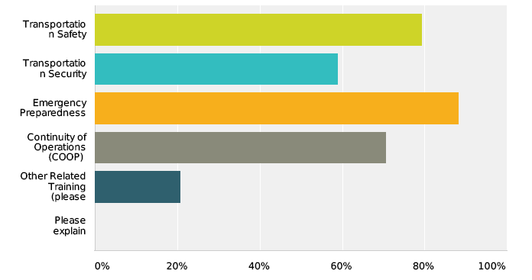
Survey Results: Recommended Training
80% of the survey respondents indicated that their organization required or encouraged emergency preparedness training.
No other types of training had substantially higher levels of response.
CASE™ and Western Management & Consulting

Slide 26
TRAINING STRATEGY | DESCRIPTION
Field Crew Meetings | Meetings are regularly scheduled alleviating scheduling issues. Held in district locations and during times convenient to field personnel.
Just-in-time training (JITT) | Useful for specific skills training not regularly required - for example, disaster reimbursement application procedures.
Interjurisdictional and interagency training and exercises | Used to prepare for large, complex disasters and emergencies. Involves multiple state and regional agencies; may also include relevant private and nonprofit organizations, community groups, and other stakeholders. Provide opportunities for personnel to meet, interact, train, and exercise with personnel from other agencies and jurisdictions.
Joint training | Combining related training topics alleviates scheduling challenges. Enhances intra-agency interactions. Examples include combining ICS training with incident management or winter maintenance training. In fact, the new SHRP 2 National TIM Responder Training course contains ICS training content.

Slide 27
TRAINING STRATEGY | DESCRIPTION
Asynchronous Training | Self-paced training, no instructors. Requires self-discipline. Examples include YouTube videos, prepackaged CDs/DVDs.
Train-the-trainer (TTT) | Leverages training resources. In-house trainers/qualified personnel are trained, and subsequently provide the training to other personnel. Especially useful in training large workforces.
Planned Events, Incidents, and Exercises | Provide opportunities for personnel to practice their training and skills. After-action reports and improvement planning identify additional training needs and gaps for individual field personnel and teams, and scenarios for future training.
Computer Simulations and Virtual Exercises | Allow real-time interaction in realistic but safe environments. Delivery through web-based or non-web-based technologies. Provision of simulated players possible. On demand exercise play is possible.

Slide 28
Helpful Training Tips
Determine who (what positions) need what type of EM training including NIMS Core Curriculum training.
Training should progress from individuals to teams to interagency/ interjurisdictional exercises.
Establish relevant professional qualifications, certifications, and/or performance standards.
Ensure content/methods comply with applicable standards, produce required skills, and measurable proficiency.
Incorporate NIMS/ICS into all training and exercises.
Ensure all personnel with a direct EM role complete the designated FEMA training.
Establish or leverage partnerships with other agencies and organizations.
Identify community training needs to support response and evacuation/shelter‐in‐place/quarantine activities.
Make the training as interactive as possible.
Make the training specific and relevant to real‐world problems.

Slide 29
Helpful Training Tips
Acknowledge experience and knowledge by encouraging sharing of knowledge, information among training participants.
Provide a chance for learners to reflect on their training. Then, shortly thereafter, provide opportunities to apply new learning.
Maintain comprehensive training records, following applicable standards .
Connect with the NIC for guidance on NIMS/ICS personnel training.
The FHWA Peer‐to‐Peer (P2P) program offers technical assistance, training and education on TIM/planned special event planning, procurement, deployment, and operations.
Leverage professional organization memberships and events for training and certification.
Job aids and on‐the‐job learning can help with training retention and recall.
Technologies such as VOIP and VTC can broadcast classroom instruction to other districts or regional offices.
Minor incidents provide training and practice opportunities.

Slide 30
Task 4 – Case Studies
Agencies/Topics
Agencies/Topics
California (Caltrans)
Overview of Caltrans’ Emergency Training & Exercise Program
Technologies for emergency response and recovery
Emergency communications
Emergency Management Common Operational Picture (EMCOP)
Role of MPOs in emergency management coordination
San Francisco Bay Area MPO’s roles in regional emergency planning and information sharing.
Louisiana DOTD
Numerous improvements in emergency response based on lessons learned from Hurricanes Katrina and Isaac;
Pre‐disaster, pre‐event inspection and documentation of transportation asset conditions;
Asset tracking of transportation resources from mobilization through demobilization; and
Explicit plans and procedures for emergency transportation for people with access and functional needs.
DOTD practices support the local evacuation practices throughout the state.

Slide 31
Task 4 - Case Studies
Agencies/Topics
Agencies/Topics
Iowa DOT
Iowa DOT’s real‐time weather and operations information and its role in enhancing safety;
Resource Management System modules allowing Iowa DOT to increase the efficiency of reimbursement processes and make cost recovery from small disasters cost effective; and,
Electronic Detailed Damage Inspection Reports (DDIRs).
Tennessee DOT
Tennessee DOT’s emergency management roles and responsibilities and emergency management plan;
A synopsis of the DOT’s training and exercise program including the Comprehensive Exercise Program;
Process Milestone Tracking to track/monitor emergency repair projects; and,
Bridge Monitoring Tool for prioritizing and scheduling disaster assessments.

Slide 32
Tasks 5 & 6 – Outline & Work Plan
Task 5 – Prepare Detailed Outline and Phase II Work Plan
Task 6 – Prepare Interim Report
Principles for Guide Development
Will reorganize, restructure and consolidate the Guide
Will make the report more concise and user-friendly, and take a higher-level approach to the topics
Will meet the expanded project objectives and scope in the broader context of Emergency Management

Slide 33
Guide Development
Deliverable Schedule
Initial Draft Guide
Stakeholder Review
Final Guide
Preparation Tasks
Collect materials
Plan modules
Contact potential reviewers
Development Tasks
Revise/refine content
Format & edit
Production Tasks
Revise material
Create print quality version
CASE™ and Western Management & Consulting

Slide 34
Phase 2 – Tasks 7, 8, & 9
Implementation
Final deliverables
The Second Edition Guide;
Final report;
Interim meeting PowerPoint presentation;
1-page executive summary; and
Task 8 implementation technical memorandum.

Slide 35
Original Table of Contents
Section 1: Introduction
Section 2: Institutional Context for Emergency Response
Section 3: Assess Agency Status in Emergency Response Training
Section 4: Develop an Emergency Preparedness Program
Section 5: Nature and Degree of Hazards/Threats
Section 6: Resource Guide
Appendices
Guide to using Portions of the 2002 Guide
Emergency Response Legal Authorities
Emergency Response Stakeholder Responsibilities
Key Emergency Response Definitions
Key Traffic Incident Definitions
Intelligence Fusion Centers
Transportation Emergency Response Effects Tracking (TERET)
Model Emergency Operations Plans
Policy and Procedural Memoranda and Memoranda of Understanding
Training/Exercise Plans

Slide 36
Guide Revisions
Met expanded project objectives and scope in the broader context of Emergency Management.
Title Changed from “Emergency Response Planning” to Emergency Management
All-Hazards Approach
Reorganized, restructured, and consolidated the Guide
More concise and user-friendly
High Level Approach vs. Detailed “How To” Planning Orientation

Slide 37
Table of Contents: Sections
Original TOC
Updated TOC
Section 1: Introduction
Section 2: Institutional Context for Emergency Response
Section 3: Assess Agency Status in Emergency Response Training (now Chap 6)
Section 4: Develop an Emergency Preparedness Program
Section 5: Nature and Degree of Hazards/Threats (now Chap 3)
Section 6: Resource Guide/Self-Assessment (now Appendix)
Chapter 1: Introduction
Chapter 2: Institutional Context for Emergency Management
Chapter 3: Nature and Degree of Hazards/Threats
Chapter 4: Develop an Emergency Preparedness Program
Chapter 5: Stakeholders and Regional Collaboration (NEW)
Chapter 6: Training and Exercises (EXPANDED)

Slide 38
Table of Contents: Appendices
Original TOC
Updated TOC
Guide to using Portions of the 2002 Guide (Outdated)
Emergency Response Legal Authorities (now in Chap 2)
Emergency Response Stakeholder Responsibilities (now in Chap 5)
Key Emergency Response Definitions (now in D Glossary)
Key Traffic Incident Definitions (now in D Glossary)
Intelligence Fusion Centers (now in A Resource Guide)
Transportation Emergency Response Effects Tracking (TERET) (Outdated)
Model Emergency Operations Plans (now in B Examples)
Policy and Procedural Memoranda and Memoranda of Understanding (now in B Examples)
Training/Exercise Plans (now in B Examples)
A: Resource Guide
B: Case Studies
C: Acronyms, Abbreviations, and Initialisms
D: Glossary
E: Tennessee DOT Needs Assessment
F: Example Materials from Transportation Agencies

Slide 39
Table of Contents
Executive Summary
Chapter 1: Introduction
Chapter 2: Institutional Context for Emergency Management
Chapter 3: Nature and Degree of Hazards/Threats
Chapter 4: Develop an Emergency Preparedness Program
Chapter 5: Emergency Management Stakeholders and Regional Collaboration
Chapter 6: Emergency Management Training and Exercises

Slide 40
Table of Contents
Appendix A: Resource Guide
Appendix A1: Annotated Bibliography
Appendix A2: Fusion Centers
Appendix A2: Information Sharing Analysis Centers (ISACs)
Appendix A3: Plan Checklist
Appendix A3: Prepare Checklist
Appendix A3: Respond Checklist
Appendix A3: Recover Checklist
Appendix A3: NIMS Compliance Issues
Appendix A4: Checklist of Potential Transportation Assets (High Level)
Appendix A4: Checklist for Inter‐Agency Communications and Information Sharing
Appendix A4 Checklist for Emergency Events Affecting Multiple Jurisdictions, Transportation, And Interdependencies
Appendix A4: Checklist of Potential Stakeholders
Appendix A4: Transportation Resources Detailed Checklist
Appendix A4: Strategies to Exercise Regional Transportation Plan for Disasters, Emergencies and Significant Events Checklist
Appendix A5: Agency Resources Contact Sheet Template
Appendix A5: Agency Contact Sheet Template
Appendix A5: Summary of Full After Action Report Template
Appendix A6: Collaboration and Coordination Guides

Slide 41
Table of Contents
Appendices B-F
Appendix B: Case Studies
Appendix C. Acronyms, Abbreviations, & Initialisms
Appendix D: Glossary
Appendix E: Tennessee DOT Needs Assessment
Appendix F: Example Materials from Transportation Agencies

Slide 42
Further Research Needs
Understanding the relationship between resilience and emergency management and the impact that relationship has on the roles, needs and capabilities of state DOTs. More specifically, understanding how resilience can be built into recovery efforts and into mitigation planning.
Better understanding and documentation of the benefits of mitigation and resilience. What are documented financial and economic benefits from transportation investments that foster resilience?

Slide 43
Further Research Needs
Understanding the interdependencies of all transportation modes and other sectors such as power, water, communications on emergency management and the impact on state DOTs and other transportation agencies.
Understanding the impact of cascading events on transportation emergency management planning, response and recovery.
Research on emergency management approaches to address concurrent events or events that have an impact on an extensive area or region.

Slide 44
Further Research Needs
Understanding how to identify and train the resources needed to carry out all-hazards resilience-focused emergency management, recognizing that it is difficult for most transportation agencies to allocate significant personnel, monetary, and material resources to planning and training for events that occur on infrequent bases or may not occur in their state or region.

Slide 45
Thank You
For additional information please contact:
Ron Frazier
ronfrazier@caseexperts.com
Jeff Western
Jeffrey.Western@consultingwestern.com

