Slide 1
NCHRP 10-101 Improving Mid-Term, Intermediate, and Long-Range Cost Forecasting: Guidance for State Departments of Transportation
Guidebook
Notes:
Welcome message and introduction of the scope of the presentation.
This is overview of the Transportation Cost Forecasting Guidebook developed under NCHRP Project 10-101 Improving Mid-Term, Intermediate, and Long-Range Cost Forecasting: Guidance for State Departments of Transportation.
1/42
April 2020

Slide 2
NCHRP 10-101: Research Team
Jorge A. Rueda Principal Investigator Auburn University - HRC
Ghada Gad Co-Principal Investigator Cal Poly Pomona
Cliff Schexnayder Co-Principal Investigator Arizona State University
Dan D’Angelo Co-Principal Investigator Applied Research Associates
Cesar F. Mayorga Graduate Research Assistant Auburn University
Notes:
Introduce the research team:
Dr. Jorge Rueda-Benavides, Principal Investigator – Auburn University
Dr. Clifford Schexnayder, Co-Principal Investigator – Arizona State University
Dr. Ghada Gad, Co-Principal Investigator – Cal Poly Pomona
Mr. Daniel D’Angelo Co-Principal Investigator – Applied Research Associates
Mr. Cesar Mayorga Co-Principal Investigator – Graduate Research Assistant
2/42

Slide 3
Webinar Scope & Associated Products
Webinar – Final Report
Webinar – Guidebook
Cost Forecasting Toolkit
Notes:
There are three main products that resulted from the research efforts conducted under NCHRP Project 10-101: a Final Report, a Transportation Cost Forecasting Guidebook, and a Cost Forecasting Toolkit.
The Final Report summarizes the research efforts, discusses the main project findings, and includes general descriptions of traditional and novel cost forecasting approaches evaluated by the research team. The Guidebook, on the other hand, describes the proposed methodologies at a greater level of detail and in a more technical manner, providing complete descriptions of the mathematical processes associated with those methodologies.
Two separate recorded webinars were prepared to summarized the content of the Final Report and the Guidebook. This webinar is the one associated with the Guidebook. Thus, if a more general, and less technical description of the proposed methodologies is desired, webinar participants are recommended to see the webinar associated with the Final Report instead.
A Cost Forecasting Toolkit has also been developed to consolidate most of the findings and recommendations from this study into three spreadsheet-based tools. The toolkit is explained in detailed in the Guidebook and has been made available to transportation agencies through the NCHRP’s website. The toolkit is not described in this presentation.
3/42

Slide 4
NCHRP 10-101 Project - Overview
Scope:
Forecasting time horizons:
Short-Term: 1 – 2 years → FHWA Report
Mid-Term: 3 – 5 years
Intermediate-Range: up to 15 years
Long-Range: more than 15 years
The study is focused on cost forecasting methods rather than on the estimation of the unforecasted cost estimates.
Notes:
Description of the scope of the NCHRP Project 10-101 to make clear that the study is focused on cost forecasting methods rather than on the estimation of the “unforecasted” cost estimates.
Discussion of the classification of forecasting time horizons in transportation planning .
4/42

Slide 5
Current Typical Cost Forecasting Process
Notes:
This figure illustrates the typical cost forecasting process currently followed by STAs. Once the scope of a given program has been defined, a cost estimate in current dollars is performed, which is then projected into the future using a given inflation rate to generate a single-value estimate. These types of outputs, also called deterministic outputs, tend to ignore the unavoidable uncertainty inherent in the cost forecasting process.
Ideally, the inflation rate should be determined as a function of the intended scope of work, but that does not seem to be the case among STAs. In fact, a number of agencies use standard one-size-fits-all inflation rates to forecast costs for all transportation programs regardless of their anticipated scopes.
A few agencies estimate inflation rates using CCIs to identify market trends; however, the CCIs being used are also usually one-size-fits-all indexes or CCIs with calculation inputs that do not align or are completely unrelated to the intended scope of work
5/42

Slide 6
Ideal Cost Forecasting Process
Notes:
Results from NCHRP Project 10-101 and input from STA estimators allowed the definition an ideal cost forecasting process, which is the one illustrated in this figure. It was found that an ideal cost forecasting system should be able to handle different scopes of work at various levels of detail. The rest of this presentation is divided into four parts. The first three parts explained how the cost forecasting process was customized through the development of an innovative cost indexing system that generates scope-based CCIs.
Traditional forecasting practices need to evolve from deterministic into risk-based outputs to account for estimating uncertainty and to facilitate the communication of such uncertainty to different types of stakeholders and decision-makers. Likewise, an ideal cost forecasting process should also provide decision-makers with a forecasting timeline showing the progression of the cost forecast as it moves across the desired forecasting time period. These two observations where consolidate into the proposed Risk-Based Forecasting Timeline shown in this figure. This part will be addressed in the fourth part of this presentation.
6/42

Slide 7
Overview
Part 1: Limitations of Traditional Construction Cost Indexes
Part 2: Development and implementation of Multilevel Construction Cost Index (MCCI)
Part 3: Comparative suitability analysis of cost indexing approaches
Part 4: Development and implementation of Moving Forecasting Error (MFE)
Notes:
This rest of the presentation has been divided into 4 parts, following a logical other.
The first part discusses some serious limitations of traditional cost indexing approaches, making it necessary the development and implementation of more efficient cost indexing alternatives, such as the Multilevel Construction Cost Index (MCCI) methodology described in the second part of the presentation.
Part 3 of the presentation discusses a comparative suitability analysis protocol for cost indexing alternatives. This can be used to find the most suitable cost indexing alternative among a group of available alternatives for a given cost forecasting process. Those alternative could include multiple MCCI configurations and traditional CCIs.
After identifying the most suitable cost indexing alternative, the novel Moving Forecasting Error (MFE) method described in Part 4 of this presentation would help to generate effective inflation rates from that alternative.
7/42

Slide 8
Part 1: Limitation of Traditional Cost Indexes
Notes:
No comments are anticipated in this slide.
8/42

Slide 9
Traditional Price Index Equations
Traditional price index equations were developed before the “computer era” in the 1920s, or even before that.
Laspeyers:
Paasche:
Fisher:
$$F(p)=\sqrt{\frac{\sum_{j=1}^{n}{p_{j,t} q_{j,0}}}{\sum_{j=1}^{n}{p_{j,0}{ q}_{j,0}}}×\frac{\sum_{j=1}^{n}{p_{j,t} q_{j,t}}}{\sum_{j=1}^{n}{p_{j,0}{ q}_{j,t}}}}$$
$$L(p)=\frac{\sum_{j=1}^{n}{p_{j,t} q_{j,0}}}{\sum_{j=1}^{n}{p_{j,0}{ q}_{j,0}}}$$
$$P(p)=\frac{\sum_{j=1}^{n}{p_{j,t} q_{j,t}}}{\sum_{j=1}^{n}{p_{j,0}{ q}_{j,t}}}$$
Where: ${ p}_{j,t}=Prevailing price of item j in period t$
$q_{j,0}= Quantity of item j purchased in period 0$
Notes:
The price index equations shown in this slide are the three most commonly used equations used by STAs for the development of in-house CCIs. However, this, and previous studies, has found that they have a limited capacity to handle the complexities of the construction market.
Before discussing some specific limitations of these equations, it should be noted that these equations were proposed in the 1920s, or even before that. They were proposed before the “computer era,” when the estimation of index values was limited to hand-made calculations, constraining data processing and analysis capabilities. This could explain the simplicity of these equations and the reason for the limitations discussed in the following slides.
9/42

Slide 10
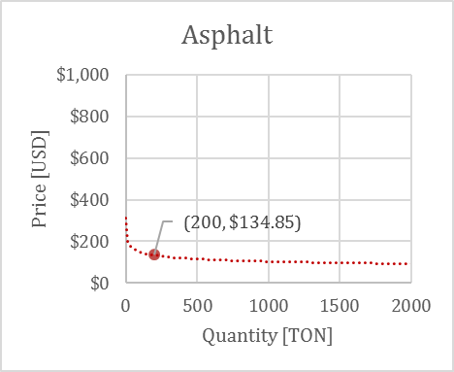
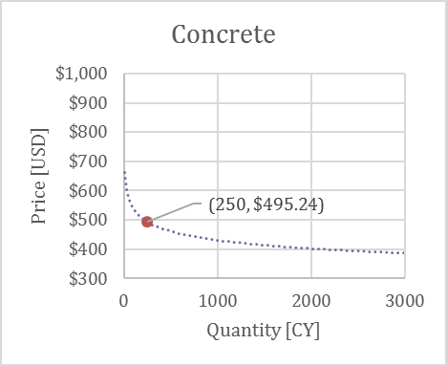
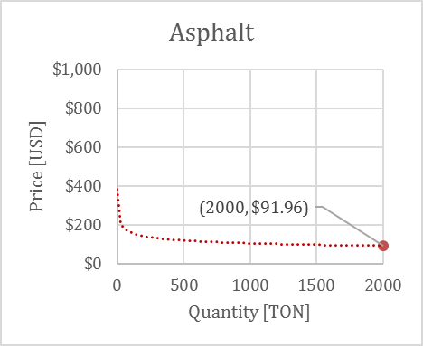
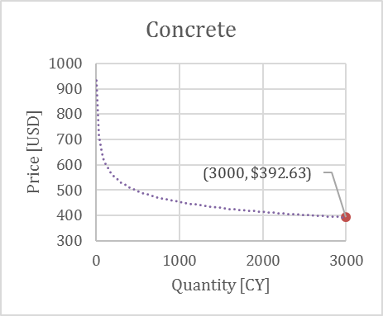
Traditional Price Index Equations
Traditional index equations are unable to consider economies of scale.
Equation | Index Values
 | Period 1 | Period 2
Laspeyres | 100.0 | 77.4
Paasche | 100.0 | 77.7
Fisher | 100.0 | 77.5
Index Period 1
No market change between periods
All price index equations perceived an nonexistent decrease in construction prices of about 23%
Index Period 2
Notes:
Research results from NCHRP Project 10-101 have revealed a significant issue associated with these typical index calculation procedures. Those equations are not able to factor the economies of scale principles into the cost indexing process. Economies of scale refers to a reduction in total cost per unit as the quantities of work increases, and vice versa. This limitation is clearly demonstrated with the example presented in this slide.
The slides shows two curves that represent the market conditions for two commodities for a given STA; asphalt and concrete, at two consecutive index periods. For the purposes of this example, it is assumed that market conditions will remain unchanged between these indexing periods. Thus, the curves at Period 1 and 2 are exactly the same. Since the market has not changed between these two indexing periods, an effective composite cost index calculated with these two inputs should show no change at Period 2 with respect to Period 1. In order words, the index values for both periods should be the same. However, if only the four data points shown in these four curves are used in the calculation of the index values at their respective periods, the traditional cost indexing equations would perceive an inexistent overall decrease of about 23% in market prices.
10/42

Slide 11
Matching and Proportionality Principles
The application of traditional cost indexing alternatives at the project or program level frequently violates the Matching and Proportionality Principles.
Matching Principle: There should be a reasonable correlation between index calculation inputs and cost elements in the intended scope of work.
Proportionality Principle: There should be a reasonable correlation between the weights of index calculation inputs and the weights of their corresponding cost elements in the intended scope of work.
Notes:
In addition to their lack of ability to consider quantity-unit price relationships, there are two principles that are repeatedly violated when traditional CCIs are used for cost estimating purposes at the program or project level: the matching and proportionality principles.
The matching principle refers to the degree of similarity between the components used in the calculation of a CCI and the scope to be forecasted. Once the matching principle has been reasonably met, the proportionality principle appears. It refers to the degree of consistency between the relative weights of index components and the actual contribution of the same components to the total cost of the intended program/project. Therefore, an ideal, but unlikely scenario, would be one in which each cost element in the program is represented by an input element in the CCI, and the relative weight of each element is the same in the CCI as in the program. It should be noted that a violation of the matching principle implies a violation of the proportionality principle since not sharing the same components would make it impossible to match the weights. Moreover, while there is considerable variability in the scope and configuration of programs and projects within an STA during the planning and programming phases, the set of input components in a typical CCI usually remains unchanged over time. This means that the matching principle cannot always be met.
11/42

Slide 12
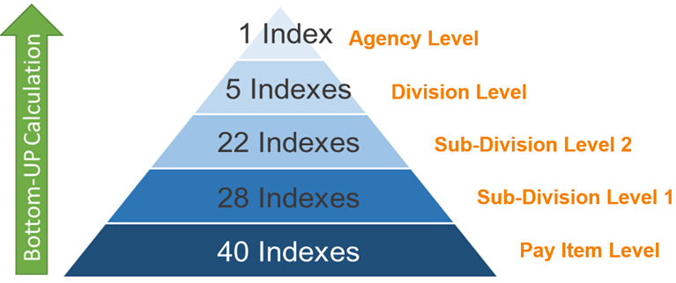
Part 2: Development and Implementation of Multilevel Construction Cost Index
Note: Configuration of CDTO MCCI
Notes:
An MCCI consists of a group of indexes organized in a multi-level arrangement. Thus, each cost element in a program/project can be individually represented by its closest matching MCCI index. After selecting the most relevant group of MCCI indexes for the scope of work under consideration, they are mathematically combined into a single scope-based CCI, which is then used to generate annual inflation rates. Costs for different programs/projects are forecasted with different sets of indexes, offering great flexibility to customize the forecasting process to the specifics of each program or project.
12/42

Slide 13
Staff and IT Requirements & Considerations
Development
Above avearge mathematical and statistical skills.
Above average computer hardware specifications and processing capabilities.
Spreadsheet applications are sufficient.
Good data management practices facilitate MCCI development efforts.
Notes:
The presenter will read the information presented in this slide without providing major additional information.
13/42

Slide 14
Staff and IT Requirements & Considerations (Cont.)
Maintenance
Average mathematical and statistical skills.
Average computer hardware specifications and processing capabilities.
Spreadsheet applications are sufficient, but agencies are encourage to develop customized IT applications to automate MCCI maintenance.
Good data management practices facilitate MCCI maintenance efforts.
Notes:
The presenter will read the information presented in this slide without providing major additional information.
14/42

Slide 15
Data Collection and Cleaning
Mid-term and Intermediate-Range Forecasting:
No less than 10 years of historical bid data
Long-Range Forecasting:
No less than 15 years of historical bid data (ideally, 20 years)
Source: MnDOT Tabulation of Bids
Notes:
Results for NCHRP 10-101 allowed the research team to formulate recommendations regarding the minimum amounts of historical bid data required to conduct effective cost forecasting procedures.
In the case of mid-term and intermediate-range forecasting procedures, the study recommends the used of no less than 10 years of historical bid data, while no less than 15 years are recommended for long-range forecasts, but ideally, 20 years of pricing data.
The NCHRP 10-101 Final Report and the Transportation Cost Forecasting Guidebook provide additional recommendations regarding effective data collection and cleaning procedures, including instructions to integrate all available data into a data-processing-friendly database, as well as descriptions of two outlier detection and elimination methods.
15/42

Slide 16
Definition of Basket of Pay Items for MCCI
Discard items whose units do not consistently refer to the same set of specifications or amounts work (e.g., each, lump sum), and keep those units that are comparable between projects (e.g., linear feet, cubic yards, tons).
Identify those pay items frequently used by the agency, ideally but not necessarily, at least once in the first and second halves of each year.
Discard those items that show no apparent correlation between their unit prices and their respective quantities of work
Notes:
After finishing the data collection and cleaning part, the MCCI development process continues with the selection of the pay items that will become the foundation of the indexing system. The largest the basket of MCCI pay items, the better. However, not all items are suitable to become part of this process either because they are not relevant, are not frequently used, or because their unit prices are not comparable between projects. This slide shows three basic steps that help in the identification of the largest possible group of significant repetitive MCCI pay items.
Discard those items whose units do not consistently refer to the same set of specifications or amounts work (e.g., each, lump sum), and keep those units that are comparable between projects (e.g., linear feet, cubic yards, tons). Pay items measured on an “each” or “lump sum” basis are usually not comparable between projects. Therefore, it is not appropriate to track their price changes using historical unit prices.
Identify those pay items frequently used by the agency, ideally but not necessarily, at least once in the first and second halves of each year. Although items used on a semi-annual frequency are preferred, that should not be a strict requirement since that could lead to the dismissal of relevant items whose frequency of use could skip a few periods. MCCI systems are able to handle missing values.
Discard those items that show no apparent correlation between their unit prices and their respective quantities of work. That would be a violation of the economies of scale principle, which could mean that unit prices for those items are not comparable between projects. The MCCI methodology has the capacity to consider economies of scale in the calculation of index values.
16/42

Slide 17
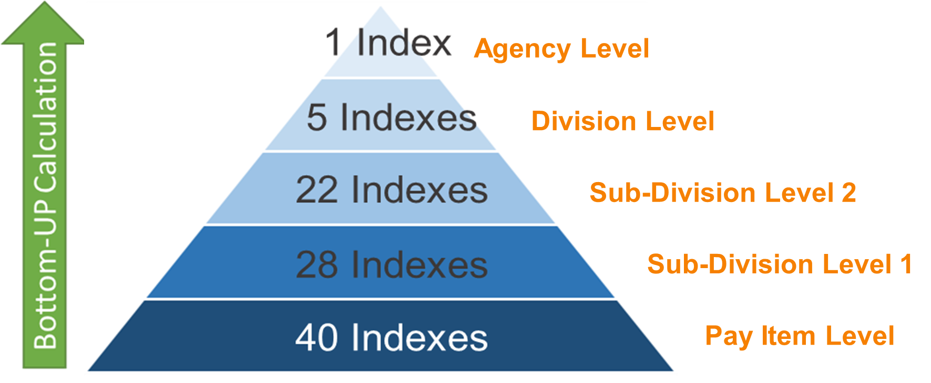
MCCI Configuration (CDOT MCCI)
Notes:
Historical bid data from the selected basket of pay items is then used to develop several cost indexes organized in a multilevel arrangement like the one shown in this figure. This is a five-level arrangement with 96 cost indexes developed for CDOT. These 96 indexes were developed with a basket of 40 pay items. The lowest level in the MCCI is the Pay Item Level, which contains one cost index for each of those 40 pay items. This level has the most specific cost indexes. Each of the 40 cost indexes at this level is only intended to be used on its respective pay item.
Following a bottom-up calculation approach, CDOT’s indexes at the Pay Item Level were used to calculate the 28 indexes at Sub-Division Level 1, which are less specific. Similarly, the indexes at Sub-Division Level 1 were used to calculate 22 broader indexes at Sub-Division Level 2, and so on, until reaching the top level where a single general index was calculated at the Agency Level.
17/42

Slide 18
MCCI Configuration (CDOT MCCI) (Cont.)
Pay Item Level | Sub-Division Level 1 | Sub-Division Level 2 | Division Level | Agency Level
202-00035 | 202-000 | 202 | 2 | 1
202-00210 | 202-002
202-00220
202-00240
202-00250
203-00010 | 203-000 | 203
203-00060
203-00100 | 203-001
206-00000 | 206-000 | 206
206-00065
206-00100 | 206-001
206-00360 | 206-003
207-00205 | 207-002 | 207
- | - | - | 3
- | - | - | 4
- | - | - | 5
- | - | - | 6
Notes:
Indexes at all levels are grouped according to the coding scheme used by each STA to classify its pay items. Pay item identification numbers could communicate information about the scope, materials, and/or activities associated with each item. Thus, pay items with similar identification numbers can be assumed to be closely related. STAs’ pay item coding schemes, which usually align with their standard specification books, can also be used to label each of the cost indexes in the MCCI, as shown in this table.
The table shows how some of the indexes were grouped and labeled for CDOT’s MCCI. This table only shows identification labels for indexes across the bottom-up pathways of the 13 pay item indexes under Division 2. Divisions 3 to 6 also have downward ramifications, but those are not shown in this table.
As moving from the Pay Item Level to the Agency Level, the number of digits used to identify the MCCI indexes is reduced, meaning that now the index represents a broader scope of work. In other words, the degree of detail of an index is given by its MCCI level, with the scope becoming increasingly broader at upper levels. For example, cost indexes 203-00010 and 203-00060 in this table only represent these two specific pay items. Bid data from these two indexes were then used to calculate cost index 203-000 at Sub-Division Level 1, which is intended to represent all items that start with 203-000. In the same way, index 203 represents all pay items that start with 203, and index 2 represents all pay items starting with 2. Division Level indexes in CDOT’s MCCI align with actual construction divisions from its standard specification book.
18/42

Slide 19
MCCI Divisions - Colorado
Division 2 – Earthwork
Division 3 – Bases
Division 4 – Pavements
Division 5 – Structures
Division 6 – Miscellaneous Construction
Notes:
This slide shows the five construction divisions in CDOT Standard Specification Book. Thus, there is an index in the Division Level of CDOT’s MCCIs to represent the overall market behavior of each of these construction divisions. Therefore, the MCCI Index 2 in the previous example would represent all earthwork activities.
19/42

Slide 20
MCCI Calculations
The development of a MCCI involves two major calculation steps:
Calculation of indexes at the pay item level
Bottom-up calculation indexes at upper levels
Notes:
There are two main calculation steps involved in the development of an MCCI:
The calculation of cost indexes for each item at the pay item level; and
The bottom-up calculation of indexes at the upper levels
20/42

Slide 21
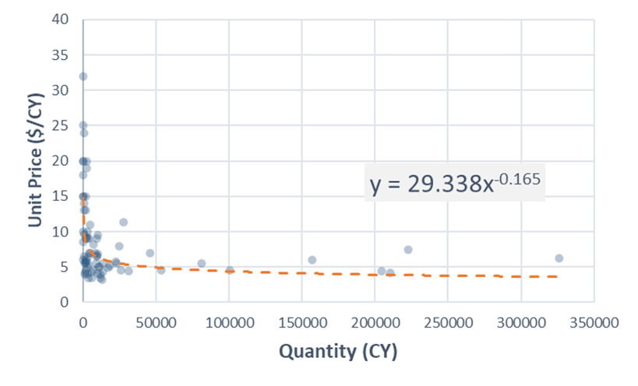
Calculation of MCCI Indexes at the Pay Item Level
Extract historical bid data for all selected MCCI pay items.
Identify a five-year period with sufficient data and develop a base curve for each item.
Example of Base Curve for Common Excavation 2008-2012 - MnDOT
Notes:
All indexes at the Pay Item Level are single-component indexes (calculated with a single pay item). Therefore, there is no need to deal with the challenges associated with the combination of different types of index inputs. Nevertheless, to effectively track unit price fluctuations at the pay item level, it is necessary to consider the economies of scale principle, which is done by tracking the average movements of the regression curve that define the quantity-unit price relationship. That is done through five steps.
First, the estimator should extract all the historical bid data for all selected MCCI pay items.
Through a quick exploratory data analysis, the estimator then identifies a five-year with sufficient data to effectively model the relationship between quantities and unit prices for each item. The selection of the same five-year period for all items would simplify the calculation process. Quantity-unit price relationships can be modeled with power regression curves, like the one shown in this slide. Power regression curves are commonly used to explain the reduction in construction prices as the quantities of work increase. This is called a base curve.
21/42

Slide 22
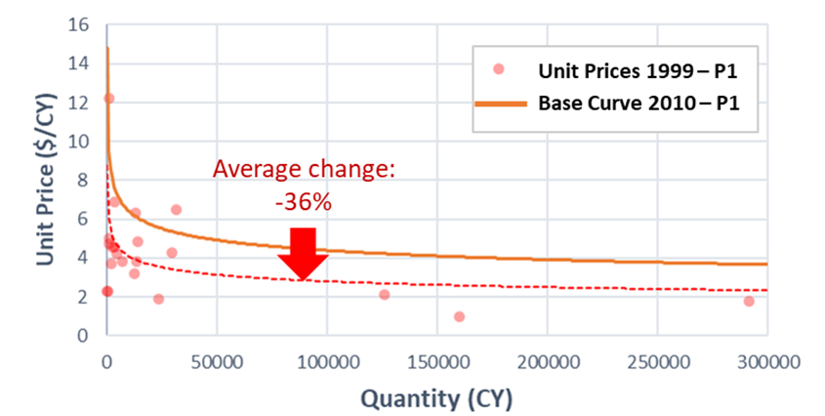
Calculation of MCCI Indexes at the Pay Item Level (Cont.)
For each item, calculate average movement of the base curve at each indexing period.
Use average base curve movements to calculate index values for each item at each indexing period.
Establish a system to constantly update all MCCI indexes at the of each indexing period by repeating the same process.
Example of Base Curve Fluctuation Calculation for Common Excavation - MnDOT
Notes:
The third step refers to the quantification of the movements of the base curve across all indexing period, as shown in this figure.
Using the base curves as appoint of reference, and the quantified movements of the base curves in the previous step, the estimator now proceeds to quantify index values across all index periods.
The first four steps would produce a cost index for each of the MCCI pay items using the available historical bid data. After that, the agency needs to establish a system to constantly update all indexes at the end of each indexing period by repeating the same calculation process.
22/42

Slide 23
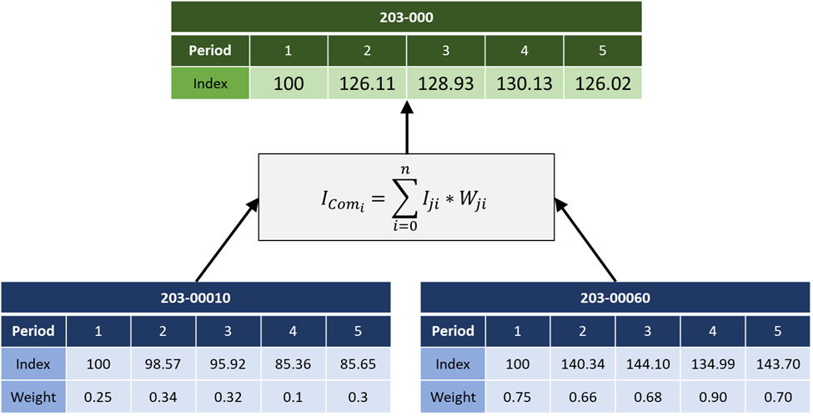
Bottom-Up Calculation of Indexes at Upper Levels
Note: $I_{comi }=Combined index value at index period i$
$I_{ji }=Index Value for Item j at index period j$
$W_{ji }=Weight for Item j at index period j$
Notes:
The second major step in the development of an MCCI refers to bottom-up calculations to define indexes at the upper levels. To calculate the CDOT indexes at Sub-Division Level 1 (the second level), indexes at the pay item level are grouped based on similar characteristics and aggregated to produce a single overall cost index per group. It means that, for CDOT’s MCCI, 28 groups were formed out of the 40 pay item cost indexes, resulting in the 28 indexes at Sub-Division Level 1. In a similar way, these 28 indexes were divided into 22 groups to produce the 22 indexes at Sub-Division Level 2, and so on until calculating a single Agency Level index with the 5 indexes from the Division Level.
This figure shows one of the groups of indexes at the pay item; a group formed by two indexes: 203-00010 and 203-00060. It also shows how these two indexes were used to calculated their corresponding index at the second level; 203-000. This is just a weighted average calculation. Weights for this calculation are proportional to the dollar amounts awarded on the items under consideration during each indexing period within the group. It means that during index Period 1, 203-00010 contributed with 25% of the combined awarded amount between 203-00010 and 203-00060, and the latter contributed to the remaining 75%.
23/42

Slide 24
Development of Project-Specific CCI
CDOT Asphalt Paving Sample Project
MULTI-LEVEL CONSTRUCTION COST INDEX ASPHALT PAVING
Item ID | Description | Unit | % of Total Cost | Index
614-00011 | Sign Panel (Class I) | SF | 0.00% | SW-614-000
630-80363 | Drum Channelizing Device (With Light) (Flashing) | EACH | 0.01% | SW-6
203-01500 | Blading | HOUR | 0.12% | SW-203
208-00103 | Removal and Disposal of Sediment (Labor) | HOUR | 0.04% | SW-2
626-01000 | Public Information Services | L S | 0.01% | SW-6
614-80385 | Rumble Strip | LF | 0.23% | SW-614
208-00045 | Concrete Washout Structure | EACH | 0.01% | SW-2
606-00301 | Guardrail Type 3 (6-3 Post Spacing) | LF | 0.85% | SW-606-00301
403-00720 | Hot Mix Asphalt (Patching) (Asphalt) | TON | 0.61% | SW-403-00720
630-00012 | Traffic Control Management | DAY | 1.24% | SW-6
614-00012 | Sign Panel (Class II) | SF | 0.01% | SW-614-00012
630-80355 | Portable Message Sign Panel | EACH | 0.32% | SW-6
627-00005 | Epoxy Pavement Marking | GAL | 0.90% | SW-627-00005
630-80341 | Construction Traffic Sign (Panel Size A) | EACH | 0.13% | SW-6
403-34731 | Hot Mix Asphalt (Grading SX) (75) (PG 58-34) | TON | 55.76% | SW-403
403-34721 | Hot Mix Asphalt (Grading SX) (75) (PG 58-28) | TON | 23.20% | SW-403
Project-Specific CCI
Weighted average of selected cost indexes
Notes:
After completing the bottom-up calculations, the MCCI can now be used to generate scope-based indexes a the project- and program-level. This slide illustrates the development of a project-specific CCI for an asphalt paving project to be awarded by CDOT.
In summary, a project-specific cost index is developed through the combination of individual relevant MCCI indexes; one MCCI index for each anticipated pay item. Each pay item is paired with the MCCI index that best represents its scope. Item identification numbers are used to find matching indexes.
The final project-specific CCI is just the weighted average of the selected MCCI indexes. The weighted average calculation is similar to the one discussed before for the bottom-up calculation process. However, this time, weights are calculated for each item and not for each indexing period. The weight for each pay item is proportional to its contribution to the total engineer’s estimate. Actual awarded prices cannot be used to calculate weights because they will only be known after awarding the project. Engineer’s estimates are calculated based on current prices observed at the moment of developing the project-specific CCI. It should be noted that, at this point in the process, the relative relevance of each item is more important than predicting the actual prices to be submitted by the successful contractor at the letting date.
24/42

Slide 25
Development of Program-Specific CCI
Notes:
In the case of program-specific CCIs, the first step is to understand the composition of the scope of work associated with the program. Some programs, like Bridge or Pavement Management Programs, are aimed to plan construction activities for specific types of work. In those cases, the program-specific cost index could be a project-specific index for a carefully selected sample project intended to represent the scope of the intended program. For example, the asphalt paving project in used in the previous slide was initially identified as a good representative of CDOT’s typical asphalt paving activities. Thus, a planning program focused only on asphalt paving could use that index to determine a program-specific inflation rate.
The process to develop program-specific indexes for programs that involve various types of work has a few additional steps, but it is still a simple four-step process:
Identify the different types of work contained in the program.
Approximate the percentage of the total program that corresponds to each type of work.
Identify a sample project that reasonably represents each type of work and develop project-specific CCIs for those projects.
Combine all project-specific indexes through a weighted average calculation using the weights defined at Step 2.
This slide shows a program-specific CCI developed for a paving program whose scope if 70% related to asphalt paving activities, while the remaining 30% corresponds to concrete paving activities.
25/42

Slide 26
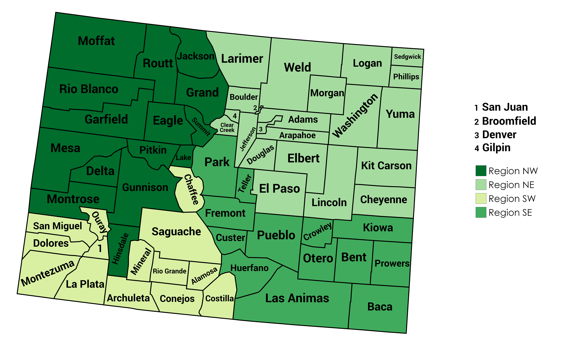
MCCIs Developed and Assessed
Geographic Classification
Index Input
Awarded Unit Prices
Average Unit Prices per Project
Median Unit Price per Project
All Unit Prices
Notes:
Multiple MCCI versions were developed for each case study in NCHRP Project 10-101, taking into consideration different geographic regions and price inputs. This slide shows the different geographic regions defined for CDOT, as well as the four index inputs considered for all regions in the three case studies.
The regional classification done for each agency was intended to produce regions large enough to provide a constant stream of bid data, but at the same time, not too large to keep them relevant geographic-wise. The regional classification also tried to meet the apparent criteria followed by the selected agencies for the designation of their operational districts/regions. For example, each geographic region in this figure is associated with a given regional office of CDOT, except for the Northeast region, which combines CDOT’s Regions 1 and 4.
26/42

Slide 27
Top Three Cost Indexing Alternatives per Region
Notes:
After developing all the statewide and regional MCCIs for each agency, and after identifying the existing cost indexing alternatives to be considered in the case studies, the research team proceeded to design and perform a comparative analysis to identify the most suitable cost indexing approach for each region under each case study. In all cases, MCCIs outperformed traditional cost indexing alternatives.
Likewise, this table shows an apparent better performance of statewide over regional CCIs, as well as a better performance of MCCIs built with awarded and all unit prices over average and median pricing inputs.
In other to optimize implementation efforts, STAs could evaluate only statewide MCCIs, considering regional versions only for those parts of the state consuming considerable portions of the construction budget. Implementation efforts could be further optimized by considering only MCCIs developed with awarded unit prices and with all the unit prices received by the agencies.
27/42

Slide 28
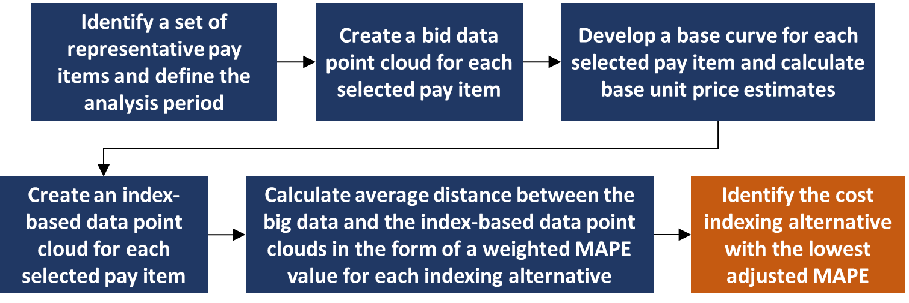
Part 3: Comparative Suitability Analysis of Cost Indexing Approaches
Notes:
After developing different MCCIs, and after identifying any other existing cost indexing alternatives to be considered, STAs can proceed to perform a comparative suitability analysis using the protocol presented in Part 3 of this presentation. This protocol would help to identify the most suitable MCCI alternative for each region.
This proposed protocol is not aimed to find the best possible CCI. It is instead intended to facilitate a comparative analysis to identify the most suitable alternative among a set of available options, even if all options are traditional CCIs affected by the limitations discussed before. This means that the protocol can still be used by STAs that decide not to implement MCCIs.
It should be noted that the proposed protocol for the assessment of cost indexes is not intended to evaluate their cost forecasting capabilities. Those capabilities are ultimately provided by the forecasting methodologies discussed in the next part of this presentation. The protocol is instead aimed to identify the indexing alternative that most closely resembles the observed behavior of the construction market, which should be the most suitable source of historical pricing data for the intended cost forecasting process.
In summary, each cost indexing alternative under consideration is evaluated on its capacity to track price fluctuations over time for a group of representative pay items along a defined analysis period. The analysis consists of comparing data point clouds developed by index-based unit price estimates again bid data point clouds formed by actual awarded bids recorded for the selected pay items. The different steps in this flow chart are explained in the following slides.
28/42

Slide 29
Representative Pay Items and Analysis Period
Select a group of relevant pay items. Ideally, including pay items that represent the most relevant construction divisions.
Analysis Period = At least 10 years.
Example of pay items selected for MnDOT’s case study:
Item ID | Description
2106507/00010 | Excavation - Common
2301507/00010 | Structural Concrete
2360509/23200 | Type SP 12.5 Wearing Course Mixture (3,B)
2360509/23300 | Type SP 12.5 Wearing Course Mixture (3,C)
2360509/24500 | Type SP 12.5 Wearing Course Mixture (4,E)
Notes:
The pay items used for the comparative analysis of cost indexing alternatives do not necessarily need to include all the pay items used for the development of MCCIs. It could involve only the most relevant pay items. Ideally, a group of pay items representing the most relevant construction division. This table shows the items selected for MnDOT’s case study. They were selected to represent the three main construction activities performed by MnDOT: asphalt paving, concrete paving, and earthwork.
Likewise, the analysis period used for the identification of the most suitable cost indexing alternative does not need to be the same 20-year period suggested for the development of MCCIs. The analysis period for the proposed protocol should be long enough to include a good amount of cost indexing data, but not too long, so that the indexing alternatives are still evaluated on their suitability to the current construction industry. If a given cost index shows the best effectiveness at tracking price fluctuations over the last 20 years, but a different one is found to be more effective over the last 10 years, preference should be given to the latter. Thus, the guidebook recommends an analysis period of about 10 years.
29/42

Slide 30
Bid Data Point Clouds
Unit Price (Y)
Recorded awarded unit price ‘y’ at letting date ‘z’ for bid quantity ‘x’
Bid Quantity (X)
Letting Date (Z)
Notes:
The bid data point clouds are created with actual awarded unit prices recorded for each selected pay item along the analysis period. This results in a set of separate three-dimensional clouds, as the one shown in this slide. One bid data point cloud should be developed for each selected pay item. The three parameters that give the location of each point in the cloud are: 1) letting data; 2) bid quantity; and 3) and recorded awarded unit price.
Bid data point clouds are then compared against the index-based data point clouds generated by each cost indexing approach under consideration. The indexing approach producing data point clouds closer to the bid base data point clouds is deemed to be the most suitable option.
30/42

Slide 31
Index-Based Data Point Clouds
Data points in Index-Based Data Point Clouds share the same letting dates and bid quantities as the Bid Data Point Clouds.
Calculation of unit price for data points in Index-Based Clouds:
Adjustment to Letting Date with Cost index:
Base curve for Item A with first year of data
$$Base Unit Price×\frac{Index Value at Letting Date}{Base Index Value}$$
Base
Unit Price
Bid
Quantity
Notes:
Data points in Index-Based Data Point Clouds share the same letting dates and bid quantities as the Bid Data Point Clouds.
The unit price measure in the Index-Based Data Point Clouds is calculated through the adjustment of base unit price estimates to their respective letting dates using each cost indexing alternative. Base unit prices are estimated with base regression curves as the one shown in this slide and based on the recorded bid quantity for each observation. These base curves are built with bid data from projects awarded during the first year of the analysis period. Therefore, since the regression curves are developed with data from the first year of the analysis period, all unit price estimates produced with those curves are assumed to yield average unit prices in the middle of that year. Those prices are then adjusted to their letting dates with each cost index using the equation shown in this slide.
31/42

Slide 32
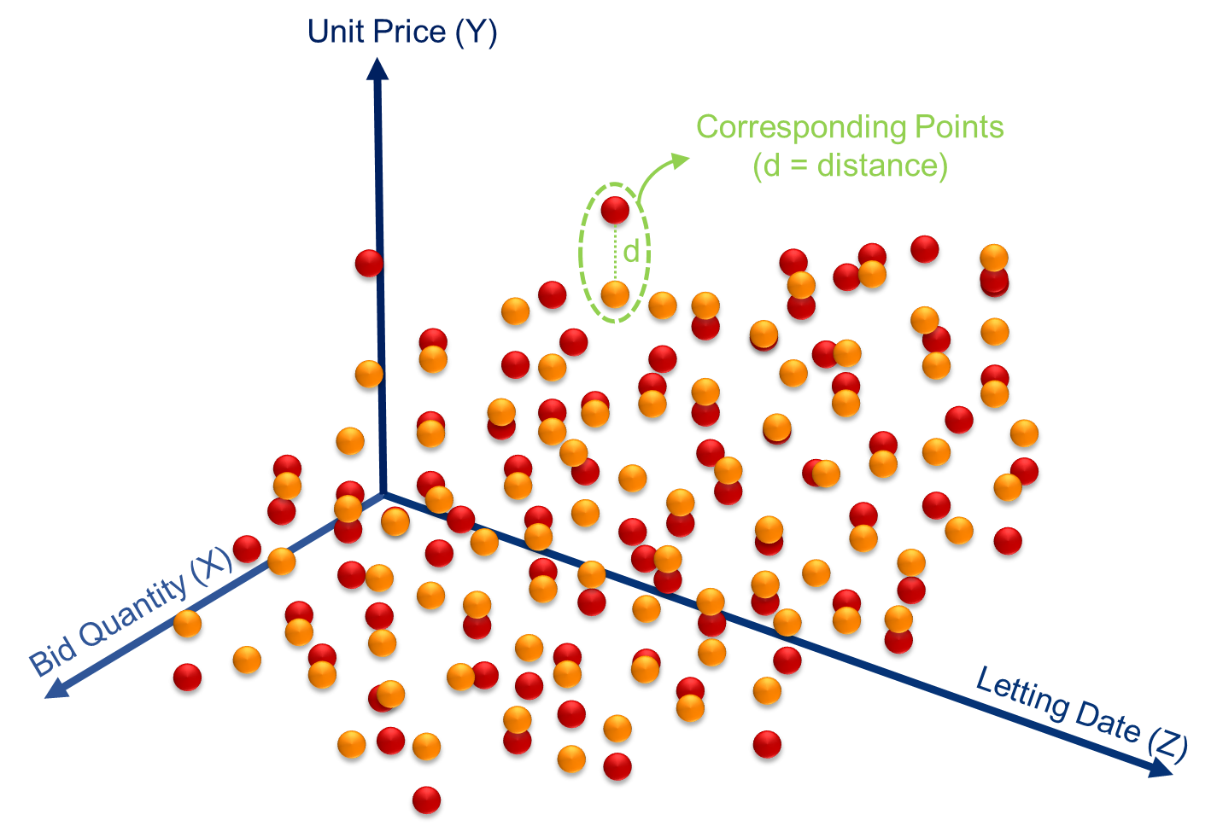
Index-Based Data Point Clouds (Cont.)
Average distances are measured in the form of Mean Absolute Percentage Error (MAPE) values. One MAPE value per item per index.
All MAPE values for each index are integrated through a single Weighted MAPE value.
The index with the lowest Weighted MAPE would be the most suitable alternative
Notes:
At this point, the STA would have all three coordinates for all points in the Index-Based Data Point Cloud. Now, each cost indexing alternative would have a pair of bid and index-based data point clouds for each item, so the next step is to calculate the average distance between them. The shorter the average distance, the larger the overlapping between the bid data and the index-based data point clouds, and the more suitable the cost indexing alternative. It should be noted that corresponding points have the same letting date and awarded quantity. Thus, the average distance between them is only the difference between the actual awarded unit price and the index-based unit price.
Average distances between the bid data and the index-based data point clouds are quantified in the form of Mean Absolute Percentage Error (MAPE) values. One MAPE value per pay item per indexing alternative. MAPE values are commonly used to measure and compare accuracy between cost estimating approaches, but in this case, those values are aimed to indicate the degree of overlap between data point clouds for each selected pay item.
The MAPE values associated with each cost indexing approach are then combined into a single overall MAPE taking into consideration the relative weight of each pay item. The result of this combination is a weighted MAPE, which is just the weighted average of all pay item MAPE values. Weights corresponds the relative relevance of each selected pay item to the total construction program of the agency (total amount of dollars spent on the pay item/total construction program).
The most suitable alternative for each region is then assumed to be the one with the lowest weighted MAPE.
32/42

Slide 33
Part 4: Development and Implementation of Moving Forecasting Error Method
Notes:
The fourth, and last part of this presentation is aimed to explain the procedures associated with development and implementation of the proposed Moving Forecasting Error (MFE) methodology to actually forecast construction costs after identifying the most suitable alternative, but it is first important to remember the difference between simple and compounded inflation rates.
33/42

Slide 34
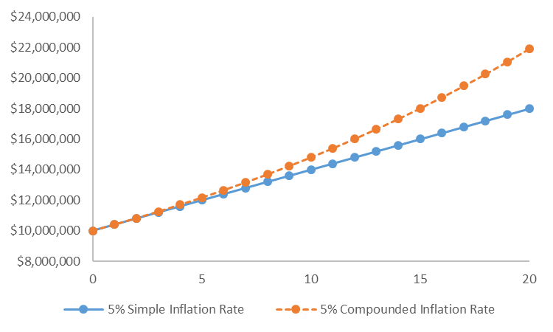
Inflation Rates
Notes:
When a simple inflation rate is used, the projected cost is increased by the same number of dollars every year, and the magnitude of the increase is equal to the cost estimate in current dollars multiplied by the fixed annual inflation rate. On the other hand, a compounded annual inflation rate is applied every year to the cumulative inflation in the previous year.
This figure shows the difference between a 5% simple and a 5% compounded inflation rate when applied to a $10-million project (current-dollar estimate) over 20 years. Even though the two curves start deviating from each other after the first year, the difference between them starts becoming evident after the fifth year, suggesting that there is no significant difference in applying a simple and compounded inflation rate for mid-term forecasts. The difference between the approaches increases as the forecasted time horizon is extended. As shown in this figure, a fixed compounded inflation rate is more suitable when an exponential increase in construction prices is expected or assumed while a simple inflation rate assumes a linear growth trend.
34/42

Slide 35
MFE – Development and Implementation
Apply the comparative suitability analysis protocol to identify the most suitable cost indexing alternative for the cost forecasting scenario under consideration.
Through an iterative process, evaluate the performance of a 4% annual compounded inflation rate across all possible forecasting time horizons for the first index value.
Repeat the iterative process in Step 2 for each known index value.
Notes:
The proposed MFE methodology is applied through the following 3-step process.
Apply the comparative suitability analysis protocol to identify the most suitable cost indexing alternative for the cost forecasting scenario under consideration.
Through an iterative process, evaluate the performance of a 4% annual compounded inflation rate across all possible forecasting time horizons contained within the available data, as explained in the next slide.
35/42

Slide 36
MFE – Steps 2 and 3: Iterative Process
Forecasting
Error
1 Forecasting
Error
One 19.5-year period
10 Forecasting
Error
Ten 15-year periods
10-year periods = 20 Forecasting Errors
5-year periods = 30 Forecasting Errors
3-year periods = 34 Forecasting Errors
Notes:
The MFE methodology is an iterative process designed to maximize the value of the available data. For example, some traditional data analysis methods used in cost estimating research would probably generalize any findings resulting from the single 20-year datasets available for this study. However, the MFE method recognizes that there are a number of 3, 5, 10, and 15-year periods within the available data and takes advantage of those smaller data partitions.
Since the first index value is calculated after the first six months of data, the available dataset would not even allow the calculation of a single forecasting error for a 20-year forecast. The longest possible forecast that could be assessed would be over 19.5 years, and only one forecasting error could be generated for that scenario. However, there are 10 15-years periods that generate 10 forecasting errors for that time horizon, providing a better idea of the uncertainty of that scenario. Likewise, there are 20, 30, and 34 10-, 5-, and 3-year periods with a 20-year data set.
In this step, index values at all index periods, in six month intervals, are projected into the future across all possible forecasting periods contained within the available data with 4% compounded annual inflation rate. In a perfect world, any arbitrary inflation rate (even simple inflation rates) would yield the same results, but that is not the case. There are some regression analysis procedures later in the MFE process that, which result in the generation of slightly different inflation rates when another rate is used as a point of reference. Research results suggest that the use of reasonable inflation rates as a point of reference produces more accurate results, and that is the reason that motivated the selection of the suggested rate (4%). However, future research efforts will further investigate this matter, in other to determine if a different input would offer better forecasting effectiveness.
36/42

Slide 37
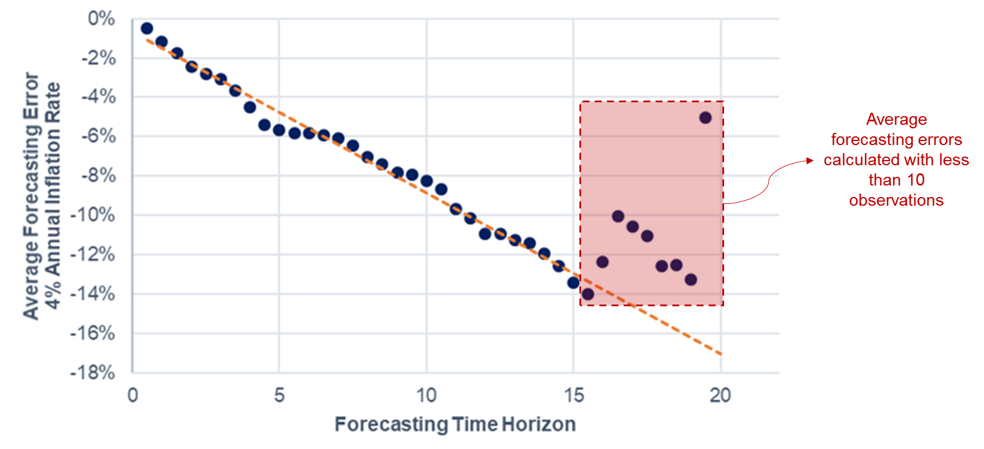
MFE – Development and Implementation (Cont.)
Calculate the average forecasting error for each forecasting time horizon, and then create a scatterplot.
Notes:
Instead of relying on this single long-range forecasting error, the proposed MFE method takes advantage of the more reliable assessments conducted for shorter forecasting periods, identifies trends, and extrapolate those trends to the long-range forecasting zone. That is what is done at this step.
Step 4 consists of calculating the average forecasting error for each forecasting time horizon, and then plotting all average forecasting errors, as shown in this figure. This figure corresponds to the forecasting errors calculated for the example shown in the previous slide. Each point in this figure corresponds to the average forecasting error calculated for each forecasting period from 0.5 to 19.5 years.
The number of error measurements used to calculate each average value in this figure decreases as the forecasted time horizon increases. The average error for 0.5 years was calculated with 39 values, while the one for 19.5 years is not actually an average. That is the only measured error for that period of time. The figure shows how the iterative MFE process was able to model a trend for the change in average percentage errors over time.
This figure corresponds to an asphalt paving CCI developed for the Northeast Region in Colorado. Similar linear trends were found in all case study regions for both asphalt and concrete paving. In most cases, points tend to start falling off the trend after about 15 years, where average values start to be calculated with less than ten observed forecasting errors. Thus, the MFE method was designed to ignore all values calculated with less than ten observations, and to use regression analysis to project the remaining values into the future to estimate expected errors for long-range forecasts.
37/42

Slide 38
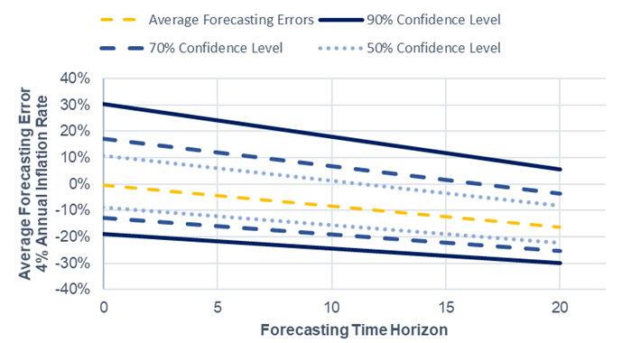
MFE – Development and Implementation (Cont.)
Add 50%, 70%, and 90% confidence intervals to the trend modelled in Step 4.
Confidence intervals in the long-range zone are also projections of confidence intervals for shorter forecasting periods.
Forecasting errors at each forecasting periods are assumed to be normally distributed.
Notes:
The MFE method not only facilitates a better assessment of average forecasting errors, but also allowed the projection of percentiles around average values to establish error ranges at 50%, 70%, and 90% confidence levels. This figure shows the same linear trend of average errors from the previous slide, but this time with its respective confidence intervals. Based on this figure, CDOT could reasonably assume, with a 90% confidence level, that any 15-year asphalt paving cost forecast estimated in this region with a 4% compounded inflation rate would offer a forecasting error between +12% and -27%.
Confidence intervals in the long-range zone are also projections of confidence intervals for shorter forecasting periods, and assuming that forecasting errors at each forecasting period are normally distributed.
38/42

Slide 39
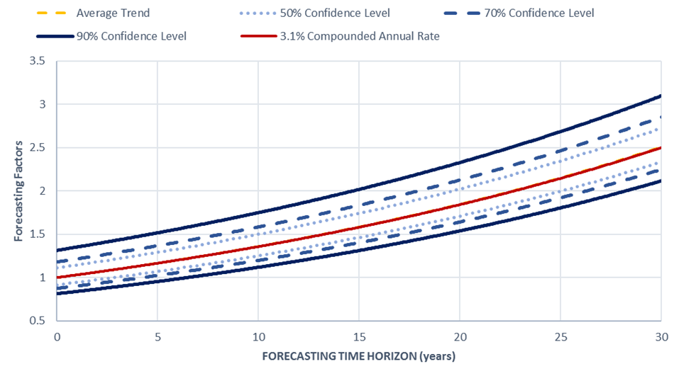
MFE – Development and Implementation (Cont.)
Use the average forecasting errors and their confidence intervals from Step 5 to generate a Risk-Based Forecasting Timeline of Forecasting Factors.
Notes:
MFE cost forecasting errors, like those shown in Figure 4.4, can now be used to create a risk-based forecasting timeline of forecasting factors, as the one shown in this slide. Forecasting factors are unitless values that form a generic risk-based forecasting timeline that can be used to estimate the intended inflation rate. For example, this figure suggest that the long-range market behavior of the scope of work represented by the cost index under consideration would be better represented by a 3.1 percent compounded annual inflation rate.
The quantitative process to generate risk-based forecasting timeline of forecasting factors, as the one shown in this slide, is explained in detailed in Transportation Cost Forecasting Guidebook developed under NCHRP Project 10-101.
39/42

Slide 40
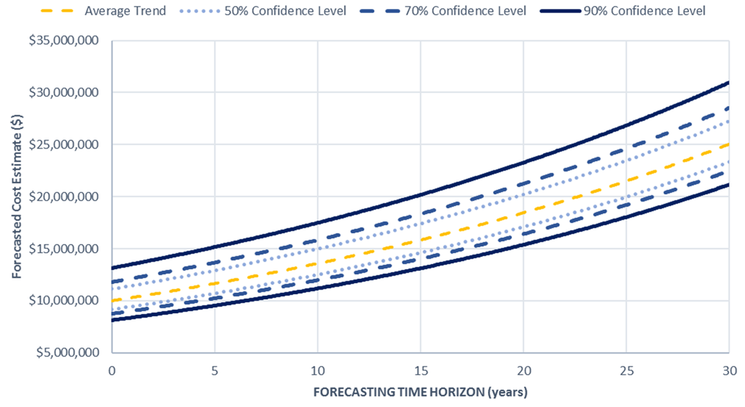
MFE – Risk-Based Forecasting Timeline in Dollars
Forecasting Factors x Current-Dollar Cost Estimate
Notes:
The generic forecasting timelines for forecasting factors can be easily be transformed into dollar values to generate a risk-based forecasting output just by multiplying all forecasting factors by the given current-dollar estimate. For example, if the current-dollar estimate for a given asphalt paving program in Colorado is $10 million, the multiplication of this value by each of the forecasting factors in the previous slide would generate the risk-based forecasting timeline shown in this slide. This figure is actually a scaled version of the previous figure. With this figure CDOT could conclude that the expected average value for this program in 15 years would be around $15.8 million. With a 70% confidence level, CDOT could expect this value to be between $14 and $18 million, approximately.
40/42

Slide 41
Summary
Limitations of Traditional Construction Cost Indexes
Development and implementation of Multilevel Construction Cost Index (MCCI)
Comparative suitability analysis of cost indexing approaches
Development and implementation of Moving Forecasting Error (MFE)
Notes:
This webinar discussed the limitations of traditional cost indexing approaches, making it clear why it is necessary to explore other alternatives such as the proposed Multilevel Construction Cost Index (MCCI) methodology, which was described in this webinar.
Given that different MCCI configurations could work best for different agencies or indifferent regions, and recognizing that not all STAs may be willing to invest on the development of an MCCI, NCHRP 10-101 also proposed a comparative suitability analysis protocol for cost indexing alternatives. This can be used to find the most suitable cost indexing alternative among a group of available alternatives. Those alternative could include multiple MCCI configurations and traditional CCIs.
Having identified the most suitable cost indexing alternative, the next step is to produce a reliable inflation rate out of it. There is where the proposed Moving Forecasting Error (MFE) methodology, described in the last part of this presentation, plays a critical role.
41/42

Slide 42
Thank you!
Any Questions?
Jorge Rueda
Assistant Professor
Department of Civil Engineering
Auburn University
Phone: 334-844-3725
Email: JRueda@auburn.edu
For more information, go to:
www.TRB.org
(type “NCHRP 10-101” in the search tool)
The National Cooperative Highway Research Program (NCHRP) produces ready-to-implement solutions to the challenges facing transportation professionals. NCHRP is sponsored by the individual state departments of transportation of the American Association of State Highway and Transportation Officials (AASHTO), in cooperation with the Federal Highway Administration (FHWA). NCHRP is administered by the Transportation Research Board (TRB), part of the National Academies of Sciences, Engineering, and Medicine. Any opinions and conclusions expressed or implied in resulting research products are those of the individuals and organizations who performed the research and are not necessarily those of TRB; the National Academies of Sciences, Engineering, and Medicine; or NCHRP sponsors.
Notes:
Webinar participants are thanked for their participation, and Dr. Jorge Rueda’s contact information is provided for any questions or comments associated with the presentation.
42/42

