Slide 1
NCHRP 17-76 Guidance for the Setting of Speed Limits
By
Kay Fitzpatrick
Texas A&M Transportation Institute
Team: Kay Fitzpatrick, Subasish Das,
Tim Gates, Mike Pratt, Karen Dixon,
Eun Sug Park, Raul Avelar

Slide 2
NCHRP Project 17-76
Objective:
Identify and describe factors that influence operating speed
Research report = web-only document
Provide guidance (User Guide and Tool) to make informed decisions related to establishing speed limits on roadways
User Guide / Tool = published within NCHRP series
Currently with NCHRP editors

Slide 3
Speed Limits
Source of graphic: FHWA “Speed Limit Basics” FHWA-SA-16-076

Slide 4
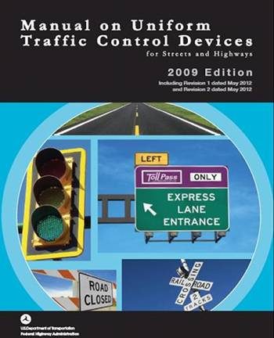
Existing Guidance
MUTCD
Traffic study using 85th percentile speed of free-flowing traffic along with consideration of other factors
Several other resources available
FHWA website and reports, USLIMITS2, ITE website, state documents, etc.

Slide 5
Trends / Recent Activity
NACTO 2017 policy that includes the following statement: “State rules or laws that set speed limits at the 85th percentile speed should be repealed”
National Transportation Safety Board’s publication (Reducing Speeding-Related Crashes Involving Passenger Vehicles) provides specific recommendations in their report, such as removing the guidance in the MUTCD that speed limits should be within 5 mph of the 85th percentile speed
Several state initiatives

Slide 6
NCUTCD Task Force Survey: How would you set speed limits if given the choice?

Slide 7
NCHRP 17-76 Speed Limit Setting User Guide (will be published within NCHRP series) Speed Limit Setting Tool (SLS-Tool) (spreadsheet)

Slide 8
Developing Guide and Tool Guiding Principles
Data-driven approach
Transparency in the decision process
Research-based decision rules that accounts for diverse roadway characteristics (context)
Consistent results
Consider drivers’ speed choice and roadway safety
Allow future modifications to accommodate new knowledge

Slide 9
Developing Speed Limit Setting Tool (SLS-Tool) Guiding Principles for Spreadsheet
Most or all data on one screen
Colors to indicate what user should enter / what is being calculated, also warning / advisory notes
Data input organized by type (e.g., site description, speed data, site characteristics, and crashes)
Only show needed site characteristics for the particular speed limit setting group

Slide 10
Speed Limit Setting Procedure
Roadway Context and Type
Speed Distribution
Safety
Suggested Speed Limit
Decision Rules

Slide 11
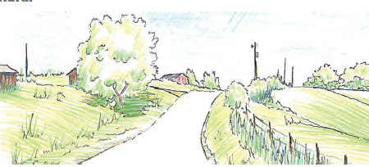
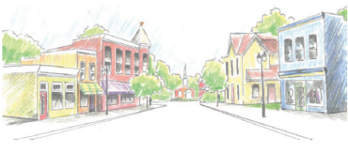
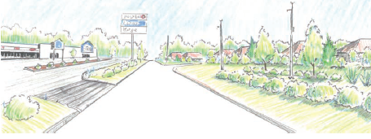
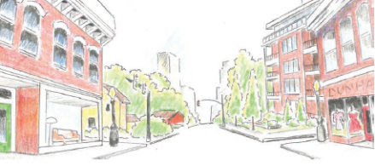
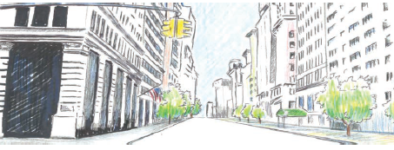
Roadway Context (NCHRP Report 855)
Context | Density | Illustration
Rural | Lowest (few houses or other structures)
Rural Town | Low to medium (single family houses and other single purpose structures)
Suburban | Low to medium (single and multifamily structures and multi-story commercial)
Urban | High (multi-story, low rise structures with designated off-street parking)
Urban Core | Highest (multi-story and high-rise structures)

Slide 12
Roadway Type (NCHRP Report 855)
Interstates/Freeways/Expressways
Principal Arterials
Minor Arterials
Collectors
Locals

Slide 13
Speed Limit Setting Groups
Context Type | Rural | Rural Town | Suburban | Urban | Urban Core
Freeways | Limited Access | Limited Access | Limited Access | Limited Access | Limited Access
Principal Arterial | Undeveloped | Developed | Developed | Developed | Full Access
Minor Arterial | Undeveloped | Developed | Developed | Developed | Full Access
Collector | Undeveloped | Full Access | Developed | Full Access | Full Access
Local | Undeveloped | Full Access | Full Access | Full Access | Full Access

Slide 14
Suggested Speed Limit Starting Point…
Speed Limit Setting Groups | Method, Engineering Use decision rules to identify percentile speed (and rounding) based on roadway characteristics & crashes Check maximum speed limits, where appropriate
Limited access Undeveloped Developed | Closest 85th (C85) | Roadway conditions OK
 | Rounded down from 85th (RD85) | Between
 | Closest 50th (C50) | Not favorable to all users or crashes a significant concern
Full Access (< 30 mph typically) | Closest 50th (C50) | Roadway conditions OK
 | Rounded down from 50th (RD50) | Not favorable to all users or crashes a significant concern

Slide 15
Developing Decision Rules in 17-76
Findings from the literature, especially:
Freeways: NCHRP Project 17-45, NCHRP Report 783
Developed: 17-76 data for Austin, TX and Washtenaw County, MI
Undeveloped: Stapleton et al, Das et al, Gates et al
Rules used in USLIMITS2
Guidance from the Green Book and the Highway Safety Manual
Research Team expert opinions
Feedback from experts, including the project panel

Slide 16
Limited Access Decision Rules
Variable | Closest 50th (C50) | Rounded Down 85th (RD85) | Closest 85th (C85)
Interchange spacing | Inter_spac ≤ 0.5 mi and AADT ≥ 180,000 veh/d | 0.5 mi < Inter_spac ≤ 1 mi and AADT ≥ 180,000 veh/d | All other cases
Grade (G) & design speed (DS) |  | DS ≥ 60 mph & G > 4% DS ≤ 55 mph & G > 5% | All other cases
Outside shoulder (SW) |  | SW < 8 ft | SW ≥ 8 ft
Inside shoulder (ISW), # ln (N), truck (tk) |  | Tk > 250 & ISW < 12 Tk ≤ 250, N ≥ 6, ISW< 10 Tk ≤ 250, N < 6, ISW< 4 | All other cases
Crash rate | High | Medium | Low

Slide 17
Considering Safety and Roadway Characteristics
Decision rules for each speed limit setting group
Considers geometric variables, human factors (driver speed choice), and safety
Decision rules identify:
Which speed distribution measure to start with (85th or 50th)
How to round (rounding closest or rounding down)

Slide 18
Previous Research
Solomon (1964), Cirillo (1968):
Rural highways and freeways
Harkey et al (1990):
<55 mph urban roads, NC and CO, 44 sites, weekday/nonalcohol/non intersection crashes, operating speeds estimated
West and Dunn(1971):
Turning crashes very influential
Hauer (1971):
Curve to reflect overtaking risk

Slide 19
Crash Rate and PSL-Average Speed from 17-76
Data from Austin, Texas
Urban / suburban streets

Slide 20
Tool Demonstration

Slide 21
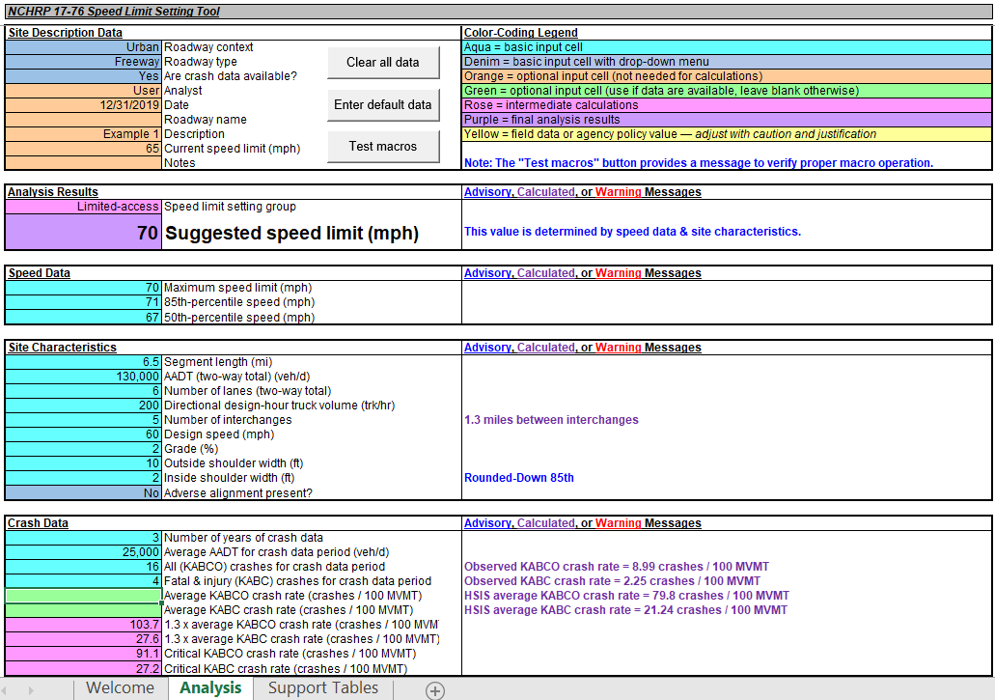
Example 1: Limited Access - Spreadsheet

Slide 22
Example 1: Limited Access - Spreadsheet

Slide 23
Example 1: Limited Access - Spreadsheet

Slide 24
Example 1: Limited Access - Spreadsheet

Slide 25
Example 1: Limited Access - Spreadsheet

Slide 26
Example 1: Limited Access - Spreadsheet

Slide 27
Example 1: Limited Access – Input Data
Segment length = 6.5 mi
AADT = 30,000 veh/day
DDHTV = 200 trucks/hr
Number of lanes (total in both directions) = 6
Number of interchanges = 5
Design speed = 60 mph
Grade = 2%
Outside shoulder width = 10 ft
Inside shoulder width = 2 ft
Maximum speed limit = 70 mph
Current PSL = 65 mph
85th percentile = 71 mph
50th percentile = 67 mph

Slide 28
Example 1: Limited Access - Spreadsheet
The basis for the suggested speed limit decision is noted here

Slide 29
Example 1: Limited Access - Spreadsheet
Variables that influence the calculated suggested speed limit are noted with advisory or calculated messages

Slide 30
NCHRP 17-76 Guidance for the Setting of Speed Limits
Questions?

