Slide 1
NCHRP 03-133: Traffic Signal Design and Operations Strategies for Non-Motorized Users
Pedestrian Recall and Actuation Research:
Preliminary Findings

Slide 2
NCHRP 03-133: Traffic Signal Design and Operations Strategies for Non-Motorized Users
Develop toolbox of strategies and treatments to make traffic signals work better for peds/bikes

Slide 3
Pedestrian Recall and Actuation Research: Preliminary Findings

Slide 4
Pedestrian Recall vs. Pushbutton Actuation
Research Need
Decision involves a tradeoff between
Impact on operations (traffic delay, capacity, progression, cycle length)
Impact on pedestrians (delay, compliance/safety)
Vehicle Green Time Need
 | Short | Medium | Long
Low | Actuation | ? | Recall
Medium | ? | ? | Recall
High | Recall | Recall | Recall
Pedestrian Volume | Decision
Low | Actuation
Medium | ?
High | Recall
Pedestrian
volume

Slide 5
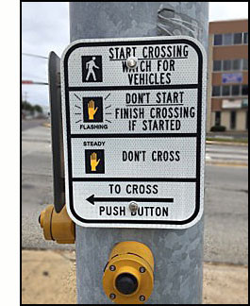
Research Questions
When would there be a small traffic impact of putting ped phases on recall?
Is there a ped volume threshold to set ped phases on recall?
How is it different for peds crossing major street or side street?

Slide 6
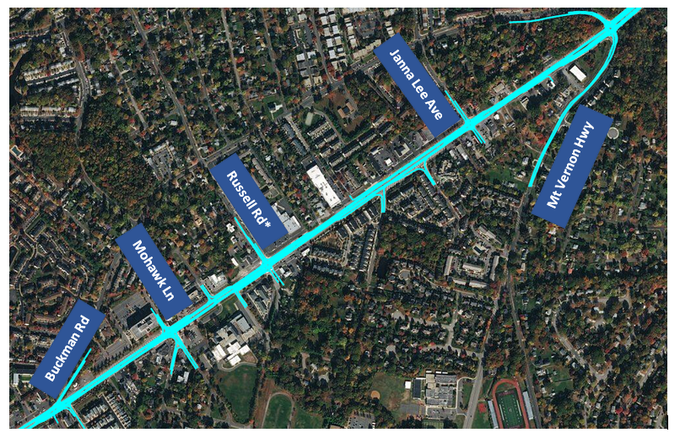
Research Methodology: Base Model
Microsimulation on a real arterial in Virginia (Route 1)
Coordinated-actuated arterial with 110 seconds cycle length
Focusing on a single (test) intersection that is non-critical (i.e., has slack capacity)
Modeled both peds crossing main arterial and side street
Recall was tested only for peds crossing main arterial (7 sec of Walk and 20 sec of FDW)
Crosswalk across side street was set to Rest in Walk

Slide 7
Research Methodology: Scenario Testing and Variables
Probability of pedestrian demand in a given cycle (denoted as “PP”)
0.1 (4 peds/hr)
0.3 (12 peds/hr)
0.5 (24 peds/hr)
0.7 (42 peds/hr)
0.9 (80 peds/hr)
Side street vehicle green time required as a fraction of Min Ped Green time required (denoted as “SSG”)
0.5
0.6
0.7
0.85
1.0
1.2

Slide 8
Preliminary Results: Delay Change for Peds Crossing the Main Arterial
With small PP, delay change is nearly equal to Walk time
With high PP, almost no change since ped actuation functions like a recall

Slide 9
Preliminary Results: Delay Change for Peds Crossing the Side Street
With high SSG, regardless of ped volume, impact is small
SSG=0.5, PP=0.1 Scenario
Peds Crossing Main Arterial | Peds Crossing Side Street
-7 seconds 59 seconds to 52 seconds | +5 seconds 8 seconds to 13 seconds

Slide 10
Preliminary Results: Intersection Vehicle Delay
With low PP and SSG, more pronounced impact but still less than 3 seconds
With high SSG, almost no impact on intersection delay

Slide 11
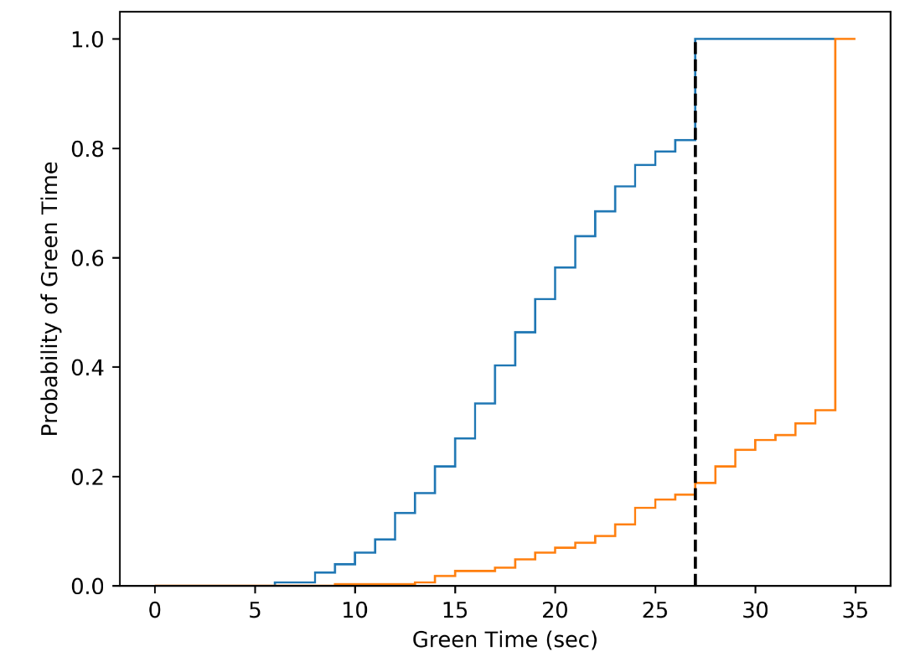
Preliminary Results: Side Street Phase Green Time Distribution
About 80% of the time, vehicle phase requires less than min ped green
Minimum Ped Green
Only about 20% of the time, vehicle phase requires less than min ped green

Slide 12
Key Findings
High pedestrian demand:
Pedestrian recall is appropriate and has no impact on intersection delay
Long side street vehicular phase green time required:
Regardless of pedestrian demand, pedestrian recall will reduce pedestrian delay with almost no impact on intersection delay
Low pedestrian volumes:
Pedestrian recall will reduce ped delay by about the same duration of the Walk interval.

Slide 13
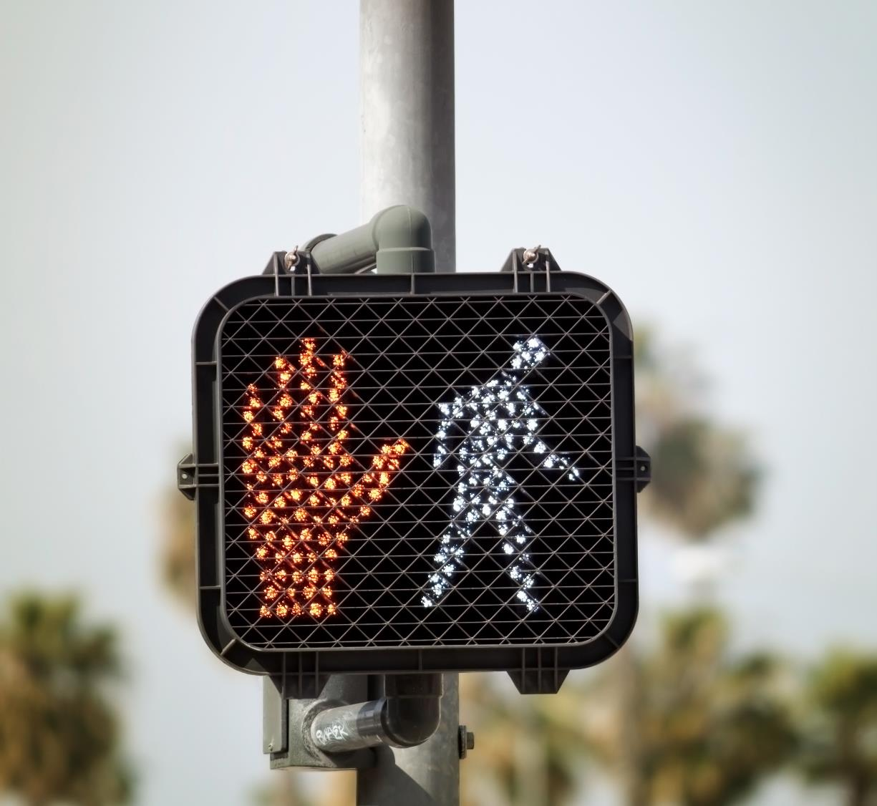
Questions?

