Slide 1


NCHRP 25-57
Breaking Barriers: Alternative Approaches to Avoiding and Reducing Highway Traffic Noise Impacts

Slide 2
Acknowledgement and Disclaimer
The research team would like to thank the project’s technical advisory panel for their guidance, constructive comments, and sharing this project experience, which we hope will help in expanding the strategies applied to reduce highway traffic noise. The panel includes: Chair Adam Alexander; AASHTO Monitor Noel Alcala, P.E.; Members Patrick Gant, P.E., John Hencken, Mary Dickens Pair, P.E., Kenneth Polcak, and Peter Wasko; FHWA Liaison Aileen Varela-Margolles; TRB Liaison Christine Gerencher; and NCHRP Staff Ann M. Hartell and Jarrel McAfee. In addition, the researchers would like to thank the more than 50 individuals who participated in the literature/data review survey and interviews and provided documents and data, including those from the American Association of State Highway Transportation Officials (AASHTO) and Transportation Research Board (TRB). Lastly, we thank Dr. Ysbrand Wijnant and Bart Willems from the University of Twente and 4Silence, for providing valuable noise predictions for barrier diffractor tops.
The National Cooperative Research Program (NCHRP) produces ready‐to‐implement solutions to the challenges facing transportation professionals. NCHRP is sponsored by the individual state departments of transportation of the American Association of State Highway and Transportation Officials (AASHTO), in cooperation with the Federal Highway Administration (FHWA). NCHRP is administered by the Transportation Research Board (TRB), part of the National Academies of Sciences, Engineering, and Medicine. Any opinions and conclusions expressed or implied in resulting research products are those of the individuals and organizations who performed the research and are not necessarily those of TRB; the National Academies of Sciences, Engineering, and Medicine; or NCHRP sponsors.

Slide 3
Research Team
Cross-Spectrum Acoustics
Judy Rochat, Ph.D., Principal Investigator
Herb Singleton, P.E., Project Administrator
Doug Barrett
Shannon McKenna, P.E.
Keith Yoerg, P.E.
MS Consultants, Inc.
Karel Cubick
Lisa Samples, Ph.D., P.E.
Sean Riffle, P.E.
The Transtec Group
Rob Rasmussen, Ph.D., P.E.
Richard Sohaney

Slide 4
Outline
Motivation and objectives
Research approach
Findings by strategy category
Application of findings
Conclusions
Suggested research

Slide 5
Motivation and Objectives

Slide 6
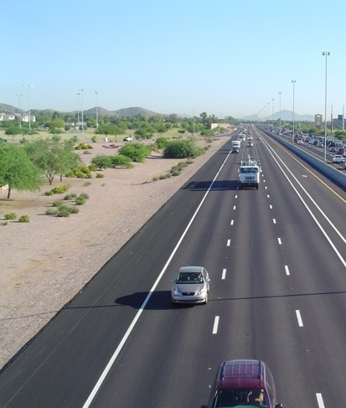
Motivation
Highway traffic noise can adversely affect adjacent communities
Noise barriers are effective but cannot always be constructed in accordance with state policies
A broader examination of modern noise reduction strategies could allow states to more effectively improve the noise environment

Slide 7
Objectives
Key objective: develop a resource detailing innovative approaches beyond the use of noise barriers to avoid and minimize highway traffic noise and address noise complaints
Resource to provide:
  Ranges of noise reduction benefits
  Cost factors
  Context-appropriateness for design choices and management strategies that may be adopted for other reasons, but that provide noise reduction co-benefits, as well as those adopted specifically to address noise

Slide 8
Research Approach

Slide 9
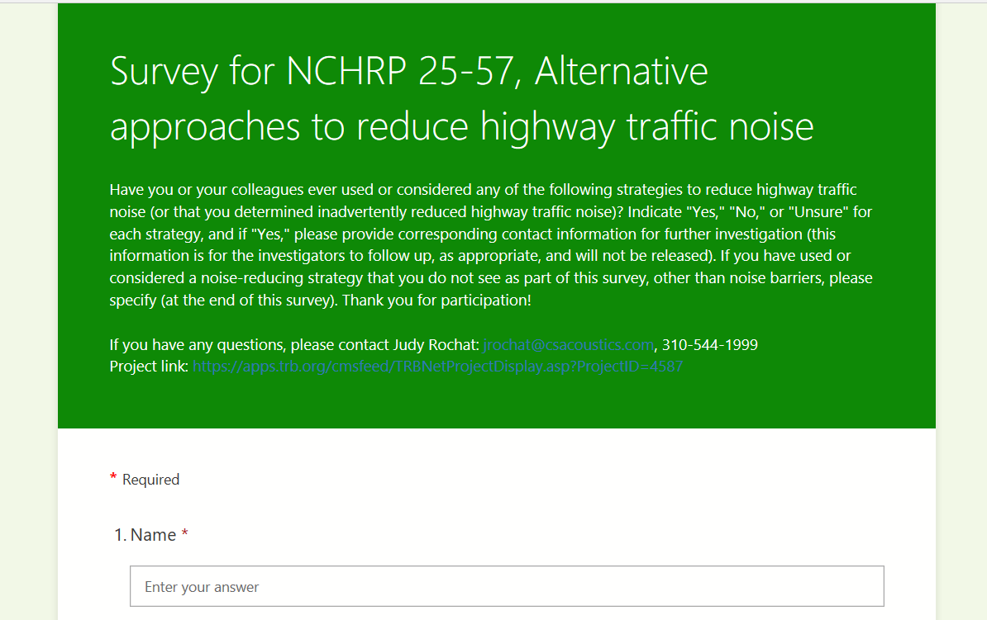
Literature and Data Review
14 primary strategies were examined and summarized in terms of noise reductions, cost, and context appropriateness
Over 170 references were reviewed
  National and international references
  Published research and practice reports, papers, and policies
Examination supplemented by survey with AASHTO and TRB noise professional respondents
  Provided additional references and information
Brief Traffic Noise Model (TNM)
analysis completed for some strategies
Notes:
Survey: 54 respondents

Slide 10
Noise-Reducing Strategy Category | Strategy
On-road design choices | Quieter bridge decks and joints
 | Quieter rumble strip design
 | Quieter pavements for travel lanes and/or shoulders
Highway design choices | Horizontal and vertical alignment
 | Solid safety barriers in lieu of guardrail
 | Separation zones between vehicle travel lanes and side paths for nonmotorized users
Right-of-way design choices | Low berms
 | Vegetated screens
 | Vegetated swales and retention basins
 | Sound-absorbing ground surface and ground treatment adjacent to the highway
 | Solar panels
Operations management strategies | Speed or truck restrictions
Implementations by receptors or local governments | Approaches that can be implemented by subdivision developers, homeowner associations, special districts, or local governments
Sound absorptive treatment | Sound absorptive treatment on retaining walls, bridge understructures, or other surfaces

Slide 11
Noise-Reducing Strategy Category | Strategy
On-road design choices | Quieter bridge decks and joints
 | Quieter rumble strip design
 | Quieter pavements for travel lanes and/or shoulders
Highway design choices | Horizontal and vertical alignment
 | Solid safety barriers in lieu of guardrail
 | Separation zones between vehicle travel lanes and side paths for nonmotorized users
Right-of-way design choices | Low berms
 | Vegetated screens
 | Vegetated swales and retention basins
 | Sound-absorbing ground surface and ground treatment adjacent to the highway
 | Solar panels
Operations management strategies | Speed or truck restrictions
Implementations by receptors or local governments | Approaches that can be implemented by subdivision developers, homeowner associations, special districts, or local governments
Sound absorptive treatment | Sound absorptive treatment on retaining walls, bridge understructures, or other surfaces
Supplement with road elevation and diffractor top
Supplement with road depression and soft ground on berm
Selected for further
investigation
Supplement with quieter pavement

Slide 12
Further Investigations
Used FHWA Traffic Noise Model (TNM) v3.0 to predict noise reduction with varying parameters
8 roadway base cases
  2- and 4-lane narrow and wide streets
  4- and 8-lane narrow and wide freeways/highway
Default ground acoustically hard (hard soil) and soft (lawn)
0, 5, and 15% heavy trucks
Receivers
  Distances every 25 ft, out to 1000 ft (from center of near travel lane)
  Heights 5 and 15 ft

Slide 13
Findings

Slide 14
On-Road Design Choices
Quieter bridge decks and joints
Quieter rumble strip design
Quieter pavements for travel lanes and/or shoulders

Slide 15
On-road design choices – quieter bridges, rumble strips, and pavements
Strategy | Noise Benefit | Costs ($-$$$$$) | Context Appropriateness
Quieter bridge decks | 5-10 dB compared to conventional bridge decks (near source) | $$- $$$ | Bridges or other structures
Quieter bridge joints | 6-9 dB compared to conventional bridge joints (near source) | $$$-$$$$ | Bridges or other structures with expansion joints, particularly designed seismic activity
Quieter rumble strips | 3-7 dB compared to conventional rumble strips (near source) | $- $$$ | Outside edges of travel lanes or centerline of undivided roadway
Quieter pavements | Up to 7 dB reduction for diamond grinding Up to 9 dB reduction for open-graded/rubberized Up to 6 dB reduction for thin bonded asphalt | $$- $$$$ | All pavement surfaces

Slide 16
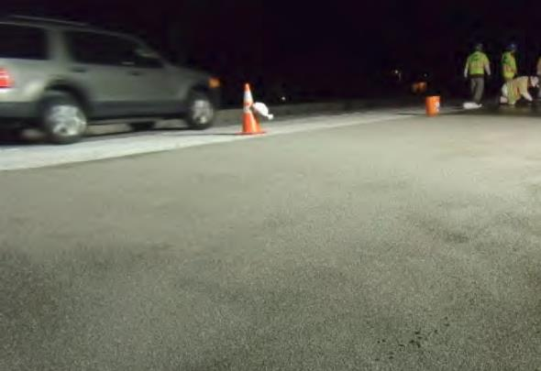
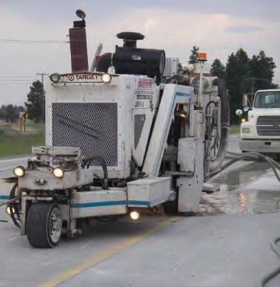
Noise Benefit
5-10 dB compared to conventional bridge decks (near source)
Quieter bridge decks
Quieter applications
  Polyester overlay
  Diamond grinding
  Reduce texture depth
  Improve texture uniformity
  Create “negative” texture that reduces tire tread block vibrations
  Result is reduced tire-pavement noise

Slide 17
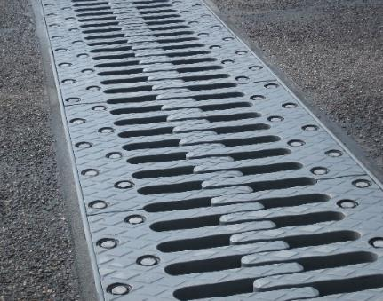
Noise Benefit
6-9 dB compared to conventional bridge joints (near source)
Quieter bridge joints
Quieter applications
  Patterned joint cover plates; examples: finger joints, sinusoidal shapes
  Eliminate undesirable “zipper” sound commonly associated with large expansion joints
Washington DOT (2019) Example: TENSA®FINGER cantilever Glaesser, et al., NCEJ, Vol. 60, No. 2 (2012)

Slide 18
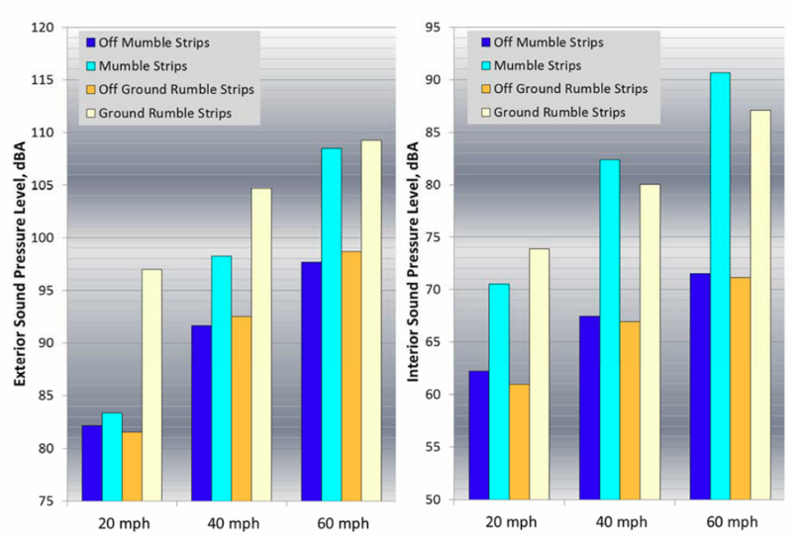
Noise Benefit
3-7 dB compared to conventional rumble strips (near source)
Quieter rumble strips
Quieter rumble strips
  Unique patterns to reduce impact energy
  Rumble “wave” using a sinusoid pattern, optimized for occupant safety while reducing exterior noise level
  Can be installed using conventional equipment with minor modifications
Minnesota DOT (2015) Caltrans (2012, 2018)

Slide 19
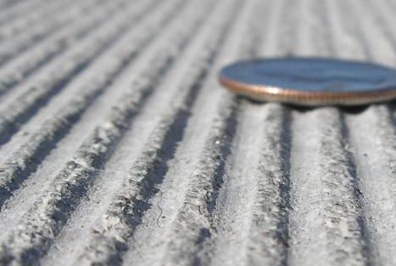
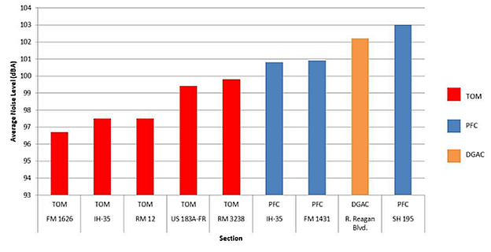
Noise Benefit
Up to 7 dB reduction for diamond grinding Up to 9 dB reduction for open-graded/rubberized Up to 6 dB reduction for thin bonded asphalt
Quieter pavement
Quieter pavement
  Diamond grinding
  Open-graded or rubberized asphalt
  Thin bonded asphalt layers
  Reduce texture depth
  Improve texture uniformity
  Create “negative” texture that reduces tire tread block vibrations
  For some alternatives, increase acoustical absorption
  Additional benefit from absorptive treatments of pavements on shoulders

Slide 20
Highway Design Choices
Horizontal and vertical alignment
Solid safety barriers in lieu of guardrail
Separation zones

Slide 21
Horizontal and vertical alignment
Strategy | Noise Benefit | Costs ($-$$$$$) | Context Appropriateness
Horizontal alignment shift | < 1 dB to 10+ dB depending on extent of shift, site topography, and vehicle types | $$$$-$$$$$ | Highways or local roadways with vacant land opposite the sensitive sites
Vertical alignment shift | < 1 dB to 10+ dB depending on extent of shift, site topography, and vehicle types | $$$$-$$$$$ | Highways or local roadways where right-of-way is sufficient
Acceptable abatement measures per 23 CFR 772.15

Slide 22
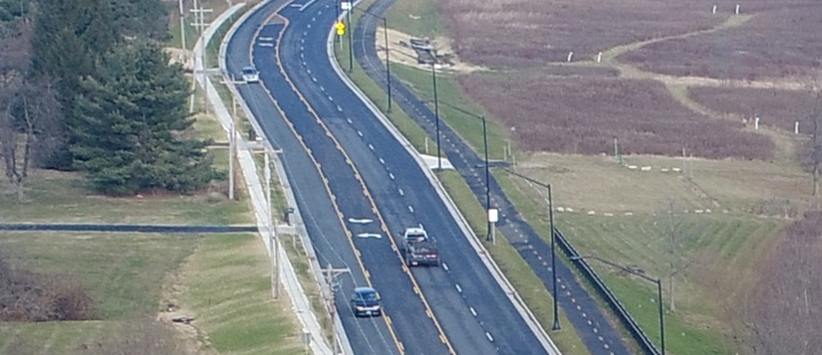
Noise Benefit
< 1 dB to 10+ dB depending on extent of shift, site topography, and vehicle types
Horizontal alignment shift
Moving the roadway away from noise sensitive sites
Very expensive and frequently discounted
Concept overlaps with analysis of alternative alignments intended to avoid utility conflicts, reduce construction cost, or minimize right-of-way impacts
TNM v2.5 evaluation for arterial street project with minor impacts
  Roadway shifted 15.2 m (50 ft) away from 1st row receivers: no noise impact (about 2 dB reduction)
  ROW and construction cost for shifting 533 m (1,750 ft) of roadway 15.2 m (50 ft) laterally exceeds $2,350,000

Slide 23
Noise Benefit
< 1 dB to 10+ dB depending on extent of shift, site topography, and vehicle types
Vertical alignment shift
Raising or lowering the roadway relative to the noise sensitive site
May be less expensive than horizontal shift, but still frequently discounted
1997 Texas report showed that depressed freeway sections provide the greatest reduction in noise
TNM v2.5 evaluation for arterial street project with minor impacts
  Roadway lowered 0.6 m (2 ft) = no noise impact (2 dB reduction)
  Excavation cost for 457 linear m (1,500 linear ft) of roadway was $101,655
  No additional right-of-way required for this project
  Sight distance, drive adjustments, drainage, utility conflicts, not evaluated

Slide 24
Solid safety barriers in lieu of guardrail
Strategy | Noise Benefit | Costs ($-$$$$$) | Context Appropriateness
Solid safety barrier in lieu of guardrail freeway | Preliminary: 0.4 dB to 2.6 dB depending on distance to receiver and site topography Further investigations: at 100 ft, 5-7 dB reduction, up to 8 dB with road slightly elevated (assumes tall freeway/highway safety barrier, 6.8 ft) | $$ | Limited-access highways if state standards allow
Solid safety barrier in lieu of guardrail arterial | Preliminary: 2.0 dB to 6.6 dB depending on distance to receiver and site topography Further investigations: at 100 ft, 3-4 dB reduction, up to 6 dB with road slightly elevated (assumes tall street/arterial safety barrier, 4.8 ft) | $$ | State or local roadways if state or local standards allow

Slide 25
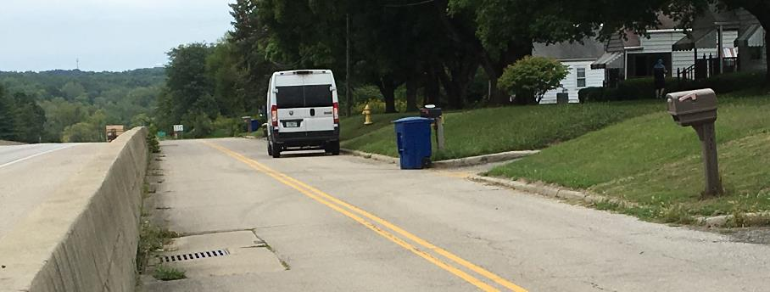
Solid safety barriers in lieu of guardrail
A solid safety barrier (guardrail or concrete barrier) shields motorists from structures/steep slopes
  Considerations: consult roadway designer to evaluate safety performance; need to maintain access to adjacent properties
Further investigations
Parameter | Values/descriptions
Safety barrier height | 3.5 ft and 4.8 ft for city streets; 4.8 ft and 6.8 ft for freeways
Roadway elevation | At grade and elevated 1, 2, and 3 ft
Diffractor | Safety barrier with and without diffractor

Slide 26
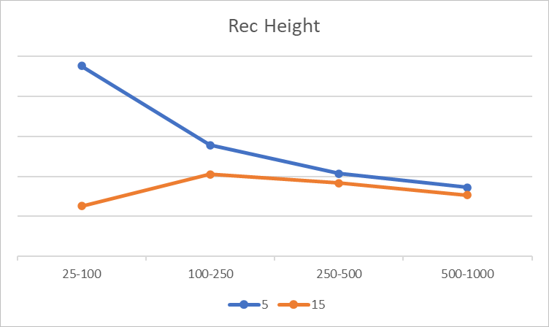
Noise Benefit
Freeway Preliminary: 0.4 dB to 2.6 dB depending on distance to receiver and site topography Further investigations: at 100 ft, 5-7 dB reduction, up to 8 dB with road slightly elevated (assumes tall freeway/highway safety barrier, 6.8 ft)
Street Preliminary: 2.0 dB to 6.6 dB depending on distance to receiver and site topography Further investigations: at 100 ft, 3-4 dB reduction, up to 6 dB with road slightly elevated (assumes tall street/arterial safety barrier, 4.8 ft)
Solid safety barriers in lieu of guardrail
Noise reduction for same height barrier generally greater for streets
  Freeways allow for taller safety barrier, however, so can achieve greater reduction
Noise reduction – further investigations
  Best for: tallest barriers (4.8 ft for streets, 6.8 ft for freeways), narrow roadways, hard ground sites (e.g., pavement, packed dirt), lower % heavy trucks
  Enhanced with small road elevation (+1-2 dB)
  Receiver height/distance dependent
Reduction as a function of distance (ft)

Slide 27
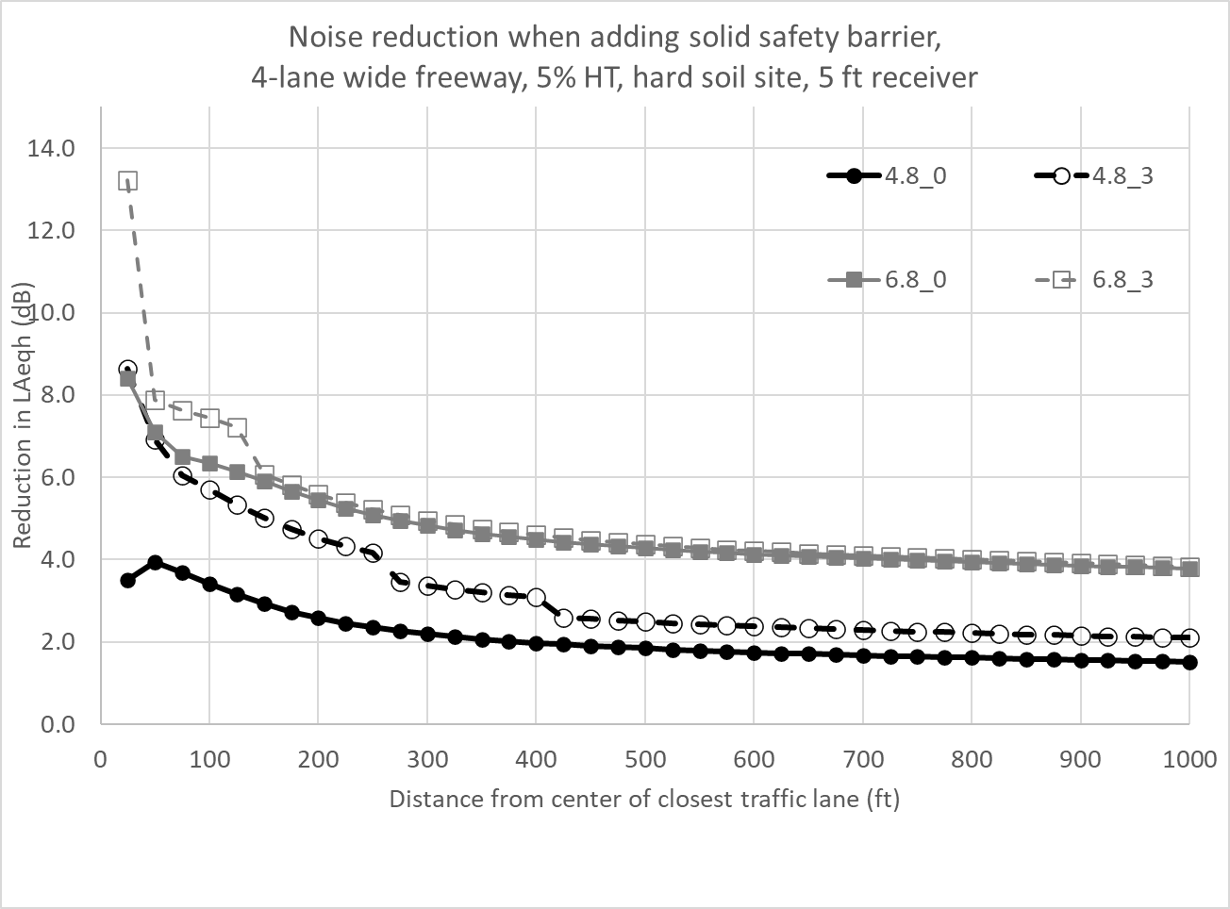
Solid safety barrier – freeway/highway
Example with 4.8 and 6.8 ft barriers, at grade and road elevated 3 ft

Slide 28
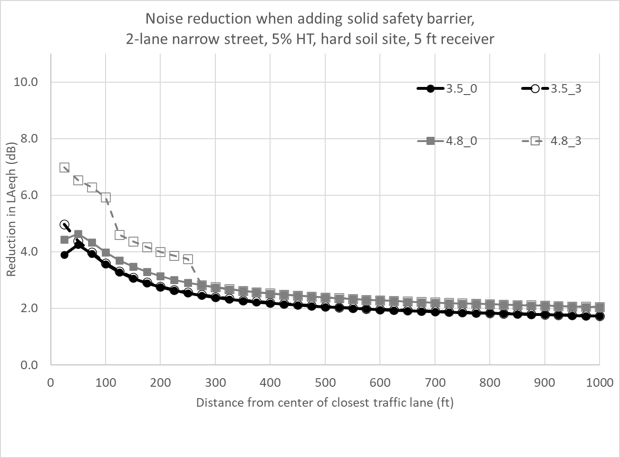
Solid safety barrier – street/arterial
Example with 3.5 and 4.8 ft barriers, at grade and road elevated 3 ft

Slide 29
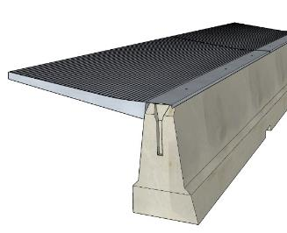
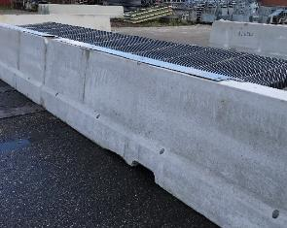
Solid safety barrier – diffractor top
Diffractor top enhances noise reduction
  Estimated 3 dB broadband increase (noise reduction increase = decrease in sound level)
Substantial reduction at frequencies important to highway traffic noise, 500-1600 Hz
  Could be tuned for lower frequencies
This system has not yet been tested for crashworthiness in the U.S.
©4Silence, WHIStop diffractor

Slide 30
Separation zones between vehicle travel lanes and side paths for non-motorized vehicles
Strategy | Noise Benefit | Costs ($-$$$$$) | Context Appropriateness
Separation zone between roadway and side path in TNM (different from default ground type) | Up to 0.3 dB minimal noise reduction | $ | Roadways with sidewalks or shared-use paths
Separation zone between roadway and side path in TNM (similar to default ground type) | 0.1 dB or 0.2 dB only a slight difference. | $ | Roadways with sidewalks or shared-use paths
separation zones between travel lanes and sidewalks, bike trails, shared-use paths has not been frequently considered
increase model accuracy 1.2 dB to 1.6 dB if separation zone different from default ground type (hard soil or pavement compared to lawn)

Slide 31
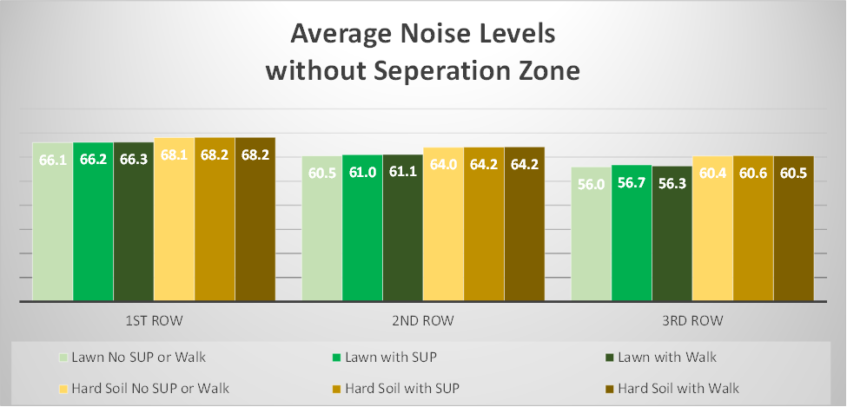
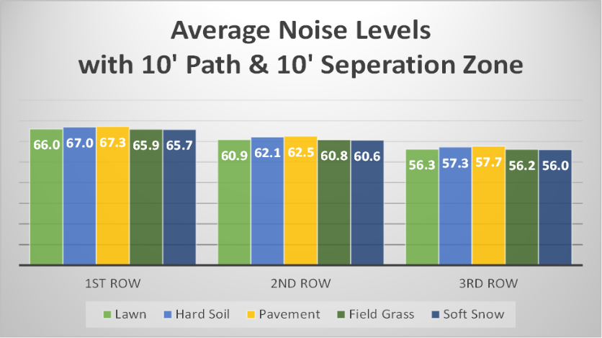
Separation zones between vehicle travel lanes and shared-use paths (SUPs) for non-motorized vehicles
TNM v2.5 evaluation for a previously completed project
Added a sidewalk or SUP and separations zones
Very little noise reduction regardless of separation zone ground type
Notes:
multiple ground type were used in the separation zones

Slide 32
Right-of-Way Design Choices
Low-height noise berms
Vegetated screens
Vegetated swales and retention basins
Sound-absorbing ground surfaces and ground treatments
Solar panels

Slide 33
Low-height noise berms
Strategy | Noise Benefit | Costs ($-$$$$$) | Context Appropriateness
Standard low-height berms (up to 1.8 m or 6 ft) | 2-10 dB (greatest when receivers below road elevation) Further investigations: at 100 ft, 4-7 dB reduction for a 6 ft berm, up to 9 dB with road slightly depressed | $-$$$ | Space in ROW
Engineered low-height berms with steeper slopes | Could increase noise reduction by moving peak closer to road Unusually shaped provide no additional benefit | $$-$$$$ | Space in ROW (requires less than standard berm)
Low-height berms with absorptive ground | Could increase reduction by up to 5 dB | Geo-graphically dependent | Space in ROW, likely requires maintenance

Slide 34
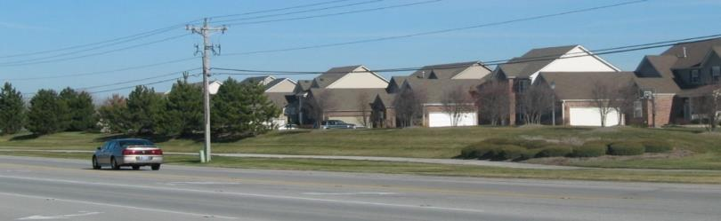
Low-height berms
Noise barriers constructed from natural earthen materials in an unsupported condition
  Can be low-cost (using surplus materials) and low-maintenance
Further investigations
Parameter | Values/descriptions
Berm height | 3, 4.5, and 6 ft
Berm shape | Slopes 2:1 and 4:1; Slopes 2:1 and 4:1 mixed with 6:1 on traffic side; and Slopes 2:1 and 4:1 mixed with retaining wall on traffic side
Berm top width | 2 ft and 4 ft
Berm placement | In ROW and considering berm footprints: “near” (close to road) and “far” (at ROW line)
Roadway depression | At grade and depressed 1, 2, and 3 ft

Slide 35
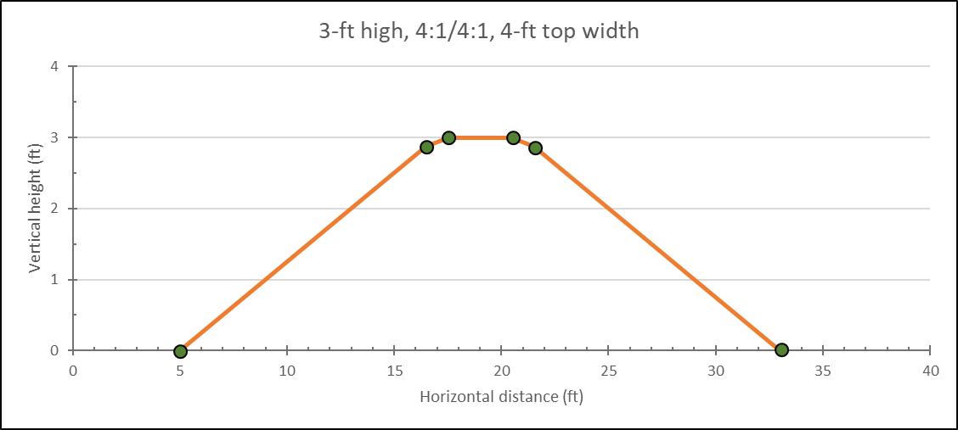
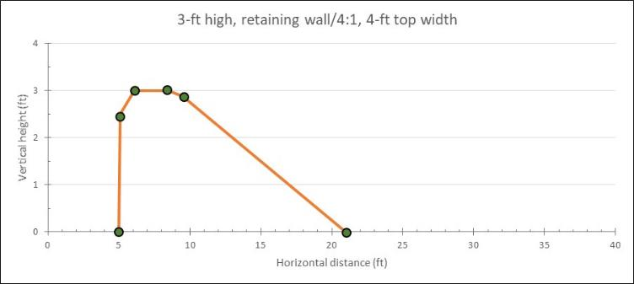
Example TNM modeling
Standard berm
Engineered (retaining wall near road)

Slide 36
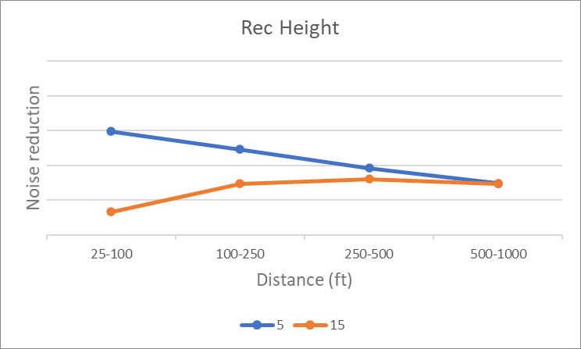
Noise Benefit
2-10 dB (greatest when receivers below road elevation) Further investigations: at 100 ft, 4-7 dB reduction for a 6 ft berm, up to 9 dB with road slightly depressed
Standard low-height berms
Noise reduction – further investigations
  Best for: tallest berm (6 ft), narrow roadways, hard ground sites (e.g., pavement, packed dirt), lower % heavy trucks
  Enhanced with small road depression (+2 dB); also with absorptive surface if site is generally hard ground (+2 dB)
  Berm shape (slope, top width, engineered with retaining wall to move closer to traffic: up to 2 dB influence)
  Receiver height/distance dependent

Slide 37
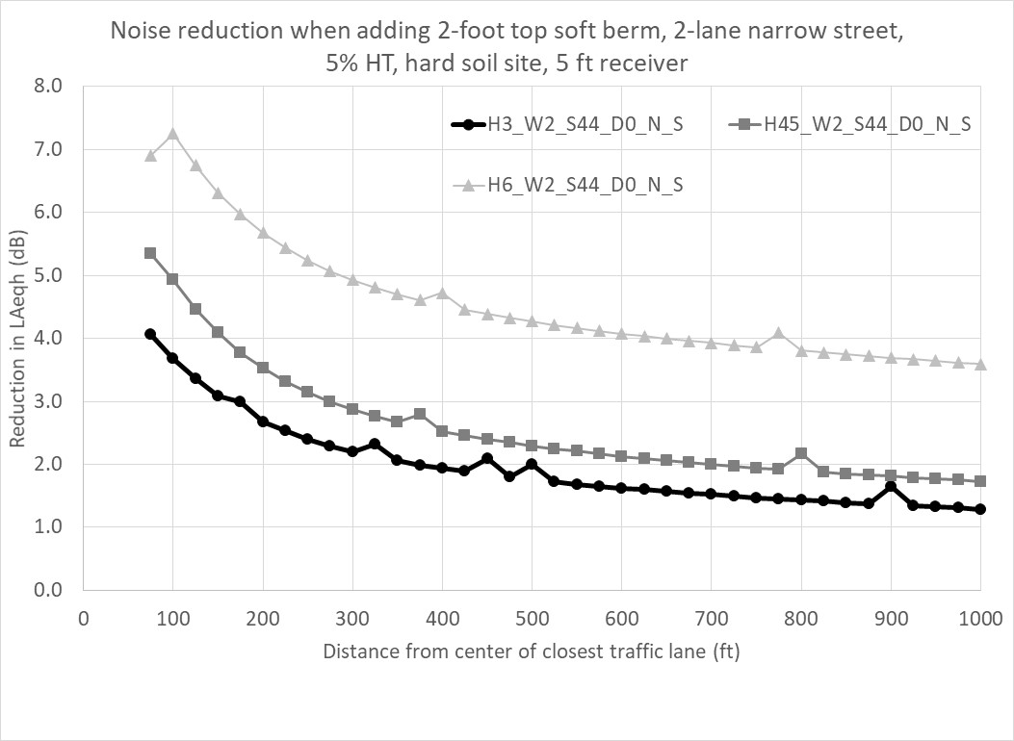
Low-height berms – noise reduction over distance
Example with berm heights 3, 4.5, and 6 ft, 4:1 slope, 2 ft top width, soft berm, at grade
Notes:
Effect of berm at three heights – does not include effect of road depression

Slide 38
Vegetated screens
Strategy | Noise Benefit | Costs ($-$$$$$) | Context Appropriateness
Wide vegetation belts (> 20 m or 65 ft) | Measured 3-9 dB; up to 10 dB predicted with optimized planting | $-$$$ | Space in ROW; areas that can support vegetation
Moderate-to-low thickness vegetation (< 20 m or 65 ft) | Measured 1-3 dB; up to 6 dB predicted with optimized planting | $-$$ | Space in ROW; areas that need minor noise reduction and can support vegetation
Vegetation to improve adverse sound propagation effects | Reduce negative downwind effects; reduce likelihood of temperature inversion | $$ | Sites with a wall noise barrier; sites that can support vegetation
Vegetation to improve perception | None, but subjective reports of decrease in annoyance | $ | Areas that do not qualify for noise abatement, but report traffic noise annoyance

Slide 39
Noise Benefit
Wide belts (> 20 m or 65 ft): measured 3-9 dB; up to 10 dB predicted with optimized planting Low-to-moderate thickness (< 20 m or 65 ft): measured 1-3 dB; up to 6 dB predicted with optimized planting
Vegetated screens
Optimized planting
  Tree-spacing as close as possible (< 3 m or 10 ft)
  Pseudo-random spacing
  Tree stem diameter > 0.11 m (4 in)
  Height of tree canopy affects reduction (too high and sound goes under)
  Canopy shape affects reduction
    Triangular may be ideal behind barriers to reduce adverse downwind effects
    Start of canopy below, at, or above the top of wall affects distance where reduction is seen
Undergrowth important to noise reduction
  Wide belts with trees too dense may limit growth
Shrubs may be effective with low source and receptor heights
Vegetation may have a calming effect and reduce annoyance

Slide 40
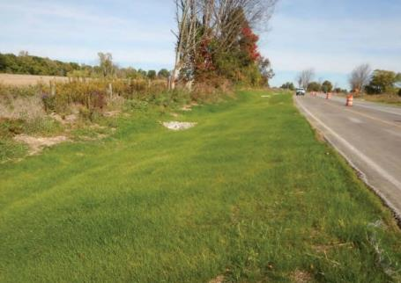
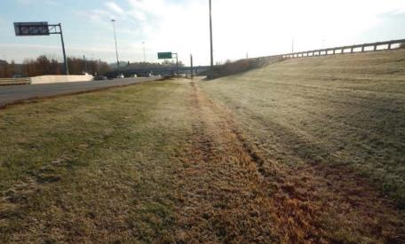
Vegetated swales and retention basins
Strategy | Noise Benefit | Costs ($-$$$$$) | Context Appropriateness
Vegetated bio-filter basin | < 1 dB for multi-lane highway 1-2 dB for 2-lane road (most reduction farther from road, > 91 m or 300 ft) | $ | Highways/roads where swale/basin is needed
Constructed to reduce or store storm water run-off
A vegetated biofilter consists of a grassed portion of the graded shoulder, grassed foreslope, and flat grassed ditch

Slide 41
Sound-absorbing ground surfaces and ground treatments adjacent to a highway
Strategy | Noise Benefit | Costs ($-$$$$$) | Context Appropriateness
Acoustically soft ground | 1-3 dB for traditional soft surfaces Up to 12 dB for highly absorptive surfaces, most reduction with placement close to source (narrow shoulder) and extending over half the distance to receiver Further investigations: at 100 ft, 4-5 dB reduction, up to 6 dB combined with quieter pavement | $-$$$ | Space in median and ROW
In-ground treatments | 2-8 dB, most reduction for wider strip, lattice structure | $$$ | ROWs that can accommodate embedded structures close to travel lane (likely 2-lane road)
Above-ground treatments | 3-11 dB, most reduction for wider strip, lattice structure | $$-$$$$ | ROWs that can accommodate above-ground low structures close to travel lane (likely 2-lane road)

Slide 42
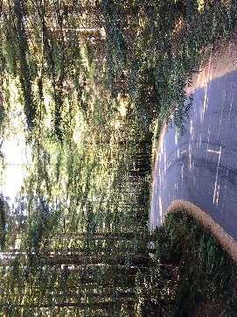
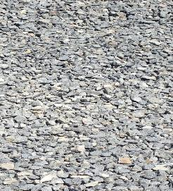


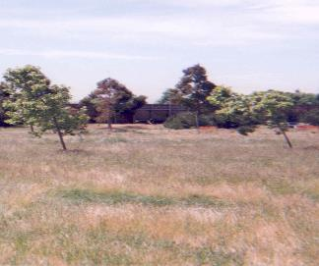
Acoustically soft ground
Soft ground examples: gravel (highly absorptive), forest floor, grass
Further investigations
Gravel Shredded rubber mat Forest floor Sand Field grass
Parameter | Values/descriptions
Absorptive strip placement | Edge of shoulder with strip widths of 10, 20, and 50 ft
Absorption value | 5,000; 10; and 1 cgs rayls [representing hard soil (for default ROW and for comparison to softer surfaces), gravel, and very highly absorptive gravel, respectively]
Roadway pavement | TNM Average and OGAC
Notes:
For hard ground, destructive interference occurs at higher frequencies that have little effect on the overall sound level.
Soft ground affects frequencies that contribute to broadband sound level.

Slide 43
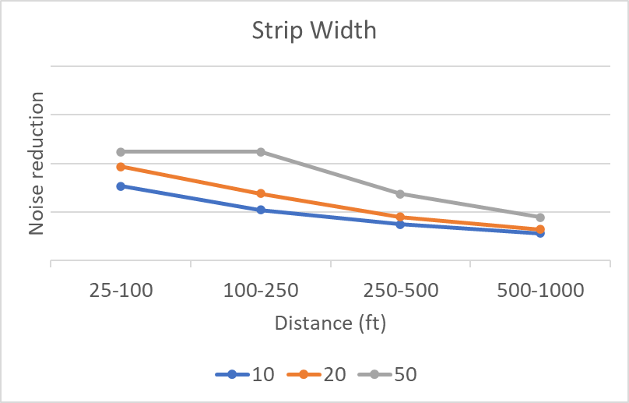
Noise Benefit
1-3 dB for traditional soft surfaces Up to 12 dB for highly absorptive surfaces, most reduction with placement close to source (narrow shoulder) and extending over half the distance to receiver Further investigations: at 100 ft, 4-5 dB reduction, up to 6 dB combined with quieter pavement
Acoustically soft ground
Noise reduction – further investigations
  Best for: widest strip (50 ft), narrow roadways, hard ground sites (e.g., pavement, packed dirt), lower % heavy trucks
  Enhanced with quieter pavement (+1-2 dB for TNM OGAC, more for quieter pavements)
  Effects at acoustically soft ground sites < 1 dB
  Differences between highly absorptive gravel (EFR 10 cgs rayls) and very highly absorptive gravel (EFR 1 cgs rayls) is negligible
  Effect of strip widths is distance dependent

Slide 44
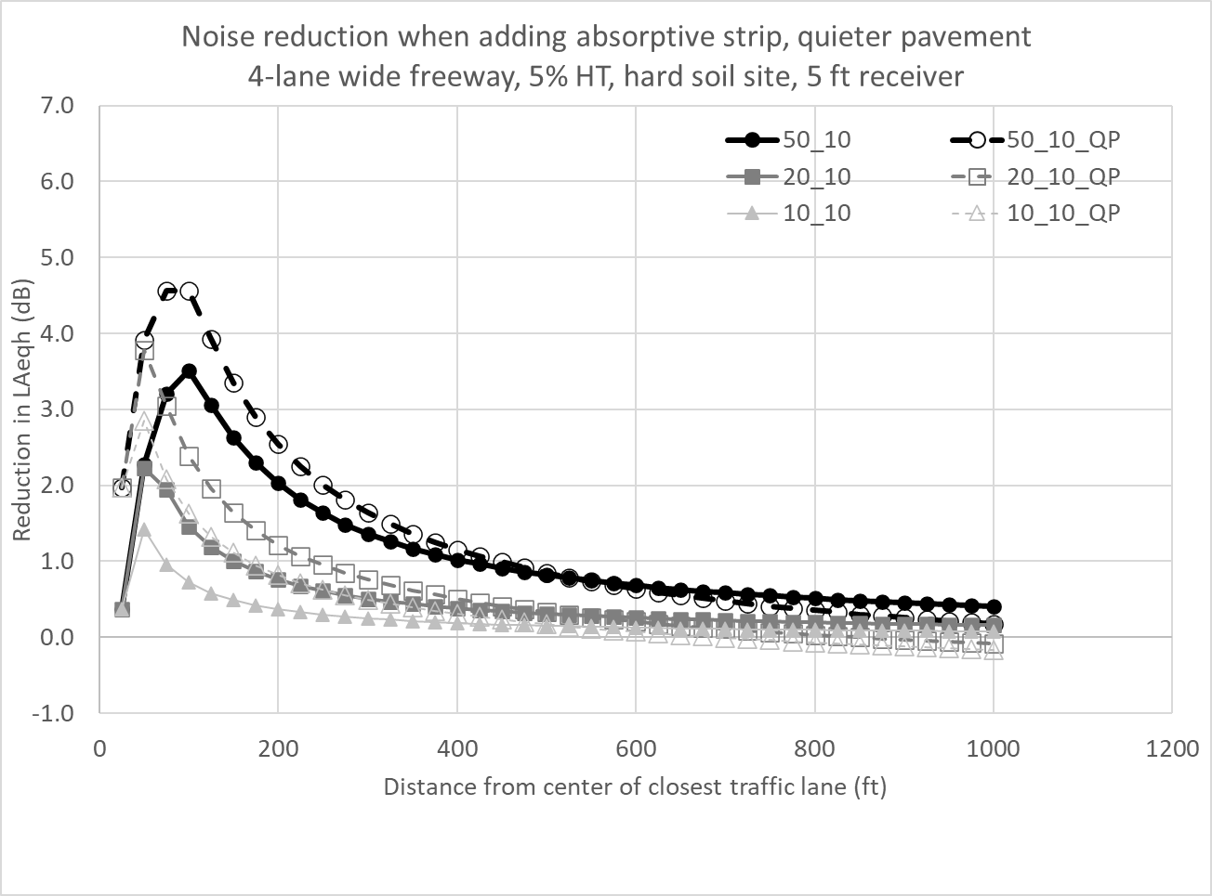
Acoustically soft ground
Example with strip widths 10, 20, and 50 ft; EFR 10 cgs rayls; with and without quieter pavement

Slide 45
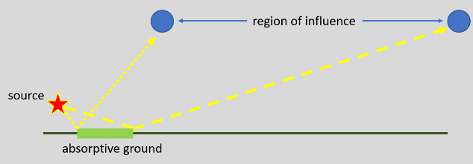
Acoustically soft ground (ASG) – targeted investigations
ASG and quieter pavement (QP) complementary noise reduction
  At lower frequencies, reduction is controlled by ASG
  At mid to higher frequencies, reduction is controlled by ASG and QP
Region of influence (ROI)
Wider strip = wider ROI
Higher noise source = ROI closer to road
Higher receiver = ROI farther from road
Road lane closer to strip = ROI closer to road

Slide 46
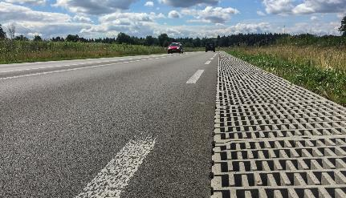
Noise Benefit
2-8 dB, most reduction for wider strip, lattice structure
In-ground treatments
Grooves or pits add ground roughness to help reduce sound
Structure types
  Multiple parallel walls
  Lattice structure
  Resonators (can be tuned to reduce specific frequency, although only 2-3 dB reduction embedded in shoulder)
Structure parameters investigated (walls, lattice)
  0.2-0.3 m (0.7-1 ft) deep
  1-24 m (3-79 ft) wide
  2.5 m (8 ft) from nearest source
Less effective than raised structure, but may be preferred
  May be above ground construction restrictions
  Might be combined usefully with drainage arrangements
©4Silence, WHISstone lattice structure

Slide 47
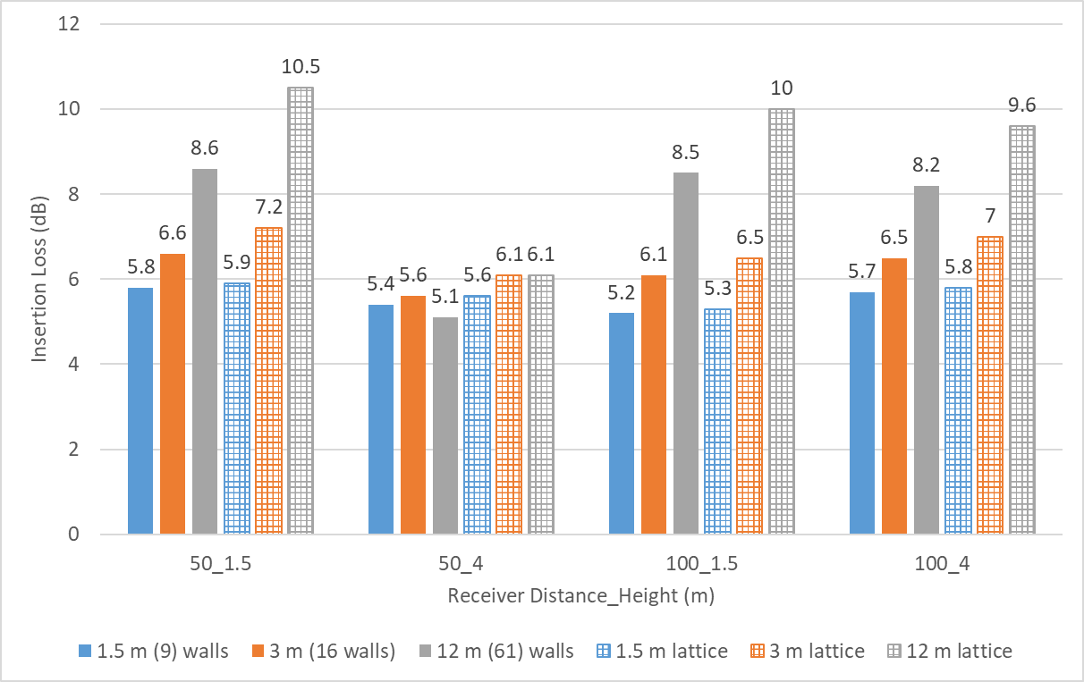
Noise Benefit
3-11 dB, most reduction for wider strip, lattice structure
Above-ground treatments
Adds ground roughness to scatter and help reduce sound
Structure types
  Multiple parallel walls
  Lattice structure
Structure parameters investigated
  0.25-0.3 m (0.8-1 ft) height
  2-12 m (7-39 ft) wide
  2.5 m (8 ft) from nearest source
Reduction depends on height, spacing, width, cross-sectional shape
  Lattice configurations ½ width of parallel walls have comparable reduction
  Effectiveness not affected by receiver height or distance
  Gaps between walls/cells can be filled up to 30% by gravel, sand, soil, plants
Data source: Attenborough (2016)
Notes:
1 ft height is approximately the wavelength of the sound in air at 1 kHz; less than or equal to this height is considered ground roughness.
Spacing: periodic can focus effect; random is more of a broadband effect – although other reference contradicts this.

Slide 48
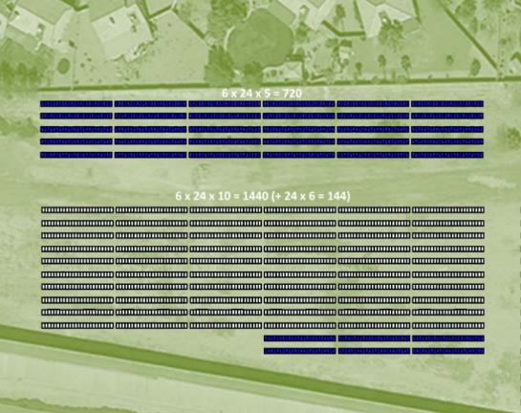
Solar panels
Strategy | Noise Benefit | Costs ($-$$$$$) | Context Appropriateness
Solar panels | If continuous panels assumed, then > 11 dB, however gaps between arrays and panel angles need to be considered | ($$-$$$$) Cost for purchase, installation, and maintenance of panels | Highways with ROW space
Most effective:
  Multi-row array
  Minimal gaps horizontally and vertically
Arizona DOT (2019)

Slide 49
Operations Management Strategies
Speed restrictions
Truck restrictions

Slide 50
Speed and truck restrictions
Strategy | Noise Benefit | Costs ($-$$$$$) | Context Appropriateness
Speed restrictions | ~2 dB with a mixed traffic reduction in speed of 16 km/h (10 mph) | $-$$ | Limited-access highways or local road networks
Truck restrictions | 10 dB or more, vehicle max pass-by levels 1-6 dB overall noise (L_{Aeq}) | $-$$ | Most commonly implemented on local road networks; may be used on limited access roads

Slide 51
Noise Benefit
~2 dB with a mixed traffic reduction in speed of 16 km/h (10 mph)
Speed restrictions
Based on TNM: for combined traffic, expect a 2 dB reduction (L_{Aeq}) for a 16 km/h (10 mph) reduction in speed
Danish Road Institute, 10% heavy trucks
Speed Reduction | Noise Benefit Leq (dBA)
110 to 100 km/h (68 to 62 mph) | 0.7
100 to 90 km/h (62 to 56 mph) | 0.7
90 to 80 km/h (56 to 50 mph) | 1.3
80 to 70 km/h (50 to 43 mph) | 1.7
70 to 60 km/h (43 to 37 mph) | 1.8
60 to 50 km/h (37 to 31 mph) | 2.1
50 to 40 km/h (31 to 25 mph) | 1.4
40 to 30 km/h (25 to 19 mph) | 0.0

Slide 52
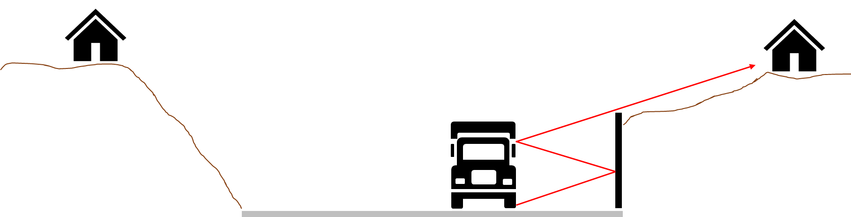
Noise Benefit
10 dB or more, vehicle max pass-by levels 1-6 dB overall noise (L_{Aeq})
Truck restrictions
TNM emission level differences between heavy trucks (HTs) and automobiles
  HTs about 9-10 dB higher for highway speeds
  HTs about 11-14 dB higher for local road speeds
  Removing HTs reduces pass-by noise substantially
TNM traffic noise predictions with 10% HTs removed
  Reduces highway noise about 3 dB
  Reduces local road noise about 6 dB
Possible to apply to nighttime only to reduce sleep disturbance (may affect daytime traffic, though)

Slide 53
Sound Absorptive Treatment on Structures
Retaining walls
Understructure of bridges
Tunnels
Other applications

Slide 54
Sound absorptive treatment on structures
Strategy | Noise Benefit | Costs ($-$$$$$) | Context Appropriateness
Treatment on retaining walls | 1-2 dB for opposite side reflections Predicted up to 2.5 for parallel barriers and up to 4 dB for truck/barrier reflections | $-$$$ | Where retaining walls can reflect noise to sensitive receptors
Treatment on bridge understructures | Measured up to 6 dB for highway and 11 dB in lab Predicted up to 4 dB for sound absorptive treatment | $$-$$$$ | Elevated highway bridge structures or those over depressed highways where reflections can affect sensitive receptors
Treatment in tunnels | Measured 5-10 dB for sound absorptive treatment Predicted 4 dB for surface roughening | $$-$$$$ | Highway tunnels where reflections can affect sensitive receptors
Other structure applications | Engineered products: Helmholtz resonators or metamaterials – can be tuned to optimize traffic noise reduction Considerations: curvature of a wall – avoid focusing sound; application to safety barriers Green wall systems on walls and rooftops can reduce reflections | -- | Locations where structure surfaces can reflect noise

Slide 55
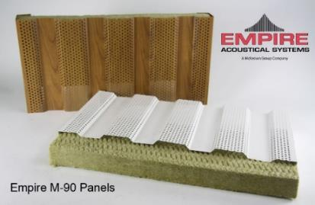
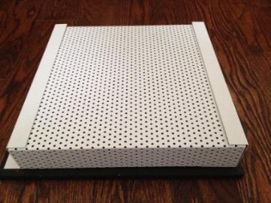


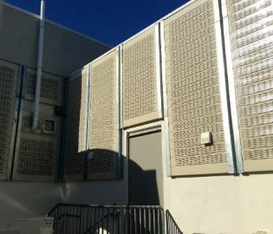
Reflections and absorptive treatment
Reflections of sound at a structure interface can increase noise at a receptor
  Substantial increase if direct noise is shielded
Sound absorptive treatment
  Can benefit receptors on one or both sides of a roadway
  Reduces magnitude of sound energy: as sound travels through the material, the sound waves change direction and follow a longer path, decreasing the energy
  Example sound absorptive material, Noise Reduction Coefficient (NRC) values of 0.7 – 1
Notes:
Manufacturers for photos: Empire M-90 panels, Sound Fighter RetroSorb, AIL Silent Protector, Concrete Solutions SoundSorb, Durisol precast acoustic facings

Slide 56
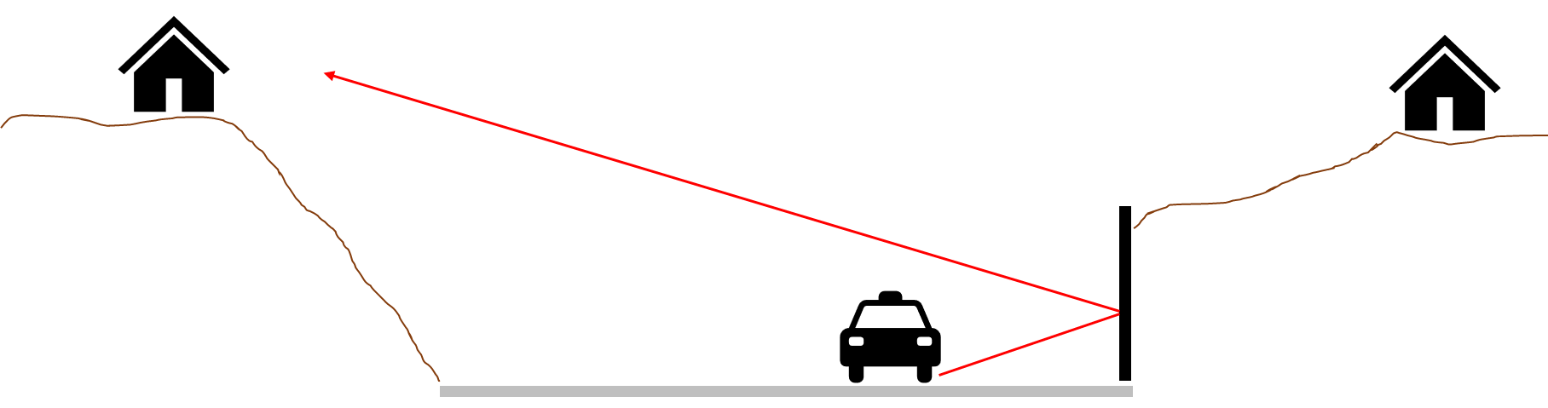
Noise Benefit
1-2 dB for opposite side reflections Predicted up to 2.5 for parallel barriers and up to 4 dB for truck/barrier reflections
Retaining walls
Treatment helps with multiple or single reflections for depressed parallel walls or single wall
TNM analysis showed parallel barrier analysis provided an accurate estimate of reflected noise and sound absorptive material
Percent coverage and placement is dependent on site
NCHRP Research Report 886 showed treatment can …
  Reduce reflected noise magnitude
  Minimize elevation of background noise (L90, L99)
  May reduce adverse sound wave interaction effects (comb-filtering effect)

Slide 57
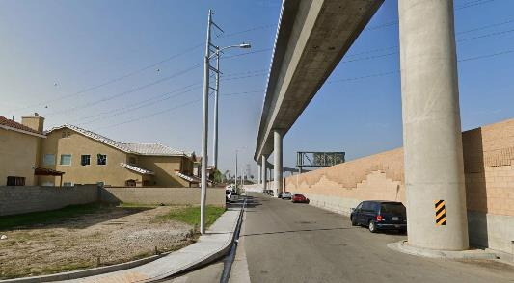
Noise Benefit
Measured up to 6 dB for highway and 11 dB in lab Predicted up to 4 dB for sound absorptive treatment
Understructure of bridges
Sound absorptive treatment on bridge substructures most effective when direct line-of-site blocked
Steel bridge structure: low frequency vibration dampers can help reduce noise
Depressed road: reflections from overpass best controlled by understructure treatment and sound absorptive pavement
Image: ©2021 Google

Slide 58

Noise Benefit
Measured 5-10 dB for sound absorptive treatment Predicted 4 dB for surface roughening
Tunnels
Noise propagates out from tunnel opening
Absorptive treatment effectiveness dependent on …
  Tunnel/receptor geometry
    Angle to tunnel axis: greater angle + greater length of treatment = greater noise reduction (limit to reduction past 45 degrees)
  Cross-section size of tunnel (minor effect)
  Skewing the opening (minor effect)
  Trumpet form opening (strong effect)
    Directs sound in direction of tunnel axis, decreases other directions

Slide 59
Implementations by Receptors or Local Governments
Site planning
Building design
Construction methods

Slide 60
Implementations by Receptors or Local Governments
Strategy | Noise Benefit | Costs ($-$$$$$) | Context Appropriateness
Site Planning | Up to 3 dB reduction when distance to roadway is doubled 10 dB+ reduction when non-sensitive buildings shield sensitive areas | $ when considered early | New development
Building Design | Up to 13 dB reduction by placing the sensitive rooms farthest from the highway | $ when considered early | New development or redevelopment
Construction Methods | Up to 35 dB interior reduction because of construction methods and materials | $$-$$$$ | New development or redevelopment
Strategies are not directly implementable by state DOTs
Property owners and land developers depend upon local government to provide guidance
State DOTs may be asked to assist local government

Slide 61
Guidance and references
The Audible Landscape: A Manual for Highway Noise and Land Noise and Land Use (FHWA 1974)
Growing Neighborhoods in Growing Corridors: Land Use Planning for Highway Noise (Montana DOT 2008)
Entering the Quiet Zone – Noise Compatible Land Use Planning (Texas Southern University 2002)
Clark County Nevada Building Department
  http://clarkcounty-nv.elaws.us/code/coor_title22_ch22.22

Slide 62
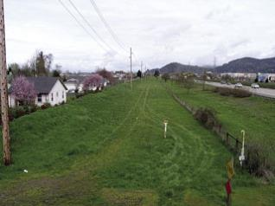
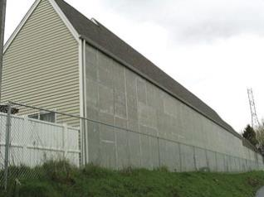
Guidance and references
Land uses:
  Identify noise compatible land uses and noise sensitive land uses
    Includes using noise contours to position these land uses
  Place less noise-sensitive land uses next to highways including retail stores, warehouses, industrial operations, agriculture, and mining
Site planning: reduce noise impacts by utilizing natural terrain, open space, and building placement to shield noise-sensitive areas
Building design: consider highway noise when developing room layout, window placement, balcony, or open space
Construction methods: consider noise transmission through walls, windows, doors, ceilings, and floors
FHWA Noise Compatible Land Use Planning

Slide 63
Application of Findings

Slide 64
Choosing a Strategy
Process starts with consideration of context appropriateness, considering roadway configuration and other elements:
  Noise source / path / receptor geometry
  General site ground type
  Other site-specific considerations
Will there be limitations/advantages for strategies due to …
  The defined project area? (e.g., consider ROW width, water table, strategies that may already be included as part of design)
  The general site parameters? (e.g., consider site ground type, % heavy trucks)
  The receptor locations? (e.g., consider receptor elevation in relation to vehicle noise source elevations)
Process continues with desired noise reduction and cost
  Certain strategies may be eliminated, although combinations of strategies could be explored

Slide 65
Practitioner’s Handbook
Procedural screening of alternate noise reduction strategies
Four-step process
  Determine appropriate roadway type for your highway project
  Review Roadway Type vs Strategy Matrix to extract eligible strategies (includes relative costs)
  Read through overviews of eligible strategies to refine selection
  Use flowchart for each strategy of interest to determine the approximate maximum potential noise reduction
Prior to recommending any strategy for implementation, practitioner must consider policy implications and conduct site specific investigations to more accurately predict noise reduction

Slide 66
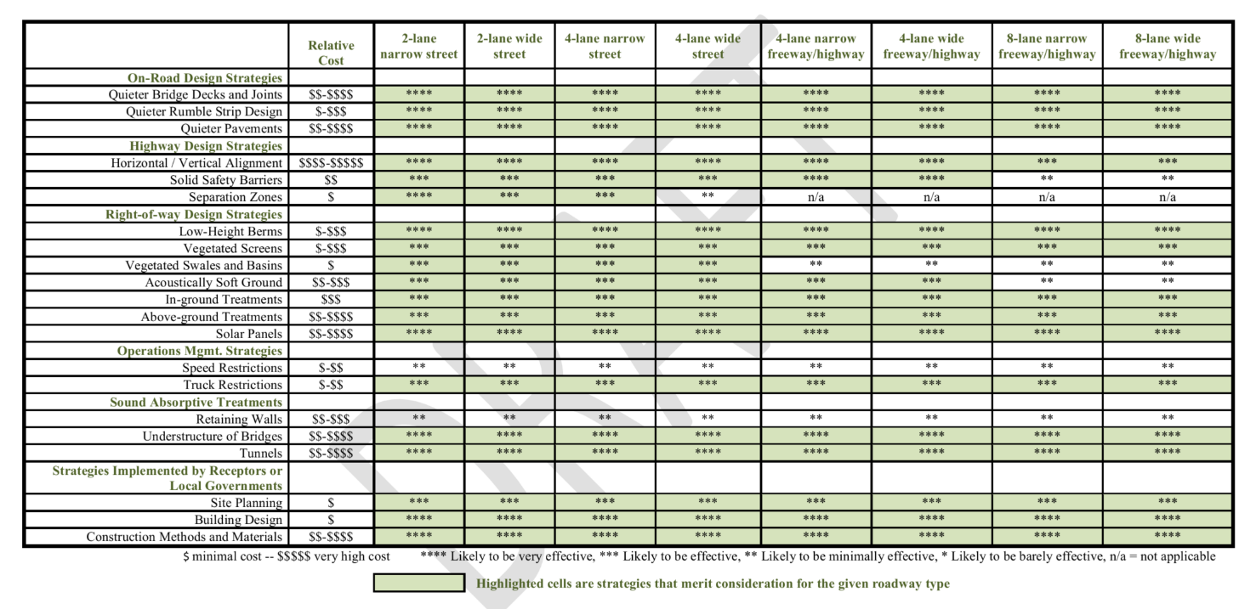
Roadway Type vs Strategy Matrix (Step 2)

Slide 67
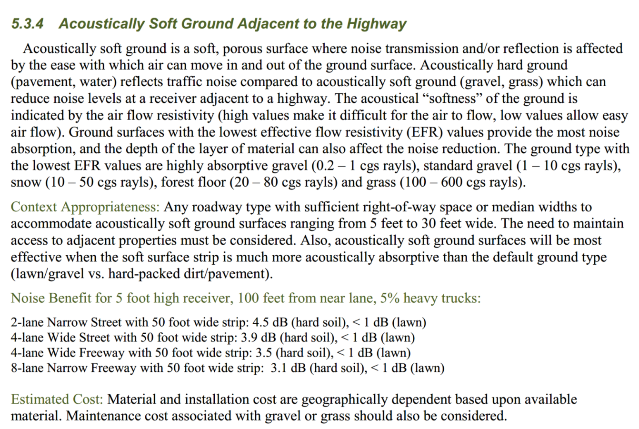
Example strategy overview (Step 3)

Slide 68
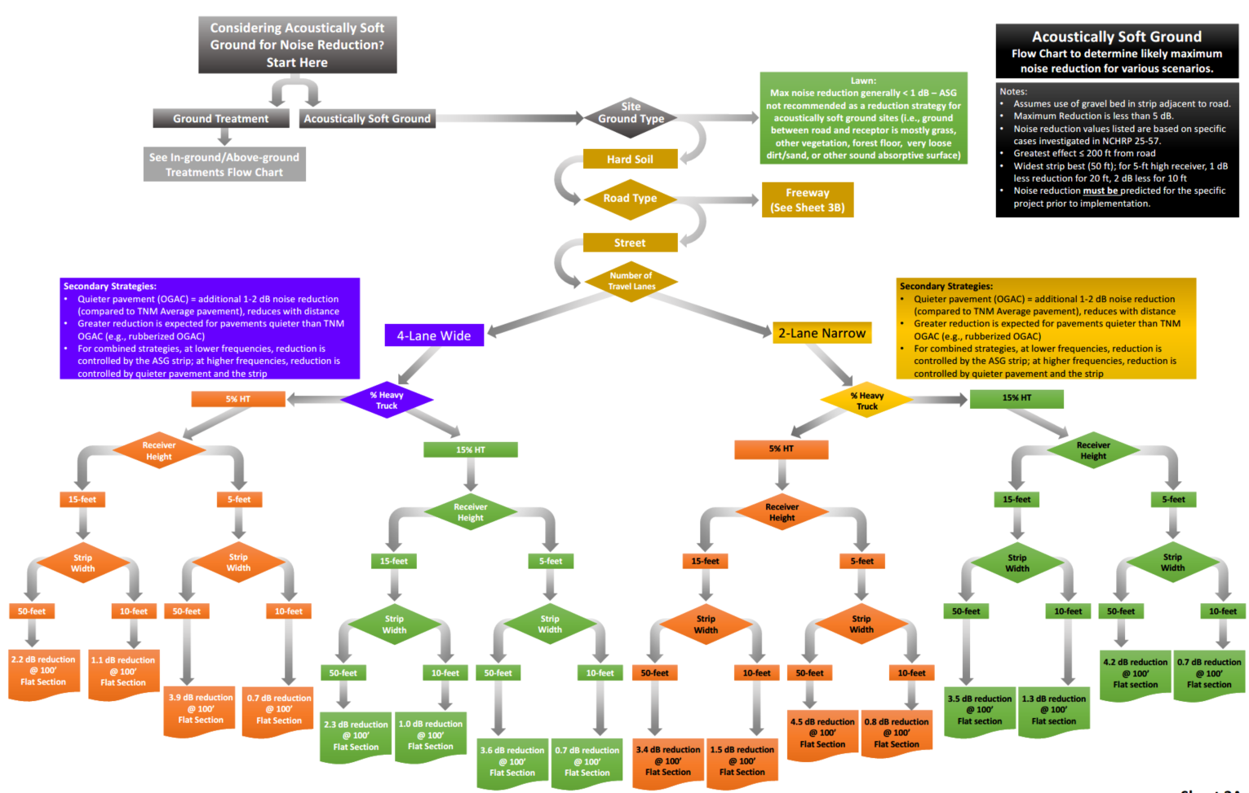
Example flowchart (Step 4)

Slide 69
Conclusions

Slide 70
Conclusions
Opportunities to apply alternative noise reduction strategies include:
  When a barrier cannot be constructed due to site constraints, safety considerations, or federal and state policies on reasonable expenditure per benefited receptor
  When applying the strategies may prevent noise impacts
Project report and practitioner’s handbook allow identification of viable strategies
  Options include 14 primary strategies with sub-strategies also discussed
Some strategies are currently implementable, some require further investigation

Slide 71
Suggested Research

Slide 72
Suggested Research – 6 promising research topics
Effectiveness of low barriers to reduce noise generated by different types of highway vehicles
  Includes consideration of berms and safety barriers with diffractor top
  Includes field measurements
Effectiveness of solar panels to reduce highway traffic noise
  Includes consideration of number of rows, spacing, height, and angles
  Includes field measurements
Effectiveness of gravel in ROW to reduce highway traffic noise
  Includes consideration of realistic implementation
  Includes field measurements

Slide 73
Suggested Research – 6 promising research topics
Effectiveness of vegetated screens to reduce highway traffic noise and when to include effects in modeling
  Includes consideration of width, density, climate
  Includes measurements and modeling
Effectiveness of in-ground treatments to reduce highway traffic noise
  Includes consideration of drivable structures and related safety and maintenance, also innovative designs (lattice, porous panel, etc.)
  Includes modeling and possibly measurements
Effectiveness of absorptive treatment on a bridge understructure to reduce highway traffic noise
  Includes consideration of elevated bridge and bridge over depressed road
  Includes modeling

Slide 74
For More Information
About NCHRP 25-57 Visit: https://apps.trb.org/cmsfeed/TRBNetProjectDisplay.asp?ProjectID=4587

