Slide 1
NCHRP 19-15: Guidebook for Effective Policies and Practices for Managing Surface Transportation Debt
March 2021

Slide 2
Presentation Contents
Guidebook Background & Application
Guidebook Contents
Types of Information
Phases of Debt Issuance & Management

Slide 3
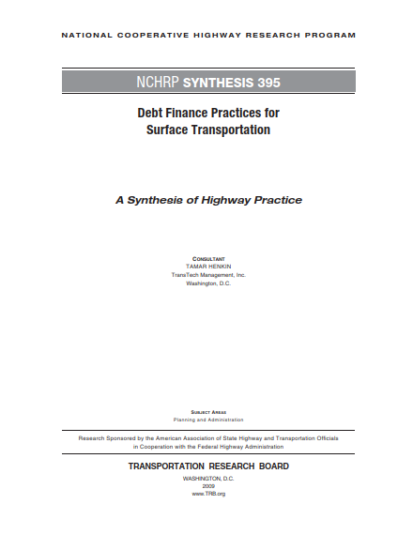
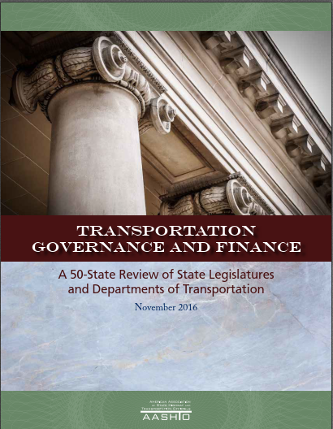
Study Need
Past studies suggested that debt-financing practitioners need guidance on strategic and day-to-day decision-making
Notes:
Past studies and the state of the surface transportation field called for research and guidance on the practices that debt financing practitioners can adopt to improve the issuance and management of debt to effectively meet state/agency surface transportation goals.

Slide 4
Purpose
Share effective user-focused practices for debt issuance and management to help practitioners address key challenges, including:
1. Accessing complete information about the entity’s comprehensive debt obligations
2. Planning for economic uncertainty
3. Adapting to technological advancements

Slide 5
Guidebook Audience
The Guidebook is a useful resource for a variety of audiences, including:
Surface transportation debt managers & staff
Surface transportation executives
Surface transportation project managers & planning professionals
Centralized debt management staff (e.g., division of bond finance staff)
State treasurer’s office staff
Legislative and elected official aides

Slide 6
When and how to use the Guidebook
Useful to practitioners when...
Conducting day-to-day activities
Establishing a new debt program
Developing or updating policies and procedures
Engaging with outside professionals and credit rating agencies
Useful to practitioners to...
Inform and establish internal policies and procedures
Establish regular communication with:
Internal collaborators, such as the state treasurer’s office
External collaborators, such as Credit Rating Agencies, etc.
Inform development of relevant debt documents

Slide 7
Guidebook Contents
Types of Information
Practices Reflected
Universal Effective Practices
Tailored Effective Practices
Debt Issuance & Management Phases
Tools
Collaboration & Communication
Phase of Debt Issuance & Management
Phase 1: The Decision Process – Planning for Debt Issuance
Phase 2: Individual Transaction Preparation & Development
Phase 3: Marketing & Placement of Individual Transactions
Phase 4: Post-Issuance Compliance Strategy

Slide 8
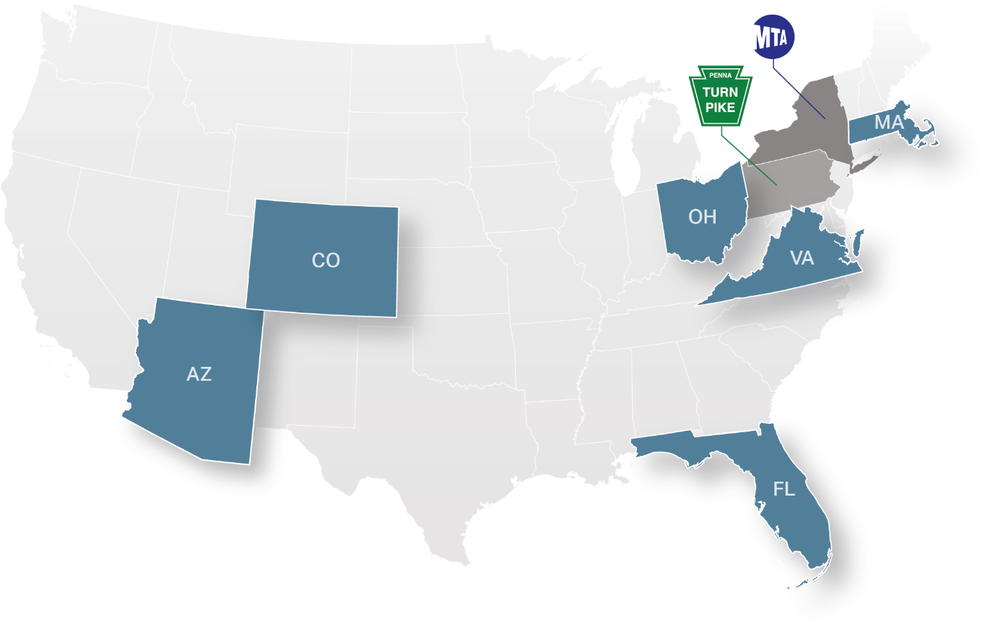
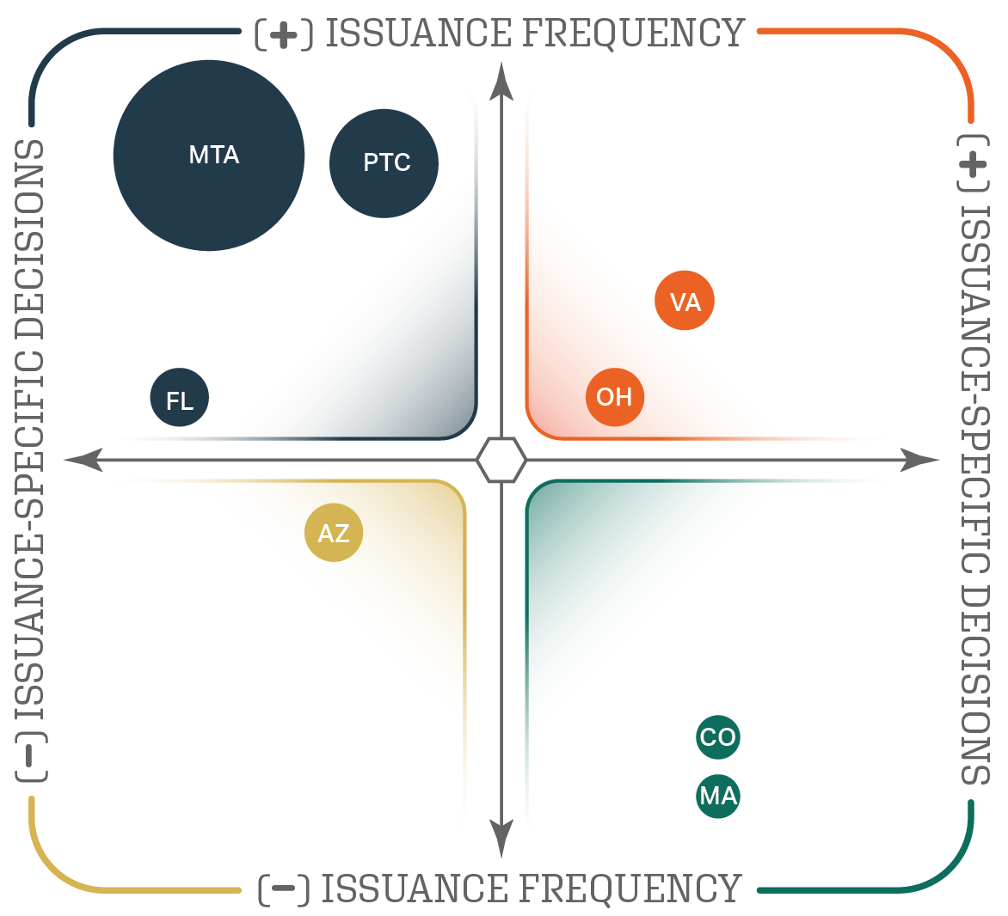
Practices Reflected
Guidebook reflects geographic and programmatic diversity through case studies

Slide 9
Organizing Framework
Guidebook presents effective high-level decision-making approaches, process and coordination practices, and tools for debt financing practitioners
 | High-level decision making and approaches to debt issuance and management.
 | Process, communication, and coordination
 | Effective tools

Slide 10
Universal Effective Practices
Several practices are effective in each debt issuance and management phase for most issuers:
Communicating frequently within and amongst relevant agencies
Utilizing outside professionals at key decision points
Aligning debt issuances and strategy with state surface transportation priorities
Establishing clear policies and procedures that support consistent approaches to key debt management responsibilities and tasks
Allocating resources appropriately for debt issuances and post-issuance compliance

Slide 11
Tailored Effective Practices
Debt programs vary greatly, meaning effective practices will differ from issuer to issuer, and from sale to sale, which is highlighted throughout the Guidebook.
Differences in Engaging with Credit Rating Agencies
Pennsylvania Turnpike | COLORADO
Regular communication One-on-one meetings with agencies at least once per year Regularly disclose up-to-date financial information to CRAs | Communication usually primarily occurs before an issuance Provide project/issuance-specific presentations to CRAs at this time Dedicate time prior to an issuance to educate the CRAs on the project to provide for best credit rating

Slide 12
Debt Issuance & Management Phases
The Guidebook provides guidance and examples for all phases of the debt issuance and management process
Phases of Debt Issuance and Management

Slide 13
Phase 1: The Decision Process – Planning for Debt Issuance
Key findings:
Debt affordability studies are effective for strategic debt management and intra/inter-agency communication
Debt policies are effective for organizing a debt program
Debt strategies can be understood on a spectrum ranging from programmatic to project-driven approaches
Market analysis and support from outside professionals can help programs evolve and improve over time
Key Components of Debt Affordability Study
Notes:
Sub-sections:
How to determine the need to issue debt.
How to develop guiding policies and tools that consider statutory and regulatory parameters and constraints
How the various types of surface transportation debt may be aligned with surface transportation priorities and policies to establish an approach to debt issuance
How to incorporate iterative learning and strategy enhancement, including market analysis

Slide 14
Phase 2: Individual Transaction Preparation & Development
Collaborative Analyses for Project-Specific Decision-Making (Virginia)
Key findings:
Collaboration, debt calendars and other information sharing tools like databases, and web-based forecasting tools are effective for determining the timing & amount of the issuance
Support from outside professionals is critical to effective debt management
Approaches for engaging with credit rating agencies differ based on issuance frequency
Notes:
Sub-sections:
How to develop a bond pricing strategy.
Strategies for marketing individual transactions.
Closing requirements and guidelines.

Slide 15
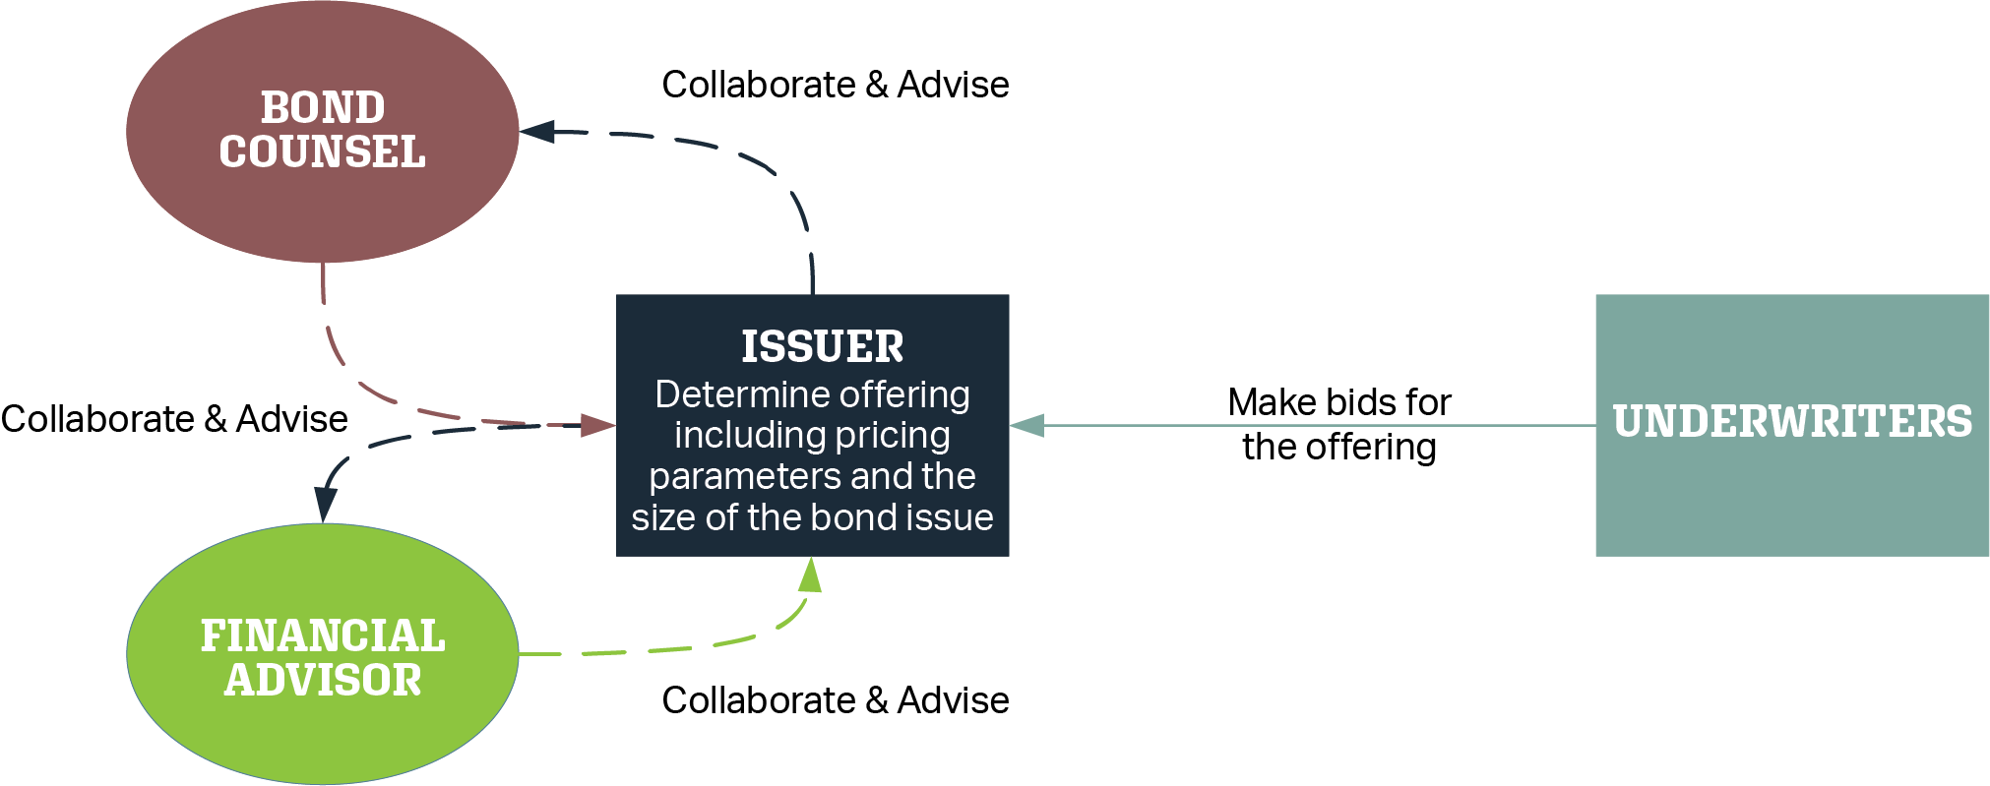
Phase 3: Marketing & Placement of Individual Transactions
Key findings:
Outside professionals, including bond counsel, rating agencies, auditors, etc. can help inform a bond pricing strategy
Presentations, roadshows, and investor webpages are effective tools to market individual transactions
Effectively tracking issuance information via templates and checklists can help issuers to successfully meet closing requirements
Competitive Sale Overview
Notes:
Sub-sections:
How to develop a bond pricing strategy.
Strategies for marketing individual transactions.
Closing requirements and guidelines.

Slide 16
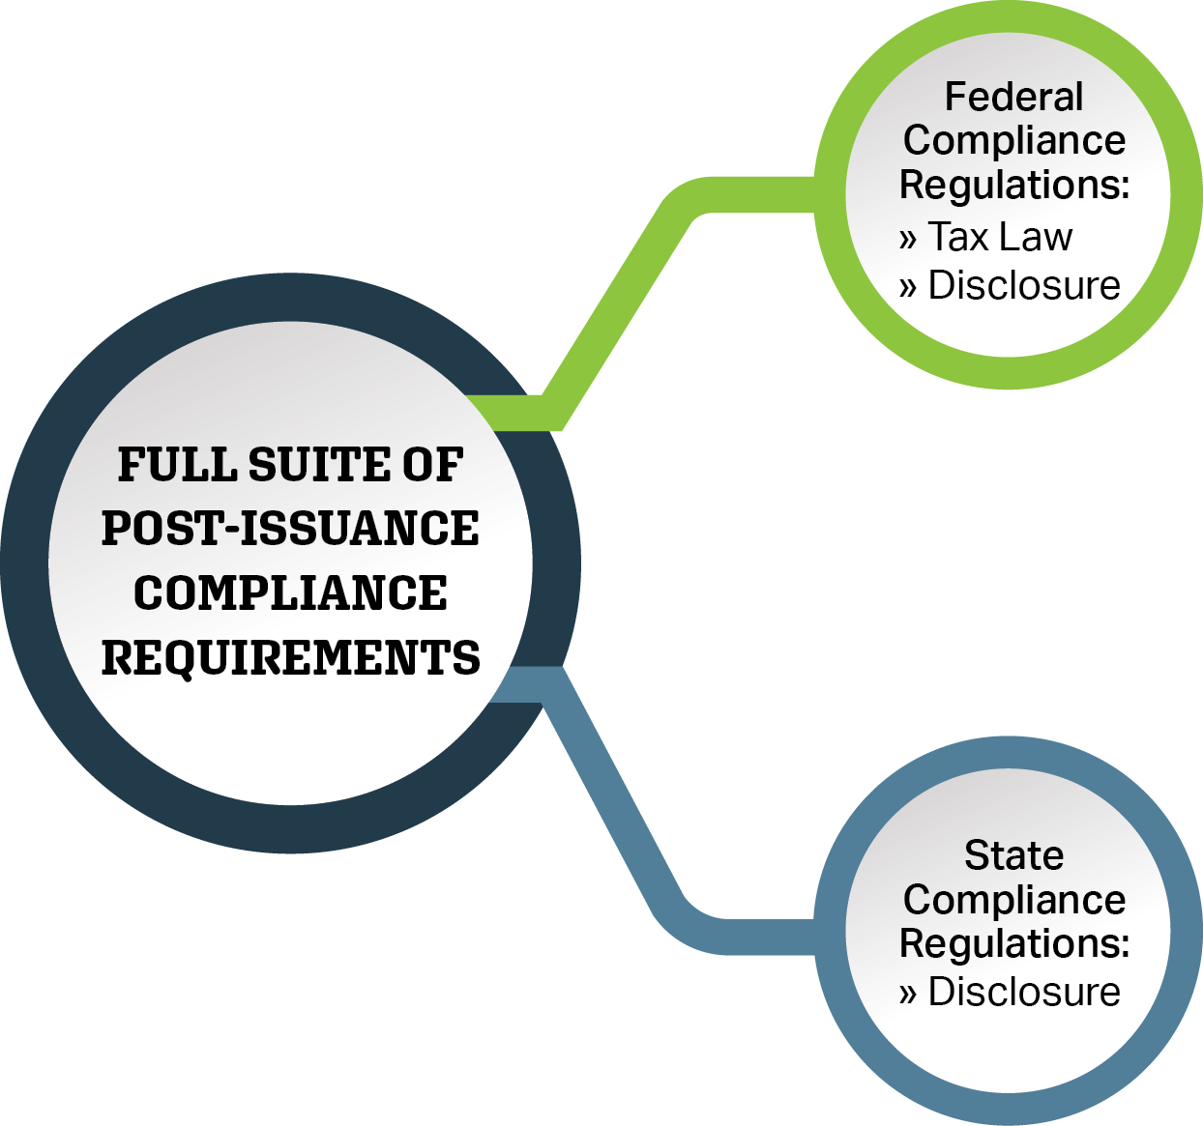
Phase 4: Post-Issuance Compliance Strategy
Key findings:
Collaboration and communication are essential to successfully meeting post-issuance requirements
Post-issuance compliance policies and procedures and leveraging outside professionals can help streamline the process
Excel-based tools, a dissemination agent, and databases can help agencies to track post-issuance compliance data
Federal & State Law Compliance Requirements
Notes:
Sub-sections:
Post-issuance compliance requirements.
Variation in structure in managing post-issuance requirements.
Capacity and resources to manage post-issuance compliance requirements.
Strategies to track and adjust to changes.
How to establish a repeatable and reliable process.

Slide 17
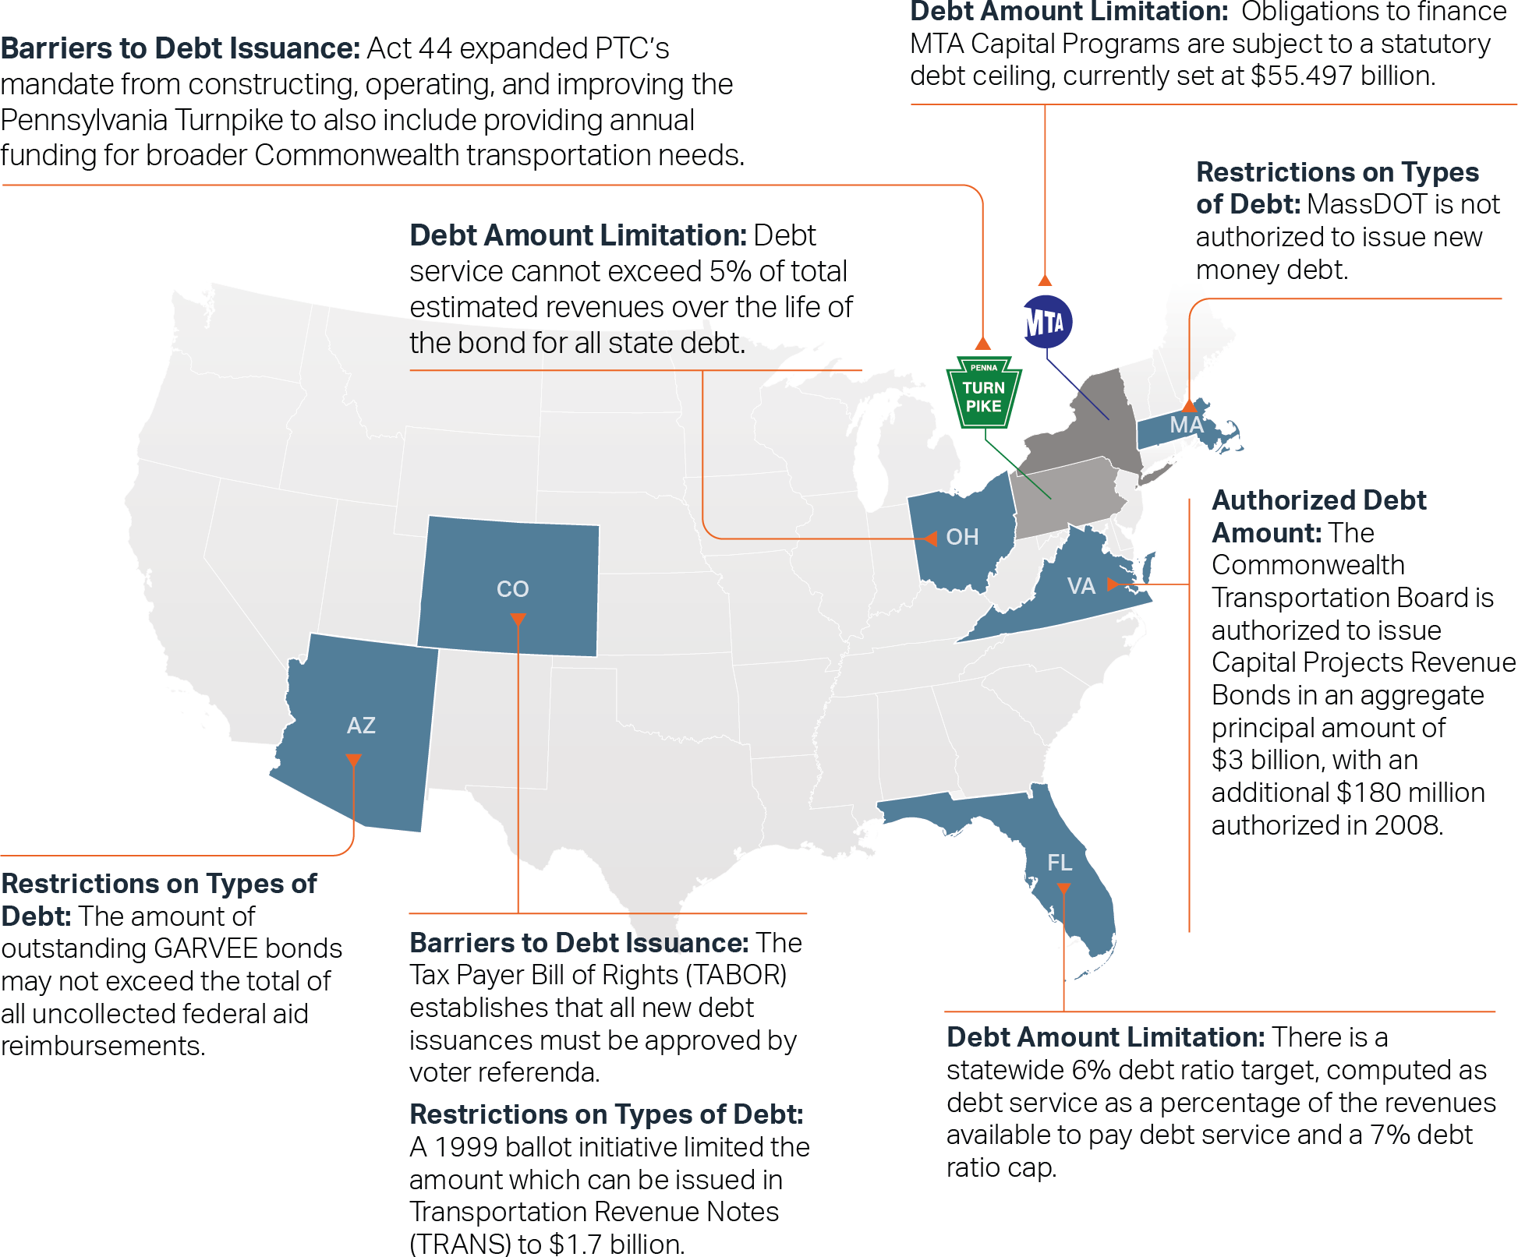
Examines Diversity of Practices
Analyzes differences across agencies (e.g., debt restrictions)

Slide 18
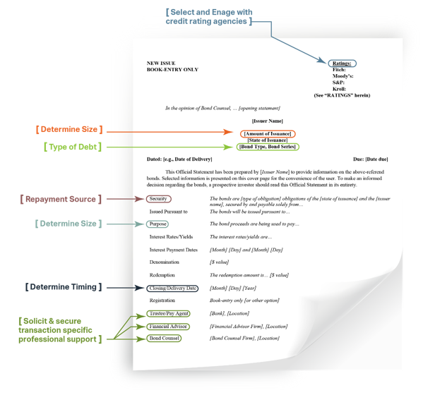
Summarizes Key Decision Points
Preliminary OS & Key Decision Points
Highlights key decision points during the issuance process that supports the facts relayed in the official statement (OS)

Slide 19
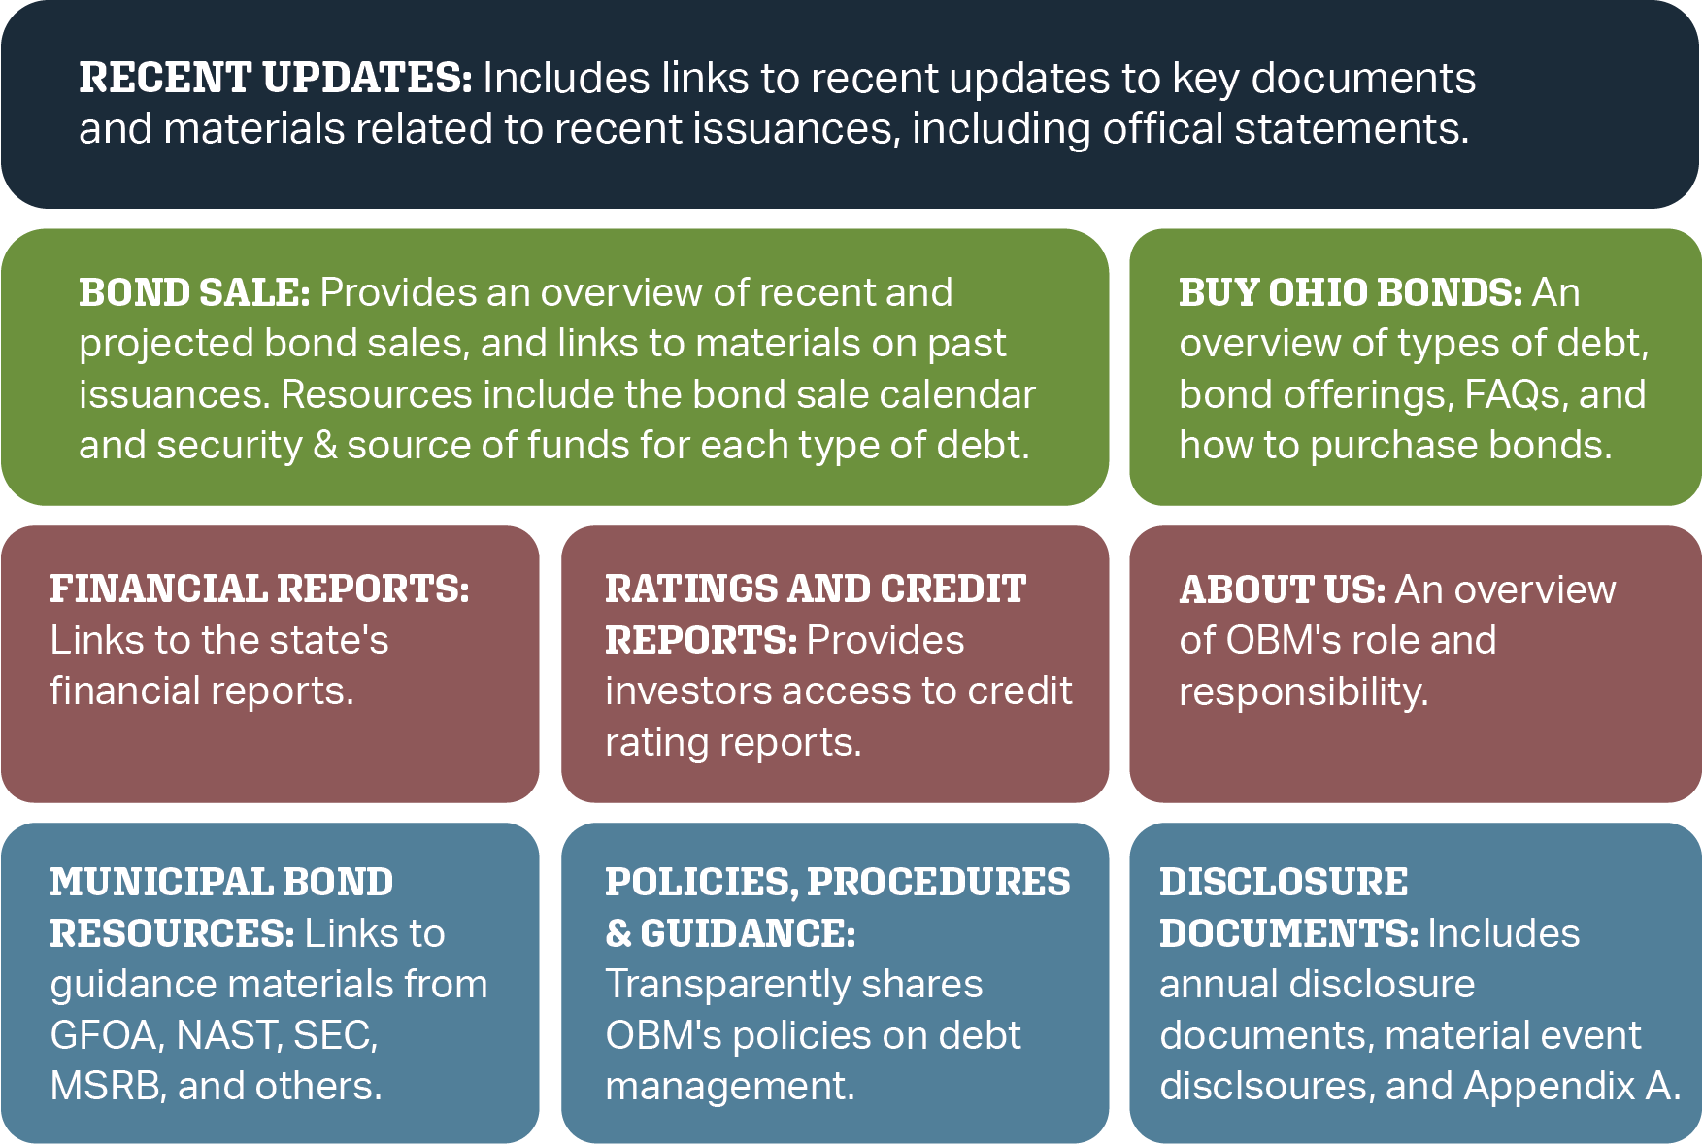
Highlights Best Practices
Ohio’s Investor Relations Page
Identifies examples of effective investor relations websites

Slide 20
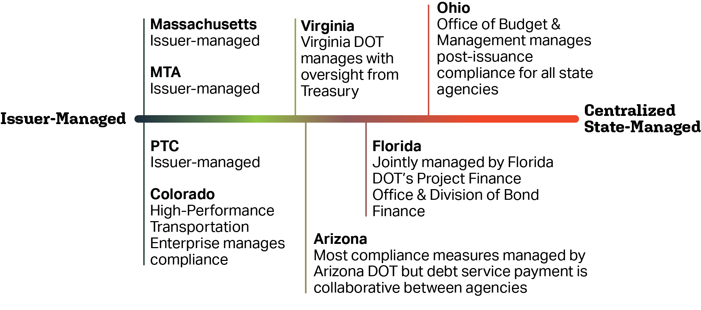
Demonstrates a Range of Approaches
Describes a spectrum of management approaches for post-issuance compliance requirements

Slide 21
Conclusion
Guidebook helps surface transportation debt issuers:
Understand roles and responsibilities of various national institutions with jurisdiction over municipal finance
Reflect on diversity of debt issuance programs and identify how their specific program fits within this landscape
Identify effective practices to maintain complete information about comprehensive debt obligations and plan for economic uncertainty.

Slide 22
NCHRP 19-15 Principal Investigator
Nathan M. Macek, AICP Senior Vice President Director of Project Development & Finance
WSP USA
1250 23rd Street NW Washington, DC 20037
Ph. +1 (202) 365-2927 Nathan.Macek@wsp.com wsp.com

