Slide 1
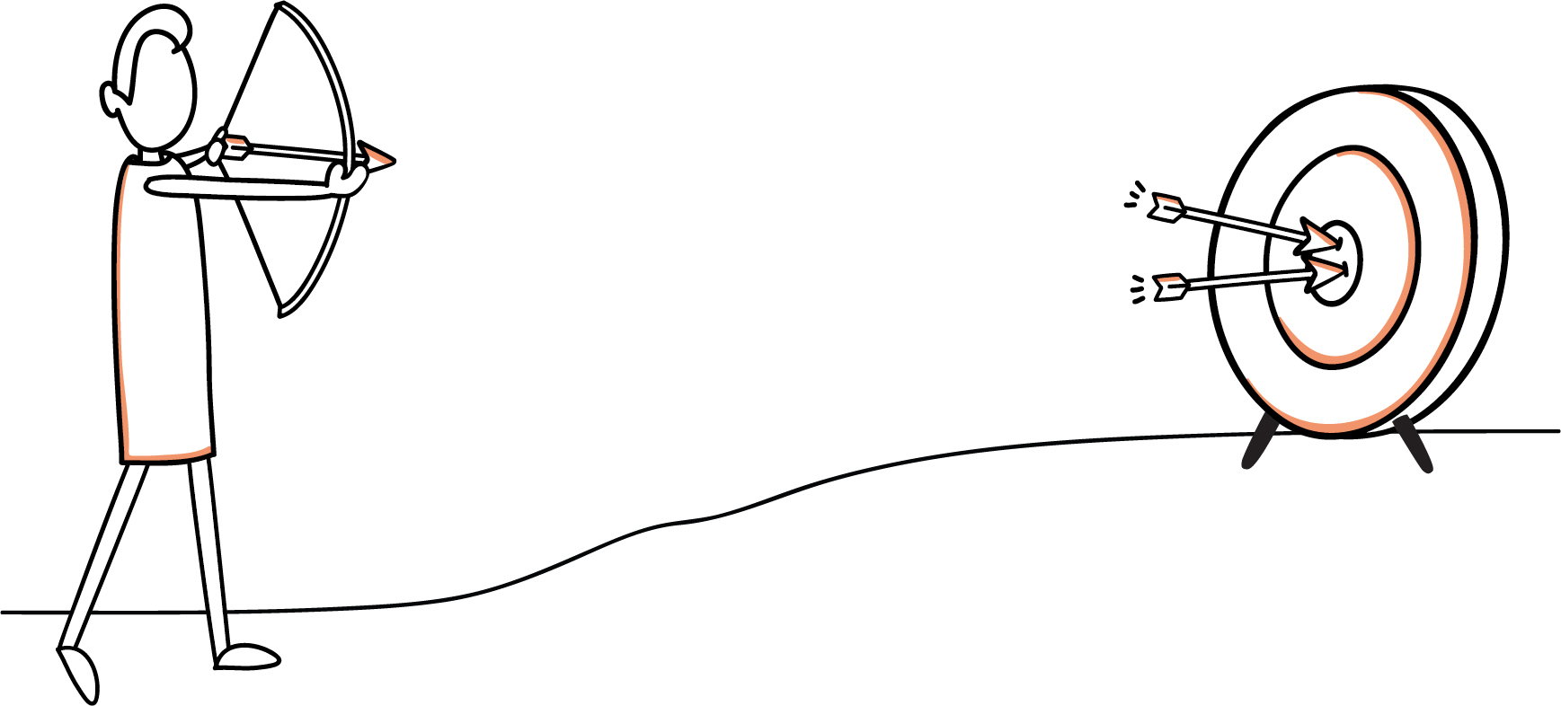
Making Targets Matter
Managing Performance to Enhance Decision-Making
NCHRP Project 02-27

Slide 2
This presentation was developed by High Street Consulting Group and ICF International under National Cooperative Highway Research Program (NCHRP) Project 02-27. More information about this topic can be found in NCHRP Research Report 993: Managing Performance to Enhance Decision-Making: Making Targets Matter, available on the National Academies Press website (www.nap.edu).
NCHRP is sponsored by the individual state departments of transportation of the American Association of State Highway and Transportation Officials. NCHRP is administered by the Transportation Research Board (TRB), part of the National Academies of Sciences, Engineering, and Medicine, under a cooperative agreement with the Federal Highway Administration (FHWA). Any opinions and conclusions expressed or implied in resulting research products are those of the individuals and organizations who performed the research and are not necessarily those of TRB; the National Academies of Sciences, Engineering, and Medicine; FHWA; or NCHRP sponsors.

Slide 3
Major Research Components
1
Practice Review & Survey
149 Respondents
2
Peer Exchanges
45 Participants
3
In-Depth Interviews
11 Interviewees

Slide 4
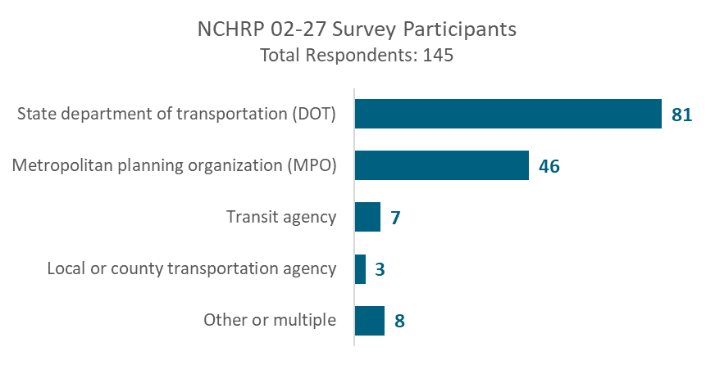
Practice Review: Survey on Monitoring & Adjustment

Slide 5
Peer Exchanges
Date | City | Host
10/10/2019 | St. Louis | East-West Gateway
10/21/2019 | Baltimore | AMPO Conference
11/13/2019 | Atlanta | Atlanta Regional Council
11/19/2019 | Salt Lake City | Wasatch Front Regional Council

Slide 6
Case Study Interviews
Wasatch Front Regional Council Deputy Director | Maricopa Association of Governments Performance Manager
Iowa DOT Strategic Management | Arizona DOT Asset Manager
Virginia DOT HSIP Planning Manager Asst. State Traffic Engineer | Nebraska DOT Performance Manager Lean Manager Business Analytics Chief Strategy Officer
Virginia Office of Intermodal Planning and Investment Program Manager Analyst | Washington Metropolitan Area Transit Authority Performance Manager

Slide 7
What does it mean to ‘Make Targets Matter’?

Slide 8
Targets drive decisions

Slide 9
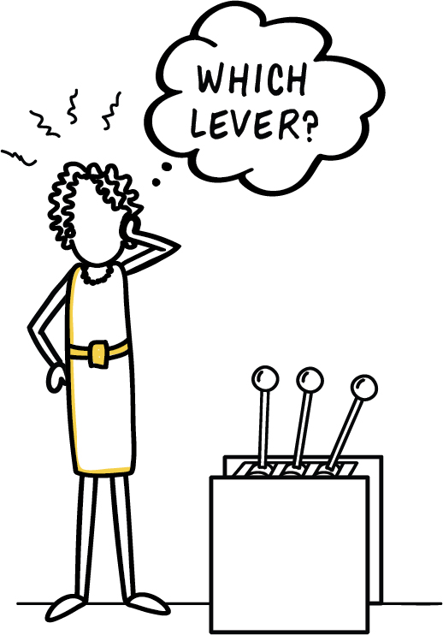
How do you find out which actions will meet targets?

Slide 10
Feedback

Slide 11
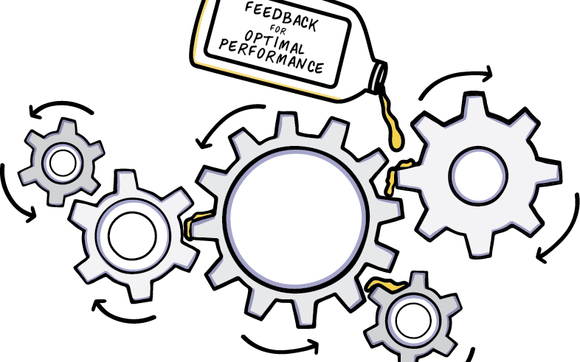
Feedback Optimizes Performance

Slide 12
NCHRP 02-27 Project Thesis
More accurate and more frequent feedback from the people and data that experience the transportation network can help agencies make decisions and take actions that improve performance and meet targets.

Slide 13
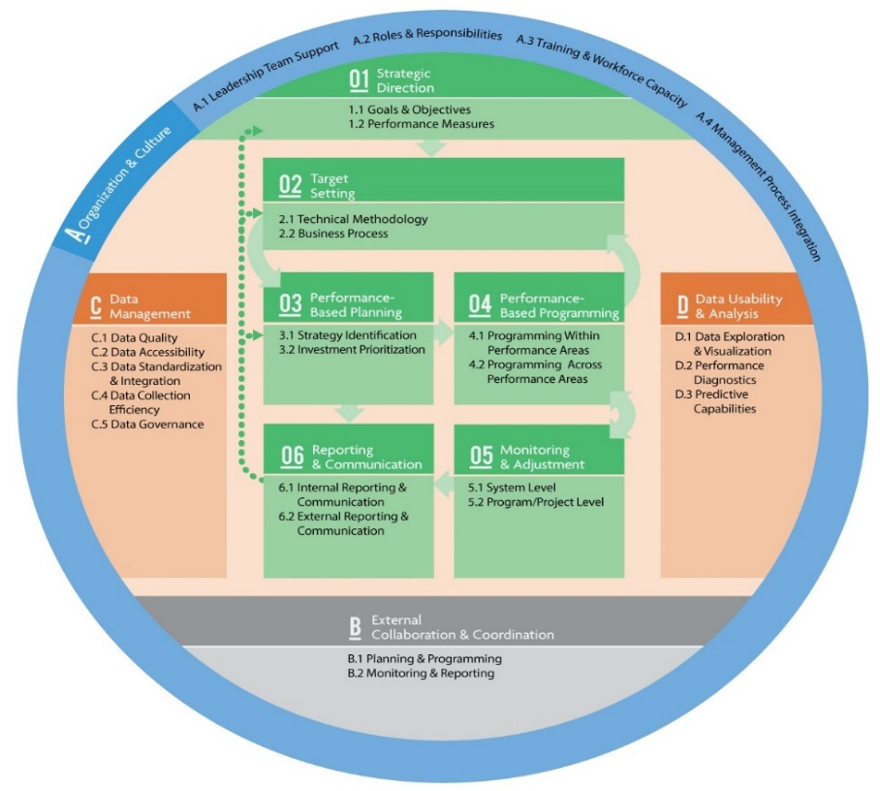
Rooted In Existing Frameworks
Transportation Performance Management (TPM)
Performance-Based Planning and Programming (PBPP)

Slide 14
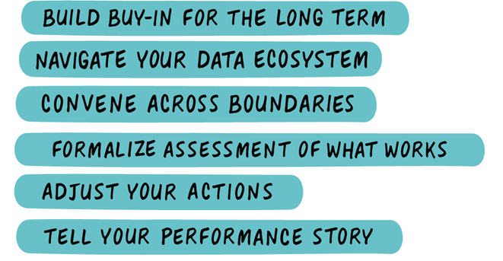
Major Results
Feedback Framework
Strategies for Better Feedback
Case Studies of Feedback in Action

Slide 15
What Is Feedback?

Slide 16
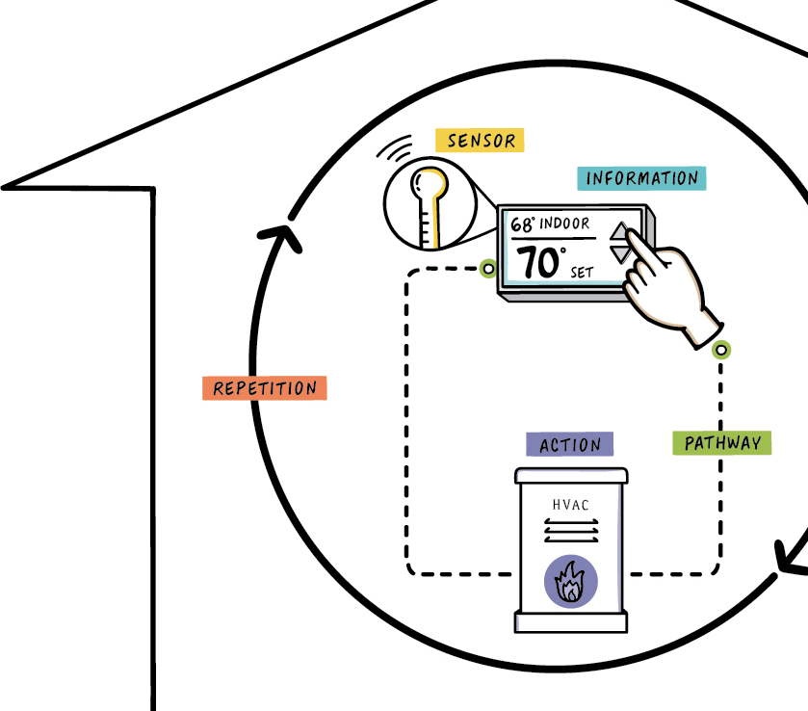
A simple feedback example:
Your Home Heating System

Slide 17
Information
Pathways
Action
Elements of Feedback
Sensors
Repetition

Slide 18
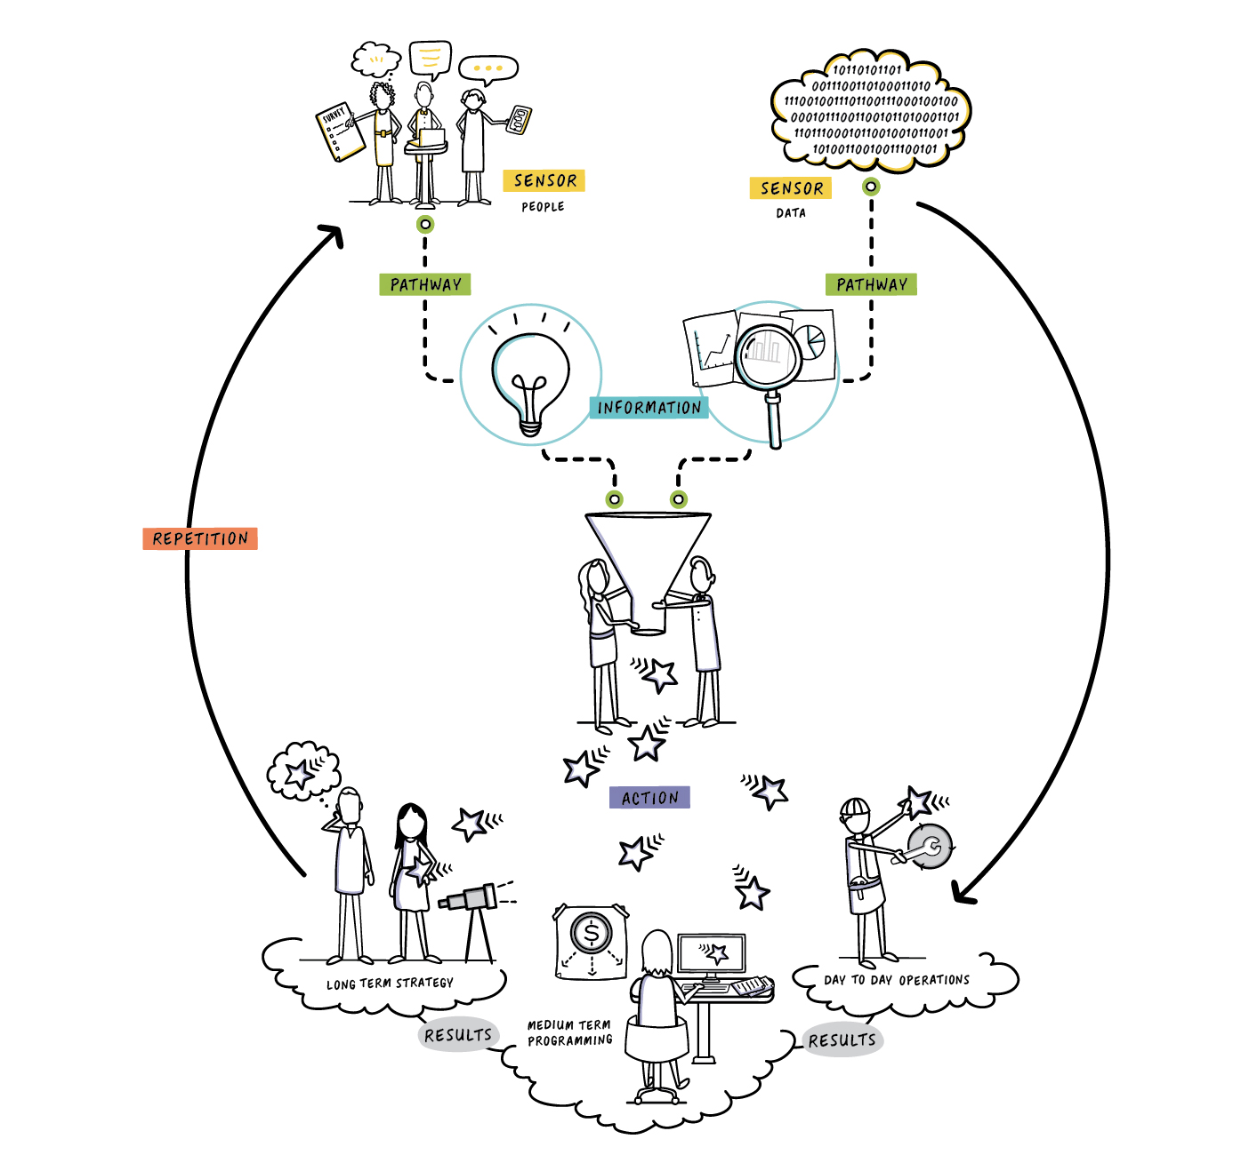
Feedback in a Transportation System

Slide 19
Strategies for Better Feedback

Slide 20
Strategies for Better Feedback
Prepare Your Sensors
Build Buy-In
Navigate Data
Establish Pathways
Convene
Formalize Assessments
Put It to Work
Adjust Actions
Tell Your Story

Slide 21
Prepare Sensors

Slide 22
Notes:
Relationships
Actually listening
Shared vision
Get feedback but also support for initiatives down the road

Slide 23
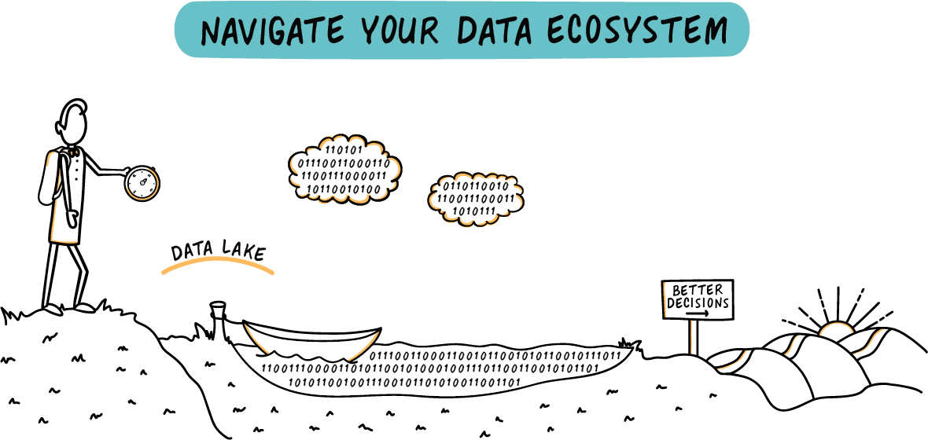
Notes:
Knowing what data is out there
Where it us
How to access it
Conversations with data owners

Slide 24
Establish Pathways

Slide 25
Notes:
Gather people across titles, agencies, boundaries
Visioning or problem-solving
Short frequent conversations

Slide 26
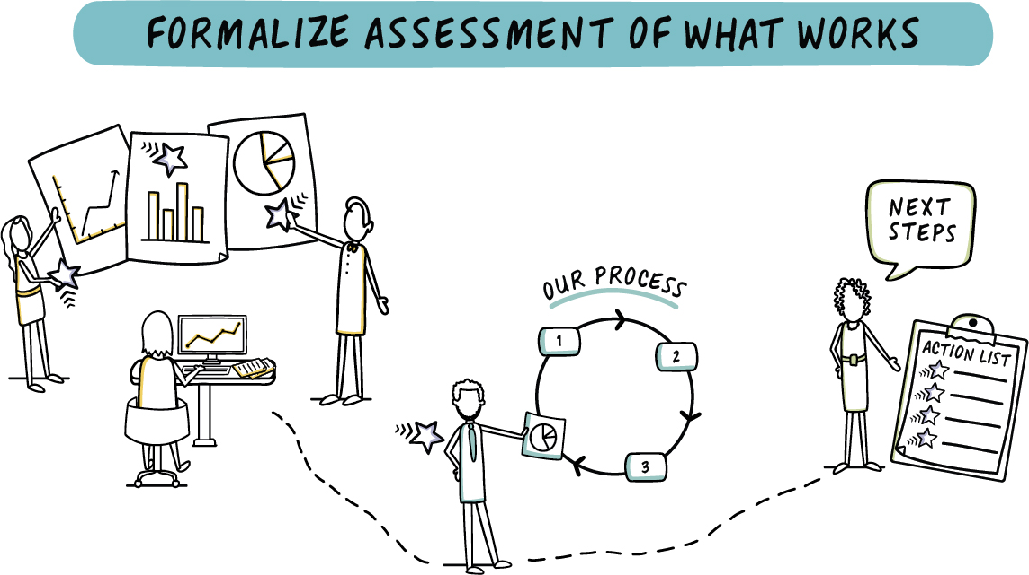
Notes:
Understand analytical options
Align technical and planning conversations
Set assessment points

Slide 27
Put It to Work

Slide 28
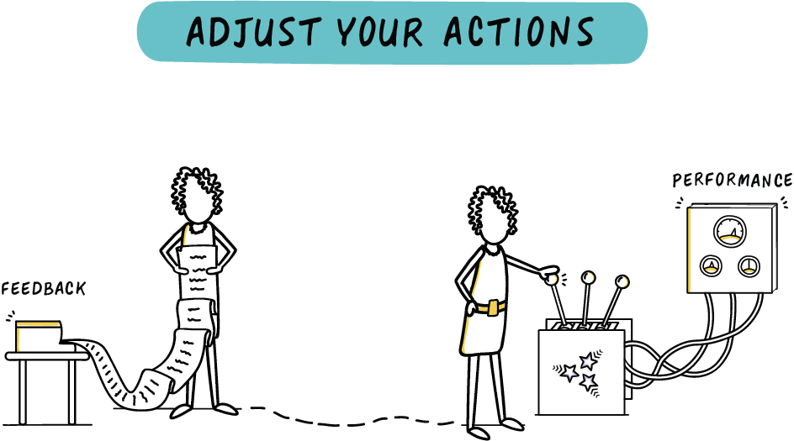
Notes:
Know menu of “adjustment” options
Embrace incrementalism
Seize opportunities as they arise
Just try something!

Slide 29
Notes:
Tell performance truths
Blend data and story
Stories let people “hear” you

Slide 30
Case Studies Span Agency Activities
Long-Term
Planning & Strategy
Medium-Term Programming
Day-to-Day Operations

Slide 31
Six Case Studies of Strategies in Action
Long-Term Strategy
Medium-Term Programming
Day-to-Day Operations
Washington Metro Area Transit Authority (WMATA)
STAT Meetings for Operational Problem Solving
Shared Regional Vision
Needs Assessment Data Tool
Iowa DOT
Strategic Alignment of Performance Measures
Virginia DOT/ OIPI
Safety Investment Policy Analysis
Lean DOTs
Implementation of Lean at DOTs for continuous improvement

Slide 32
Contact Information
For more information about this project or implementation, contact:
Anna Batista
Project Manager
batista@highstreetconsulting.com
Joe Crossett
Principal Investigator
crossett@highstreetconsulting.com
Notes:
Showcase the strategies in case studies

Slide 33
Strategies for Better Feedback
Prepare Sensors
Establish Pathways
Put It to Work
Notes:
Showcase the strategies in case studies

Slide 34
Strategies for Better Feedback
Prepare Sensors
Establish Pathways
Put It to Work
Make connections early.
Allow for a sense of ownership.
Maintain transparency and neutrality.
Listen, and show you are listening.
Build a habit of short, frequent dialogue.
Gather the right people. (Up and down the agency, across boundaries.)
Let discussion flourish.
Time strategically.
Tell performance truths.
Simplify, but not too much.
Blend data and storytelling.
Evolve your story.
Create a data map and wish list.
Automate where possible.
Have early conversations with data owners.
Invite data owners to participate in performance.
Ask for data elements.
Know your analytical options.
Align technical and planning conversations.
Understand the mechanics of your metrics.
Set assessment points.
Start where you are.
Embrace incrementalism.
Institutionalize feedback.
Seize opportunities as they arise.
Just try something!

