Slide 1
NCHRP 25-25/Task 115 (Panel D2525115) Zero Emission Vehicles: Forecasting Fleet Scenarios and their Emissions Implications
November 27, 2019
STI-7205
Notes:
The overall objectives of the NCHRP 25-25 Task 115 project are to understand factors that affect ZEV adoption, and evaluate future electric vehicle fleet changes and the impact on total light-duty vehicle emissions. The work for this project was completed by Louis Berger and Sonoma Technology under the advisement of the project panel and project officer.

Slide 2
Research Agency: Louis Berger U.S. Inc. & Sonoma Technology, Inc. (STI)
Garnet Erdakos, PhD (Principal Investigator, STI)
Shih Ying Chang, PhD (STI)
Douglas Eisinger, PhD (Senior Advisor, STI)
Adrienne Heller, AICP, ENV SP (Louis Berger)
Heather Unger, LEED AP, ENV SP (Louis Berger)
NCHRP Senior Program Officer
Ann M. Hartell, PhD

Slide 3
Author Acknowledgments
Colleen M. Turner, Maryland Department of Transportation
Rick Baker, Eastern Research Group, Inc.
Jeffrey R. Lidicker, California Air Resources Board
Jane Jie Lin, University of Illinois – Chicago
Natalie Ries, Minnesota Department of Transportation
Lubna Shoaib, East West Gateway Council of Government
Benjamin P. VanGessel, U.S. Environmental Protection Agency
John Davies, Federal Highway Administration (Liaison)
Melissa Savage, American Association of State Highway and Transportation Officials (Liaison)
The research team also thanks Dr. Song Bai of the Bay Area Air Quality Management District for his input on the research approach used in this study. In addition, appreciation goes to John Davies of the U.S. Federal Highway Administration, Dr. Zhenhong Lin of the Oak Ridge National Laboratory, and Andrew Breck of the Volpe National Transportation Systems Center, for their assistance regarding use of the MA³T model.

Slide 4
Project Tasks
Task 1: Amplified work plan
Task 2: Brief literature review
Task 3: Develop analysis scenarios
Task 4: Assess emissions reductions
Task 5: Project report
Objective of this webinar: present the activities conducted for NCHRP 25-25 Task 115 and the emission reduction estimates in the analysis scenarios
Notes:
With input from the panel a work plan was developed to accomplish the goals of the Task 115 project (Task 1). The remaining tasks focused on
A review of literature on policies, programs, and other factors affecting ZEV adoption
Development of analysis scenarios used to demonstrate different levels of ZEV adoption given different future policy, consumer, technology, and infrastructure assumptions, considering results from the literature review and assessment of the MA3T model for estimating future ZEV populations
Modeling reduction of light-duty vehicle exhaust emissions using MOVES2014b (the MOtor Vehicle Emission Simulator) and estimated vehicle populations and sales from MA3T.
This webinar summarizes the activities performed for the project and the results and implications of the MA3T and MOVES modeling.

Slide 5
Outline
Key findings from the literature review
Rationale for using the MA³T model
Guiding principles for development and selection of scenarios
ZEV adoption scenarios
Modeled ZEV population increases
Modeled emissions reductions
Implications and future research suggestions
Notes:
This slide shows an overview of what will be presented in this webinar. These items cover work completed in Tasks 2, 3, and 4 of the project.
First, key findings from the literature review (Task 2) will be presented,
An overview of the MA3T model used for estimating ZEV populations for various future ZEV adoption scenarios will be presented along with the rationale for using the model in this project,
The guiding principles for development of the analysis scenarios and the scenarios selected will then be summarized, and
The modeling results for ZEV sales and population increases and corresponding emissions reductions for the analysis scenarios will be summarized.
The webinar will end with a summary of the implications of this study and suggestions for future research.
The MA3T parameters adjusted in each scenario and the assumptions underlying the parameter value adjustments are included in the Supplemental slides.

Slide 6
Brief Literature Review to Support Modeling Scenario Development
Investigated use of the panel-recommended MA³T model and identified key inputs to guide the literature review
Reviewed various resources representing historical data, a variety of forecast resources, consumer preferences, policies, technology, infrastructure, and other topics
Identified key factors affecting adoption of all types of alternative technology vehicles (ATVs): battery electric vehicles (BEV), fuel-cell electric vehicles (FCEV), plug-in hybrid electric vehicles (PHEV), and hybrid electric vehicles (HEV).
Notes:
The structure of the MA³T model, which was used for modeling ZEV populations for emissions analysis, includes infrastructure, policy, technology, and consumer parameters. This structure provided a useful framework for linking policy shifts to ATV adoption, and helped focus the literature review.
MA3T = Market Acceptance of Advanced Automotive Technologies
During the brief literature review, several topic areas were considered:
historical data on ATV market share and projected adoption rates and sales trends
state and local goals for electric vehicle adoption, and the rates of adoption necessary to achieve those goals
how the vehicle fleet will transition
policies and programs understood to affect ATV adoption rates
Much of the literature that was reviewed covered other advanced technology vehicles (ATVs), including hybrid electric vehicles (HEVs) and plug-in hybrid electric vehicles (PHEVs), in addition to ZEVs.

Slide 7
Historical U.S. Sales by Advanced Technology Vehicle Category
ZEVs
Data Source: Alliance of Automobile Manufacturers 2019
Notes:
The Alliance of Automobile Manufacturers, in their Advanced Technology Vehicles Sales Dashboard, has recorded advanced technology vehicle (ATV) sales since 2011, including HEVs, PHEVs, BEVs, and FCEVs.
Between 2011 and 2018, FCEVs had the fastest annual growth among all types of alternative technology vehicles, but accounted for less than one percent of all ATVs sold in 2018. Setting aside FCEVs, BEVs had the highest growth in sales between 2011 and 2018. California leads the nation in terms of total ATV sales. Florida is second, followed by Texas, New York, Illinois, and Washington.
Under this Task 115, ZEVs refers to BEVs and FCEVs, the types of ATVs considered in this project. For ZEVs, California leads in sales between 2011 and 2018, followed by Washington, which had ten times less ZEV sales. Georgia, Florida, and Texas follow Washington in terms of ZEV sales.
ATV sales slumped substantially in 2015. This is likely due to reductions in manufacture incentives, declining gasoline prices, and potential delays in consumer purchases as a result of future electric vehicle releases. These factors are captured within the MA³T forecast of the future vehicle fleet.

Slide 8
Drivers to ATV Adoption
ID | Driver of ATV Adoption | Relative Importance | MA³T Parameter | MA³T Factor
1 | Long Driving Range | High | Yes | Technology
2 | Improved EVSE Infrastructure | High | Yes | Technology, Infrastructure
3 | Purchase Cost Parity with ICEVs (due to federal and state incentives) | High | Yes | Policy, Technology
4 | HOV Lane Access (for large metropolitan area) | High | Yes | Policy
5 | High Vehicle Performance and Reliability | High | No | Not applicable
6 | Lower Fuel (e.g., Electricity) Cost | Medium | Yes | Infrastructure
7 | Free Parking | Medium | Yes | Policy
8 | Environmental Benefits | Low | No | Not applicable
Examples from the literature review: Beacon Economics (2018) The Road Ahead for Zero-Emission Vehicles in California; U.S. Energy Information Administration (2017) Analysis of the Effect of Zero Emission Vehicle Policies: State-Level Incentives and the California Zero-Emission Vehicle Regulations; Consumers Union and Union of Concerned Scientists (2016) Electric Vehicle Survey Methodology and Assumptions: Driving Habits, Vehicle Needs, and Attitude towards Electric Vehicles in the Northeast and California
Notes:
The literature review results suggest several key drivers of ATV adoption. Several of the top drivers are highlighted here, ordered by relative importance in terms of their impact on potential ATV adoption. The related parameters and modules in the MA3T model are also highlighted in the table. Top barriers to ATV adoption are listed on the next slide.
The analysis scenarios discussed later consider the key drivers and barriers covered here and on the next slide.

Slide 9
Barriers to ATV Adoption
ID | Barrier to ATV Adoption | Relative Importance | MA³T Parameter | MA³T Factor
1 | Limited Vehicle Range | High | Yes | Technology
2 | Limited EVSE Infrastructure | High | Yes | Technology, Infrastructure
3 | Higher Purchase Cost | High | Yes | Policy, Technology
4 | Lack of Home Charging | High | Yes | Infrastructure, Consumer
5 | Negative Attitude Towards New Technology | High | Yes | Consumer
6 | Lack of Knowledge about ATVs | High | No | Consumer
7 | Limited Vehicle Model Choice and Availability | High | No | Not applicable
8 | Battery Concerns (reliability, safety) | Medium | No | Not applicable
9 | Slow Charging Time | Low | No | Not applicable
Examples from the literature review: National Academies Press (2015) Overcoming Barriers to Deployment of Plug-in Electric Vehicles; Volkswagen Group of America (2017) California ZEV Investment Plan: Cycle 1; M. Lunetta and G. Coplon-Newfield (2017) REV UP Electric Vehicles: Multi-State Study of the Electric Vehicle Shopping Experience
Notes:
Some of the key barriers to ATV adoption reflect the same concepts and parameters as the drivers. Overall, the key drivers and barriers with high relative importance for ATV adoption are related to technology, infrastructure, and policy factors.
Again, these highlighted key barriers are addressed in the analysis scenarios.
Although MA3T has input parameters representing Negative Attitude Towards New Technology—specifically, willingness to pay for new technology related to perceived risk factors—that barrier is not considered in any of the analysis scenarios, since one of the developers of the MA3T model recommended against making adjustments to those input parameters.

Slide 10
Overview of Analysis Methodology
Developed analysis approach to test the sensitivity of ZEV adoption to changes in key factors identified in the literature review
Based on the literature review findings and NCHRP panel input, the MA³T model developed by Oak Ridge National Laboratory (ORNL) was selected for use in the modeling analyses.
Assessed MA³T for comparable output results with other ZEV adoption data sources
Worked with Volpe (an MA³T user) and ORNL to understand the model’s strengths and limitations
Developed a sensitivity test strategy to leverage literature review findings and MA³T structure
Notes:
The analysis approach for this study was developed to test the sensitivity of ZEV adoption to the key factors identified in the literature review.
At the suggestion of the Panel, the MA3T model was selected to model future ZEV populations, and the literature review findings guided the approach for applying the model to a set of future ZEV adoption scenarios.
MA3T was assessed for its outputs compared to other ZEV adoption data sources; the research team worked with a Volpe Center research team that was investigating the use of MA3T, as well as a model developer from the Oak Ridge National Laboratory; and a strategy for the sensitivity testing was developed to leverage the literature findings and structure of the MA3T model.
MA3T parameters fit into four categories affecting ATV adoption, which were found to be key factors in the literature review:
Technology --- Cost, characteristics, and performance of ATVs
Infrastructure --- Refueling and recharging availability
Policy --- ATV policies and programs
Consumer --- Attributes and behaviors of consumers

Slide 11
Overview of the MA³T Model
MA³T: Market Acceptance of Advanced Automotive Technologies model
A consumer choice model to predict light-duty ATV sales, population, and energy consumption
Includes multiple input parameters representing key factors affecting ATV adoption
Calibrated to total light-duty vehicle sales data from the 2019 Annual Energy Outlook (AEO) reference case
Notes:
MA3T is a comprehensive consumer choice model that can be used to estimate ATV populations. The model was created in Microsoft Excel® and constructs its forecasts by integrating several behavioral models with certain known technology, infrastructure, and policy parameters. The model disaggregates the household market into thousands of segments representing geographic area, area type, attitudes toward technology risk, vehicle use intensity, and recharging access.
The AEO reference case assumes that trend improvements in known technologies continues, along with current best estimates of economic and demographic trends; current laws and regulations remain unchanged.

Slide 12
Sample MA³T Projected National BEV Sales
AEO represents the standard U.S. federal government forecast for energy demand and ATV market share. Alternate forecasts are available from other sources (e.g., Navigant Consulting and Bloomberg New Energy Finance); this is an area of recommended further research.
Charts developed with data from the 2019 Annual Energy Outlook (AEO) and MA³T
12
Notes:
As this plot shows, MA³T predicts fewer BEV sales than the AEO does between 2018 and 2029, but much greater sales between 2030 and 2050. The large increase in sales from MA³T is likely a result of the internal feedback loops in MA3T. A few features of the growth in BEV sales for both forecasts reflect some key assumptions, effects of MA³T’s feedback loops, and real-world milestones:
The AEO forecast shows a “leveling off” of the rate of increase in BEV sales in 2025
The California ZEV program requirement of a 22% credit percentage does not change after 2025, and
The CAFE standards (as of 2019) extend until 2025, at which time they will be revaluated.
MA³T assumes no availability of public charging until 2017, and roughly a doubling of availability between 2017 and 2050, although the sales seem slow to respond to the initial public charging availability.
MA³T predicts relatively slow growth in BEV sales between 2017 and 2025, during which period the model assumes no change in home and workplace charging availability.
The MA³T model shows growth in sales of BEVs becoming relatively steep beginning around 2025 (2025 is the first of two “Year Points” in MA³T, between which home charging power doubles).
MA³T estimates that the growth in sales will begin to slow in 2030, which happens to be the target year for a goal of 5 million PHEVs, BEVs, and FCEVs on the road in California. This goal spurred the ZEV program, though it is not clear if the goal is accounted for in the AEO forecast and carried over to MA³T.
The rate of increase in BEV sales forecasted by the two models is similar between 2035 and 2045, at which time the growth in sales estimated by MA³T seems to reach an inflection point.
In general, by 2050, MA³T assumes that home, workplace, and public charging availability and power reach levels much greater than what is assumed for the first year of its modeling period (i.e., 2005), and the feedback loops appear to maximize BEV sales between 2045 and 2050, the end of the model’s forecast period.
It is important to recognize that alternate forecasts could potentially be used to calibrate the MA³T model, and that two forecasts (one from Navigant Consulting and one from Bloomberg) forecast much greater ZEV adoption than the 2019 AEO.

Slide 13
Sample MA³T Projected Populations
Charts developed with data from the 2019 Annual Energy Outlook (AEO), the Auto Alliance Advanced Technology Vehicle Sales Dashboard, and MA³T
13
Notes:
These two figures show that BEV population estimates are generally consistent among the three data sources: 2019 Annual Energy Outlook (AEO), Auto Alliance ATV Sales Dashboard, and the MA³T model.
2017 historical ZEV populations are roughly the same across the three data sources.
Based on the data from these three sources, the total ZEV on-road light-duty vehicle fleet will reach approximately 22 to 25 million vehicles by 2040
AEO population is the “reference” case stock data
Auto Alliance population is calculated as the sum of sales between 2011 and 2018, plus estimated 2005-2011 and 2018-2040 sales using linear fits of data – it does not include scrappage of vehicles;
MA3T population is from the base case run with all default parameter values
MA3T estimates 3.7 million (17%) more ZEVs in 2040 than are estimated in the AEO, and 2.3 million (9%) more ZEVs in 2040 than are estimated from the ATV Sales Dashboard data. These differences are likely a result of the different assumptions used in estimating the future ZEV populations. The relatively small differences support confidence in using the MA3T model for estimating ZEV populations for the analysis scenarios and subsequent estimations of emissions reductions.

Slide 14
Guiding Principles for Scenario Construction
Scenarios reflect important perspectives that are supported by the reviewed literature (drivers and barriers)
Scenarios include key parameters that can have reasonable quantitative adjustments (using MA³T)
Scenarios represent an important area of concern for DOTs/MPOs, and DOTs/MPOs can have practical influence over key factors driving ATV adoption
Notes:
While evaluating the scenarios besides the base case, these questions were considered:
Does this scenario reflect key drivers and barriers identified in the reviewed literature?
Does the scenario include key parameters that can be reasonably adjusted?
Does the scenario represent an important area of concern for DOTs/MPOs, and can adjustments to default parameter values represent initiatives over which DOTs/MPOs have practical influence?

Slide 15
ZEV Adoption Scenarios (1 of 3)
Scenario ID | Scenario Name and Key Concepts | MA³T Parameters and Value Adjustments
B | Base Case Business as usual. | No changes to default MA³T input parameters
I | Substantial Expansion of Infrastructure Expansion of electric vehicle charging stations beyond recent and pending improvements. | Charging availability: public, home, and workplace Charging power level: public, home, and workplace Approach: increase the availability of electric vehicle supply equipment (EVSE) (expressed as a percentage of traditional gas stations) and accelerate the availability of fast charging stations
Notes:
Scenario B: Baseline scenario with national AEO trends of ATV penetration and current federal and state policies; Baseline MA³T inputs; No adjustments to default parameter values; MA³T incorporates AEO projections, and 2040 population estimates are similar in MA³T and AEO.
Scenario I: Expansion of electric vehicle supply equipment (EVSE) (i.e., recharging infrastructure) beyond recent and pending improvements; Public charging availability, Home charging availability, Workplace charging availability; Increase availability of EVSE (expressed as a percentage of traditional gas stations); Charging power levels (public, home, and workplace). Default MA3T parameters for FCEVs do not produce sales of FCEVs (more information on FCEVs is needed – area for further research).

Slide 16
ZEV Adoption Scenarios (2 of 3)
Scenario ID | Scenario Name and Key Concepts | MA³T Parameters and Value Adjustments
P | Advanced Use of Incentives/Policy Wide implementation of high-impact incentives policies/programs. | ARRA tax credit State rebates (amount and duration) HOV lane access duration Approaches: for ARRA credit, increase # vehicles cap per OEM, adjust credit amount, and increase # of OEM producing eligible vehicles; increase rebate amounts and durations; apply rebates to states w/out current rebates; increase HOV lane access duration
Notes:
Scenario P: Wide implementation of incentives policies and programs that have a high impact on ATV adoption; Federal ARRA tax credit, rebates, HOV/HOT lane access; Increase value of rebate ($) or duration in years; Increase HOV access duration.

Slide 17
ZEV Adoption Scenarios (3 of 3)
Scenario ID | Scenario Name and Key Concepts | MA³T Parameters and Value Adjustments
C | Accelerated Achievement of Cost Parity Accelerated reduction of vehicle costs and increased fuel costs. | Vehicle manufacturer cost Gasoline price Diesel price Approach: Set manufacturer cost parity in 2040, 2035, and 2030; increase gasoline and diesel prices at different accelerated rates
It is important to acknowledge auto industry reports (for example, as of 2019, reports by Ford, General Motors and Volkswagen) announcing that automakers will release tens of ZEV models by 2025. The auto industry reports suggest that cost parity will be reached sooner than may have previously been expected, perhaps by the mid-2020s or 2030.
Notes:
Scenario C: Accelerated timeline of reduced ZEV purchase costs, reflecting battery cost reduction and increased fuel costs; Decrease ZEV manufacturer cost to achieve cost parity in earlier years; Adjust fuel costs to reflect higher gasoline and diesel prices over time.

Slide 18
Model Simulations for the Scenarios
With the addition of one MA³T simulation for the Base Case analysis scenario, 16 sets of simulations were conducted for this analysis.
Each of the simulation sets consists of three separate simulations (with “Low”, “Medium”, and “High” parameter adjustment), which allowed further analysis of the sensitivity of MA³T to changes in input parameters.
Results of the simulations are summarized on the following nine slides.
Notes:
Information gathered in the literature review completed for this project was used to inform the selection of which MA³T parameters to adjust, and, to the extent possible, the magnitude of the parameter adjustments made in the ZEV adoption scenario simulations. For example, the availability of public charging stations was based on data from the Electrify America National ZEV Plans.
The results of the simulations are shown in the next nine slides.
The assumptions made for each set of parameter adjustments are shown in supplemental slides.
In general, the parameter adjustments for the Infrastructure (I) simulations are informed by more quantitative information compared to the Incentive/Policy (P) and Cost Parity (C) simulations, for which quantitative projection data are lacking. A more generalized approach was used for many of the Policy and Cost Parity scenario simulations. Where applied, large parameter adjustments were used to better understand the relative importance of each parameter within the MA³T consumer choice model. These parameter adjustments do not necessarily reflect a likely future condition, but rather a possible future condition given current technology and known investments.

Slide 19
Results of the ZEV Adoption Scenario Simulations
Notes:
Results of the modeling simulations are summarized on the following nine slides.

Slide 20
Modeled Total ZEV Vehicle Population in 2040 (Millions of Vehicles; Base Case: 25.5 Million)
Scenario ID | Scenario Description | Low | Medium | High
C1 | Vehicle Manufacturer Cost | 30.9 | 69.3 | 113.5
C2 | Gasoline Prices | 28.3 | 32.5 | 38.5
I2 | Public Charging Power Level | NAª | 34.7 | 37.3
P5 | Rebate Applied to Other States | 25.5 | 26.8 | 36.6
P6 | HOV Lane Access Duration | 26.3 | 28.0 | 31.6
I1 | Public Charging Availability | 25.5 | 27.7 | 30.0
P2 | ARRA Number of OEM Producers | 28.1 | 29.9 | 29.9
P4 | Instant Rebate Duration | 25.5 | 26.5 | 29.5
P1 | ARRA Vehicle Cap and Maximum Subsidy | 26.8 | 27.9 | 29.4
I3 | Home Charging Availability | NA | 27.3 | 29.2
ª NA indicates Not Applicable; no changes were made to default parameter values.
Results are only shown for simulations where the market share of ZEVs increased by more than 0.1%.
Notes:
The population of ZEVs in the Base Case scenario is 25.5 million (9.3% of the total light-duty vehicle population). Although the percentage of ZEVs does not increase from the Base Case for several of the simulations, it does increase by 3% on average, and by as much as almost 40% across all simulations. The median increase in percentage of ZEVs across all scenario simulations is 0.5%. For comparison, the market share of BEVs, FCEVs, and PHEVs in California in 2018 was 8%. The results indicate that—based on the MA³T simulations—by 2040, the nationwide percentage of ZEVs could surpass the current market share of ZEVs in California, where sales of BEVs and FCEVs were ten times than sales in the state with the next highest sales (Florida) in 2018.

Slide 21
Modeled Annual Light-Duty Vehicle Emissions Reductions in 2040 (Criteria Pollutants) (tons)
Simulation Set ID | Simulation Description | NO_{x} (%) | CO (%) | PM₁₀ (%) | PM_{2.5} (%) | Total HCs (%)
C1 | Vehicle Manufacturer Cost (High) | 21,233 (16) | 411,466 (16) | 1,236 (16) | 1,095 (-16) | 15,739 (15)
C2 | Gasoline Price (High) | 15,255 (11) | 304,390 (12) | 848 (11) | 751 (11) | 12,160 (12)
P5 | Other States Rebates (High) | 11,326 (8) | 220,487 (9) | 648 (9) | 573 (9) | 8,540 (8)
C2 | Gasoline Price (Medium) | 9,200 (7) | 182,173 (7) | 517 (7) | 458 (7) | 7,280 (7)
C1 | Vehicle Manufacturer Cost (Medium) | 8,409 (6) | 161,684 (6) | 513 (7) | 454 (7) | 6,491 (6)
C2 | Gasoline Price (Low) | 4,182 (3) | 82,099 (3) | 238 (3) | 211 (3) | 3,289 (3)
Results are only shown for simulations where the emissions decreased by 3% or more, except the HOV lane High case, which also had reductions of 3%.
Notes:
SPEAKER: Note that the results on this slide are shown in graphical format on the next slide.
Across all simulations, the maximum emissions reductions are generally 2% for all pollutants. This includes criteria pollutants, total HCs, and MSATs (the maximum reductions are slightly higher for GHGs [3%]). As the data here show, the maximum reductions are substantially greater than 2% in a few of the simulations.
The greatest emissions reductions across all simulations for criteria pollutants are for the High cases of vehicle manufacturer cost parity and gasoline price increase (up to 16%).
Initial ZEV purchase cost, driven by battery cost, is the greatest barrier to ZEV adoption.
The simulations for vehicle manufacturer costs also produced the greatest increases in ZEV population.
One study found that gasoline price is one of the most significant factors affecting ZEV adoption.
Another study found a correlation between BEV sales and gasoline prices.
These results are only for simulations where the emissions decreased by 3% or more, although, not shown in this table, the High case of the HOV lane access duration simulations also resulted in a 3% decrease in emissions.
In 2013, HOV lane access was the primary motivation for purchasing ZEVs in California; this has continued to be true considering other more recent reports cited earlier in this report.
The relatively small impact on emissions reductions in this simulation set is likely because HOV/HOT lane access is not a primary driver for markets without large metropolitan areas.
Remaining simulations show decreases in emissions that were less than or equal to 2%.

Slide 22
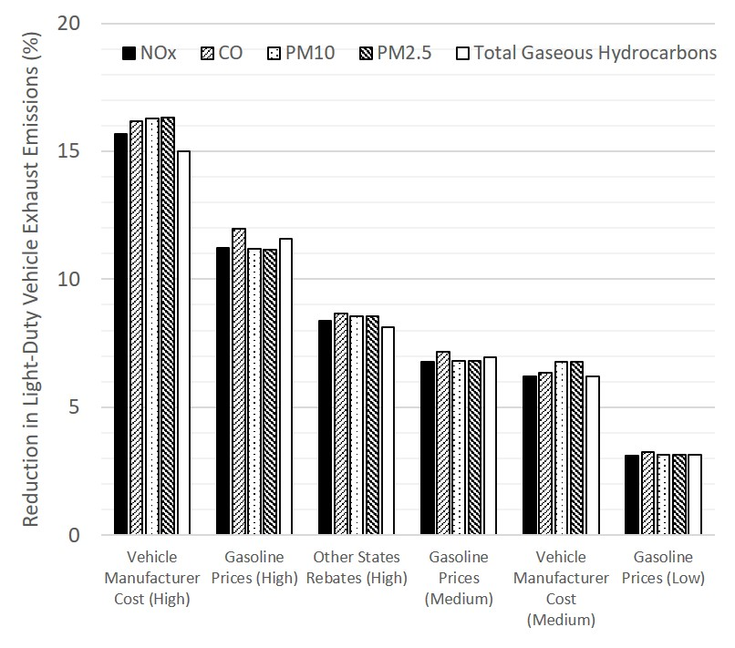
Modeled Annual Light-Duty Vehicle Emissions Reductions in 2040 (Criteria Pollutants), in tons, from the MA³T base case
Results are only shown for simulations where the emissions decreased by 3% or more, except the HOV lane High case, which also had reductions of 3%.
Notes:
SPEAKER: Note that the results on this slide are shown in tabular format on the previous slide.
Across all simulations, the maximum emissions reductions are generally 2% for all pollutants. This includes criteria pollutants, total HCs, and MSATs (the maximum reductions are slightly higher for GHGs [3%]). As the data here show, the maximum reductions are substantially greater than 2% in a few of the simulations.
The greatest emissions reductions across all simulations for criteria pollutants are for the High cases of vehicle manufacturer cost parity and gasoline price increase (up to 16%).
Initial ZEV purchase cost, driven by battery cost, is the greatest barrier to ZEV adoption.
The simulations for vehicle manufacturer costs also produced the greatest increases in ZEV population.
One study found that gasoline price is one of the most significant factors affecting ZEV adoption.
Another study found a correlation between BEV sales and gasoline prices.
These results are only for simulations where the emissions decreased by 3% or more, although, not shown in this table, the High case of the HOV lane access duration simulations also resulted in a 3% decrease in emissions.
In 2013, HOV lane access was the primary motivation for purchasing ZEVs in California; this has continued to be true considering other more recent reports cited earlier in this report.
The relatively small impact on emissions reductions in this simulation set is likely because HOV/HOT lane access is not a primary driver for markets without large metropolitan areas.
Remaining simulations show decreases in emissions that were less than or equal to 2%.

Slide 23
Modeled Annual Light-Duty Vehicle Emissions Reductions in 2040 (MSATs) (tons)
Simulation Set ID | Simulation Description | 1,3-Butadiene (%) | Acetaldehyde (%) | Acrolein (%) | Benzene (%)
C1 | Vehicle Manufacturer Cost (High) | 103 (15) | 351 (15) | 20 (15) | 585 (15)
C2 | Gasoline Price (High) | 82 (12) | 273 (11) | 16 (11) | 464 (1)
P5 | Other States Rebates (High) | 56 (8) | 190 (8) | 11 (8) | 329 (8)
C2 | Gasoline Price (Medium) | 49 (7) | 158 (7) | 9 (7) | 276 (7)
C1 | Vehicle Manufacturer Cost (Medium) | 42 (6) | 144 (6) | 8 (6) | 235 (6)
C1 | Gasoline Prices (Low) | 22 (3) | 72 (3) | 4 (3) | 48 (3)
Results are only shown for simulations where the emissions decreased by more than 3%.
Notes:
SPEAKER: Note that the results on this slide are shown in graphical format on the next slide.
The results shown here for four of the eight MSATs modeled are consistent with those for the criteria pollutants and HCs in terms of the simulations producing the greatest decreases in emissions, and the percentage reductions in emissions.

Slide 24
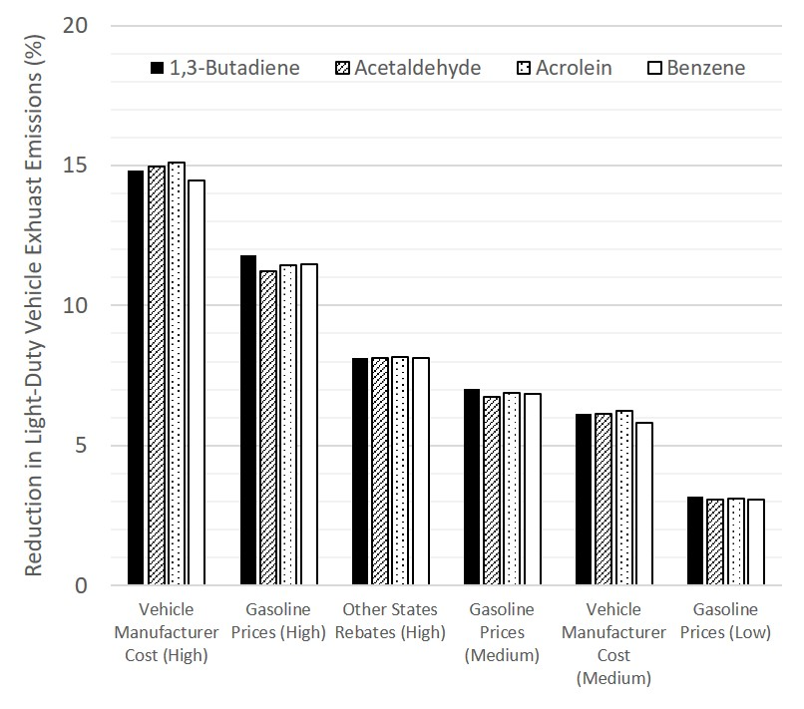
Modeled Annual Light-Duty Vehicle Emissions Reductions in 2040 (MSATs), in tons, from the MA³T base case
Results are only shown for simulations where the emissions decreased by more than 3%.
Notes:
SPEAKER: Note that the results on this slide are shown in tabular format on the previous slide.
The results shown here for four of the eight MSATs modeled are consistent with those for the criteria pollutants and HCs in terms of the simulations producing the greatest decreases in emissions, and the percentage reductions in emissions.

Slide 25
Modeled Annual Light-Duty Vehicle Emissions Reductions in 2040 (MSATs), in tons, from the MA³T base case
Simulation Set ID | Simulation Description | Ethylbenzene (%) | Formaldehyde (%) | Napthalene gas (%) | Napthalene particle (%)
C1 | Vehicle Manufacturer Cost (High) | 226 (15) | 206 (15) | 34 (15) | 0.1 (16)
C2 | Gasoline Price (High) | 179 (12) | 147 (11) | 26 (11) | 0 (11)
P5 | Other States Rebates (High) | 127 (8) | 110 (8) | 19 (8) | 0.1 (9)
C2 | Gasoline Price (Medium) | 107 (7) | 89 (7) | 16 (7) | 0 (7)
C1 | Vehicle Manufacturer Cost (Medium) | 91 (6) | 85 (6) | 14 (6) | 0.1 (7)
C2 | Gasoline Price (Low) | 48 (3) | 41 (3) | 7 (3) | 0 (0)
Results are only shown for simulations where the emissions decreased by 3% or more, except the HOV lane High case, which also had reductions of 3%.
Notes:
SPEAKER: Note that the results on this slide are shown in graphical format on the next slide.
The results for the other MSATs modeled are also consistent with those for the other pollutants in terms of the simulations producing the greatest decreases in emissions, and the percentage reductions in emissions.

Slide 26
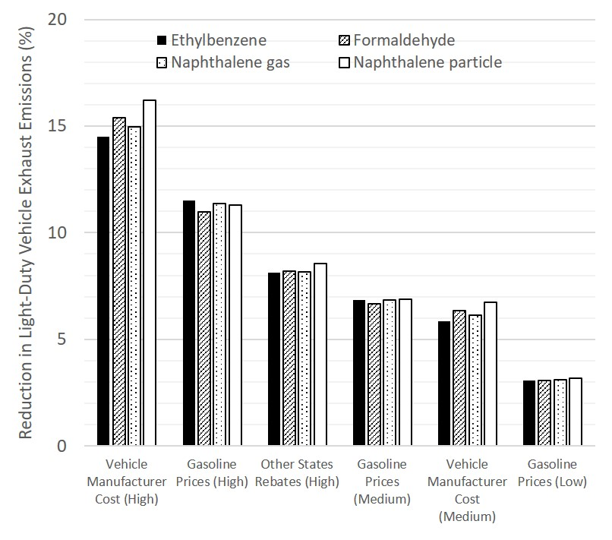
Modeled Annual Light-Duty Vehicle Emissions Reductions in 2040 (MSATs) (tons)
Results are only shown for simulations where the emissions decreased by 3% or more, except the HOV lane High case, which also had reductions of 3%.
Notes:
SPEAKER: Note that the results on this slide are shown in tabular format on the previous slide.
The results for the other MSATs modeled are also consistent with those for the other pollutants in terms of the simulations producing the greatest decreases in emissions, and the percentage reductions in emissions.

Slide 27
Modeled Annual Light-Duty Vehicle Emissions Reductions in 2040 (GHGs) 10⁶ metric tons CO₂, metric tons CH₄ and N₂O
Simulation Set ID | Simulation Description | CO₂ (%) | CH₄ (%) | N₂O (%) | GHG Equivalent (# vehicles)
C1 | Vehicle Manufacturer Cost (High) | 99 (23) | 1,581 (21) | 2,291 (20) | 21,255,112
C2 | Gasoline Price (High) | 64 (15) | 1,018 (14) | 1,551 (14) | 13,779,446
C1 | Vehicle Manufacturer Cost (Medium) | 49 (11) | 784 (11) | 1,081 (10) | 10,431,866
C2 | Gasoline Price (Medium) | 40 (9) | 638 (9) | 955 (8) | 8,578,846
P5 | Other States Rebates (High) | 39 (9) | 610 (8) | 995 (9) | 8,335,632
C2 | Gasoline Price (Low) | 19 (4) | 305 (4) | 449 (4) | 4,081,797
Results are only shown for simulations where the emissions decreased by more than 3%.
Notes:
SPEAKER: Note that the results on this slide are shown in graphical format on the next slide.
GHG Equivalent = Equivalent number of passenger vehicles’ annual GHG emissions (# vehicles); the GHG equivalence in terms of the number of passenger vehicles driven for one year, which was obtained from EPA’s Greenhouse Gas Equivalencies Calculator (available at https://www.epa.gov/energy/greenhouse-gas-equivalencies-calculator).
Once again, the results for the GHGs modeled are consistent with those for the other pollutants in terms of the simulations producing the greatest decreases in emissions, and the percentage reductions in emissions.
The Cost Parity simulations for vehicle manufacturer cost result in reductions of (1) conventional vehicles equivalent to as much as 11% of the on-road light-duty vehicle fleet in 2017, and (2) GHG emissions equivalent to as much as 2% of total U.S. GHG emissions (CO₂ equivalent) in 2017. For the High and Medium cases of the gasoline price simulations, the GHG emissions reductions are 1% relative to total U.S. GHG emissions in 2017. The amount relative to total U.S. GHG emissions for all other simulations is much less than 1%. The reductions in GHG emissions for each simulation are generally greater than reductions in other pollutant emissions. The GHG equivalence values (equivalent to the number of passenger vehicles driven in one year) are roughly one million vehicles per 1% decrease in CO₂ equivalent GHG emissions. Emissions reductions for CO₂ equivalent (CO₂e) are not presented with the GHG results because the differences between CO2e and CO₂ emissions were 1% or less across all simulations.
The total population of short- and long-wheel base light-duty vehicles in 2017 was equal to approximately 300 million vehicles (https://www.bts.gov/content/number-us-aircraft-vehicles-vessels-and-other-conveyances).
Total U.S. GHG emissions in 2017 as CO₂ equivalent were 6,457 million metric tons (https://www.epa.gov/ghgemissions/overview-greenhouse-gases#colorbox-hidden).

Slide 28
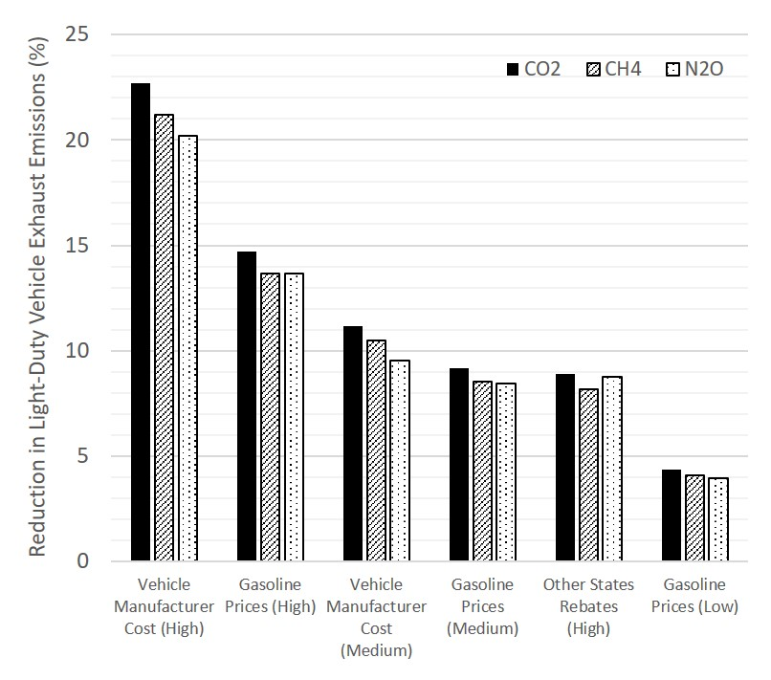
Modeled Annual Light-Duty Vehicle Emissions Reductions in 2040 (GHGs) 10⁶ metric tons CO₂, metric tons CH₄ and N₂O
Results are only shown for simulations where the emissions decreased by more than 3%.
Notes:
SPEAKER: Note that the results on this slide are shown in tabular format on the previous slide.
GHG Equivalent = Equivalent number of passenger vehicles’ annual GHG emissions (# vehicles); the GHG equivalence in terms of the number of passenger vehicles driven for one year, which was obtained from EPA’s Greenhouse Gas Equivalencies Calculator (available at https://www.epa.gov/energy/greenhouse-gas-equivalencies-calculator).
Once again, the results for the GHGs modeled are consistent with those for the other pollutants in terms of the simulations producing the greatest decreases in emissions, and the percentage reductions in emissions.
The Cost Parity simulations for vehicle manufacturer cost result in reductions of (1) conventional vehicles equivalent to as much as 11% of the on-road light-duty vehicle fleet in 2017, and (2) GHG emissions equivalent to as much as 2% of total U.S. GHG emissions (CO₂ equivalent) in 2017. For the High and Medium cases of the gasoline price simulations, the GHG emissions reductions are 1% relative to total U.S. GHG emissions in 2017. The amount relative to total U.S. GHG emissions for all other simulations is much less than 1%. The reductions in GHG emissions for each simulation are generally greater than reductions in other pollutant emissions. The GHG equivalence values (equivalent to the number of passenger vehicles driven in one year) are roughly one million vehicles per 1% decrease in CO₂ equivalent GHG emissions. Emissions reductions for CO₂ equivalent (CO₂e) are not presented with the GHG results because the differences between CO2e and CO₂ emissions were 1% or less across all simulations.
The total population of short- and long-wheel base light-duty vehicles in 2017 was equal to approximately 300 million vehicles (https://www.bts.gov/content/number-us-aircraft-vehicles-vessels-and-other-conveyances).
Total U.S. GHG emissions in 2017 as CO₂ equivalent were 6,457 million metric tons (https://www.epa.gov/ghgemissions/overview-greenhouse-gases#colorbox-hidden).

Slide 29
Implications (1 of 2)
The findings of this study suggest that, to support efforts to promote adoption of ZEVs, state DOTs and MPOs should consider the following (listed in order of importance):
Cost Parity simulations resulted in the greatest reductions of light-duty vehicle emissions.
The Incentive/Policy simulation with the application of a long-duration rebate to states without current rebates had the next highest reductions of light-duty vehicle emissions.
The high case of the HOV lane access simulations (HOV lane access from 2014‒2030) had the next highest emissions reductions.

Slide 30
Implications (2 of 2)
Potential actions for DOTs and MPOs include the following:
Promoting advancement of policies that support ZEV adoption, such as reduced vehicle manufacturer costs of ZEVs, increased gasoline prices, and long-duration HOV lane access and rebate programs
Expanding infrastructure to support charging or fueling of ZEVs (e.g., deploy charging stations and install signage for directing drivers); for example, the California Department of Transportation (Caltrans) is building infrastructure to support widespread adoption of ZEVs¹
Providing resources to address the need for consumer awareness and education; for example, the North Carolina Department of Transportation (NCDOT) includes promotion of public awareness and education about electric vehicles in their recent draft Zero-Emission Vehicle Plan²
¹ https://dot.ca.gov/programs/sustainability
² https://www.ncdot.gov/news/press-releases/Pages/2019/2019-08-22-ncdot-draft-zev-plan-released.aspx

Slide 31
Suggestions for Future Research (1 of 5)
Because the emission reduction results in this study rely on outputs from the MA³T model, recommendations for further research focus on factors used by MA³T to modify ZEV fleet size.
Research into the influence of education programs would provide insight into programs and actions that fall well within many transportation agencies’ area of influence.
Research into the long-term influence of range anxiety, price factors, home charge availability, and other factors will also provide insight into how consumers might respond to important factors.
Notes:
Consumer behavior is not well understood with regard to new vehicle technology. The need for consumer and auto dealer education related to purchasing ZEVs was identified in the literature review. Research into the influence of education programs would provide insight into programs and policies that fall well within many transportation agencies’ area of influence.
Research into the long-term influence of range anxiety, price factors, home charge availability, and other factors will also provide insight into how consumers might respond to important factors.

Slide 32
Suggestions for Future Research (2 of 5)
Research into the manufacturer cost differences by ZEV size classes could improve the assumptions in MA³T as more large-class ZEVs come into the market.
MA³T needs to consider the influence of the “normalizing” of new electric vehicle technology for representing how consumers might behave once electric vehicles represent a large portion of the market (e.g., 40 percent or more); one of the MA³T model developers indicated that future updates to the model will include these factors if funding becomes available.
Notes:
Because ZEV battery costs continue to decline at a rapid rate, research into ZEV manufacturer cost assumptions in MA³T are warranted. Modeling results in this study showed that cost parity of ZEVs with ICEVs had some of the largest impacts on ZEV adoption and emission reductions. The default vehicle manufacturer costs in MA³T show that manufacturer cost for ZEVs and their conventional vehicle counterparts differ more for larger vehicle classes (e.g., SUVs). Research into the manufacturer cost differences by ZEV size classes could improve the assumptions in MA³T as more large-class ZEVs come into the market.
Finally, one of the MA³T model developers indicated that future updates to the model will consider the influence of the “normalizing” of new electric vehicle technology. The modelers intend to investigate how consumer behavior might change once electric vehicles represent a large portion of the market (e.g., 40 percent or more), and integrate that consumer behavior into the MA³T model.

Slide 33
Suggestions for Future Research (3 of 5)
As ZEVs become a larger portion of the light-duty vehicle fleet, there is potential for new policies that could offset positive incentives. Policies such as state-level increases in ZEV registration fees as a result of losses in gas taxes could be considered in future developments of the MA³T model.
The MA³T model is calibrated to the AEO forecast. Other forecasts, such as the Navigant Consulting forecast or the Bloomberg New Energy Finance forecast, project substantially greater ATV adoption. This is an area for further investigation, as calibrating the model to other forecasts would provide alternate outcomes.
Notes:
As ZEVs become a larger portion of the light-duty vehicle fleet, there is potential for new policies that could offset positive incentives. Policies such as state-level increases in ZEV registration fees as a result of losses in gas taxes could be considered in future developments of the MA³T model.
The MA³T model is calibrated to the AEO forecast. Other forecasts, such as the Navigant Consulting forecast or the Bloomberg New Energy Finance forecast, project substantially greater ATV adoption. This is an area for further investigation, as calibrating the model to other forecasts would provide alternate outcomes.

Slide 34
Suggestions for Future Research (4 of 5)
By default, MA³T assumes that there are no FCEVs on the market, even by the end of the modeling time period (2050). Future calibration of the MA³T model would benefit from including data for FCEVs. Although the 2019 AEO forecasts that FCEVs will account for less than half a percent of the total light-duty vehicle fleet in 2040, it is highly uncertain what the FCEV technology and supporting infrastructure will be 20 or 30 years from now.
The MA³T model uses nominal 2018 dollars for all costs, prices, and tax credit and rebate amounts. This could affect model outcomes. For example, ARRA tax credits could be issued beyond 2018 if a vehicle manufacturer has not yet reached the maximum number of subsidized vehicles after 2018. Adjustment of dollar amounts to account for inflation could be added to the model formulation in a future version.
Notes:
By default, MA³T V20190404 assumes that there are no FCEVs on the market, even by the end of the modeling time period (2050). Future calibration of the MA³T model would benefit from including data for FCEVs. Although the 2019 AEO forecasts that FCEVs will account for less than half a percent of the total light-duty vehicle fleet in 2040, it is highly uncertain what the FCEV technology and supporting infrastructure will be 20 or 30 years from now (2019).
The MA³T model uses nominal 2018 dollars for all costs, prices, and tax credit and rebate amounts. This could affect model outcomes. For example, ARRA tax credits could be issued beyond 2018 if a vehicle manufacturer has not yet reached the maximum number of subsidized vehicles after 2018. Adjustment of dollar amounts to account for inflation could be added to the model formulation in a future version.

Slide 35
Suggestions for Future Research (5 of 5)
MA³T considers only the U.S. household users of light-duty vehicles as the consumer market. However, as of 2017, medium- and heavy-duty vehicles contributed approximately 23 percent of all GHG emissions associated with the transportation sector (U.S. Environmental Protection Agency, 2019). More research is needed into factors that reduce emissions associated with freight.
As electric vehicles become increasingly commonplace, the change in emissions associated with electric vehicles will increasingly be driven at the grid level. Renewable sources for FCEV fuel will also be important. Integrating vehicle emissions models with scenarios that focus on transportation network and grid level impacts or renewable fuel sources would provide a more complete picture of future emissions.
Notes:
MA³T considers only the U.S. household users of light-duty vehicles as the consumer market. However, as of 2017, medium- and heavy-duty vehicles contributed approximately 23 percent of all GHG emissions associated with the transportation sector (U.S. Environmental Protection Agency, 2019). More research is needed into factors that reduce emissions associated with freight. This includes policies targeting glider trucks (i.e., trucks with new bodies and old engines that can emit up to 40 times more emissions than new diesel engines), “electric roads” that provide electric power to vehicles via overhead catenary cables or conductor rails, truck stop electrification (i.e., providing heating/cooling and other services at truck stops without the need for trucks to idle), and factors responsible for growth and sales of newer battery and FCEV technology for freight.
The total emissions associated with electric vehicles are already strongly associated with the electricity source used for charging; for example, a BEV charged exclusively on electricity sourced from a coal-fired power plant would have equivalent wheel-to-well emissions of a 29-mpg car (with cleaner electricity sources resulting in far greater equivalent emissions) (Nealer et. al, 2015). As electric vehicles become increasingly commonplace, the change in emissions associated with electric vehicles will increasingly be driven at the grid level. These impacts will likely overlap other developments in the transportation industry (e.g., the spread of autonomous vehicles), in utilities (e.g., distributed generation and storage, structural shifts in traditional investor owned utilities as overall electricity consumption declines), and even in the supply chain of electric vehicle manufacturing (i.e., ‘cradle to grave’ emissions generated from the sourcing of raw materials to the disposal of obsolete vehicles). Integrating vehicle emissions models with scenarios that focus on transportation network and grid level impacts would provide a more complete picture of future emissions.
* Nealer, R., D. Reichmuth, D. Anair, D. 2015. How Electric Cars Beat Gasoline Cars on Lifetime Global Warming Emissions. Union of Concerned Scientists. Available at https://www.ucsusa.org/sites/default/files/attach/2015/11/Cleaner-Cars-from-Cradle-to-Grave-full-report.pdf (As of September 23, 2019).

Slide 36
For More Information
https://apps.trb.org/cmsfeed/TRBNetProjectDisplay.asp?ProjectID=4485

Slide 37
Supplemental Slides

Slide 38
Key Assumptions for MA³T Infrastructure Parameter Adjustments
To reflect the rapid deployment of EVSE and the high degree of uncertainty around anticipated demand, and to test the impact of charging infrastructure availability, public charging infrastructure is set to 100% availability in 2050 for the High case.
Based on advances in the technology known to be underway, the High case assumes power levels of 350 kW (maximum power for Level 3 DC fast chargers) for all area types (central city, suburb, and rural locations) in 2050.
The High case for home charging availability was assumed to equal 100% for all areas by 2050.
For the Medium and High cases, it was assumed that home chargers will have access to Level 2 chargers (at maximum power of 19.2 kW) in 2050.
For the High case, based on known initiatives in the rollout of charging infrastructure, it was assumed that workplace charging ability will be 100% by 2050.
Based on the availability of technology discussed above for public charging, the High case assumes charging power of 350 kW in 2050.

Slide 39
Key Assumptions for MA³T Policy Parameter Adjustments
ARRA tax credit:
Increasing caps on the number of subsidized vehicles were assumed; the cap was set to 600,000 for the High case.
A conservative value of $3,500 was used for the tax credit.
The Low case value for number of OEMs producing eligible vehicles was assumed to equal 17, which is supported by recent data¹; for the Medium case, it was assumed that nearly all auto manufacturers (approximately 20 as of 2019) selling light-duty passenger vehicles in the U.S. produce eligible vehicles; and for the High case it was assumed that five additional manufacturers of ZEVs would enter the market.
State rebates: Increase amount by 10%, 12% and 15%; increase duration to 10, 15, and 20 years; apply the median rebate amount ($2,500) to all state without current rebates (as of 2019) for 10, 15, and 20 years.
Increase HOV lane access duration (with default start year of 2014) to 10, 12, and 15 years.
¹ https://www.nanalyze.com/2017/03/electric-cars-usa/
Notes:
For the ARRA tax credit simulations, the following was considered:
The maximum cumulative number of subsidized vehicles per OEM was assumed to represent a range of values based on recent legislative proposals. For example, the proposed Driving America Forward Act (Congressional Research Service 2019) essentially raises the cap on the number of subsidized vehicles from 200,000 to 600,000. For each case of the simulation set with the vehicle cap and subsidy parameters, increasing caps were assumed, and the cap was set to 600,000 for the High case. In addition to the input for the cap on vehicle sales, that simulation set also included adjustment of the maximum subsidy per eligible vehicle. Although the Driving America Forward Act proposes a credit of up to $7,000 for the number of vehicles beyond the current 200,000 cap, only a single subsidy value can be used in MA³T. A more conservative value ($3,500) was used.
The HOV lane access adjustments were informed by several studies and research findings, including:
In 2013, HOV lane access in California was found to be the primary motivation for the purchase of several models of plug-in electric vehicles (US EIA: https://www.eia.gov/analysis/studies/transportation/zeroemissions/)
A UCLA study asserted that access to HOV and high-occupancy toll (HOT) lanes is the “single biggest incentive” for Californians to purchase ZEVs (e.g., see Los Angeles Times, 2018 https://www.latimes.com/local/california/la-me-ln-clean-air-car-decals-20180917-story.html and Digital Trends, 2018 https://www.digitaltrends.com/cars/california-drivers-lose-clean-air-decals/)
Another UCLA study found that HOV lane access for ZEVs had no capital costs and is more cost effective than the state’s rebate program (Sheldon and DeShazo, 2016 https://innovation.luskin.ucla.edu/wp-content/uploads/2019/03/How_Does_the_Presence_of_HOV_Lanes_Affect_PEV_Adoption_in_CA.pdf)
California introduced a new 4-year HOV lane access incentive beginning in 2019 (California DMV, 2019https://www.dmv.ca.gov/portal/dmv/?1dmy&urile=wcm:path:/dmv_content_en/dmv/vr/decal).

Slide 40
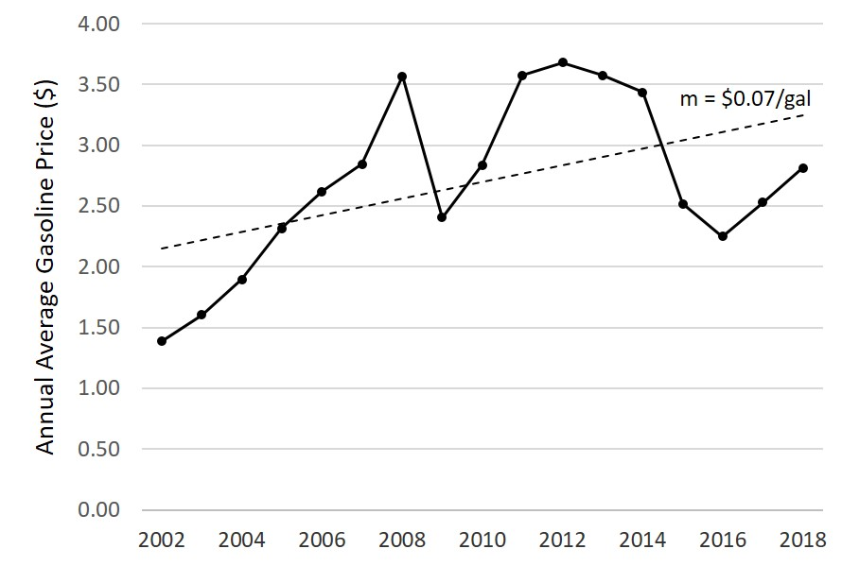
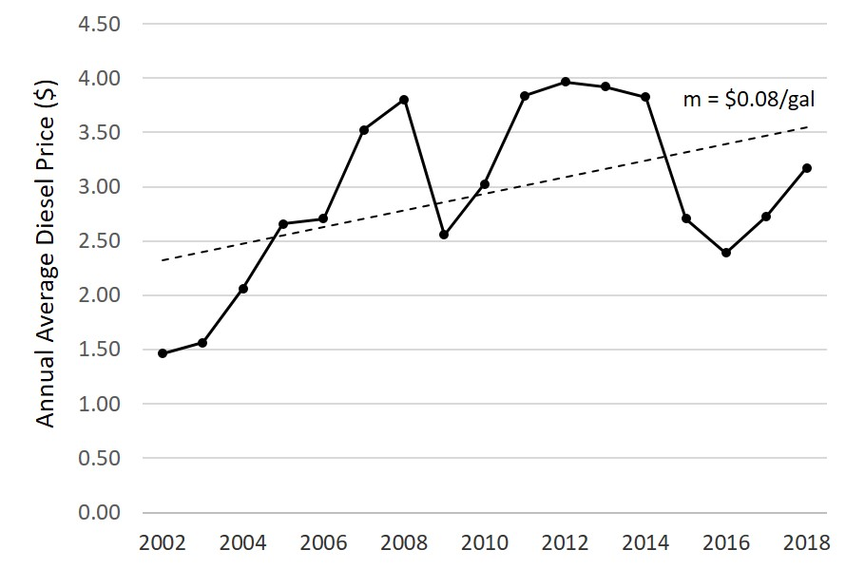
Key Assumptions for MA³T Cost Parity Parameter Adjustments
Vehicle manufacturer cost parity between BEVs and their conventional (ICE) vehicle counterparts in 2040, 2035, and 2030
Gasoline prices rise at an accelerated rate using data from the EIA as a baseline
Diesel prices rise at an accelerated rate using data from the EIA as a baseline
Gasoline and diesel prices from EIA (https://www.eia.gov/petroleum/gasdiesel/)
Notes:
In MA³T, battery electric cars with a range of 100 miles (EV100s) reach cost parity with conventional spark-ignition cars in 2035. No other ZEVs in other vehicle classes in MA³T reach cost parity out to 2050. In fact, MA³T embeds default values that assume the costs of ZEVs in the other classes (i.e., car-SUVs, pickup trucks, truck-SUVs, and vans) are substantially greater than their conventional vehicle counterparts. However, in order to assess the extent of vehicle manufacturer cost impacts on ZEV populations, the vehicle manufacturer cost simulations included aggressive adjustments to MA³T inputs
Data for weekly U.S. retail gasoline (all grades and formulations) and diesel (U.S. No. 2) prices from the U.S. EIA (https://www.eia.gov/petroleum/gasdiesel/) were used to estimate rates of price increase for the Low, Medium, and High case simulations. From 2002 through 2018, theses prices increased by a small constant rate (on an annual average, $0.07 for gasoline and $0.08 for diesel). The default gasoline and diesel fuel prices in MA³T vary by region of the U.S. and year. From 2019 to 2050, the forecasted prices for both gasoline and diesel increase on an annual basis by only $0.02. To capture the historical rates of increase in gasoline and diesel prices (based on the U.S. EIA data) in the C2 and C3 simulations, annual growth rates of $0.07 and $0.08 were applied for the Medium cases of the gasoline and diesel price simulations, respectively. A rate of $0.05/year for both simulation sets was used for the Low case, and a rate of $0.10/year for both simulation sets was used for the High case. The adjusted price inputs in were applied in MA³T for all regions. Increases in fuel price can affect whether a consumer will choose to buy (either an ICEV or ATV) or not buy a vehicle, as well as the mode of transportation a consumer chooses. MA³T includes a no-buy option that can be influenced by high fuel prices.

Slide 41
Modeled Increases in ZEV Populations in 2040 Compared to the Base Case (1 of 2)
Simulation Set ID | Scenario Description | Low | Medium | High
C1 | Vehicle Manufacturer Cost | 21% | 172% | 345%
C2 | Gasoline Prices | 11% | 27% | 51%
I2 | Public Charging Power Level | NAª | 36% | 46%
P5 | Instant Rebate Amount and Duration Applied to Other States | 0.1% | 5% | 43%
P6 | HOV Lane Access Duration | 3% | 10% | 24%
I1 | Public Charging Availability | 0% | 9% | 18%
P2 | ARRA Number of OEM Producers | 10% | 17% | 17%
P4 | Instant Rebate Duration | 0% | 4% | 16%
I3 | Home Charging Availability | NA | 7% | 15%
ª NA indicates Not Applicable; no changes were made to default parameter values.
Notes:
Cost Parity simulations (vehicle manufacturer cost and gasoline price simulations) result in the largest changes in ZEV population across all scenarios.
Diesel price increase has only a small impact on ZEV adoption, possibly because of the higher cost of diesel vehicles and small number of diesel vehicle options in MA³T.
The public charging power level simulations produce some of the highest increases in ZEV adoption across the simulations. Slow charging time was identified in the literature review as a key barrier to ZEV adoption. The modeled increases in ZEV adoption for the public charging availability simulations were less than for the charging power level simulations.
Although ZEV cost was identified as the greatest barrier to ZEV adoption in the literature review, and financial incentives such as rebates effectively reduce the cost of ZEVs, changes to state rebate amounts had only a modest impact on the ZEV populations estimated by MA³T, although applying a rebate with long duration (High case) to states that currently (as of 2019) do not have rebates produced a large change in ZEV population.
Reflective of the importance of HOV lane access to ZEV adoption, the corresponding simulations resulted in ZEV population increases that are among the highest across simulations, , after consideration of vehicle costs and gasoline costs.
Increasing the number of OEMs producing eligible ZEVs had a greater impact on ZEV population than increasing the cap on the number of vehicles eligible for the ARRA credit (shown on the next slide).

Slide 42
Modeled Increases in ZEV Populations in 2040 Compared to the Base Case (2 of 2)
Simulation Set ID | Scenario Description | Low | Medium | High
P1 | ARRA Vehicle Cap and Maximum Subsidy | 5% | 9% | 13%
I5 | Workplace Charging Availability | NA | 1% | 2%
C3 | Diesel Prices | 0% | 1% | 2%
P3 | Instant Rebate Amount | 0% | 0.1% | 0.2%
I6 | Workplace Charging Power Level | NA | 0% | 0%
I4 | Home Charging Power Level | NA | 0% | 0%
ª NA indicates Not Applicable; no changes were made to default parameter values.
Notes:
Increasing the ARRA cap (number of eligible vehicles sold per OEM; with a $3,500 credit amount) had impacts similar to increasing the duration of state rebates .
The remaining simulations showed very little impact on ZEV population.
The percentage changes for simulation set C1b are for EV100 populations only. That is, by setting the cost of EV100s (BEVs with 100-mile range) equal to the cost of an ICE car in 2030, 2025, and 2020, resulted in increases of EV100 population by 4.6%, 19.9%, and 61.8%. However, the total ZEV population changes are 0% for the Low, Medium, and High case simulations for the EV100 cost scenario.

