Slide 1
Methods for State DOTs to Reduce Greenhouse Gas Emissions from the Transportation Sector
NCHRP Project 25-56 – Final Project Briefing
[audience]
Chris Porter, Cambridge Systematics, Inc.
Gary McVoy, McVoy Associates, LLC
John Zamurs, ZAMURS AND ASSOCIATES, LLC
Josh Proudfoot, Good Company ,LLC
[DATE]
Notes:
This briefing is to provide information on National Cooperative Highway Research Program (NCHRP) Project 25-56, which developed a guide for State Departments of Transportation (DOTs) to estimate and reduce GHG emissions from the transportation sector. The project was completed in early 2021.
The project team included:
Cambridge Systematics, Inc. (Chris Porter, Principal Investigator)
Gary McVoy, McVoy Associates, LLC
John Zamurs, ZAMURS AND ASSOCIATES, LLC
Good Company ,LLC (Josh Proudfoot, lead)

Slide 2
Purpose of the Guide - “Methods for State DOTs to Reduce Transportation Greenhouse Gas Emissions”
Identify and describe tools, methods, and data sources that State DOTs can use to estimate GHG emissions from the transportation system and evaluate and implement GHG reduction opportunities
Help State DOTs understand how they can address GHGs through all stages of their activities
Help State DOTs respond to and support State, local, and/or Federal GHG requirements or initiatives
Notes:
The primary product of NCHRP Project 25-56 was a guide on methods for State DOTs to reduce greenhouse gas emissions from the transportation sector.
The purpose of the guide is to:
Provide information on tools, methods, and data sources to estimate GHG emissions from the transportation system.
Help State DOTs evaluate and implement GHG reduction opportunities through all stages of their activities.
Help state DOTs be ready to respond to and support State, local, and/or Federal GHG requirements or initiatives as they come down the line.

Slide 3
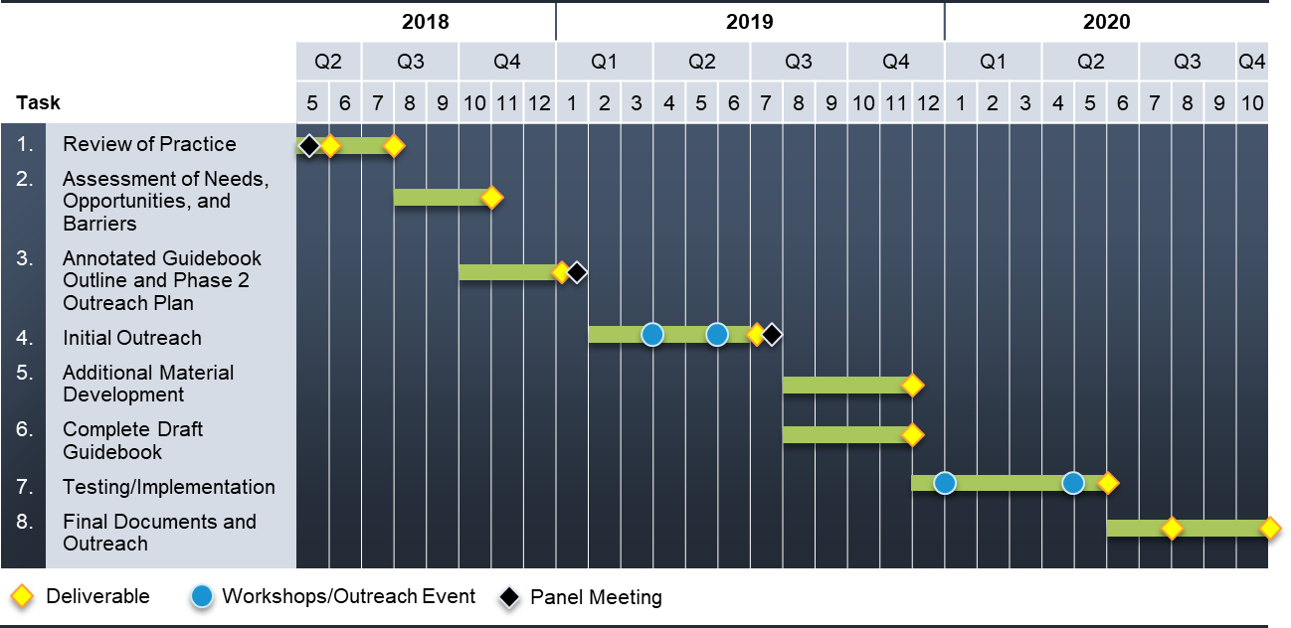
Project Overview and Timeline
Notes:
The overall project had a 2 ½ year timeline. The strategy was to test, learn, and improve, with two rounds of outreach and input from state DOTs. It started in the summer of 2018 with a literature review of GHG resources and tools, a web survey of state DOTs about their current activities and needs, and interviews with about a dozen states to learn about their practices in more detail.
An outline and sample sections of the guide were then developed. In May and June 2019 three workshops were conducted to review preliminary guide material in detail. The workshops were hosted by the Minnesota, Texas, and Washington State DOTs; representatives from the Iowa and Oregon DOTs also participated, as well as other local partners. A complete draft guidebook was then developed.
Between May 2020 and January 2021 implementation support was conducted with four State DOTs – Colorado, Nevada, Delaware, and Hawaii. The purpose of the implementation task, which is a fairly new approach for NCHRP, was to both obtain feedback on the draft guide and also to help jump-start implementation activities.
The project had a couple months of delays due to COVID and the final guide was delivered in March 2021.

Slide 4
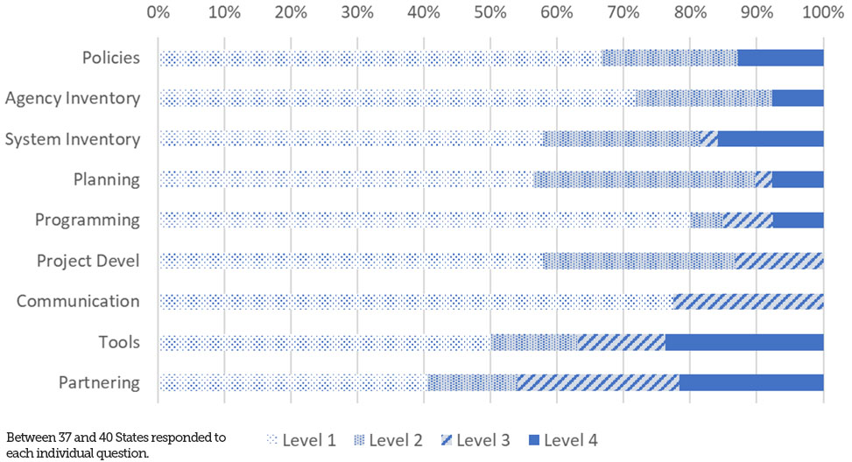
GHG “Level of Engagement” Based on 2018 Survey Responses
Notes:
A web-based survey was distributed to 52 State DOTs (including the District of Columbia and Puerto Rico) to identify recent and planned activities and needs with respect to GHG consideration. Up to 41 States completed the survey. Details on outreach methods and the survey results are included in Appendix A to the final report.
The results were used to loosely classify States into four “levels of engagement” on GHG issues, ranging from “just getting started” (level 1) to a comprehensive approach (level 4).
The survey results indicate a few States had adopted a comprehensive set of policies and were implementing these through activities across functional areas. Most of the responding States had taken some action related to GHG, such as conducting an inventory, discussing GHG impacts qualitatively in environmental documents, or supporting another State agency’s efforts. Overall, the level of engagement varied by functional area.

Slide 5
Overview of Guide
Notes:
Next we’ll present an overview of the guide.

Slide 6
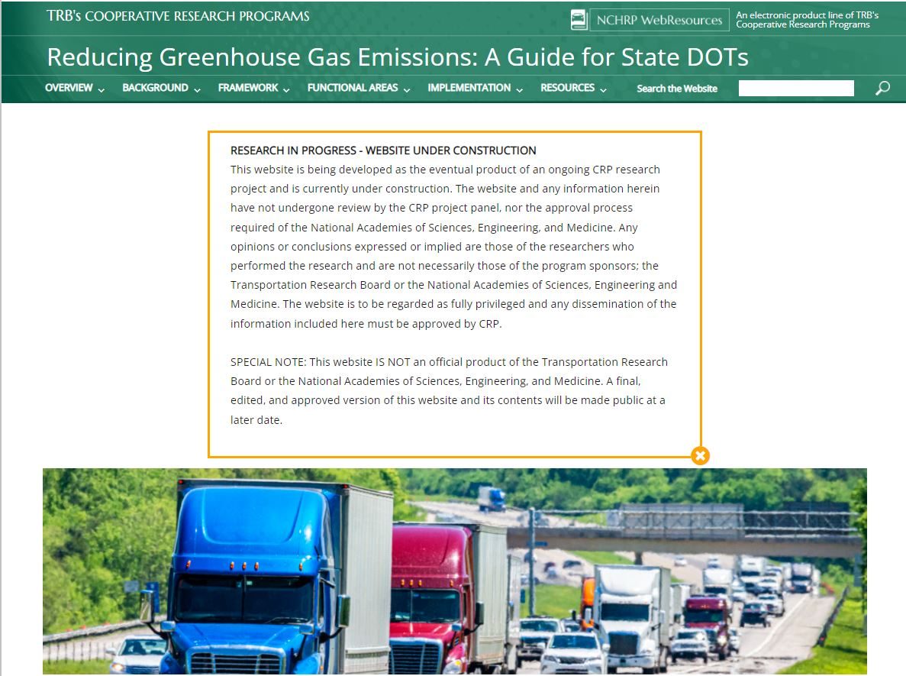
WebResources Publication
Notes:
This is the first NCHRP guide to be published in the “online” WebResources format – it is not published as a traditional PDF or printed report. WebResources has already been used for a few Airport Cooperative Research Program publications, but this is the first time for NCHRP. So the user can navigate to specific sections using drop-down menus from the header and can jump between sections.

Slide 7
Guide Contents
Overview
Background
Framework
Functional Areas
Implemen-tation
Resources
Home Page
Contents
Acronyms
Purpose and How to Use the Guide (1.0)
Greenhouse Gas Basics (2.0)
Scenario Planning for an Uncertain Future (3.0)
Greenhouse Gas Action Across the Agency (4.0)
Developing a Greenhouse Gas Policy (5.0)
Institutional Considerations and Alignment (6.0)
Partnerships (7.0)
Communications (8.0)
Central Administration (9.0)
Transportation Systems Planning (10.0)
Programming (11.0)
Project Dev. and Preliminary Design (12.0)
Environmental Review (13.0)
Final Design and Construction (14.0)
Maintenance (15.0)
TSM&O (16.0)
Regions/Districts (17.0)
Performance Monitoring, Evaluation, and Reporting (18.0)
Putting It All Together (19.0)
Annotated Bibliography (Appendix A)
Greenhouse Gas Evaluation Tools (Appendix B)
Bridge Replacement Example (Appendix C)
Zero-Emission Vehicle Resources (Appendix D)
Self-Assessments
Notes:
To help you “find your way”, The guide is grouped into six general parts, accessible from drop-down menus at the top of the screen:
First is the front matter and an introduction to the guide.
Second is background - An overview of greenhouse gas issues and climate change, discussion of scenario planning in the face of uncertainty.
The third group of sections provides the overall framework for addressing GHGs in a DOT, firs discussing GHGs across the entire spectrum of a state transportation agency’s activities, then institution-wide considerations including policy, institutional alignment, partnerships, and communications.
The fourth set of sections describe how each functional area of a transportation agency, from planning to construction and operations, can address GHG emissions.
The fifth set discusses implementation approaches including performance monitoring and reporting, and “putting it all together” – a look at how GHG considerations can be integrated across all aspects of an agency’s activities.
The final set includes additional resources including data sources, tools, and references, plus additional material on electrification efforts.

Slide 8
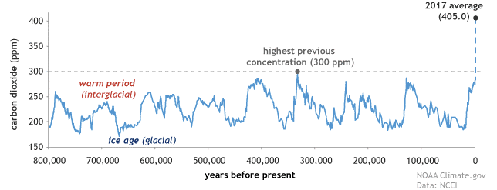
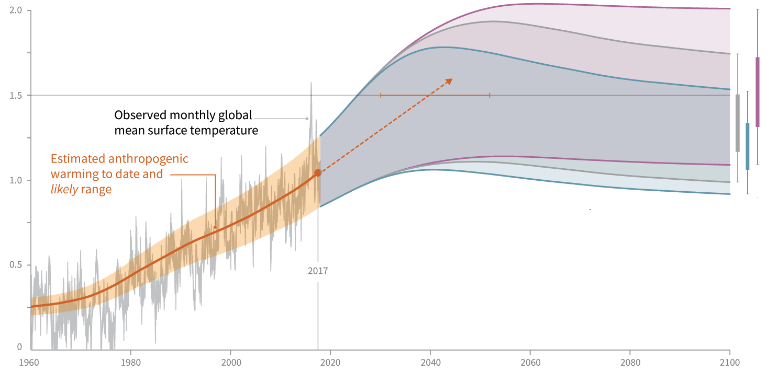
Why Address Climate Change?
Source: National Centers for Environmental Information and National Oceanic and Atmospheric Administration Climate.gov.
Impact | Potential Magnitude
Sea level rise | 1’–8.2’ by 2100
More intense storms | 50 to 300% increase in extreme precipitation events by 2100
Excessive summer heat | +2.5–2.9 °F by mid century +5.0–8.7 °F by late century
Prolonged droughts
Source: IPCC, 2014
Notes:
Section 2 provides some background information on climate change and why States are taking action to address climate change and reduce greenhouse gas emissions.
Carbon dioxide or CO2 is one of a number of so-called “greenhouse gases” in the atmosphere that trap heat. Though CO2 levels fluctuate over tens of thousands of years, the current level of CO2 is much higher, and has increased much more rapidly, than ever previously observed (upper left figure).
Given current emissions and warming trends, the average temperature of the planet may increase by 1.5°C by 2040 and close to 2.0°C by 2060. Holding temperature increases to below 2.0°C—a threshold limit for some of the most disruptive environmental effects—will require net zero CO₂ emissions by at least 2055 and significant reduction by at least 2030 (lower right figure).
Sea level rise, more intense storms, rising heat, and prolonged droughts leading to effects such as wildfires are already affecting transportation systems and will have greater impacts in the future.

Slide 9
Contribution of U.S. Transportation Sector to GHGs
Projected U.S. Transportation Emissions, million metric tons CO2
Source: U.S. EPA, 2018
Source: U.S. Dept. of Energy, 2019
Notes:
Direct emissions from transportation sources represent just under 30 percent of U.S. GHG emissions (left figure). Light duty vehicles account for almost 60 percent of these emissions, with approximately 20 percent from freight trucks, 9 percent from aircraft, and the remainder from other modes.
Transportation emissions have been relatively constant since 2000 but are projected to decline somewhat as a result of increasing vehicle efficiency. The U.S. DOE Annual Energy Outlook projects light-duty vehicle emissions will decline by about 25 percent by 2050. The projection also indicates a slight growth in freight truck emissions and growth from air travel.
One thing to note is that trends based on current policies will leave the U.S. well short of achieving target GHG reductions of 80 to 100% by 2050.

Slide 10
The GHG Action Spectrum
 | Functional Area
GHG Step | Execs and Whole Agency | Planning | Program-ming | Env Analysis | Design | Construc-tion | Mainten-ance | Opera-tions | Admin-istration | Regions/ Districts
Policy | ✓ | ✓ |  | ✓
Institutional Alignment | ✓ | ✓ |  | ✓ |  |  | ✓ | ✓ | ✓ | ✓
Partnerships | ✓ | ✓ |  | ✓ |  |  | ✓ | ✓ | ✓ | ✓
Inventory | ✓ | ✓ |  | ✓ |  | ✓ | ✓ | ✓ | ✓ | ✓
Communication & Public Engmnt. | ✓ | ✓ |  | ✓ | ✓ |  |  |  |  | ✓
Strategy Identification | ✓ | ✓ | ✓ | ✓ | ✓ | ✓ | ✓ | ✓ | ✓ | ✓
Strategy Assessment | ✓ | ✓ | ✓ | ✓ | ✓ | ✓ | ✓ | ✓ | ✓ | ✓
Implementation | ✓ |  | ✓ | ✓ | ✓ | ✓ | ✓ | ✓ | ✓ | ✓
Monitoring and Evaluation | ✓ | ✓ |  | ✓ |  |  | ✓ | ✓ | ✓ | ✓
Notes:
This matrix is one of the foundational elements of the guide. It provides a framework for addressing GHG across the agency’s activities.
The rows present a multi-step process that includes developing an inventory (understanding what the agency and the transportation system is emitting) and moves to developing and implementing mitigation strategies and monitoring results.
The columns present the State DOT’s functional areas.
For example planning staff would be involved in early stages of GHG policy development for the agency, such as target-setting, as well as identifying and assessing strategies at a systems level. Areas such as programming, design, construction, etc. will be more active with assessing and implementing strategies specific to their responsibilities, such as project level assessment and materials specifications.

Slide 11
Levels of Engagement
Level | Policy | Practice – Internal | Practice - System | Data & Analysis
Level 1 | New to the topic; few or no formal actions to address GHG.
Level 2 | Has established general policies, goals, and/or objectives related to GHG. | Agency emissions considered. | No formal consideration of transportation system emission reduction. | No or limited/partial GHG inventory.
Level 3 | Has established specific policies, goals, and/or objectives related to GHG. | Applies quantitative project or program evaluation criteria to agency emissions. | Qualitative project or program evaluation criteria. | Has developed GHG inventory and/or forecast.
Level 4 | Coordinated multiagency effort. | Strategic planning: has evaluated GHG reduction strategies, linked strategies to plans and programs, and conducted quantitative assessment. |  | Has developed inventory, forecast, specific data and tracking methods, and established specific policies and goals related to targeted GHG reductions.
Notes:
The “levels of engagement” model is another foundational element of the guide.
This model helps States assess where they are with respect to GHG engagement and where they want to go. Four levels are established that can be described with reference to policy, practice, and data and analysis.
“Practice” is divided into internal (the agency’s own emissions) and “system” (emissions generated by transportation system users).
Level 1 is new to the topic. Level 2 generally involves qualitative and/or limited scope consideration of GHG. Level 4 means GHG considerations are integrated throughout an agency’s activities, including quantitative assessment.
The “level of engagement” concept is applied both to the agency as a whole, and to the specific processes / functional areas presented in the last slide. For example, an agency may be at Level 3 with respect to Planning and inventory, but only Level 1 for construction, maintenance, and partnering.

Slide 12
Section-by-Section Contents
What’s included?
Why address GHGs at this level?
Level of effort
Complementarity/consistency with other transportation goals
Who—roles and responsibilities
Inventory development and forecasting
Goal and target setting
Strategy identification
Strategy evaluation
Implementation
Monitoring, evaluation, and reporting
Self-assessment tool
Notes:
Each section of the guide follows the same general outline, as applicable to the topic area.
The guide talks about what’s included in the scope of this topic area, why it’s important to address GHGs here, the level of effort that might be expected, how addressing GHGs can support or be consistent with other goals, and who should be responsible – depending upon your own circumstances.
The technical sections for each functional area start with inventory and forecast development, and discuss goal or target setting, strategy identification and evaluation, implementation, and monitoring.
A “self-assessment” tool is also provided at the end of each section to help determine how engaged your part of the agency currently is on GHG issues and what steps you may want to take to engage further.

Slide 13
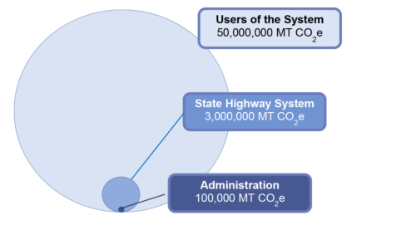
Transportation Sources – Sample State
Notes:
As an example of some background information – The project team took a closer look at emissions related to a typical state’s highway system, using data from some sample states.
The vast majority of emissions is from Users of the System – the passenger and freight vehicles that travel on the network. About 5-6% is from the construction, maintenance, and operation of the State Highway System itself. & while important symbolically - Less than 0.2% is from a DOT’s Administration including office buildings energy use and passenger vehicles.
This doesn’t mean you shouldn’t work to make your buildings, equipment, and materials more efficient and less carbon-intensive. These are the things that a State DOT has direct control over, whereas they can only indirectly influence the emissions of transportation system users. So the DOT’s actions make an important contribution and also send a message of leadership and concern about the issue.

Slide 14
System-Level Scenario Planning Examples
Notes:
In Section 3, the guide provides examples of scenario planning to look at future GHG emission reduction baselines and policy scenarios.
For example, Oregon’s Statewide Transportation System vision (2013) showed a reduction by 2050 for surface transportation under current trends, but stronger actions are needed to get close to the state’s goal.
The analysis at right shows a study for Maryland done nearly 10 years ago showing the potential contributions of a variety of transportation actions to reducing GHG emissions.
The lower left graph shows a much more conservative analysis in which MassDOT (2016) looked only at financially- and politically-constrained strategies under the agency’s direct control – illustrating the cooperative action across multiple agencies and sectors is needed to achieve aggressive goals.

Slide 15
Tools and Data Sources: Systems Planning & Policies
Tool | Emission Rates/‌Factors | GHG Inventory Development | Construction and Maint. Activities | Highway Network and Operations | Transit Investment and Operations | Nonmotorized Improvements | Pricing Policies | Land Use and Smart Growth | TDM and Public Education | Shared Mobility | Freight Rail and Marine Strategies | Clean Vehicle and Fuel Strategies
MOVES/EMFAC | ● | ● |  |  |  |  |  |  |  |  |  | ●
GREET | ● |  |  |  |  |  |  |  |  |  |  | ●
FHWA ICE |  | ● | ●
VISION | ● |  |  |  |  |  |  |  |  |  |  | ●
MA3T | ● |  |  |  |  |  |  |  |  |  |  | ●
Travel Demand Model |  | ● |  | ● | ● |  | ● | ●
VisionEval/EERPAT |  | ● |  | ● | ● | ● | ● | ● | ● | ● | ● | ●
Impacts 2050 |  |  |  |  | ● |  | ● | ● |  | ●
TRIMMS |  |  |  |  | ● | ● | ● | ● | ●
Transit GHG Emissions Est |  |  | ● |  | ●
Land Use Scenario Tools |  |  |  |  |  | ● |  | ●
Notes:
There are a bewildering number of tools available for GHG analysis but very few that do everything in one package – only some examples are shown here, focusing on the transportation systems planning level.
The VisionEval family of tools, as well as the related Federal Highway Administration EERPAT model, are the primary “one stop shop” for systems-level GHG scenario analysis and policy evaluation. They can be applied at a state or metro level. VE is an open source tool that is continually evolving. Efforts are underway, led by FHWA and Oregon DOT with support from AASHTO pooled fund studies, to make VisionEval suitable for use by many different users as well as to further expand its technical capabilities.
Appendix B provides a much more detailed list and assessment of available tools.

Slide 16
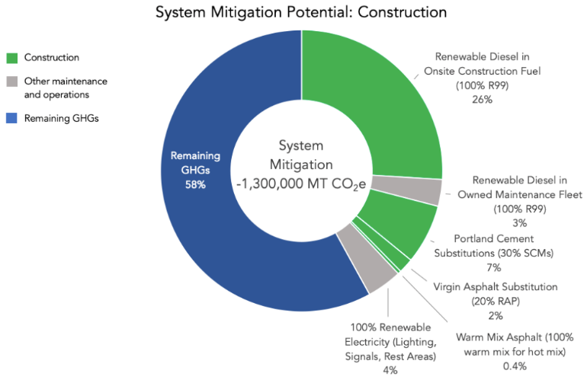
Construction & Maintenance
Mitigation Strategies – Illustrative Impacts
Source: Good Company, LLC based on analysis of data from Oregon DOT
Notes:
This example looks specifically at mitigation potential from state highway system construction and maintenance, using illustrative impacts for Oregon DOT.
There is significant mitigation potential for highway system construction & maintenance, at least 40% of emissions can be reduced with existing technologies, including renewable diesel, and less energy-intensive materials and processes.

Slide 17
Tools & Data Sources: Construction & Maintenance
Data Source/Tool | Material Factors | Fuel Factors | Calculation Platform
Infrastructure Carbon Estimator (ICE) | ✓ | ✓ | ✓
GreenDOT | ✓ | ✓ | ✓
Pavement Life Cycle Assessment Tool (PaLATE) | ✓ |  | ✓
U.S. Environmentally Extended Input- Output Model | ✓ | ✓ | ✓
U.S. EPA Waste Reduction Model (WARM) | ✓ |  | ✓
National Precast Concrete Association Environmental Product Declarations | ✓
FHWA Environmental Product Declarations | ✓
National Asphalt Pavement Association’s Environmental Product Declarations | ✓
Portland Cement Association Environmental Impact Reporting | ✓
Individual producers’ Environmental Product Declarations | ✓
Argonne - AFLEET |  | ✓ | ✓
Heavy-Duty Vehicle Emissions Calculator |  | ✓ | ✓
U.S. EPA Diesel Emissions Quantifier |  | ✓ | ✓
CARB Carbon Intensity Factors |  | ✓
Notes:
These are examples of tools and data sources for construction & maintenance emissions .
These emissions are mostly from materials and fuels. It’s a matter of estimating quantities of materials – mainly concrete, asphalt and steel – as well as fuel consumed, and applying appropriate emission factors.
There are a lot of tools and data sources for looking at material and fuels emissions, some more relevant and useful to DOTs than others.
The Infrastructure Carbon Estimator, developed by FHWA and recently updated through a pooled fund study led by the Minnesota DOT, is a good all-around planning-level tool for infrastructure assessment.
The guide includes much more detail on all of these tools, to help users select the most appropriate tool.

Slide 18
Self-Assessment Tools - Level of Engagement
Now | Within 3 Years? | Has Your Agency Defined Institutional Roles and Responsibilities Related to GHG Emissions Reduction? | Level of Engagement
_____ | _____ | No roles defined. | 1
_____ | _____ | Assigned leadership/lead role for GHG activities, but not a comprehensive set of roles and coordination mechanisms. Primary focus on agency emissions. | 2
_____ | _____ | Assigned leadership and some supporting roles for GHG activities but limited/‌incomplete coordination mechanisms. Focus includes system emissions. | 3
_____ | _____ | Assigned complete set of leadership and supporting roles for GHG activities, covering all functional areas, and with comprehensive coordination mechanisms, including internal and external coordination. Focus mainly on system emissions and includes agency purchases and operations. | 4
Notes:
For each functional area, the guide provides a self-assessment worksheet to help DOT staff understand where they are and where they want to be.
For example, for institutional coordination, Level 4 means that a complete set of leadership and supporting roles is defined for GHG activities, covering all functional areas, and with comprehensive coordination mechanisms including internal and external coordination.

Slide 19
Self-Assessment Worksheets – Strategies and Actions
Now? | Within 3 Years? | Strategy | Level of Engagement
_____ | _____ | Specify lower carbon fuels such as biodiesel, renewable diesel, and electricity where practical. | 2
_____ | _____ | Follow procedures to improve traffic flow and reduce congestion and idling in detours. | 2
_____ | _____ | Build in renewable energy generation mechanisms (e.g., solar lighting in remote areas, wind). | 3
_____ | _____ | Implement revegetation/reforestation to support carbon sequestration. | 3
_____ | _____ | Develop and deploy standardized specifications and methods that reduce GHGs. | 4
_____ | _____ | Etc. | X
Action | Timeframe | Lead Responsibility
Action 1 | 1 year | Staff X
Action 2 | 1-2 years | Staff Y
Action 3 … | 2-5 years | Staff Z
Notes:
The self-assessment tools also lists potential strategies by level of engagement and lets the user identify which ones they are doing now, and which ones they want to be doing in the near future. The example shown here is for construction and maintenance.
Finally, the tools provide a blank template for creating an action plan, assigning specific tasks to individuals.

Slide 20
What Can a DOT Do to Support GHG Goals?
Observations from Scenario Analysis | State DOT Implications
Most emission reductions will come from clean vehicle and fuel technologies | Support EV/AFV infrastructure, clean transit & fleets
Demand reduction and systems efficiency strategies can get us another ~5-20% | Implement ITS/efficient traffic operations Support alternative modes
Additional 2-3% reduction potential from DOT construction materials, fuels/fleets, & buildings | Use low-carbon, recycled/reused materials where feasible Switch to clean fuel light and heavy vehicles
GHG reduction targets of 75-80% or more by 2050 are challenging and will require widespread electrification + clean grid | Collaborate with other state, regional, and local agencies to do everything within collective power
Most strategies require implementation at multiple levels (state, regional, local)
Notes:
These are some lessons learned from DOTs and other agencies that have looked at GHG reduction scenarios, as documented in Section 3 of the guide.
Getting to 80% by 2050 will require widespread electrification combined with clean electricity.
Travel demand strategies and system efficiency (such as improved traffic flow) can make contributions, but may have more important impacts on mobility and other factors.
Strong collaboration will be needed across state, regional, and local agencies to achieve state and local targets.
DOTs can play a lead role in some strategies and a supporting role in others, as noted in the right hand column.
EV = electric vehicle
AFV = alternative fuel vehicle
ITS = intelligent transportation system

Slide 21
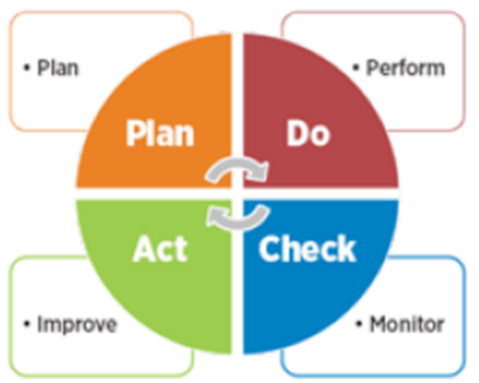
The “Plan, Do, Check, Act (Improve)” Cycle
Plan | Set policy | Establish targets | Make assignments
Do | Develop procedures | Train staff | Implement
Check | Report | Consolidate reports | Evaluate performance
Act (Improve) | Check-in agency wide | Explore alternatives | Revise procedures
Source: American Society for Quality
Notes:
Implementation at any level of the agency follows the standard “Plan, Do, Check, Act (Improve)” cycle typically employed by DOT organizations.
This cycle is a continuous feedback cycle that includes setting policy and targets, assigning responsibilities, training staff, reporting, evaluating performance, and revising procedures as needed.

Slide 22
Implementation
XDOT GHG Task Force Charter
Date: December 0, 2020
Purpose: The GHG Mitigation Task Force shall investigate, assess, report on, and implement GHG emission reduction measures for all direct and indirect DOT related GHG emissions, including…
Membership: The GHG Task Force will be composed of the Division Directors of each DOT Division or their designates…
Meetings: The Task Force is expected to meet on a monthly basis as scheduled by the chair….
Reporting: The Task Force Chair will formally report on progress to the Executive Sponsor on a quarterly basis…
Deliverables:
Strategic Plan—Within 3 months the Task Force will develop an initial strategic plan…
Assignment Matrix—Within 6 months the Task Force will develop an initial list of “Who / What / When / How” assignments …
Annual Report—At the end of year one the Task Force shall make a formal report on its progress…
Signed, Commissioner XDOT
Notes:
Section 19 includes a variety of other resources to support implementation within an agency.
A model executive charter to “mitigate GHG emissions” is offered. Charters may be drafted by executive, staff, or by a task force. They should be periodically revisited in a systematic manner. With agency intentions clarified, individual program units may be asked to familiarize themselves with possible roles and responsibilities as detailed in their unit sections of the guide.
As appropriate, each functional unit should also be required to perform an individual self-assessment and asked to develop an initial list of potential deliverables for discussion at a kickoff meeting of a GHG Mitigation Task Force. A model kickoff meeting agenda is also provided.

Slide 23
Implementation Support Task
Notes:
This section highlights a few lessons learned from the implementation support task. This task was mainly in the form of workshops, with some follow-on assistance provided upon request.

Slide 24
Implementation Task - Workshops
Four States
  Nevada (May 2020)
  Colorado (June 2020)
  Delaware (August 2020)
  Hawaii (January 2021)
Agenda: 3.5 to 7 hours total
  Guide walk-through
  Breakout discussions
  Self-assessments
  Feedback, questions and next steps
Participation
  DOT staff
  State partner agencies
  MPOs
  Universities
  Other groups
Notes:
The project team held workshops in four States, all of which had recently had leadership increase their focus on GHG activities and support new state activities including more direct engagement of the DOT in achieving state climate and renewable energy goals.
Since in-person meetings were impossible due to the COVID-19 pandemic, all of these workshops were done virtually using various on-line platforms. Usually they were split into sessions of 2 to 2.5 hours each, sometimes over multiple days. Each workshop included a walk-through of the guide, then either breakouts or full group discussion depending on attendance. The discussion was mainly by functional areas, focusing on what the agency is already doing, what they could do, and questions they would like to answer. The workshops also requested feedback on the guide itself.
Participation varied, ranging from a small group of a dozen DOT staff, to a larger group of over 50 diverse participants from the DOT and its partner agencies and stakeholders, depending on the need of the state.

Slide 25
Workshop Evaluation
Participating States were at different levels of engagement in GHG
  New to the topic, vs. more experienced
Helpful to see the big picture / spectrum of actions across an agency
Guide provides a good overview of available tools, methods, and resources
On-line, modular format is user friendly
Helpful to have non-DOT participants
Workshops raised questions where further policy direction was needed
Notes:
Participants generally found the draft guide, and the workshops, helpful.
They found it helpful to focus on institutional procedures as well as technical tools.
Despite the volume of material on the guide, the modular on-line format was user-friendly.
Even though the audience for the guide is state DOTs, some non-DOT participants found it helpful to better understand the inner workings of a DOT.
Direction from executive and management level is needed for technical staff to implement methods in guide.

Slide 26
NCHRP Project 25-56 Summary
Final guide delivered March 2021
  WebResource: “Methods for State DOTs to Reduce Transportation Greenhouse Gas Emissions”
Publication expected late spring/early summer 2021
Interested in a workshop on the guide, or other implementation support?
→ please contact NCHRP
Contacts:
  Ann Hartell, NCHRP Senior Program Officer, ahartell@nas.edu
  Chris Porter, Principal Investigator, cporter@camsys.com
Notes:
The final guide and the final report for the project were delivered to NCHRP in March 2021.
After that they need to go through the NCHRP publication process which is typically 3 to 6 months.
There may be additional funding available through NCHRP for implementation support. If you would like to host a workshop on the guide, or otherwise are interested in assistance with applying the guide, please contact Ann Hartell at NCHRP.

